Slide 1
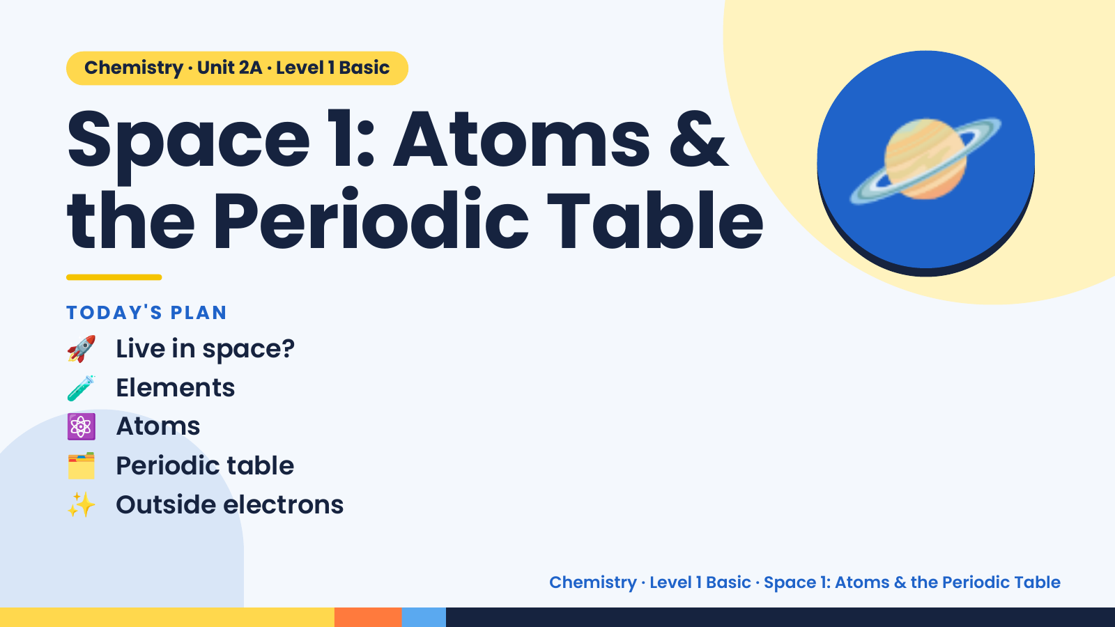
Notes:
Chemistry · Unit 2A · Level 1 Basic
Space 1: Atoms &
the Periodic Table
🚀 Live in space?
TODAY'S PLAN
🪐
🧪 Elements
⚛️ Atoms
🗂️ Periodic table
✨ Outside electrons
Chemistry · Level 1 Basic · Space 1: Atoms & the Periodic Table

Slide 2
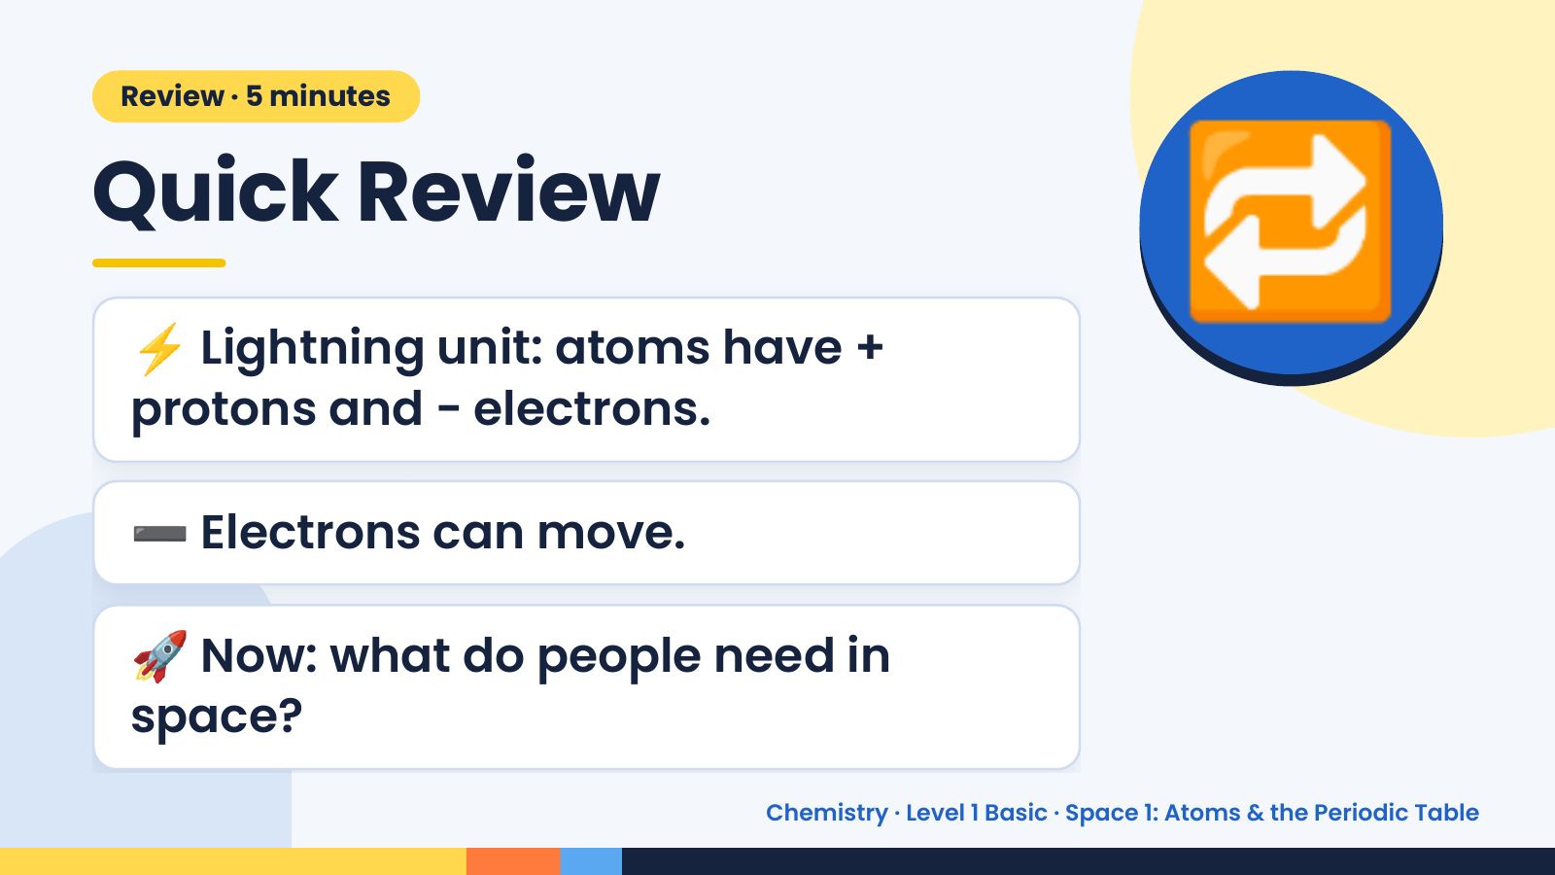
Notes:
Review · 5 minutes
Quick Review
⚡ Lightning unit: atoms have +
protons and − electrons.
🔁
➖ Electrons can move.
🚀 Now: what do people need in
space?
Chemistry · Level 1 Basic · Space 1: Atoms & the Periodic Table

Slide 3
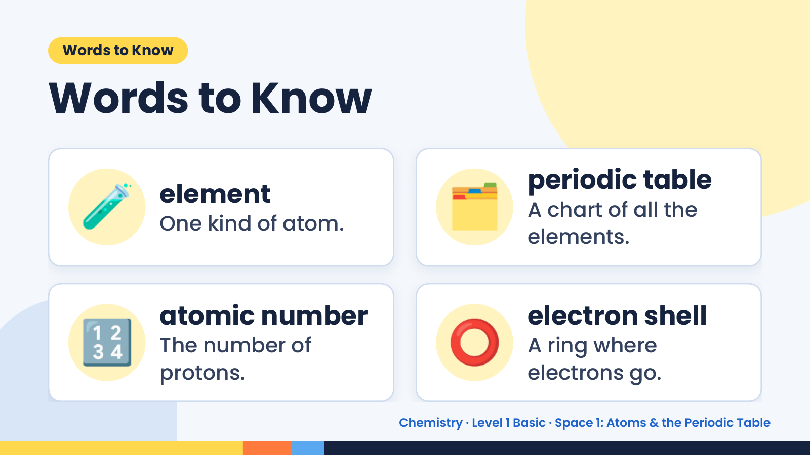
Notes:
Words to Know
Words to Know
🧪 element
One kind of atom. 🗂️ periodic table
A chart of all the
elements.
🔢 atomic number
The number of
protons.
⭕ electron shell
A ring where
electrons go.
Chemistry · Level 1 Basic · Space 1: Atoms & the Periodic Table

Slide 4
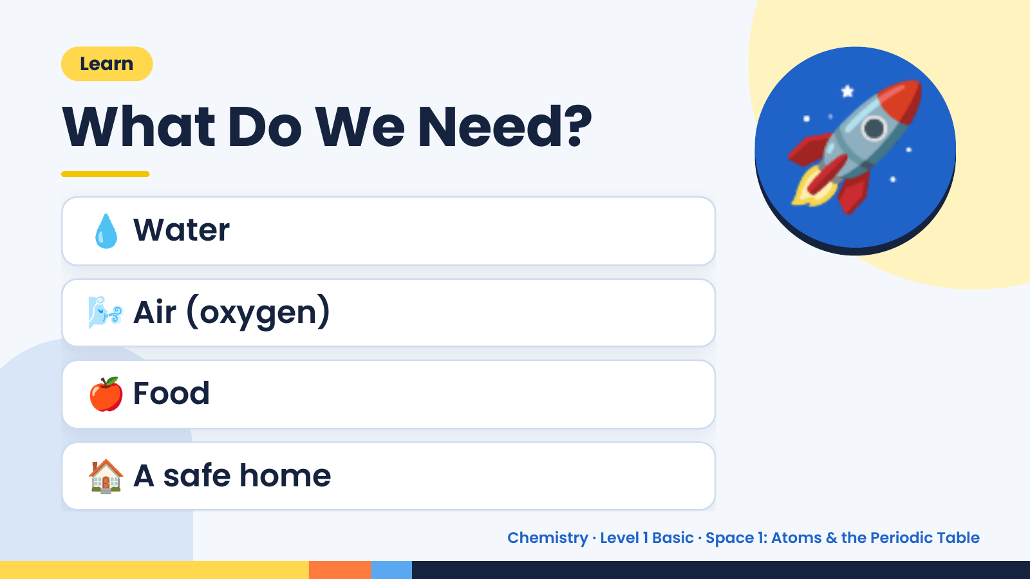
Notes:
Learn
What Do We Need?
💧 Water
🌬️ Air (oxygen)
🚀
🍎 Food
🏠 A safe home
Chemistry · Level 1 Basic · Space 1: Atoms & the Periodic Table

Slide 5
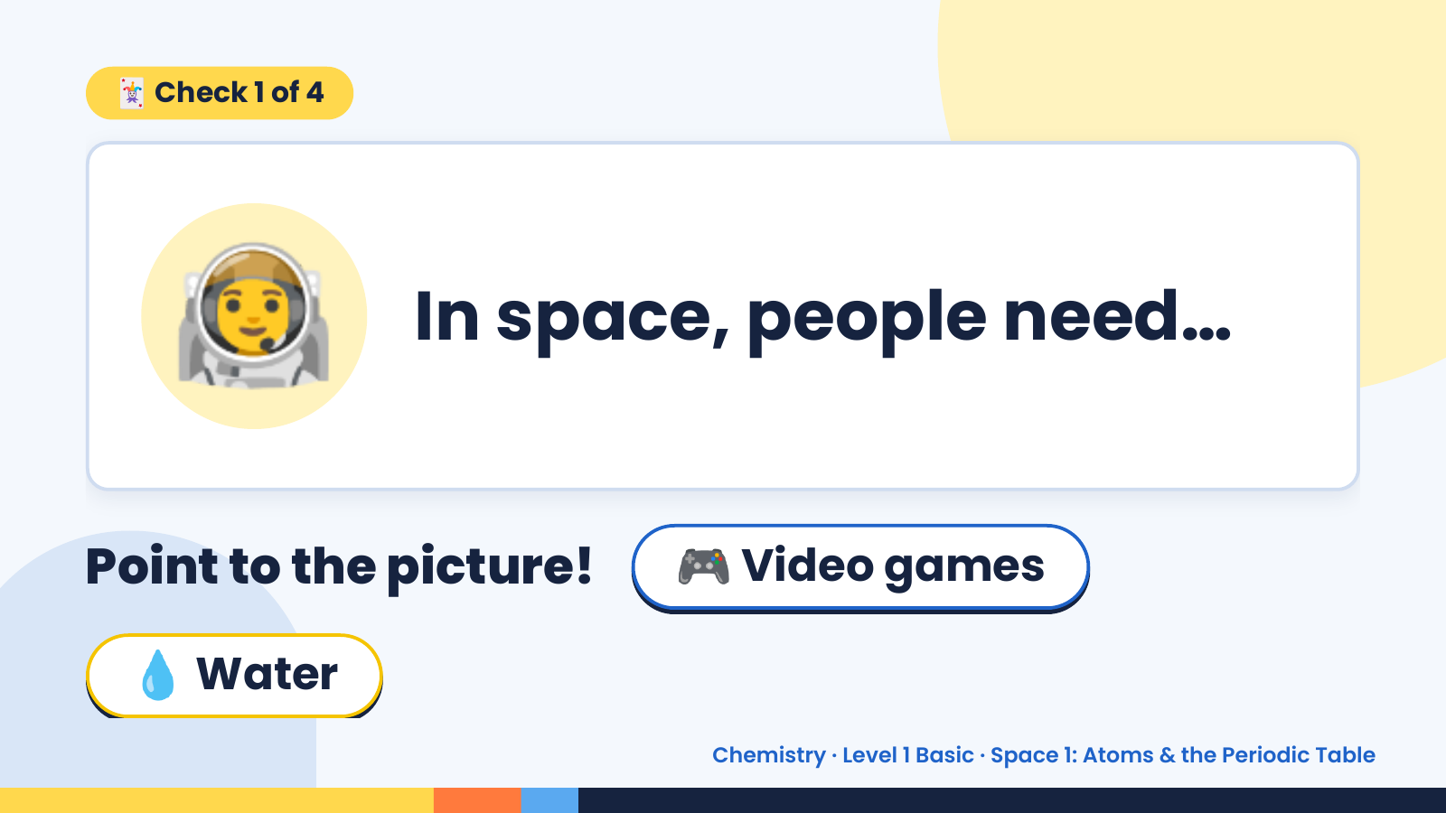
Notes:
🃏 Check 1 of 4
🧑‍🚀 In space, people need…
Point to the picture! 🎮 Video games
💧 Water
Chemistry · Level 1 Basic · Space 1: Atoms & the Periodic Table

Slide 6
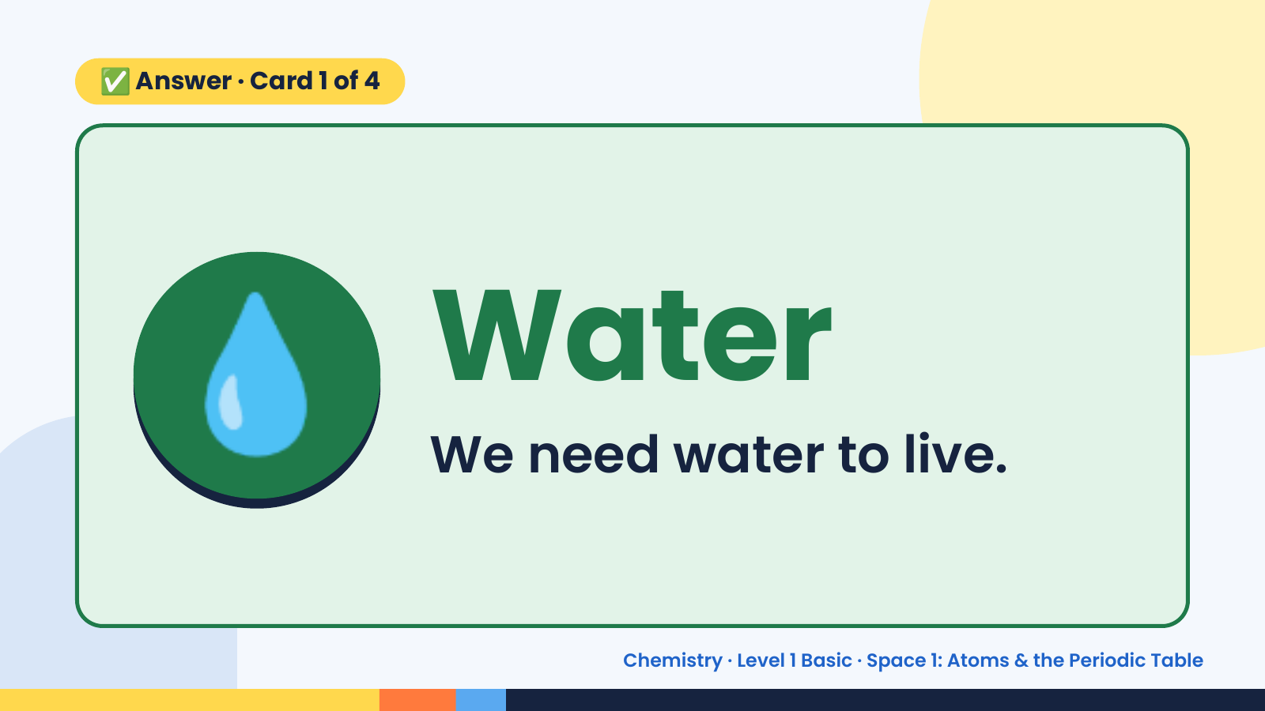
Notes:
✅ Answer · Card 1 of 4
💧 Water
We need water to live.
Chemistry · Level 1 Basic · Space 1: Atoms & the Periodic Table

Slide 7
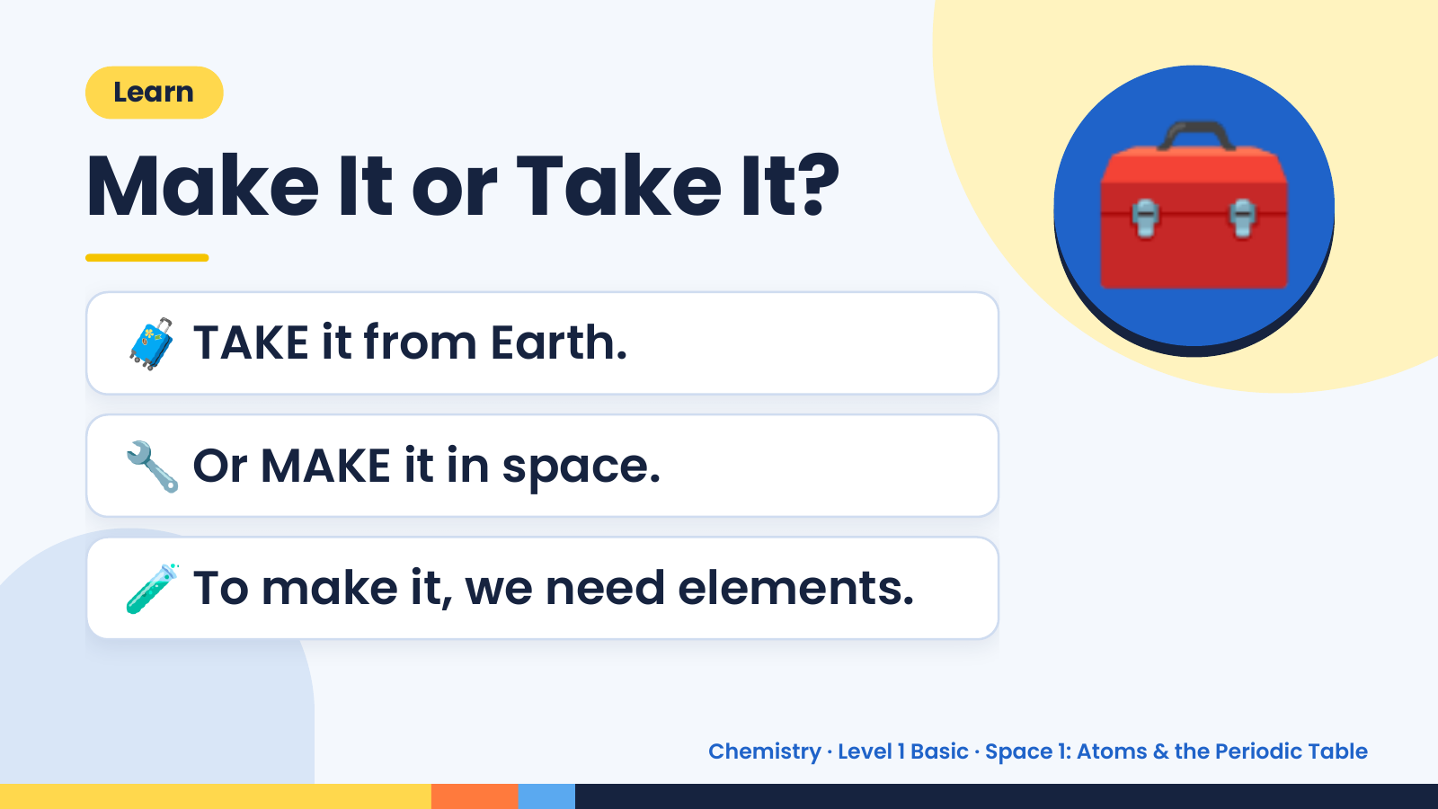
Notes:
Learn
Make It or Take It?
🧳 TAKE it from Earth.
🧰
🔧 Or MAKE it in space.
🧪 To make it, we need elements.
Chemistry · Level 1 Basic · Space 1: Atoms & the Periodic Table

Slide 8
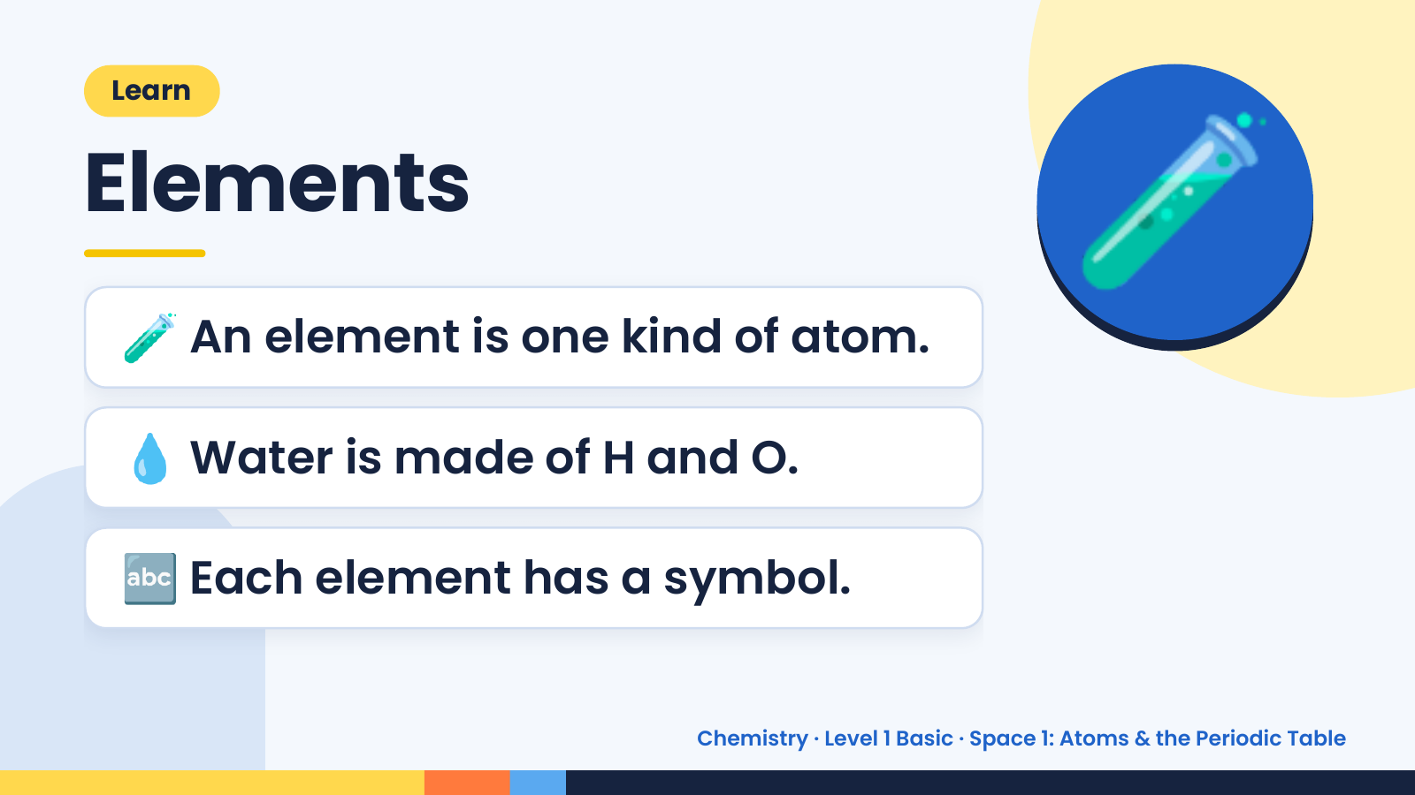
Notes:
Learn
Elements
🧪 An element is one kind of atom.
🧪
💧 Water is made of H and O.
🔤 Each element has a symbol.
Chemistry · Level 1 Basic · Space 1: Atoms & the Periodic Table

Slide 9
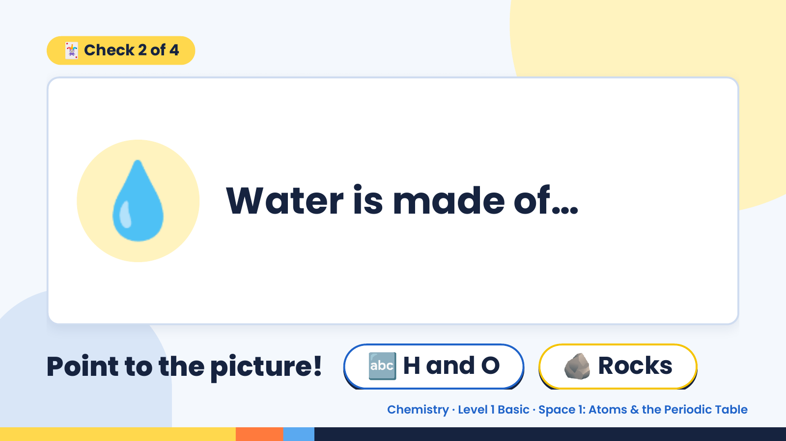
Notes:
🃏 Check 2 of 4
💧 Water is made of…
Point to the picture! 🔤 H and O 🪨 Rocks
Chemistry · Level 1 Basic · Space 1: Atoms & the Periodic Table

Slide 10
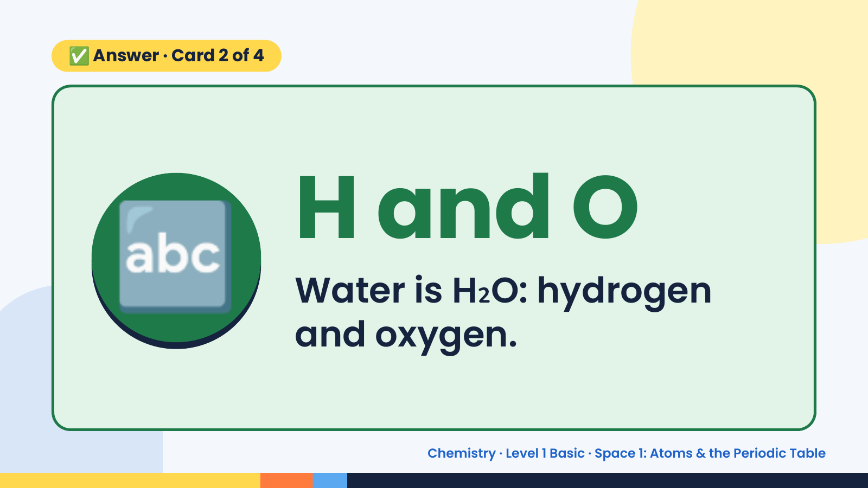
Notes:
✅ Answer · Card 2 of 4
🔤 H and O
Water is H₂O: hydrogen
and oxygen.
Chemistry · Level 1 Basic · Space 1: Atoms & the Periodic Table

Slide 11
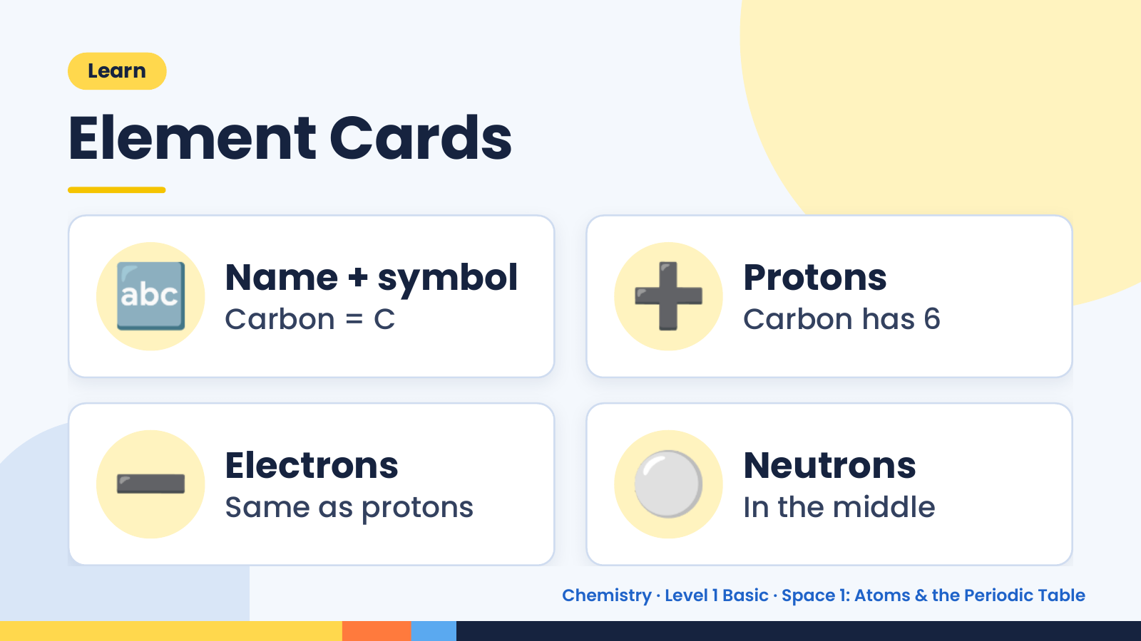
Notes:
Learn
Element Cards
🔤 Name + symbol
Carbon = C ➕ Protons
Carbon has 6
➖ Electrons
Same as protons ⚪ Neutrons
In the middle
Chemistry · Level 1 Basic · Space 1: Atoms & the Periodic Table

Slide 12
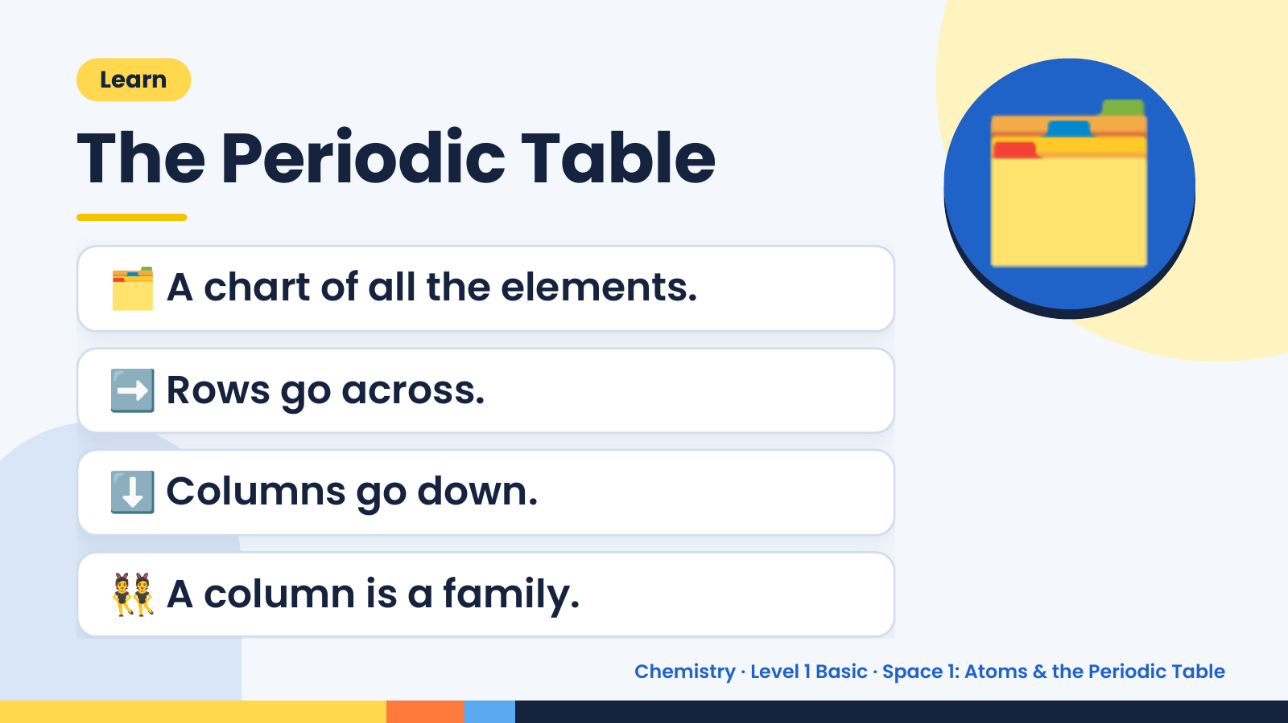
Notes:
Learn
The Periodic Table
🗂️ A chart of all the elements.
➡️ Rows go across.
🗂️
⬇️ Columns go down.
👯 A column is a family.
Chemistry · Level 1 Basic · Space 1: Atoms & the Periodic Table

Slide 13
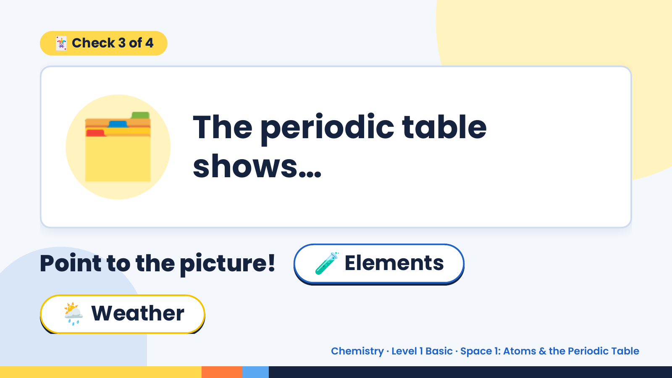
Notes:
🃏 Check 3 of 4
🗂️ The periodic table
shows…
Point to the picture! 🧪 Elements
🌦️ Weather
Chemistry · Level 1 Basic · Space 1: Atoms & the Periodic Table

Slide 14
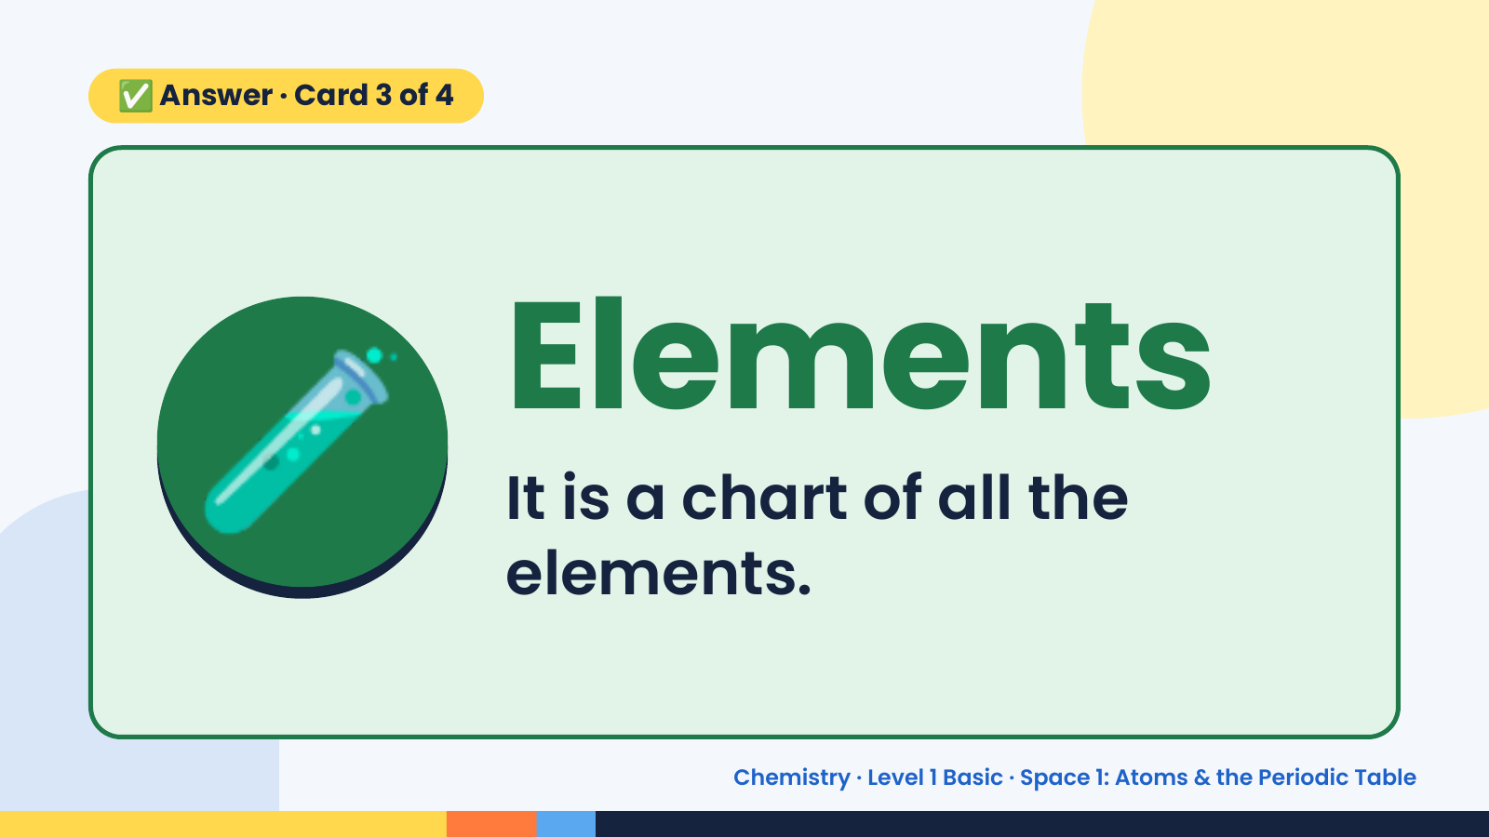
Notes:
✅ Answer · Card 3 of 4
🧪 Elements
It is a chart of all the
elements.
Chemistry · Level 1 Basic · Space 1: Atoms & the Periodic Table

Slide 15
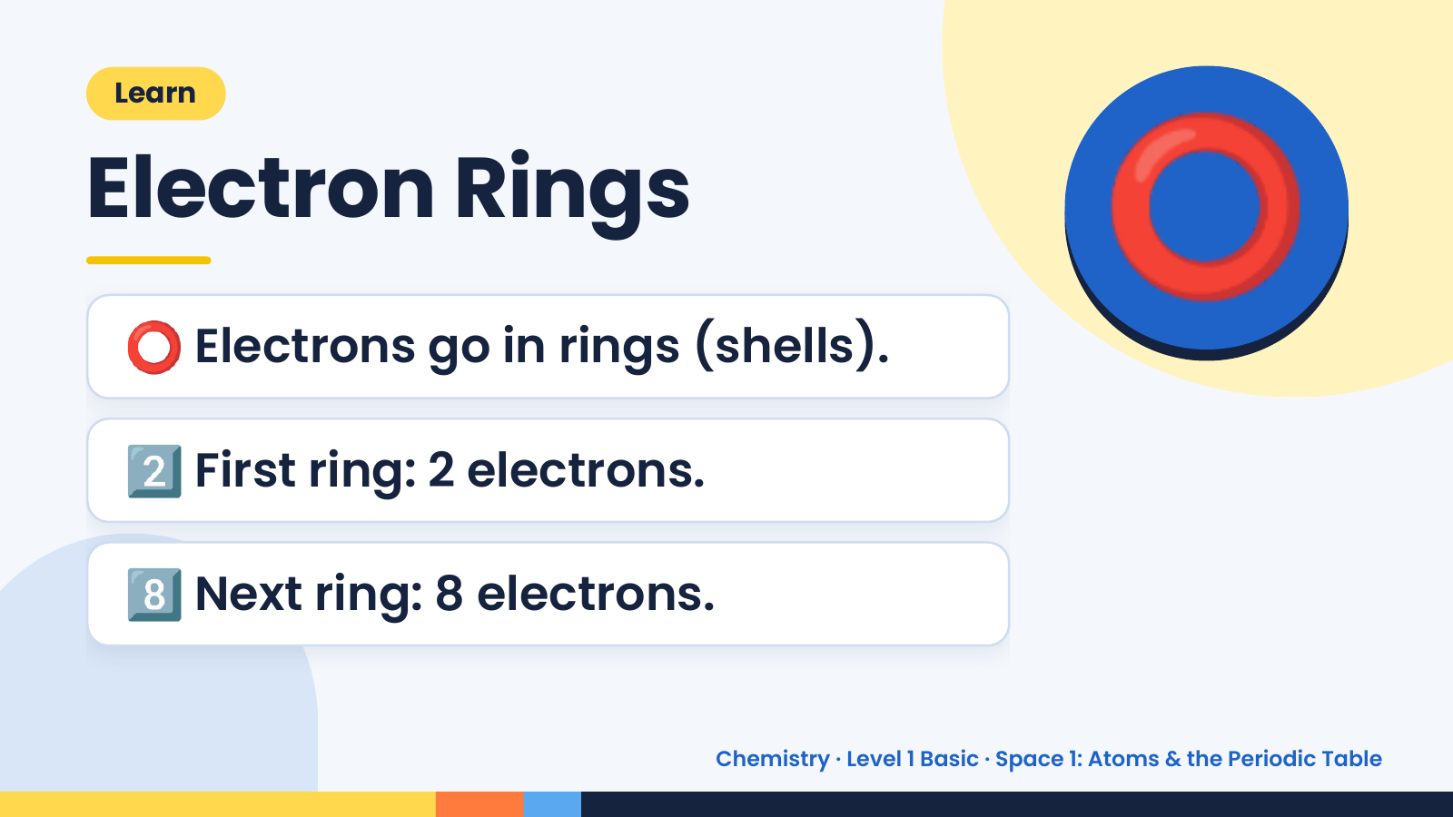
Notes:
Learn
Electron Rings
⭕ Electrons go in rings (shells).
⭕
2️⃣ First ring: 2 electrons.
8️⃣ Next ring: 8 electrons.
Chemistry · Level 1 Basic · Space 1: Atoms & the Periodic Table

Slide 16
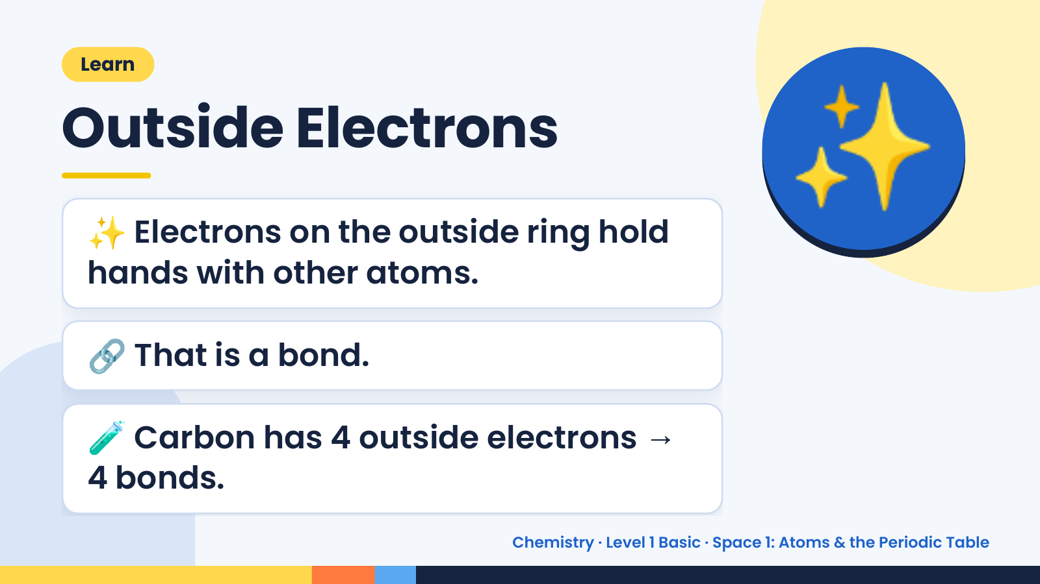
Notes:
Learn
Outside Electrons
✨ Electrons on the outside ring hold
hands with other atoms.
✨
🔗 That is a bond.
🧪 Carbon has 4 outside electrons →
4 bonds.
Chemistry · Level 1 Basic · Space 1: Atoms & the Periodic Table

Slide 17
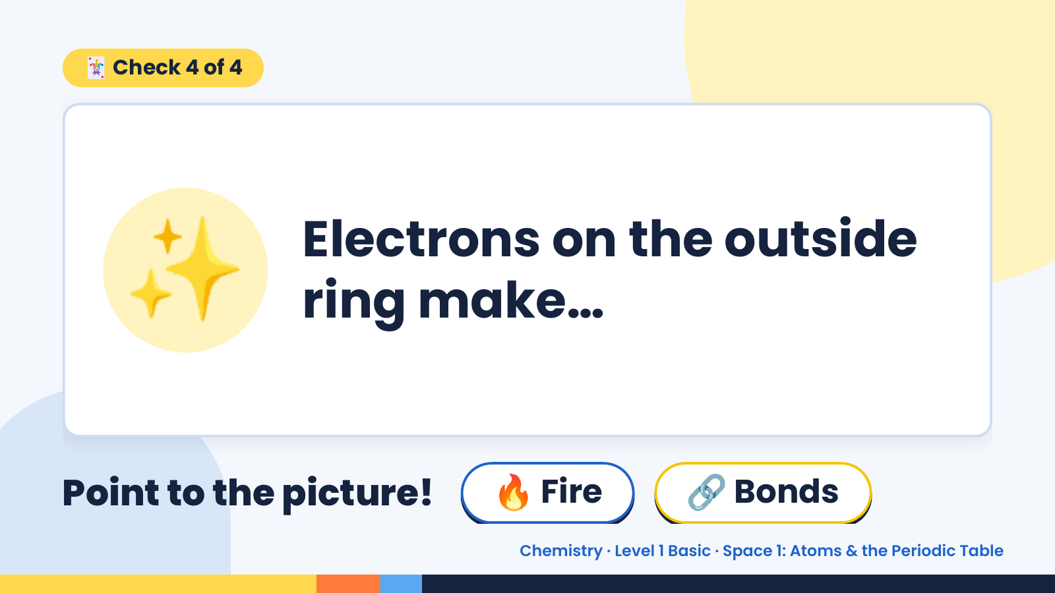
Notes:
🃏 Check 4 of 4
✨ Electrons on the outside
ring make…
Point to the picture! 🔥 Fire 🔗 Bonds
Chemistry · Level 1 Basic · Space 1: Atoms & the Periodic Table

Slide 18
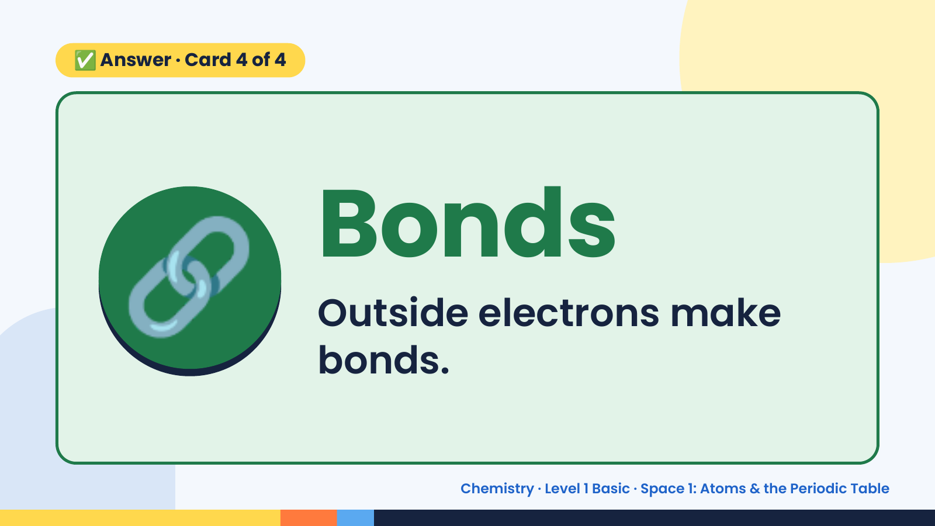
Notes:
✅ Answer · Card 4 of 4
🔗 Bonds
Outside electrons make
bonds.
Chemistry · Level 1 Basic · Space 1: Atoms & the Periodic Table

Slide 19
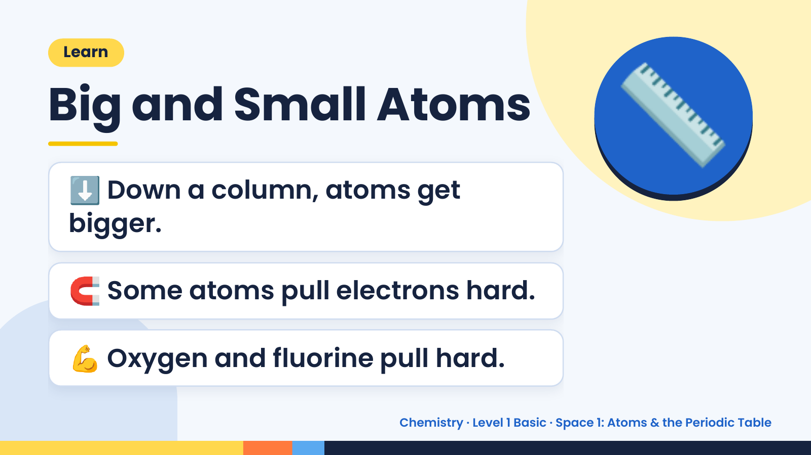
Notes:
Learn
Big and Small Atoms
⬇️ Down a column, atoms get
bigger.
📏
🧲 Some atoms pull electrons hard.
💪 Oxygen and fluorine pull hard.
Chemistry · Level 1 Basic · Space 1: Atoms & the Periodic Table

Slide 20
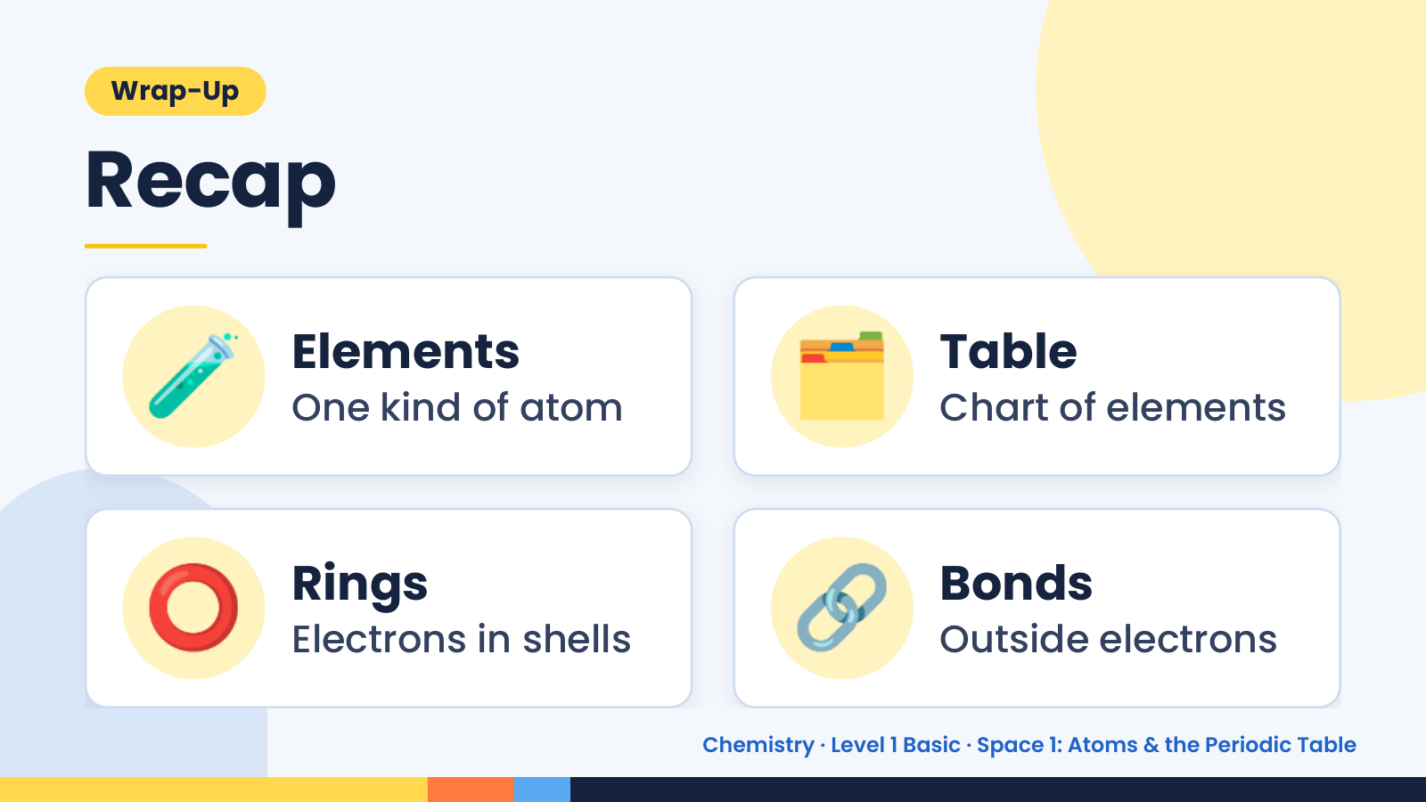
Notes:
Wrap-Up
Recap
🧪 Elements
One kind of atom 🗂️ Table
Chart of elements
⭕ Rings
Electrons in shells 🔗 Bonds
Outside electrons
Chemistry · Level 1 Basic · Space 1: Atoms & the Periodic Table

Slide 21
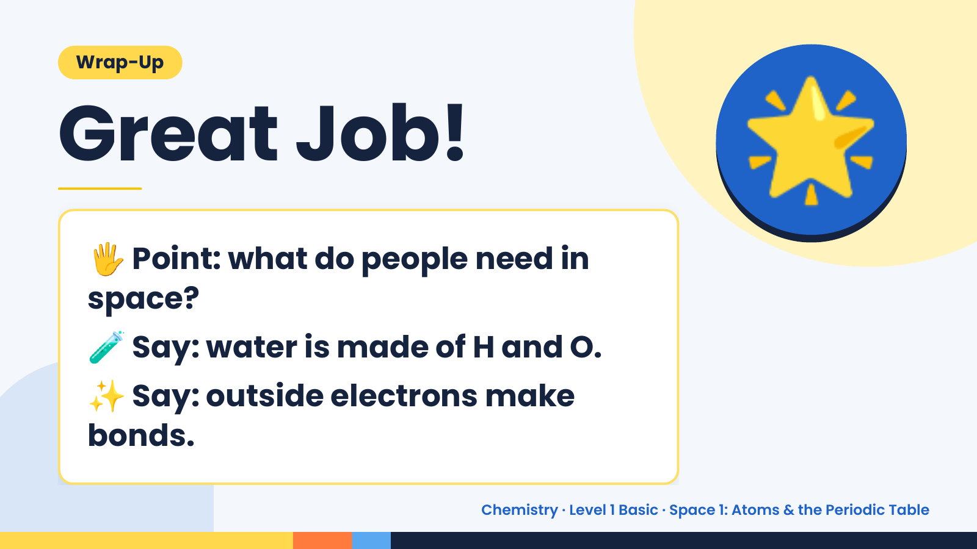
Notes:
Wrap-Up
Great Job!
🖐️
Point: what do people need in
space?
🌟
🧪 Say: water is made of H and O.
✨Say: outside electrons make
bonds.
Chemistry · Level 1 Basic · Space 1: Atoms & the Periodic Table

