Slide 1
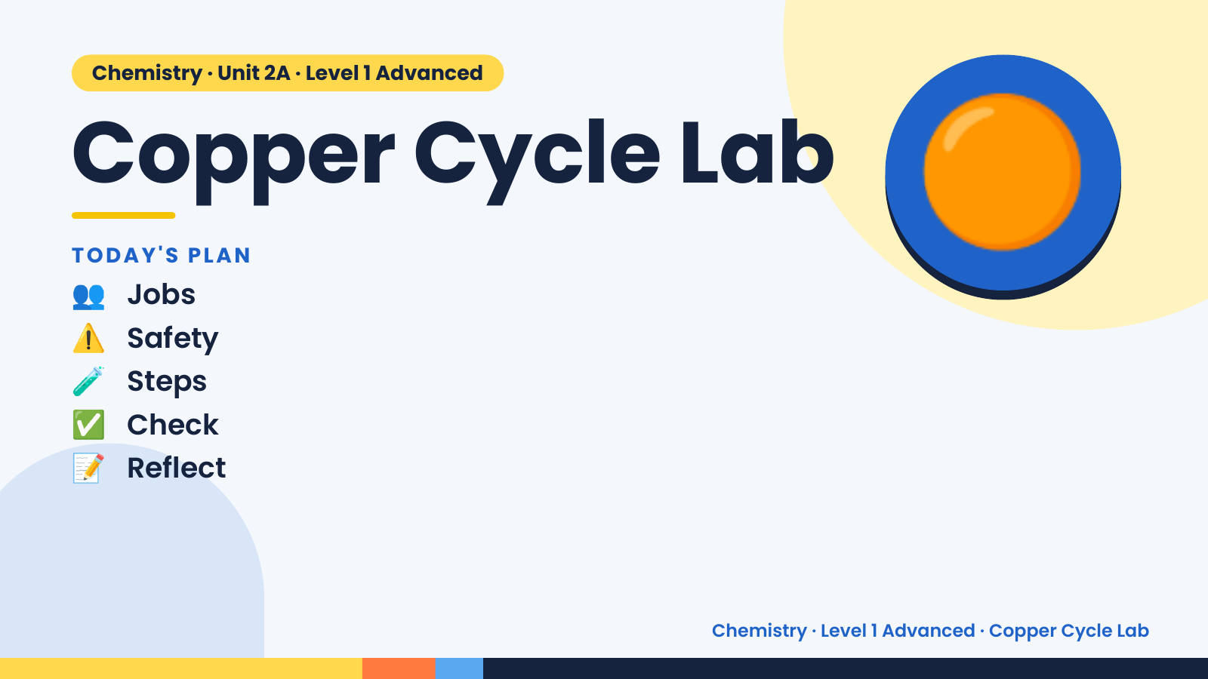
Notes:
Chemistry · Unit 2A · Level 1 Advanced
Copper Cycle Lab
👥 Jobs
TODAY'S PLAN
⚠️ Safety
🧪 Steps
🟠
✅ Check
📝 Reflect
Chemistry · Level 1 Advanced · Copper Cycle Lab

Slide 2
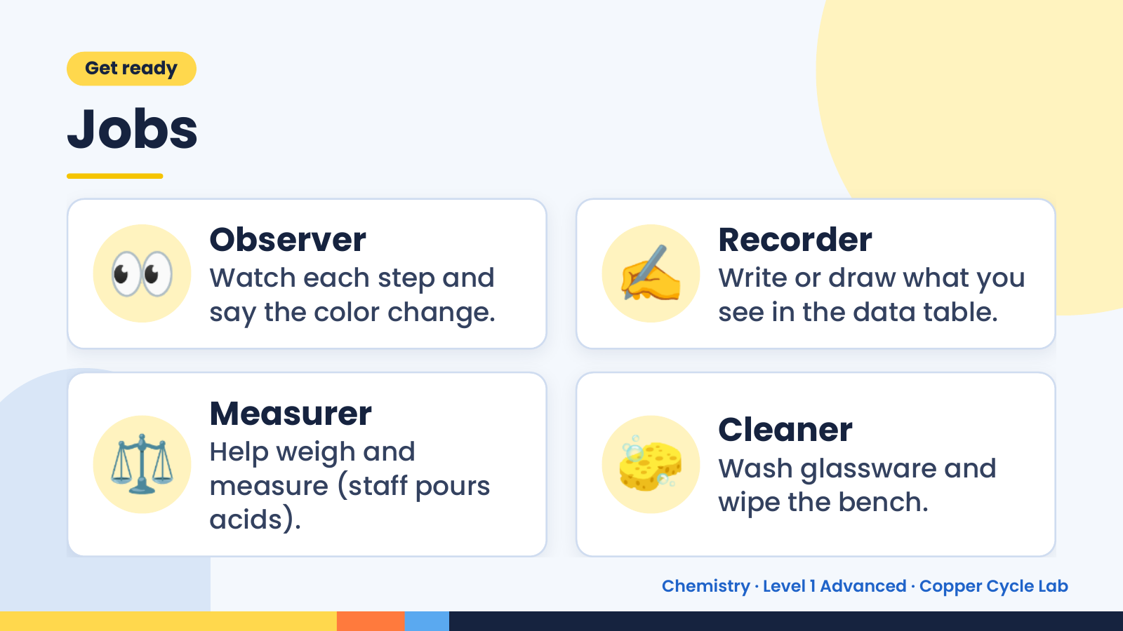
Notes:
Get ready
Jobs
👀 Observer
Watch each step and
say the color change.
✍️ Recorder
Write or draw what you
see in the data table.
⚖️ Measurer
Help weigh and
measure (staff pours
acids).
🧽 Cleaner
Wash glassware and
wipe the bench.
Chemistry · Level 1 Advanced · Copper Cycle Lab

Slide 3
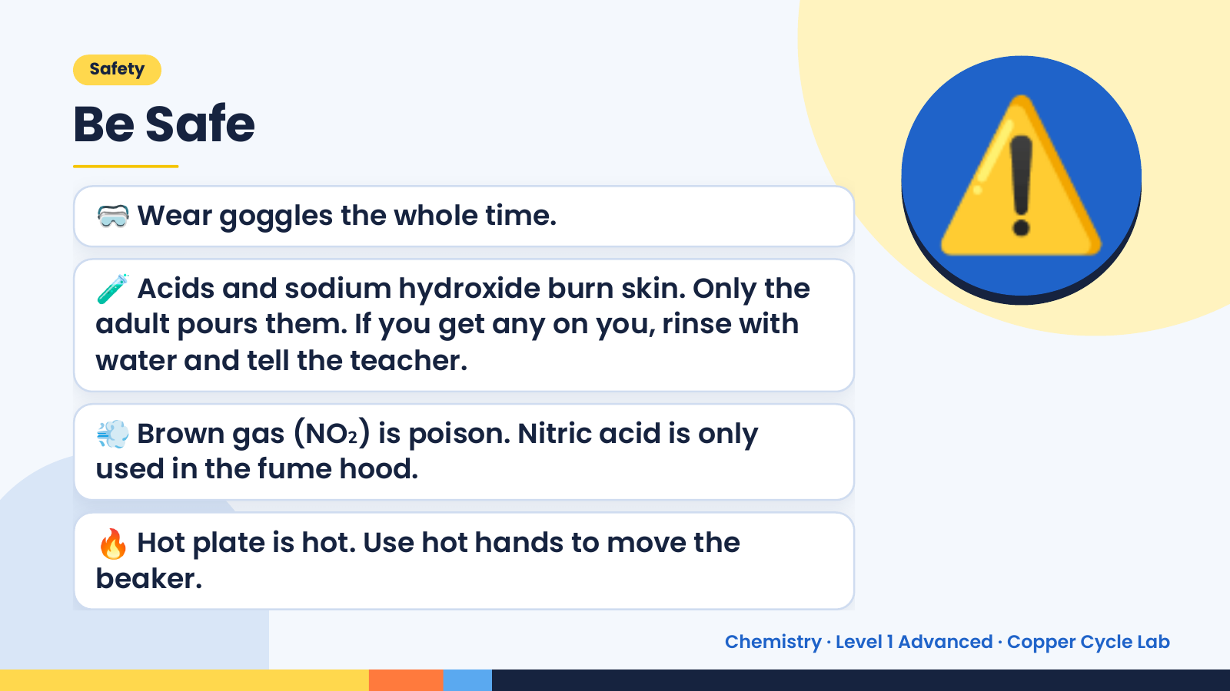
Notes:
Safety
Be Safe
🥽 Wear goggles the whole time.
🧪 Acids and sodium hydroxide burn skin. Only the
adult pours them. If you get any on you, rinse with
water and tell the teacher.
⚠️
💨 Brown gas (NO₂) is poison. Nitric acid is only
used in the fume hood.
🔥 Hot plate is hot. Use hot hands to move the
beaker.
Chemistry · Level 1 Advanced · Copper Cycle Lab

Slide 4
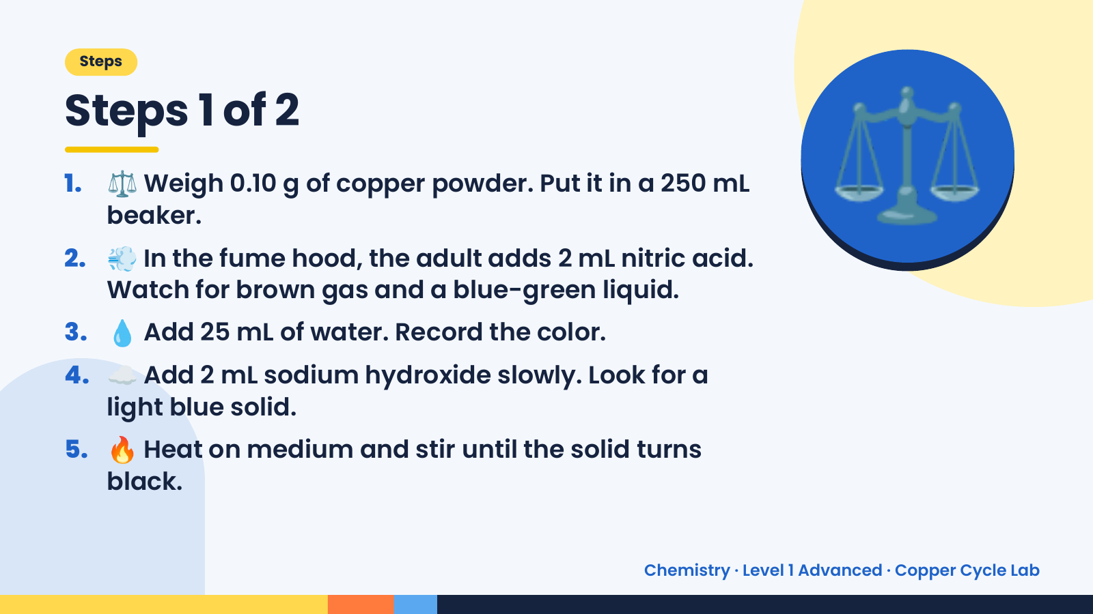
Notes:
Steps
Steps 1 of 2
1. ⚖️ Weigh 0.10 g of copper powder. Put it in a 250 mL
beaker.
2. 💨 In the fume hood, the adult adds 2 mL nitric acid.
Watch for brown gas and a blue-green liquid.
3. 💧 Add 25 mL of water. Record the color.
⚖️
4. ☁️ Add 2 mL sodium hydroxide slowly. Look for a
light blue solid.
5. 🔥 Heat on medium and stir until the solid turns
black.
Chemistry · Level 1 Advanced · Copper Cycle Lab

Slide 5
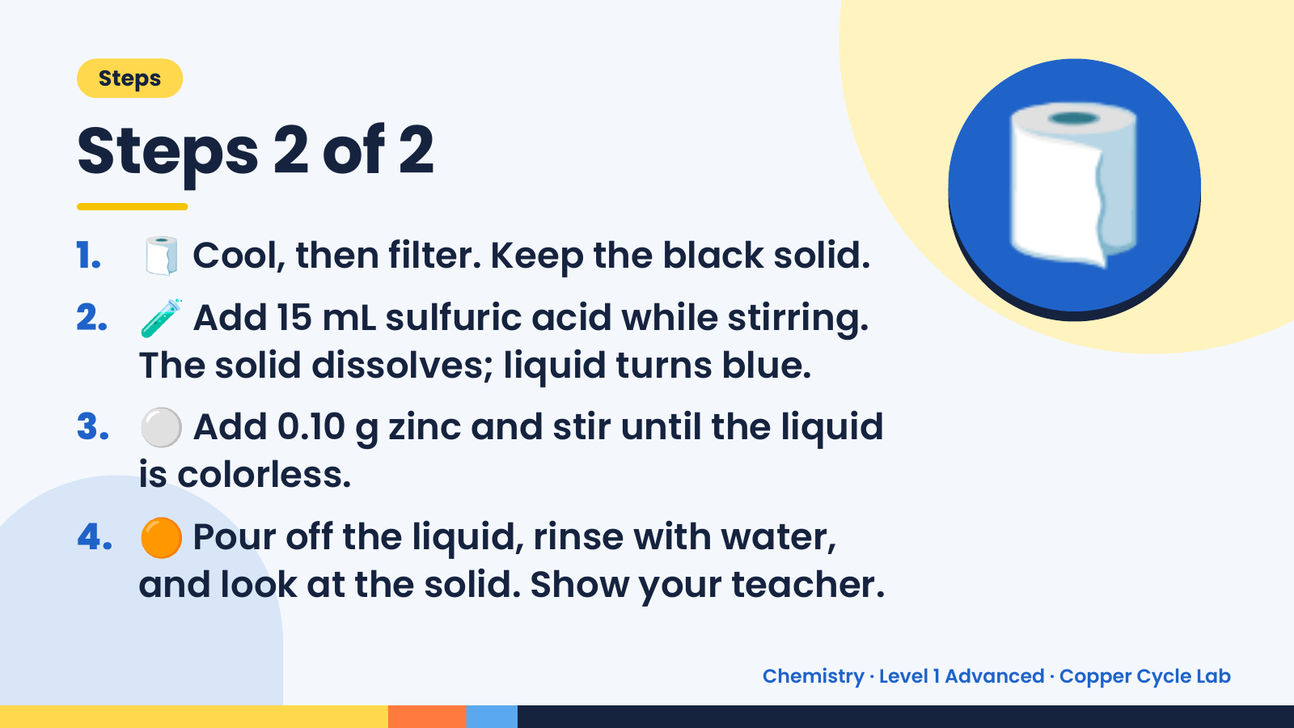
Notes:
Steps
Steps 2 of 2
1. 🧻 Cool, then filter. Keep the black solid.
2. 🧪 Add 15 mL sulfuric acid while stirring.
The solid dissolves; liquid turns blue.
🧻
3. ⚪ Add 0.10 g zinc and stir until the liquid
is colorless.
4. 🟠 Pour off the liquid, rinse with water,
and look at the solid. Show your teacher.
Chemistry · Level 1 Advanced · Copper Cycle Lab

Slide 6
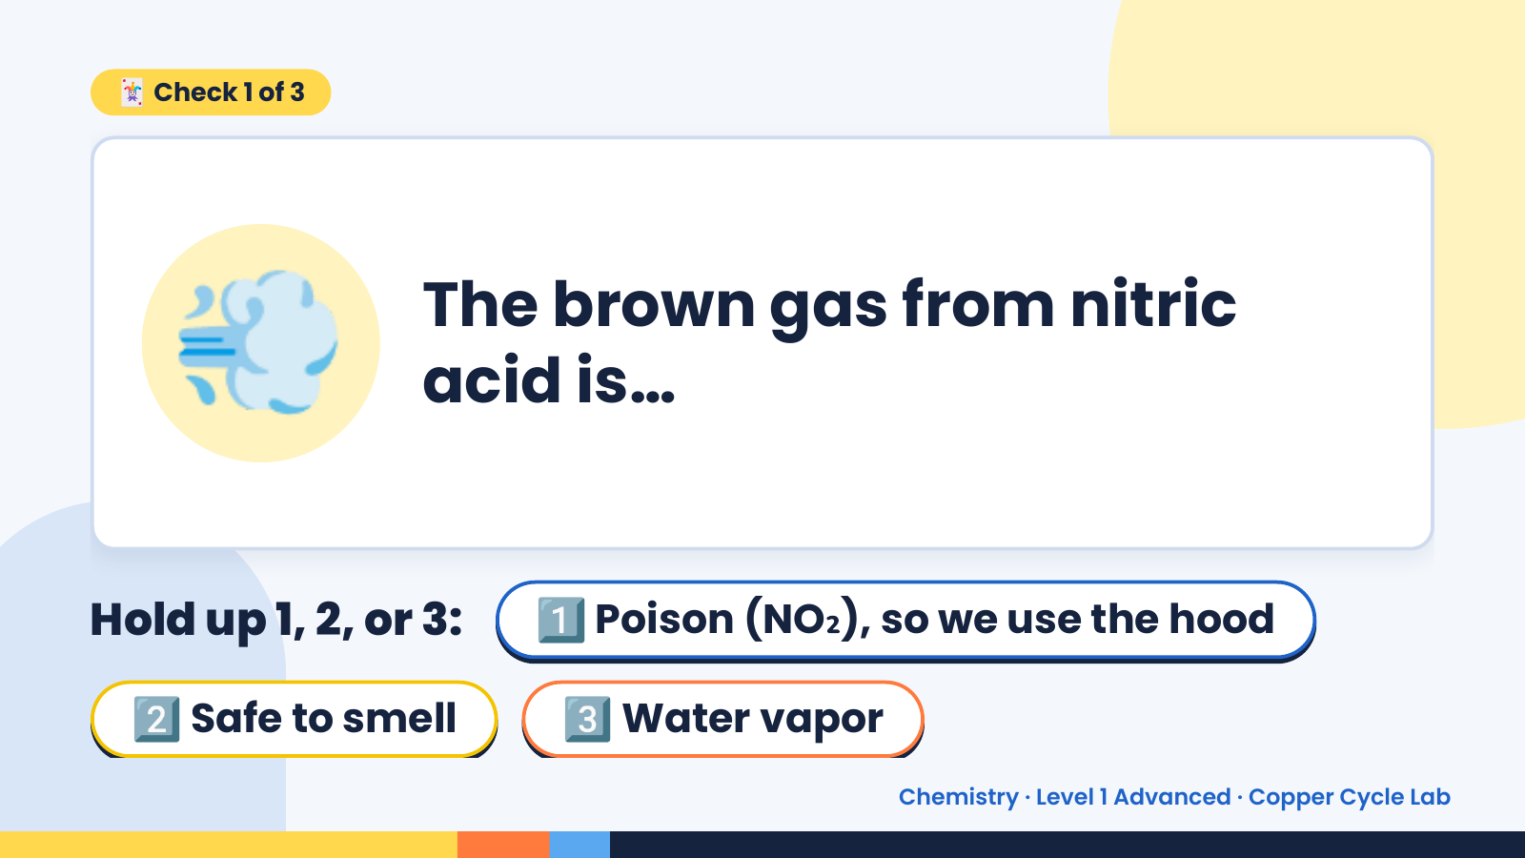
Notes:
🃏 Check 1 of 3
💨 The brown gas from nitric
acid is…
Hold up 1, 2, or 3: 1️⃣ Poison (NO₂), so we use the hood
2️⃣ Safe to smell 3️⃣ Water vapor
Chemistry · Level 1 Advanced · Copper Cycle Lab

Slide 7
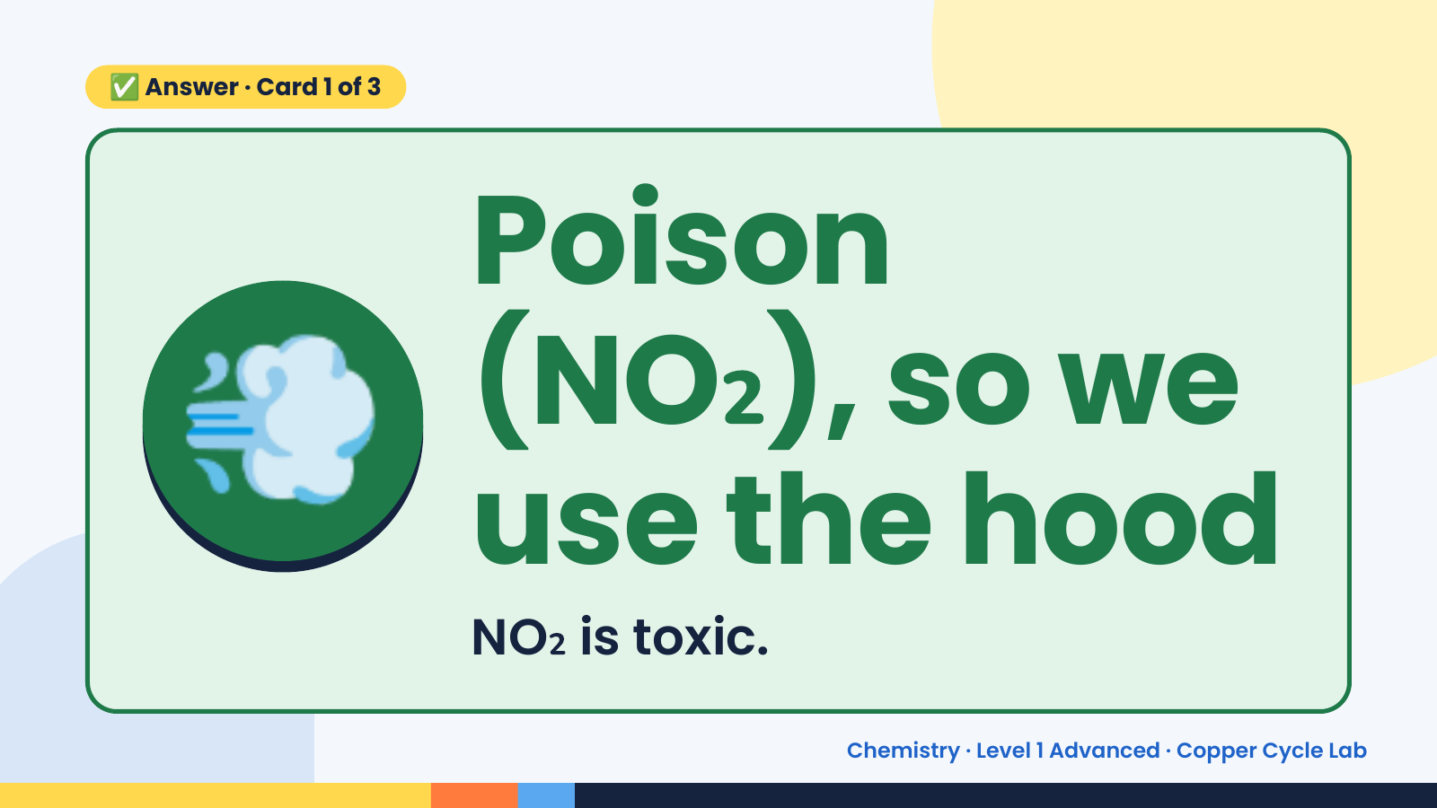
Notes:
✅ Answer · Card 1 of 3
💨 Poison
(NO₂), so we
use the hood
NO₂ is toxic.
Chemistry · Level 1 Advanced · Copper Cycle Lab

Slide 8
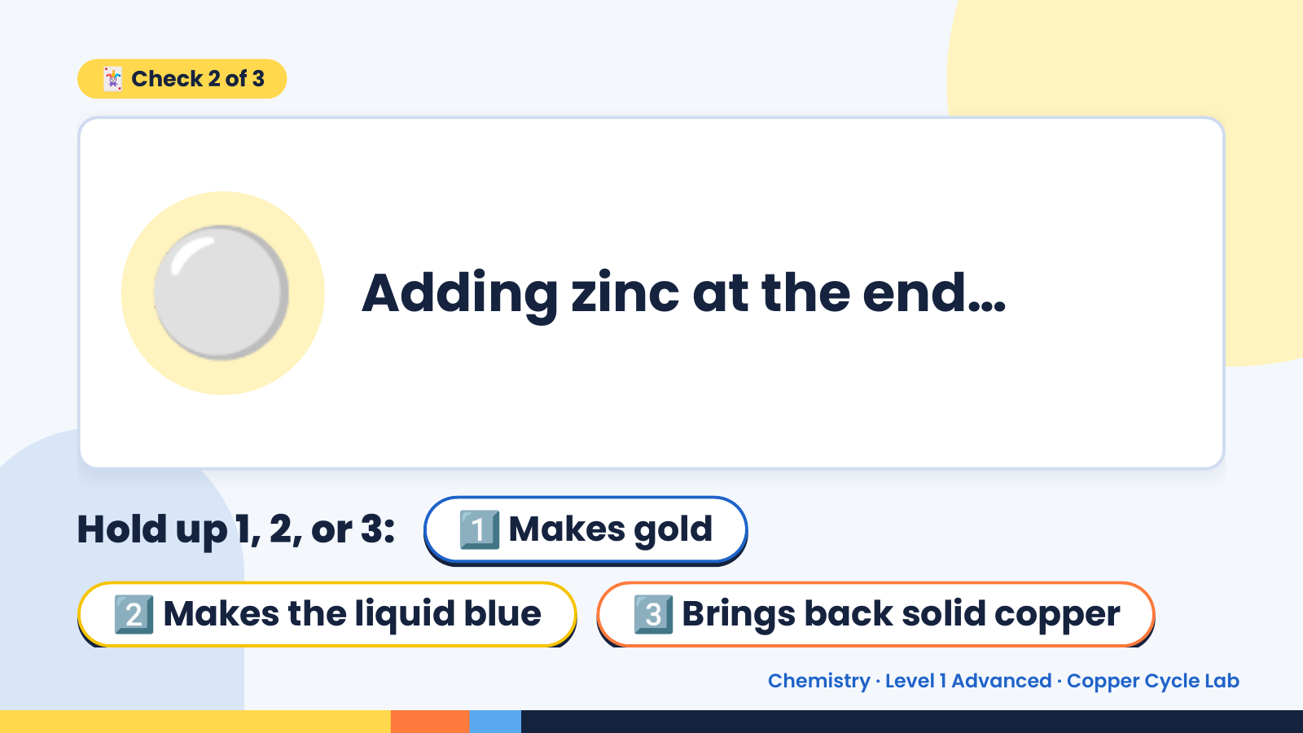
Notes:
🃏 Check 2 of 3
⚪ Adding zinc at the end…
Hold up 1, 2, or 3: 1️⃣ Makes gold
2️⃣ Makes the liquid blue 3️⃣ Brings back solid copper
Chemistry · Level 1 Advanced · Copper Cycle Lab

Slide 9
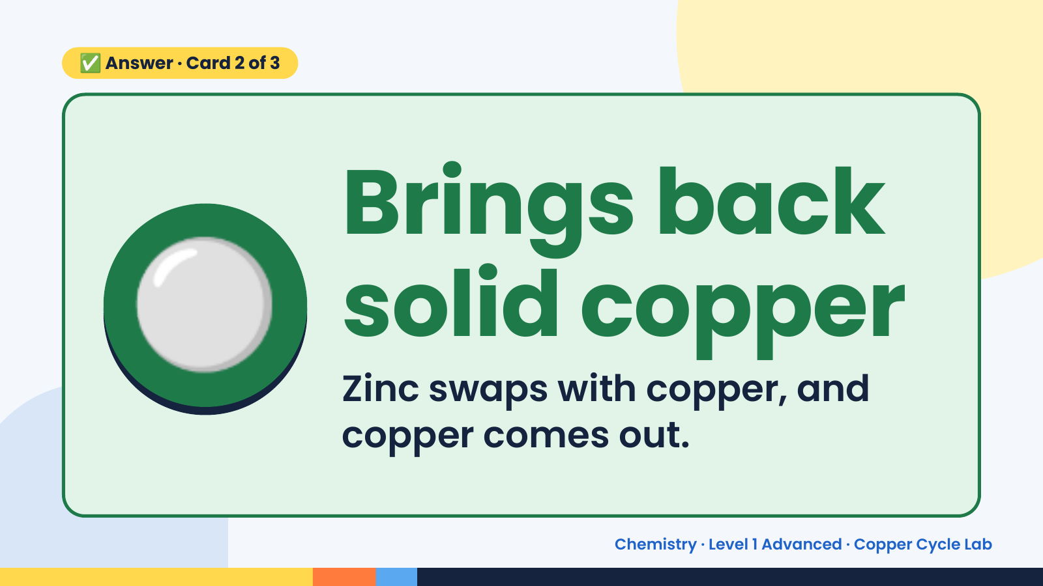
Notes:
✅ Answer · Card 2 of 3
⚪ Brings back
solid copper
Zinc swaps with copper, and
copper comes out.
Chemistry · Level 1 Advanced · Copper Cycle Lab

Slide 10
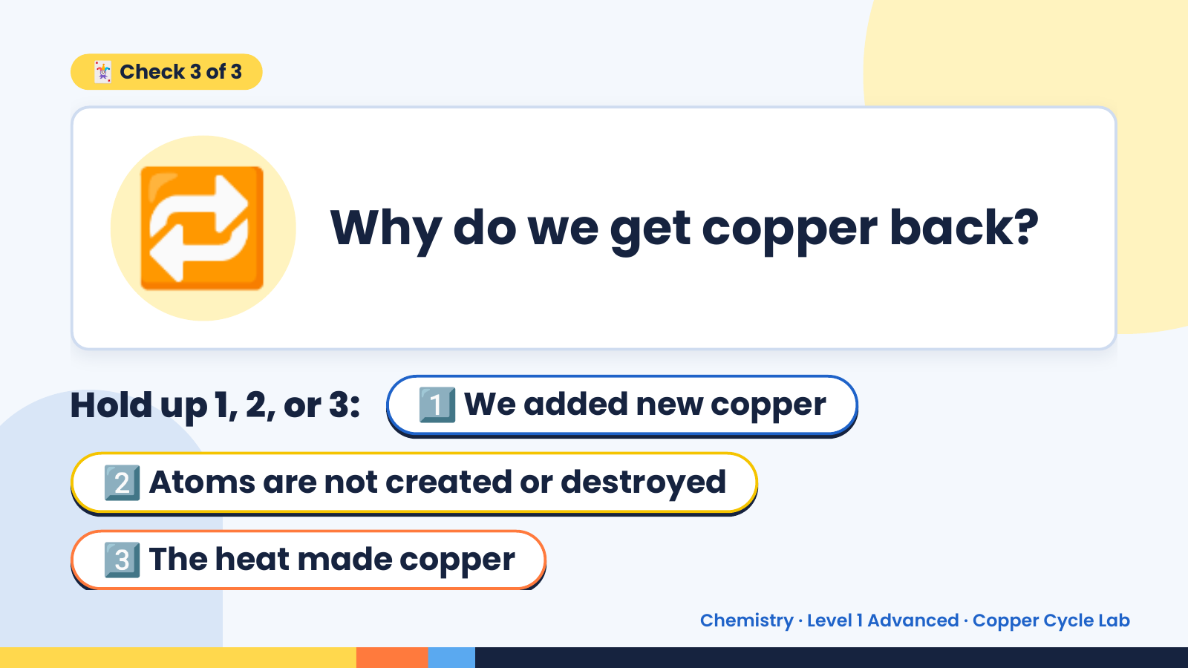
Notes:
🔁
🃏 Check 3 of 3
Why do we get copper back?
Hold up 1, 2, or 3: 1️⃣ We added new copper
2️⃣ Atoms are not created or destroyed
3️⃣ The heat made copper
Chemistry · Level 1 Advanced · Copper Cycle Lab

Slide 11
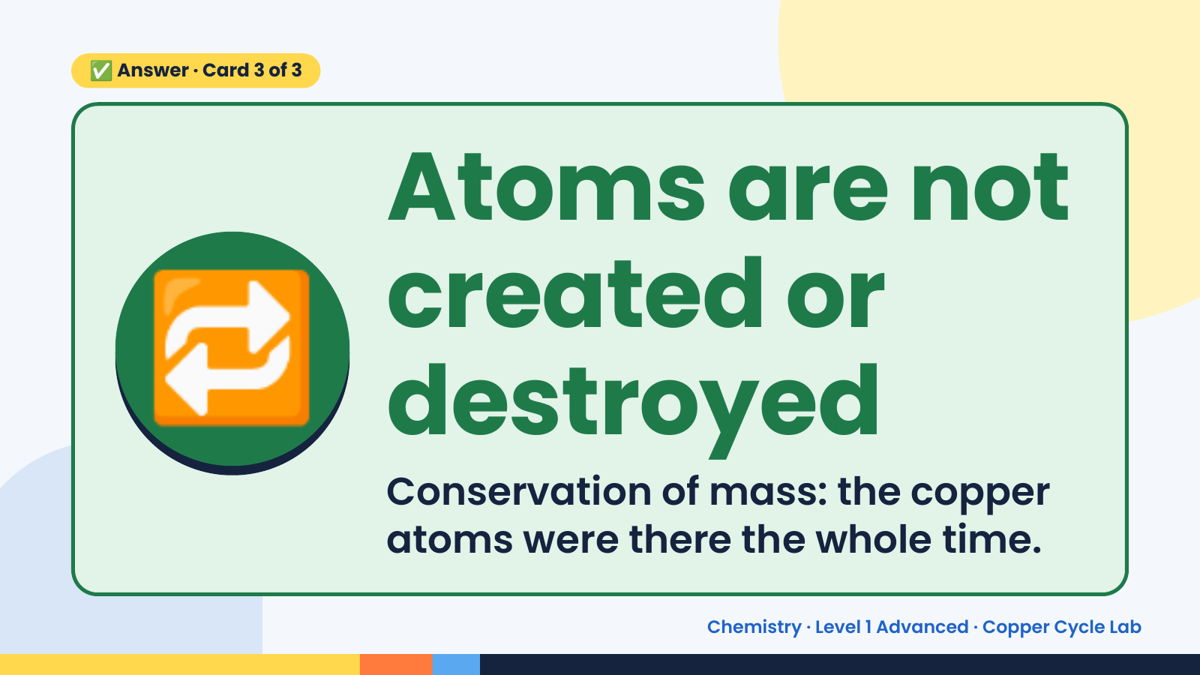
Notes:
✅ Answer · Card 3 of 3
🔁
Atoms are not
created or
destroyed
Conservation of mass: the copper
atoms were there the whole time.
Chemistry · Level 1 Advanced · Copper Cycle Lab

Slide 12
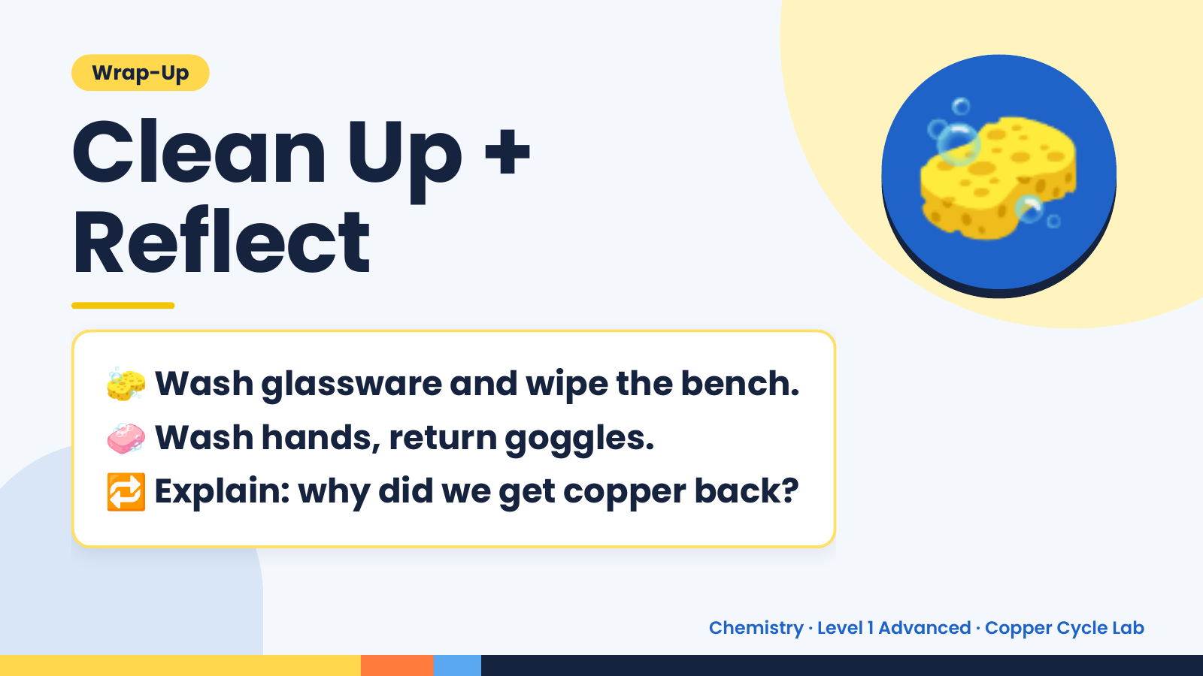
Notes:
Wrap-Up
Clean Up +
Reflect
🧽
🧽 Wash glassware and wipe the bench.
🧼 Wash hands, return goggles.
🔁 Explain: why did we get copper back?
Chemistry · Level 1 Advanced · Copper Cycle Lab

