Slide 1
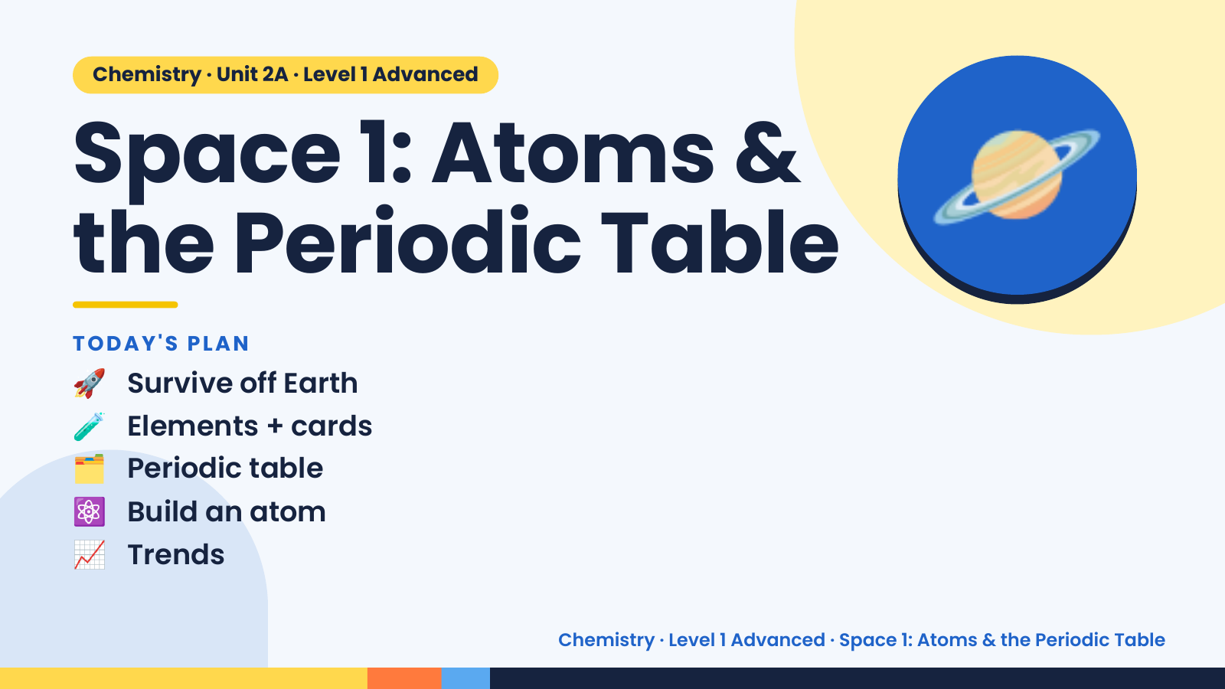
Notes:
Chemistry · Unit 2A · Level 1 Advanced
Space 1: Atoms &
the Periodic Table
🚀 Survive off Earth
TODAY'S PLAN
🪐
🧪 Elements + cards
🗂️ Periodic table
⚛️ Build an atom
📈 Trends
Chemistry · Level 1 Advanced · Space 1: Atoms & the Periodic Table

Slide 2
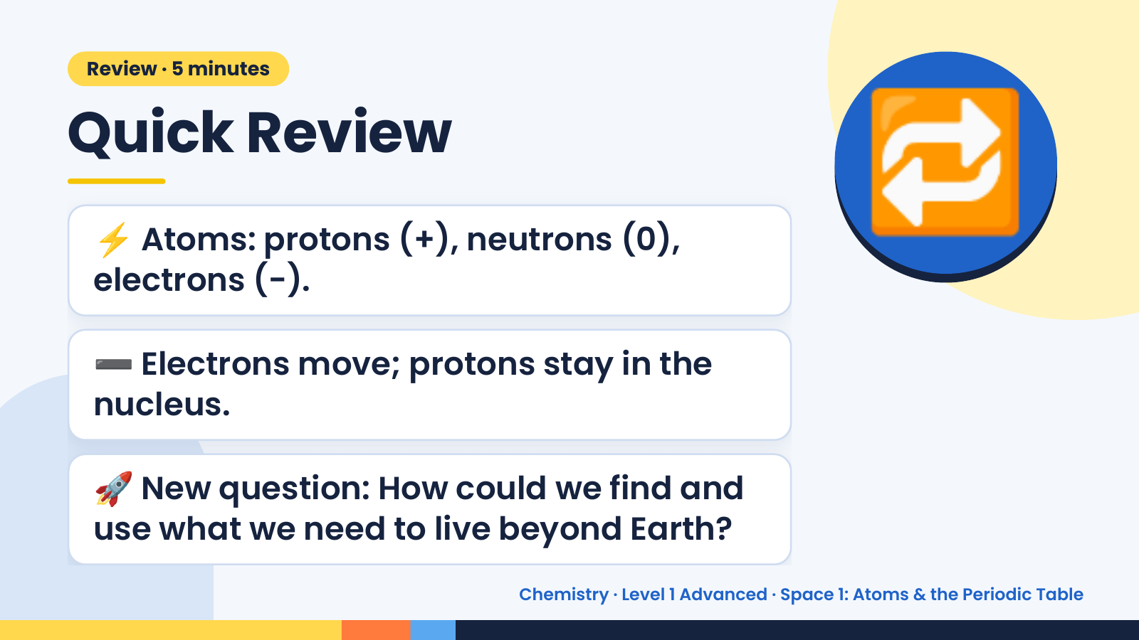
Notes:
Review · 5 minutes
Quick Review
⚡ Atoms: protons (+), neutrons (0),
electrons (−).
🔁
➖ Electrons move; protons stay in the
nucleus.
🚀 New question: How could we find and
use what we need to live beyond Earth?
Chemistry · Level 1 Advanced · Space 1: Atoms & the Periodic Table

Slide 3
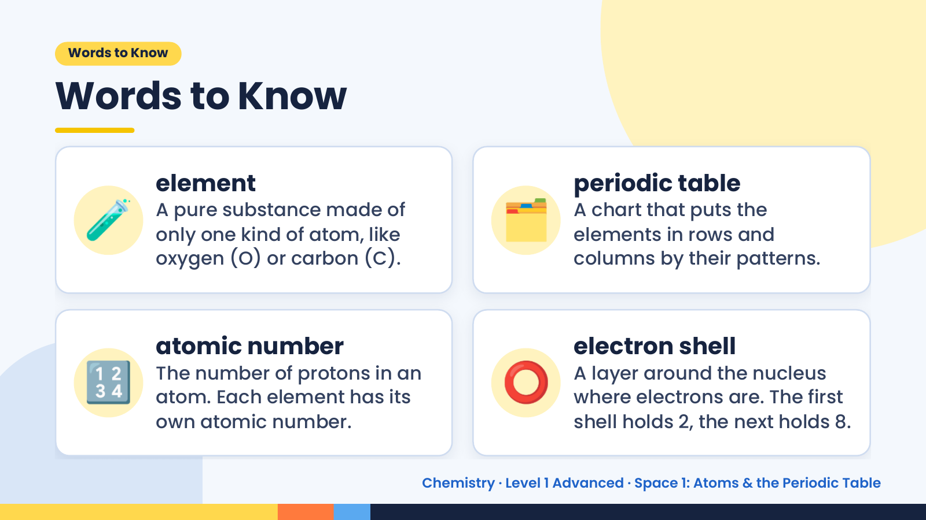
Notes:
Words to Know
Words to Know
🧪 element
A pure substance made of
only one kind of atom, like
oxygen (O) or carbon (C).
🗂️ periodic table
A chart that puts the
elements in rows and
columns by their patterns.
🔢 atomic number
The number of protons in an
atom. Each element has its
own atomic number.
⭕ electron shell
A layer around the nucleus
where electrons are. The first
shell holds 2, the next holds 8.
Chemistry · Level 1 Advanced · Space 1: Atoms & the Periodic Table

Slide 4
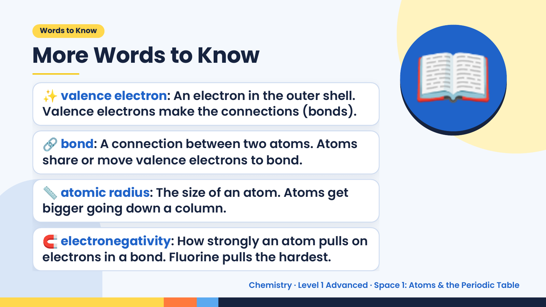
Notes:
Words to Know
More Words to Know
✨ valence electron: An electron in the outer shell.
Valence electrons make the connections (bonds).
🔗 bond: A connection between two atoms. Atoms
share or move valence electrons to bond.
📖
📏 atomic radius: The size of an atom. Atoms get
bigger going down a column.
🧲 electronegativity: How strongly an atom pulls on
electrons in a bond. Fluorine pulls the hardest.
Chemistry · Level 1 Advanced · Space 1: Atoms & the Periodic Table

Slide 5
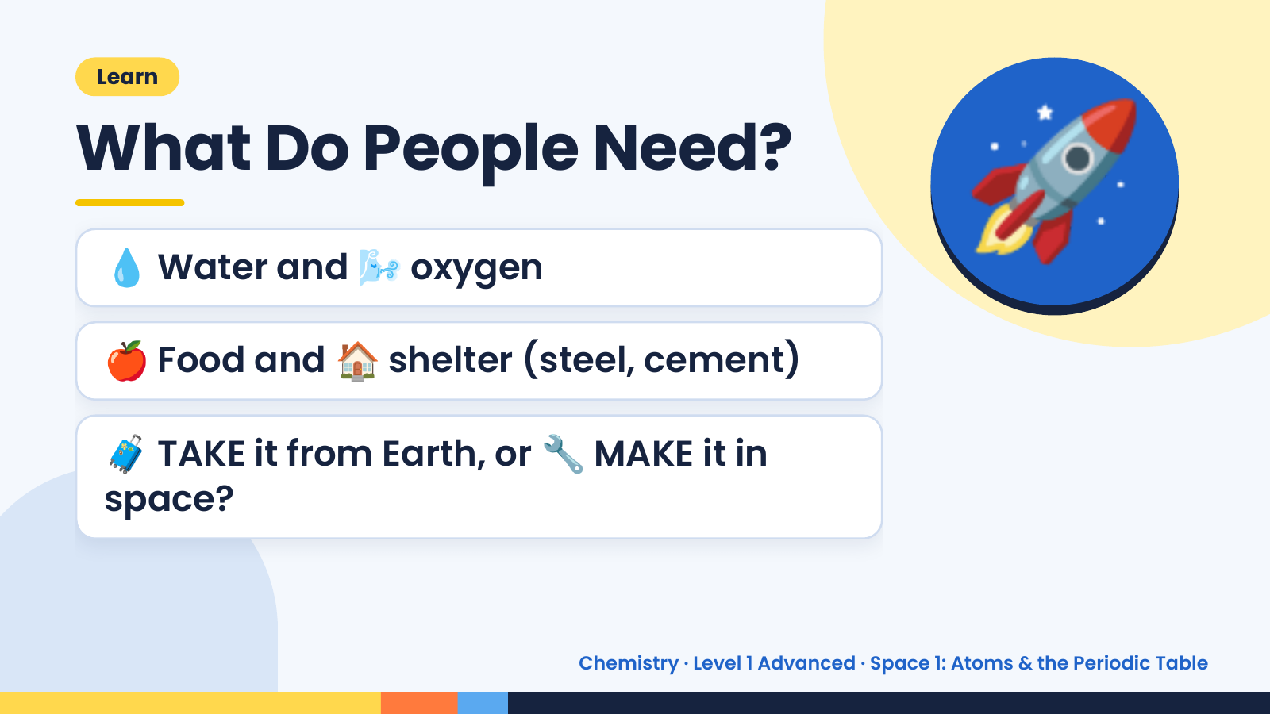
Notes:
Learn
What Do People Need?
💧 Water and 🌬️ oxygen
🍎 Food and 🏠 shelter (steel, cement)
🚀
🧳 TAKE it from Earth, or 🔧 MAKE it in
space?
Chemistry · Level 1 Advanced · Space 1: Atoms & the Periodic Table

Slide 6
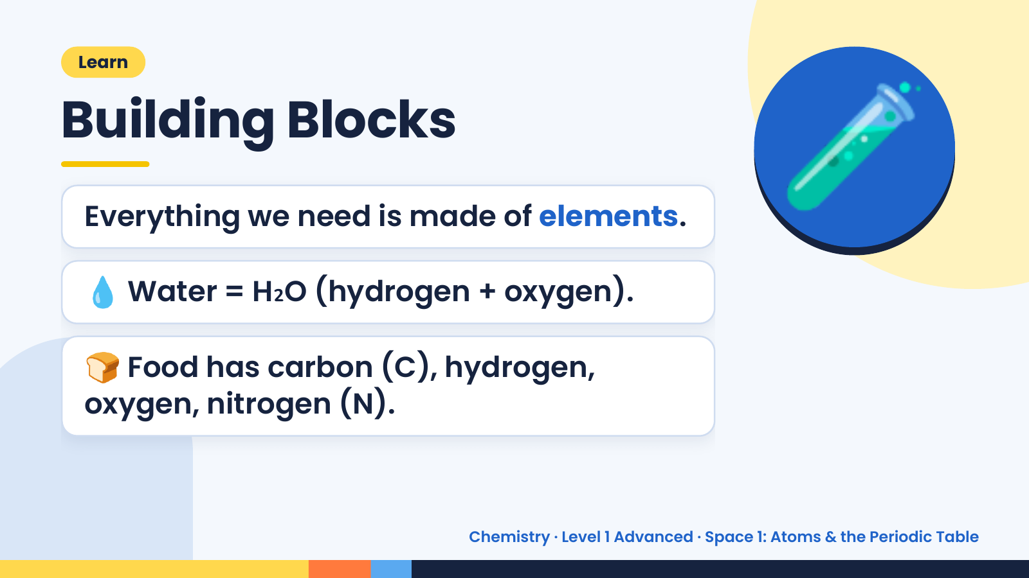
Notes:
Learn
Building Blocks
Everything we need is made of elements.
💧 Water = H₂O (hydrogen + oxygen).
🧪
🍞 Food has carbon (C), hydrogen,
oxygen, nitrogen (N).
Chemistry · Level 1 Advanced · Space 1: Atoms & the Periodic Table

Slide 7
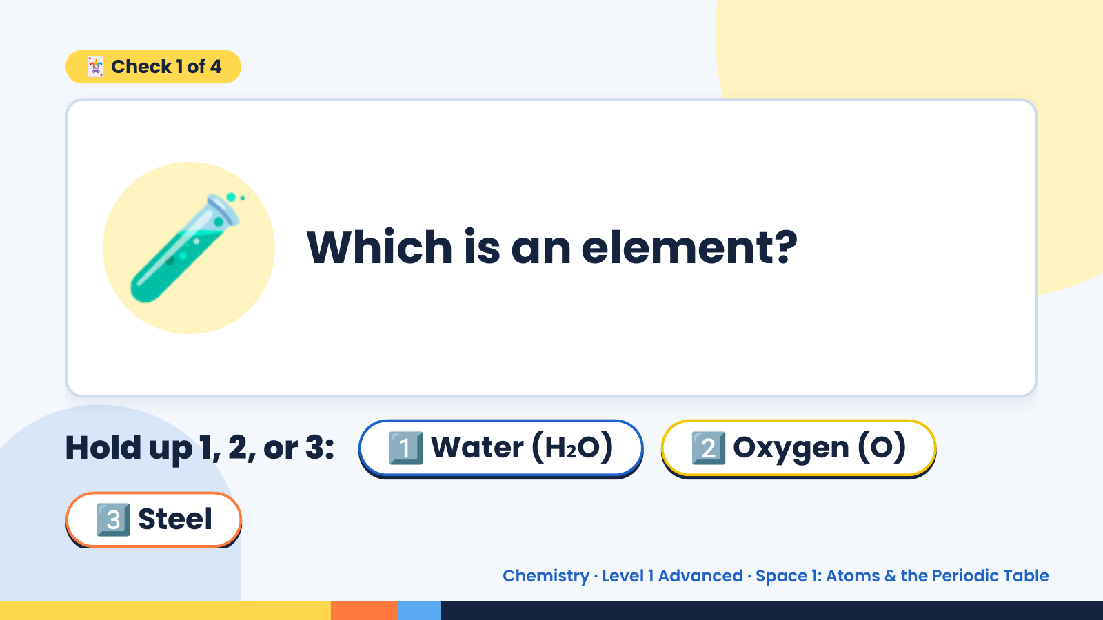
Notes:
🃏 Check 1 of 4
🧪 Which is an element?
Hold up 1, 2, or 3: 1️⃣ Water (H₂O) 2️⃣ Oxygen (O)
3️⃣ Steel
Chemistry · Level 1 Advanced · Space 1: Atoms & the Periodic Table

Slide 8
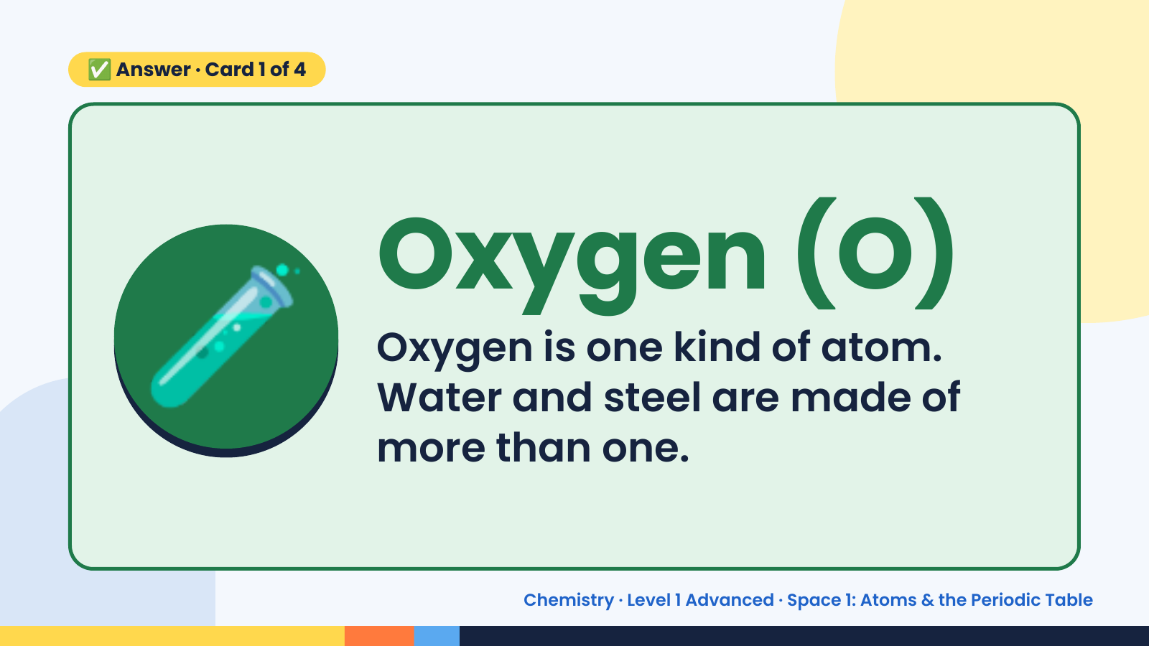
Notes:
✅ Answer · Card 1 of 4
🧪 Oxygen (O)
Oxygen is one kind of atom.
Water and steel are made of
more than one.
Chemistry · Level 1 Advanced · Space 1: Atoms & the Periodic Table

Slide 9
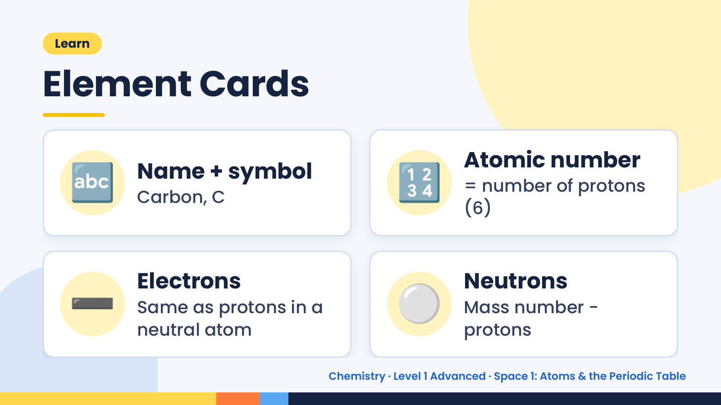
Notes:
Learn
Element Cards
🔤 Name + symbol
Carbon, C 🔢 Atomic number
= number of protons
(6)
➖ Electrons
Same as protons in a
neutral atom
⚪ Neutrons
Mass number −
protons
Chemistry · Level 1 Advanced · Space 1: Atoms & the Periodic Table

Slide 10
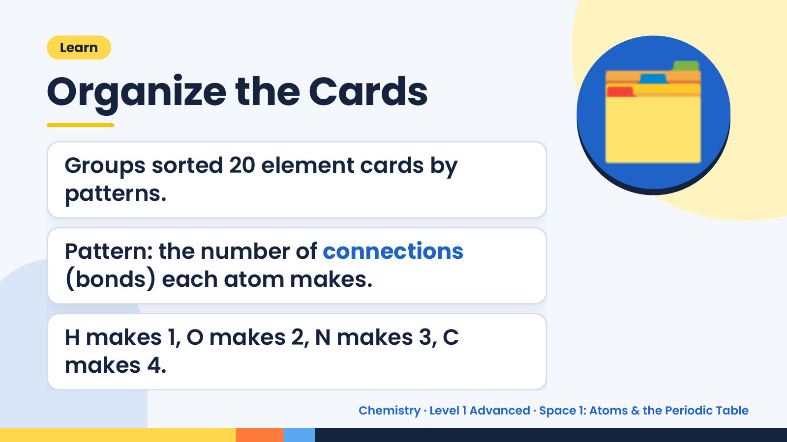
Notes:
Learn
Organize the Cards
Groups sorted 20 element cards by
patterns.
🗂️
Pattern: the number of connections
(bonds) each atom makes.
H makes 1, O makes 2, N makes 3, C
makes 4.
Chemistry · Level 1 Advanced · Space 1: Atoms & the Periodic Table

Slide 11
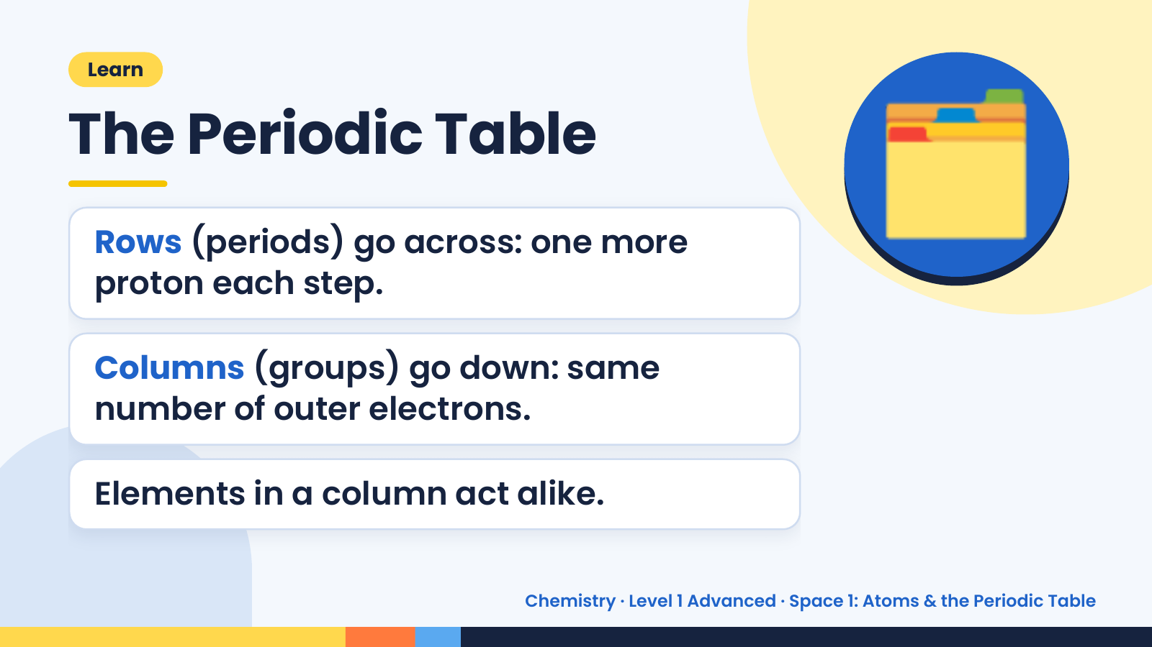
Notes:
Learn
The Periodic Table
Rows (periods) go across: one more
proton each step.
🗂️
Columns (groups) go down: same
number of outer electrons.
Elements in a column act alike.
Chemistry · Level 1 Advanced · Space 1: Atoms & the Periodic Table

Slide 12
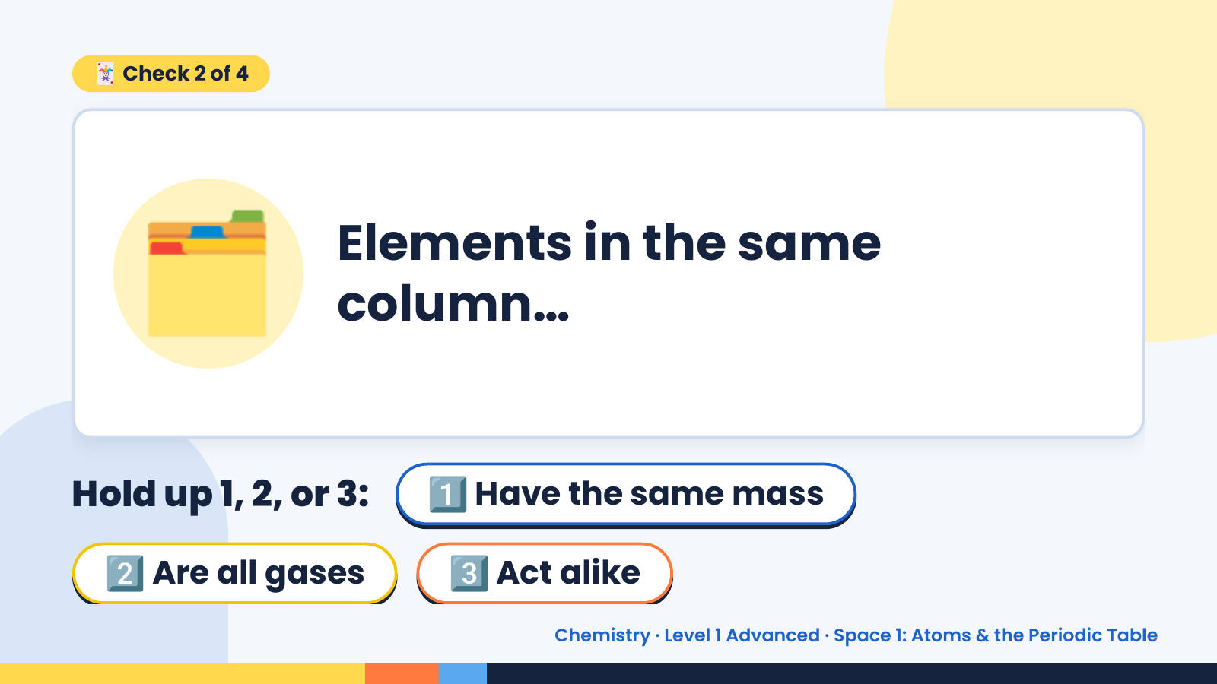
Notes:
🃏 Check 2 of 4
🗂️ Elements in the same
column…
Hold up 1, 2, or 3: 1️⃣ Have the same mass
2️⃣ Are all gases 3️⃣ Act alike
Chemistry · Level 1 Advanced · Space 1: Atoms & the Periodic Table

Slide 13
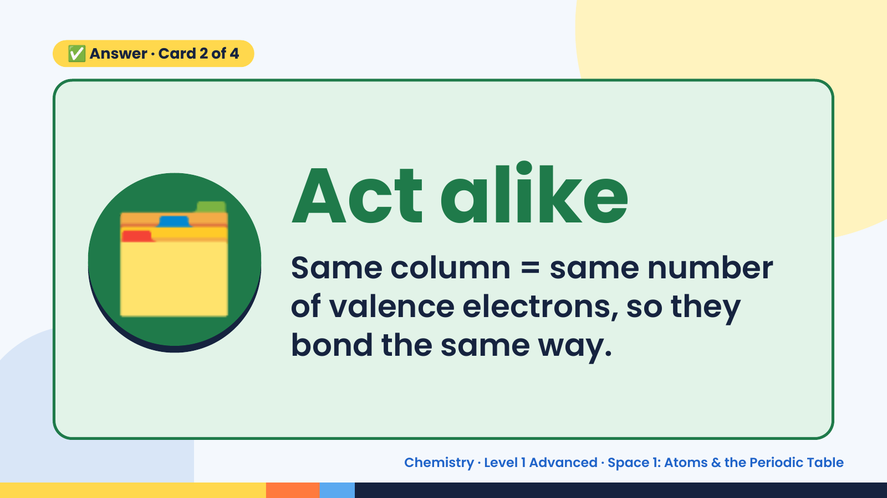
Notes:
✅ Answer · Card 2 of 4
🗂️ Act alike
Same column = same number
of valence electrons, so they
bond the same way.
Chemistry · Level 1 Advanced · Space 1: Atoms & the Periodic Table

Slide 14
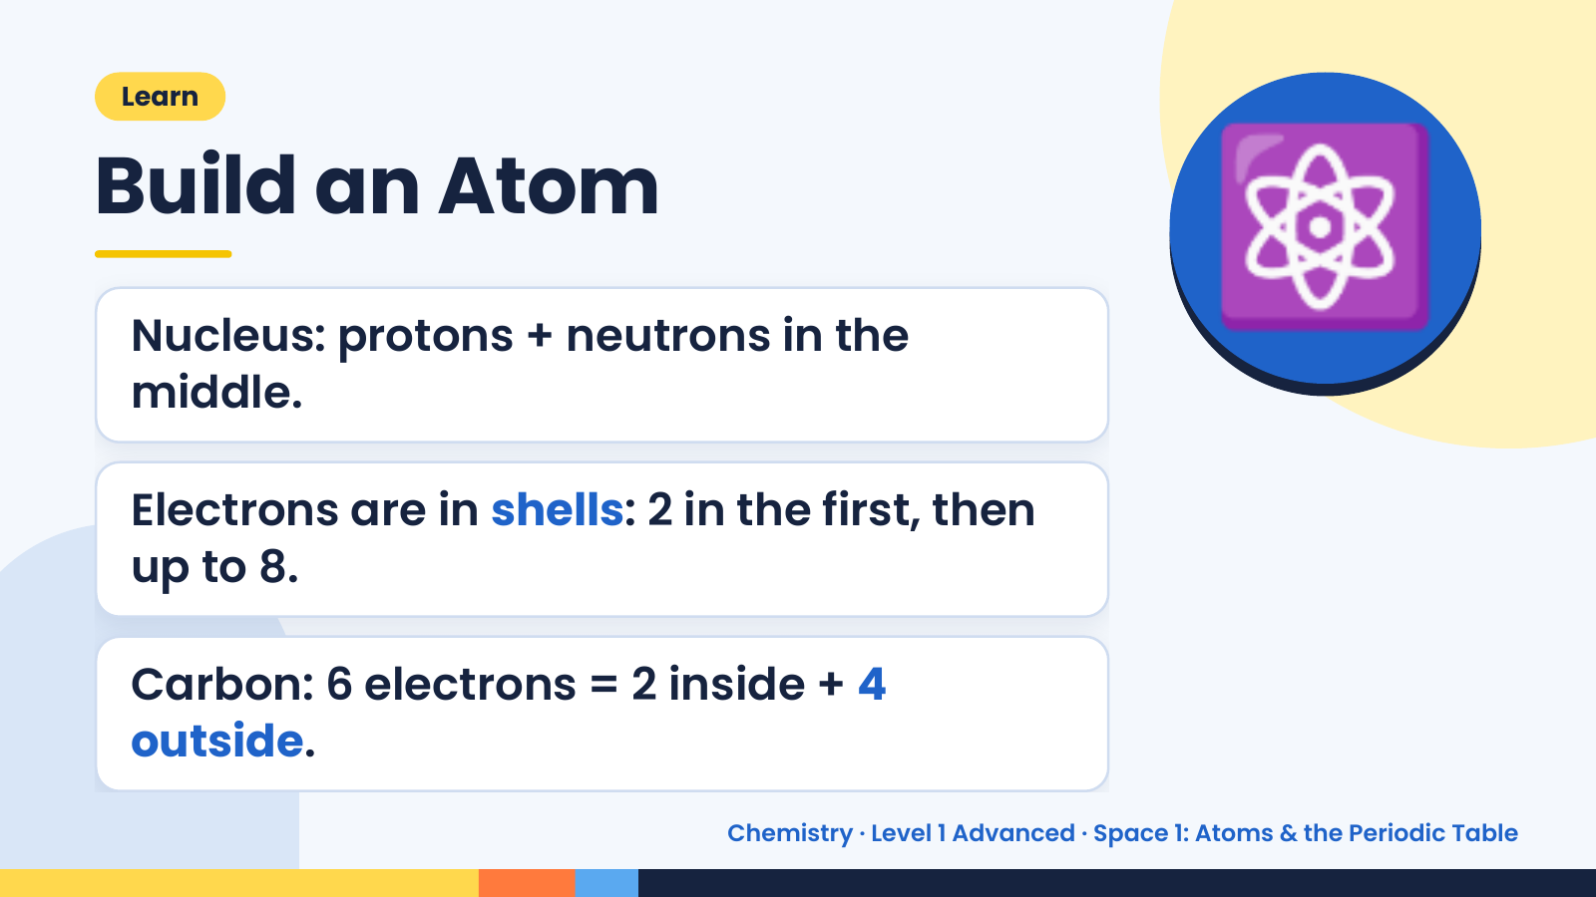
Notes:
Learn
Build an Atom
Nucleus: protons + neutrons in the
middle.
⚛️
Electrons are in shells: 2 in the first, then
up to 8.
Carbon: 6 electrons = 2 inside + 4
outside.
Chemistry · Level 1 Advanced · Space 1: Atoms & the Periodic Table

Slide 15
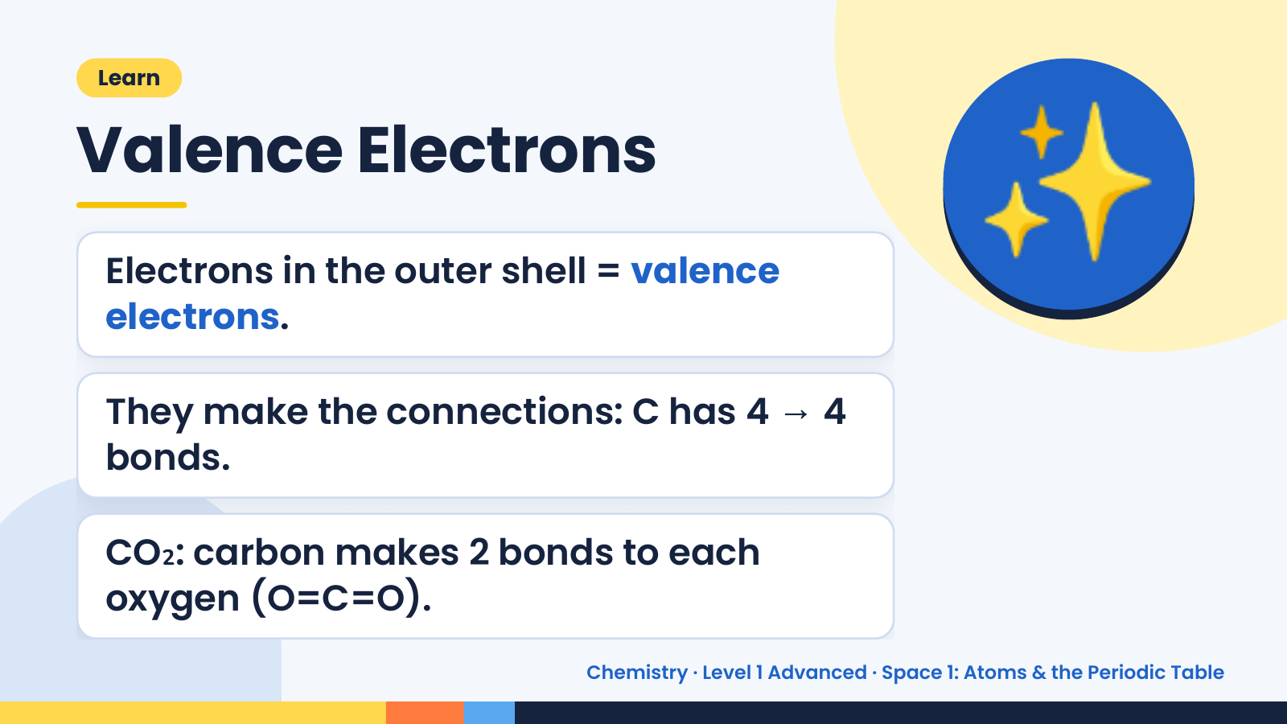
Notes:
Learn
Valence Electrons
Electrons in the outer shell = valence
electrons.
✨
They make the connections: C has 4 → 4
bonds.
CO₂: carbon makes 2 bonds to each
oxygen (O=C=O).
Chemistry · Level 1 Advanced · Space 1: Atoms & the Periodic Table

Slide 16
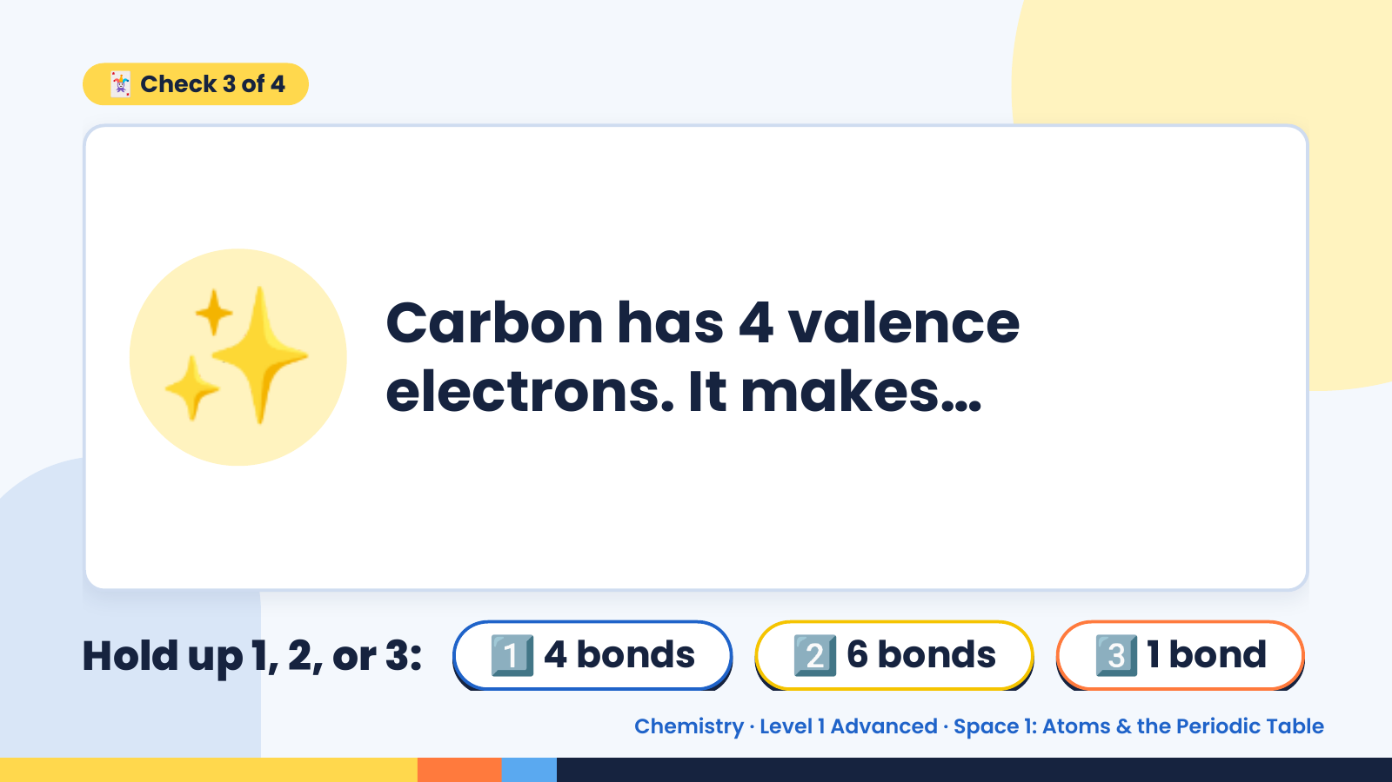
Notes:
🃏 Check 3 of 4
✨ Carbon has 4 valence
electrons. It makes…
Hold up 1, 2, or 3: 1️⃣ 4 bonds 2️⃣ 6 bonds 3️⃣ 1 bond
Chemistry · Level 1 Advanced · Space 1: Atoms & the Periodic Table

Slide 17
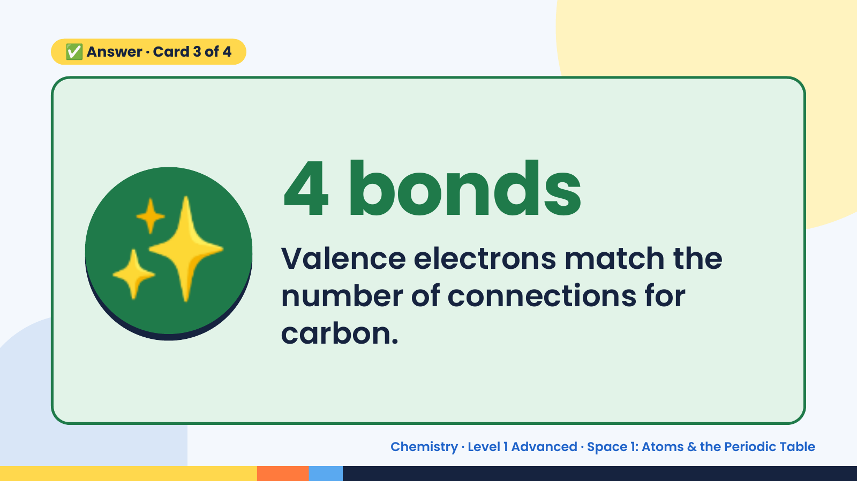
Notes:
✅ Answer · Card 3 of 4
✨ 4 bonds
Valence electrons match the
number of connections for
carbon.
Chemistry · Level 1 Advanced · Space 1: Atoms & the Periodic Table

Slide 18
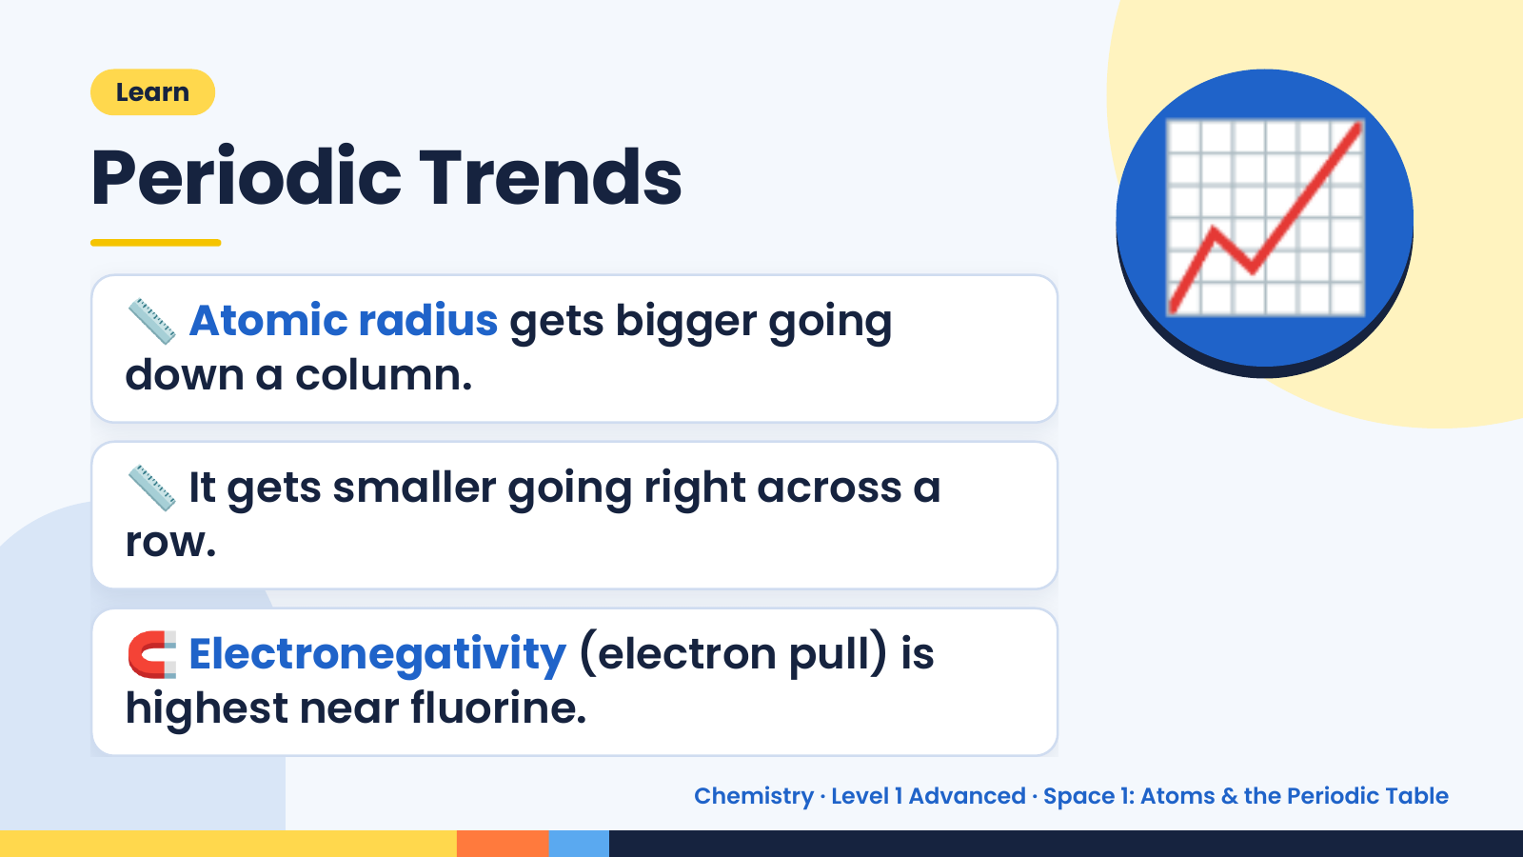
Notes:
Learn
Periodic Trends
📏 Atomic radius gets bigger going
down a column.
📈
📏 It gets smaller going right across a
row.
🧲 Electronegativity (electron pull) is
highest near fluorine.
Chemistry · Level 1 Advanced · Space 1: Atoms & the Periodic Table

Slide 19
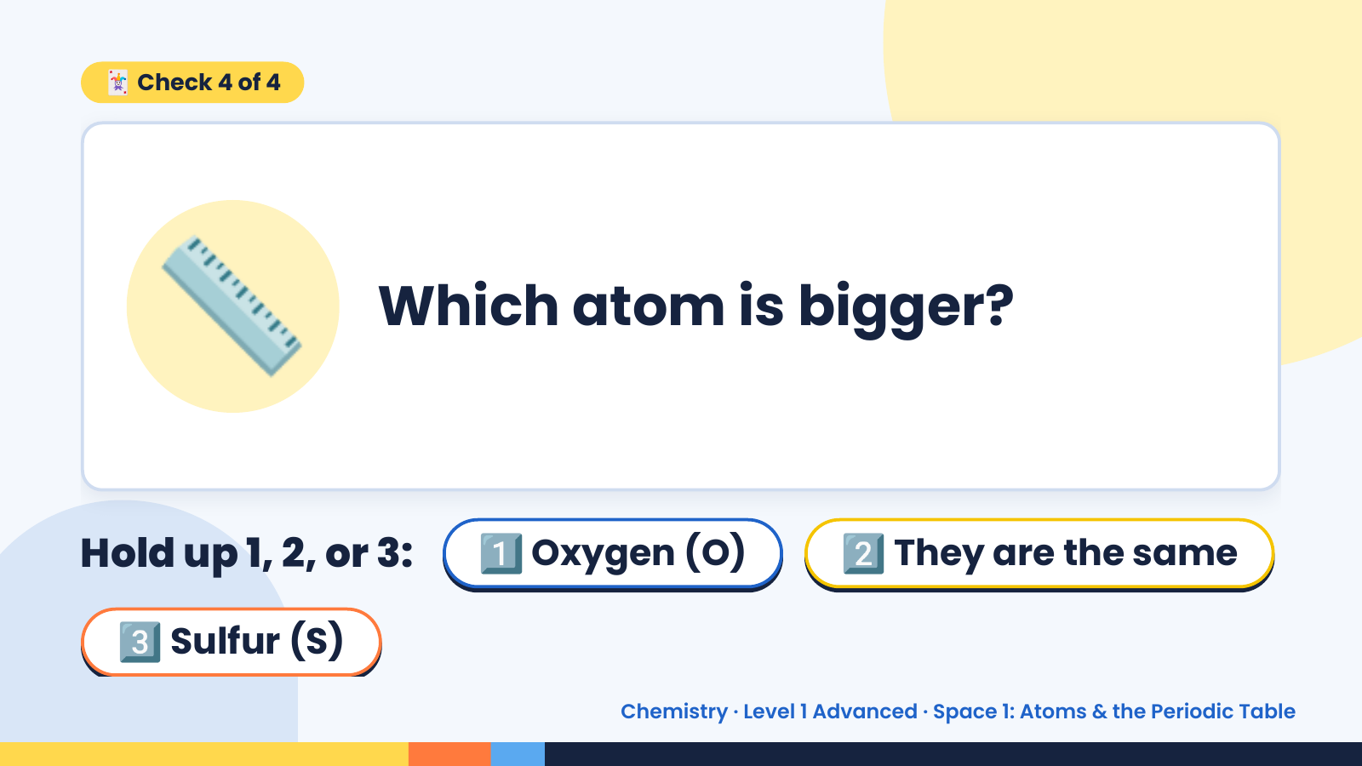
Notes:
🃏 Check 4 of 4
📏 Which atom is bigger?
Hold up 1, 2, or 3: 1️⃣ Oxygen (O) 2️⃣ They are the same
3️⃣ Sulfur (S)
Chemistry · Level 1 Advanced · Space 1: Atoms & the Periodic Table

Slide 20
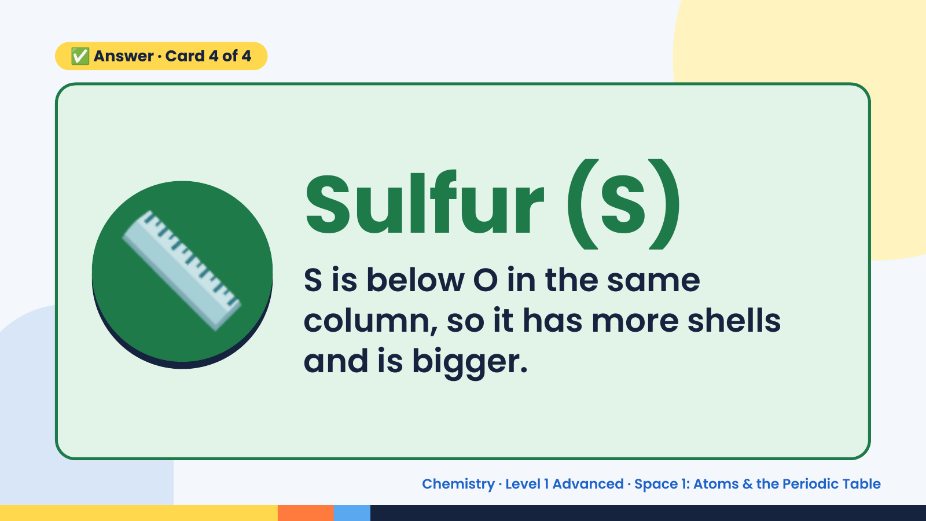
Notes:
✅ Answer · Card 4 of 4
📏 Sulfur (S)
S is below O in the same
column, so it has more shells
and is bigger.
Chemistry · Level 1 Advanced · Space 1: Atoms & the Periodic Table

Slide 21
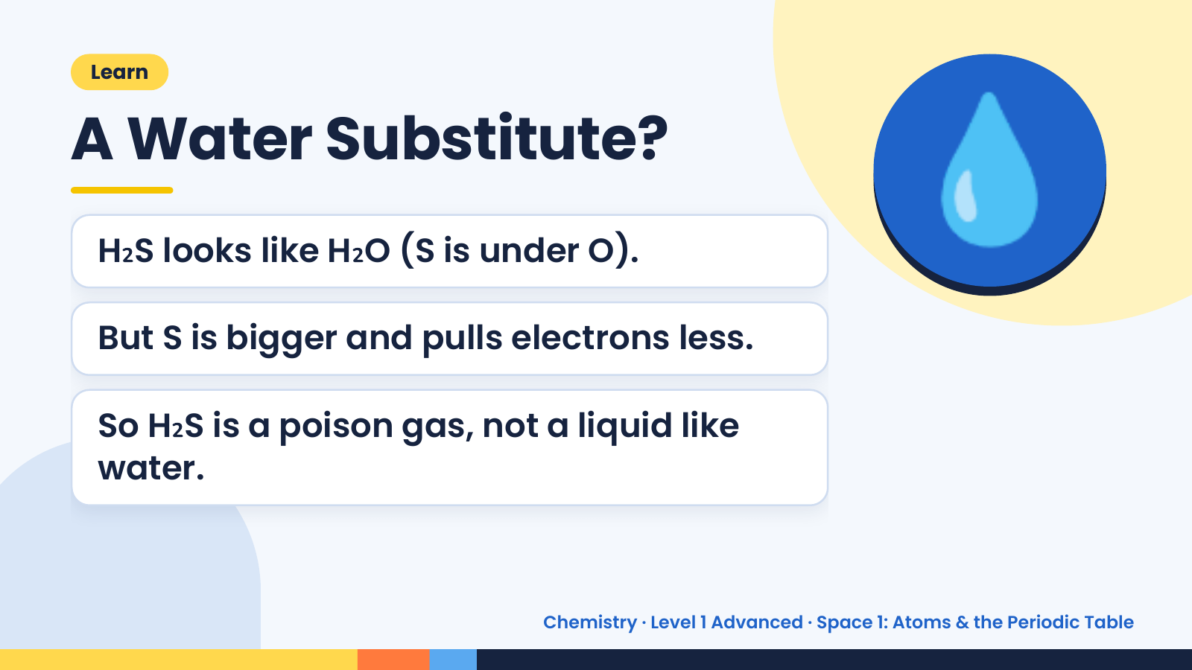
Notes:
Learn
A Water Substitute?
H₂S looks like H₂O (S is under O).
But S is bigger and pulls electrons less.
💧
So H₂S is a poison gas, not a liquid like
water.
Chemistry · Level 1 Advanced · Space 1: Atoms & the Periodic Table

Slide 22
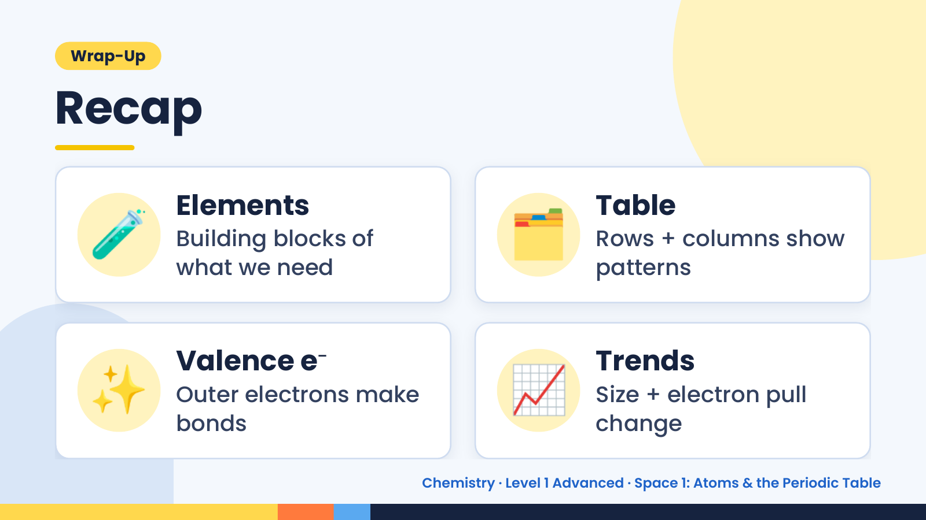
Notes:
Wrap-Up
Recap
🧪 Elements
Building blocks of
what we need
🗂️ Table
Rows + columns show
patterns
✨ Valence e⁻
Outer electrons make
bonds
📈 Trends
Size + electron pull
change
Chemistry · Level 1 Advanced · Space 1: Atoms & the Periodic Table

Slide 23
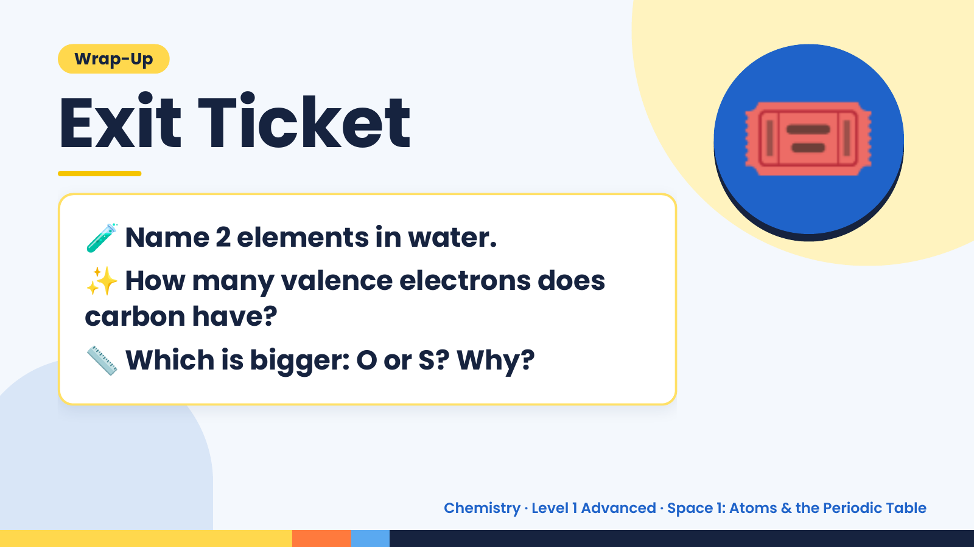
Notes:
Wrap-Up
Exit Ticket
🧪
✨
Name 2 elements in water.
How many valence electrons does
🎟️
carbon have?
📏 Which is bigger: O or S? Why?
Chemistry · Level 1 Advanced · Space 1: Atoms & the Periodic Table

