Slide 1
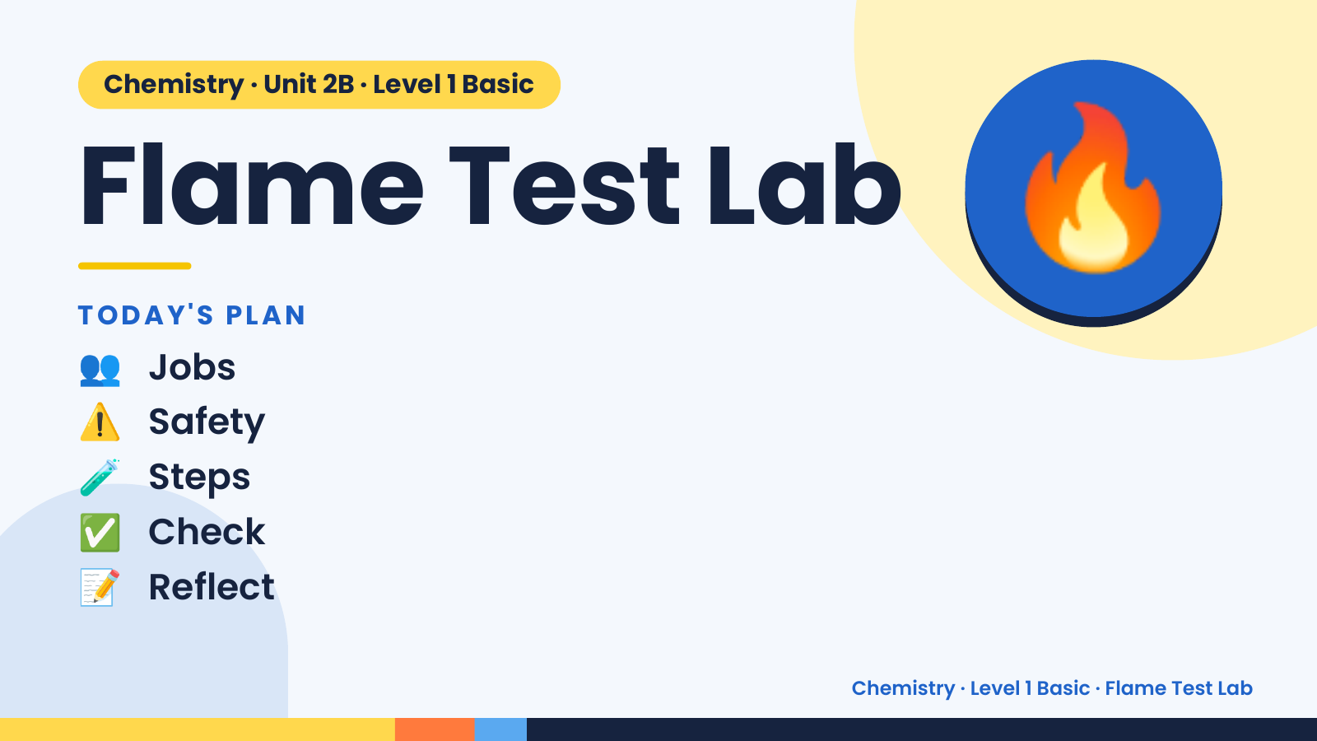
Notes:
Chemistry · Unit 2B · Level 1 Basic
Flame Test Lab
TODAY'S PLAN
👥 Jobs
🔥
⚠️ Safety
🧪 Steps
✅ Check
📝 Reflect
Chemistry · Level 1 Basic · Flame Test Lab

Slide 2
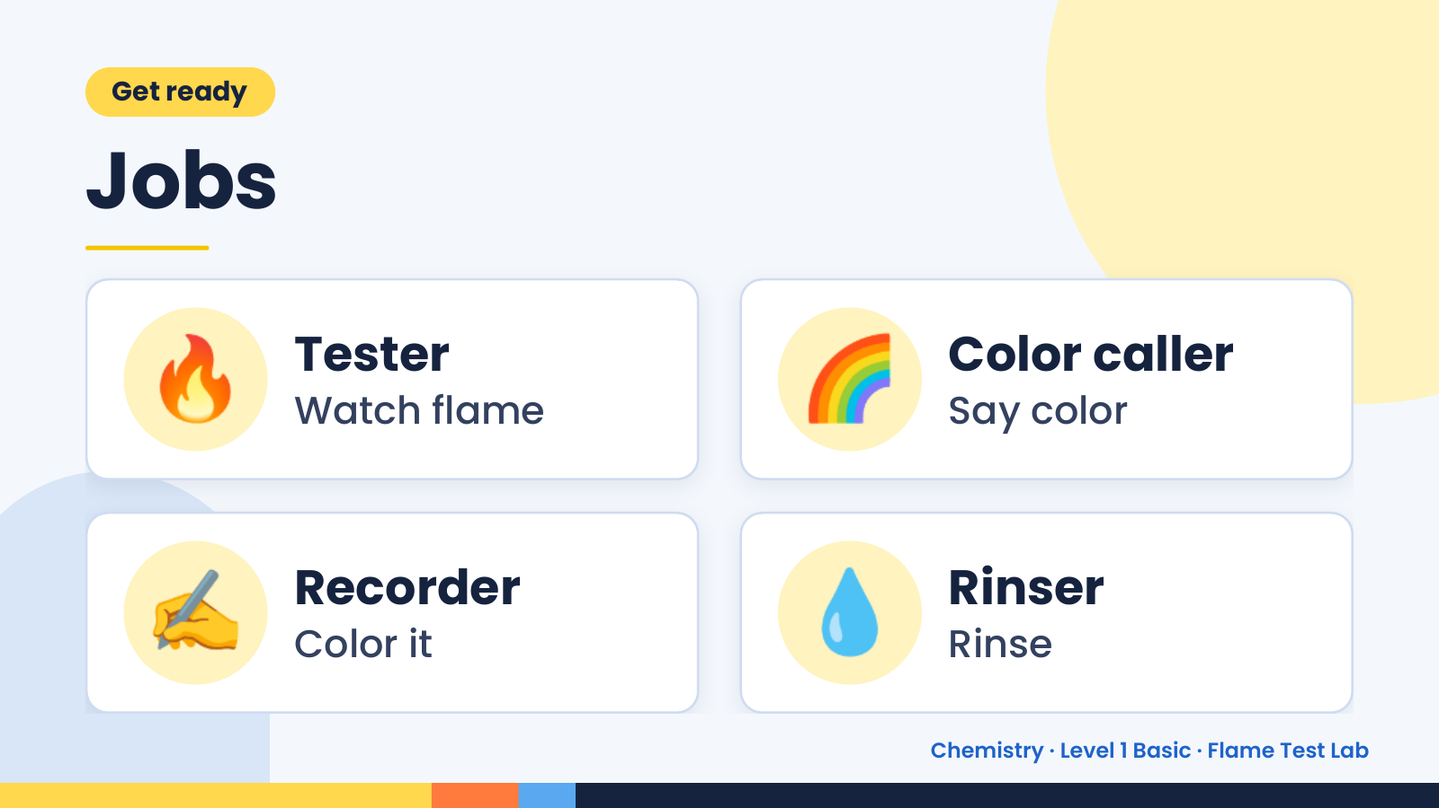
Notes:
Get ready
Jobs
🔥 Tester
Watch flame 🌈 Color caller
Say color
✍️ Recorder
Color it 💧 Rinser
Rinse
Chemistry · Level 1 Basic · Flame Test Lab

Slide 3
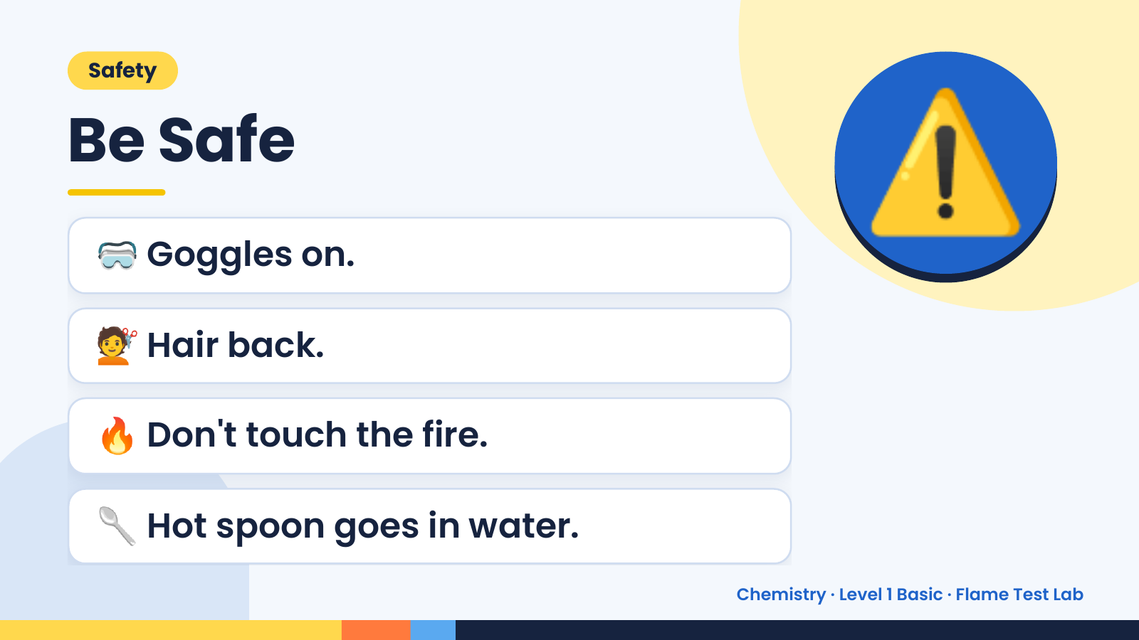
Notes:
Safety
Be Safe
🥽 Goggles on.
💇 Hair back.
⚠️
🔥 Don't touch the fire.
🥄 Hot spoon goes in water.
Chemistry · Level 1 Basic · Flame Test Lab

Slide 4
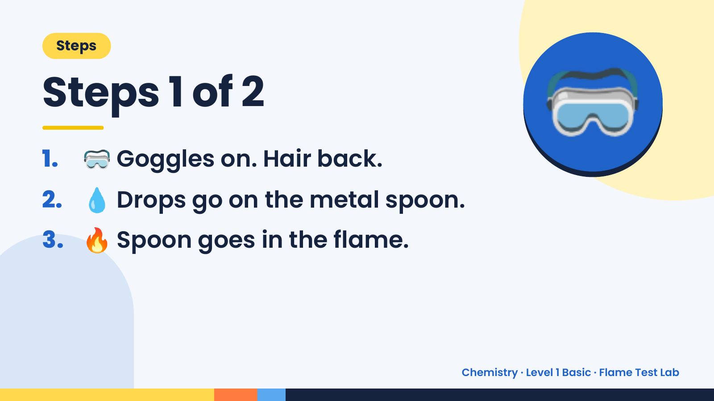
Notes:
Steps
Steps 1 of 2
1. 🥽 Goggles on. Hair back.
2. 💧 Drops go on the metal spoon.
🥽
3. 🔥 Spoon goes in the flame.
Chemistry · Level 1 Basic · Flame Test Lab

Slide 5
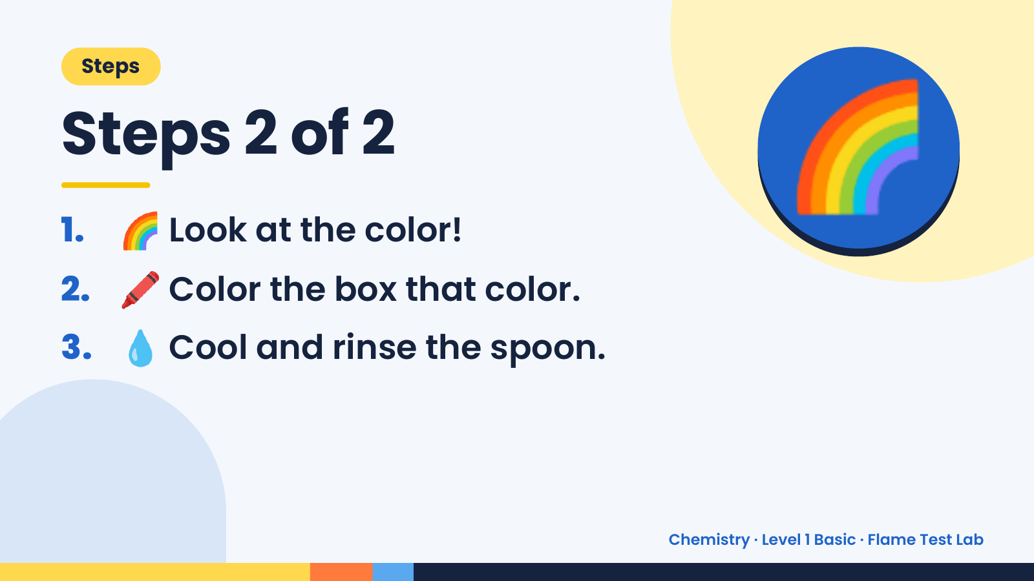
Notes:
Steps
Steps 2 of 2
1. 🌈 Look at the color!
2. 🖍️ Color the box that color.
🌈
3. 💧 Cool and rinse the spoon.
Chemistry · Level 1 Basic · Flame Test Lab

Slide 6
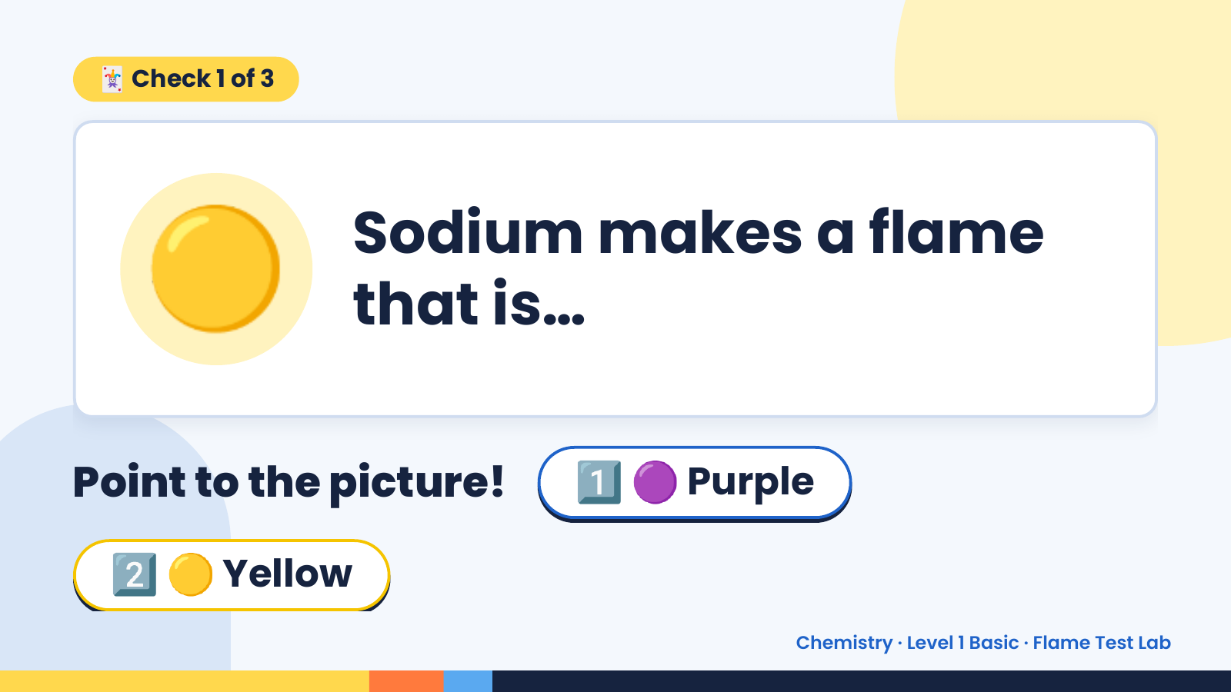
Notes:
🃏 Check 1 of 3
🟡 Sodium makes a flame
that is…
Point to the picture! 1️⃣ 🟣 Purple
2️⃣ 🟡 Yellow
Chemistry · Level 1 Basic · Flame Test Lab

Slide 7
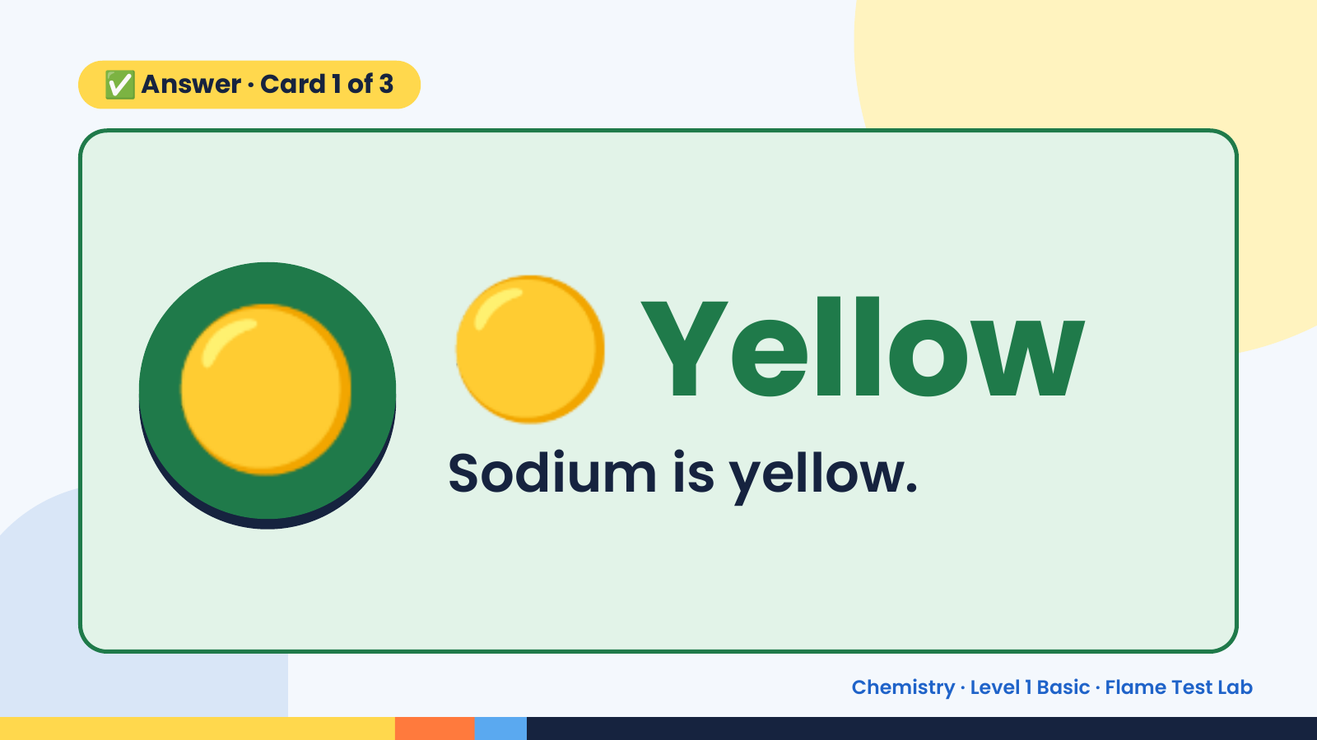
Notes:
✅ Answer · Card 1 of 3
🟡 🟡 Yellow
Sodium is yellow.
Chemistry · Level 1 Basic · Flame Test Lab

Slide 8
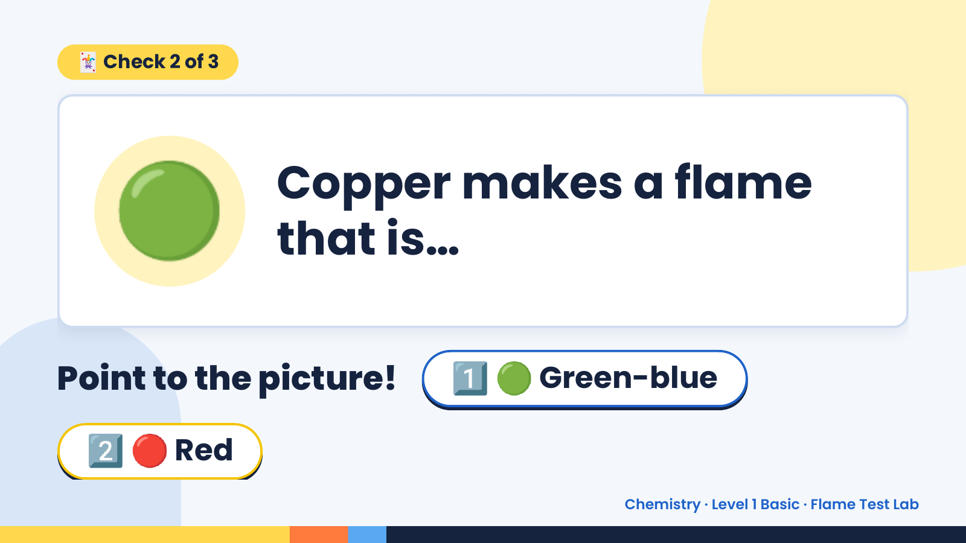
Notes:
🃏 Check 2 of 3
🟢 Copper makes a flame
that is…
Point to the picture! 1️⃣ 🟢 Green-blue
2️⃣ 🔴 Red
Chemistry · Level 1 Basic · Flame Test Lab

Slide 9
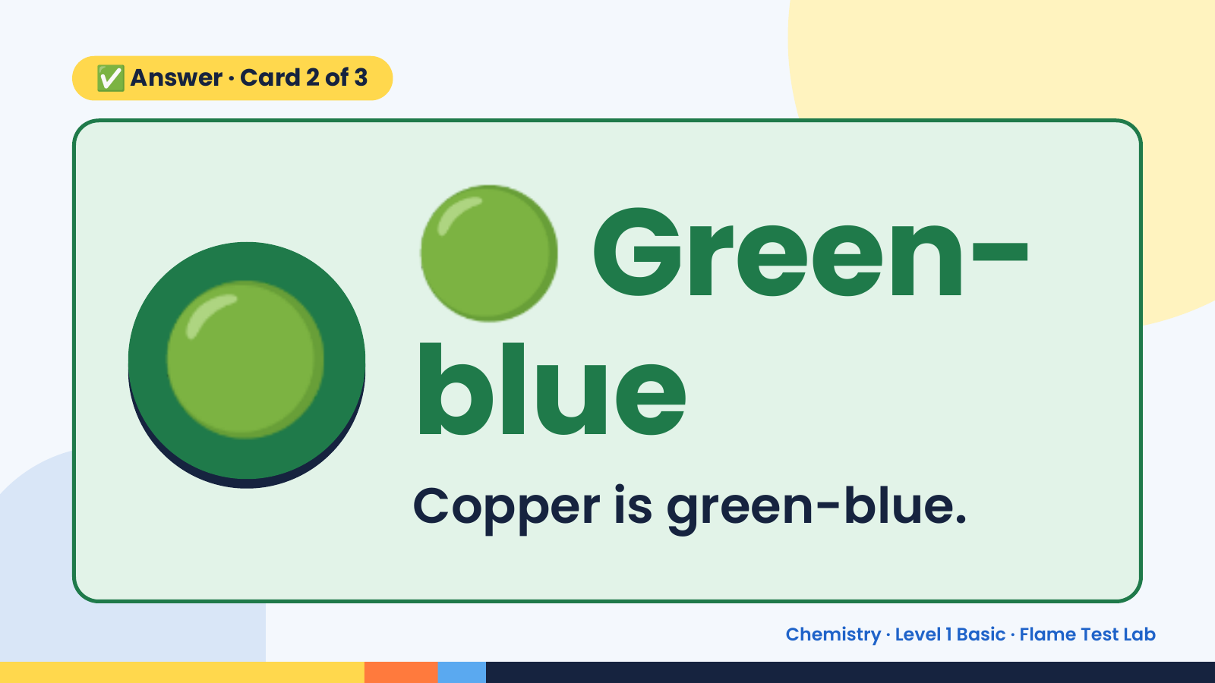
Notes:
🟢
✅ Answer · Card 2 of 3
🟢 blue
Green-
Copper is green-blue.
Chemistry · Level 1 Basic · Flame Test Lab

Slide 10
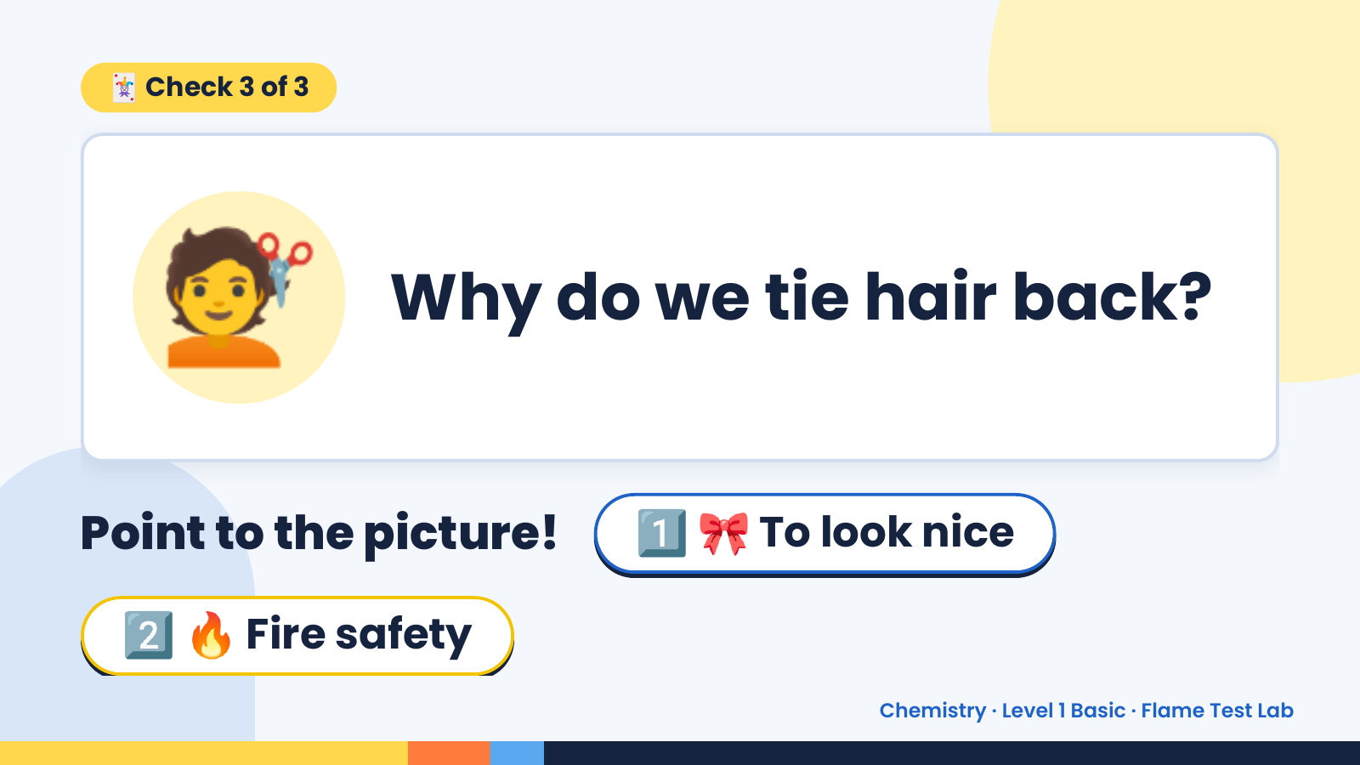
Notes:
🃏 Check 3 of 3
💇 Why do we tie hair back?
Point to the picture! 1️⃣ 🎀 To look nice
2️⃣ 🔥 Fire safety
Chemistry · Level 1 Basic · Flame Test Lab

Slide 11
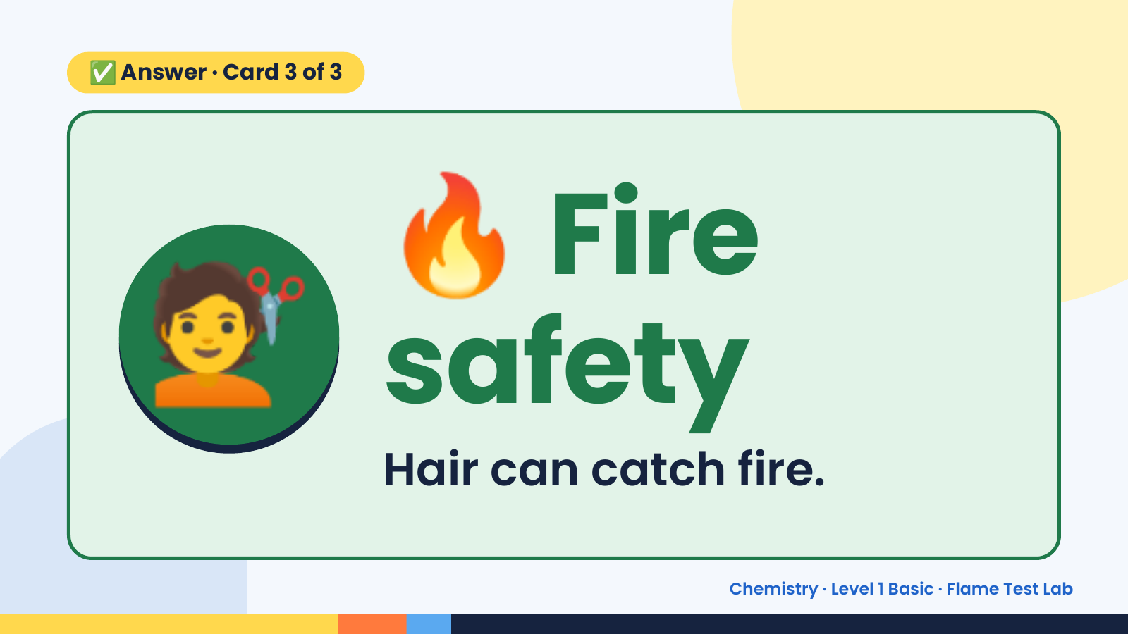
Notes:
🔥
✅ Answer · Card 3 of 3
💇 safety
Fire
Hair can catch fire.
Chemistry · Level 1 Basic · Flame Test Lab

Slide 12
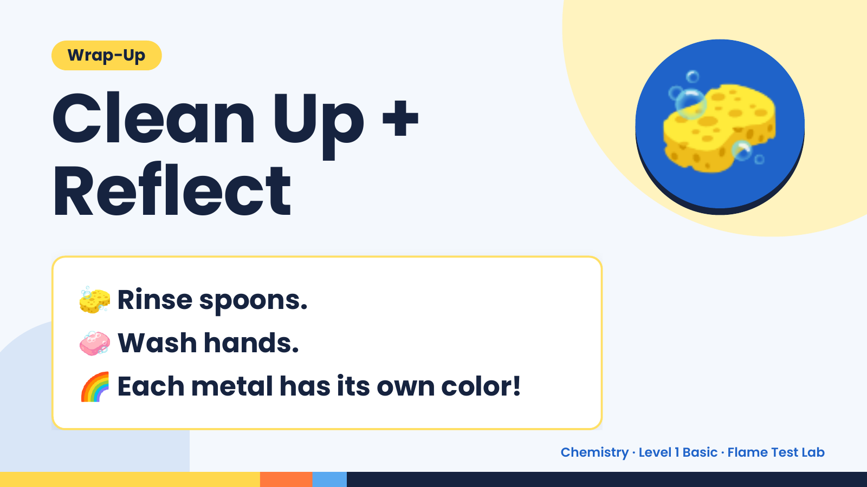
Notes:
Wrap-Up
Clean Up +
Reflect
🧽
🧽 Rinse spoons.
🧼 Wash hands.
🌈 Each metal has its own color!
Chemistry · Level 1 Basic · Flame Test Lab

