Slide 1
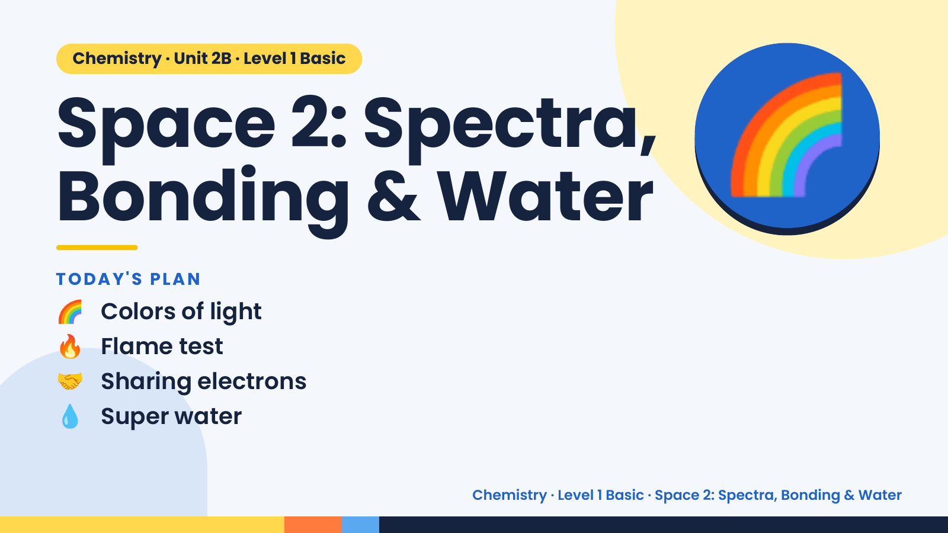
Notes:
Chemistry · Unit 2B · Level 1 Basic
Space 2: Spectra,
Bonding & Water
TODAY'S PLAN
🌈
🌈 Colors of light
🔥 Flame test
🤝 Sharing electrons
💧 Super water
Chemistry · Level 1 Basic · Space 2: Spectra, Bonding & Water

Slide 2
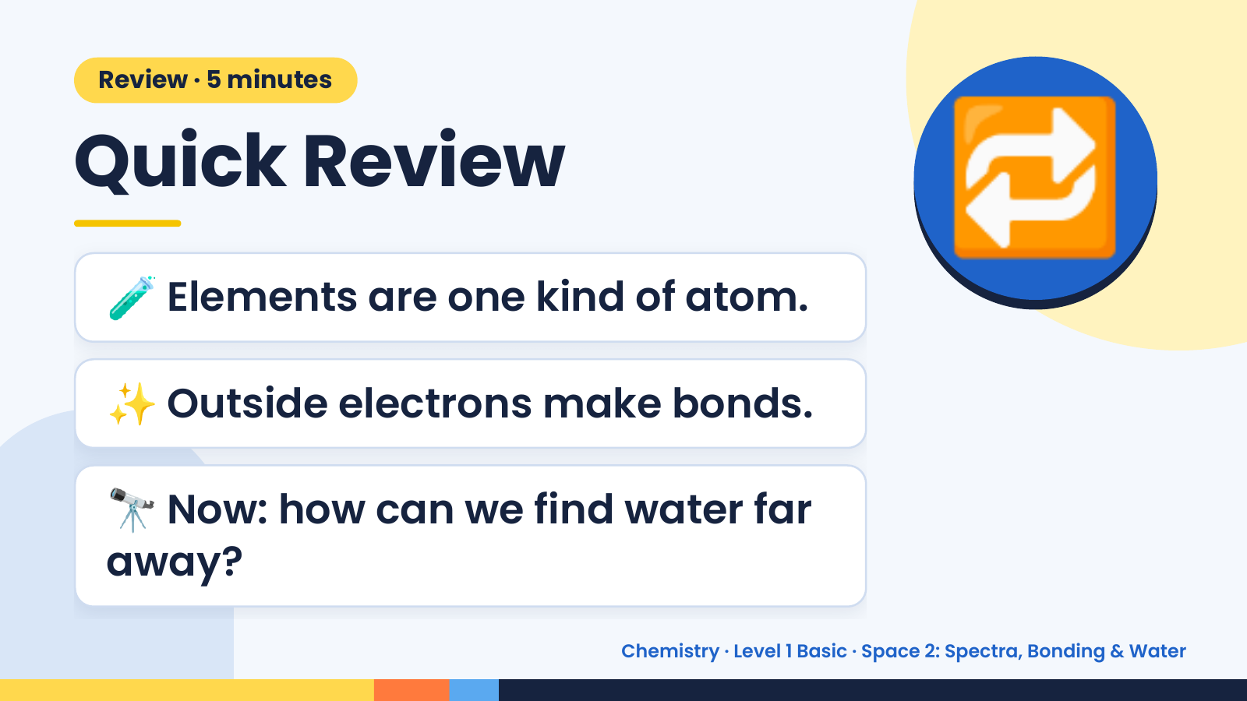
Notes:
Review · 5 minutes
Quick Review
🧪 Elements are one kind of atom.
🔁
✨ Outside electrons make bonds.
🔭 Now: how can we find water far
away?
Chemistry · Level 1 Basic · Space 2: Spectra, Bonding & Water

Slide 3
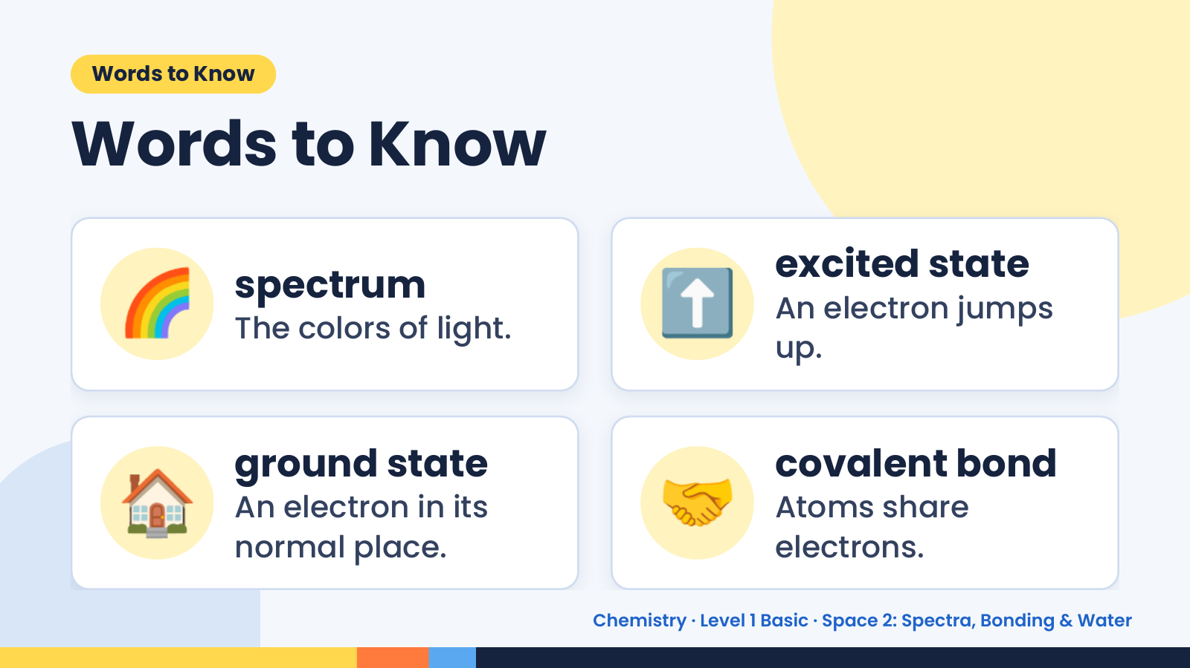
Notes:
Words to Know
Words to Know
🌈 spectrum
The colors of light. ⬆️ excited state
An electron jumps
up.
🏠 ground state
An electron in its
normal place.
🤝 covalent bond
Atoms share
electrons.
Chemistry · Level 1 Basic · Space 2: Spectra, Bonding & Water

Slide 4
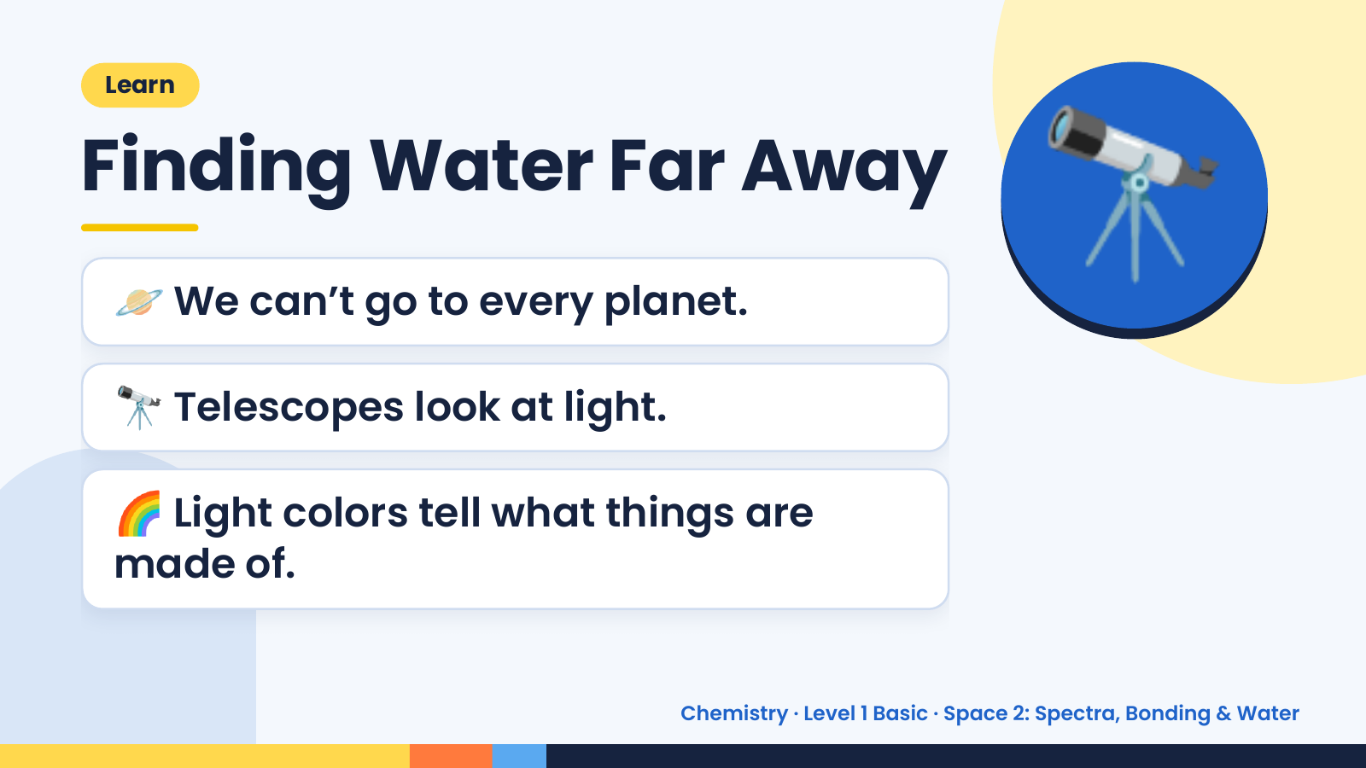
Notes:
Learn
Finding Water Far Away
🪐 We can’t go to every planet.
🔭 Telescopes look at light.
🔭
🌈 Light colors tell what things are
made of.
Chemistry · Level 1 Basic · Space 2: Spectra, Bonding & Water

Slide 5
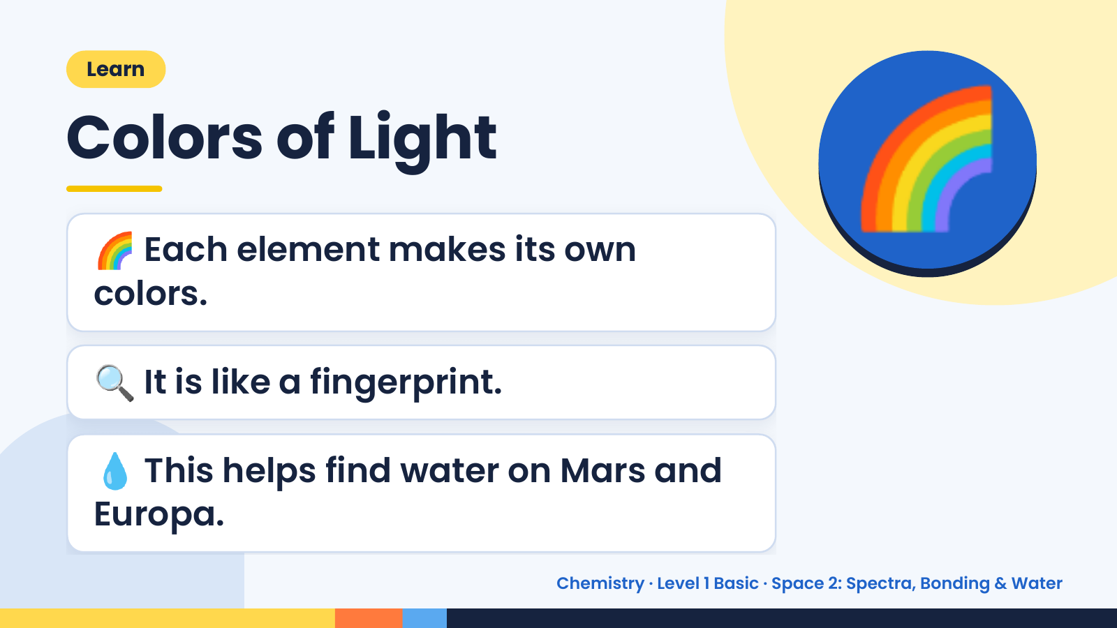
Notes:
Learn
Colors of Light
🌈 Each element makes its own
colors.
🌈
🔍 It is like a fingerprint.
💧 This helps find water on Mars and
Europa.
Chemistry · Level 1 Basic · Space 2: Spectra, Bonding & Water

Slide 6
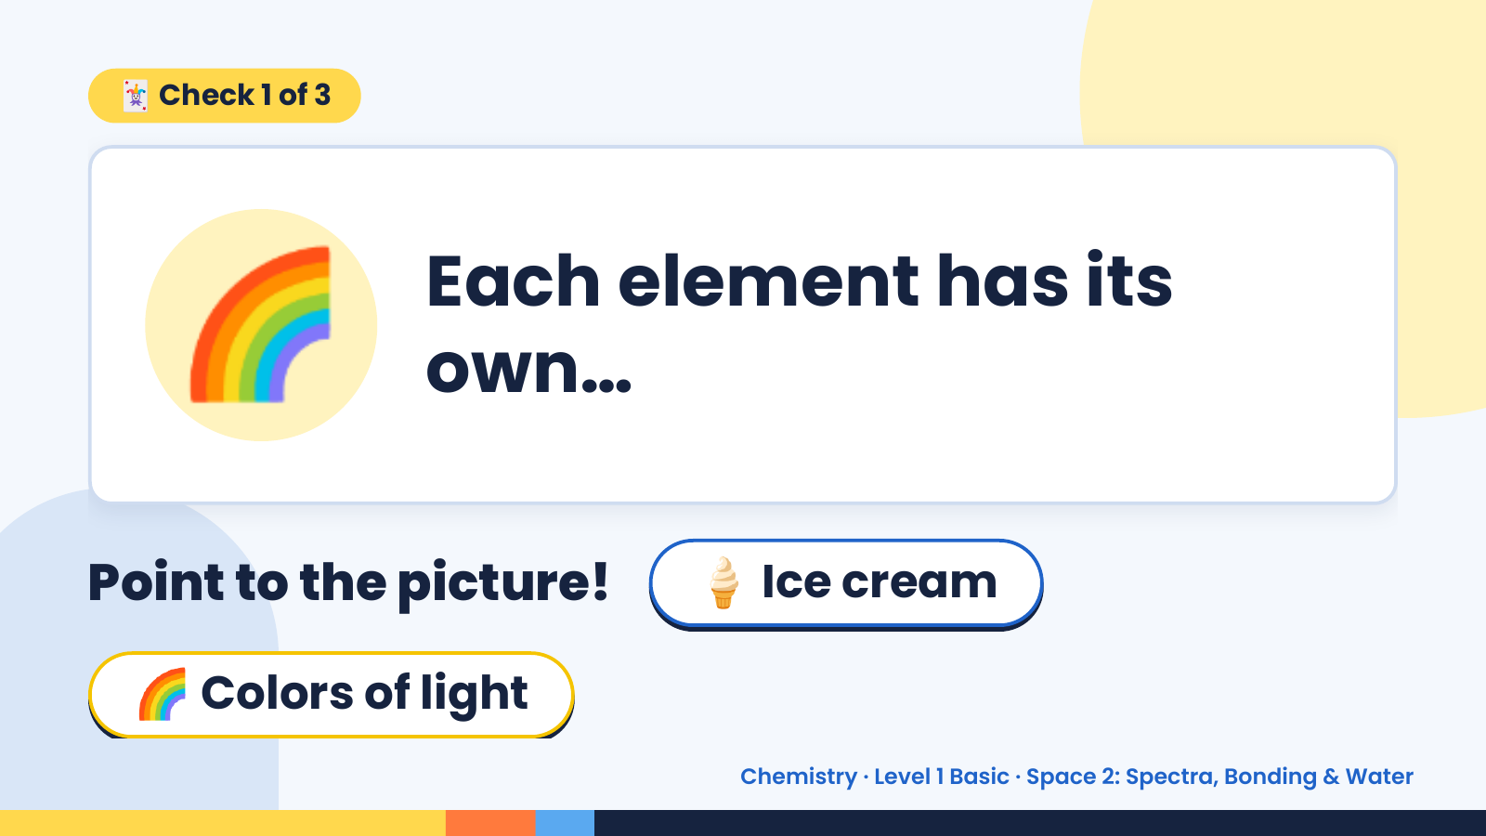
Notes:
🃏 Check 1 of 3
🌈 Each element has its
own…
Point to the picture! 🍦 Ice cream
🌈 Colors of light
Chemistry · Level 1 Basic · Space 2: Spectra, Bonding & Water

Slide 7
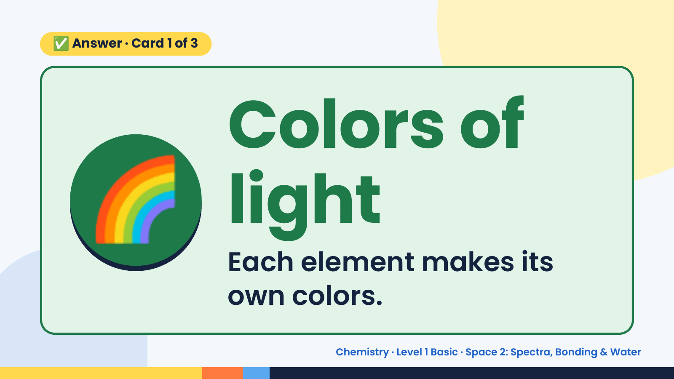
Notes:
✅ Answer · Card 1 of 3
🌈 Colors of
light
Each element makes its
own colors.
Chemistry · Level 1 Basic · Space 2: Spectra, Bonding & Water

Slide 8
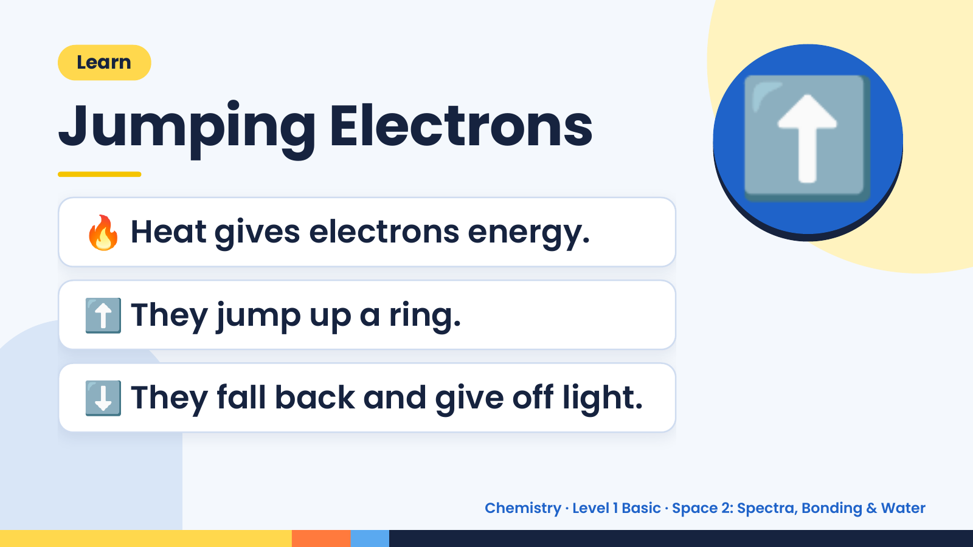
Notes:
Learn
Jumping Electrons
🔥 Heat gives electrons energy.
⬆️
⬆️ They jump up a ring.
⬇️ They fall back and give off light.
Chemistry · Level 1 Basic · Space 2: Spectra, Bonding & Water

Slide 9
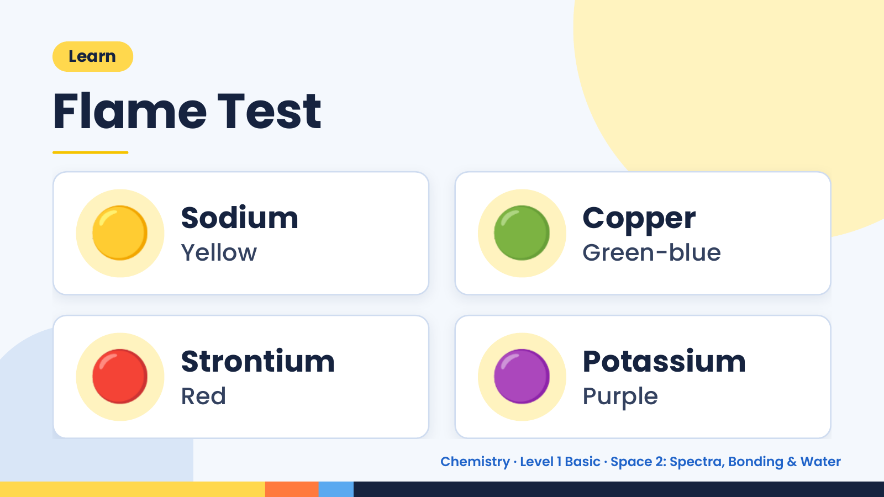
Notes:
Learn
Flame Test
🟡 Sodium
Yellow 🟢 Copper
Green-blue
🔴 Strontium
Red 🟣 Potassium
Purple
Chemistry · Level 1 Basic · Space 2: Spectra, Bonding & Water

Slide 10
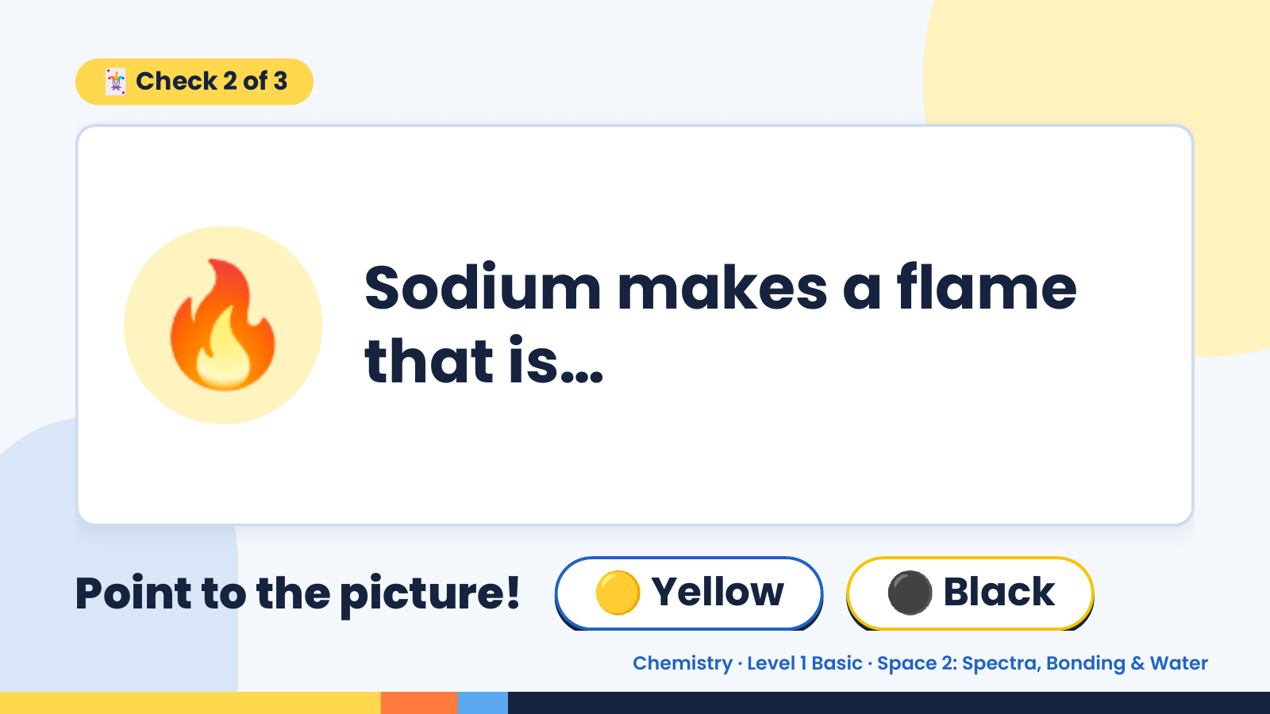
Notes:
🃏 Check 2 of 3
🔥 Sodium makes a flame
that is…
Point to the picture! 🟡 Yellow ⚫ Black
Chemistry · Level 1 Basic · Space 2: Spectra, Bonding & Water

Slide 11
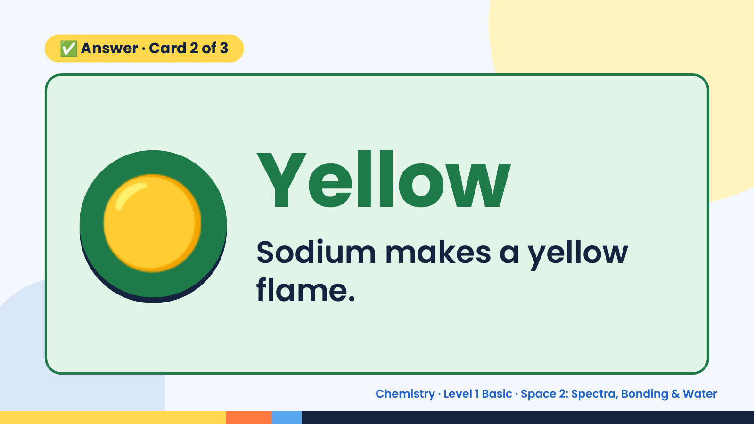
Notes:
✅ Answer · Card 2 of 3
🟡 Yellow
Sodium makes a yellow
flame.
Chemistry · Level 1 Basic · Space 2: Spectra, Bonding & Water

Slide 12
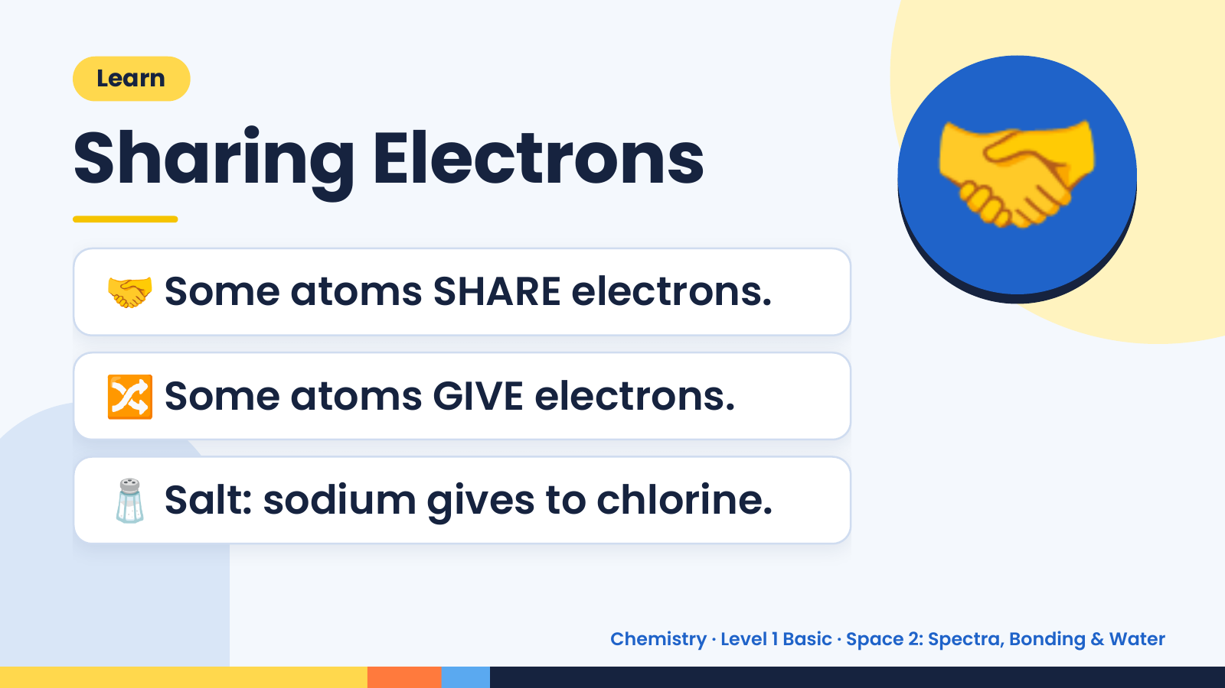
Notes:
Learn
Sharing Electrons
🤝 Some atoms SHARE electrons.
🤝
🔀 Some atoms GIVE electrons.
🧂 Salt: sodium gives to chlorine.
Chemistry · Level 1 Basic · Space 2: Spectra, Bonding & Water

Slide 13
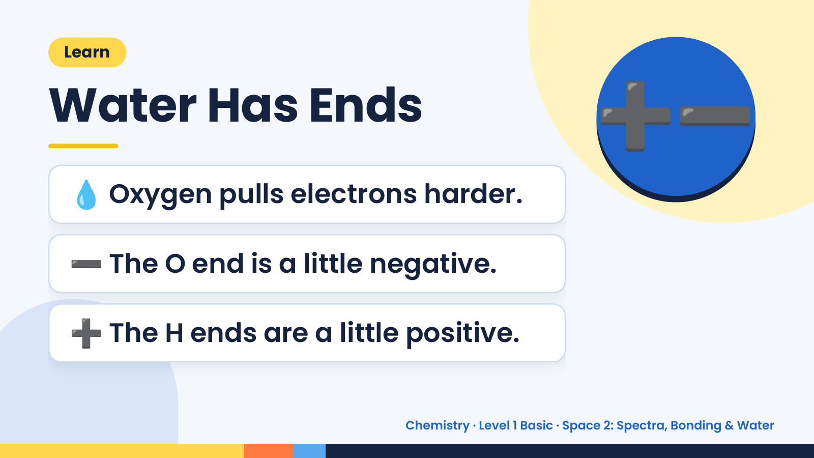
Notes:
➕➖
Learn
Water Has Ends
💧 Oxygen pulls electrons harder.
➖ The O end is a little negative.
➕ The H ends are a little positive.
Chemistry · Level 1 Basic · Space 2: Spectra, Bonding & Water

Slide 14
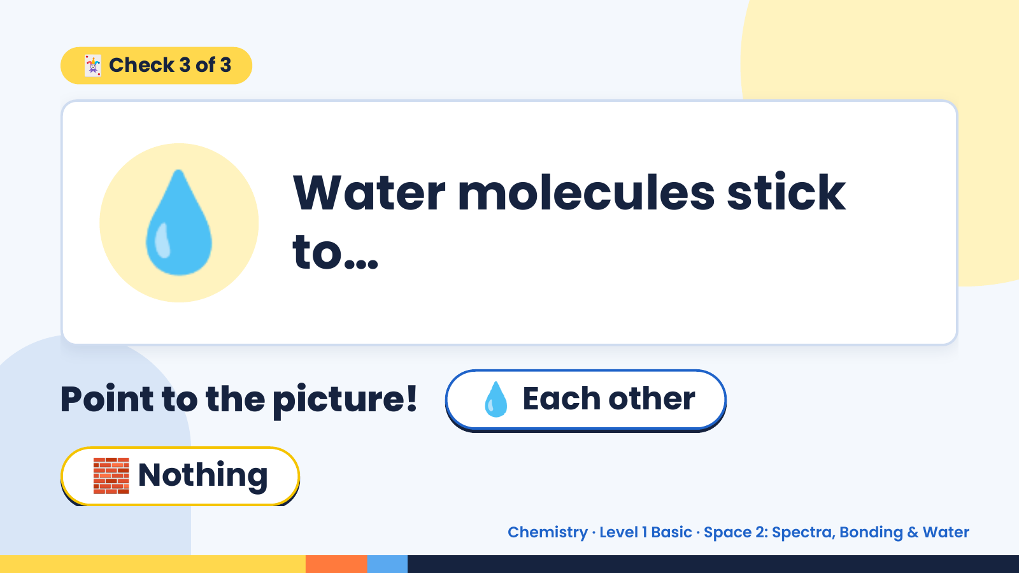
Notes:
🃏 Check 3 of 3
💧 Water molecules stick
to…
Point to the picture! 💧 Each other
🧱 Nothing
Chemistry · Level 1 Basic · Space 2: Spectra, Bonding & Water

Slide 15
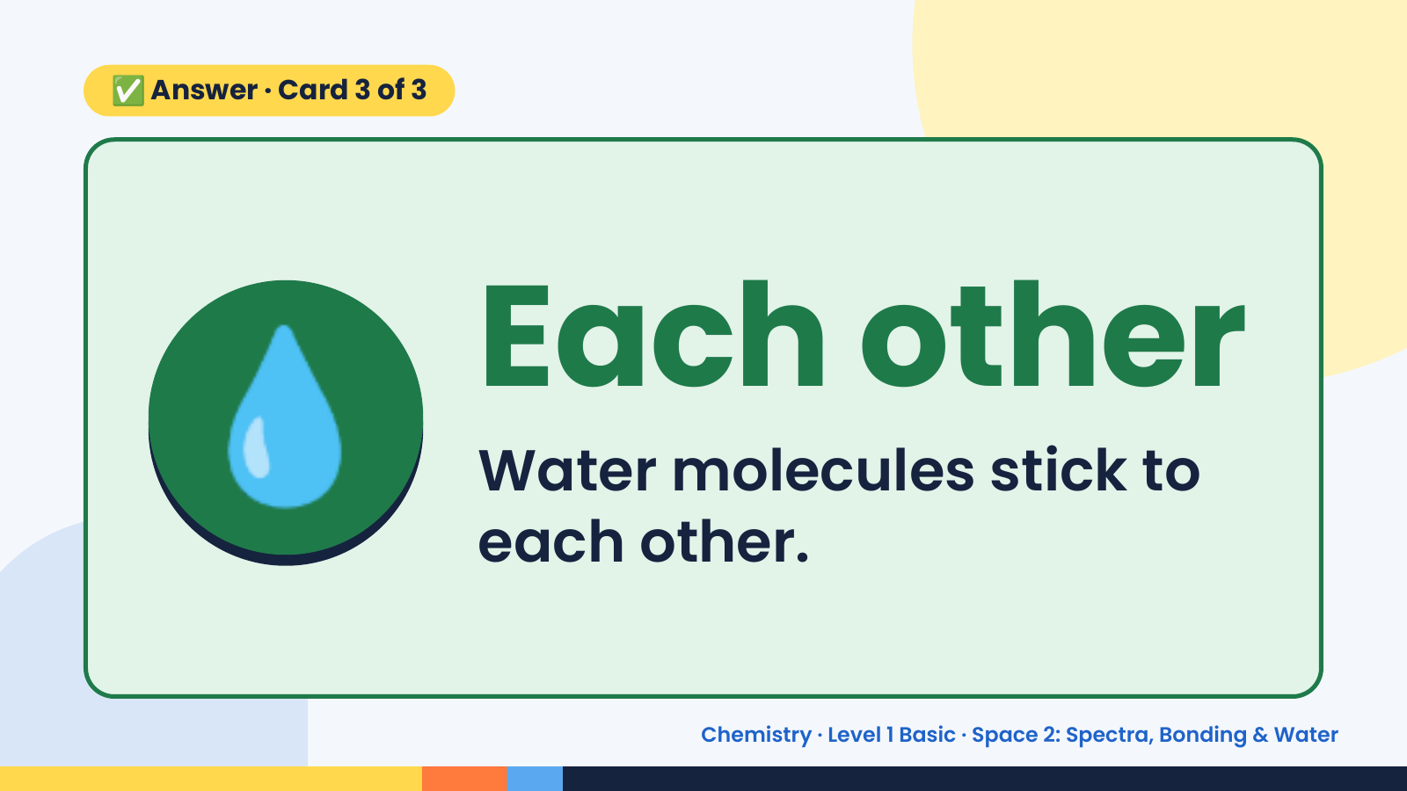
Notes:
✅ Answer · Card 3 of 3
💧 Each other
Water molecules stick to
each other.
Chemistry · Level 1 Basic · Space 2: Spectra, Bonding & Water

Slide 16
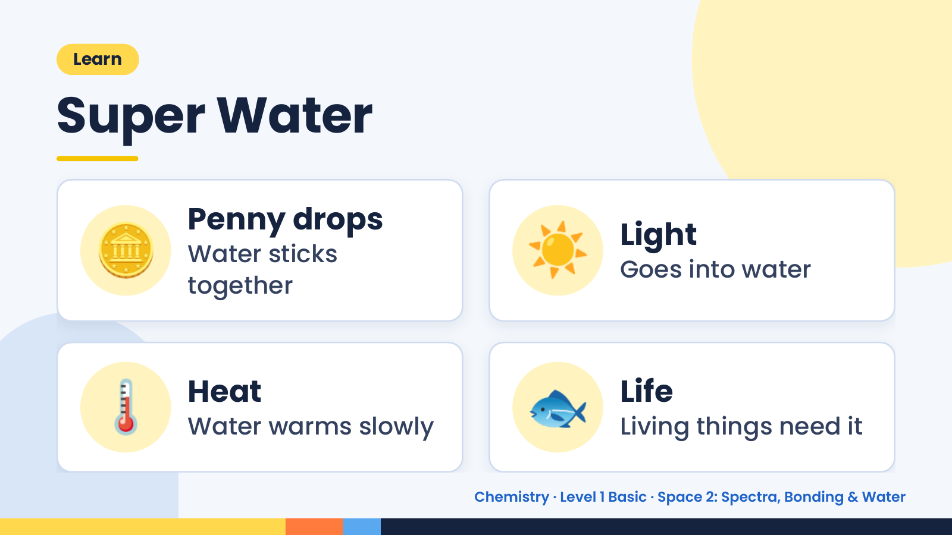
Notes:
Learn
Super Water
🪙 Penny drops
Water sticks
together
☀️ Light
Goes into water
🌡️ Heat
Water warms slowly 🐟 Life
Living things need it
Chemistry · Level 1 Basic · Space 2: Spectra, Bonding & Water

Slide 17
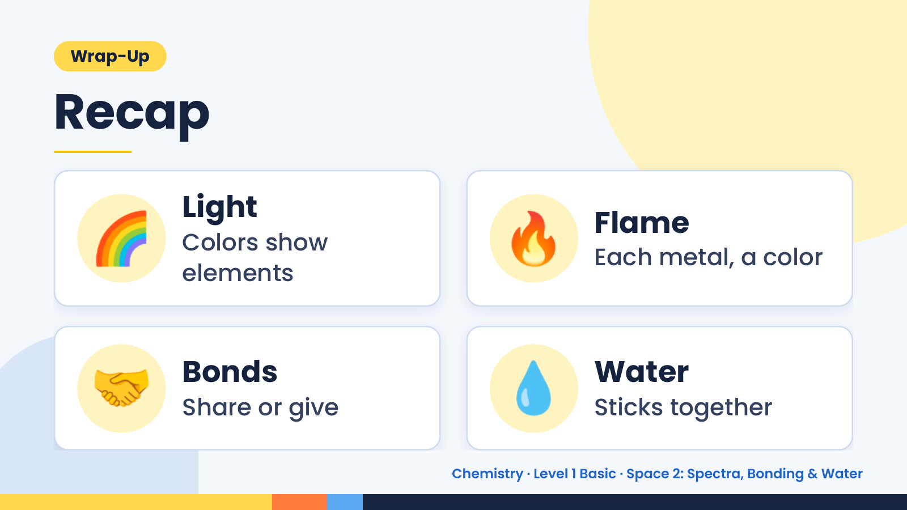
Notes:
Wrap-Up
Recap
🌈 Light
Colors show
elements
🔥 Flame
Each metal, a color
🤝 Bonds
Share or give 💧 Water
Sticks together
Chemistry · Level 1 Basic · Space 2: Spectra, Bonding & Water

Slide 18
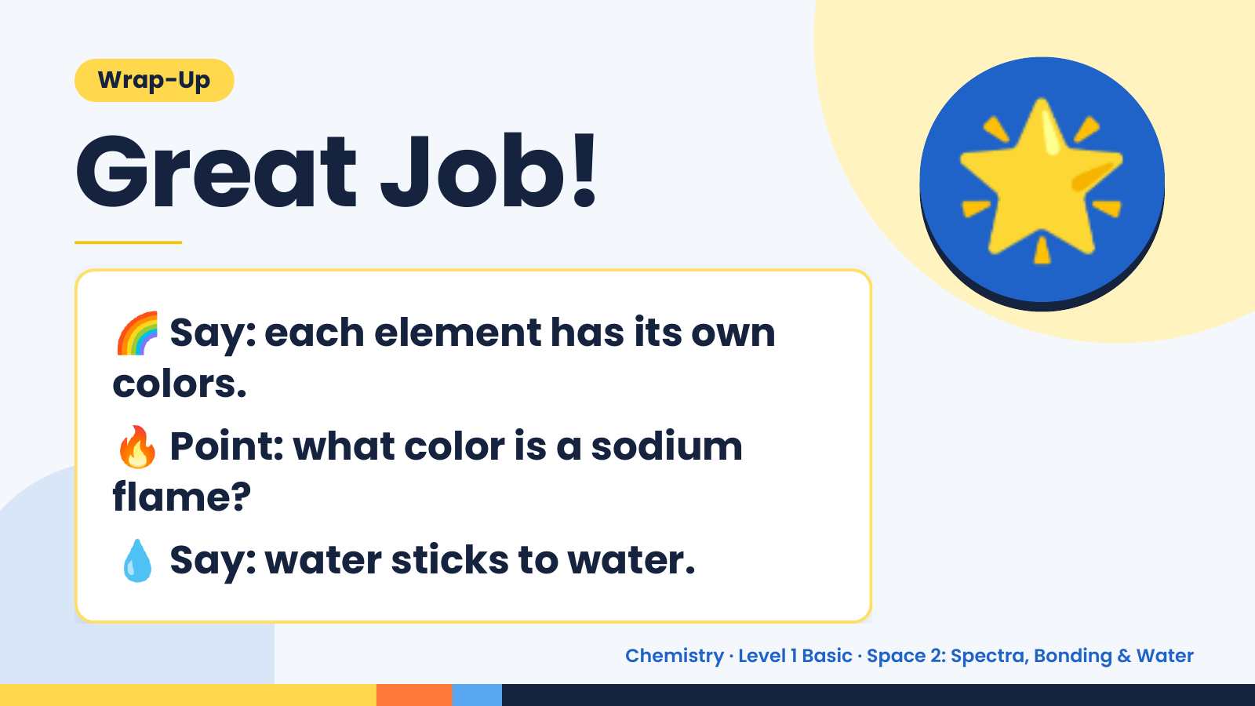
Notes:
Wrap-Up
Great Job!
🌈 Say: each element has its own
colors.
🌟
🔥 Point: what color is a sodium
flame?
💧 Say: water sticks to water.
Chemistry · Level 1 Basic · Space 2: Spectra, Bonding & Water

