Slide 1
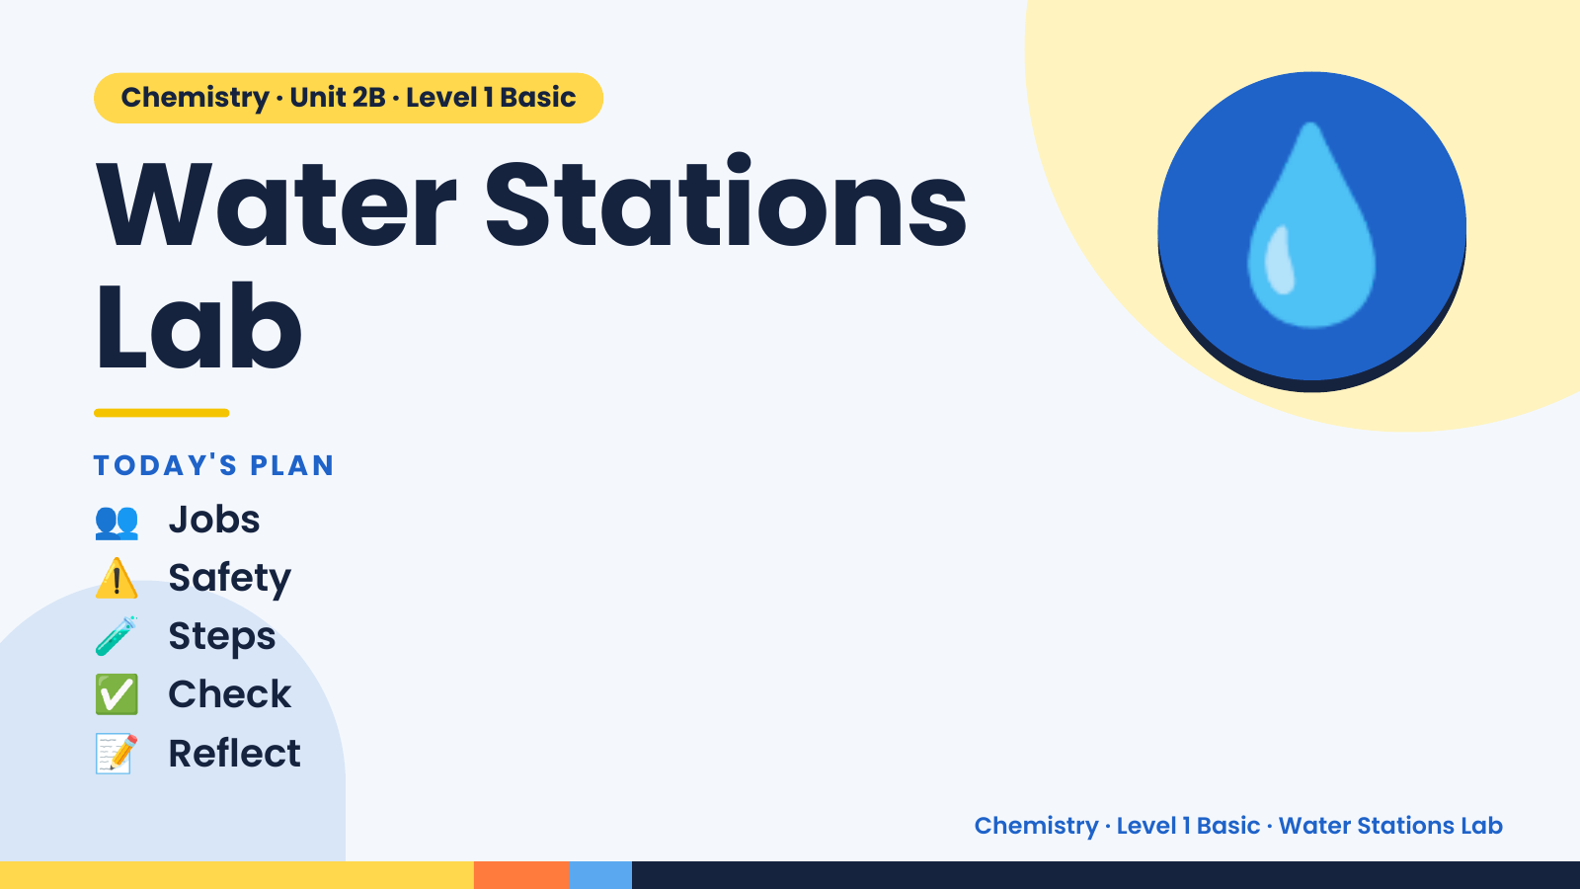
Notes:
Chemistry · Unit 2B · Level 1 Basic
Water Stations
Lab
TODAY'S PLAN
💧
👥 Jobs
⚠️ Safety
🧪 Steps
✅ Check
📝 Reflect
Chemistry · Level 1 Basic · Water Stations Lab

Slide 2
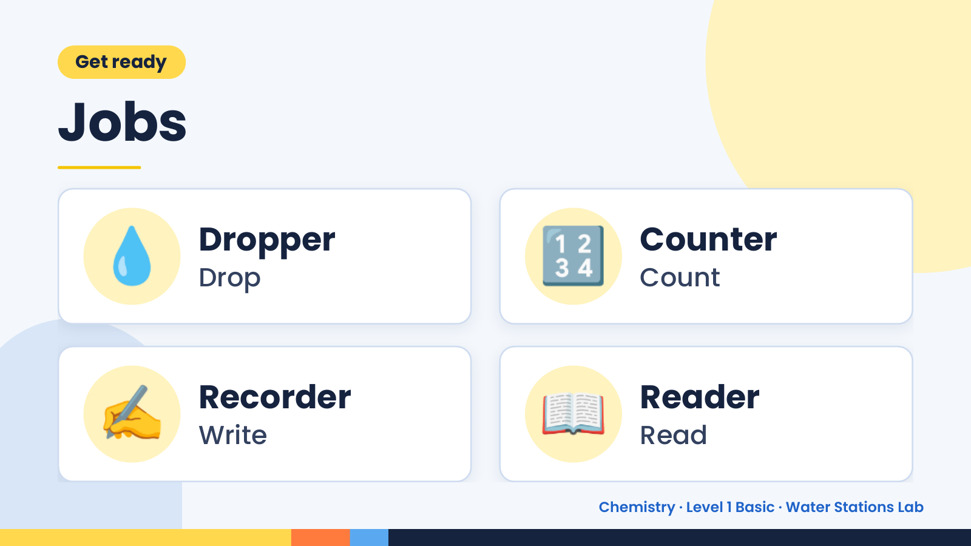
Notes:
Get ready
Jobs
💧 Dropper
Drop 🔢 Counter
Count
✍️ Recorder
Write 📖 Reader
Read
Chemistry · Level 1 Basic · Water Stations Lab

Slide 3
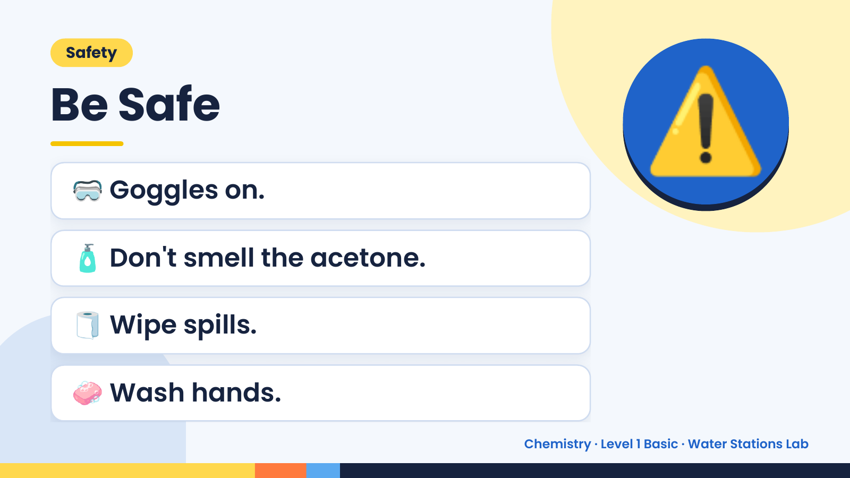
Notes:
Safety
Be Safe
🥽 Goggles on.
🧴 Don't smell the acetone.
⚠️
🧻 Wipe spills.
🧼 Wash hands.
Chemistry · Level 1 Basic · Water Stations Lab

Slide 4
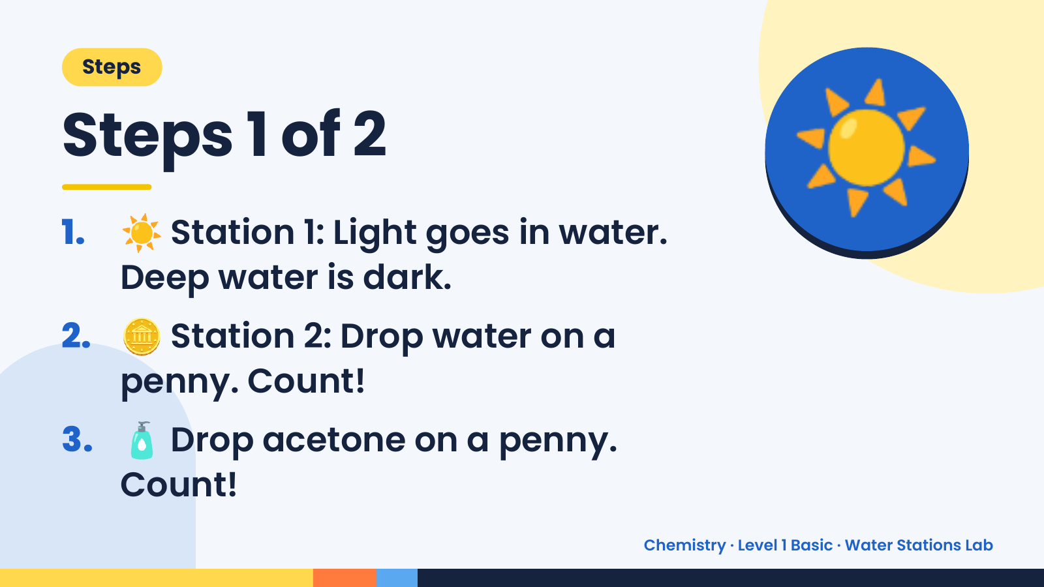
Notes:
Steps
Steps 1 of 2
1. ☀️ Station 1: Light goes in water.
Deep water is dark.
☀️
2. 🪙 Station 2: Drop water on a
penny. Count!
3. 🧴 Drop acetone on a penny.
Count!
Chemistry · Level 1 Basic · Water Stations Lab

Slide 5
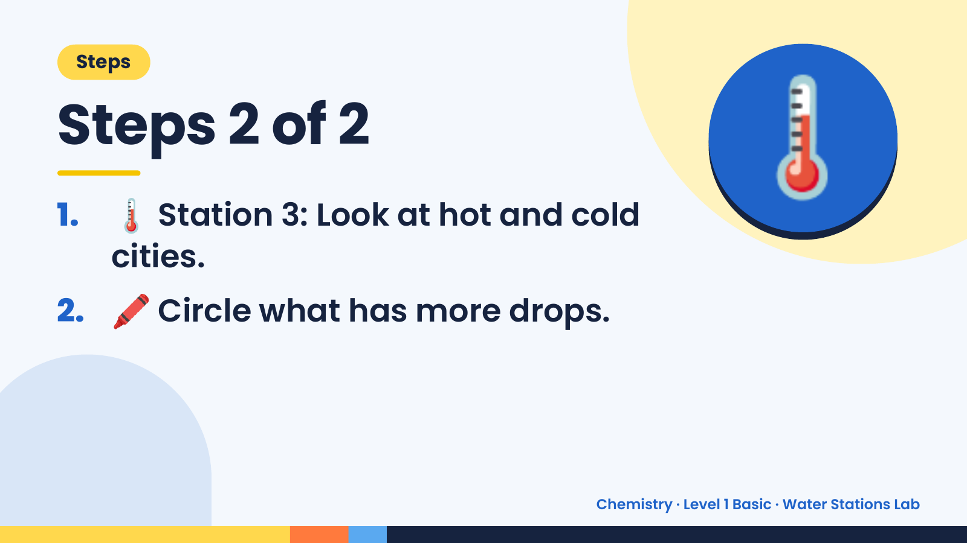
Notes:
Steps
Steps 2 of 2
1. 🌡️ Station 3: Look at hot and cold
cities.
🌡️
2. 🖍️ Circle what has more drops.
Chemistry · Level 1 Basic · Water Stations Lab

Slide 6
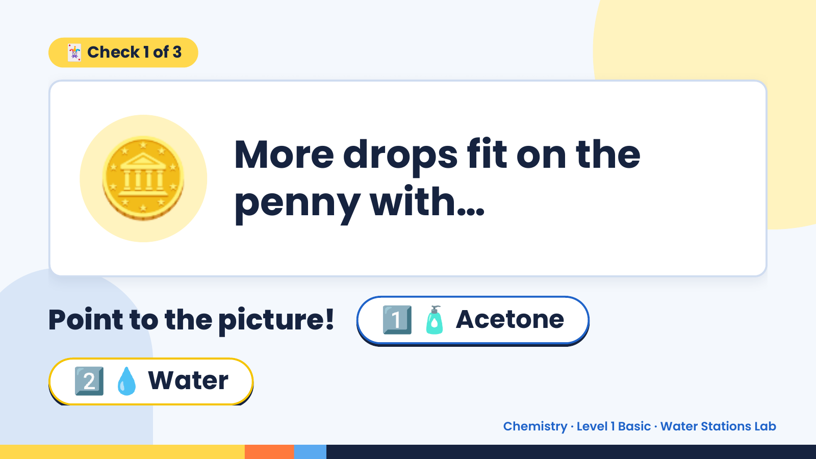
Notes:
🃏 Check 1 of 3
🪙 More drops fit on the
penny with…
Point to the picture! 1️⃣ 🧴 Acetone
2️⃣ 💧 Water
Chemistry · Level 1 Basic · Water Stations Lab

Slide 7
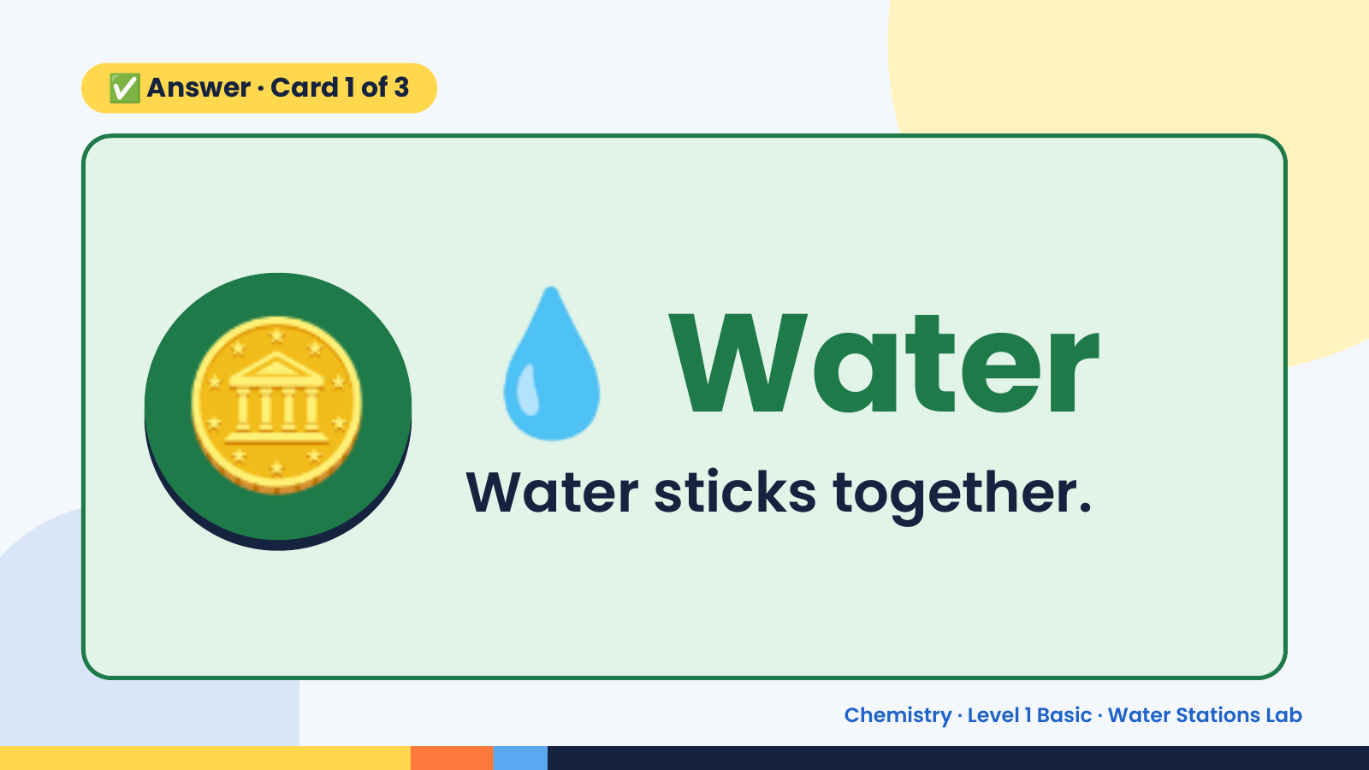
Notes:
✅ Answer · Card 1 of 3
🪙 💧 Water
Water sticks together.
Chemistry · Level 1 Basic · Water Stations Lab

Slide 8
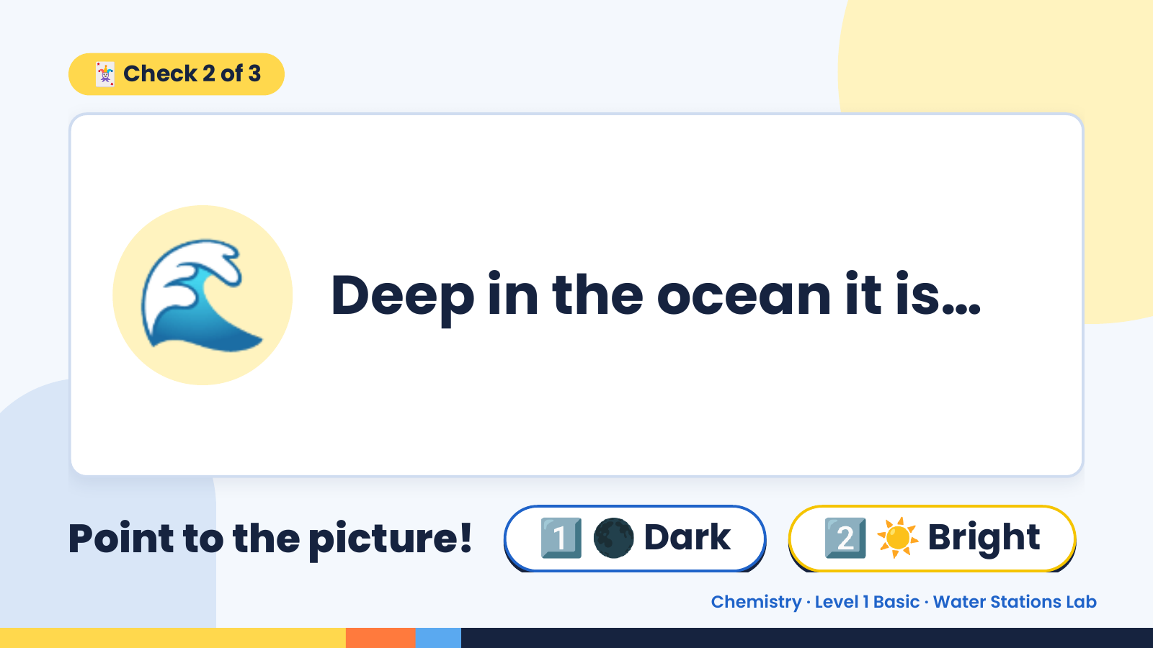
Notes:
🃏 Check 2 of 3
🌊 Deep in the ocean it is…
Point to the picture! 1️⃣ 🌑 Dark 2️⃣ ☀️ Bright
Chemistry · Level 1 Basic · Water Stations Lab

Slide 9
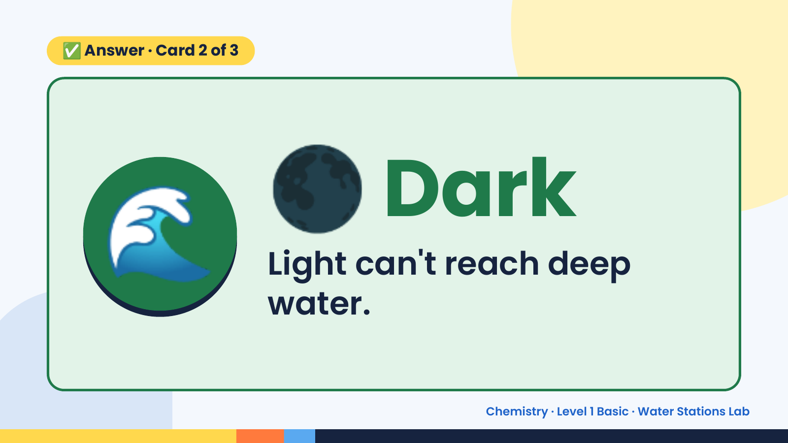
Notes:
✅ Answer · Card 2 of 3
🌊 🌑 Dark
Light can't reach deep
water.
Chemistry · Level 1 Basic · Water Stations Lab

Slide 10
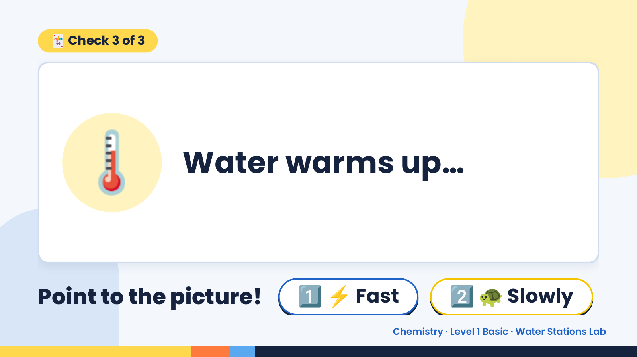
Notes:
🃏 Check 3 of 3
🌡️ Water warms up…
Point to the picture! 1️⃣ ⚡ Fast 2️⃣ 🐢 Slowly
Chemistry · Level 1 Basic · Water Stations Lab

Slide 11
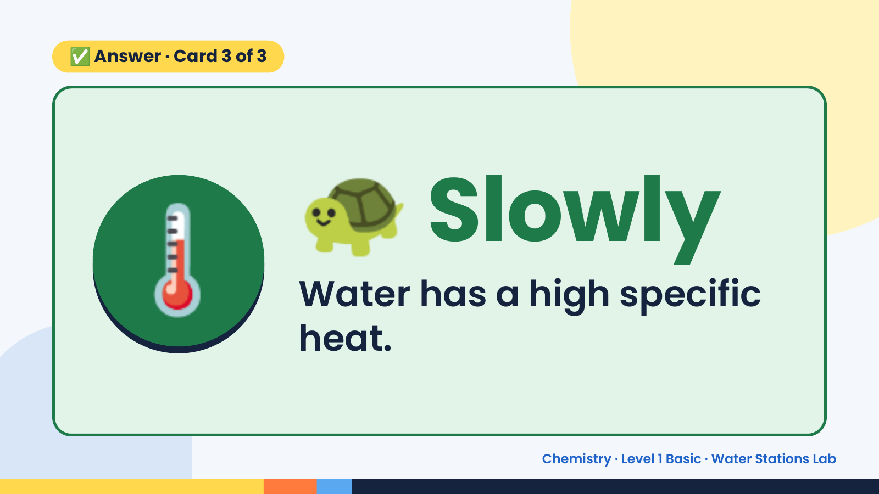
Notes:
✅ Answer · Card 3 of 3
🌡️ 🐢 Slowly
Water has a high specific
heat.
Chemistry · Level 1 Basic · Water Stations Lab

Slide 12
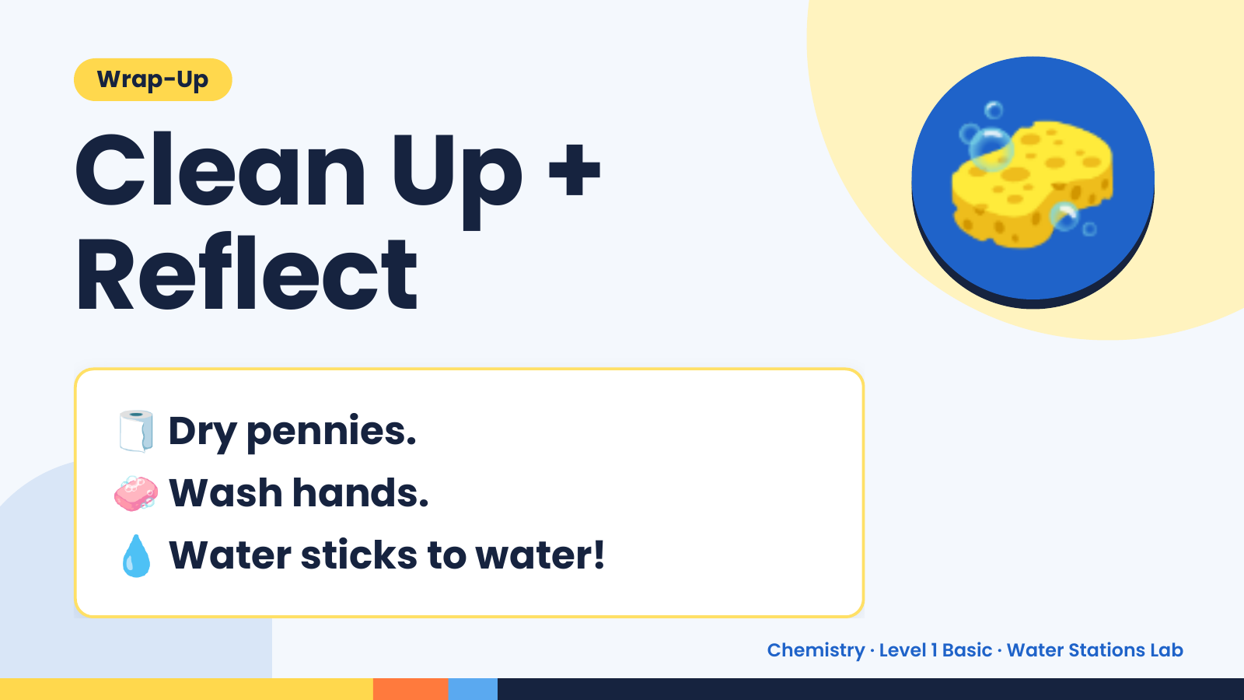
Notes:
Wrap-Up
Clean Up +
Reflect
🧽
🧻 Dry pennies.
🧼 Wash hands.
💧 Water sticks to water!
Chemistry · Level 1 Basic · Water Stations Lab

