Slide 1
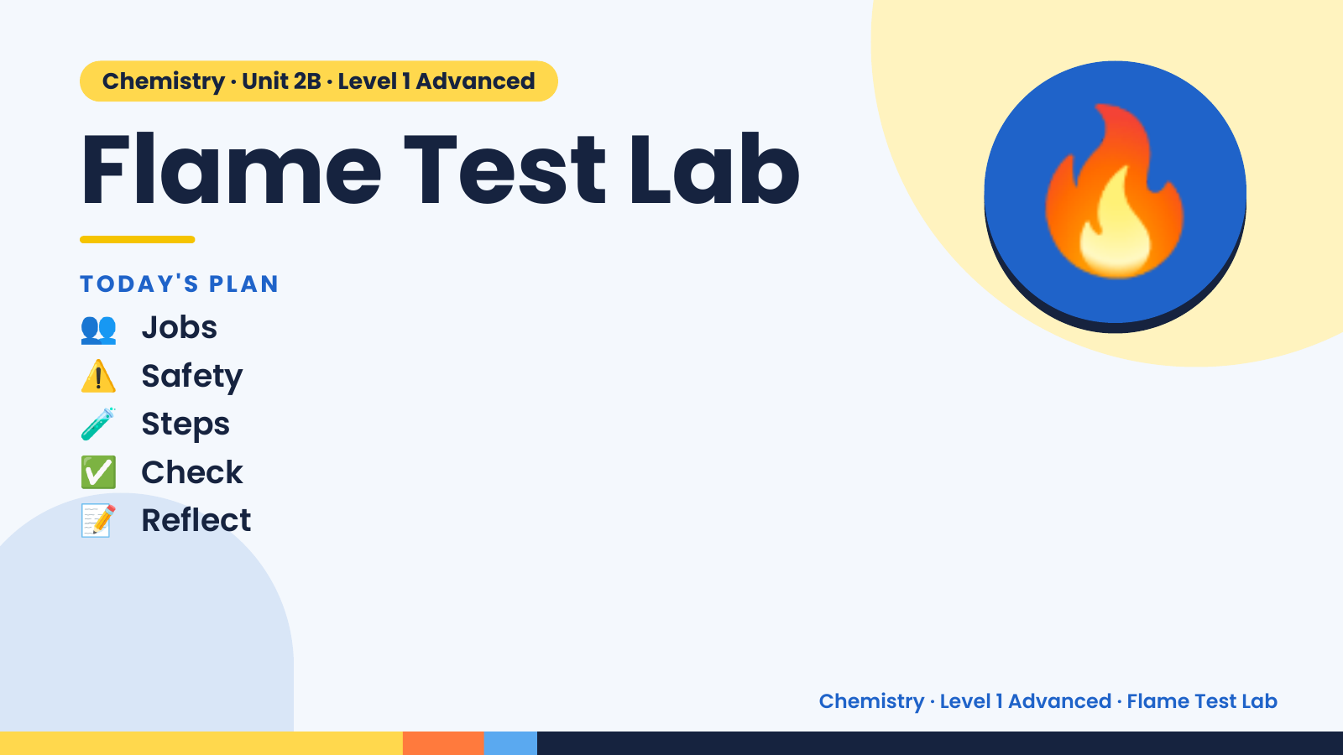
Notes:
Chemistry · Unit 2B · Level 1 Advanced
Flame Test Lab
👥 Jobs
TODAY'S PLAN
⚠️ Safety
🧪 Steps
🔥
✅ Check
📝 Reflect
Chemistry · Level 1 Advanced · Flame Test Lab

Slide 2
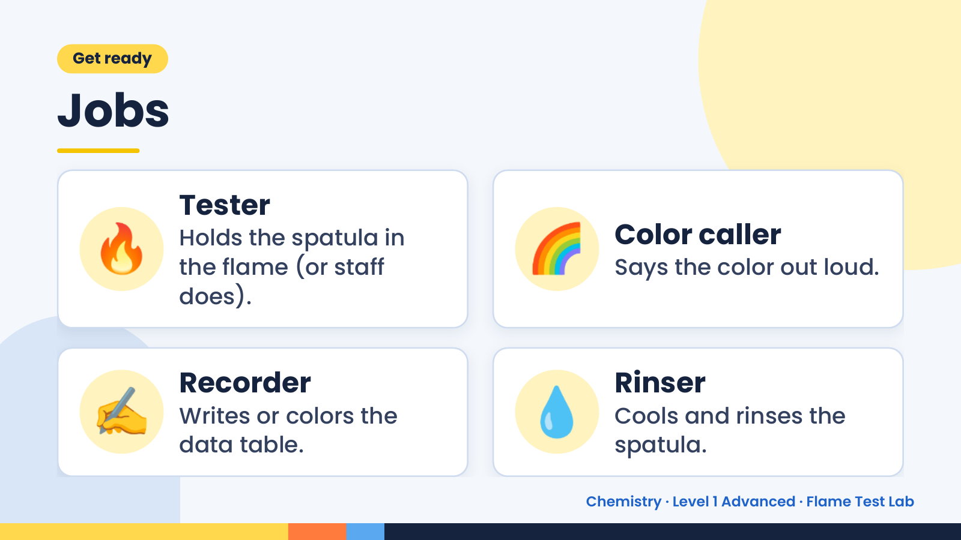
Notes:
Get ready
Jobs
🔥 Tester
Holds the spatula in
the flame (or staff
does).
🌈 Color caller
Says the color out loud.
✍️ Recorder
Writes or colors the
data table.
💧 Rinser
Cools and rinses the
spatula.
Chemistry · Level 1 Advanced · Flame Test Lab

Slide 3
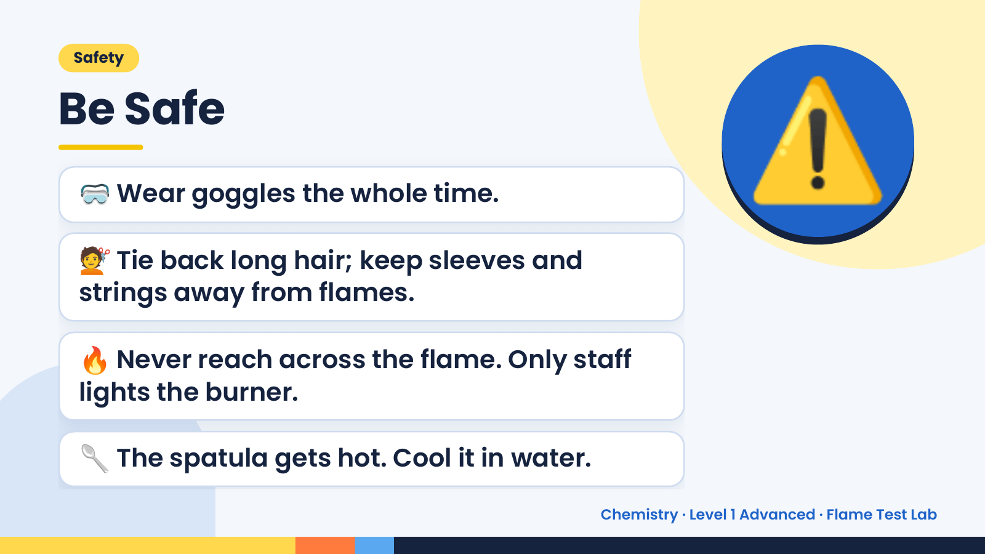
Notes:
Safety
Be Safe
🥽 Wear goggles the whole time.
💇 Tie back long hair; keep sleeves and
strings away from flames.
⚠️
🔥 Never reach across the flame. Only staff
lights the burner.
🥄 The spatula gets hot. Cool it in water.
Chemistry · Level 1 Advanced · Flame Test Lab

Slide 4
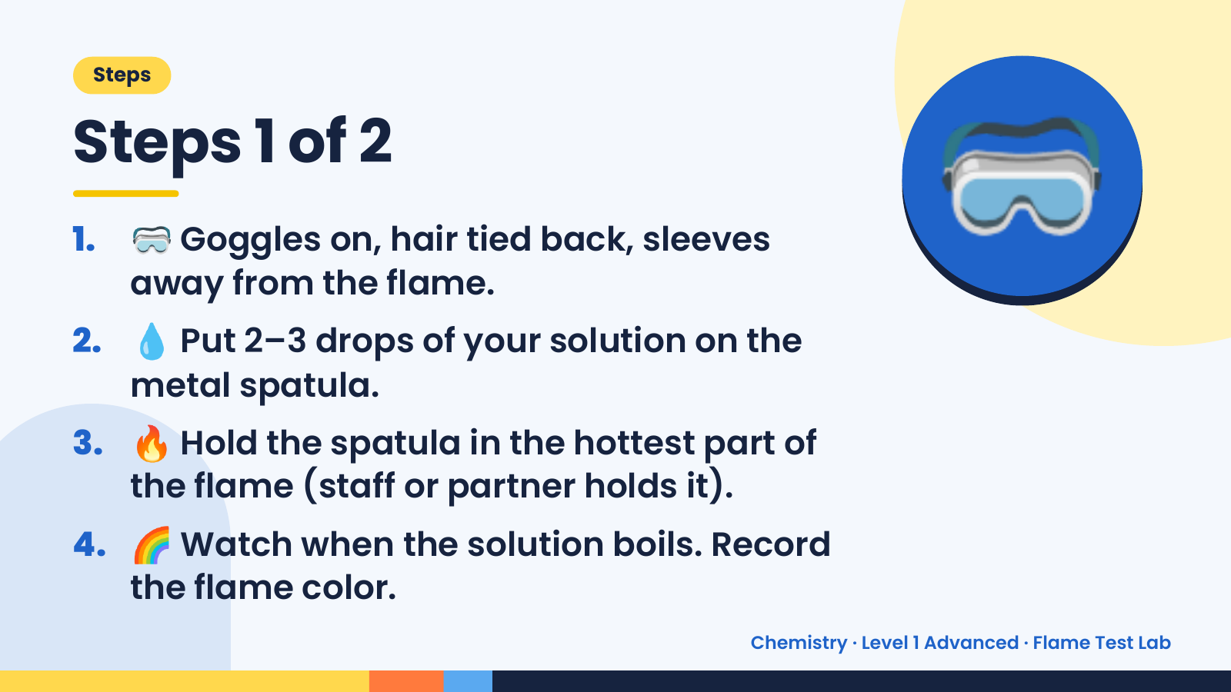
Notes:
Steps
Steps 1 of 2
1. 🥽 Goggles on, hair tied back, sleeves
away from the flame.
2. 💧 Put 2–3 drops of your solution on the
metal spatula.
🥽
3. 🔥 Hold the spatula in the hottest part of
the flame (staff or partner holds it).
4. 🌈 Watch when the solution boils. Record
the flame color.
Chemistry · Level 1 Advanced · Flame Test Lab

Slide 5
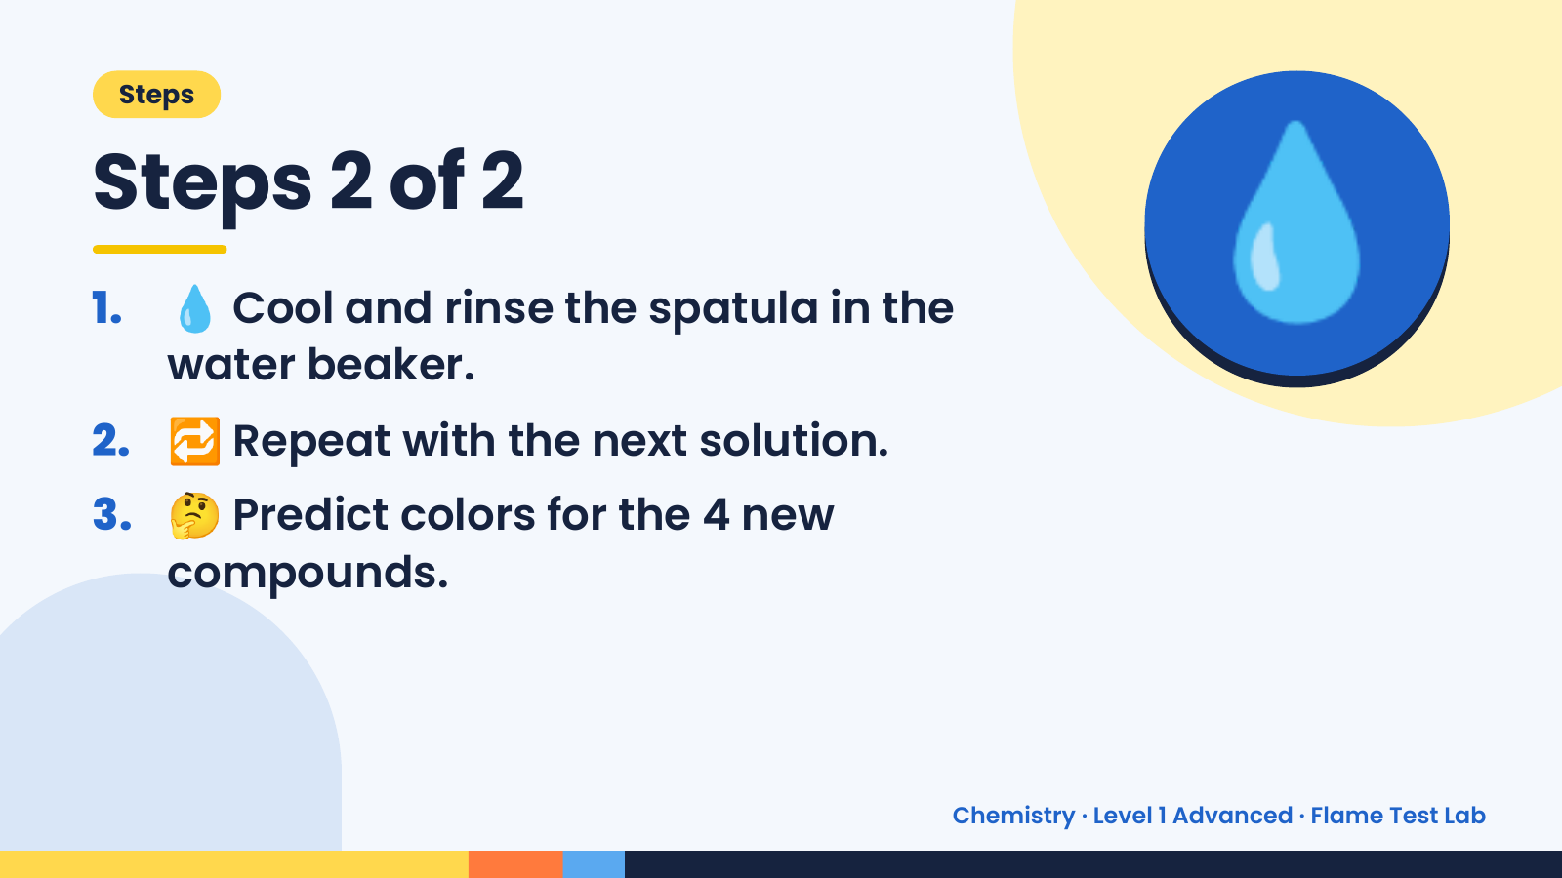
Notes:
Steps
Steps 2 of 2
1. 💧 Cool and rinse the spatula in the
water beaker.
2. 🔁 Repeat with the next solution.
💧
3. 🤔 Predict colors for the 4 new
compounds.
Chemistry · Level 1 Advanced · Flame Test Lab

Slide 6
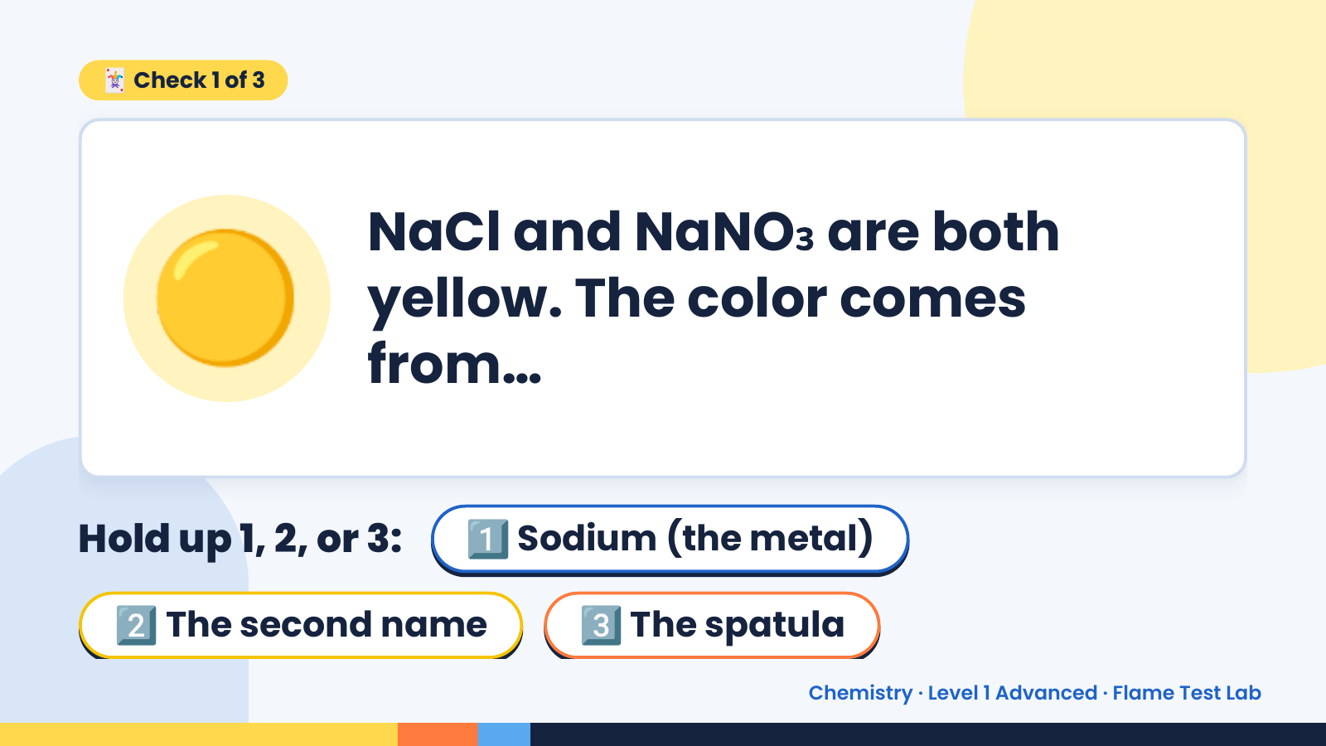
Notes:
🃏 Check 1 of 3
🟡 NaCl and NaNO₃ are both
yellow. The color comes
from…
Hold up 1, 2, or 3: 1️⃣ Sodium (the metal)
2️⃣ The second name 3️⃣ The spatula
Chemistry · Level 1 Advanced · Flame Test Lab

Slide 7
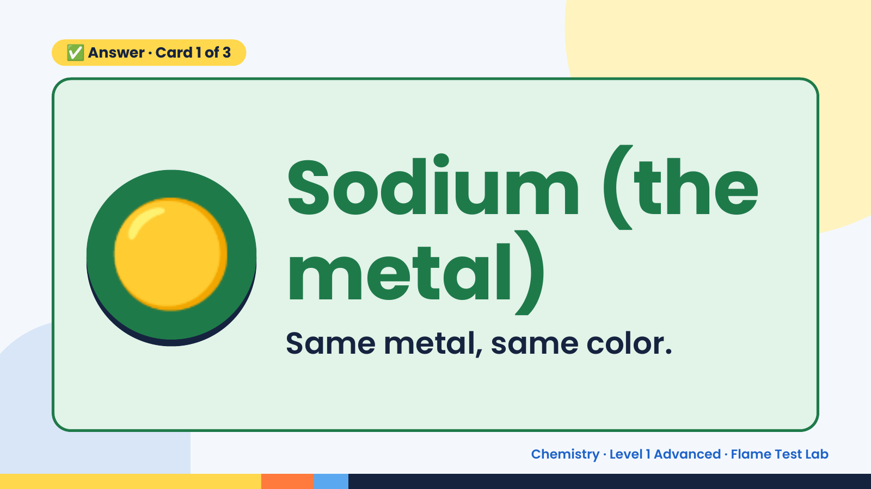
Notes:
✅ Answer · Card 1 of 3
🟡 Sodium (the
metal)
Same metal, same color.
Chemistry · Level 1 Advanced · Flame Test Lab

Slide 8
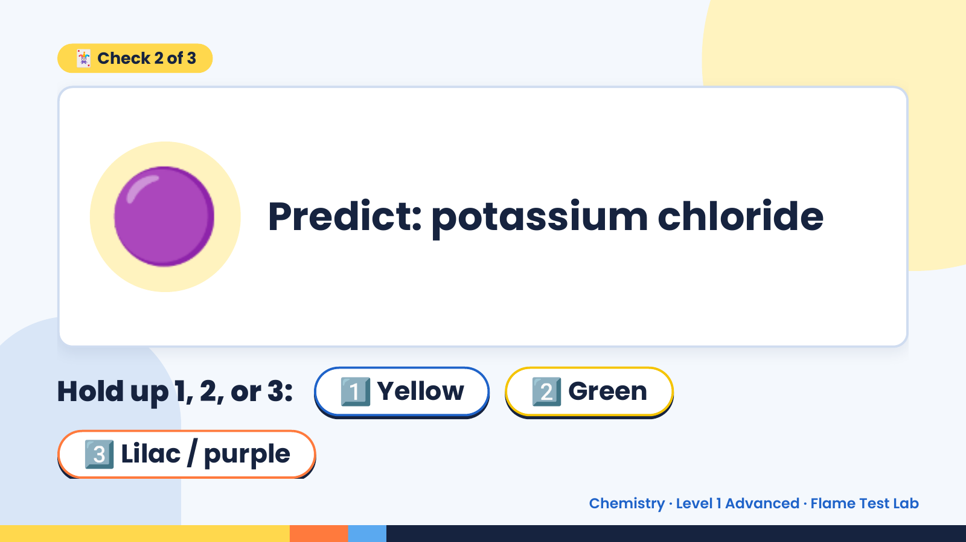
Notes:
🃏 Check 2 of 3
🟣 Predict: potassium chloride
Hold up 1, 2, or 3: 1️⃣ Yellow 2️⃣ Green
3️⃣ Lilac / purple
Chemistry · Level 1 Advanced · Flame Test Lab

Slide 9
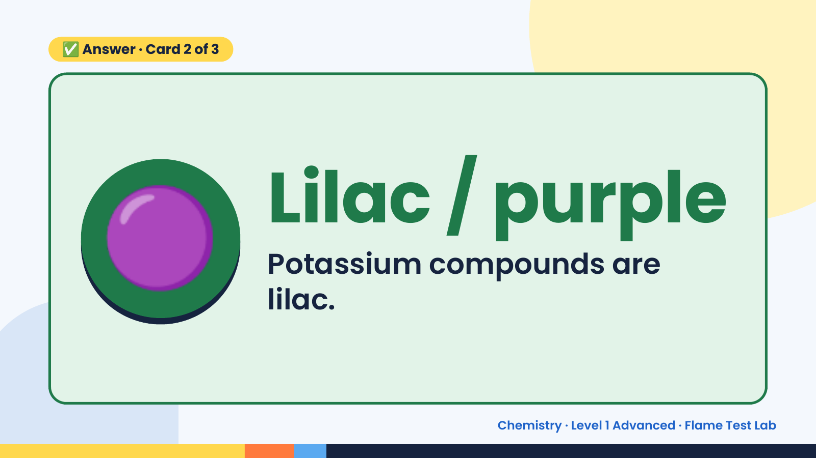
Notes:
✅ Answer · Card 2 of 3
🟣 Lilac / purple
Potassium compounds are
lilac.
Chemistry · Level 1 Advanced · Flame Test Lab

Slide 10
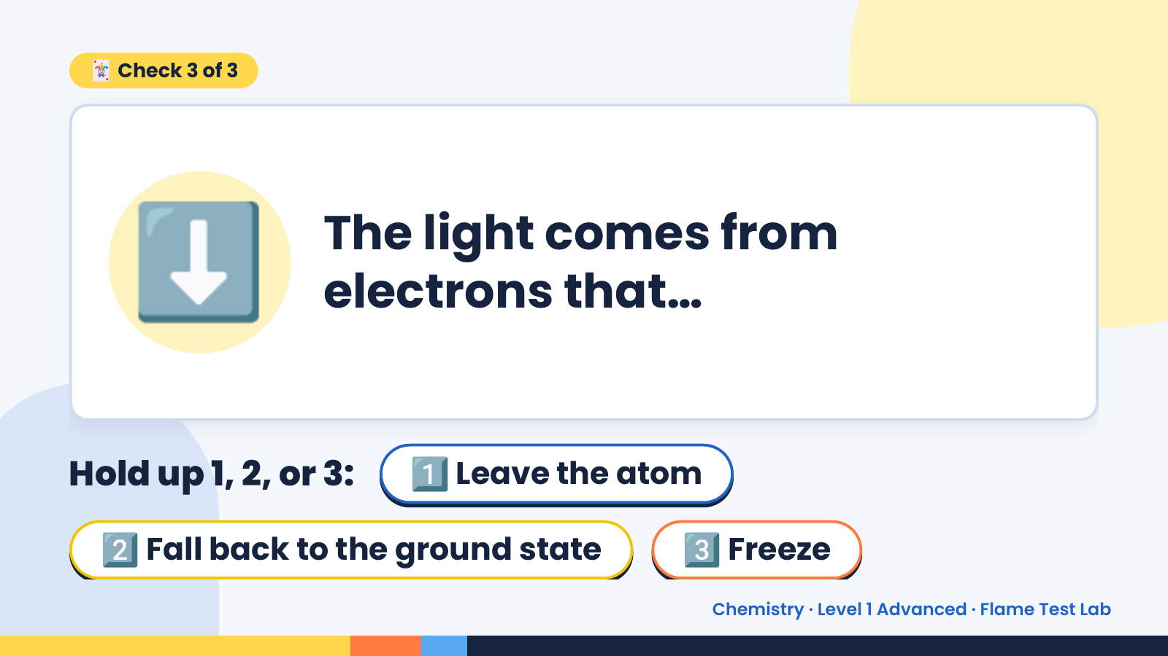
Notes:
🃏 Check 3 of 3
⬇️ The light comes from
electrons that…
Hold up 1, 2, or 3: 1️⃣ Leave the atom
2️⃣ Fall back to the ground state 3️⃣ Freeze
Chemistry · Level 1 Advanced · Flame Test Lab

Slide 11
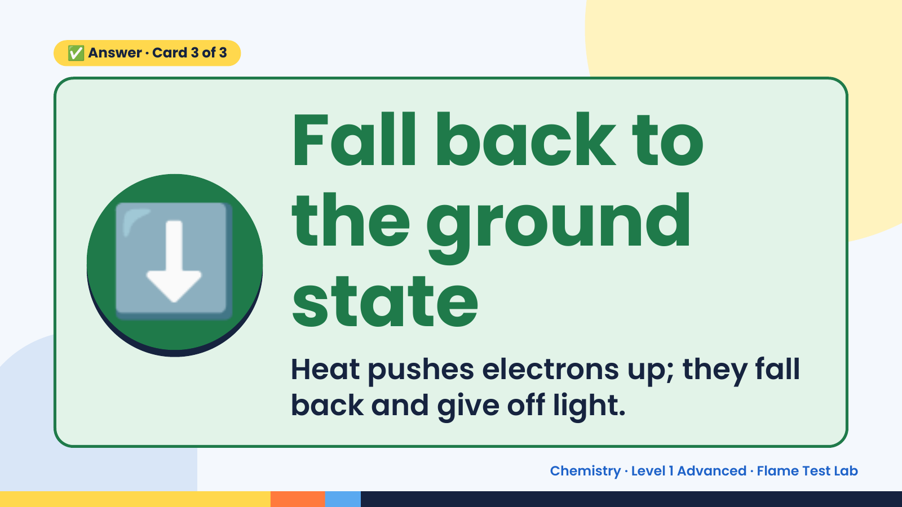
Notes:
✅ Answer · Card 3 of 3
⬇️
Fall back to
the ground
state
Heat pushes electrons up; they fall
back and give off light.
Chemistry · Level 1 Advanced · Flame Test Lab

Slide 12
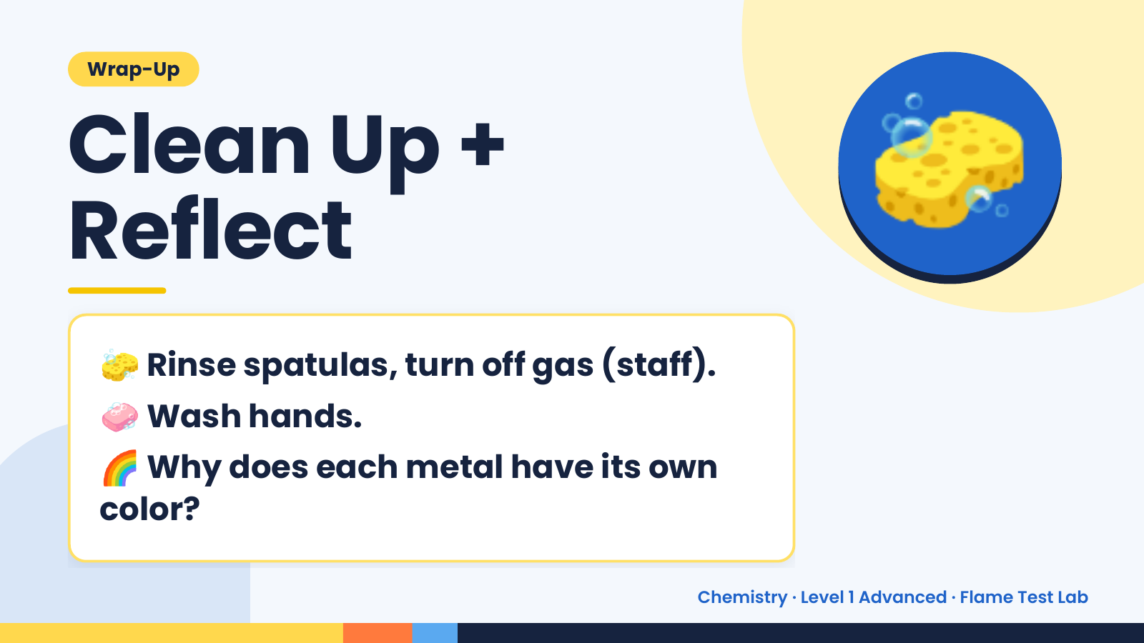
Notes:
Wrap-Up
Clean Up +
Reflect
🧽
🧽 Rinse spatulas, turn off gas (staff).
🧼 Wash hands.
🌈 Why does each metal have its own
color?
Chemistry · Level 1 Advanced · Flame Test Lab

