Slide 1
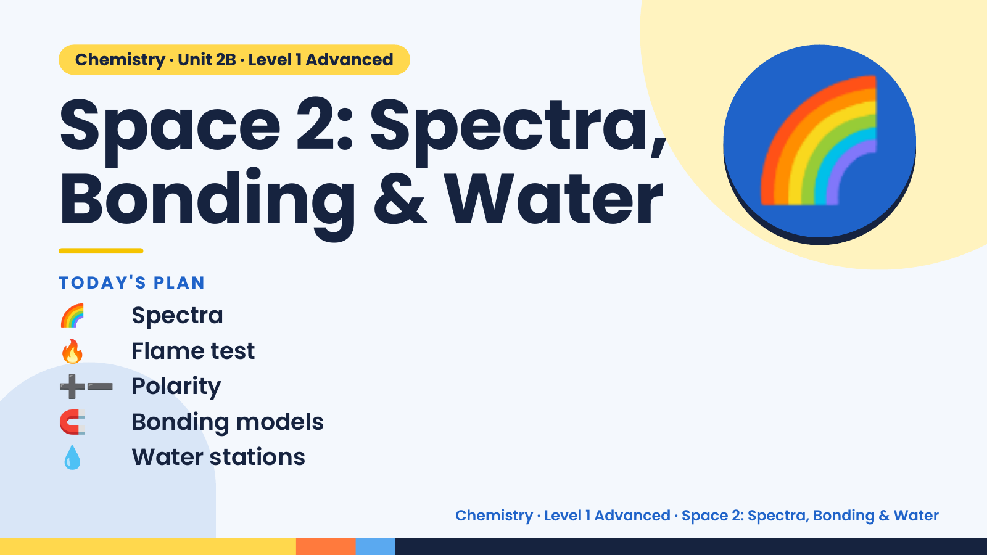
Notes:
Chemistry · Unit 2B · Level 1 Advanced
Space 2: Spectra,
Bonding & Water
🌈 Spectra
TODAY'S PLAN
🌈
🔥 Flame test
➕➖ Polarity
🧲 Bonding models
💧 Water stations
Chemistry · Level 1 Advanced · Space 2: Spectra, Bonding & Water

Slide 2
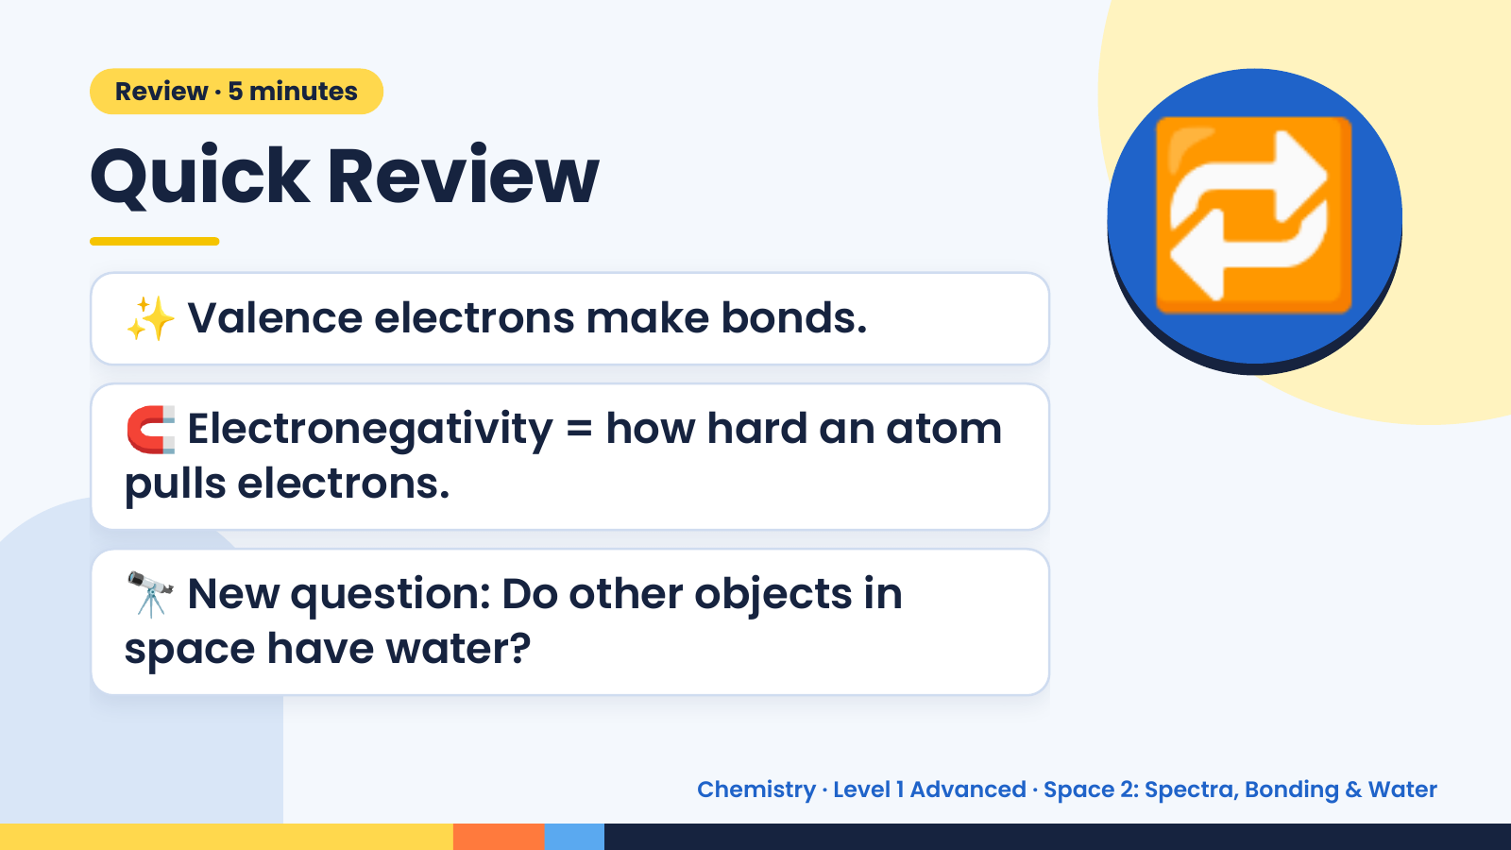
Notes:
Review · 5 minutes
Quick Review
✨ Valence electrons make bonds.
🧲 Electronegativity = how hard an atom
🔁
pulls electrons.
🔭 New question: Do other objects in
space have water?
Chemistry · Level 1 Advanced · Space 2: Spectra, Bonding & Water

Slide 3
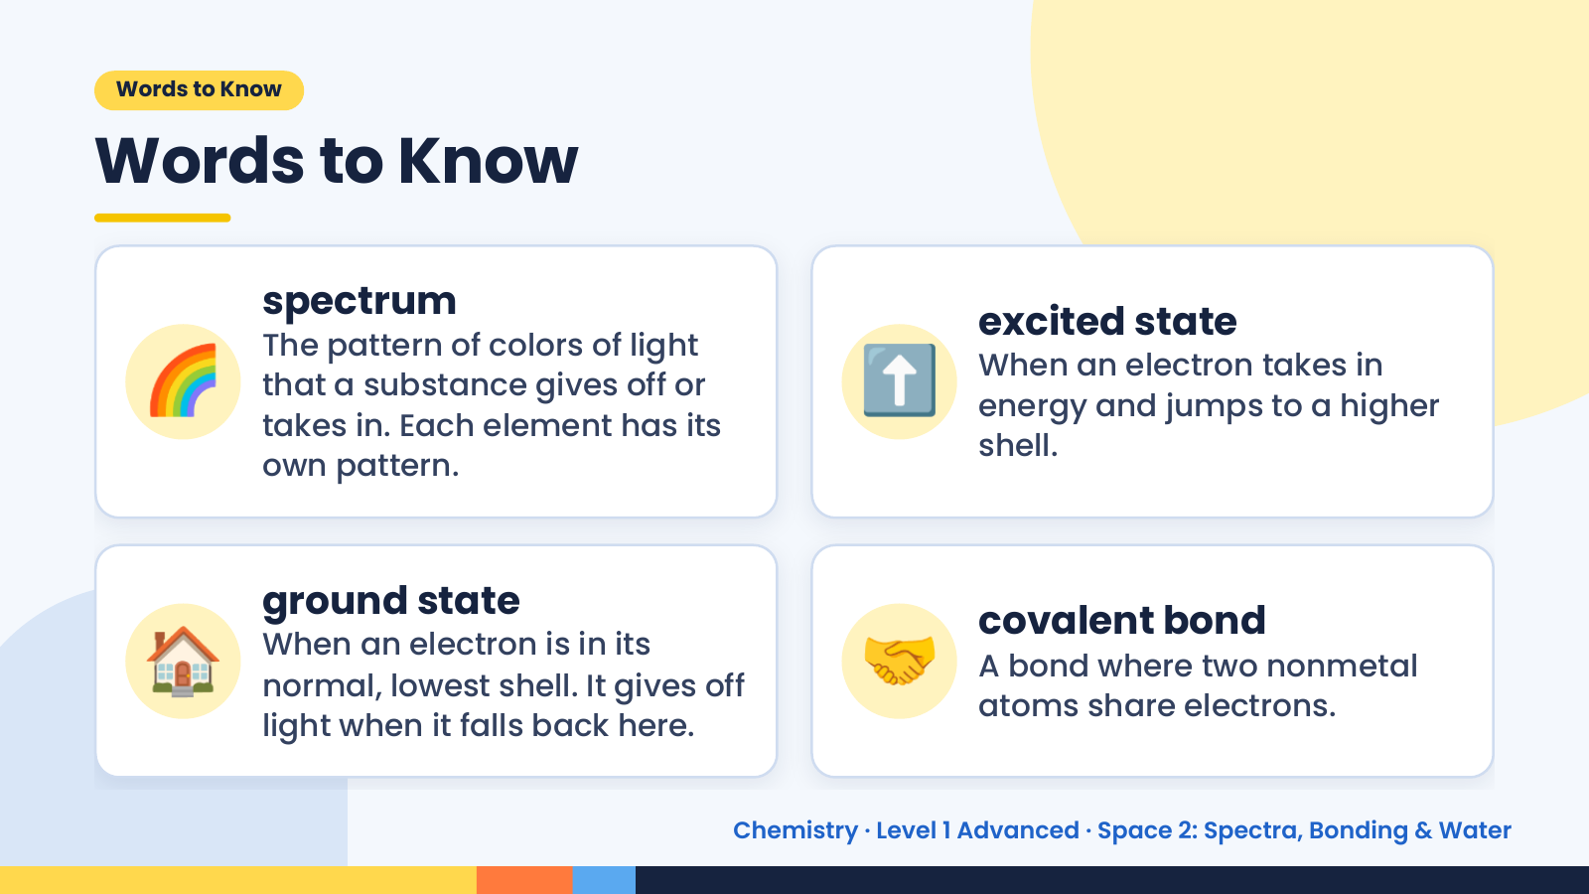
Notes:
Words to Know
Words to Know
🌈 ⬆️
spectrum
excited state
The pattern of colors of light
When an electron takes in
that a substance gives off or
energy and jumps to a higher
takes in. Each element has its
shell.
own pattern.
🏠 ground state
When an electron is in its
normal, lowest shell. It gives off
light when it falls back here.
🤝 covalent bond
A bond where two nonmetal
atoms share electrons.
Chemistry · Level 1 Advanced · Space 2: Spectra, Bonding & Water

Slide 4
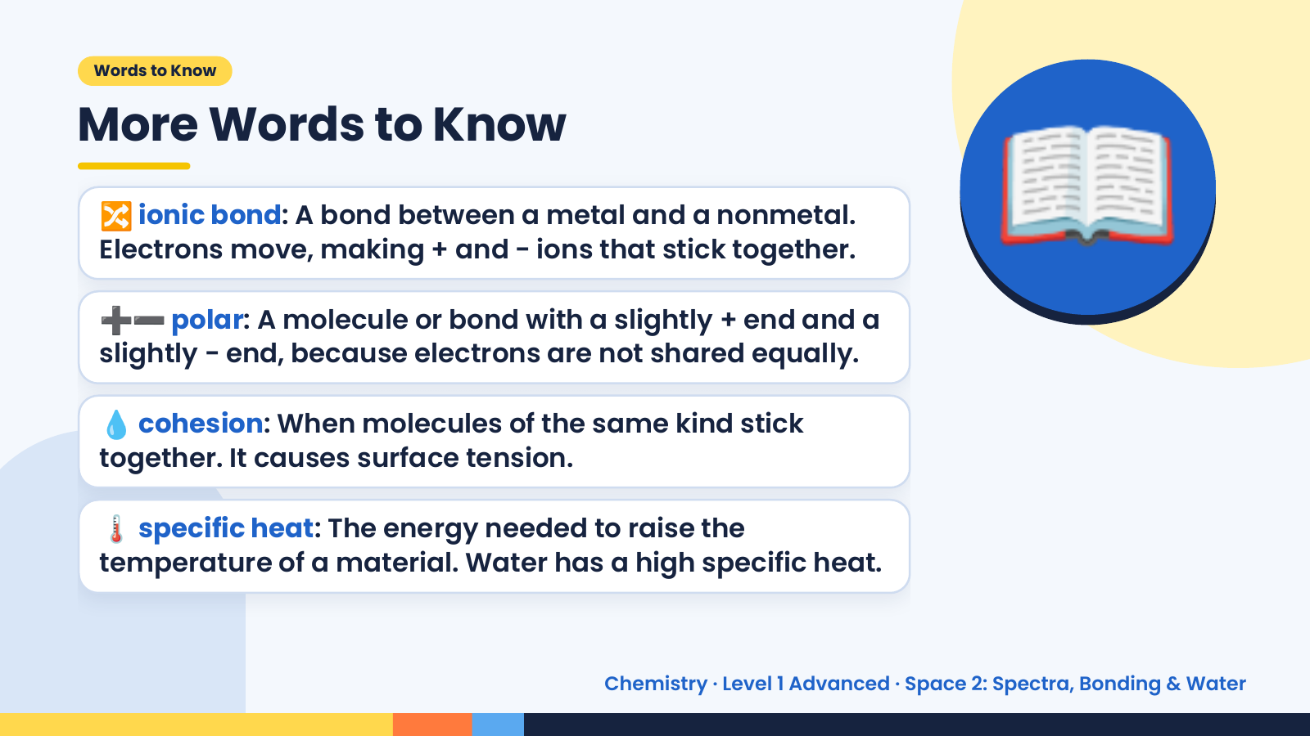
Notes:
Words to Know
More Words to Know
🔀 ionic bond: A bond between a metal and a nonmetal.
Electrons move, making + and − ions that stick together.
➕➖ polar: A molecule or bond with a slightly + end and a
slightly − end, because electrons are not shared equally.
📖
💧 cohesion: When molecules of the same kind stick
together. It causes surface tension.
🌡️ specific heat: The energy needed to raise the
temperature of a material. Water has a high specific heat.
Chemistry · Level 1 Advanced · Space 2: Spectra, Bonding & Water

Slide 5
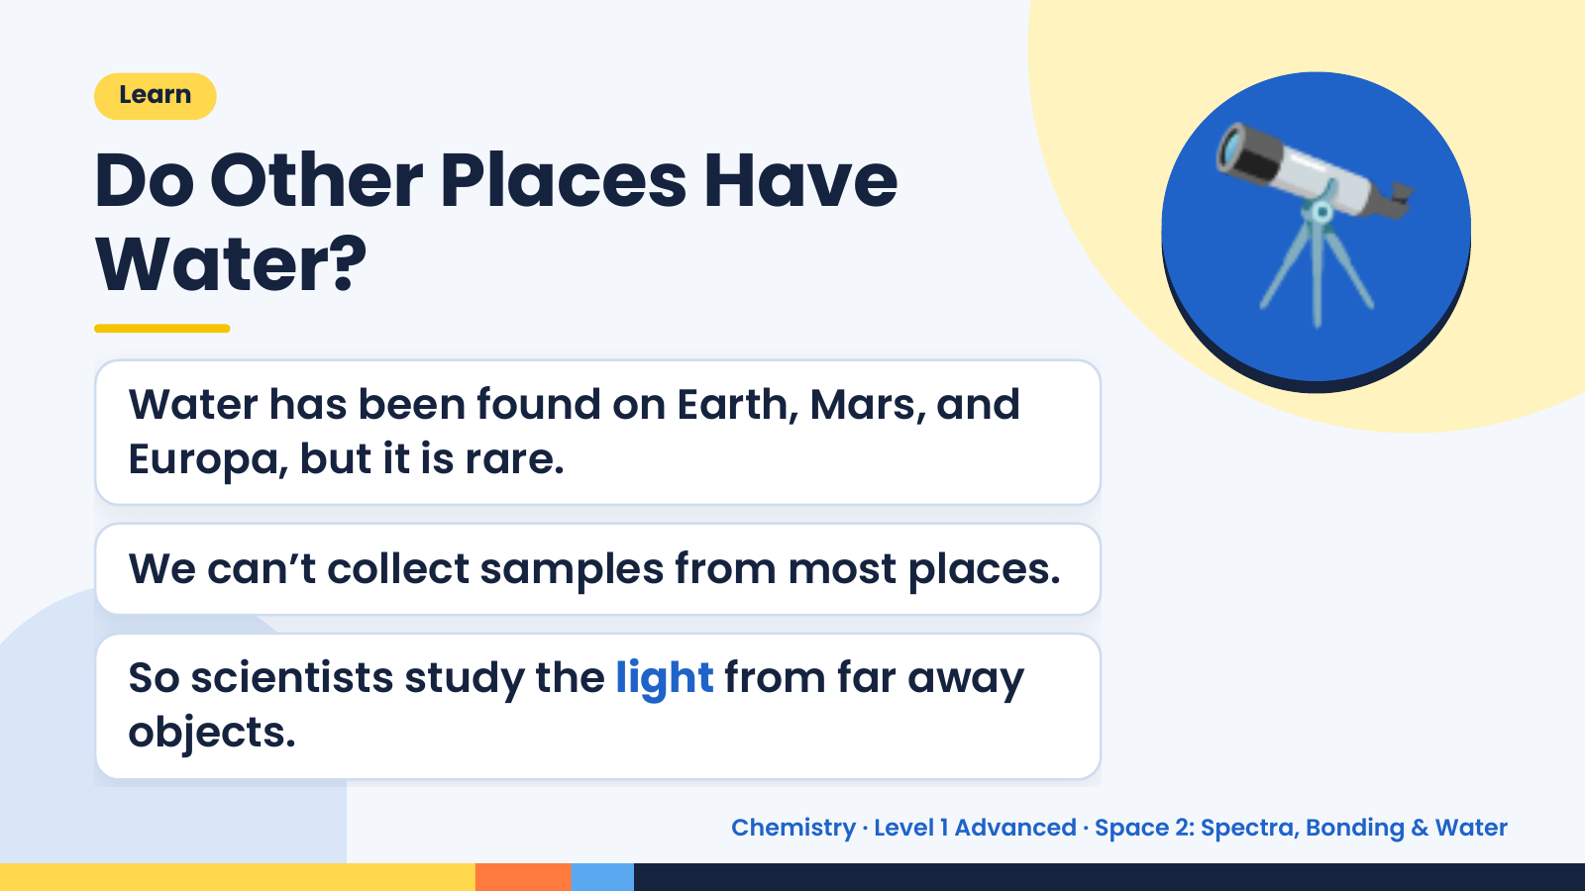
Notes:
Learn
Do Other Places Have
Water?
Water has been found on Earth, Mars, and
Europa, but it is rare.
🔭
We can’t collect samples from most places.
So scientists study the light from far away
objects.
Chemistry · Level 1 Advanced · Space 2: Spectra, Bonding & Water

Slide 6
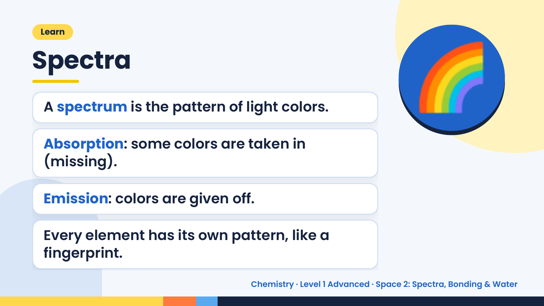
Notes:
Learn
Spectra
A spectrum is the pattern of light colors.
Absorption: some colors are taken in
(missing).
🌈
Emission: colors are given off.
Every element has its own pattern, like a
fingerprint.
Chemistry · Level 1 Advanced · Space 2: Spectra, Bonding & Water

Slide 7
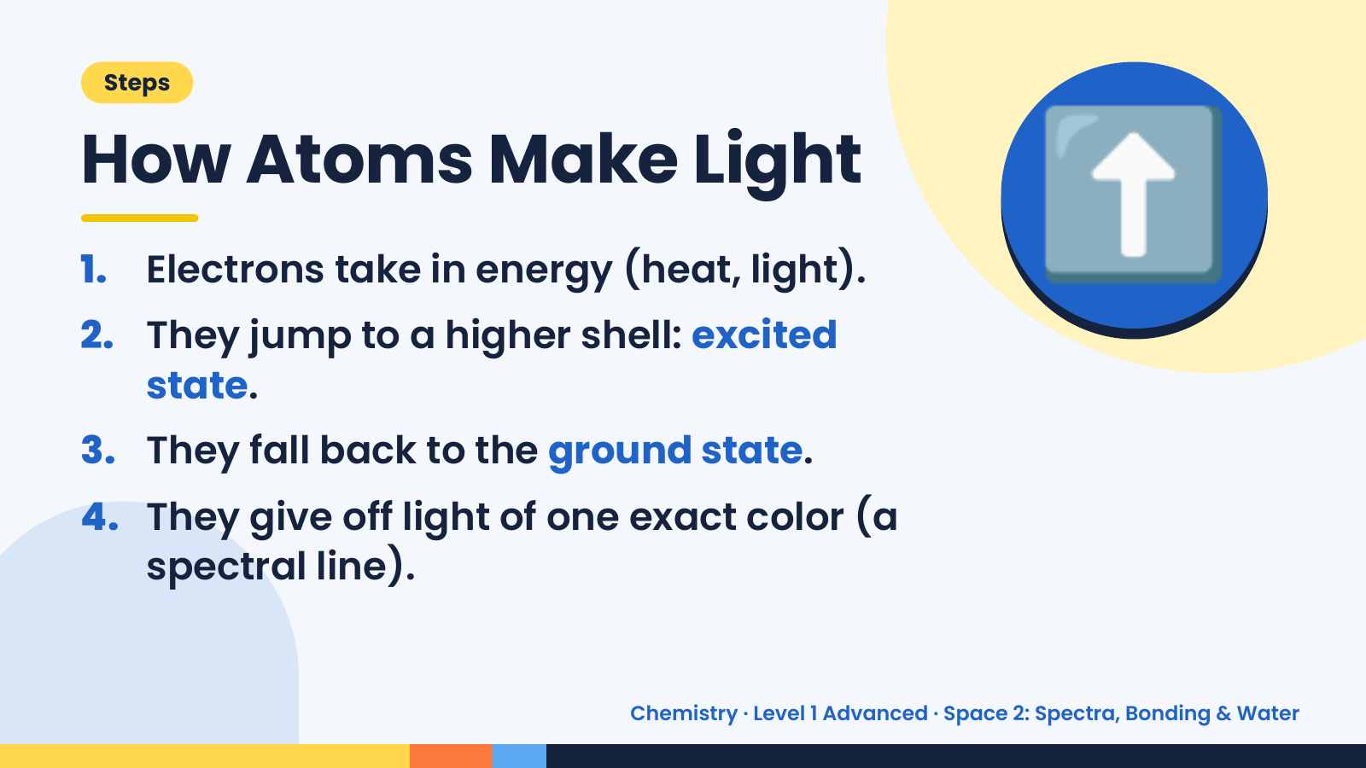
Notes:
Steps
How Atoms Make Light
1. Electrons take in energy (heat, light).
2. They jump to a higher shell: excited
state.
⬆️
3. They fall back to the ground state.
4. They give off light of one exact color (a
spectral line).
Chemistry · Level 1 Advanced · Space 2: Spectra, Bonding & Water

Slide 8
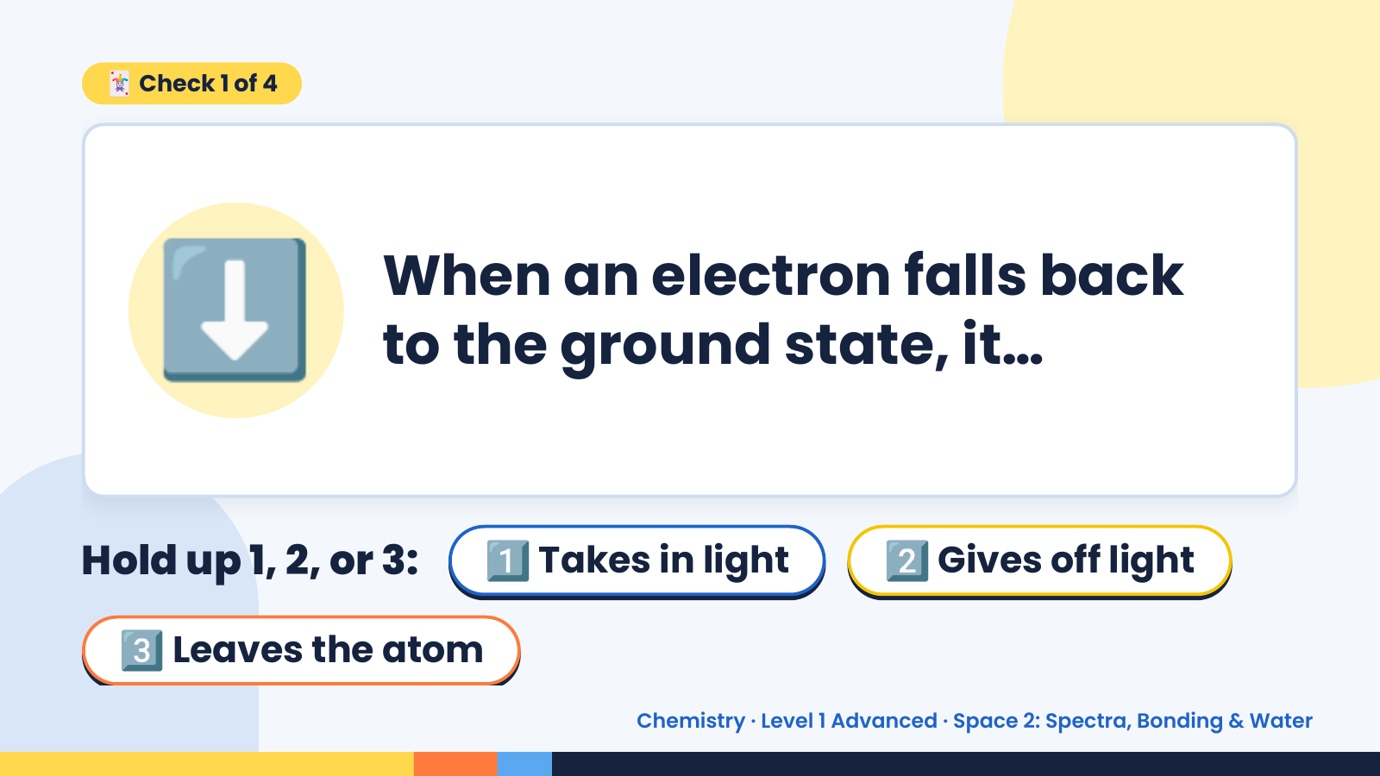
Notes:
🃏 Check 1 of 4
⬇️ When an electron falls back
to the ground state, it…
Hold up 1, 2, or 3: 1️⃣ Takes in light 2️⃣ Gives off light
3️⃣ Leaves the atom
Chemistry · Level 1 Advanced · Space 2: Spectra, Bonding & Water

Slide 9
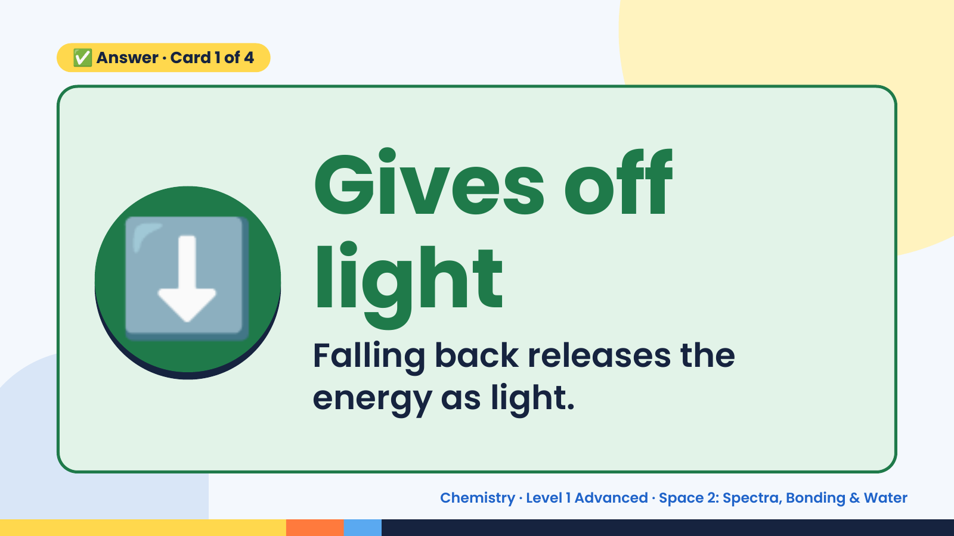
Notes:
✅ Answer · Card 1 of 4
⬇️ Gives off
light
Falling back releases the
energy as light.
Chemistry · Level 1 Advanced · Space 2: Spectra, Bonding & Water

Slide 10
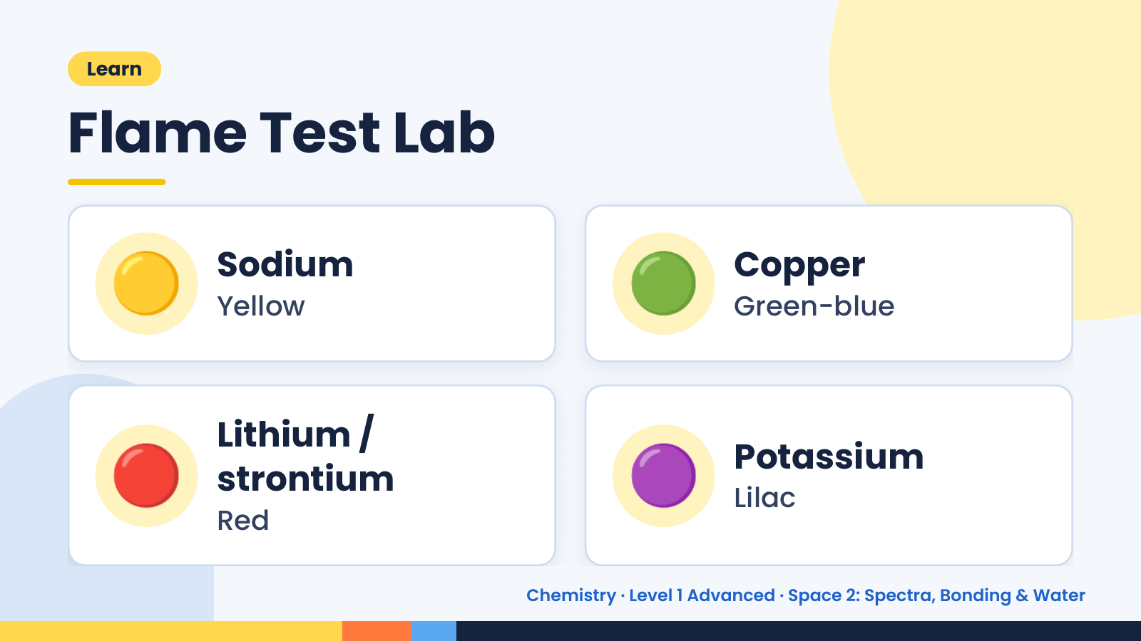
Notes:
Learn
Flame Test Lab
🟡 Sodium
Yellow 🟢 Copper
Green-blue
🔴 Lithium /
strontium
Red
🟣 Potassium
Lilac
Chemistry · Level 1 Advanced · Space 2: Spectra, Bonding & Water

Slide 11
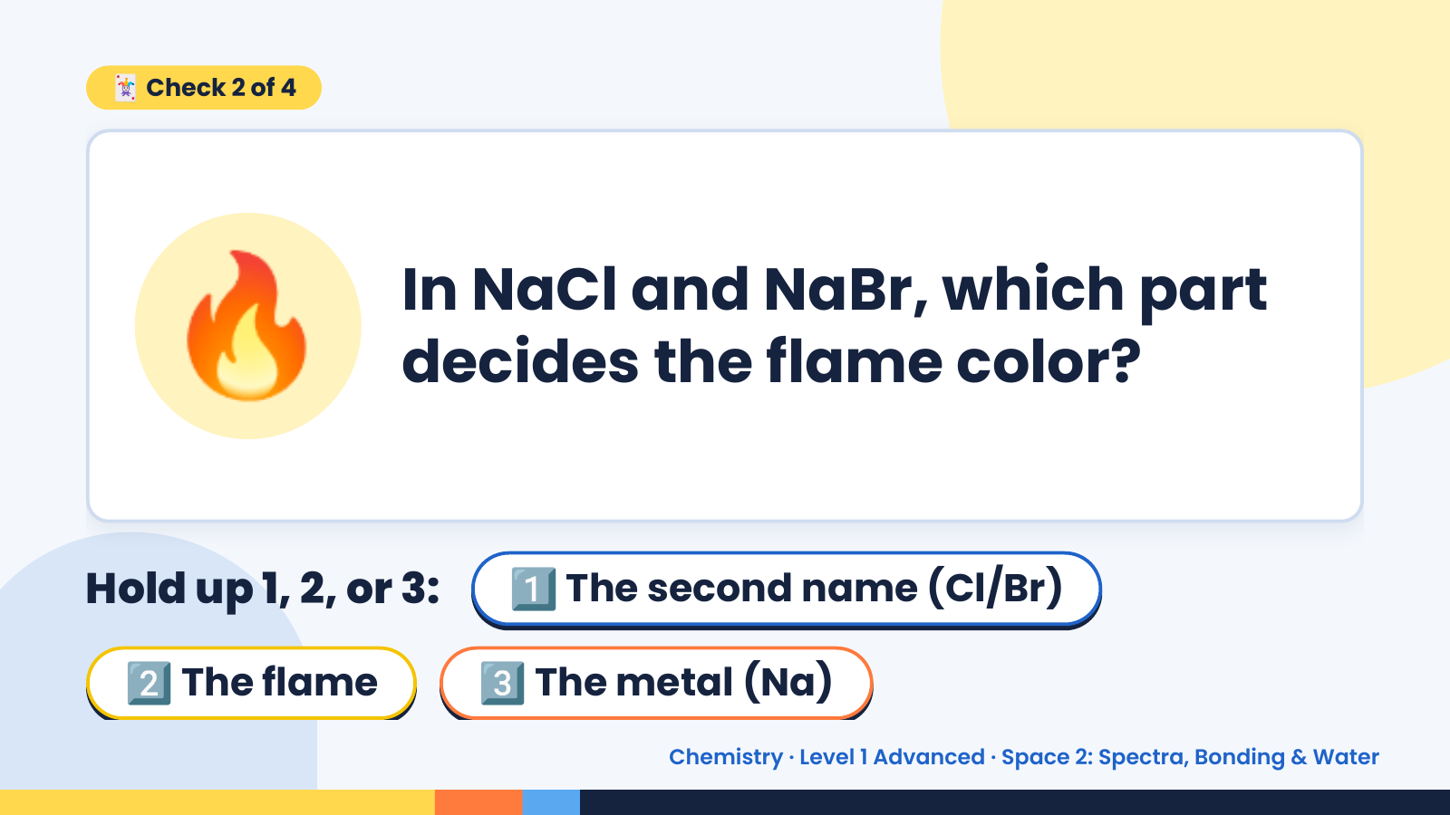
Notes:
🃏 Check 2 of 4
🔥 In NaCl and NaBr, which part
decides the flame color?
Hold up 1, 2, or 3: 1️⃣ The second name (Cl/Br)
2️⃣ The flame 3️⃣ The metal (Na)
Chemistry · Level 1 Advanced · Space 2: Spectra, Bonding & Water

Slide 12
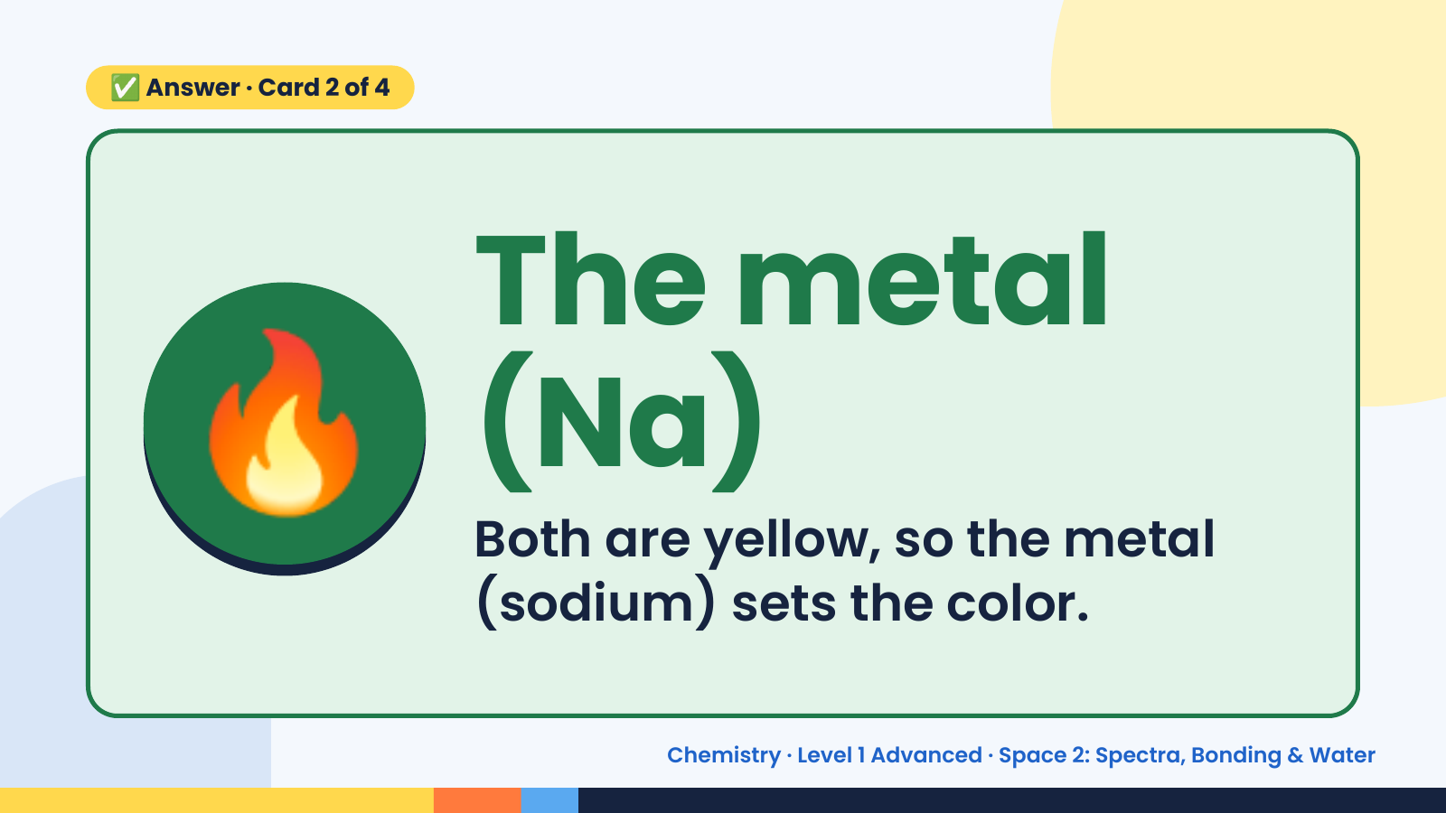
Notes:
✅ Answer · Card 2 of 4
🔥 The metal
(Na)
Both are yellow, so the metal
(sodium) sets the color.
Chemistry · Level 1 Advanced · Space 2: Spectra, Bonding & Water

Slide 13
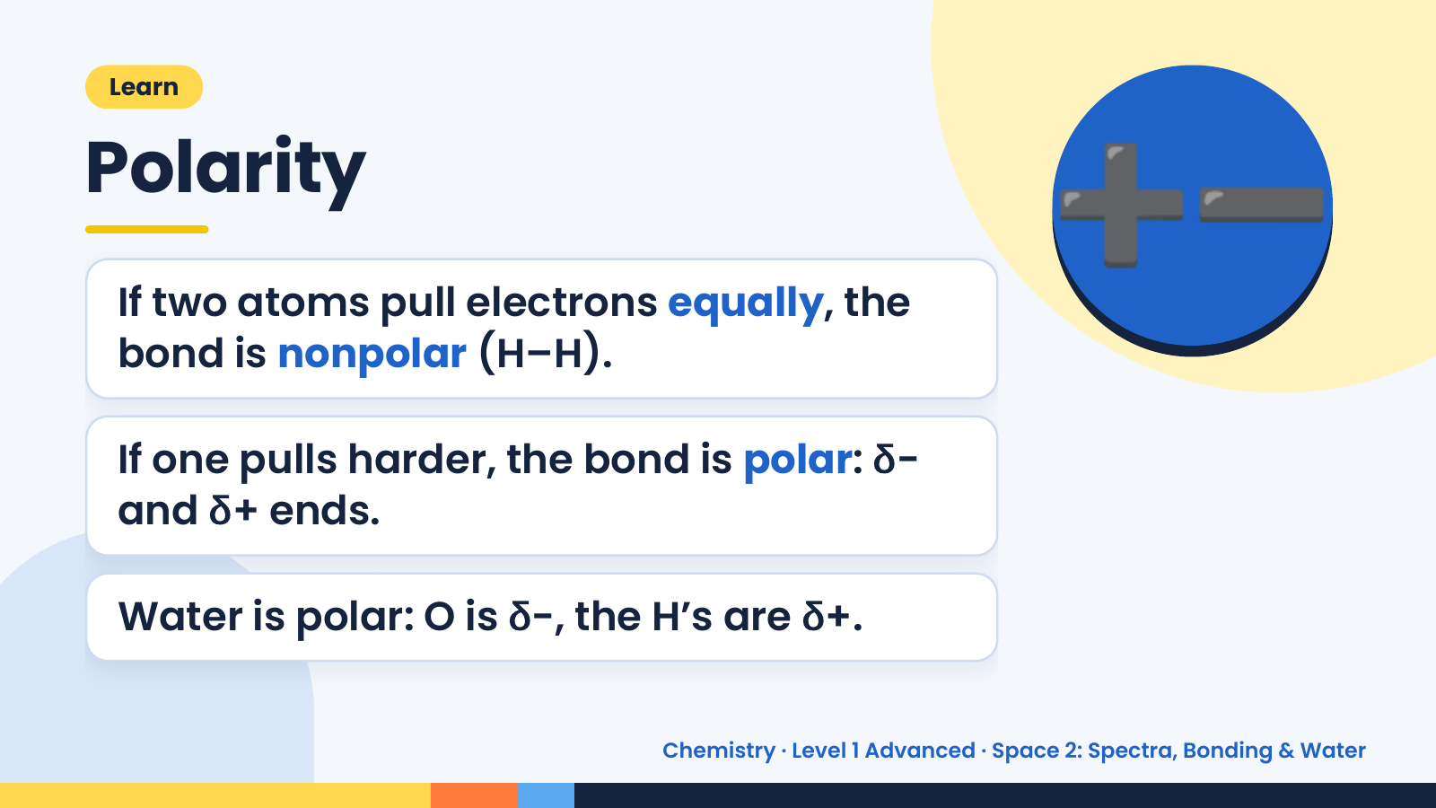
Notes:
➕➖
Learn
Polarity
If two atoms pull electrons equally, the
bond is nonpolar (H–H).
If one pulls harder, the bond is polar: δ−
and δ+ ends.
Water is polar: O is δ−, the H’s are δ+.
Chemistry · Level 1 Advanced · Space 2: Spectra, Bonding & Water

Slide 14
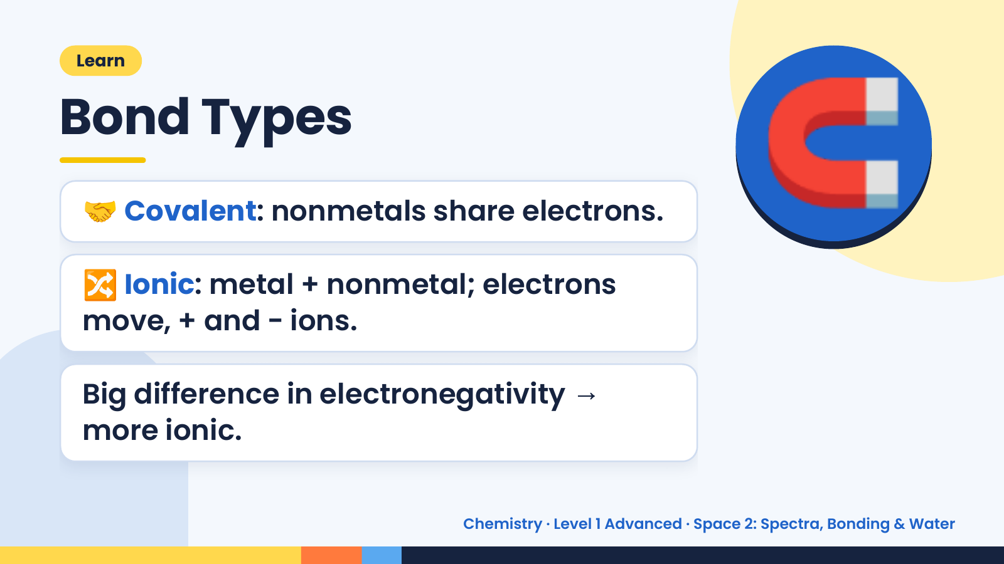
Notes:
Learn
Bond Types
🤝 Covalent: nonmetals share electrons.
🔀 Ionic: metal + nonmetal; electrons
🧲
move, + and − ions.
Big difference in electronegativity →
more ionic.
Chemistry · Level 1 Advanced · Space 2: Spectra, Bonding & Water

Slide 15
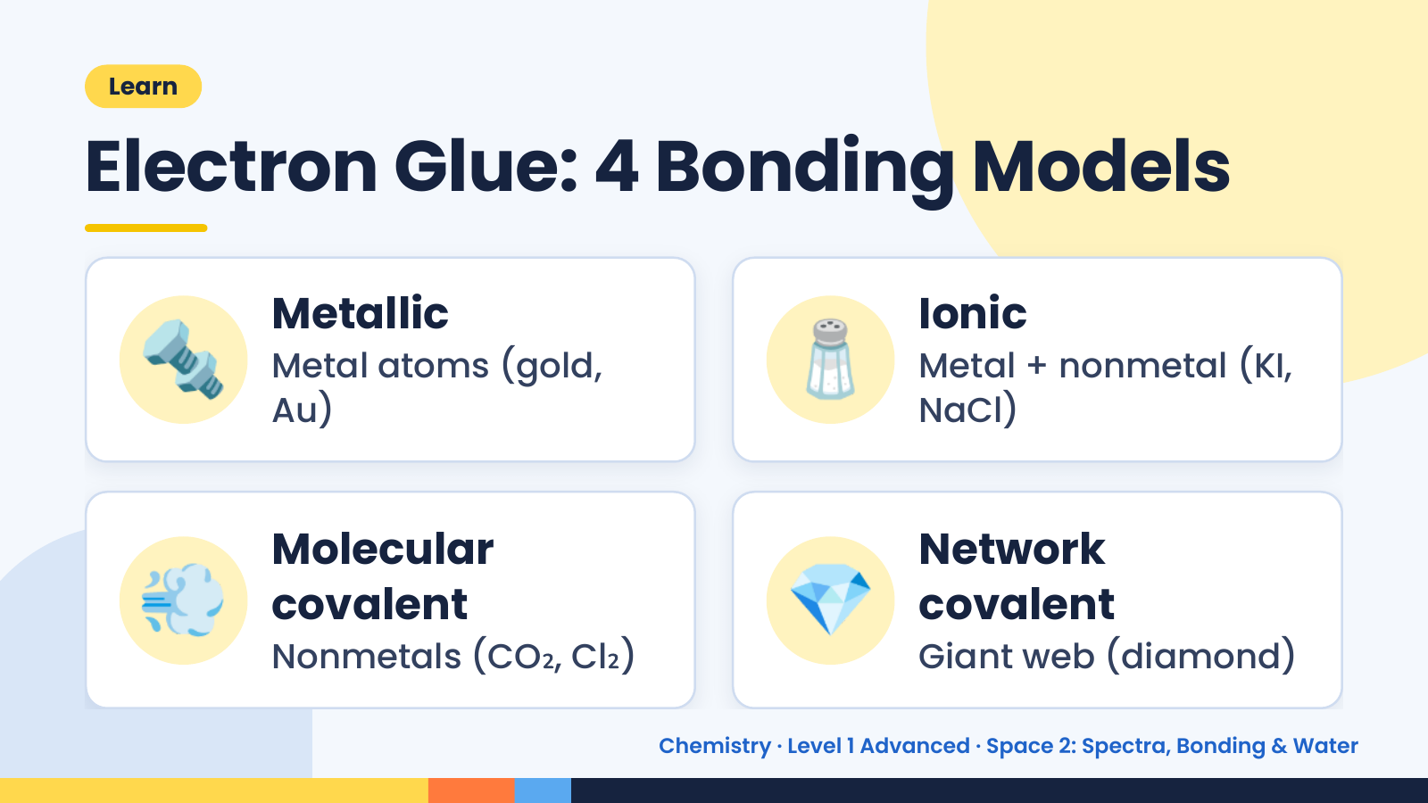
Notes:
Learn
Electron Glue: 4 Bonding Models
🔩 Metallic
Metal atoms (gold,
Au)
🧂 Ionic
Metal + nonmetal (KI,
NaCl)
💨 Molecular
covalent
Nonmetals (CO₂, Cl₂)
💎 Network
covalent
Giant web (diamond)
Chemistry · Level 1 Advanced · Space 2: Spectra, Bonding & Water

Slide 16
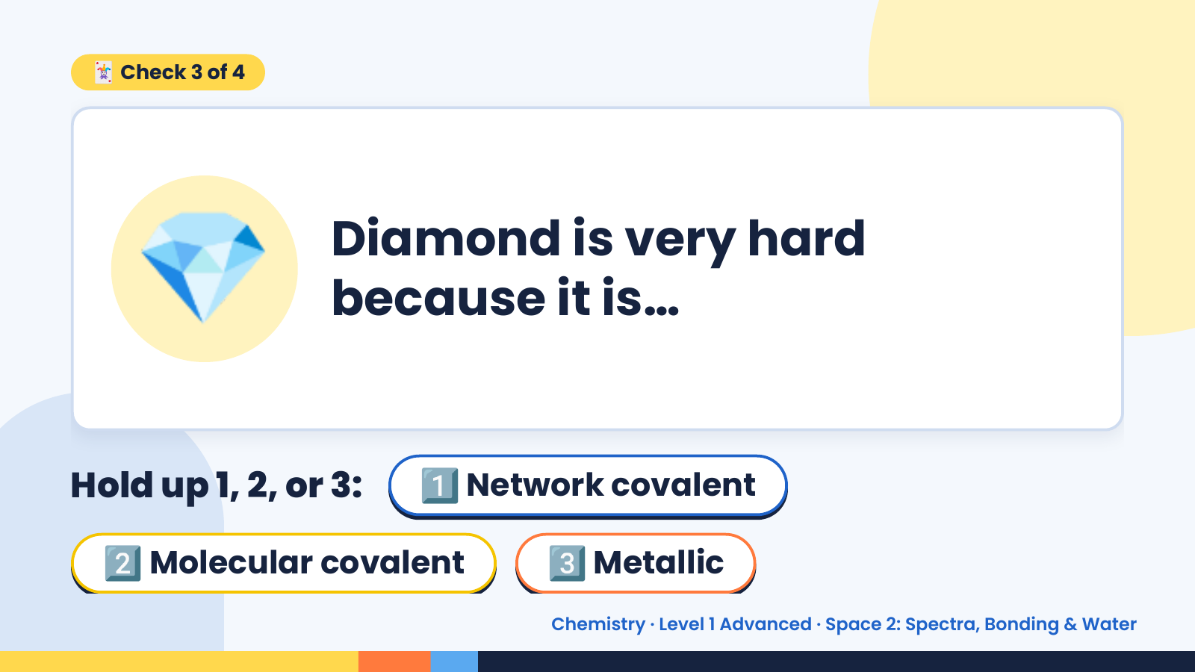
Notes:
🃏 Check 3 of 4
💎 Diamond is very hard
because it is…
Hold up 1, 2, or 3: 1️⃣ Network covalent
2️⃣ Molecular covalent 3️⃣ Metallic
Chemistry · Level 1 Advanced · Space 2: Spectra, Bonding & Water

Slide 17
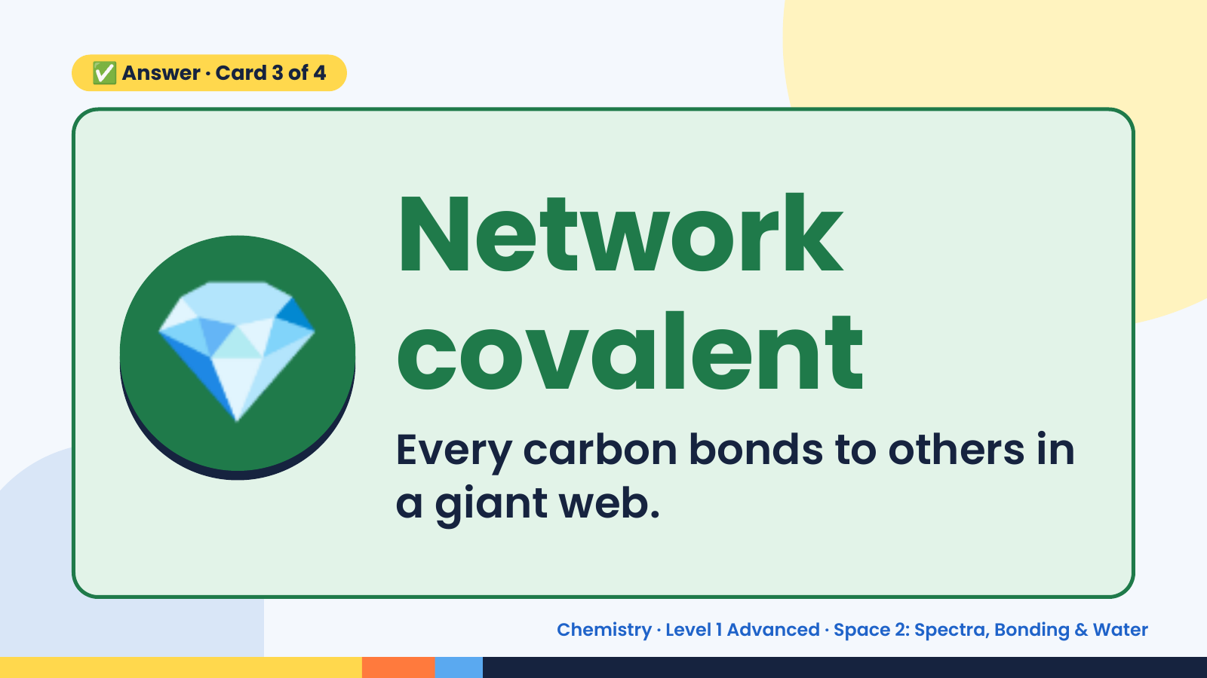
Notes:
✅ Answer · Card 3 of 4
💎 Network
covalent
Every carbon bonds to others in
a giant web.
Chemistry · Level 1 Advanced · Space 2: Spectra, Bonding & Water

Slide 18
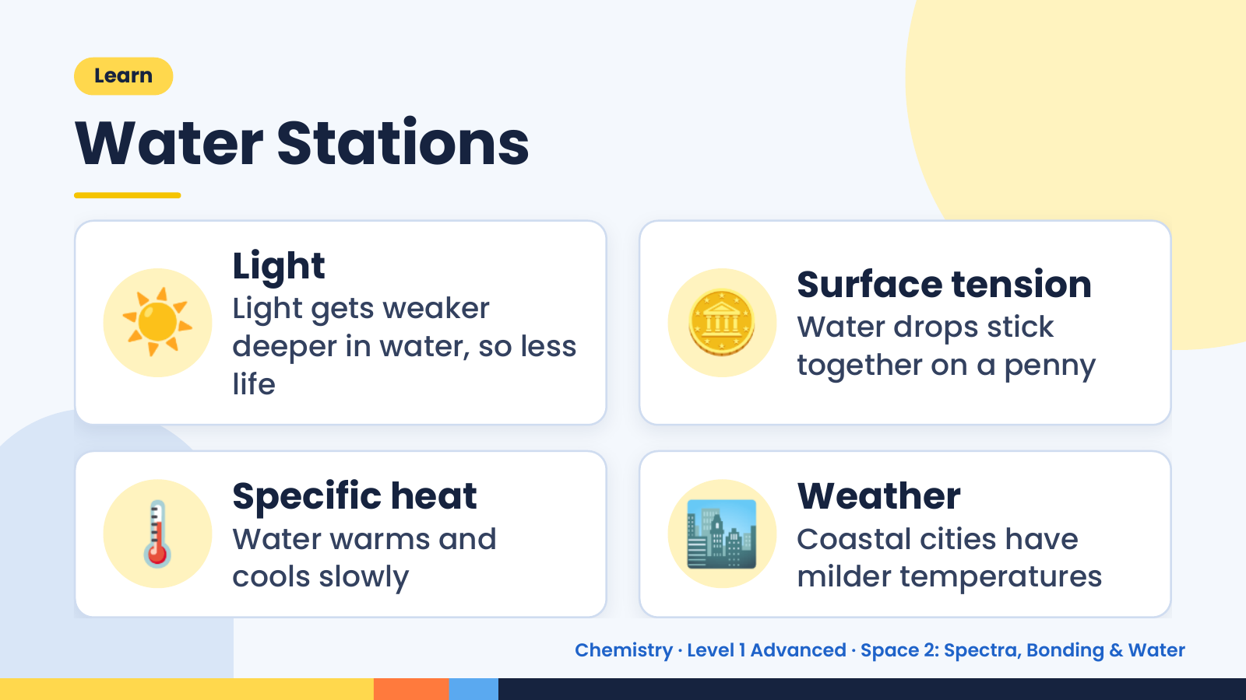
Notes:
Learn
Water Stations
☀️ Light
Light gets weaker
deeper in water, so less
life
🪙 Surface tension
Water drops stick
together on a penny
🌡️ Specific heat
Water warms and
cools slowly
🏙️ Weather
Coastal cities have
milder temperatures
Chemistry · Level 1 Advanced · Space 2: Spectra, Bonding & Water

Slide 19
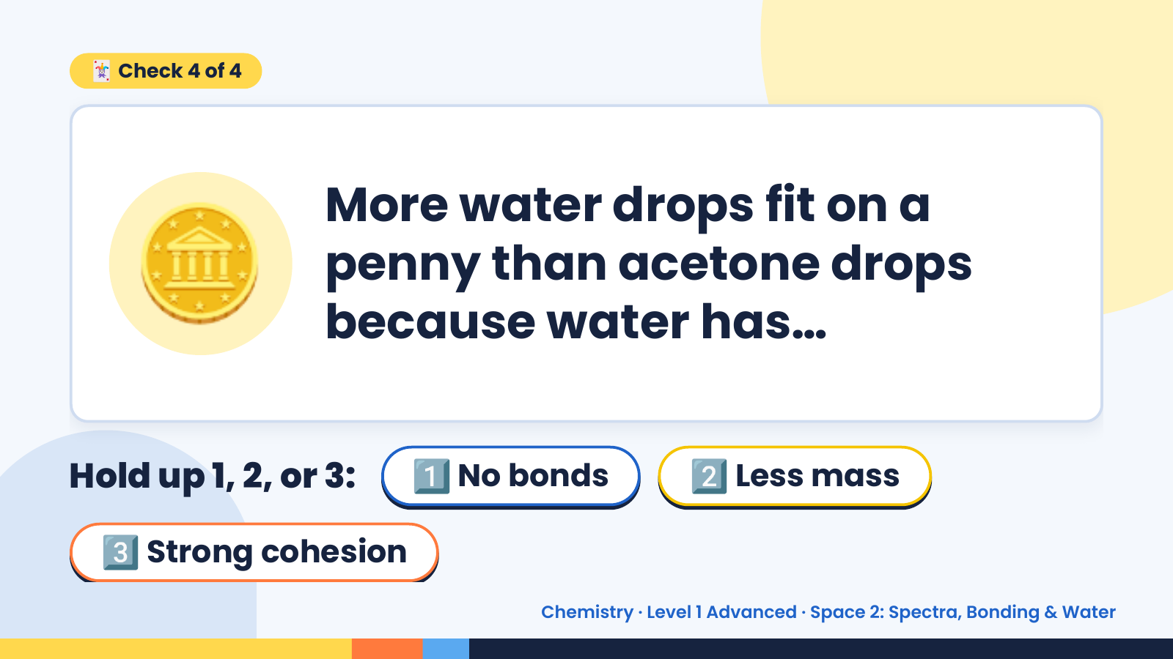
Notes:
🃏 Check 4 of 4
🪙 More water drops fit on a
penny than acetone drops
because water has…
Hold up 1, 2, or 3: 1️⃣ No bonds 2️⃣ Less mass
3️⃣ Strong cohesion
Chemistry · Level 1 Advanced · Space 2: Spectra, Bonding & Water

Slide 20
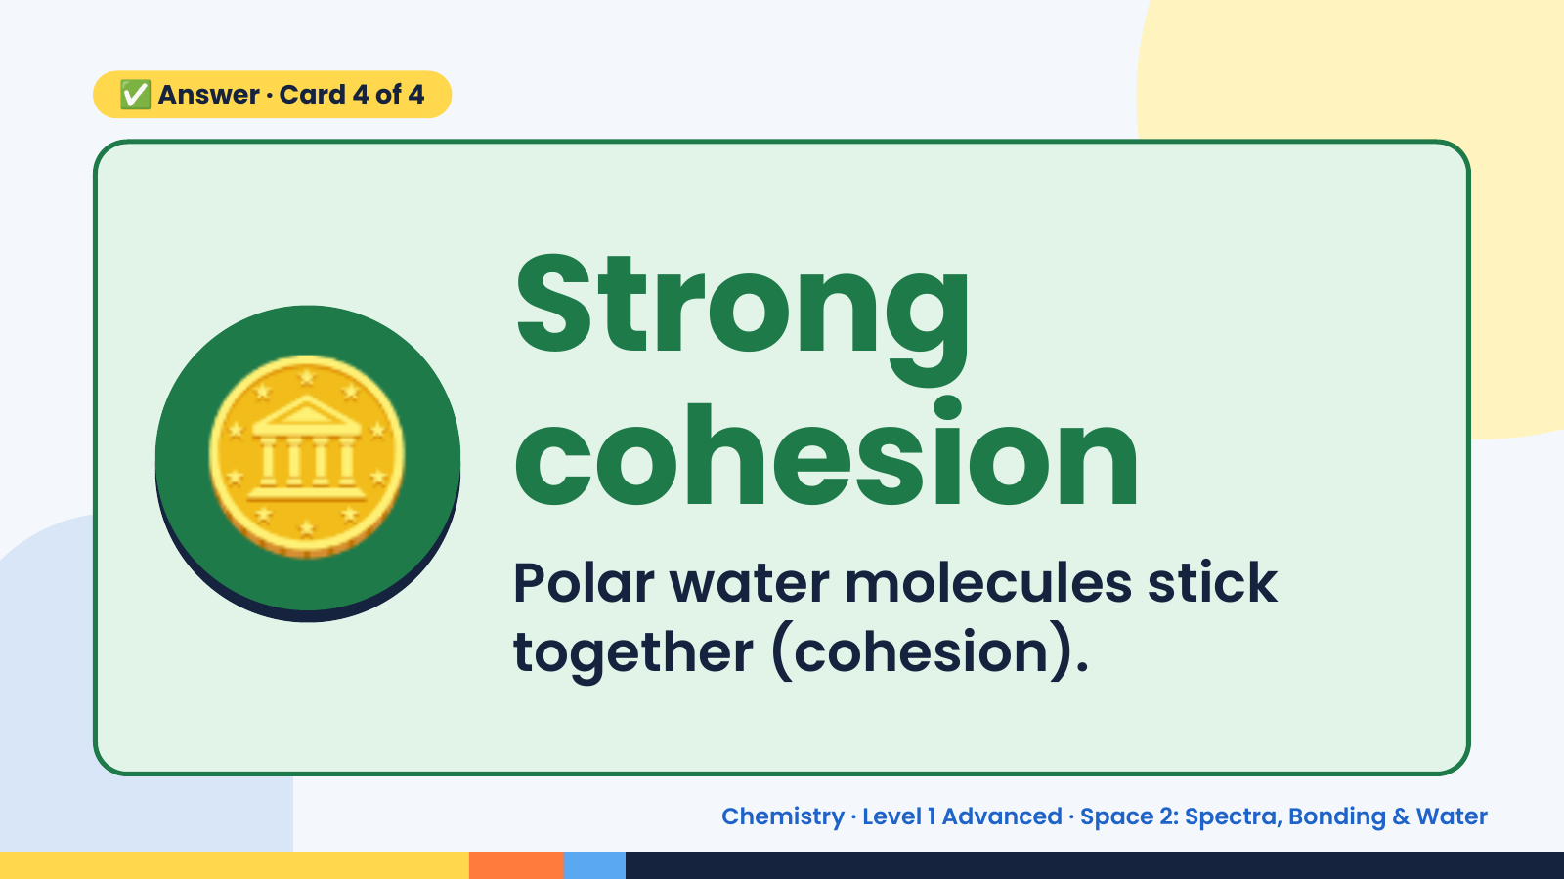
Notes:
✅ Answer · Card 4 of 4
🪙 Strong
cohesion
Polar water molecules stick
together (cohesion).
Chemistry · Level 1 Advanced · Space 2: Spectra, Bonding & Water

Slide 21
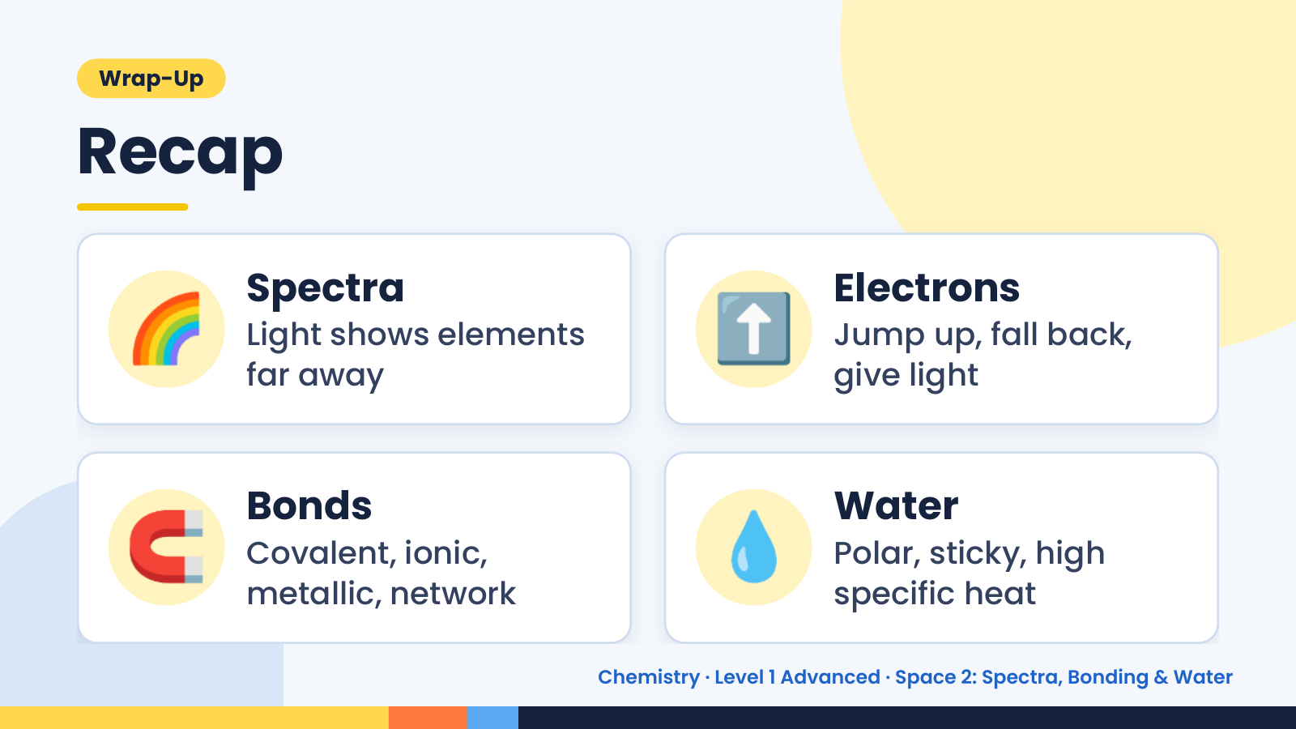
Notes:
Wrap-Up
Recap
🌈 Spectra
Light shows elements
far away
⬆️ Electrons
Jump up, fall back,
give light
🧲 Bonds
Covalent, ionic,
metallic, network
💧 Water
Polar, sticky, high
specific heat
Chemistry · Level 1 Advanced · Space 2: Spectra, Bonding & Water

Slide 22
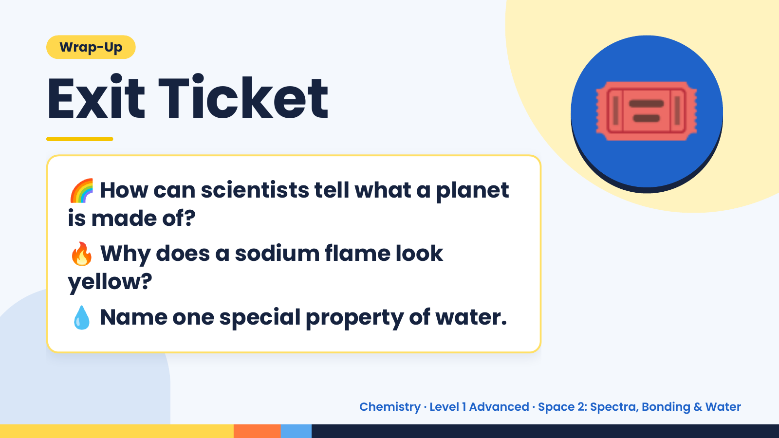
Notes:
Wrap-Up
Exit Ticket
🌈 How can scientists tell what a planet
is made of?
🎟️
🔥 Why does a sodium flame look
yellow?
💧 Name one special property of water.
Chemistry · Level 1 Advanced · Space 2: Spectra, Bonding & Water

