Slide 1
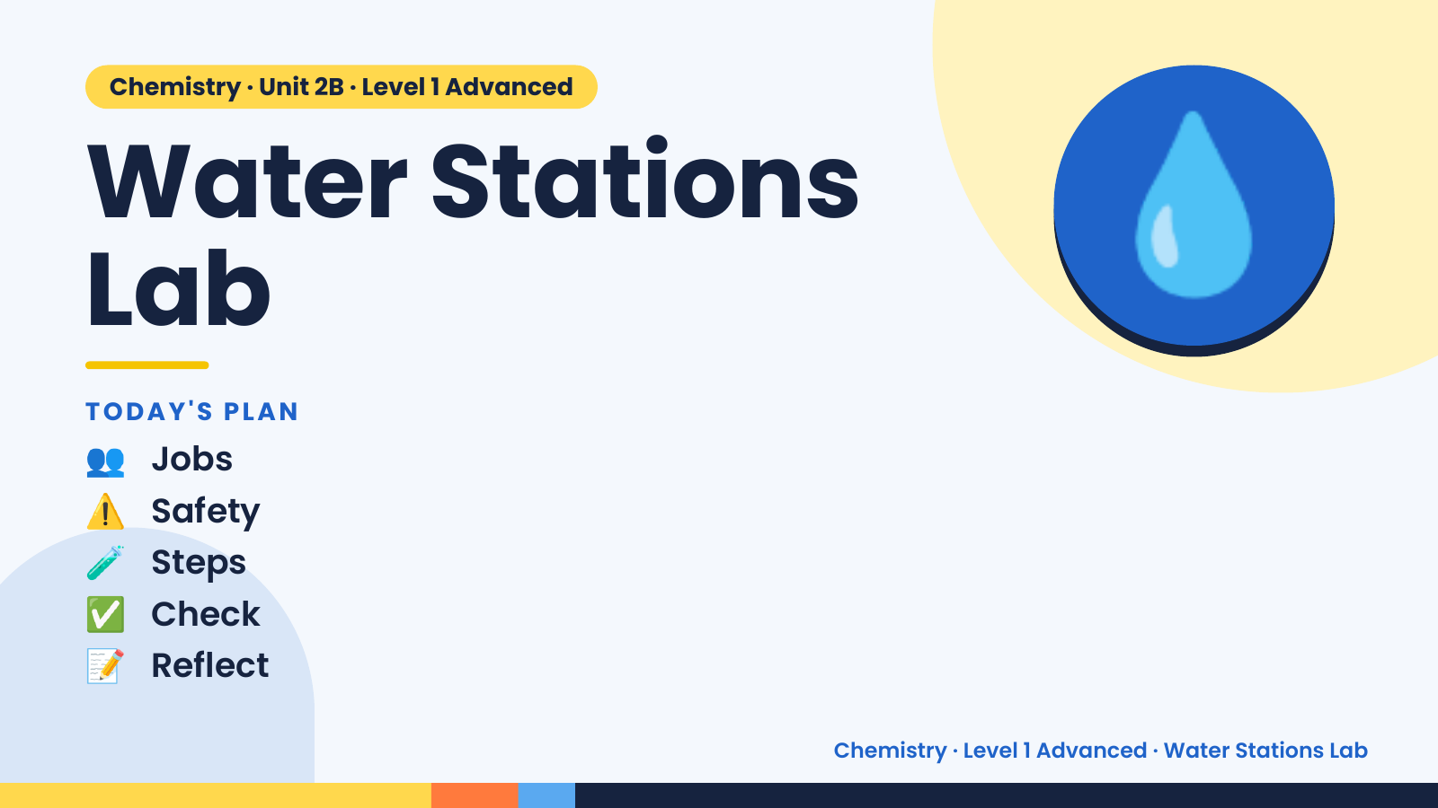
Notes:
Chemistry · Unit 2B · Level 1 Advanced
Water Stations
Lab
👥 Jobs
TODAY'S PLAN
💧
⚠️ Safety
🧪 Steps
✅ Check
📝 Reflect
Chemistry · Level 1 Advanced · Water Stations Lab

Slide 2
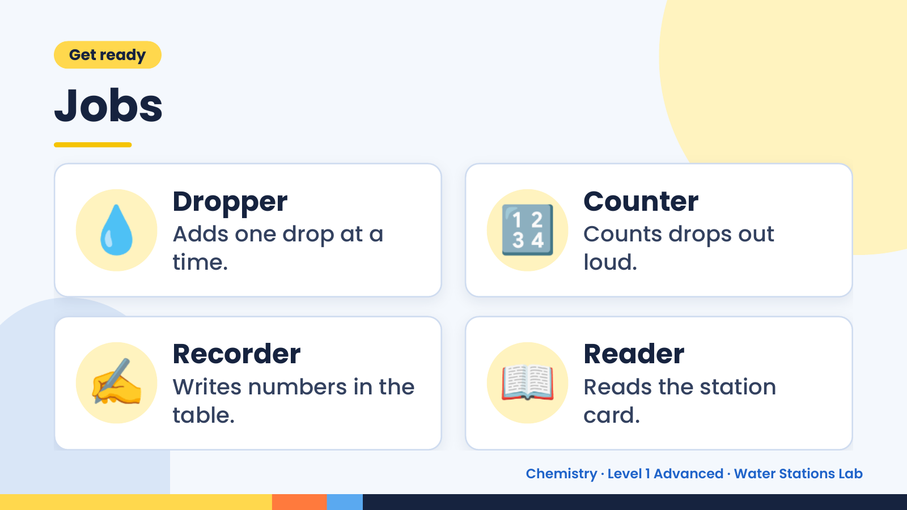
Notes:
Get ready
Jobs
💧 Dropper
Adds one drop at a
time.
🔢 Counter
Counts drops out
loud.
✍️ Recorder
Writes numbers in the
table.
📖 Reader
Reads the station
card.
Chemistry · Level 1 Advanced · Water Stations Lab

Slide 3
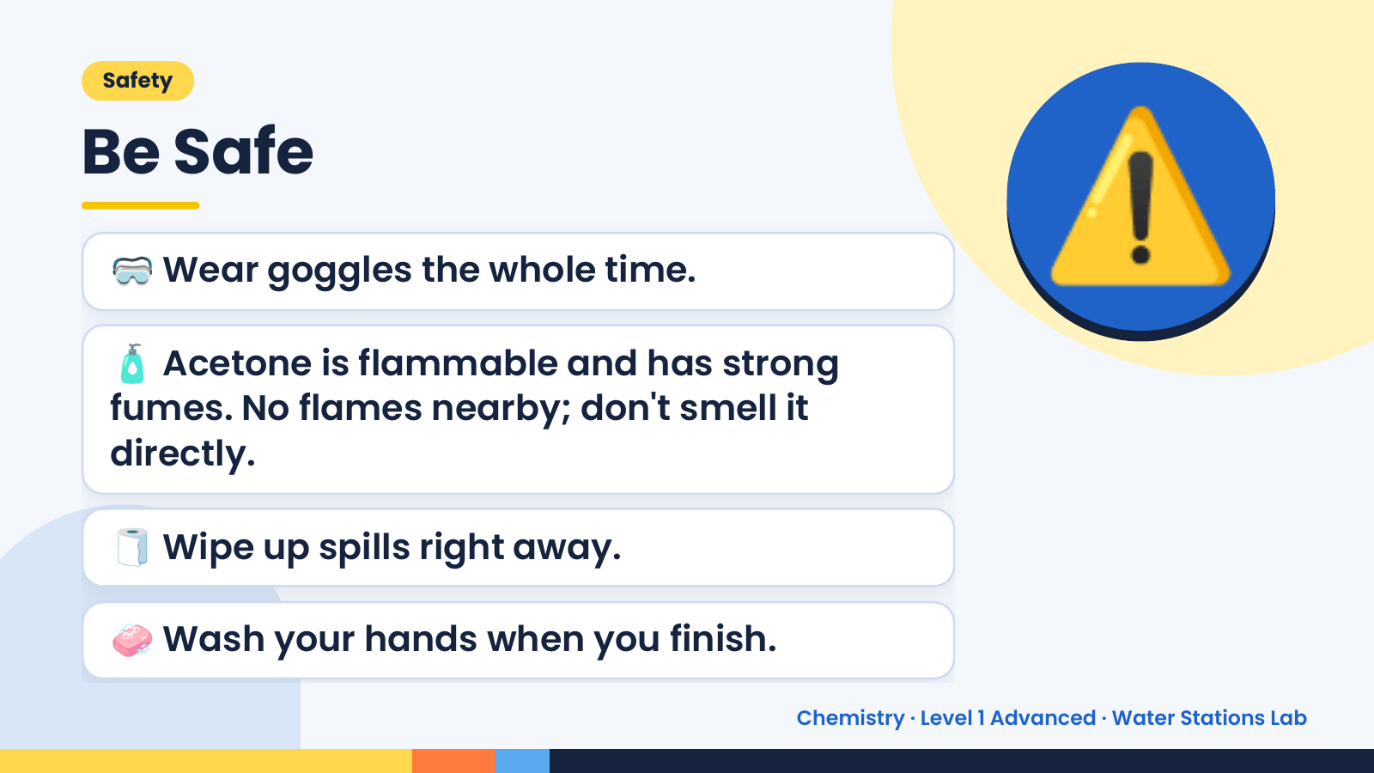
Notes:
Safety
Be Safe
🥽 Wear goggles the whole time.
🧴 Acetone is flammable and has strong
fumes. No flames nearby; don't smell it
⚠️
directly.
🧻 Wipe up spills right away.
🧼 Wash your hands when you finish.
Chemistry · Level 1 Advanced · Water Stations Lab

Slide 4
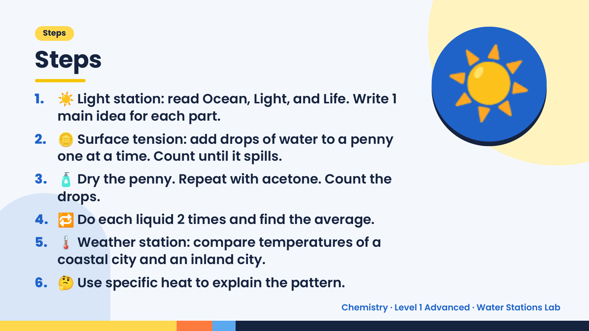
Notes:
Steps
Steps
1. ☀️ Light station: read Ocean, Light, and Life. Write 1
main idea for each part.
2. 🪙 Surface tension: add drops of water to a penny
one at a time. Count until it spills.
3. 🧴 Dry the penny. Repeat with acetone. Count the
☀️
drops.
4. 🔁 Do each liquid 2 times and find the average.
5. 🌡️ Weather station: compare temperatures of a
coastal city and an inland city.
6. 🤔 Use specific heat to explain the pattern.
Chemistry · Level 1 Advanced · Water Stations Lab

Slide 5
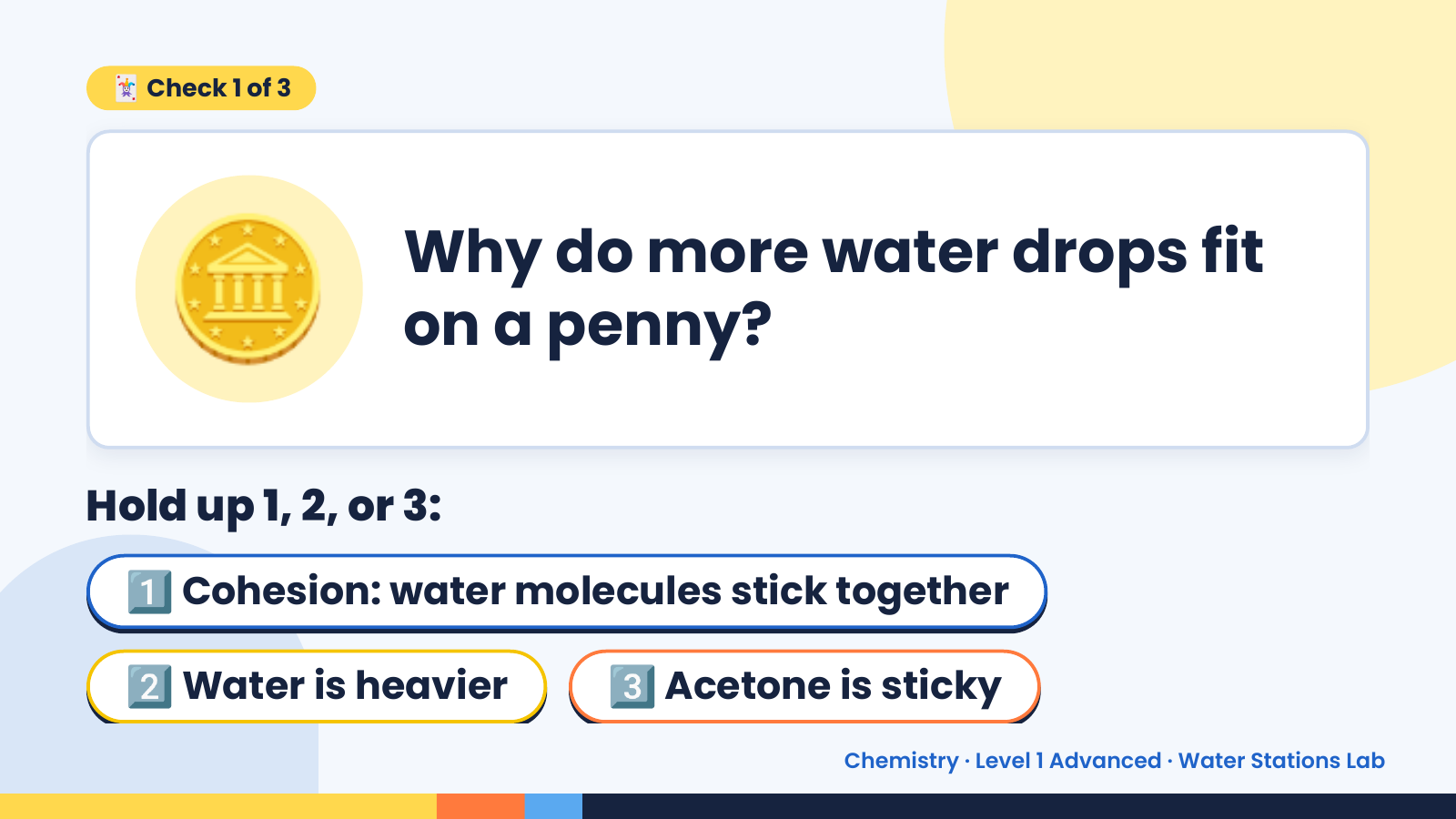
Notes:
🪙
🃏 Check 1 of 3
Why do more water drops fit
on a penny?
Hold up 1, 2, or 3:
1️⃣ Cohesion: water molecules stick together
2️⃣ Water is heavier 3️⃣ Acetone is sticky
Chemistry · Level 1 Advanced · Water Stations Lab

Slide 6
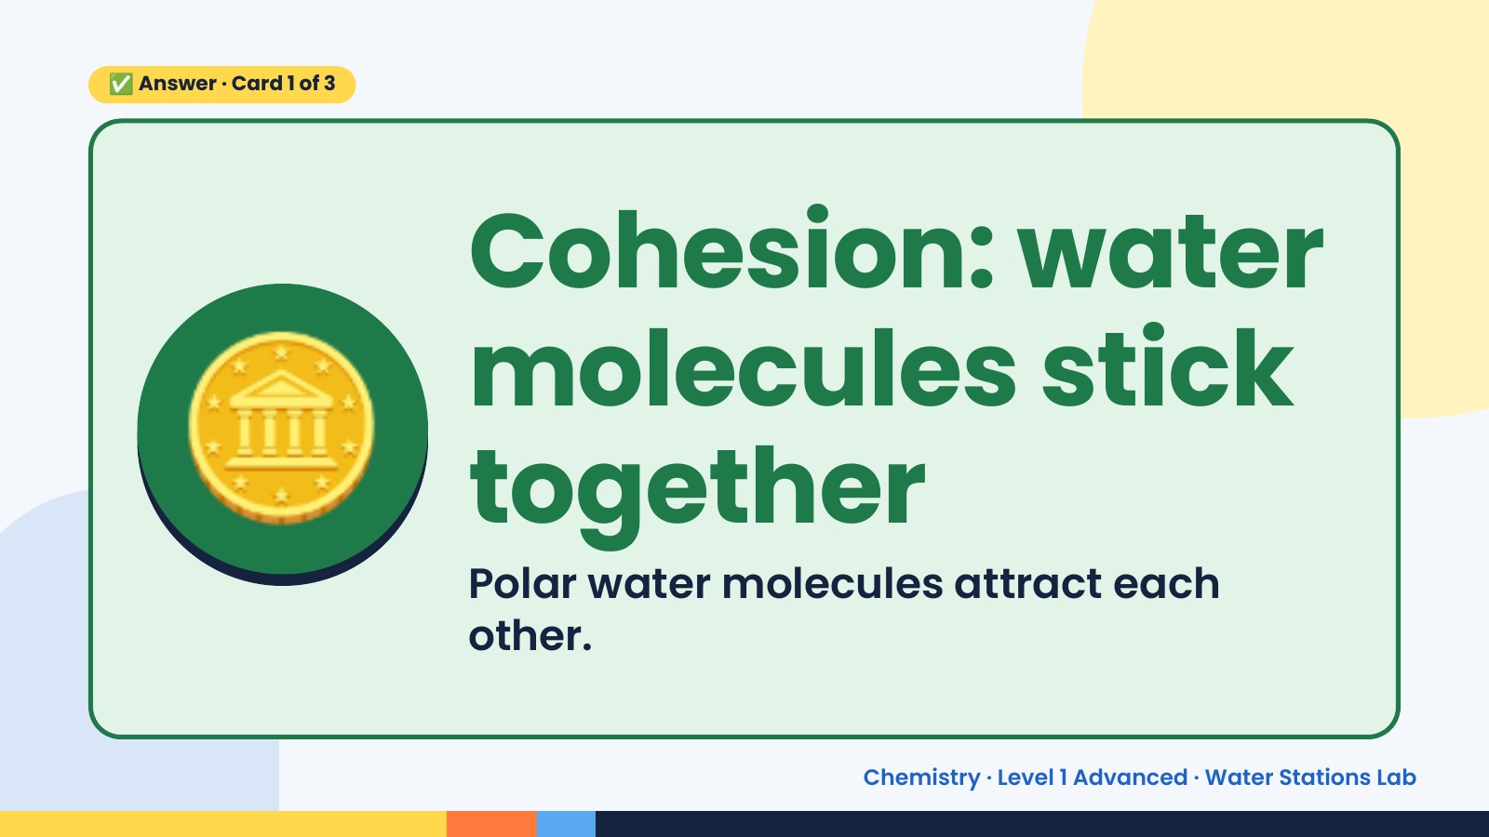
Notes:
✅ Answer · Card 1 of 3
🪙 Cohesion: water
molecules stick
together
Polar water molecules attract each
other.
Chemistry · Level 1 Advanced · Water Stations Lab

Slide 7
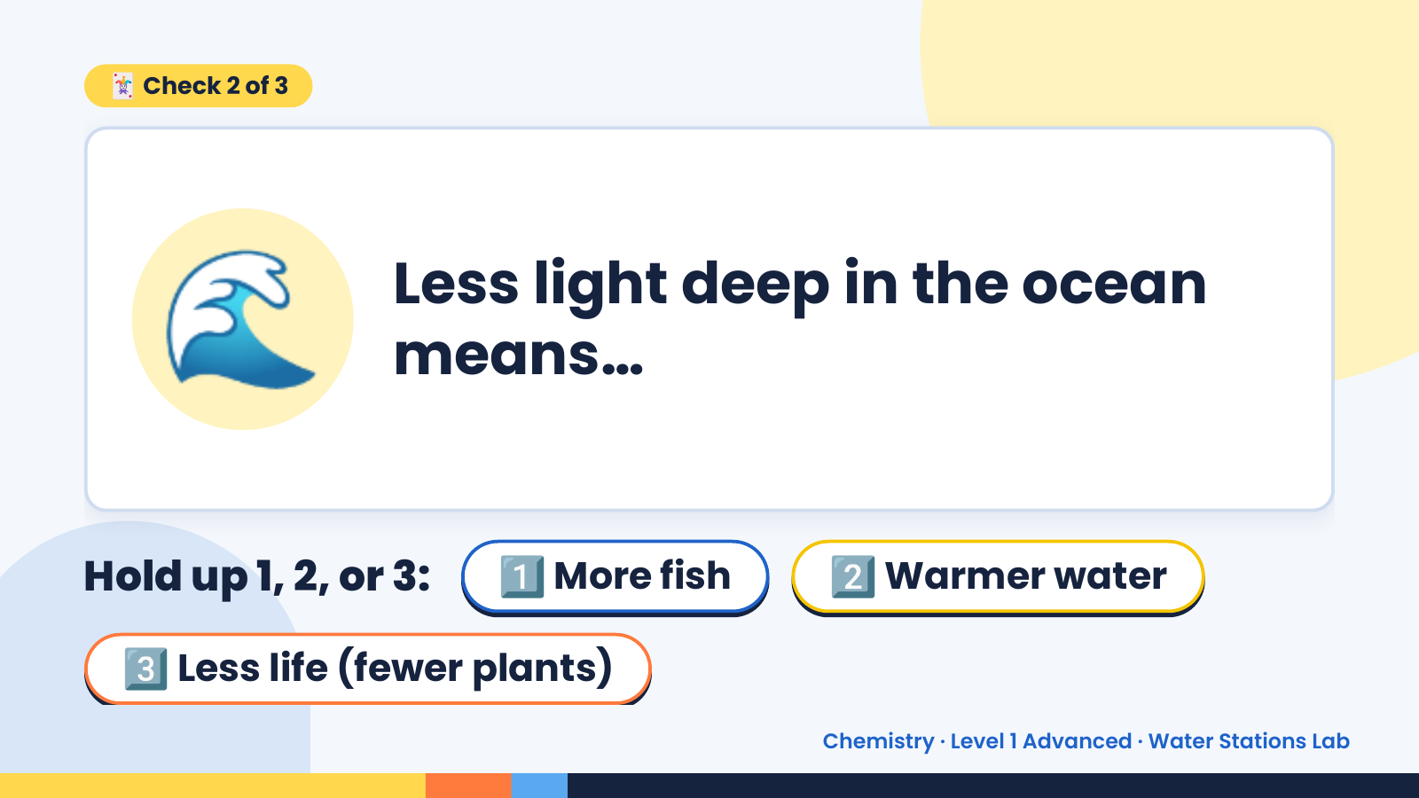
Notes:
🃏 Check 2 of 3
🌊 Less light deep in the ocean
means…
Hold up 1, 2, or 3: 1️⃣ More fish 2️⃣ Warmer water
3️⃣ Less life (fewer plants)
Chemistry · Level 1 Advanced · Water Stations Lab

Slide 8
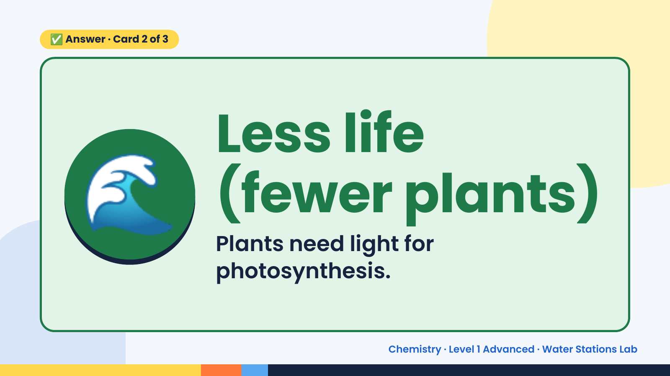
Notes:
✅ Answer · Card 2 of 3
🌊 Less life
(fewer plants)
Plants need light for
photosynthesis.
Chemistry · Level 1 Advanced · Water Stations Lab

Slide 9
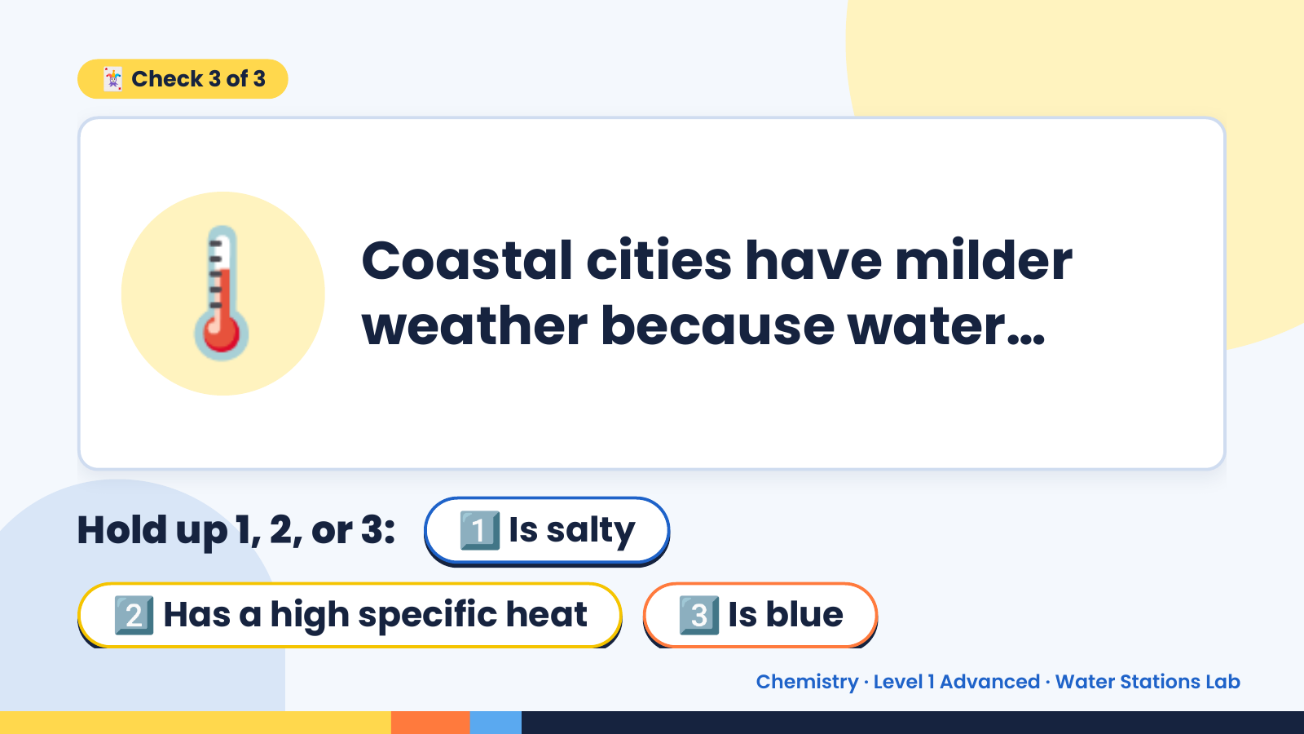
Notes:
🃏 Check 3 of 3
🌡️ Coastal cities have milder
weather because water…
Hold up 1, 2, or 3: 1️⃣ Is salty
2️⃣ Has a high specific heat 3️⃣ Is blue
Chemistry · Level 1 Advanced · Water Stations Lab

Slide 10
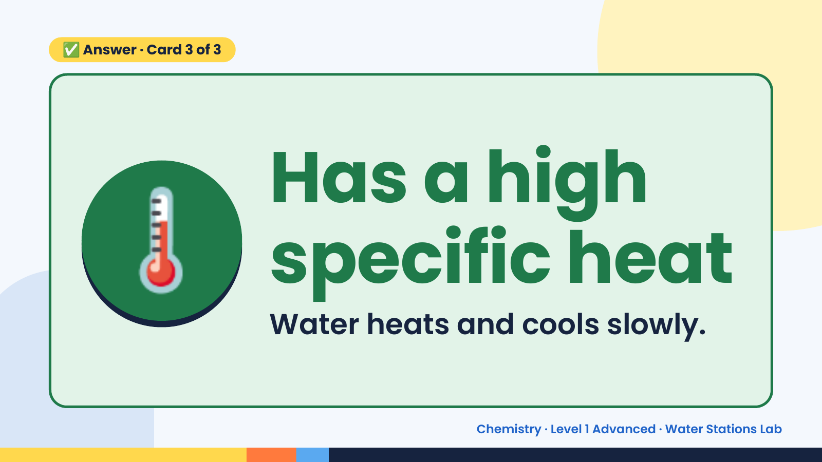
Notes:
✅ Answer · Card 3 of 3
🌡️ Has a high
specific heat
Water heats and cools slowly.
Chemistry · Level 1 Advanced · Water Stations Lab

Slide 11
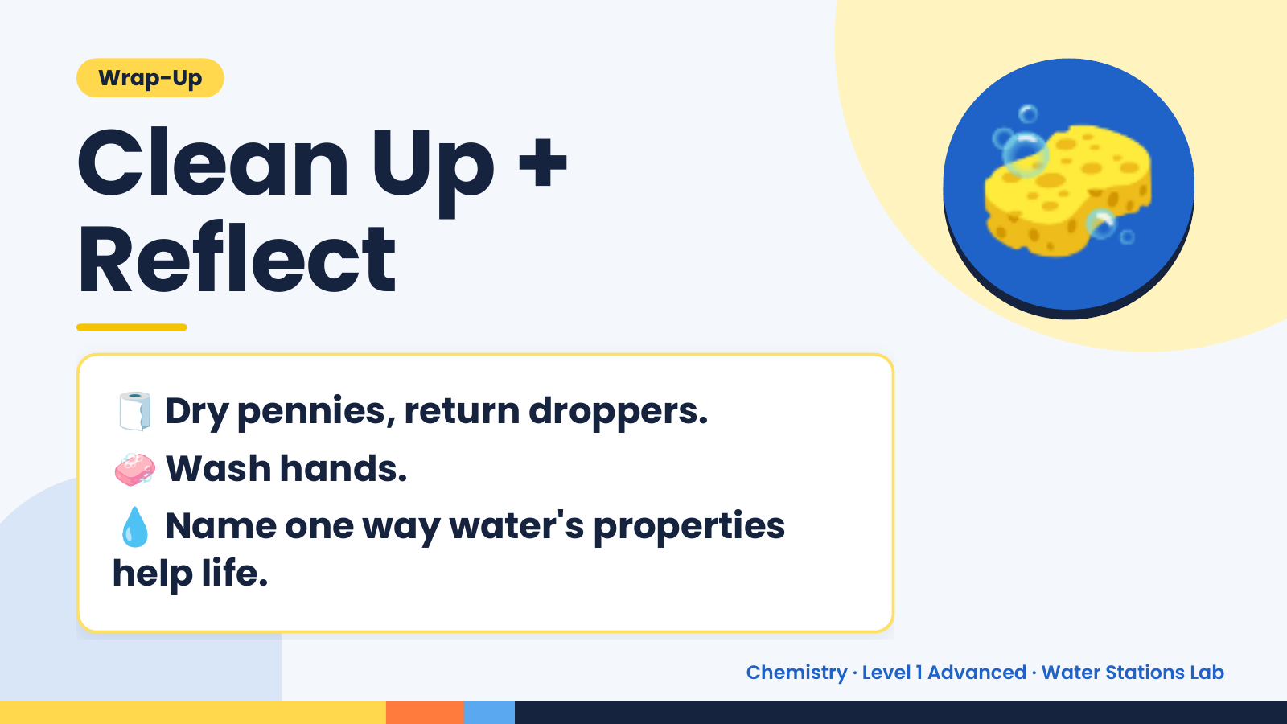
Notes:
Wrap-Up
Clean Up +
Reflect
🧽
🧻 Dry pennies, return droppers.
🧼 Wash hands.
💧 Name one way water's properties
help life.
Chemistry · Level 1 Advanced · Water Stations Lab

