Slide 1
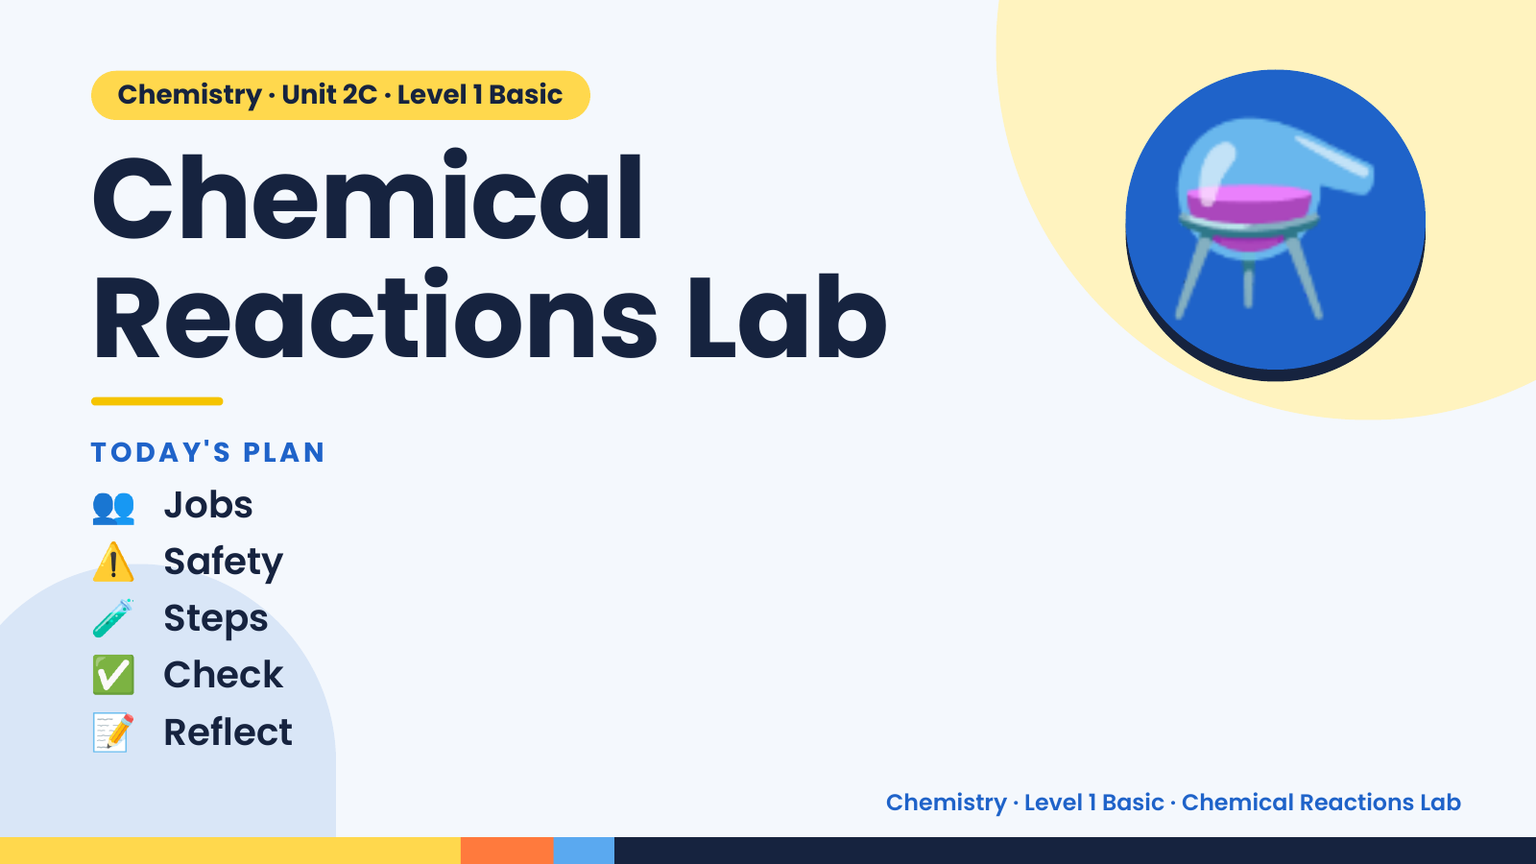
Notes:
Chemistry · Unit 2C · Level 1 Basic
Chemical
Reactions Lab
TODAY'S PLAN
⚗️
👥 Jobs
⚠️ Safety
🧪 Steps
✅ Check
📝 Reflect
Chemistry · Level 1 Basic · Chemical Reactions Lab

Slide 2
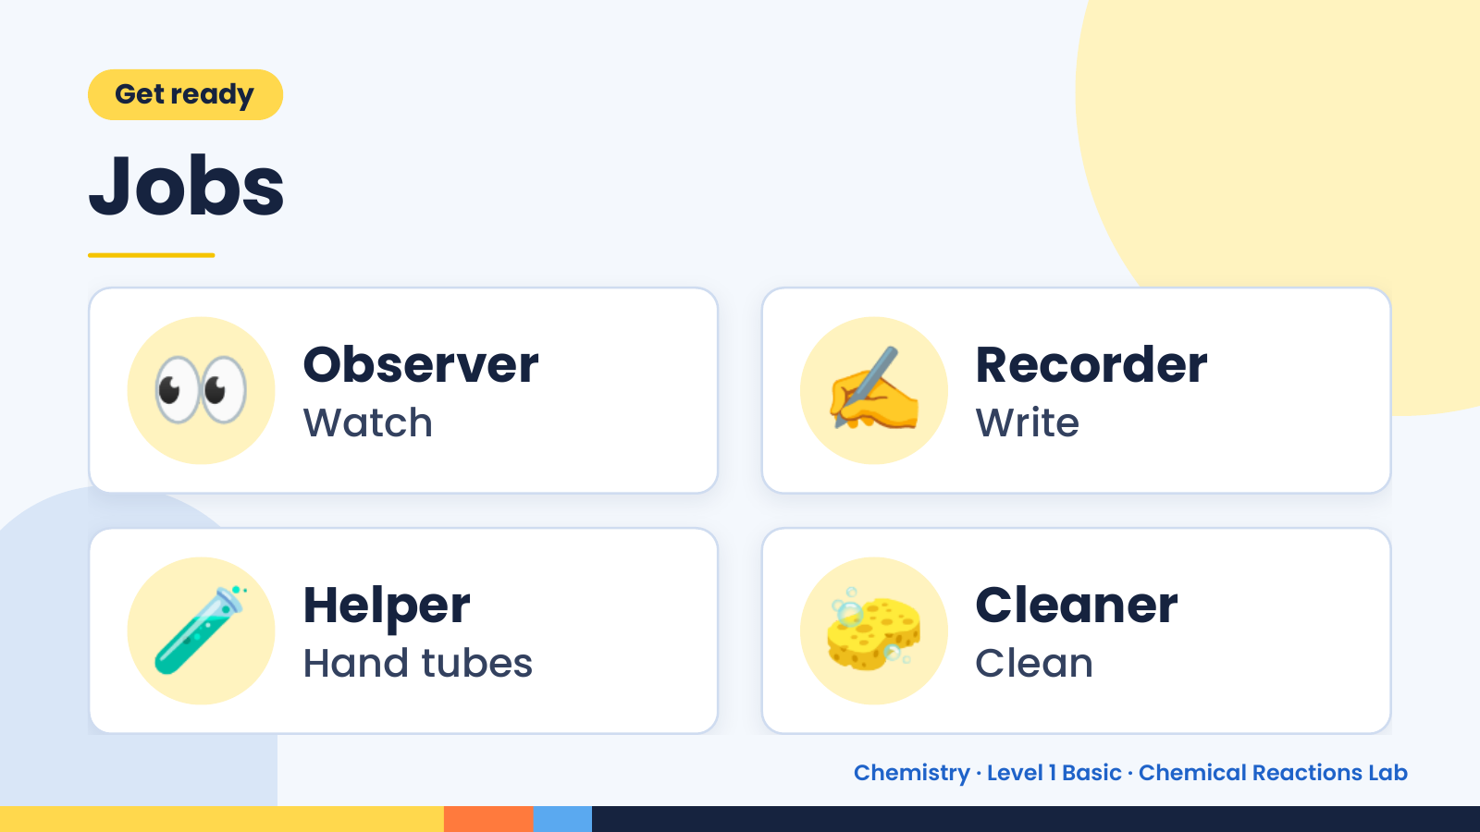
Notes:
Get ready
Jobs
👀 Observer
Watch ✍️ Recorder
Write
🧪 Helper
Hand tubes 🧽 Cleaner
Clean
Chemistry · Level 1 Basic · Chemical Reactions Lab

Slide 3
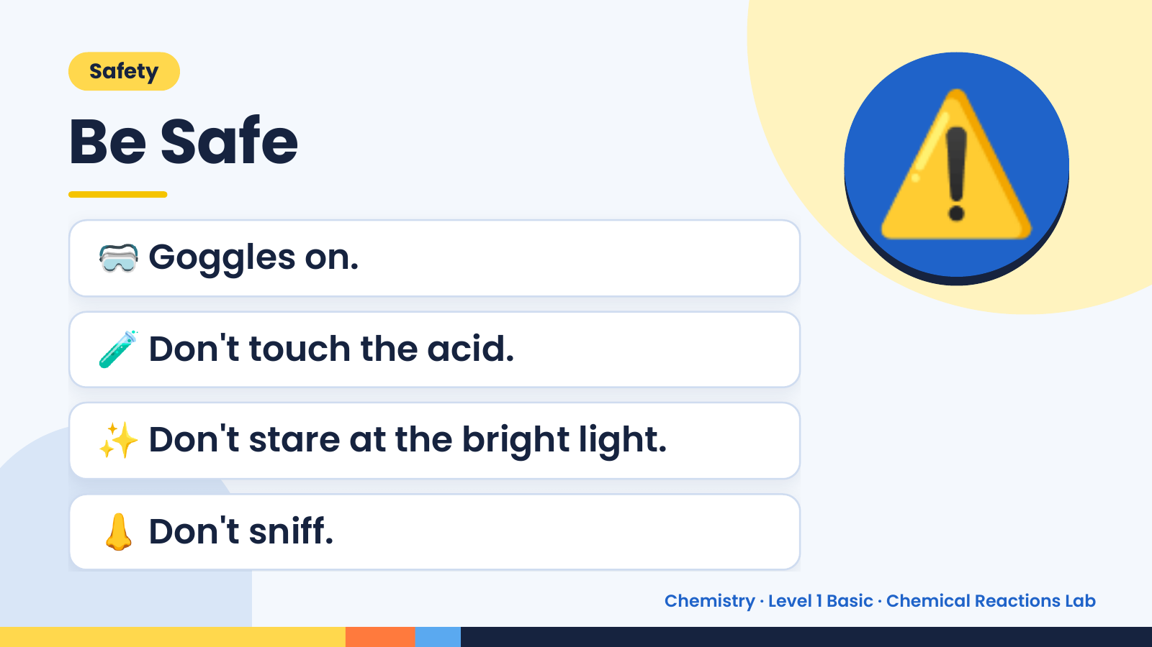
Notes:
Safety
Be Safe
🥽 Goggles on.
🧪 Don't touch the acid.
⚠️
✨ Don't stare at the bright light.
👃 Don't sniff.
Chemistry · Level 1 Basic · Chemical Reactions Lab

Slide 4
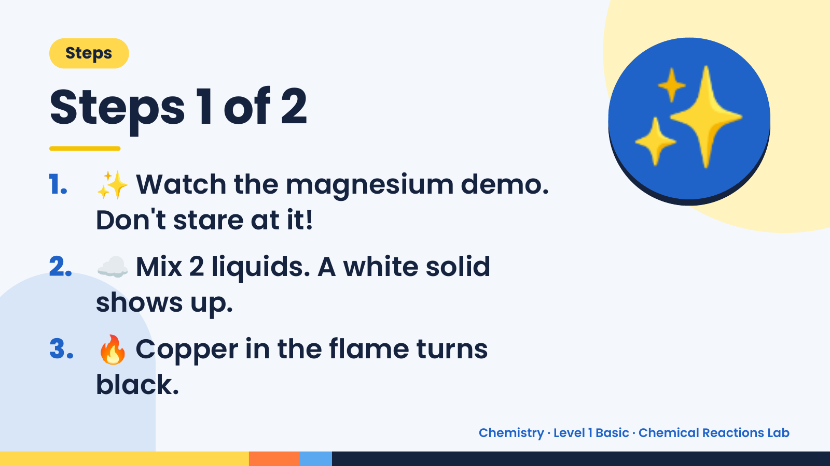
Notes:
Steps
Steps 1 of 2
1. ✨ Watch the magnesium demo.
Don't stare at it!
✨
2. ☁️ Mix 2 liquids. A white solid
shows up.
3. 🔥 Copper in the flame turns
black.
Chemistry · Level 1 Basic · Chemical Reactions Lab

Slide 5
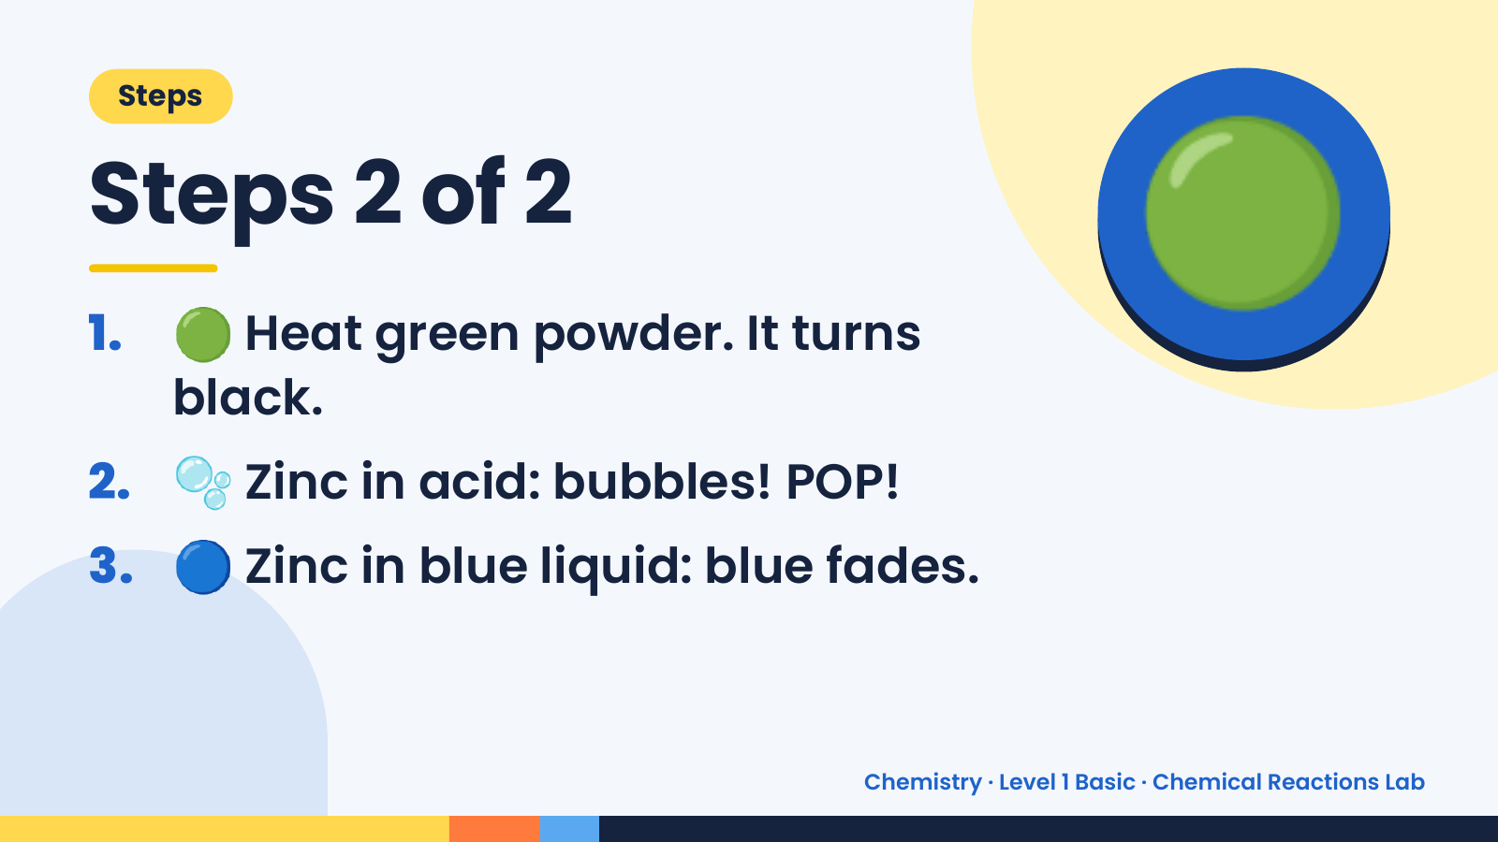
Notes:
Steps
Steps 2 of 2
1. 🟢 Heat green powder. It turns
black.
🟢
2. 🫧 Zinc in acid: bubbles! POP!
3. 🔵 Zinc in blue liquid: blue fades.
Chemistry · Level 1 Basic · Chemical Reactions Lab

Slide 6
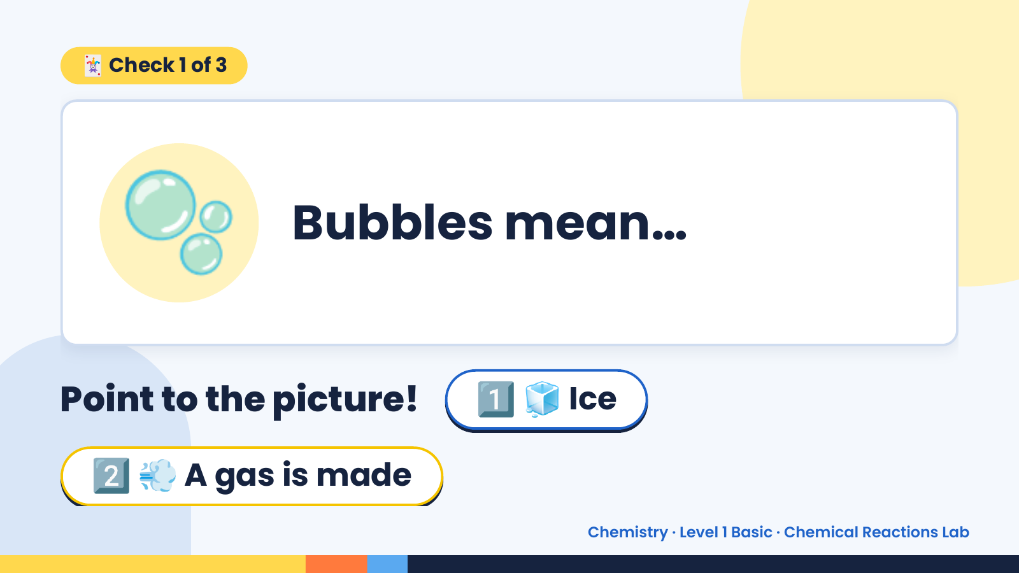
Notes:
🃏 Check 1 of 3
🫧 Bubbles mean…
Point to the picture! 1️⃣ 🧊 Ice
2️⃣ 💨 A gas is made
Chemistry · Level 1 Basic · Chemical Reactions Lab

Slide 7
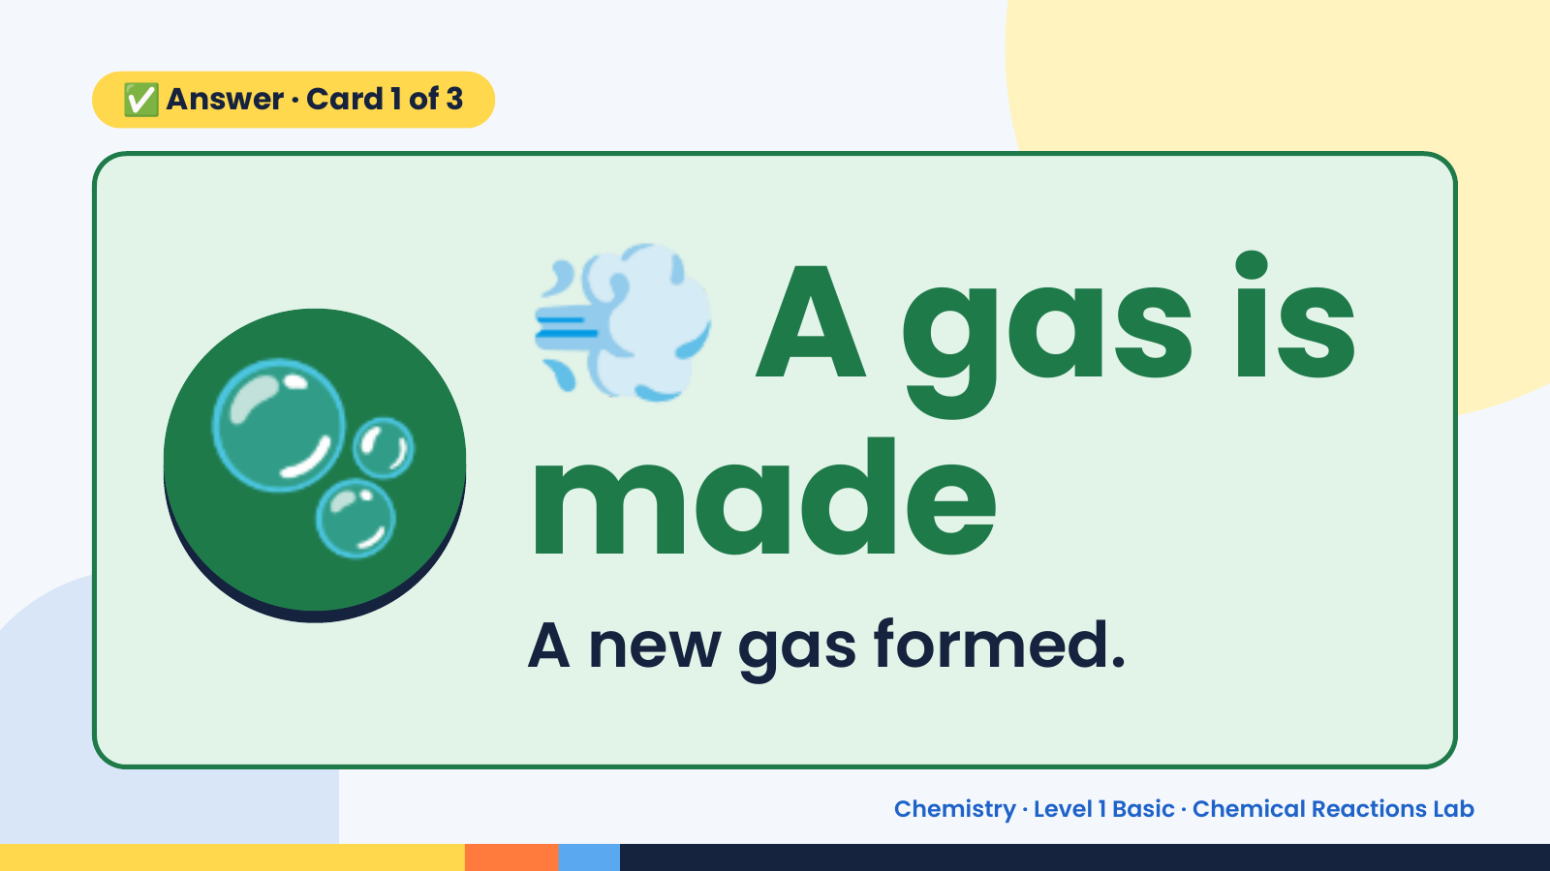
Notes:
💨
✅ Answer · Card 1 of 3
🫧 made
A gas is
A new gas formed.
Chemistry · Level 1 Basic · Chemical Reactions Lab

Slide 8
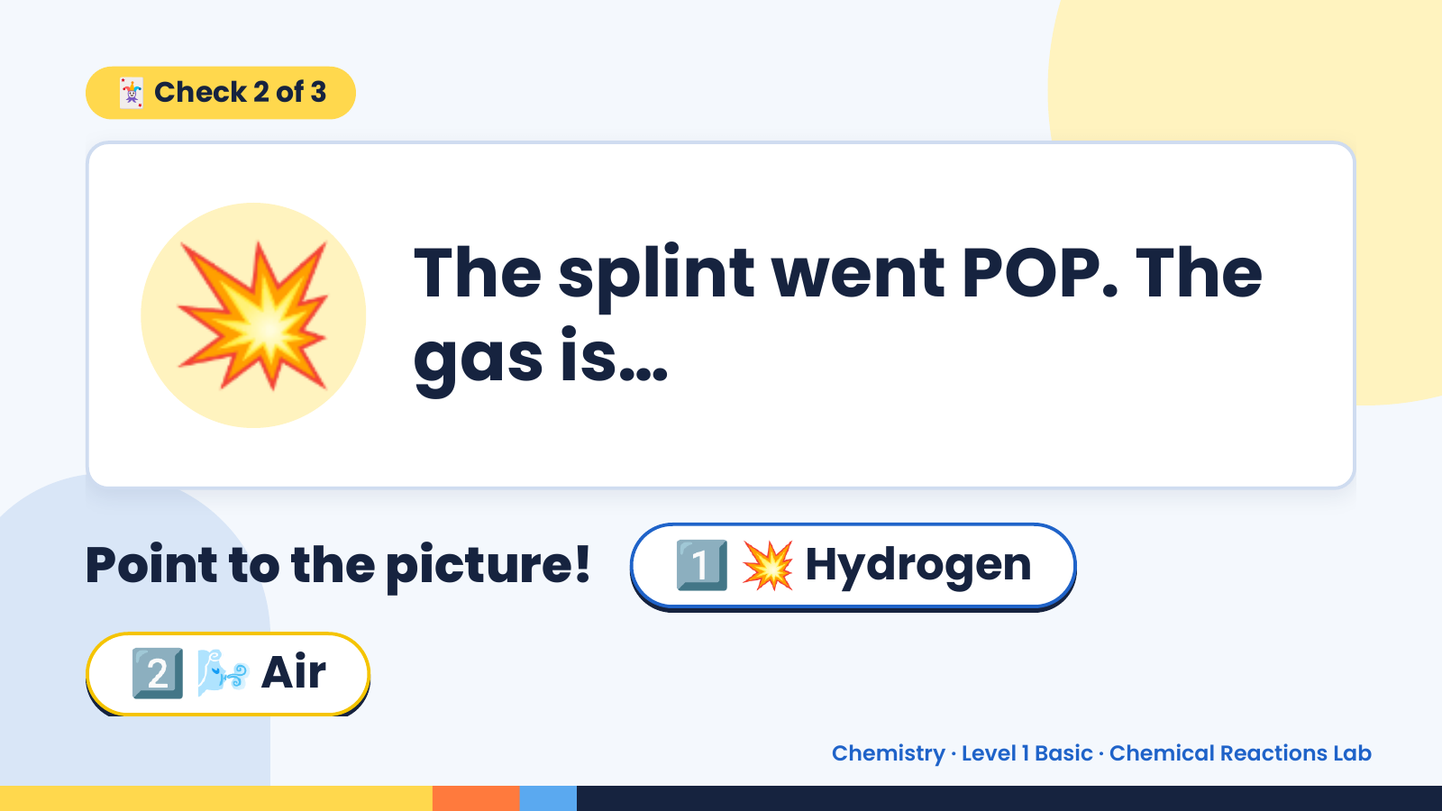
Notes:
🃏 Check 2 of 3
💥 The splint went POP. The
gas is…
Point to the picture! 1️⃣ 💥 Hydrogen
2️⃣ 🌬️ Air
Chemistry · Level 1 Basic · Chemical Reactions Lab

Slide 9
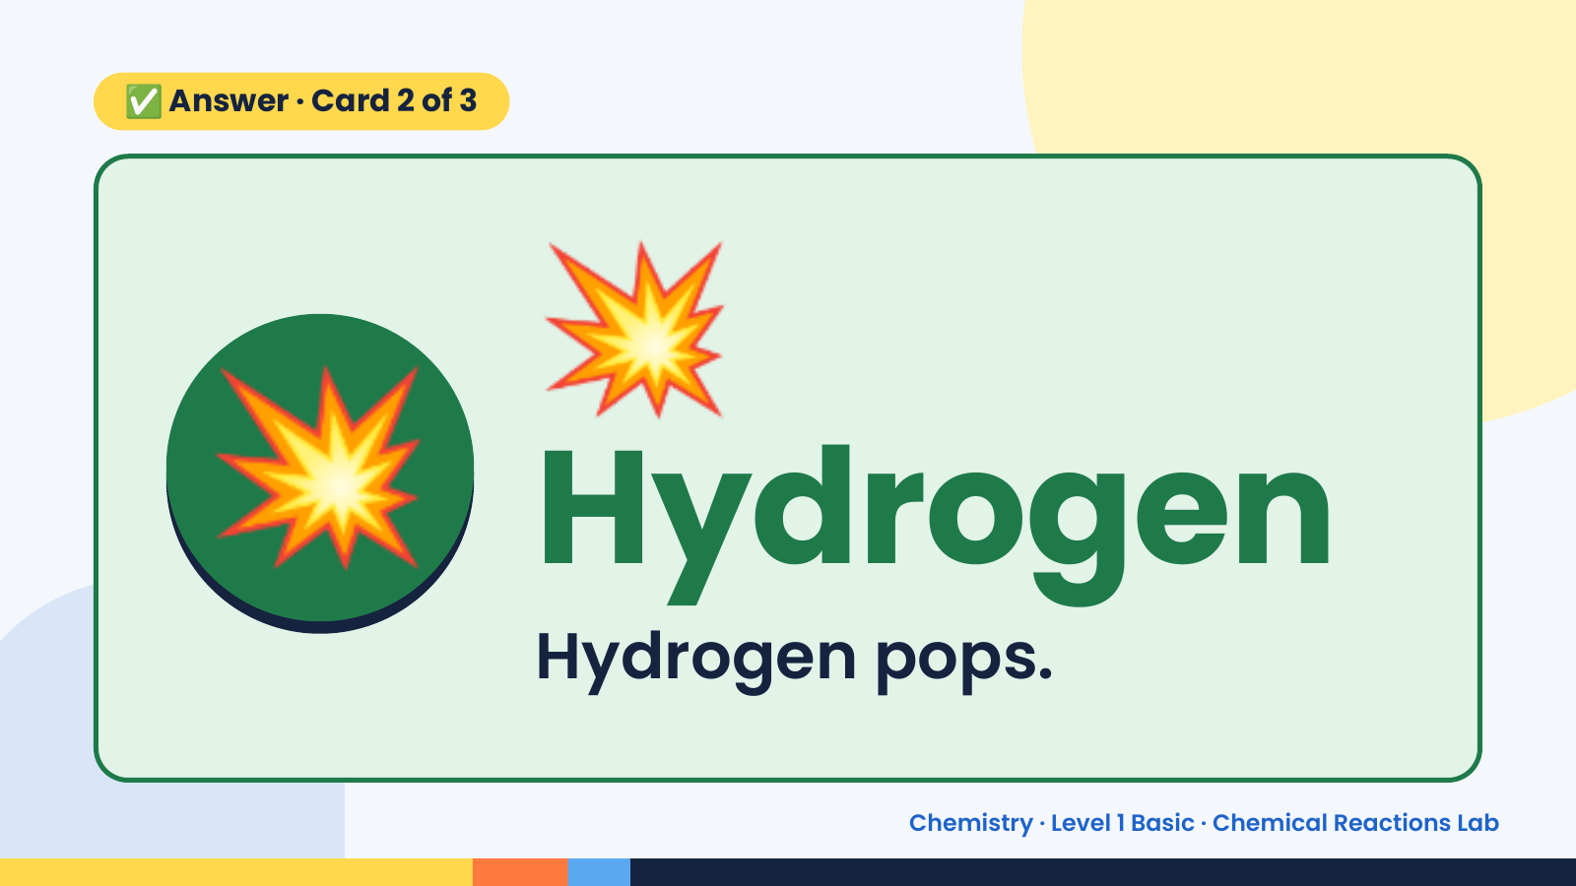
Notes:
💥
✅ Answer · Card 2 of 3
💥 Hydrogen Hydrogen pops.
Chemistry · Level 1 Basic · Chemical Reactions Lab

Slide 10
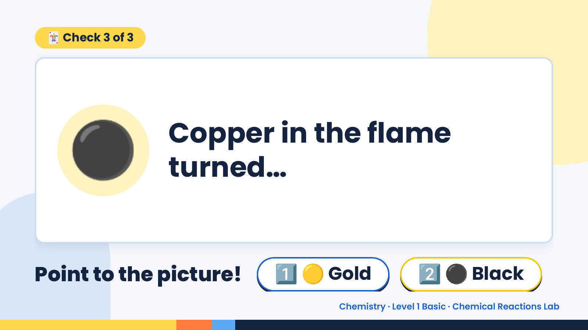
Notes:
🃏 Check 3 of 3
⚫ Copper in the flame
turned…
Point to the picture! 1️⃣ 🟡 Gold 2️⃣ ⚫ Black
Chemistry · Level 1 Basic · Chemical Reactions Lab

Slide 11
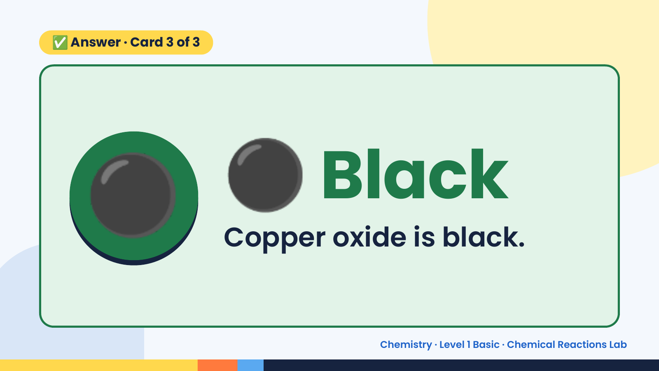
Notes:
✅ Answer · Card 3 of 3
⚫ ⚫ Black
Copper oxide is black.
Chemistry · Level 1 Basic · Chemical Reactions Lab

Slide 12
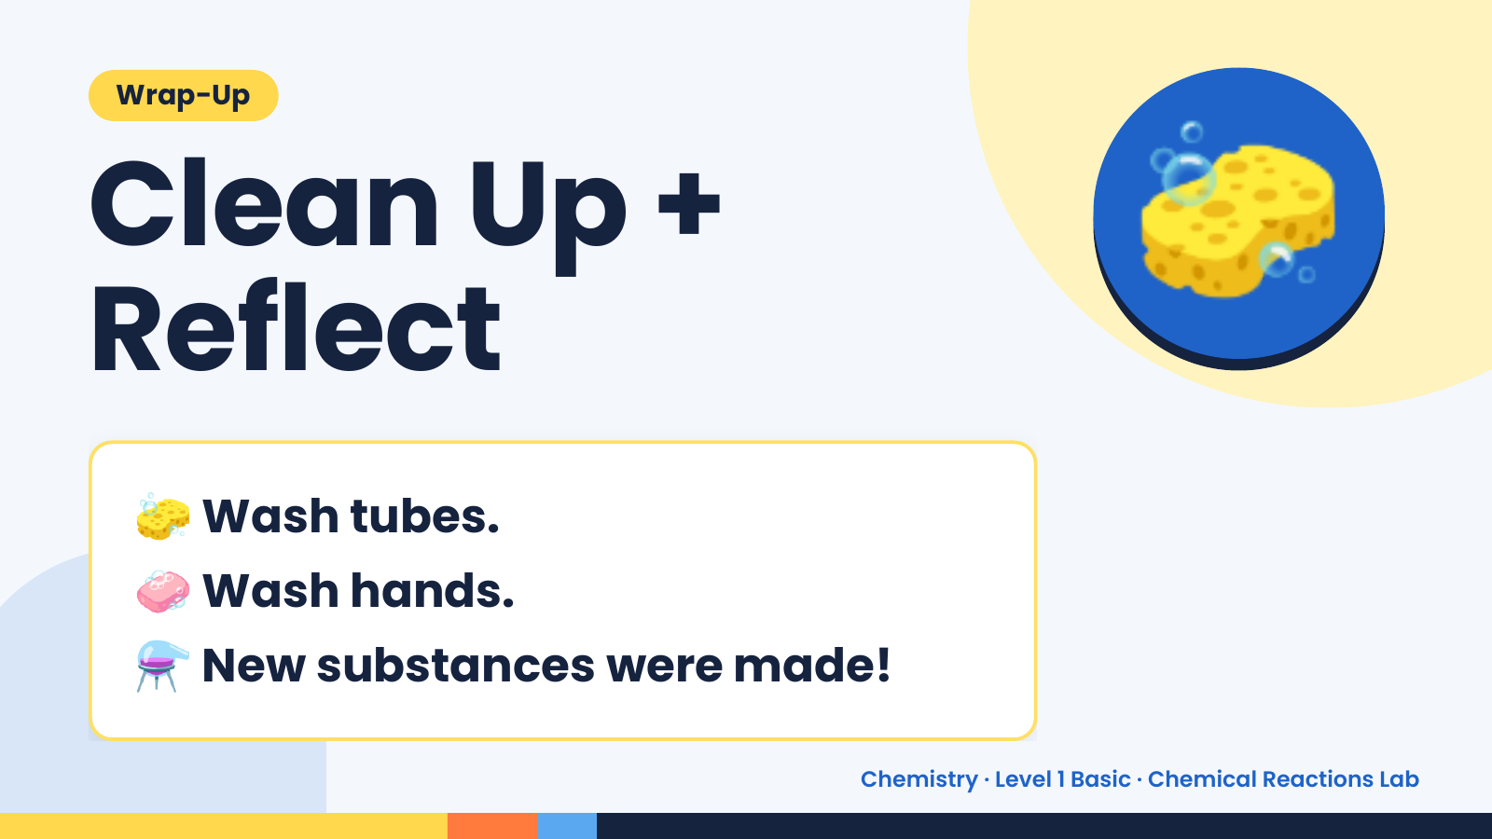
Notes:
Wrap-Up
Clean Up +
Reflect
🧽
🧽 Wash tubes.
🧼 Wash hands.
⚗️ New substances were made!
Chemistry · Level 1 Basic · Chemical Reactions Lab

