Slide 1
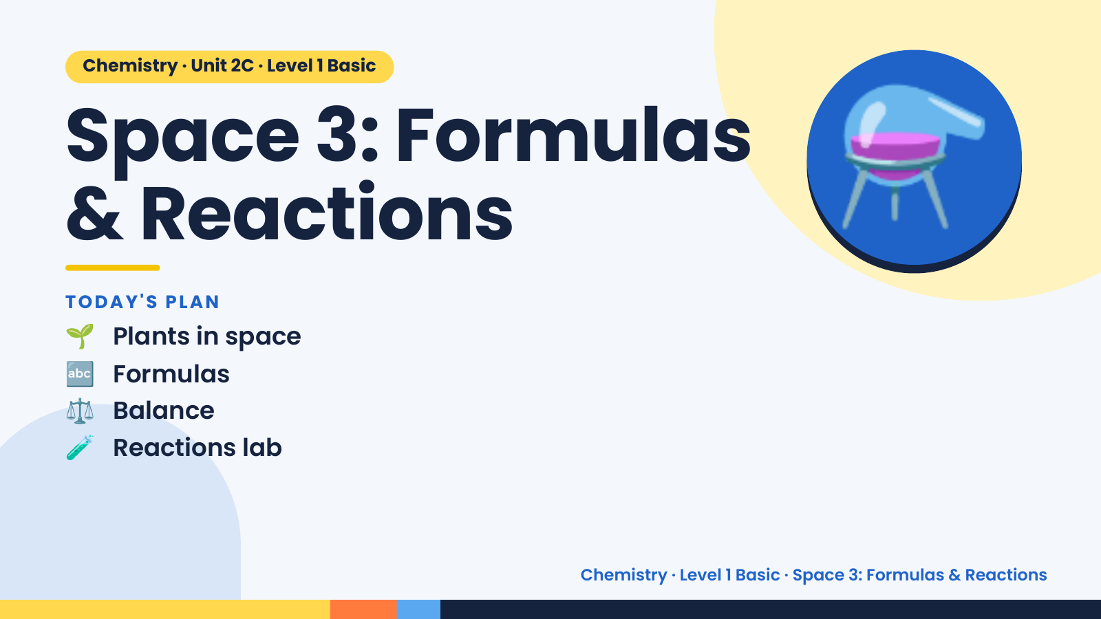
Notes:
Chemistry · Unit 2C · Level 1 Basic
Space 3: Formulas
& Reactions
🌱 Plants in space
TODAY'S PLAN
⚗️
🔤 Formulas
⚖️ Balance
🧪 Reactions lab
Chemistry · Level 1 Basic · Space 3: Formulas & Reactions

Slide 2
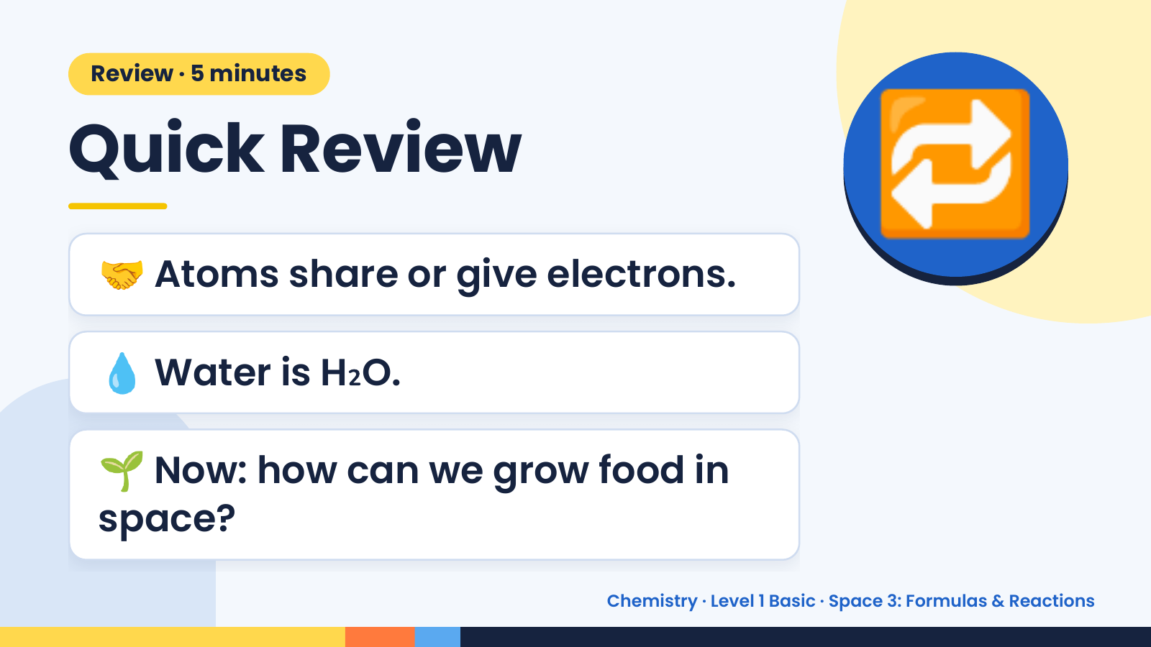
Notes:
Review · 5 minutes
Quick Review
🤝 Atoms share or give electrons.
🔁
💧 Water is H₂O.
🌱 Now: how can we grow food in
space?
Chemistry · Level 1 Basic · Space 3: Formulas & Reactions

Slide 3
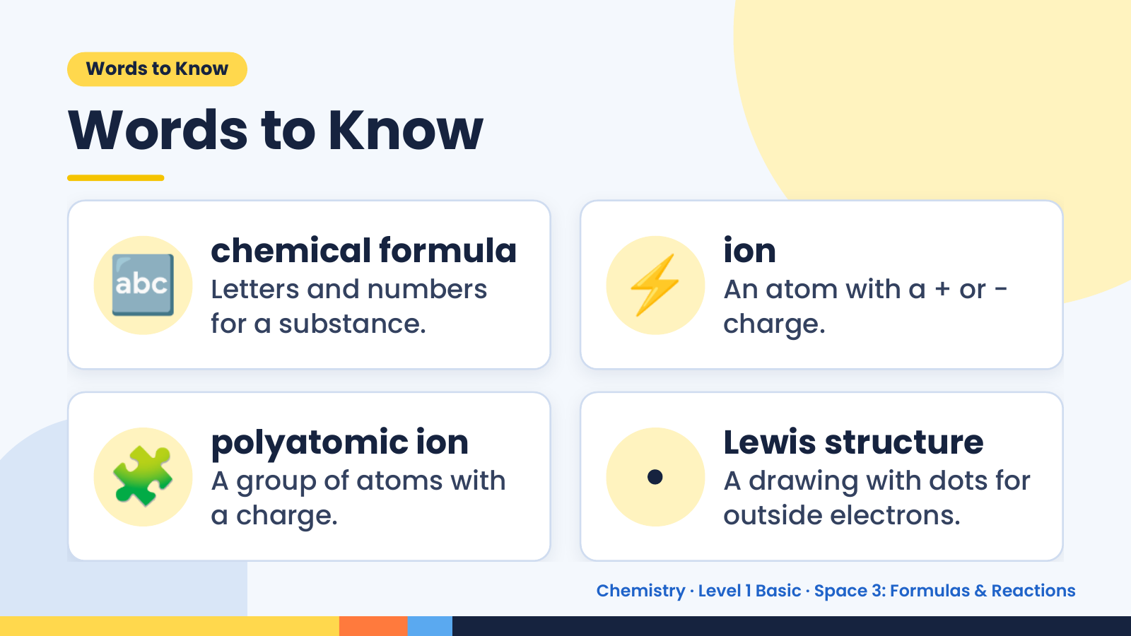
Notes:
Words to Know
Words to Know
🔤 chemical formula
Letters and numbers
for a substance.
⚡ ion
An atom with a + or −
charge.
🧩 polyatomic ion
A group of atoms with
a charge.
• Lewis structure
A drawing with dots for
outside electrons.
Chemistry · Level 1 Basic · Space 3: Formulas & Reactions

Slide 4
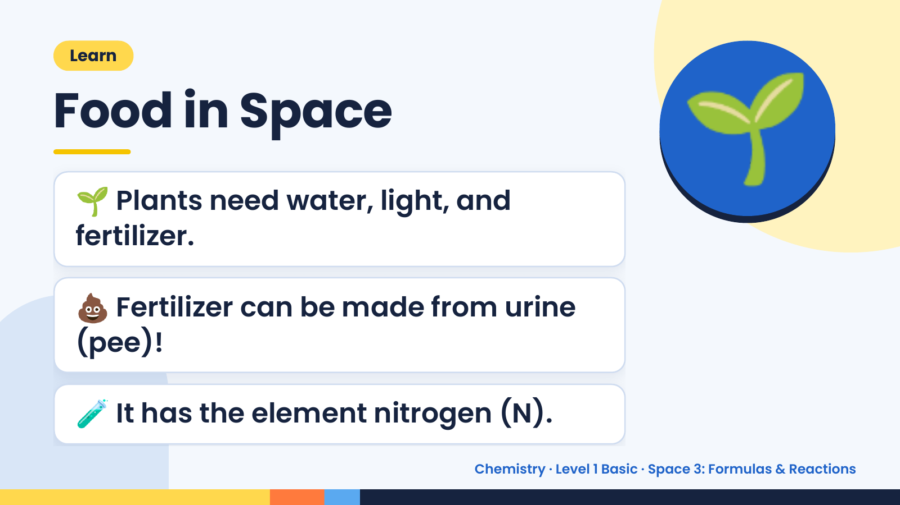
Notes:
Learn
Food in Space
🌱 Plants need water, light, and
fertilizer.
🌱
💩 Fertilizer can be made from urine
(pee)!
🧪 It has the element nitrogen (N).
Chemistry · Level 1 Basic · Space 3: Formulas & Reactions

Slide 5
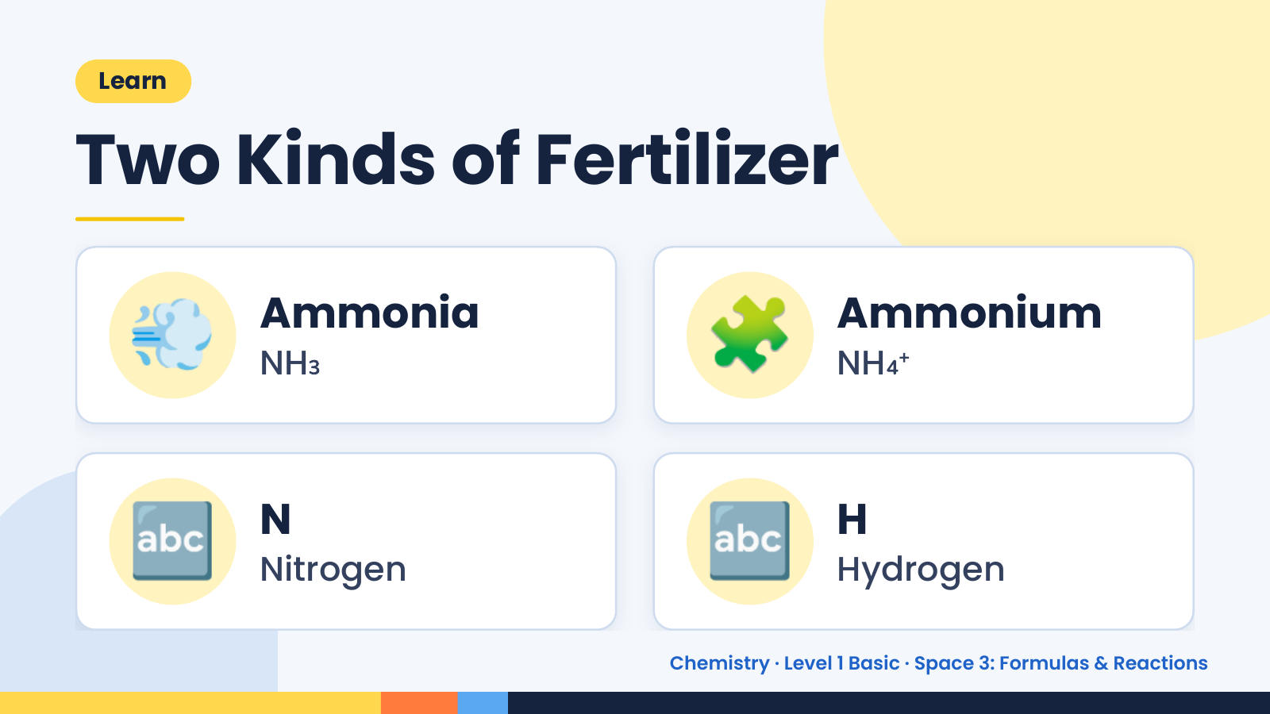
Notes:
Learn
Two Kinds of Fertilizer
💨 Ammonia
NH₃ 🧩 Ammonium
NH₄⁺
🔤 N
Nitrogen 🔤 H
Hydrogen
Chemistry · Level 1 Basic · Space 3: Formulas & Reactions

Slide 6
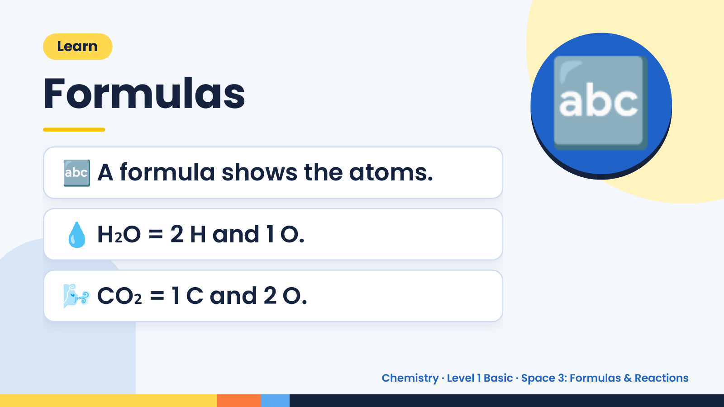
Notes:
Learn
Formulas
🔤 A formula shows the atoms.
🔤
💧 H₂O = 2 H and 1 O.
🌬️ CO₂ = 1 C and 2 O.
Chemistry · Level 1 Basic · Space 3: Formulas & Reactions

Slide 7
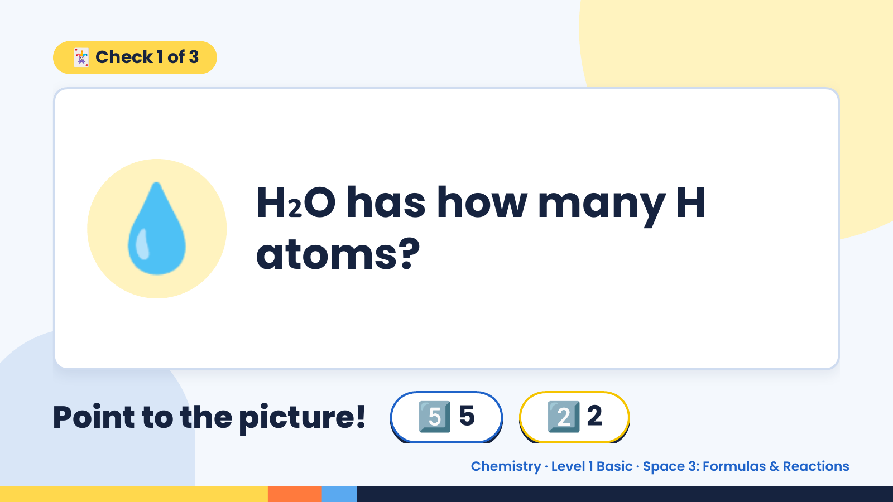
Notes:
🃏 Check 1 of 3
💧 H₂O has how many H
atoms?
Point to the picture! 5️⃣ 5 2️⃣ 2
Chemistry · Level 1 Basic · Space 3: Formulas & Reactions

Slide 8
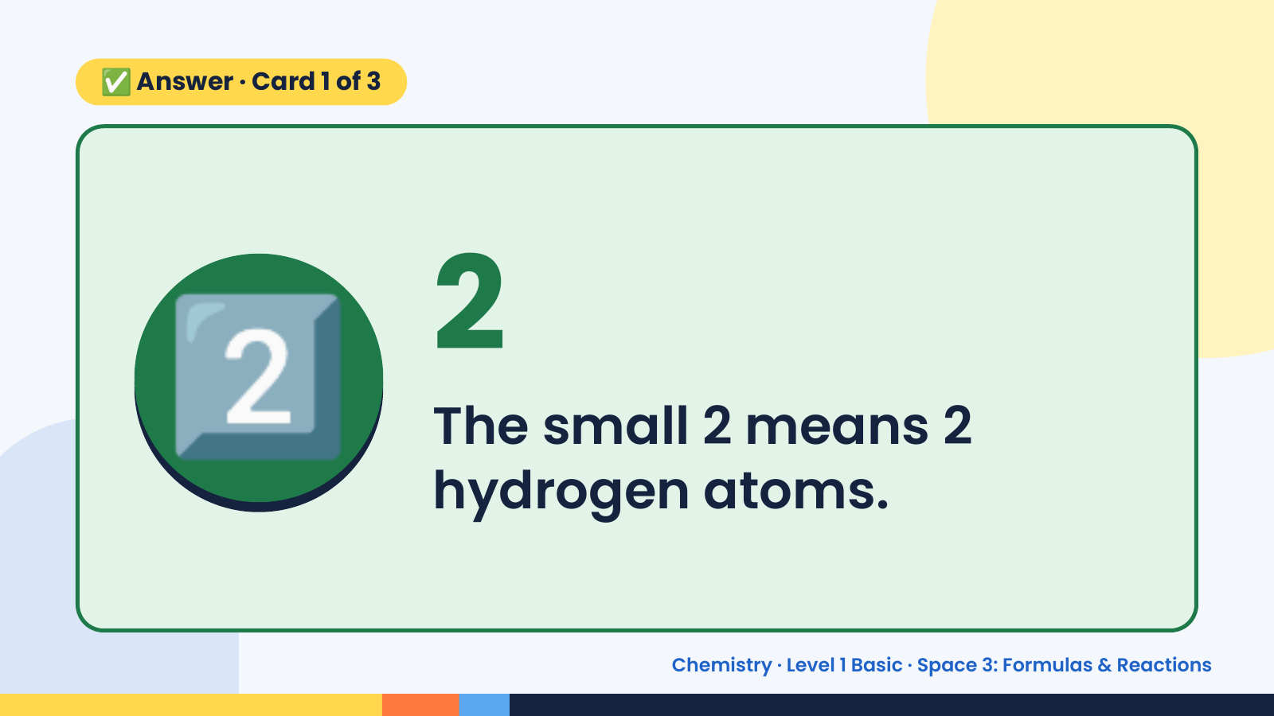
Notes:
✅ Answer · Card 1 of 3
2️⃣ 2
The small 2 means 2
hydrogen atoms.
Chemistry · Level 1 Basic · Space 3: Formulas & Reactions

Slide 9
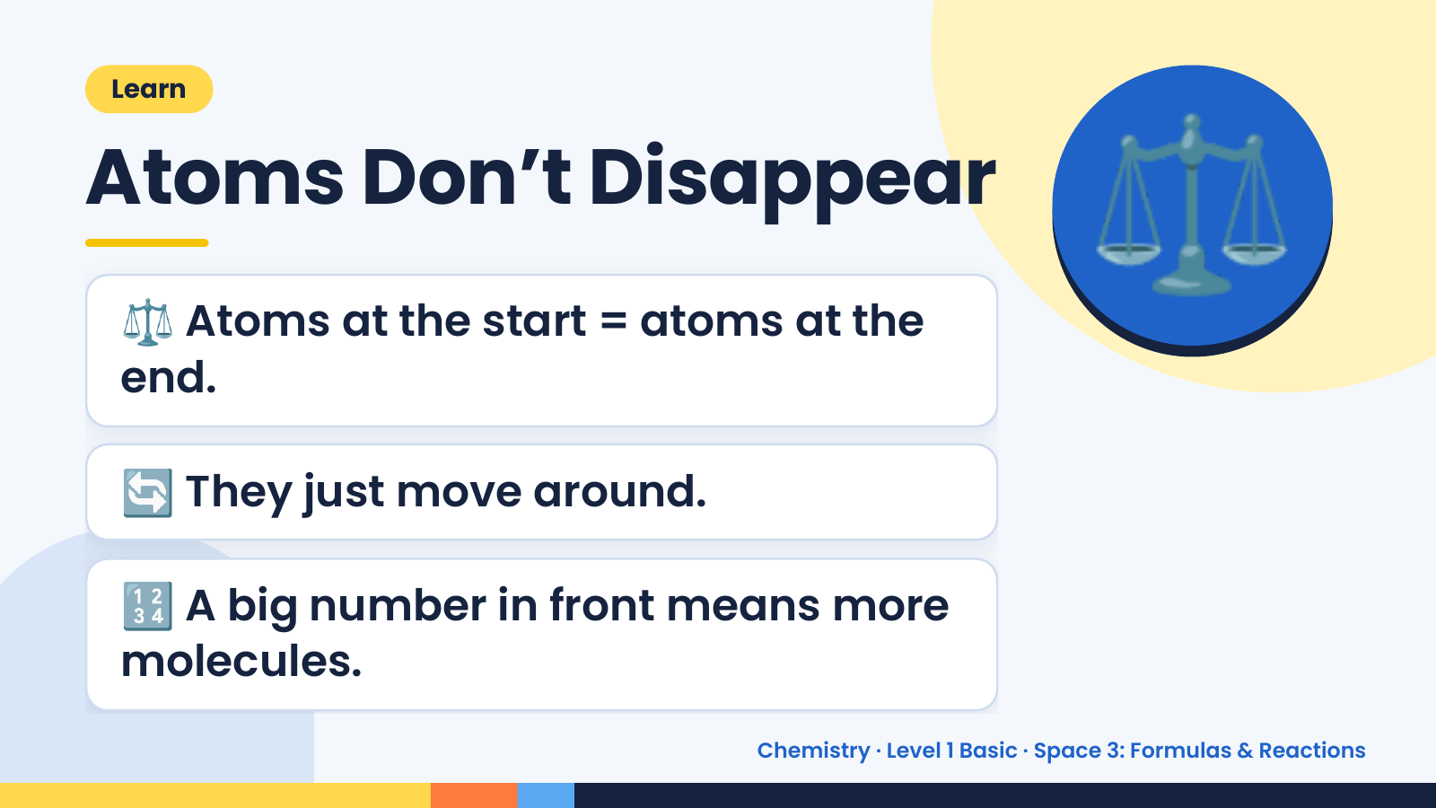
Notes:
Learn
Atoms Don’t Disappear
⚖️ Atoms at the start = atoms at the
end.
⚖️
🔄 They just move around.
🔢 A big number in front means more
molecules.
Chemistry · Level 1 Basic · Space 3: Formulas & Reactions

Slide 10
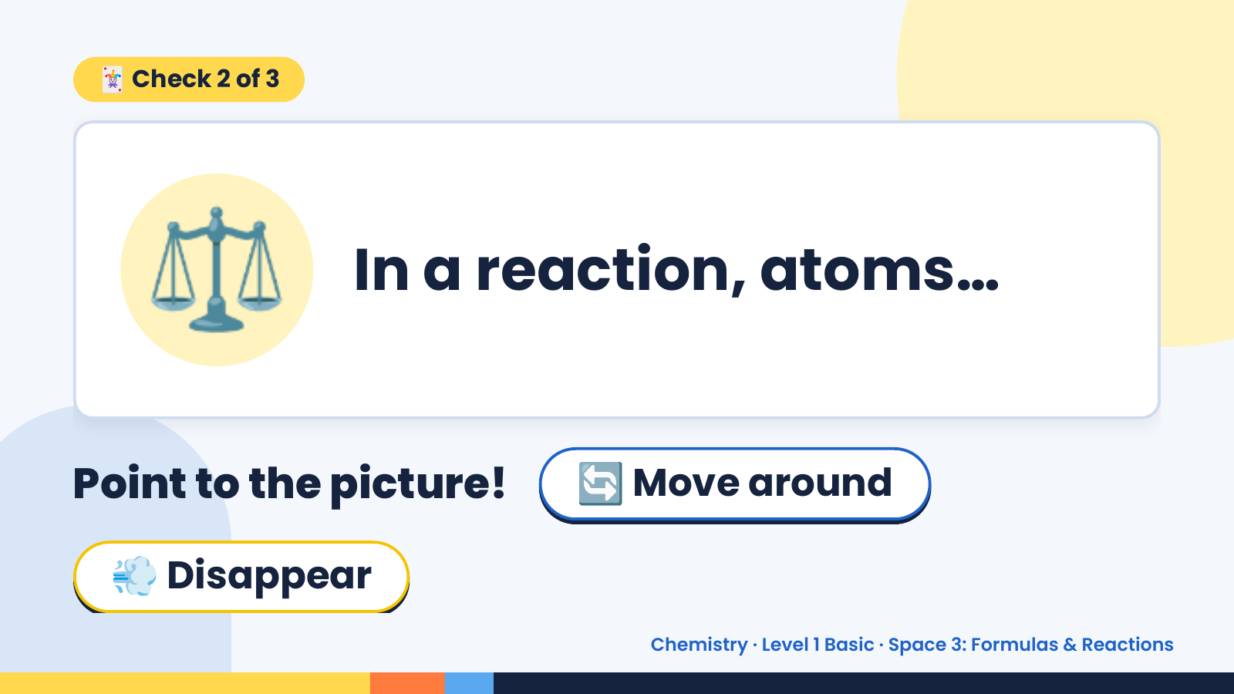
Notes:
🃏 Check 2 of 3
⚖️ In a reaction, atoms…
Point to the picture! 🔄 Move around
💨 Disappear
Chemistry · Level 1 Basic · Space 3: Formulas & Reactions

Slide 11
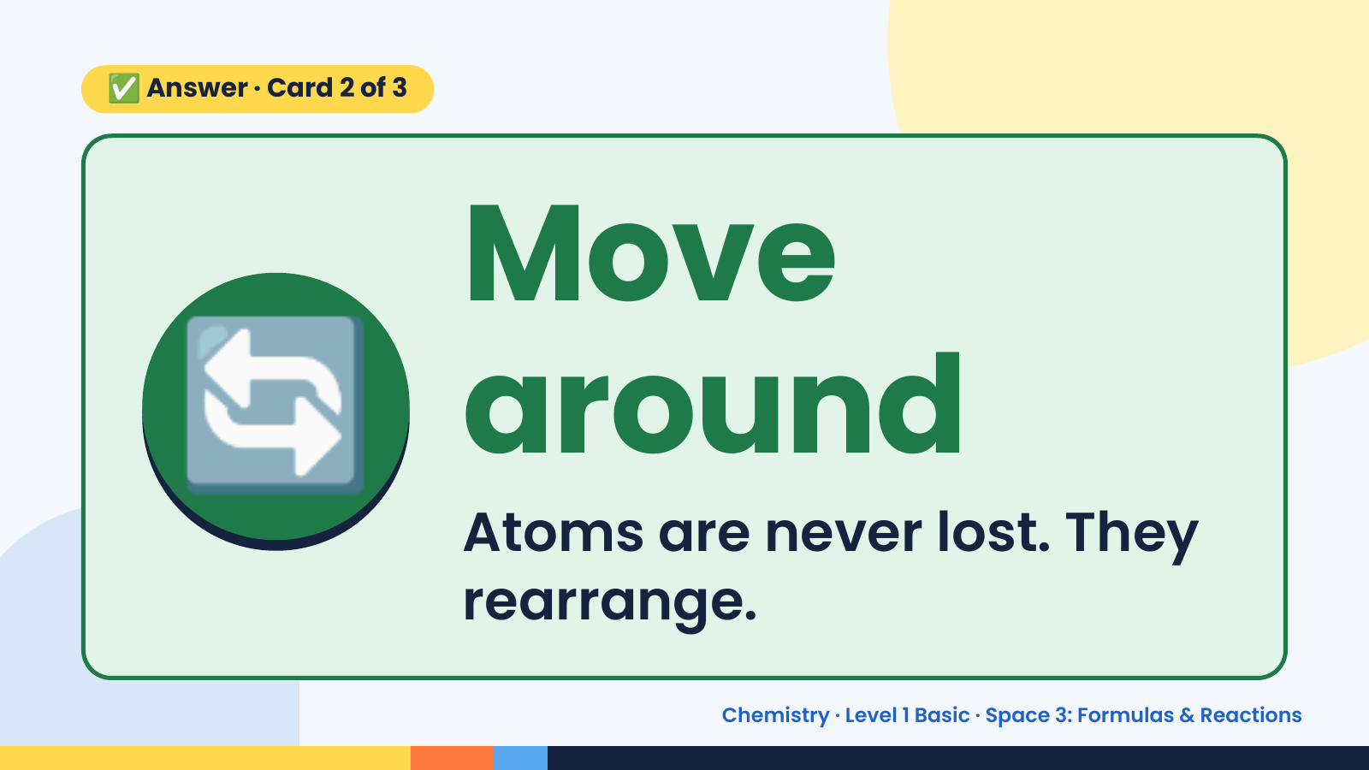
Notes:
✅ Answer · Card 2 of 3
🔄 Move
around
Atoms are never lost. They
rearrange.
Chemistry · Level 1 Basic · Space 3: Formulas & Reactions

Slide 12
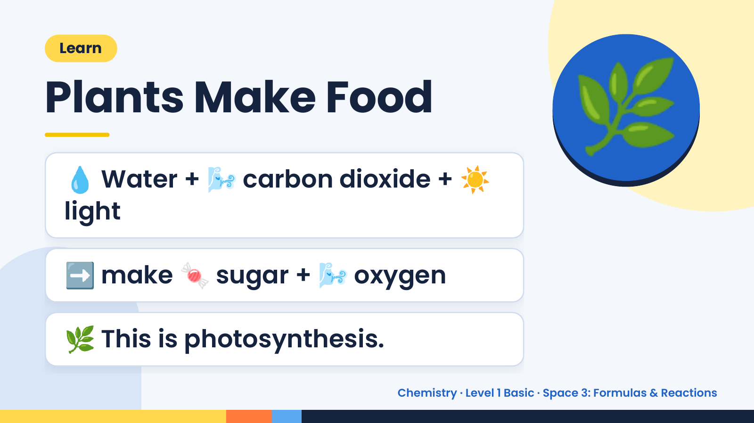
Notes:
Learn
Plants Make Food
💧 Water + 🌬️ carbon dioxide + ☀️
light
🌿
➡️ make 🍬 sugar + 🌬️ oxygen
🌿 This is photosynthesis.
Chemistry · Level 1 Basic · Space 3: Formulas & Reactions

Slide 13
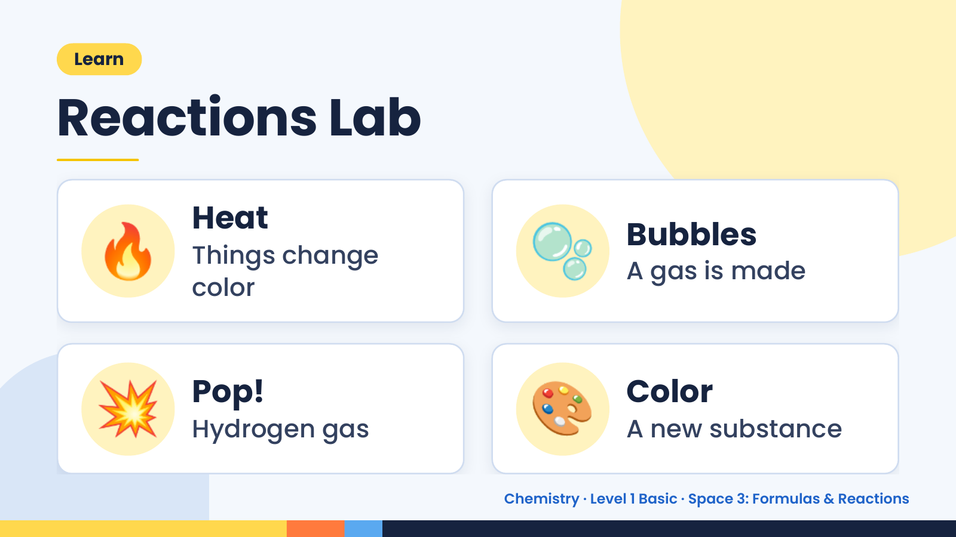
Notes:
Learn
Reactions Lab
🔥 Heat
Things change
color
🫧 Bubbles
A gas is made
💥 Pop!
Hydrogen gas 🎨 Color
A new substance
Chemistry · Level 1 Basic · Space 3: Formulas & Reactions

Slide 14
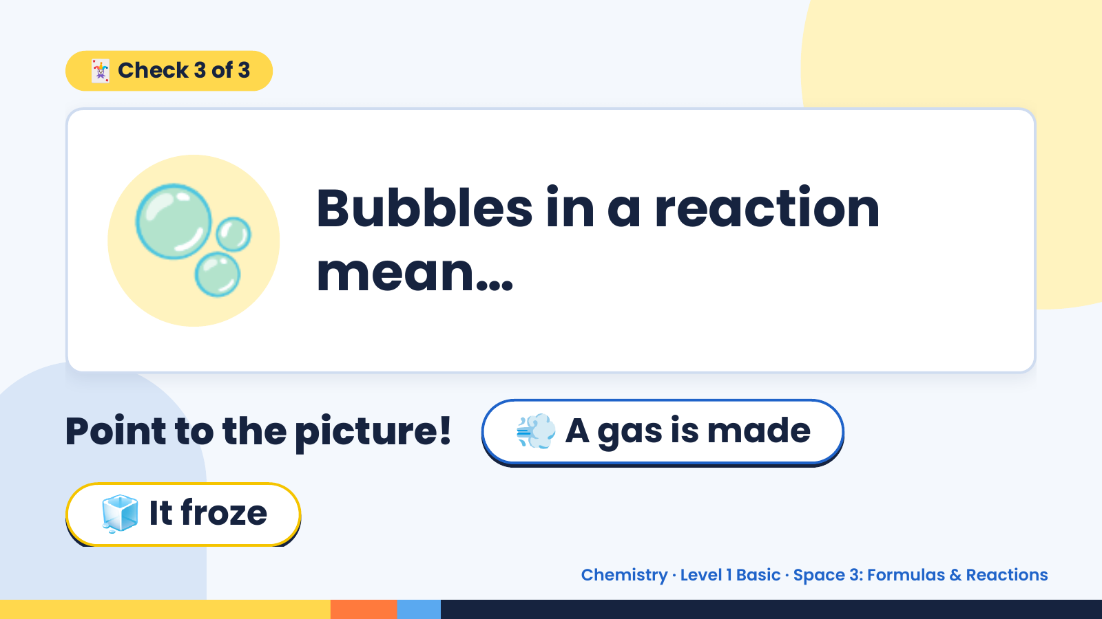
Notes:
🃏 Check 3 of 3
🫧 Bubbles in a reaction
mean…
Point to the picture! 💨 A gas is made
🧊 It froze
Chemistry · Level 1 Basic · Space 3: Formulas & Reactions

Slide 15
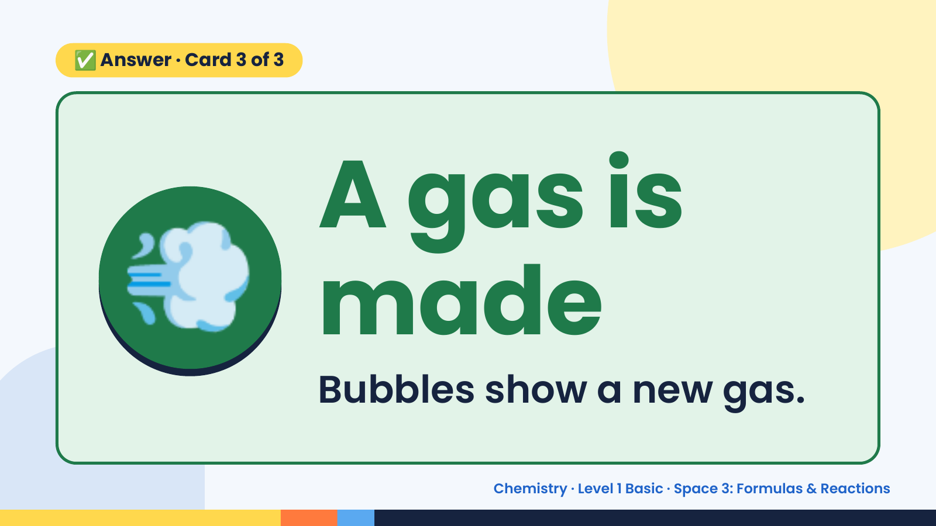
Notes:
✅ Answer · Card 3 of 3
💨 A gas is
made
Bubbles show a new gas.
Chemistry · Level 1 Basic · Space 3: Formulas & Reactions

Slide 16
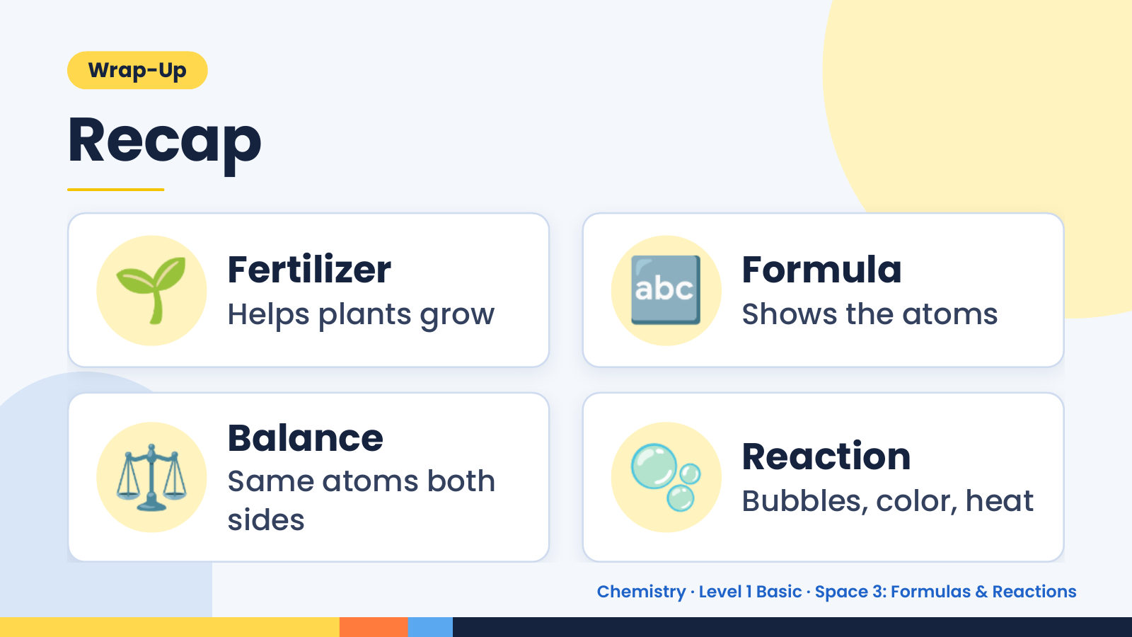
Notes:
Wrap-Up
Recap
🌱 Fertilizer
Helps plants grow 🔤 Formula
Shows the atoms
⚖️ Balance
Same atoms both
sides
🫧 Reaction
Bubbles, color, heat
Chemistry · Level 1 Basic · Space 3: Formulas & Reactions

Slide 17
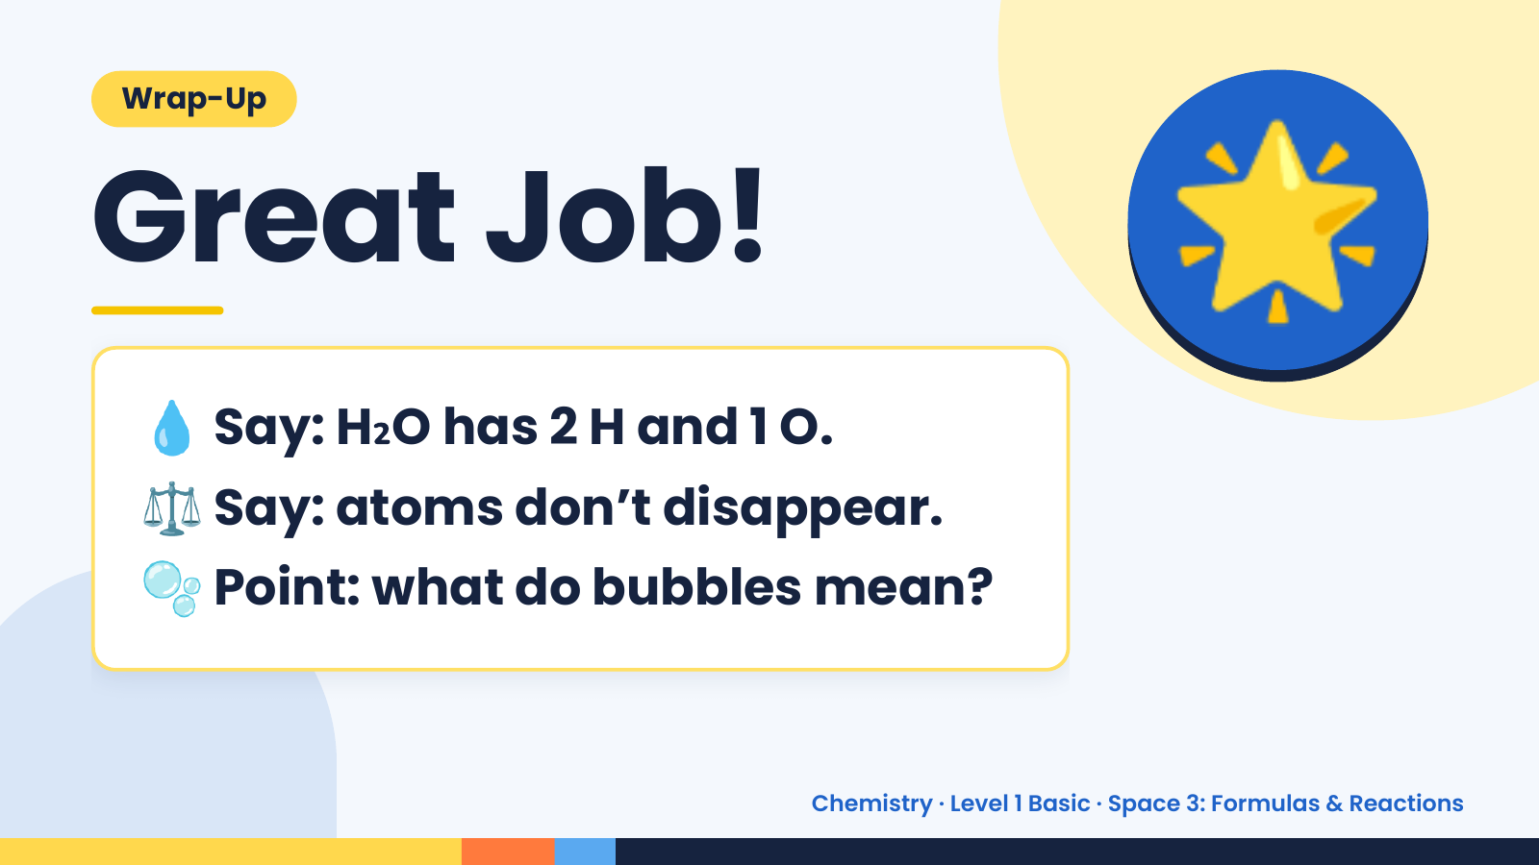
Notes:
Wrap-Up
Great Job!
💧 Say: H₂O has 2 H and 1 O.
🌟
⚖️ Say: atoms don’t disappear.
🫧 Point: what do bubbles mean?
Chemistry · Level 1 Basic · Space 3: Formulas & Reactions

