Slide 1
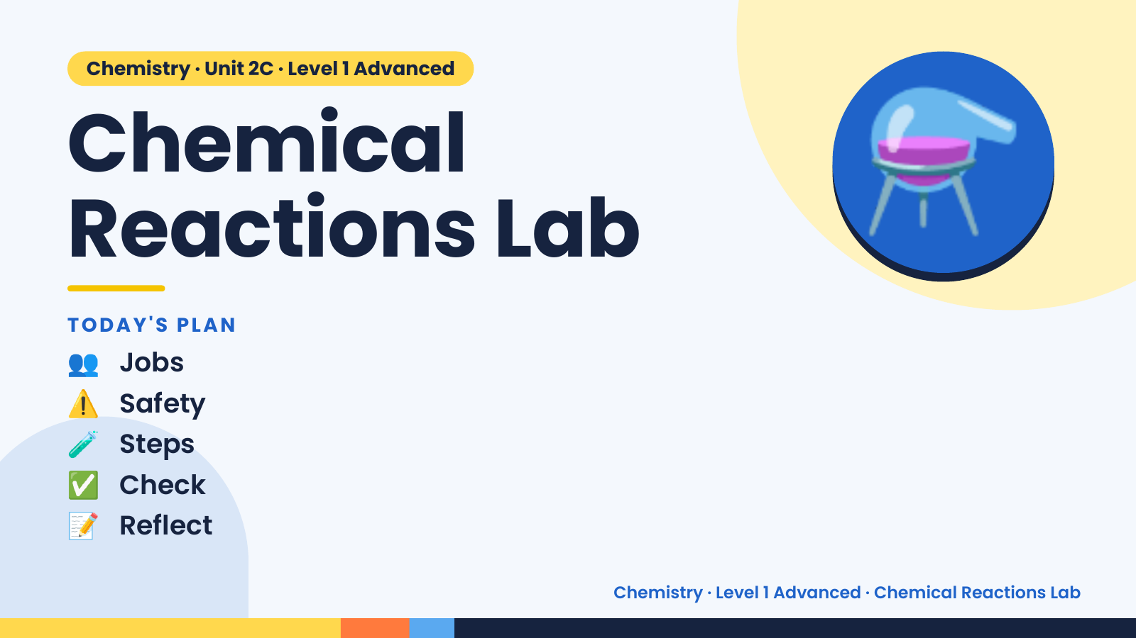
Notes:
Chemistry · Unit 2C · Level 1 Advanced
Chemical
Reactions Lab
👥 Jobs
TODAY'S PLAN
⚗️
⚠️ Safety
🧪 Steps
✅ Check
📝 Reflect
Chemistry · Level 1 Advanced · Chemical Reactions Lab

Slide 2
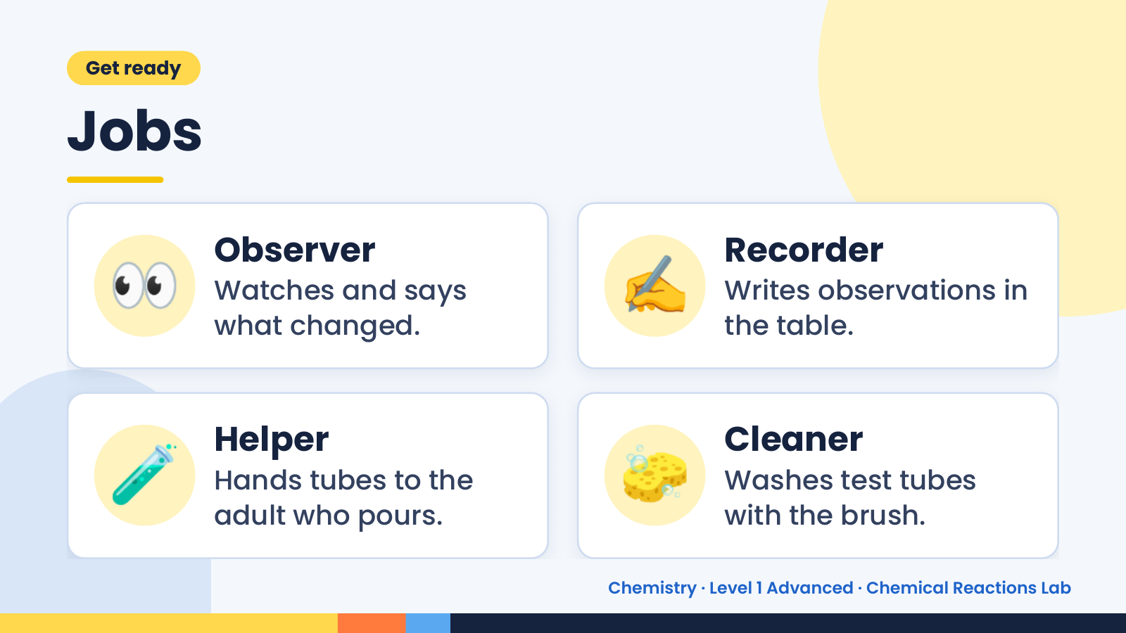
Notes:
Get ready
Jobs
👀 Observer
Watches and says
what changed.
✍️ Recorder
Writes observations in
the table.
🧪 Helper
Hands tubes to the
adult who pours.
🧽 Cleaner
Washes test tubes
with the brush.
Chemistry · Level 1 Advanced · Chemical Reactions Lab

Slide 3
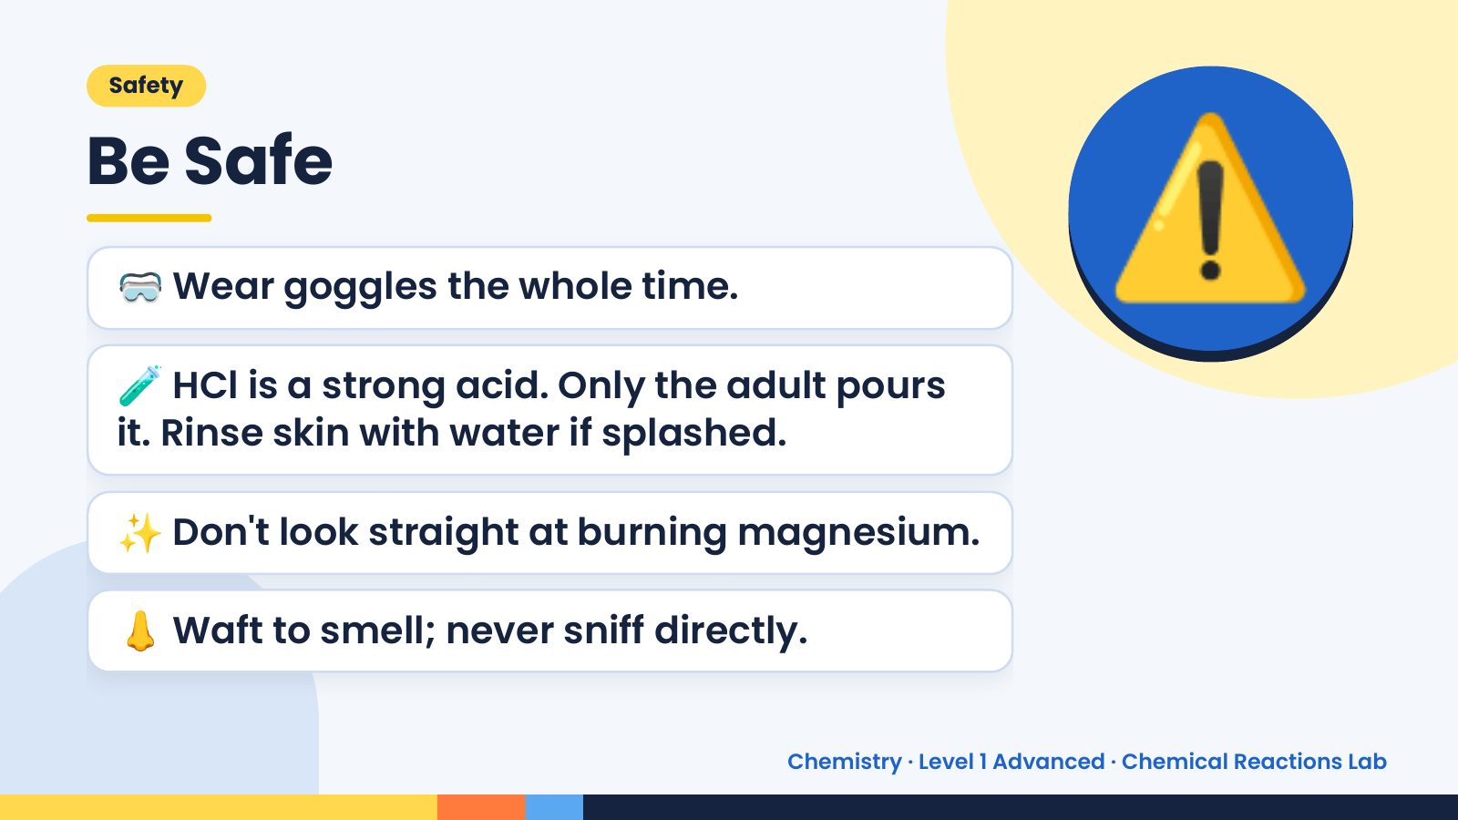
Notes:
Safety
Be Safe
🥽 Wear goggles the whole time.
🧪 HCl is a strong acid. Only the adult pours
it. Rinse skin with water if splashed.
⚠️
✨ Don't look straight at burning magnesium.
👃 Waft to smell; never sniff directly.
Chemistry · Level 1 Advanced · Chemical Reactions Lab

Slide 4
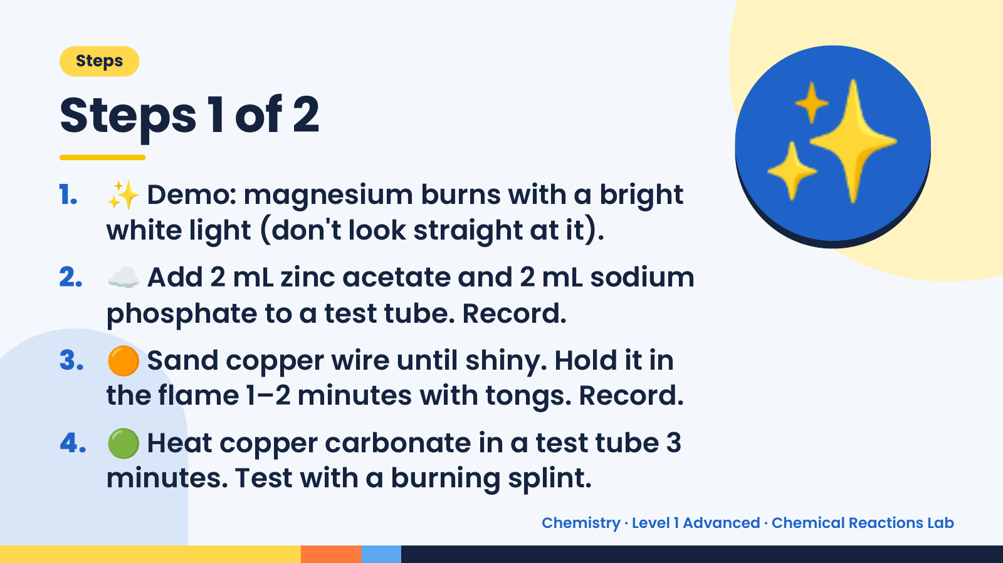
Notes:
Steps
Steps 1 of 2
1. ✨ Demo: magnesium burns with a bright
white light (don't look straight at it).
2. ☁️ Add 2 mL zinc acetate and 2 mL sodium
phosphate to a test tube. Record.
✨
3. 🟠 Sand copper wire until shiny. Hold it in
the flame 1–2 minutes with tongs. Record.
4. 🟢 Heat copper carbonate in a test tube 3
minutes. Test with a burning splint.
Chemistry · Level 1 Advanced · Chemical Reactions Lab

Slide 5
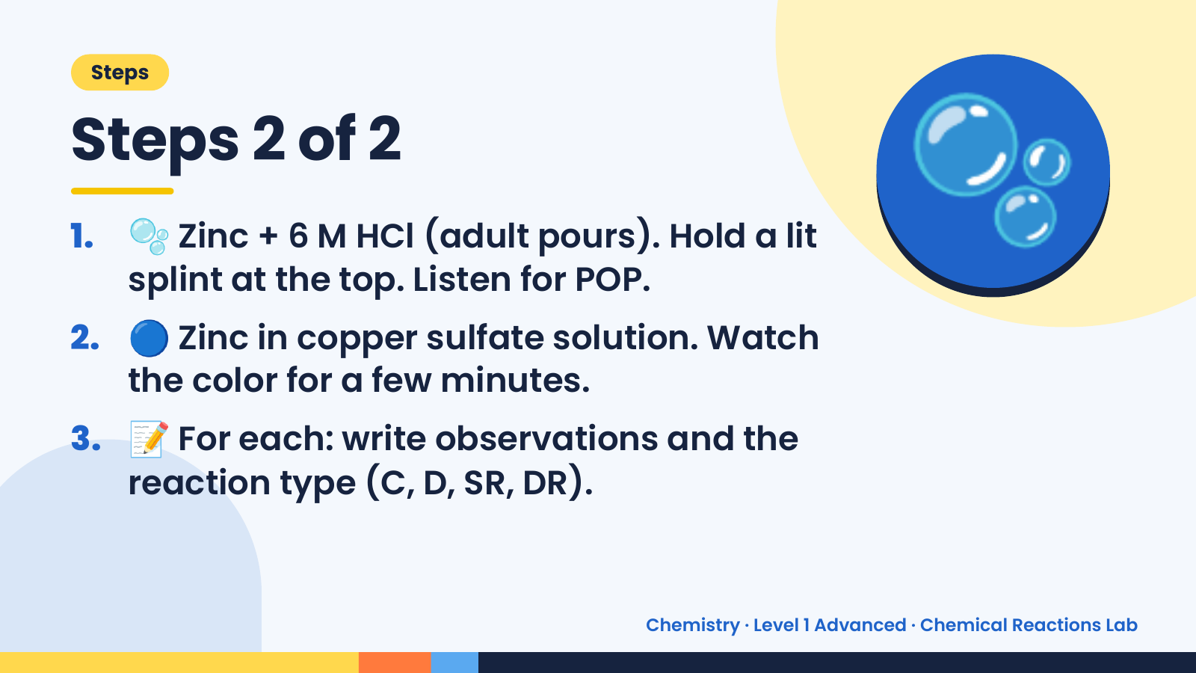
Notes:
Steps
Steps 2 of 2
1. 🫧 Zinc + 6 M HCl (adult pours). Hold a lit
splint at the top. Listen for POP.
2. 🔵 Zinc in copper sulfate solution. Watch
the color for a few minutes.
🫧
3. 📝 For each: write observations and the
reaction type (C, D, SR, DR).
Chemistry · Level 1 Advanced · Chemical Reactions Lab

Slide 6
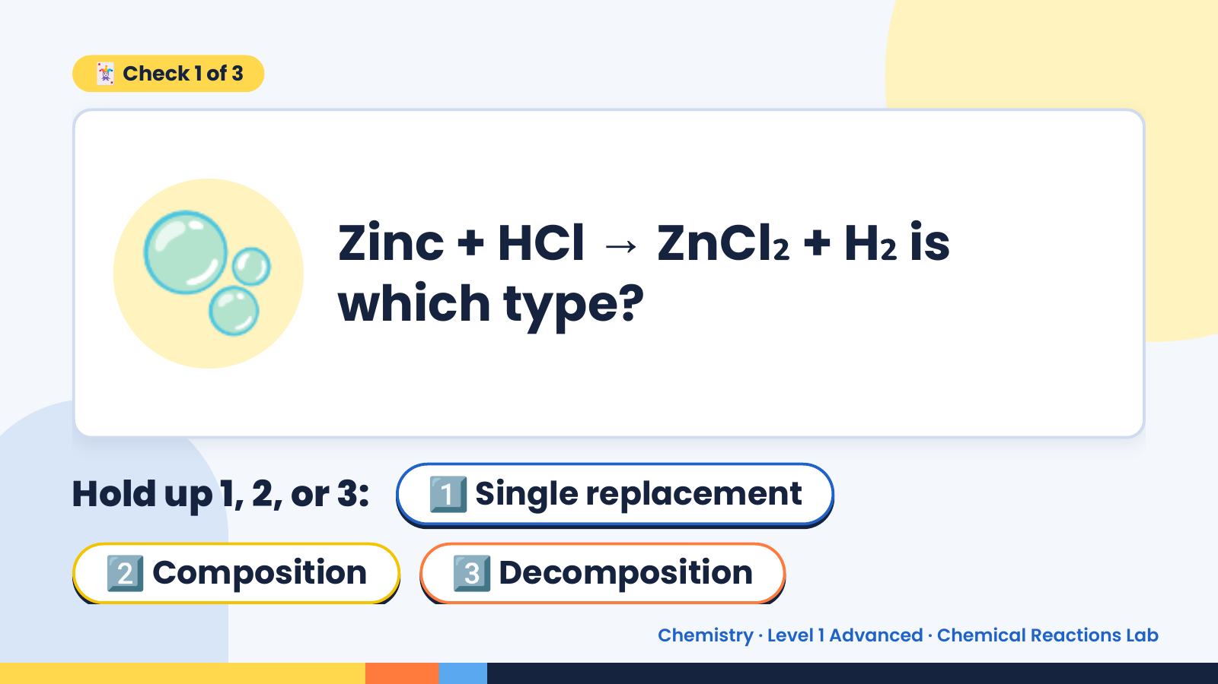
Notes:
🃏 Check 1 of 3
🫧 Zinc + HCl → ZnCl₂ + H₂ is
which type?
Hold up 1, 2, or 3: 1️⃣ Single replacement
2️⃣ Composition 3️⃣ Decomposition
Chemistry · Level 1 Advanced · Chemical Reactions Lab

Slide 7
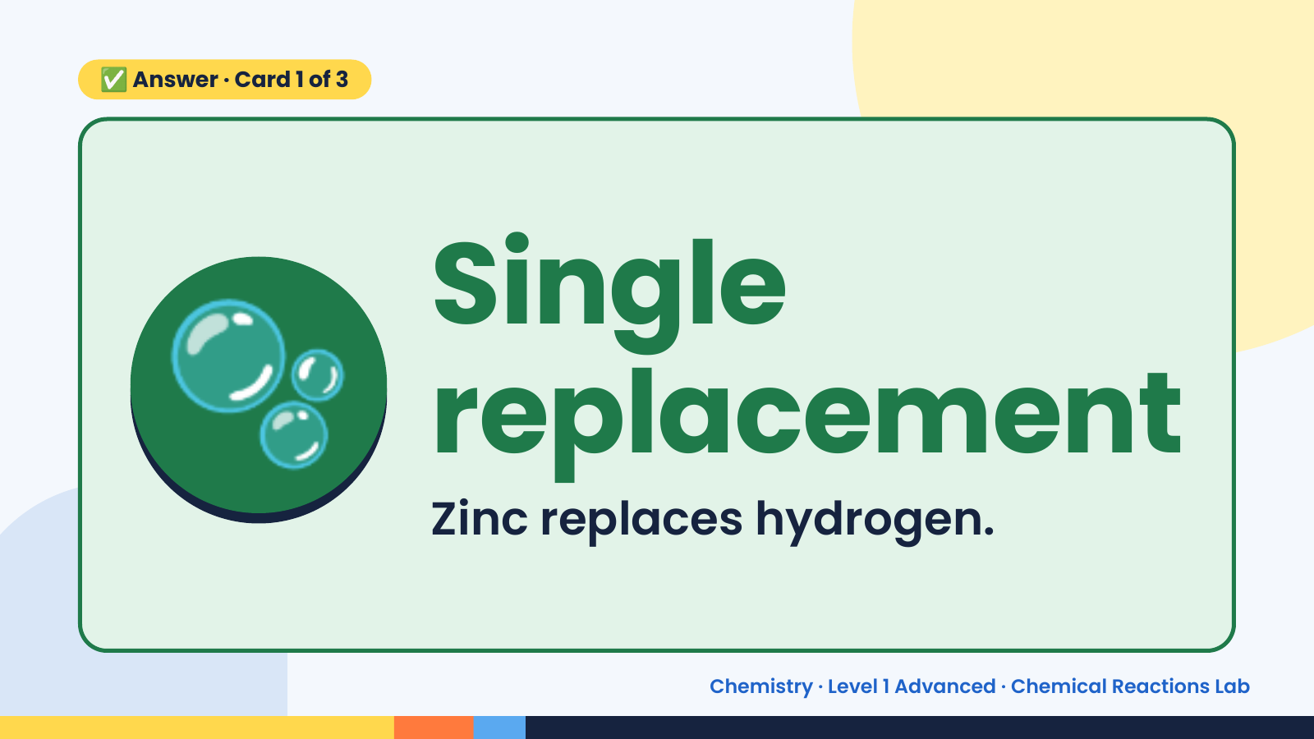
Notes:
✅ Answer · Card 1 of 3
🫧 Single
replacement
Zinc replaces hydrogen.
Chemistry · Level 1 Advanced · Chemical Reactions Lab

Slide 8
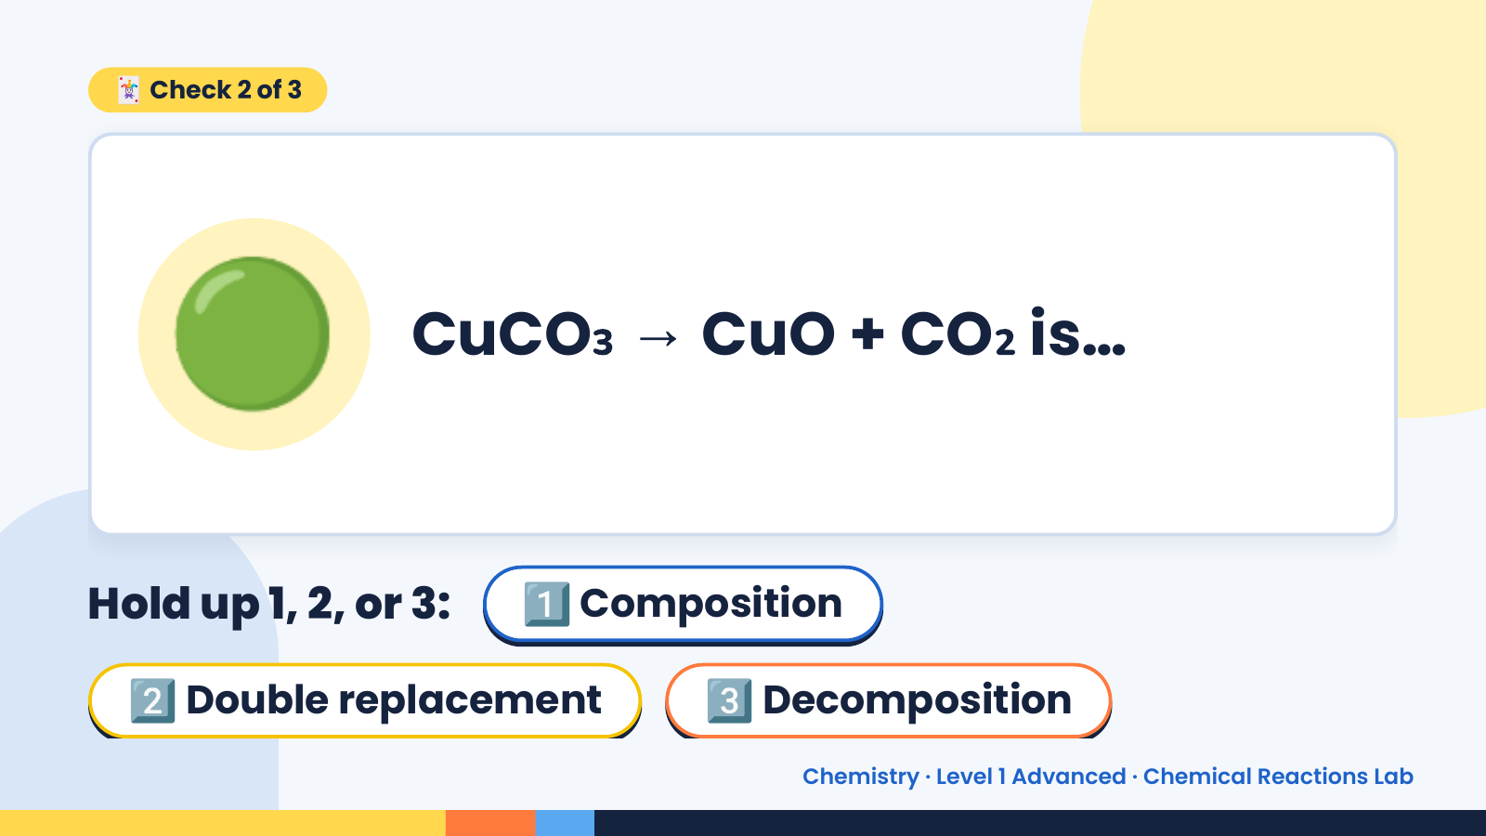
Notes:
🃏 Check 2 of 3
🟢 CuCO₃ → CuO + CO₂ is…
Hold up 1, 2, or 3: 1️⃣ Composition
2️⃣ Double replacement 3️⃣ Decomposition
Chemistry · Level 1 Advanced · Chemical Reactions Lab

Slide 9
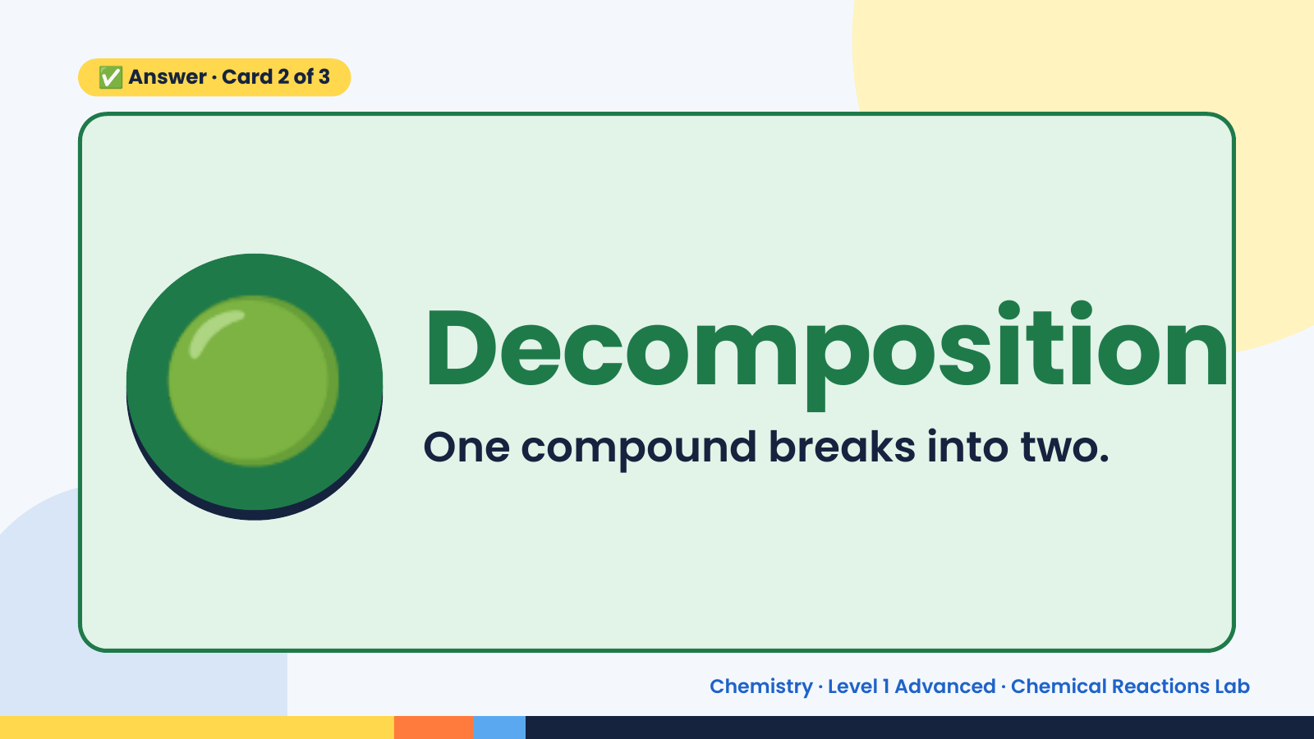
Notes:
✅ Answer · Card 2 of 3
🟢 Decomposition
One compound breaks into two.
Chemistry · Level 1 Advanced · Chemical Reactions Lab

Slide 10
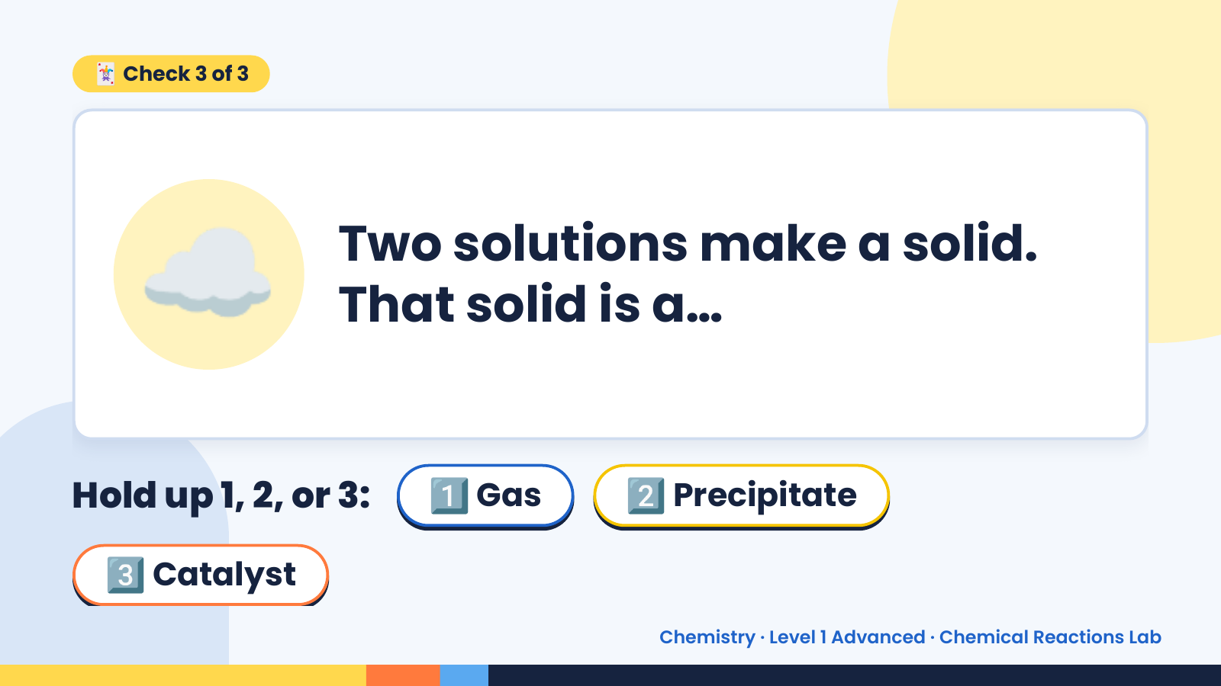
Notes:
🃏 Check 3 of 3
☁️ Two solutions make a solid.
That solid is a…
Hold up 1, 2, or 3: 1️⃣ Gas 2️⃣ Precipitate
3️⃣ Catalyst
Chemistry · Level 1 Advanced · Chemical Reactions Lab

Slide 11
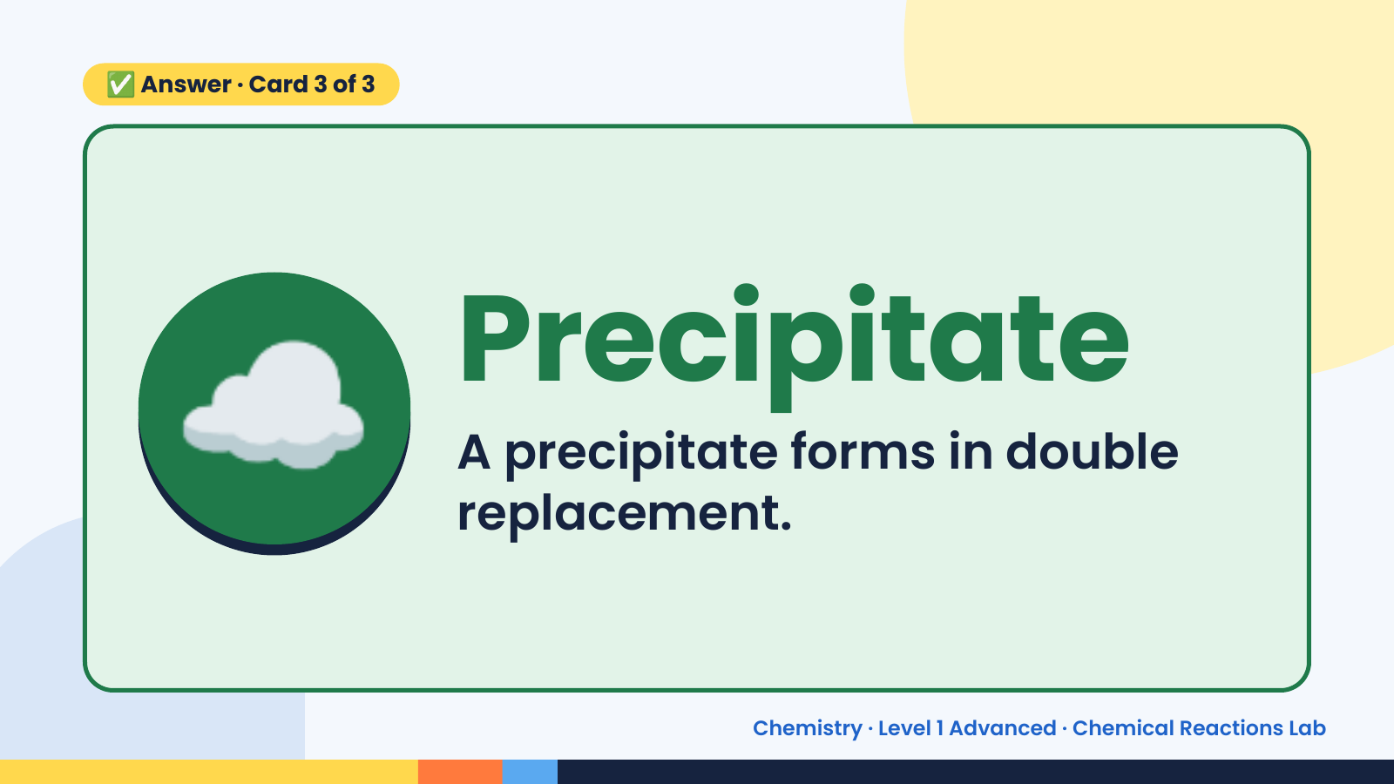
Notes:
✅ Answer · Card 3 of 3
☁️ Precipitate
A precipitate forms in double
replacement.
Chemistry · Level 1 Advanced · Chemical Reactions Lab

Slide 12
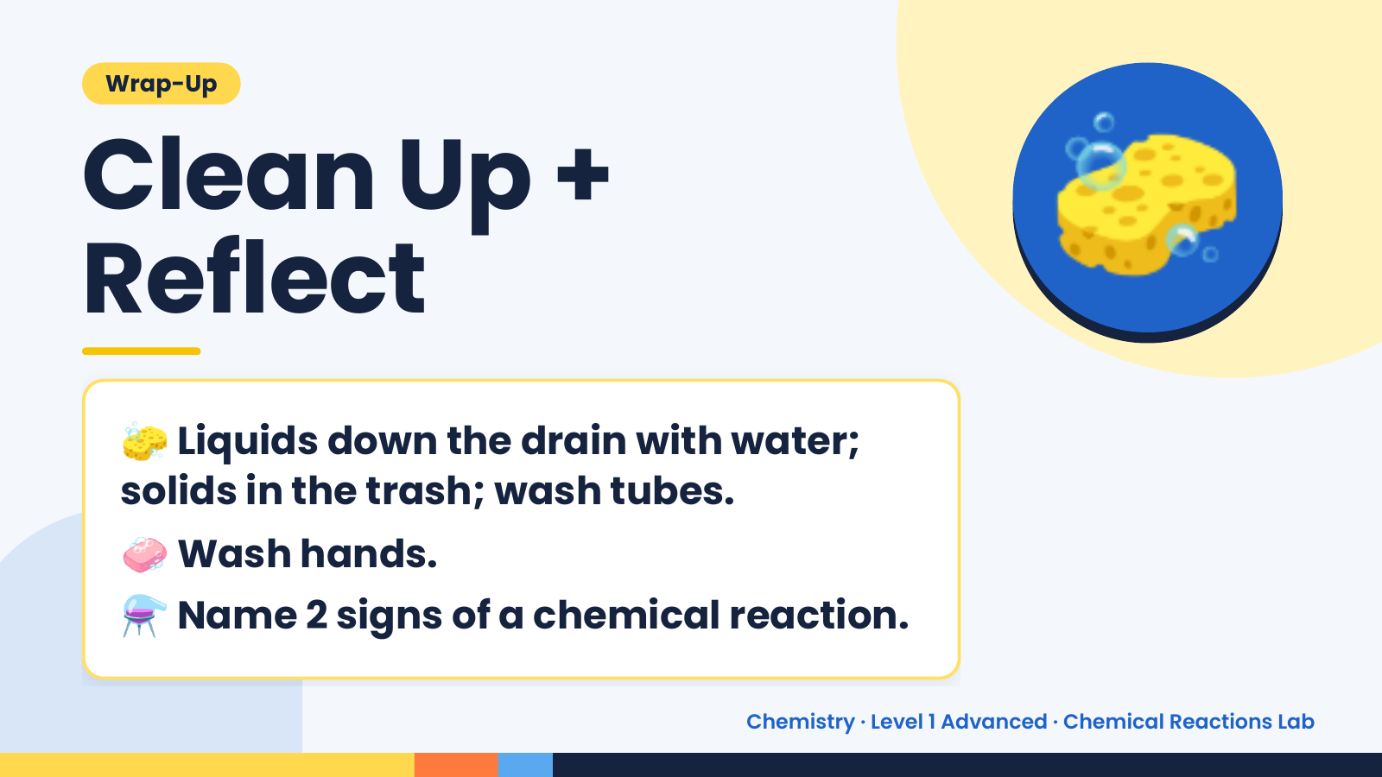
Notes:
Wrap-Up
Clean Up +
Reflect
🧽
🧽 Liquids down the drain with water;
solids in the trash; wash tubes.
🧼 Wash hands.
⚗️ Name 2 signs of a chemical reaction.
Chemistry · Level 1 Advanced · Chemical Reactions Lab

