Slide 1
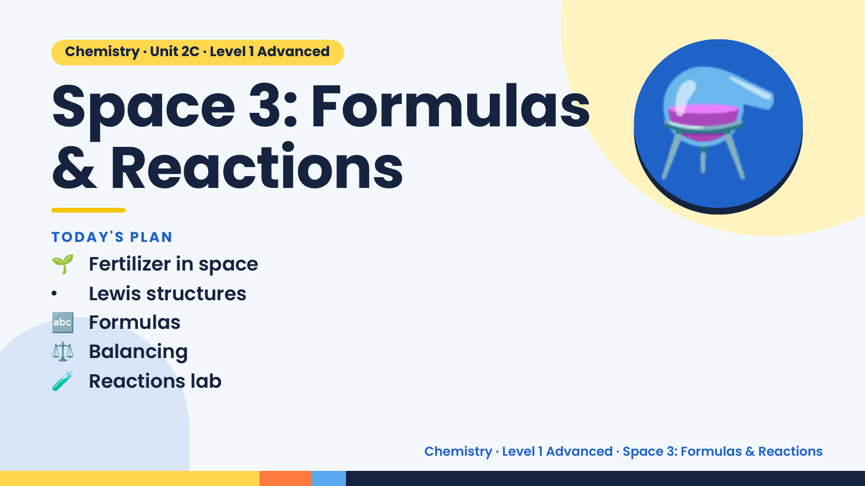
Notes:
Chemistry · Unit 2C · Level 1 Advanced
Space 3: Formulas
& Reactions
🌱 Fertilizer in space
TODAY'S PLAN
⚗️
• Lewis structures
🔤 Formulas
⚖️ Balancing
🧪 Reactions lab
Chemistry · Level 1 Advanced · Space 3: Formulas & Reactions

Slide 2
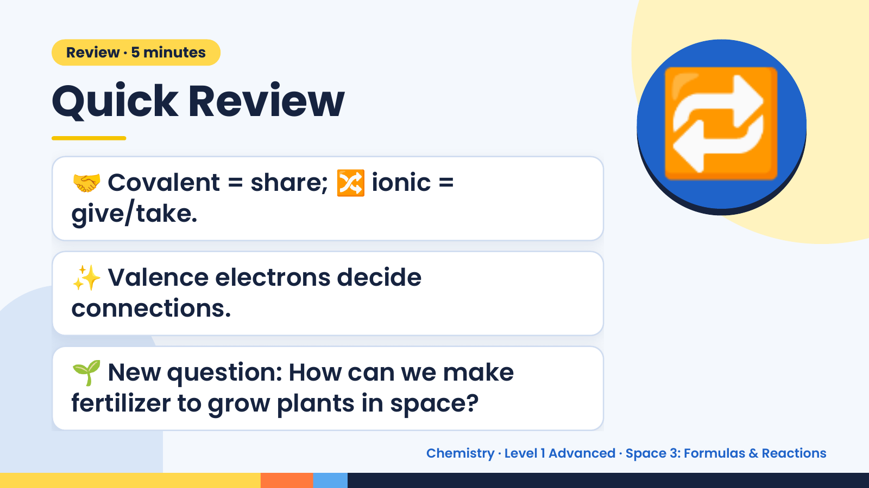
Notes:
Review · 5 minutes
Quick Review
🤝 Covalent = share; 🔀 ionic =
give/take.
🔁
✨ Valence electrons decide
connections.
🌱 New question: How can we make
fertilizer to grow plants in space?
Chemistry · Level 1 Advanced · Space 3: Formulas & Reactions

Slide 3
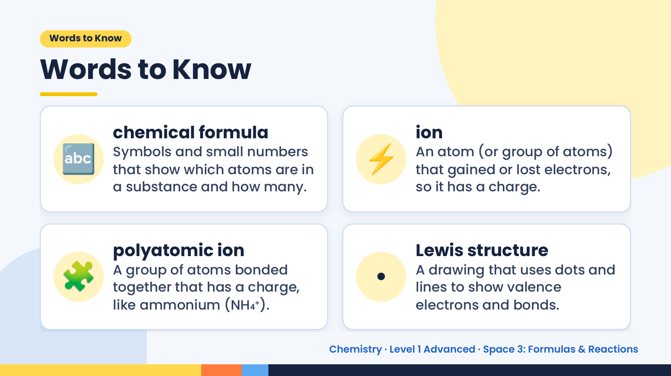
Notes:
Words to Know
Words to Know
🔤 chemical formula
Symbols and small numbers
that show which atoms are in
a substance and how many.
⚡ ion
An atom (or group of atoms)
that gained or lost electrons,
so it has a charge.
🧩 polyatomic ion
A group of atoms bonded
together that has a charge,
like ammonium (NH₄⁺).
•
Lewis structure
A drawing that uses dots and
lines to show valence
electrons and bonds.
Chemistry · Level 1 Advanced · Space 3: Formulas & Reactions

Slide 4
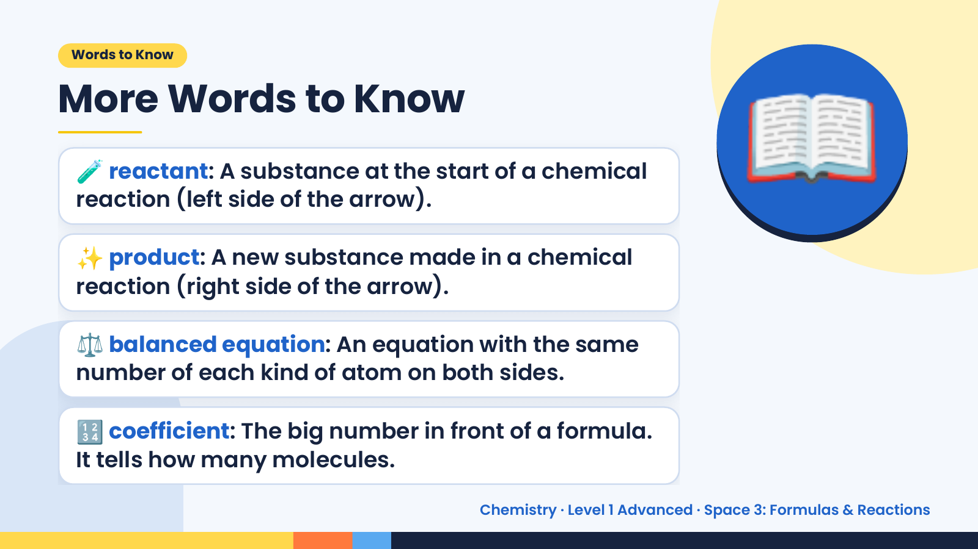
Notes:
Words to Know
More Words to Know
🧪 reactant: A substance at the start of a chemical
reaction (left side of the arrow).
✨ product: A new substance made in a chemical
reaction (right side of the arrow).
📖
⚖️ balanced equation: An equation with the same
number of each kind of atom on both sides.
🔢 coefficient: The big number in front of a formula.
It tells how many molecules.
Chemistry · Level 1 Advanced · Space 3: Formulas & Reactions

Slide 5
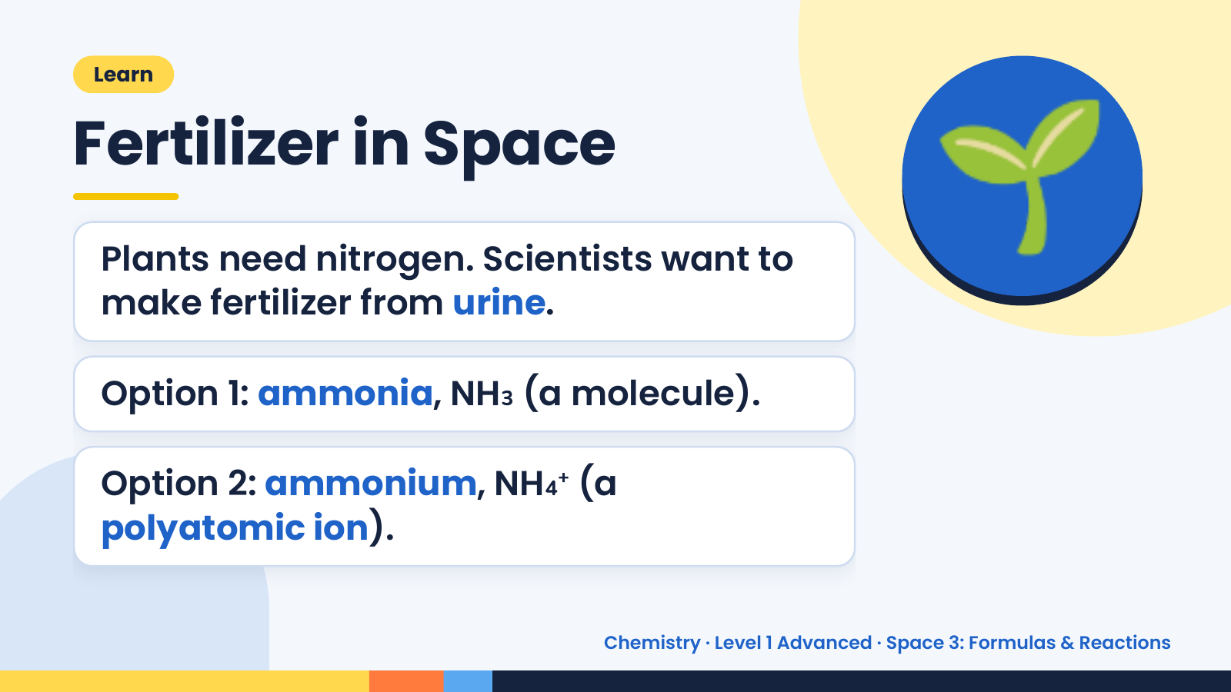
Notes:
Learn
Fertilizer in Space
Plants need nitrogen. Scientists want to
make fertilizer from urine.
🌱
Option 1: ammonia, NH₃ (a molecule).
Option 2: ammonium, NH₄⁺ (a
polyatomic ion).
Chemistry · Level 1 Advanced · Space 3: Formulas & Reactions

Slide 6
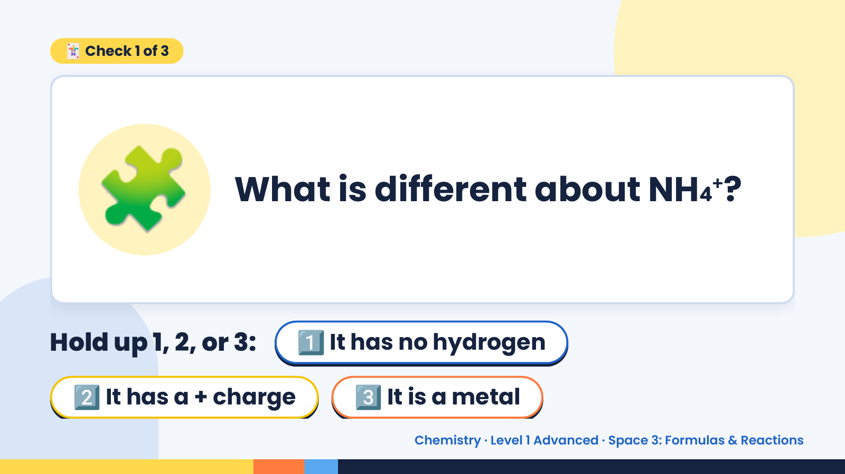
Notes:
🃏 Check 1 of 3
🧩 What is different about NH₄⁺?
Hold up 1, 2, or 3: 1️⃣ It has no hydrogen
2️⃣ It has a + charge 3️⃣ It is a metal
Chemistry · Level 1 Advanced · Space 3: Formulas & Reactions

Slide 7
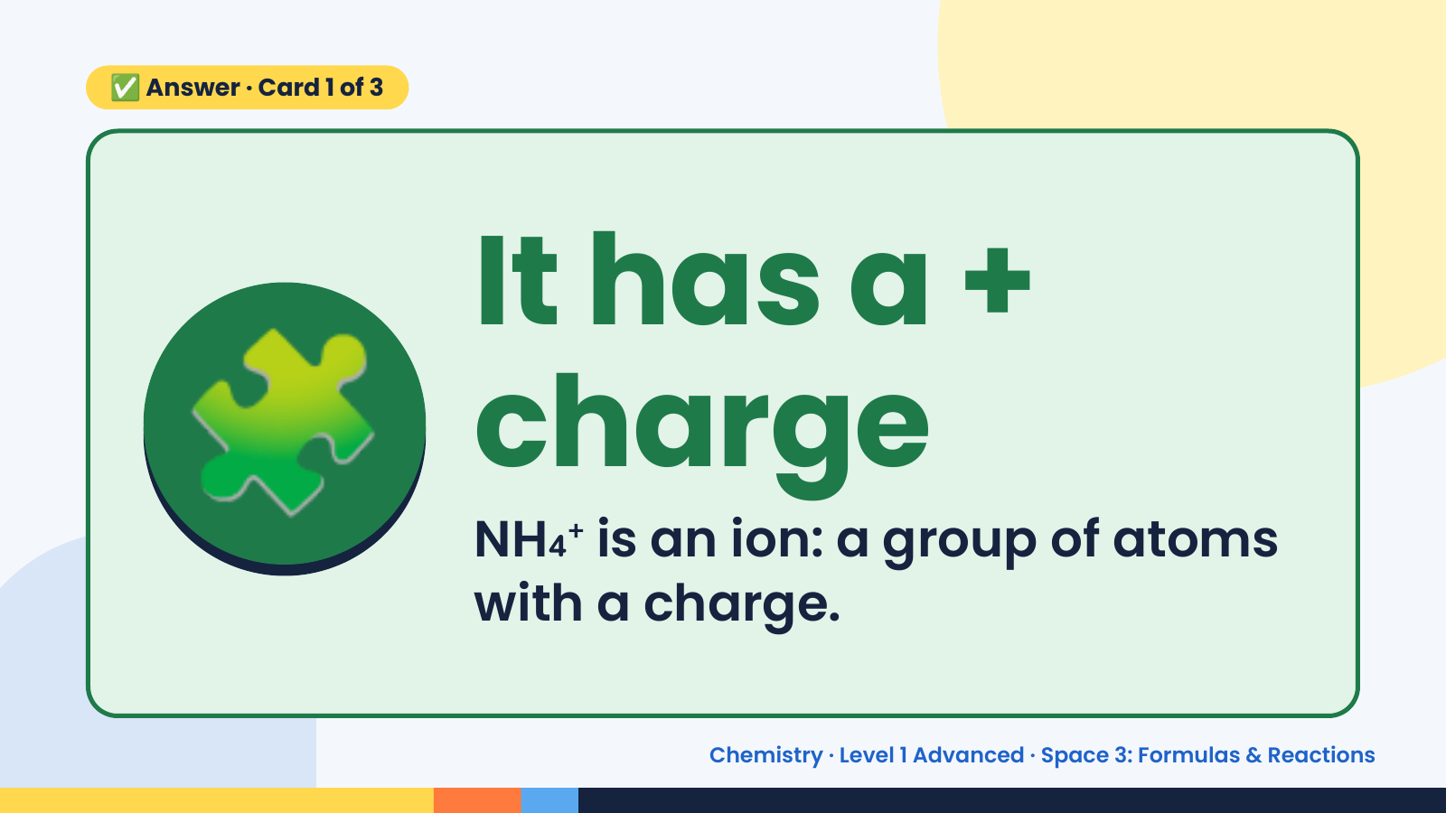
Notes:
✅ Answer · Card 1 of 3
🧩 It has a +
charge
NH₄⁺ is an ion: a group of atoms
with a charge.
Chemistry · Level 1 Advanced · Space 3: Formulas & Reactions

Slide 8
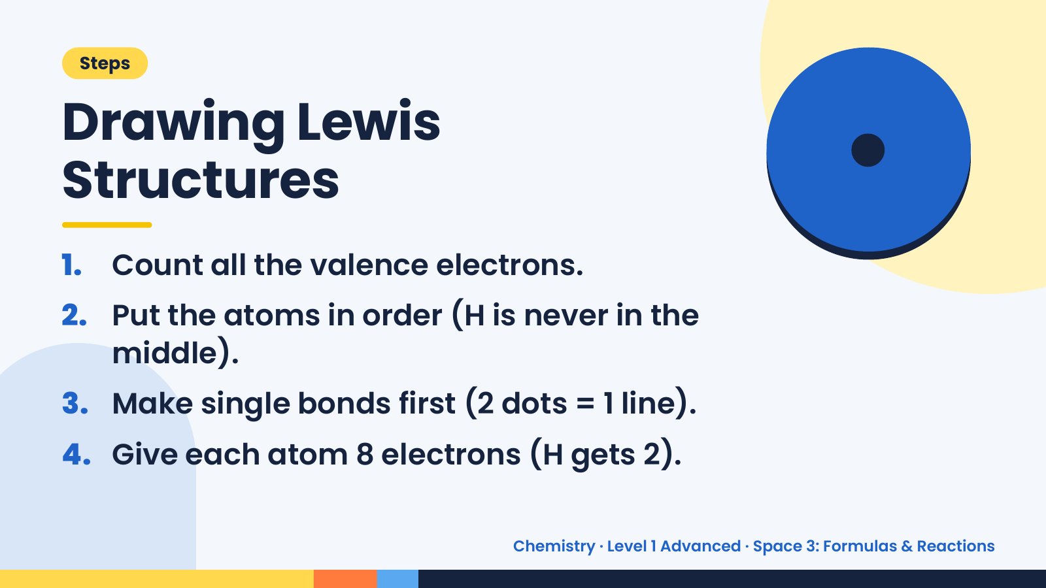
Notes:
•
Steps
Drawing Lewis
Structures
1. Count all the valence electrons.
2. Put the atoms in order (H is never in the
middle).
3. Make single bonds first (2 dots = 1 line).
4. Give each atom 8 electrons (H gets 2).
Chemistry · Level 1 Advanced · Space 3: Formulas & Reactions

Slide 9
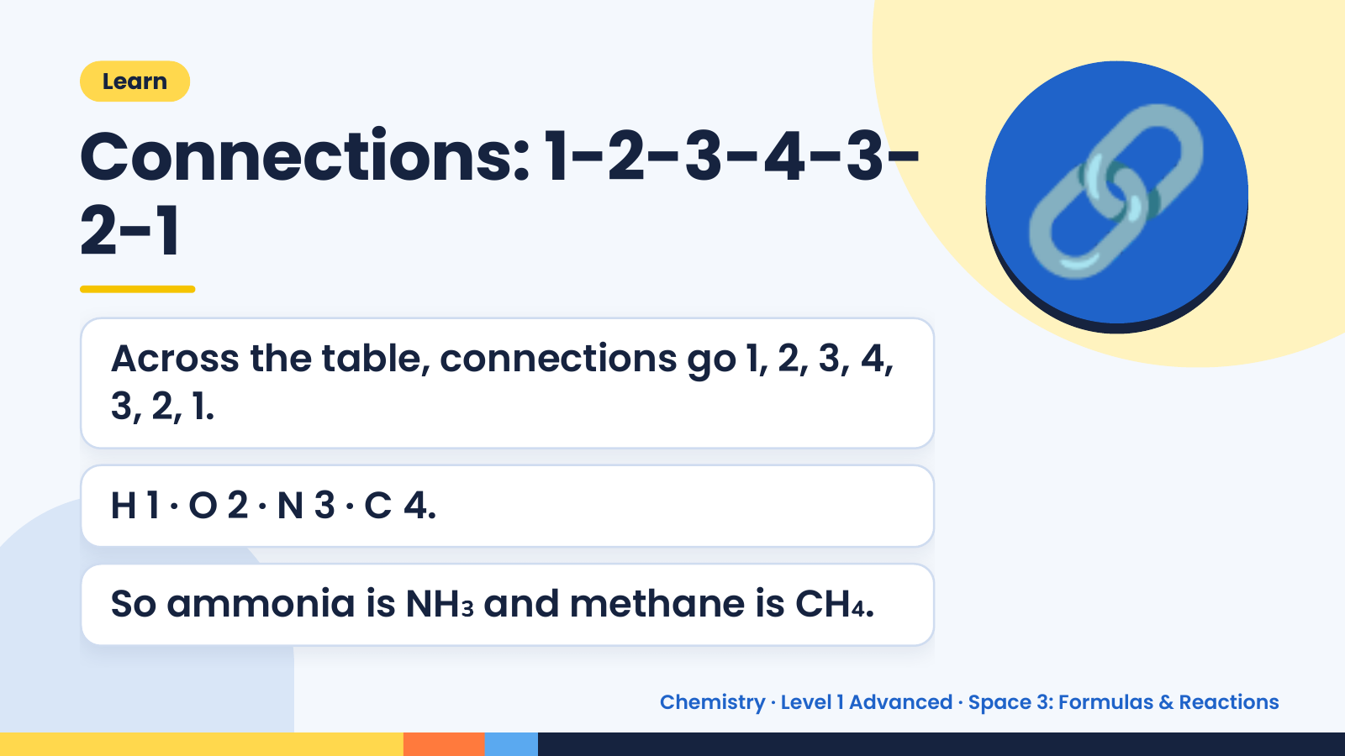
Notes:
Learn
Connections: 1-2-3-4-3-
2-1
Across the table, connections go 1, 2, 3, 4,
3, 2, 1.
🔗
H 1 · O 2 · N 3 · C 4.
So ammonia is NH₃ and methane is CH₄.
Chemistry · Level 1 Advanced · Space 3: Formulas & Reactions

Slide 10
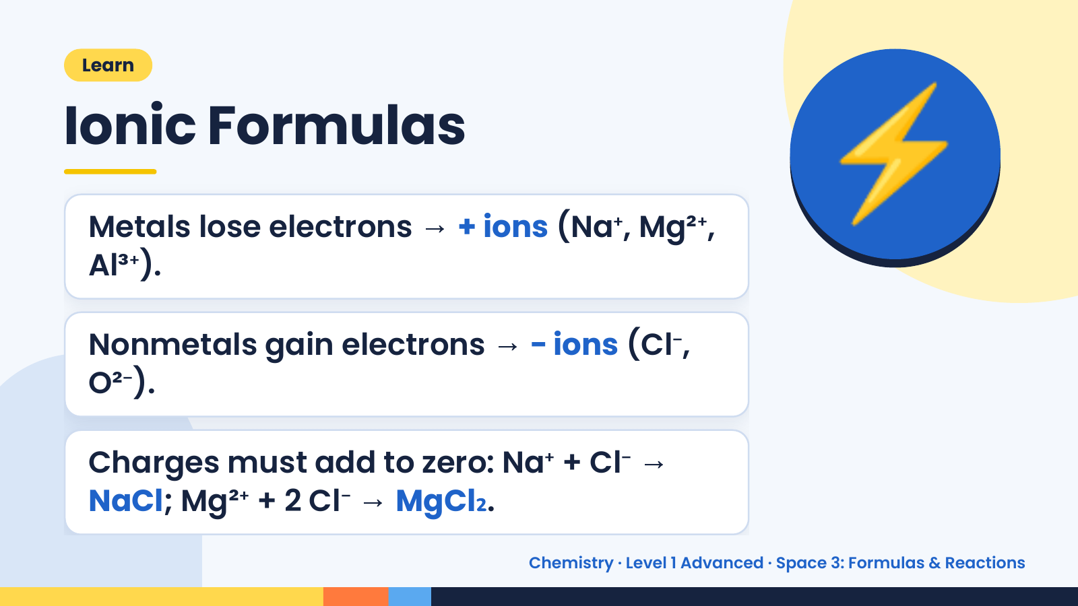
Notes:
Learn
Ionic Formulas
Metals lose electrons → + ions (Na⁺, Mg²⁺,
Al³⁺).
⚡
Nonmetals gain electrons → − ions (Cl⁻,
O²⁻).
Charges must add to zero: Na⁺ + Cl⁻ →
NaCl; Mg²⁺ + 2 Cl⁻ → MgCl₂.
Chemistry · Level 1 Advanced · Space 3: Formulas & Reactions

Slide 11
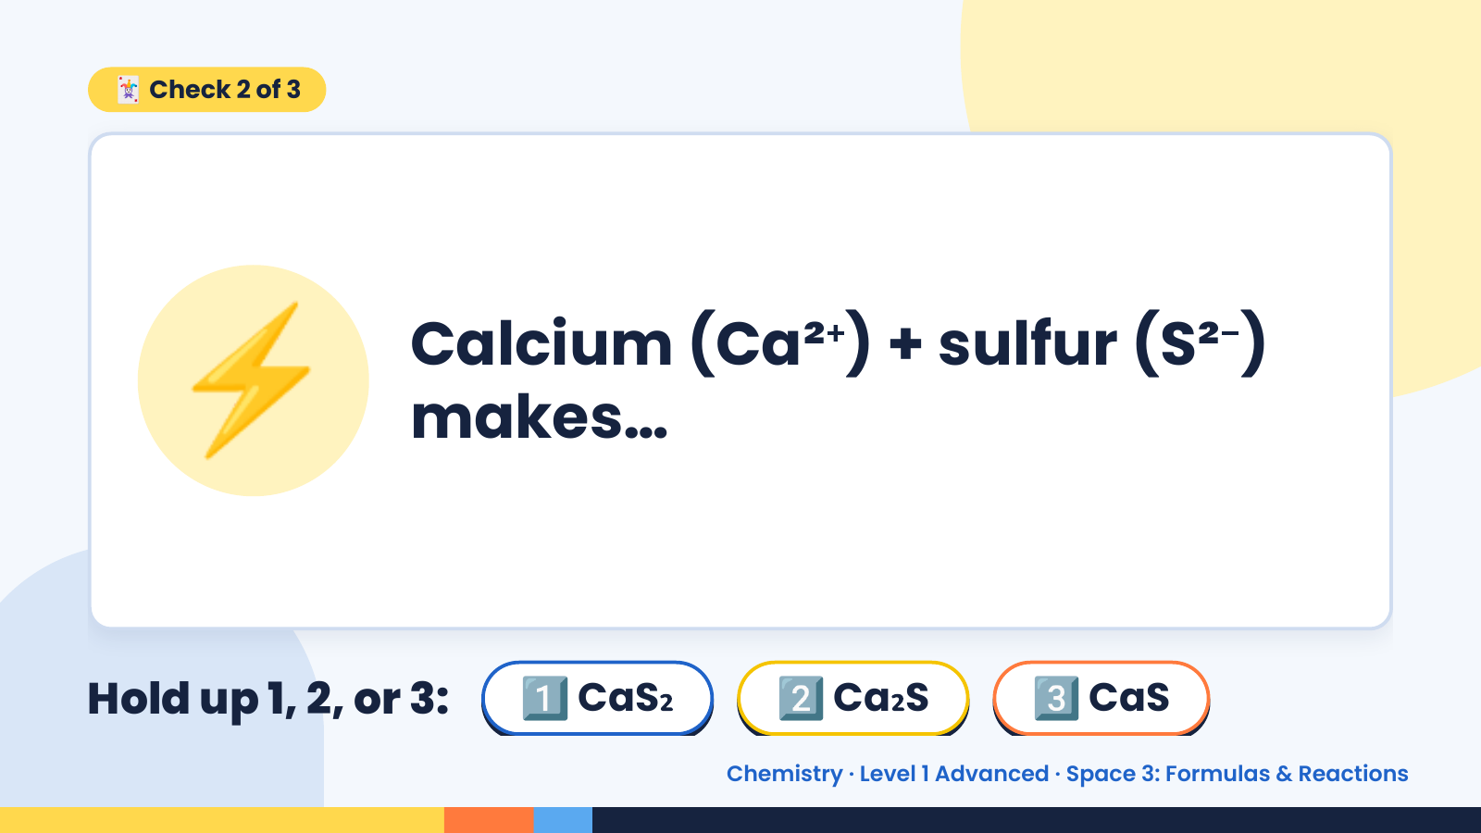
Notes:
🃏 Check 2 of 3
⚡ Calcium (Ca²⁺) + sulfur (S²⁻)
makes…
Hold up 1, 2, or 3: 1️⃣ CaS₂ 2️⃣ Ca₂S 3️⃣ CaS
Chemistry · Level 1 Advanced · Space 3: Formulas & Reactions

Slide 12
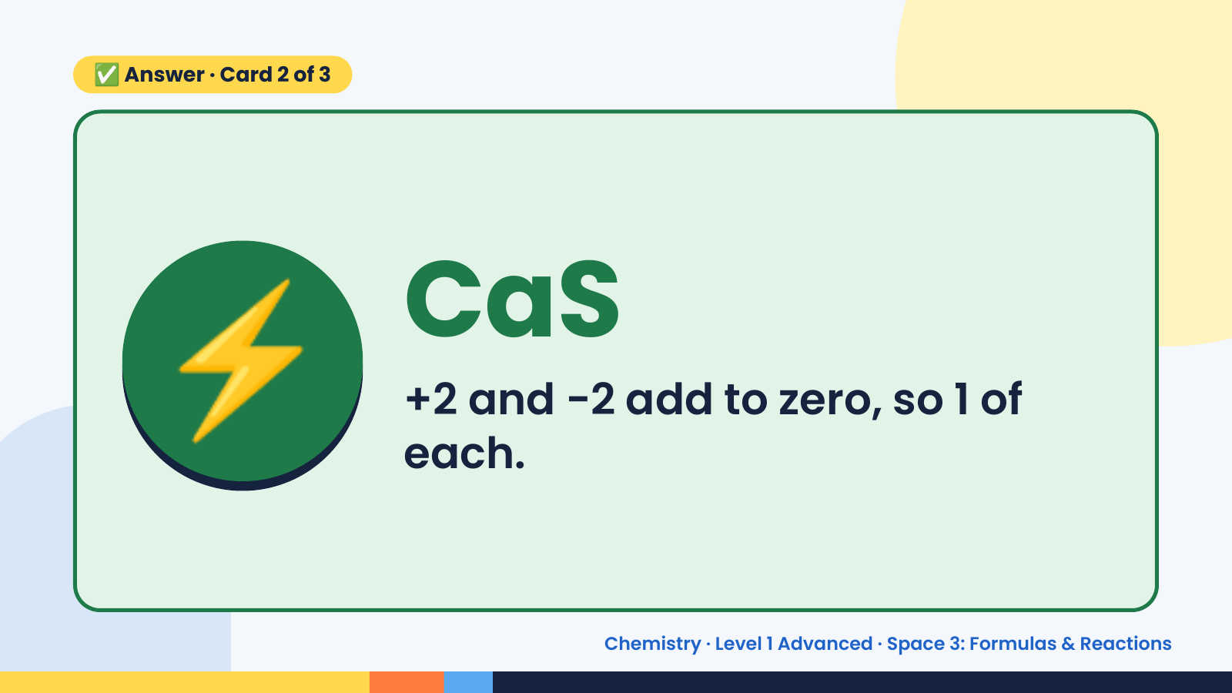
Notes:
✅ Answer · Card 2 of 3
⚡ CaS
+2 and −2 add to zero, so 1 of
each.
Chemistry · Level 1 Advanced · Space 3: Formulas & Reactions

Slide 13
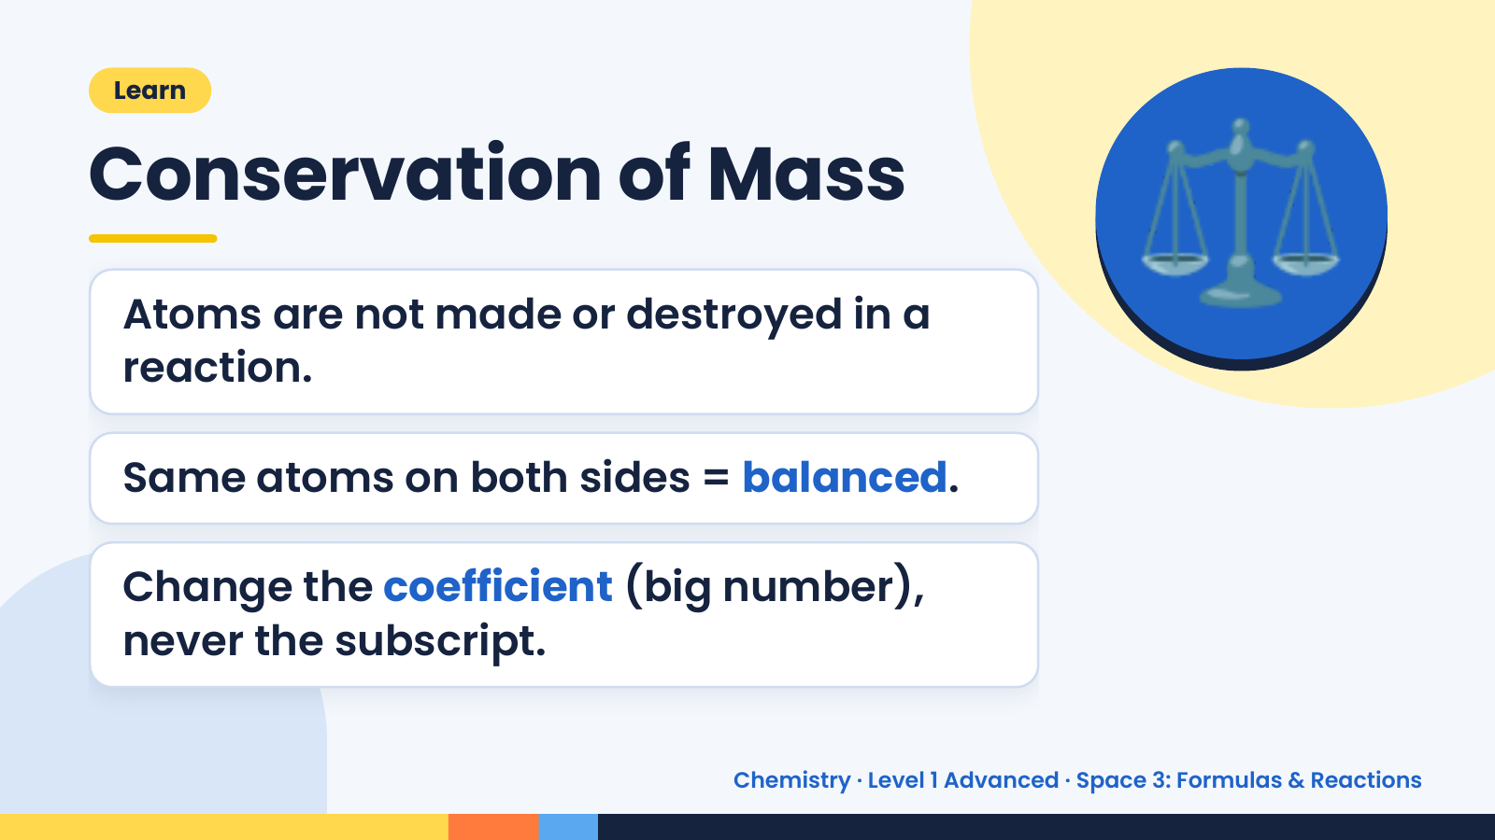
Notes:
Learn
Conservation of Mass
Atoms are not made or destroyed in a
reaction.
⚖️
Same atoms on both sides = balanced.
Change the coefficient (big number),
never the subscript.
Chemistry · Level 1 Advanced · Space 3: Formulas & Reactions

Slide 14
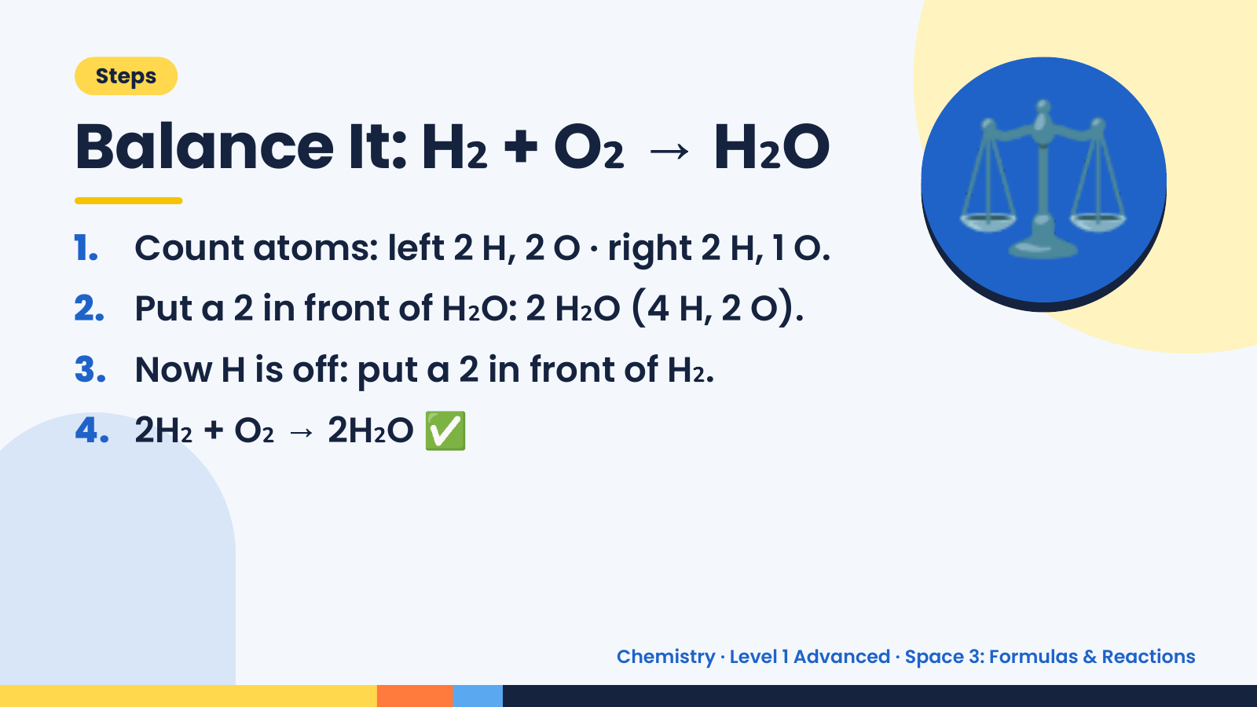
Notes:
Steps
Balance It: H₂ + O₂ → H₂O
1. Count atoms: left 2 H, 2 O · right 2 H, 1 O.
2. Put a 2 in front of H₂O: 2 H₂O (4 H, 2 O).
3. Now H is off: put a 2 in front of H₂.
⚖️
4. 2H₂ + O₂ → 2H₂O ✅
Chemistry · Level 1 Advanced · Space 3: Formulas & Reactions

Slide 15
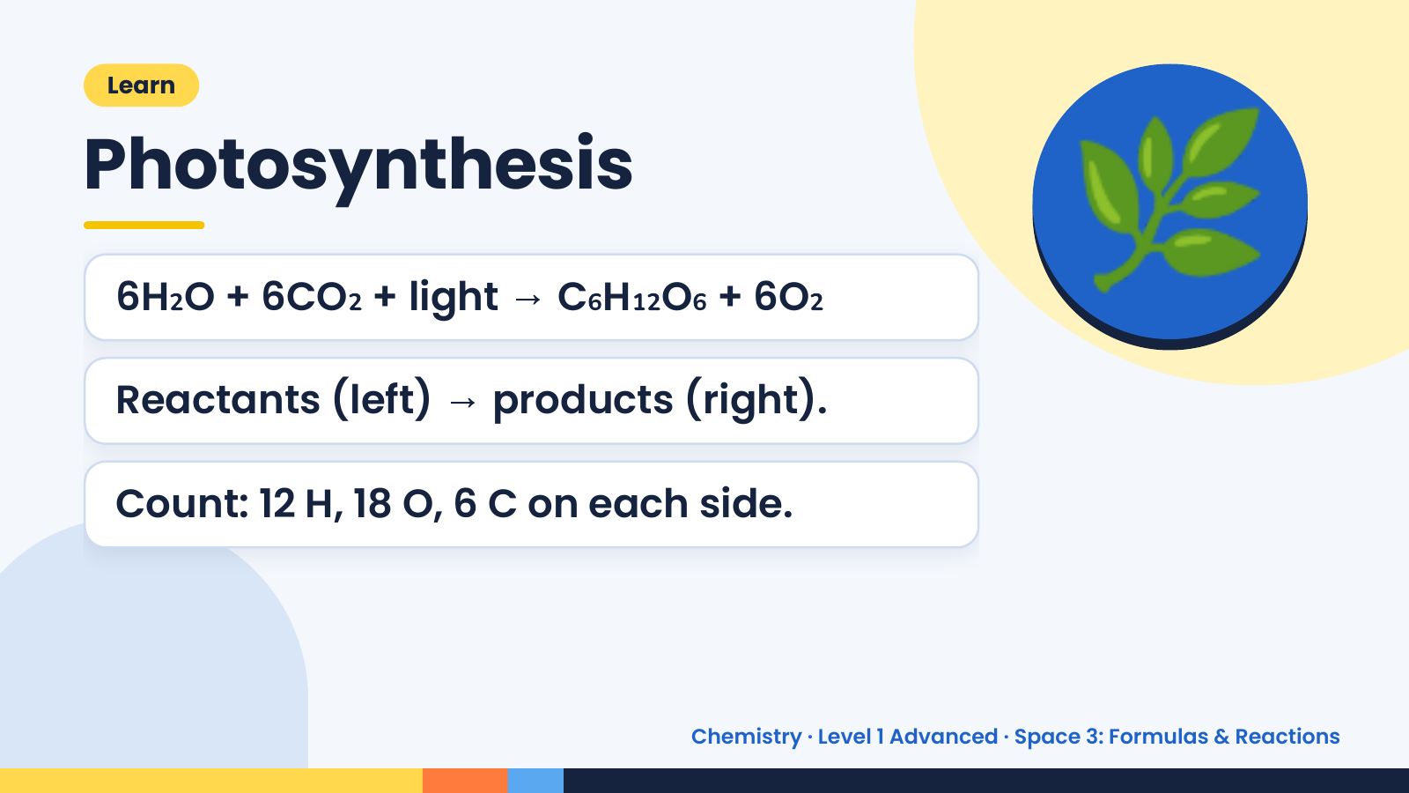
Notes:
Learn
Photosynthesis
6H₂O + 6CO₂ + light → C₆H₁₂O₆ + 6O₂
Reactants (left) → products (right).
🌿
Count: 12 H, 18 O, 6 C on each side.
Chemistry · Level 1 Advanced · Space 3: Formulas & Reactions

Slide 16
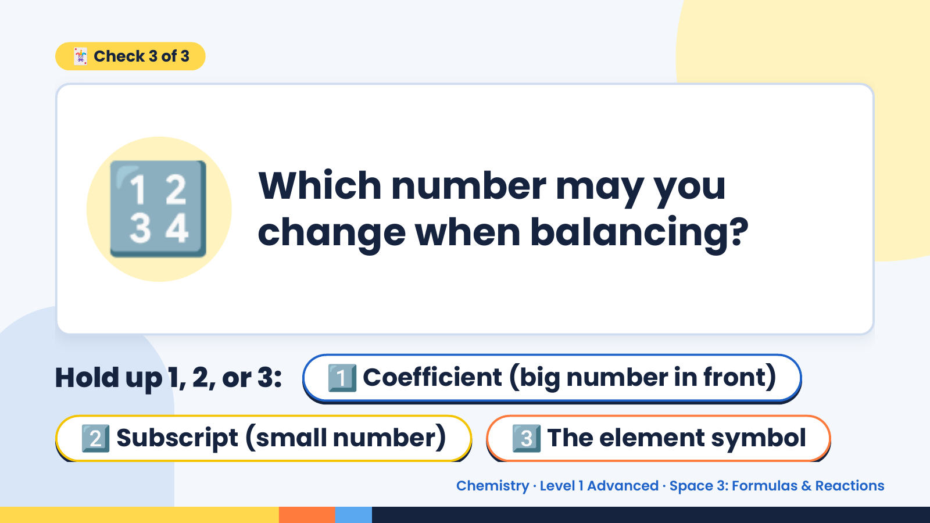
Notes:
🃏 Check 3 of 3
🔢 Which number may you
change when balancing?
Hold up 1, 2, or 3: 1️⃣ Coefficient (big number in front)
2️⃣ Subscript (small number) 3️⃣ The element symbol
Chemistry · Level 1 Advanced · Space 3: Formulas & Reactions

Slide 17
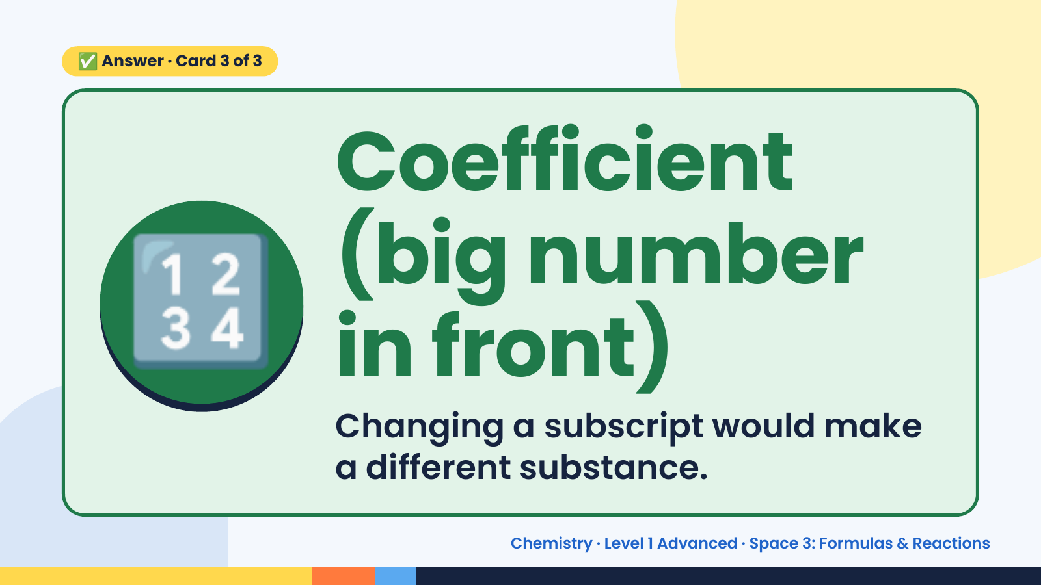
Notes:
✅ Answer · Card 3 of 3
🔢
Coefficient
(big number
in front)
Changing a subscript would make
a different substance.
Chemistry · Level 1 Advanced · Space 3: Formulas & Reactions

Slide 18
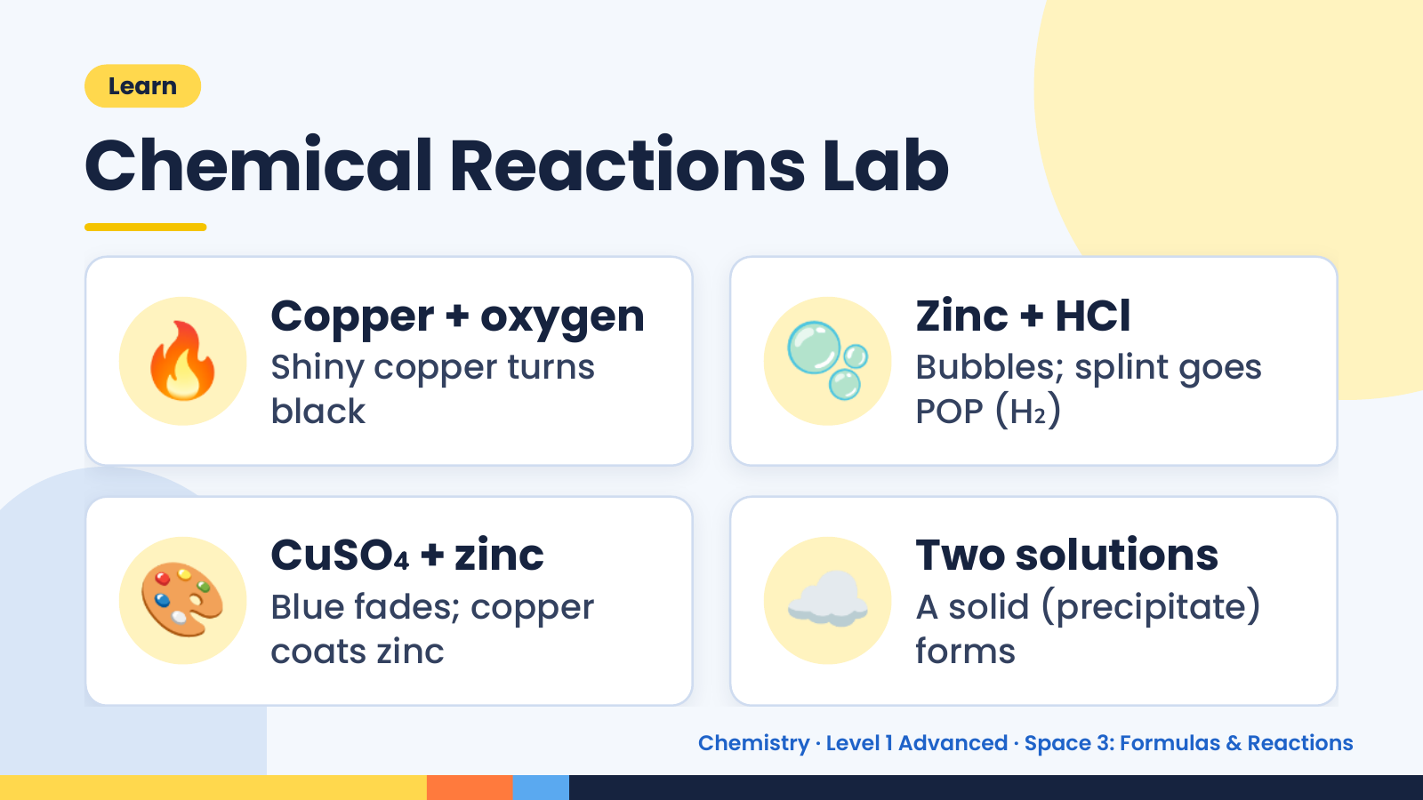
Notes:
Learn
Chemical Reactions Lab
🔥 Copper + oxygen
Shiny copper turns
black
🫧 Zinc + HCl
Bubbles; splint goes
POP (H₂)
🎨 CuSO₄ + zinc
Blue fades; copper
coats zinc
☁️ Two solutions
A solid (precipitate)
forms
Chemistry · Level 1 Advanced · Space 3: Formulas & Reactions

Slide 19
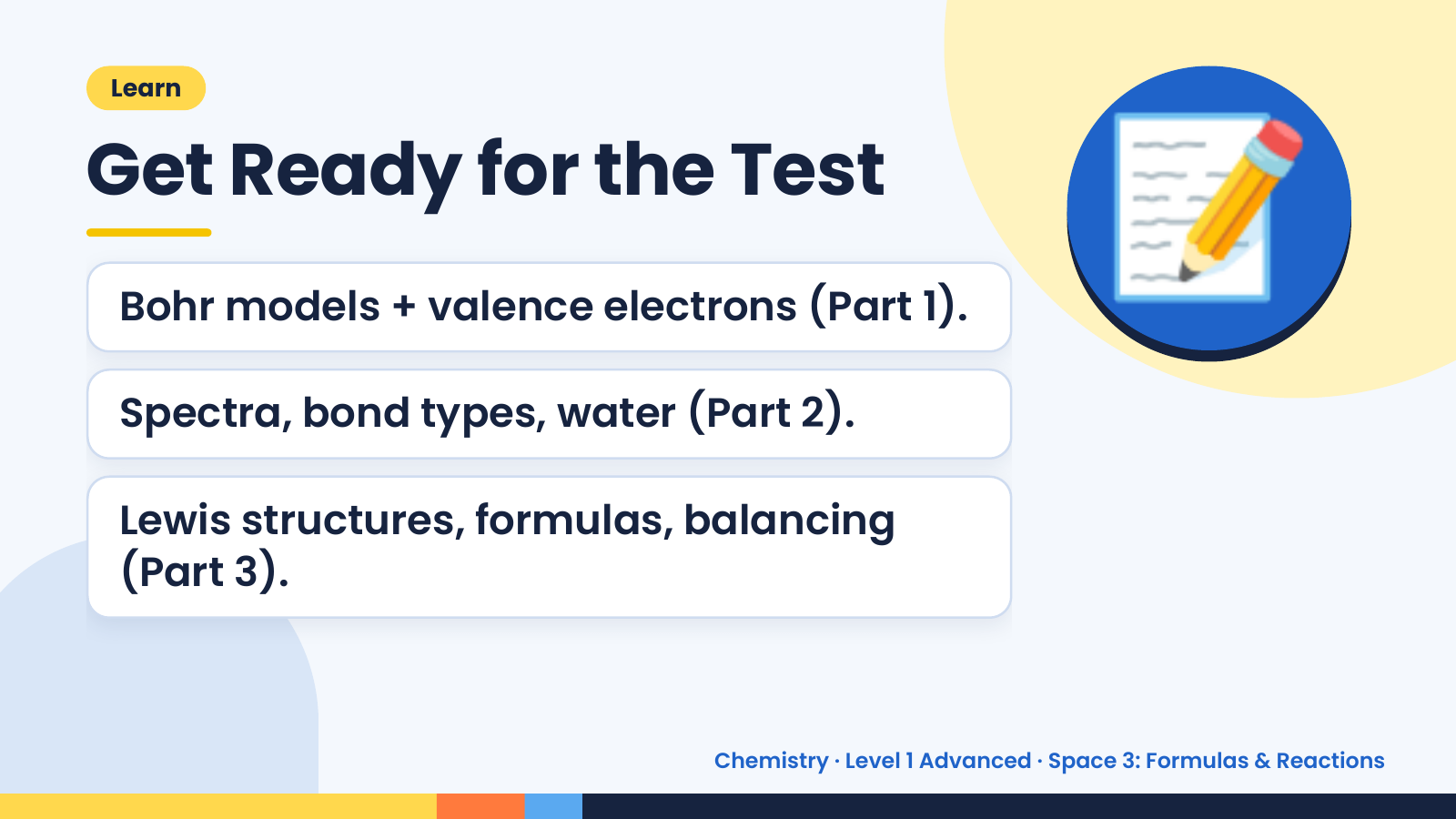
Notes:
Learn
Get Ready for the Test
Bohr models + valence electrons (Part 1).
Spectra, bond types, water (Part 2).
📝
Lewis structures, formulas, balancing
(Part 3).
Chemistry · Level 1 Advanced · Space 3: Formulas & Reactions

Slide 20
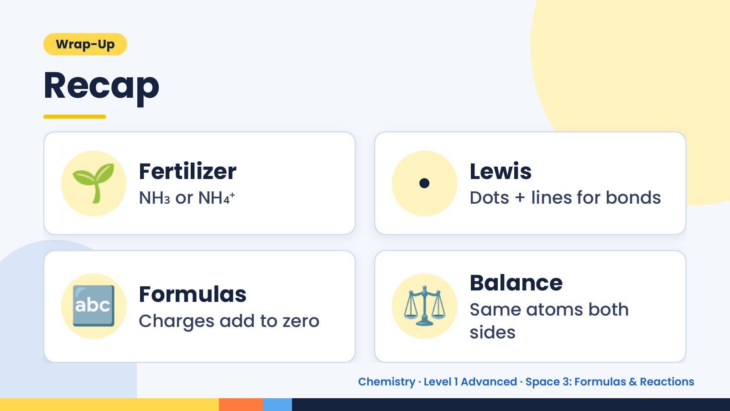
Notes:
Wrap-Up
Recap
🌱 Fertilizer
NH₃ or NH₄⁺ • Lewis
Dots + lines for bonds
🔤 Formulas
Charges add to zero ⚖️ Balance
Same atoms both
sides
Chemistry · Level 1 Advanced · Space 3: Formulas & Reactions

Slide 21
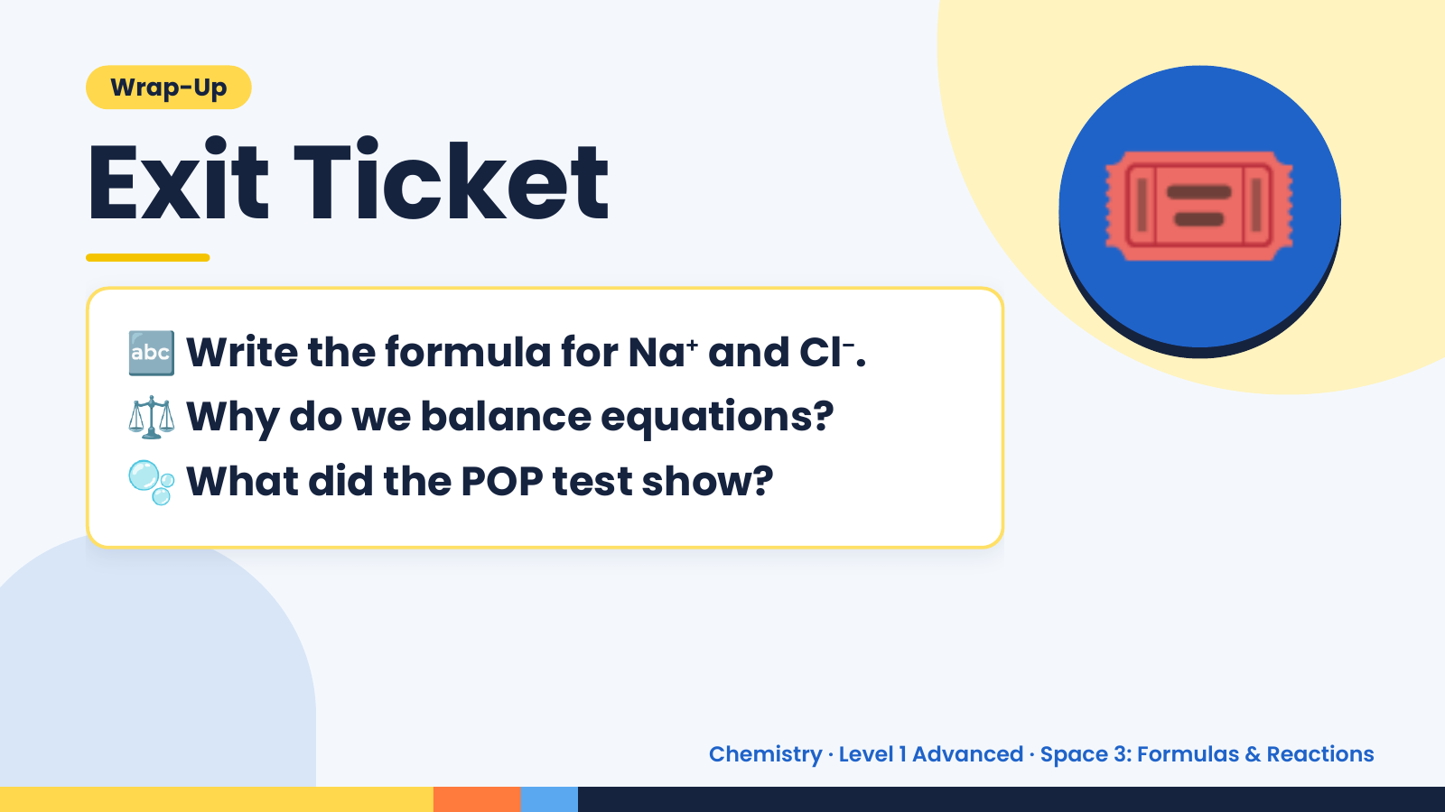
Notes:
Wrap-Up
Exit Ticket
🔤
⚖️
Write the formula for Na⁺ and Cl⁻.
Why do we balance equations?
🎟️
🫧 What did the POP test show?
Chemistry · Level 1 Advanced · Space 3: Formulas & Reactions

