Slide 1
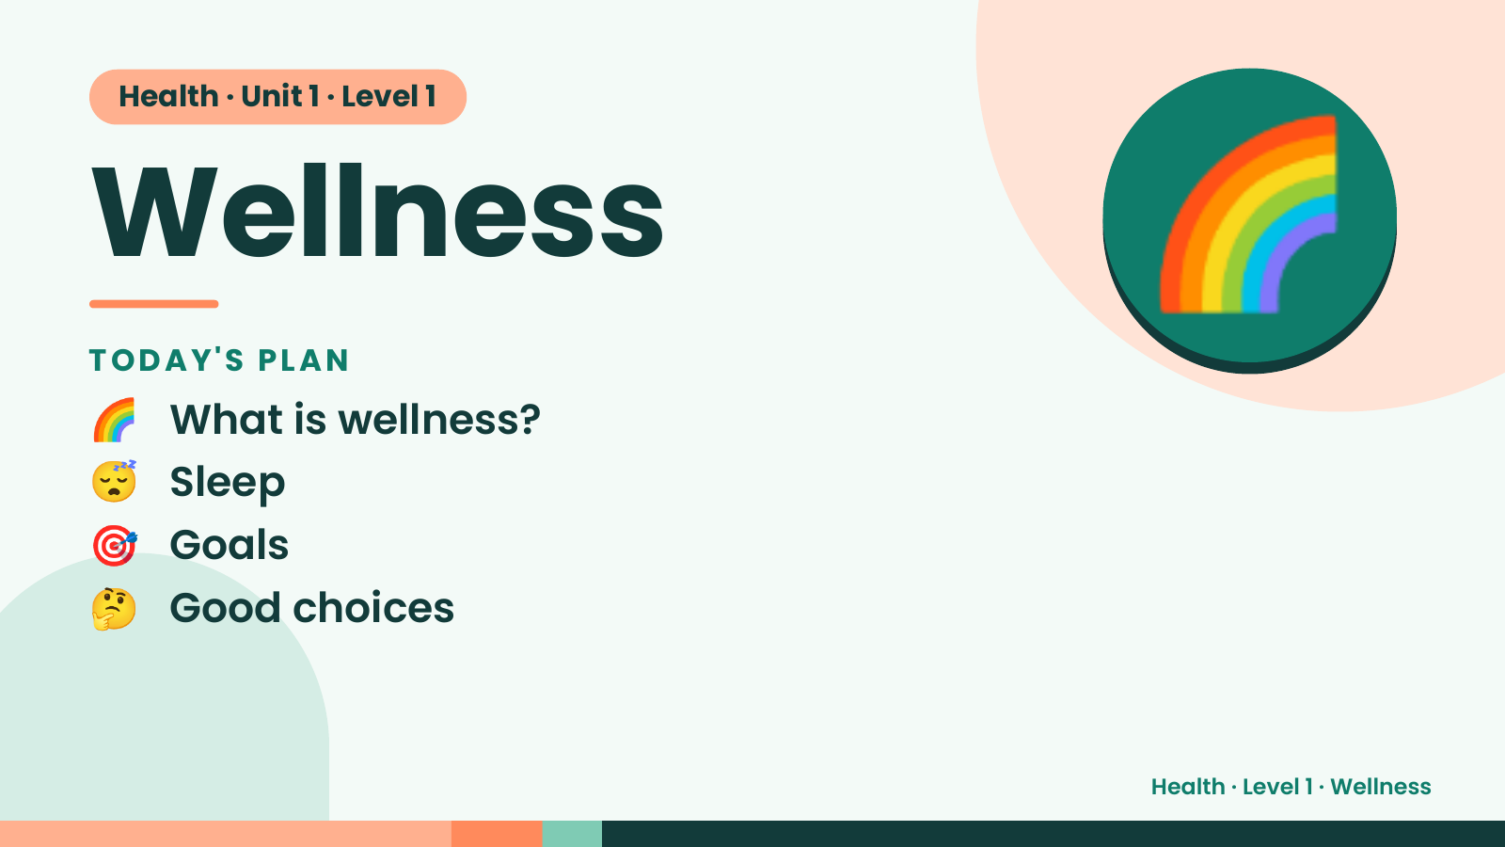
Notes:
Health · Unit 1 · Level 1
Wellness
TODAY'S PLAN
🌈 What is wellness?
🌈
😴 Sleep
🎯 Goals
🤔 Good choices
Health · Level 1 · Wellness

Slide 2
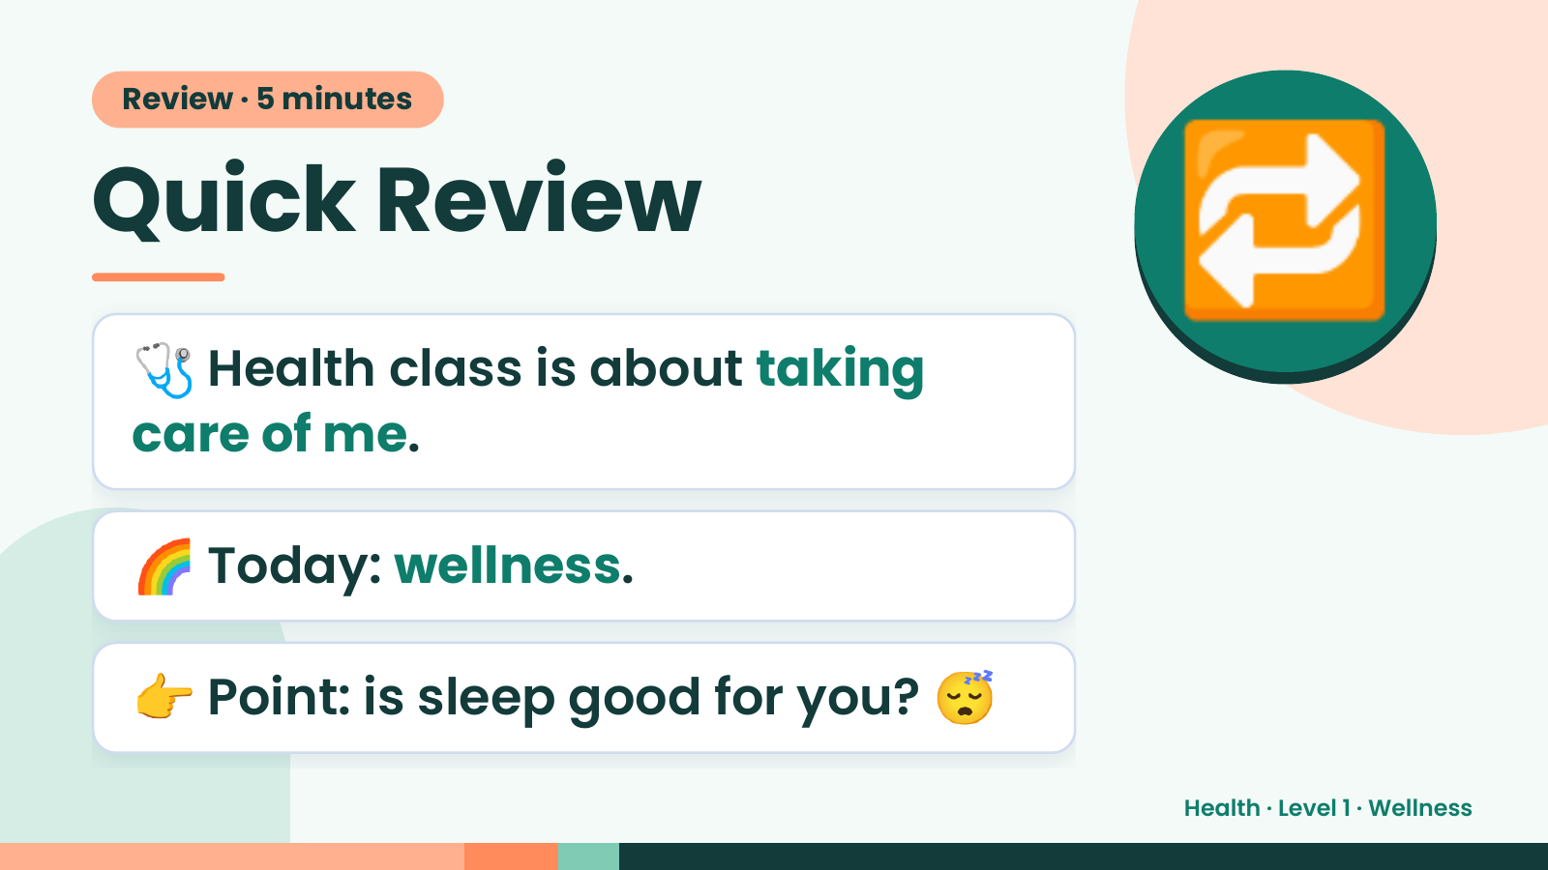
Notes:
Review · 5 minutes
Quick Review
🩺 Health class is about taking
care of me.
🔁
🌈 Today: wellness.
👉 Point: is sleep good for you? 😴
Health · Level 1 · Wellness

Slide 3
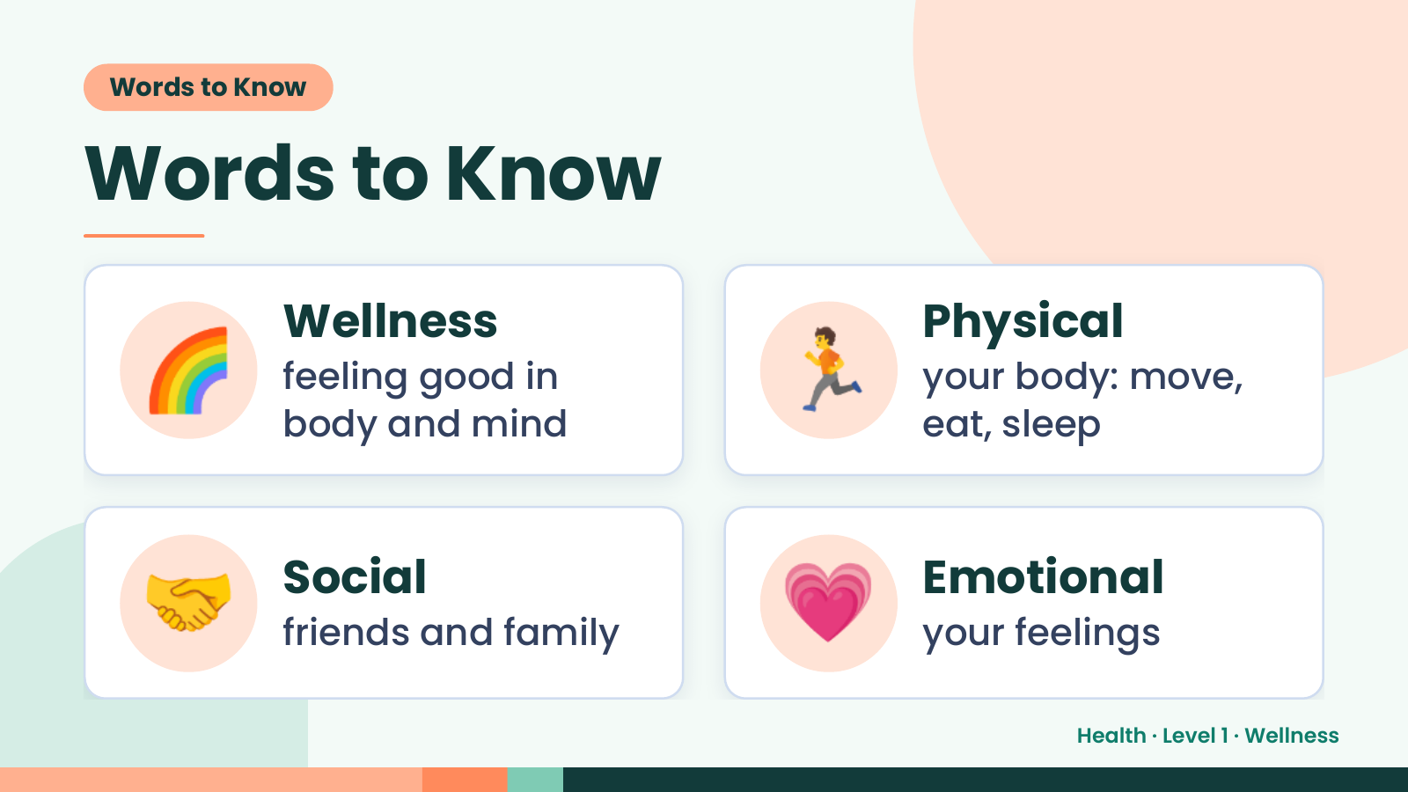
Notes:
Words to Know
Words to Know
🌈 Wellness
feeling good in
body and mind
🏃 Physical
your body: move,
eat, sleep
🤝 Social
friends and family 💗 Emotional
your feelings
Health · Level 1 · Wellness

Slide 4
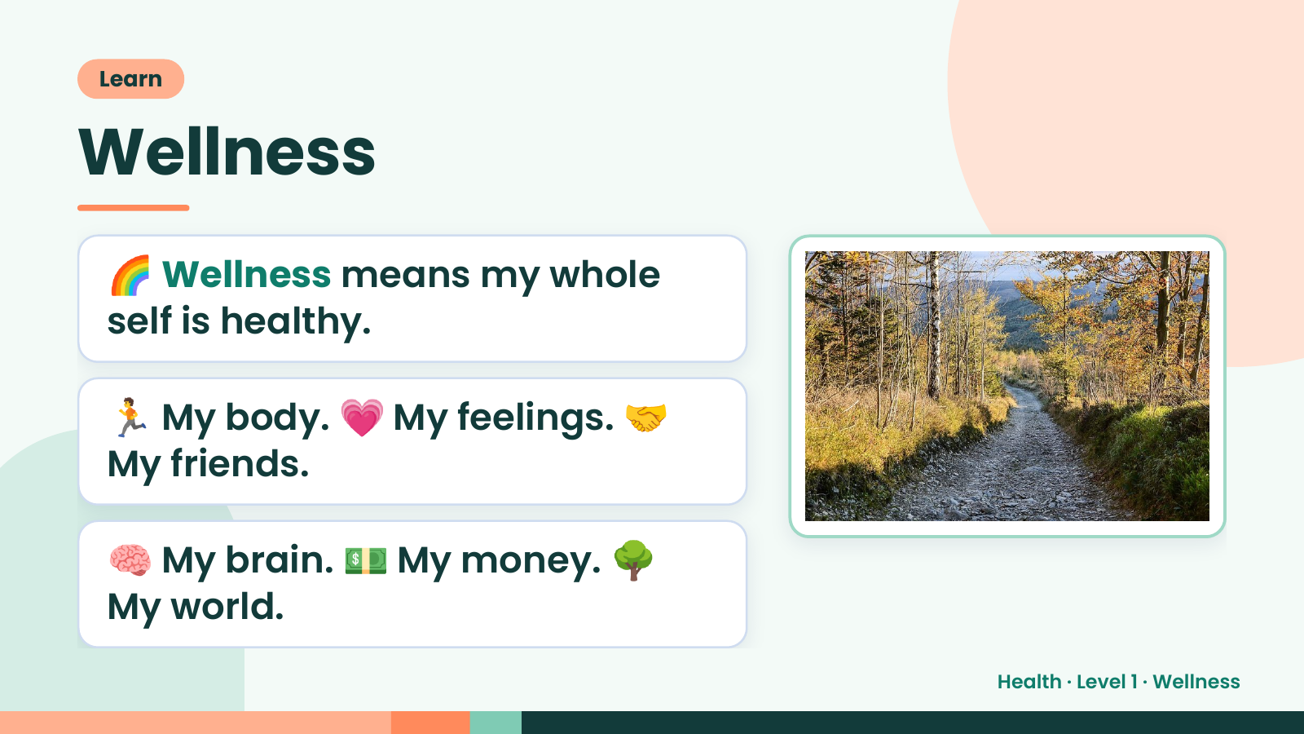
Notes:
Learn
Wellness
🌈 Wellness means my whole
self is healthy.
🏃 My body. 💗 My feelings. 🤝
My friends.
🧠 My brain. 💵 My money. 🌳
My world.
Health · Level 1 · Wellness

Slide 5
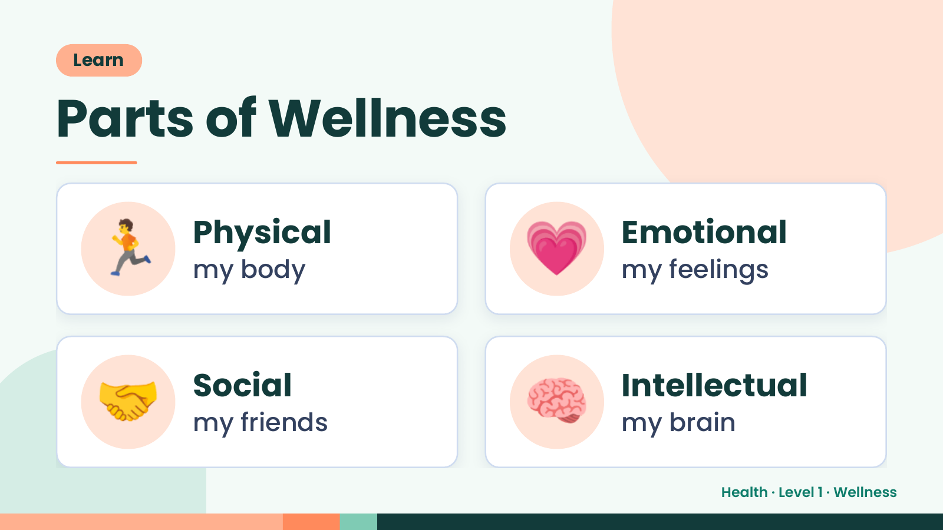
Notes:
Learn
Parts of Wellness
🏃 Physical
my body 💗 Emotional
my feelings
🤝 Social
my friends 🧠 Intellectual
my brain
Health · Level 1 · Wellness

Slide 6
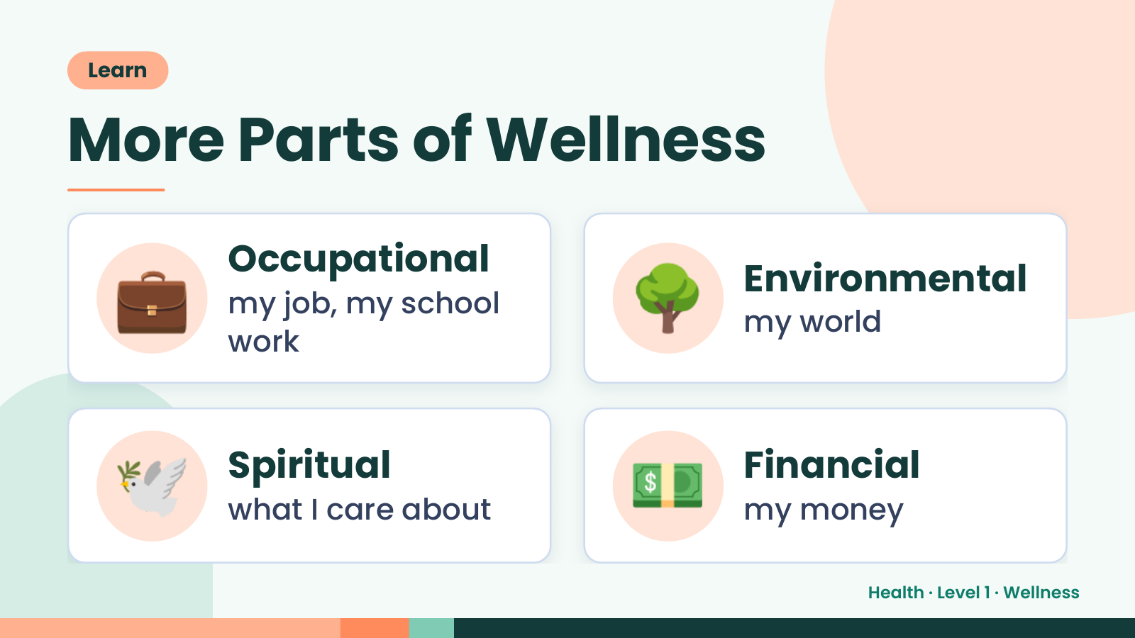
Notes:
Learn
More Parts of Wellness
💼 Occupational
my job, my school
work
🌳 Environmental
my world
🕊️ Spiritual
what I care about 💵 Financial
my money
Health · Level 1 · Wellness

Slide 7
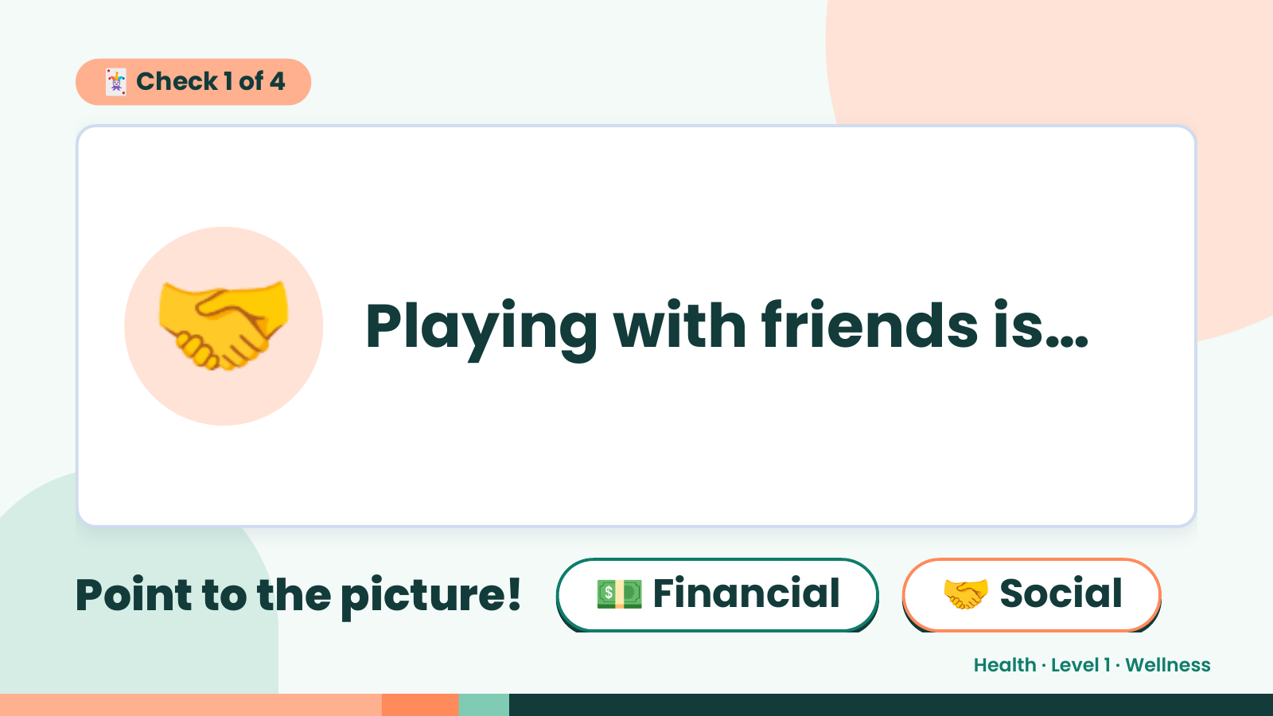
Notes:
🃏 Check 1 of 4
🤝 Playing with friends is…
Point to the picture! 💵 Financial 🤝 Social
Health · Level 1 · Wellness

Slide 8
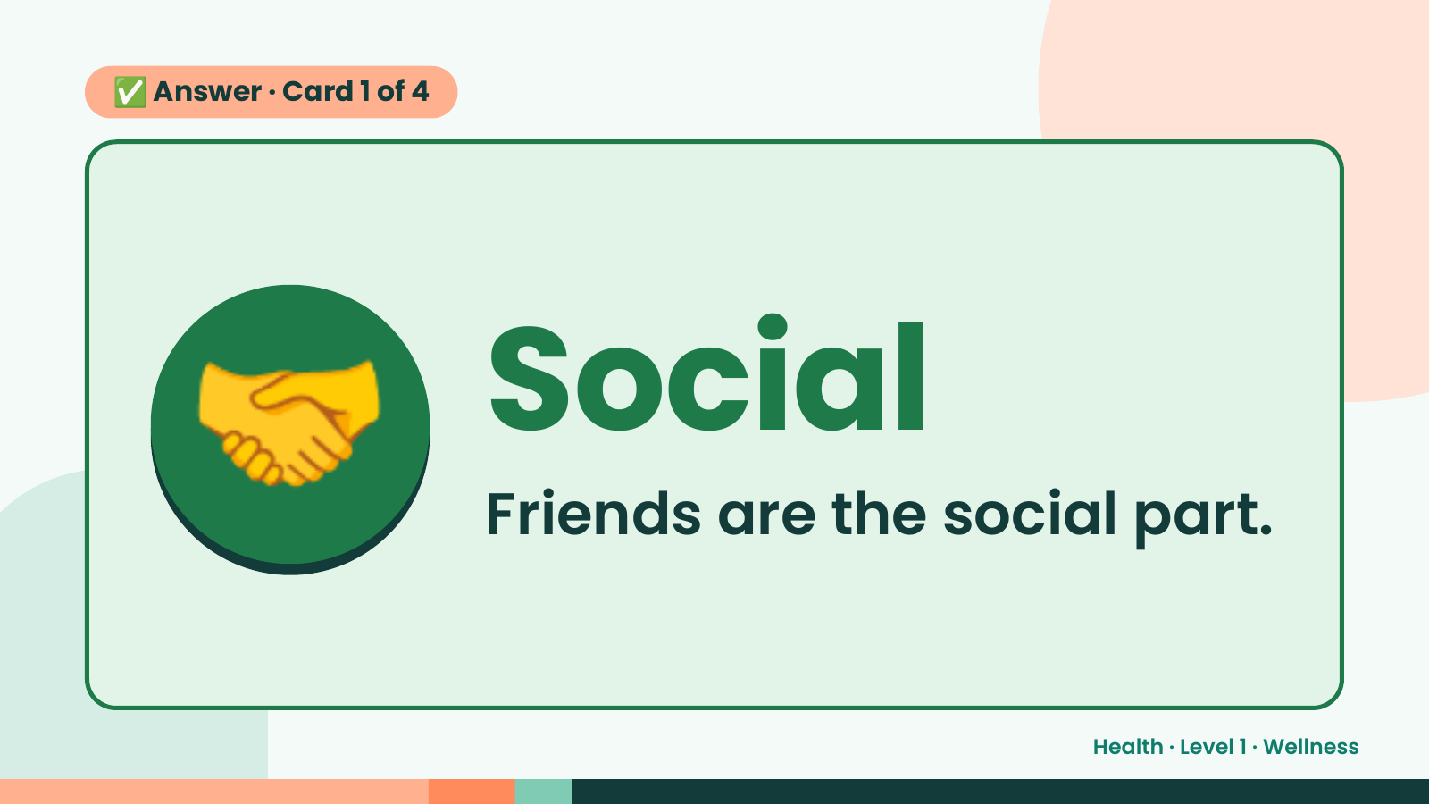
Notes:
✅ Answer · Card 1 of 4
🤝 Social
Friends are the social part.
Health · Level 1 · Wellness

Slide 9
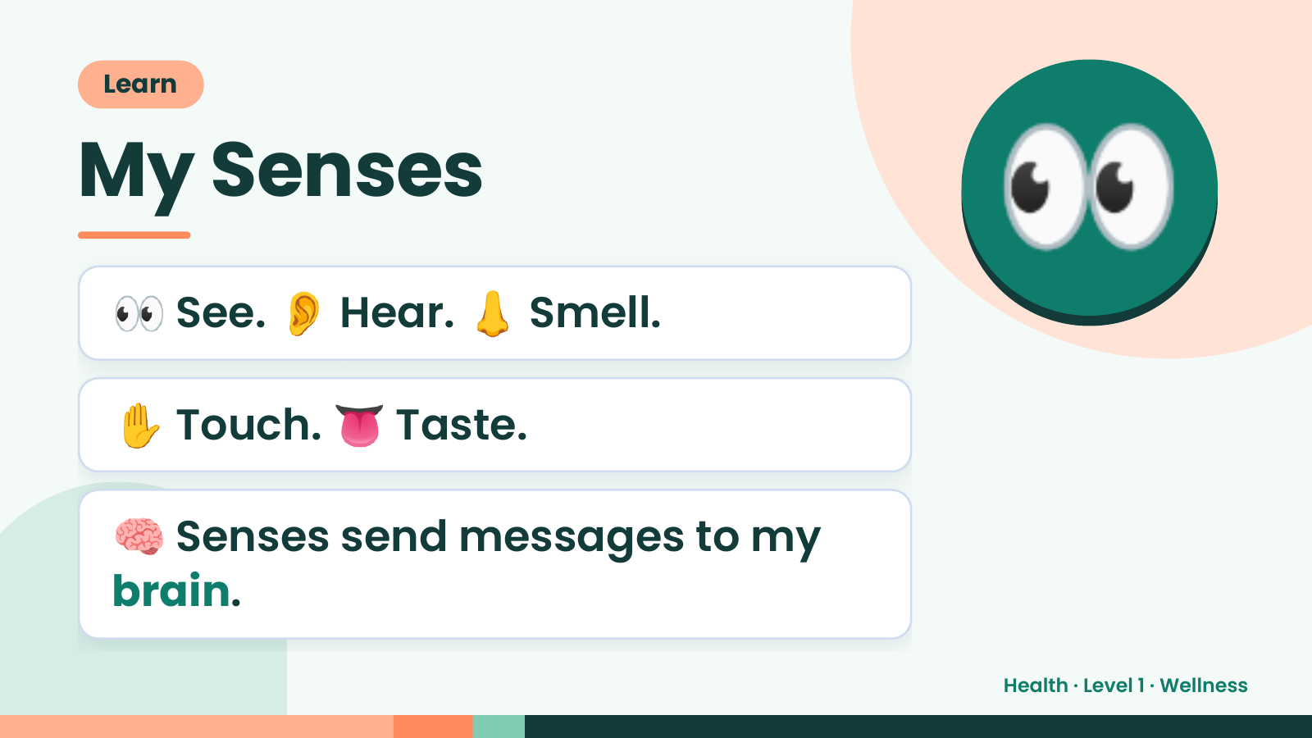
Notes:
Learn
My Senses
👀 See. 👂 Hear. 👃 Smell.
👀
✋ Touch. 👅 Taste.
🧠 Senses send messages to my
brain.
Health · Level 1 · Wellness

Slide 10
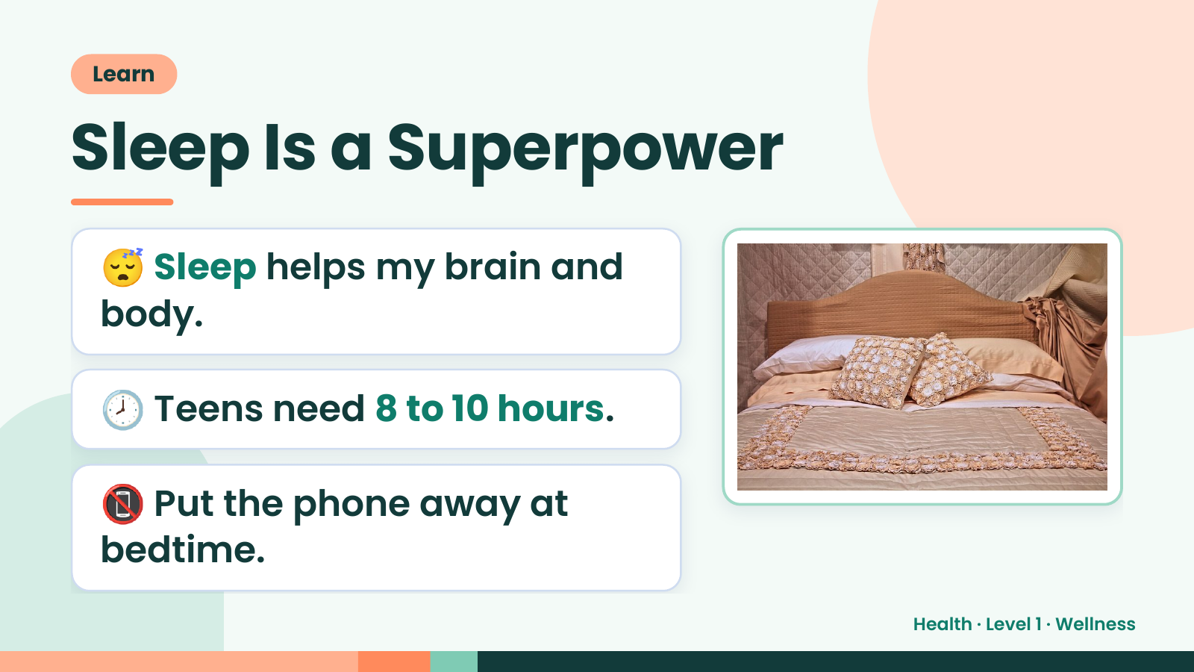
Notes:
Learn
Sleep Is a Superpower
😴 Sleep helps my brain and
body.
🕗 Teens need 8 to 10 hours.
📵 Put the phone away at
bedtime.
Health · Level 1 · Wellness

Slide 11
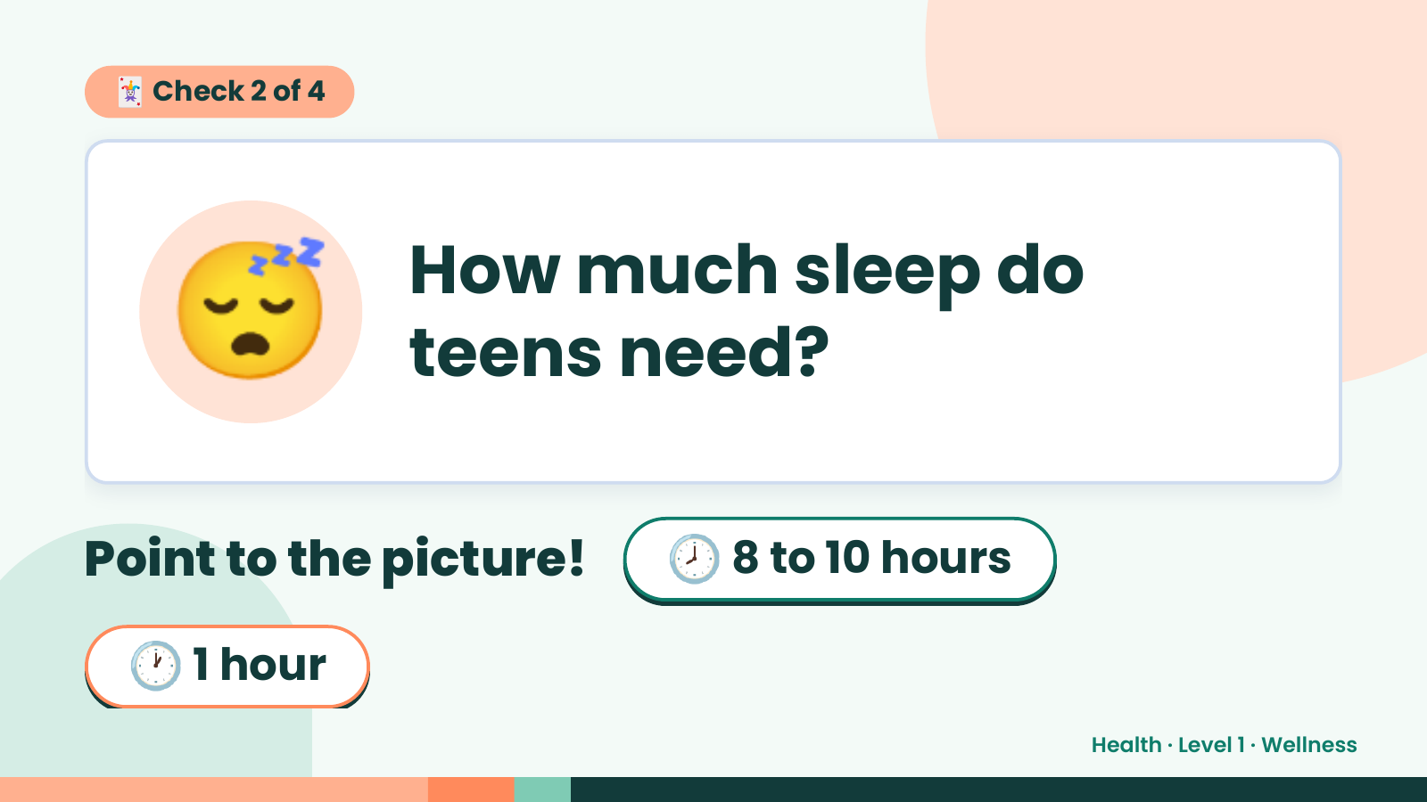
Notes:
🃏 Check 2 of 4
😴 How much sleep do
teens need?
Point to the picture! 🕗 8 to 10 hours
🕐 1 hour
Health · Level 1 · Wellness

Slide 12
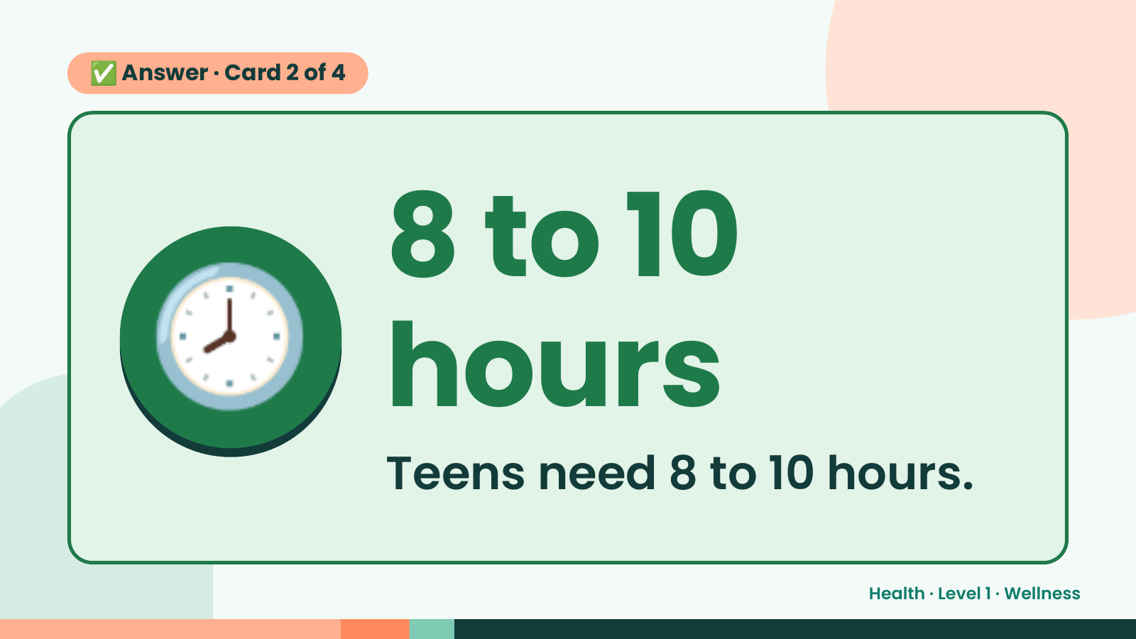
Notes:
✅ Answer · Card 2 of 4
🕗 8 to 10
hours
Teens need 8 to 10 hours.
Health · Level 1 · Wellness

Slide 13
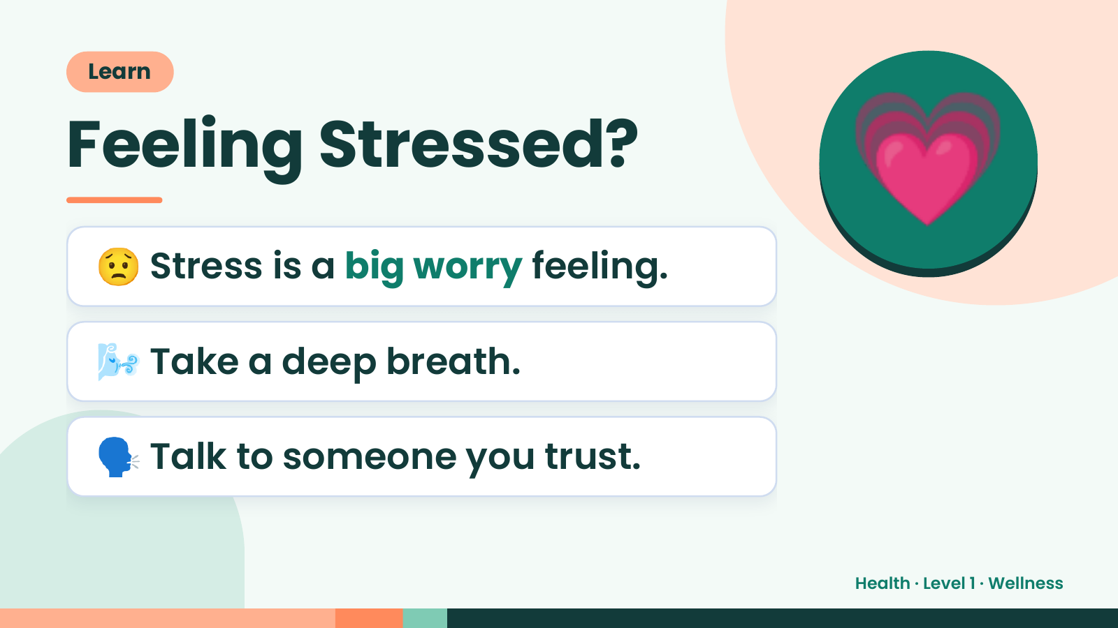
Notes:
Learn
Feeling Stressed?
😟 Stress is a big worry feeling.
💗
🌬️ Take a deep breath.
🗣️ Talk to someone you trust.
Health · Level 1 · Wellness

Slide 14
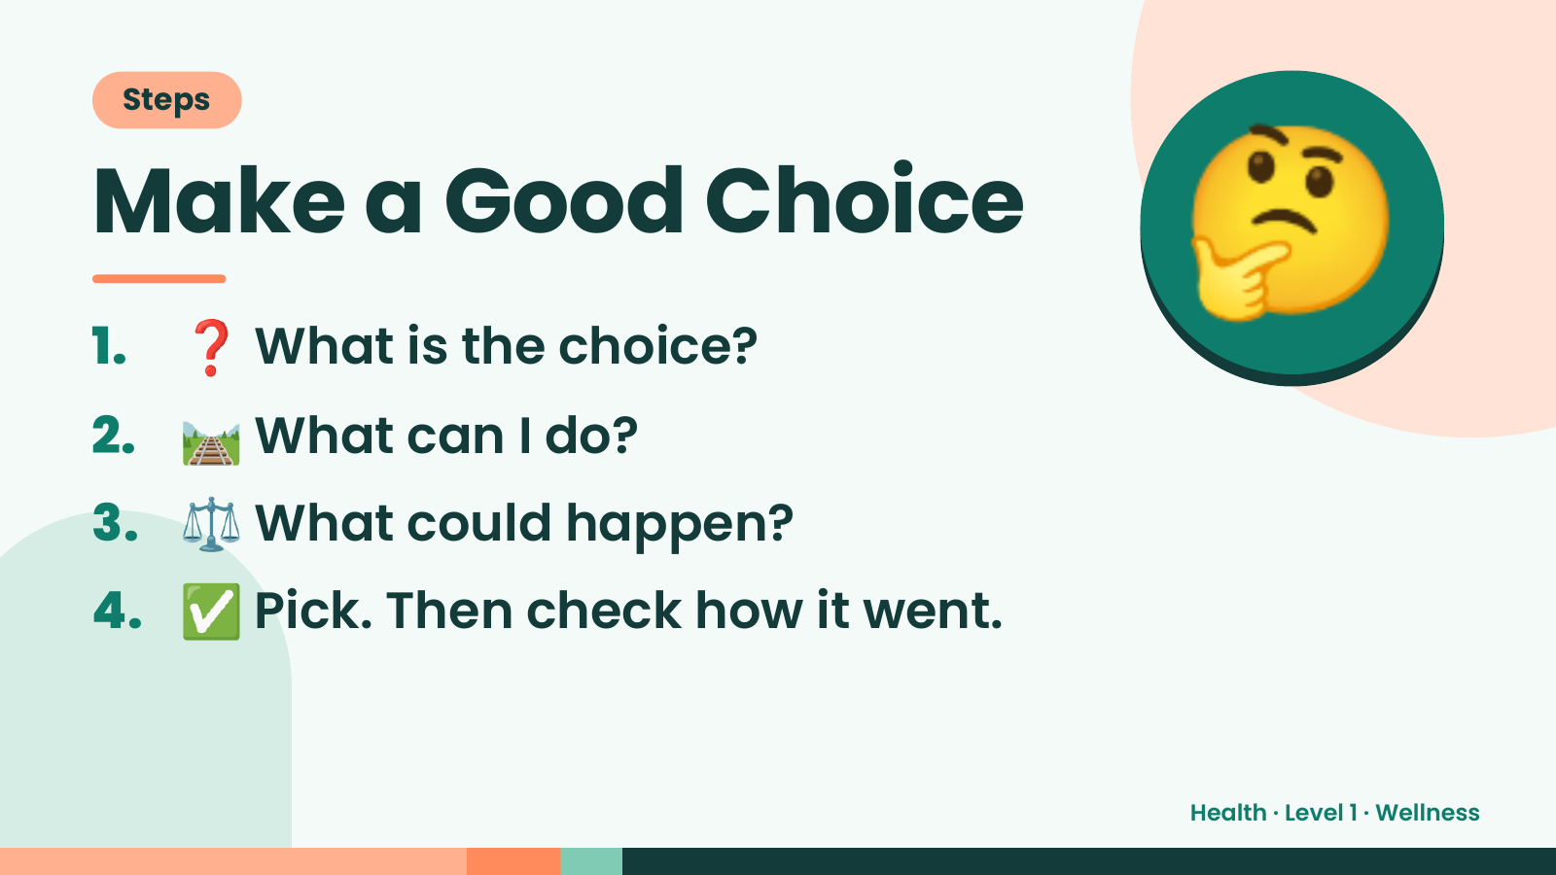
Notes:
Steps
Make a Good Choice
1. ❓ What is the choice?
2. 🛤️ What can I do?
🤔
3. ⚖️ What could happen?
4. ✅ Pick. Then check how it went.
Health · Level 1 · Wellness

Slide 15
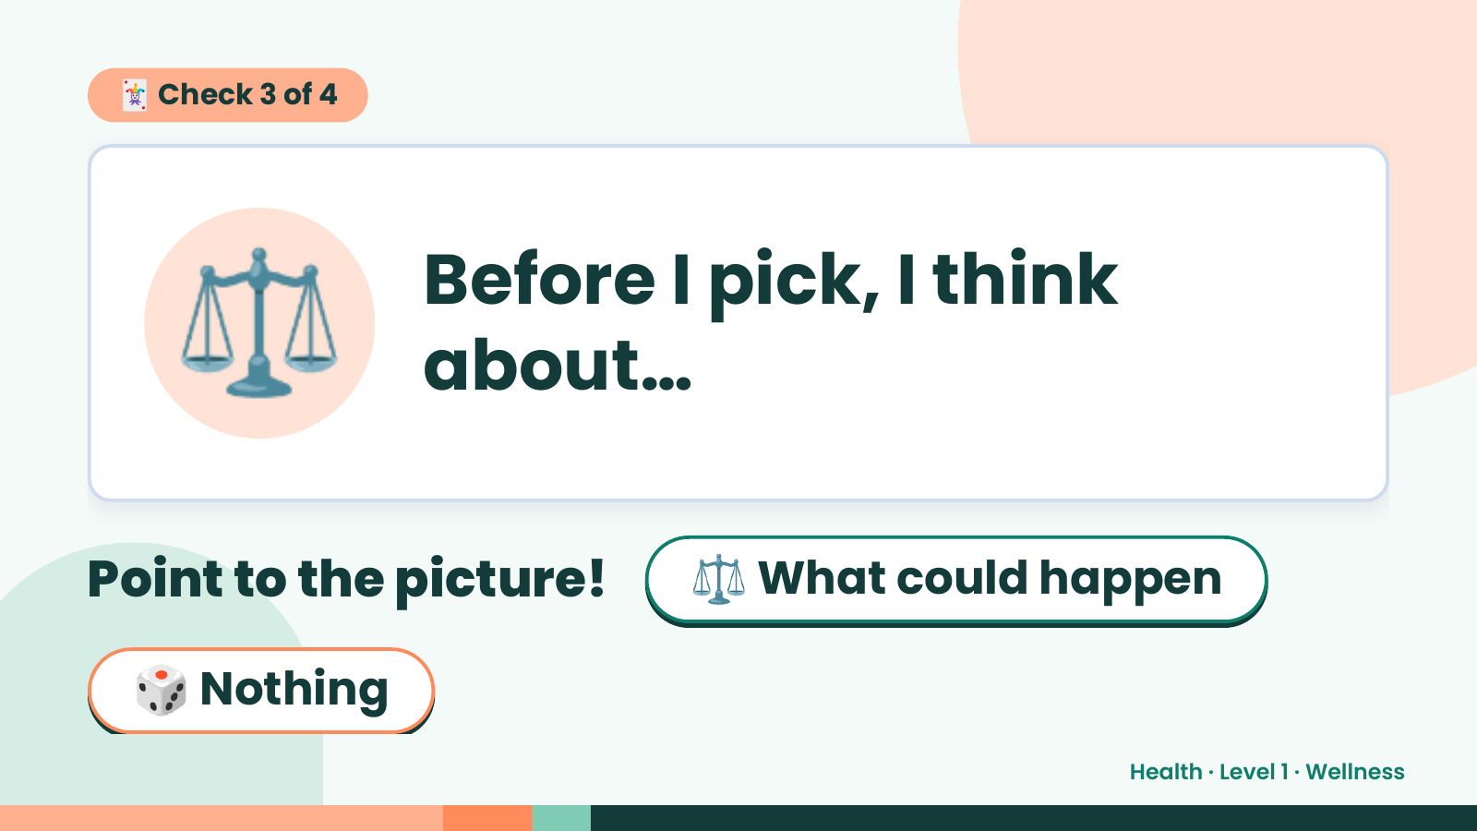
Notes:
🃏 Check 3 of 4
⚖️ Before I pick, I think
about…
Point to the picture! ⚖️ What could happen
🎲 Nothing
Health · Level 1 · Wellness

Slide 16
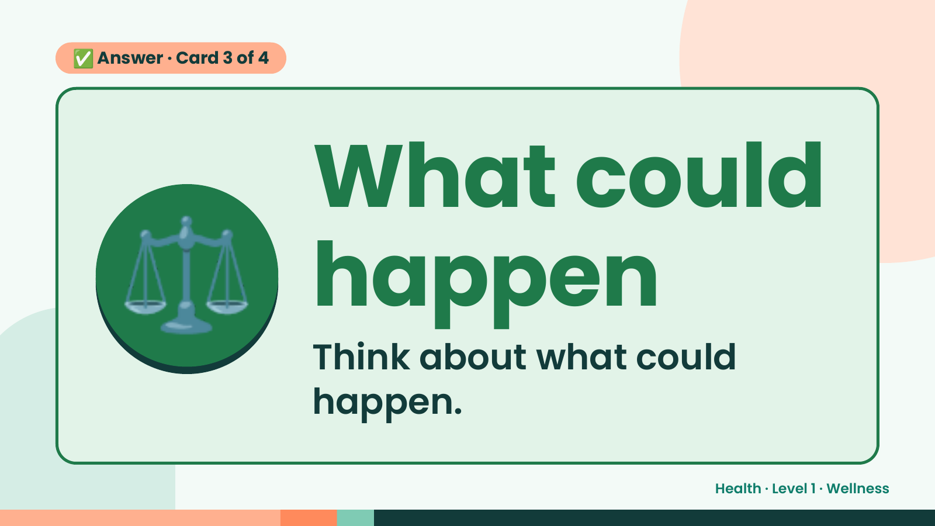
Notes:
✅ Answer · Card 3 of 4
⚖️ What could
happen
Think about what could
happen.
Health · Level 1 · Wellness

Slide 17
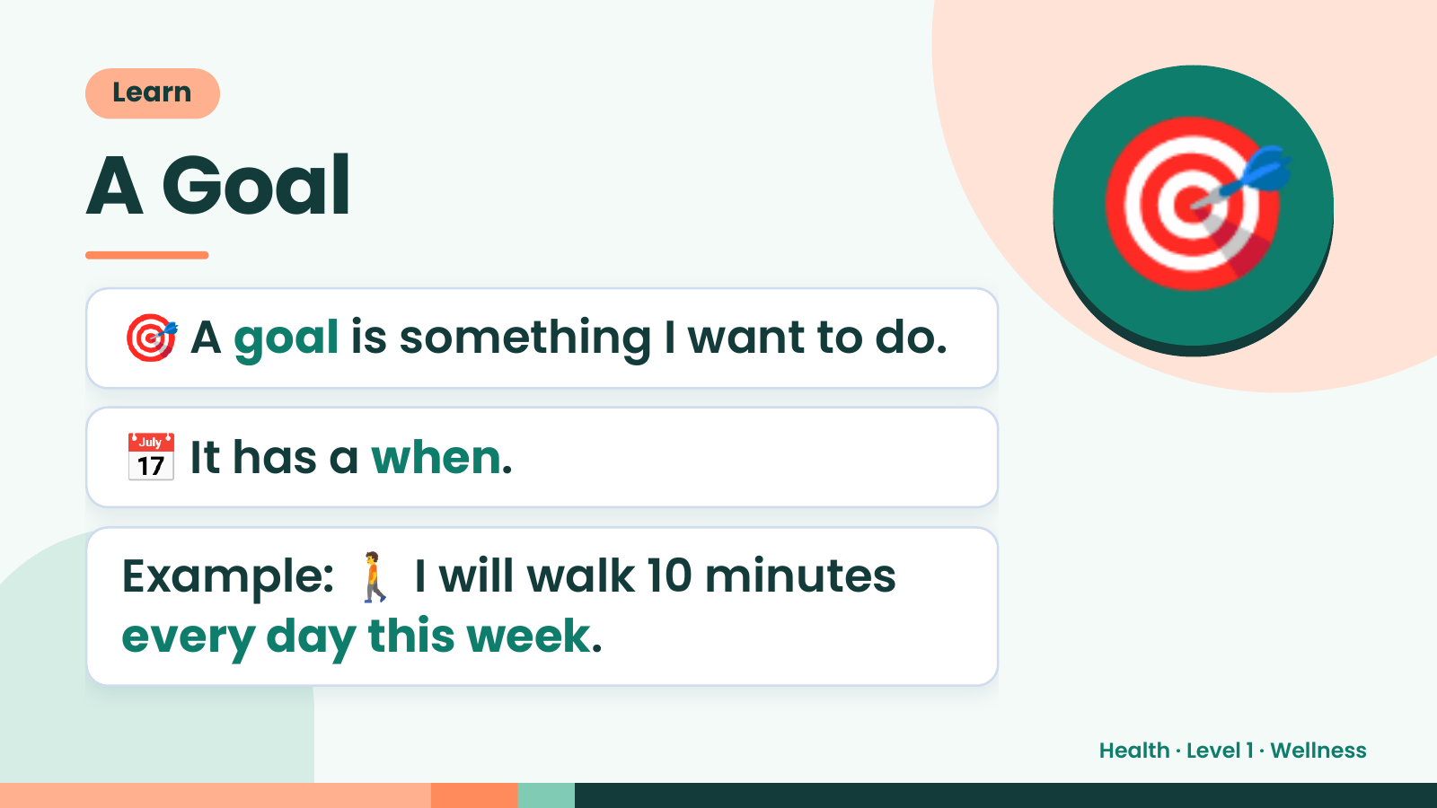
Notes:
Learn
A Goal
🎯 A goal is something I want to do.
🎯
📅 It has a when.
Example: 🚶 I will walk 10 minutes
every day this week.
Health · Level 1 · Wellness

Slide 18
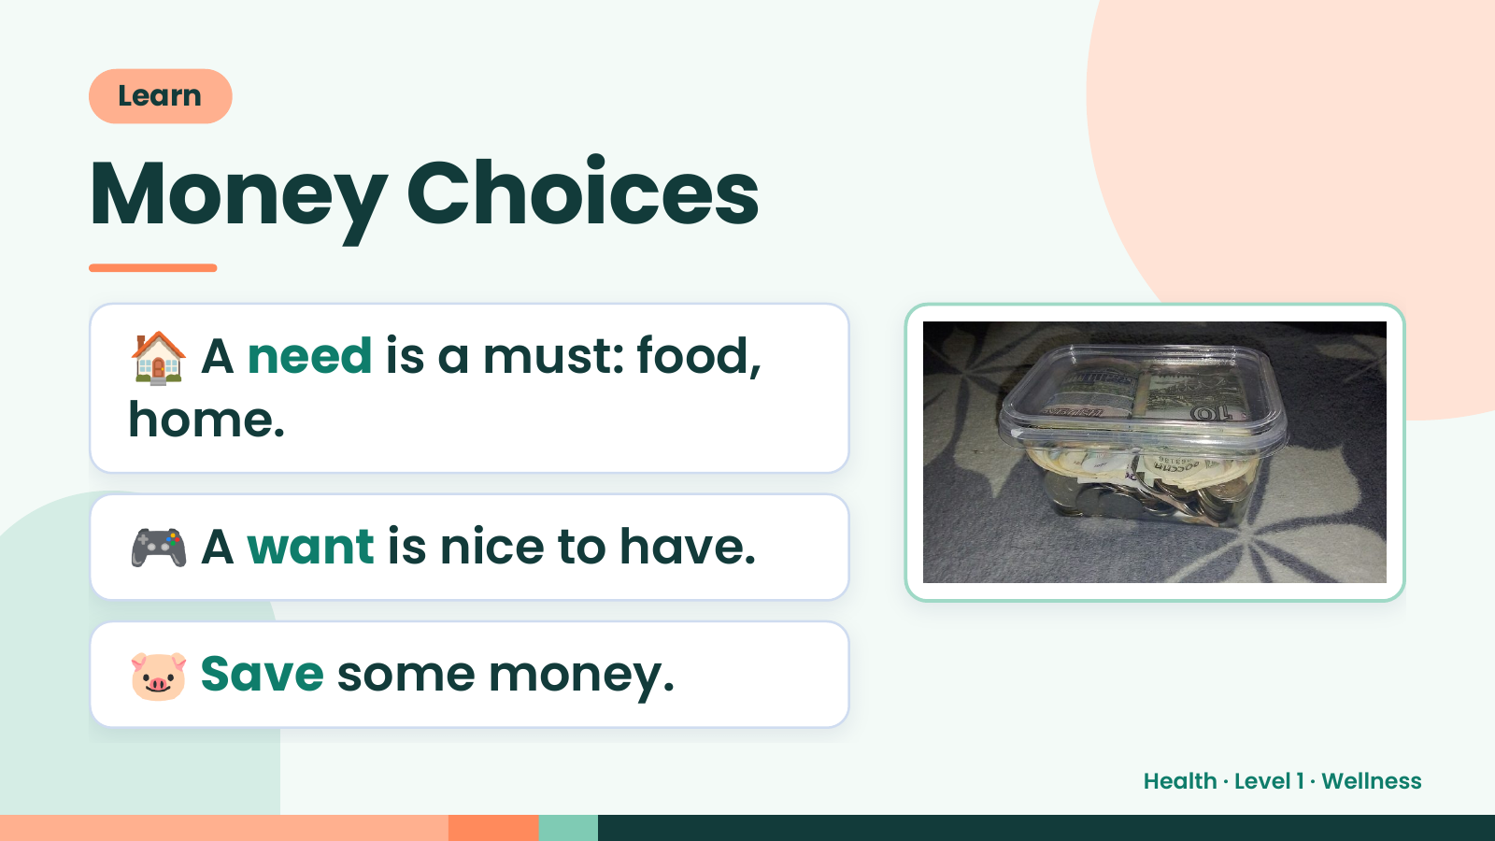
Notes:
Learn
Money Choices
🏠 A need is a must: food,
home.
🎮 A want is nice to have.
🐷 Save some money.
Health · Level 1 · Wellness

Slide 19
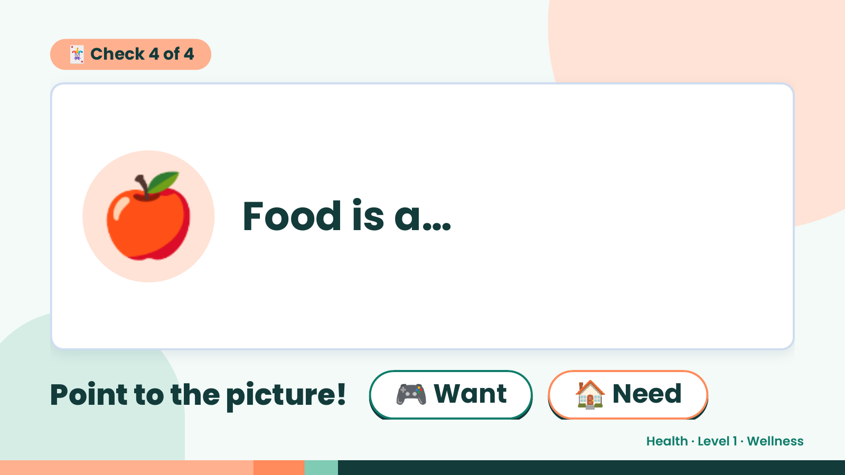
Notes:
🃏 Check 4 of 4
🍎 Food is a…
Point to the picture! 🎮 Want 🏠 Need
Health · Level 1 · Wellness

Slide 20
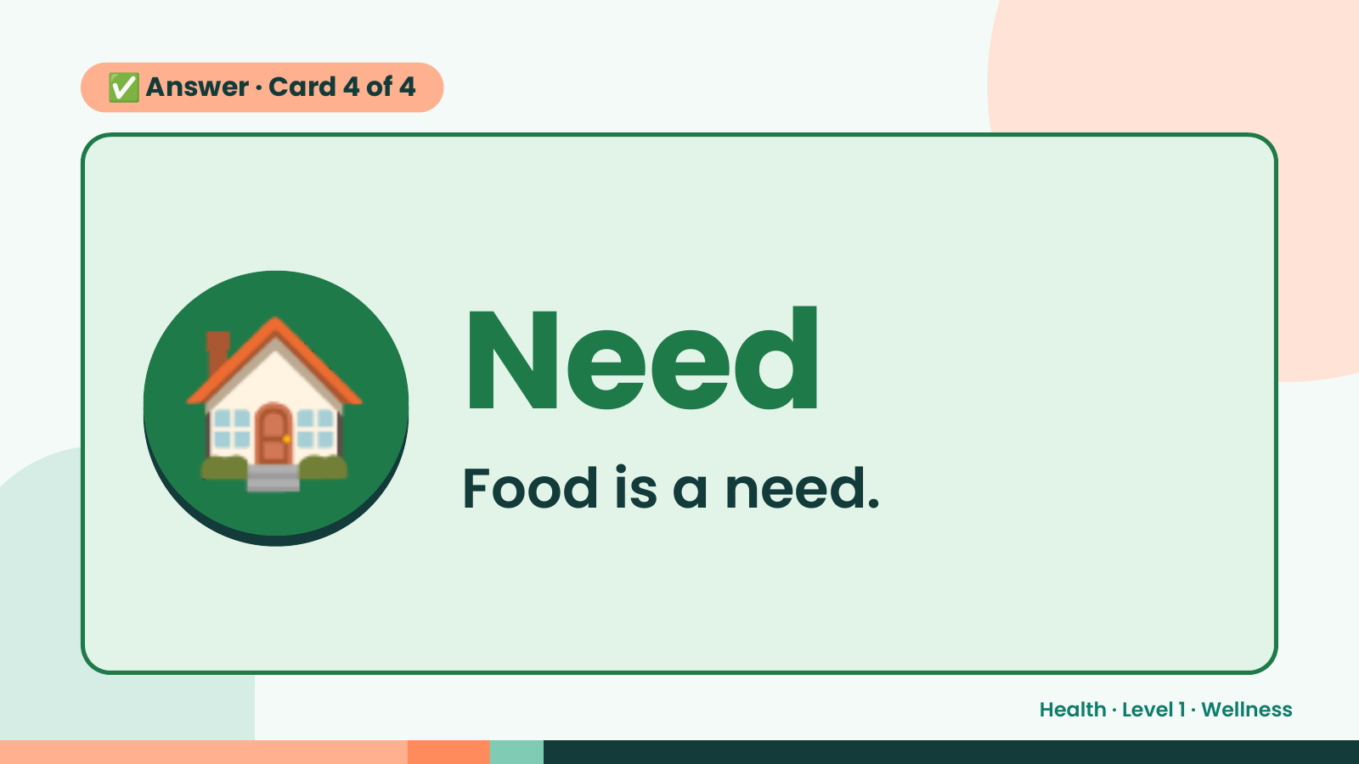
Notes:
✅ Answer · Card 4 of 4
🏠 Need
Food is a need.
Health · Level 1 · Wellness

Slide 21
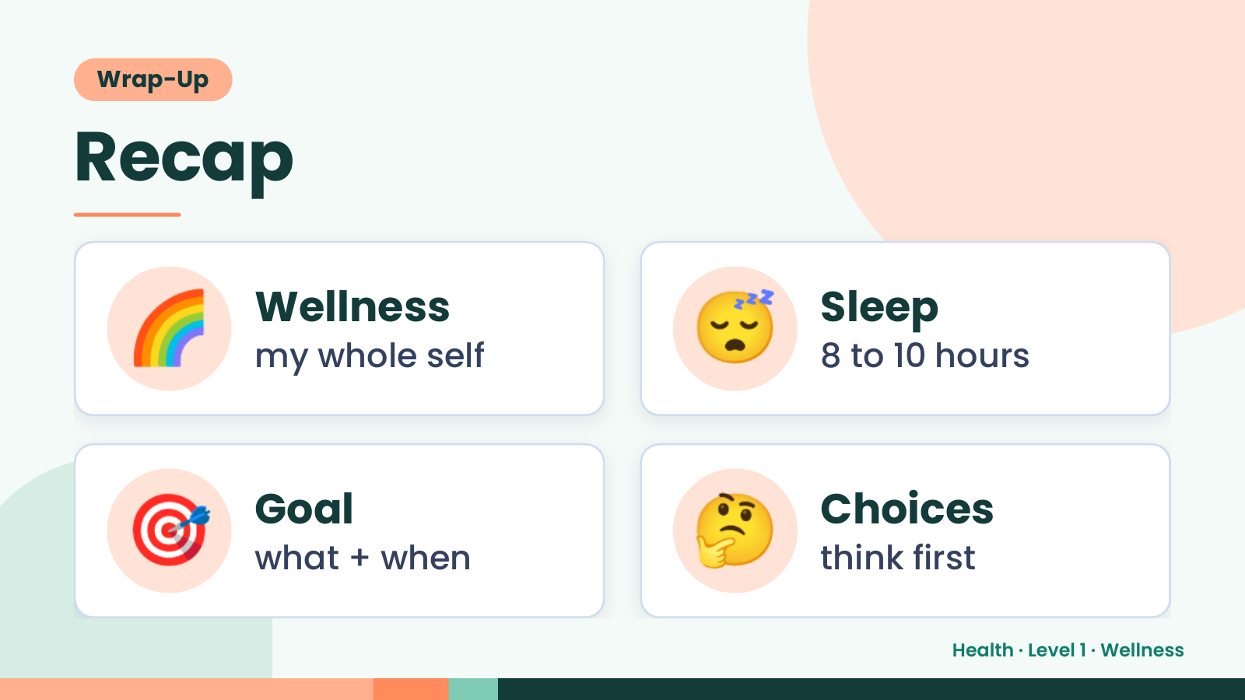
Notes:
Wrap-Up
Recap
🌈 Wellness
my whole self 😴 Sleep
8 to 10 hours
🎯 Goal
what + when 🤔 Choices
think first
Health · Level 1 · Wellness

Slide 22
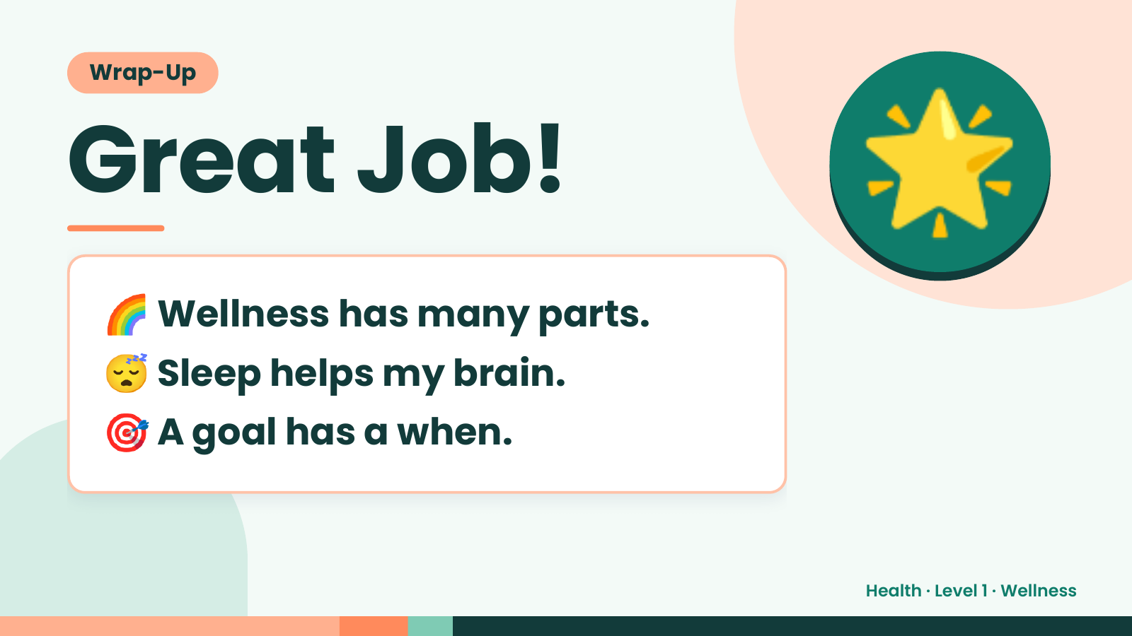
Notes:
Wrap-Up
Great Job!
🌈 Wellness has many parts.
🌟
😴 Sleep helps my brain.
🎯 A goal has a when.
Health · Level 1 · Wellness

