Slide 1
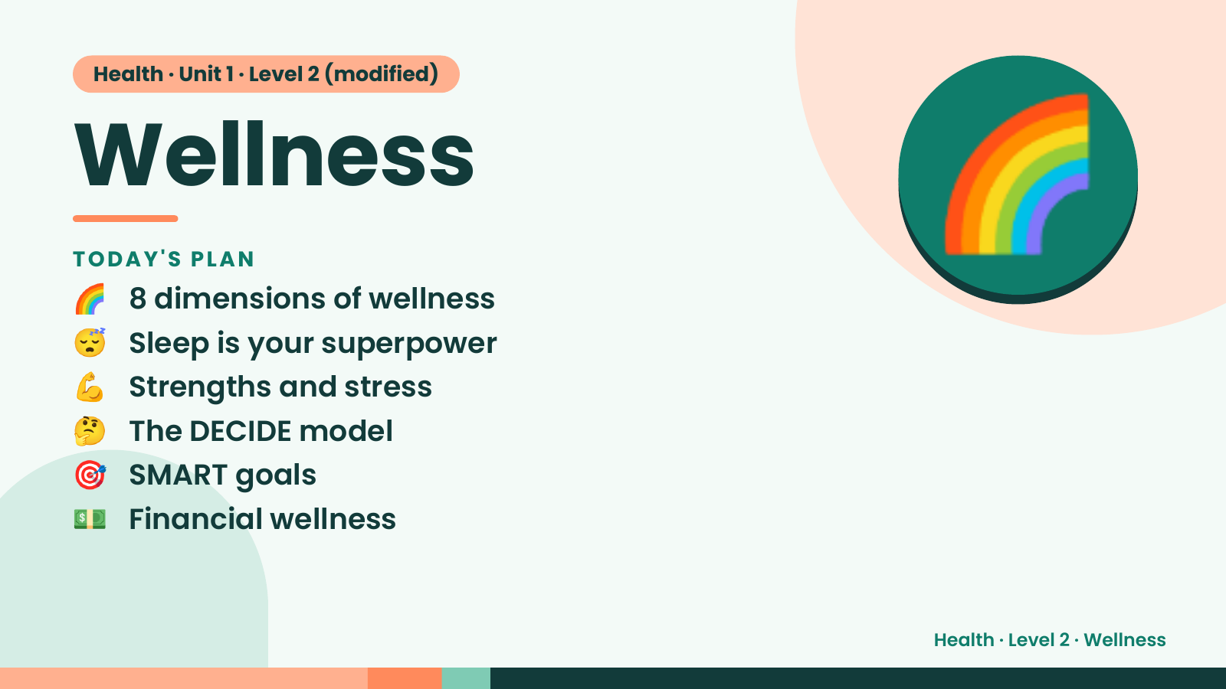
Notes:
Health · Unit 1 · Level 2 (modified)
Wellness
🌈 8 dimensions of wellness
TODAY'S PLAN
😴 Sleep is your superpower
💪 Strengths and stress
🌈
🤔 The DECIDE model
🎯 SMART goals
💵 Financial wellness
Health · Level 2 · Wellness

Slide 2
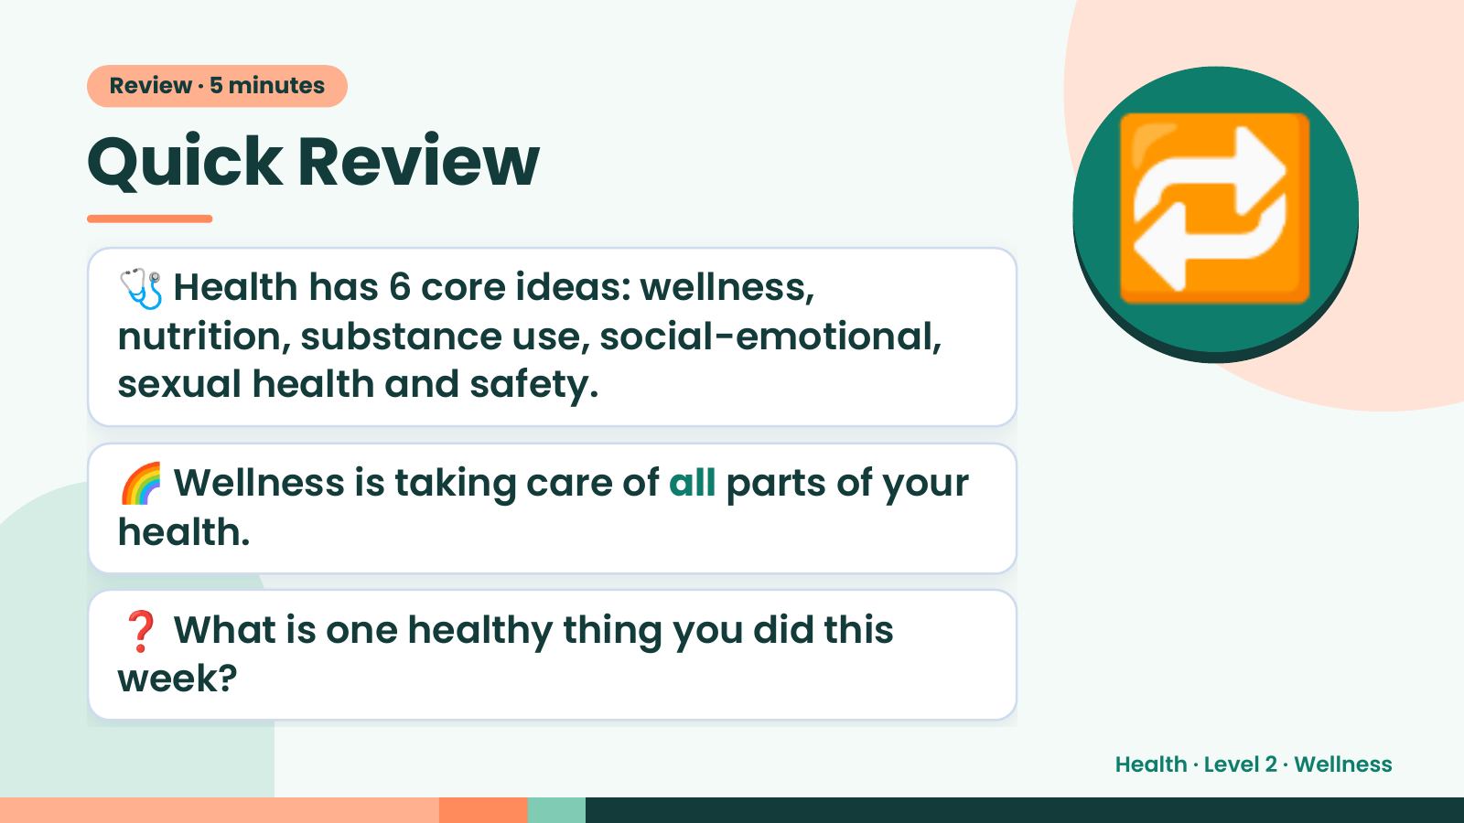
Notes:
Review · 5 minutes
Quick Review
🩺 Health has 6 core ideas: wellness,
nutrition, substance use, social-emotional,
sexual health and safety.
🔁
🌈 Wellness is taking care of all parts of your
health.
❓ What is one healthy thing you did this
week?
Health · Level 2 · Wellness

Slide 3
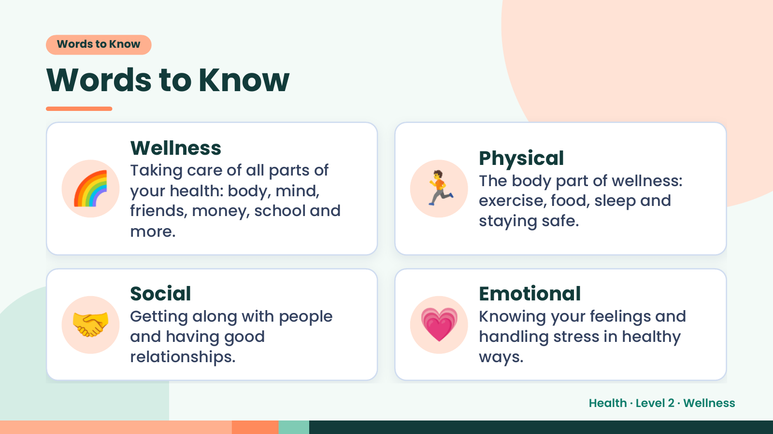
Notes:
Words to Know
Words to Know
🌈 🏃
Wellness
Physical
Taking care of all parts of
The body part of wellness:
your health: body, mind,
exercise, food, sleep and
friends, money, school and
staying safe.
more.
🤝 Social
Getting along with people
and having good
relationships.
💗 Emotional
Knowing your feelings and
handling stress in healthy
ways.
Health · Level 2 · Wellness

Slide 4
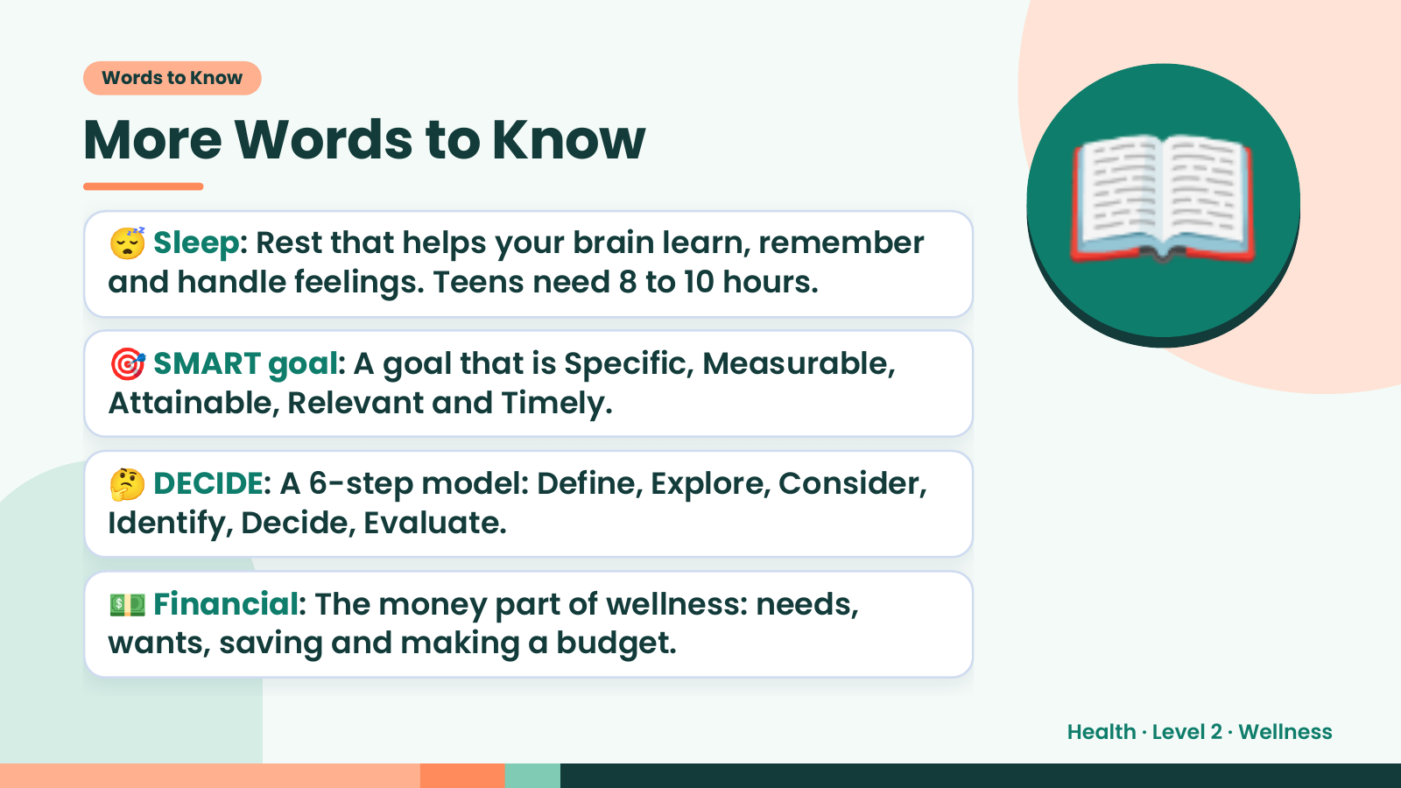
Notes:
Words to Know
More Words to Know
😴 Sleep: Rest that helps your brain learn, remember
and handle feelings. Teens need 8 to 10 hours.
🎯 SMART goal: A goal that is Specific, Measurable,
Attainable, Relevant and Timely.
📖
🤔 DECIDE: A 6-step model: Define, Explore, Consider,
Identify, Decide, Evaluate.
💵 Financial: The money part of wellness: needs,
wants, saving and making a budget.
Health · Level 2 · Wellness

Slide 5
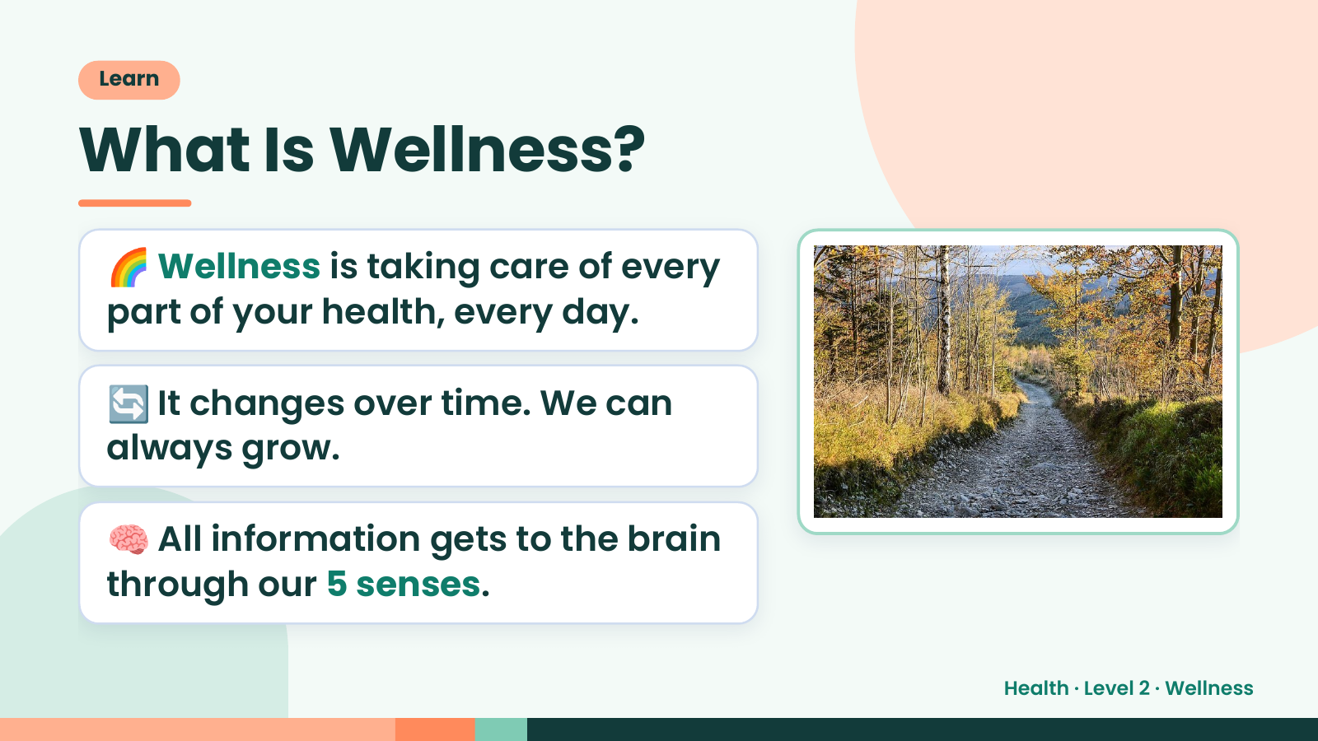
Notes:
Learn
What Is Wellness?
🌈 Wellness is taking care of every
part of your health, every day.
🔄 It changes over time. We can
always grow.
🧠 All information gets to the brain
through our 5 senses.
Health · Level 2 · Wellness

Slide 6
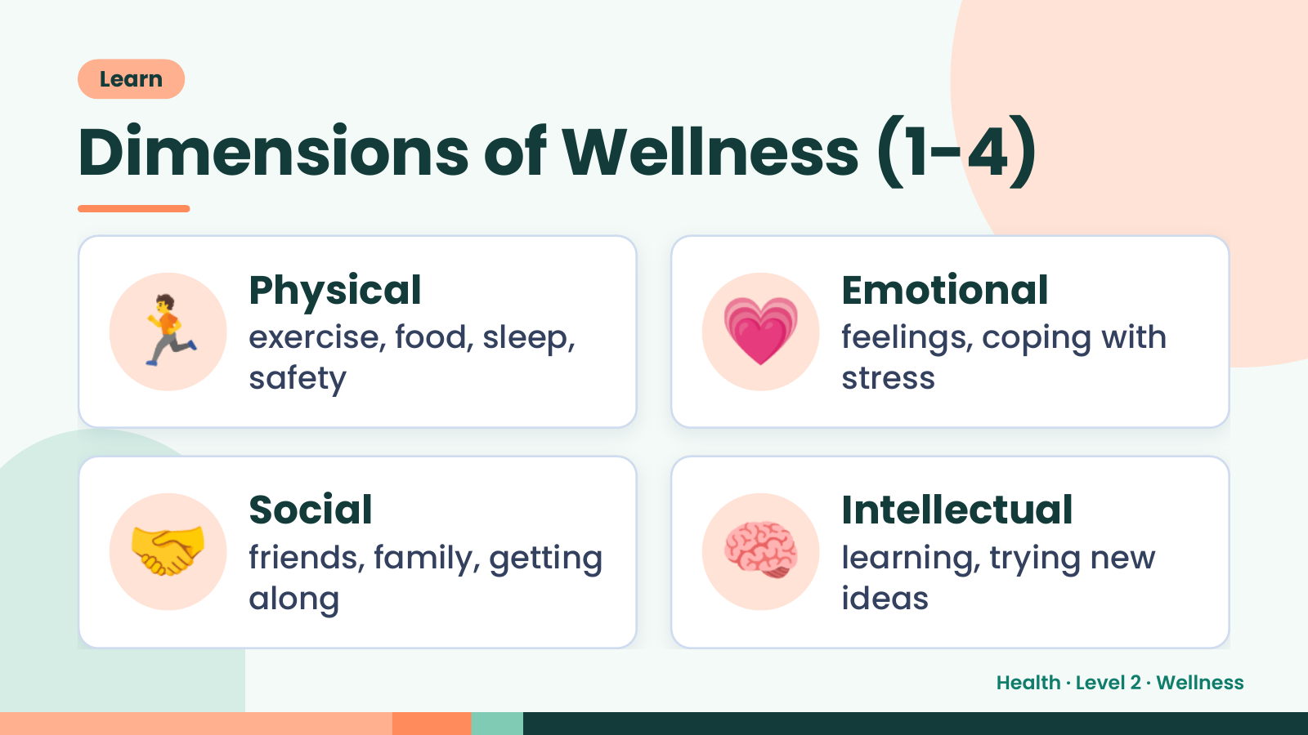
Notes:
Learn
Dimensions of Wellness (1-4)
🏃 Physical
exercise, food, sleep,
safety
💗 Emotional
feelings, coping with
stress
🤝 Social
friends, family, getting
along
🧠 Intellectual
learning, trying new
ideas
Health · Level 2 · Wellness

Slide 7
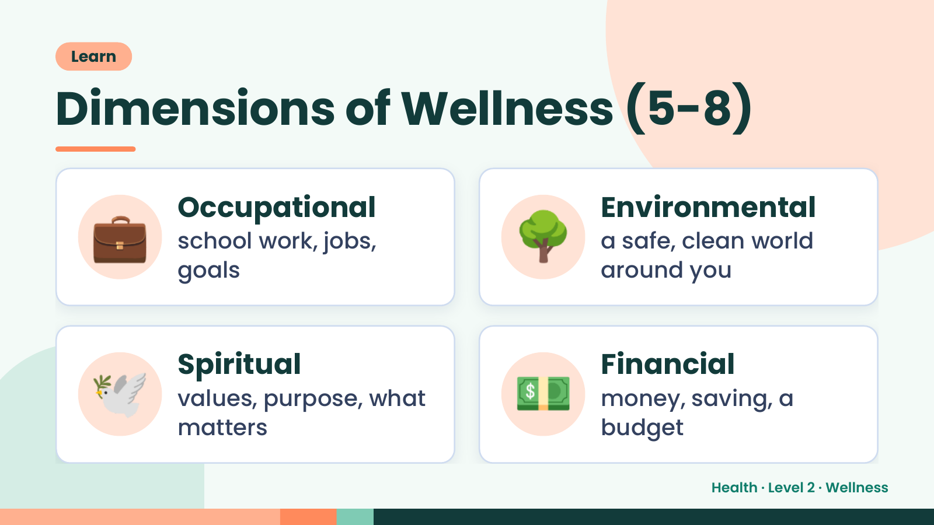
Notes:
Learn
Dimensions of Wellness (5-8)
💼 Occupational
school work, jobs,
goals
🌳 Environmental
a safe, clean world
around you
🕊️ Spiritual
values, purpose, what
matters
💵 Financial
money, saving, a
budget
Health · Level 2 · Wellness

Slide 8
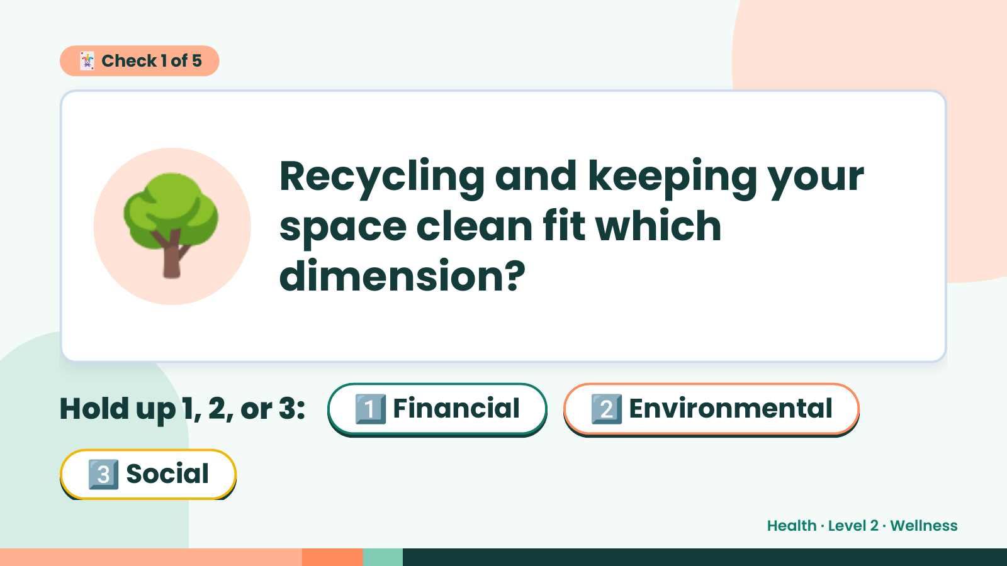
Notes:
🃏 Check 1 of 5
🌳 Recycling and keeping your
space clean fit which
dimension?
Hold up 1, 2, or 3: 1️⃣ Financial 2️⃣ Environmental
3️⃣ Social
Health · Level 2 · Wellness

Slide 9
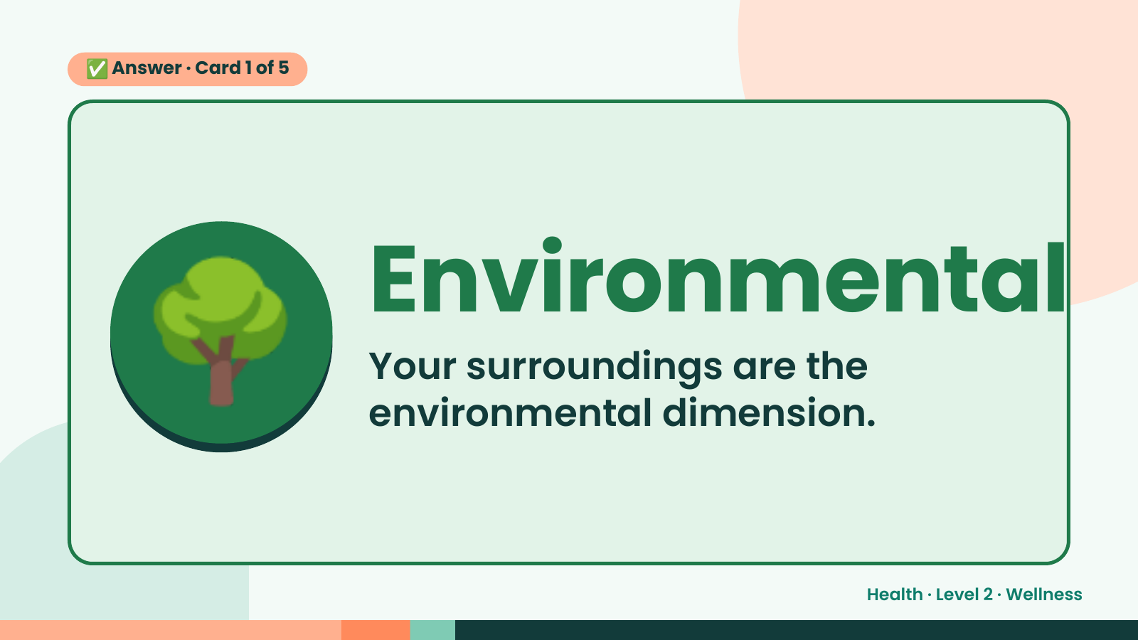
Notes:
✅ Answer · Card 1 of 5
🌳 Environmental
Your surroundings are the
environmental dimension.
Health · Level 2 · Wellness

Slide 10
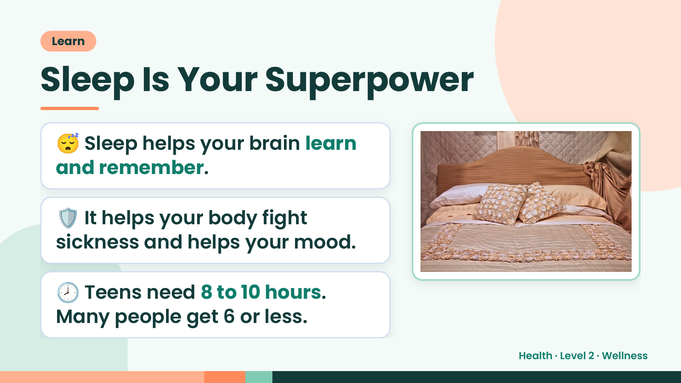
Notes:
Learn
Sleep Is Your Superpower
😴 Sleep helps your brain learn
and remember.
🛡️ It helps your body fight
sickness and helps your mood.
🕗 Teens need 8 to 10 hours.
Many people get 6 or less.
Health · Level 2 · Wellness

Slide 11
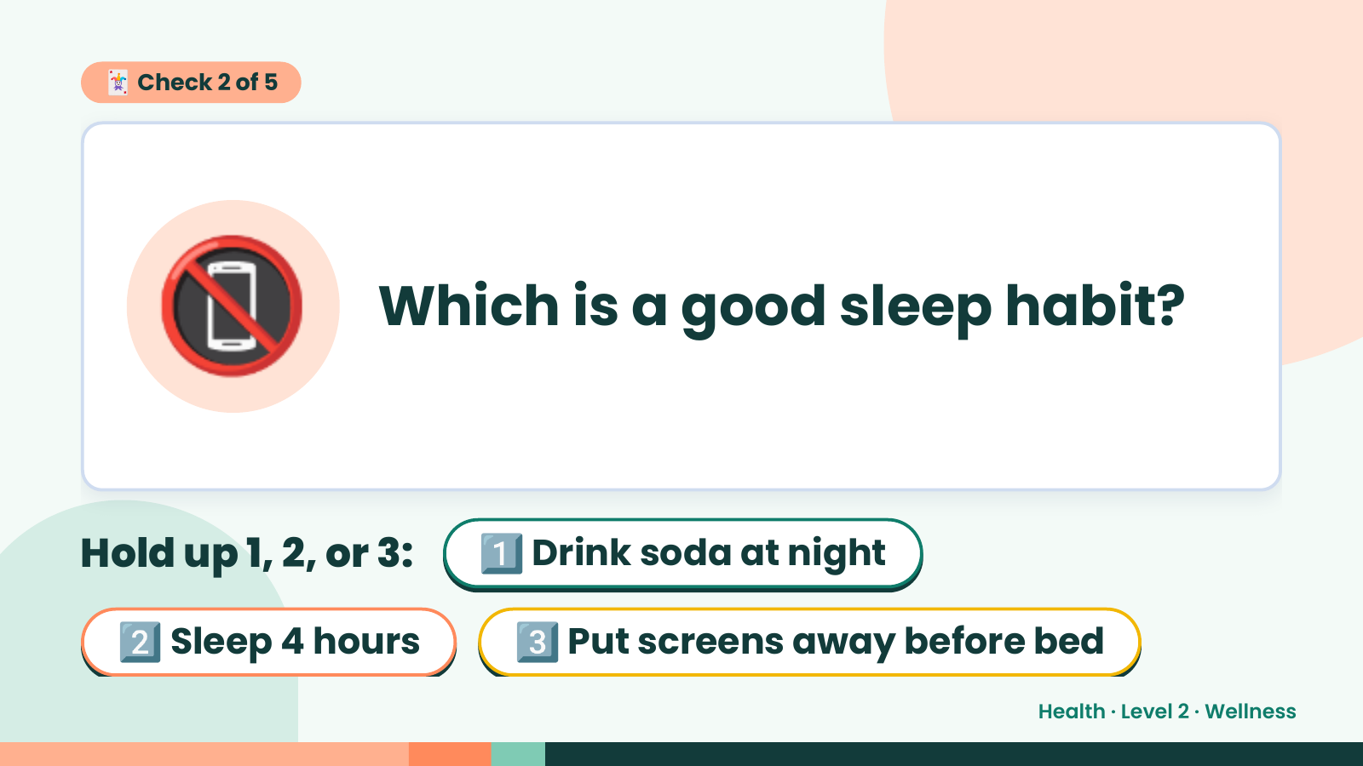
Notes:
🃏 Check 2 of 5
📵 Which is a good sleep habit?
Hold up 1, 2, or 3: 1️⃣ Drink soda at night
2️⃣ Sleep 4 hours 3️⃣ Put screens away before bed
Health · Level 2 · Wellness

Slide 12
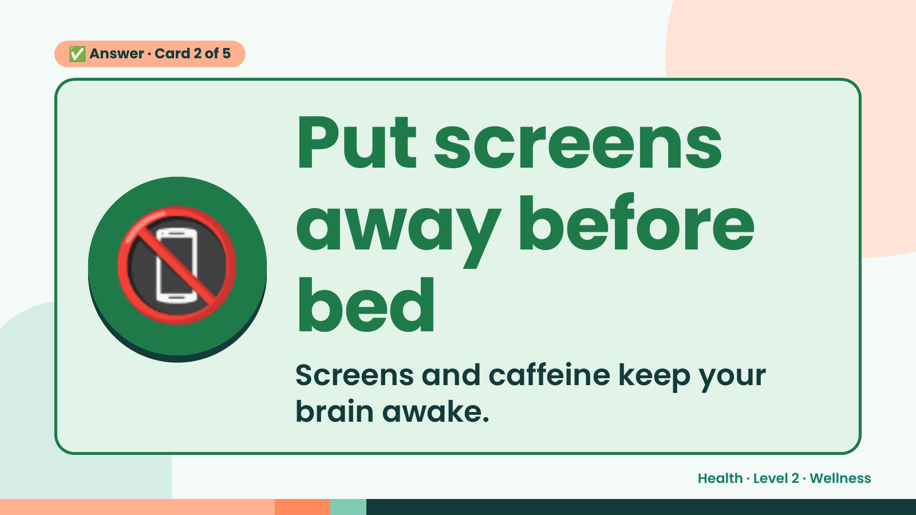
Notes:
✅ Answer · Card 2 of 5
📵
Put screens
away before
bed
Screens and caffeine keep your
brain awake.
Health · Level 2 · Wellness

Slide 13
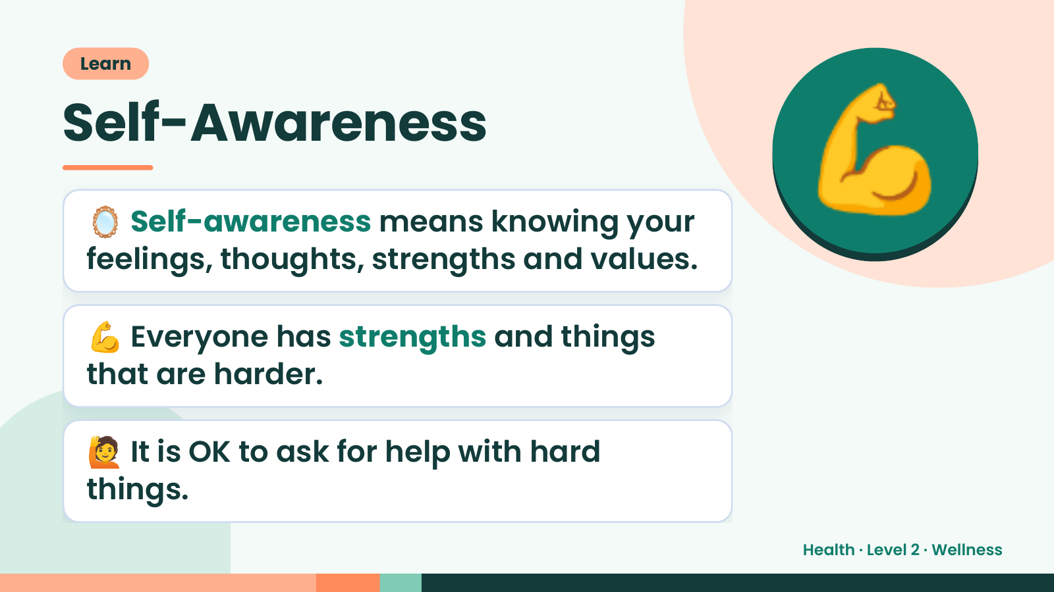
Notes:
Learn
Self-Awareness
🪞 Self-awareness means knowing your
feelings, thoughts, strengths and values.
💪
💪 Everyone has strengths and things
that are harder.
🙋 It is OK to ask for help with hard
things.
Health · Level 2 · Wellness

Slide 14
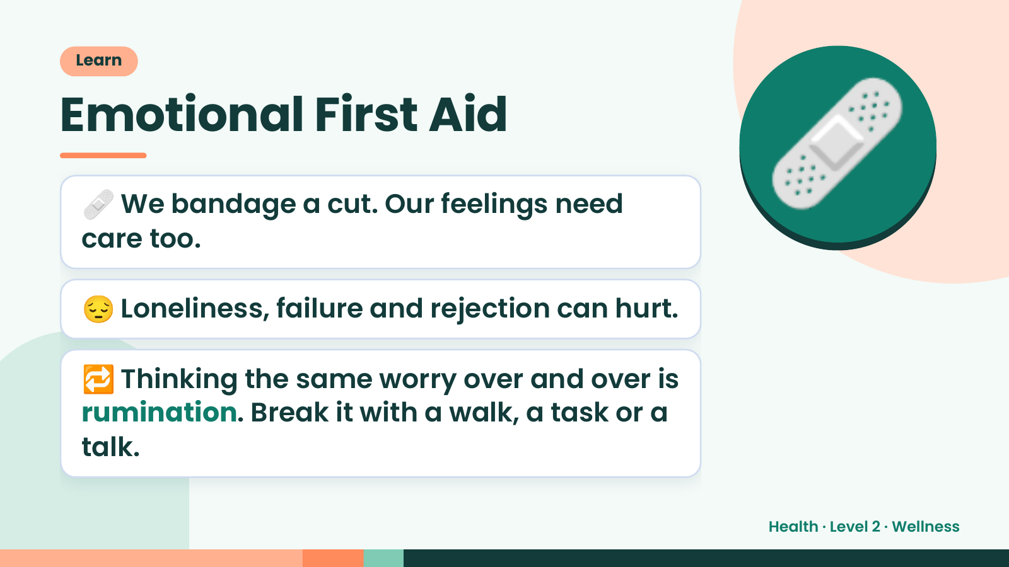
Notes:
Learn
Emotional First Aid
🩹 We bandage a cut. Our feelings need
care too.
😔 Loneliness, failure and rejection can hurt.
🩹
🔁 Thinking the same worry over and over is
rumination. Break it with a walk, a task or a
talk.
Health · Level 2 · Wellness

Slide 15
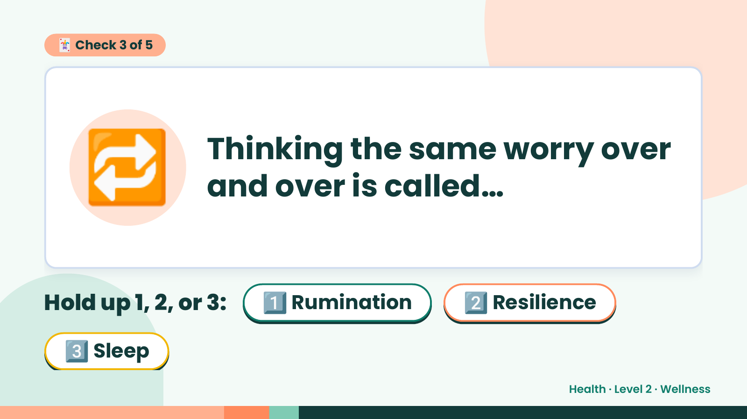
Notes:
🃏 Check 3 of 5
🔁 Thinking the same worry over
and over is called…
Hold up 1, 2, or 3: 1️⃣ Rumination 2️⃣ Resilience
3️⃣ Sleep
Health · Level 2 · Wellness

Slide 16
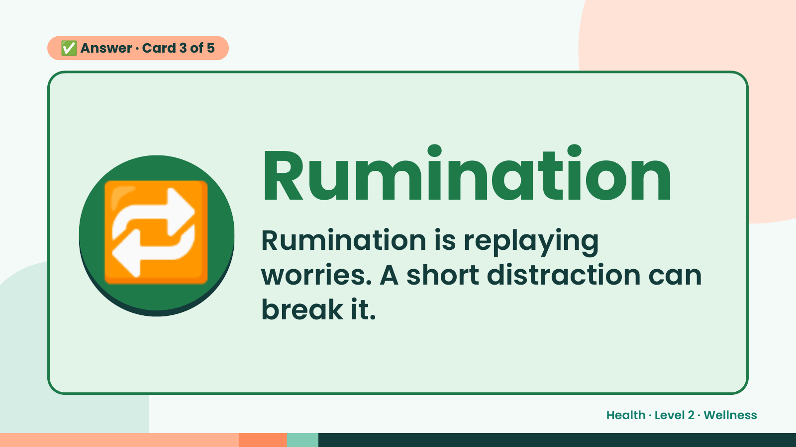
Notes:
✅ Answer · Card 3 of 5
🔁 Rumination
Rumination is replaying
worries. A short distraction can
break it.
Health · Level 2 · Wellness

Slide 17
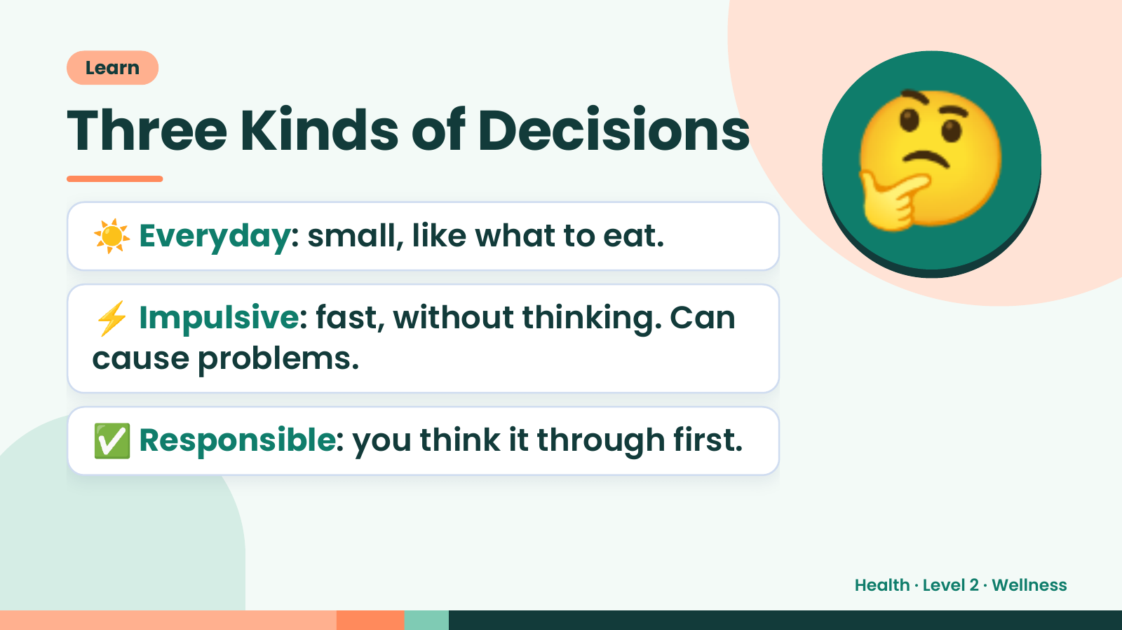
Notes:
Learn
Three Kinds of Decisions
☀️ Everyday: small, like what to eat.
⚡ Impulsive: fast, without thinking. Can
🤔
cause problems.
✅ Responsible: you think it through first.
Health · Level 2 · Wellness

Slide 18
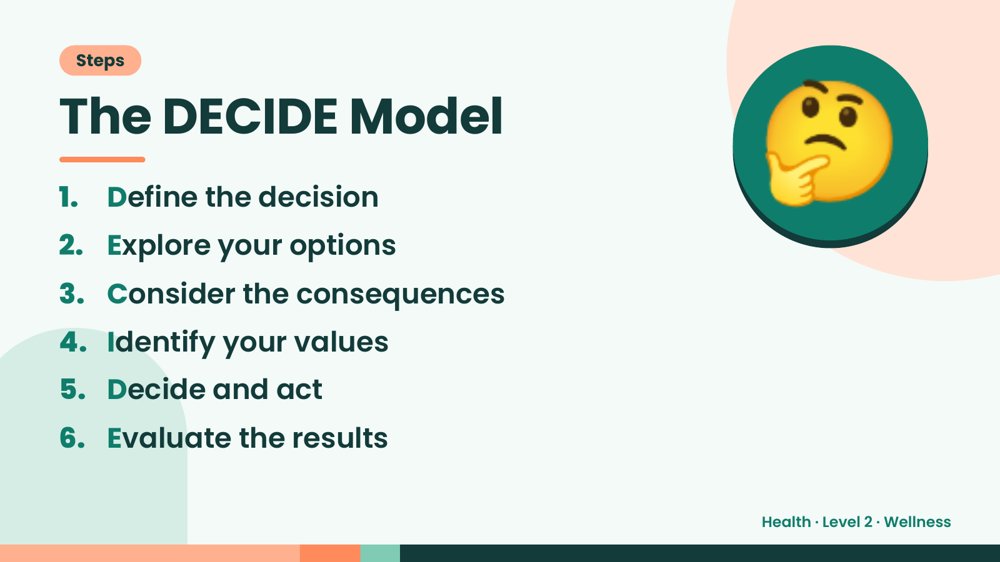
Notes:
Steps
The DECIDE Model
1. Define the decision
2. Explore your options
3. Consider the consequences
🤔
4. Identify your values
5. Decide and act
6. Evaluate the results
Health · Level 2 · Wellness

Slide 19
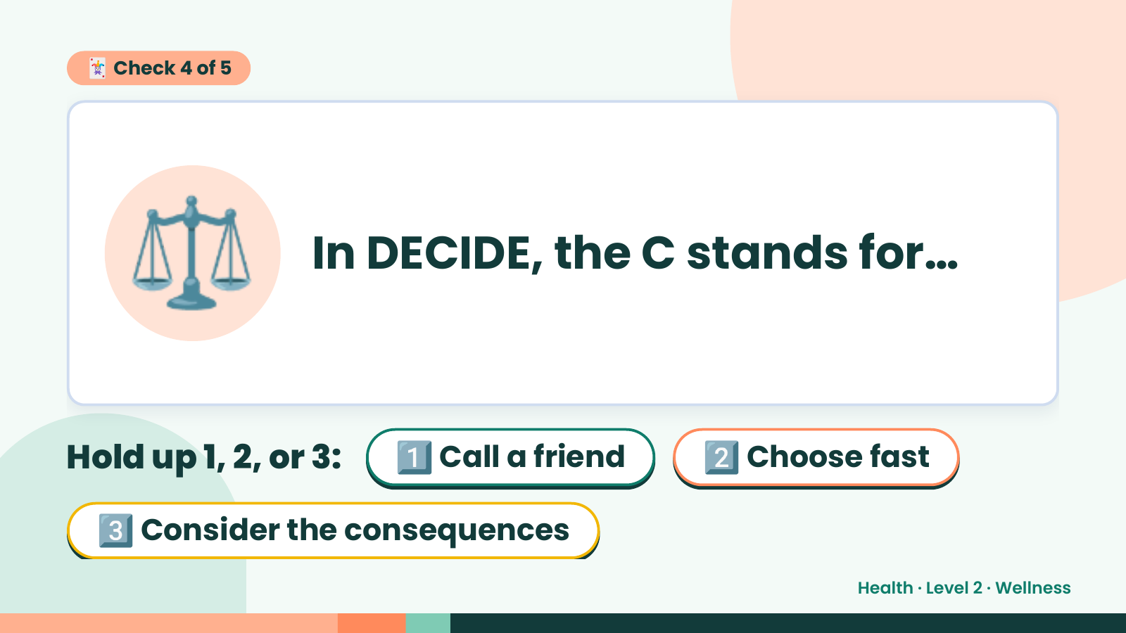
Notes:
🃏 Check 4 of 5
⚖️ In DECIDE, the C stands for…
Hold up 1, 2, or 3: 1️⃣ Call a friend 2️⃣ Choose fast
3️⃣ Consider the consequences
Health · Level 2 · Wellness

Slide 20
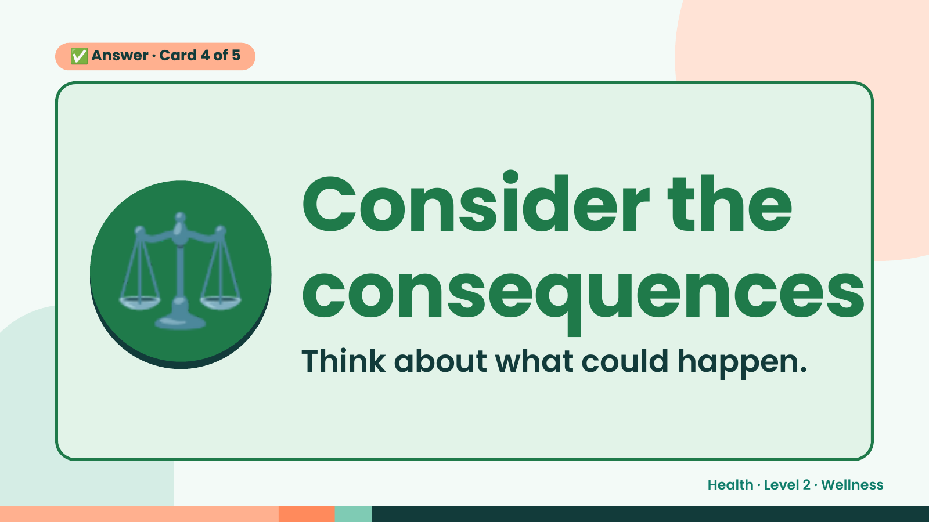
Notes:
✅ Answer · Card 4 of 5
⚖️ Consider the
consequences
Think about what could happen.
Health · Level 2 · Wellness

Slide 21
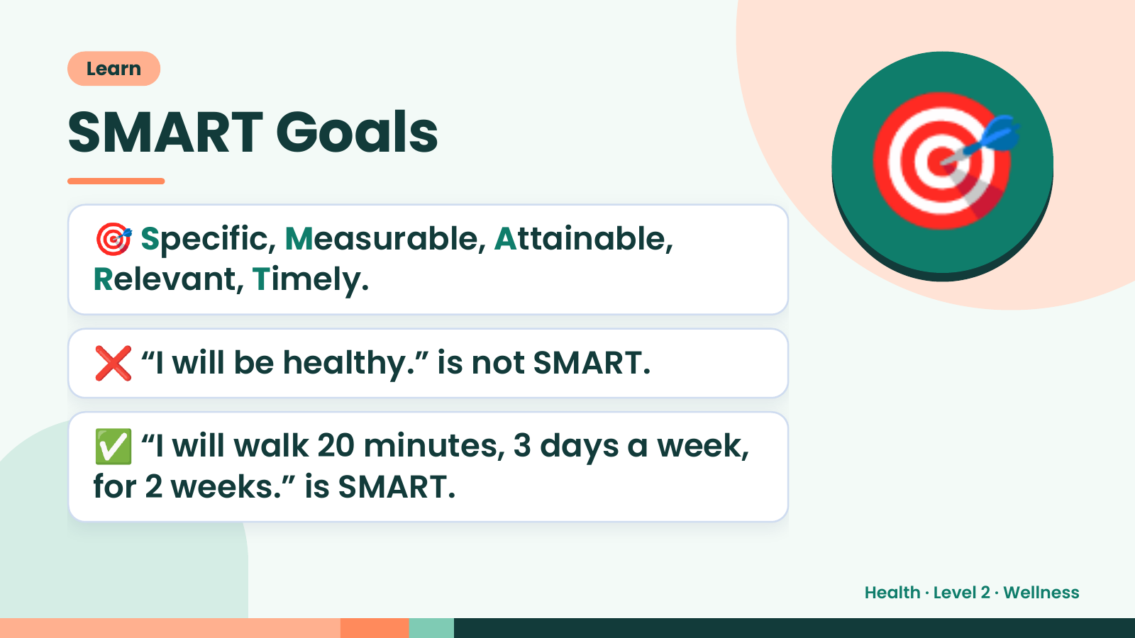
Notes:
Learn
SMART Goals
🎯 Specific, Measurable, Attainable,
Relevant, Timely.
🎯
❌ “I will be healthy.” is not SMART.
✅ “I will walk 20 minutes, 3 days a week,
for 2 weeks.” is SMART.
Health · Level 2 · Wellness

Slide 22
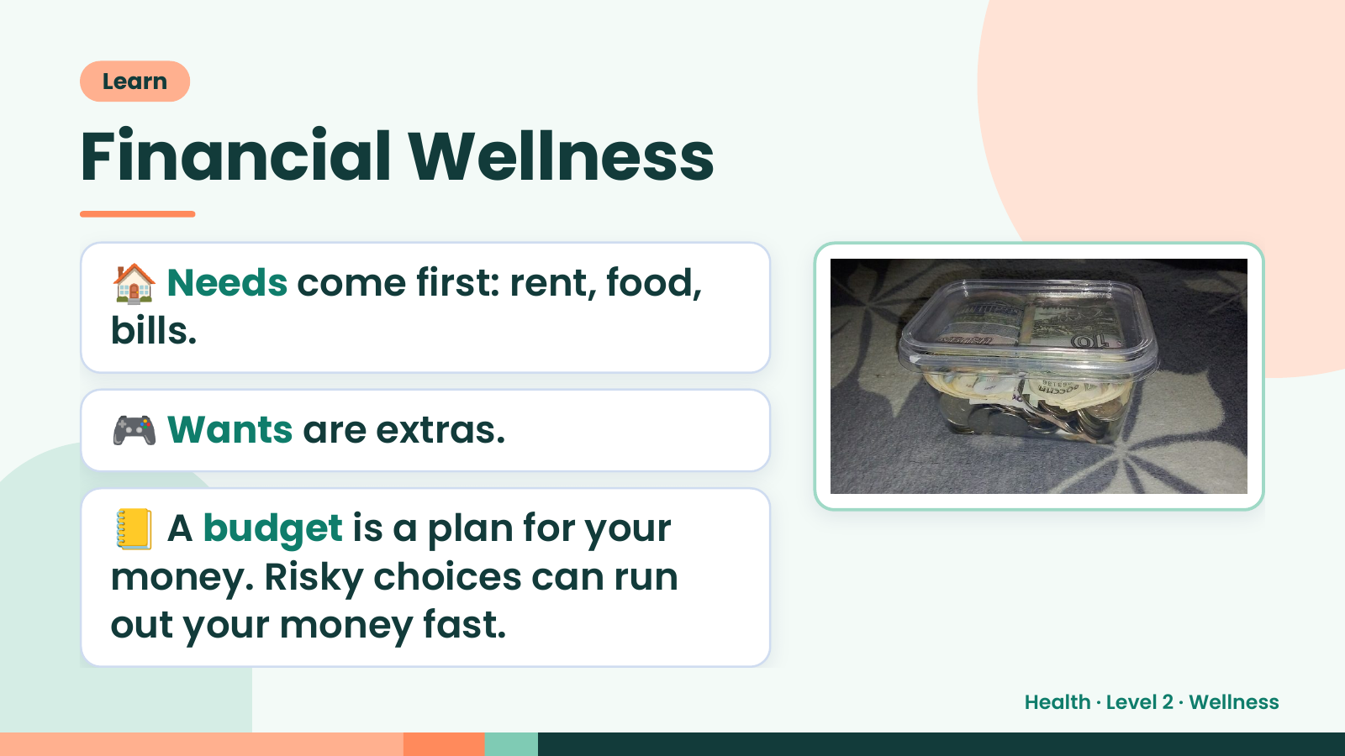
Notes:
Learn
Financial Wellness
🏠 Needs come first: rent, food,
bills.
🎮 Wants are extras.
📒 A budget is a plan for your
money. Risky choices can run
out your money fast.
Health · Level 2 · Wellness

Slide 23
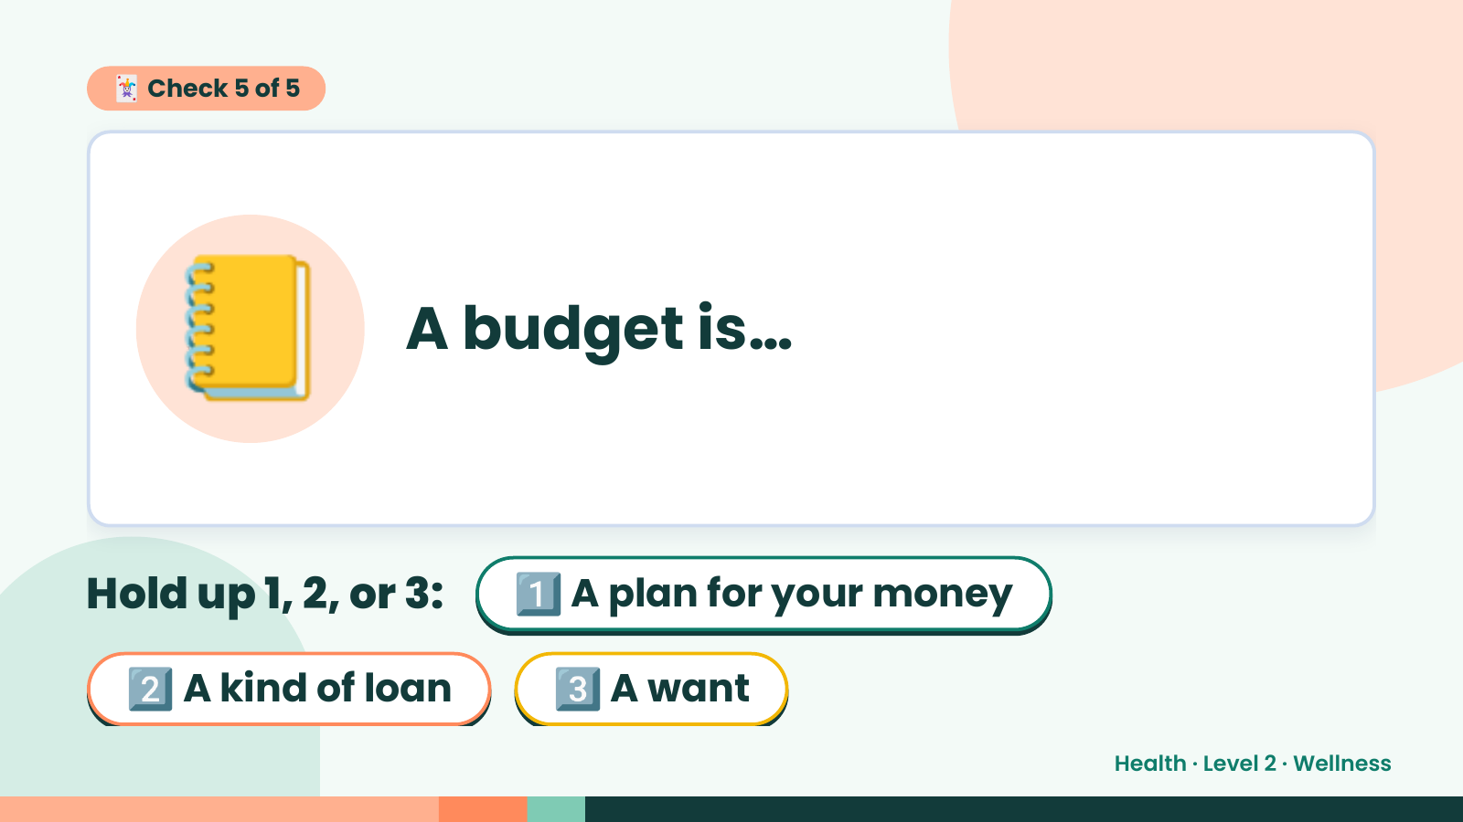
Notes:
🃏 Check 5 of 5
📒 A budget is…
Hold up 1, 2, or 3: 1️⃣ A plan for your money
2️⃣ A kind of loan 3️⃣ A want
Health · Level 2 · Wellness

Slide 24
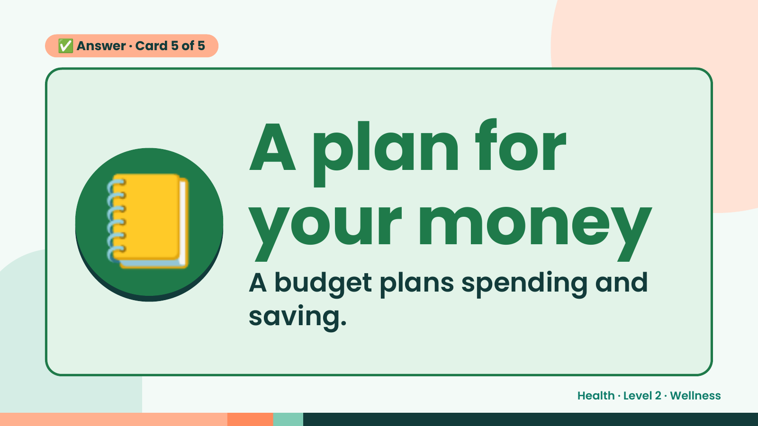
Notes:
✅ Answer · Card 5 of 5
📒 A plan for
your money
A budget plans spending and
saving.
Health · Level 2 · Wellness

Slide 25
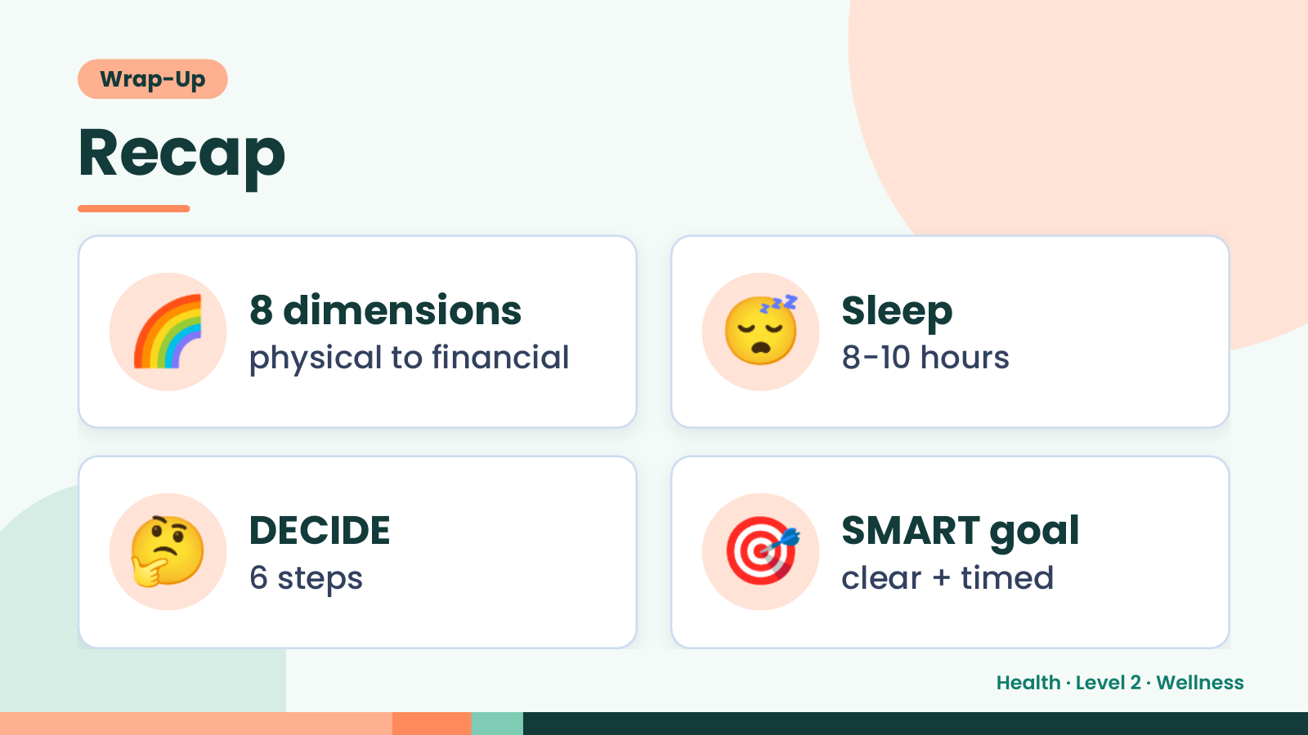
Notes:
Wrap-Up
Recap
🌈 8 dimensions
physical to financial 😴 Sleep
8-10 hours
🤔 DECIDE
6 steps 🎯 SMART goal
clear + timed
Health · Level 2 · Wellness

Slide 26
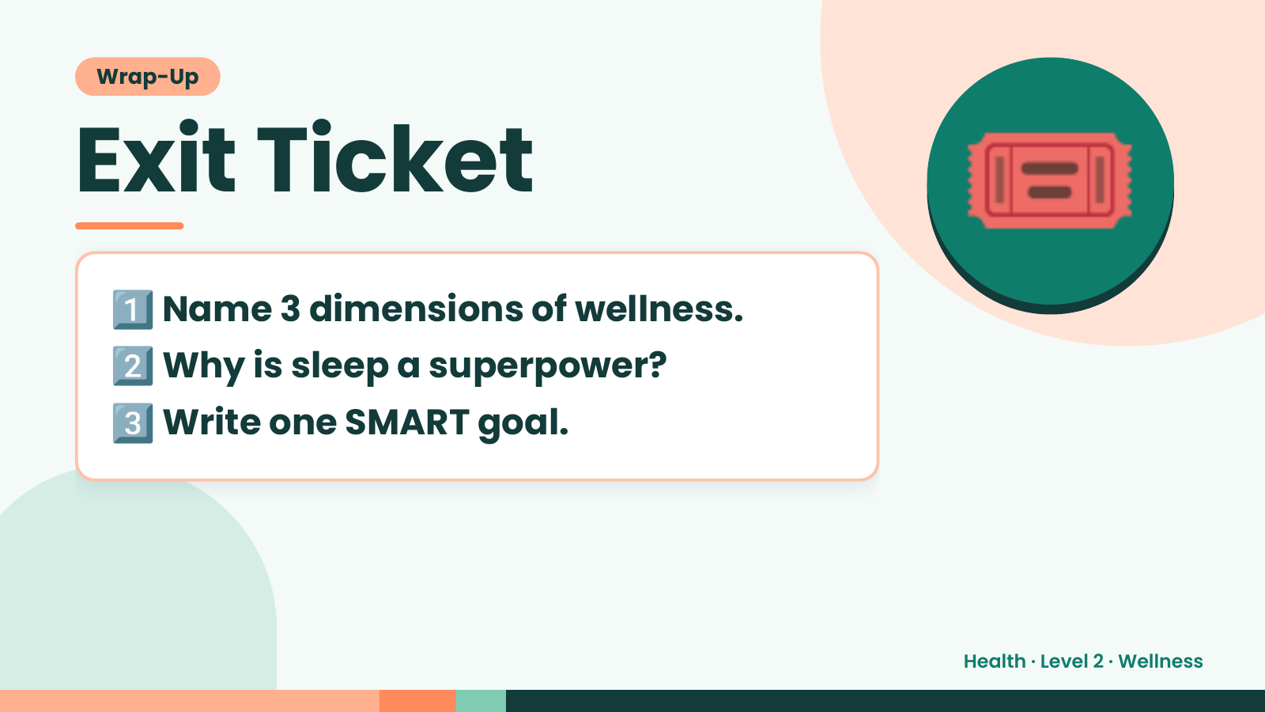
Notes:
Wrap-Up
Exit Ticket
1️⃣
2️⃣
Name 3 dimensions of wellness.
Why is sleep a superpower?
🎟️
3️⃣Write one SMART goal.
Health · Level 2 · Wellness

