Slide 1
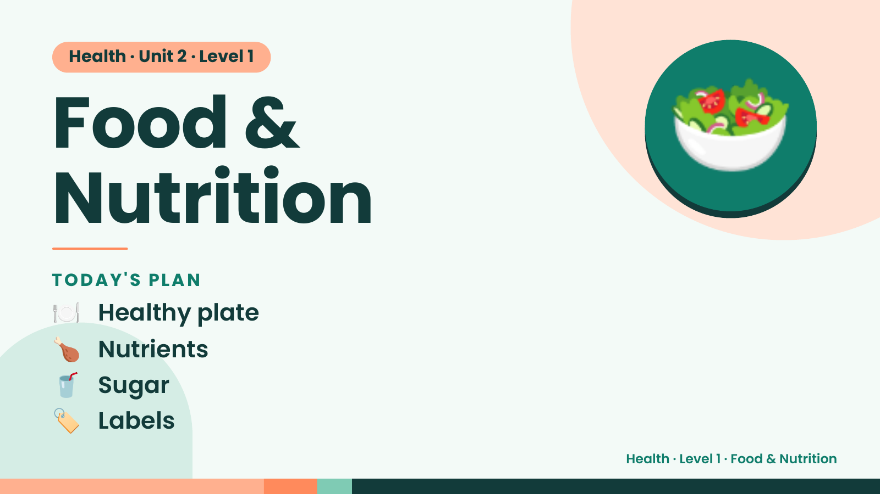
Notes:
Health · Unit 2 · Level 1
Food &
Nutrition
🥗
🍽️ Healthy plate
TODAY'S PLAN
🍗 Nutrients
🥤 Sugar
🏷️ Labels
Health · Level 1 · Food & Nutrition

Slide 2
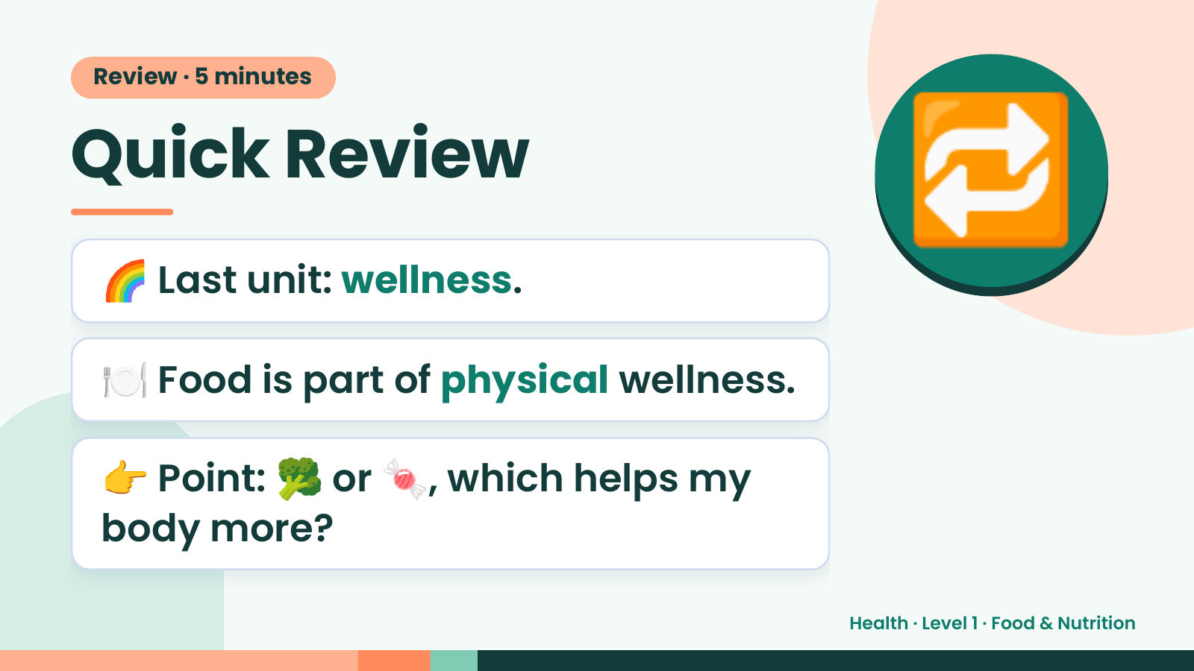
Notes:
Review · 5 minutes
Quick Review
🌈 Last unit: wellness.
🔁
🍽️ Food is part of physical wellness.
👉 Point: 🥦 or 🍬, which helps my
body more?
Health · Level 1 · Food & Nutrition

Slide 3
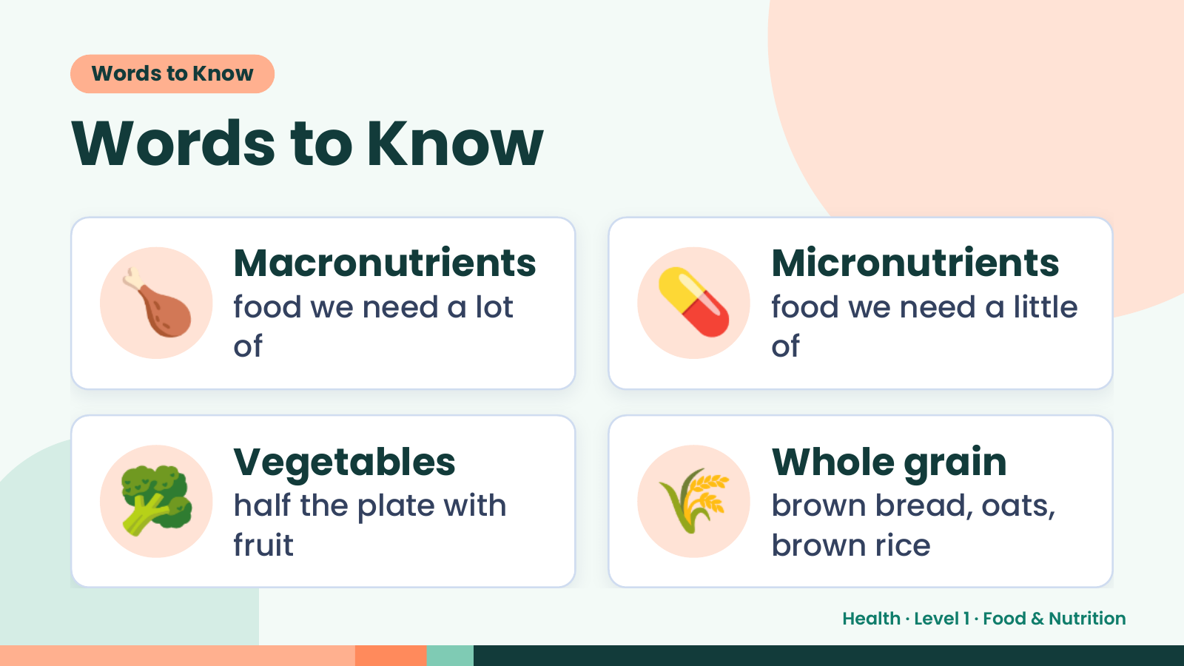
Notes:
Words to Know
Words to Know
🍗 Macronutrients
food we need a lot
of
💊 Micronutrients
food we need a little
of
🥦 Vegetables
half the plate with
fruit
🌾 Whole grain
brown bread, oats,
brown rice
Health · Level 1 · Food & Nutrition

Slide 4
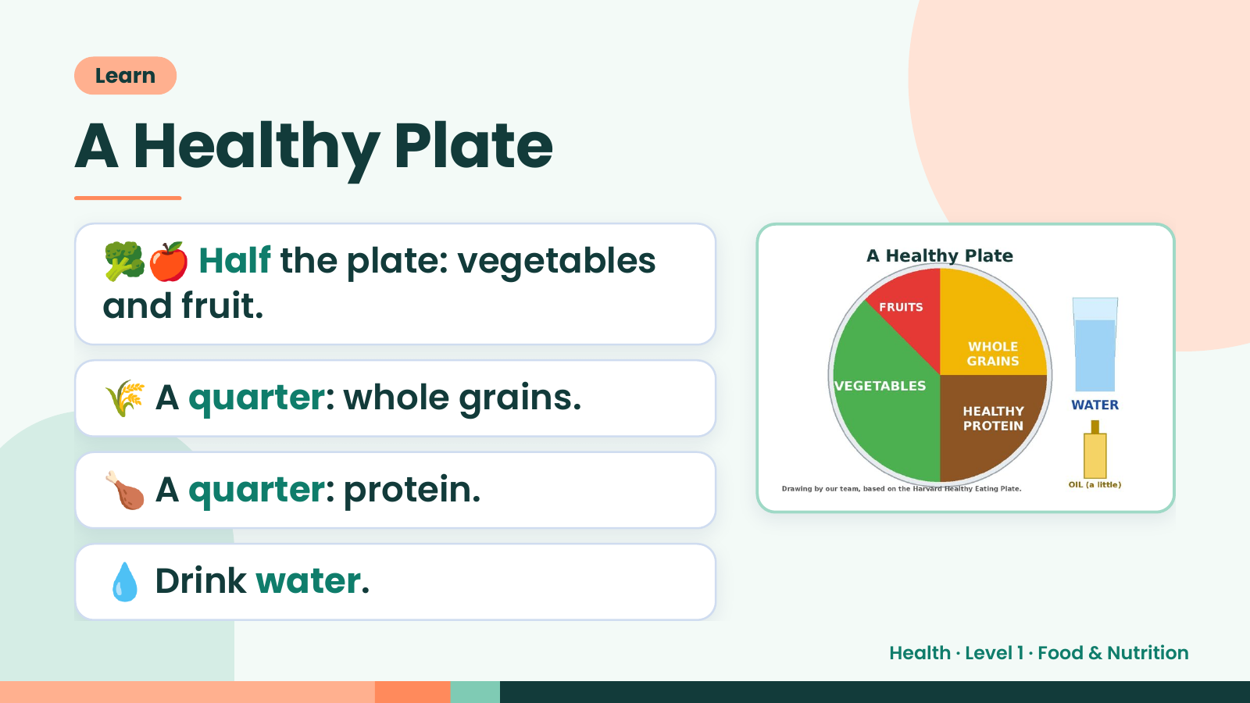
Notes:
Learn
A Healthy Plate
🥦🍎 Half the plate: vegetables
and fruit.
🌾 A quarter: whole grains.
🍗 A quarter: protein.
💧 Drink water.
Health · Level 1 · Food & Nutrition

Slide 5
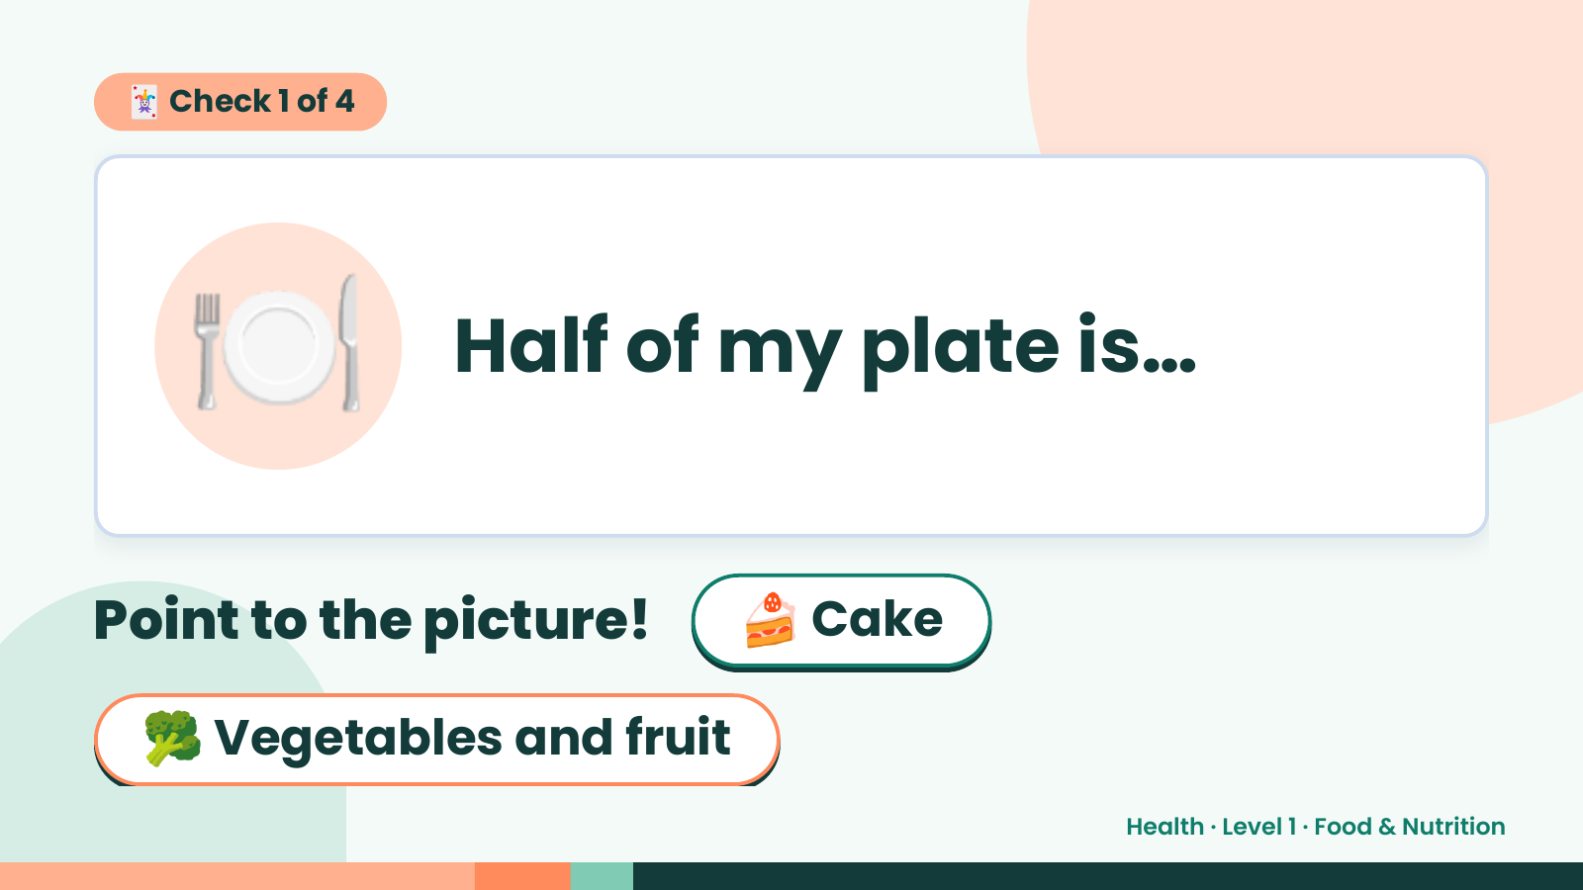
Notes:
🃏 Check 1 of 4
🍽️ Half of my plate is…
Point to the picture! 🍰 Cake
🥦 Vegetables and fruit
Health · Level 1 · Food & Nutrition

Slide 6
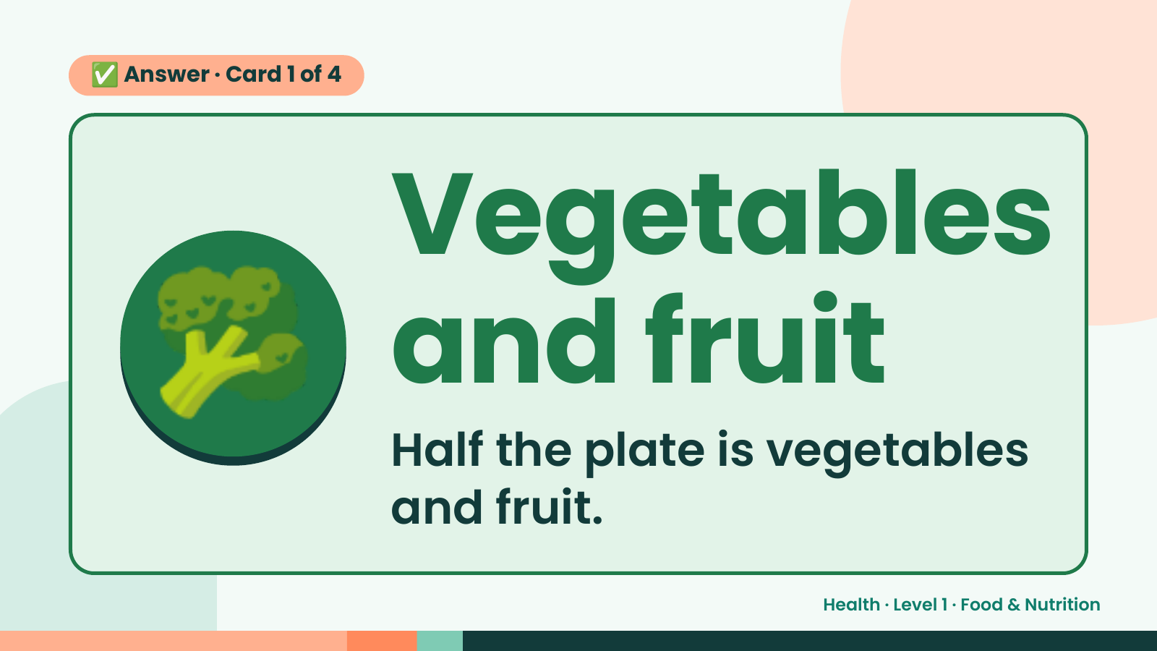
Notes:
✅ Answer · Card 1 of 4
🥦 Vegetables
and fruit
Half the plate is vegetables
and fruit.
Health · Level 1 · Food & Nutrition

Slide 7
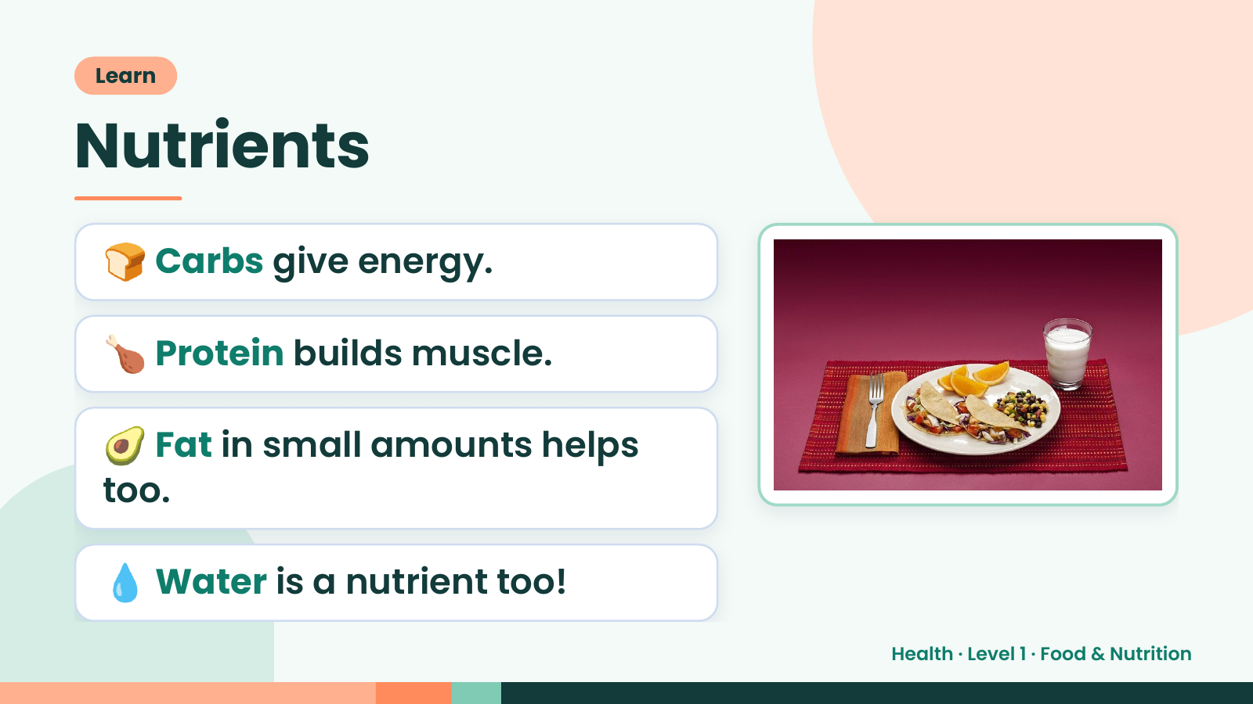
Notes:
Learn
Nutrients
🍞 Carbs give energy.
🍗 Protein builds muscle.
🥑 Fat in small amounts helps
too.
💧 Water is a nutrient too!
Health · Level 1 · Food & Nutrition

Slide 8
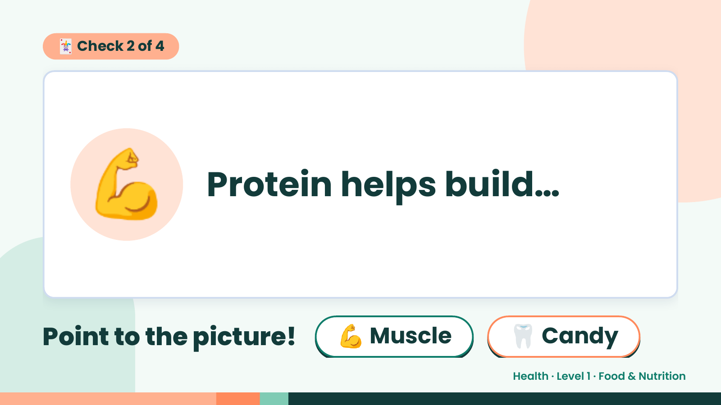
Notes:
🃏 Check 2 of 4
💪 Protein helps build…
Point to the picture! 💪 Muscle 🦷 Candy
Health · Level 1 · Food & Nutrition

Slide 9
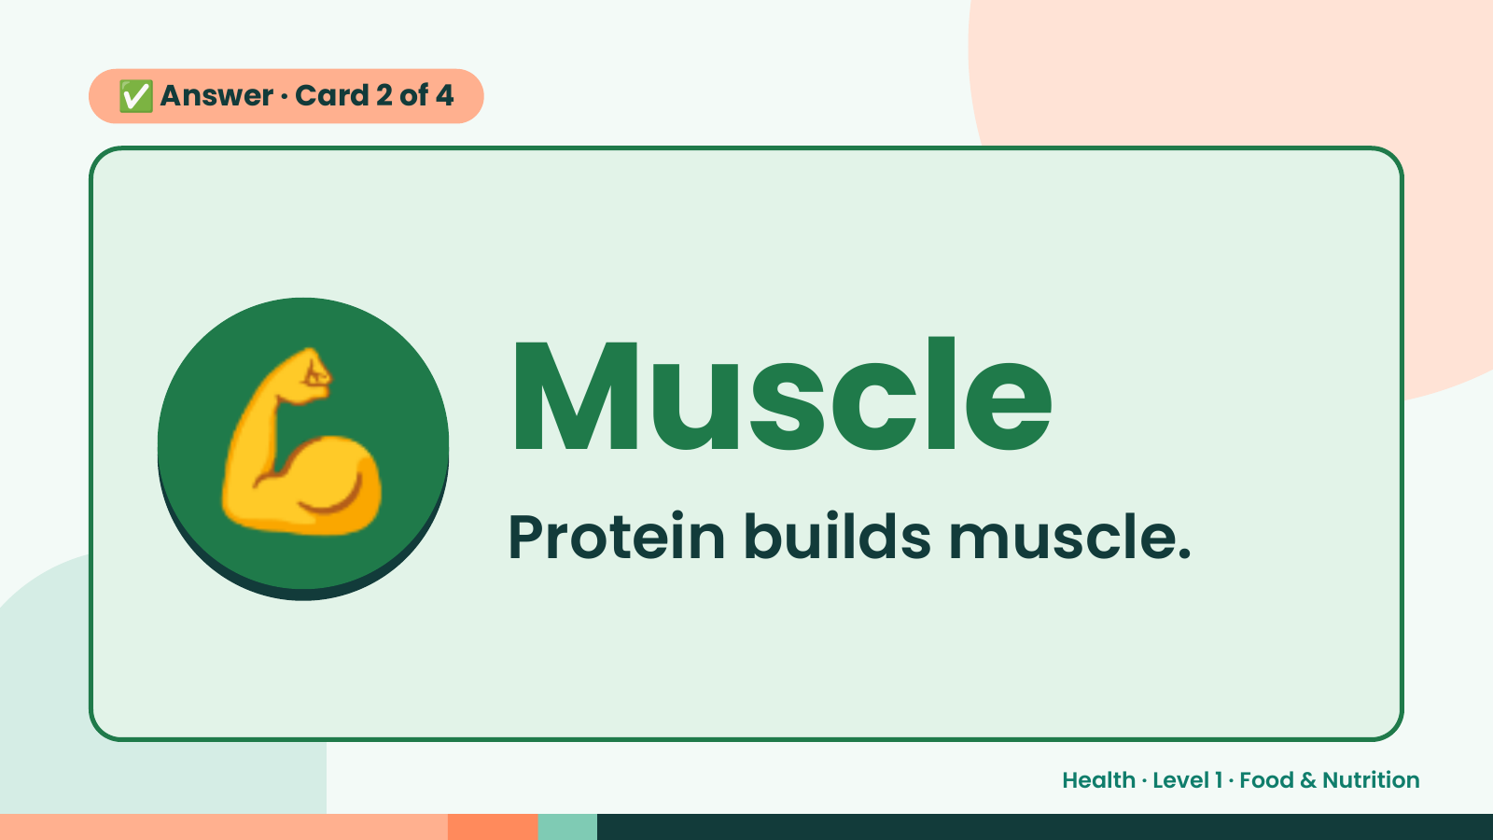
Notes:
✅ Answer · Card 2 of 4
💪 Muscle
Protein builds muscle.
Health · Level 1 · Food & Nutrition

Slide 10
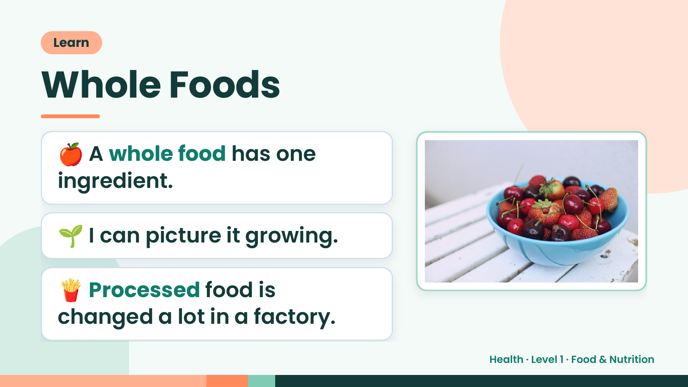
Notes:
Learn
Whole Foods
🍎 A whole food has one
ingredient.
🌱 I can picture it growing.
🍟 Processed food is
changed a lot in a factory.
Health · Level 1 · Food & Nutrition

Slide 11
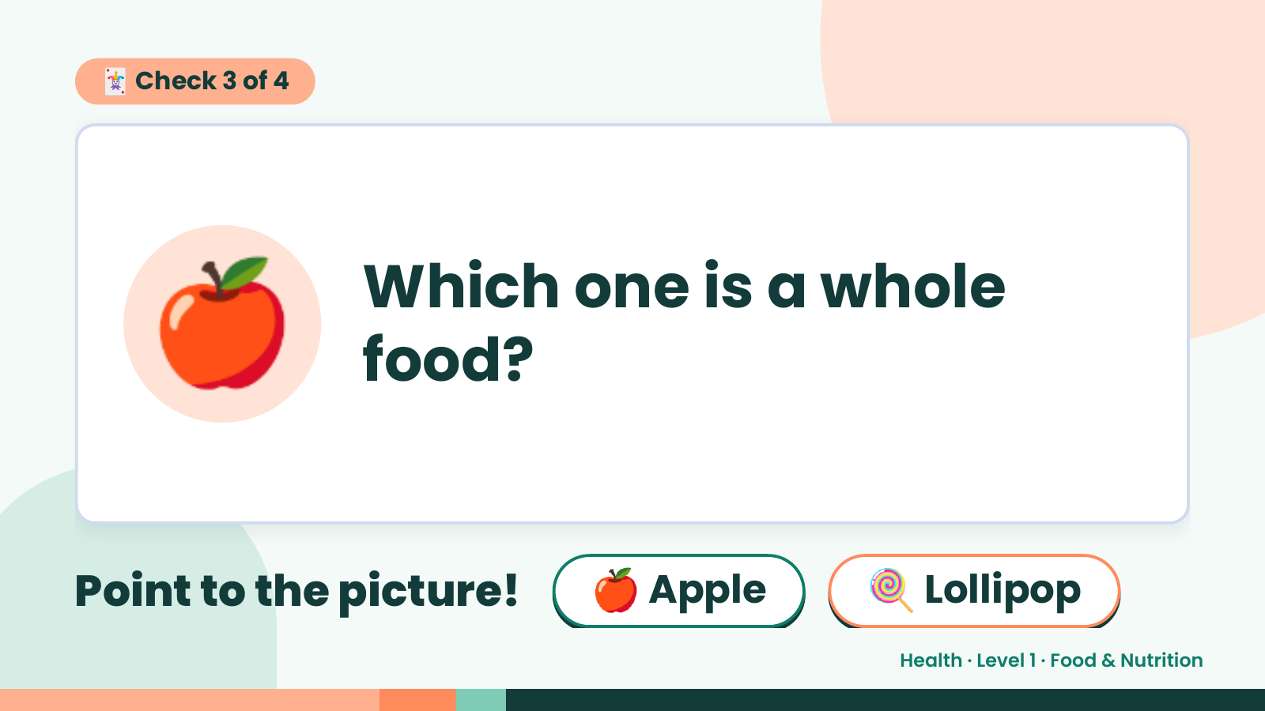
Notes:
🃏 Check 3 of 4
🍎 Which one is a whole
food?
Point to the picture! 🍎 Apple 🍭 Lollipop
Health · Level 1 · Food & Nutrition

Slide 12
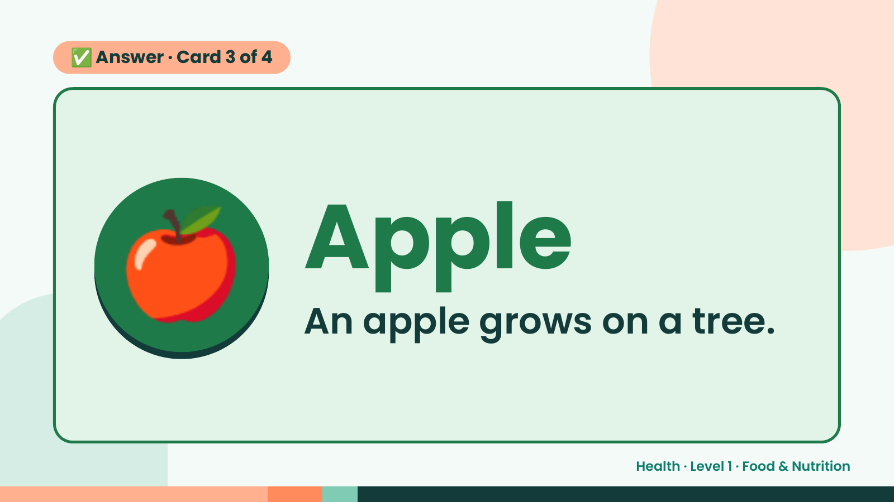
Notes:
✅ Answer · Card 3 of 4
🍎 Apple
An apple grows on a tree.
Health · Level 1 · Food & Nutrition

Slide 13
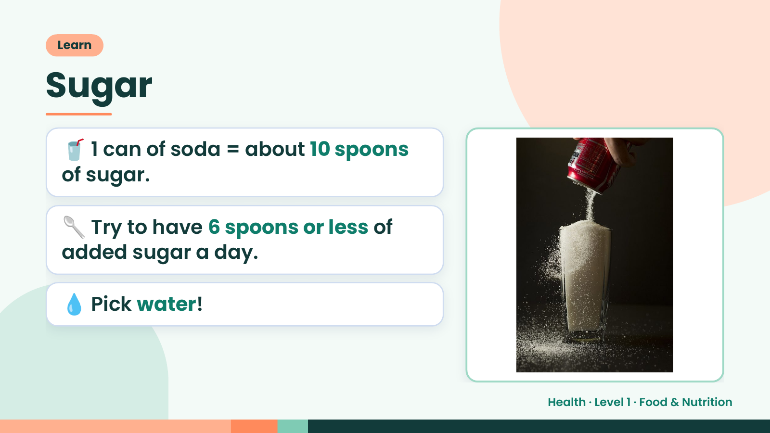
Notes:
Learn
Sugar
🥤 1 can of soda = about 10 spoons
of sugar.
🥄 Try to have 6 spoons or less of
added sugar a day.
💧 Pick water!
Health · Level 1 · Food & Nutrition

Slide 14
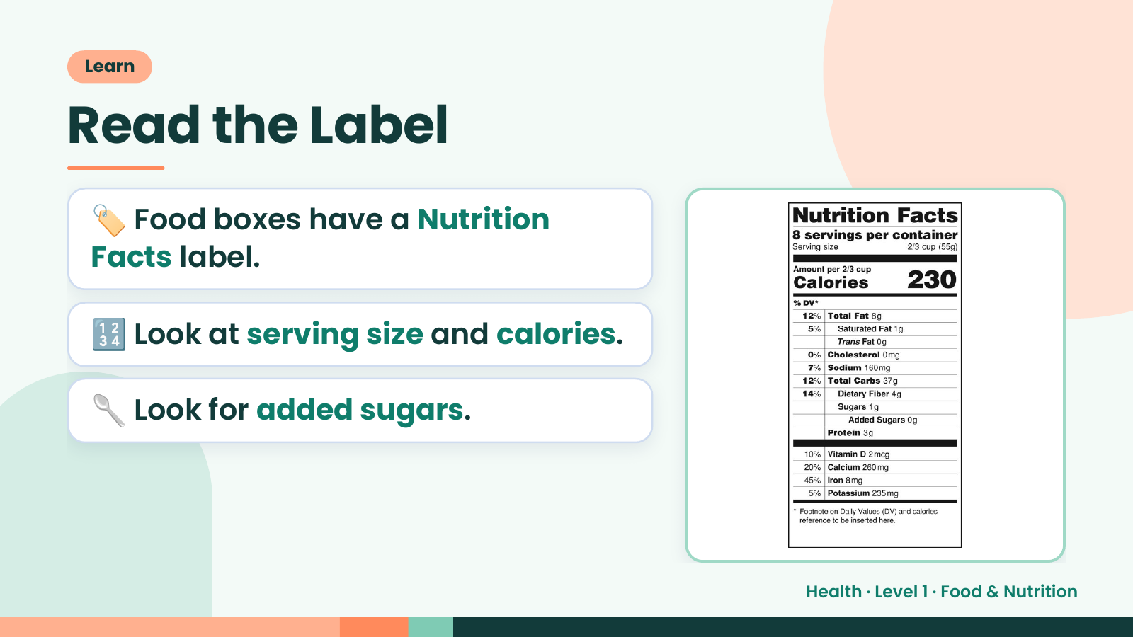
Notes:
Learn
Read the Label
🏷️ Food boxes have a Nutrition
Facts label.
🔢 Look at serving size and calories.
🥄 Look for added sugars.
Health · Level 1 · Food & Nutrition

Slide 15
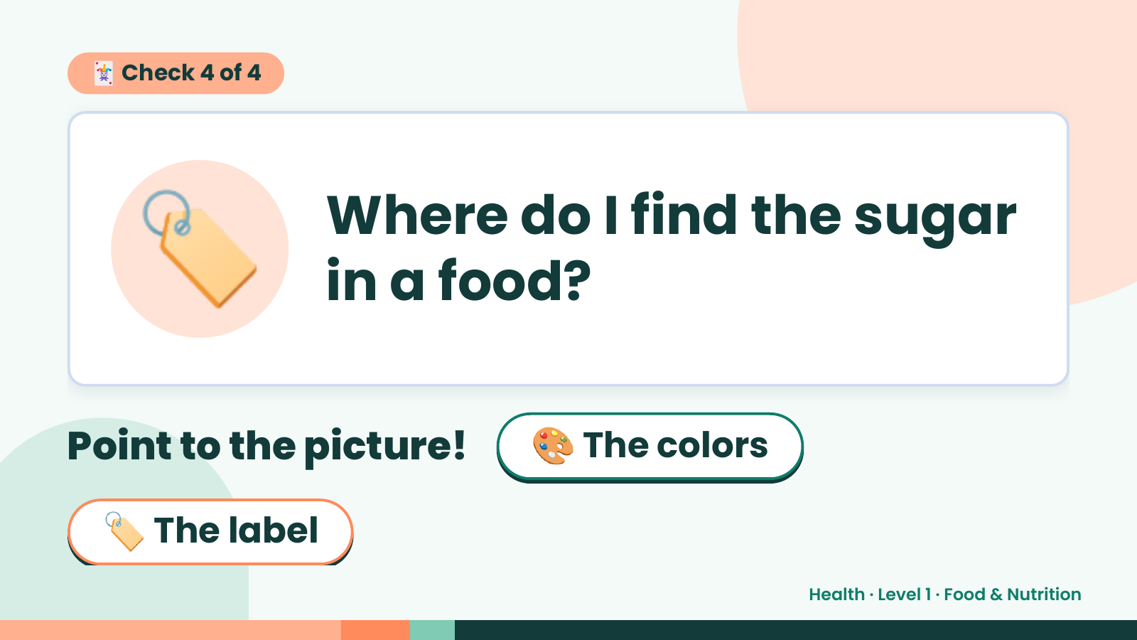
Notes:
🃏 Check 4 of 4
🏷️ Where do I find the sugar
in a food?
Point to the picture! 🎨 The colors
🏷️ The label
Health · Level 1 · Food & Nutrition

Slide 16
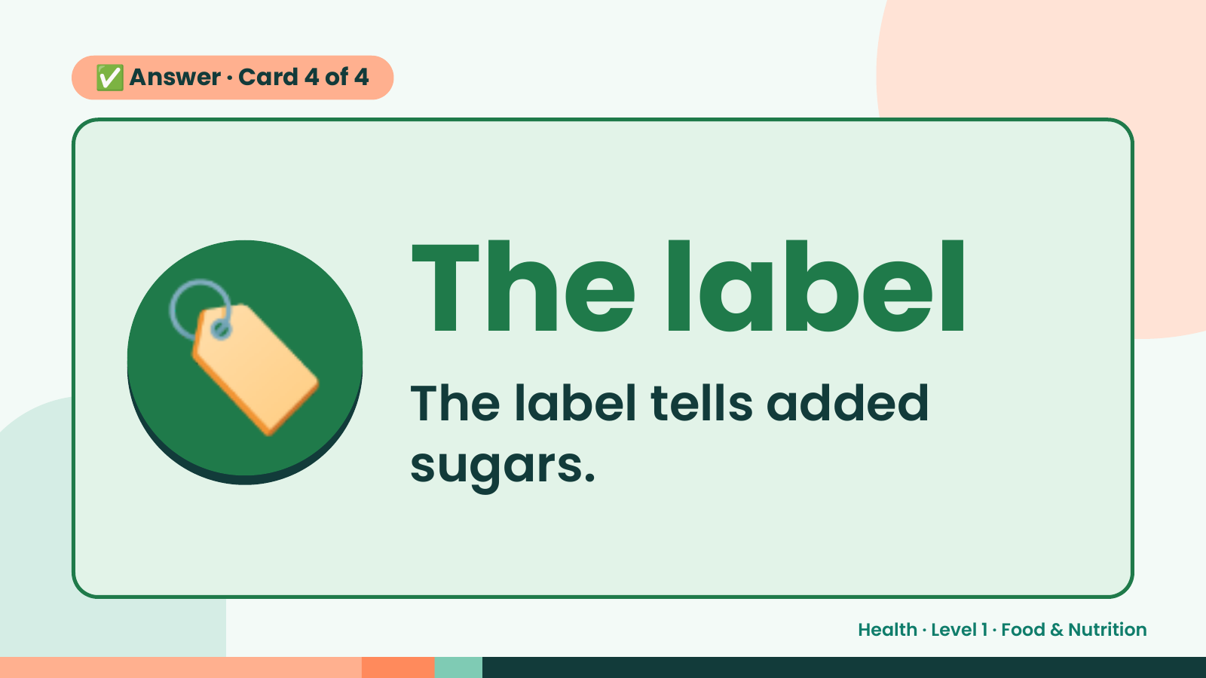
Notes:
✅ Answer · Card 4 of 4
🏷️ The label
The label tells added
sugars.
Health · Level 1 · Food & Nutrition

Slide 17
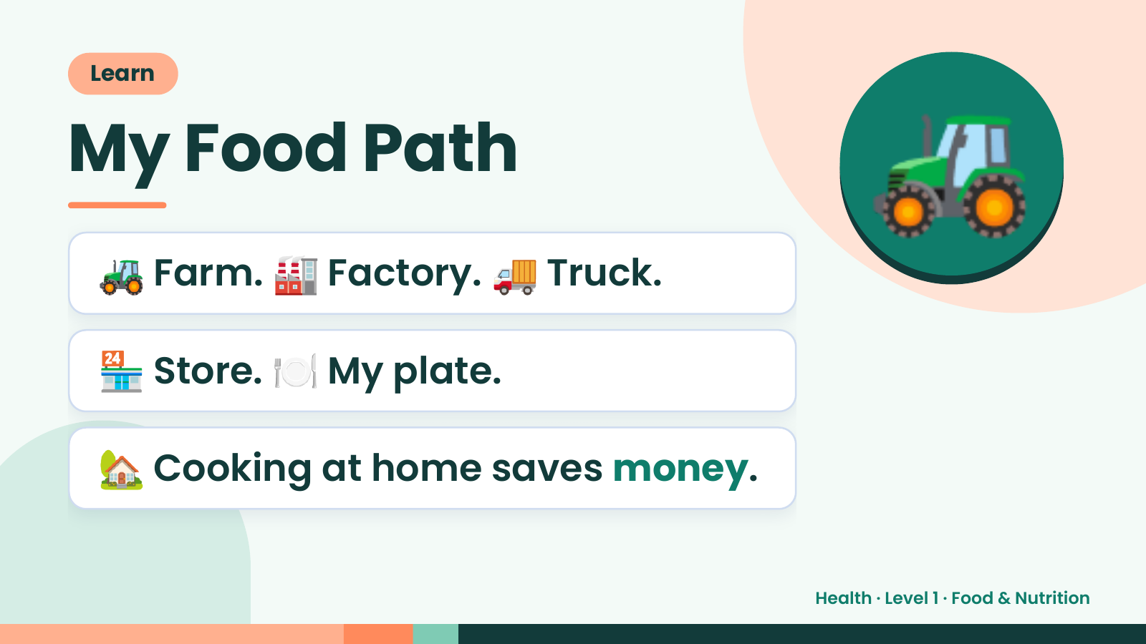
Notes:
Learn
My Food Path
🚜 Farm. 🏭 Factory. 🚚 Truck.
🚜
🏪 Store. 🍽️ My plate.
🏡 Cooking at home saves money.
Health · Level 1 · Food & Nutrition

Slide 18
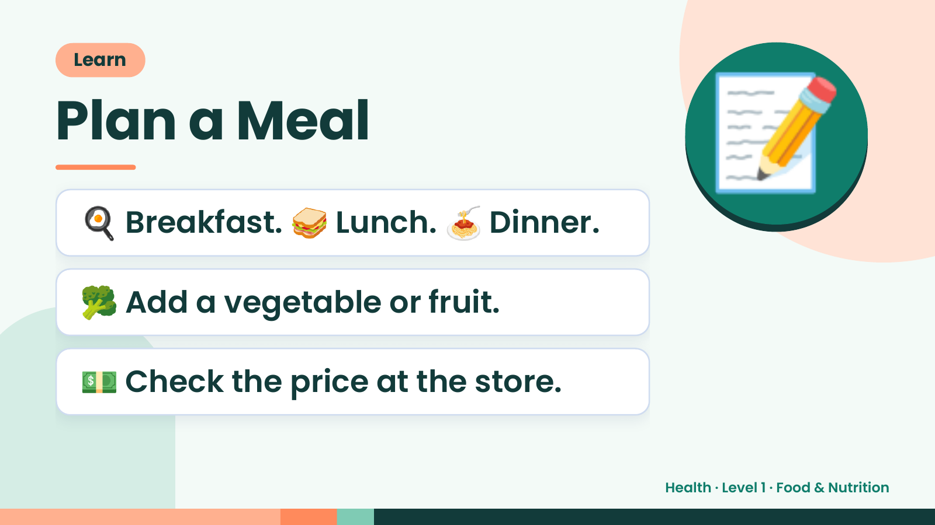
Notes:
Learn
Plan a Meal
🍳 Breakfast. 🥪 Lunch. 🍝 Dinner.
📝
🥦 Add a vegetable or fruit.
💵 Check the price at the store.
Health · Level 1 · Food & Nutrition

Slide 19
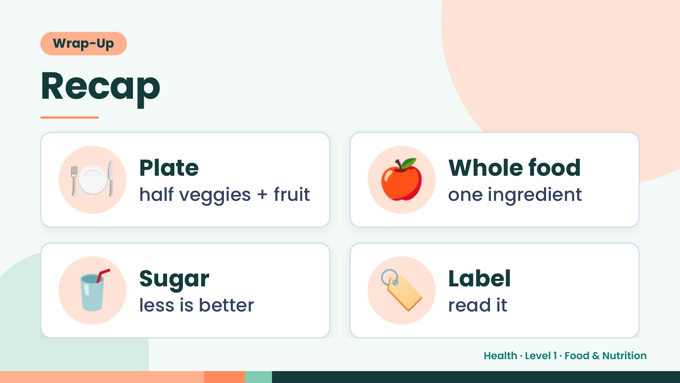
Notes:
Wrap-Up
Recap
🍽️ Plate
half veggies + fruit 🍎 Whole food
one ingredient
🥤 Sugar
less is better 🏷️ Label
read it
Health · Level 1 · Food & Nutrition

Slide 20
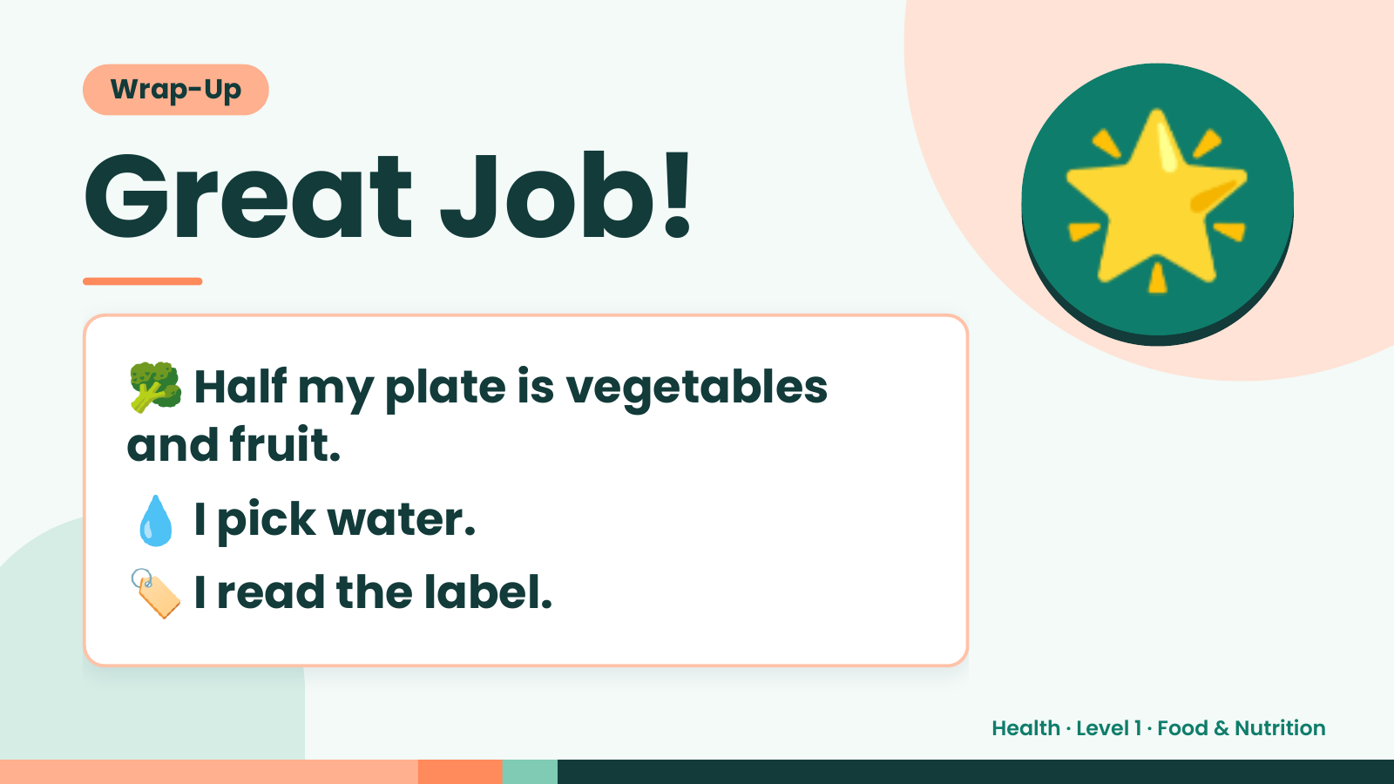
Notes:
Wrap-Up
Great Job!
🥦Half my plate is vegetables
🌟
and fruit.
💧 I pick water.
🏷️ I read the label.
Health · Level 1 · Food & Nutrition

