Slide 1
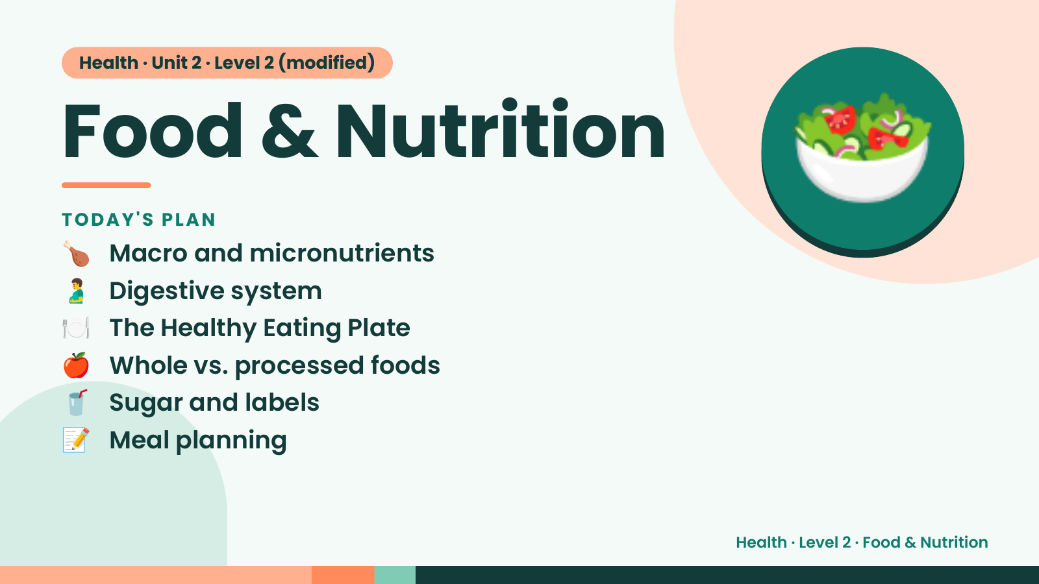
Notes:
Health · Unit 2 · Level 2 (modified)
Food & Nutrition
🍗 Macro and micronutrients
TODAY'S PLAN
🫃 Digestive system
🍽️ The Healthy Eating Plate
🥗
🍎 Whole vs. processed foods
🥤 Sugar and labels
📝 Meal planning
Health · Level 2 · Food & Nutrition

Slide 2
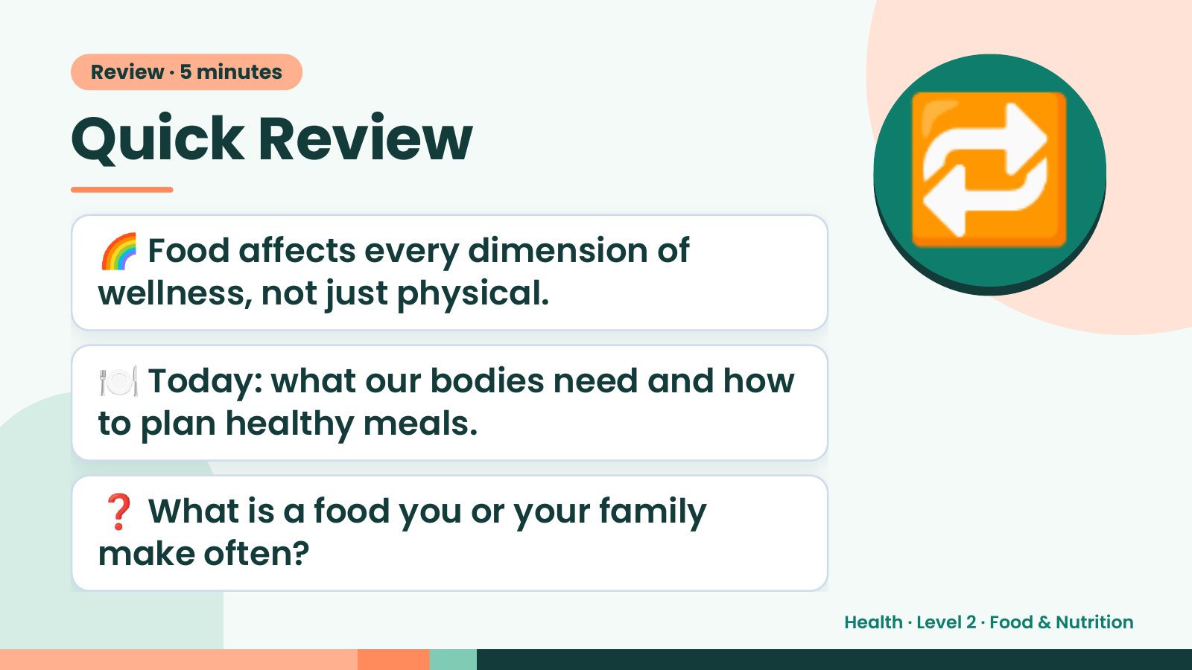
Notes:
Review · 5 minutes
Quick Review
🌈 Food affects every dimension of
wellness, not just physical.
🔁
🍽️ Today: what our bodies need and how
to plan healthy meals.
❓ What is a food you or your family
make often?
Health · Level 2 · Food & Nutrition

Slide 3
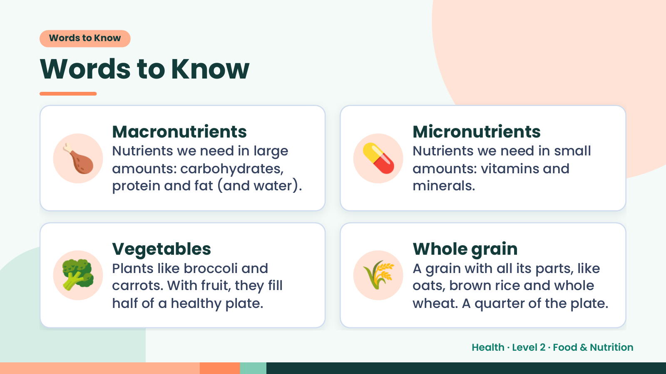
Notes:
Words to Know
Words to Know
🍗 Macronutrients
Nutrients we need in large
amounts: carbohydrates,
protein and fat (and water).
💊 Micronutrients
Nutrients we need in small
amounts: vitamins and
minerals.
🥦 Vegetables
Plants like broccoli and
carrots. With fruit, they fill
half of a healthy plate.
🌾 Whole grain
A grain with all its parts, like
oats, brown rice and whole
wheat. A quarter of the plate.
Health · Level 2 · Food & Nutrition

Slide 4
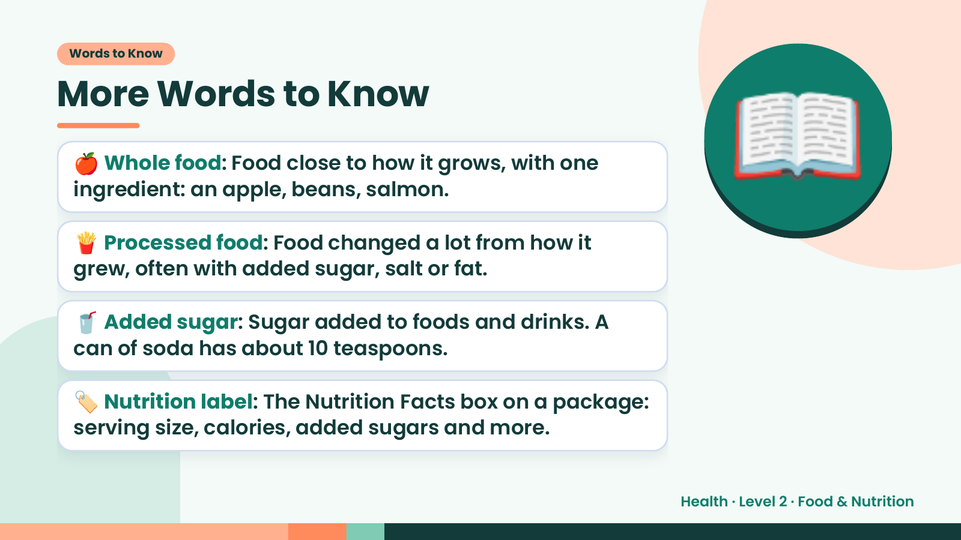
Notes:
Words to Know
More Words to Know
🍎 Whole food: Food close to how it grows, with one
ingredient: an apple, beans, salmon.
🍟 Processed food: Food changed a lot from how it
grew, often with added sugar, salt or fat.
📖
🥤 Added sugar: Sugar added to foods and drinks. A
can of soda has about 10 teaspoons.
🏷️ Nutrition label: The Nutrition Facts box on a package:
serving size, calories, added sugars and more.
Health · Level 2 · Food & Nutrition

Slide 5
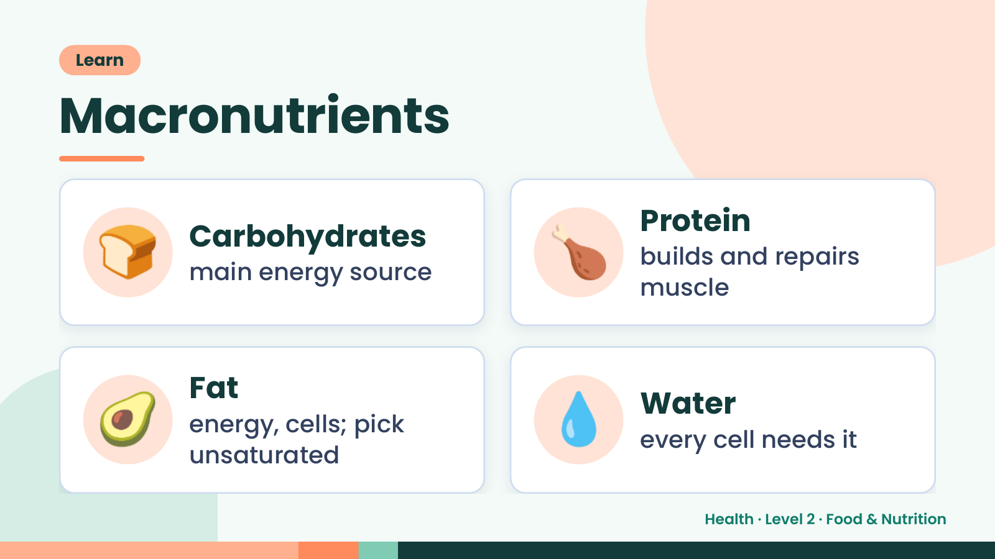
Notes:
Learn
Macronutrients
🍞 Carbohydrates
main energy source 🍗 Protein
builds and repairs
muscle
🥑 Fat
energy, cells; pick
unsaturated
💧 Water
every cell needs it
Health · Level 2 · Food & Nutrition

Slide 6
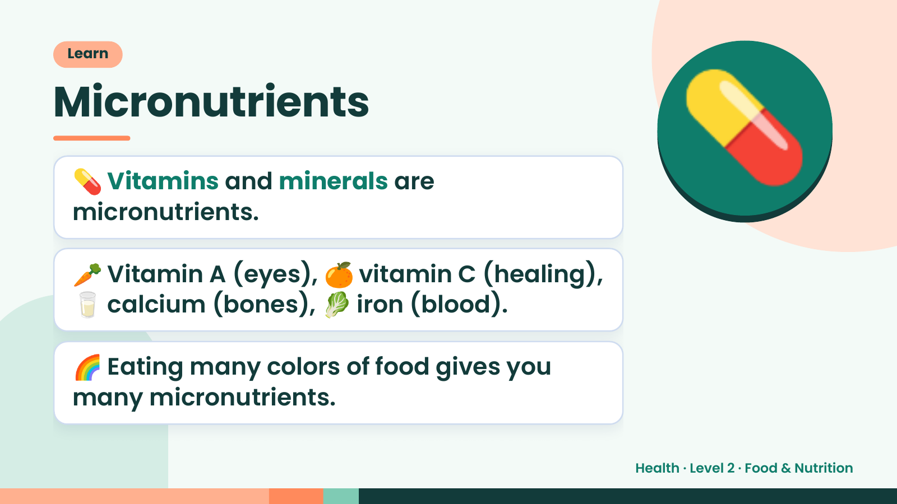
Notes:
Learn
Micronutrients
💊 Vitamins and minerals are
micronutrients.
🥕 Vitamin A (eyes), 🍊 vitamin C (healing),
💊
🥛 calcium (bones), 🥬 iron (blood).
🌈 Eating many colors of food gives you
many micronutrients.
Health · Level 2 · Food & Nutrition

Slide 7
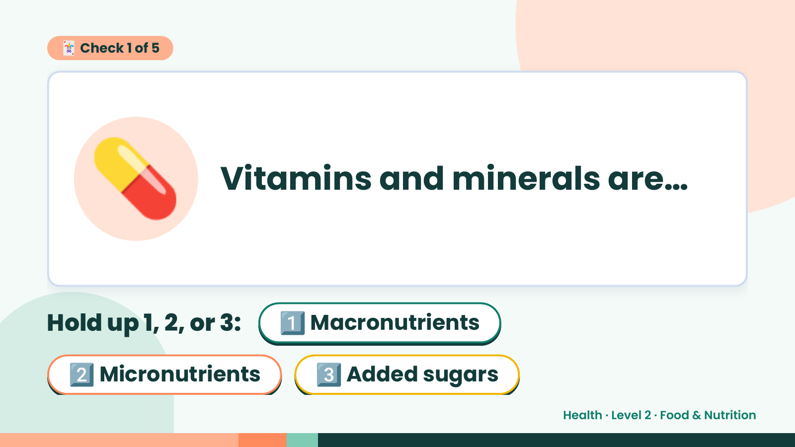
Notes:
🃏 Check 1 of 5
💊 Vitamins and minerals are…
Hold up 1, 2, or 3: 1️⃣ Macronutrients
2️⃣ Micronutrients 3️⃣ Added sugars
Health · Level 2 · Food & Nutrition

Slide 8
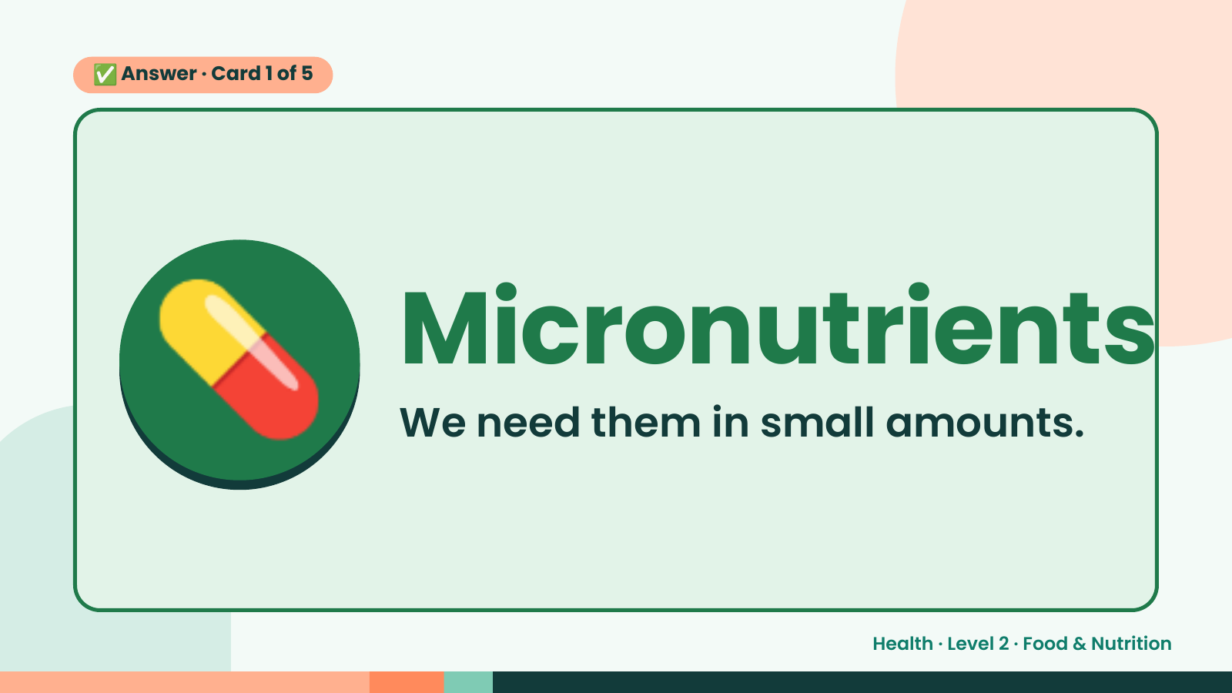
Notes:
✅ Answer · Card 1 of 5
💊 Micronutrients
We need them in small amounts.
Health · Level 2 · Food & Nutrition

Slide 9
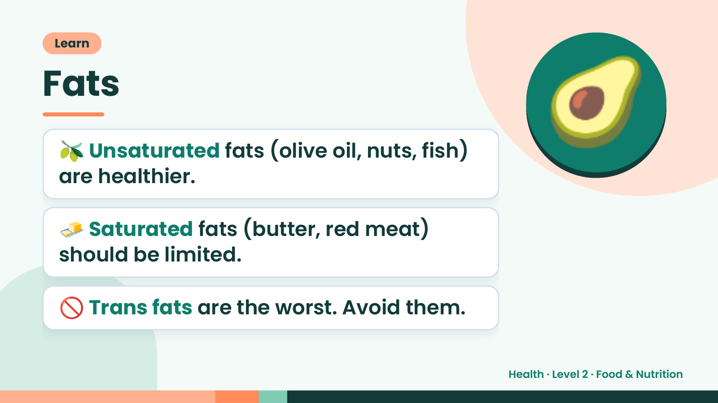
Notes:
Learn
Fats
🫒 Unsaturated fats (olive oil, nuts, fish)
are healthier.
🥑
🧈 Saturated fats (butter, red meat)
should be limited.
🚫 Trans fats are the worst. Avoid them.
Health · Level 2 · Food & Nutrition

Slide 10
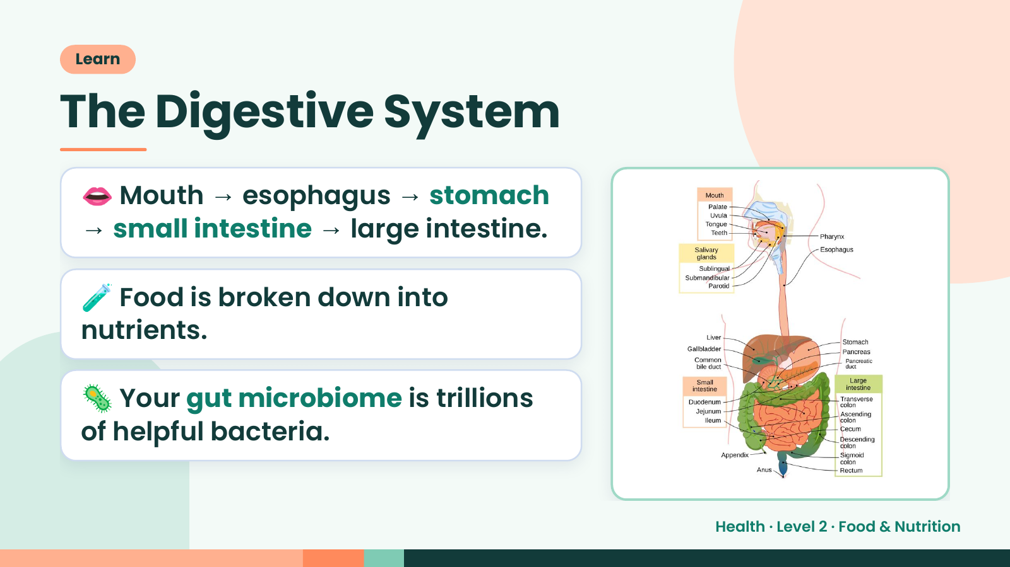
Notes:
Learn
The Digestive System
👄 Mouth → esophagus → stomach
→ small intestine → large intestine.
🧪 Food is broken down into
nutrients.
🦠 Your gut microbiome is trillions
of helpful bacteria.
Health · Level 2 · Food & Nutrition

Slide 11
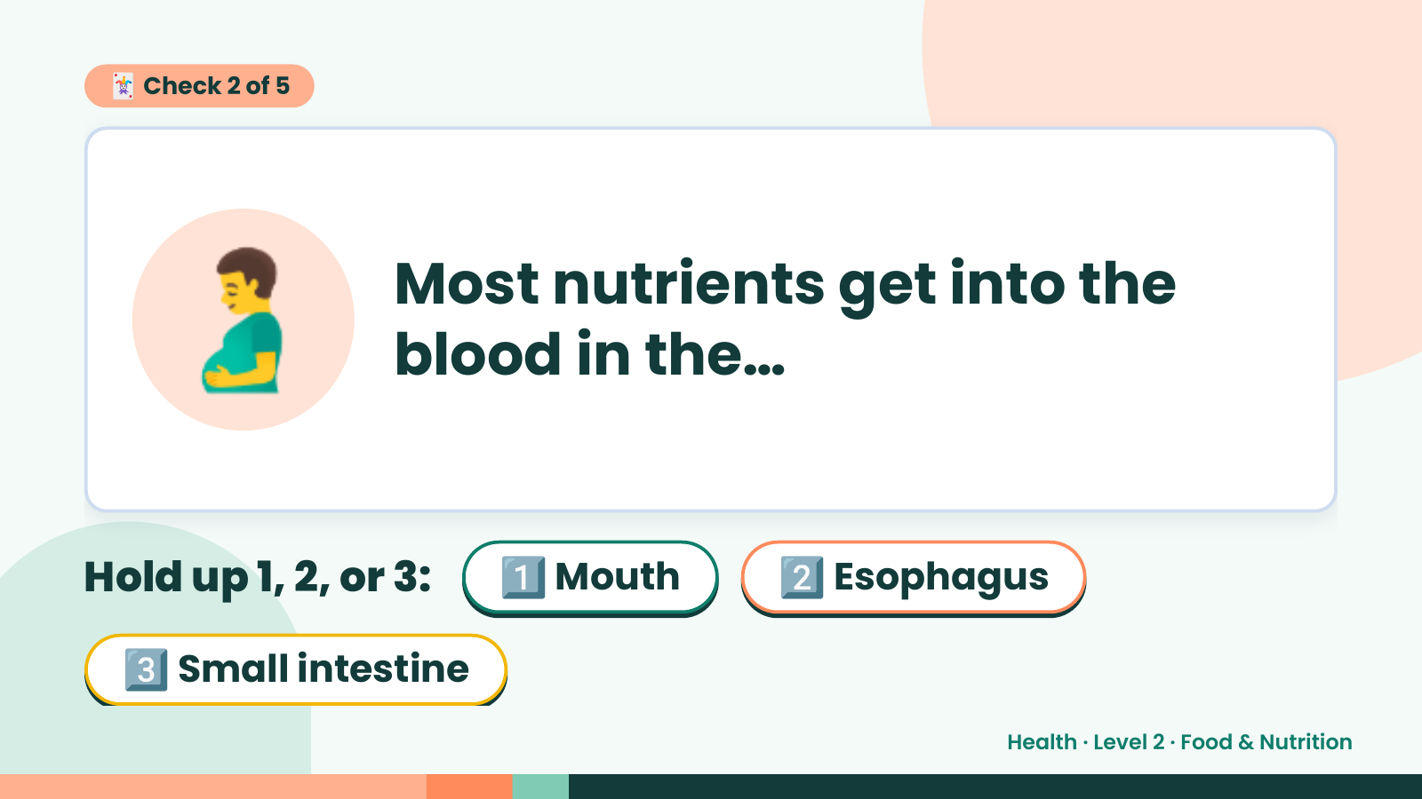
Notes:
🃏 Check 2 of 5
🫃 Most nutrients get into the
blood in the…
Hold up 1, 2, or 3: 1️⃣ Mouth 2️⃣ Esophagus
3️⃣ Small intestine
Health · Level 2 · Food & Nutrition

Slide 12
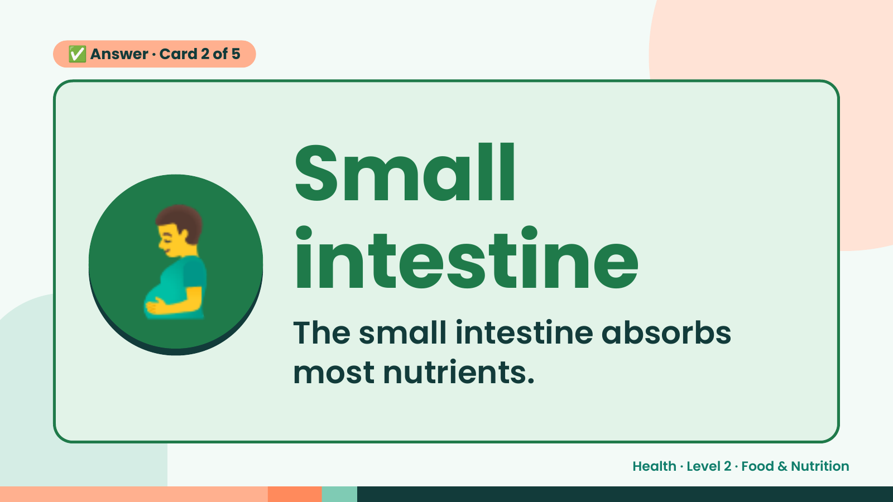
Notes:
✅ Answer · Card 2 of 5
🫃 Small
intestine
The small intestine absorbs
most nutrients.
Health · Level 2 · Food & Nutrition

Slide 13
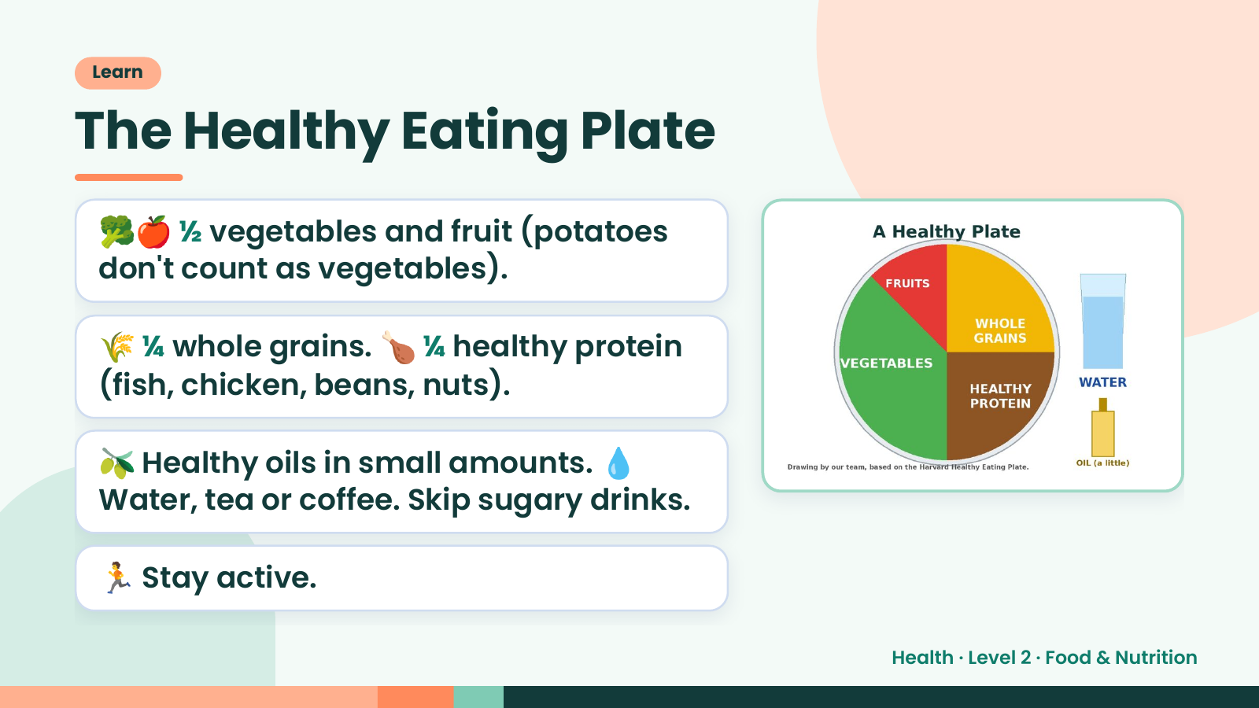
Notes:
Learn
The Healthy Eating Plate
🥦🍎 ½ vegetables and fruit (potatoes
don't count as vegetables).
🌾 ¼ whole grains. 🍗 ¼ healthy protein
(fish, chicken, beans, nuts).
🫒 Healthy oils in small amounts. 💧
Water, tea or coffee. Skip sugary drinks.
🏃 Stay active.
Health · Level 2 · Food & Nutrition

Slide 14
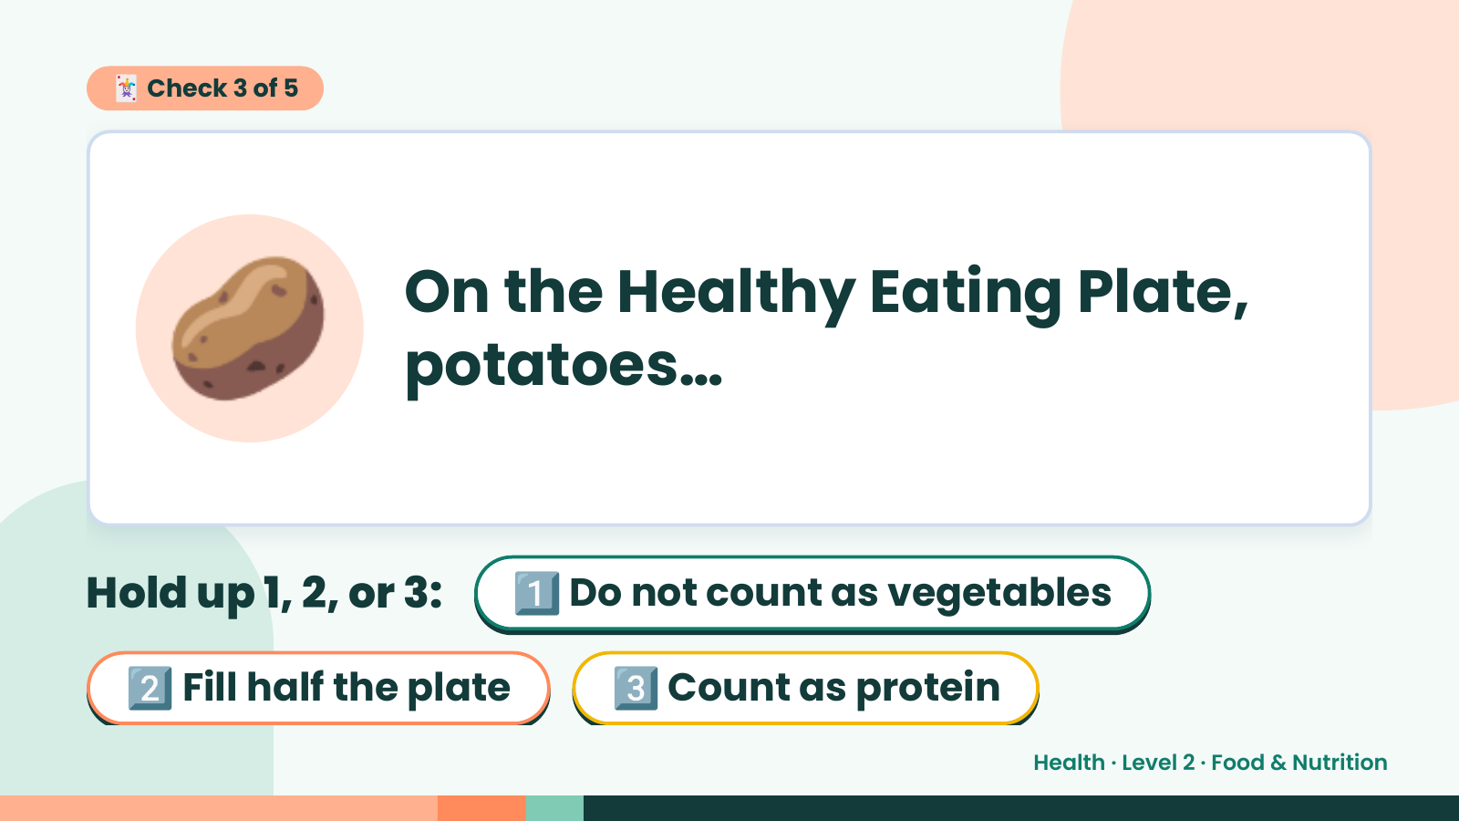
Notes:
🃏 Check 3 of 5
🥔 On the Healthy Eating Plate,
potatoes…
Hold up 1, 2, or 3: 1️⃣ Do not count as vegetables
2️⃣ Fill half the plate 3️⃣ Count as protein
Health · Level 2 · Food & Nutrition

Slide 15
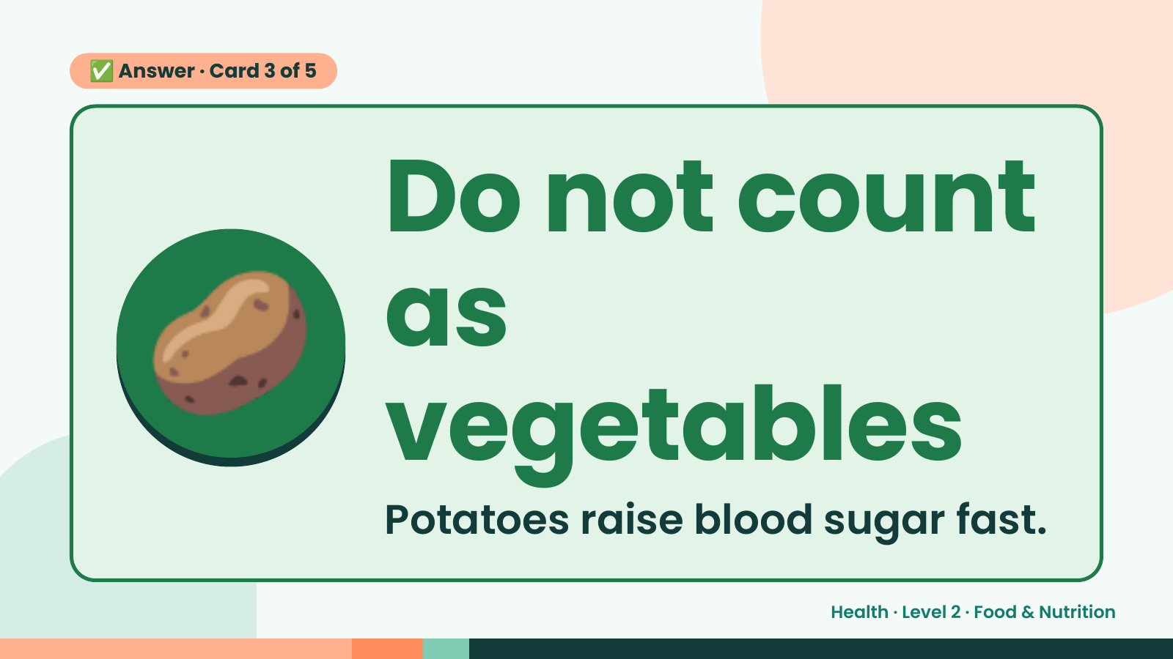
Notes:
✅ Answer · Card 3 of 5
🥔 Do not count
as
vegetables
Potatoes raise blood sugar fast.
Health · Level 2 · Food & Nutrition

Slide 16
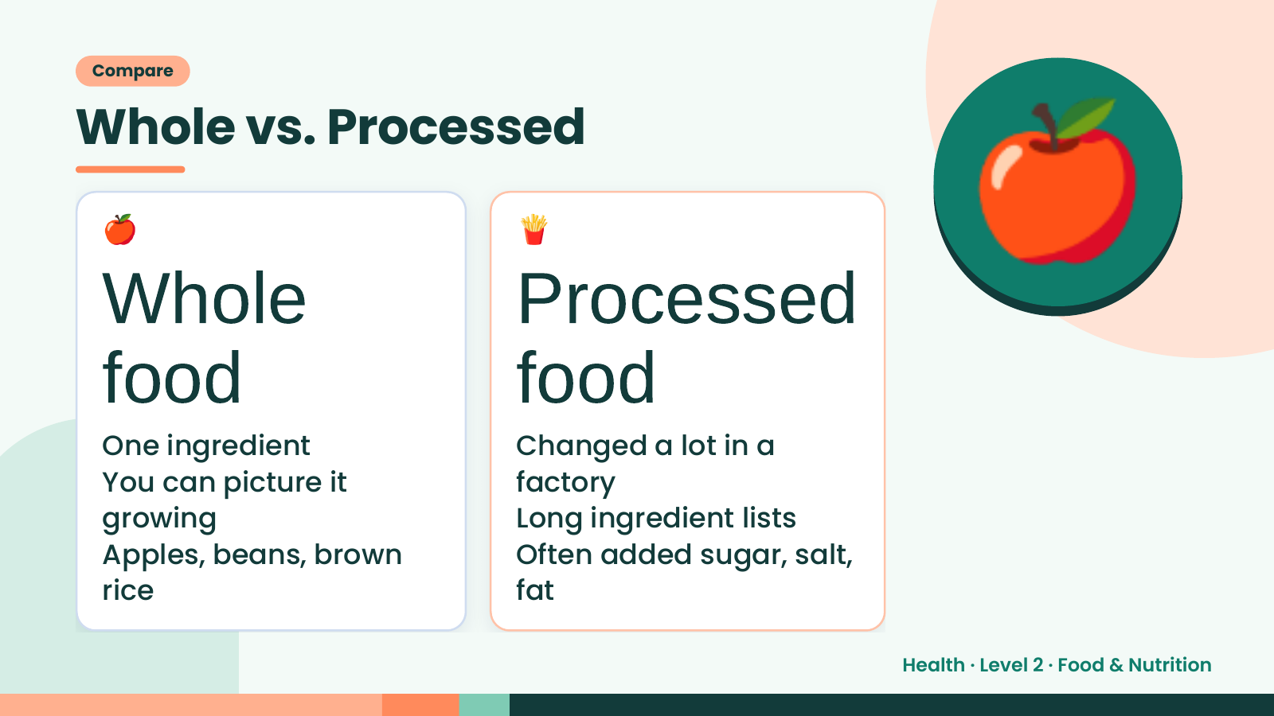
Notes:
Compare
Whole vs. Processed
🍎
Whole
food
🍟
Processed
food
🍎
One ingredient Changed a lot in a
You can picture it factory
growing Long ingredient lists
Apples, beans, brown Often added sugar, salt,
rice fat
Health · Level 2 · Food & Nutrition

Slide 17
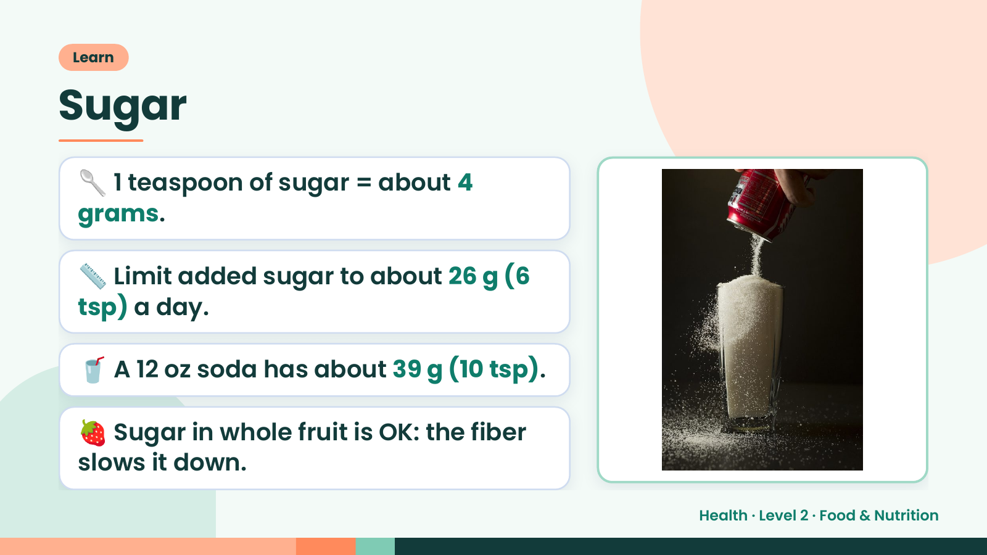
Notes:
Learn
Sugar
🥄 1 teaspoon of sugar = about 4
grams.
📏 Limit added sugar to about 26 g (6
tsp) a day.
🥤 A 12 oz soda has about 39 g (10 tsp).
🍓 Sugar in whole fruit is OK: the fiber
slows it down.
Health · Level 2 · Food & Nutrition

Slide 18
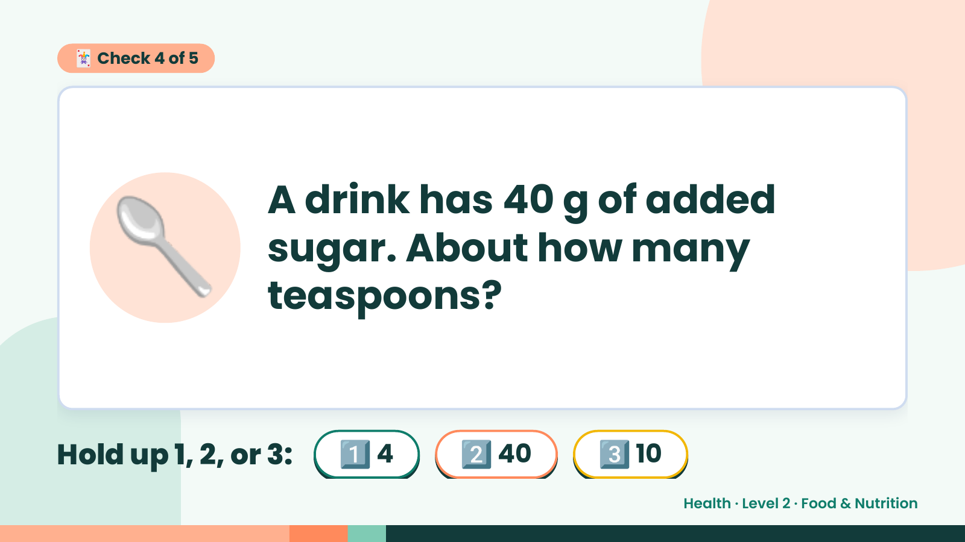
Notes:
🃏 Check 4 of 5
🥄 A drink has 40 g of added
sugar. About how many
teaspoons?
Hold up 1, 2, or 3: 1️⃣ 4 2️⃣ 40 3️⃣ 10
Health · Level 2 · Food & Nutrition

Slide 19
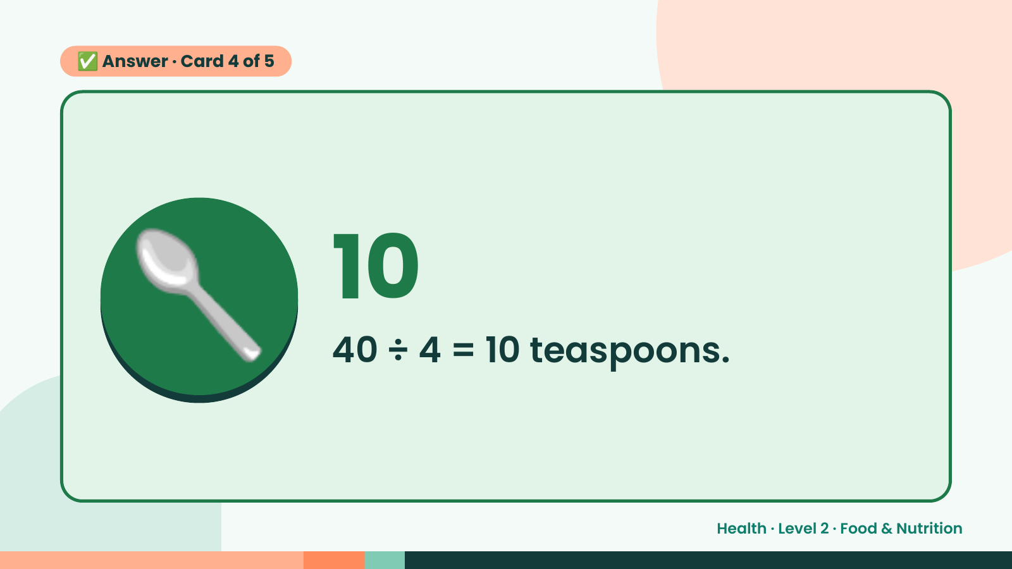
Notes:
✅ Answer · Card 4 of 5
🥄 10
40 ÷ 4 = 10 teaspoons.
Health · Level 2 · Food & Nutrition

Slide 20
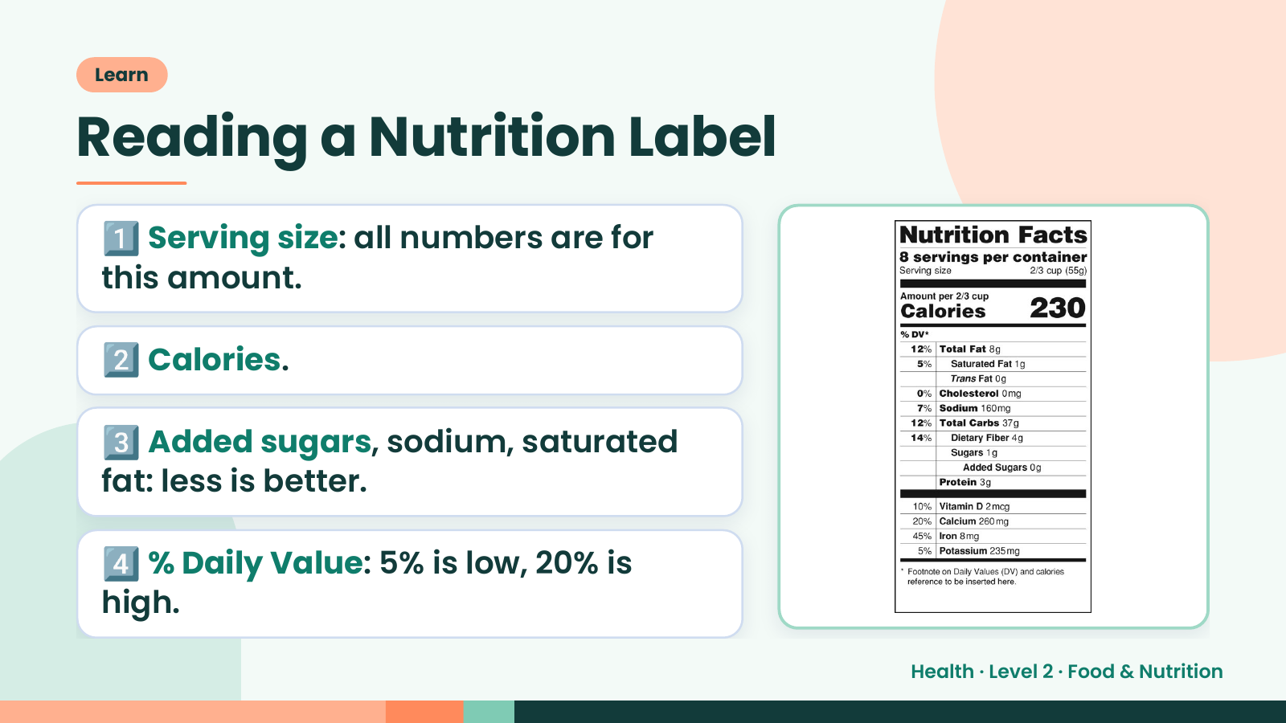
Notes:
Learn
Reading a Nutrition Label
1️⃣ Serving size: all numbers are for
this amount.
2️⃣ Calories.
3️⃣ Added sugars, sodium, saturated
fat: less is better.
4️⃣ % Daily Value: 5% is low, 20% is
high.
Health · Level 2 · Food & Nutrition

Slide 21
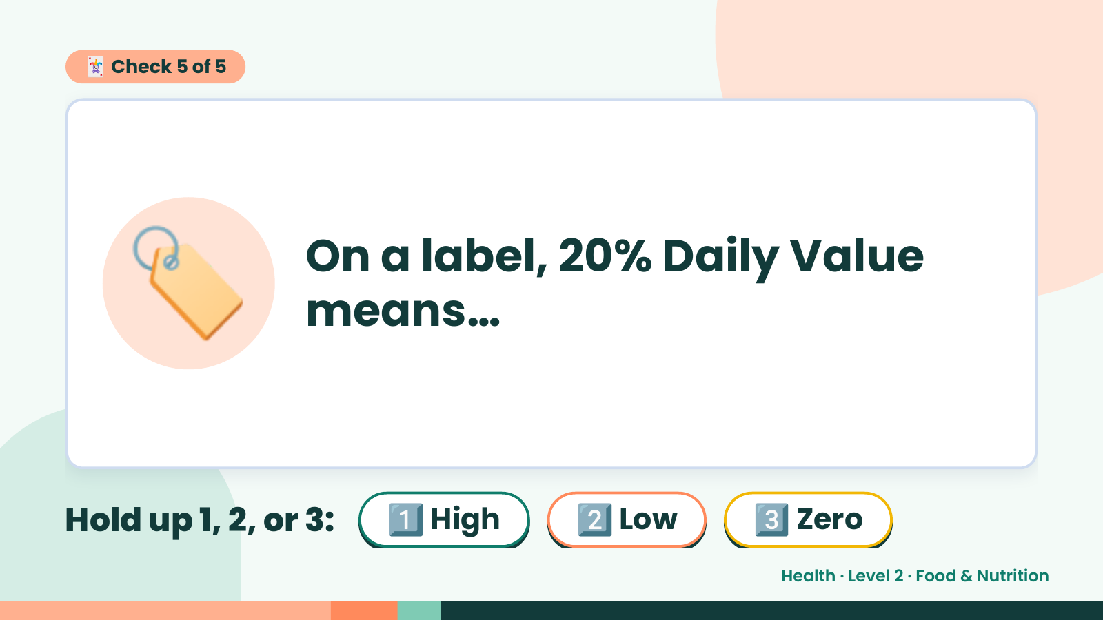
Notes:
🃏 Check 5 of 5
🏷️ On a label, 20% Daily Value
means…
Hold up 1, 2, or 3: 1️⃣ High 2️⃣ Low 3️⃣ Zero
Health · Level 2 · Food & Nutrition

Slide 22
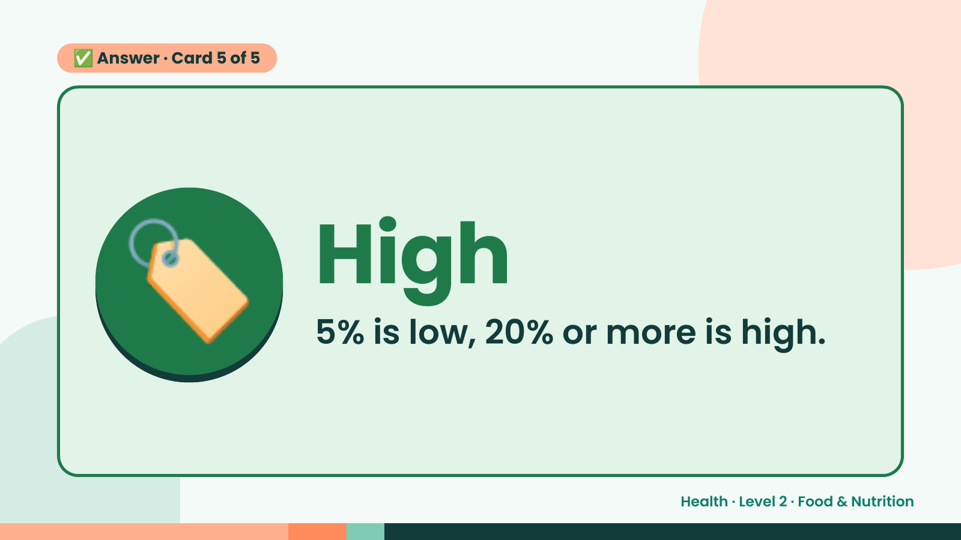
Notes:
✅ Answer · Card 5 of 5
🏷️ High
5% is low, 20% or more is high.
Health · Level 2 · Food & Nutrition

Slide 23
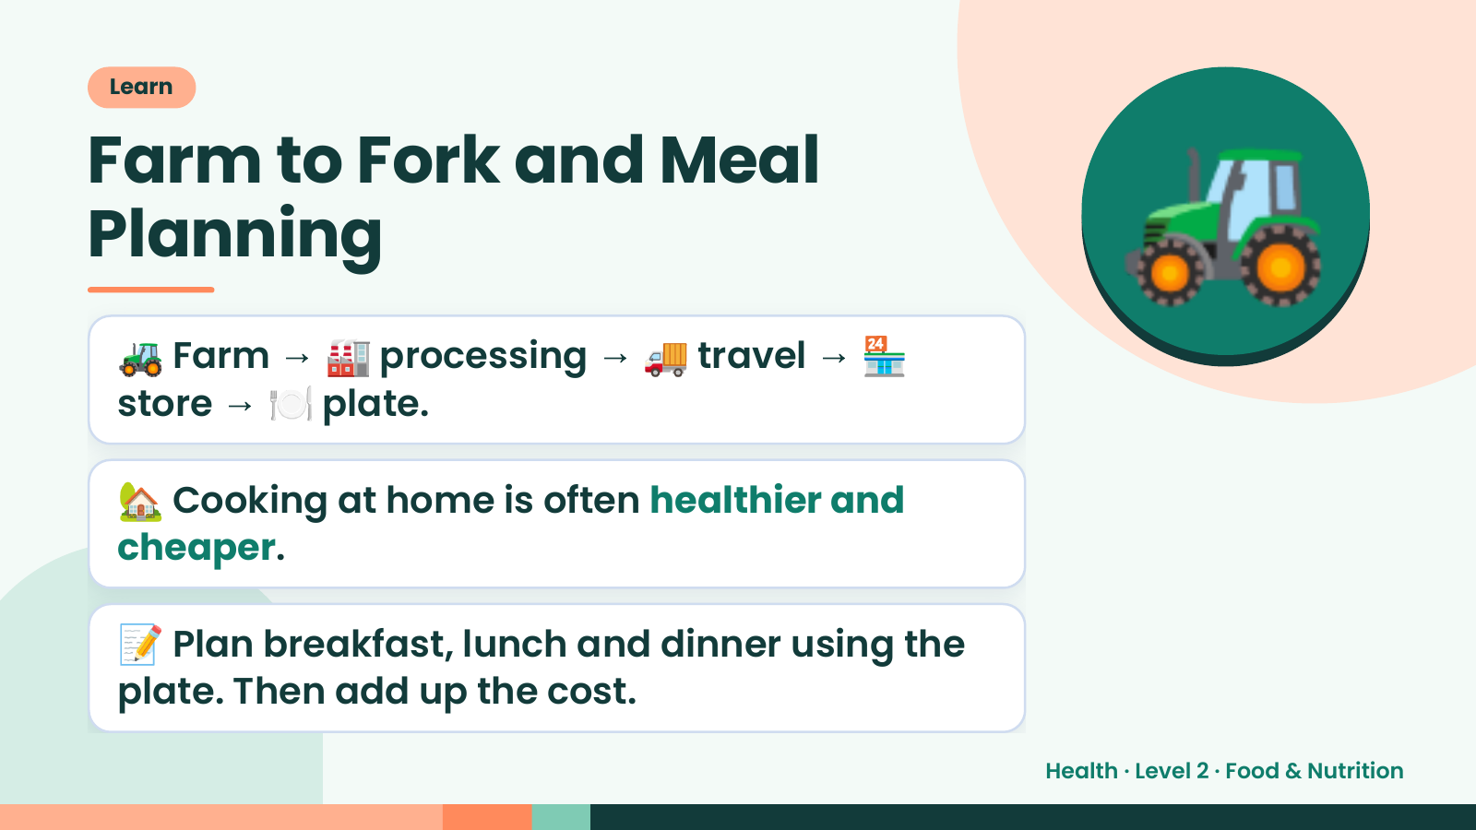
Notes:
Learn
Farm to Fork and Meal
Planning
🚜 Farm → 🏭 processing → 🚚 travel → 🏪
store → 🍽️ plate.
🚜
🏡 Cooking at home is often healthier and
cheaper.
📝 Plan breakfast, lunch and dinner using the
plate. Then add up the cost.
Health · Level 2 · Food & Nutrition

Slide 24
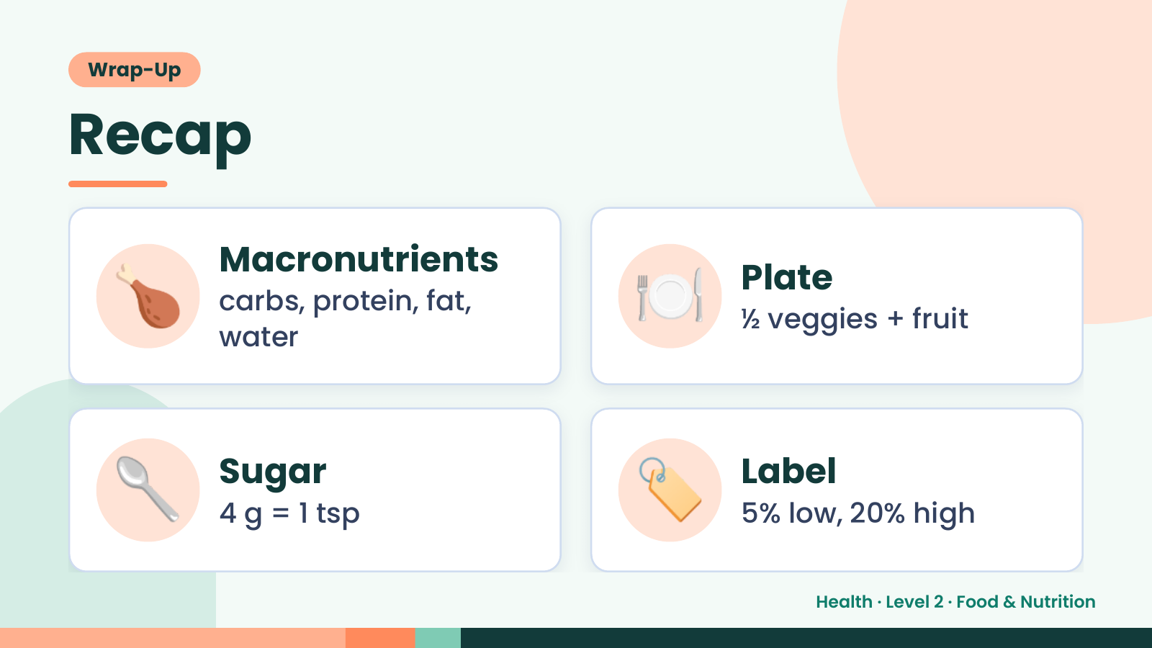
Notes:
Wrap-Up
Recap
🍗 Macronutrients
carbs, protein, fat,
water
🍽️ Plate
½ veggies + fruit
🥄 Sugar
4 g = 1 tsp 🏷️ Label
5% low, 20% high
Health · Level 2 · Food & Nutrition

Slide 25
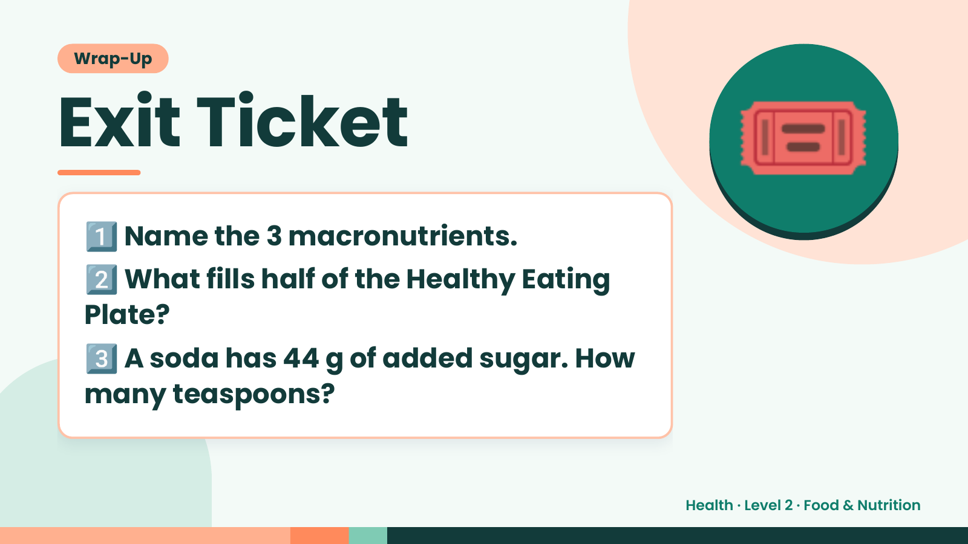
Notes:
Wrap-Up
Exit Ticket
1️⃣
2️⃣
Name the 3 macronutrients.
What fills half of the Healthy Eating
🎟️
Plate?
3️⃣
A soda has 44 g of added sugar. How
many teaspoons?
Health · Level 2 · Food & Nutrition

