Slide 1
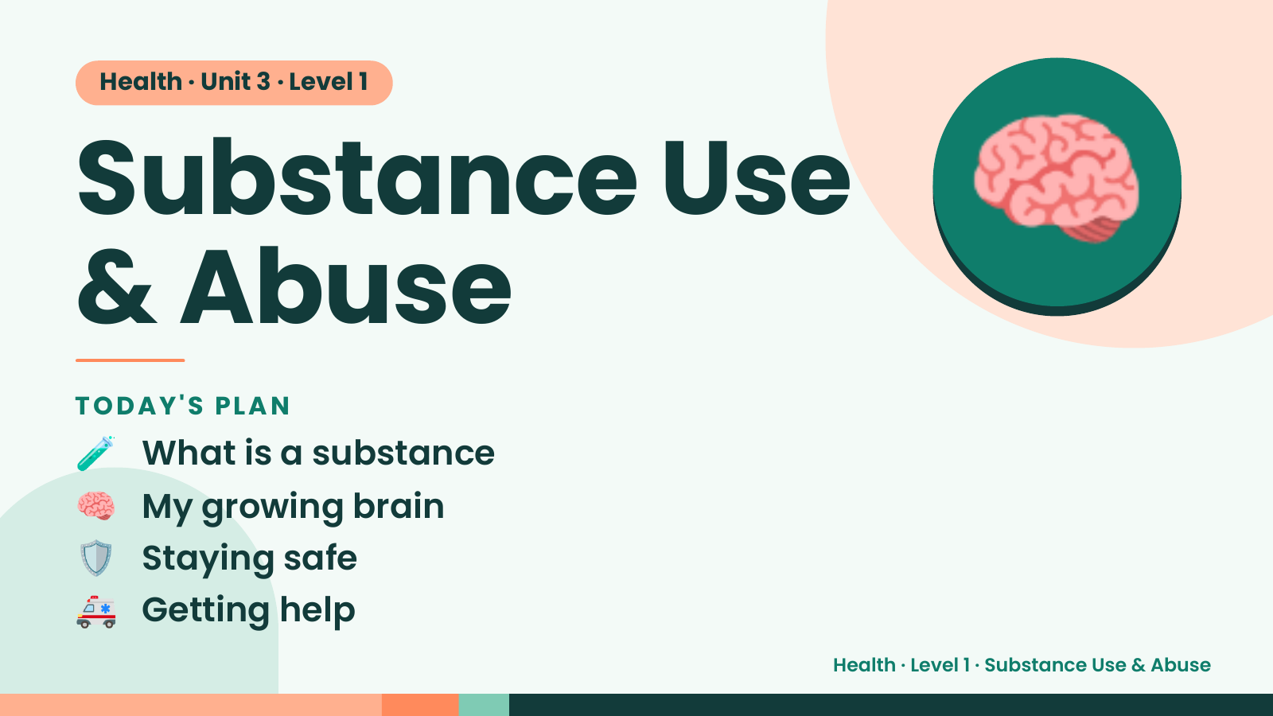
Notes:
Health · Unit 3 · Level 1
Substance Use
& Abuse
🧠
🧪 What is a substance
TODAY'S PLAN
🧠 My growing brain
🛡️ Staying safe
🚑 Getting help
Health · Level 1 · Substance Use & Abuse

Slide 2
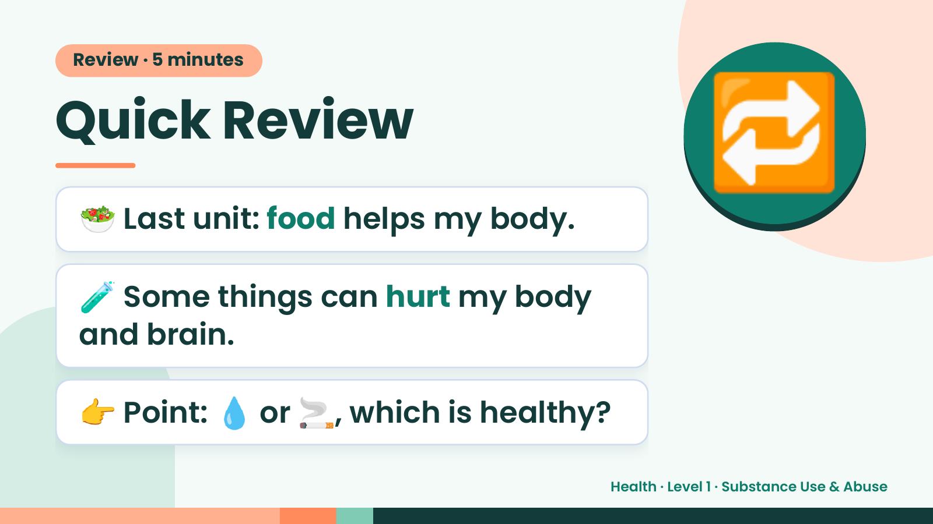
Notes:
Review · 5 minutes
Quick Review
🥗 Last unit: food helps my body.
🔁
🧪 Some things can hurt my body
and brain.
👉 Point: 💧 or 🚬, which is healthy?
Health · Level 1 · Substance Use & Abuse

Slide 3
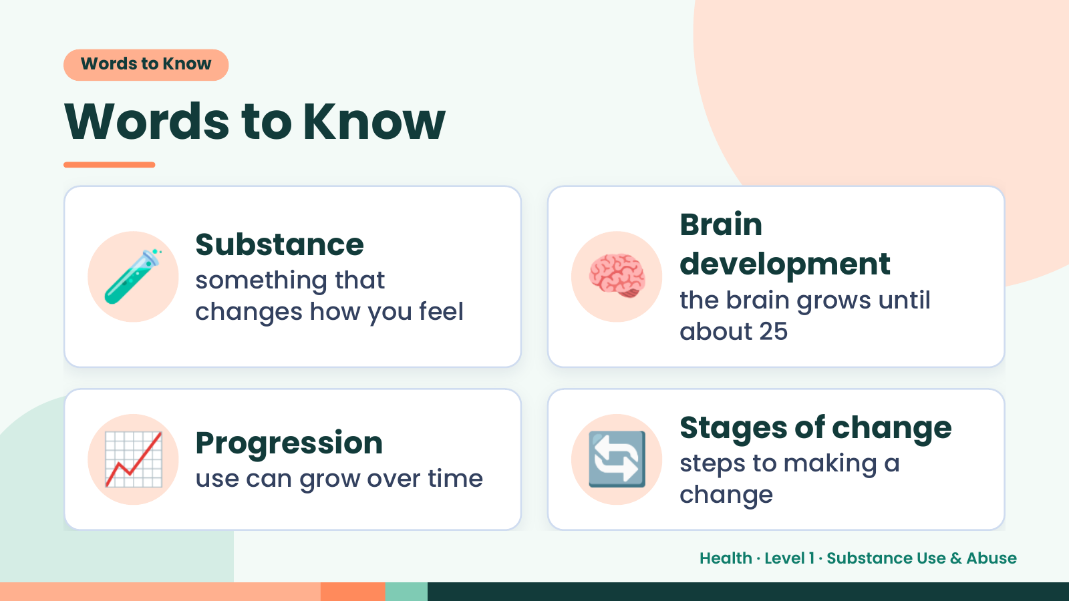
Notes:
Words to Know
Words to Know
🧪 Substance
something that
changes how you feel
🧠 Brain
development
the brain grows until
about 25
📈 Progression
use can grow over time 🔄 Stages of change
steps to making a
change
Health · Level 1 · Substance Use & Abuse

Slide 4
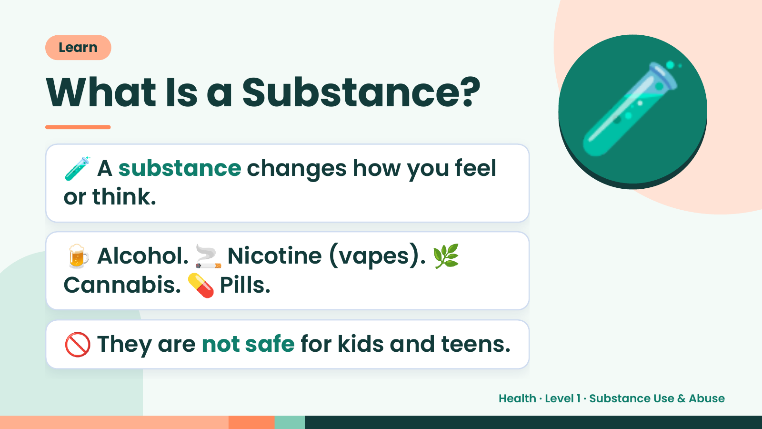
Notes:
Learn
What Is a Substance?
🧪 A substance changes how you feel
or think.
🧪
🍺 Alcohol. 🚬 Nicotine (vapes). 🌿
Cannabis. 💊 Pills.
🚫 They are not safe for kids and teens.
Health · Level 1 · Substance Use & Abuse

Slide 5
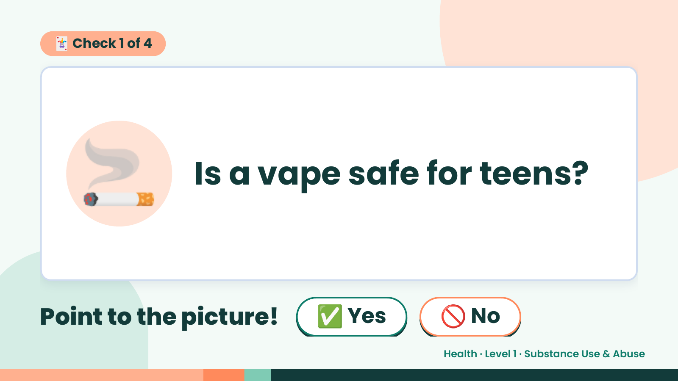
Notes:
🃏 Check 1 of 4
🚬 Is a vape safe for teens?
Point to the picture! ✅ Yes 🚫 No
Health · Level 1 · Substance Use & Abuse

Slide 6
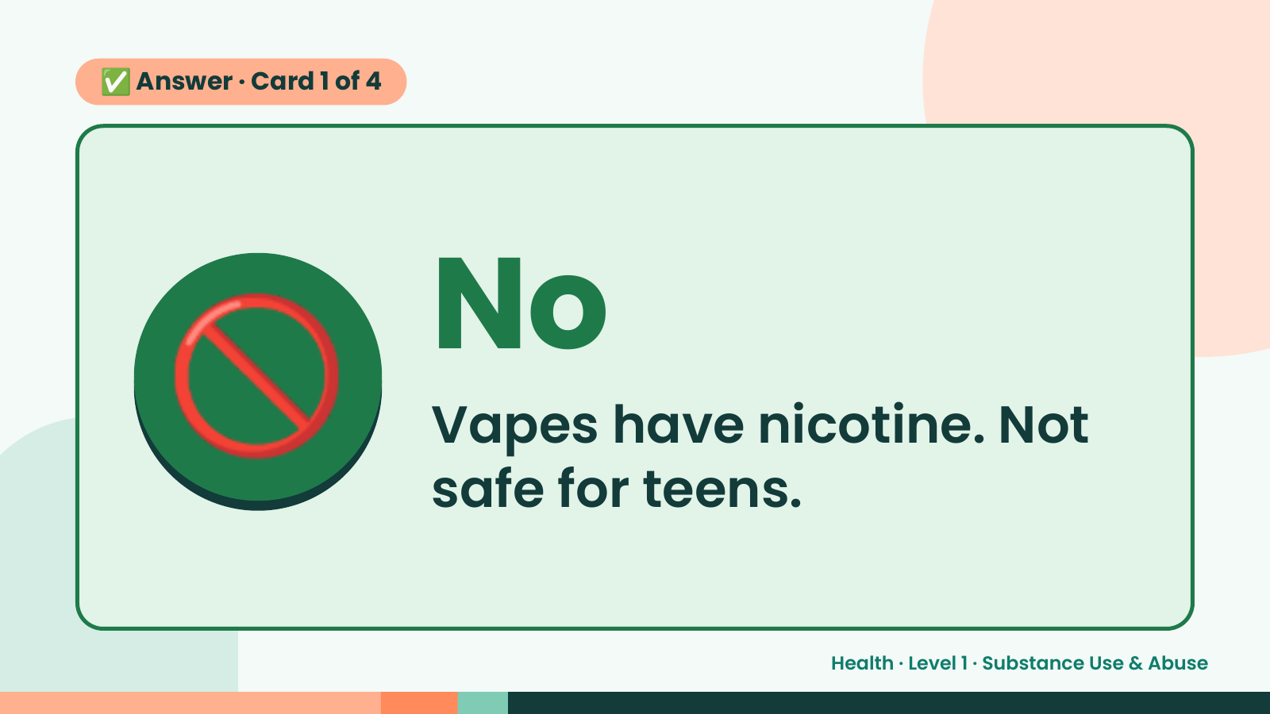
Notes:
✅ Answer · Card 1 of 4
🚫 No
Vapes have nicotine. Not
safe for teens.
Health · Level 1 · Substance Use & Abuse

Slide 7
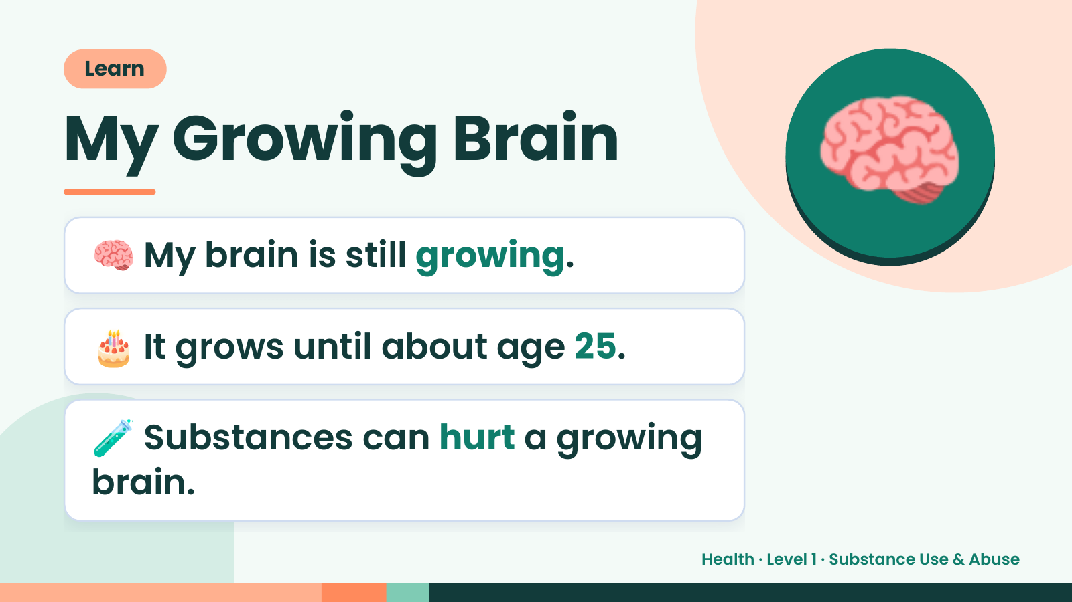
Notes:
Learn
My Growing Brain
🧠 My brain is still growing.
🧠
🎂 It grows until about age 25.
🧪 Substances can hurt a growing
brain.
Health · Level 1 · Substance Use & Abuse

Slide 8
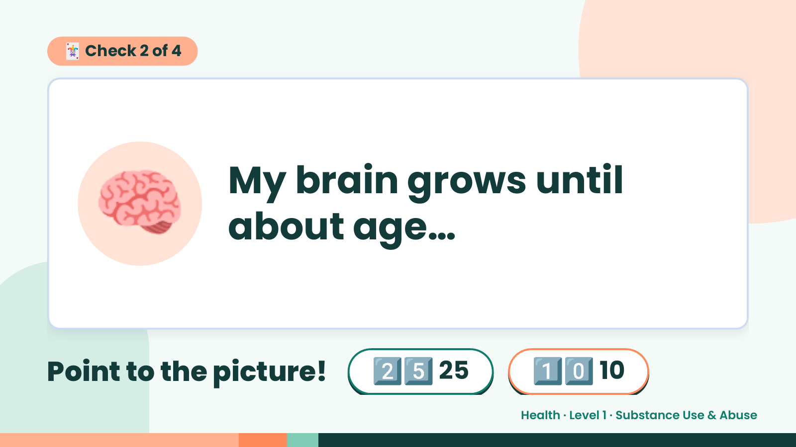
Notes:
🃏 Check 2 of 4
🧠 My brain grows until
about age…
Point to the picture! 2️⃣5️⃣ 25 1️⃣0️⃣ 10
Health · Level 1 · Substance Use & Abuse

Slide 9
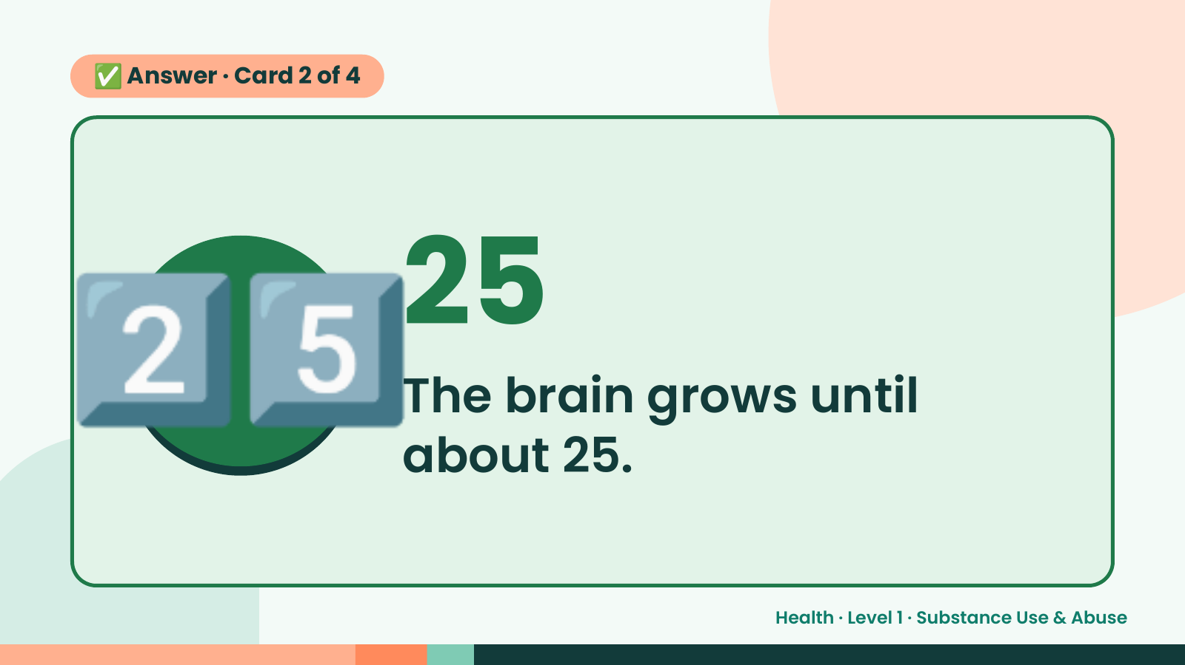
Notes:
✅ Answer · Card 2 of 4
2️⃣5️⃣ 25
The brain grows until
about 25.
Health · Level 1 · Substance Use & Abuse

Slide 10
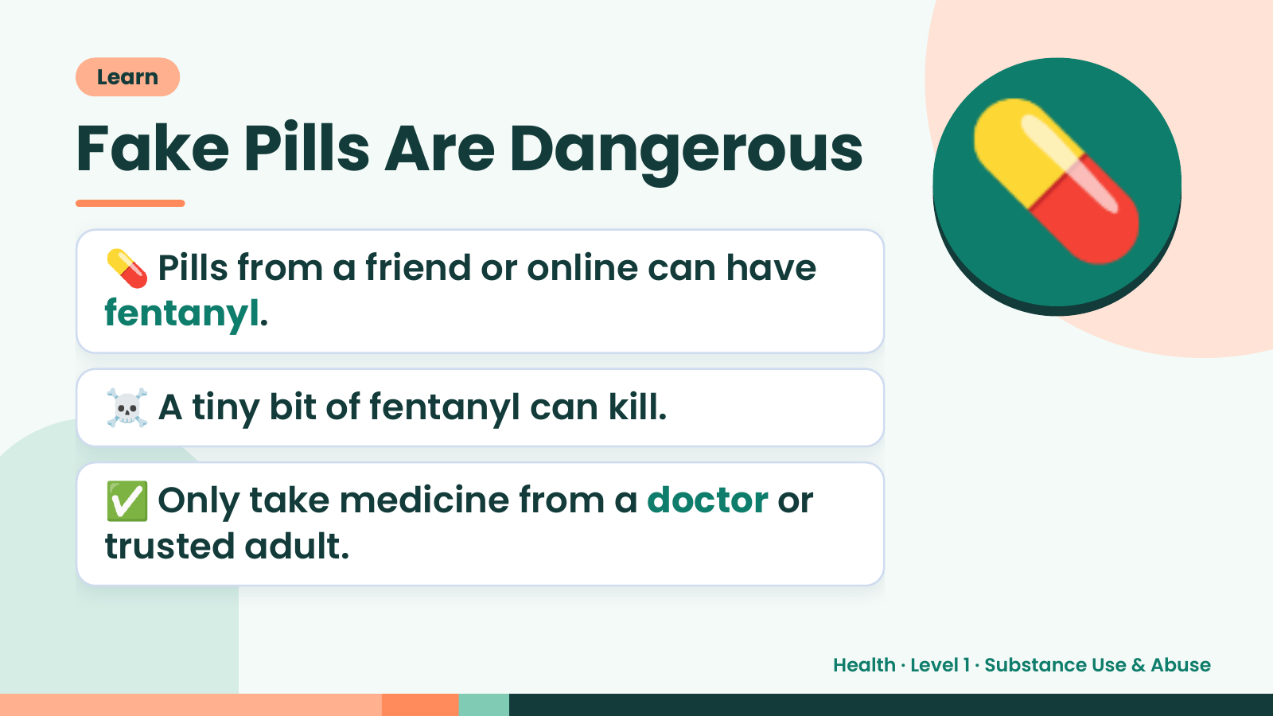
Notes:
Learn
Fake Pills Are Dangerous
💊 Pills from a friend or online can have
fentanyl.
💊
☠️ A tiny bit of fentanyl can kill.
✅ Only take medicine from a doctor or
trusted adult.
Health · Level 1 · Substance Use & Abuse

Slide 11
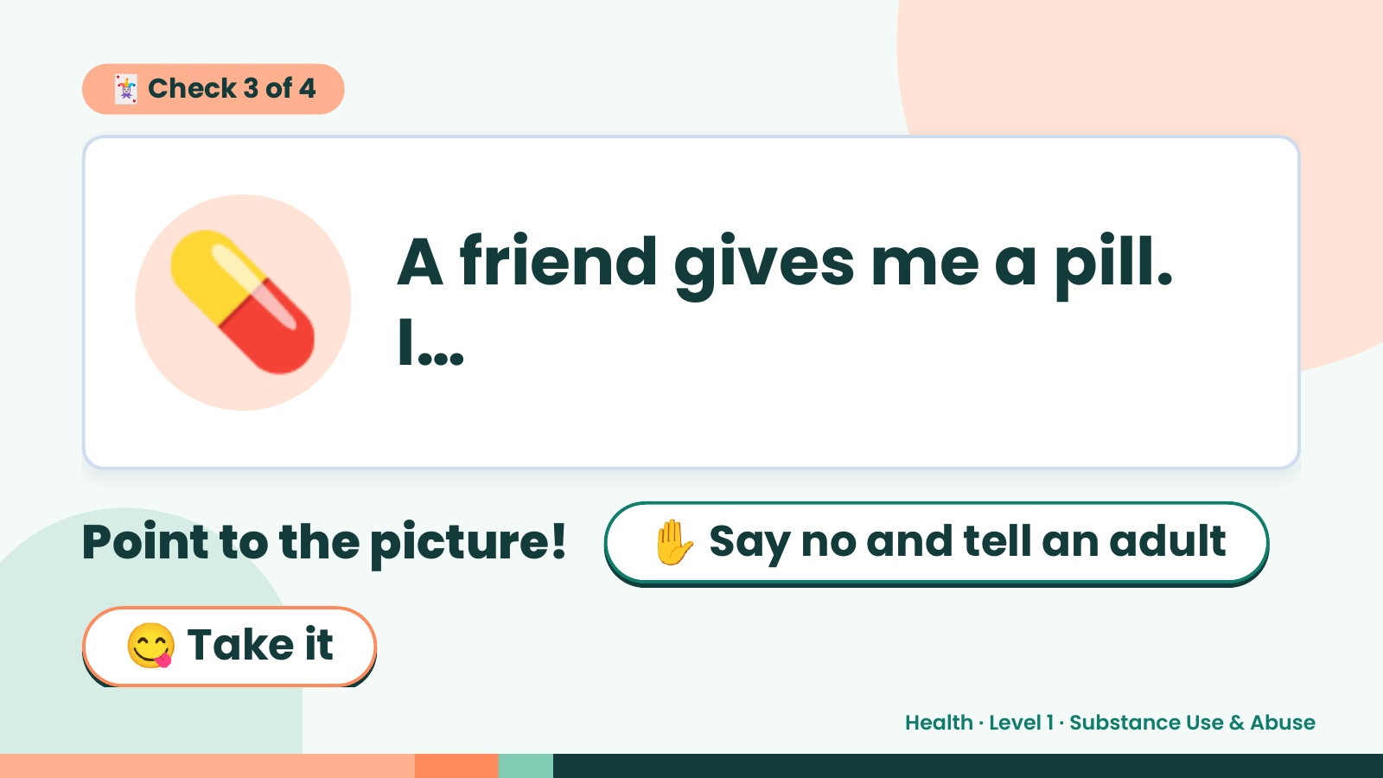
Notes:
🃏 Check 3 of 4
💊 A friend gives me a pill.
I…
Point to the picture! ✋ Say no and tell an adult
😋 Take it
Health · Level 1 · Substance Use & Abuse

Slide 12
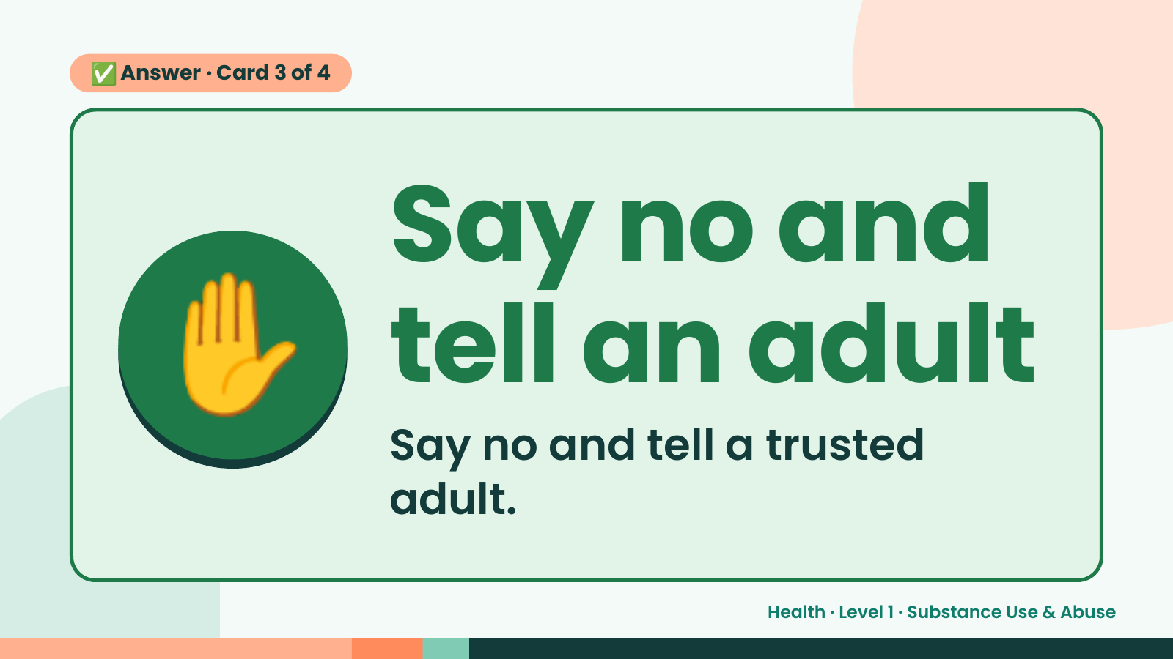
Notes:
✅ Answer · Card 3 of 4
✋ Say no and
tell an adult
Say no and tell a trusted
adult.
Health · Level 1 · Substance Use & Abuse

Slide 13
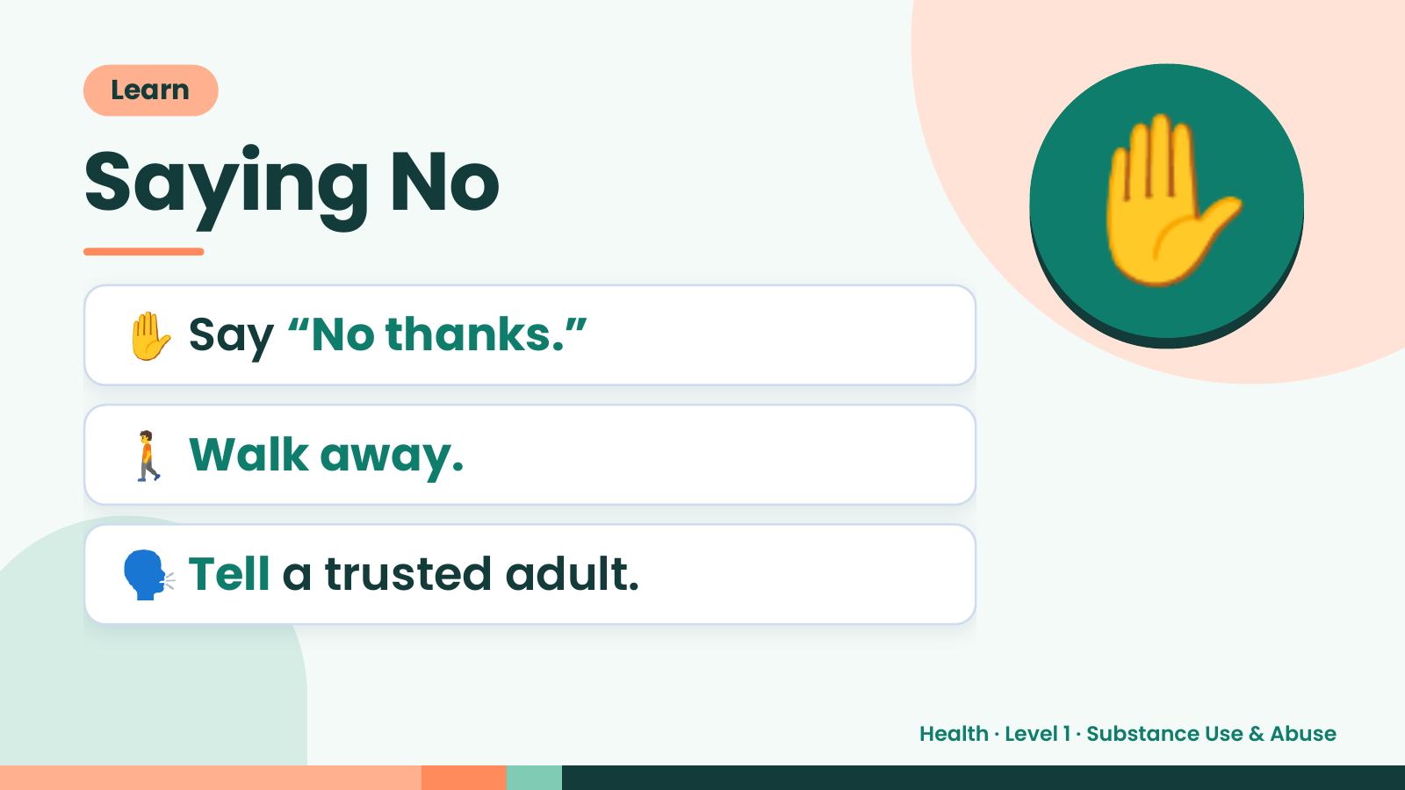
Notes:
Learn
Saying No
✋ Say “No thanks.”
✋
🚶 Walk away.
🗣️ Tell a trusted adult.
Health · Level 1 · Substance Use & Abuse

Slide 14
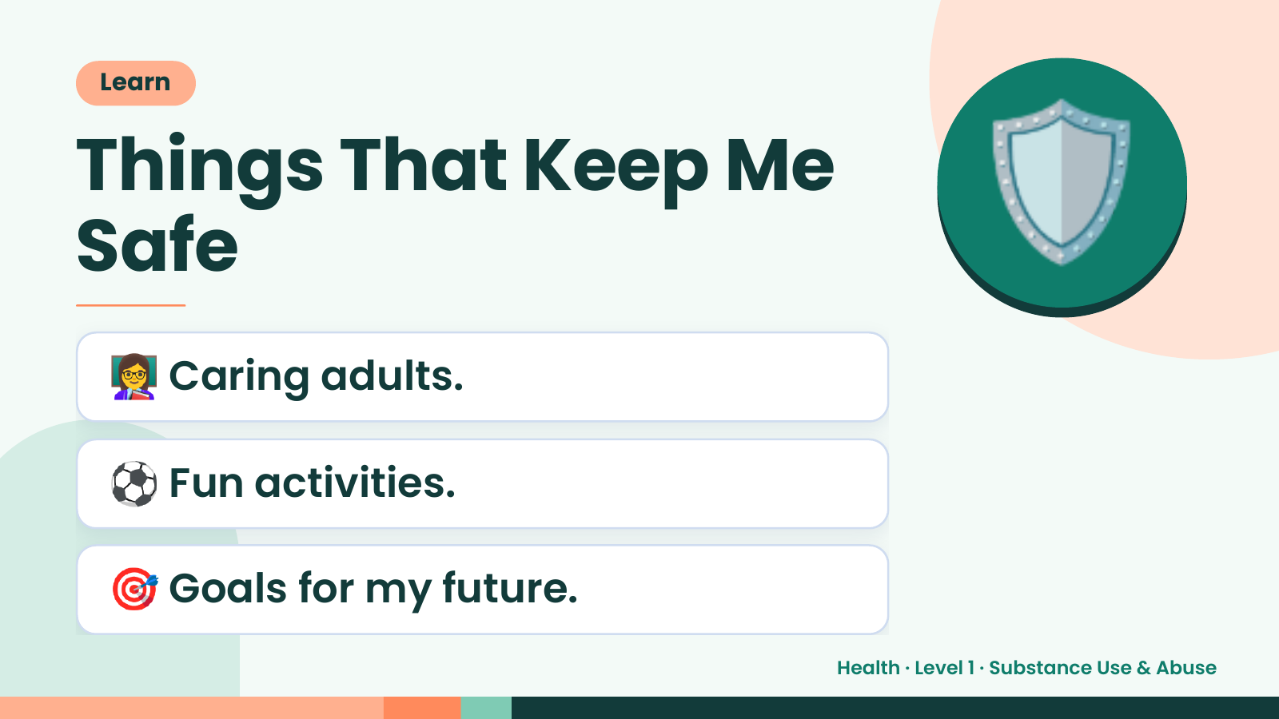
Notes:
Learn
Things That Keep Me
Safe
👩‍🏫 Caring adults.
🛡️
⚽ Fun activities.
🎯 Goals for my future.
Health · Level 1 · Substance Use & Abuse

Slide 15
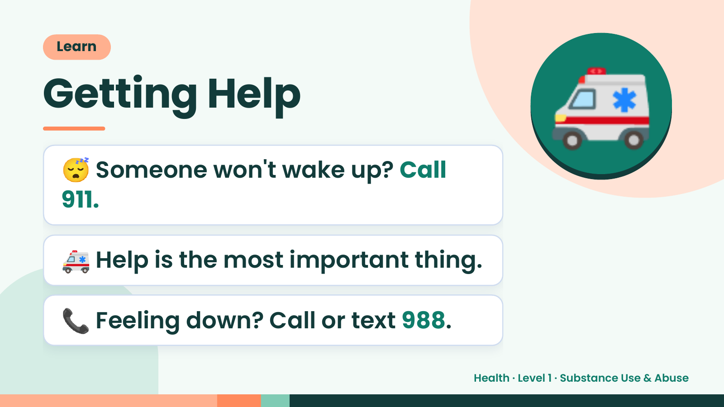
Notes:
Learn
Getting Help
😴 Someone won't wake up? Call
911.
🚑
🚑 Help is the most important thing.
📞 Feeling down? Call or text 988.
Health · Level 1 · Substance Use & Abuse

Slide 16
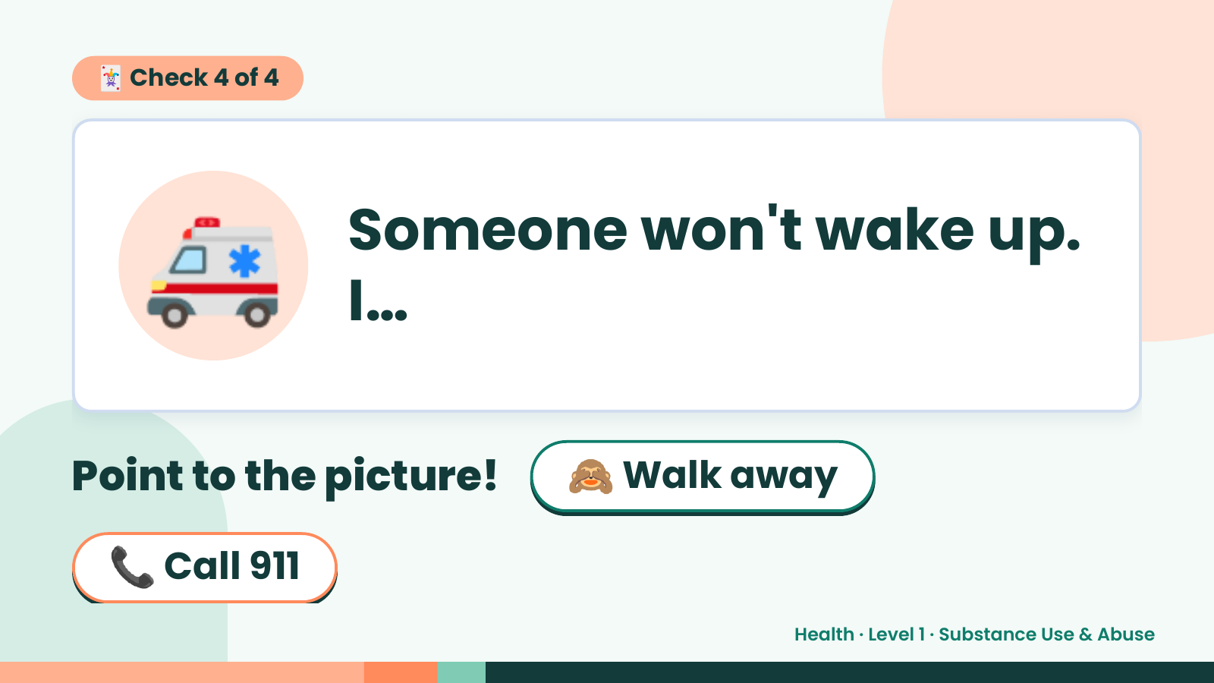
Notes:
🃏 Check 4 of 4
🚑 Someone won't wake up.
I…
Point to the picture! 🙈 Walk away
📞 Call 911
Health · Level 1 · Substance Use & Abuse

Slide 17
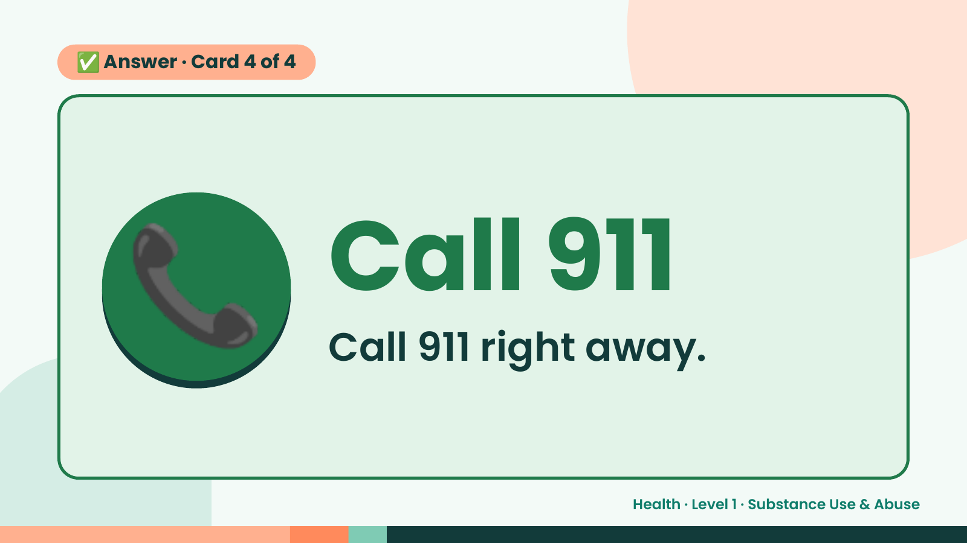
Notes:
✅ Answer · Card 4 of 4
📞 Call 911
Call 911 right away.
Health · Level 1 · Substance Use & Abuse

Slide 18
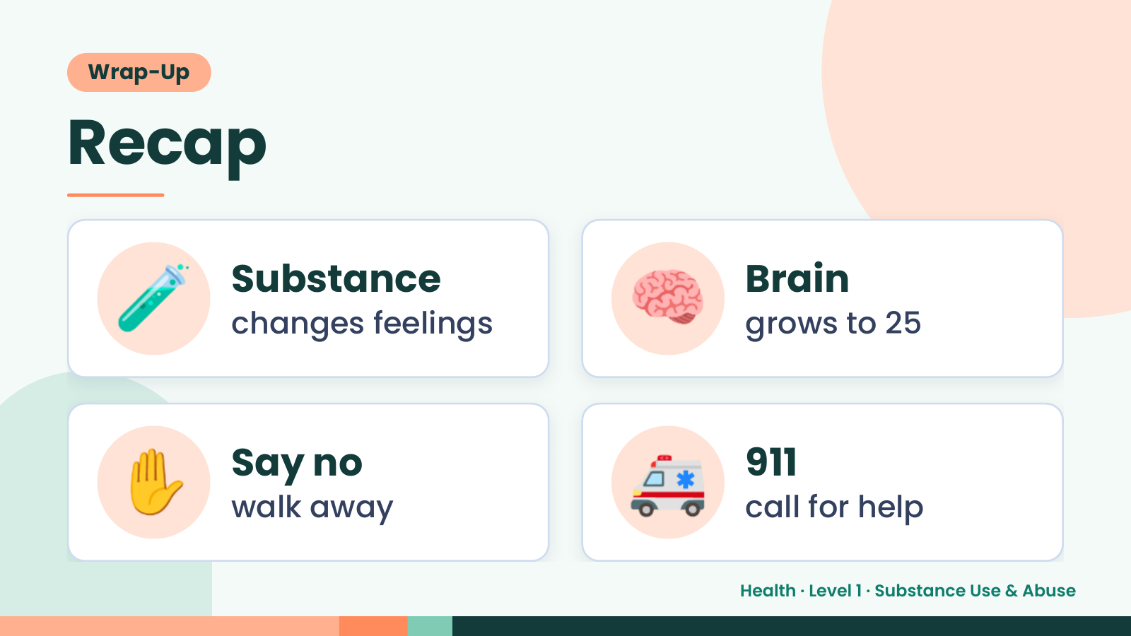
Notes:
Wrap-Up
Recap
🧪 Substance
changes feelings 🧠 Brain
grows to 25
✋ Say no
walk away 🚑 911
call for help
Health · Level 1 · Substance Use & Abuse

Slide 19
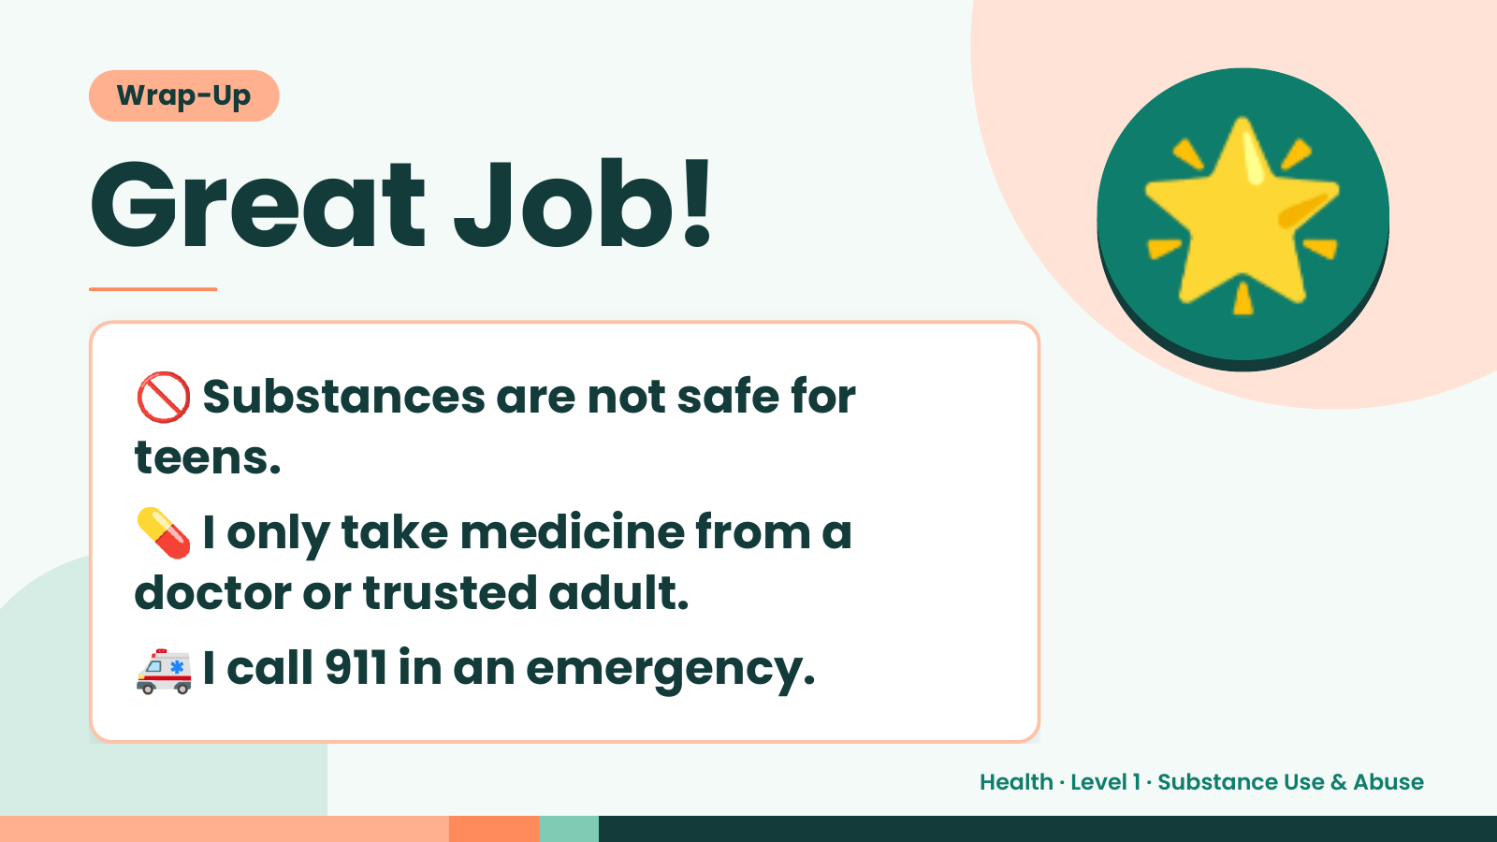
Notes:
Wrap-Up
Great Job!
🚫 Substances are not safe for
teens.
🌟
💊I only take medicine from a
doctor or trusted adult.
🚑 I call 911 in an emergency.
Health · Level 1 · Substance Use & Abuse

