Slide 1
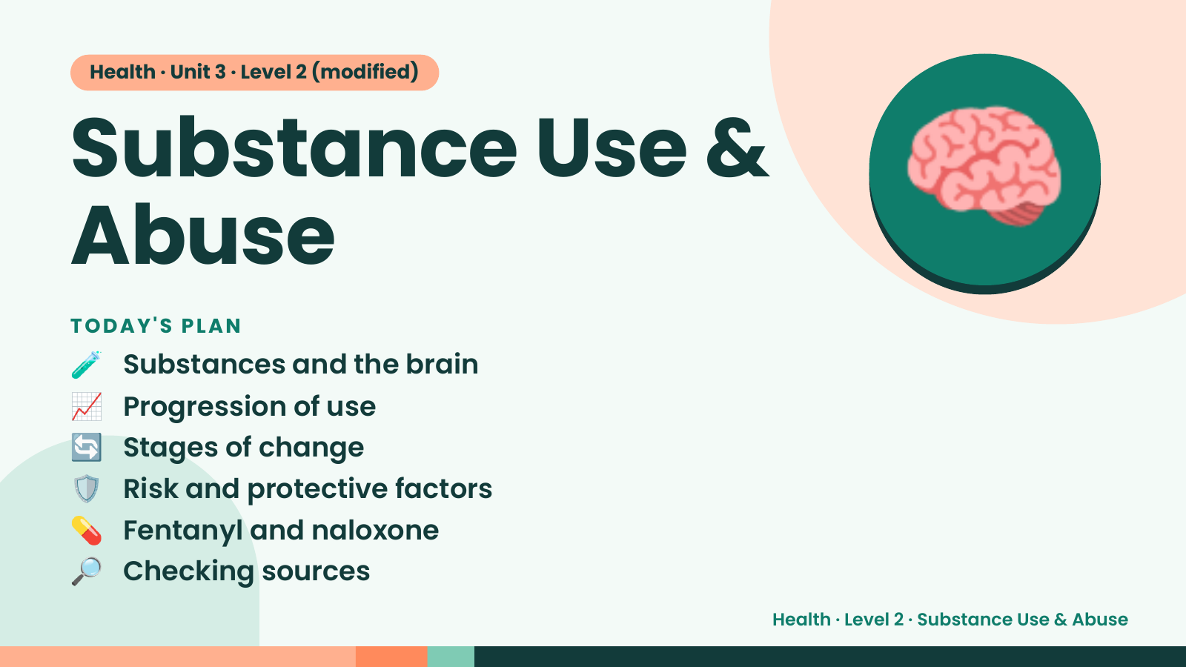
Notes:
Health · Unit 3 · Level 2 (modified)
Substance Use &
Abuse
🧪 Substances and the brain
TODAY'S PLAN
🧠
📈 Progression of use
🔄 Stages of change
🛡️ Risk and protective factors
💊 Fentanyl and naloxone
🔎 Checking sources
Health · Level 2 · Substance Use & Abuse

Slide 2
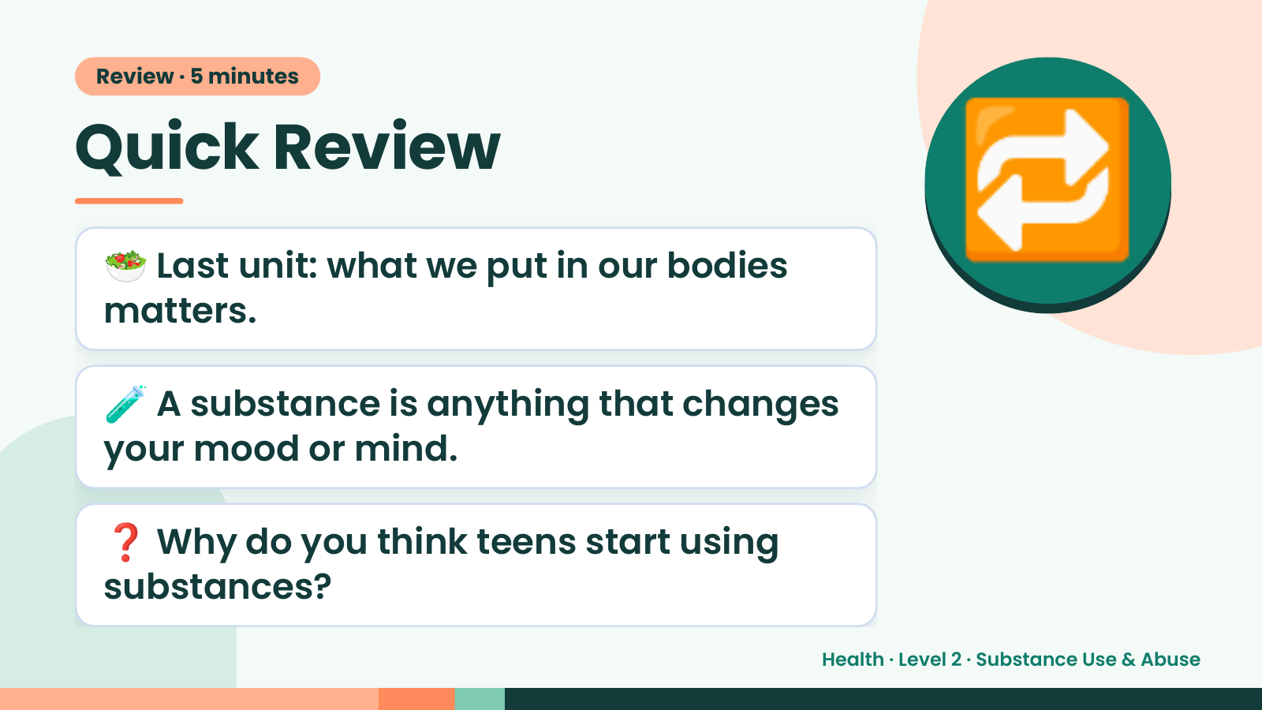
Notes:
Review · 5 minutes
Quick Review
🥗 Last unit: what we put in our bodies
matters.
🔁
🧪 A substance is anything that changes
your mood or mind.
❓ Why do you think teens start using
substances?
Health · Level 2 · Substance Use & Abuse

Slide 3
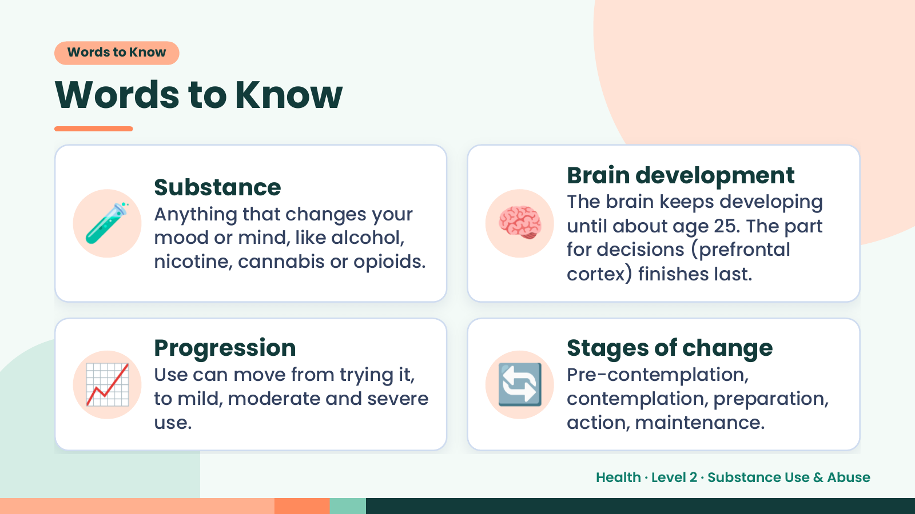
Notes:
Words to Know
Words to Know
🧪 🧠
Brain development
Substance
The brain keeps developing
Anything that changes your
until about age 25. The part
mood or mind, like alcohol,
for decisions (prefrontal
nicotine, cannabis or opioids.
cortex) finishes last.
📈 Progression
Use can move from trying it,
to mild, moderate and severe
use.
🔄 Stages of change
Pre-contemplation,
contemplation, preparation,
action, maintenance.
Health · Level 2 · Substance Use & Abuse

Slide 4
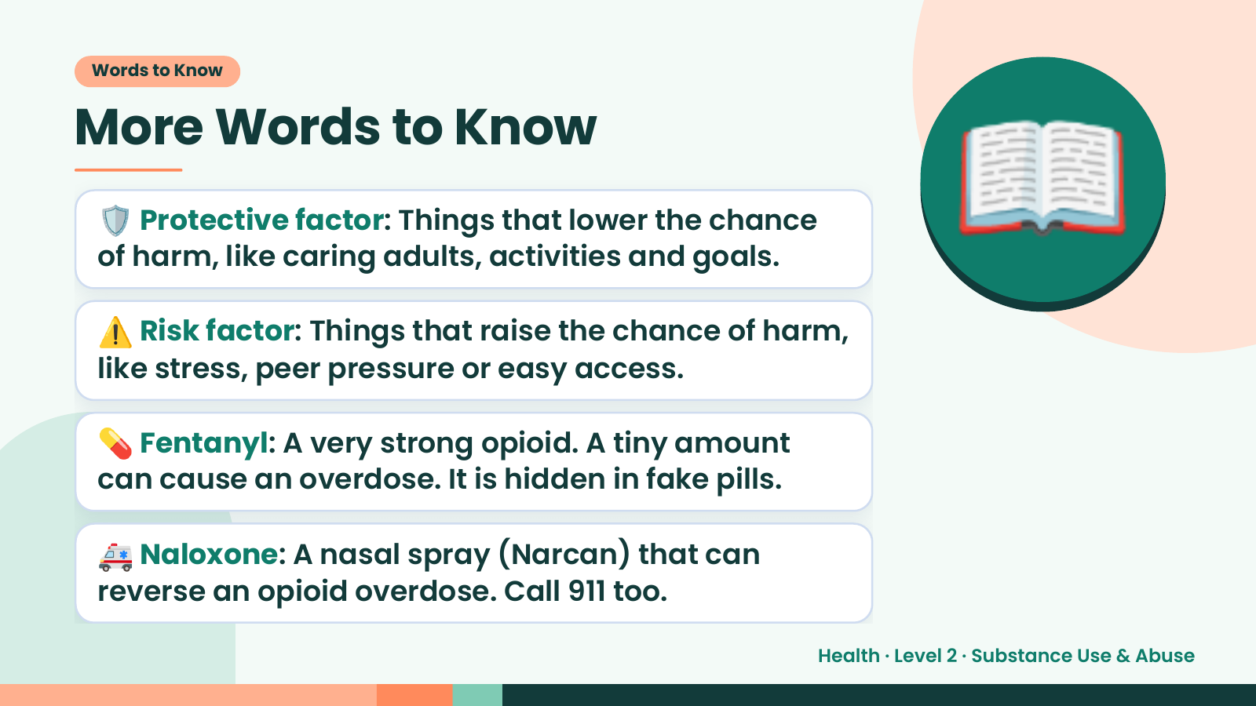
Notes:
Words to Know
More Words to Know
🛡️ Protective factor: Things that lower the chance
of harm, like caring adults, activities and goals.
⚠️ Risk factor: Things that raise the chance of harm,
like stress, peer pressure or easy access.
📖
💊 Fentanyl: A very strong opioid. A tiny amount
can cause an overdose. It is hidden in fake pills.
🚑 Naloxone: A nasal spray (Narcan) that can
reverse an opioid overdose. Call 911 too.
Health · Level 2 · Substance Use & Abuse

Slide 5
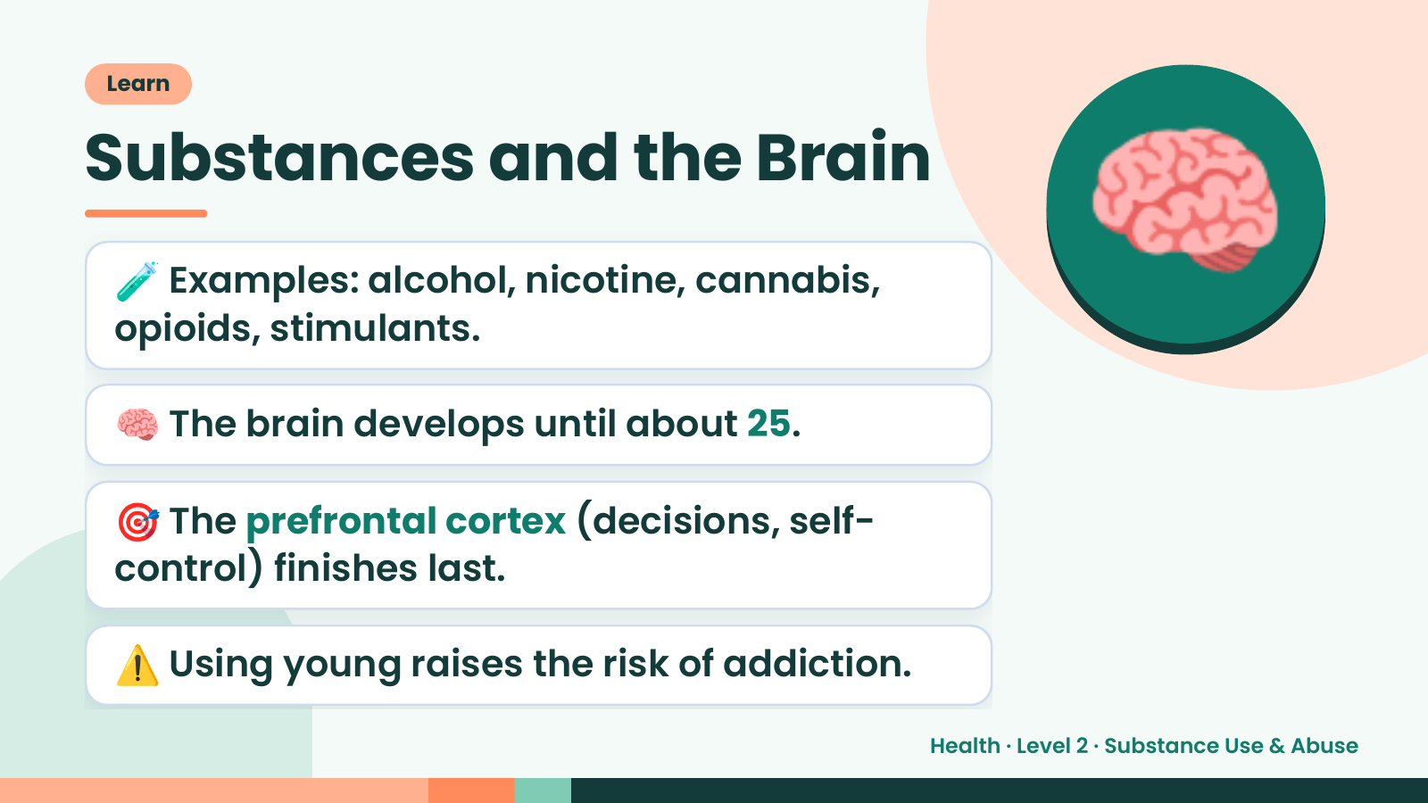
Notes:
Learn
Substances and the Brain
🧪 Examples: alcohol, nicotine, cannabis,
opioids, stimulants.
🧠 The brain develops until about 25.
🧠
🎯 The prefrontal cortex (decisions, self-
control) finishes last.
⚠️ Using young raises the risk of addiction.
Health · Level 2 · Substance Use & Abuse

Slide 6
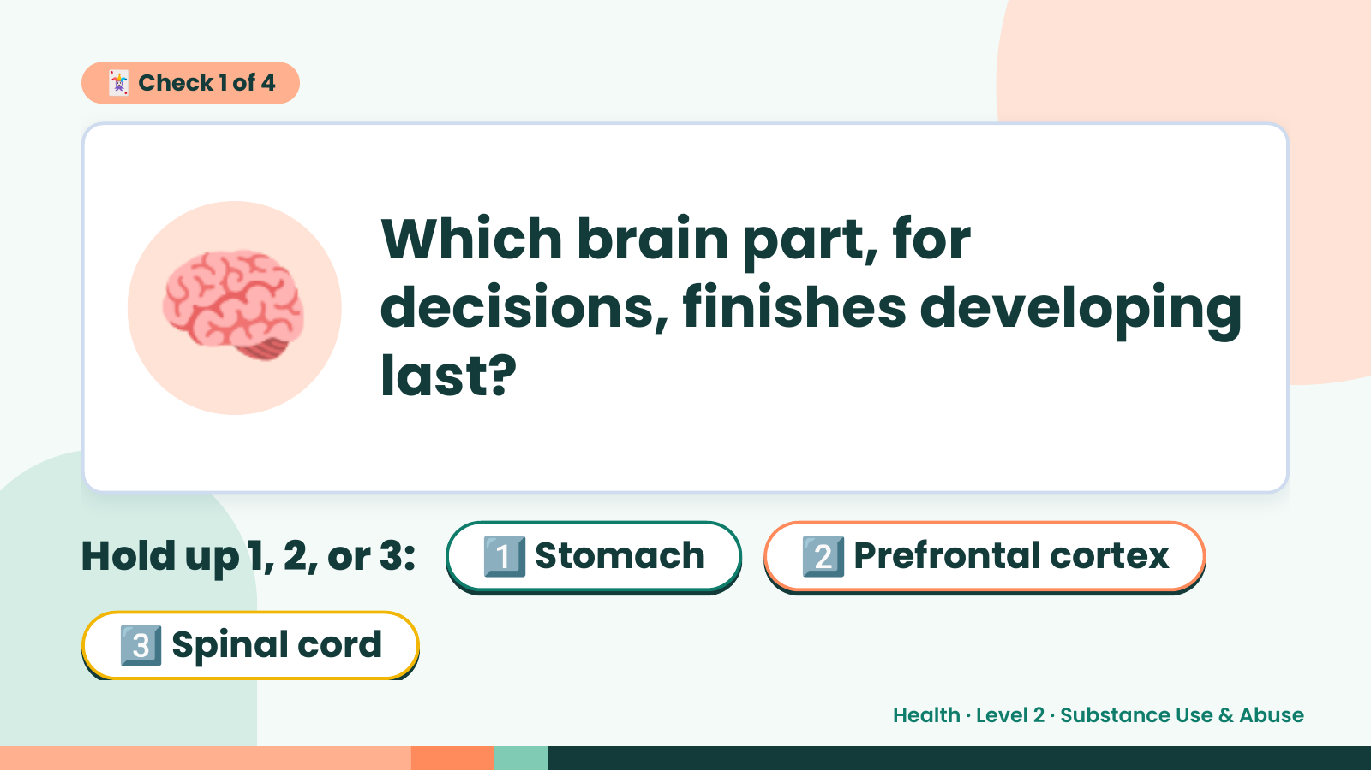
Notes:
🃏 Check 1 of 4
🧠 Which brain part, for
decisions, finishes developing
last?
Hold up 1, 2, or 3: 1️⃣ Stomach 2️⃣ Prefrontal cortex
3️⃣ Spinal cord
Health · Level 2 · Substance Use & Abuse

Slide 7
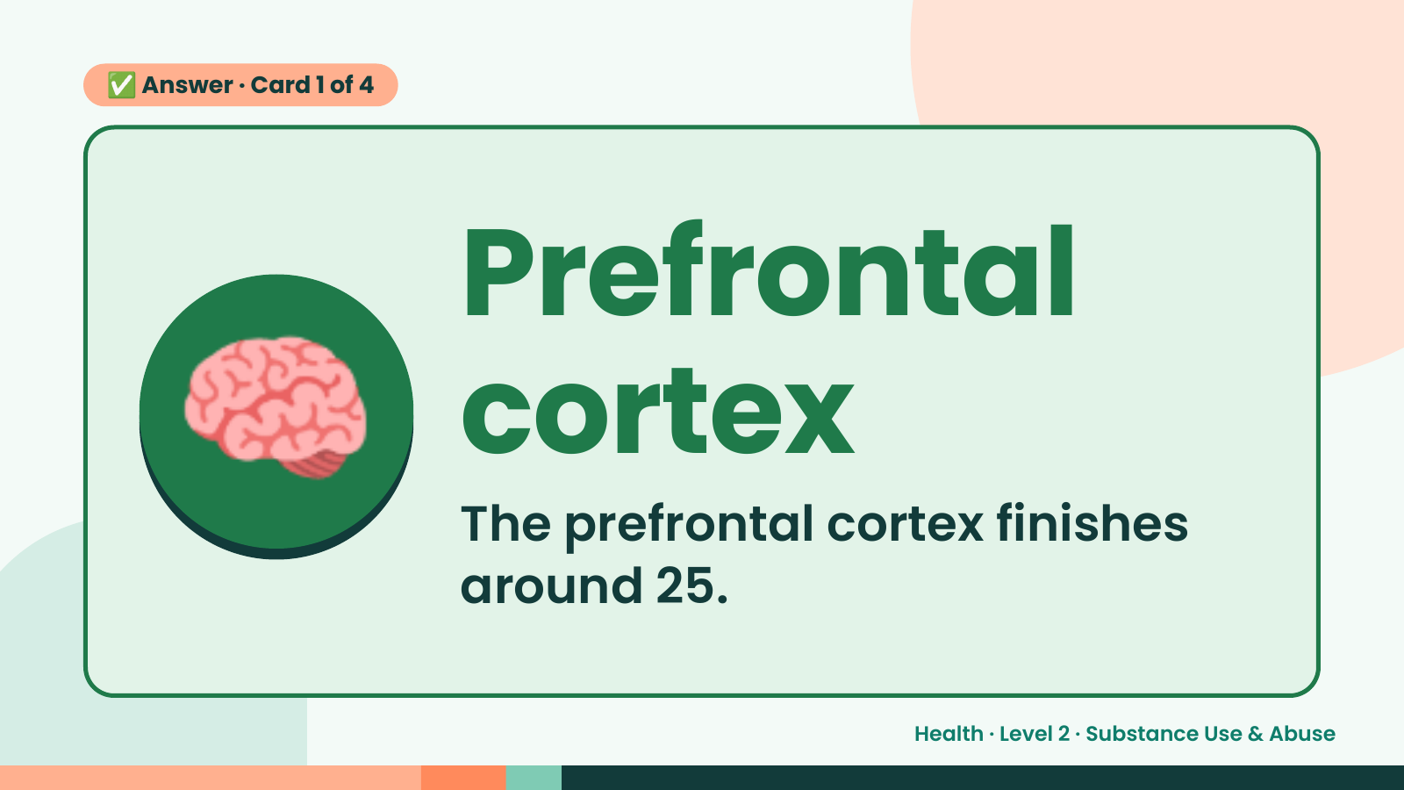
Notes:
✅ Answer · Card 1 of 4
🧠 Prefrontal
cortex
The prefrontal cortex finishes
around 25.
Health · Level 2 · Substance Use & Abuse

Slide 8
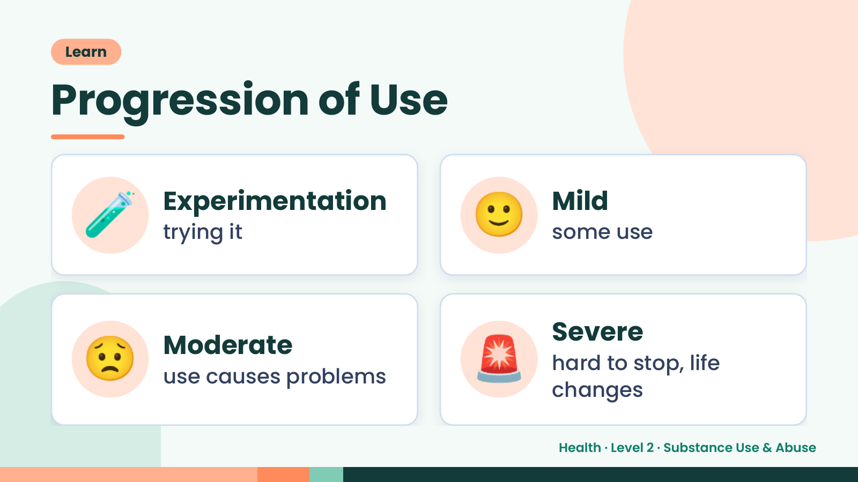
Notes:
Learn
Progression of Use
🧪 Experimentation
trying it 🙂 Mild
some use
😟 Moderate
use causes problems 🚨 Severe
hard to stop, life
changes
Health · Level 2 · Substance Use & Abuse

Slide 9
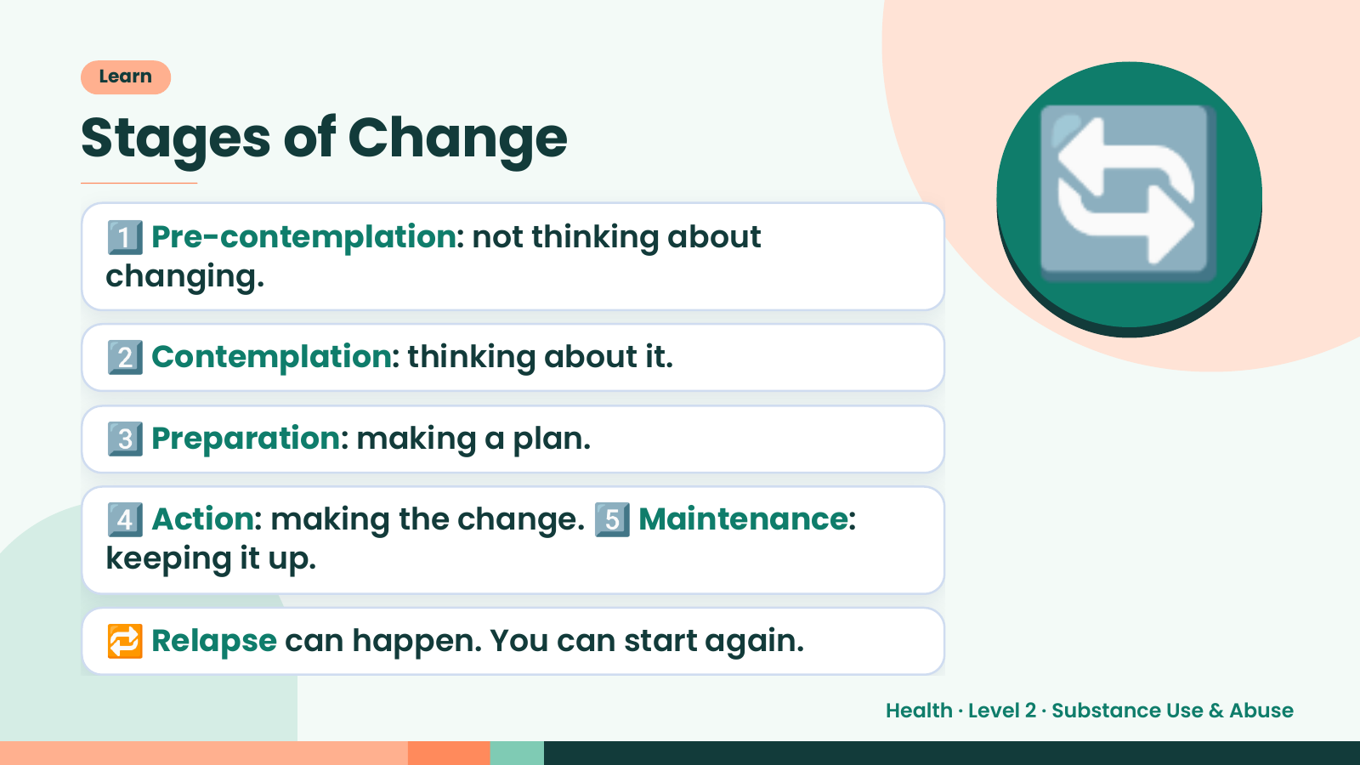
Notes:
Learn
Stages of Change
1️⃣ Pre-contemplation: not thinking about
changing.
2️⃣ Contemplation: thinking about it.
🔄
3️⃣ Preparation: making a plan.
4️⃣ Action: making the change. 5️⃣ Maintenance:
keeping it up.
🔁 Relapse can happen. You can start again.
Health · Level 2 · Substance Use & Abuse

Slide 10
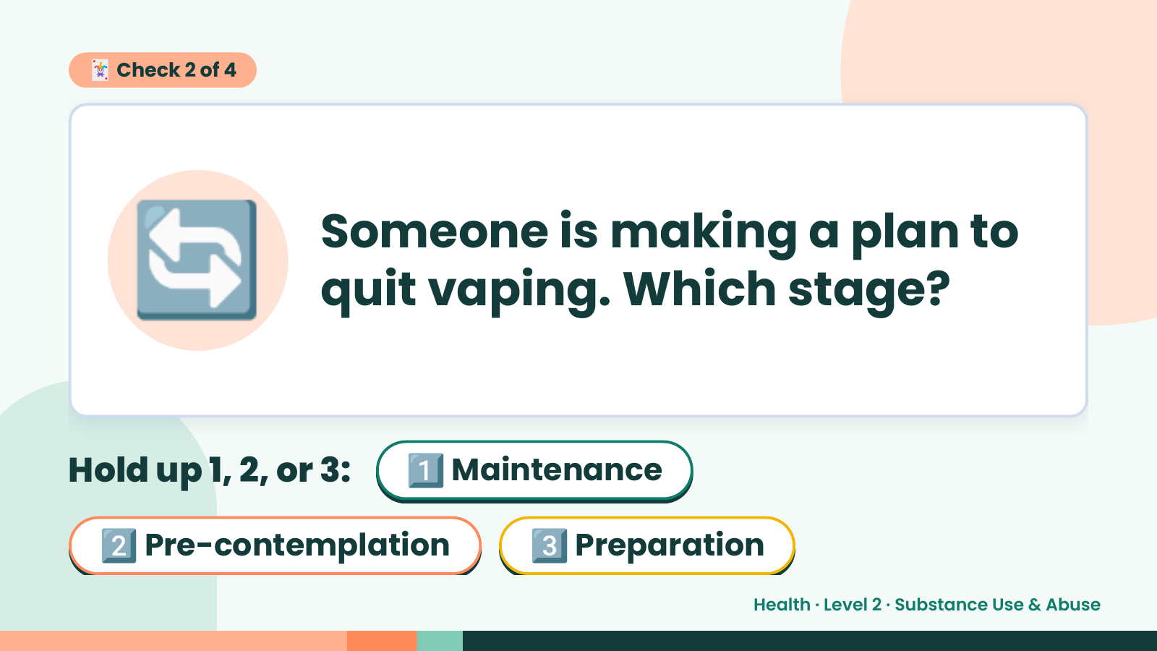
Notes:
🃏 Check 2 of 4
🔄 Someone is making a plan to
quit vaping. Which stage?
Hold up 1, 2, or 3: 1️⃣ Maintenance
2️⃣ Pre-contemplation 3️⃣ Preparation
Health · Level 2 · Substance Use & Abuse

Slide 11
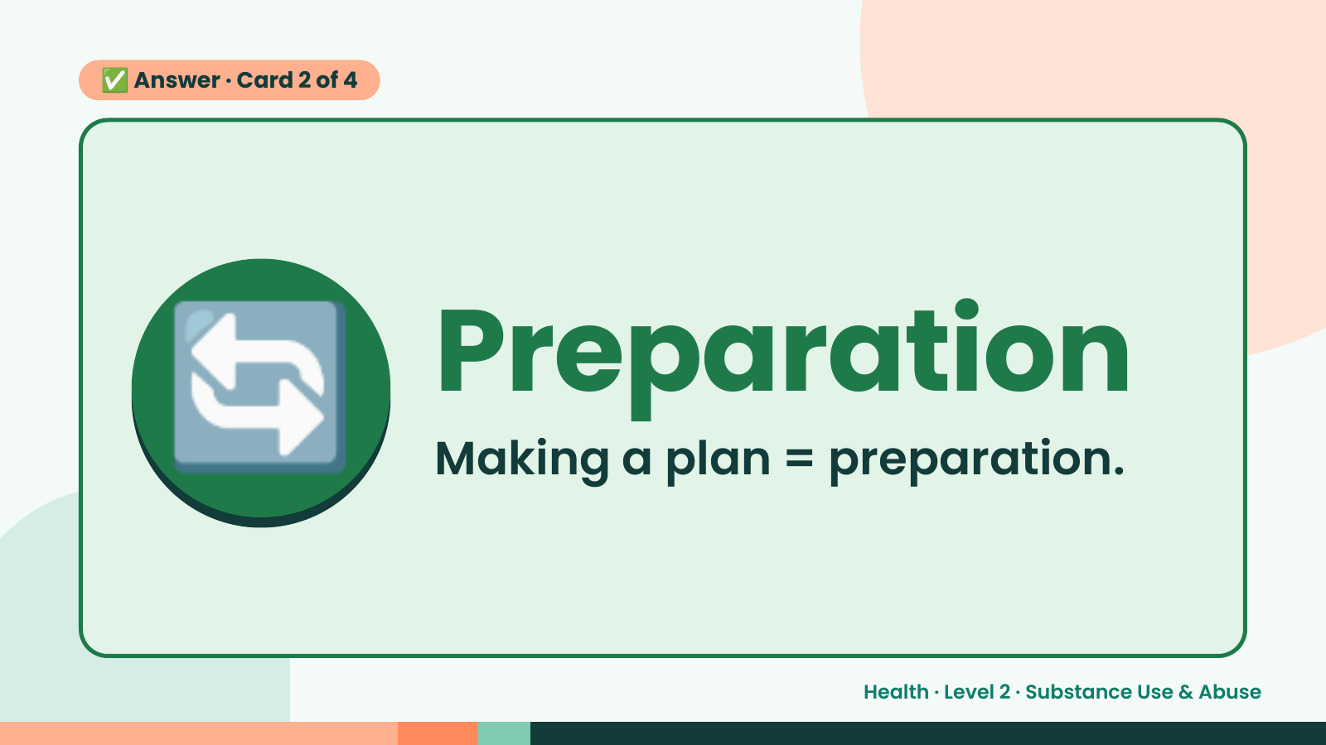
Notes:
✅ Answer · Card 2 of 4
🔄 Preparation
Making a plan = preparation.
Health · Level 2 · Substance Use & Abuse

Slide 12
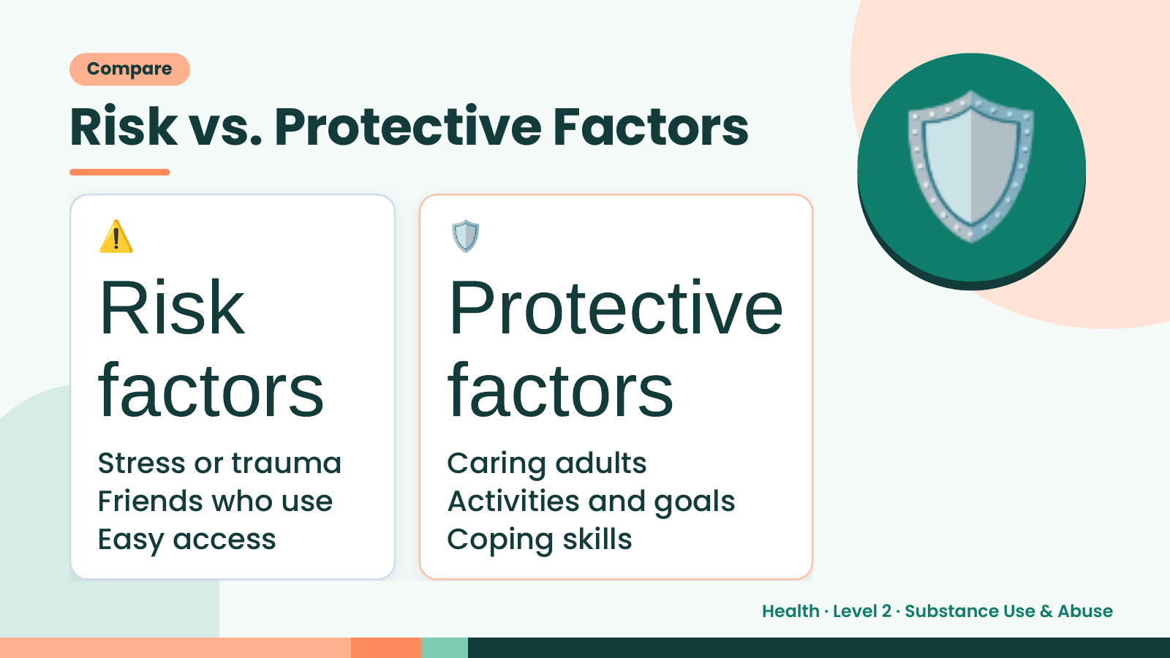
Notes:
Compare
Risk vs. Protective Factors
⚠️
Risk
🛡️
Protective
🛡️
factors
Stress or trauma
factors
Caring adults
Friends who use Activities and goals
Easy access Coping skills
Health · Level 2 · Substance Use & Abuse

Slide 13
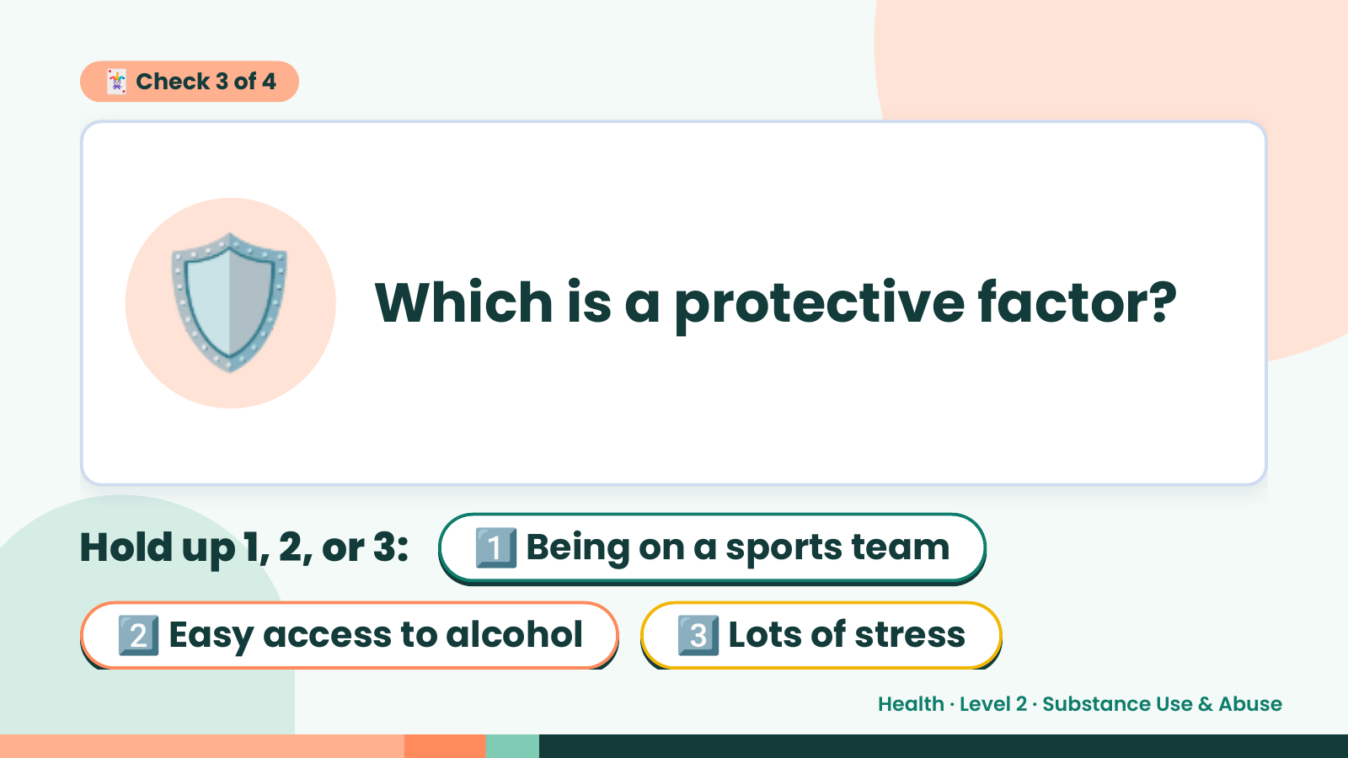
Notes:
🃏 Check 3 of 4
🛡️ Which is a protective factor?
Hold up 1, 2, or 3: 1️⃣ Being on a sports team
2️⃣ Easy access to alcohol 3️⃣ Lots of stress
Health · Level 2 · Substance Use & Abuse

Slide 14
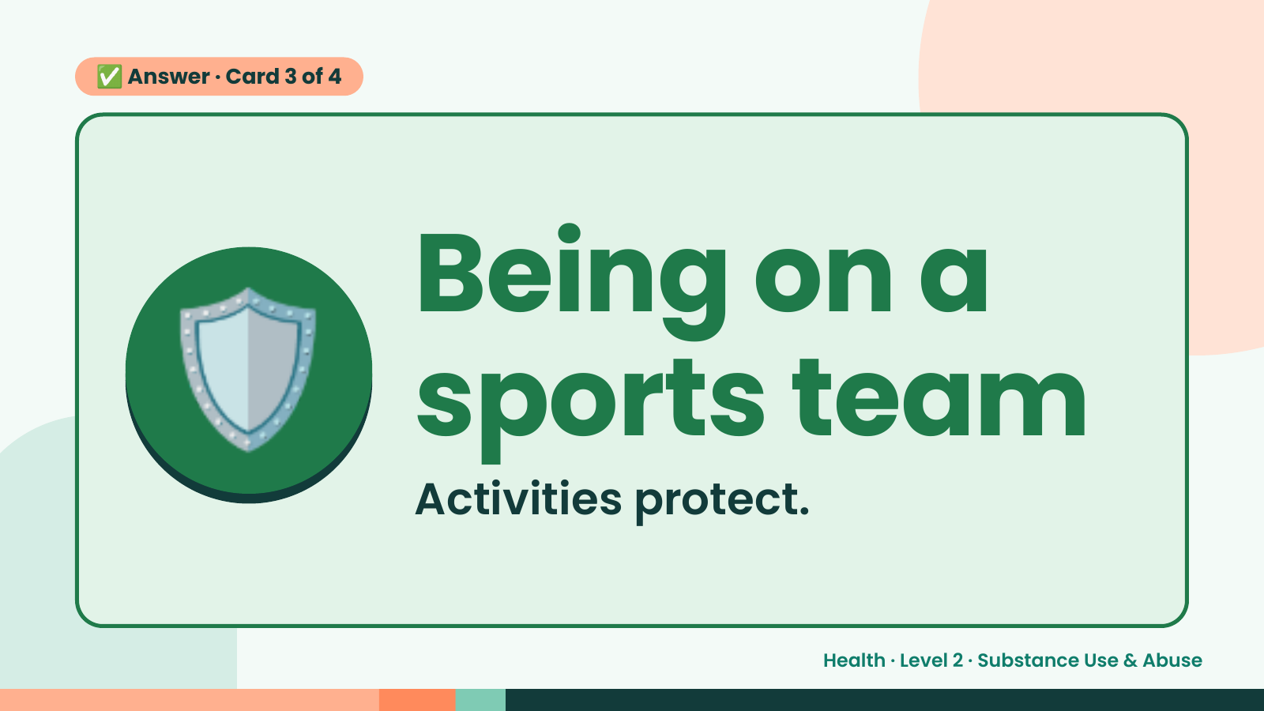
Notes:
✅ Answer · Card 3 of 4
🛡️ Being on a
sports team
Activities protect.
Health · Level 2 · Substance Use & Abuse

Slide 15
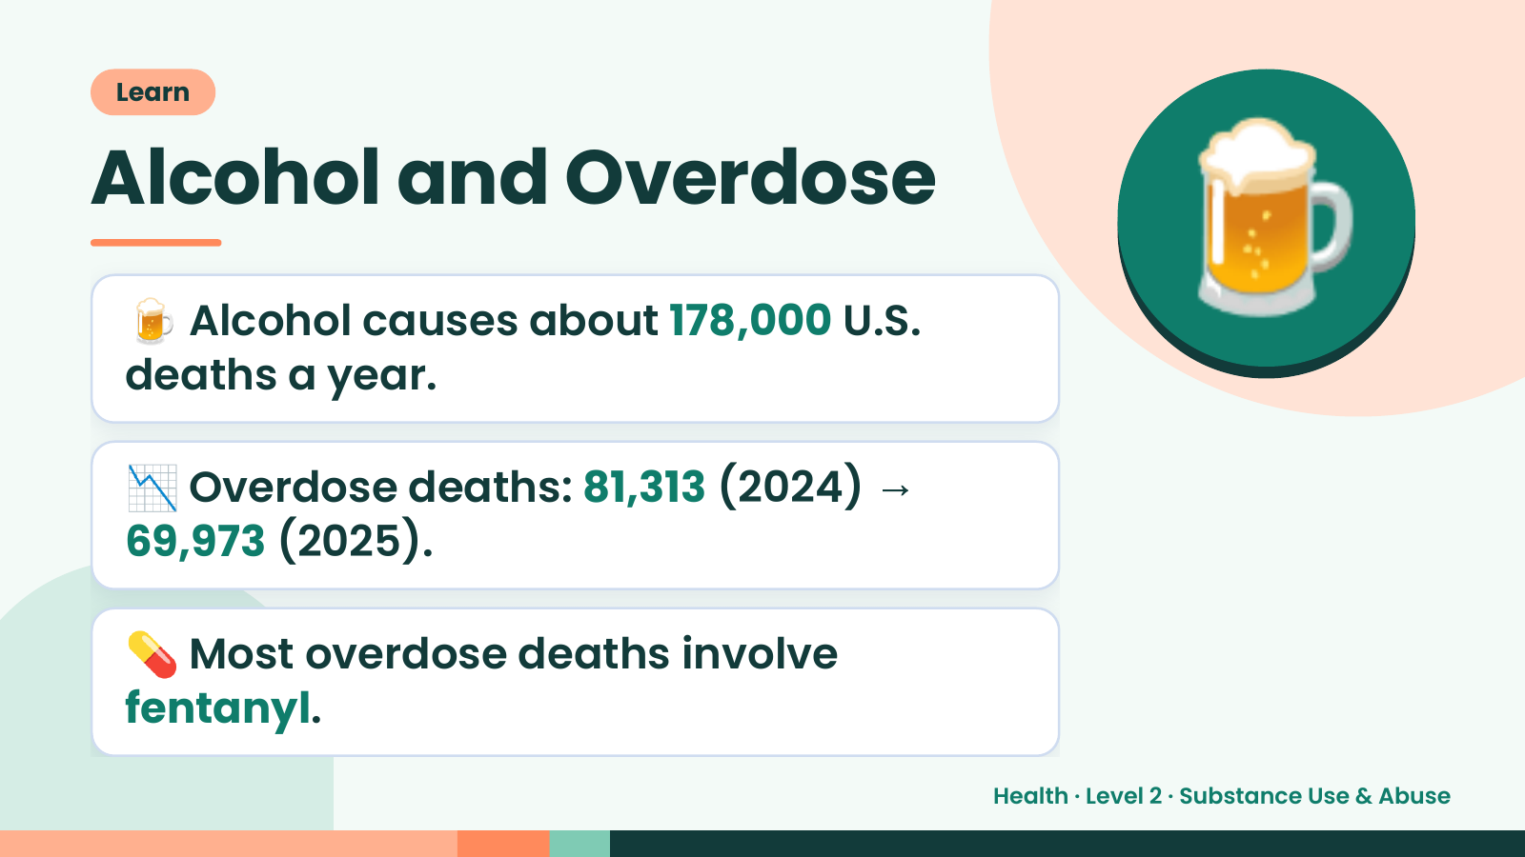
Notes:
Learn
Alcohol and Overdose
🍺 Alcohol causes about 178,000 U.S.
deaths a year.
🍺
📉 Overdose deaths: 81,313 (2024) →
69,973 (2025).
💊 Most overdose deaths involve
fentanyl.
Health · Level 2 · Substance Use & Abuse

Slide 16
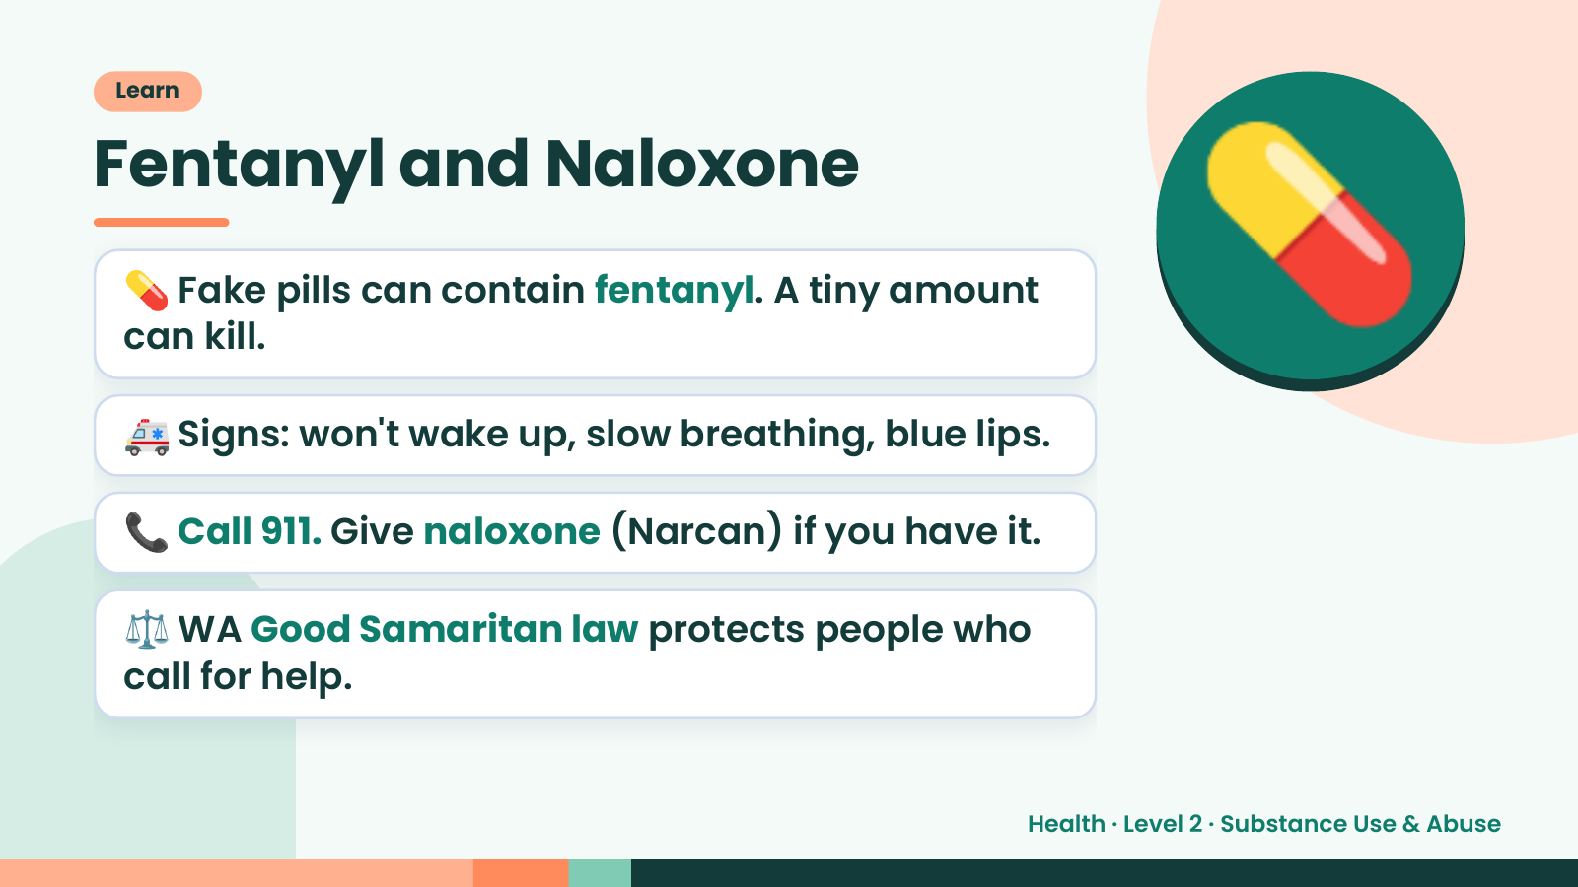
Notes:
Learn
Fentanyl and Naloxone
💊 Fake pills can contain fentanyl. A tiny amount
can kill.
🚑 Signs: won't wake up, slow breathing, blue lips.
💊
📞 Call 911. Give naloxone (Narcan) if you have it.
⚖️ WA Good Samaritan law protects people who
call for help.
Health · Level 2 · Substance Use & Abuse

Slide 17
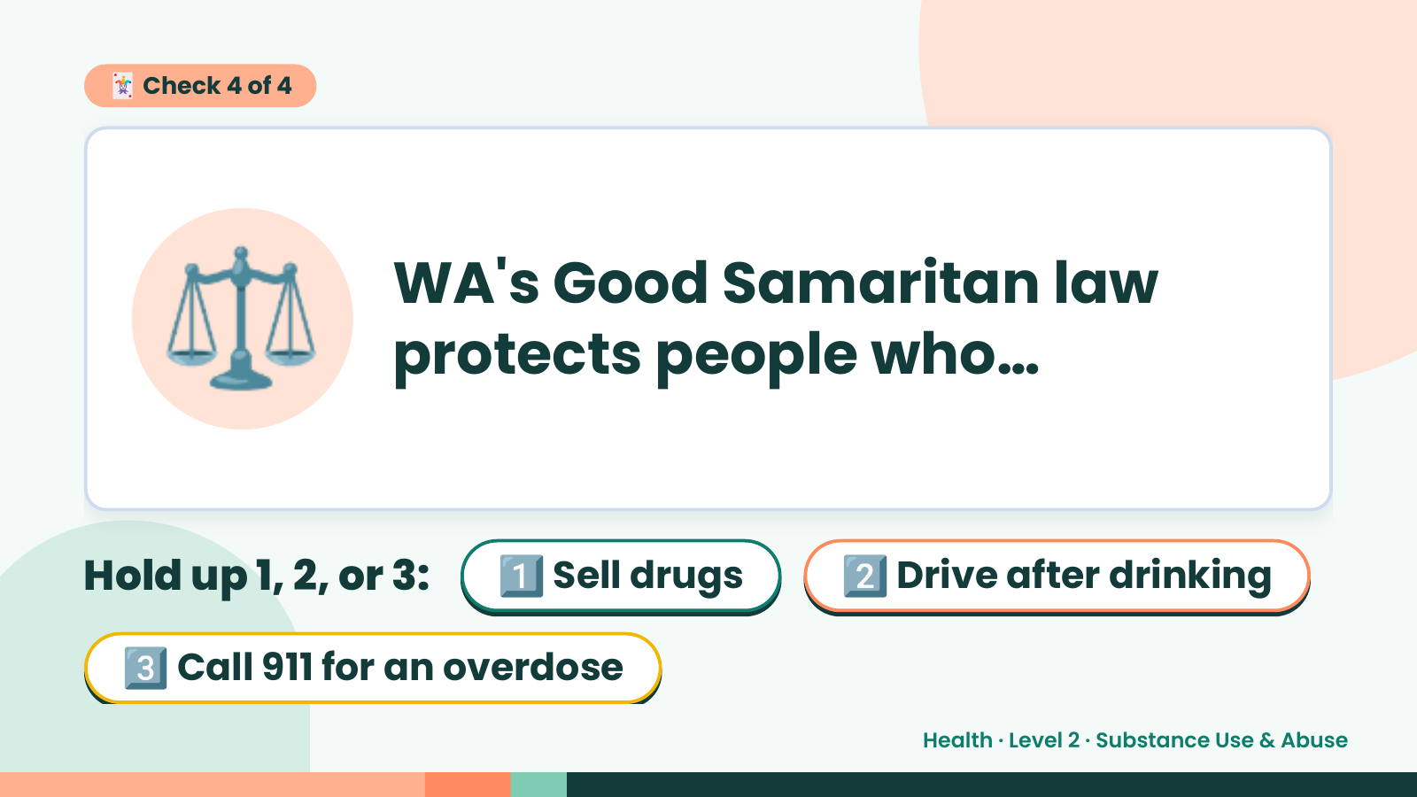
Notes:
🃏 Check 4 of 4
⚖️ WA's Good Samaritan law
protects people who…
Hold up 1, 2, or 3: 1️⃣ Sell drugs 2️⃣ Drive after drinking
3️⃣ Call 911 for an overdose
Health · Level 2 · Substance Use & Abuse

Slide 18
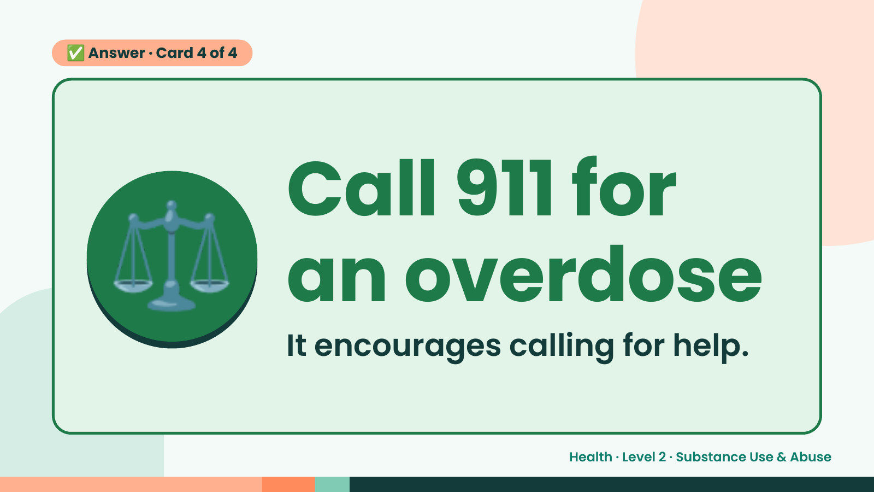
Notes:
✅ Answer · Card 4 of 4
⚖️ Call 911 for
an overdose
It encourages calling for help.
Health · Level 2 · Substance Use & Abuse

Slide 19
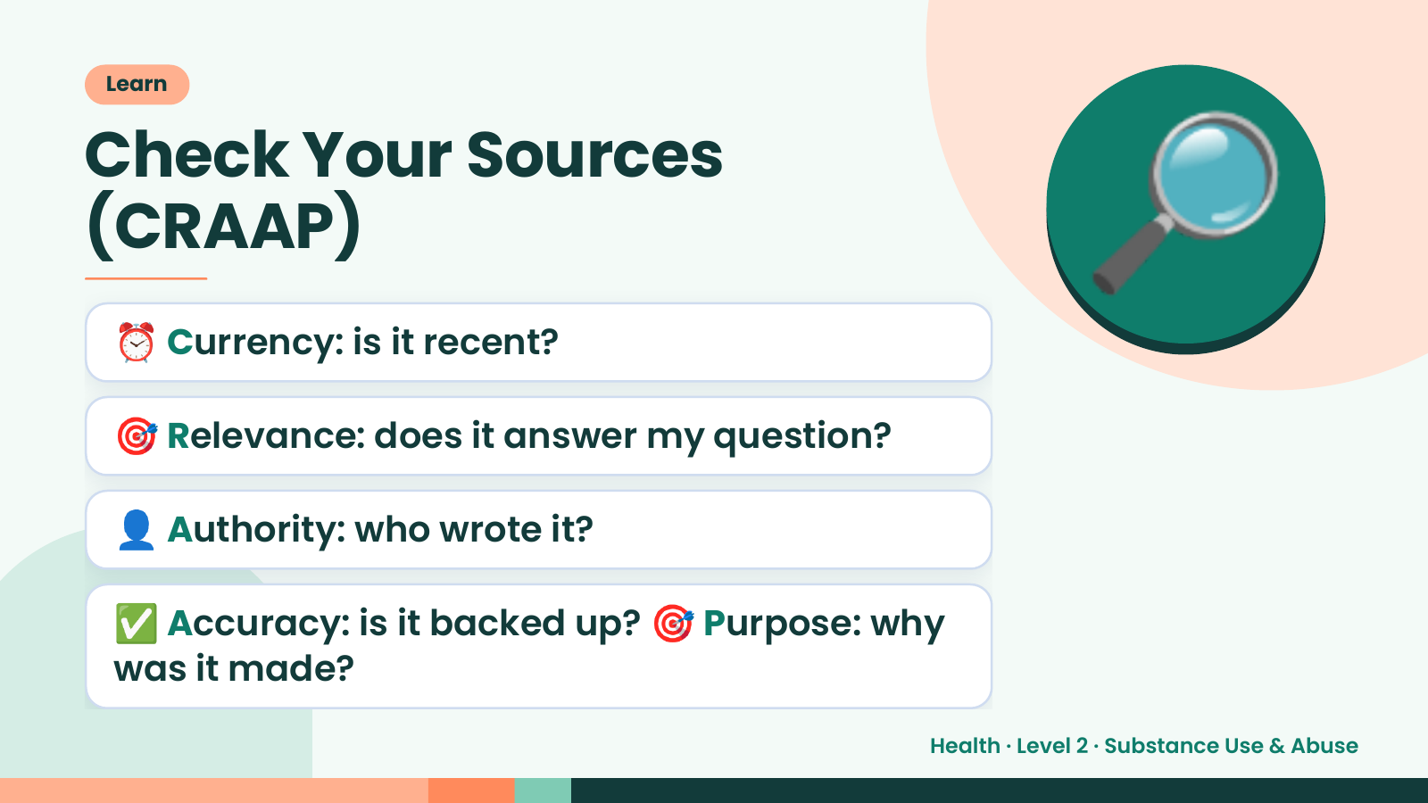
Notes:
Learn
Check Your Sources
(CRAAP)
⏰ Currency: is it recent?
🎯 Relevance: does it answer my question?
🔎
👤 Authority: who wrote it?
✅ Accuracy: is it backed up? 🎯 Purpose: why
was it made?
Health · Level 2 · Substance Use & Abuse

Slide 20
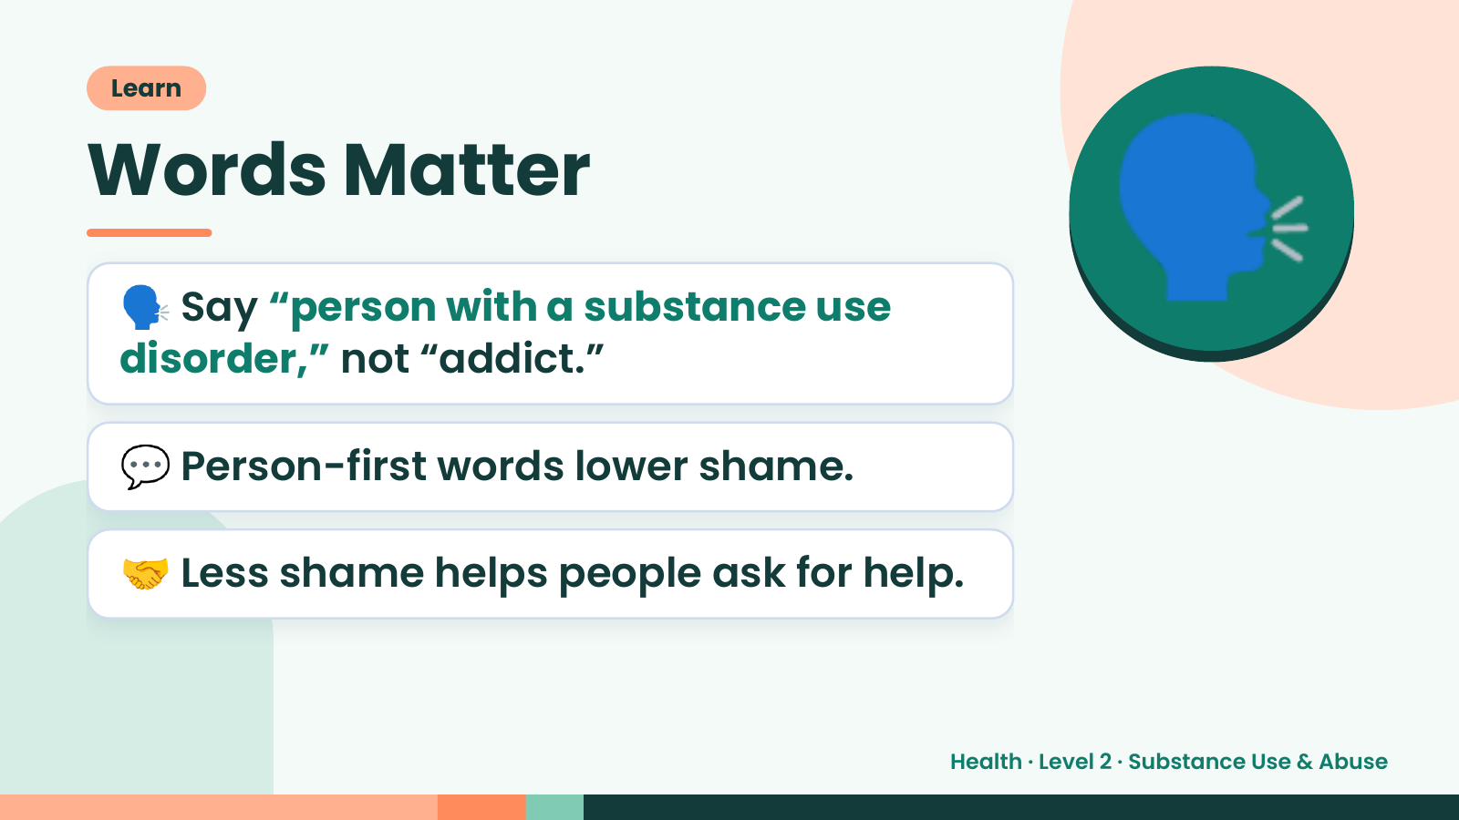
Notes:
Learn
Words Matter
🗣️ Say “person with a substance use
disorder,” not “addict.”
🗣️
💬 Person-first words lower shame.
🤝 Less shame helps people ask for help.
Health · Level 2 · Substance Use & Abuse

Slide 21
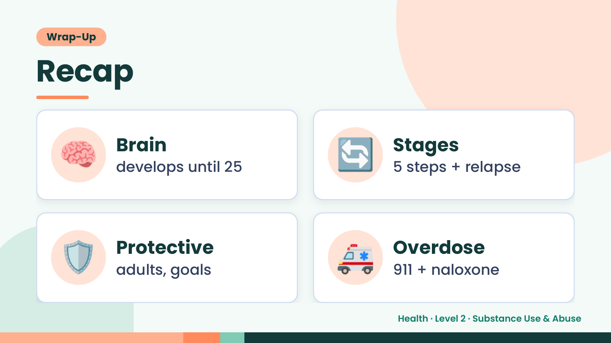
Notes:
Wrap-Up
Recap
🧠 Brain
develops until 25 🔄 Stages
5 steps + relapse
🛡️ Protective
adults, goals 🚑 Overdose
911 + naloxone
Health · Level 2 · Substance Use & Abuse

Slide 22
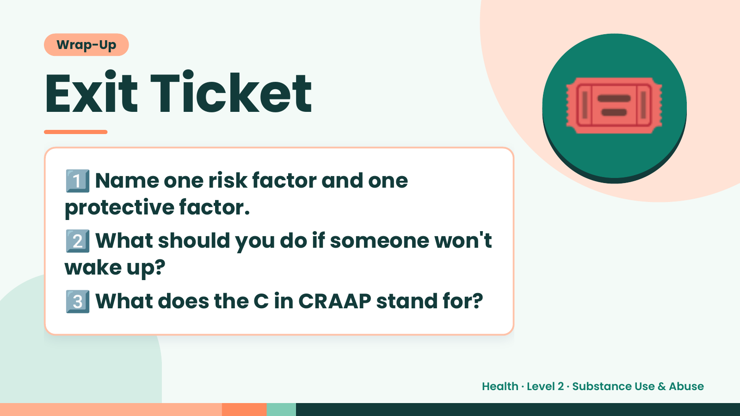
Notes:
Wrap-Up
Exit Ticket
1️⃣
Name one risk factor and one
protective factor.
🎟️
2️⃣
What should you do if someone won't
wake up?
3️⃣What does the C in CRAAP stand for?
Health · Level 2 · Substance Use & Abuse

