Slide 1
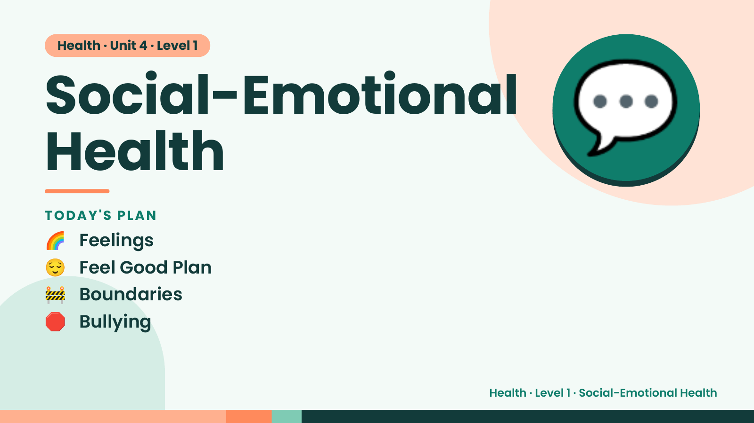
Notes:
Health · Unit 4 · Level 1
Social-Emotional
Health
🌈 Feelings
TODAY'S PLAN
💬
😌 Feel Good Plan
🚧 Boundaries
🛑 Bullying
Health · Level 1 · Social-Emotional Health

Slide 2
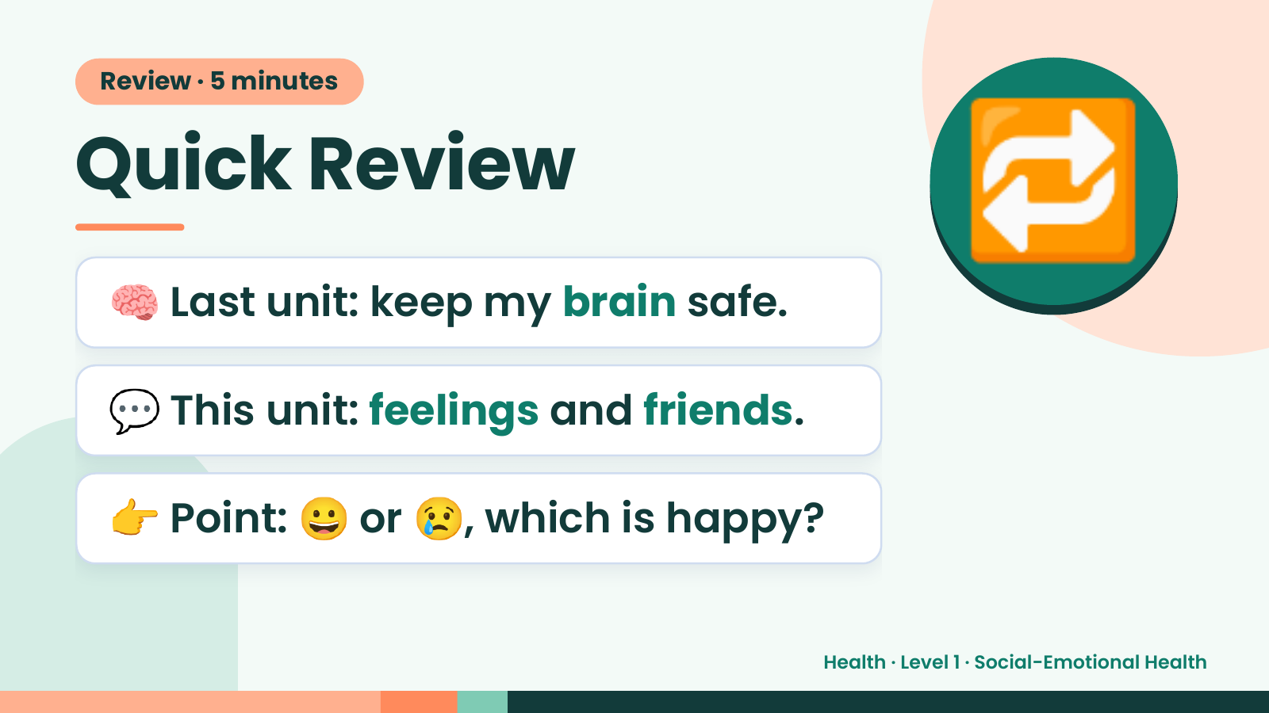
Notes:
Review · 5 minutes
Quick Review
🧠 Last unit: keep my brain safe.
🔁
💬 This unit: feelings and friends.
👉 Point: 😀 or 😢, which is happy?
Health · Level 1 · Social-Emotional Health

Slide 3
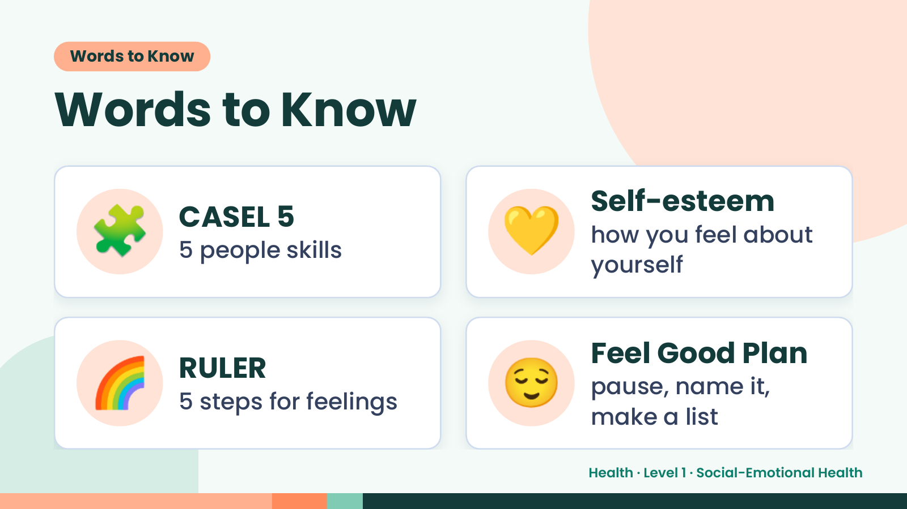
Notes:
Words to Know
Words to Know
🧩 CASEL 5
5 people skills 💛 Self-esteem
how you feel about
yourself
🌈 RULER
5 steps for feelings 😌 Feel Good Plan
pause, name it,
make a list
Health · Level 1 · Social-Emotional Health

Slide 4
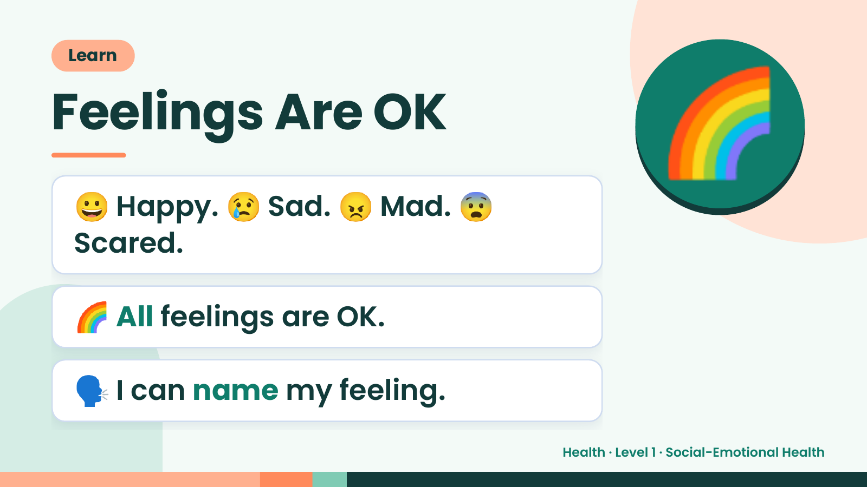
Notes:
Learn
Feelings Are OK
😀 Happy. 😢 Sad. 😠 Mad. 😨
Scared.
🌈
🌈 All feelings are OK.
🗣️ I can name my feeling.
Health · Level 1 · Social-Emotional Health

Slide 5
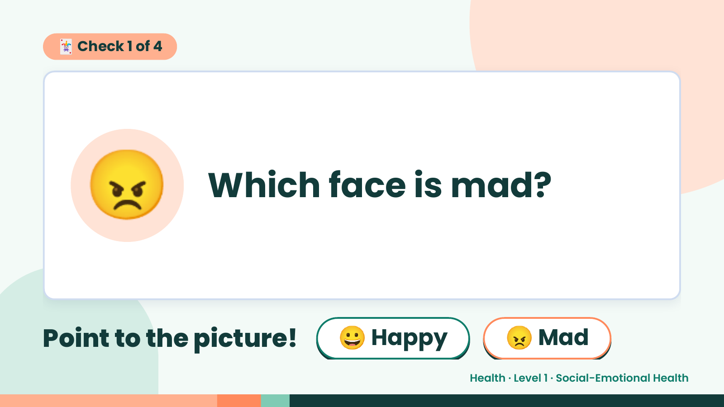
Notes:
🃏 Check 1 of 4
😠 Which face is mad?
Point to the picture! 😀 Happy 😠 Mad
Health · Level 1 · Social-Emotional Health

Slide 6
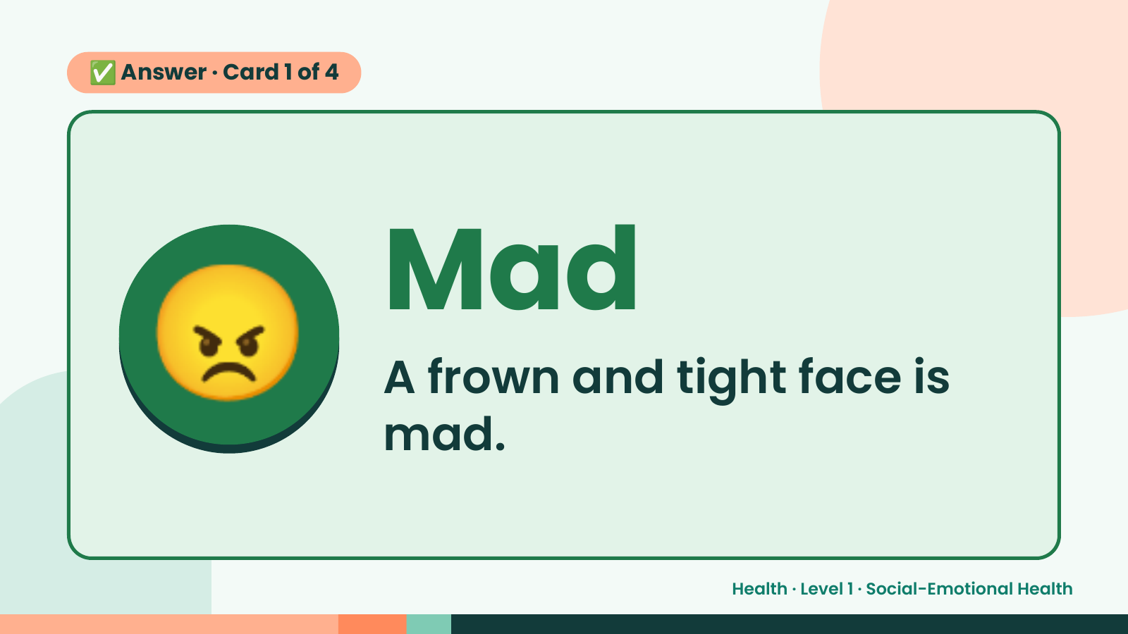
Notes:
✅ Answer · Card 1 of 4
😠 Mad
A frown and tight face is
mad.
Health · Level 1 · Social-Emotional Health

Slide 7
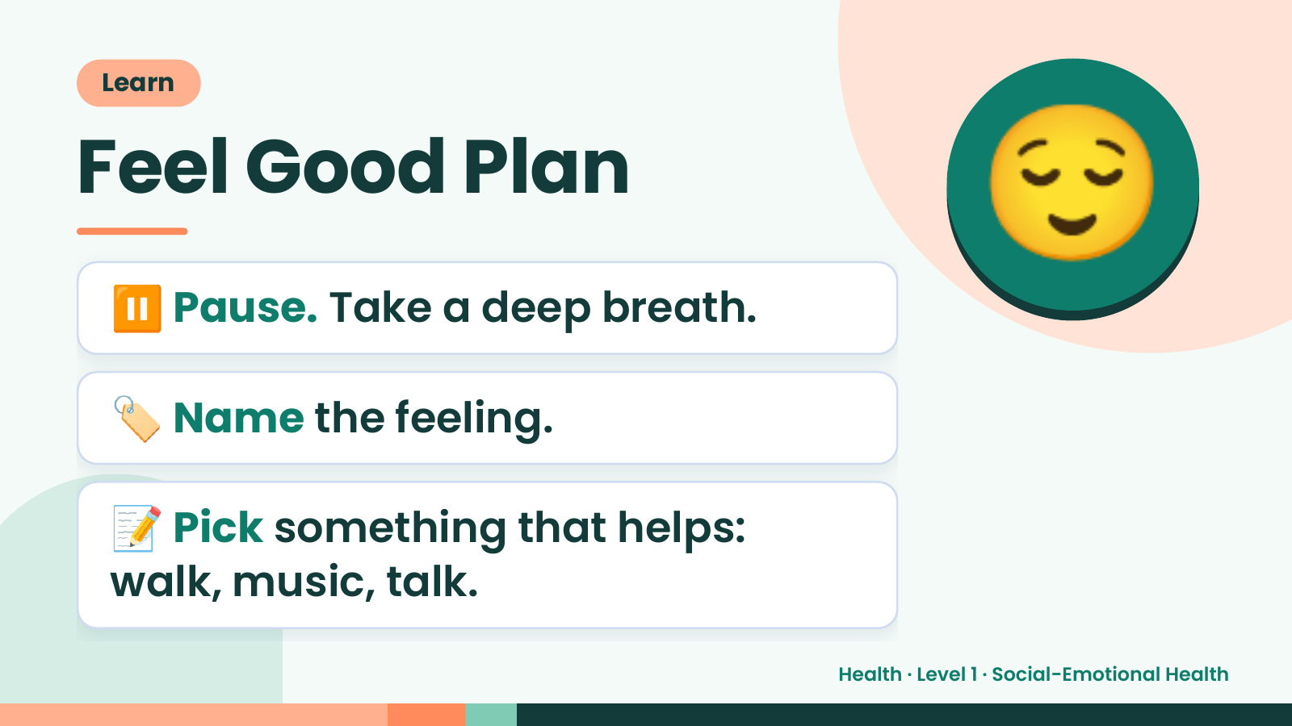
Notes:
Learn
Feel Good Plan
⏸️ Pause. Take a deep breath.
😌
🏷️ Name the feeling.
📝 Pick something that helps:
walk, music, talk.
Health · Level 1 · Social-Emotional Health

Slide 8
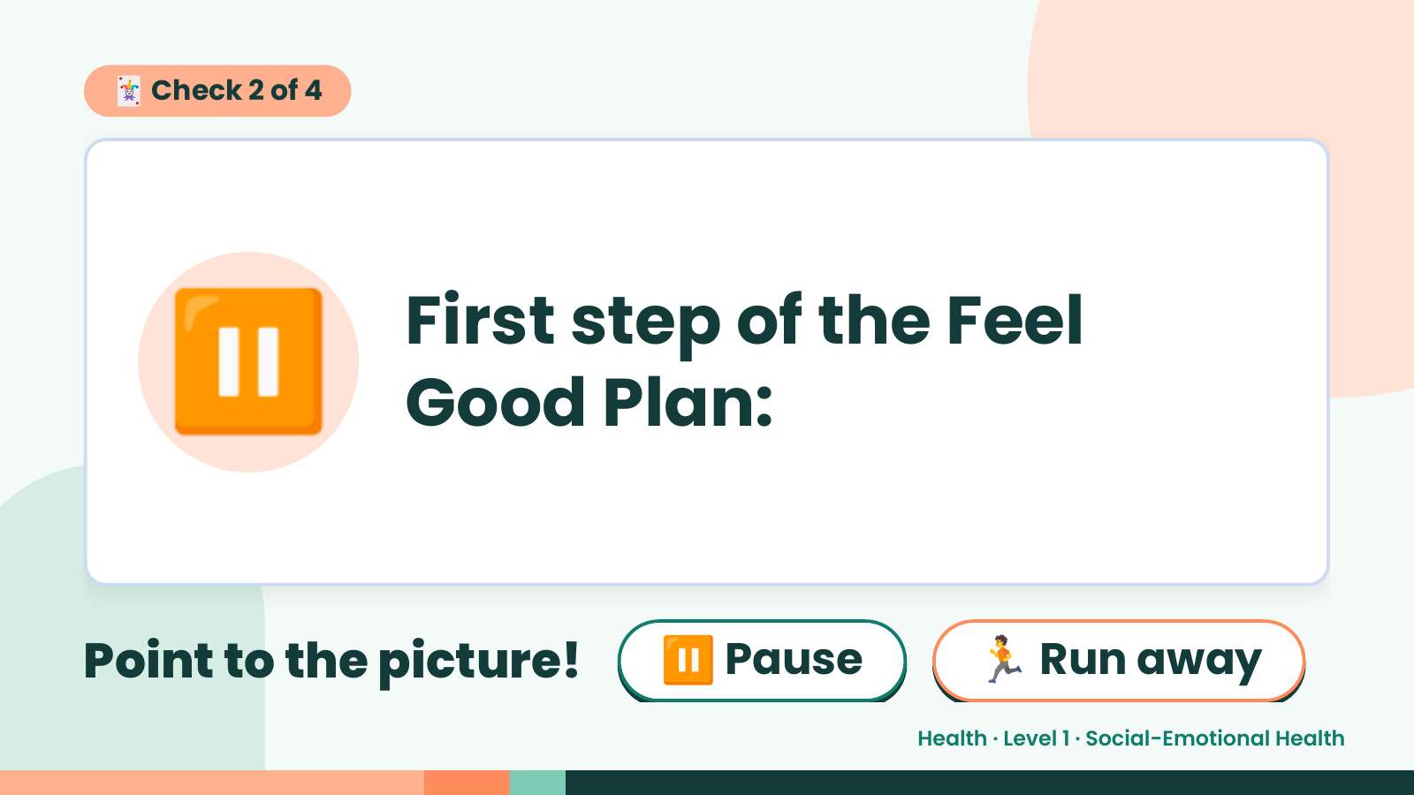
Notes:
🃏 Check 2 of 4
⏸️ First step of the Feel
Good Plan:
Point to the picture! ⏸️ Pause 🏃 Run away
Health · Level 1 · Social-Emotional Health

Slide 9
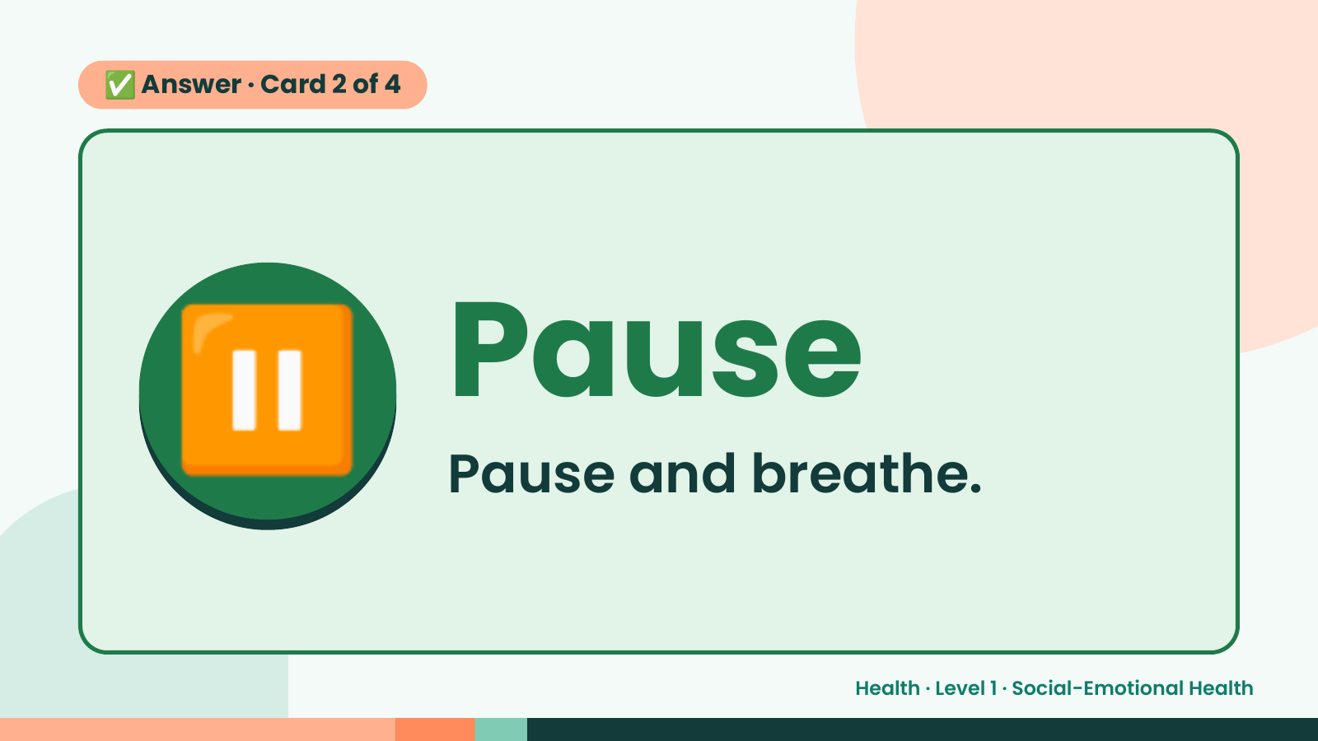
Notes:
✅ Answer · Card 2 of 4
⏸️ Pause
Pause and breathe.
Health · Level 1 · Social-Emotional Health

Slide 10
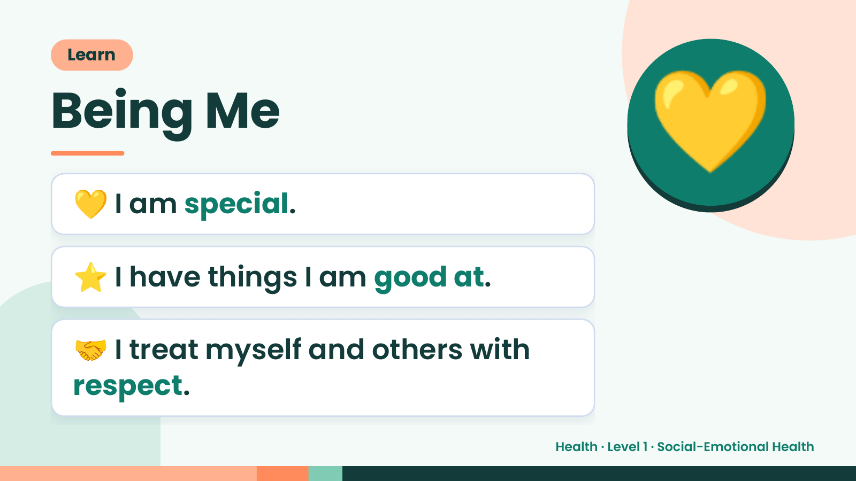
Notes:
Learn
Being Me
💛 I am special.
💛
⭐ I have things I am good at.
🤝 I treat myself and others with
respect.
Health · Level 1 · Social-Emotional Health

Slide 11
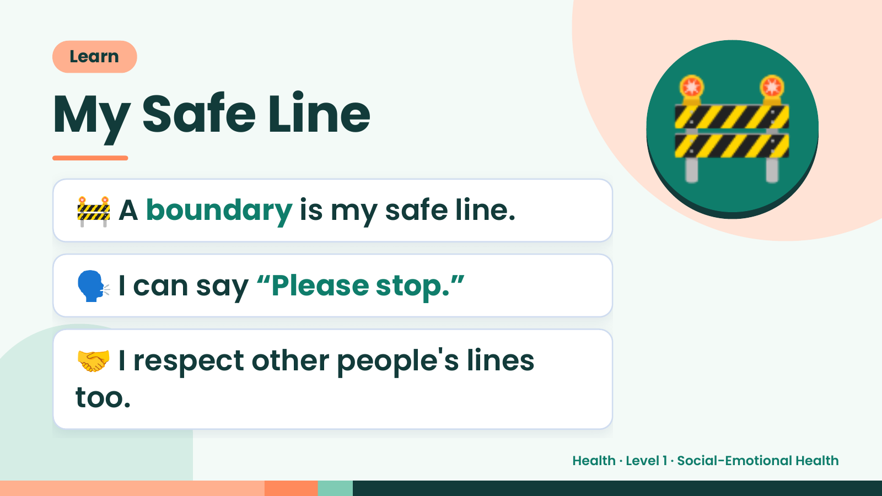
Notes:
Learn
My Safe Line
🚧 A boundary is my safe line.
🚧
🗣️ I can say “Please stop.”
🤝 I respect other people's lines
too.
Health · Level 1 · Social-Emotional Health

Slide 12
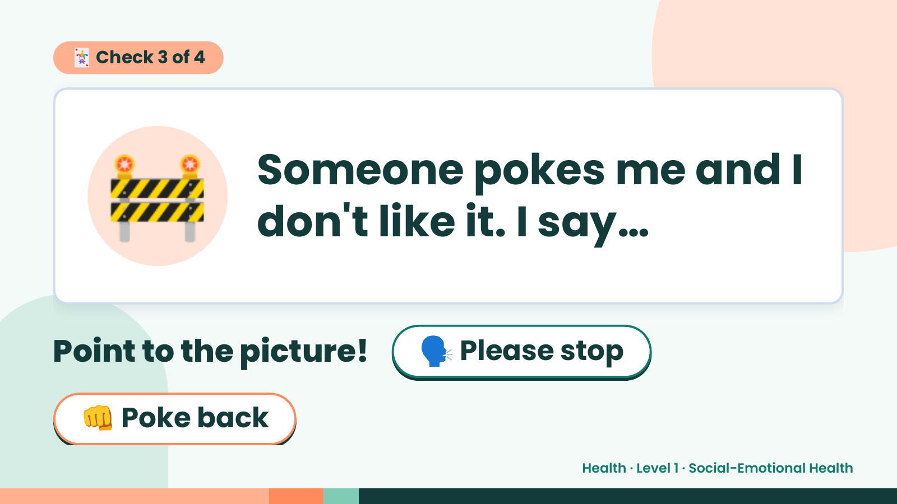
Notes:
🃏 Check 3 of 4
🚧 Someone pokes me and I
don't like it. I say…
Point to the picture! 🗣️ Please stop
👊 Poke back
Health · Level 1 · Social-Emotional Health

Slide 13
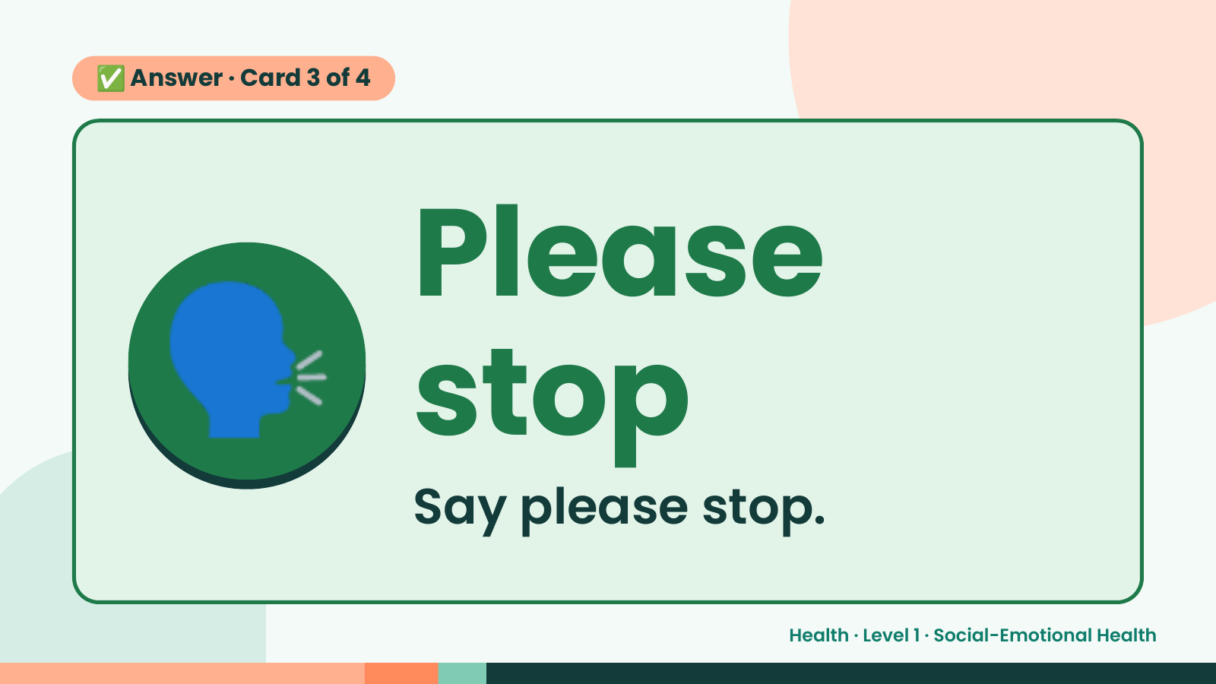
Notes:
✅ Answer · Card 3 of 4
🗣️ Please
stop
Say please stop.
Health · Level 1 · Social-Emotional Health

Slide 14
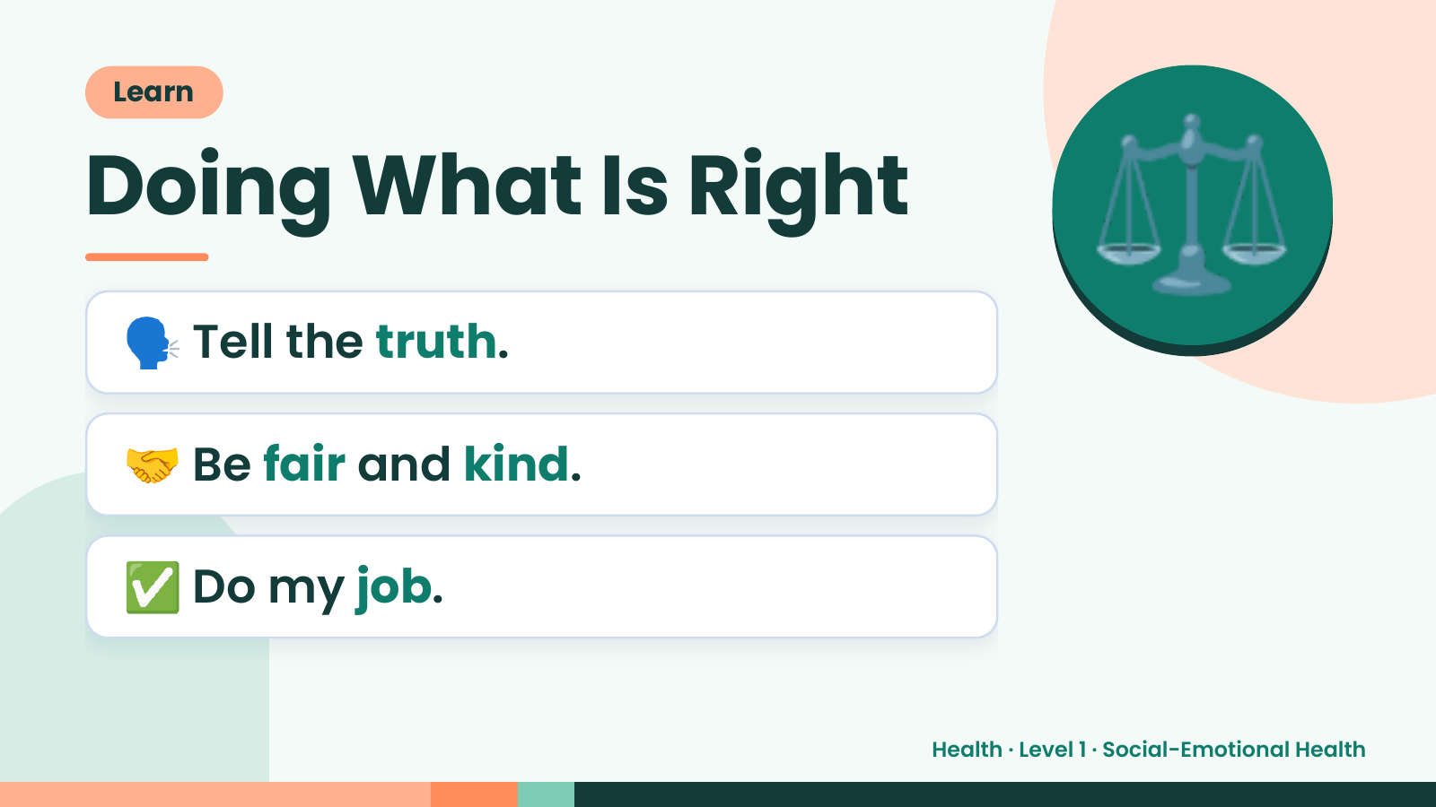
Notes:
Learn
Doing What Is Right
🗣️ Tell the truth.
⚖️
🤝 Be fair and kind.
✅ Do my job.
Health · Level 1 · Social-Emotional Health

Slide 15
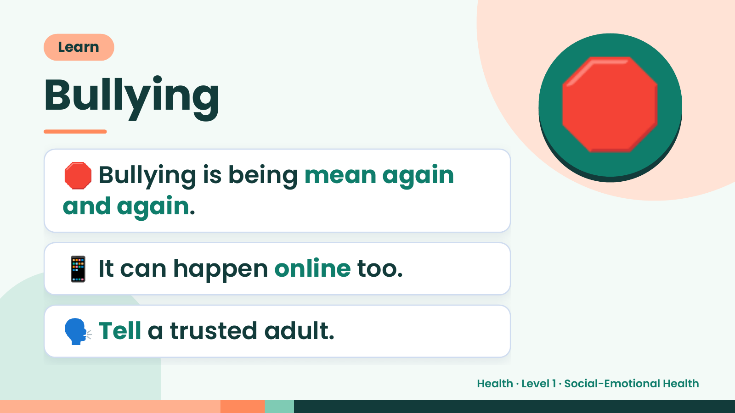
Notes:
Learn
Bullying
🛑 Bullying is being mean again
and again.
🛑
📱 It can happen online too.
🗣️ Tell a trusted adult.
Health · Level 1 · Social-Emotional Health

Slide 16
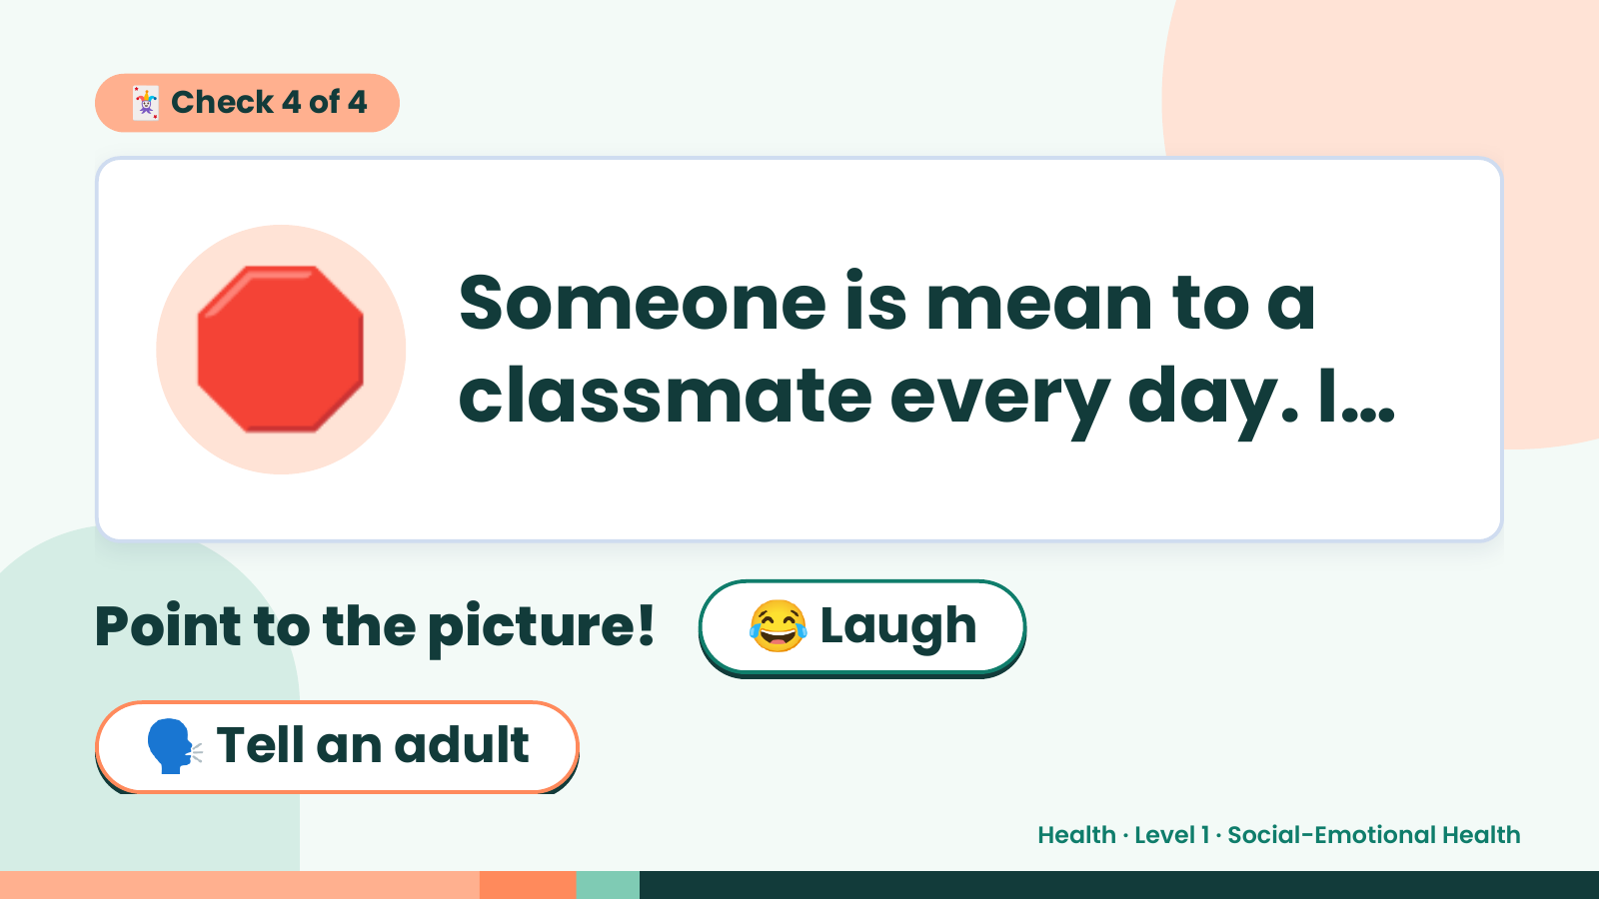
Notes:
🃏 Check 4 of 4
🛑 Someone is mean to a
classmate every day. I…
Point to the picture! 😂 Laugh
🗣️ Tell an adult
Health · Level 1 · Social-Emotional Health

Slide 17
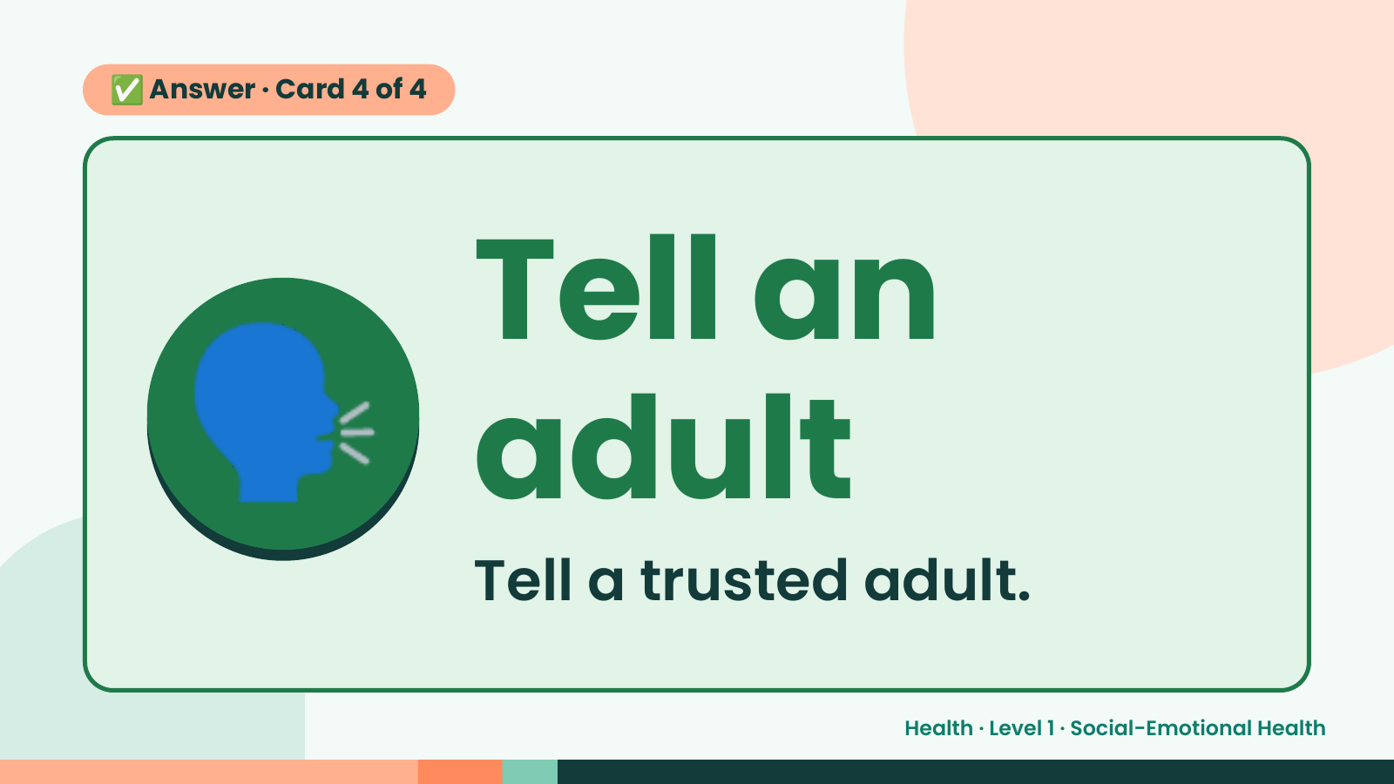
Notes:
✅ Answer · Card 4 of 4
🗣️ Tell an
adult
Tell a trusted adult.
Health · Level 1 · Social-Emotional Health

Slide 18
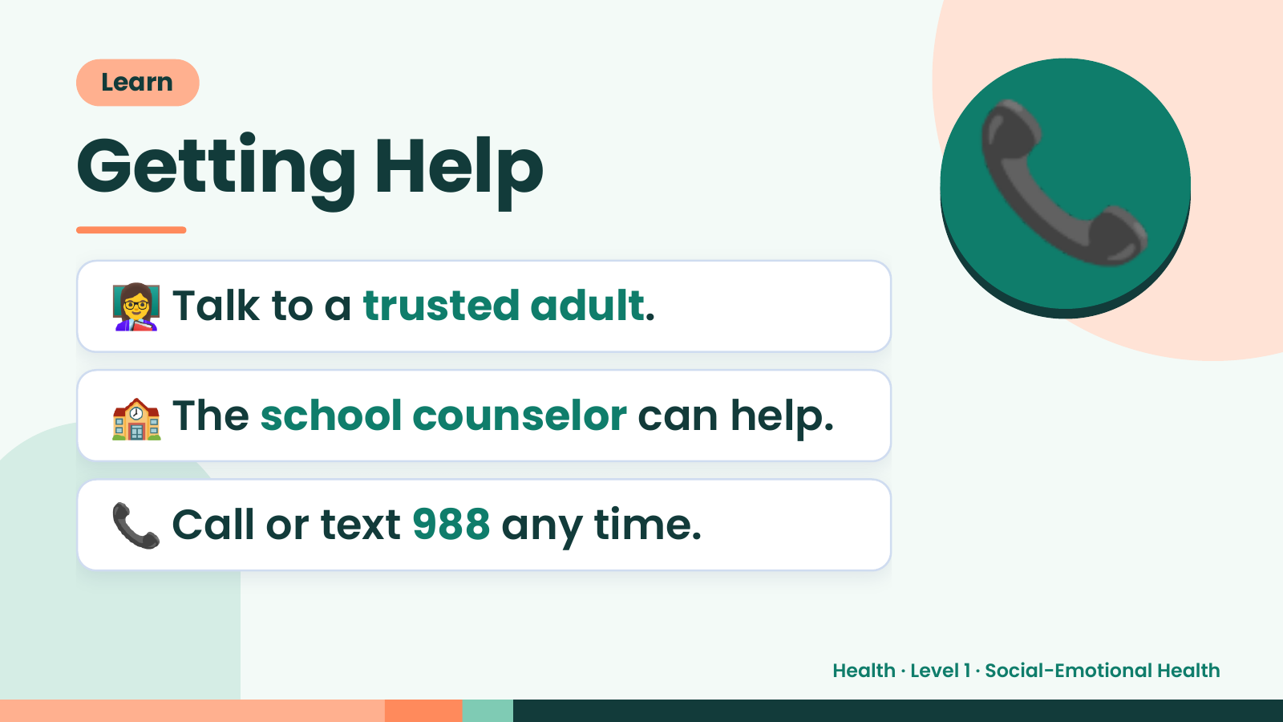
Notes:
Learn
Getting Help
👩‍🏫 Talk to a trusted adult.
📞
🏫 The school counselor can help.
📞 Call or text 988 any time.
Health · Level 1 · Social-Emotional Health

Slide 19
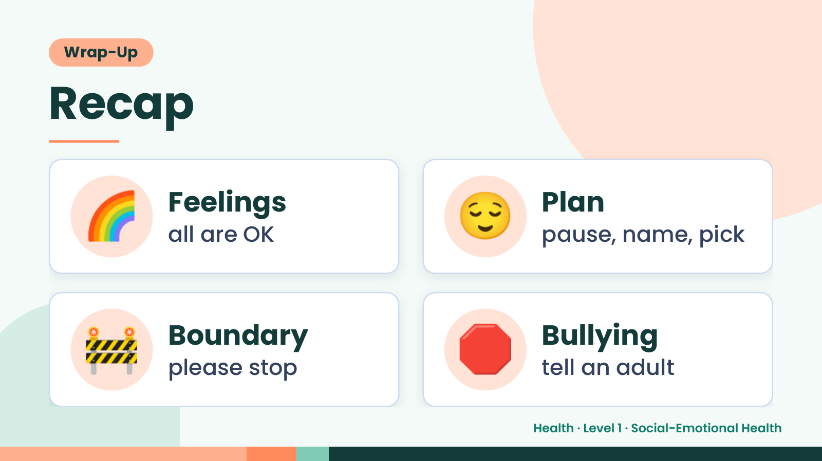
Notes:
Wrap-Up
Recap
🌈 Feelings
all are OK 😌 Plan
pause, name, pick
🚧 Boundary
please stop 🛑 Bullying
tell an adult
Health · Level 1 · Social-Emotional Health

Slide 20
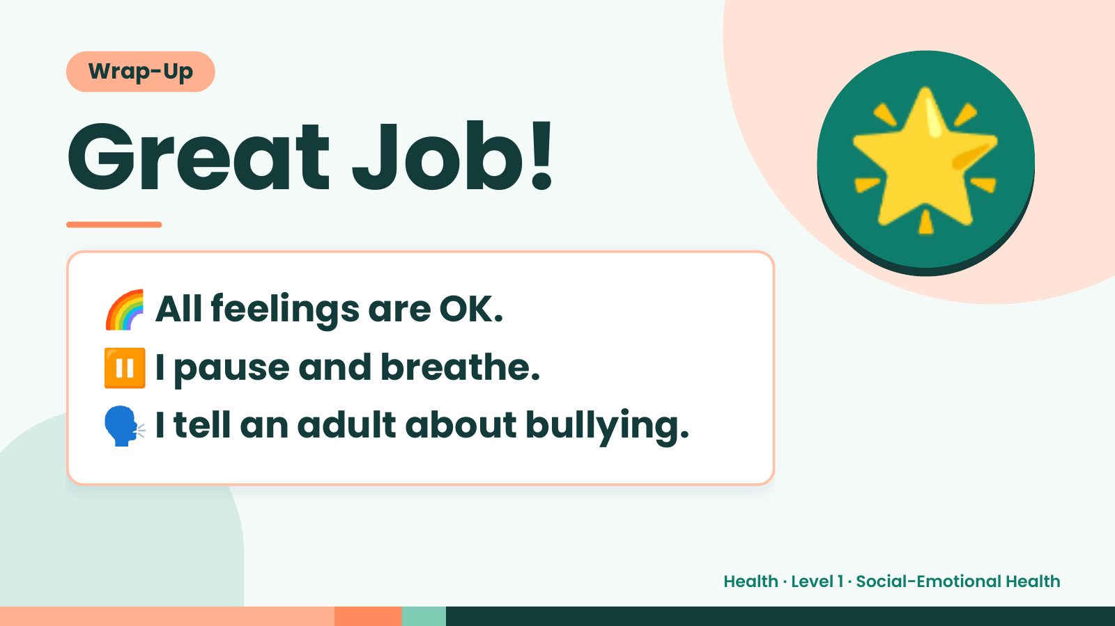
Notes:
Wrap-Up
Great Job!
🌈 All feelings are OK.
🌟
⏸️ I pause and breathe.
🗣️ I tell an adult about bullying.
Health · Level 1 · Social-Emotional Health

