Slide 1
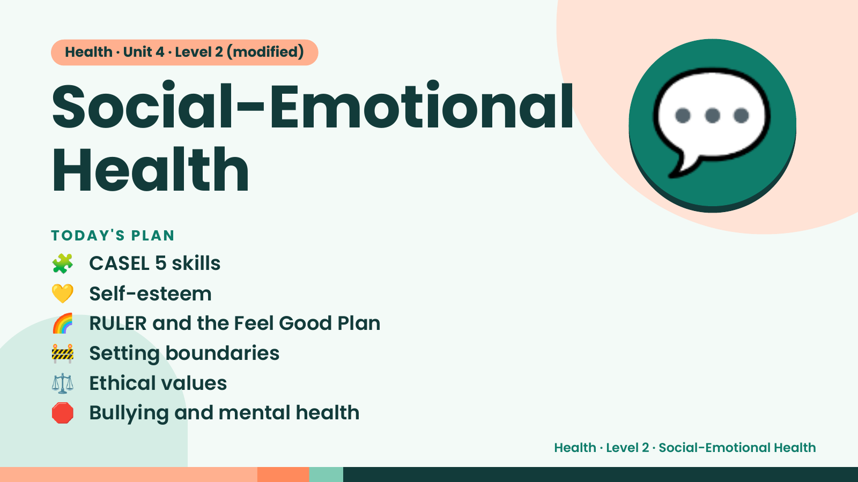
Notes:
Health · Unit 4 · Level 2 (modified)
Social-Emotional
Health
🧩 CASEL 5 skills
TODAY'S PLAN
💬
💛 Self-esteem
🌈 RULER and the Feel Good Plan
🚧 Setting boundaries
⚖️ Ethical values
🛑 Bullying and mental health
Health · Level 2 · Social-Emotional Health

Slide 2
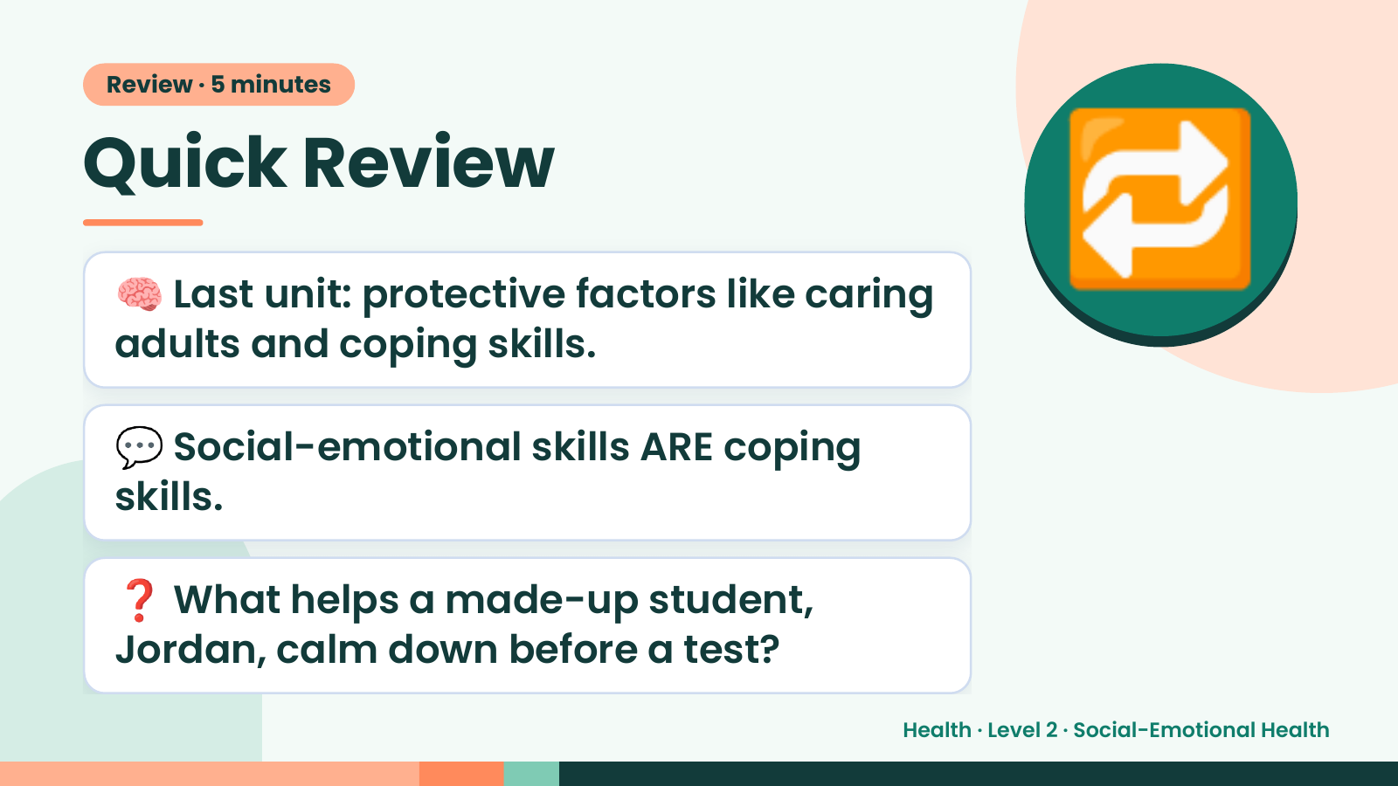
Notes:
Review · 5 minutes
Quick Review
🧠 Last unit: protective factors like caring
adults and coping skills.
🔁
💬 Social-emotional skills ARE coping
skills.
❓ What helps a made-up student,
Jordan, calm down before a test?
Health · Level 2 · Social-Emotional Health

Slide 3
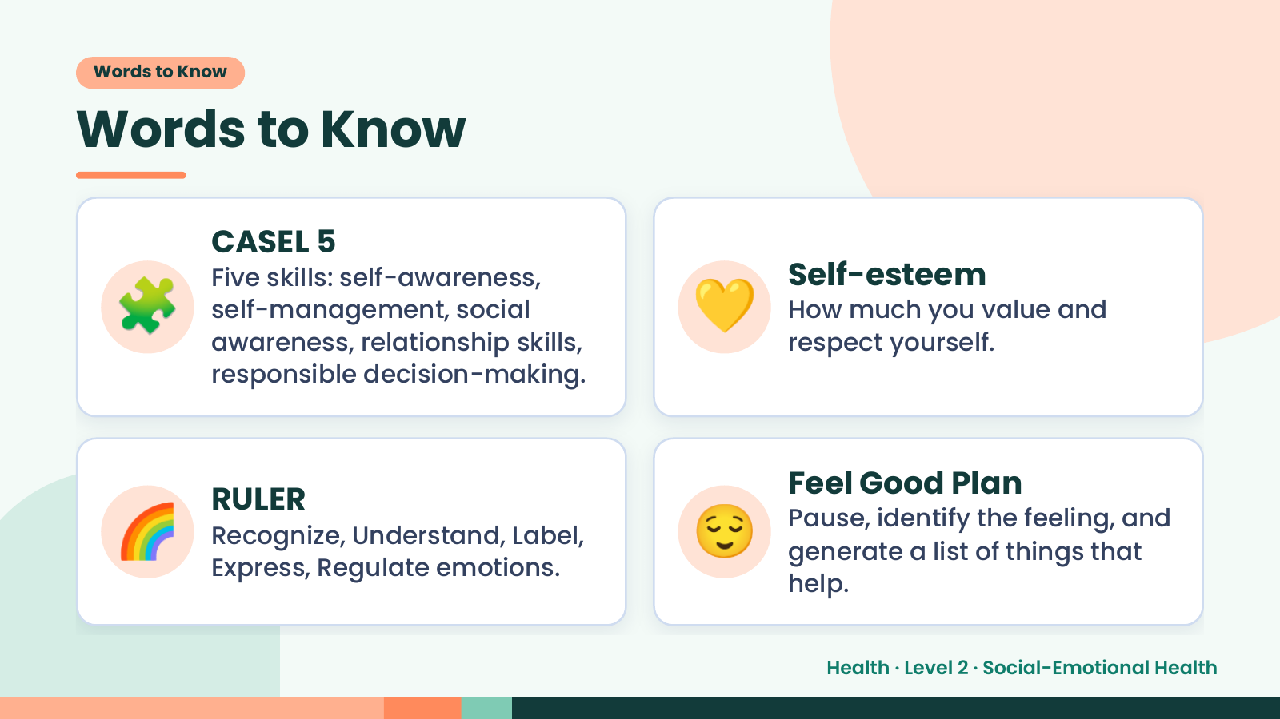
Notes:
Words to Know
Words to Know
🧩 💛
CASEL 5
Five skills: self-awareness, Self-esteem
self-management, social How much you value and
awareness, relationship skills, respect yourself.
responsible decision-making.
🌈 RULER
Recognize, Understand, Label,
Express, Regulate emotions.
😌 Feel Good Plan
Pause, identify the feeling, and
generate a list of things that
help.
Health · Level 2 · Social-Emotional Health

Slide 4
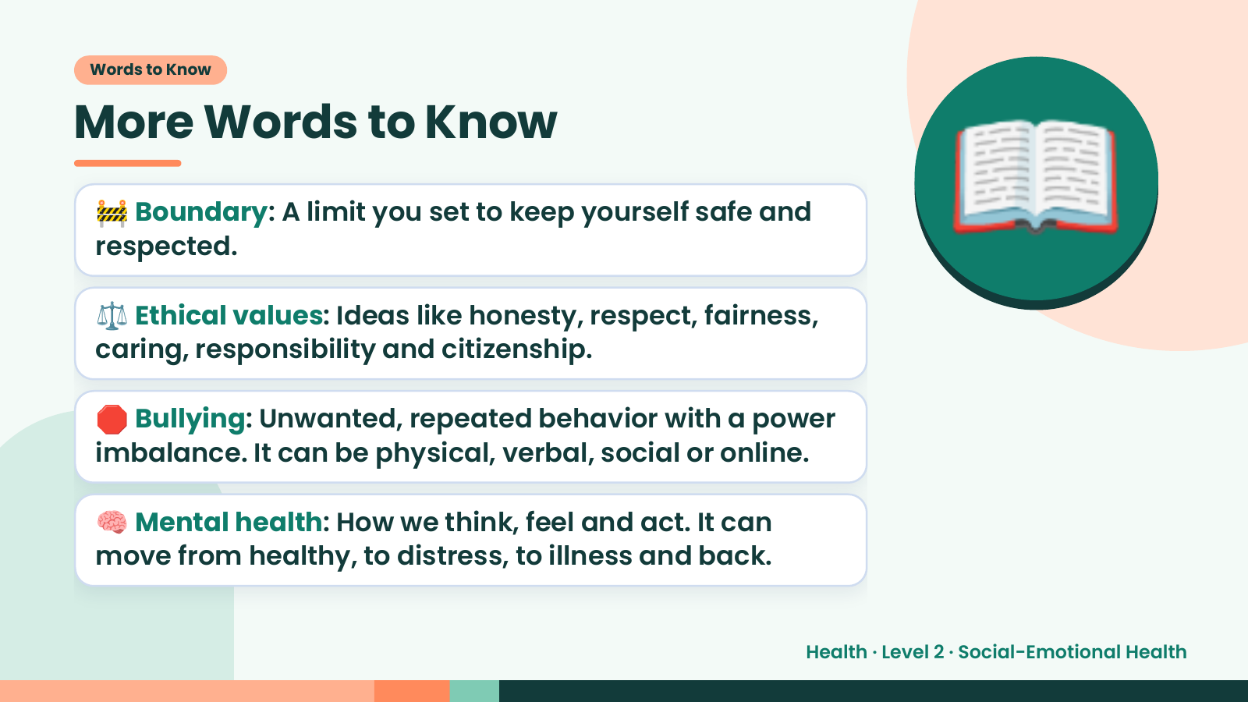
Notes:
Words to Know
More Words to Know
🚧 Boundary: A limit you set to keep yourself safe and
respected.
⚖️ Ethical values: Ideas like honesty, respect, fairness,
caring, responsibility and citizenship.
📖
🛑 Bullying: Unwanted, repeated behavior with a power
imbalance. It can be physical, verbal, social or online.
🧠 Mental health: How we think, feel and act. It can
move from healthy, to distress, to illness and back.
Health · Level 2 · Social-Emotional Health

Slide 5
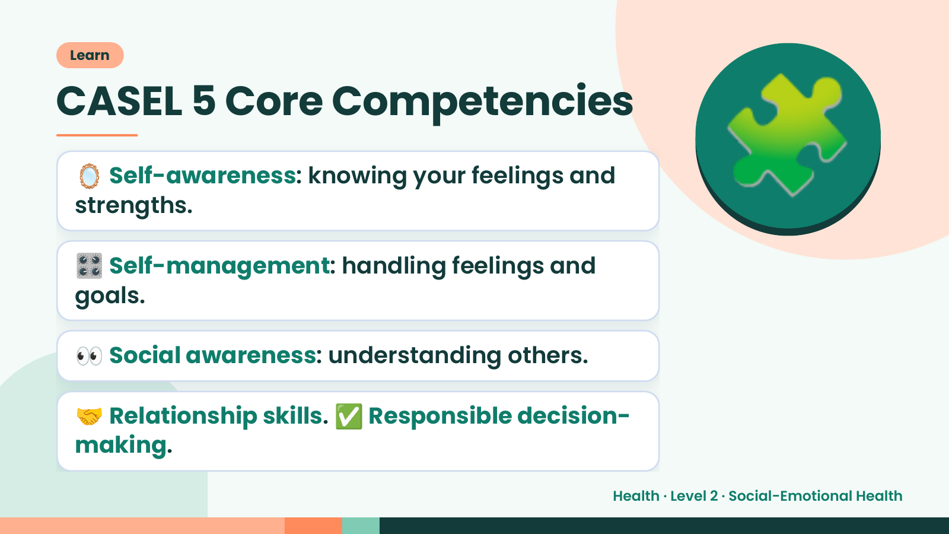
Notes:
Learn
CASEL 5 Core Competencies
🪞 Self-awareness: knowing your feelings and
strengths.
🎛️ Self-management: handling feelings and
goals.
🧩
👀 Social awareness: understanding others.
🤝 Relationship skills. ✅ Responsible decision-
making.
Health · Level 2 · Social-Emotional Health

Slide 6
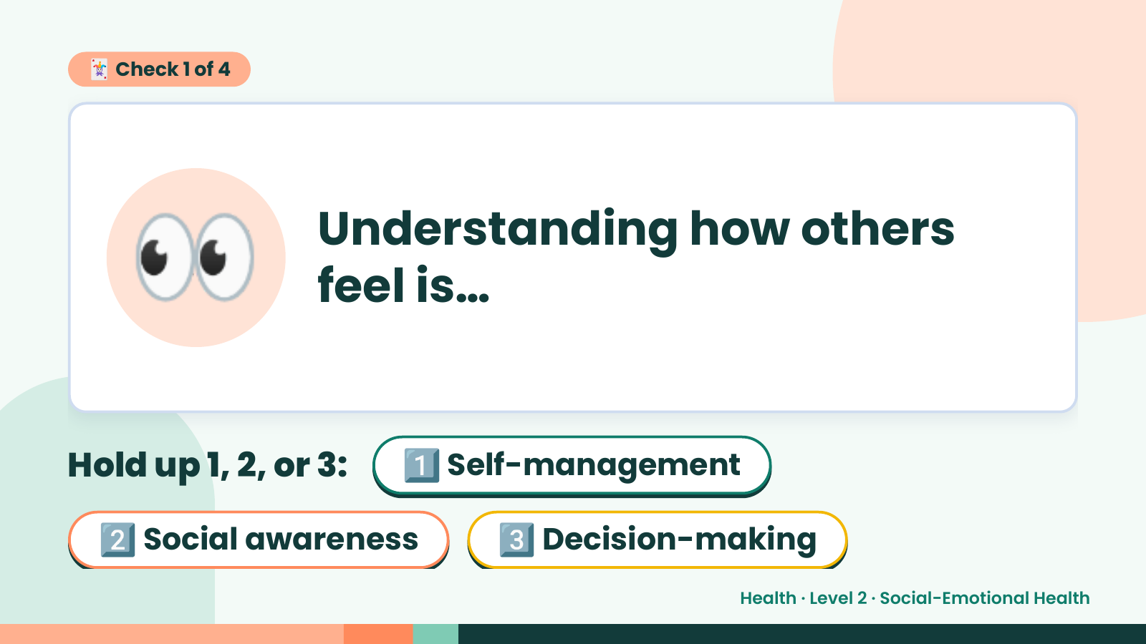
Notes:
🃏 Check 1 of 4
👀 Understanding how others
feel is…
Hold up 1, 2, or 3: 1️⃣ Self-management
2️⃣ Social awareness 3️⃣ Decision-making
Health · Level 2 · Social-Emotional Health

Slide 7
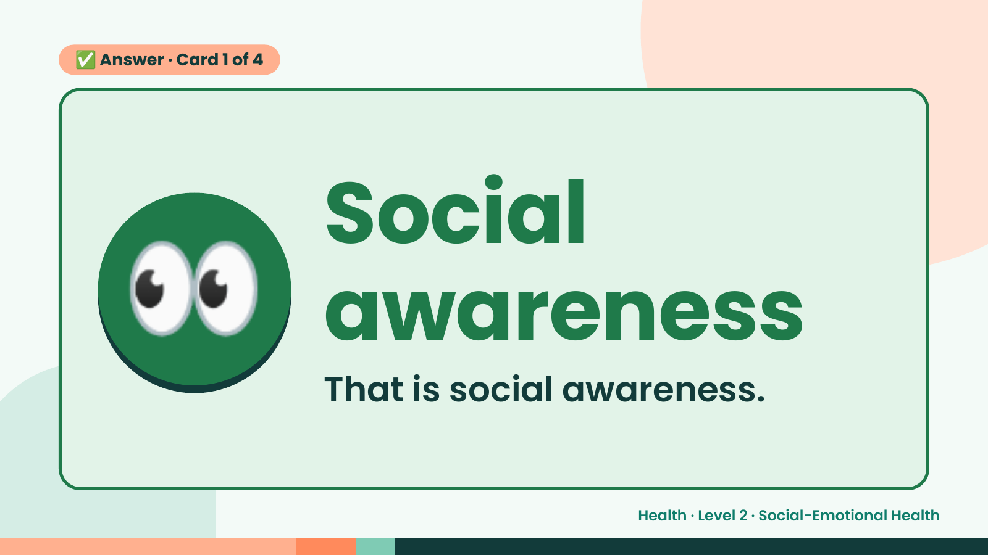
Notes:
✅ Answer · Card 1 of 4
👀 Social
awareness
That is social awareness.
Health · Level 2 · Social-Emotional Health

Slide 8
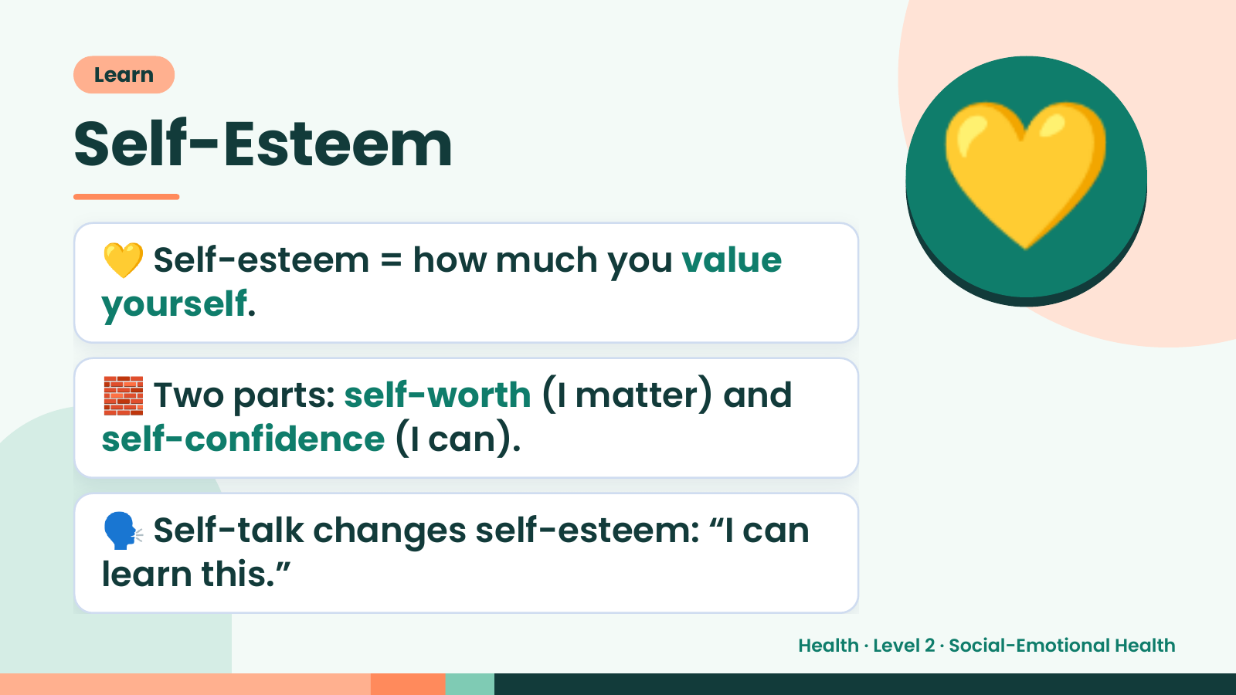
Notes:
Learn
Self-Esteem
💛 Self-esteem = how much you value
yourself.
💛
🧱 Two parts: self-worth (I matter) and
self-confidence (I can).
🗣️ Self-talk changes self-esteem: “I can
learn this.”
Health · Level 2 · Social-Emotional Health

Slide 9
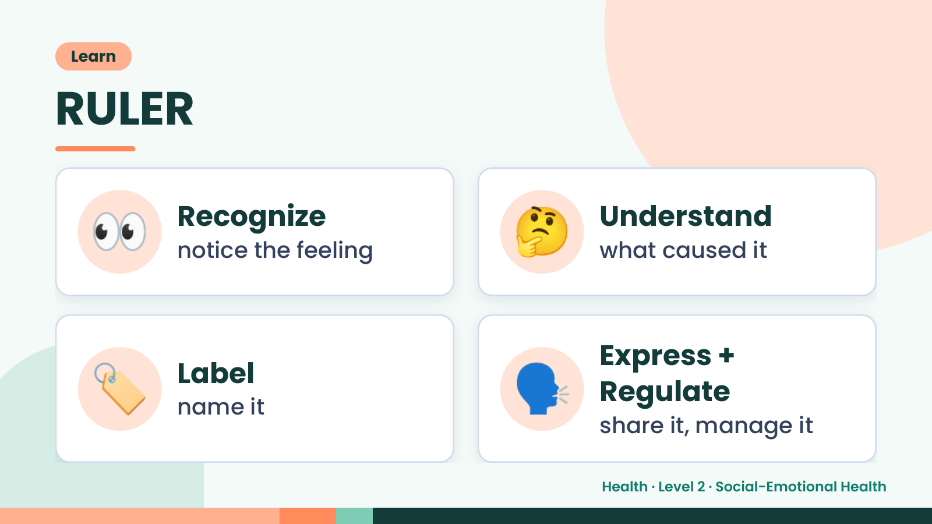
Notes:
Learn
RULER
👀 Recognize
notice the feeling 🤔 Understand
what caused it
🏷️ Label
name it 🗣️ Express +
Regulate
share it, manage it
Health · Level 2 · Social-Emotional Health

Slide 10
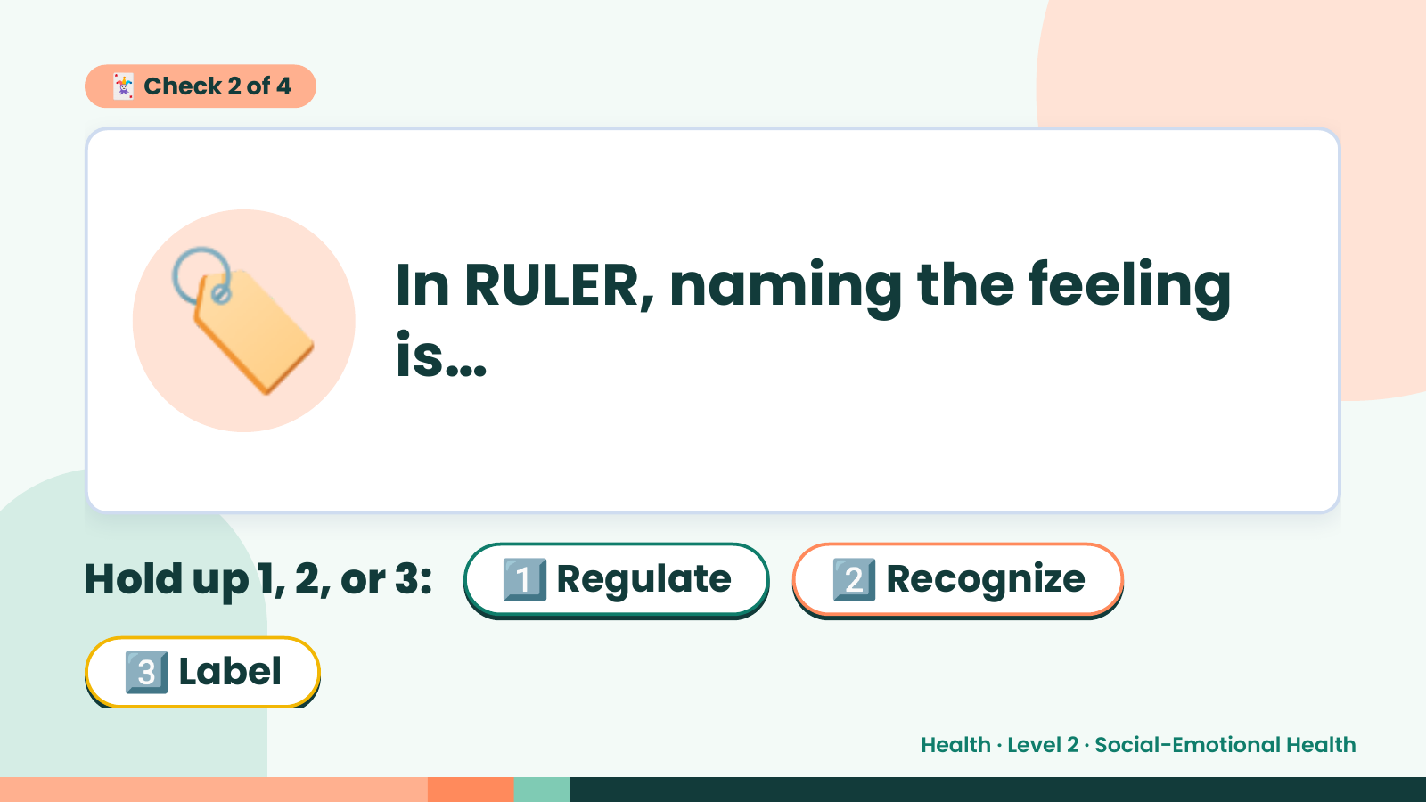
Notes:
🃏 Check 2 of 4
🏷️ In RULER, naming the feeling
is…
Hold up 1, 2, or 3: 1️⃣ Regulate 2️⃣ Recognize
3️⃣ Label
Health · Level 2 · Social-Emotional Health

Slide 11
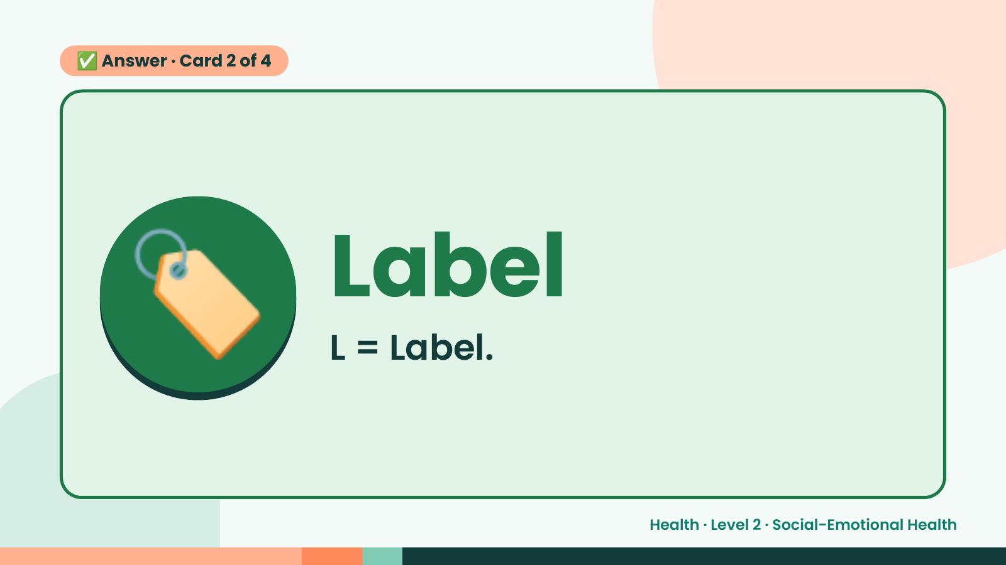
Notes:
✅ Answer · Card 2 of 4
🏷️ Label
L = Label.
Health · Level 2 · Social-Emotional Health

Slide 12
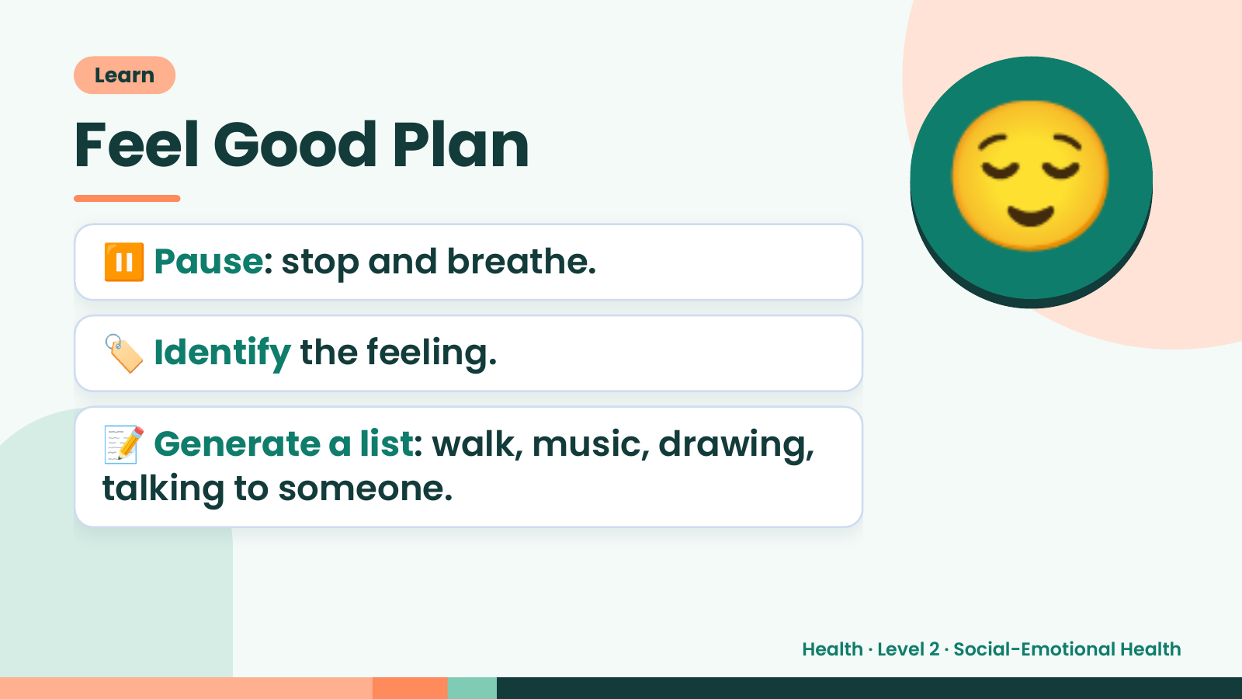
Notes:
Learn
Feel Good Plan
⏸️ Pause: stop and breathe.
🏷️ Identify the feeling.
😌
📝 Generate a list: walk, music, drawing,
talking to someone.
Health · Level 2 · Social-Emotional Health

Slide 13
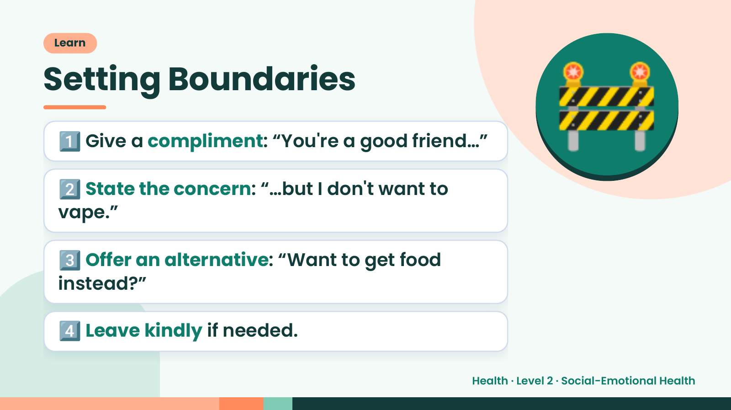
Notes:
Learn
Setting Boundaries
1️⃣ Give a compliment: “You're a good friend…”
2️⃣ State the concern: “…but I don't want to
vape.”
🚧
3️⃣ Offer an alternative: “Want to get food
instead?”
4️⃣ Leave kindly if needed.
Health · Level 2 · Social-Emotional Health

Slide 14
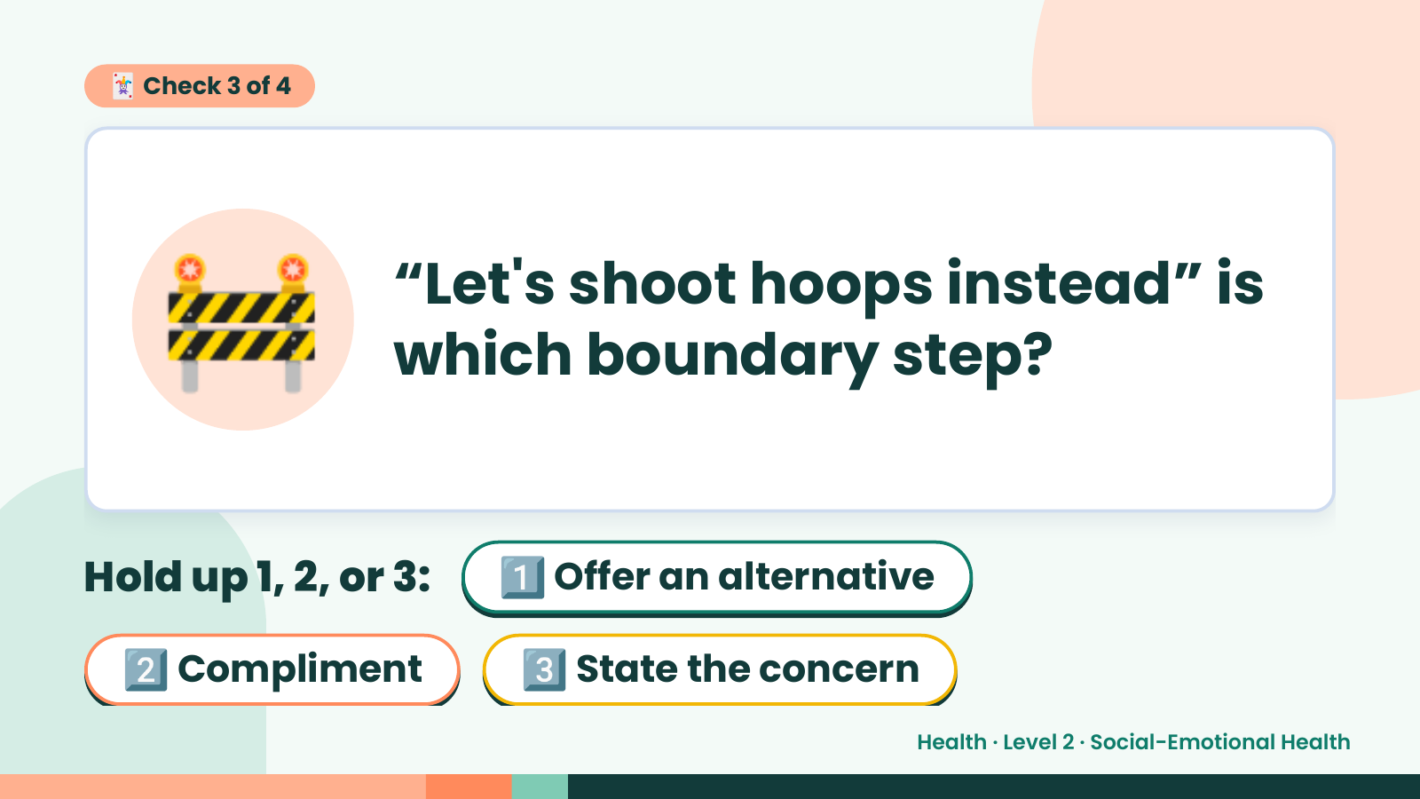
Notes:
🃏 Check 3 of 4
🚧 “Let's shoot hoops instead” is
which boundary step?
Hold up 1, 2, or 3: 1️⃣ Offer an alternative
2️⃣ Compliment 3️⃣ State the concern
Health · Level 2 · Social-Emotional Health

Slide 15
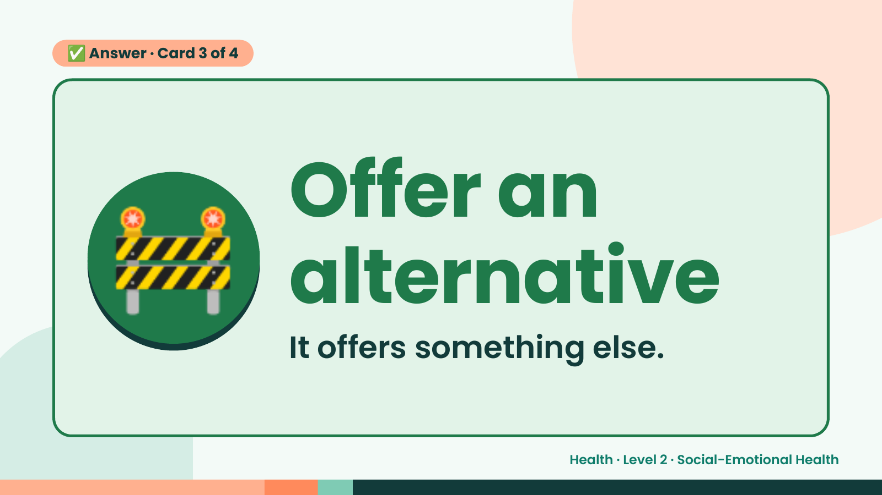
Notes:
✅ Answer · Card 3 of 4
🚧 Offer an
alternative
It offers something else.
Health · Level 2 · Social-Emotional Health

Slide 16
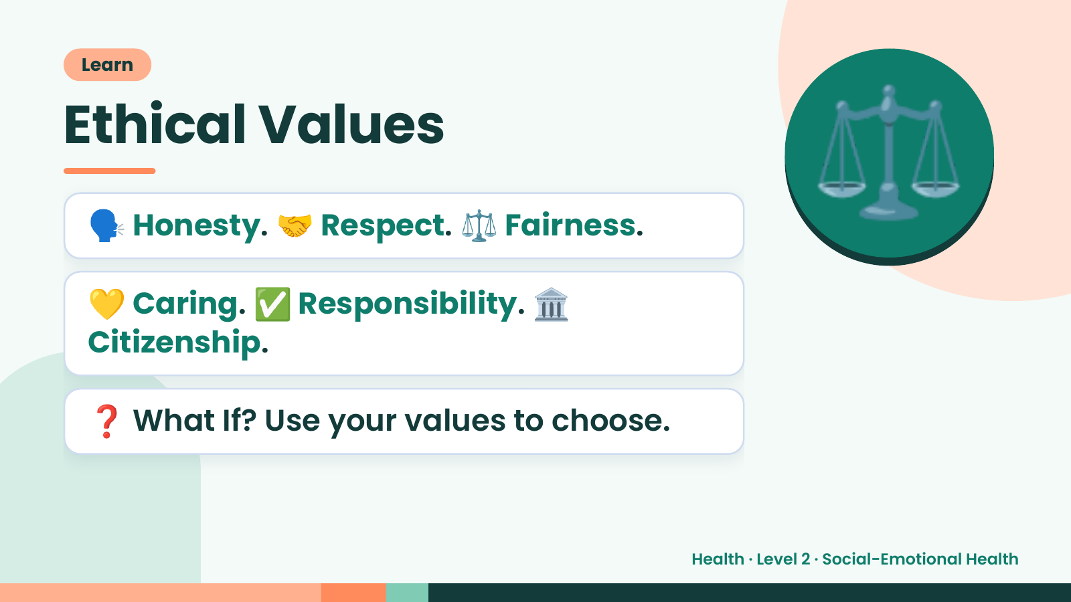
Notes:
Learn
Ethical Values
🗣️ Honesty. 🤝 Respect. ⚖️ Fairness.
💛 Caring. ✅ Responsibility. 🏛️
⚖️
Citizenship.
❓ What If? Use your values to choose.
Health · Level 2 · Social-Emotional Health

Slide 17
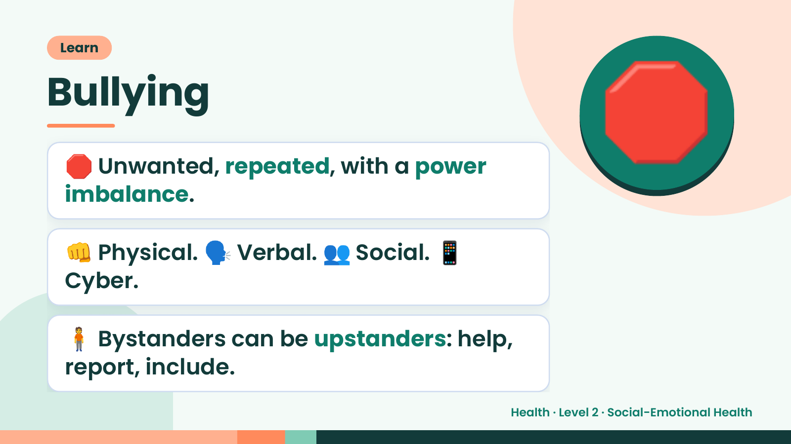
Notes:
Learn
Bullying
🛑 Unwanted, repeated, with a power
imbalance.
🛑
👊 Physical. 🗣️ Verbal. 👥 Social. 📱
Cyber.
🧍 Bystanders can be upstanders: help,
report, include.
Health · Level 2 · Social-Emotional Health

Slide 18
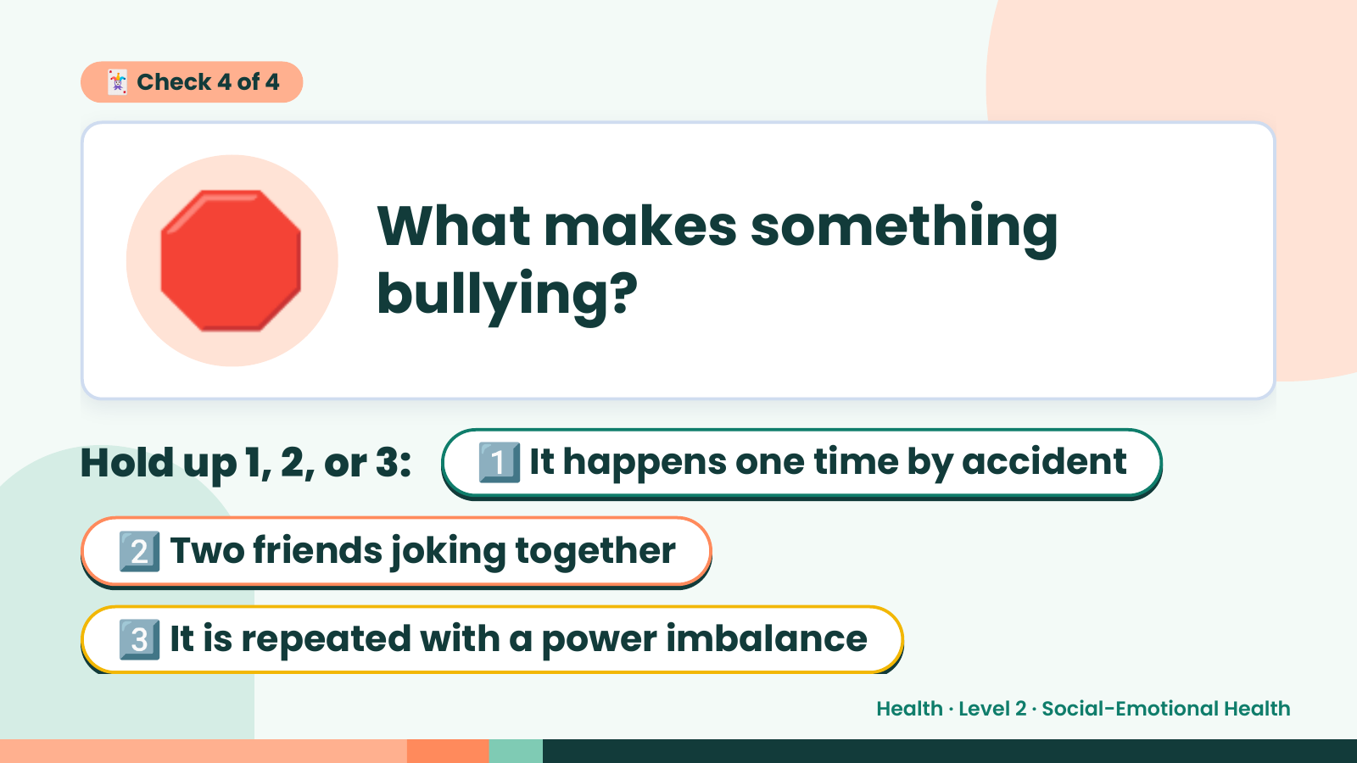
Notes:
🛑
🃏 Check 4 of 4
What makes something
bullying?
Hold up 1, 2, or 3: 1️⃣ It happens one time by accident
2️⃣ Two friends joking together
3️⃣ It is repeated with a power imbalance
Health · Level 2 · Social-Emotional Health

Slide 19
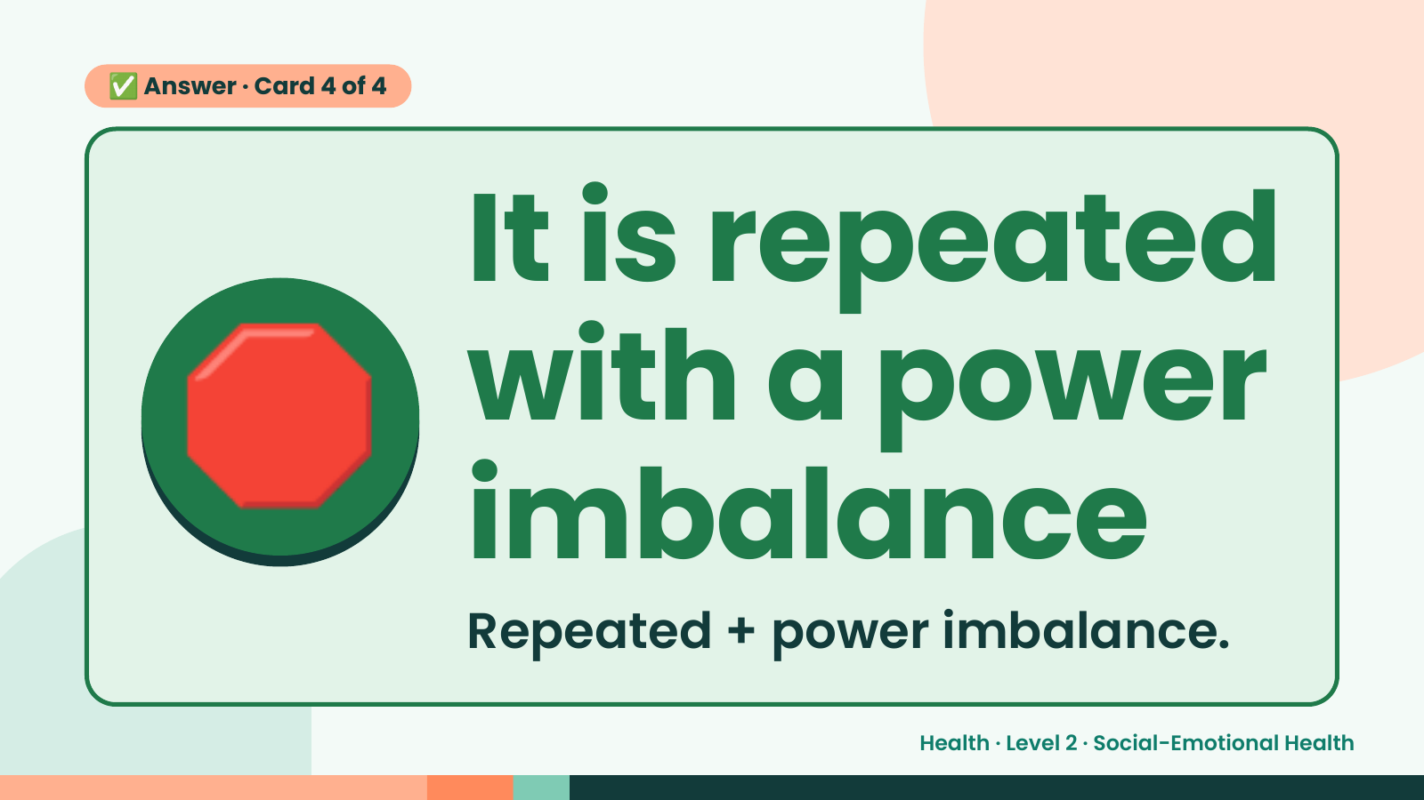
Notes:
✅ Answer · Card 4 of 4
🛑 It is repeated
with a power
imbalance
Repeated + power imbalance.
Health · Level 2 · Social-Emotional Health

Slide 20
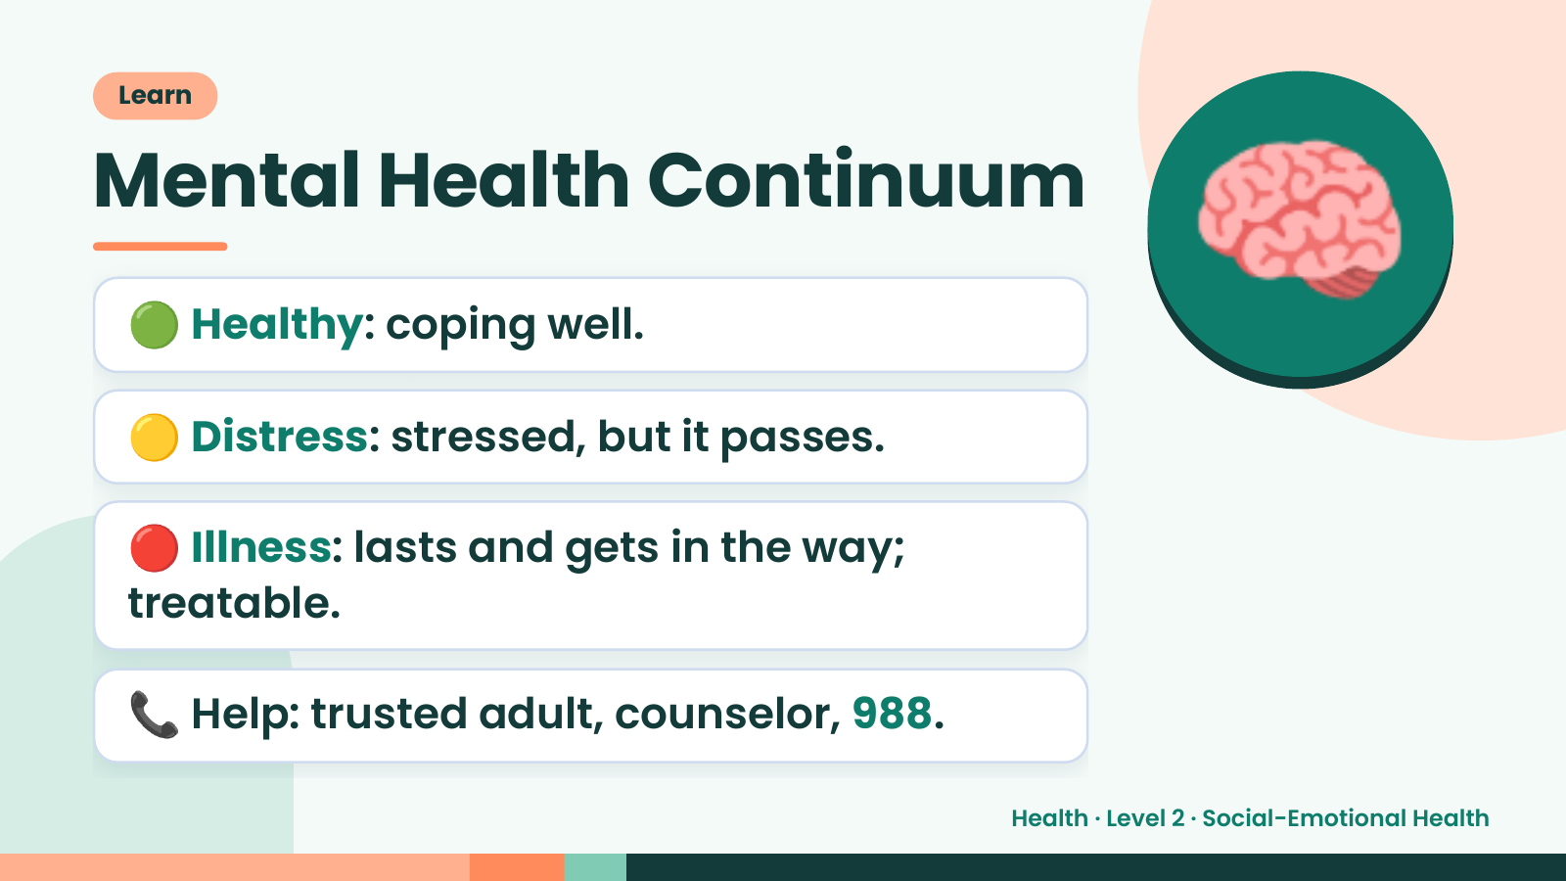
Notes:
Learn
Mental Health Continuum
🟢 Healthy: coping well.
🟡 Distress: stressed, but it passes.
🧠
🔴 Illness: lasts and gets in the way;
treatable.
📞 Help: trusted adult, counselor, 988.
Health · Level 2 · Social-Emotional Health

Slide 21
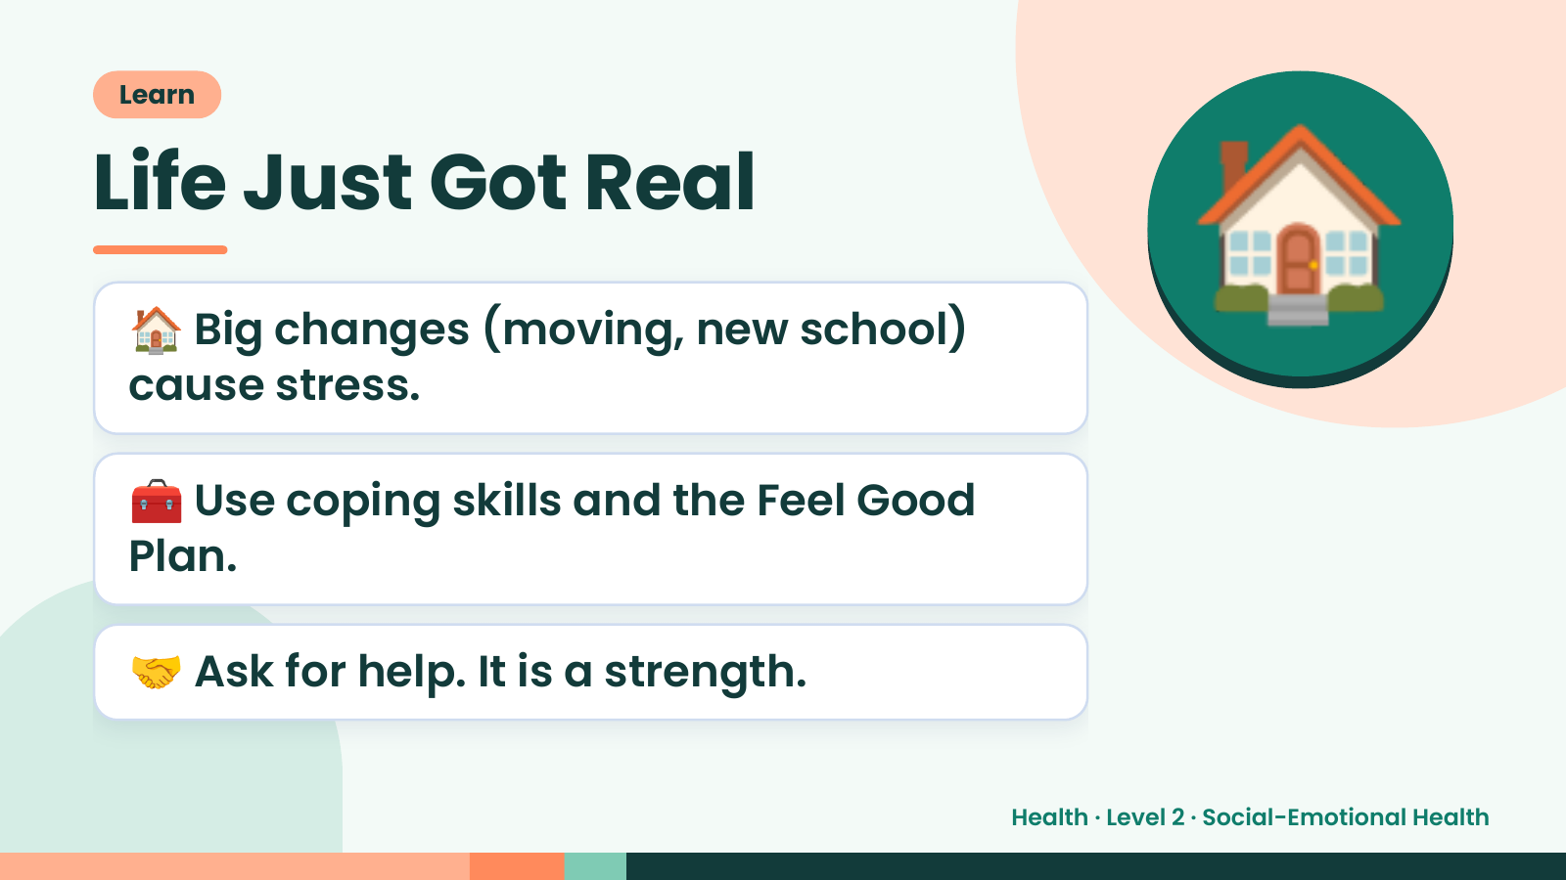
Notes:
Learn
Life Just Got Real
🏠 Big changes (moving, new school)
cause stress.
🏠
🧰 Use coping skills and the Feel Good
Plan.
🤝 Ask for help. It is a strength.
Health · Level 2 · Social-Emotional Health

Slide 22
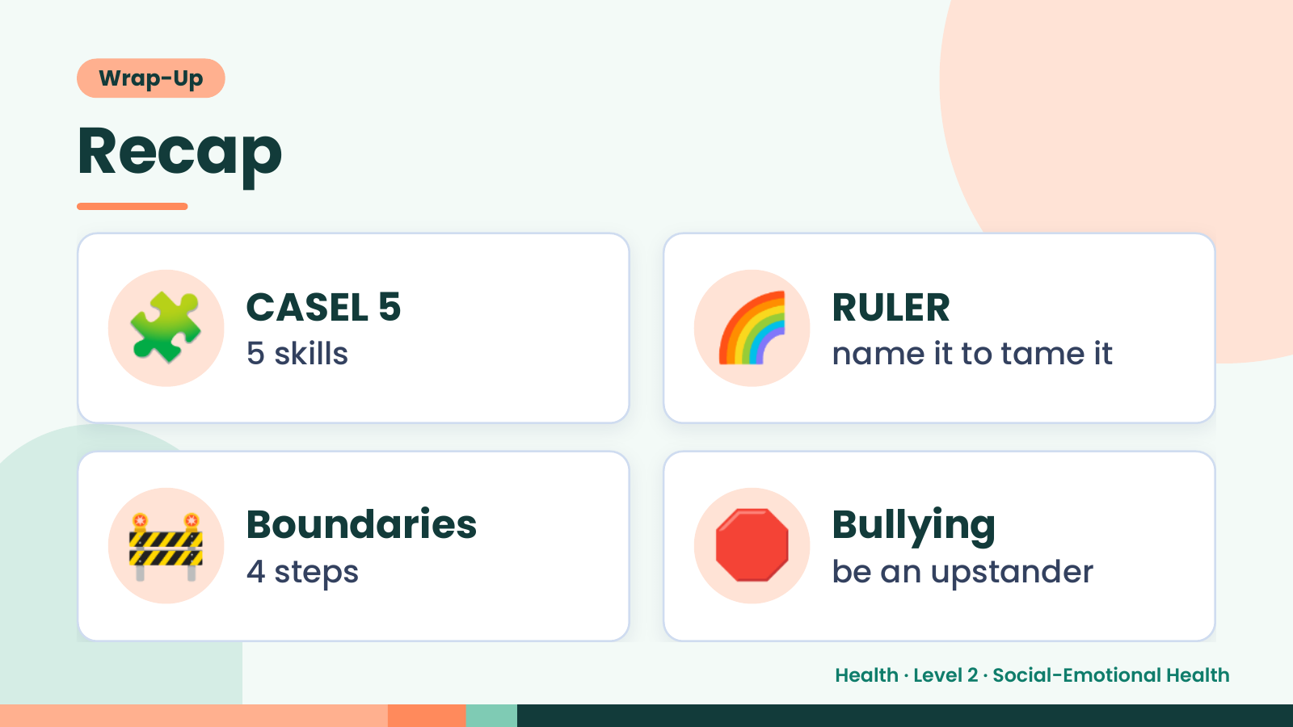
Notes:
Wrap-Up
Recap
🧩 CASEL 5
5 skills 🌈 RULER
name it to tame it
🚧 Boundaries
4 steps 🛑 Bullying
be an upstander
Health · Level 2 · Social-Emotional Health

Slide 23
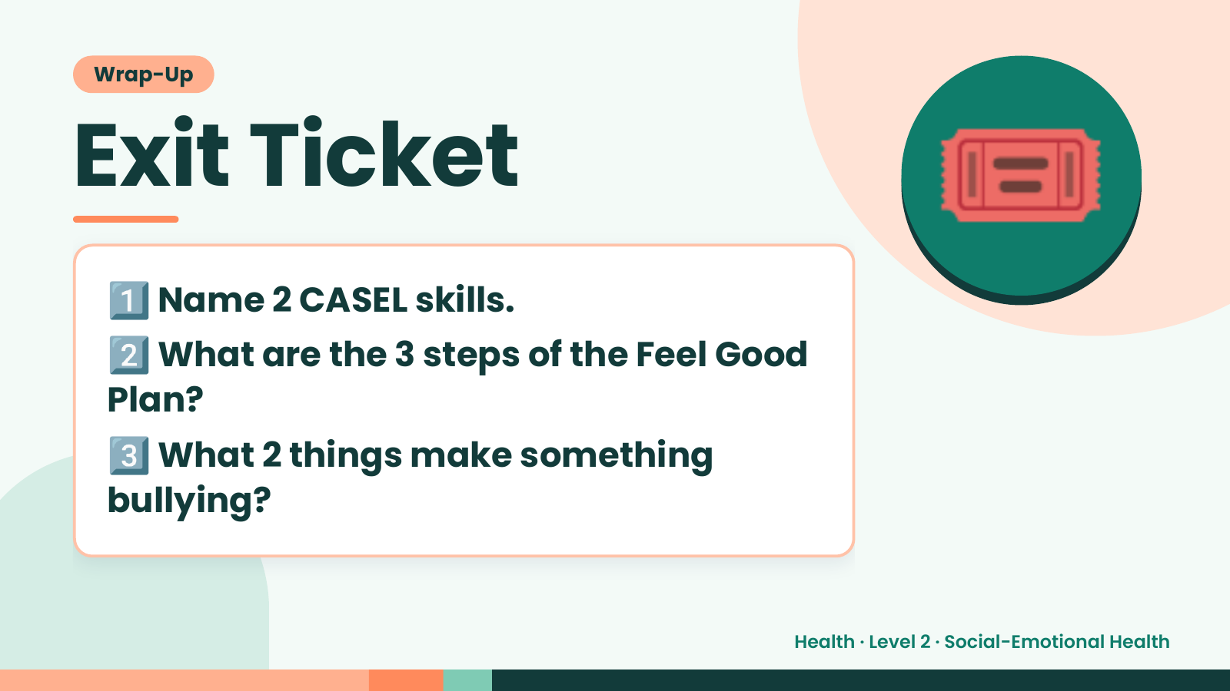
Notes:
Wrap-Up
Exit Ticket
1️⃣
2️⃣
Name 2 CASEL skills.
What are the 3 steps of the Feel Good
🎟️
Plan?
3️⃣
What 2 things make something
bullying?
Health · Level 2 · Social-Emotional Health

