Slide 1
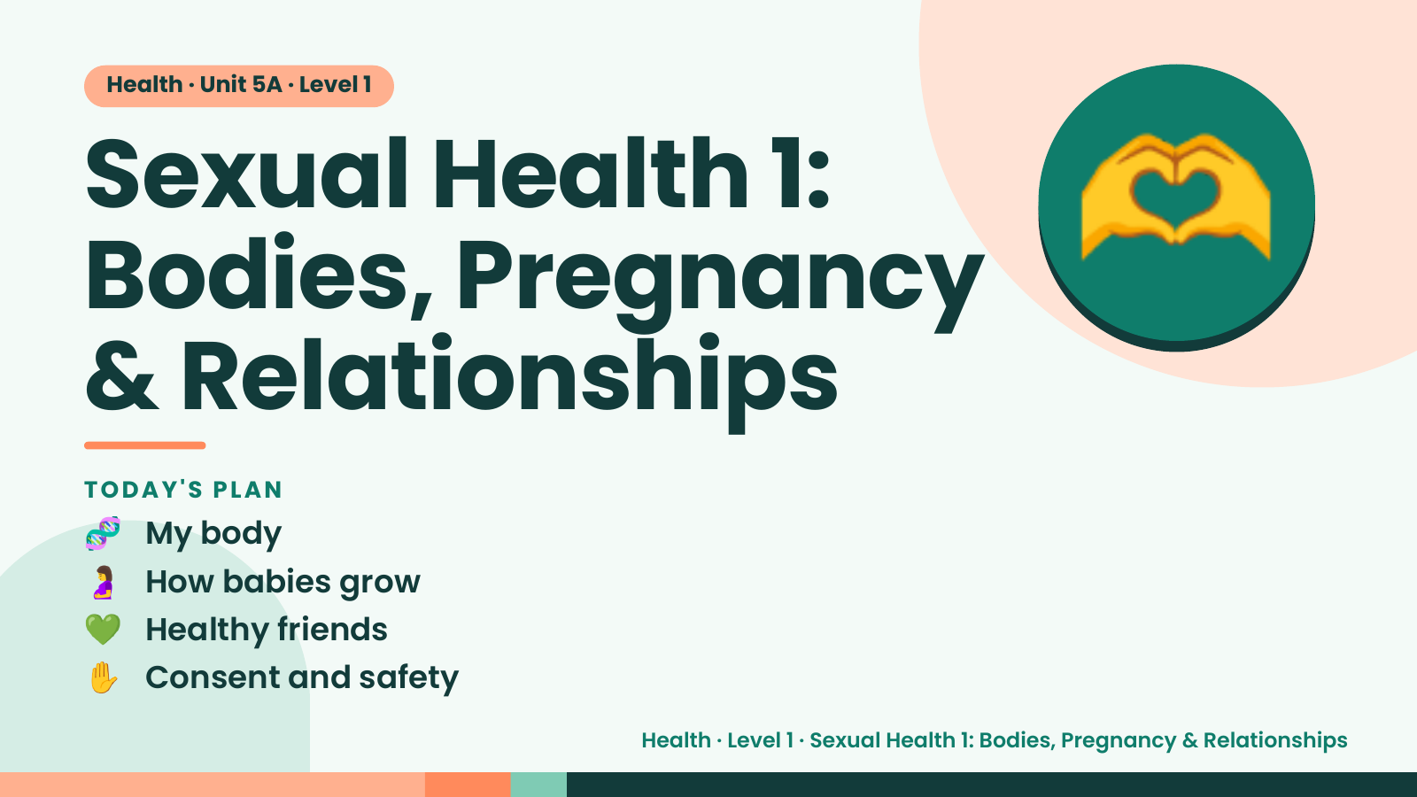
Notes:
Health · Unit 5A · Level 1
Sexual Health 1:
Bodies, Pregnancy
& Relationships
🫶
🧬 My body
TODAY'S PLAN
🤰 How babies grow
💚 Healthy friends
✋ Consent and safety
Health · Level 1 · Sexual Health 1: Bodies, Pregnancy & Relationships

Slide 2
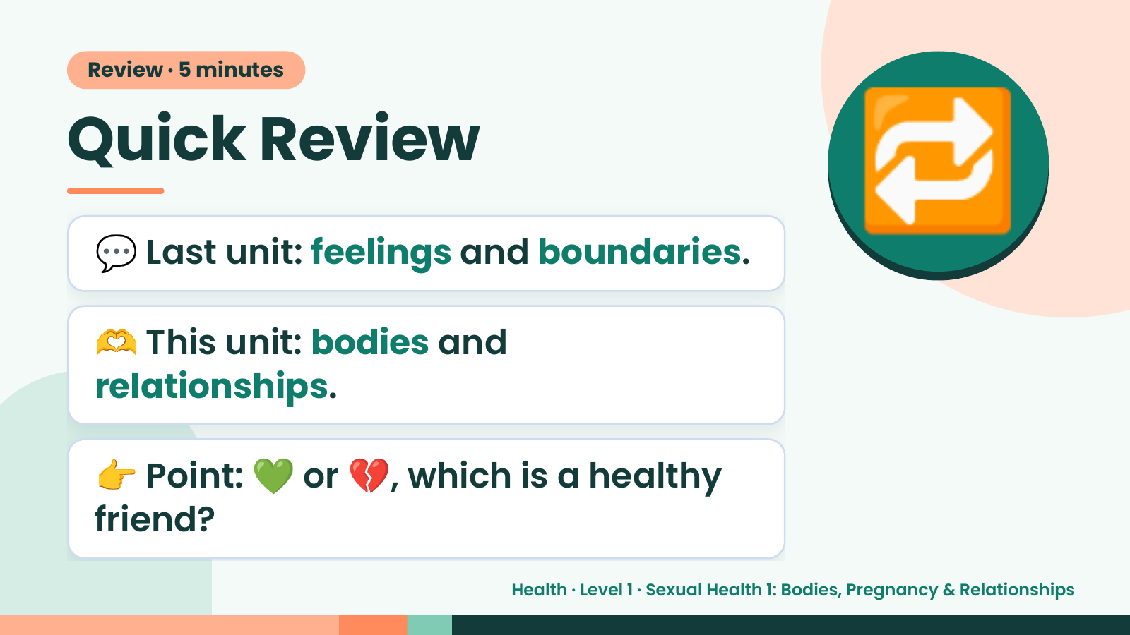
Notes:
Review · 5 minutes
Quick Review
💬 Last unit: feelings and boundaries.
🫶 This unit: bodies and
🔁
relationships.
👉 Point: 💚 or 💔, which is a healthy
friend?
Health · Level 1 · Sexual Health 1: Bodies, Pregnancy & Relationships

Slide 3
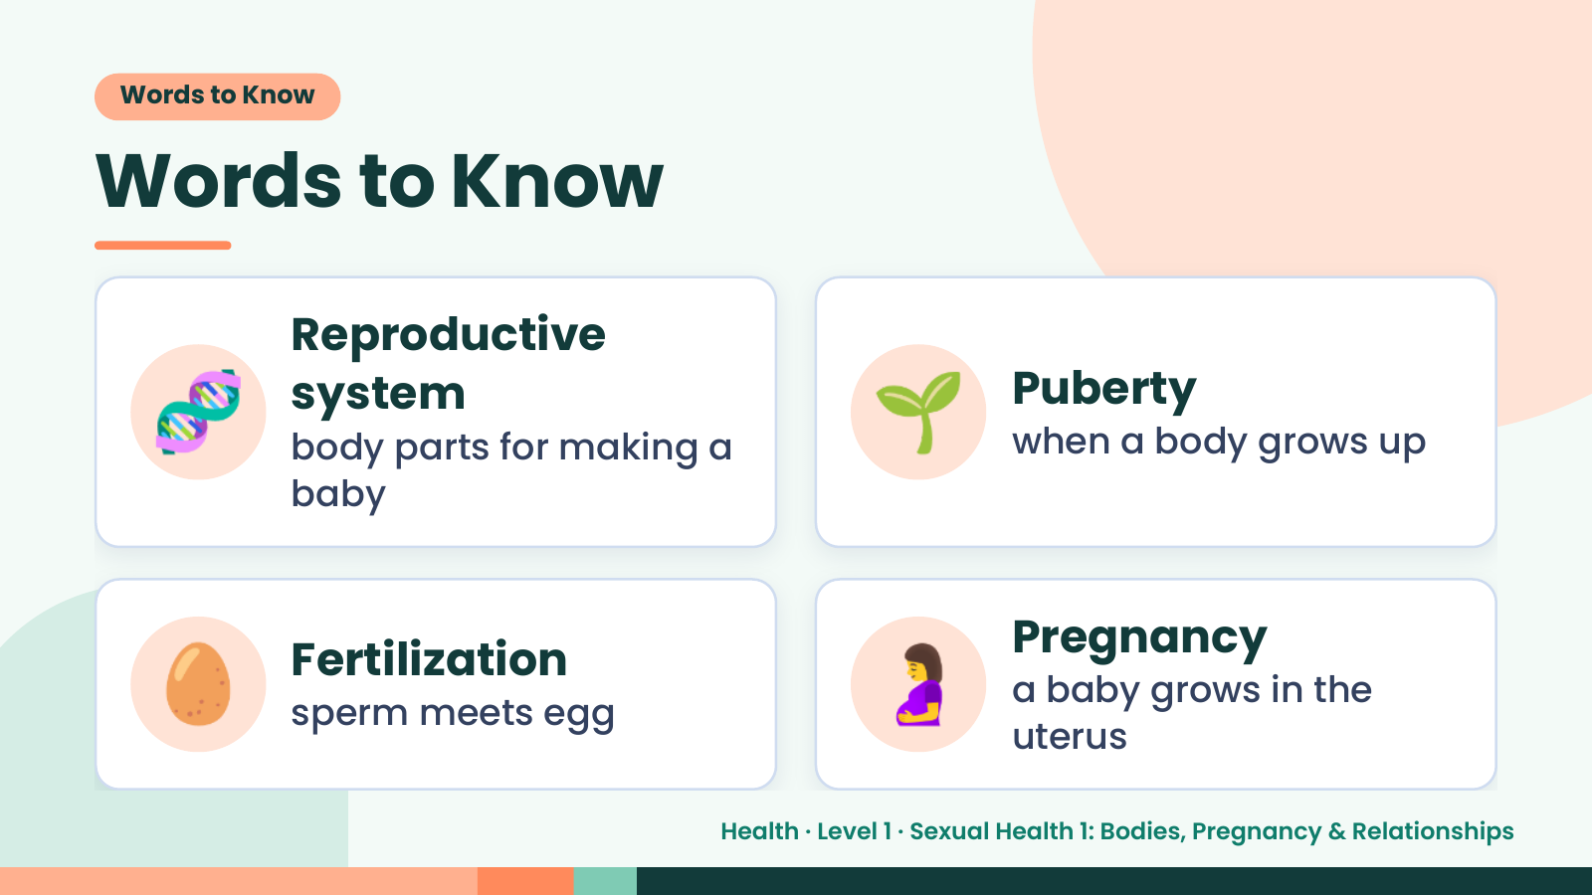
Notes:
Words to Know
Words to Know
🧬 Reproductive
system
body parts for making a
baby
🌱 Puberty
when a body grows up
🥚 Fertilization
sperm meets egg 🤰 Pregnancy
a baby grows in the
uterus
Health · Level 1 · Sexual Health 1: Bodies, Pregnancy & Relationships

Slide 4
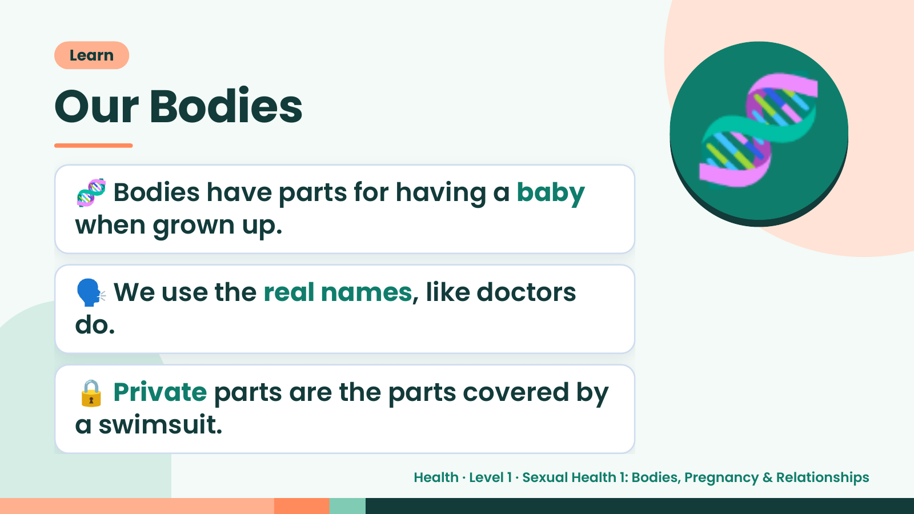
Notes:
Learn
Our Bodies
🧬 Bodies have parts for having a baby
when grown up.
🧬
🗣️ We use the real names, like doctors
do.
🔒 Private parts are the parts covered by
a swimsuit.
Health · Level 1 · Sexual Health 1: Bodies, Pregnancy & Relationships

Slide 5
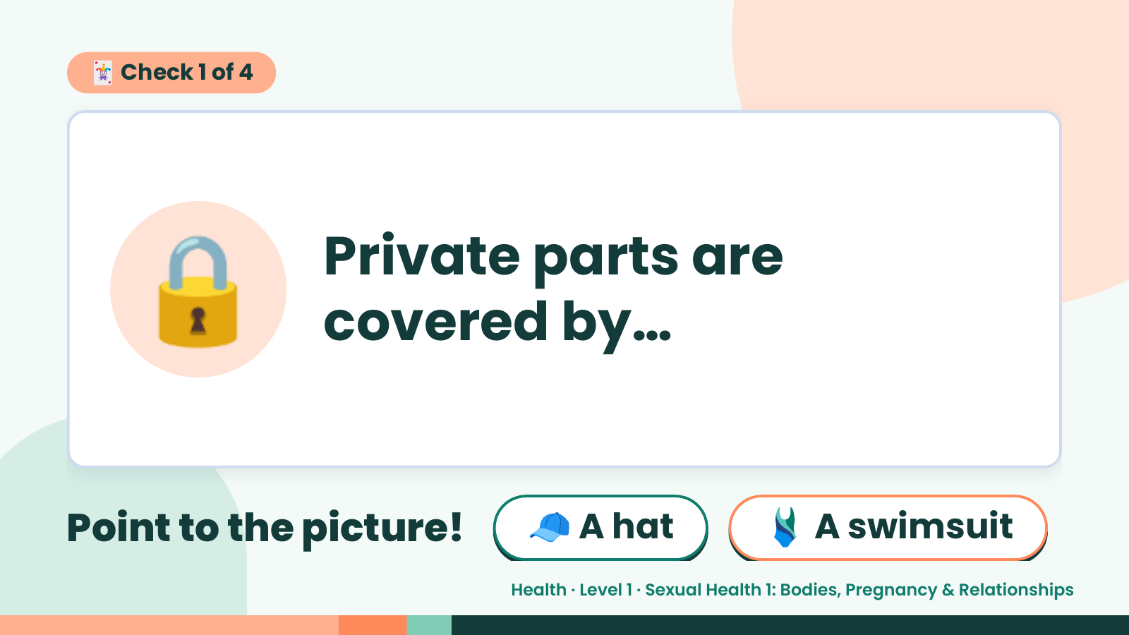
Notes:
🃏 Check 1 of 4
🔒 Private parts are
covered by…
Point to the picture! 🧢 A hat 🩱 A swimsuit
Health · Level 1 · Sexual Health 1: Bodies, Pregnancy & Relationships

Slide 6
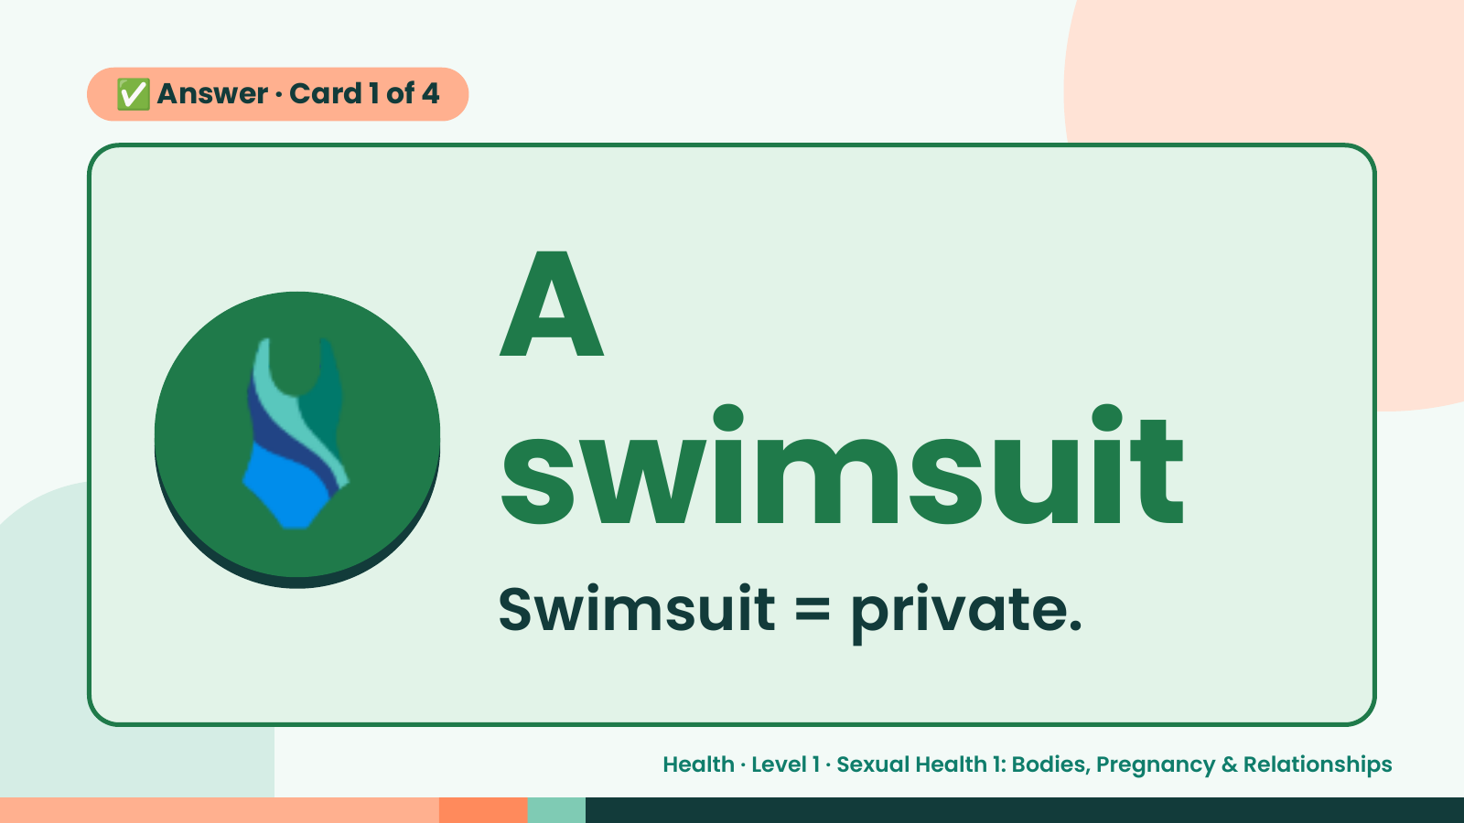
Notes:
✅ Answer · Card 1 of 4
🩱 A
swimsuit
Swimsuit = private.
Health · Level 1 · Sexual Health 1: Bodies, Pregnancy & Relationships

Slide 7
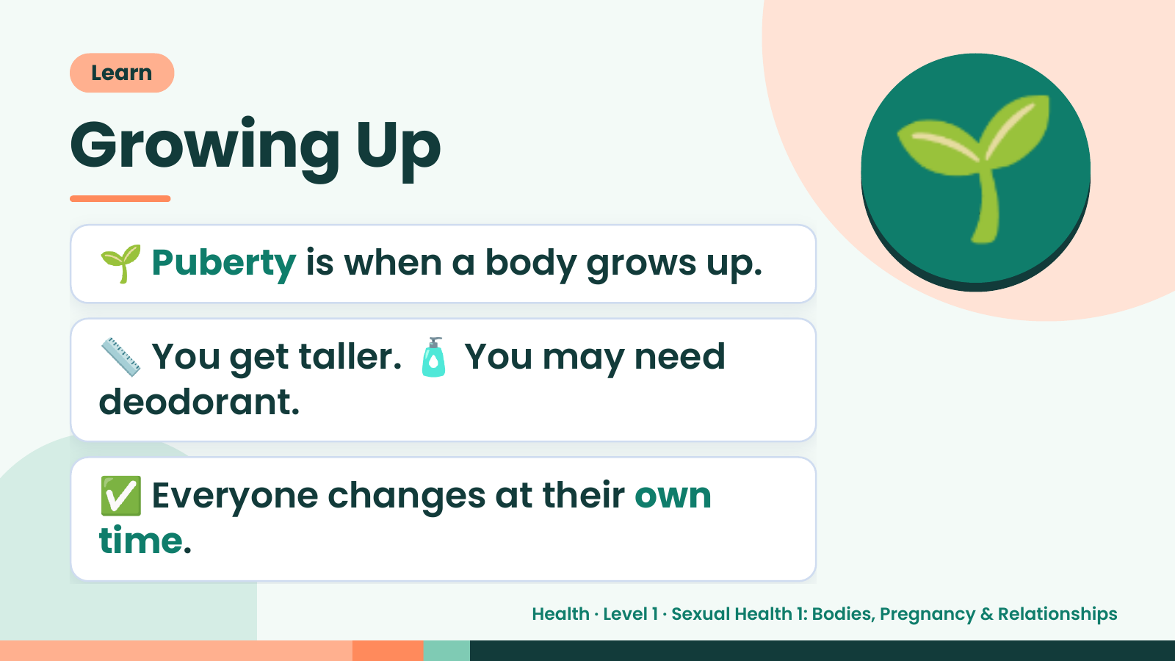
Notes:
Learn
Growing Up
🌱 Puberty is when a body grows up.
📏 You get taller. 🧴 You may need
🌱
deodorant.
✅ Everyone changes at their own
time.
Health · Level 1 · Sexual Health 1: Bodies, Pregnancy & Relationships

Slide 8
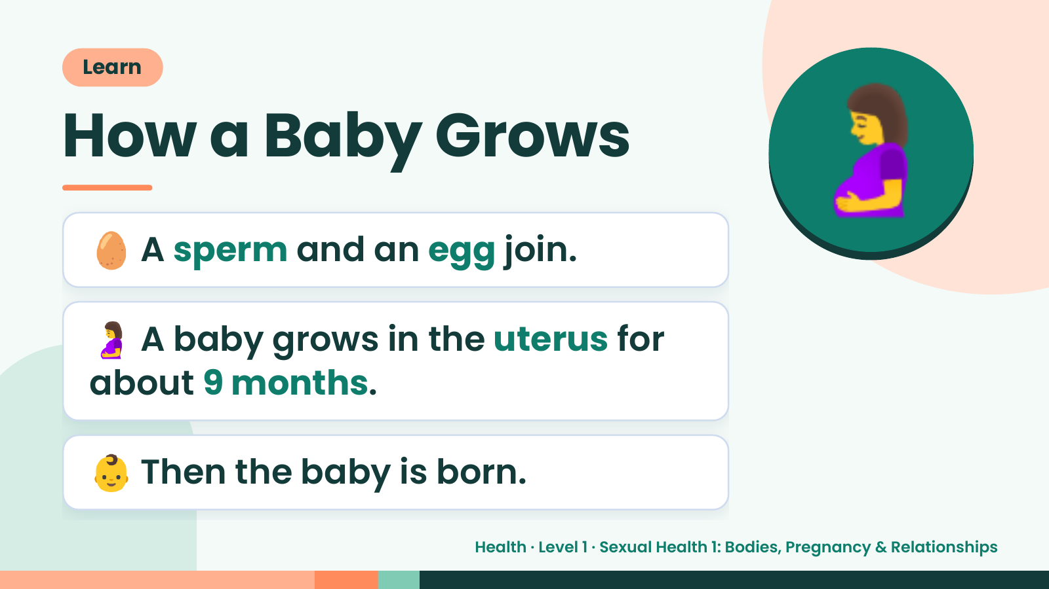
Notes:
Learn
How a Baby Grows
🥚 A sperm and an egg join.
🤰
🤰 A baby grows in the uterus for
about 9 months.
👶 Then the baby is born.
Health · Level 1 · Sexual Health 1: Bodies, Pregnancy & Relationships

Slide 9
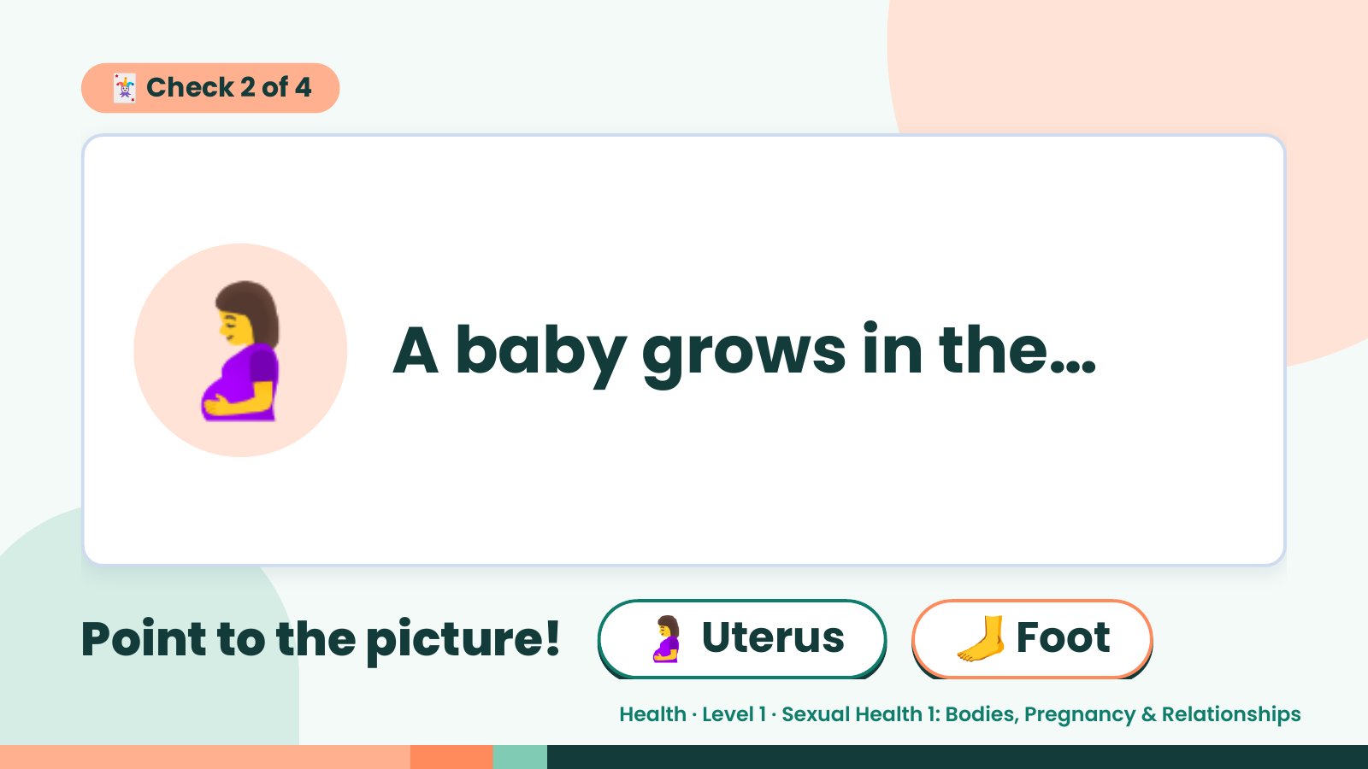
Notes:
🃏 Check 2 of 4
🤰 A baby grows in the…
Point to the picture! 🤰 Uterus 🦶 Foot
Health · Level 1 · Sexual Health 1: Bodies, Pregnancy & Relationships

Slide 10
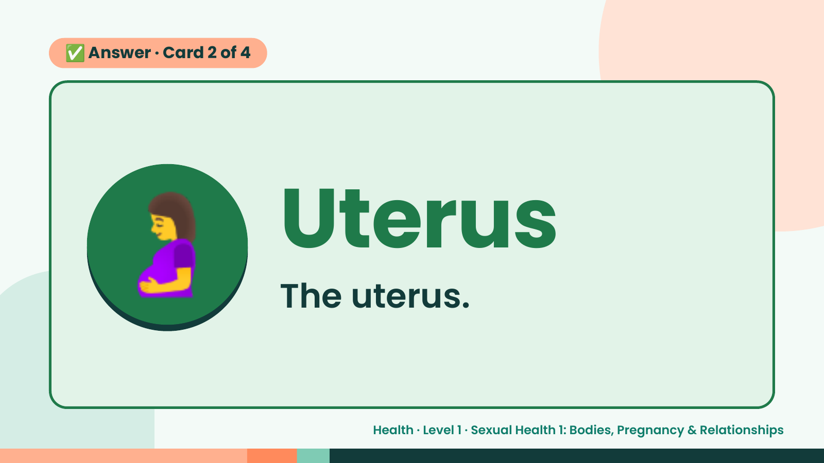
Notes:
✅ Answer · Card 2 of 4
🤰 Uterus
The uterus.
Health · Level 1 · Sexual Health 1: Bodies, Pregnancy & Relationships

Slide 11
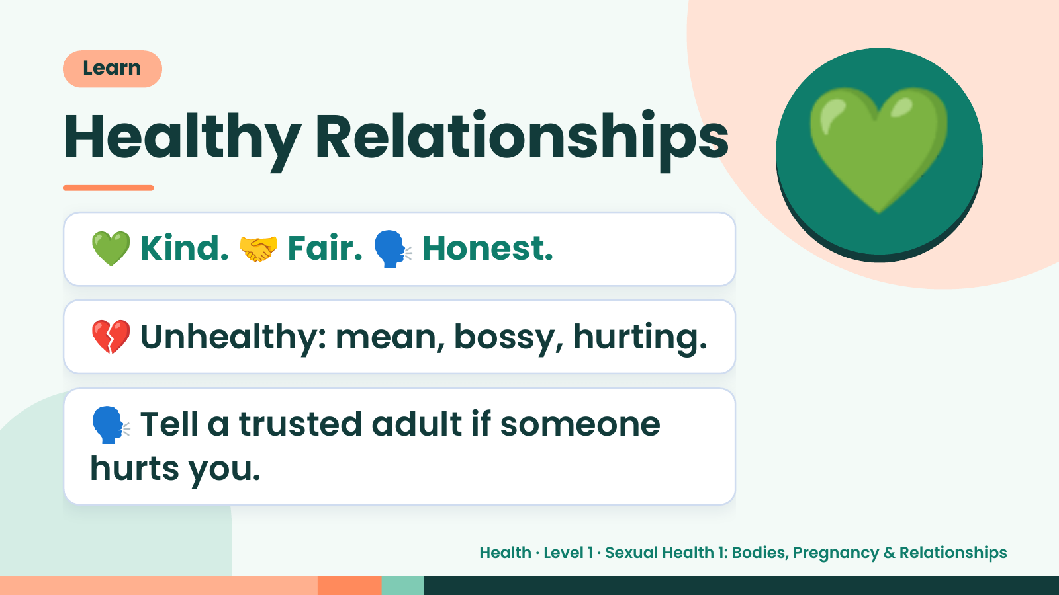
Notes:
Learn
Healthy Relationships
💚 Kind. 🤝 Fair. 🗣️ Honest.
💚
💔 Unhealthy: mean, bossy, hurting.
🗣️ Tell a trusted adult if someone
hurts you.
Health · Level 1 · Sexual Health 1: Bodies, Pregnancy & Relationships

Slide 12
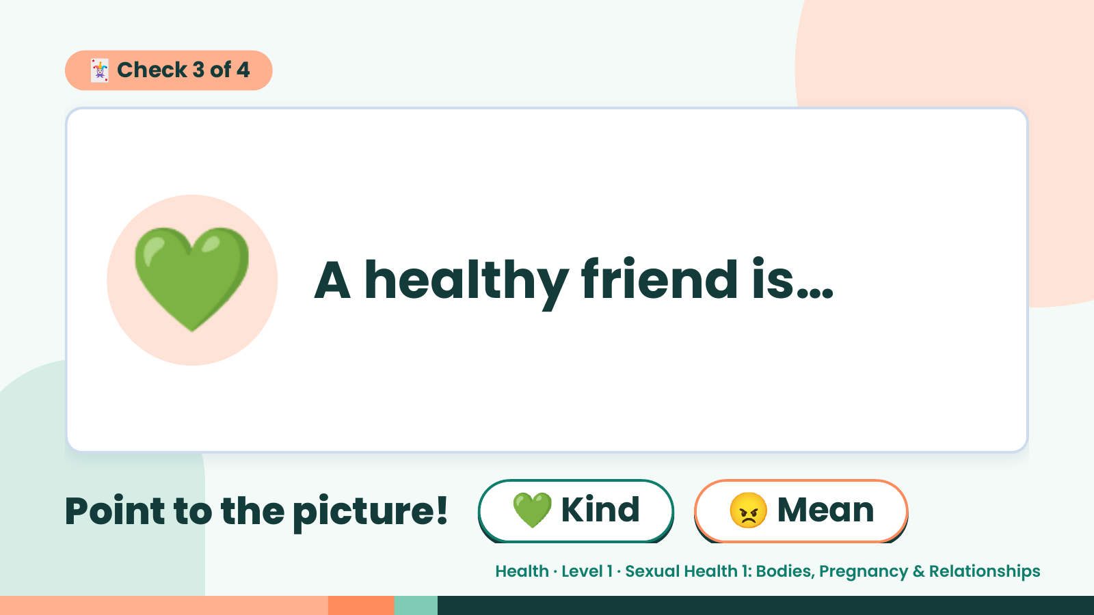
Notes:
🃏 Check 3 of 4
💚 A healthy friend is…
Point to the picture! 💚 Kind 😠 Mean
Health · Level 1 · Sexual Health 1: Bodies, Pregnancy & Relationships

Slide 13
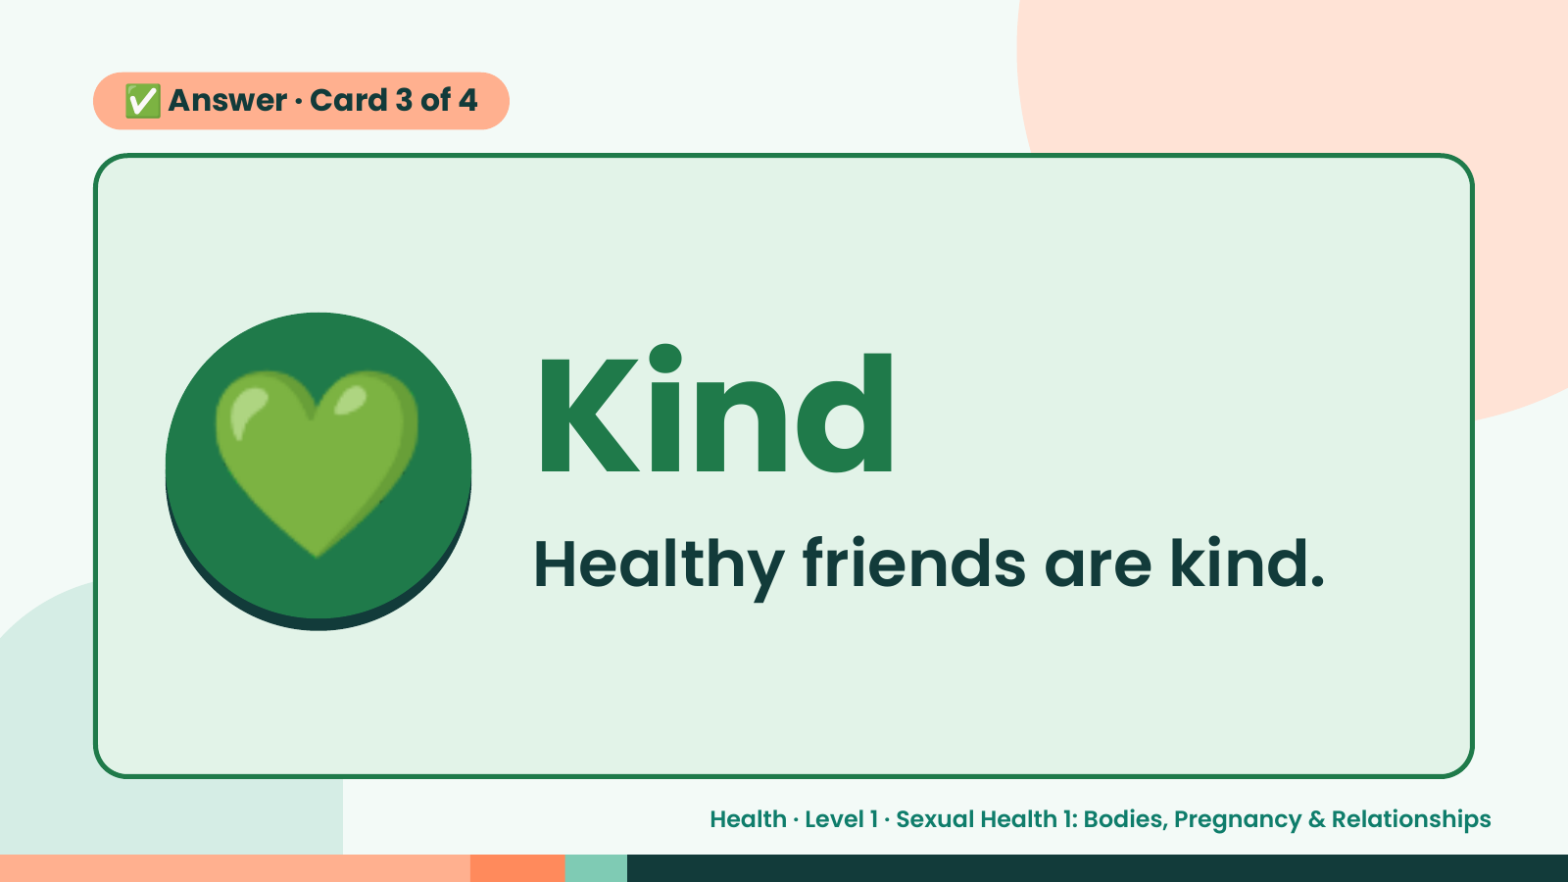
Notes:
✅ Answer · Card 3 of 4
💚 Kind
Healthy friends are kind.
Health · Level 1 · Sexual Health 1: Bodies, Pregnancy & Relationships

Slide 14
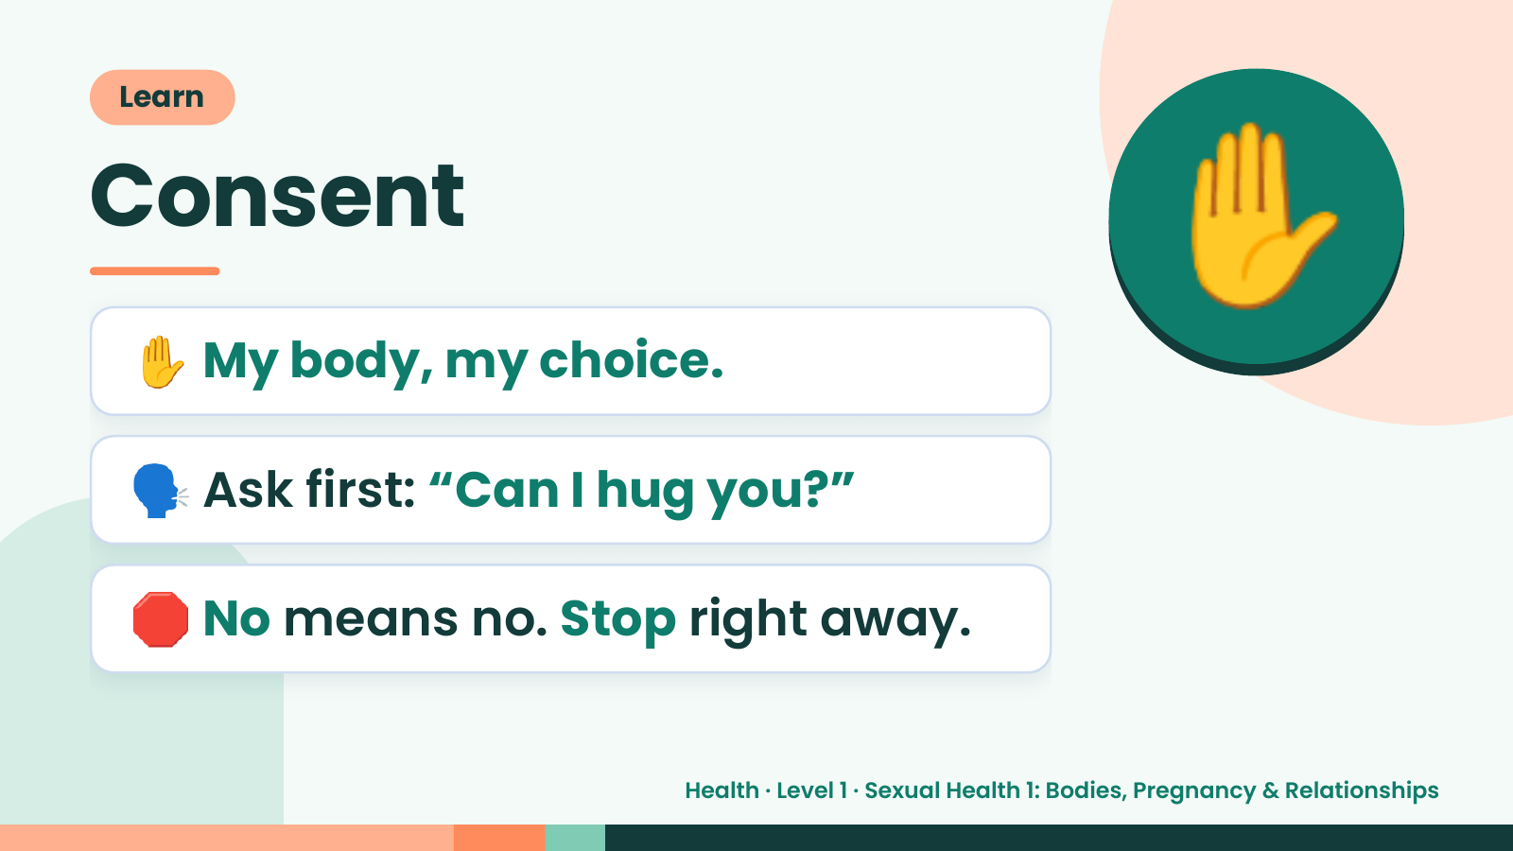
Notes:
Learn
Consent
✋ My body, my choice.
✋
🗣️ Ask first: “Can I hug you?”
🛑 No means no. Stop right away.
Health · Level 1 · Sexual Health 1: Bodies, Pregnancy & Relationships

Slide 15
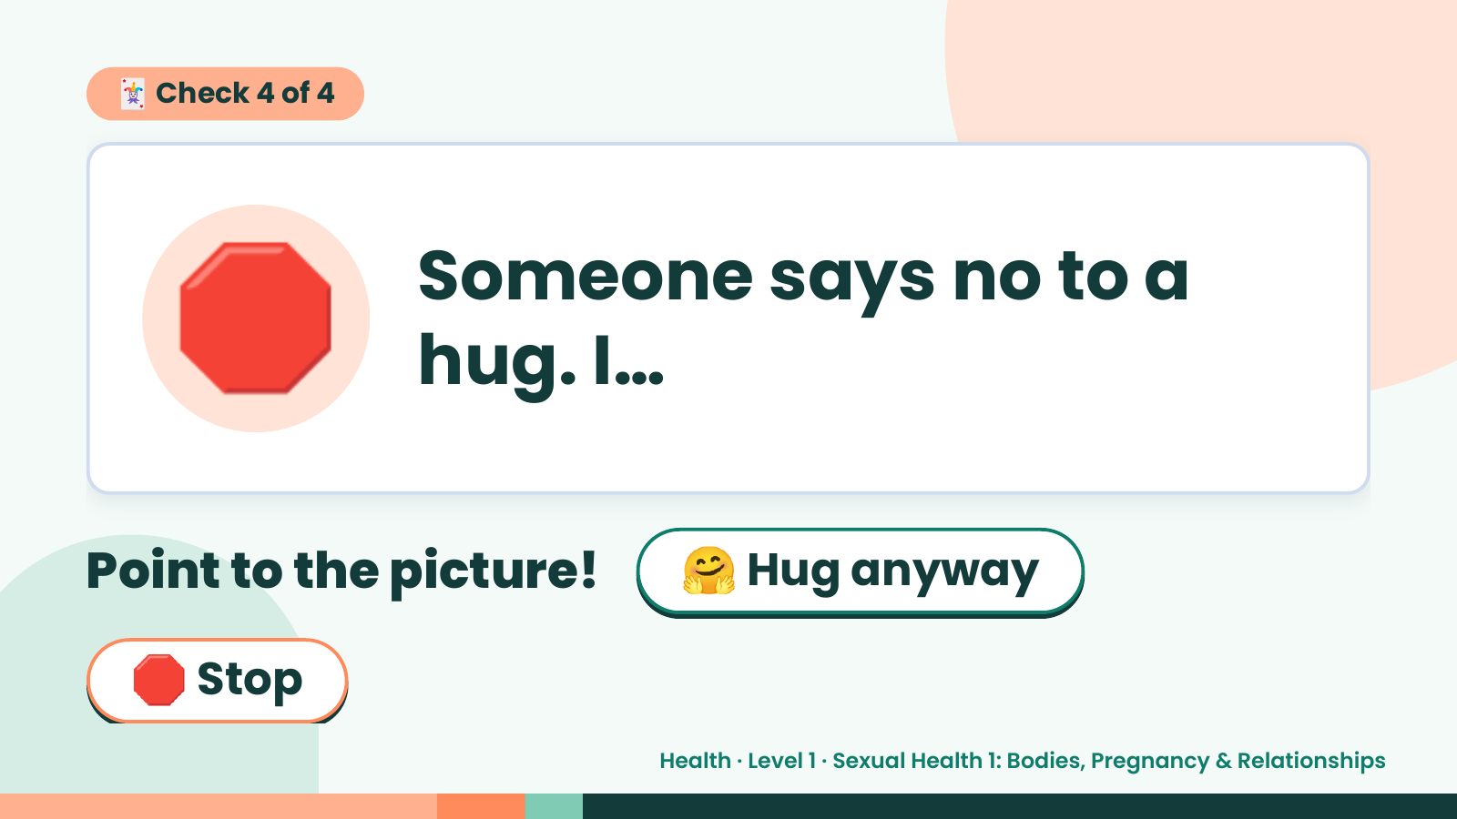
Notes:
🃏 Check 4 of 4
🛑 Someone says no to a
hug. I…
Point to the picture! 🤗 Hug anyway
🛑 Stop
Health · Level 1 · Sexual Health 1: Bodies, Pregnancy & Relationships

Slide 16
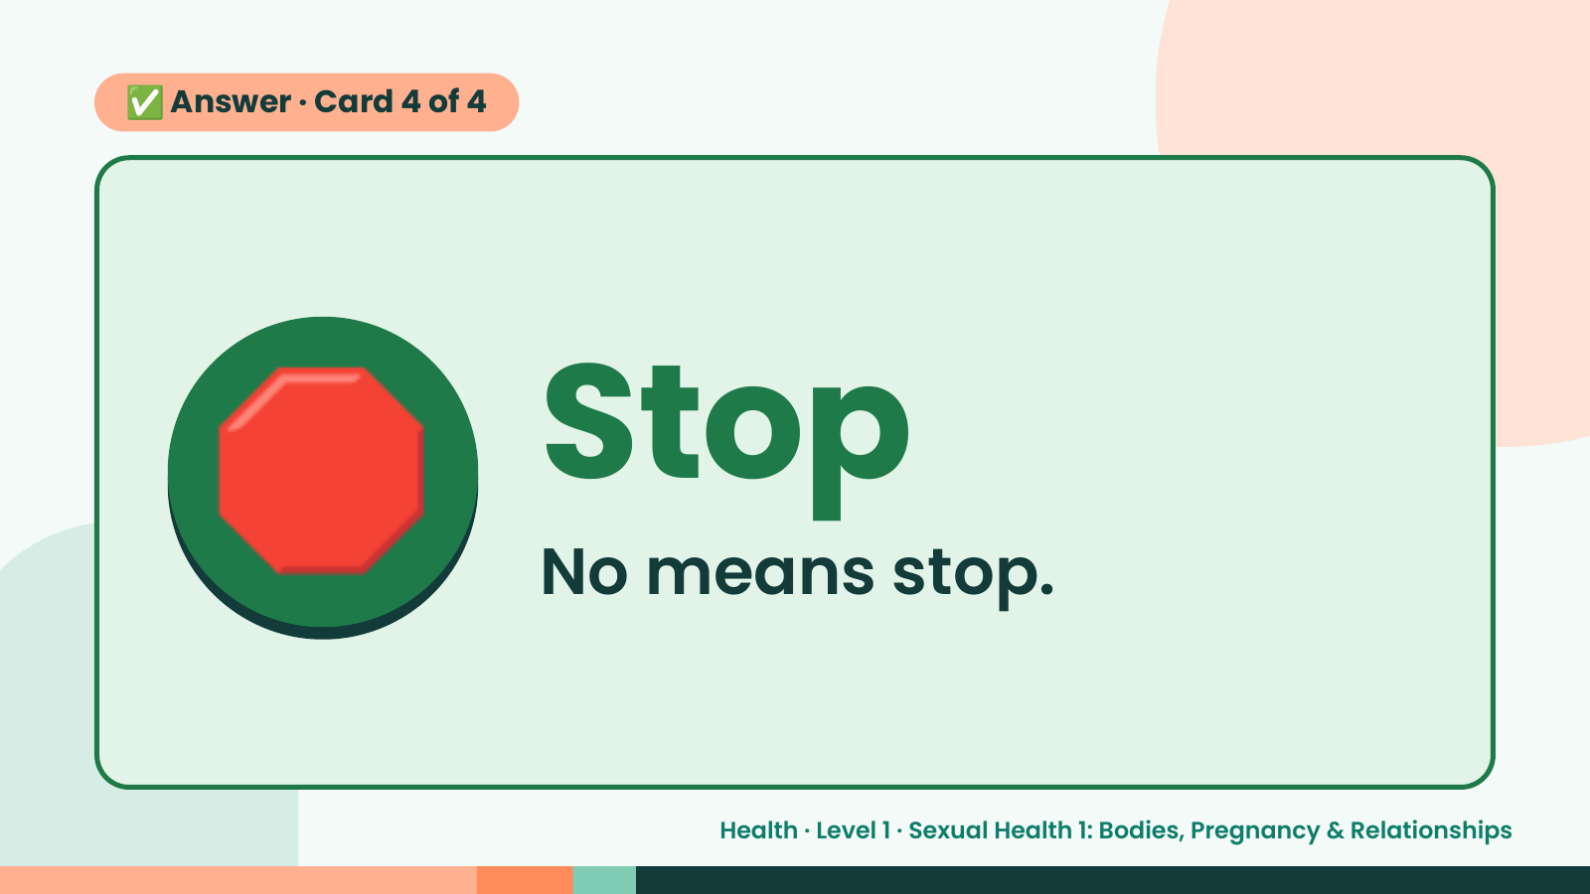
Notes:
✅ Answer · Card 4 of 4
🛑 Stop
No means stop.
Health · Level 1 · Sexual Health 1: Bodies, Pregnancy & Relationships

Slide 17
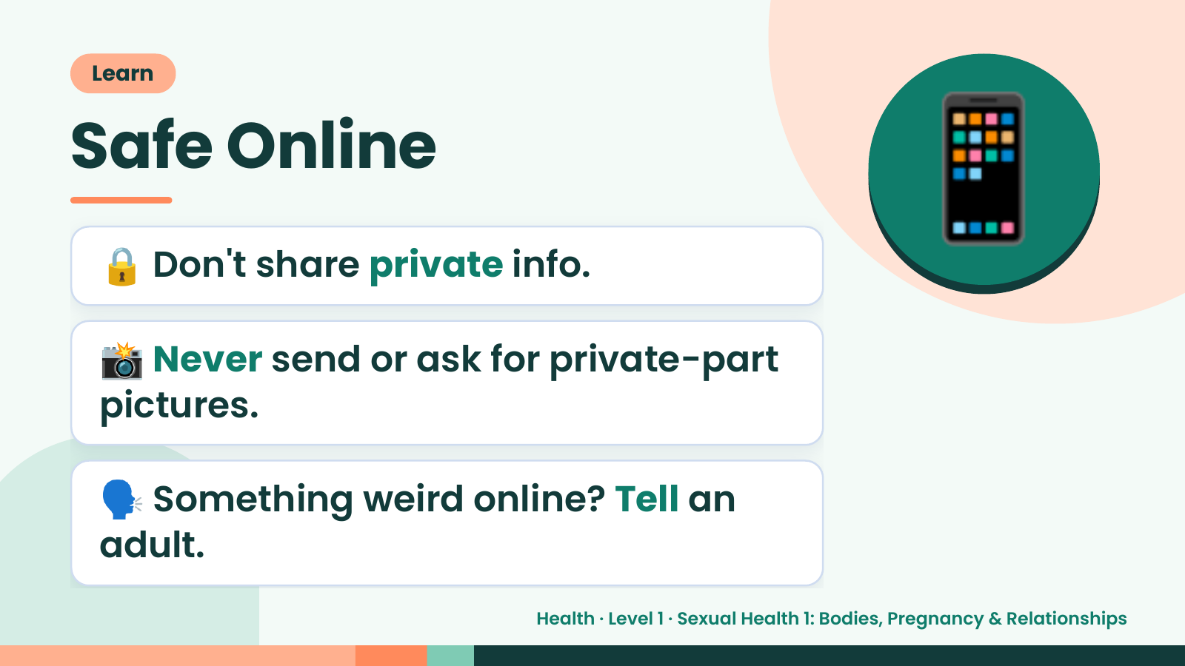
Notes:
Learn
Safe Online
🔒 Don't share private info.
📸 Never send or ask for private-part
📱
pictures.
🗣️ Something weird online? Tell an
adult.
Health · Level 1 · Sexual Health 1: Bodies, Pregnancy & Relationships

Slide 18
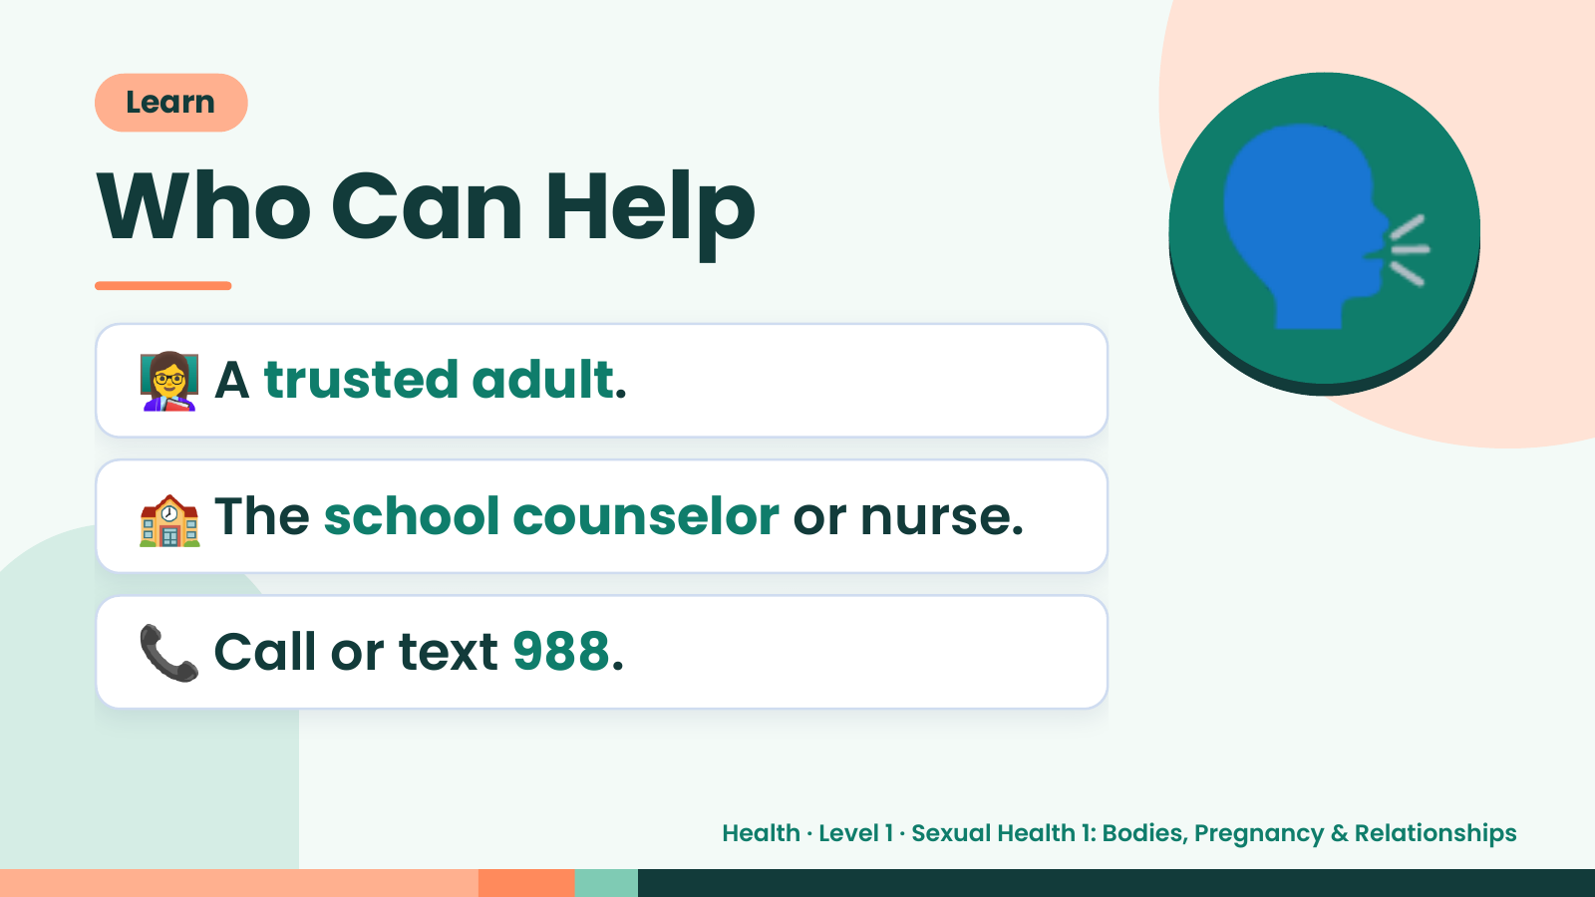
Notes:
Learn
Who Can Help
👩‍🏫 A trusted adult.
🗣️
🏫 The school counselor or nurse.
📞 Call or text 988.
Health · Level 1 · Sexual Health 1: Bodies, Pregnancy & Relationships

Slide 19
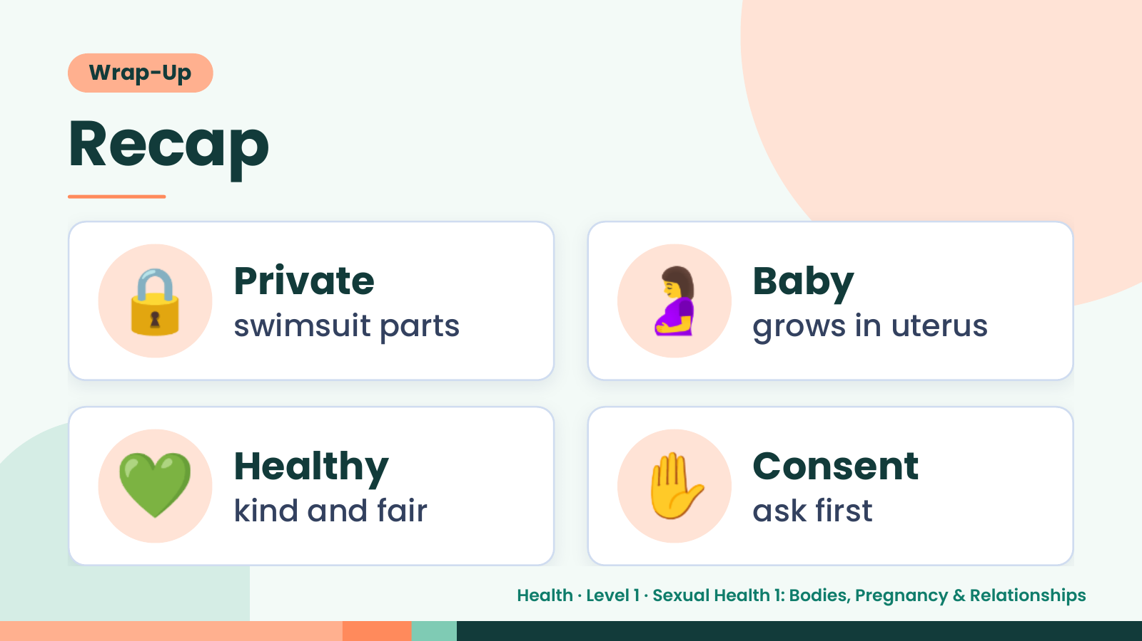
Notes:
Wrap-Up
Recap
🔒 Private
swimsuit parts 🤰 Baby
grows in uterus
💚 Healthy
kind and fair ✋ Consent
ask first
Health · Level 1 · Sexual Health 1: Bodies, Pregnancy & Relationships

Slide 20
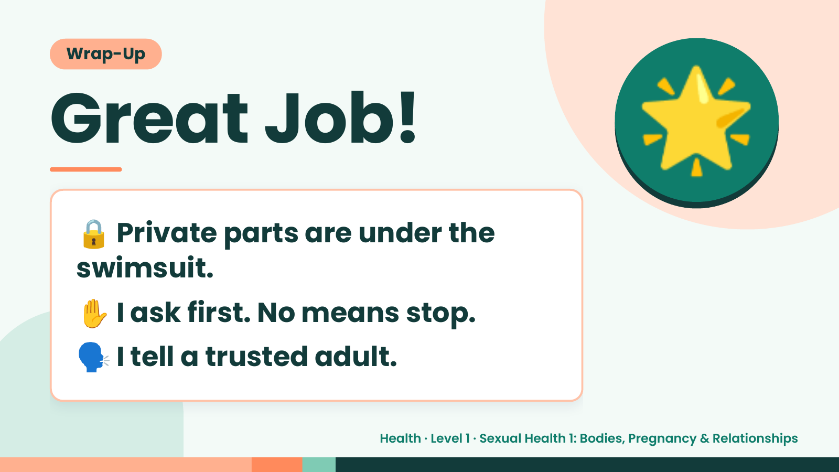
Notes:
Wrap-Up
Great Job!
🔒Private parts are under the
🌟
swimsuit.
✋ I ask first. No means stop.
🗣️ I tell a trusted adult.
Health · Level 1 · Sexual Health 1: Bodies, Pregnancy & Relationships

