Slide 1
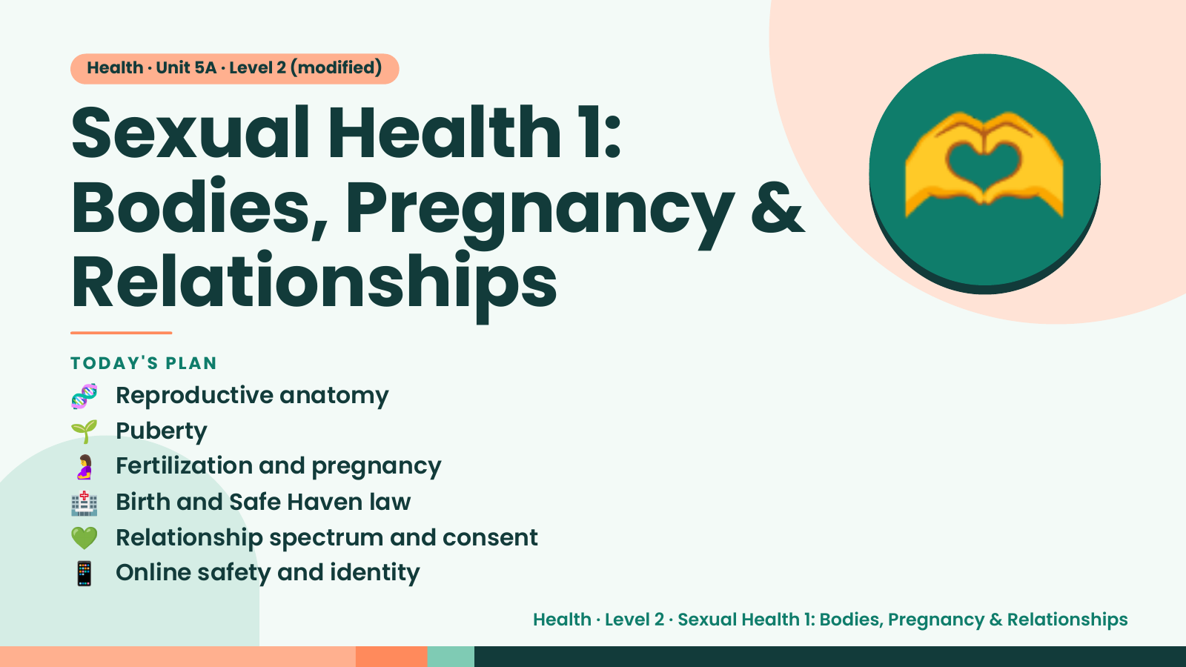
Notes:
Health · Unit 5A · Level 2 (modified)
Sexual Health 1:
Bodies, Pregnancy &
Relationships
🫶
🧬 Reproductive anatomy
TODAY'S PLAN
🌱 Puberty
🤰 Fertilization and pregnancy
🏥 Birth and Safe Haven law
💚 Relationship spectrum and consent
📱 Online safety and identity
Health · Level 2 · Sexual Health 1: Bodies, Pregnancy & Relationships

Slide 2
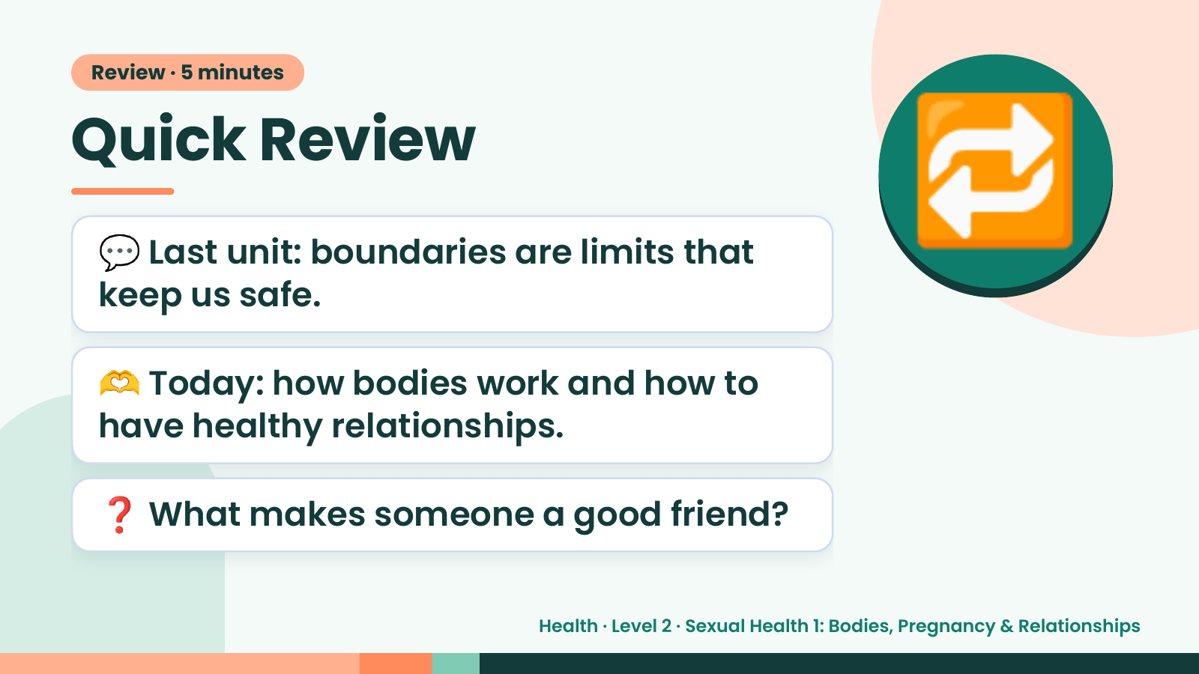
Notes:
Review · 5 minutes
Quick Review
💬 Last unit: boundaries are limits that
keep us safe.
🔁
🫶 Today: how bodies work and how to
have healthy relationships.
❓ What makes someone a good friend?
Health · Level 2 · Sexual Health 1: Bodies, Pregnancy & Relationships

Slide 3
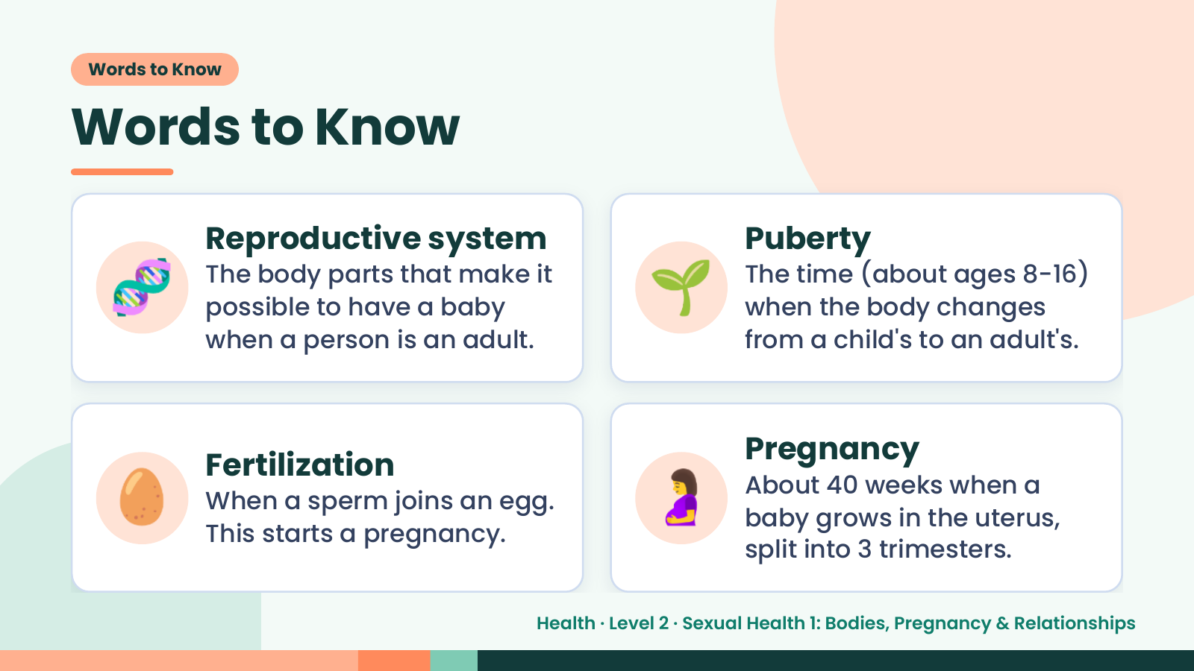
Notes:
Words to Know
Words to Know
🧬 Reproductive system
The body parts that make it
possible to have a baby
when a person is an adult.
🌱 Puberty
The time (about ages 8-16)
when the body changes
from a child's to an adult's.
🥚 Fertilization
When a sperm joins an egg.
This starts a pregnancy.
🤰 Pregnancy
About 40 weeks when a
baby grows in the uterus,
split into 3 trimesters.
Health · Level 2 · Sexual Health 1: Bodies, Pregnancy & Relationships

Slide 4
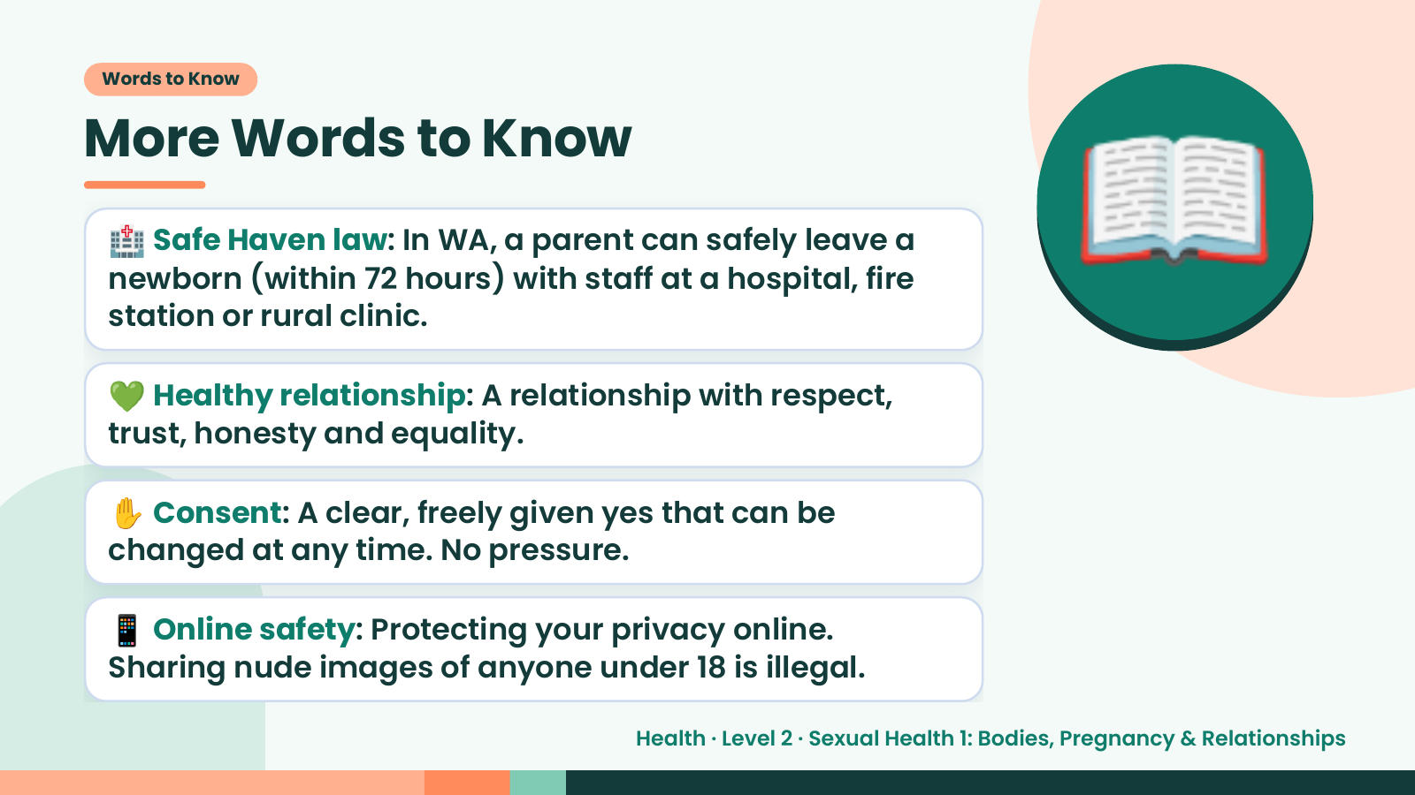
Notes:
Words to Know
More Words to Know
🏥 Safe Haven law: In WA, a parent can safely leave a
newborn (within 72 hours) with staff at a hospital, fire
station or rural clinic.
💚 Healthy relationship: A relationship with respect,
trust, honesty and equality.
📖
✋ Consent: A clear, freely given yes that can be
changed at any time. No pressure.
📱 Online safety: Protecting your privacy online.
Sharing nude images of anyone under 18 is illegal.
Health · Level 2 · Sexual Health 1: Bodies, Pregnancy & Relationships

Slide 5
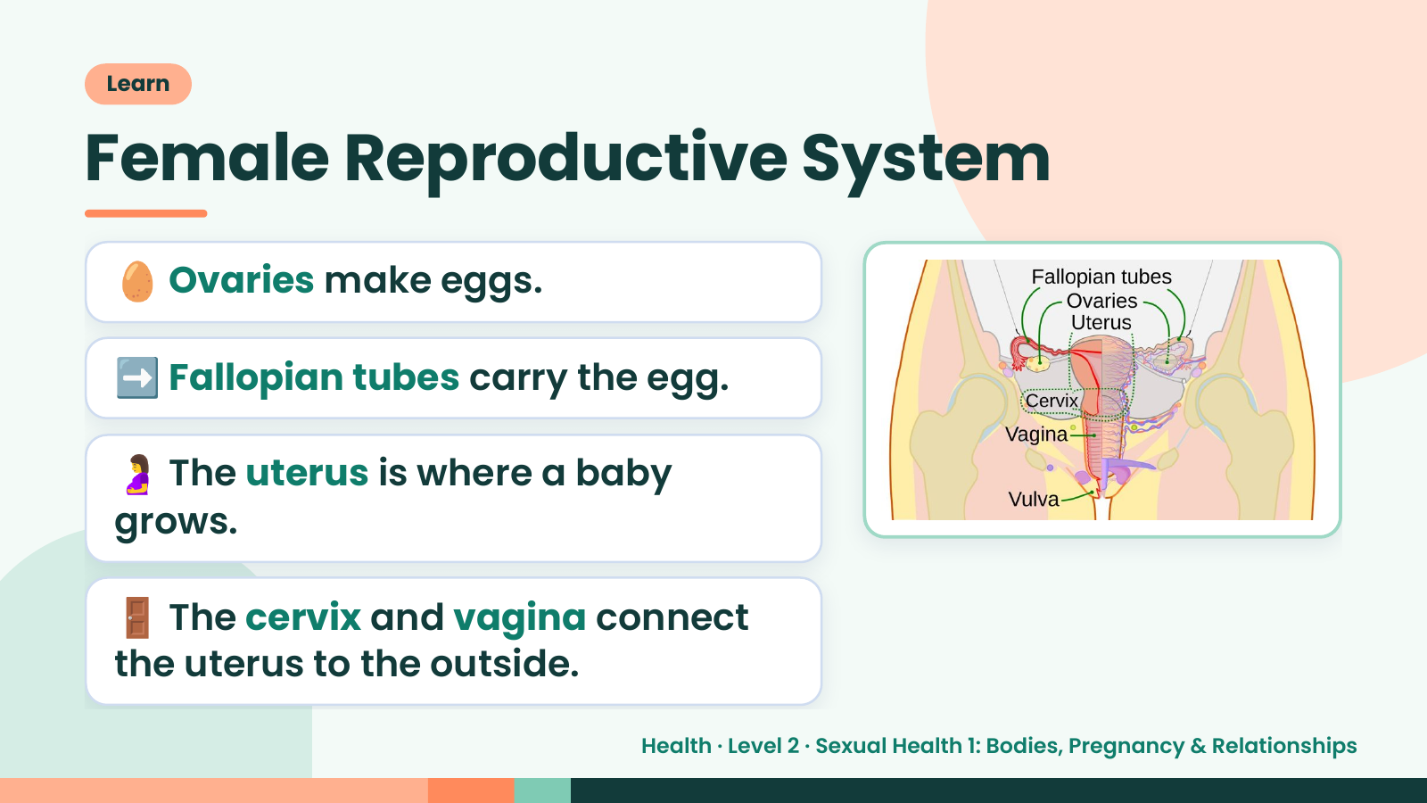
Notes:
Learn
Female Reproductive System
🥚 Ovaries make eggs.
➡️ Fallopian tubes carry the egg.
🤰 The uterus is where a baby
grows.
🚪 The cervix and vagina connect
the uterus to the outside.
Health · Level 2 · Sexual Health 1: Bodies, Pregnancy & Relationships

Slide 6
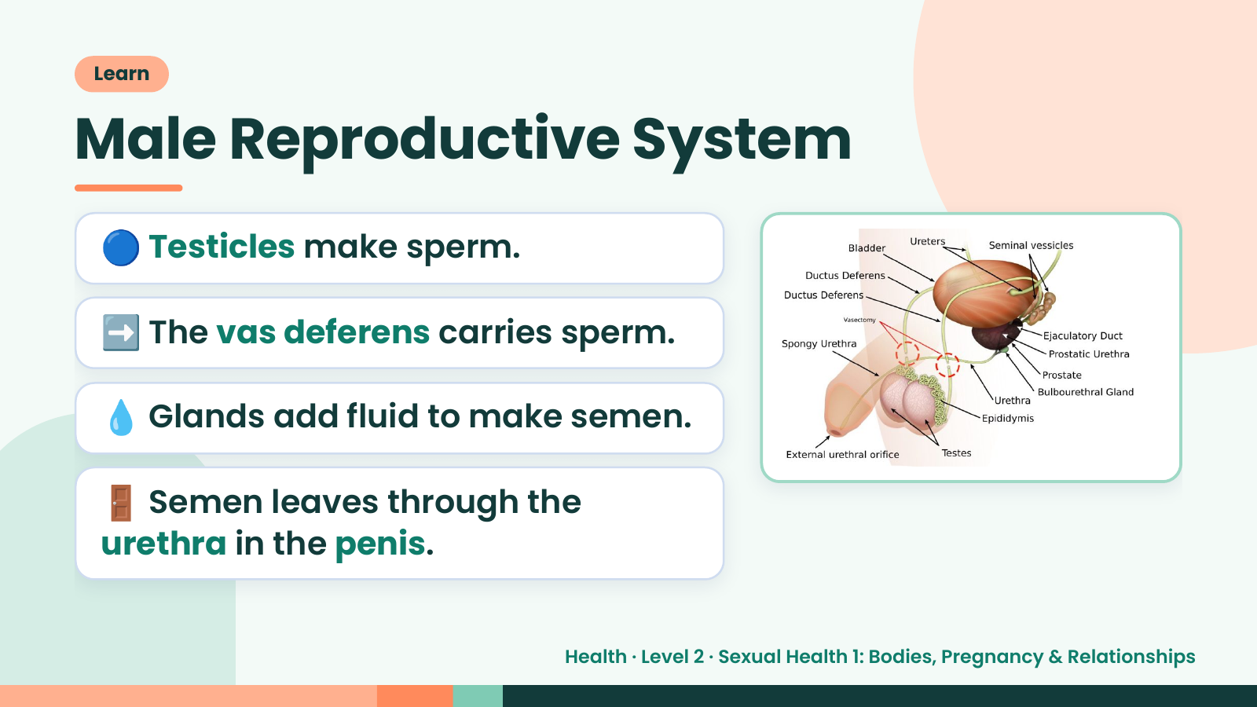
Notes:
Learn
Male Reproductive System
🔵 Testicles make sperm.
➡️ The vas deferens carries sperm.
💧 Glands add fluid to make semen.
🚪 Semen leaves through the
urethra in the penis.
Health · Level 2 · Sexual Health 1: Bodies, Pregnancy & Relationships

Slide 7
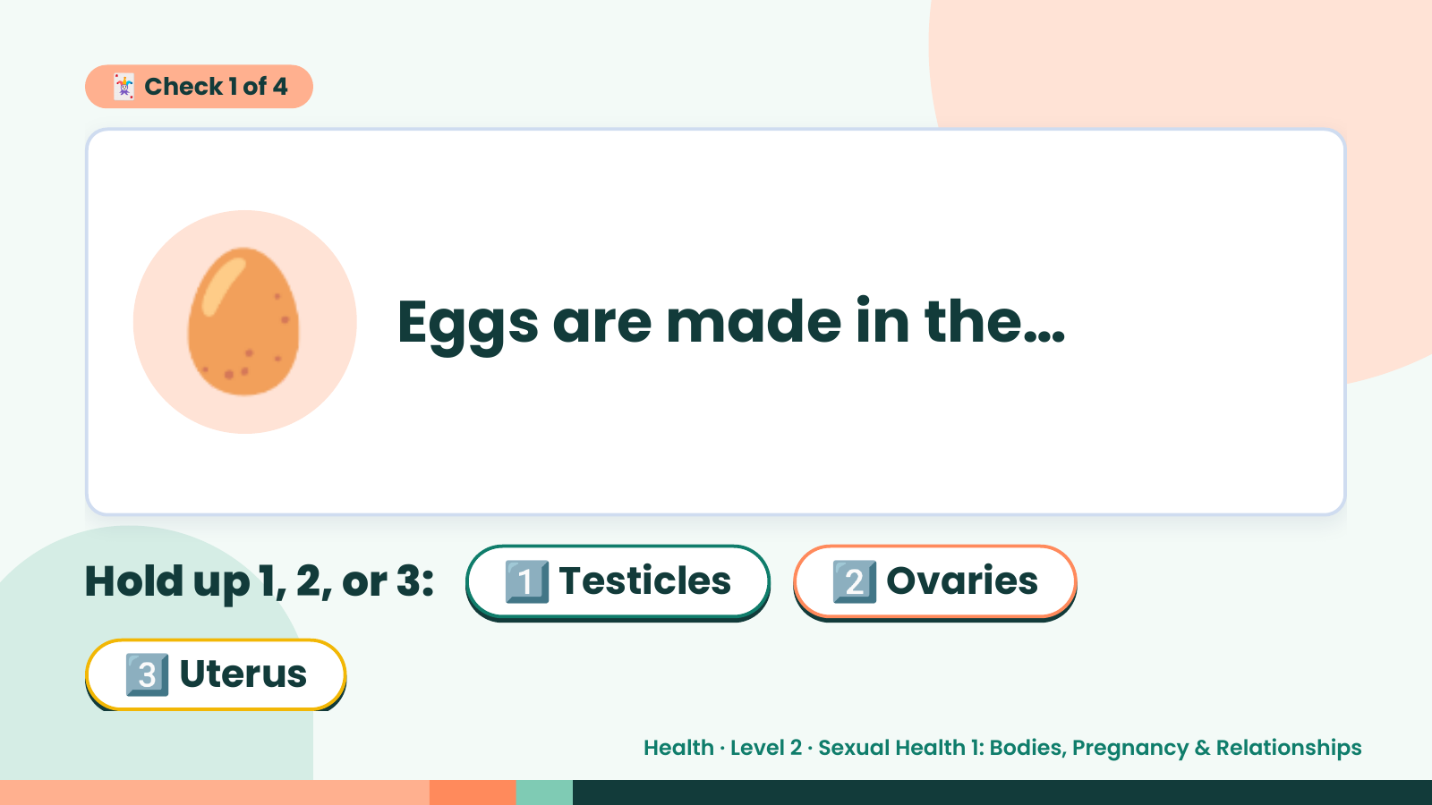
Notes:
🃏 Check 1 of 4
🥚 Eggs are made in the…
Hold up 1, 2, or 3: 1️⃣ Testicles 2️⃣ Ovaries
3️⃣ Uterus
Health · Level 2 · Sexual Health 1: Bodies, Pregnancy & Relationships

Slide 8
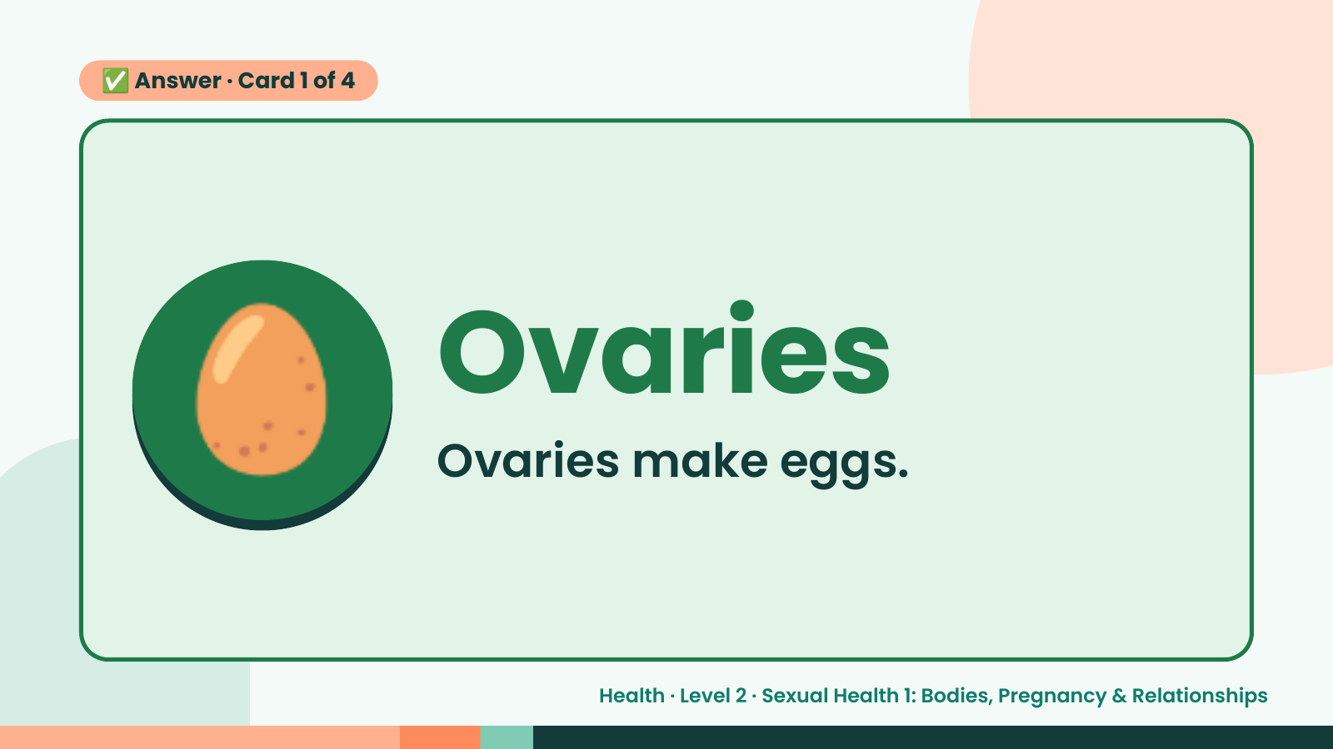
Notes:
✅ Answer · Card 1 of 4
🥚 Ovaries
Ovaries make eggs.
Health · Level 2 · Sexual Health 1: Bodies, Pregnancy & Relationships

Slide 9
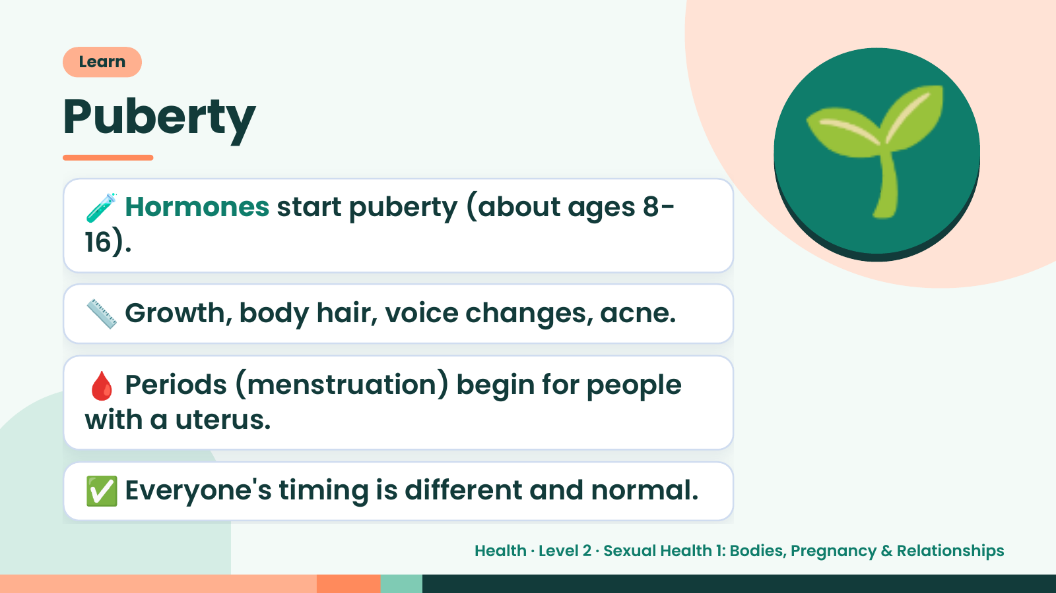
Notes:
Learn
Puberty
🧪 Hormones start puberty (about ages 8-
16).
📏 Growth, body hair, voice changes, acne.
🌱
🩸 Periods (menstruation) begin for people
with a uterus.
✅ Everyone's timing is different and normal.
Health · Level 2 · Sexual Health 1: Bodies, Pregnancy & Relationships

Slide 10
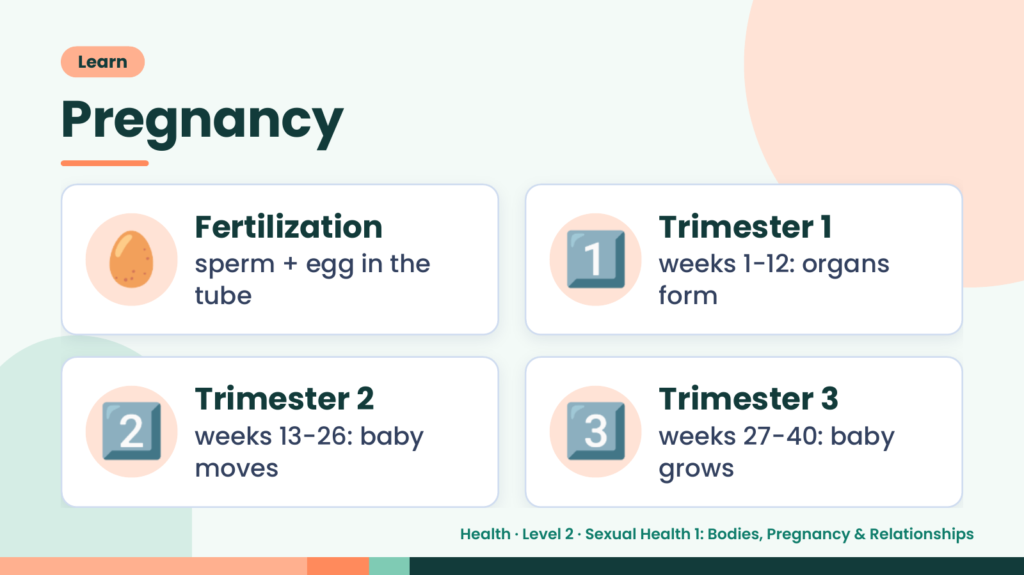
Notes:
Learn
Pregnancy
🥚 Fertilization
sperm + egg in the
tube
1️⃣ Trimester 1
weeks 1-12: organs
form
2️⃣ Trimester 2
weeks 13-26: baby
moves
3️⃣ Trimester 3
weeks 27-40: baby
grows
Health · Level 2 · Sexual Health 1: Bodies, Pregnancy & Relationships

Slide 11
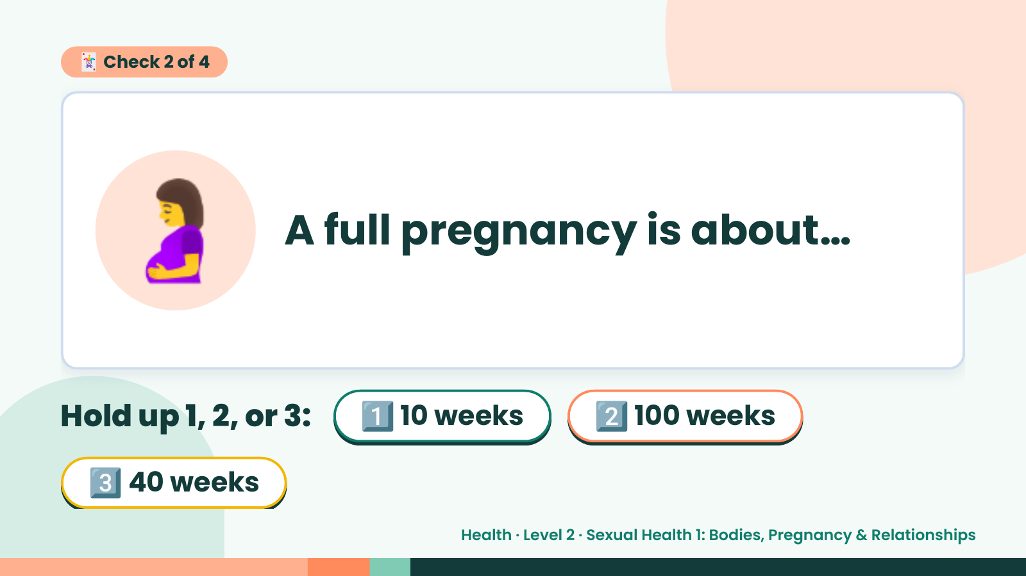
Notes:
🃏 Check 2 of 4
🤰 A full pregnancy is about…
Hold up 1, 2, or 3: 1️⃣ 10 weeks 2️⃣ 100 weeks
3️⃣ 40 weeks
Health · Level 2 · Sexual Health 1: Bodies, Pregnancy & Relationships

Slide 12
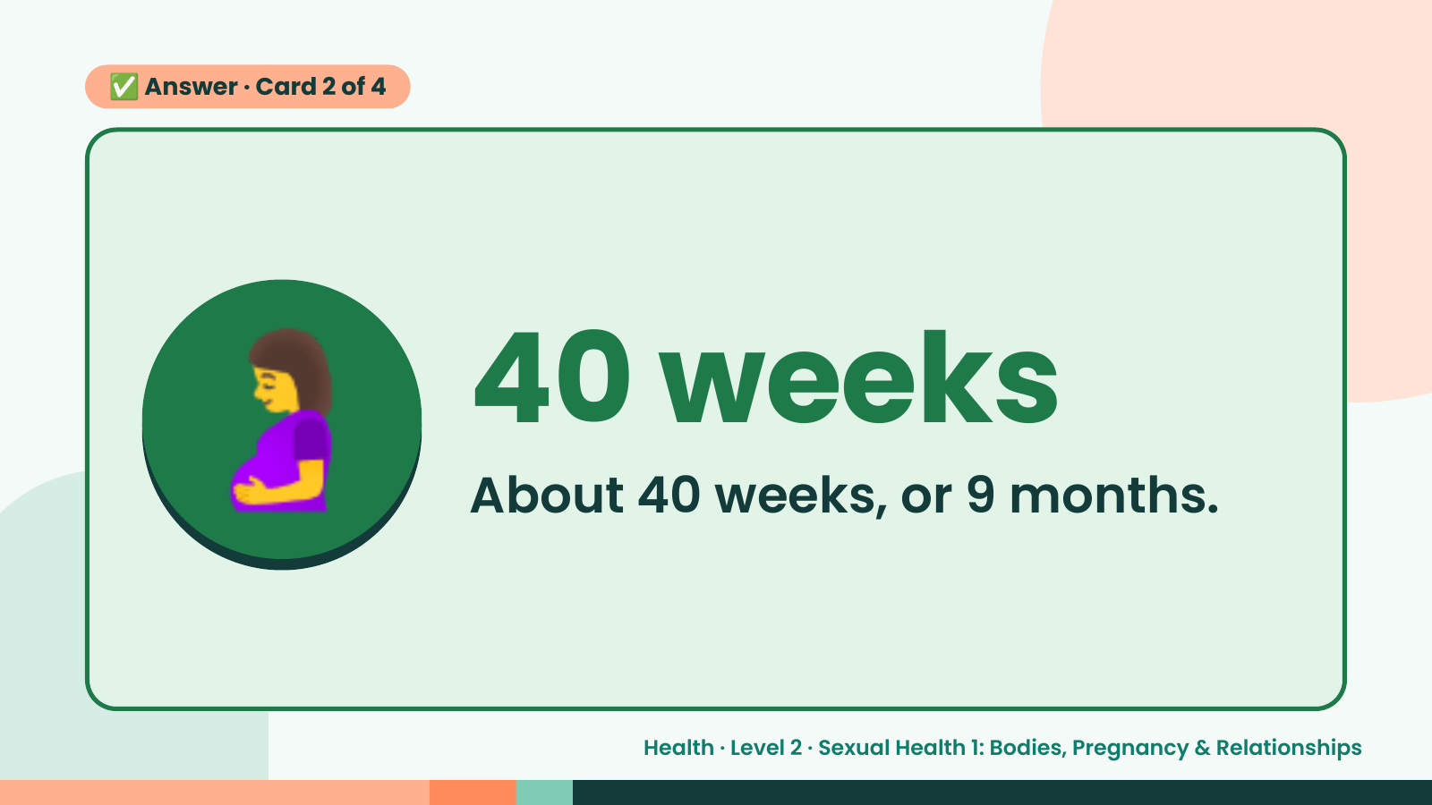
Notes:
✅ Answer · Card 2 of 4
🤰 40 weeks
About 40 weeks, or 9 months.
Health · Level 2 · Sexual Health 1: Bodies, Pregnancy & Relationships

Slide 13
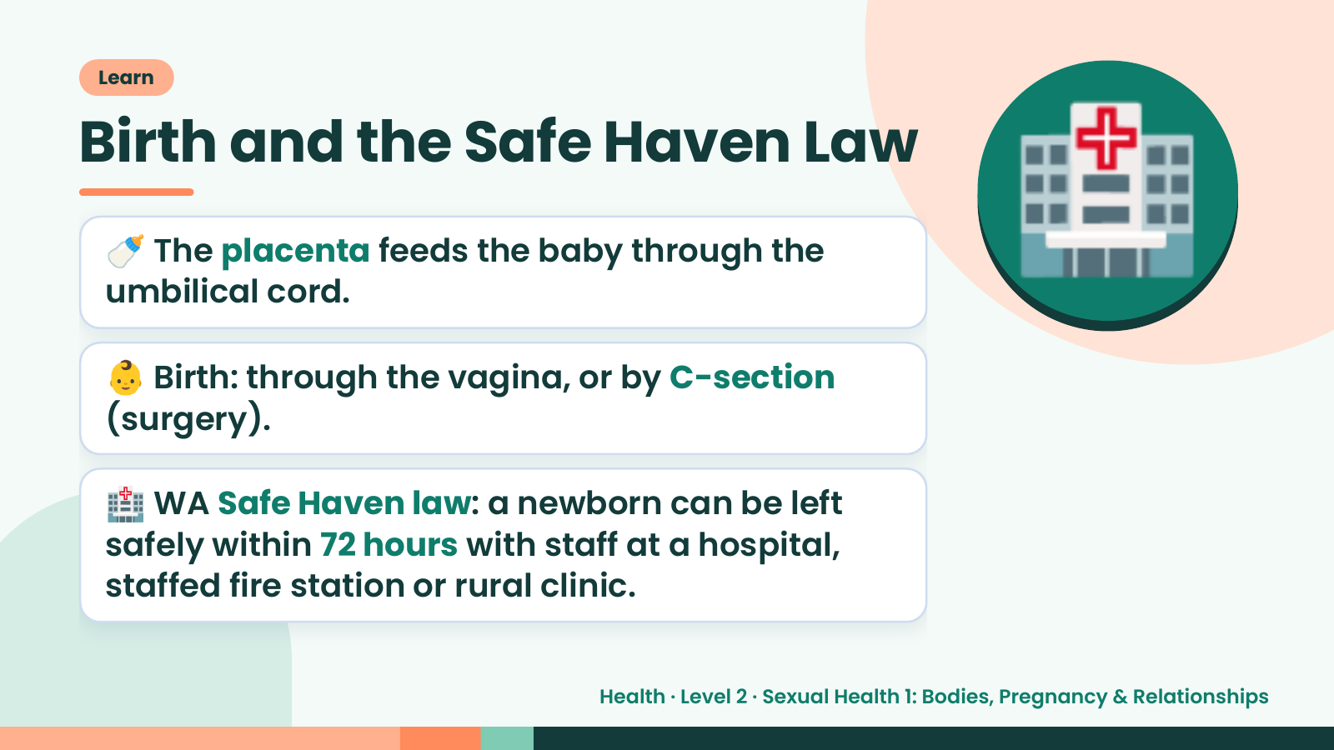
Notes:
Learn
Birth and the Safe Haven Law
🍼 The placenta feeds the baby through the
umbilical cord.
👶 Birth: through the vagina, or by C-section
(surgery).
🏥
🏥 WA Safe Haven law: a newborn can be left
safely within 72 hours with staff at a hospital,
staffed fire station or rural clinic.
Health · Level 2 · Sexual Health 1: Bodies, Pregnancy & Relationships

Slide 14
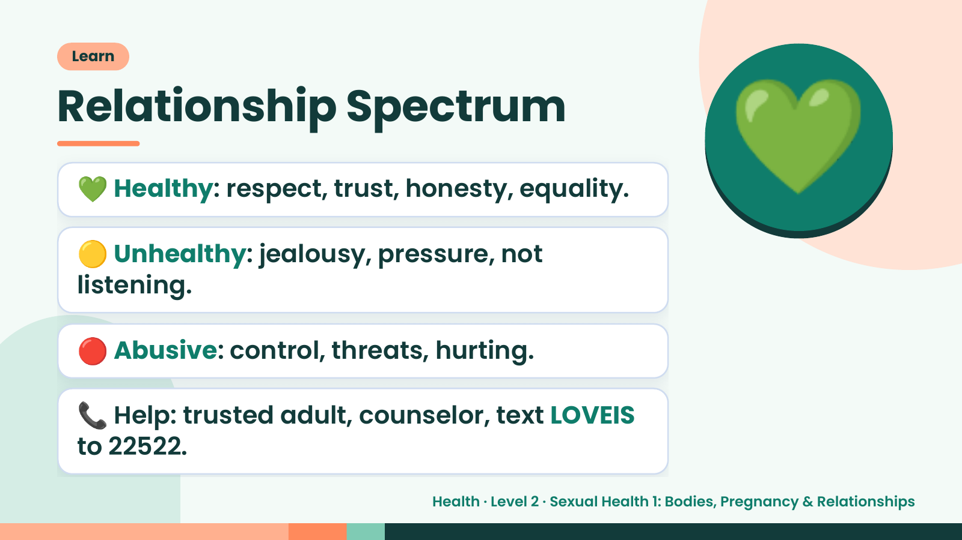
Notes:
Learn
Relationship Spectrum
💚 Healthy: respect, trust, honesty, equality.
🟡 Unhealthy: jealousy, pressure, not
listening.
💚
🔴 Abusive: control, threats, hurting.
📞 Help: trusted adult, counselor, text LOVEIS
to 22522.
Health · Level 2 · Sexual Health 1: Bodies, Pregnancy & Relationships

Slide 15
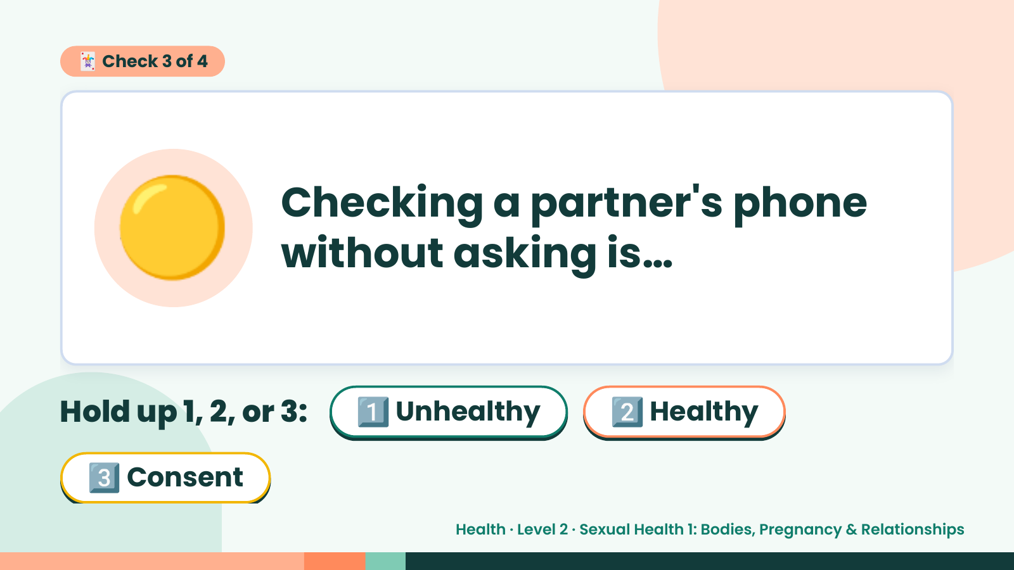
Notes:
🃏 Check 3 of 4
🟡 Checking a partner's phone
without asking is…
Hold up 1, 2, or 3: 1️⃣ Unhealthy 2️⃣ Healthy
3️⃣ Consent
Health · Level 2 · Sexual Health 1: Bodies, Pregnancy & Relationships

Slide 16
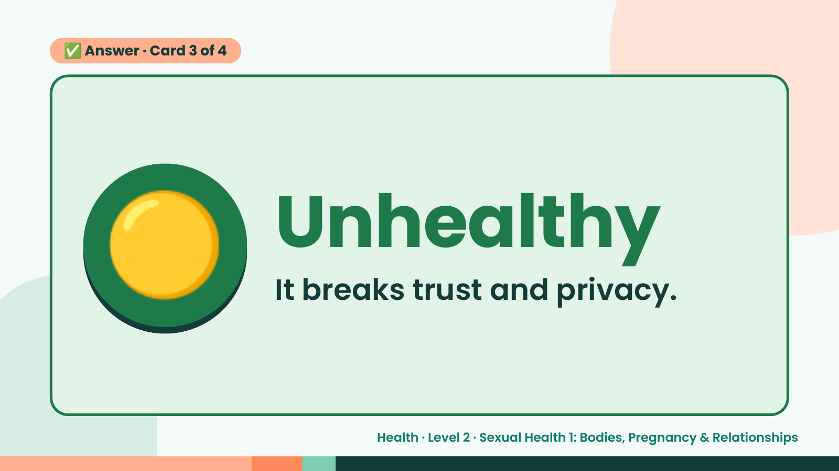
Notes:
✅ Answer · Card 3 of 4
🟡 Unhealthy
It breaks trust and privacy.
Health · Level 2 · Sexual Health 1: Bodies, Pregnancy & Relationships

Slide 17
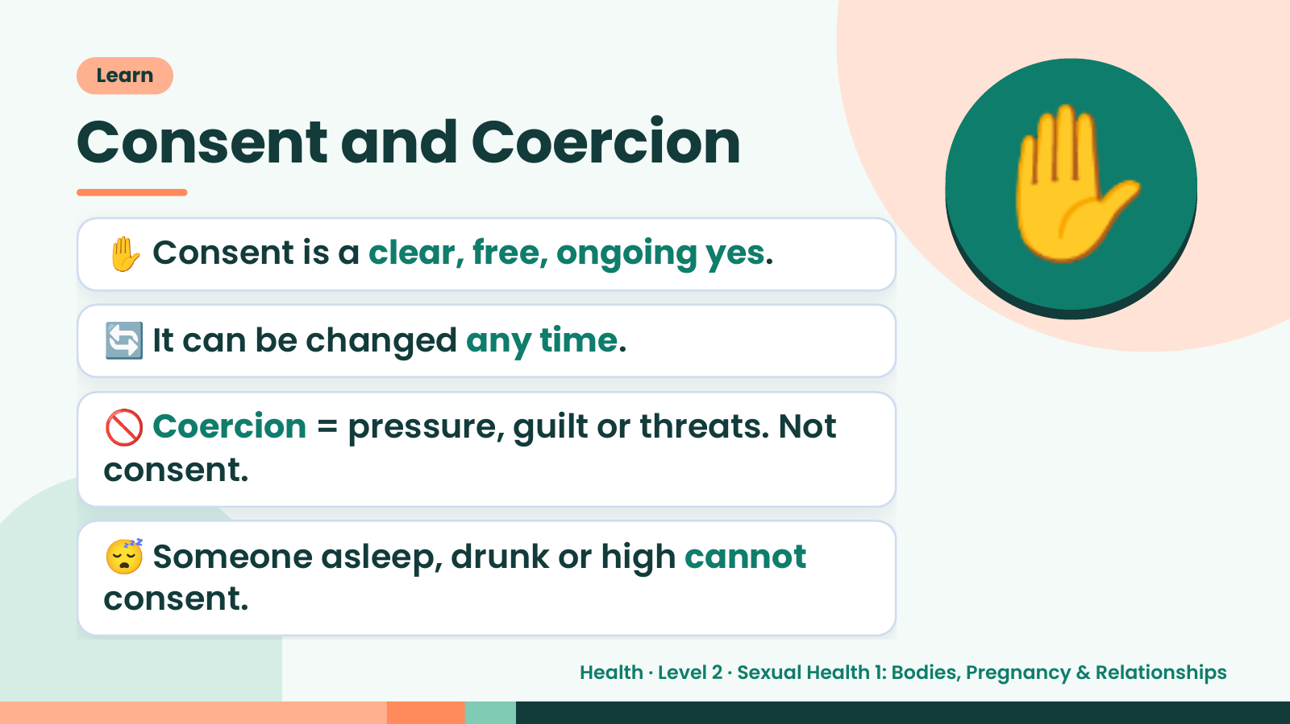
Notes:
Learn
Consent and Coercion
✋ Consent is a clear, free, ongoing yes.
🔄 It can be changed any time.
✋
🚫 Coercion = pressure, guilt or threats. Not
consent.
😴 Someone asleep, drunk or high cannot
consent.
Health · Level 2 · Sexual Health 1: Bodies, Pregnancy & Relationships

Slide 18
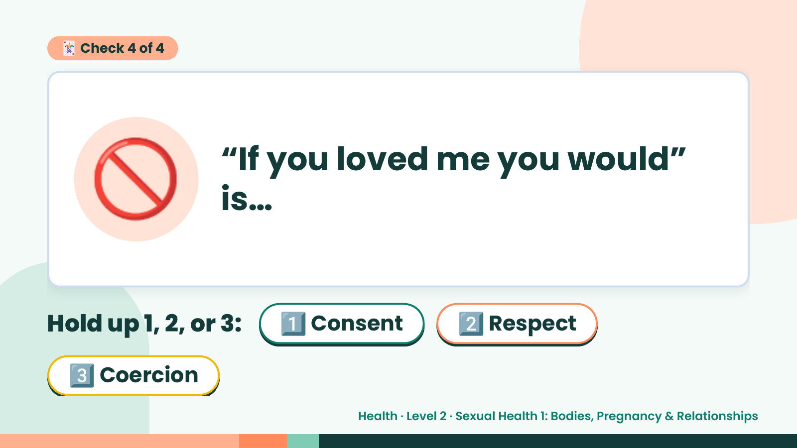
Notes:
🃏 Check 4 of 4
🚫 “If you loved me you would”
is…
Hold up 1, 2, or 3: 1️⃣ Consent 2️⃣ Respect
3️⃣ Coercion
Health · Level 2 · Sexual Health 1: Bodies, Pregnancy & Relationships

Slide 19
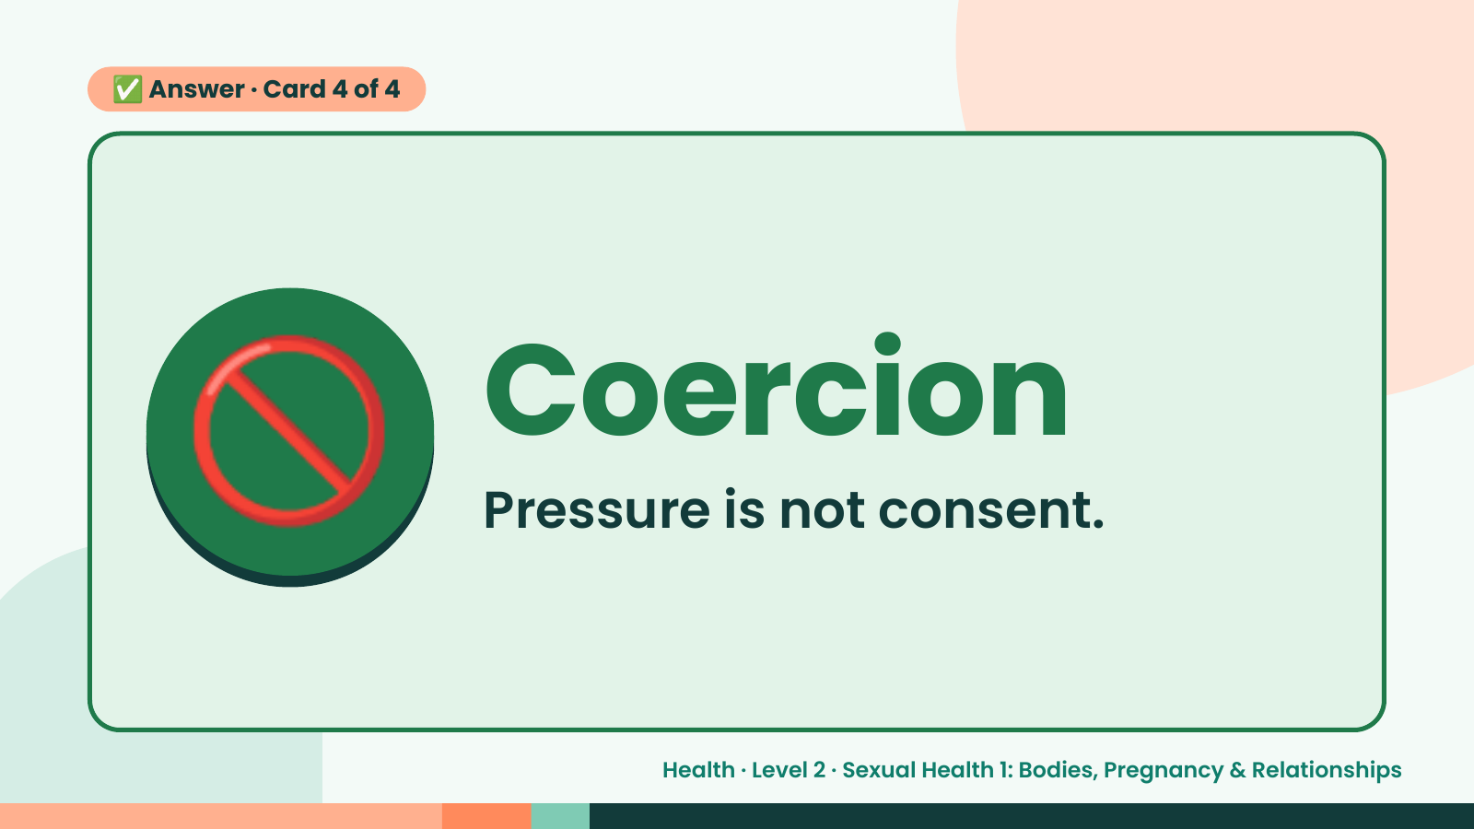
Notes:
✅ Answer · Card 4 of 4
🚫 Coercion
Pressure is not consent.
Health · Level 2 · Sexual Health 1: Bodies, Pregnancy & Relationships

Slide 20
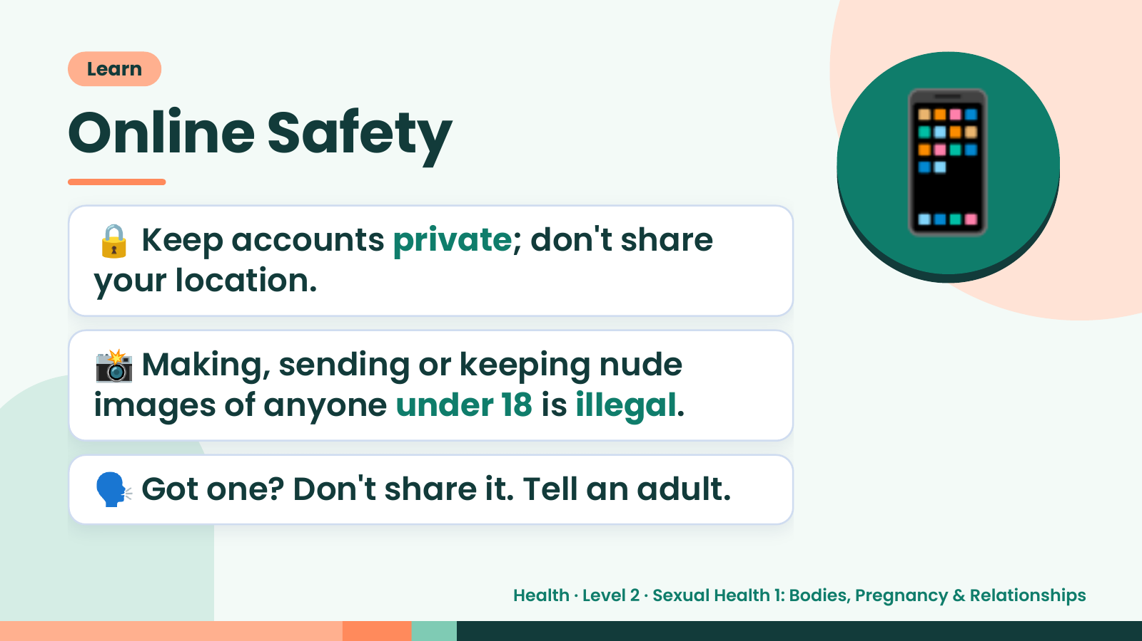
Notes:
Learn
Online Safety
🔒 Keep accounts private; don't share
your location.
📱
📸 Making, sending or keeping nude
images of anyone under 18 is illegal.
🗣️ Got one? Don't share it. Tell an adult.
Health · Level 2 · Sexual Health 1: Bodies, Pregnancy & Relationships

Slide 21
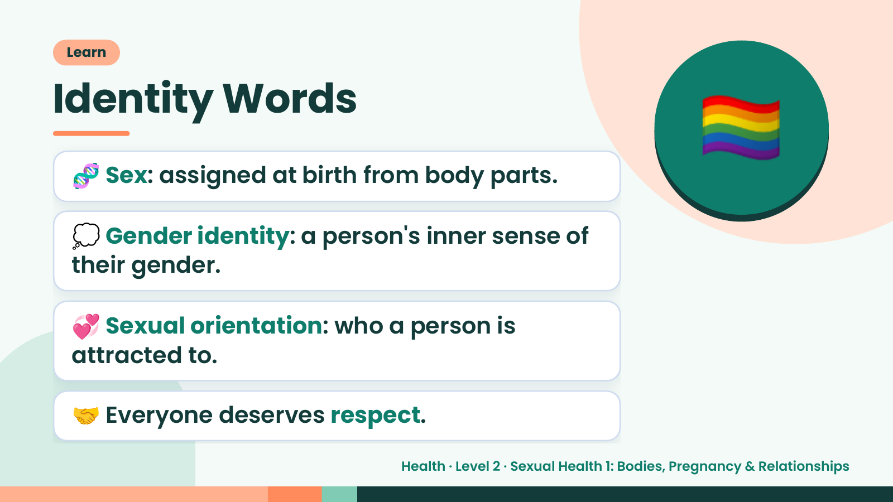
Notes:
🏳️‍🌈
Learn
Identity Words
🧬 Sex: assigned at birth from body parts.
💭 Gender identity: a person's inner sense of
their gender.
💞 Sexual orientation: who a person is
attracted to.
🤝 Everyone deserves respect.
Health · Level 2 · Sexual Health 1: Bodies, Pregnancy & Relationships

Slide 22
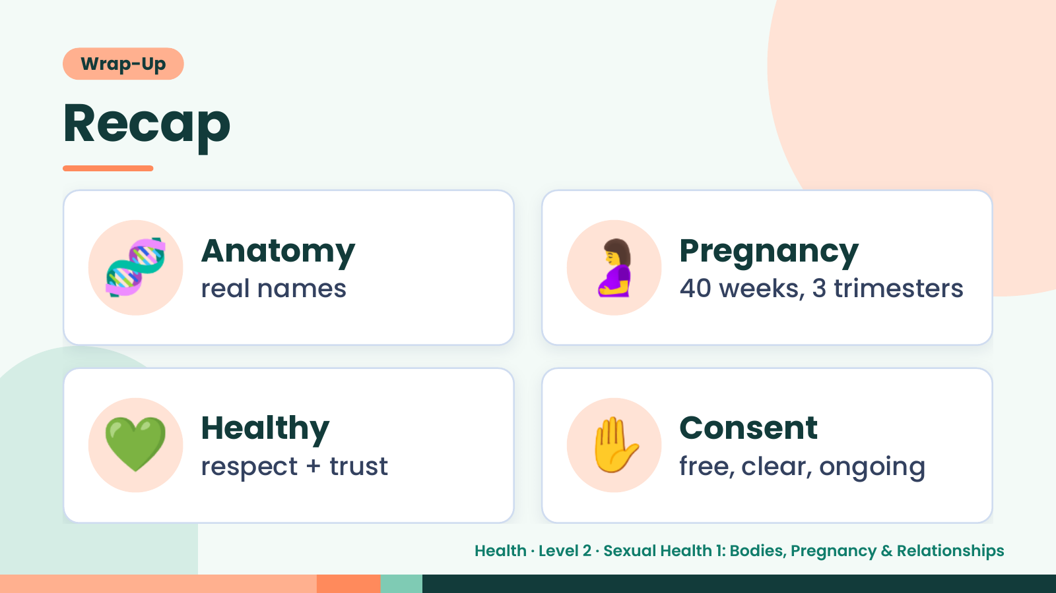
Notes:
Wrap-Up
Recap
🧬 Anatomy
real names 🤰 Pregnancy
40 weeks, 3 trimesters
💚 Healthy
respect + trust ✋ Consent
free, clear, ongoing
Health · Level 2 · Sexual Health 1: Bodies, Pregnancy & Relationships

Slide 23
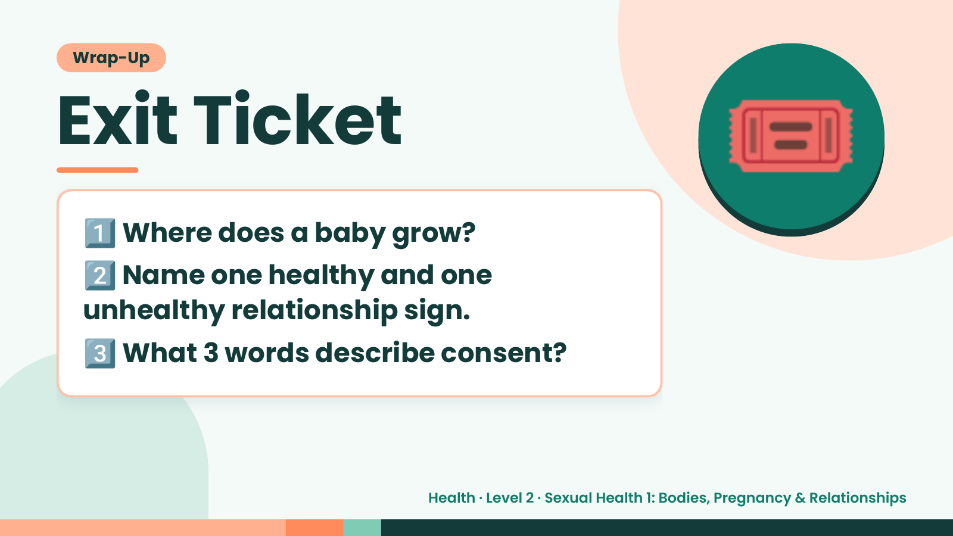
Notes:
Wrap-Up
Exit Ticket
1️⃣
2️⃣
Where does a baby grow?
Name one healthy and one
🎟️
unhealthy relationship sign.
3️⃣What 3 words describe consent?
Health · Level 2 · Sexual Health 1: Bodies, Pregnancy & Relationships

