Slide 1
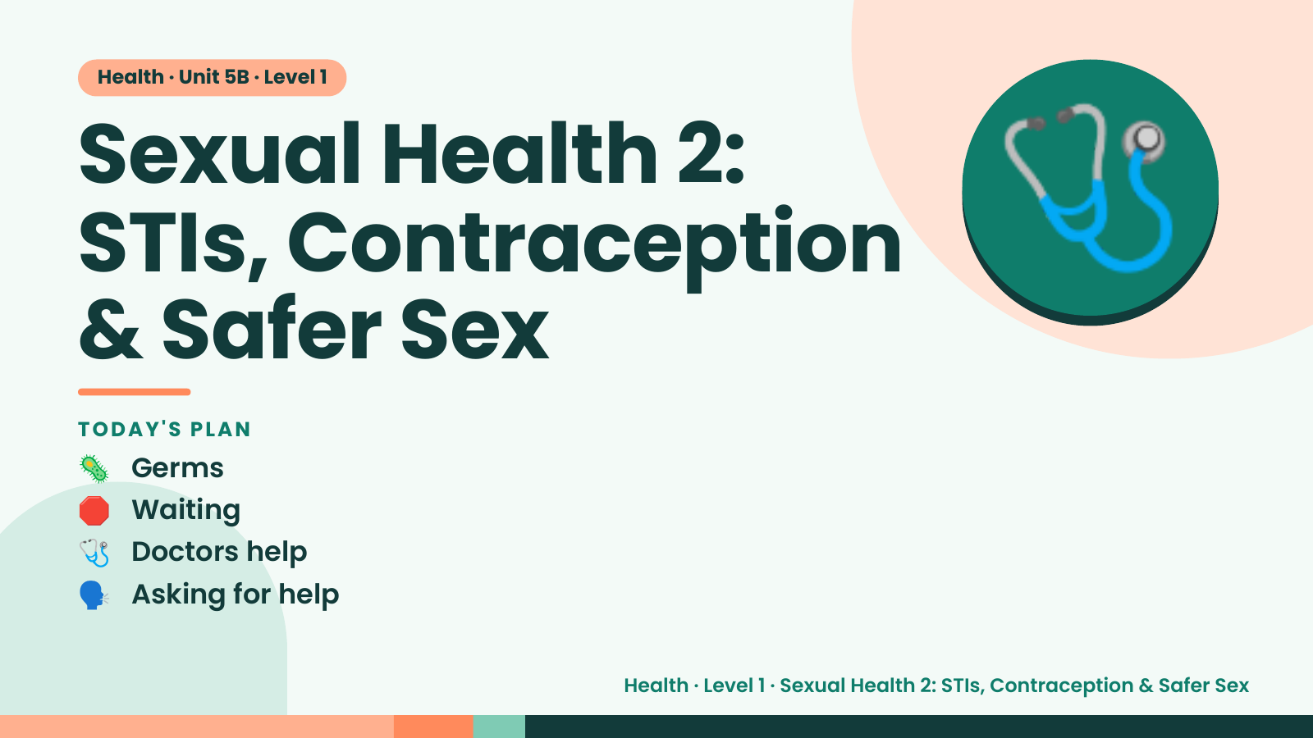
Notes:
Health · Unit 5B · Level 1
Sexual Health 2:
STIs, Contraception
& Safer Sex
🩺
TODAY'S PLAN
🦠 Germs
🛑 Waiting
🩺 Doctors help
🗣️ Asking for help
Health · Level 1 · Sexual Health 2: STIs, Contraception & Safer Sex

Slide 2
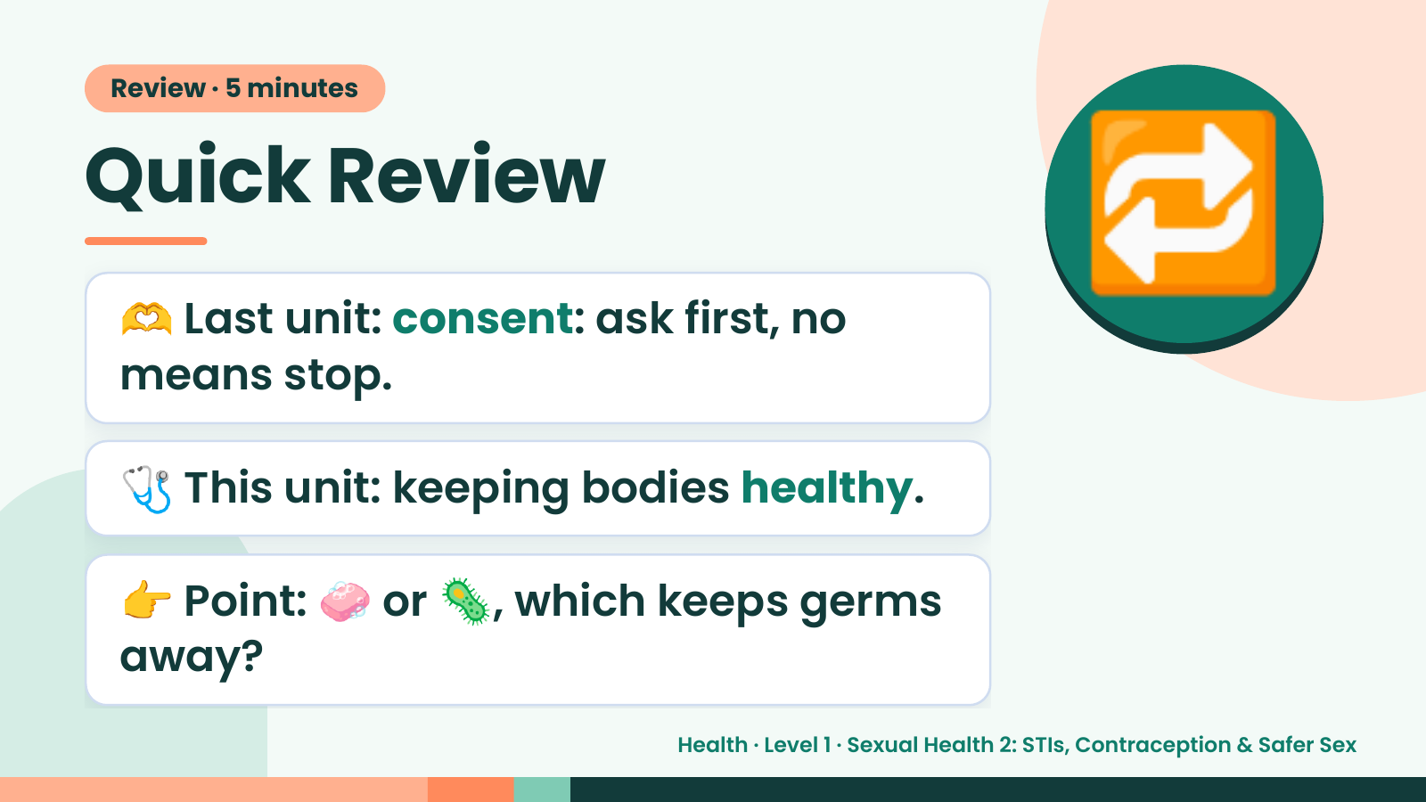
Notes:
Review · 5 minutes
Quick Review
🫶 Last unit: consent: ask first, no
means stop.
🔁
🩺 This unit: keeping bodies healthy.
👉 Point: 🧼 or 🦠, which keeps germs
away?
Health · Level 1 · Sexual Health 2: STIs, Contraception & Safer Sex

Slide 3
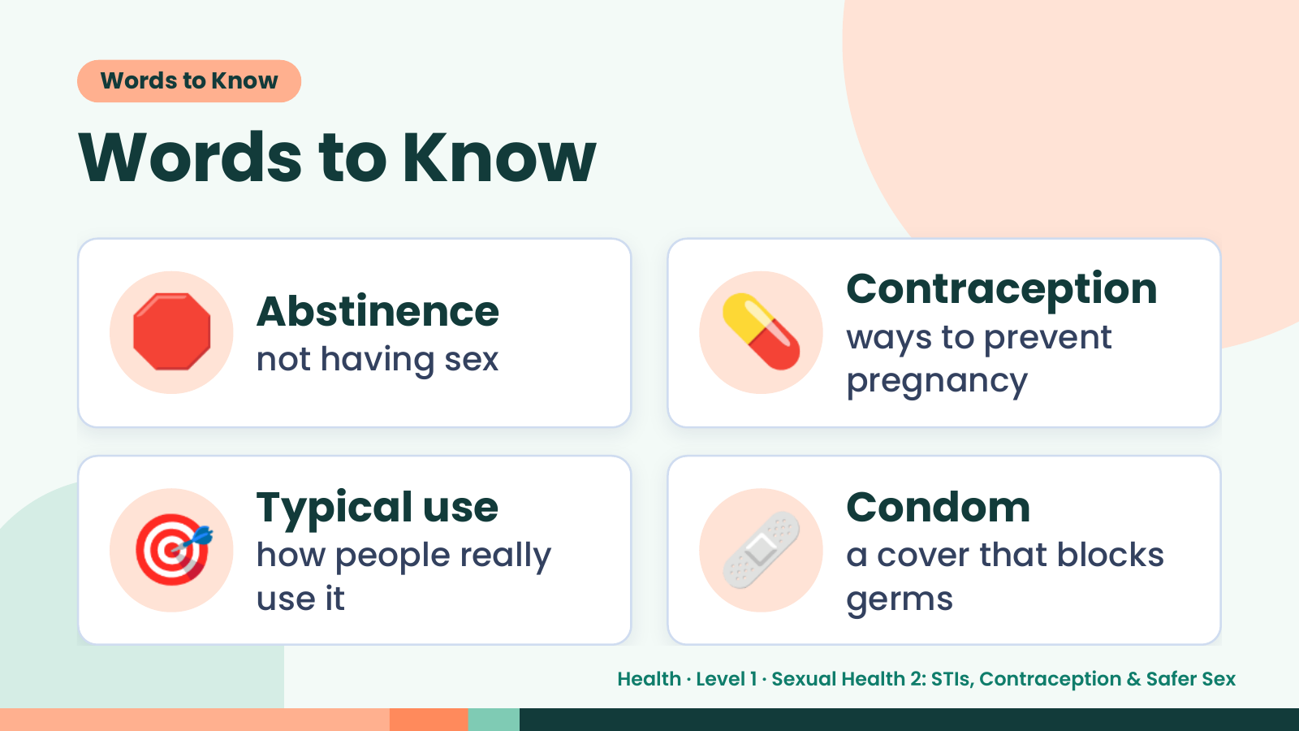
Notes:
Words to Know
Words to Know
🛑 Abstinence
not having sex 💊 Contraception
ways to prevent
pregnancy
🎯 Typical use
how people really
use it
🩹 Condom
a cover that blocks
germs
Health · Level 1 · Sexual Health 2: STIs, Contraception & Safer Sex

Slide 4
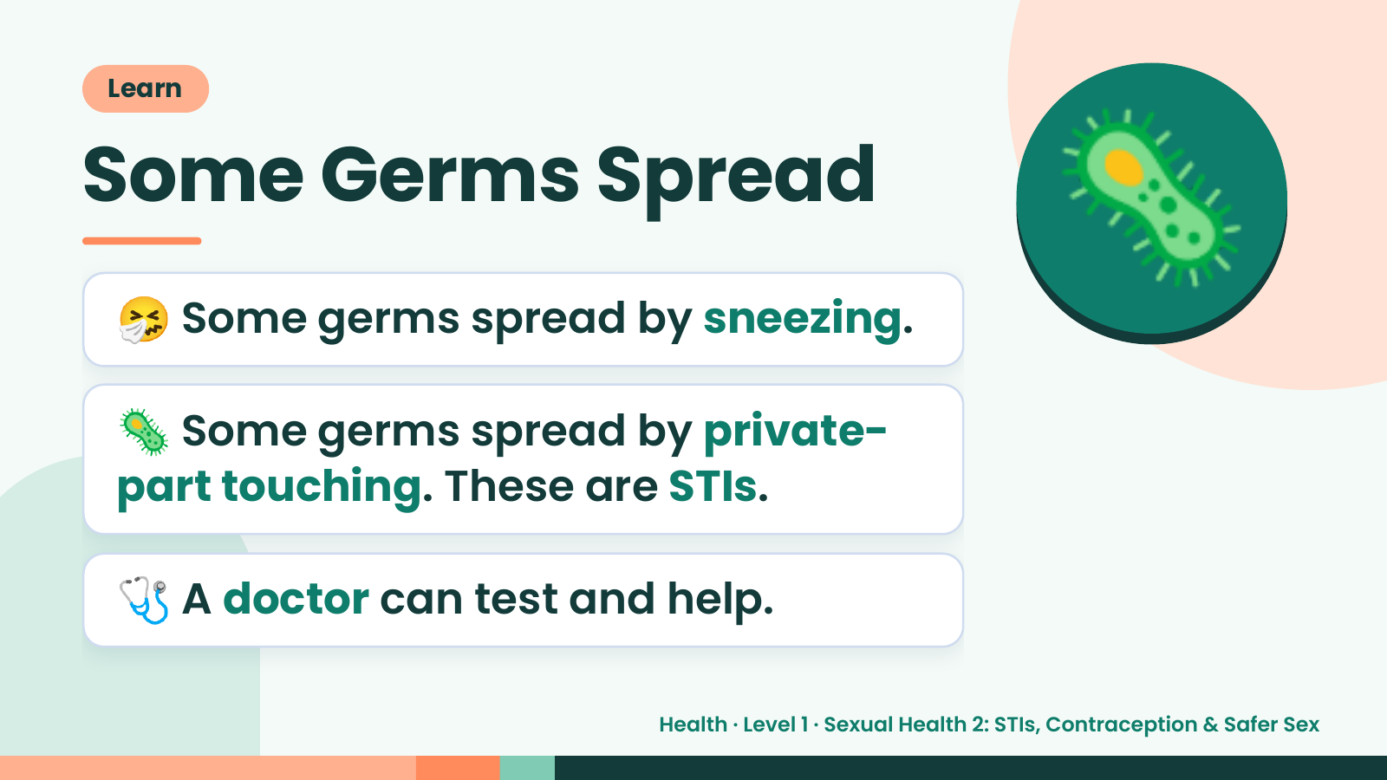
Notes:
Learn
Some Germs Spread
🤧 Some germs spread by sneezing.
🦠 Some germs spread by private-
🦠
part touching. These are STIs.
🩺 A doctor can test and help.
Health · Level 1 · Sexual Health 2: STIs, Contraception & Safer Sex

Slide 5
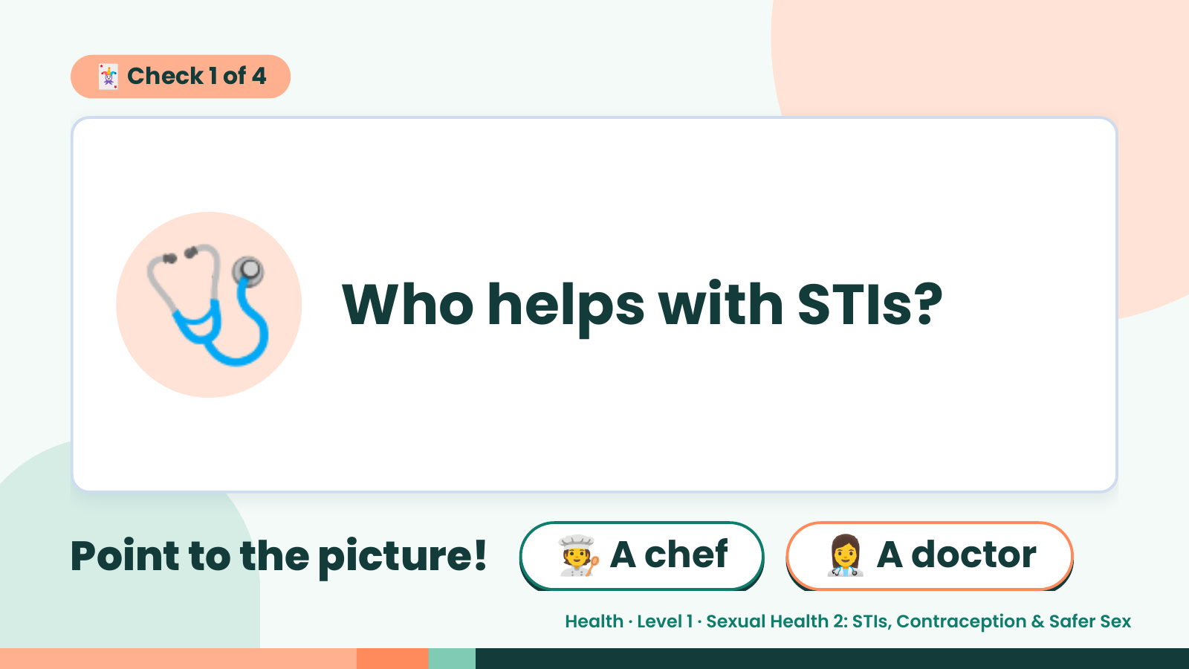
Notes:
🃏 Check 1 of 4
🩺 Who helps with STIs?
Point to the picture! 🧑‍🍳 A chef 👩‍⚕️ A doctor
Health · Level 1 · Sexual Health 2: STIs, Contraception & Safer Sex

Slide 6
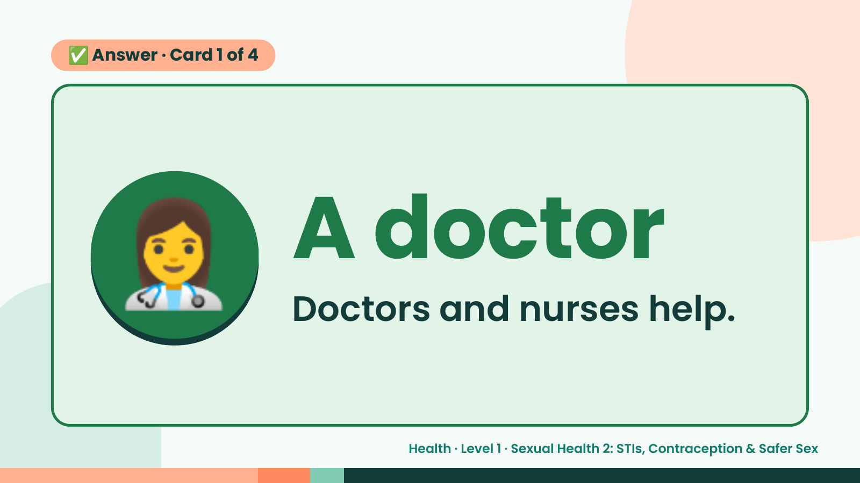
Notes:
✅ Answer · Card 1 of 4
👩‍⚕️ A doctor
Doctors and nurses help.
Health · Level 1 · Sexual Health 2: STIs, Contraception & Safer Sex

Slide 7
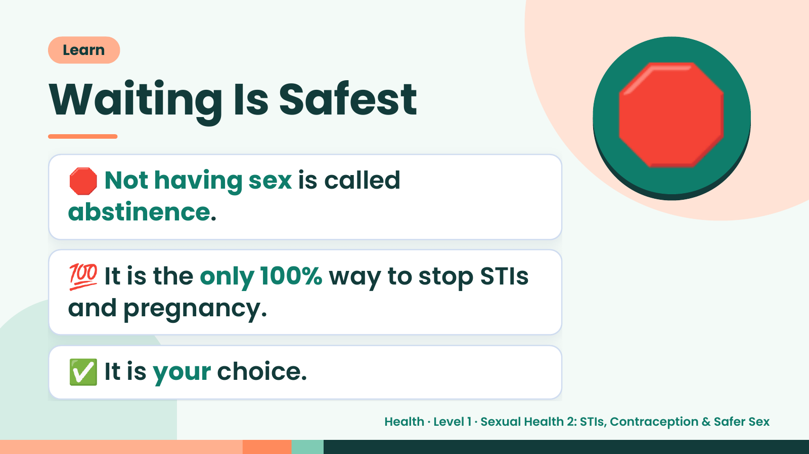
Notes:
Learn
Waiting Is Safest
🛑 Not having sex is called
abstinence.
🛑
💯 It is the only 100% way to stop STIs
and pregnancy.
✅ It is your choice.
Health · Level 1 · Sexual Health 2: STIs, Contraception & Safer Sex

Slide 8
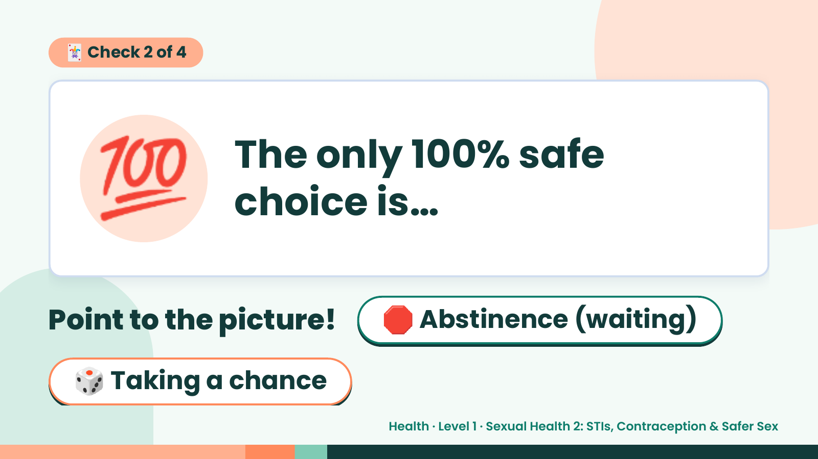
Notes:
🃏 Check 2 of 4
💯 The only 100% safe
choice is…
Point to the picture! 🛑 Abstinence (waiting)
🎲 Taking a chance
Health · Level 1 · Sexual Health 2: STIs, Contraception & Safer Sex

Slide 9
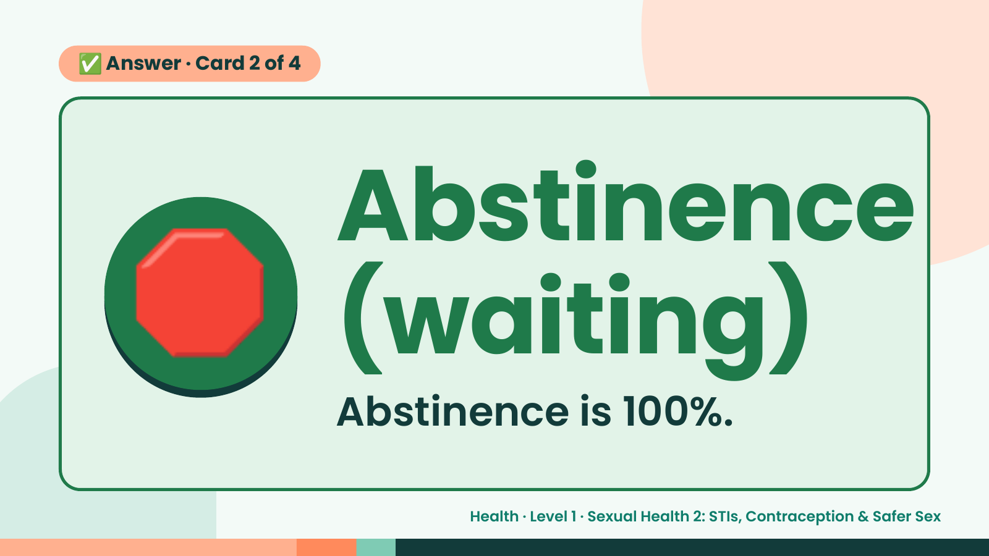
Notes:
✅ Answer · Card 2 of 4
🛑 Abstinence
(waiting)
Abstinence is 100%.
Health · Level 1 · Sexual Health 2: STIs, Contraception & Safer Sex

Slide 10
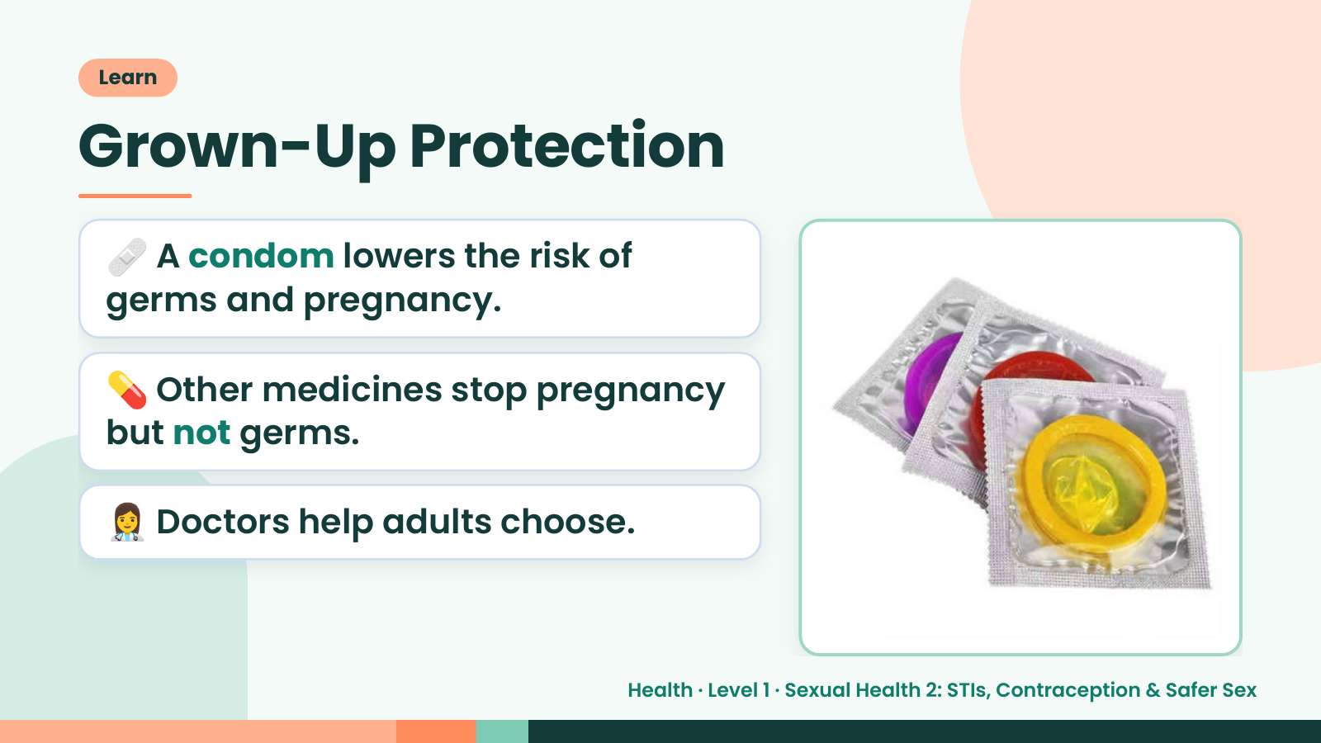
Notes:
Learn
Grown-Up Protection
🩹 A condom lowers the risk of
germs and pregnancy.
💊 Other medicines stop pregnancy
but not germs.
👩‍⚕️ Doctors help adults choose.
Health · Level 1 · Sexual Health 2: STIs, Contraception & Safer Sex

Slide 11
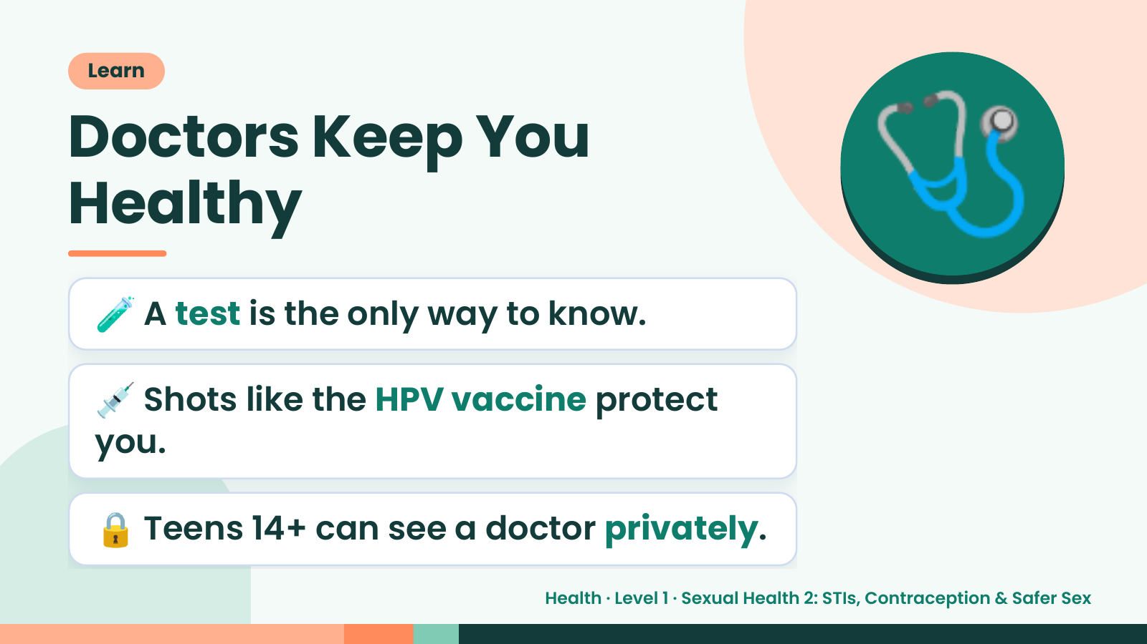
Notes:
Learn
Doctors Keep You
Healthy
🧪 A test is the only way to know.
🩺
💉 Shots like the HPV vaccine protect
you.
🔒 Teens 14+ can see a doctor privately.
Health · Level 1 · Sexual Health 2: STIs, Contraception & Safer Sex

Slide 12
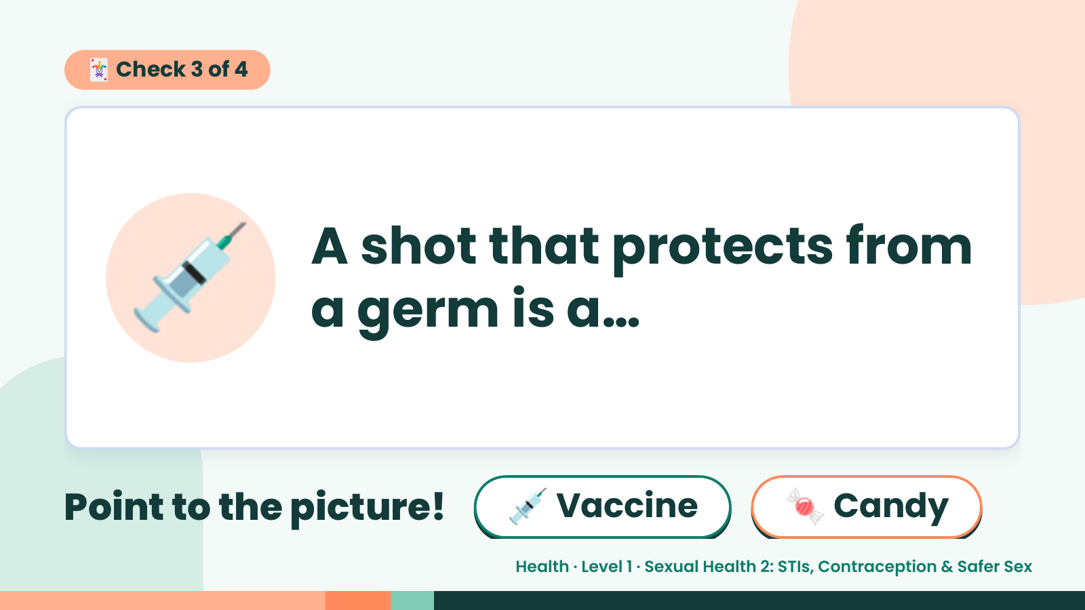
Notes:
🃏 Check 3 of 4
💉 A shot that protects from
a germ is a…
Point to the picture! 💉 Vaccine 🍬 Candy
Health · Level 1 · Sexual Health 2: STIs, Contraception & Safer Sex

Slide 13
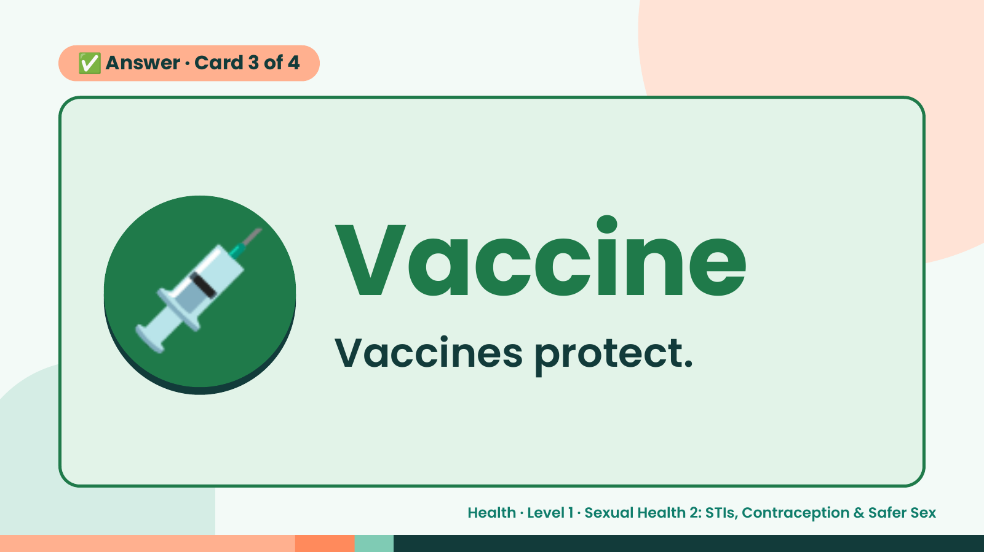
Notes:
✅ Answer · Card 3 of 4
💉 Vaccine
Vaccines protect.
Health · Level 1 · Sexual Health 2: STIs, Contraception & Safer Sex

Slide 14
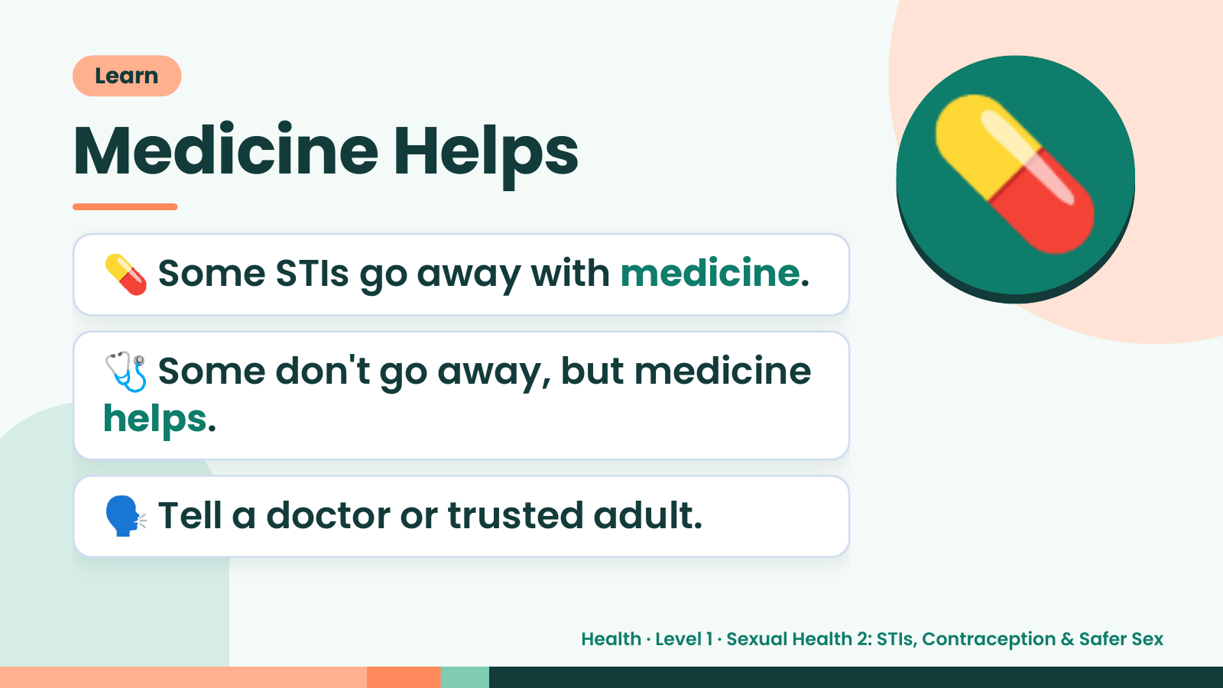
Notes:
Learn
Medicine Helps
💊 Some STIs go away with medicine.
🩺 Some don't go away, but medicine
💊
helps.
🗣️ Tell a doctor or trusted adult.
Health · Level 1 · Sexual Health 2: STIs, Contraception & Safer Sex

Slide 15
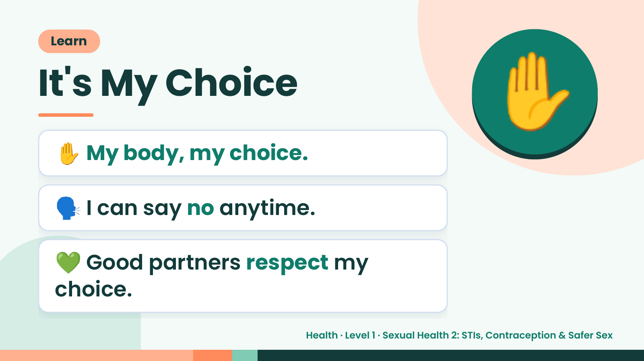
Notes:
Learn
It's My Choice
✋ My body, my choice.
✋
🗣️ I can say no anytime.
💚 Good partners respect my
choice.
Health · Level 1 · Sexual Health 2: STIs, Contraception & Safer Sex

Slide 16
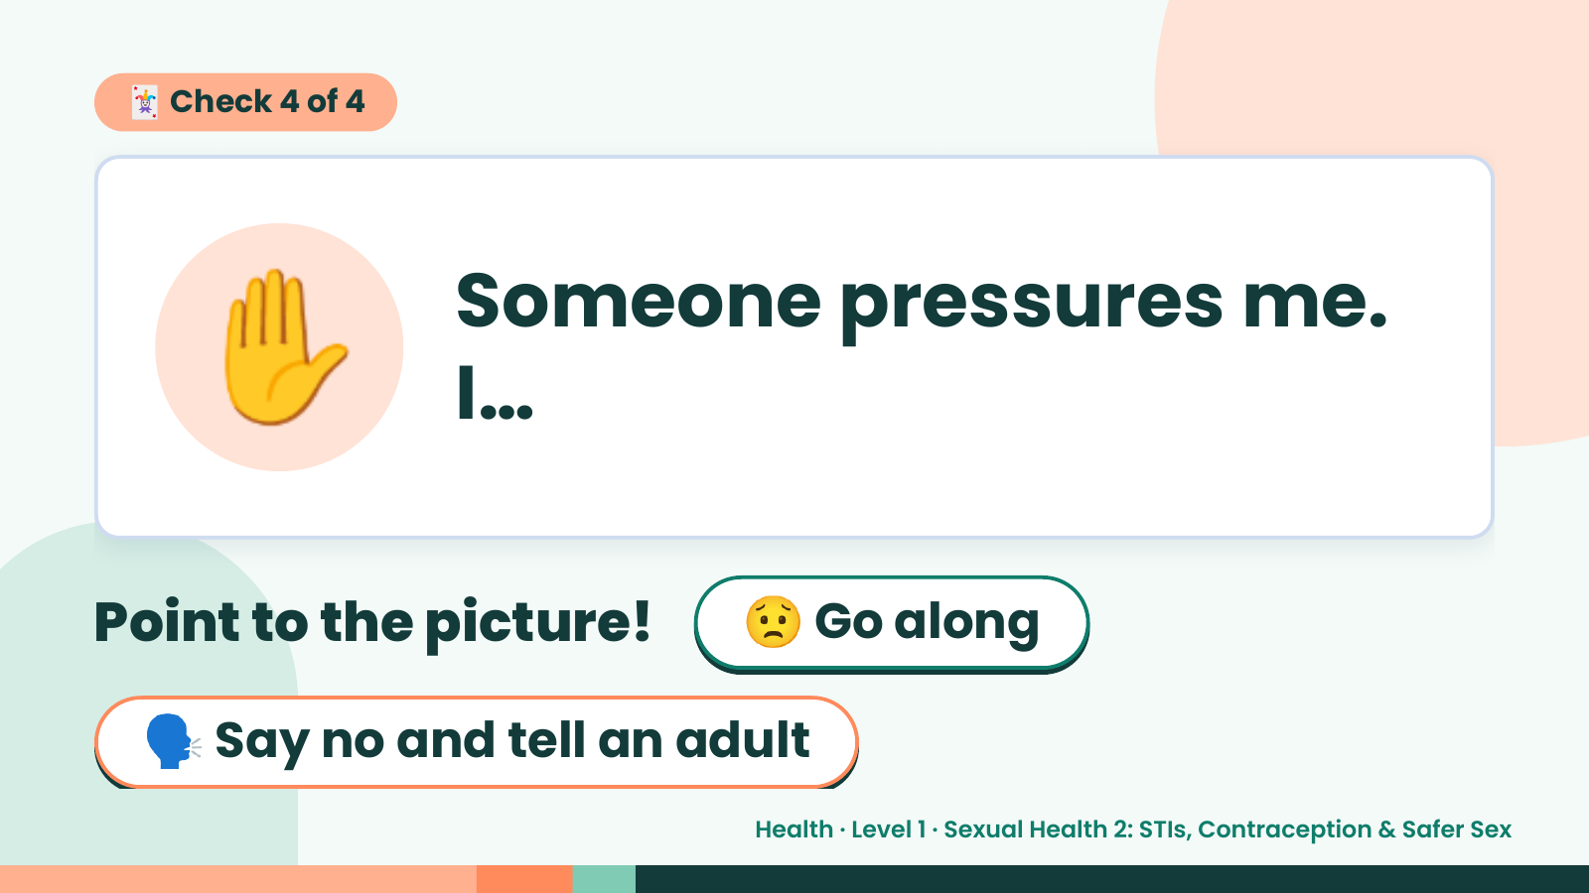
Notes:
🃏 Check 4 of 4
✋ Someone pressures me.
I…
Point to the picture! 😟 Go along
🗣️ Say no and tell an adult
Health · Level 1 · Sexual Health 2: STIs, Contraception & Safer Sex

Slide 17
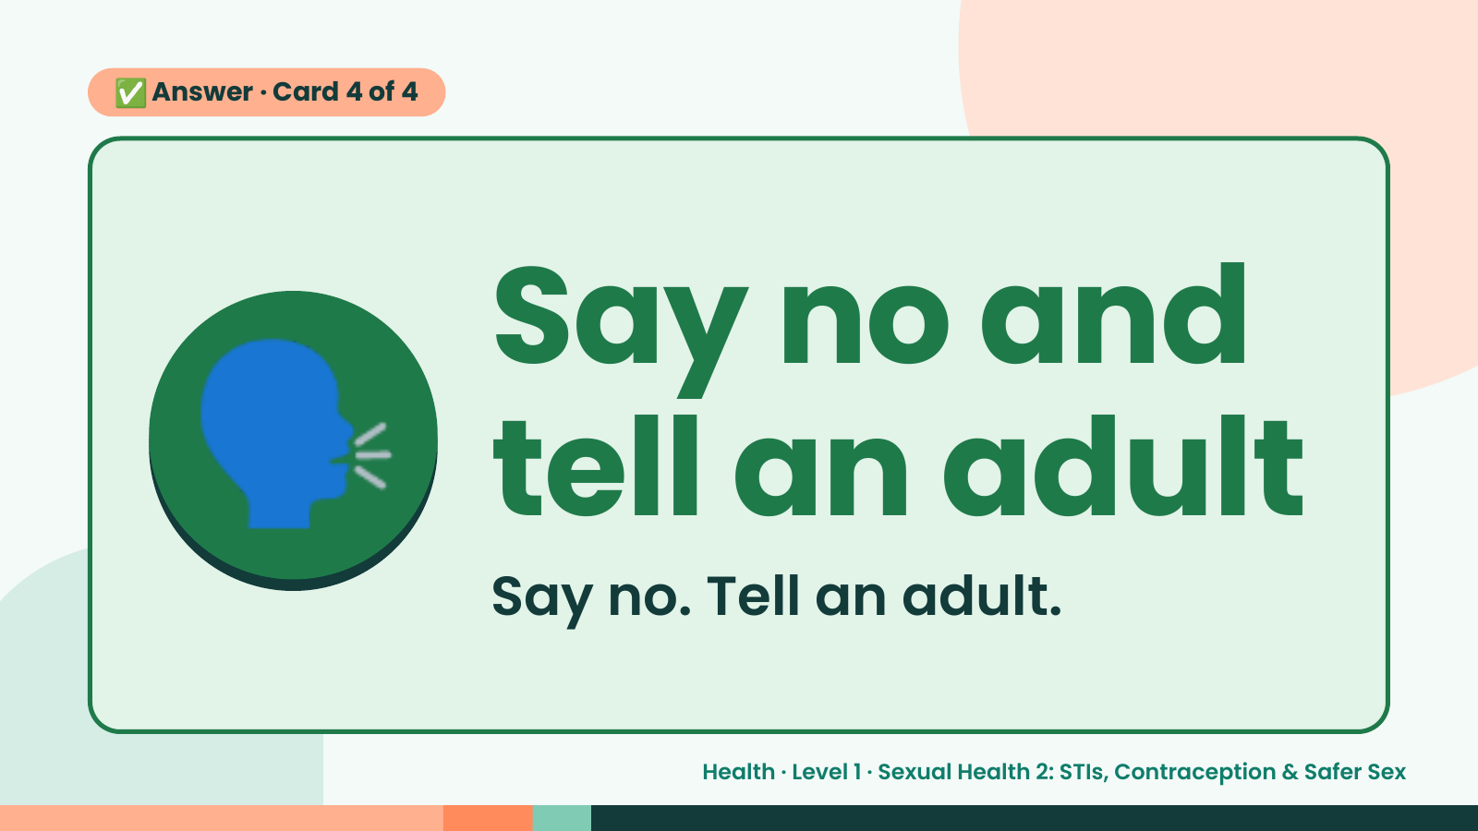
Notes:
✅ Answer · Card 4 of 4
🗣️ Say no and
tell an adult
Say no. Tell an adult.
Health · Level 1 · Sexual Health 2: STIs, Contraception & Safer Sex

Slide 18
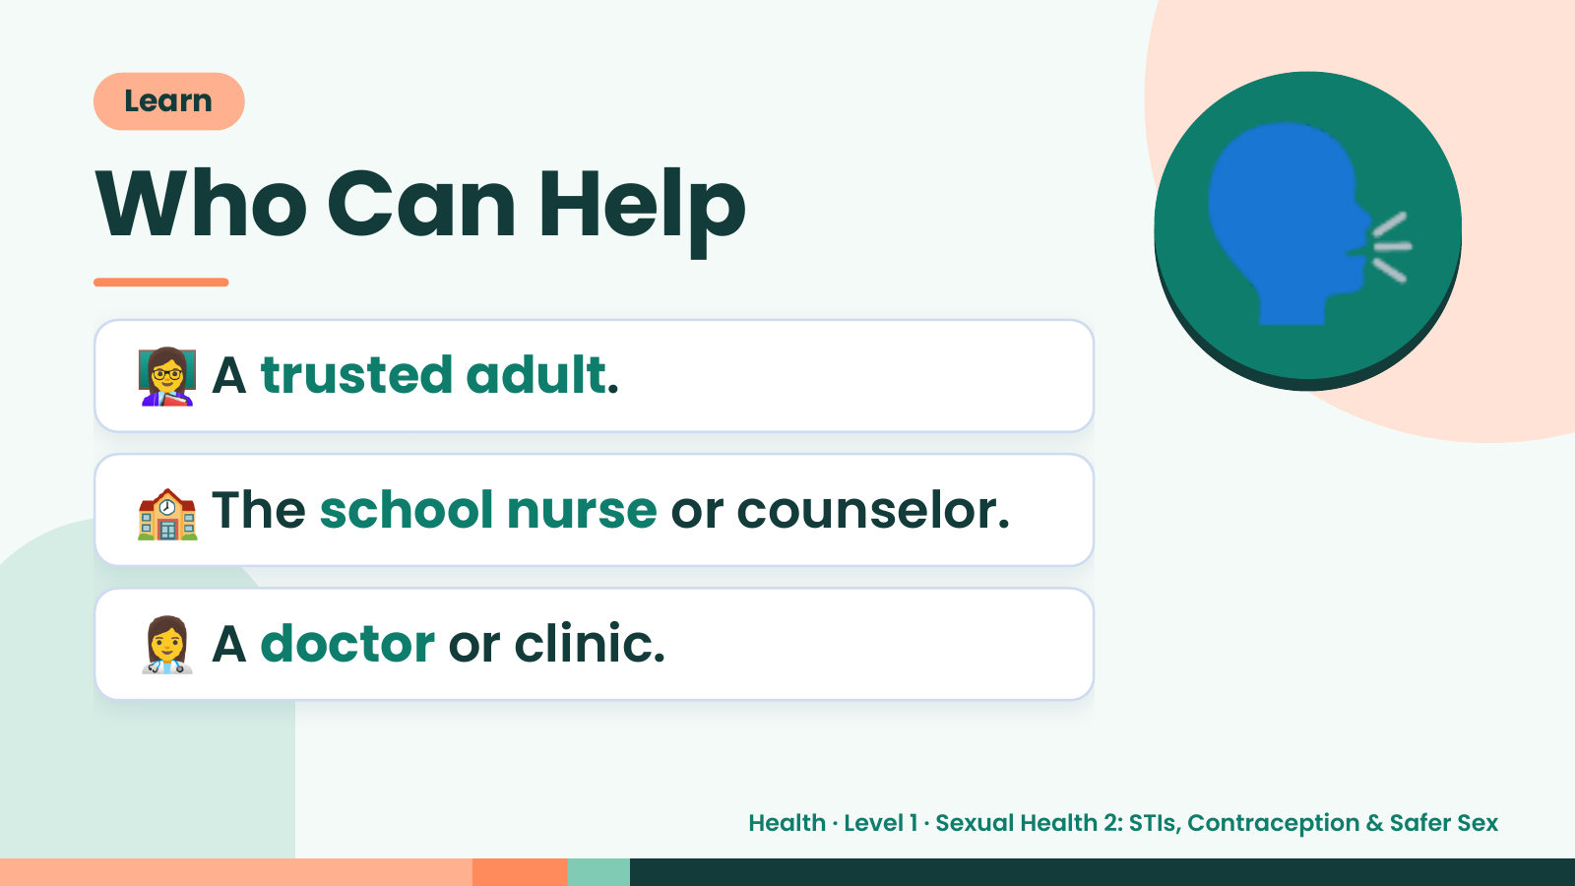
Notes:
Learn
Who Can Help
👩‍🏫 A trusted adult.
🗣️
🏫 The school nurse or counselor.
👩‍⚕️ A doctor or clinic.
Health · Level 1 · Sexual Health 2: STIs, Contraception & Safer Sex

Slide 19
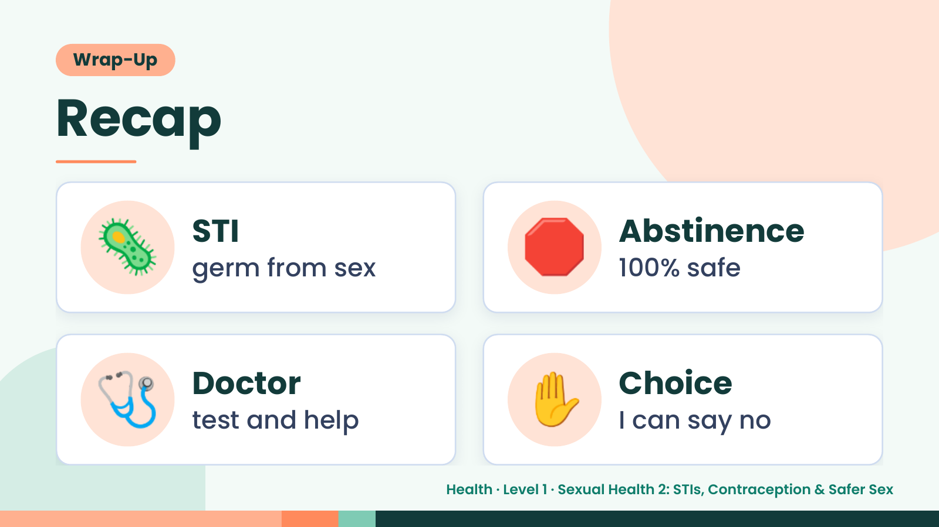
Notes:
Wrap-Up
Recap
🦠 STI
germ from sex 🛑 Abstinence
100% safe
🩺 Doctor
test and help ✋ Choice
I can say no
Health · Level 1 · Sexual Health 2: STIs, Contraception & Safer Sex

Slide 20
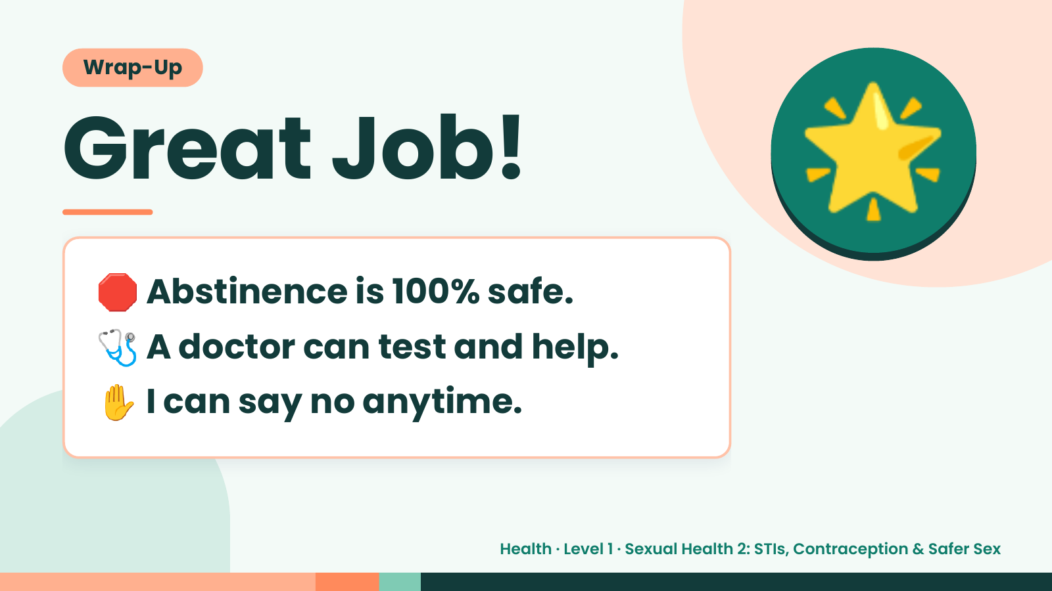
Notes:
Wrap-Up
Great Job!
🛑 Abstinence is 100% safe.
🌟
🩺 A doctor can test and help.
✋ I can say no anytime.
Health · Level 1 · Sexual Health 2: STIs, Contraception & Safer Sex

