Slide 1
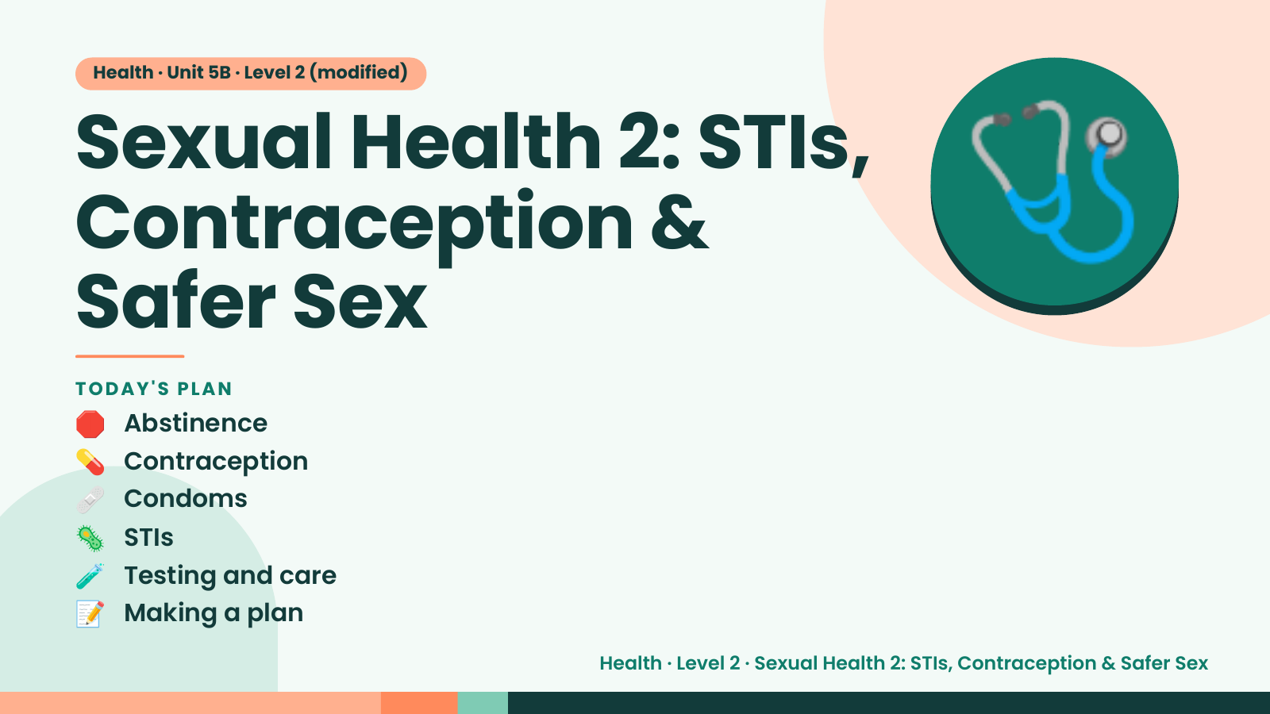
Notes:
Health · Unit 5B · Level 2 (modified)
Sexual Health 2: STIs,
Contraception &
Safer Sex
🩺
🛑 Abstinence
TODAY'S PLAN
💊 Contraception
🩹 Condoms
🦠 STIs
🧪 Testing and care
📝 Making a plan
Health · Level 2 · Sexual Health 2: STIs, Contraception & Safer Sex

Slide 2
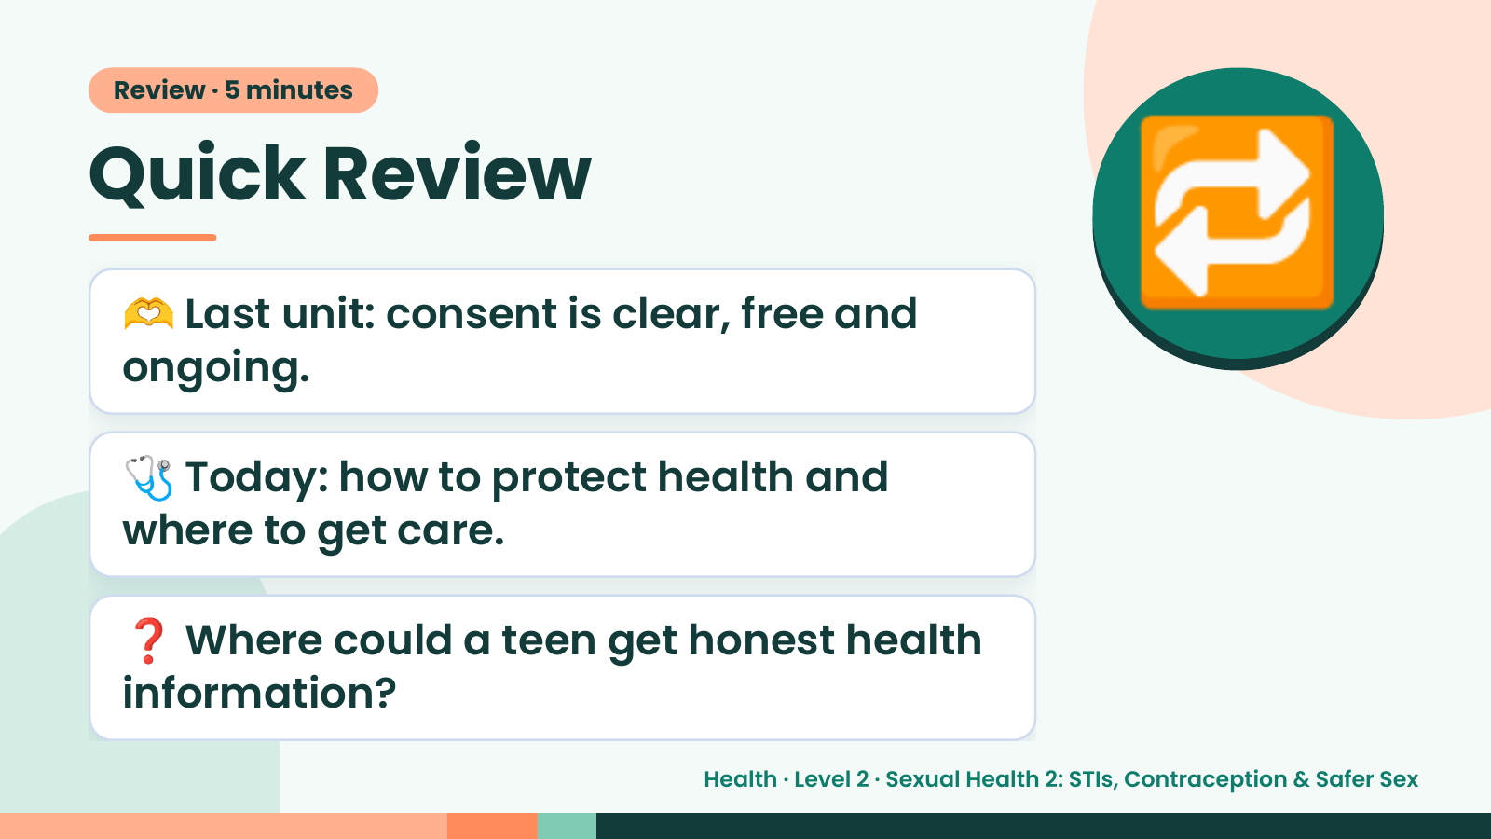
Notes:
Review · 5 minutes
Quick Review
🫶 Last unit: consent is clear, free and
ongoing.
🔁
🩺 Today: how to protect health and
where to get care.
❓ Where could a teen get honest health
information?
Health · Level 2 · Sexual Health 2: STIs, Contraception & Safer Sex

Slide 3
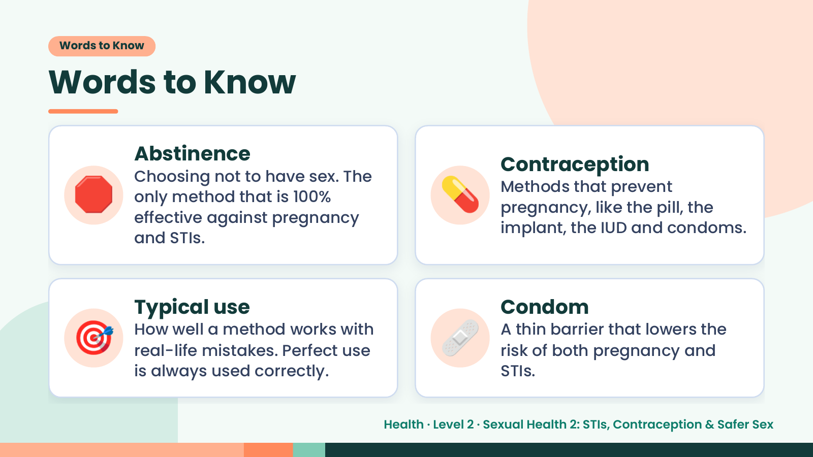
Notes:
Words to Know
Words to Know
🛑 💊
Abstinence
Contraception
Choosing not to have sex. The
Methods that prevent
only method that is 100%
pregnancy, like the pill, the
effective against pregnancy
implant, the IUD and condoms.
and STIs.
🎯 Typical use
How well a method works with
real-life mistakes. Perfect use
is always used correctly.
🩹 Condom
A thin barrier that lowers the
risk of both pregnancy and
STIs.
Health · Level 2 · Sexual Health 2: STIs, Contraception & Safer Sex

Slide 4
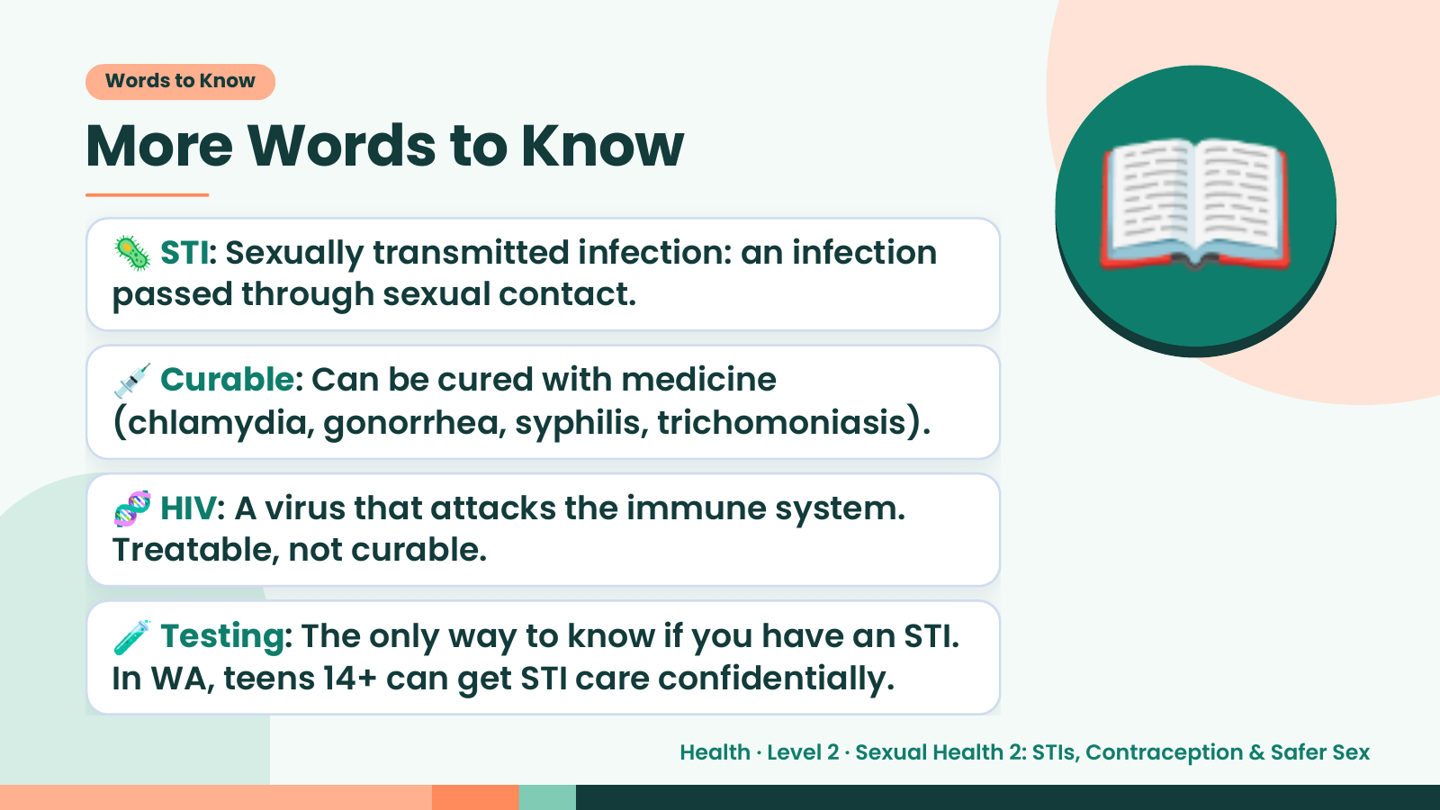
Notes:
Words to Know
More Words to Know
🦠 STI: Sexually transmitted infection: an infection
passed through sexual contact.
💉 Curable: Can be cured with medicine
(chlamydia, gonorrhea, syphilis, trichomoniasis).
📖
🧬 HIV: A virus that attacks the immune system.
Treatable, not curable.
🧪 Testing: The only way to know if you have an STI.
In WA, teens 14+ can get STI care confidentially.
Health · Level 2 · Sexual Health 2: STIs, Contraception & Safer Sex

Slide 5
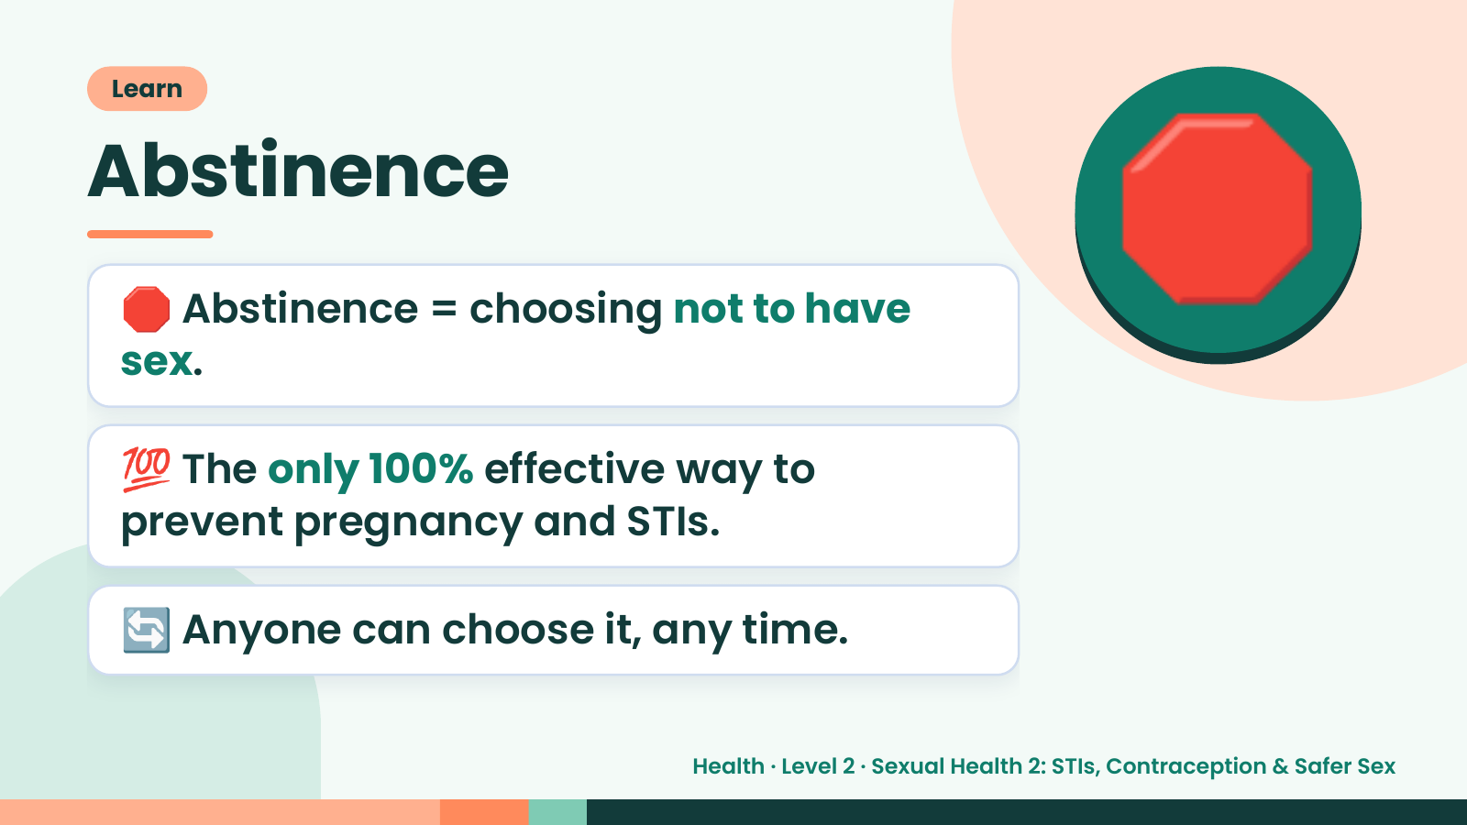
Notes:
Learn
Abstinence
🛑 Abstinence = choosing not to have
sex.
🛑
💯 The only 100% effective way to
prevent pregnancy and STIs.
🔄 Anyone can choose it, any time.
Health · Level 2 · Sexual Health 2: STIs, Contraception & Safer Sex

Slide 6
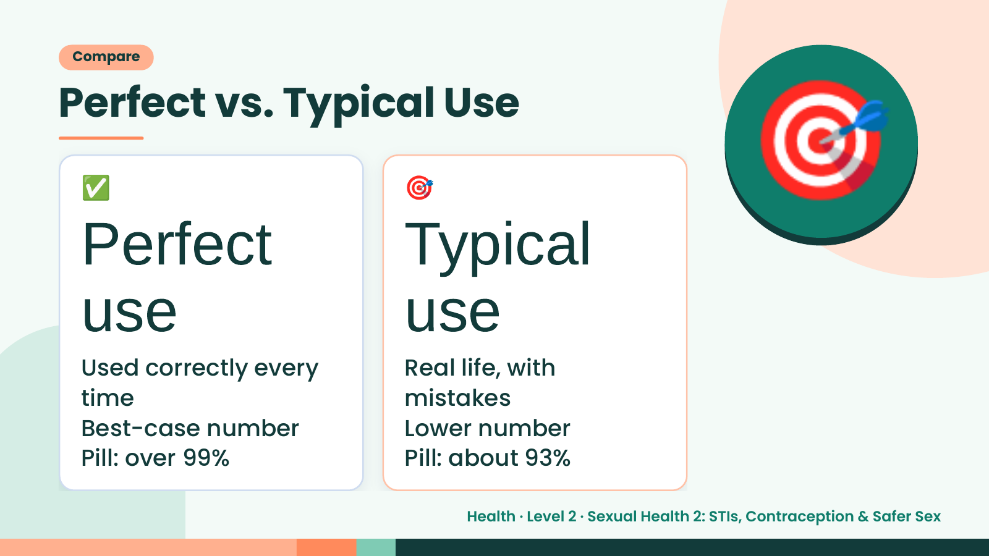
Notes:
Compare
Perfect vs. Typical Use
✅
Perfect
🎯
Typical
🎯
use
Used correctly every
use
Real life, with
time mistakes
Best-case number Lower number
Pill: over 99% Pill: about 93%
Health · Level 2 · Sexual Health 2: STIs, Contraception & Safer Sex

Slide 7
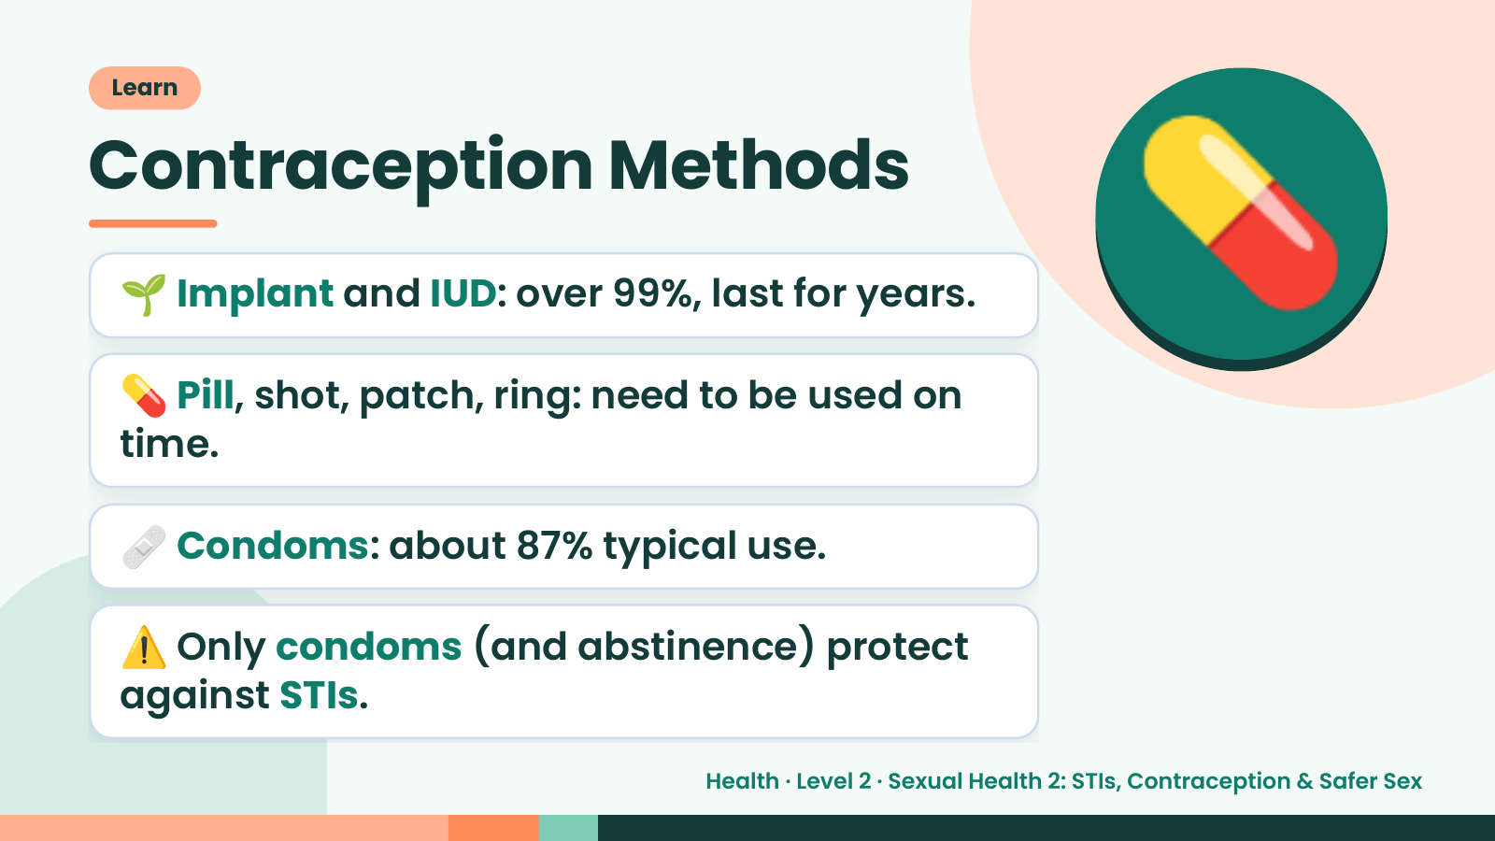
Notes:
Learn
Contraception Methods
🌱 Implant and IUD: over 99%, last for years.
💊 Pill, shot, patch, ring: need to be used on
time.
💊
🩹 Condoms: about 87% typical use.
⚠️ Only condoms (and abstinence) protect
against STIs.
Health · Level 2 · Sexual Health 2: STIs, Contraception & Safer Sex

Slide 8
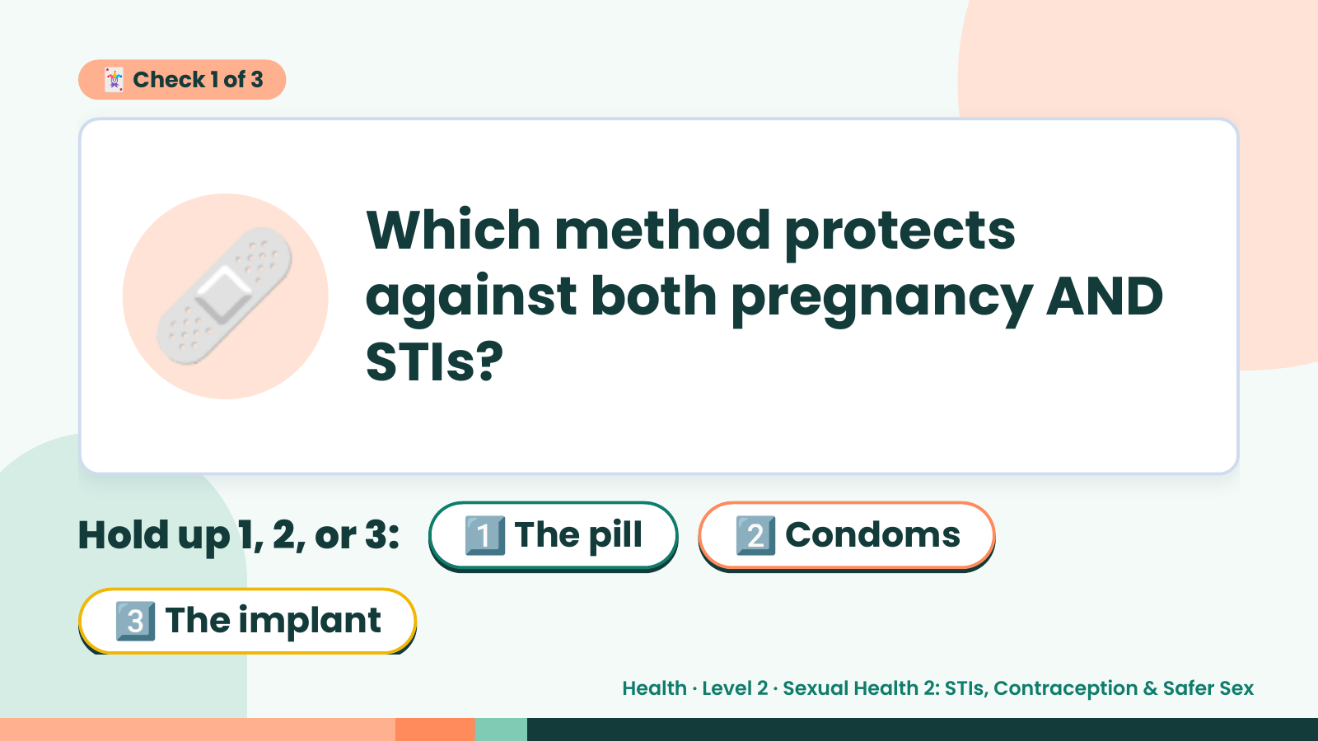
Notes:
🃏 Check 1 of 3
🩹 Which method protects
against both pregnancy AND
STIs?
Hold up 1, 2, or 3: 1️⃣ The pill 2️⃣ Condoms
3️⃣ The implant
Health · Level 2 · Sexual Health 2: STIs, Contraception & Safer Sex

Slide 9
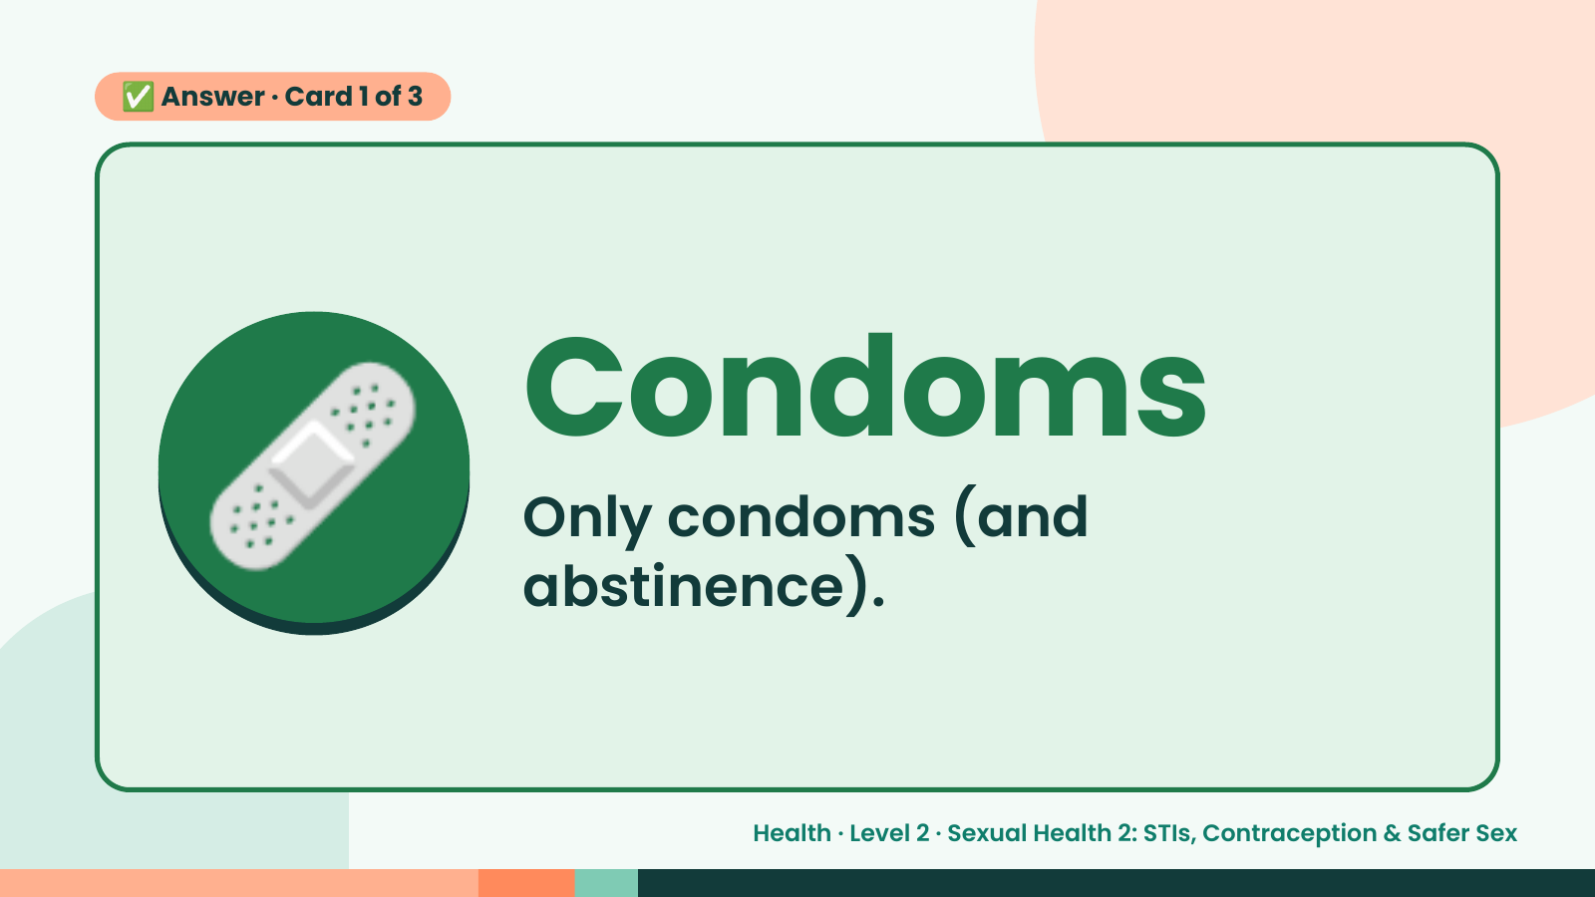
Notes:
✅ Answer · Card 1 of 3
🩹 Condoms
Only condoms (and
abstinence).
Health · Level 2 · Sexual Health 2: STIs, Contraception & Safer Sex

Slide 10
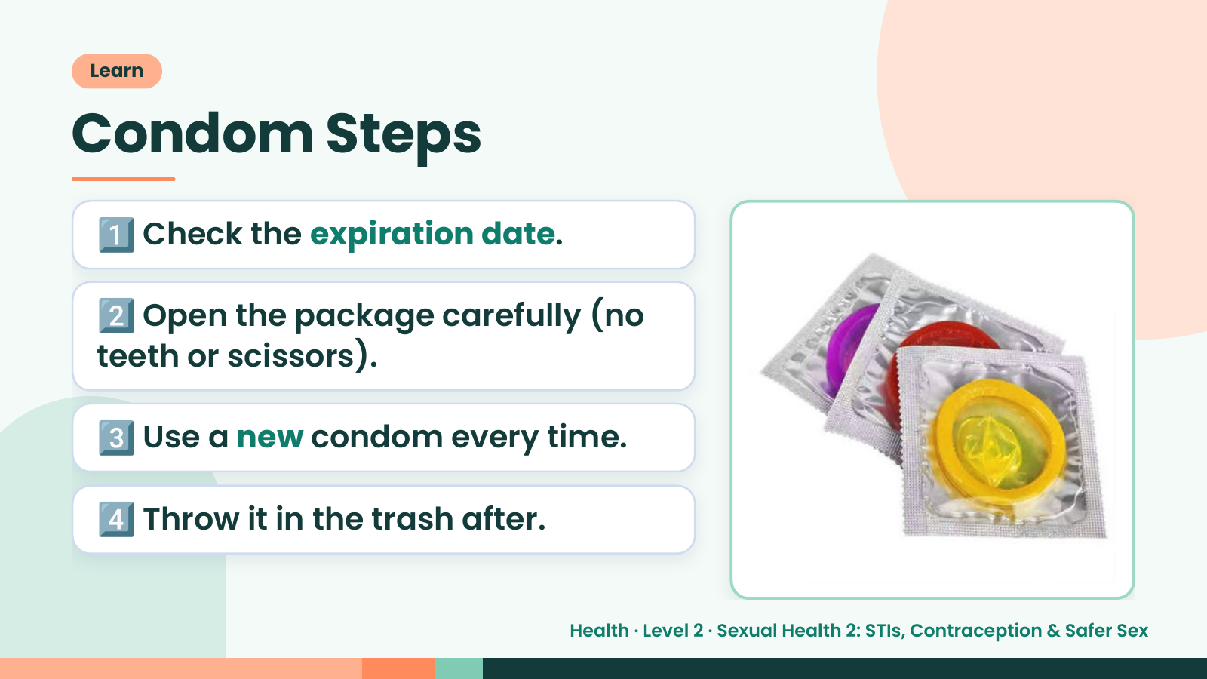
Notes:
Learn
Condom Steps
1️⃣ Check the expiration date.
2️⃣ Open the package carefully (no
teeth or scissors).
3️⃣ Use a new condom every time.
4️⃣ Throw it in the trash after.
Health · Level 2 · Sexual Health 2: STIs, Contraception & Safer Sex

Slide 11
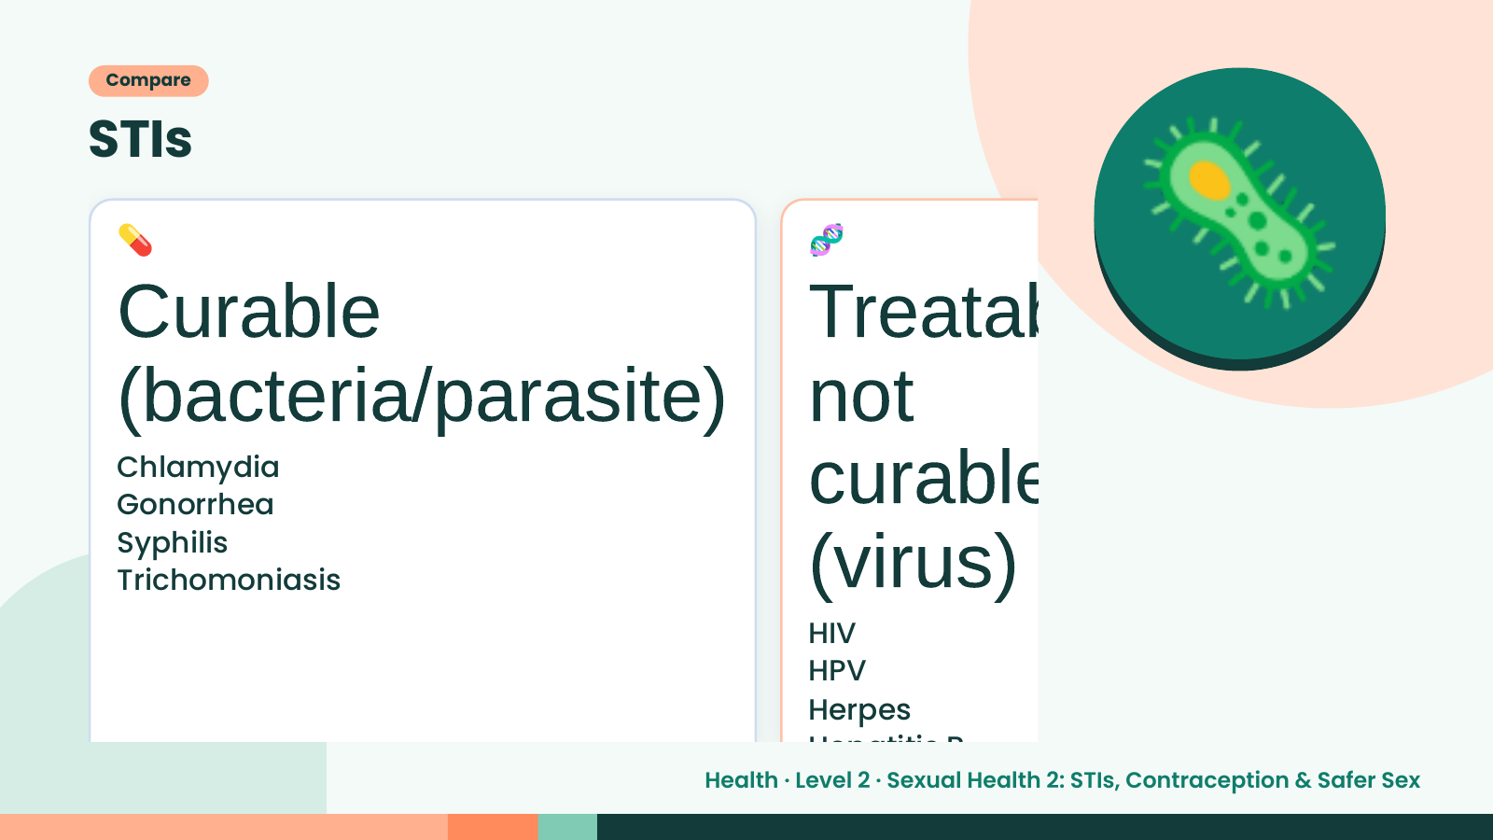
Notes:
Compare
STIs
💊
Curable
🧬
Treatab
(bacteria/parasite) not
🦠
Chlamydia
curable
(virus)
Gonorrhea
Syphilis
Trichomoniasis
HIV
HPV
Herpes
Hepatitis B
Health · Level 2 · Sexual Health 2: STIs, Contraception & Safer Sex

Slide 12
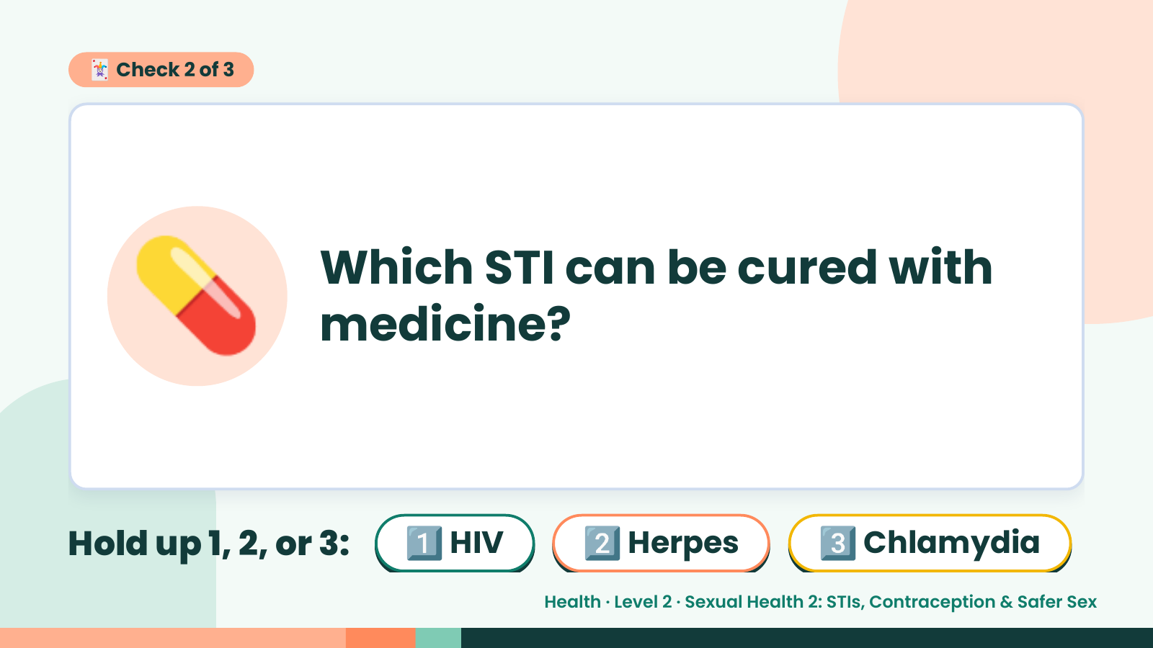
Notes:
🃏 Check 2 of 3
💊 Which STI can be cured with
medicine?
Hold up 1, 2, or 3: 1️⃣ HIV 2️⃣ Herpes 3️⃣ Chlamydia
Health · Level 2 · Sexual Health 2: STIs, Contraception & Safer Sex

Slide 13
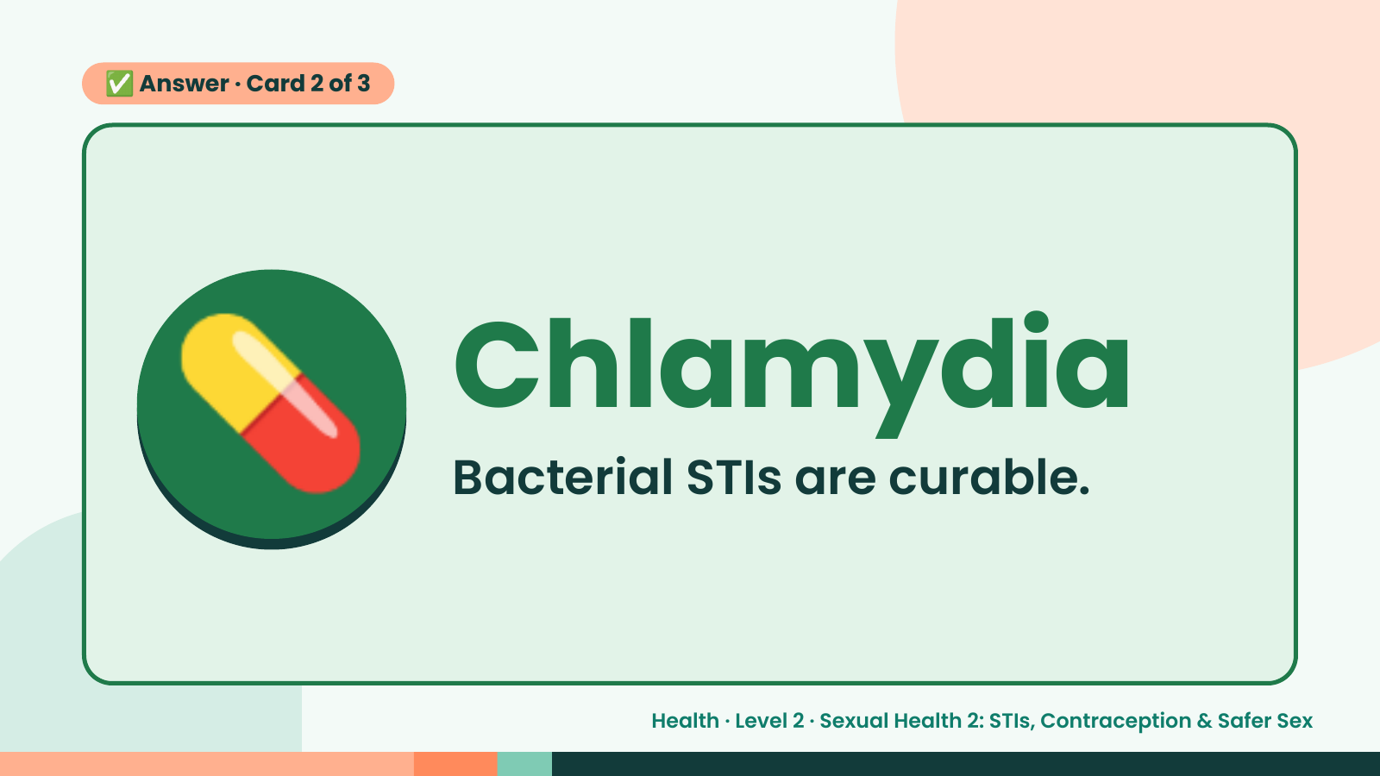
Notes:
✅ Answer · Card 2 of 3
💊 Chlamydia
Bacterial STIs are curable.
Health · Level 2 · Sexual Health 2: STIs, Contraception & Safer Sex

Slide 14
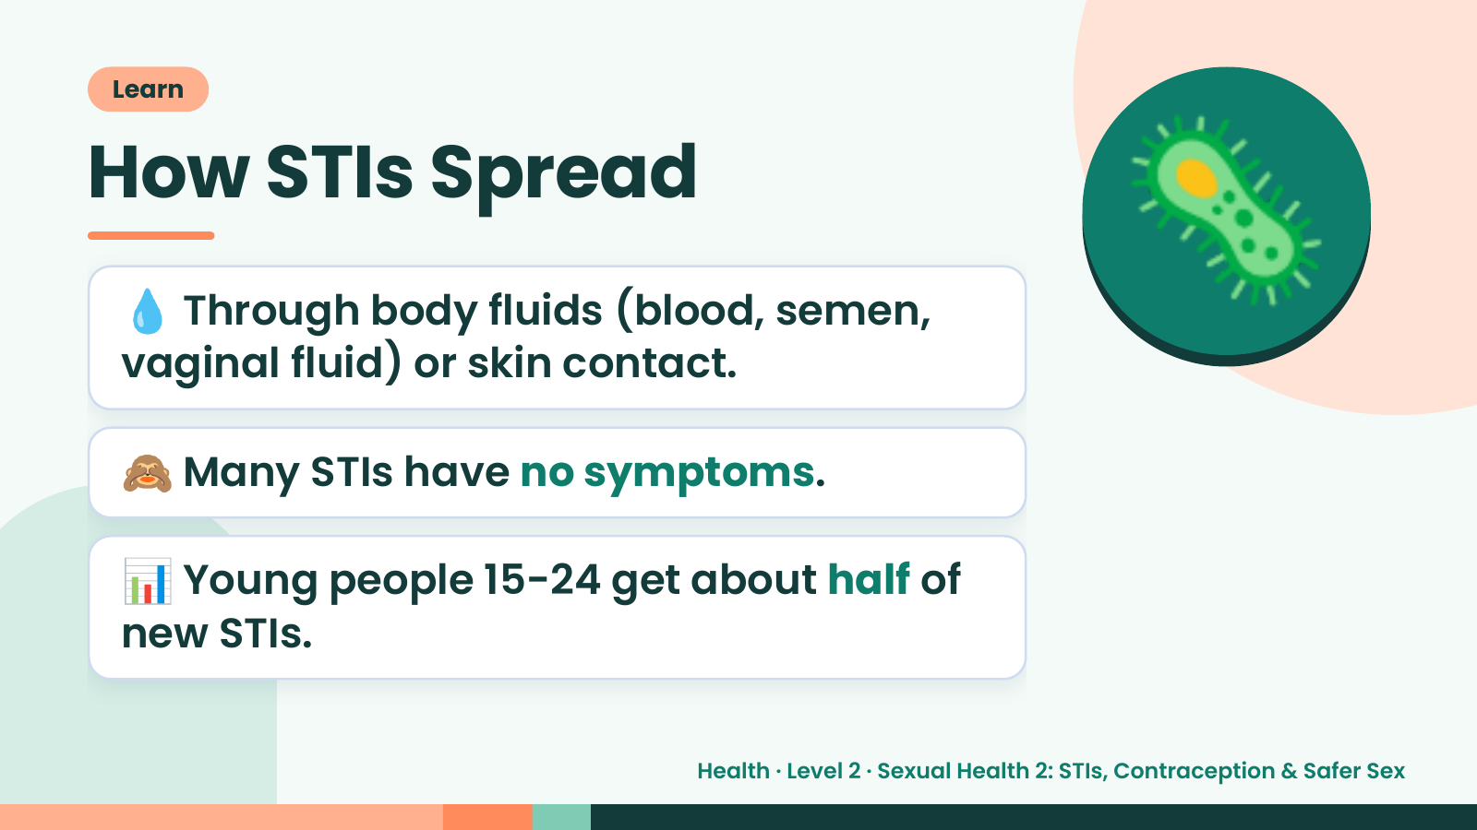
Notes:
Learn
How STIs Spread
💧 Through body fluids (blood, semen,
vaginal fluid) or skin contact.
🦠
🙈 Many STIs have no symptoms.
📊 Young people 15-24 get about half of
new STIs.
Health · Level 2 · Sexual Health 2: STIs, Contraception & Safer Sex

Slide 15
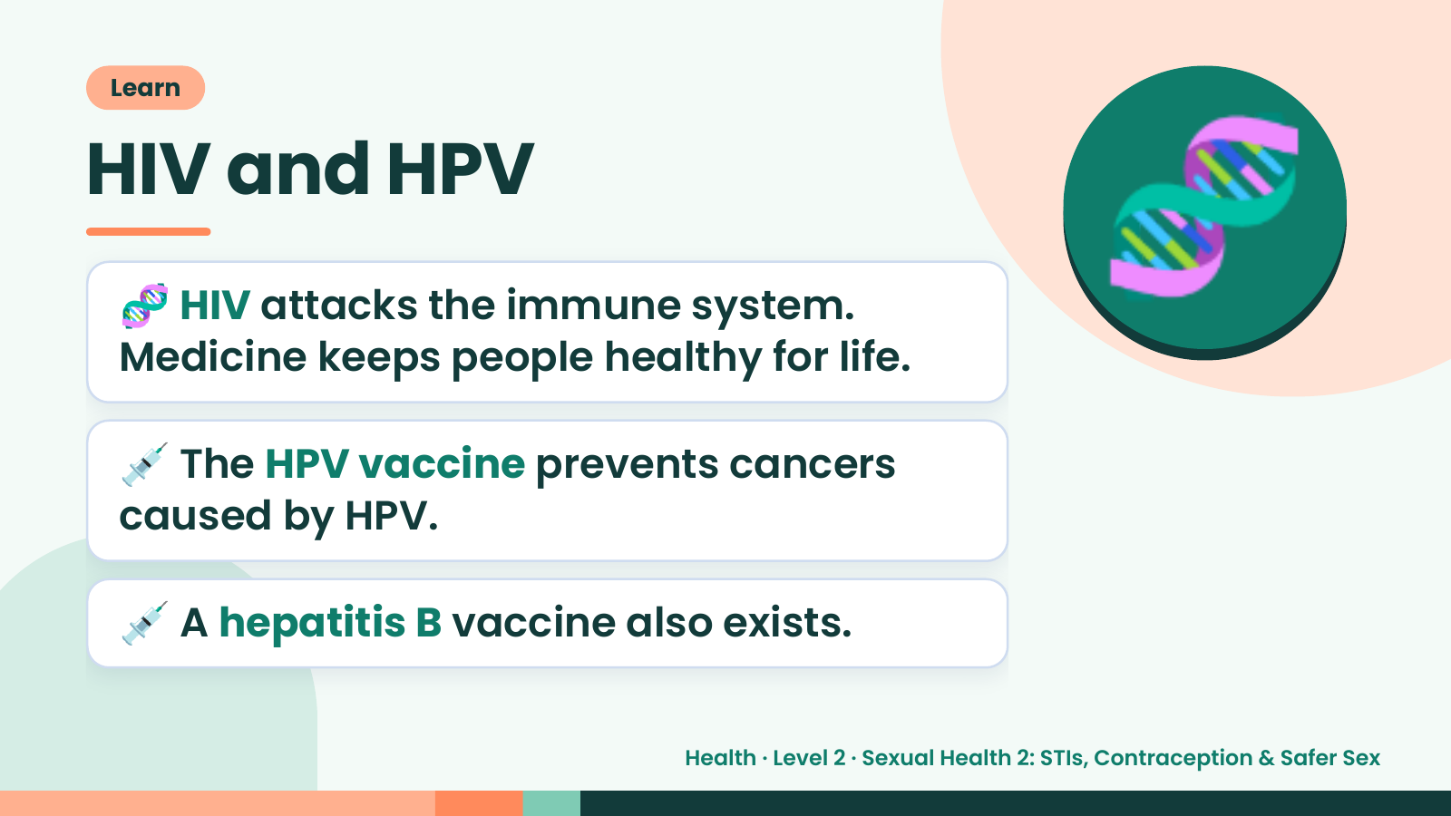
Notes:
Learn
HIV and HPV
🧬 HIV attacks the immune system.
Medicine keeps people healthy for life.
🧬
💉 The HPV vaccine prevents cancers
caused by HPV.
💉 A hepatitis B vaccine also exists.
Health · Level 2 · Sexual Health 2: STIs, Contraception & Safer Sex

Slide 16
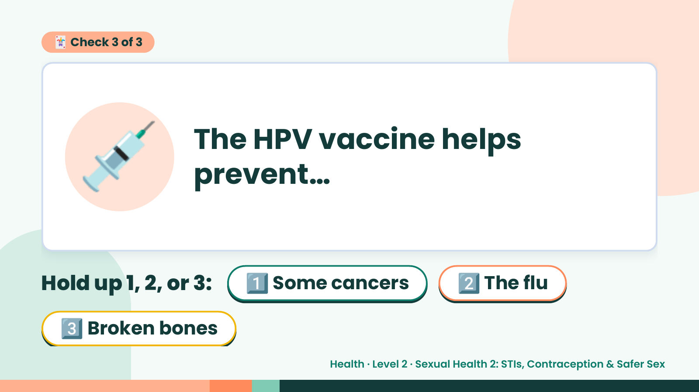
Notes:
🃏 Check 3 of 3
💉 The HPV vaccine helps
prevent…
Hold up 1, 2, or 3: 1️⃣ Some cancers 2️⃣ The flu
3️⃣ Broken bones
Health · Level 2 · Sexual Health 2: STIs, Contraception & Safer Sex

Slide 17
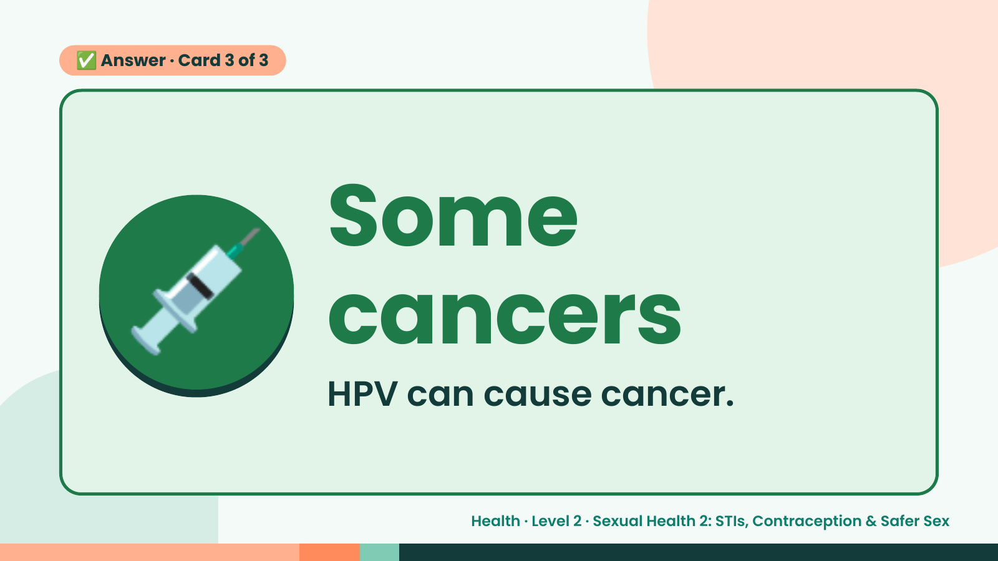
Notes:
✅ Answer · Card 3 of 3
💉 Some
cancers
HPV can cause cancer.
Health · Level 2 · Sexual Health 2: STIs, Contraception & Safer Sex

Slide 18
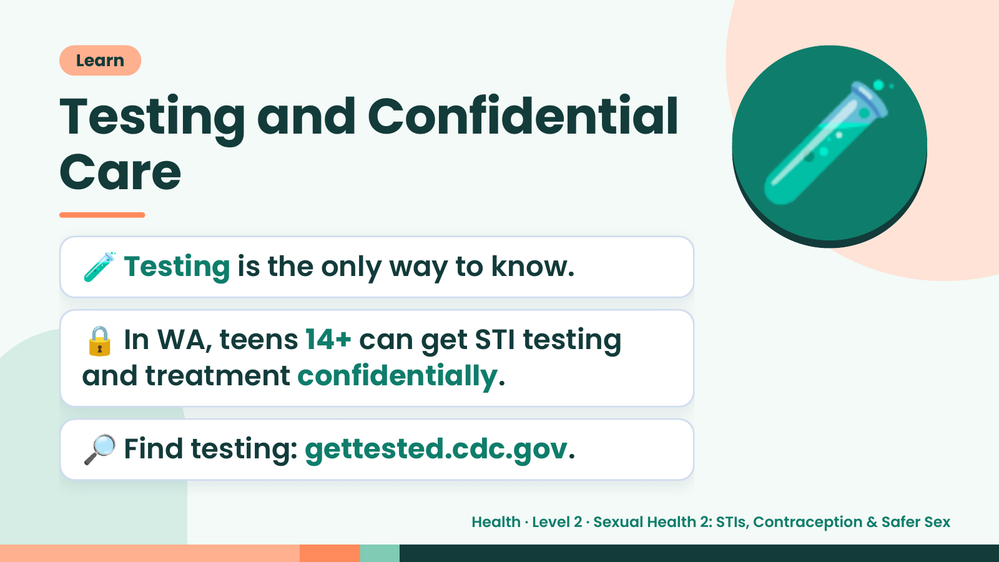
Notes:
Learn
Testing and Confidential
Care
🧪 Testing is the only way to know.
🧪
🔒 In WA, teens 14+ can get STI testing
and treatment confidentially.
🔎 Find testing: gettested.cdc.gov.
Health · Level 2 · Sexual Health 2: STIs, Contraception & Safer Sex

Slide 19
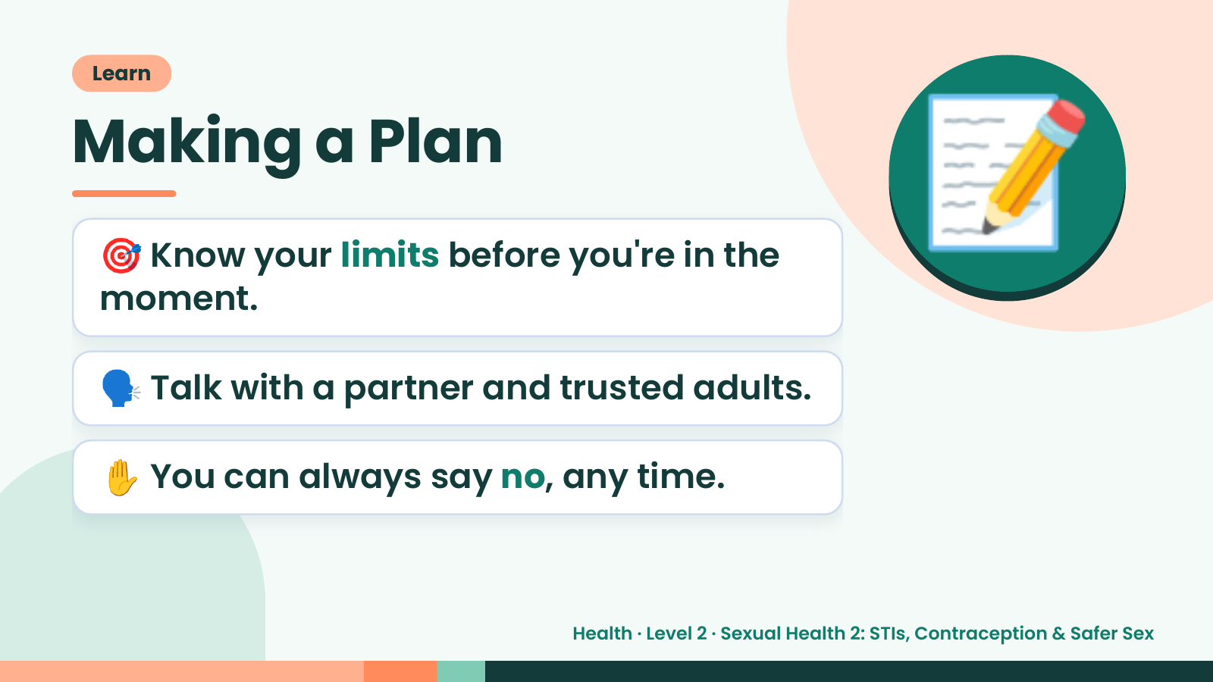
Notes:
Learn
Making a Plan
🎯 Know your limits before you're in the
moment.
📝
🗣️ Talk with a partner and trusted adults.
✋ You can always say no, any time.
Health · Level 2 · Sexual Health 2: STIs, Contraception & Safer Sex

Slide 20
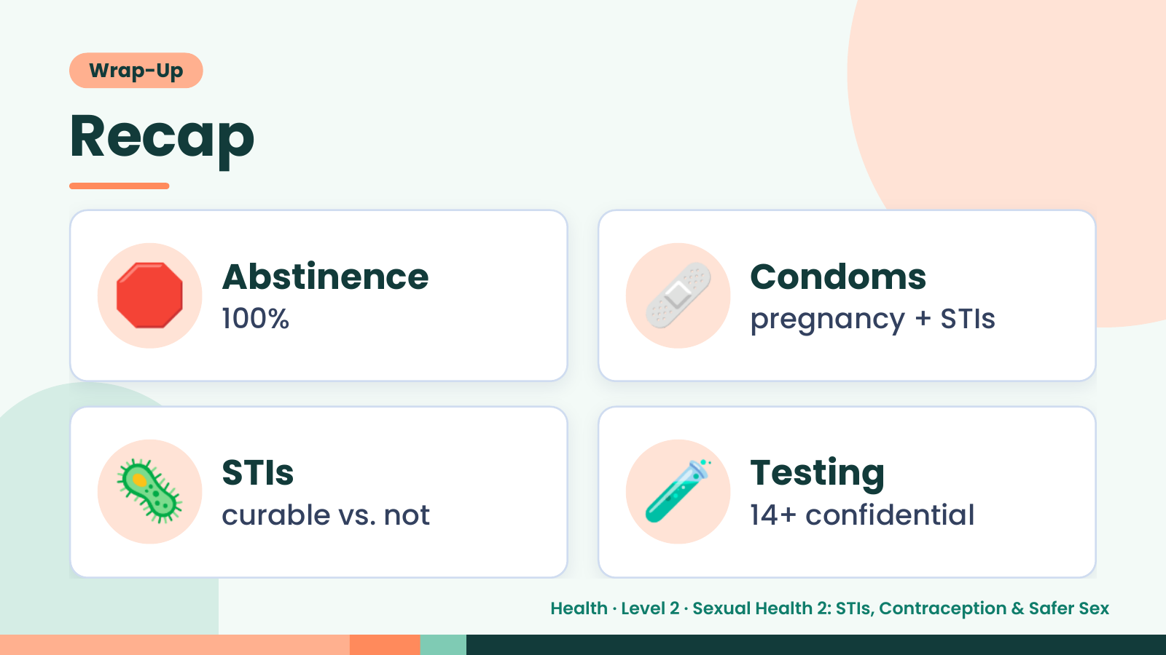
Notes:
Wrap-Up
Recap
🛑 Abstinence
100% 🩹 Condoms
pregnancy + STIs
🦠 STIs
curable vs. not 🧪 Testing
14+ confidential
Health · Level 2 · Sexual Health 2: STIs, Contraception & Safer Sex

Slide 21
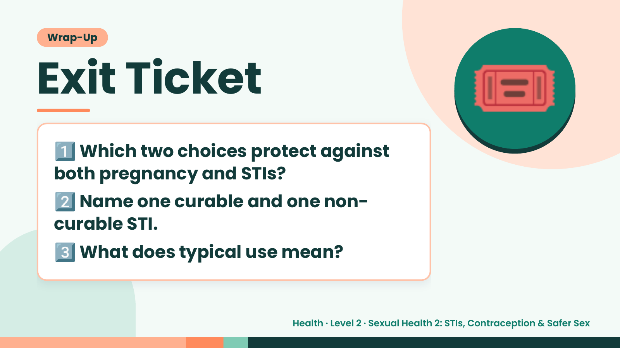
Notes:
Wrap-Up
Exit Ticket
1️⃣
Which two choices protect against
both pregnancy and STIs?
🎟️
2️⃣
Name one curable and one non-
curable STI.
3️⃣What does typical use mean?
Health · Level 2 · Sexual Health 2: STIs, Contraception & Safer Sex

