Slide 1
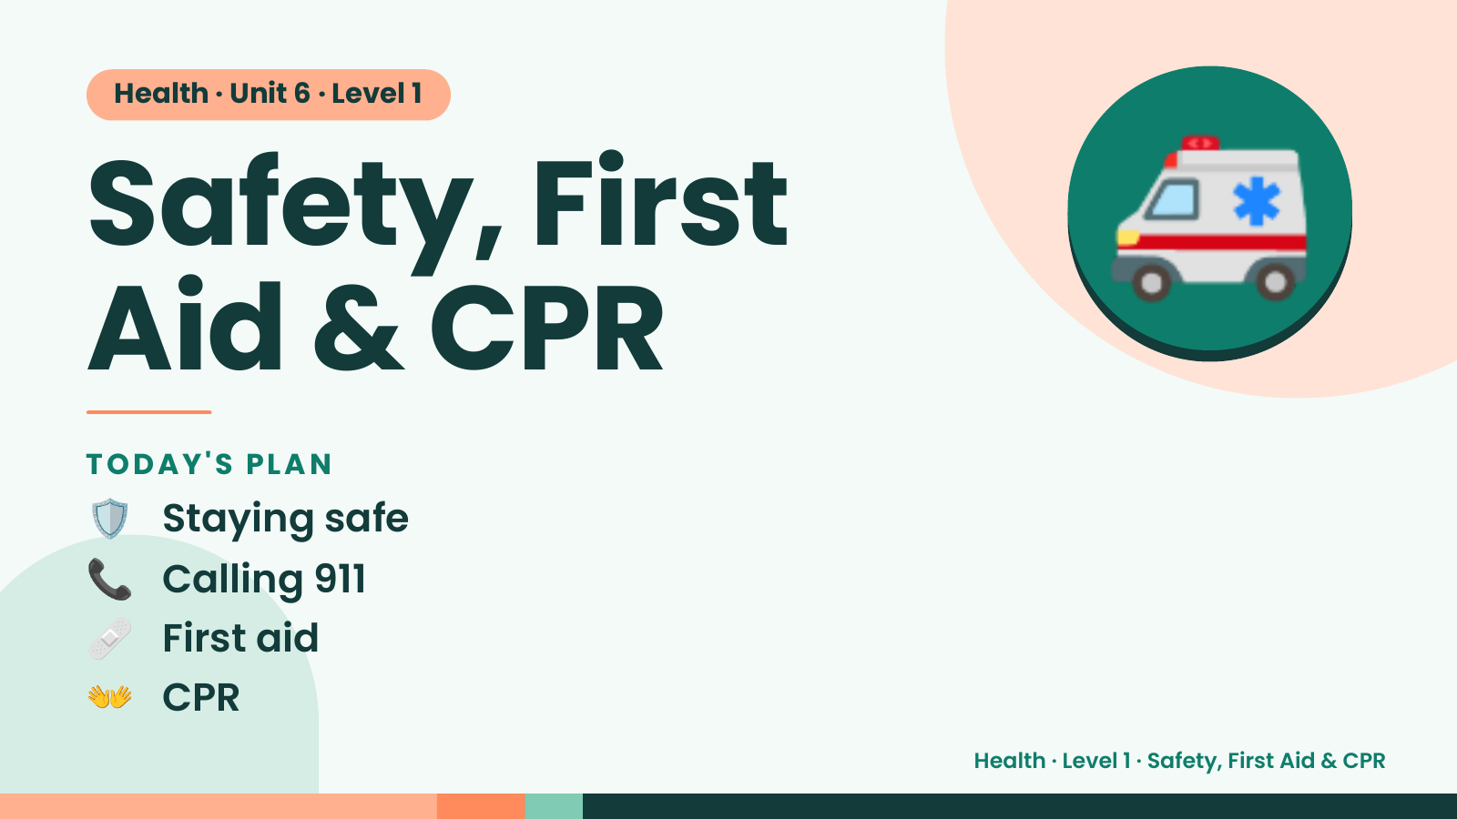
Notes:
Health · Unit 6 · Level 1
Safety, First
Aid & CPR
🚑
🛡️ Staying safe
TODAY'S PLAN
📞 Calling 911
🩹 First aid
👐 CPR
Health · Level 1 · Safety, First Aid & CPR

Slide 2
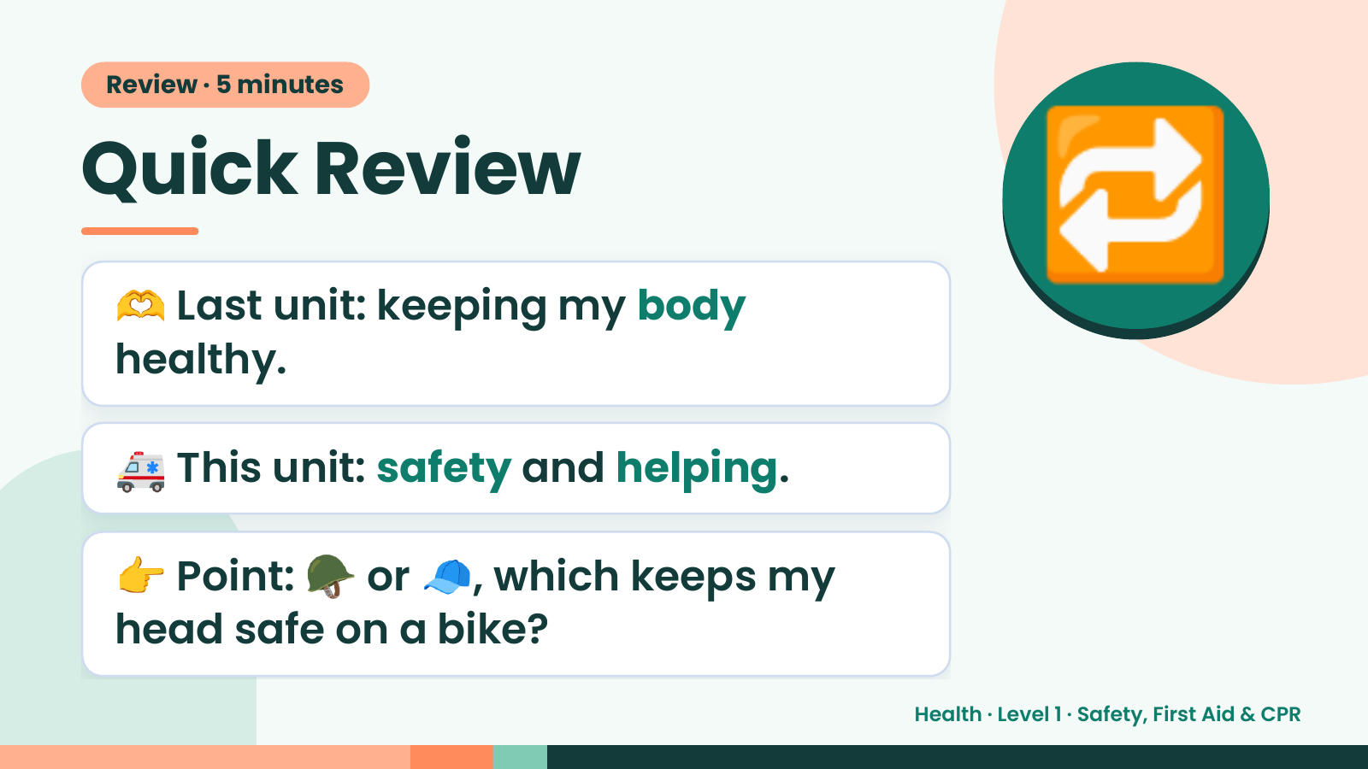
Notes:
Review · 5 minutes
Quick Review
🫶 Last unit: keeping my body
healthy.
🔁
🚑 This unit: safety and helping.
👉 Point: 🪖 or 🧢, which keeps my
head safe on a bike?
Health · Level 1 · Safety, First Aid & CPR

Slide 3
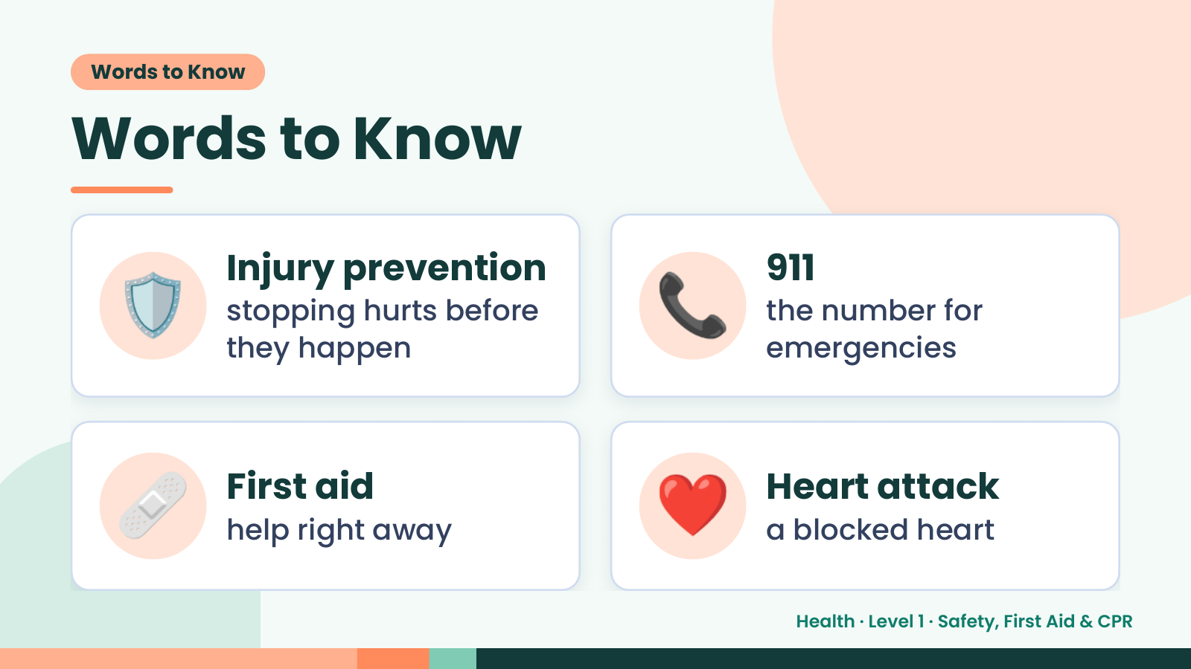
Notes:
Words to Know
Words to Know
🛡️ Injury prevention
stopping hurts before
they happen
📞 911
the number for
emergencies
🩹 First aid
help right away ❤️ Heart attack
a blocked heart
Health · Level 1 · Safety, First Aid & CPR

Slide 4
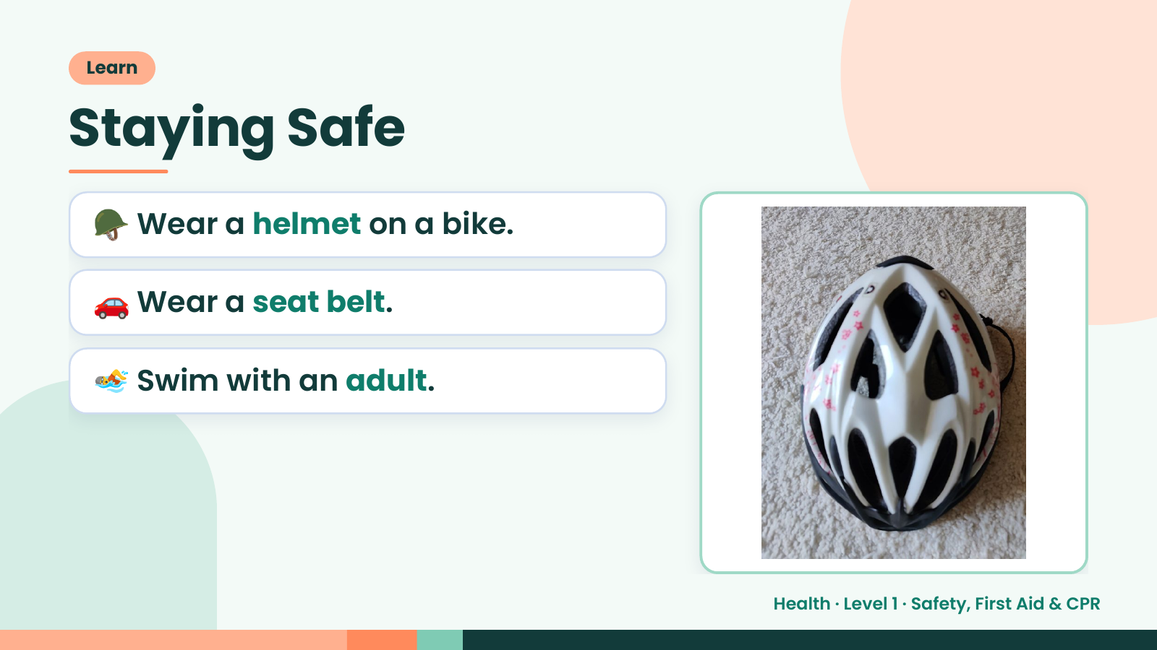
Notes:
Learn
Staying Safe
🪖 Wear a helmet on a bike.
🚗 Wear a seat belt.
🏊 Swim with an adult.
Health · Level 1 · Safety, First Aid & CPR

Slide 5
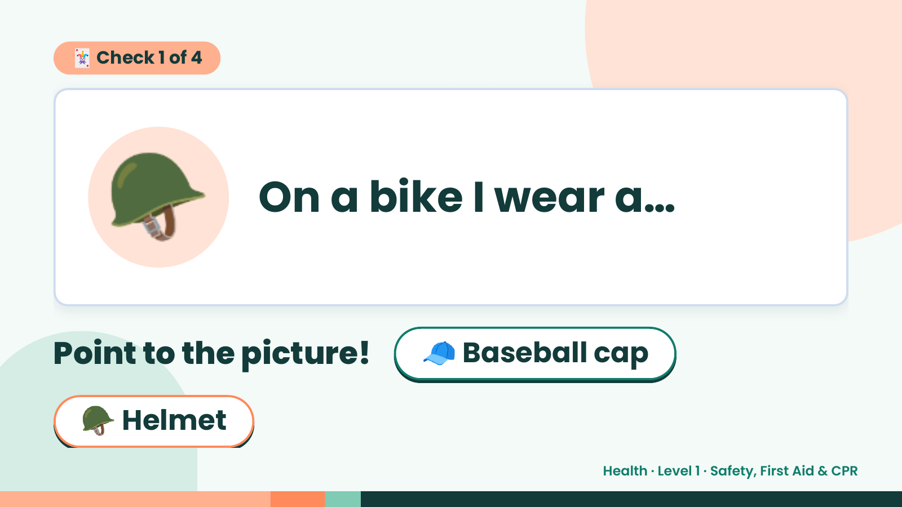
Notes:
🃏 Check 1 of 4
🪖 On a bike I wear a…
Point to the picture! 🧢 Baseball cap
🪖 Helmet
Health · Level 1 · Safety, First Aid & CPR

Slide 6
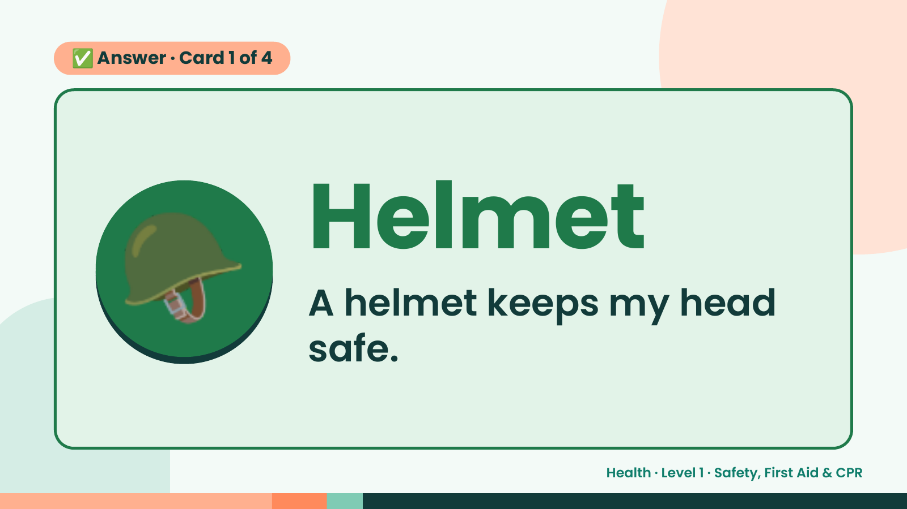
Notes:
✅ Answer · Card 1 of 4
🪖 Helmet
A helmet keeps my head
safe.
Health · Level 1 · Safety, First Aid & CPR

Slide 7
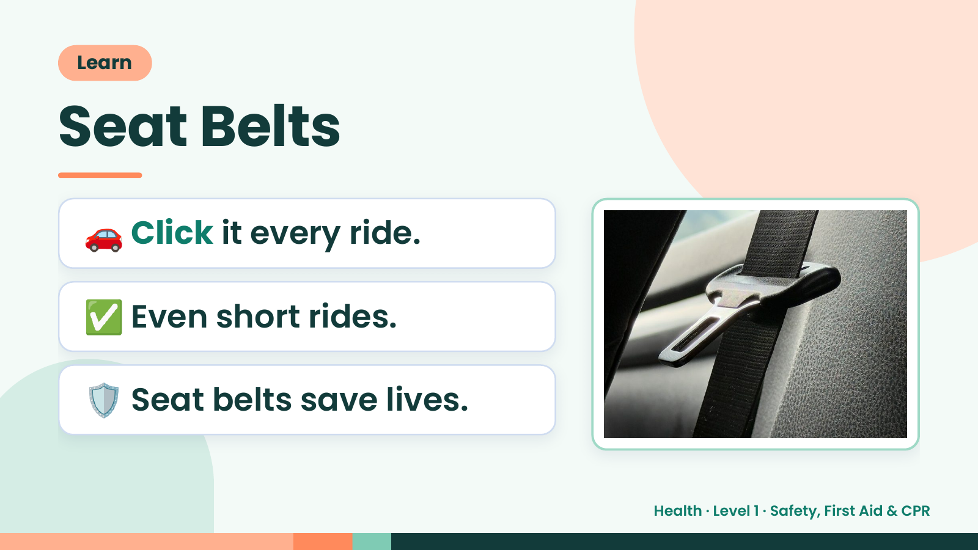
Notes:
Learn
Seat Belts
🚗 Click it every ride.
✅ Even short rides.
🛡️ Seat belts save lives.
Health · Level 1 · Safety, First Aid & CPR

Slide 8
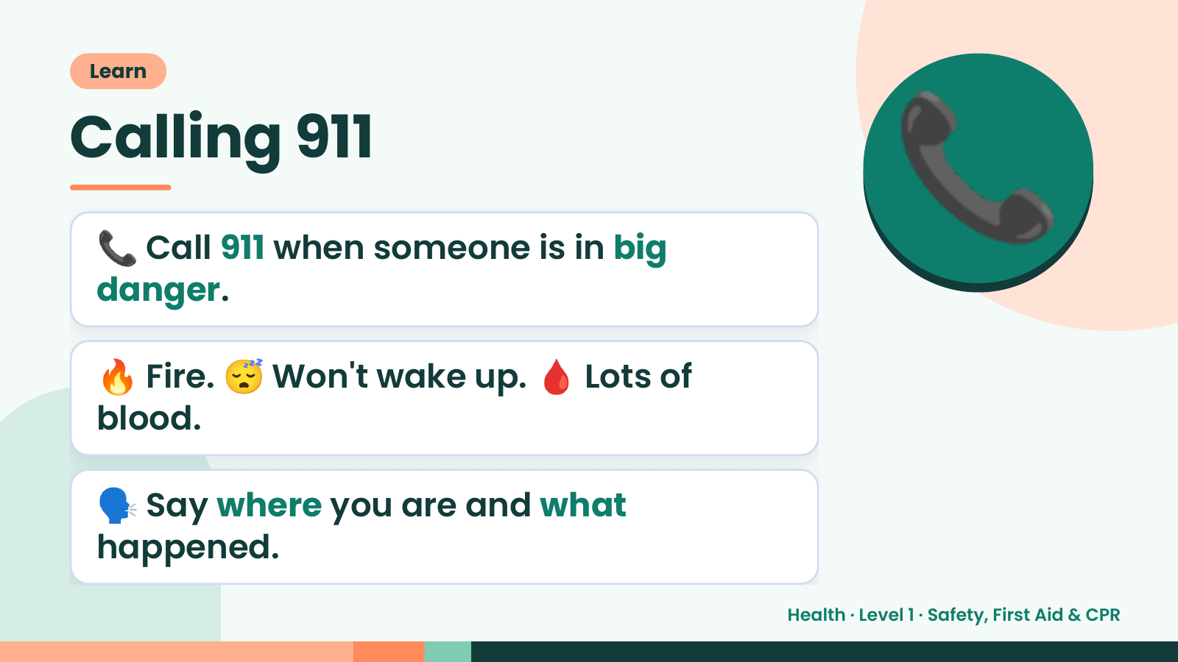
Notes:
Learn
Calling 911
📞 Call 911 when someone is in big
danger.
📞
🔥 Fire. 😴 Won't wake up. 🩸 Lots of
blood.
🗣️ Say where you are and what
happened.
Health · Level 1 · Safety, First Aid & CPR

Slide 9
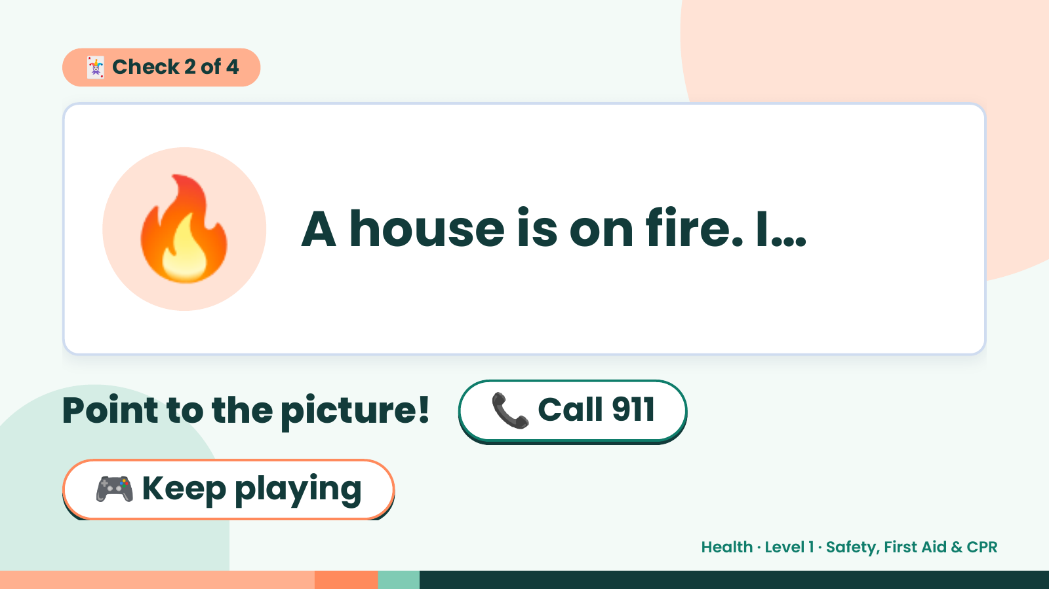
Notes:
🃏 Check 2 of 4
🔥 A house is on fire. I…
Point to the picture! 📞 Call 911
🎮 Keep playing
Health · Level 1 · Safety, First Aid & CPR

Slide 10
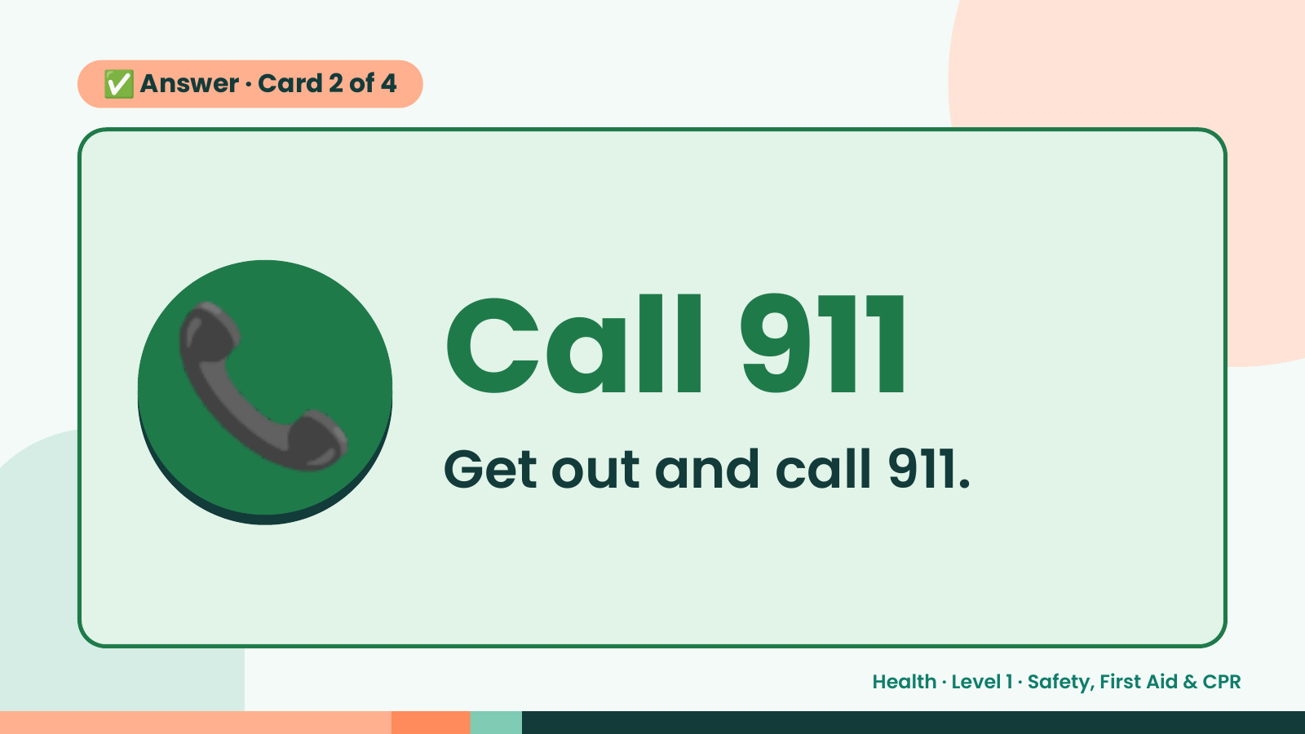
Notes:
✅ Answer · Card 2 of 4
📞 Call 911
Get out and call 911.
Health · Level 1 · Safety, First Aid & CPR

Slide 11
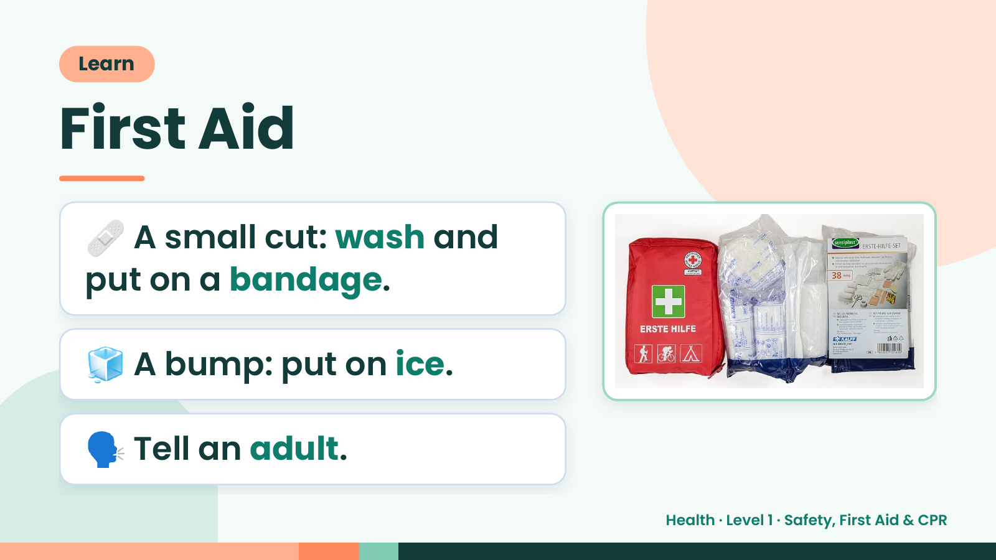
Notes:
Learn
First Aid
🩹 A small cut: wash and
put on a bandage.
🧊 A bump: put on ice.
🗣️ Tell an adult.
Health · Level 1 · Safety, First Aid & CPR

Slide 12
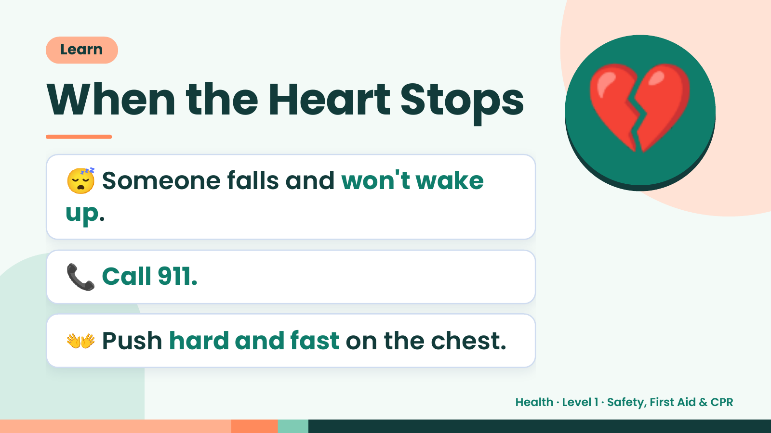
Notes:
Learn
When the Heart Stops
😴 Someone falls and won't wake
up.
💔
📞 Call 911.
👐 Push hard and fast on the chest.
Health · Level 1 · Safety, First Aid & CPR

Slide 13
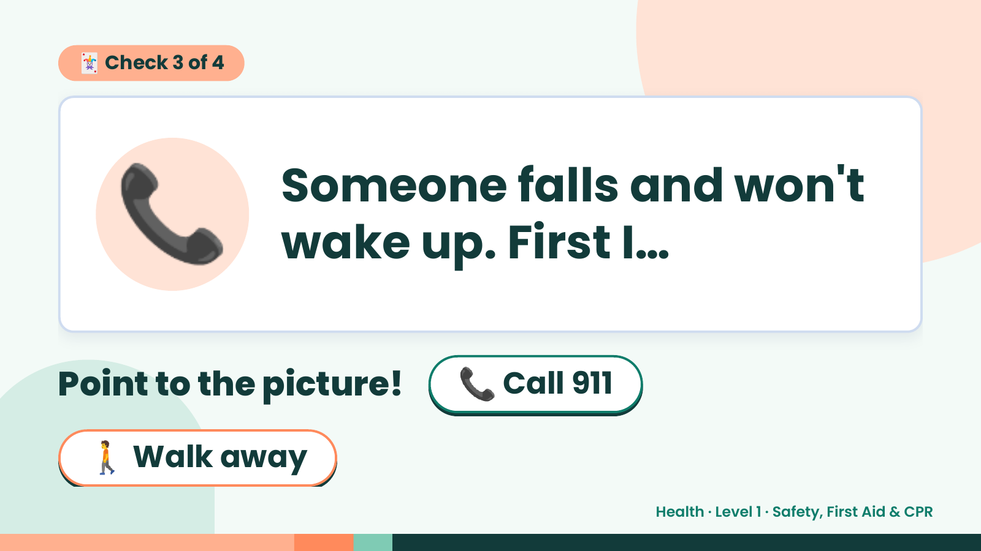
Notes:
🃏 Check 3 of 4
📞 Someone falls and won't
wake up. First I…
Point to the picture! 📞 Call 911
🚶 Walk away
Health · Level 1 · Safety, First Aid & CPR

Slide 14
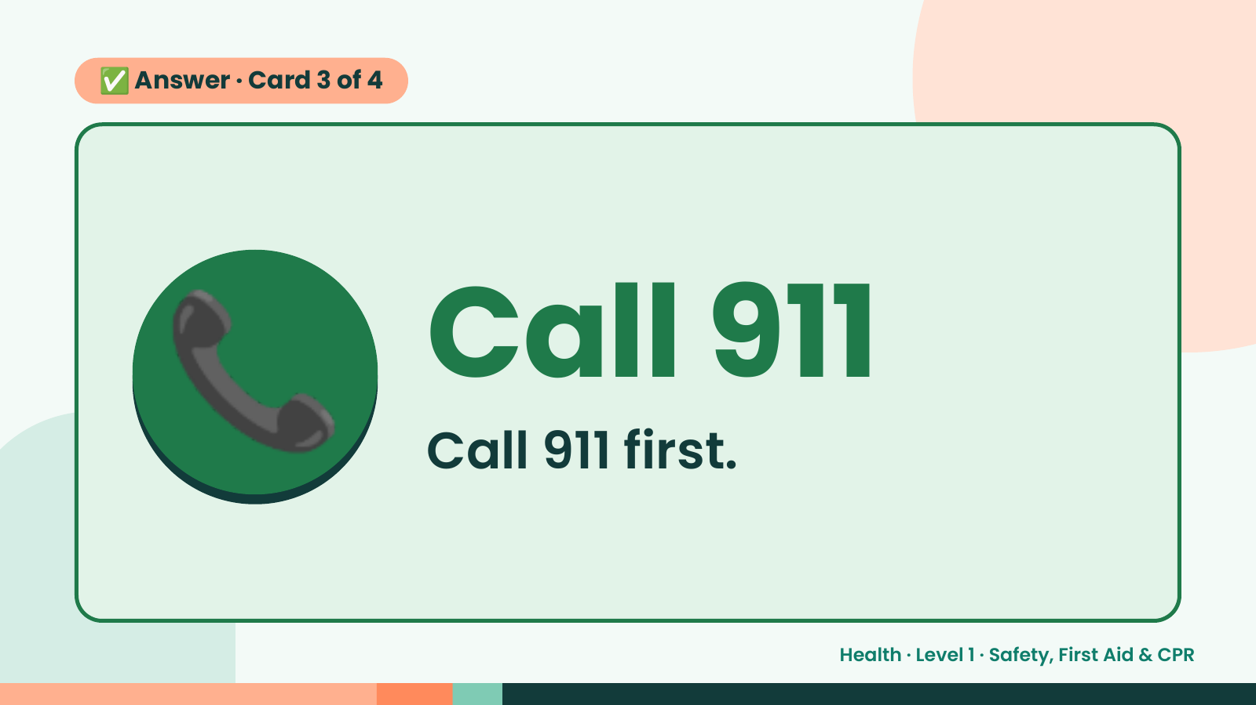
Notes:
✅ Answer · Card 3 of 4
📞 Call 911
Call 911 first.
Health · Level 1 · Safety, First Aid & CPR

Slide 15
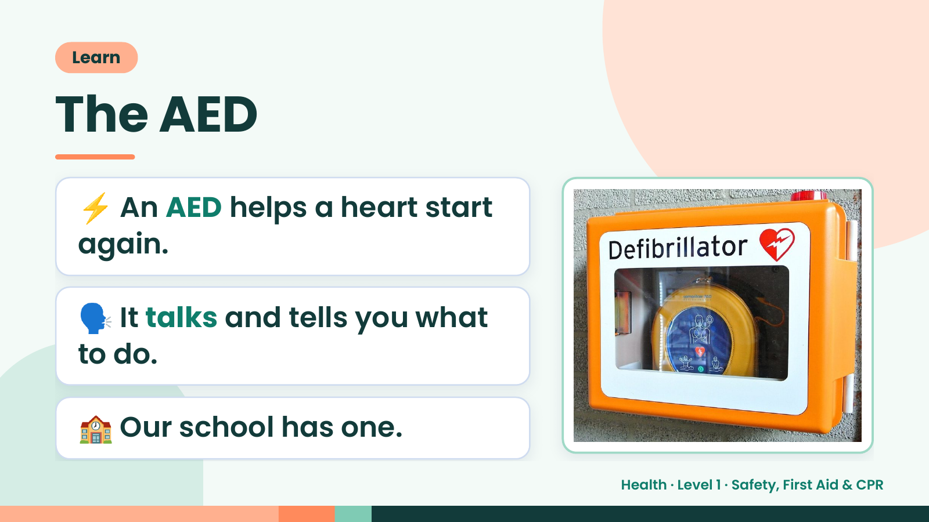
Notes:
Learn
The AED
⚡ An AED helps a heart start
again.
🗣️ It talks and tells you what
to do.
🏫 Our school has one.
Health · Level 1 · Safety, First Aid & CPR

Slide 16
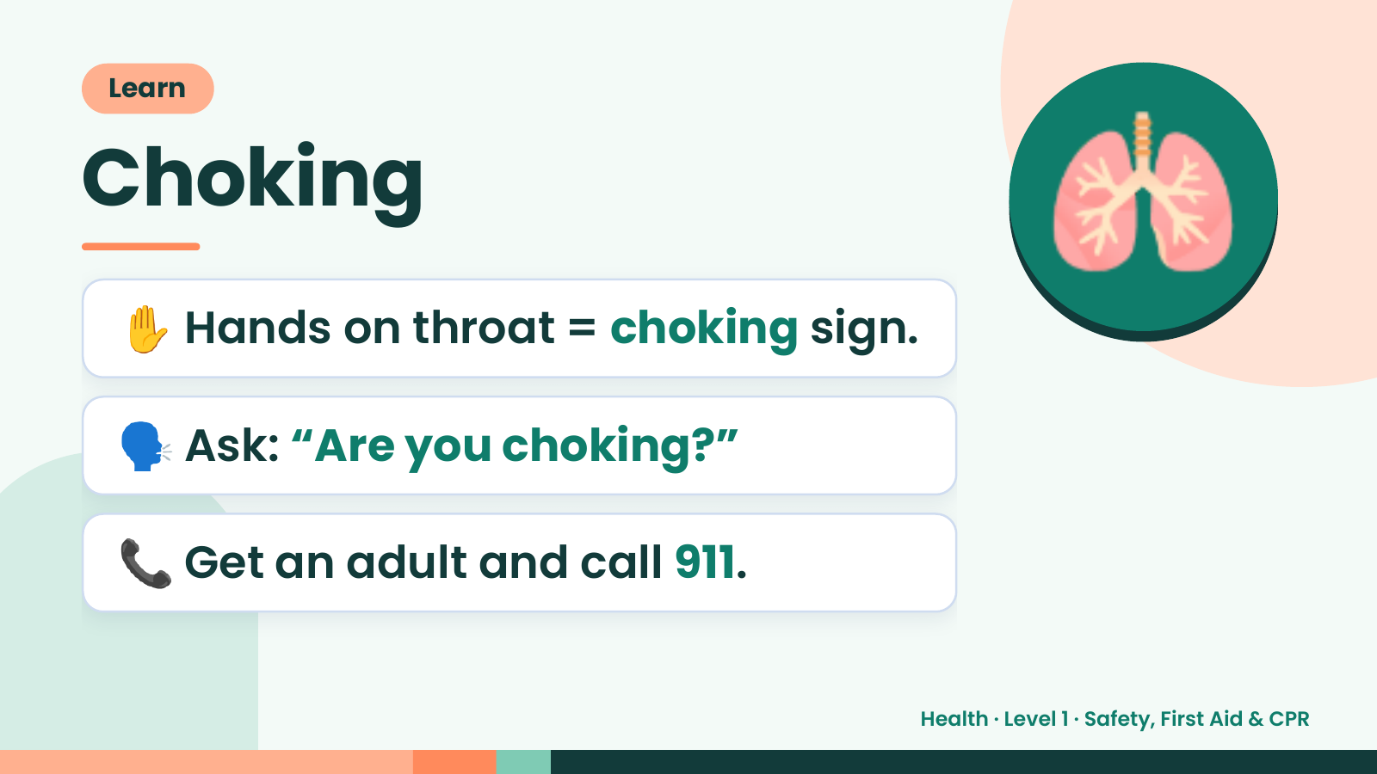
Notes:
Learn
Choking
✋ Hands on throat = choking sign.
🫁
🗣️ Ask: “Are you choking?”
📞 Get an adult and call 911.
Health · Level 1 · Safety, First Aid & CPR

Slide 17
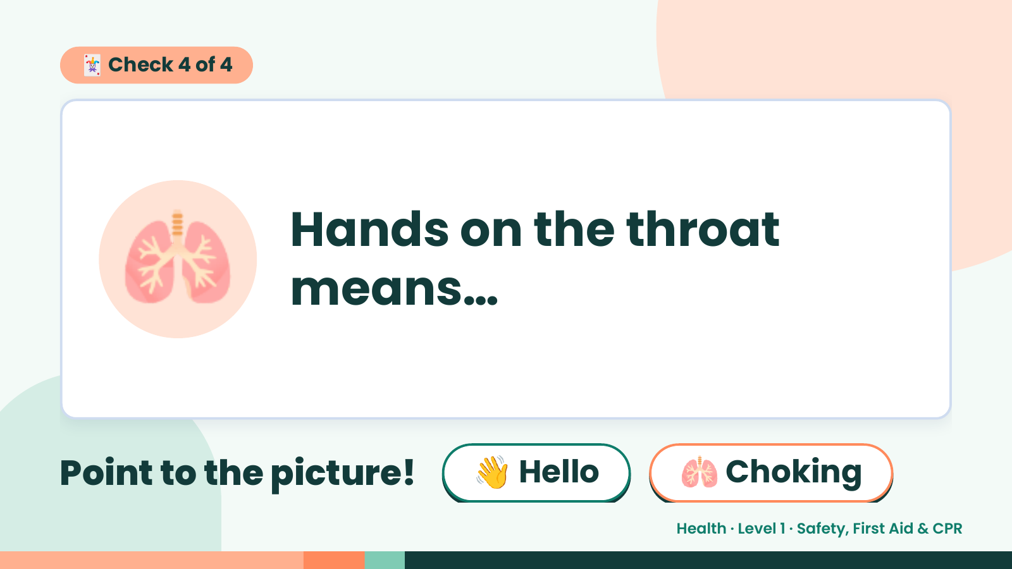
Notes:
🃏 Check 4 of 4
🫁 Hands on the throat
means…
Point to the picture! 👋 Hello 🫁 Choking
Health · Level 1 · Safety, First Aid & CPR

Slide 18
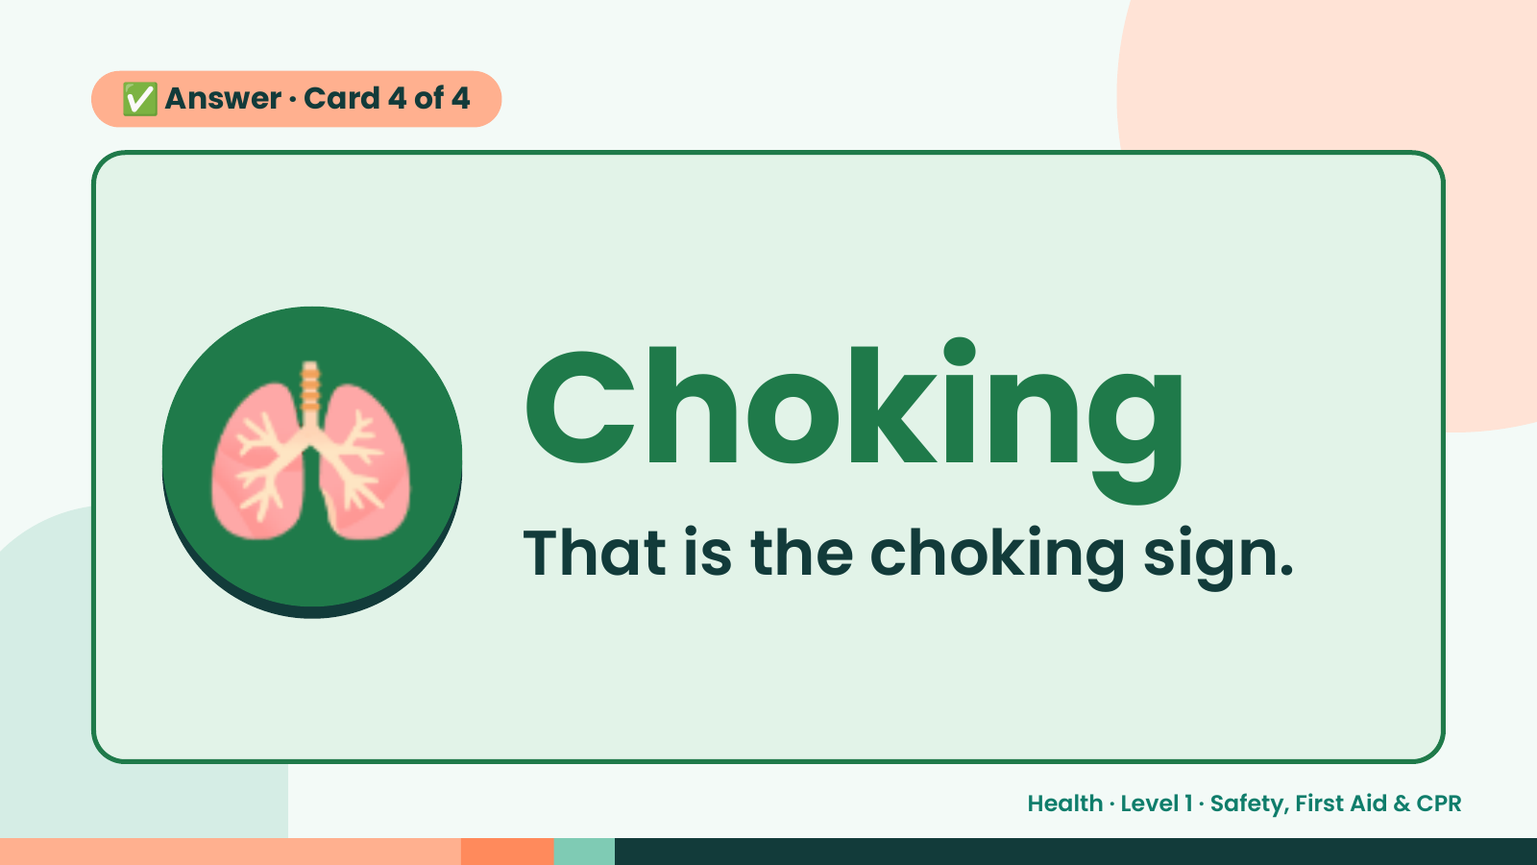
Notes:
✅ Answer · Card 4 of 4
🫁 Choking
That is the choking sign.
Health · Level 1 · Safety, First Aid & CPR

Slide 19
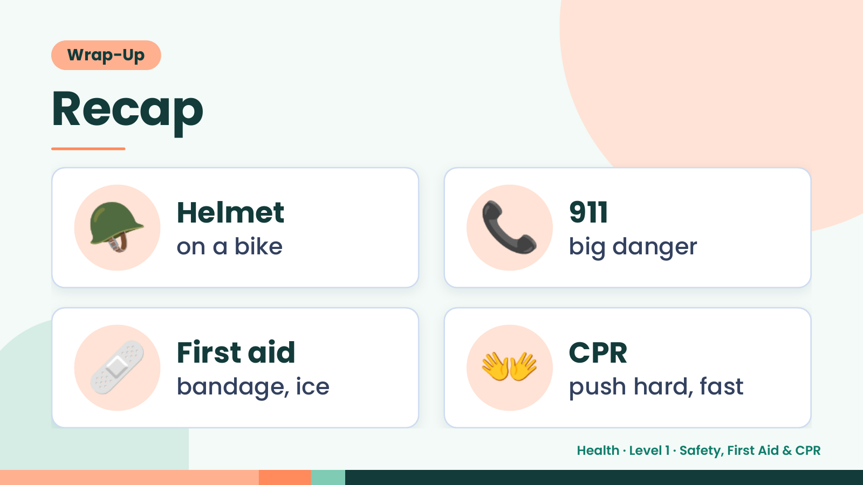
Notes:
Wrap-Up
Recap
🪖 Helmet
on a bike 📞 911
big danger
🩹 First aid
bandage, ice 👐 CPR
push hard, fast
Health · Level 1 · Safety, First Aid & CPR

Slide 20
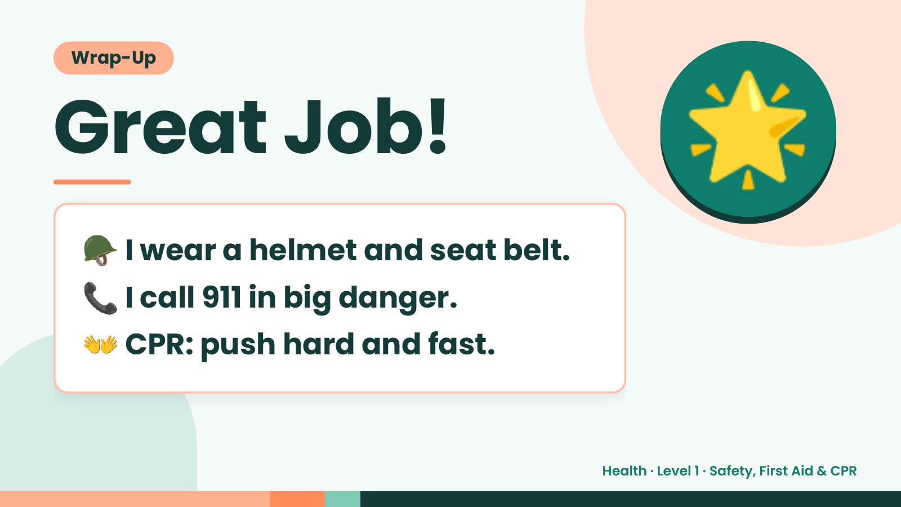
Notes:
Wrap-Up
Great Job!
🪖 I wear a helmet and seat belt.
🌟
📞 I call 911 in big danger.
👐 CPR: push hard and fast.
Health · Level 1 · Safety, First Aid & CPR

