Slide 1
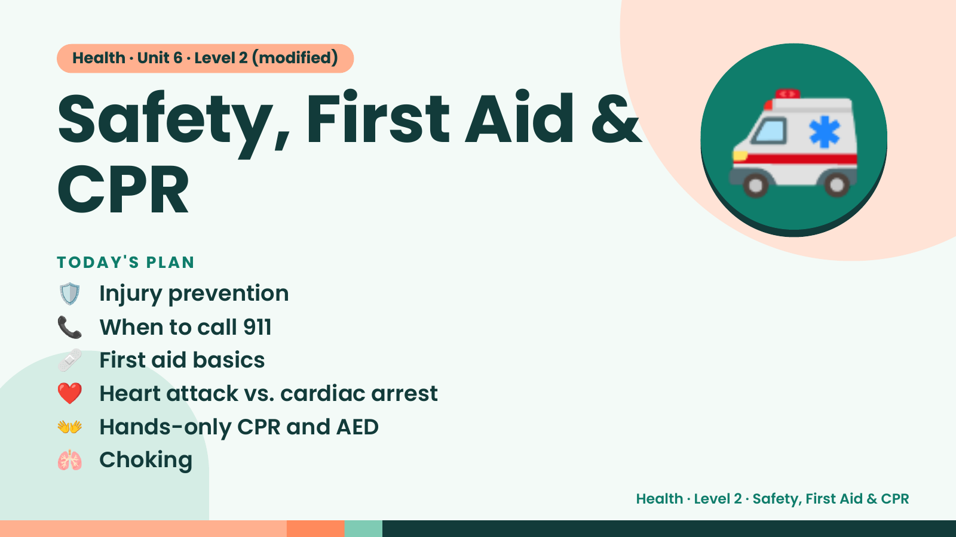
Notes:
Health · Unit 6 · Level 2 (modified)
Safety, First Aid &
CPR
🛡️ Injury prevention
TODAY'S PLAN
🚑
📞 When to call 911
🩹 First aid basics
❤️ Heart attack vs. cardiac arrest
👐 Hands-only CPR and AED
🫁 Choking
Health · Level 2 · Safety, First Aid & CPR

Slide 2
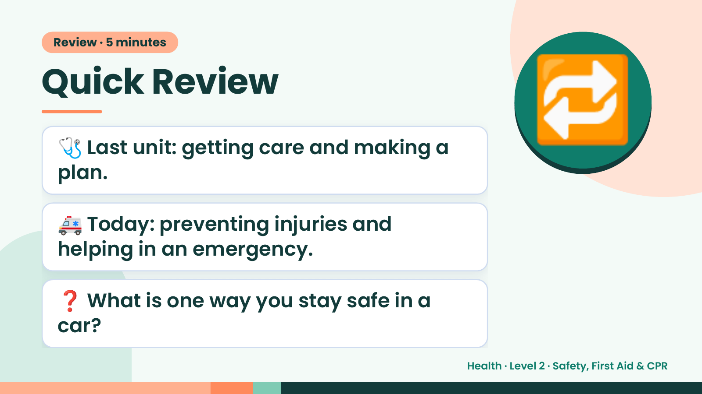
Notes:
Review · 5 minutes
Quick Review
🩺 Last unit: getting care and making a
plan.
🔁
🚑 Today: preventing injuries and
helping in an emergency.
❓ What is one way you stay safe in a
car?
Health · Level 2 · Safety, First Aid & CPR

Slide 3
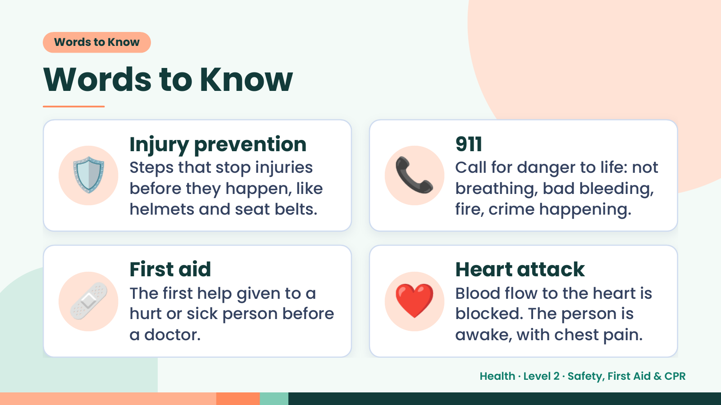
Notes:
Words to Know
Words to Know
🛡️ Injury prevention
Steps that stop injuries
before they happen, like
helmets and seat belts.
📞 911
Call for danger to life: not
breathing, bad bleeding,
fire, crime happening.
🩹 First aid
The first help given to a
hurt or sick person before
a doctor.
❤️ Heart attack
Blood flow to the heart is
blocked. The person is
awake, with chest pain.
Health · Level 2 · Safety, First Aid & CPR

Slide 4
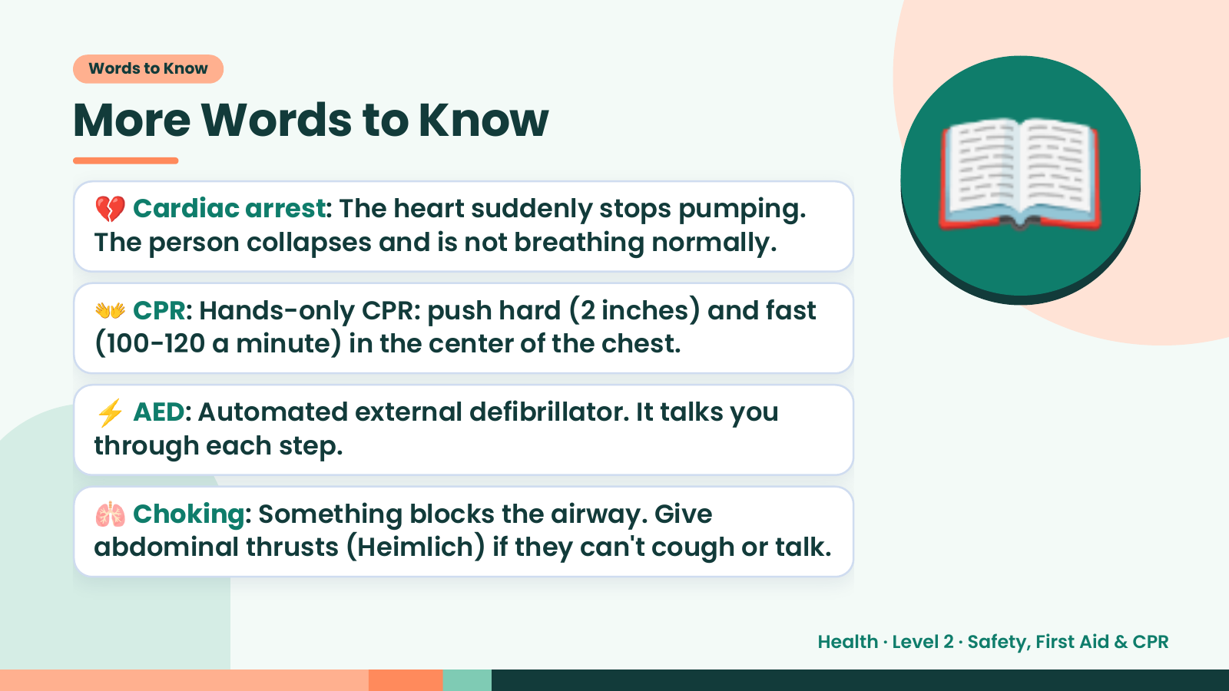
Notes:
Words to Know
More Words to Know
💔 Cardiac arrest: The heart suddenly stops pumping.
The person collapses and is not breathing normally.
👐 CPR: Hands-only CPR: push hard (2 inches) and fast
(100-120 a minute) in the center of the chest.
📖
⚡ AED: Automated external defibrillator. It talks you
through each step.
🫁 Choking: Something blocks the airway. Give
abdominal thrusts (Heimlich) if they can't cough or talk.
Health · Level 2 · Safety, First Aid & CPR

Slide 5
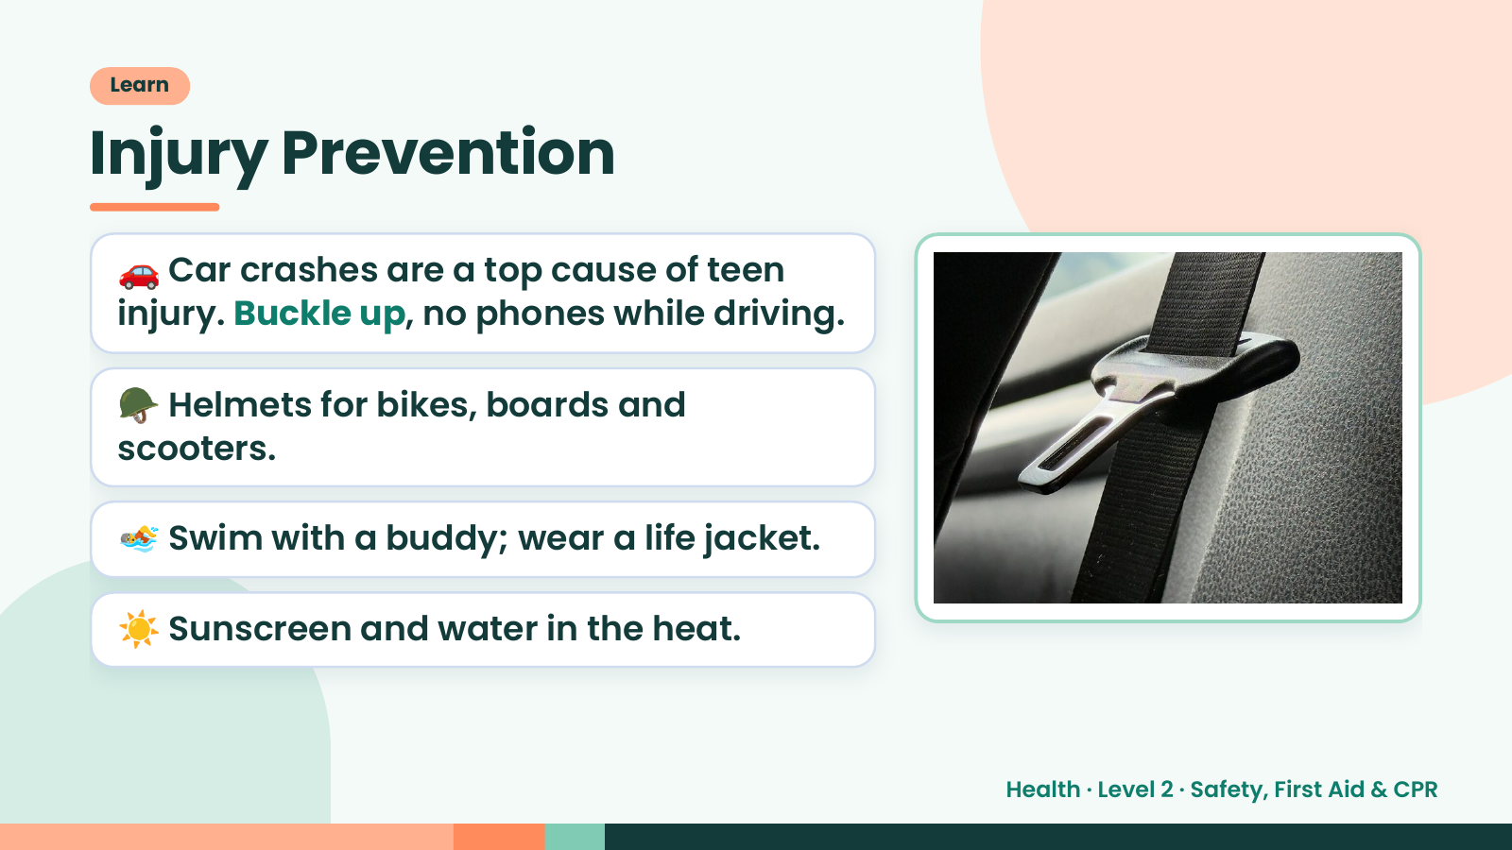
Notes:
Learn
Injury Prevention
🚗 Car crashes are a top cause of teen
injury. Buckle up, no phones while driving.
🪖 Helmets for bikes, boards and
scooters.
🏊 Swim with a buddy; wear a life jacket.
☀️ Sunscreen and water in the heat.
Health · Level 2 · Safety, First Aid & CPR

Slide 6
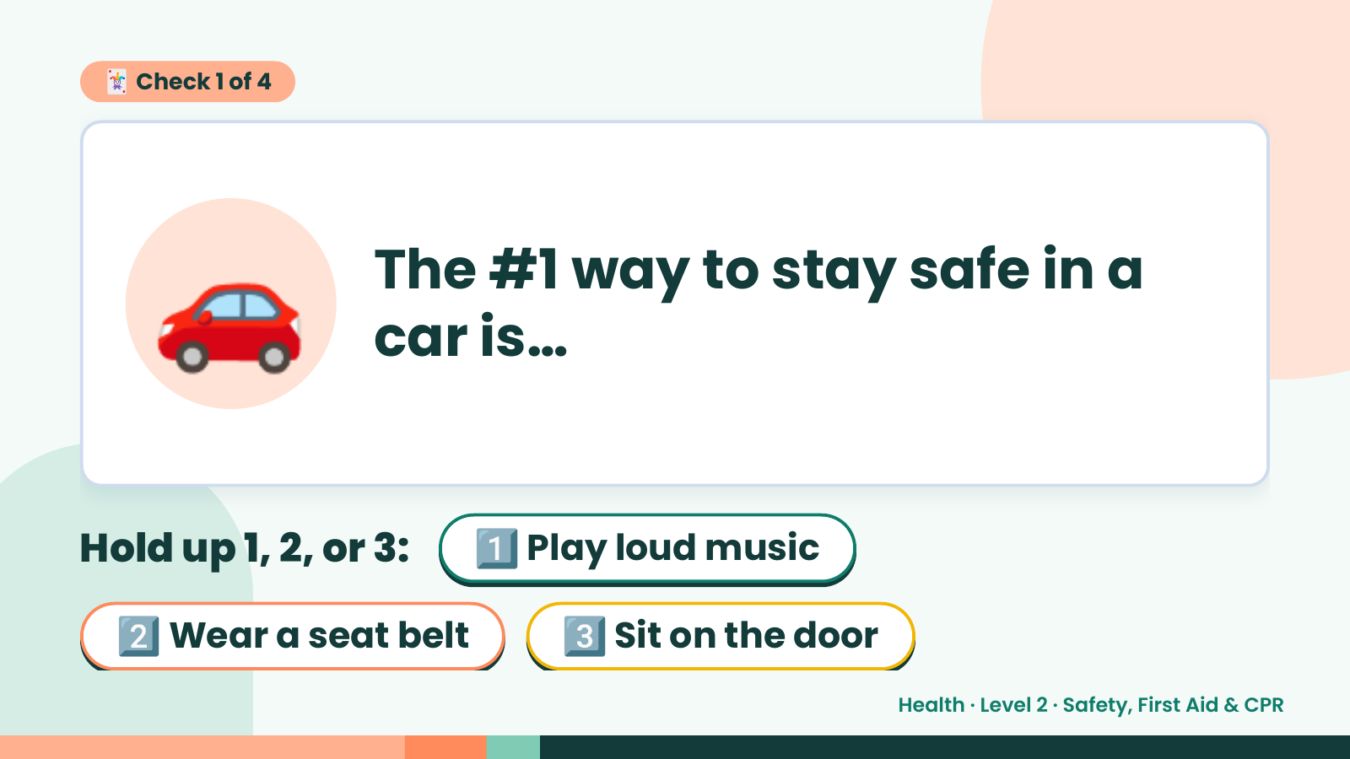
Notes:
🃏 Check 1 of 4
🚗 The #1 way to stay safe in a
car is…
Hold up 1, 2, or 3: 1️⃣ Play loud music
2️⃣ Wear a seat belt 3️⃣ Sit on the door
Health · Level 2 · Safety, First Aid & CPR

Slide 7
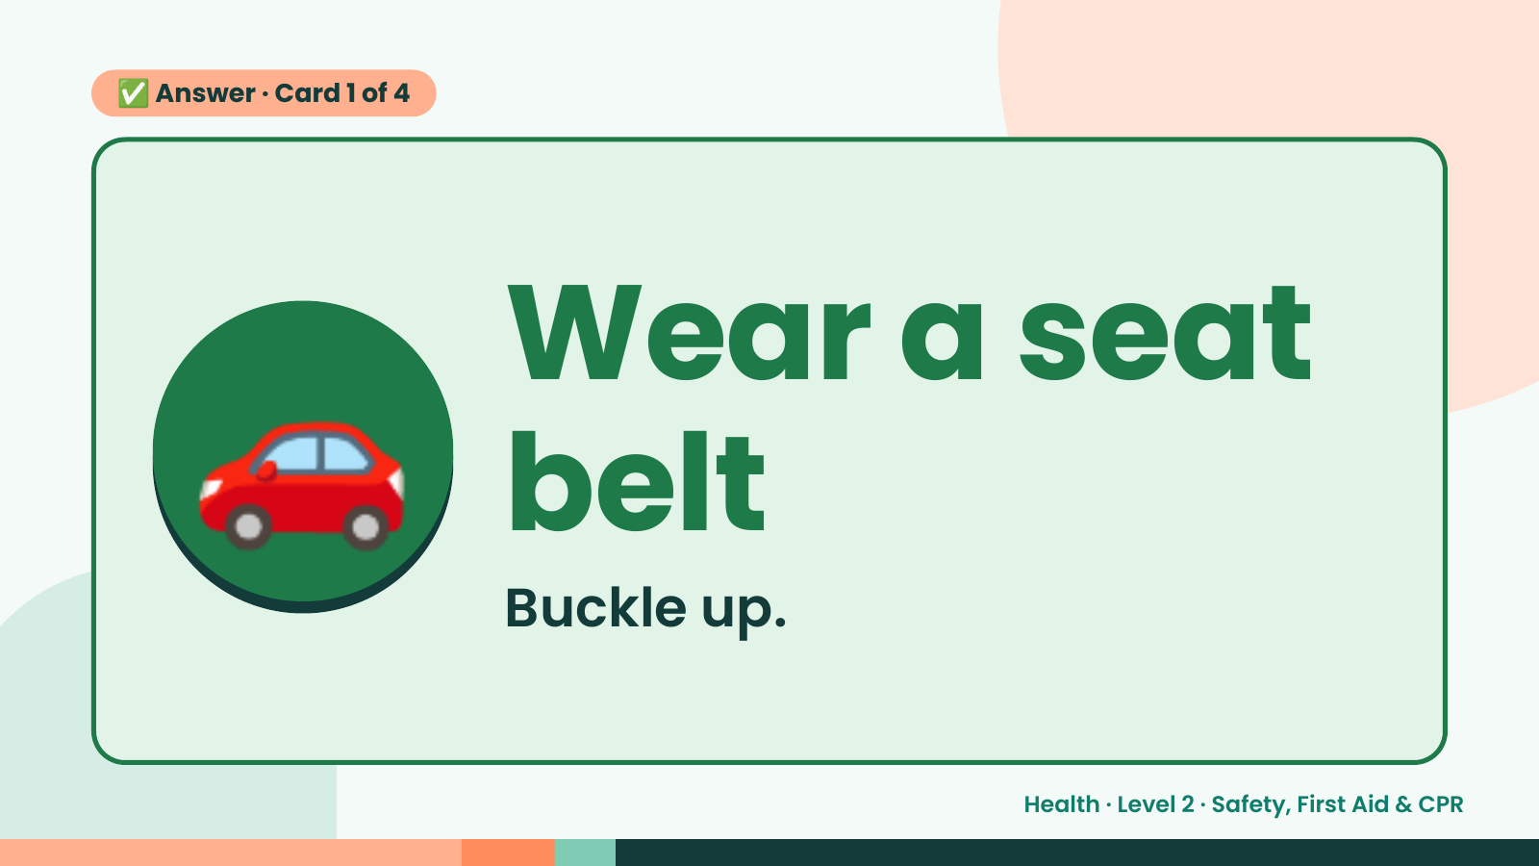
Notes:
✅ Answer · Card 1 of 4
🚗 Wear a seat
belt
Buckle up.
Health · Level 2 · Safety, First Aid & CPR

Slide 8
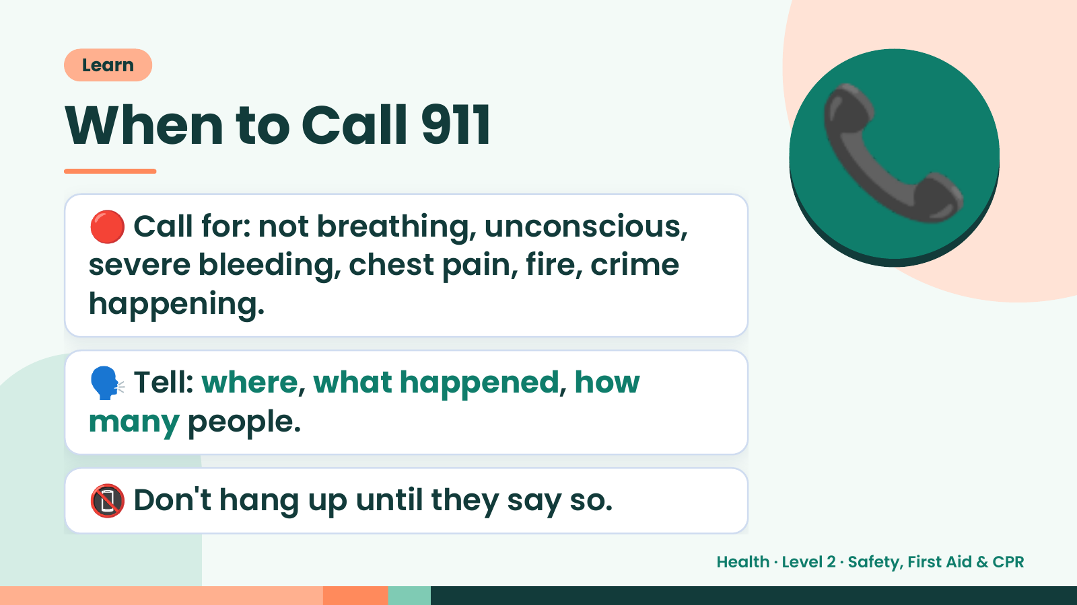
Notes:
Learn
When to Call 911
🔴 Call for: not breathing, unconscious,
severe bleeding, chest pain, fire, crime
happening.
📞
🗣️ Tell: where, what happened, how
many people.
📵 Don't hang up until they say so.
Health · Level 2 · Safety, First Aid & CPR

Slide 9
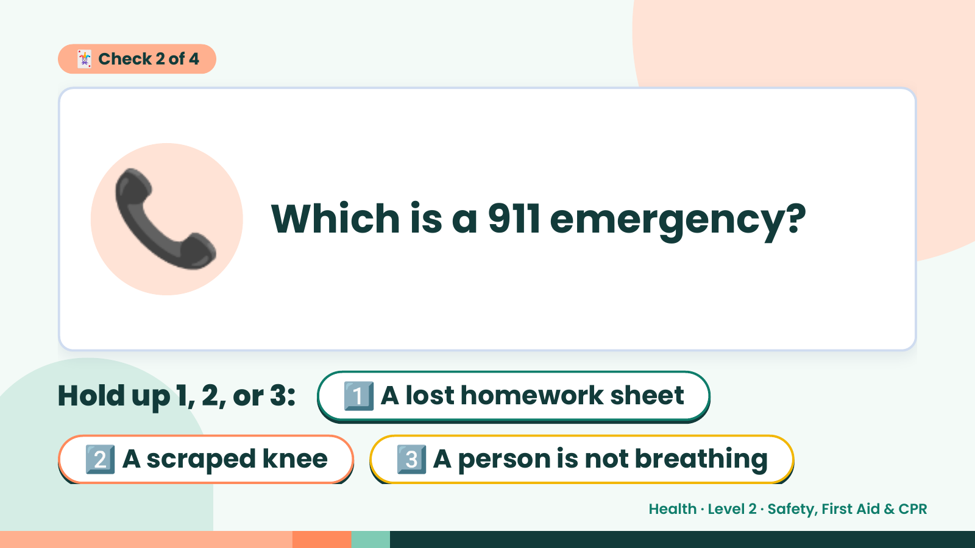
Notes:
🃏 Check 2 of 4
📞 Which is a 911 emergency?
Hold up 1, 2, or 3: 1️⃣ A lost homework sheet
2️⃣ A scraped knee 3️⃣ A person is not breathing
Health · Level 2 · Safety, First Aid & CPR

Slide 10
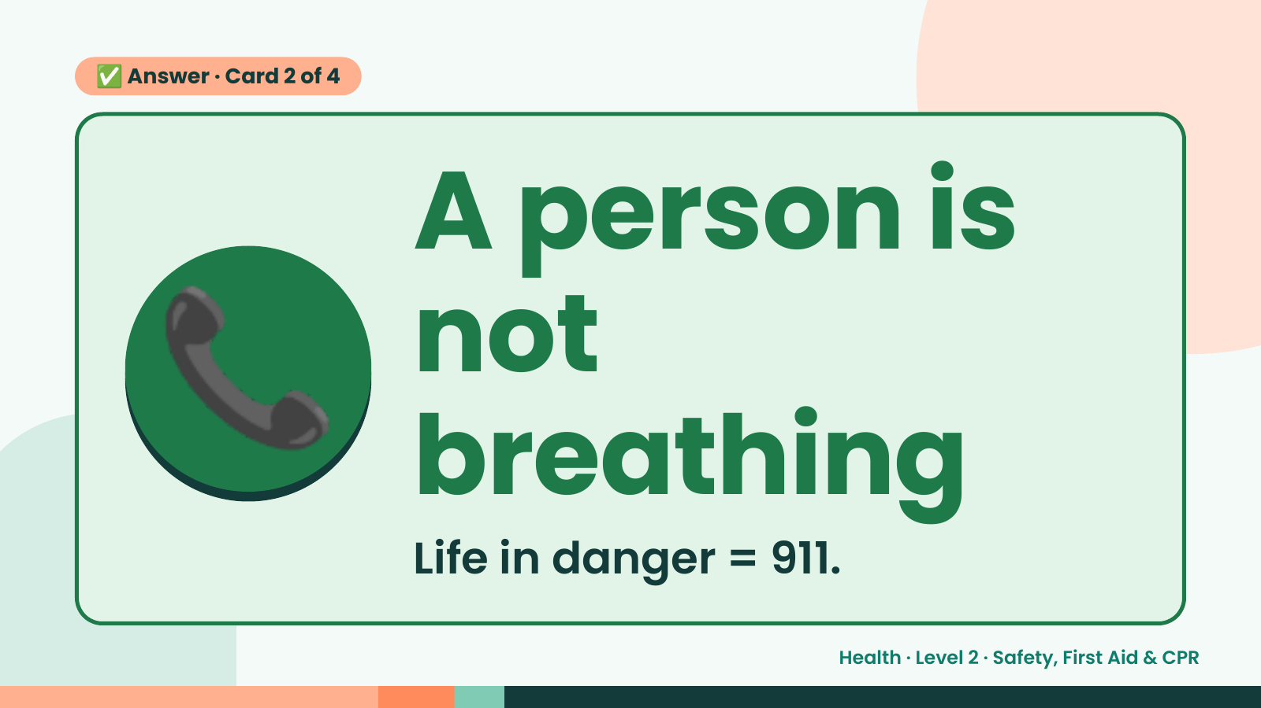
Notes:
✅ Answer · Card 2 of 4
📞 A person is
not
breathing
Life in danger = 911.
Health · Level 2 · Safety, First Aid & CPR

Slide 11
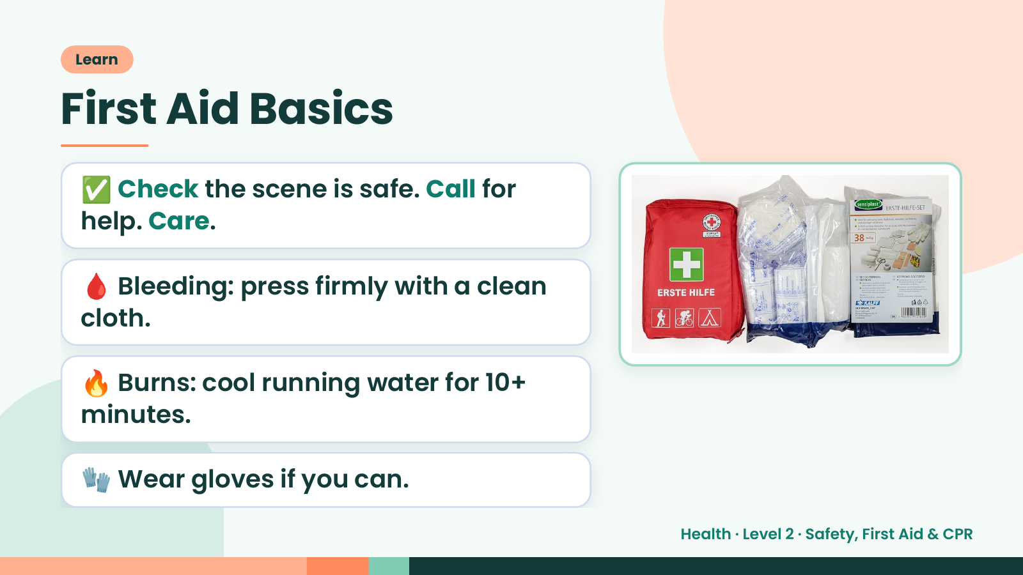
Notes:
Learn
First Aid Basics
✅ Check the scene is safe. Call for
help. Care.
🩸 Bleeding: press firmly with a clean
cloth.
🔥 Burns: cool running water for 10+
minutes.
🧤 Wear gloves if you can.
Health · Level 2 · Safety, First Aid & CPR

Slide 12
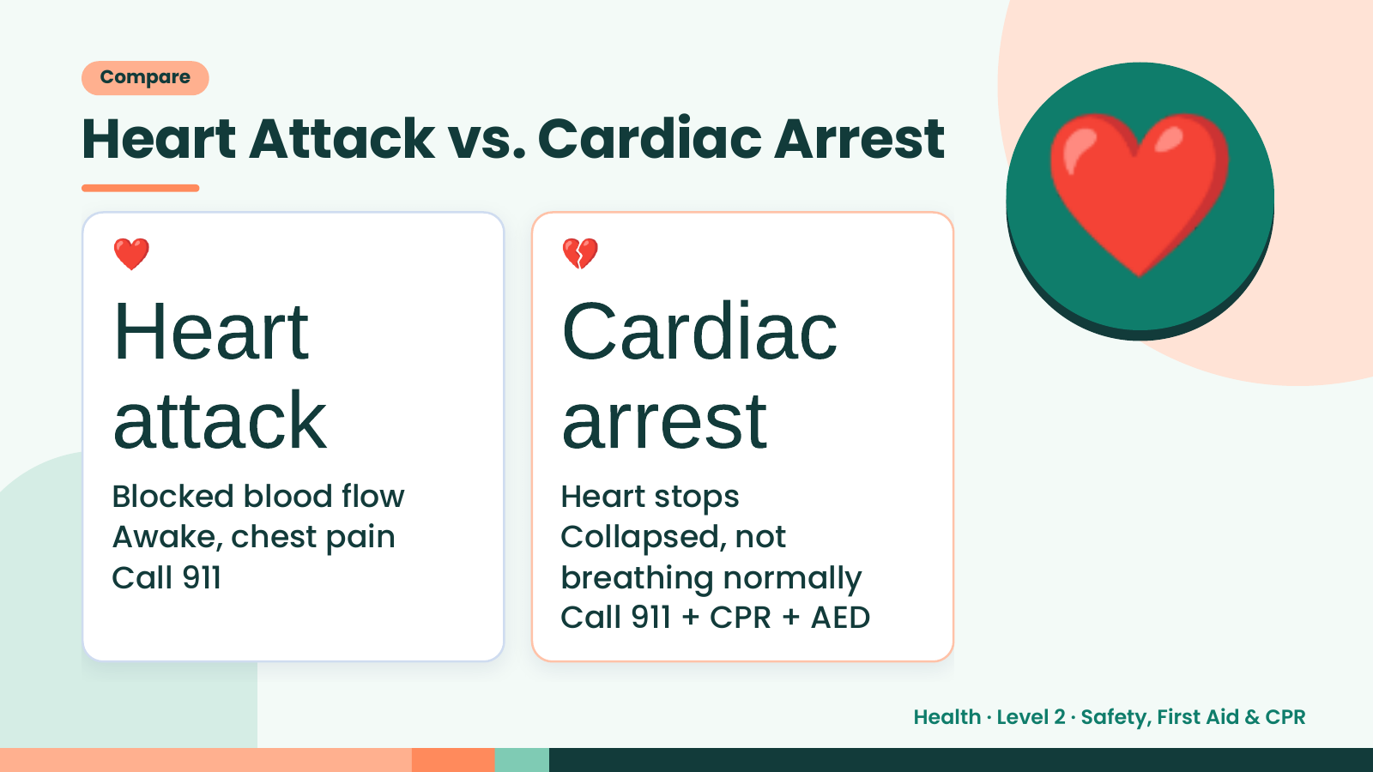
Notes:
Compare
Heart Attack vs. Cardiac Arrest
❤️
Heart
attack
💔
Cardiac
arrest
❤️
Blocked blood flow Heart stops
Awake, chest pain Collapsed, not
Call 911 breathing normally
Call 911 + CPR + AED
Health · Level 2 · Safety, First Aid & CPR

Slide 13
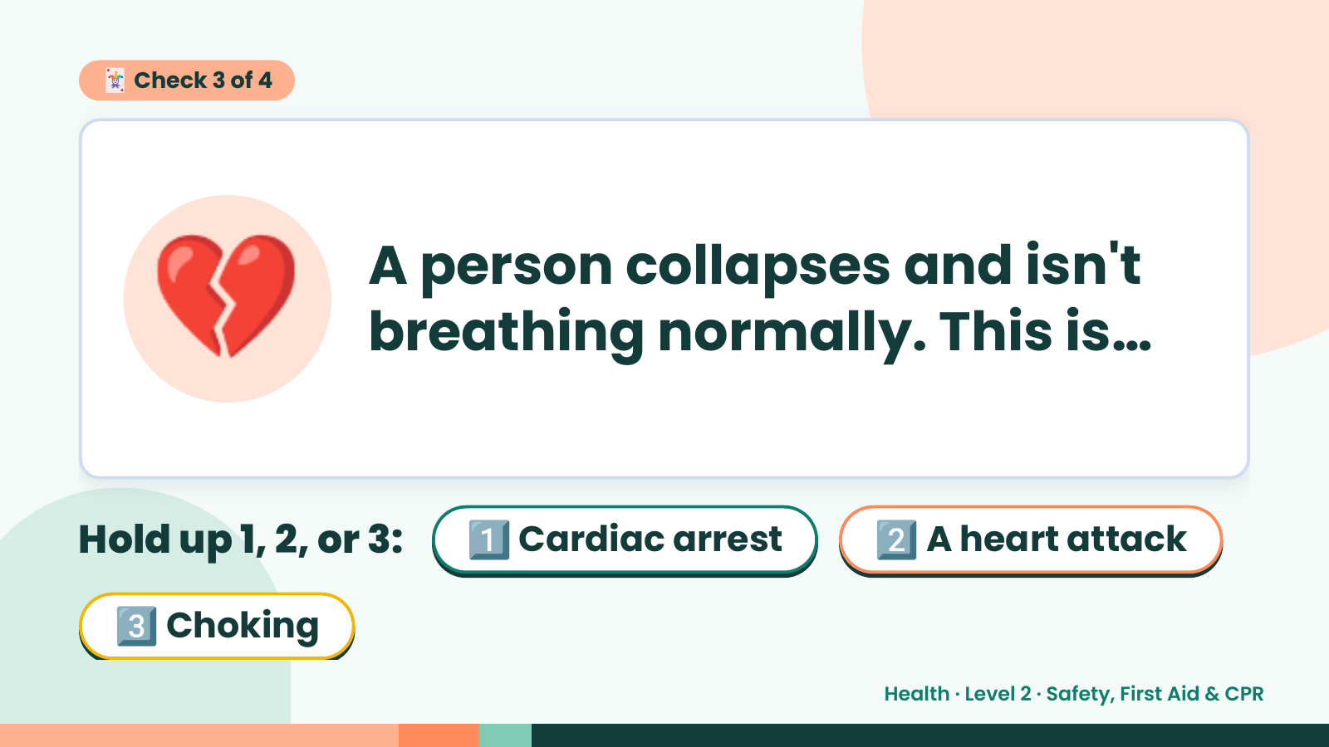
Notes:
🃏 Check 3 of 4
💔 A person collapses and isn't
breathing normally. This is…
Hold up 1, 2, or 3: 1️⃣ Cardiac arrest 2️⃣ A heart attack
3️⃣ Choking
Health · Level 2 · Safety, First Aid & CPR

Slide 14
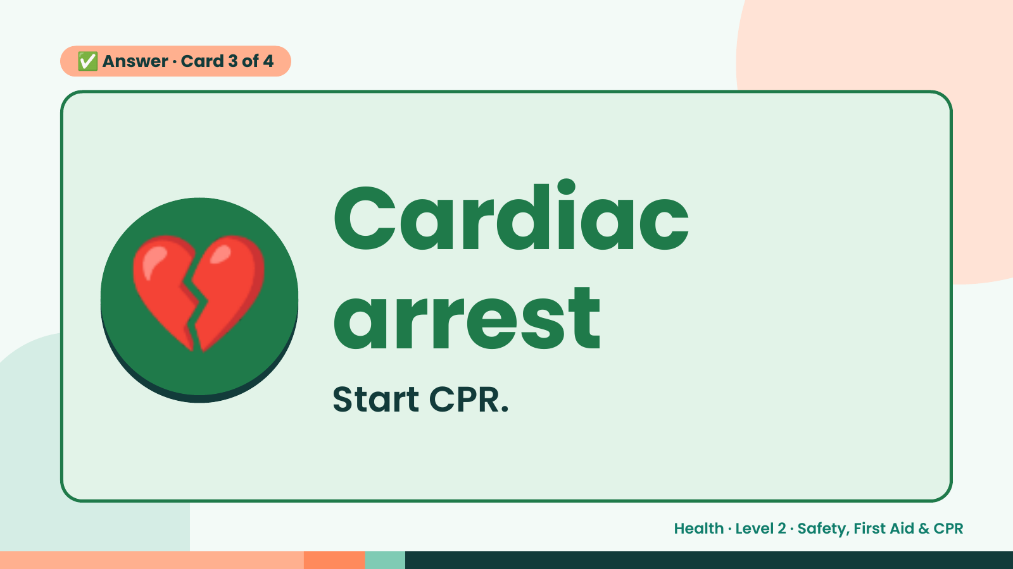
Notes:
✅ Answer · Card 3 of 4
💔 Cardiac
arrest
Start CPR.
Health · Level 2 · Safety, First Aid & CPR

Slide 15
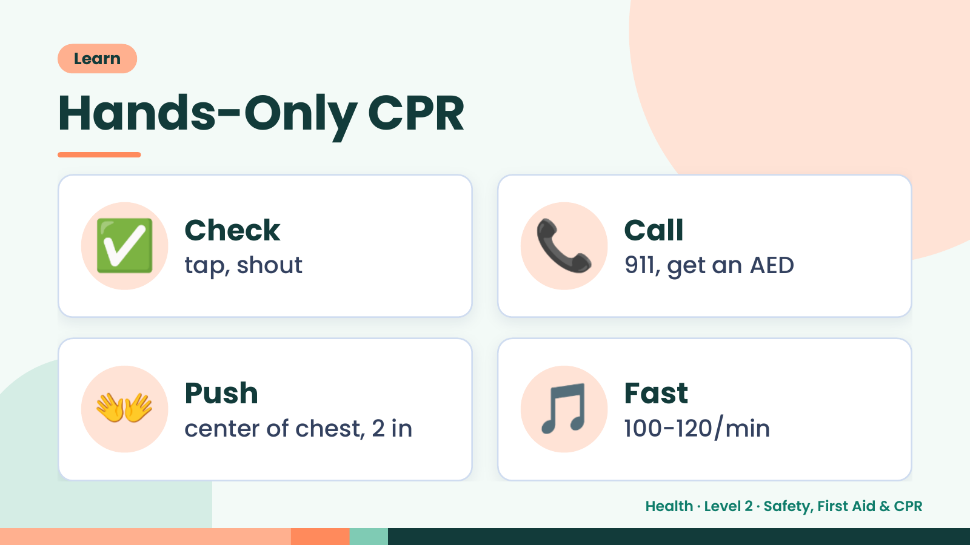
Notes:
Learn
Hands-Only CPR
✅ Check
tap, shout 📞 Call
911, get an AED
👐 Push
center of chest, 2 in 🎵 Fast
100-120/min
Health · Level 2 · Safety, First Aid & CPR

Slide 16
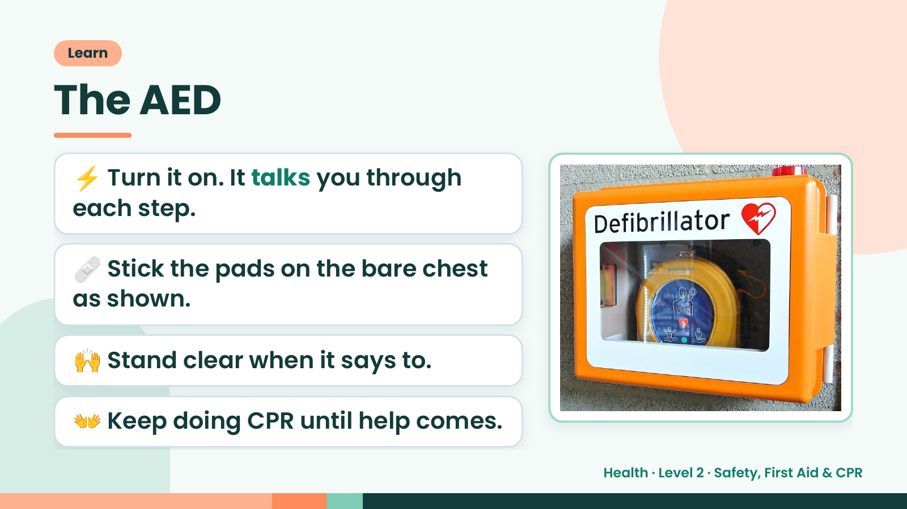
Notes:
Learn
The AED
⚡ Turn it on. It talks you through
each step.
🩹 Stick the pads on the bare chest
as shown.
🙌 Stand clear when it says to.
👐 Keep doing CPR until help comes.
Health · Level 2 · Safety, First Aid & CPR

Slide 17
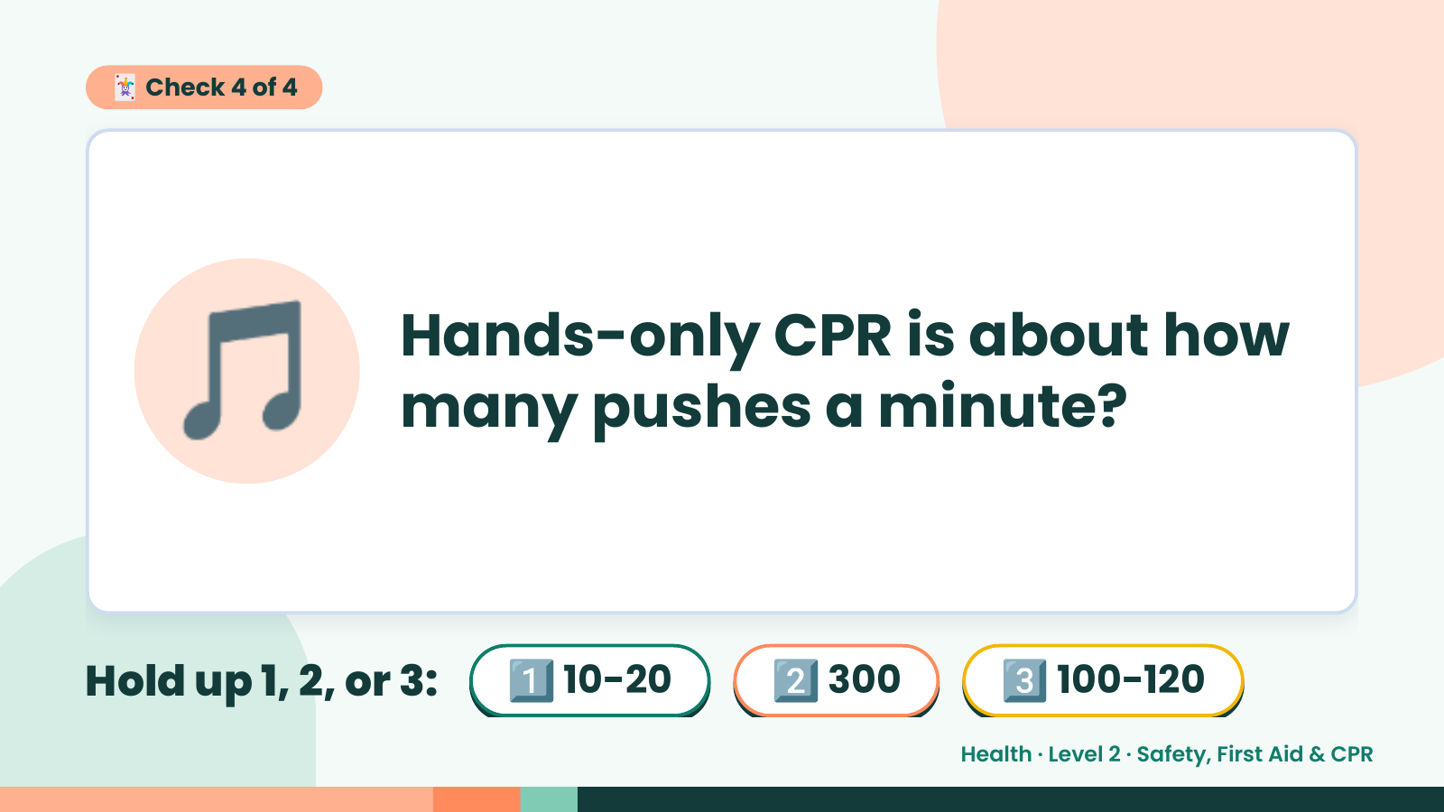
Notes:
🃏 Check 4 of 4
🎵 Hands-only CPR is about how
many pushes a minute?
Hold up 1, 2, or 3: 1️⃣ 10-20 2️⃣ 300 3️⃣ 100-120
Health · Level 2 · Safety, First Aid & CPR

Slide 18
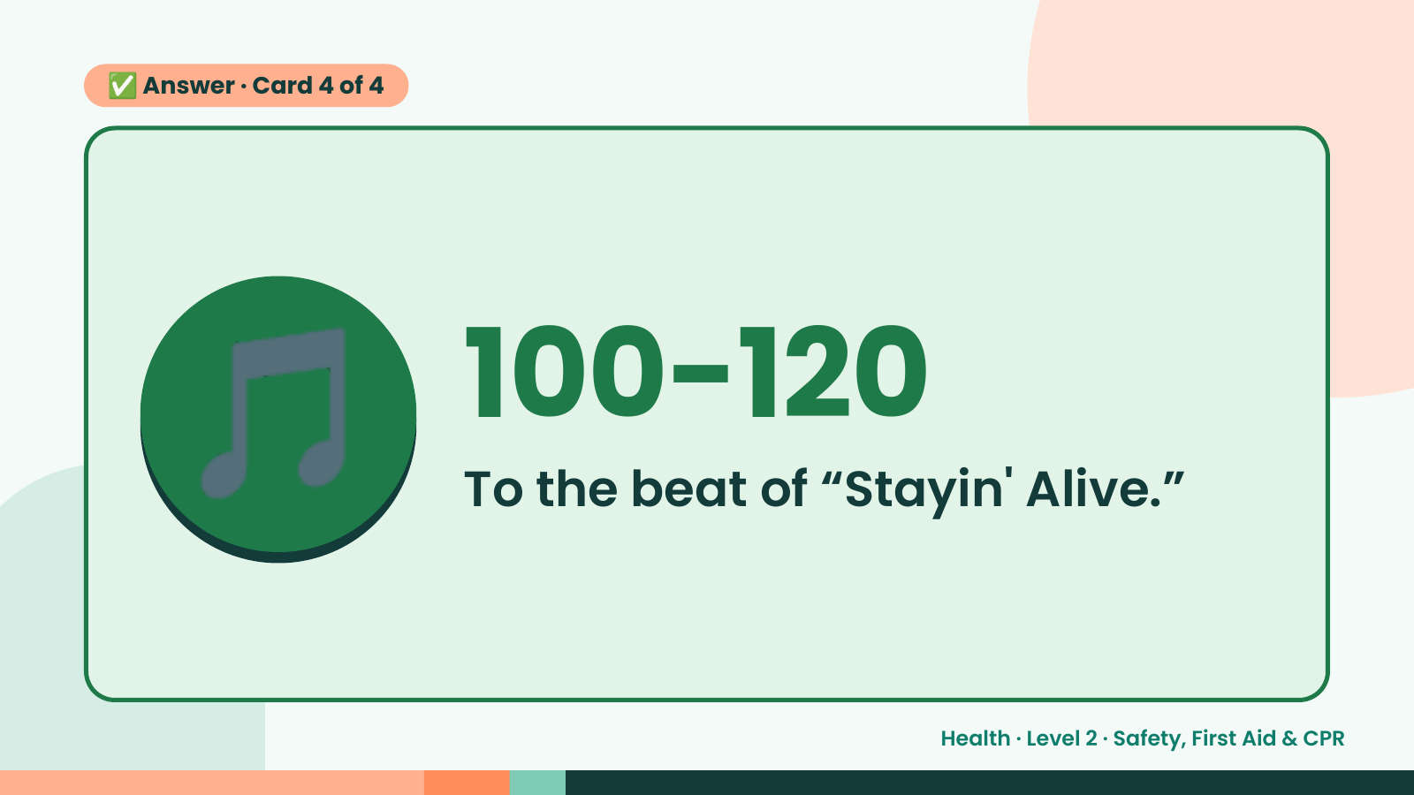
Notes:
✅ Answer · Card 4 of 4
🎵 100-120
To the beat of “Stayin' Alive.”
Health · Level 2 · Safety, First Aid & CPR

Slide 19
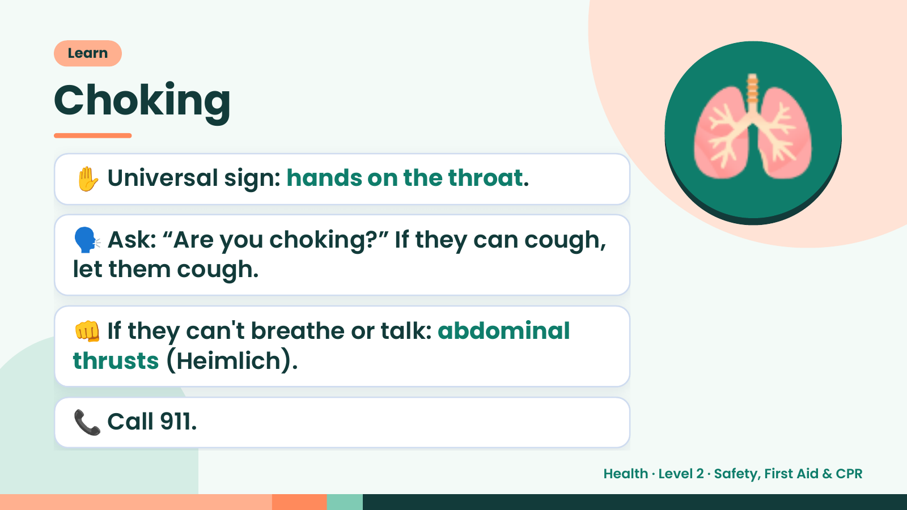
Notes:
Learn
Choking
✋ Universal sign: hands on the throat.
🗣️ Ask: “Are you choking?” If they can cough,
let them cough.
🫁
👊 If they can't breathe or talk: abdominal
thrusts (Heimlich).
📞 Call 911.
Health · Level 2 · Safety, First Aid & CPR

Slide 20
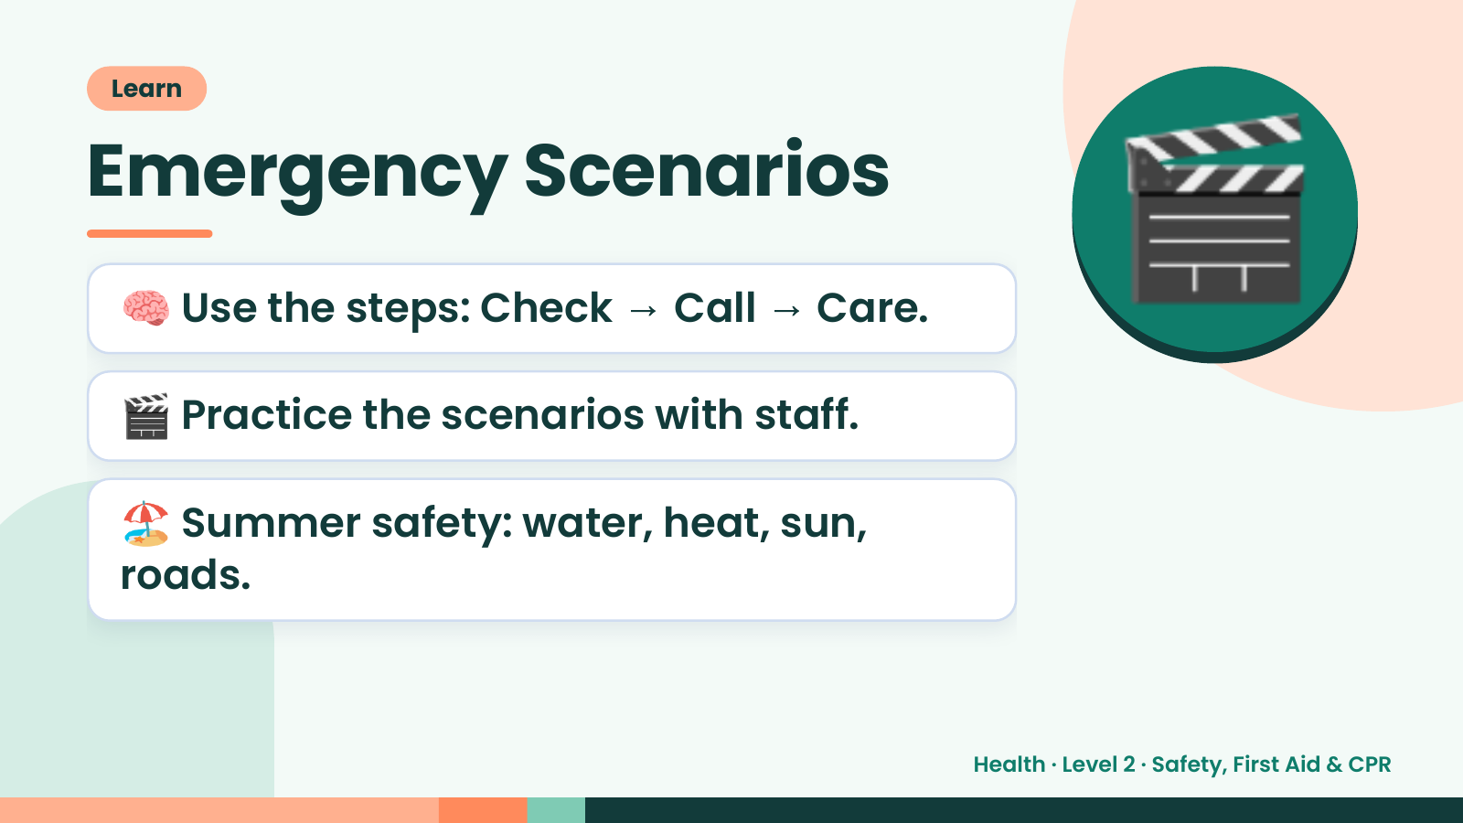
Notes:
Learn
Emergency Scenarios
🧠 Use the steps: Check → Call → Care.
🎬 Practice the scenarios with staff.
🎬
🏖️ Summer safety: water, heat, sun,
roads.
Health · Level 2 · Safety, First Aid & CPR

Slide 21
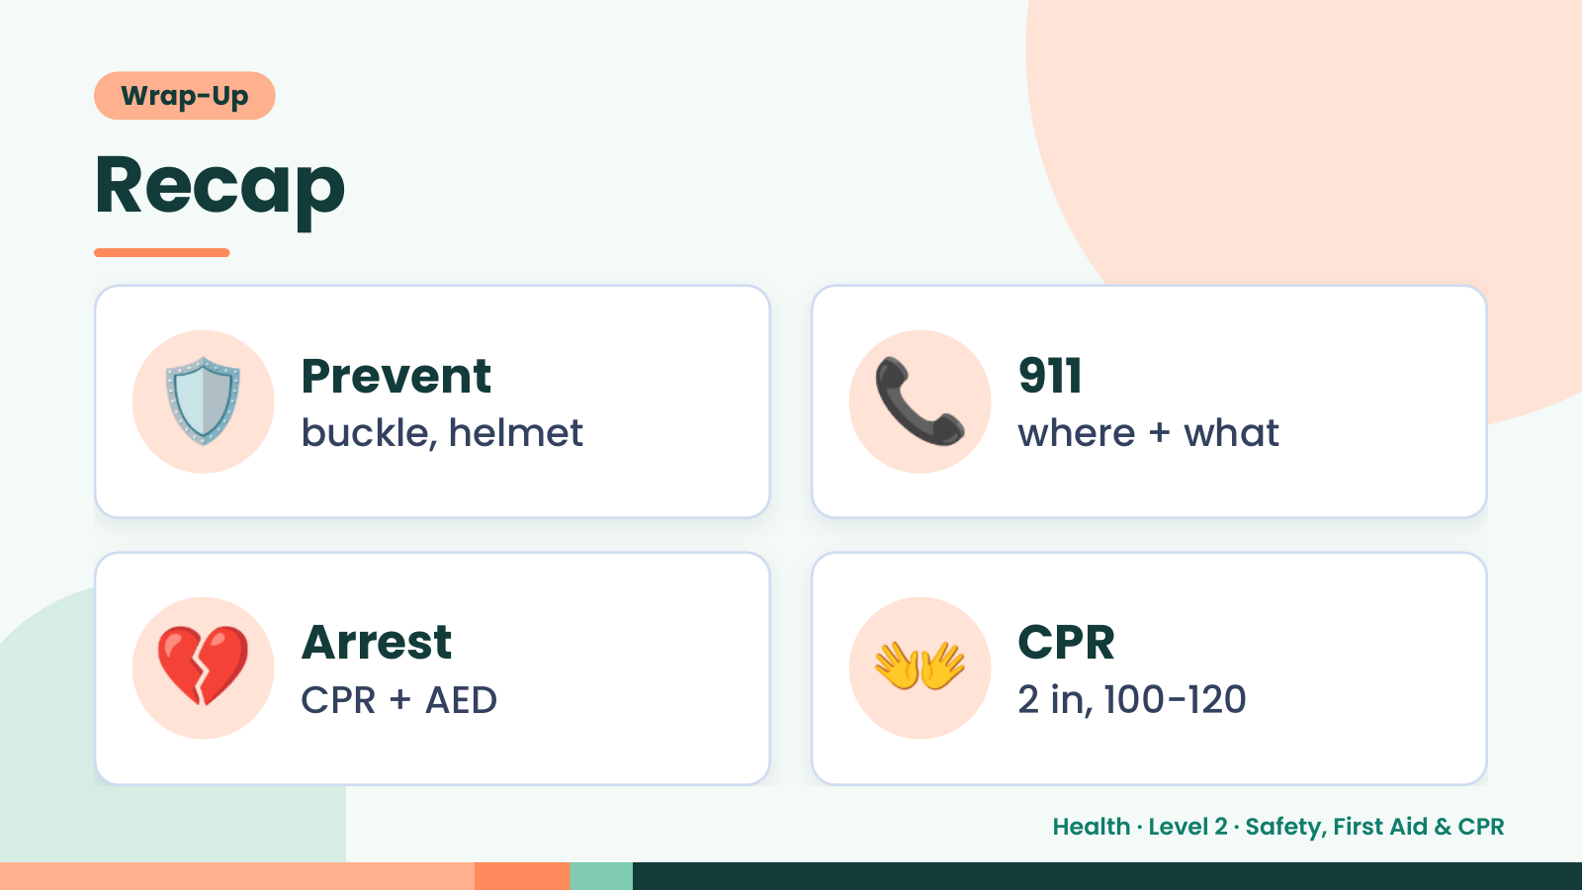
Notes:
Wrap-Up
Recap
🛡️ Prevent
buckle, helmet 📞 911
where + what
💔 Arrest
CPR + AED 👐 CPR
2 in, 100-120
Health · Level 2 · Safety, First Aid & CPR

Slide 22
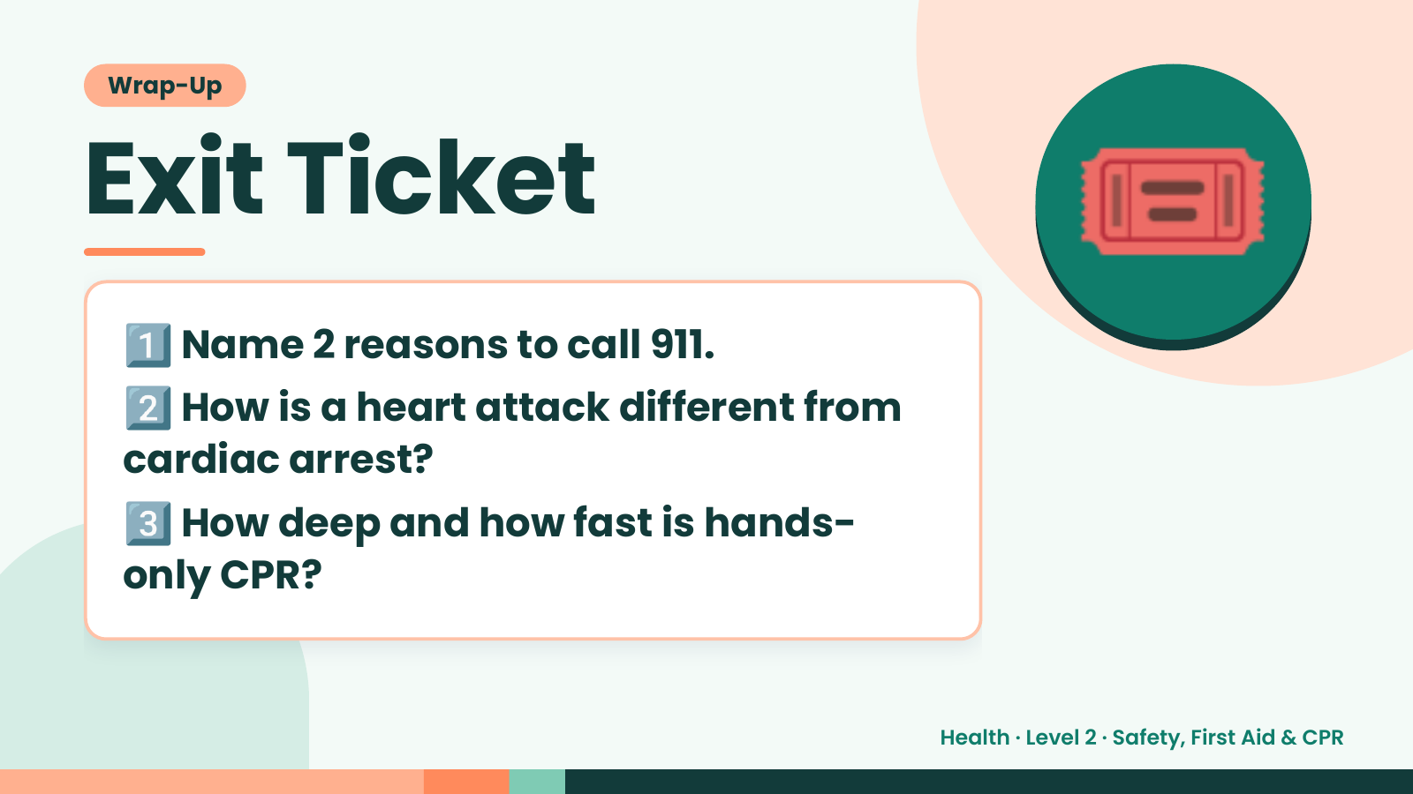
Notes:
Wrap-Up
Exit Ticket
1️⃣
2️⃣
Name 2 reasons to call 911.
How is a heart attack different from
🎟️
cardiac arrest?
3️⃣
How deep and how fast is hands-
only CPR?
Health · Level 2 · Safety, First Aid & CPR

