Slide 1
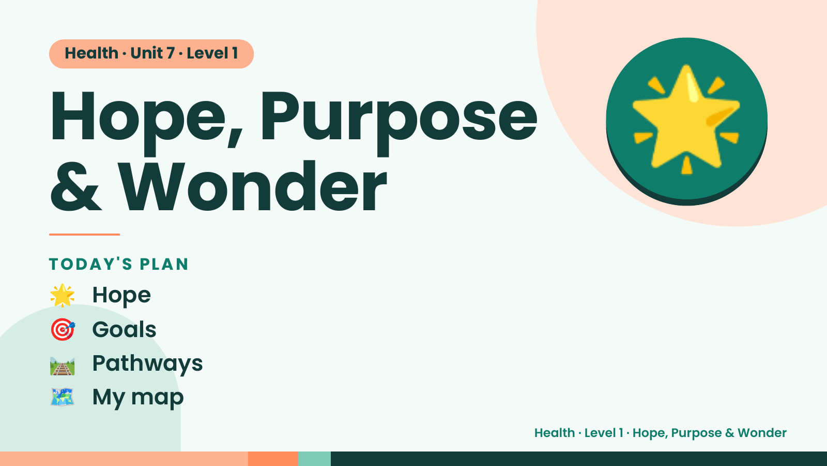
Notes:
Health · Unit 7 · Level 1
Hope, Purpose
& Wonder
🌟
🌟 Hope
TODAY'S PLAN
🎯 Goals
🛤️ Pathways
🗺️ My map
Health · Level 1 · Hope, Purpose & Wonder

Slide 2
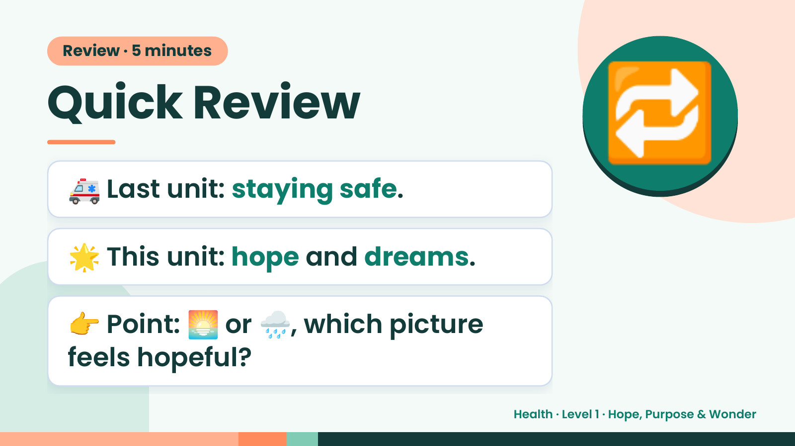
Notes:
Review · 5 minutes
Quick Review
🚑 Last unit: staying safe.
🔁
🌟 This unit: hope and dreams.
👉 Point: 🌅 or 🌧️, which picture
feels hopeful?
Health · Level 1 · Hope, Purpose & Wonder

Slide 3
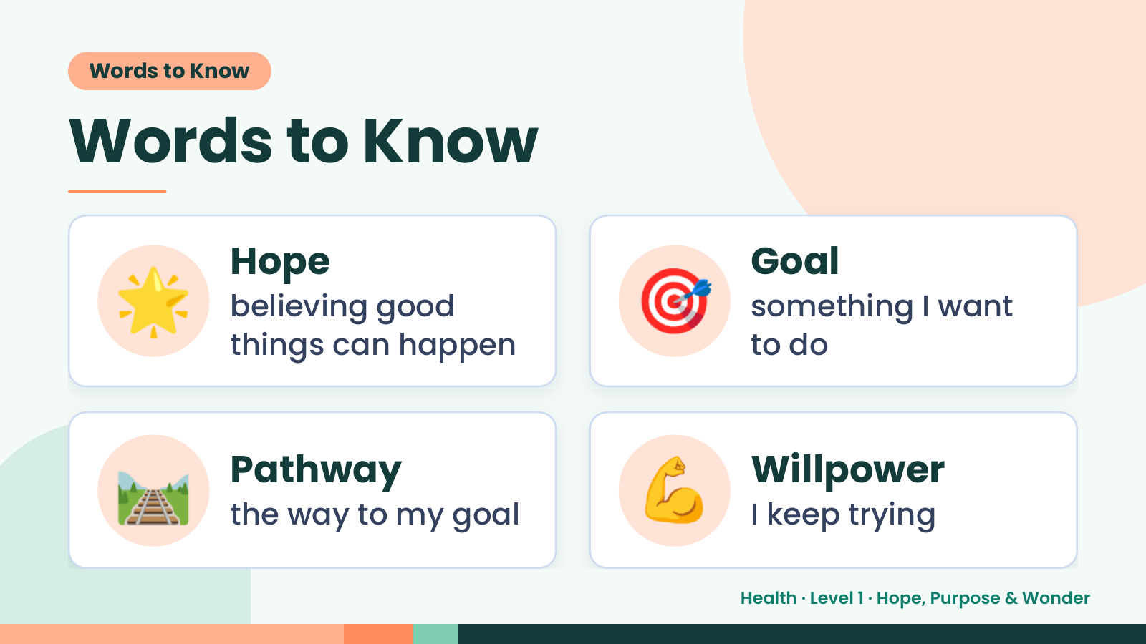
Notes:
Words to Know
Words to Know
🌟 Hope
believing good
things can happen
🎯 Goal
something I want
to do
🛤️ Pathway
the way to my goal 💪 Willpower
I keep trying
Health · Level 1 · Hope, Purpose & Wonder

Slide 4
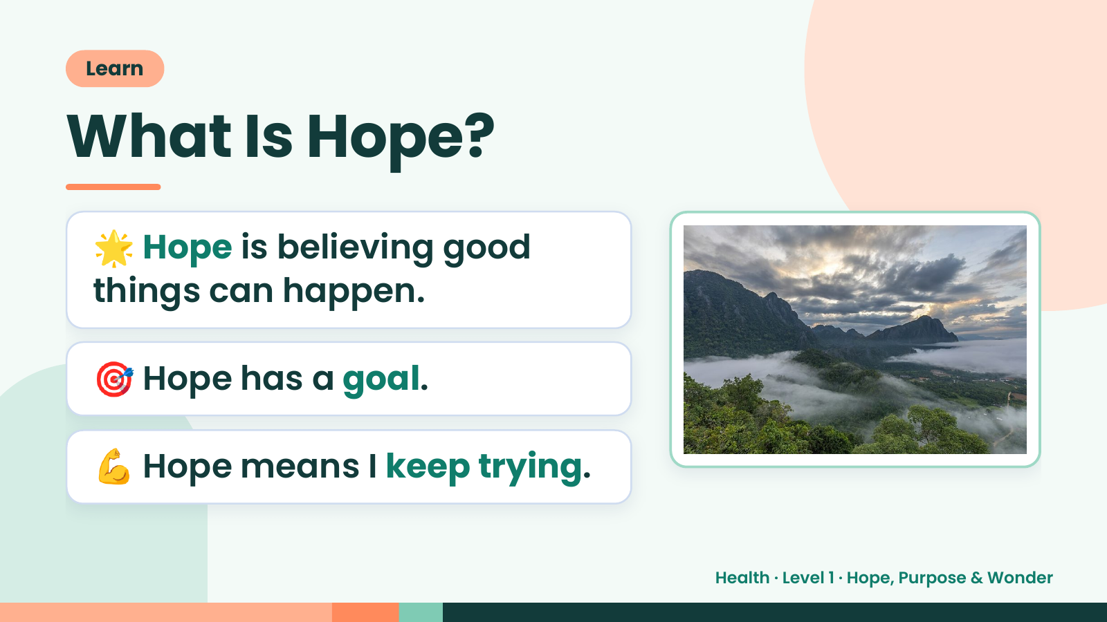
Notes:
Learn
What Is Hope?
🌟 Hope is believing good
things can happen.
🎯 Hope has a goal.
💪 Hope means I keep trying.
Health · Level 1 · Hope, Purpose & Wonder

Slide 5
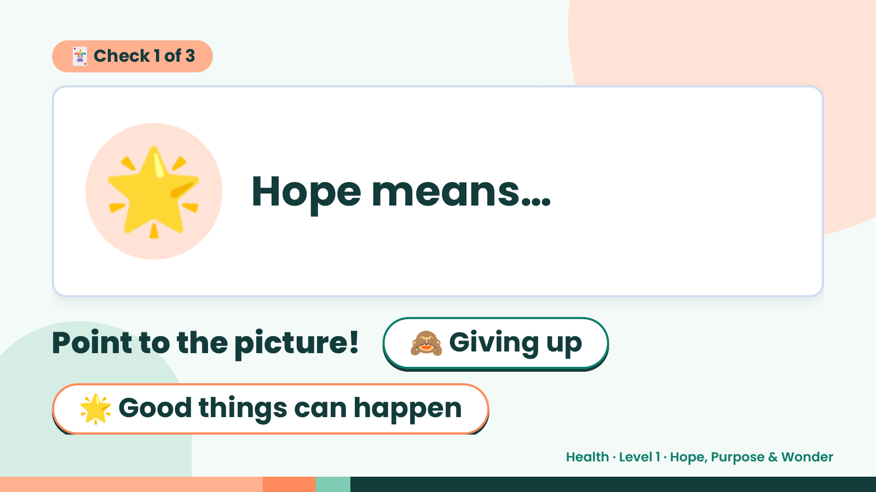
Notes:
🃏 Check 1 of 3
🌟 Hope means…
Point to the picture! 🙈 Giving up
🌟 Good things can happen
Health · Level 1 · Hope, Purpose & Wonder

Slide 6
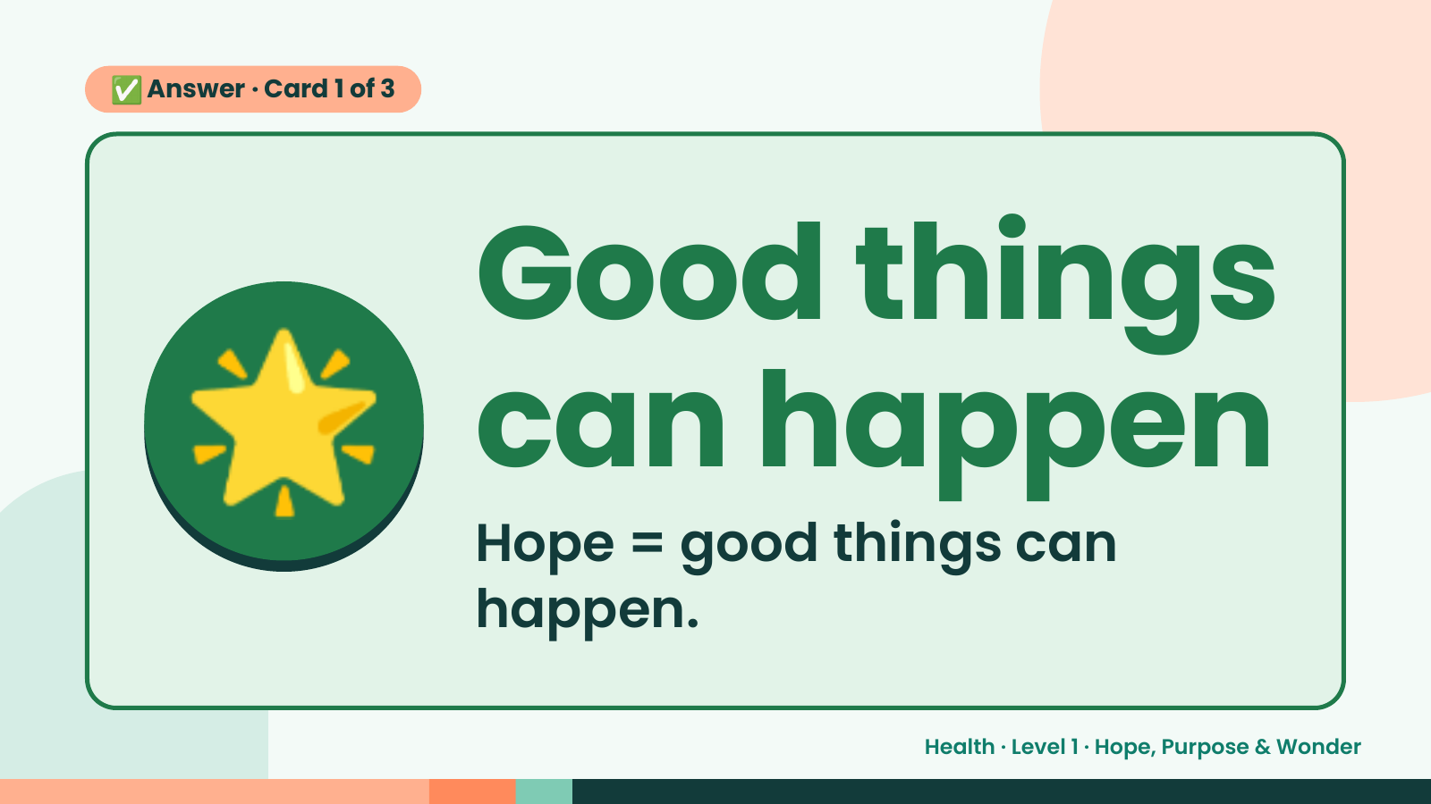
Notes:
✅ Answer · Card 1 of 3
🌟 Good things
can happen
Hope = good things can
happen.
Health · Level 1 · Hope, Purpose & Wonder

Slide 7
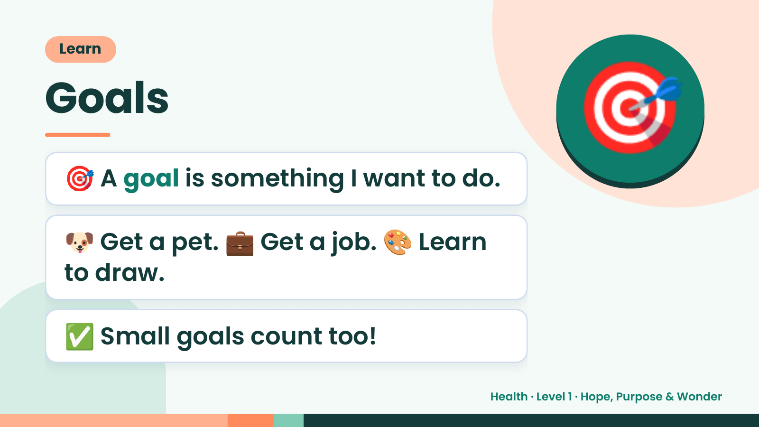
Notes:
Learn
Goals
🎯 A goal is something I want to do.
🎯
🐶 Get a pet. 💼 Get a job. 🎨 Learn
to draw.
✅ Small goals count too!
Health · Level 1 · Hope, Purpose & Wonder

Slide 8
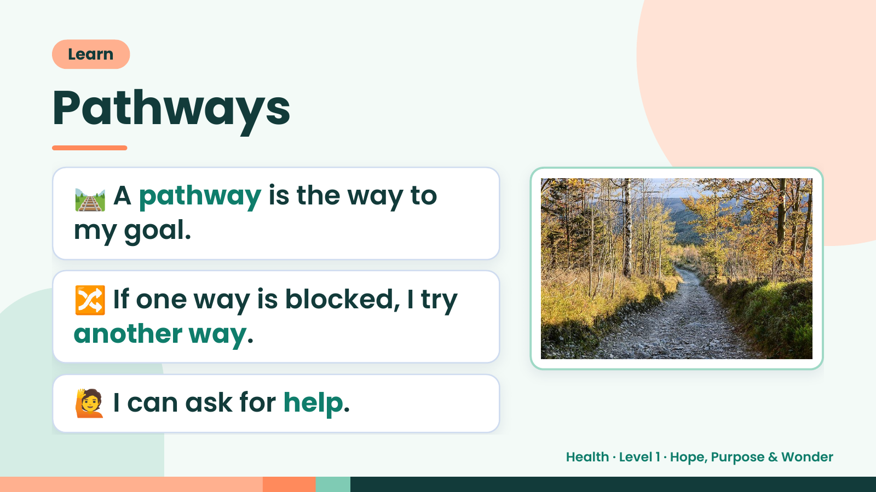
Notes:
Learn
Pathways
🛤️ A pathway is the way to
my goal.
🔀 If one way is blocked, I try
another way.
🙋 I can ask for help.
Health · Level 1 · Hope, Purpose & Wonder

Slide 9
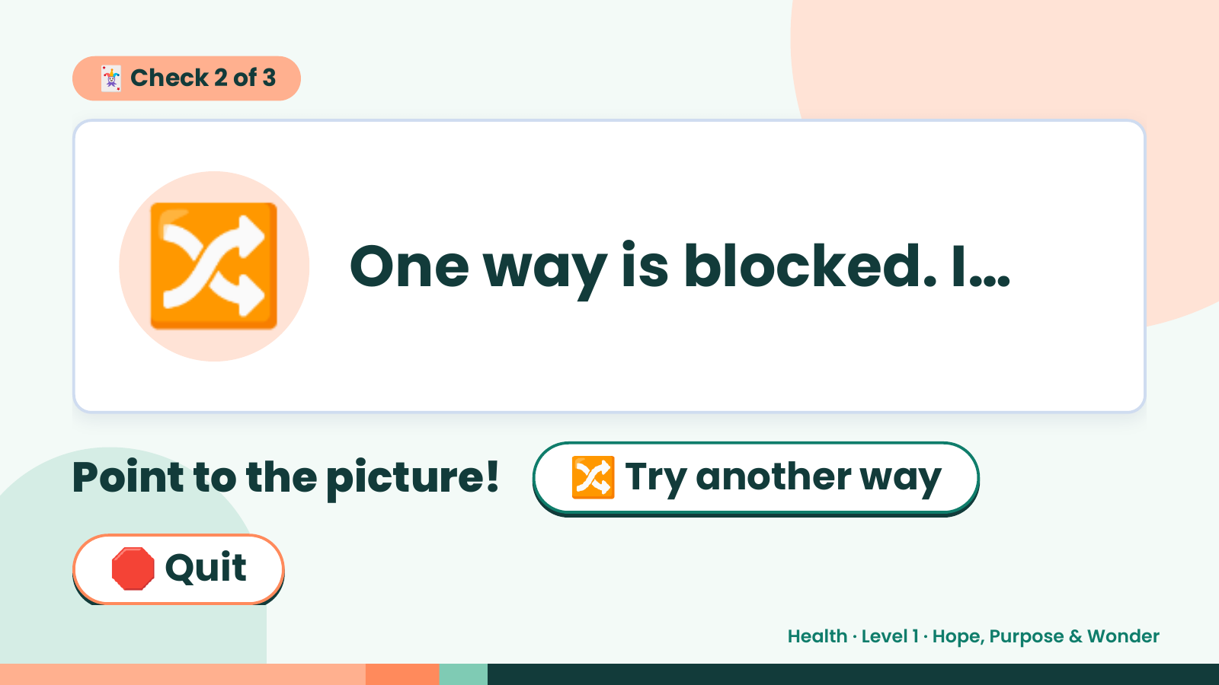
Notes:
🃏 Check 2 of 3
🔀 One way is blocked. I…
Point to the picture! 🔀 Try another way
🛑 Quit
Health · Level 1 · Hope, Purpose & Wonder

Slide 10
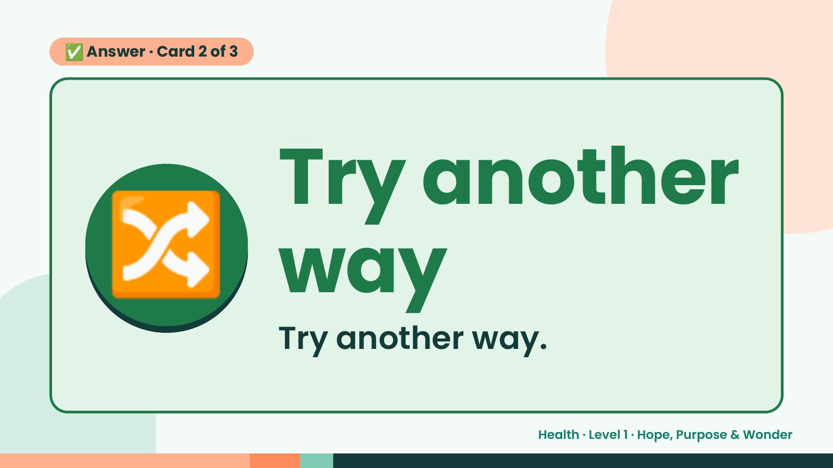
Notes:
✅ Answer · Card 2 of 3
🔀 Try another
way
Try another way.
Health · Level 1 · Hope, Purpose & Wonder

Slide 11
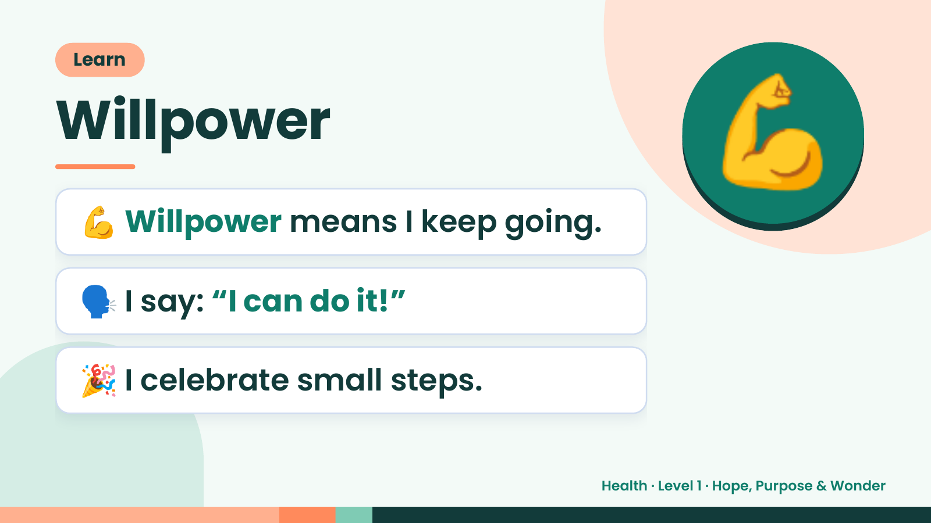
Notes:
Learn
Willpower
💪 Willpower means I keep going.
💪
🗣️ I say: “I can do it!”
🎉 I celebrate small steps.
Health · Level 1 · Hope, Purpose & Wonder

Slide 12
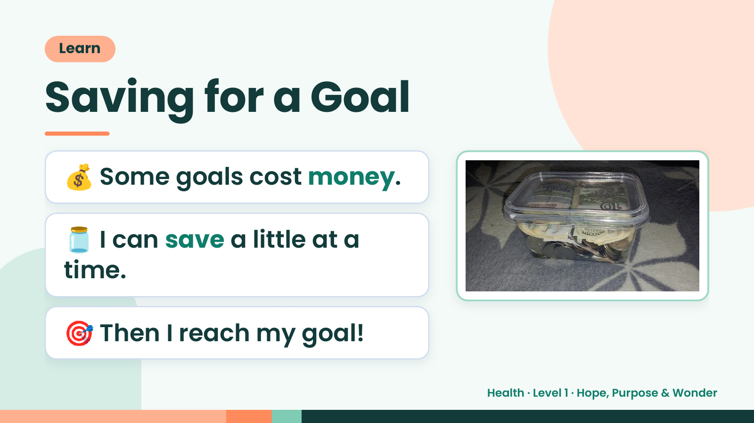
Notes:
Learn
Saving for a Goal
💰 Some goals cost money.
🫙 I can save a little at a
time.
🎯 Then I reach my goal!
Health · Level 1 · Hope, Purpose & Wonder

Slide 13
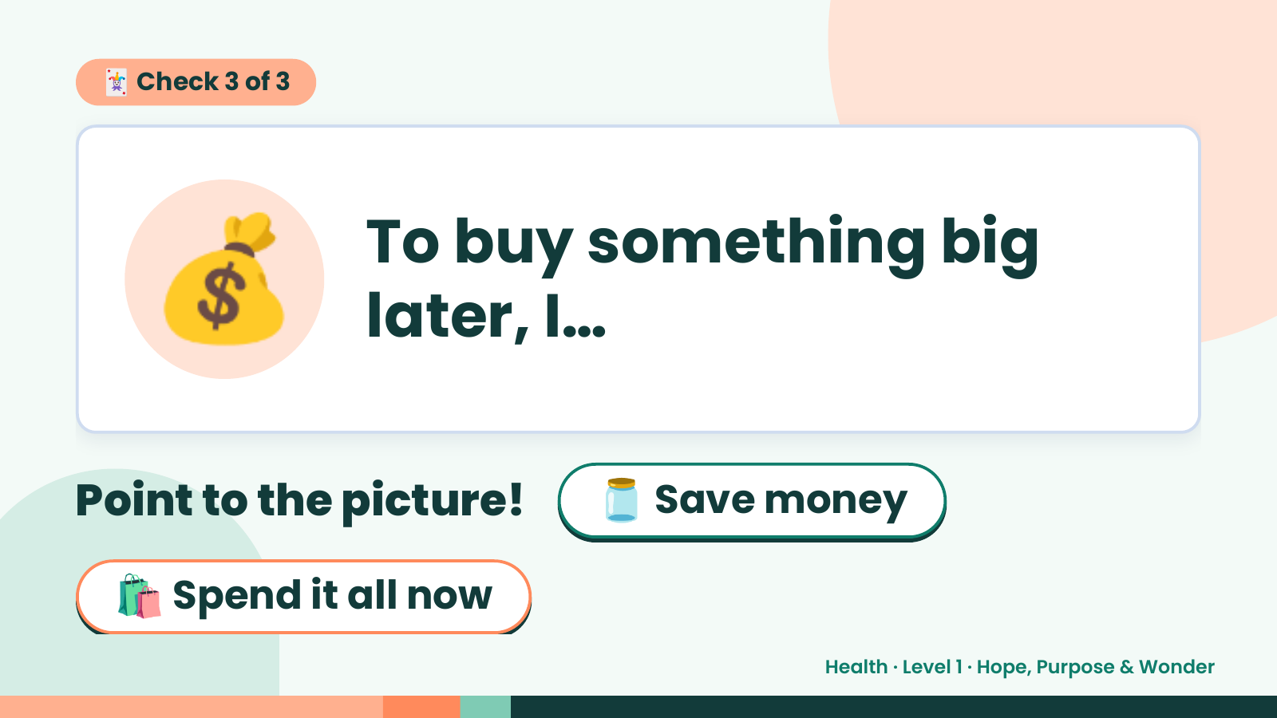
Notes:
🃏 Check 3 of 3
💰 To buy something big
later, I…
Point to the picture! 🫙 Save money
🛍️ Spend it all now
Health · Level 1 · Hope, Purpose & Wonder

Slide 14
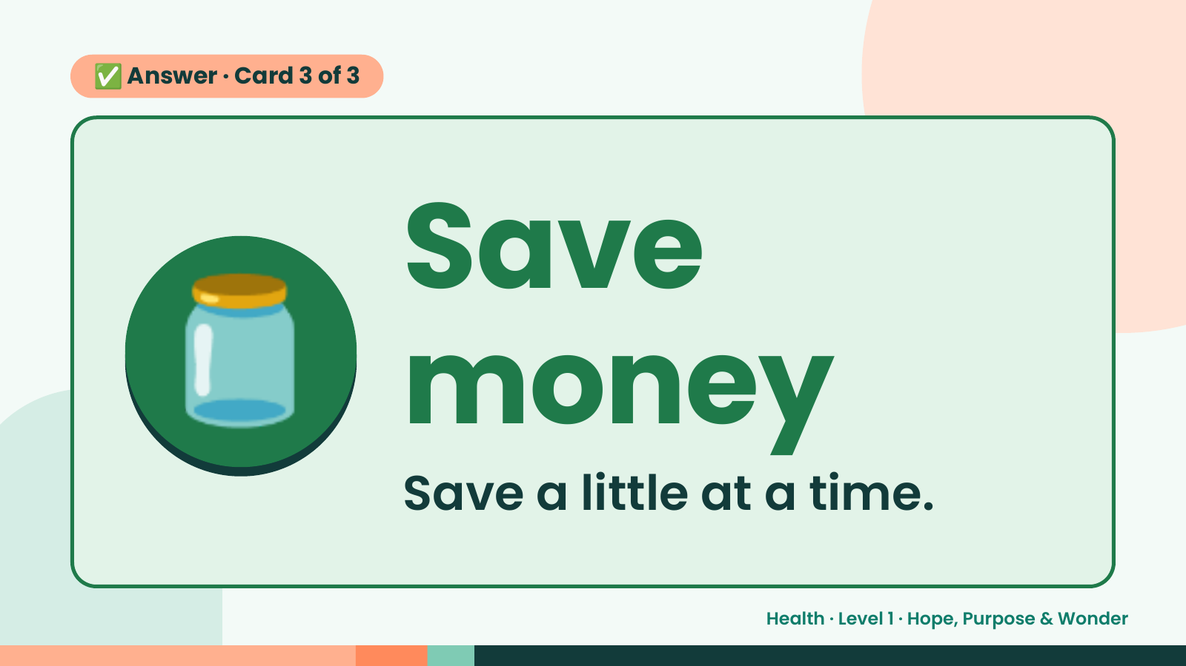
Notes:
✅ Answer · Card 3 of 3
🫙 Save
money
Save a little at a time.
Health · Level 1 · Hope, Purpose & Wonder

Slide 15
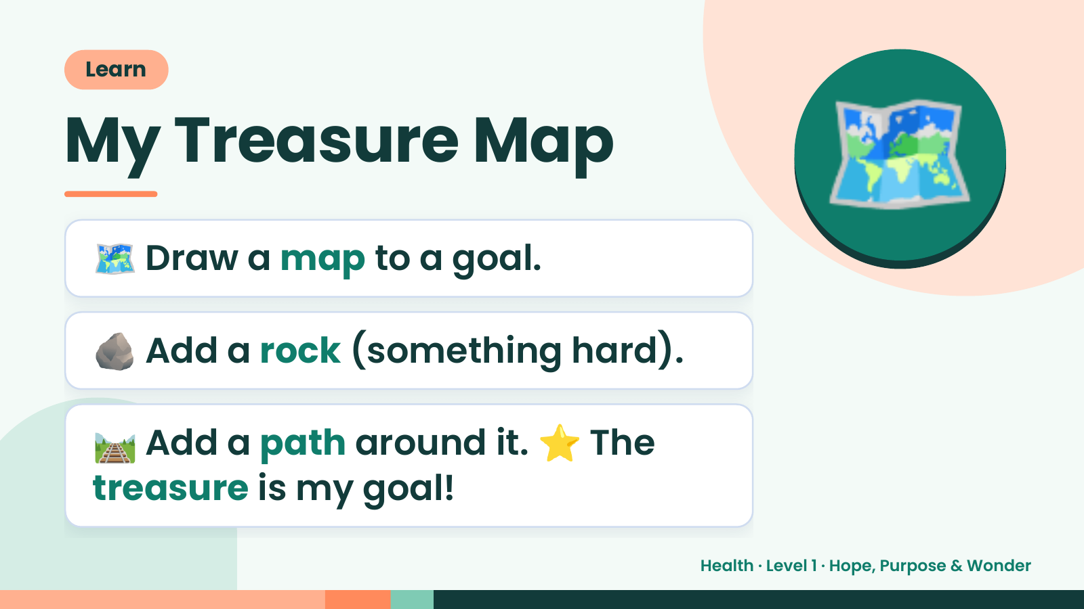
Notes:
Learn
My Treasure Map
🗺️ Draw a map to a goal.
🗺️
🪨 Add a rock (something hard).
🛤️ Add a path around it. ⭐ The
treasure is my goal!
Health · Level 1 · Hope, Purpose & Wonder

Slide 16
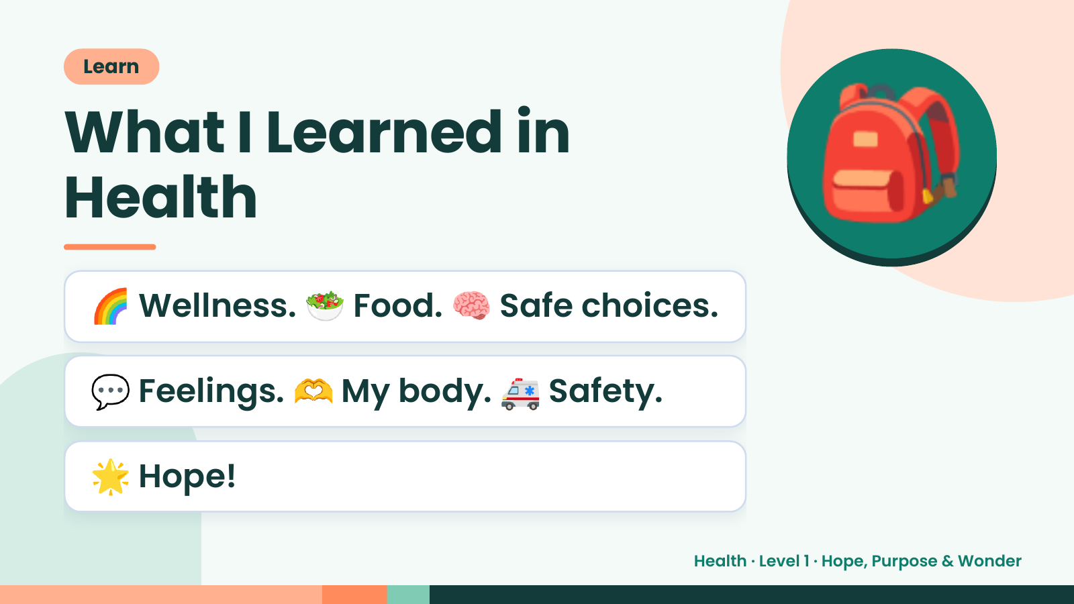
Notes:
Learn
What I Learned in
Health
🌈 Wellness. 🥗 Food. 🧠 Safe choices.
🎒
💬 Feelings. 🫶 My body. 🚑 Safety.
🌟 Hope!
Health · Level 1 · Hope, Purpose & Wonder

Slide 17
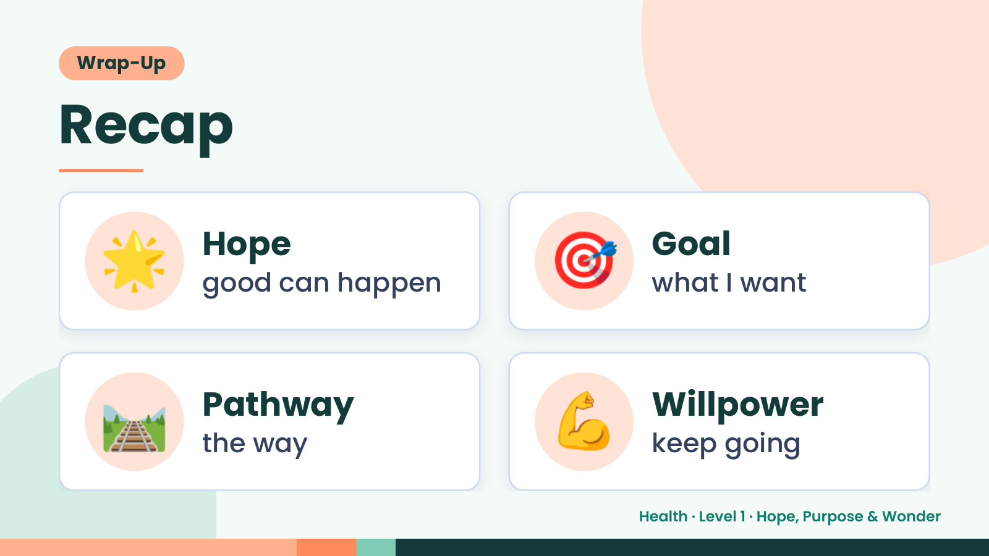
Notes:
Wrap-Up
Recap
🌟 Hope
good can happen 🎯 Goal
what I want
🛤️ Pathway
the way 💪 Willpower
keep going
Health · Level 1 · Hope, Purpose & Wonder

Slide 18
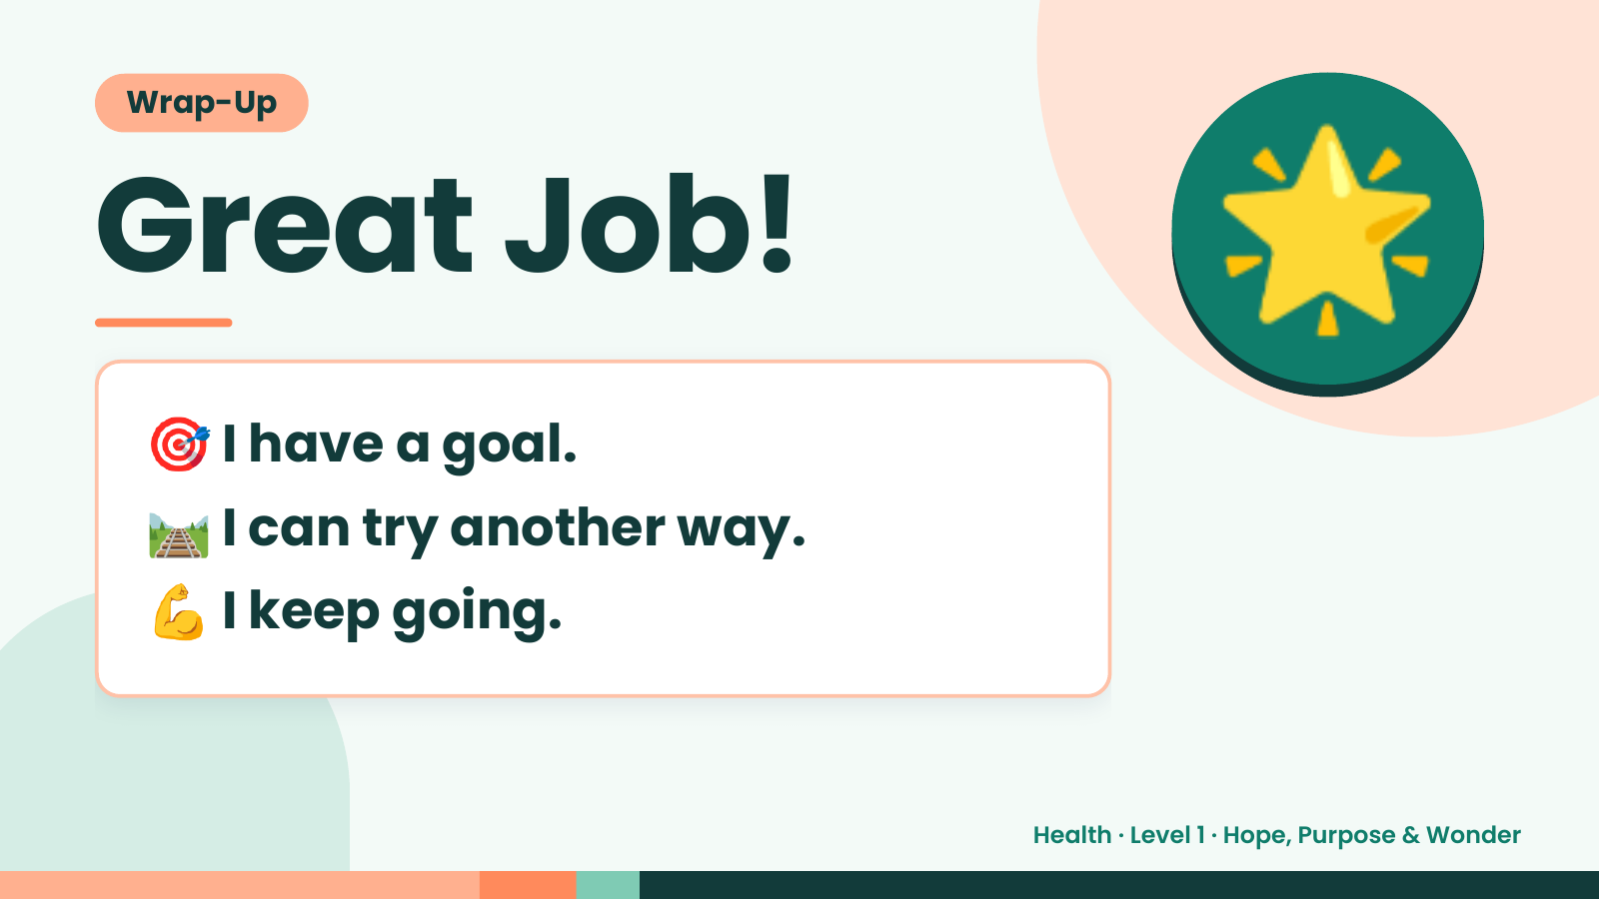
Notes:
Wrap-Up
Great Job!
🎯 I have a goal.
🌟
🛤️ I can try another way.
💪 I keep going.
Health · Level 1 · Hope, Purpose & Wonder

