Slide 1
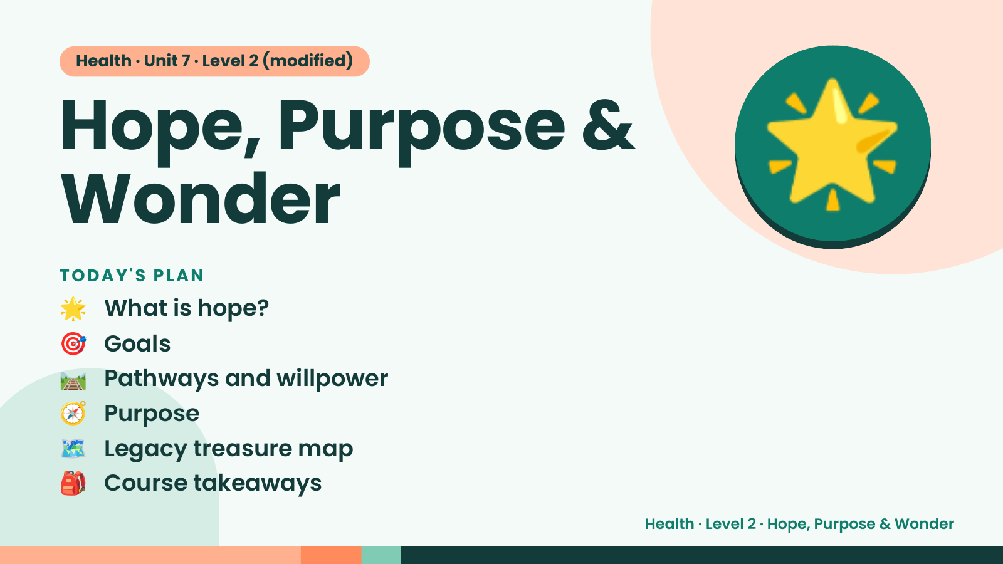
Notes:
Health · Unit 7 · Level 2 (modified)
Hope, Purpose &
Wonder
🌟 What is hope?
TODAY'S PLAN
🌟
🎯 Goals
🛤️ Pathways and willpower
🧭 Purpose
🗺️ Legacy treasure map
🎒 Course takeaways
Health · Level 2 · Hope, Purpose & Wonder

Slide 2
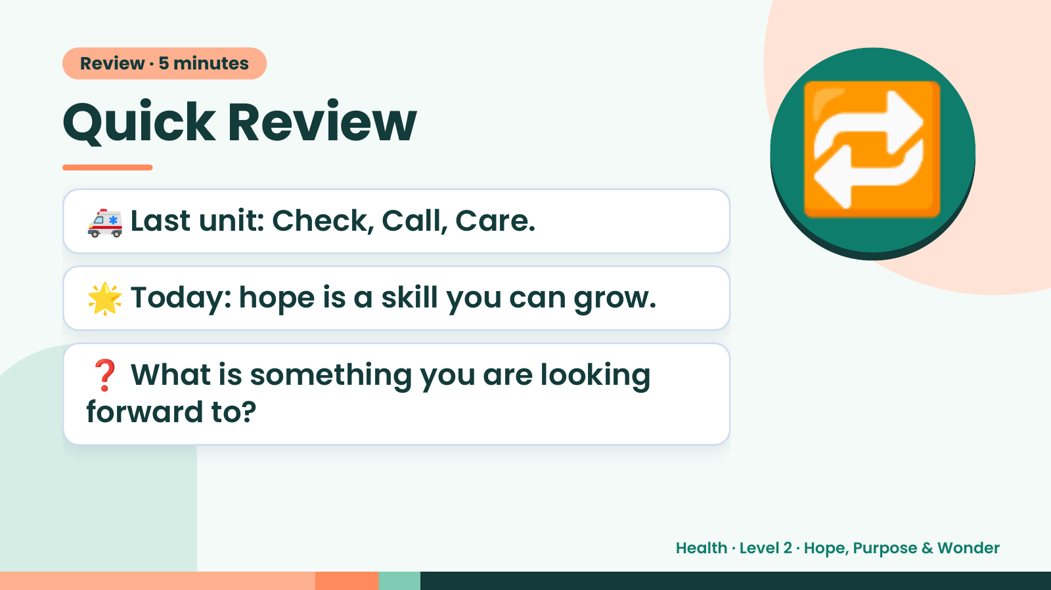
Notes:
Review · 5 minutes
Quick Review
🚑 Last unit: Check, Call, Care.
🌟 Today: hope is a skill you can grow.
🔁
❓ What is something you are looking
forward to?
Health · Level 2 · Hope, Purpose & Wonder

Slide 3
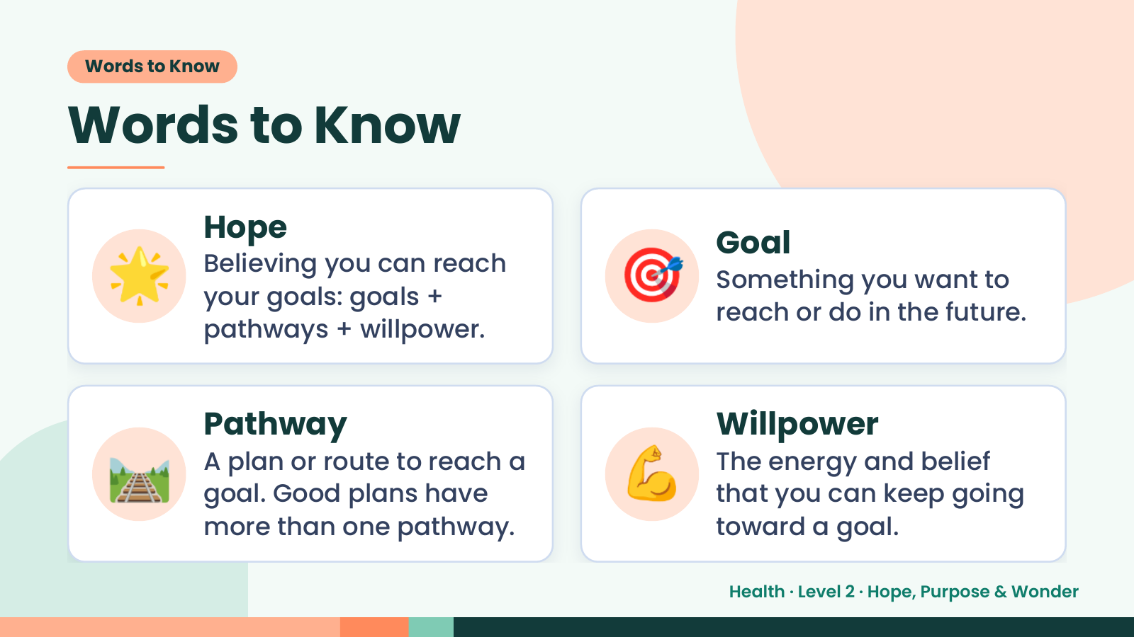
Notes:
Words to Know
Words to Know
🌟 Hope
Believing you can reach
your goals: goals +
pathways + willpower.
🎯 Goal
Something you want to
reach or do in the future.
🛤️ Pathway
A plan or route to reach a
goal. Good plans have
more than one pathway.
💪 Willpower
The energy and belief
that you can keep going
toward a goal.
Health · Level 2 · Hope, Purpose & Wonder

Slide 4
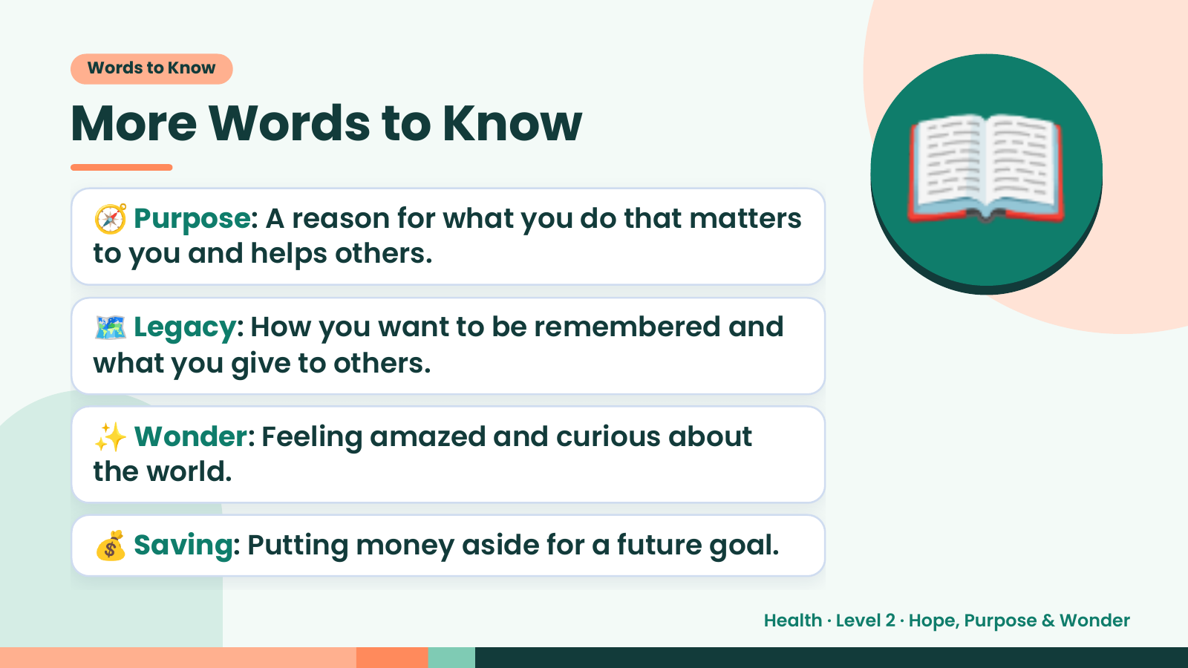
Notes:
Words to Know
More Words to Know
🧭 Purpose: A reason for what you do that matters
to you and helps others.
🗺️ Legacy: How you want to be remembered and
what you give to others.
📖
✨ Wonder: Feeling amazed and curious about
the world.
💰 Saving: Putting money aside for a future goal.
Health · Level 2 · Hope, Purpose & Wonder

Slide 5
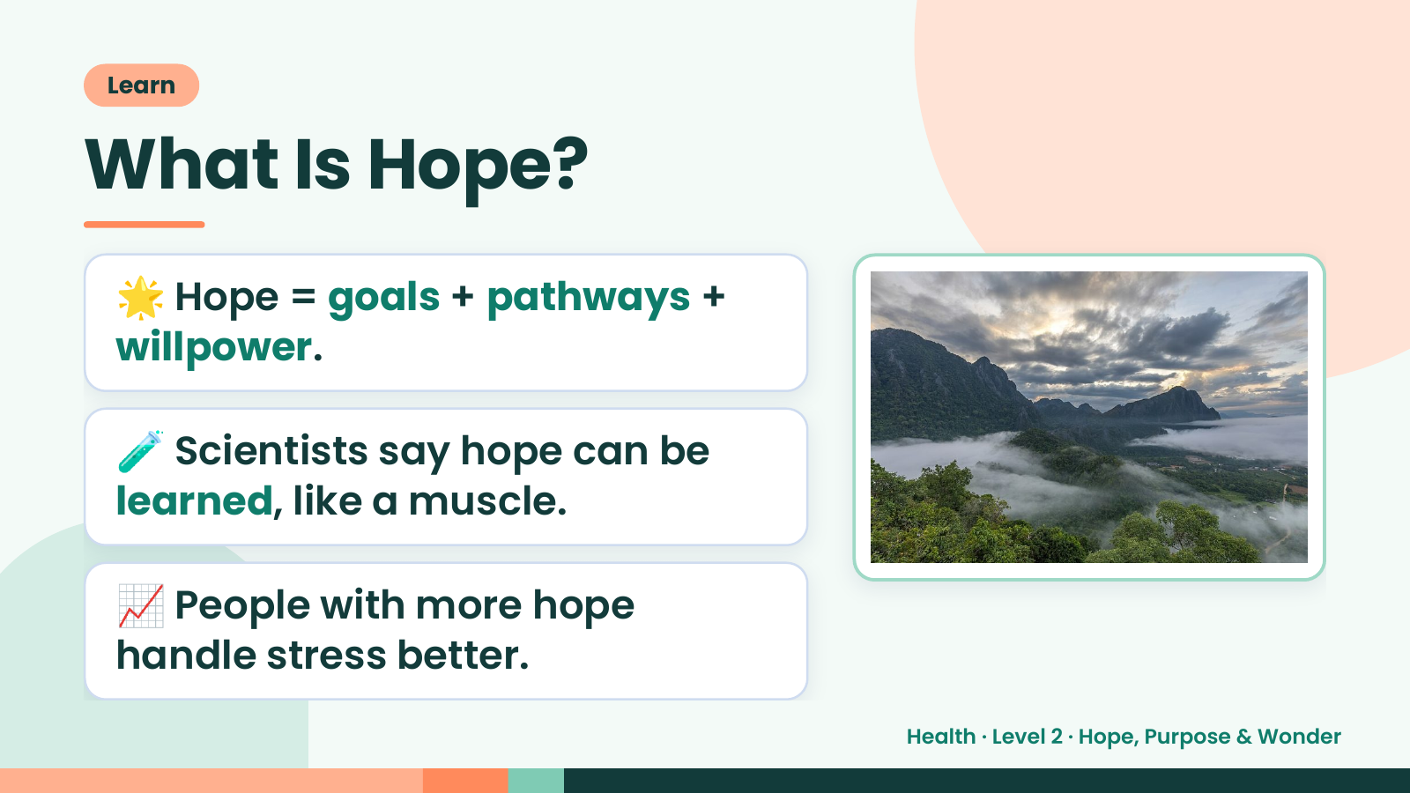
Notes:
Learn
What Is Hope?
🌟 Hope = goals + pathways +
willpower.
🧪 Scientists say hope can be
learned, like a muscle.
📈 People with more hope
handle stress better.
Health · Level 2 · Hope, Purpose & Wonder

Slide 6
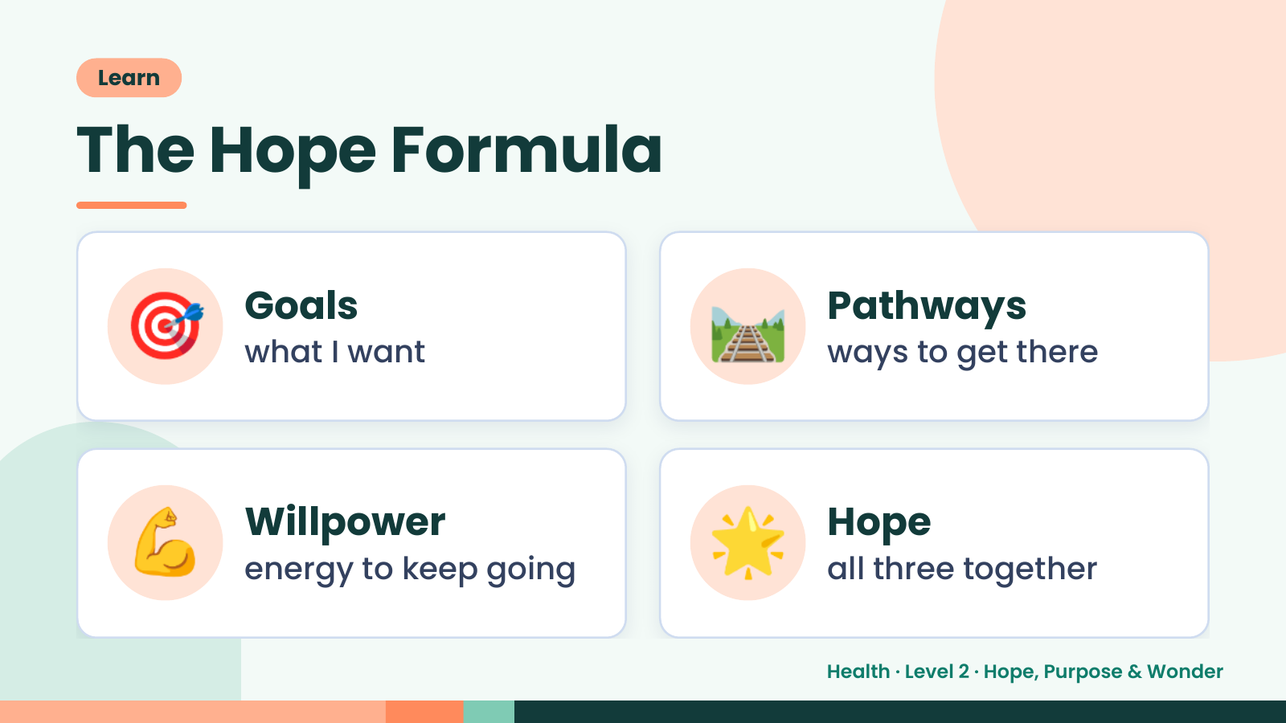
Notes:
Learn
The Hope Formula
🎯 Goals
what I want 🛤️ Pathways
ways to get there
💪 Willpower
energy to keep going 🌟 Hope
all three together
Health · Level 2 · Hope, Purpose & Wonder

Slide 7
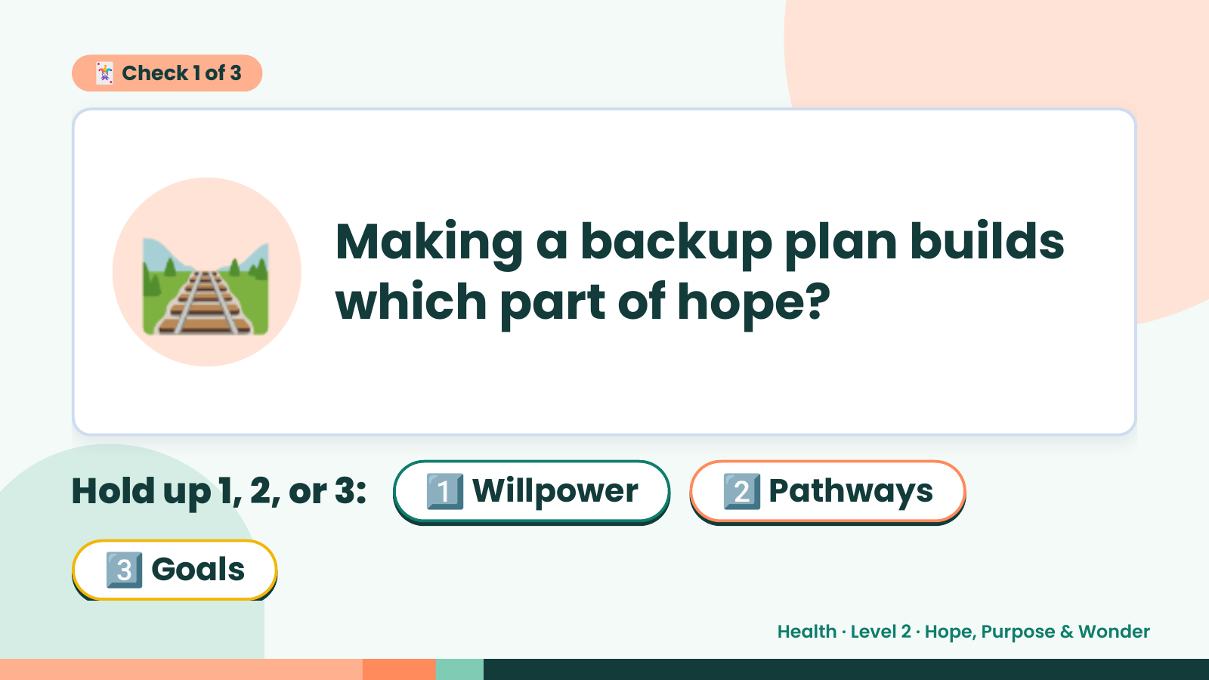
Notes:
🃏 Check 1 of 3
🛤️ Making a backup plan builds
which part of hope?
Hold up 1, 2, or 3: 1️⃣ Willpower 2️⃣ Pathways
3️⃣ Goals
Health · Level 2 · Hope, Purpose & Wonder

Slide 8
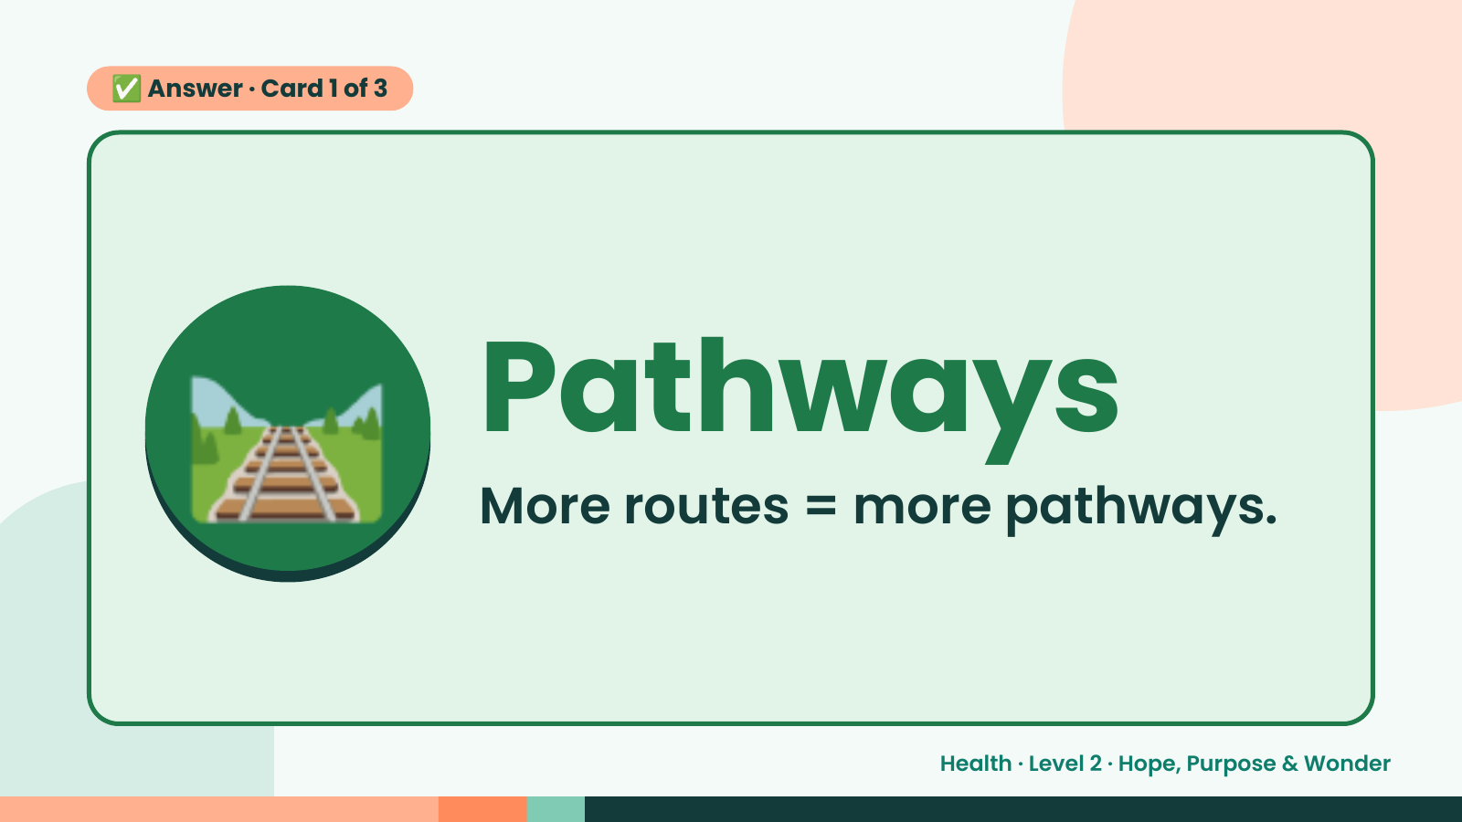
Notes:
✅ Answer · Card 1 of 3
🛤️ Pathways
More routes = more pathways.
Health · Level 2 · Hope, Purpose & Wonder

Slide 9
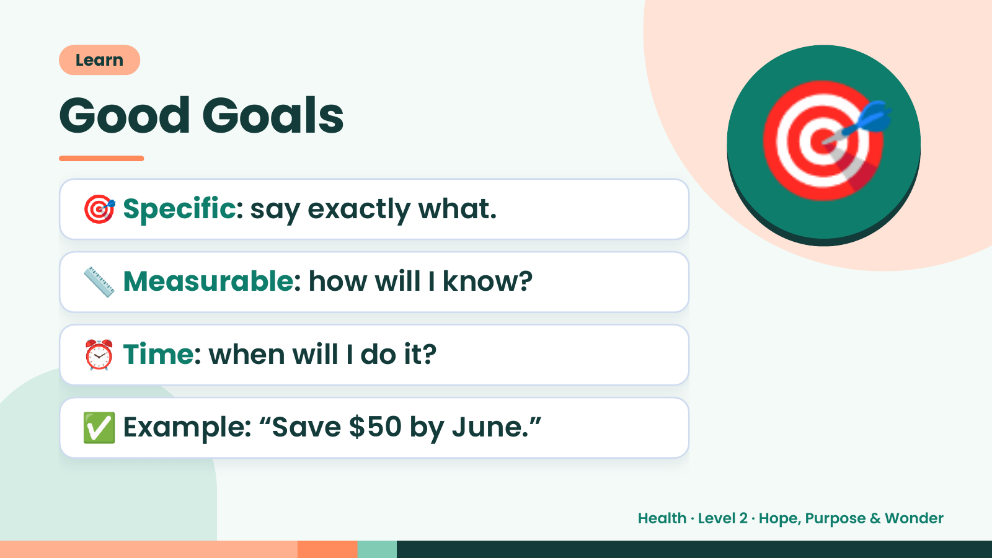
Notes:
Learn
Good Goals
🎯 Specific: say exactly what.
📏 Measurable: how will I know?
🎯
⏰ Time: when will I do it?
✅ Example: “Save $50 by June.”
Health · Level 2 · Hope, Purpose & Wonder

Slide 10
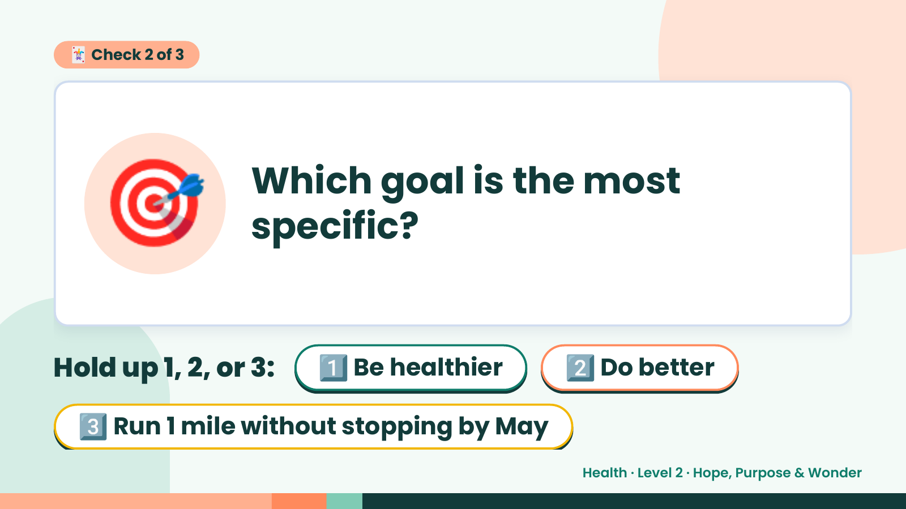
Notes:
🃏 Check 2 of 3
🎯 Which goal is the most
specific?
Hold up 1, 2, or 3: 1️⃣ Be healthier 2️⃣ Do better
3️⃣ Run 1 mile without stopping by May
Health · Level 2 · Hope, Purpose & Wonder

Slide 11
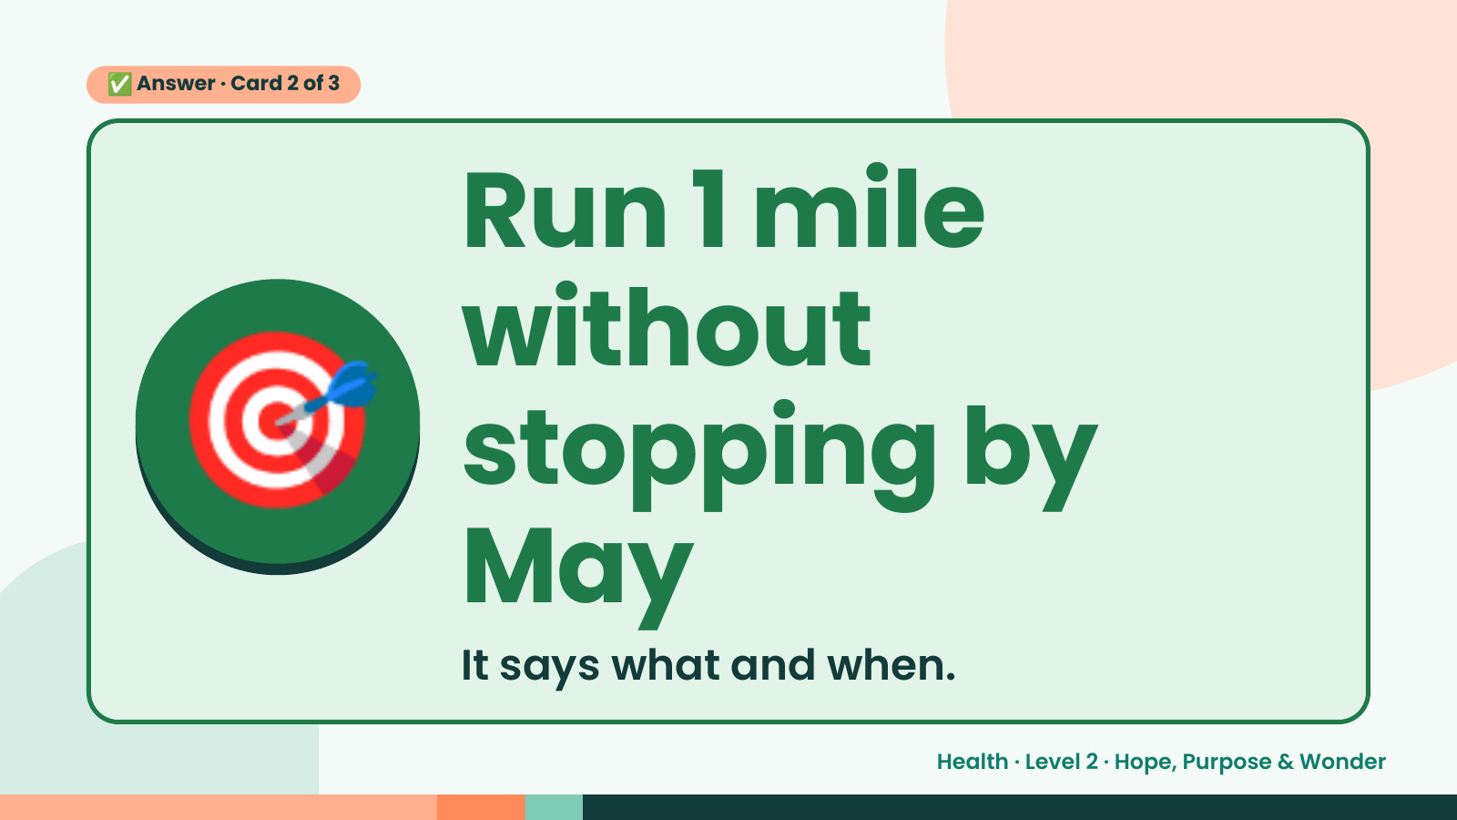
Notes:
✅ Answer · Card 2 of 3
🎯
Run 1 mile
without
stopping by
May
It says what and when.
Health · Level 2 · Hope, Purpose & Wonder

Slide 12
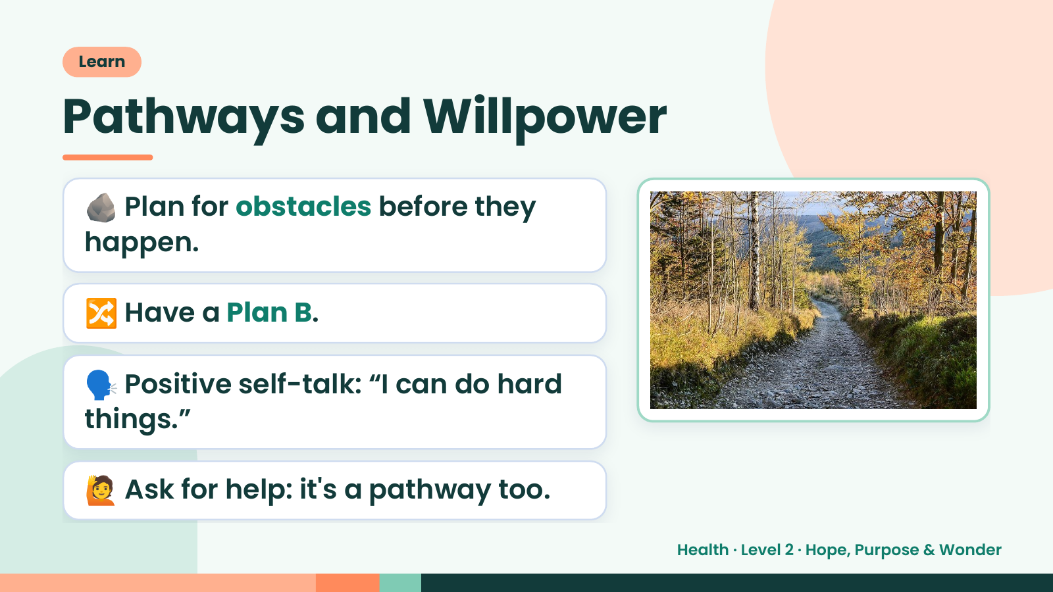
Notes:
Learn
Pathways and Willpower
🪨 Plan for obstacles before they
happen.
🔀 Have a Plan B.
🗣️ Positive self-talk: “I can do hard
things.”
🙋 Ask for help: it's a pathway too.
Health · Level 2 · Hope, Purpose & Wonder

Slide 13
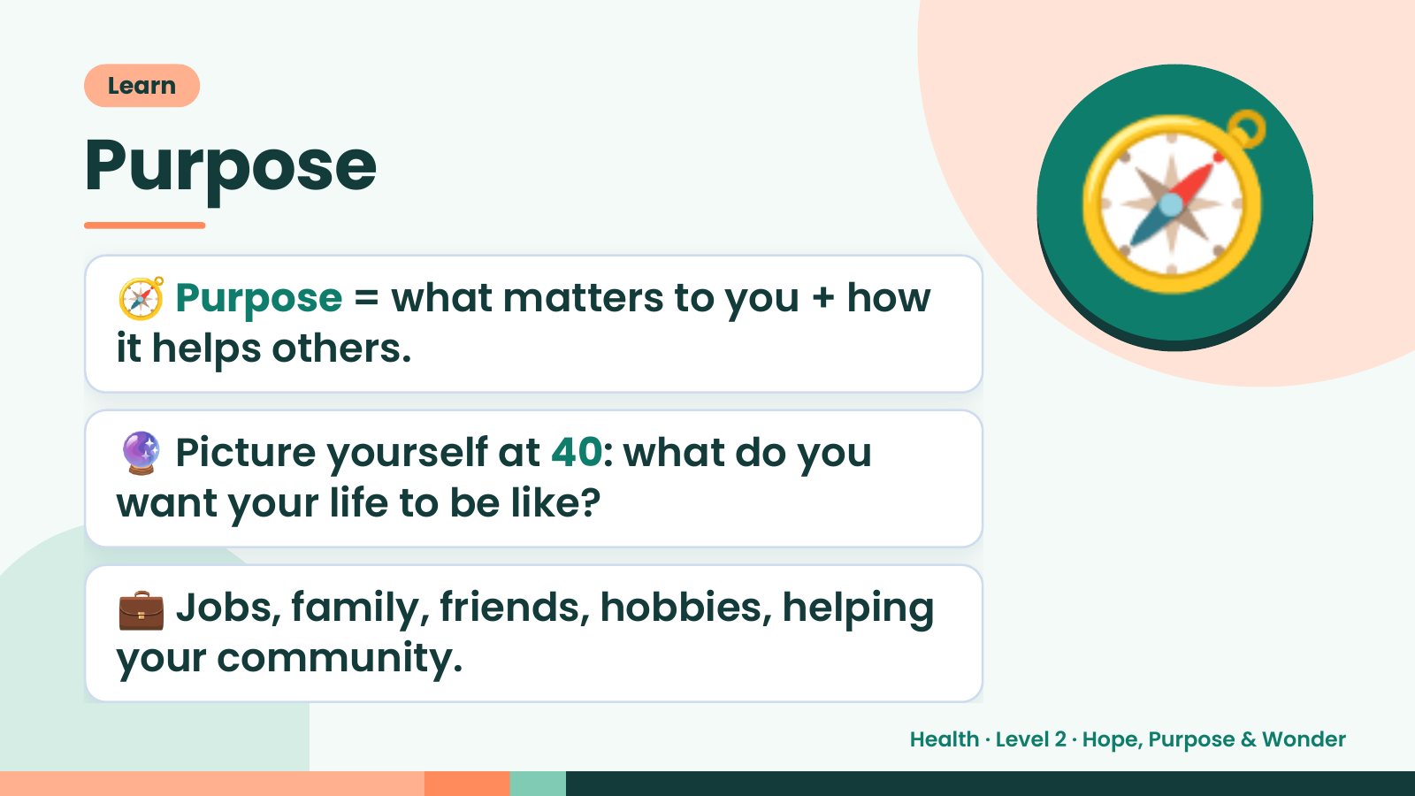
Notes:
Learn
Purpose
🧭 Purpose = what matters to you + how
it helps others.
🧭
🔮 Picture yourself at 40: what do you
want your life to be like?
💼 Jobs, family, friends, hobbies, helping
your community.
Health · Level 2 · Hope, Purpose & Wonder

Slide 14
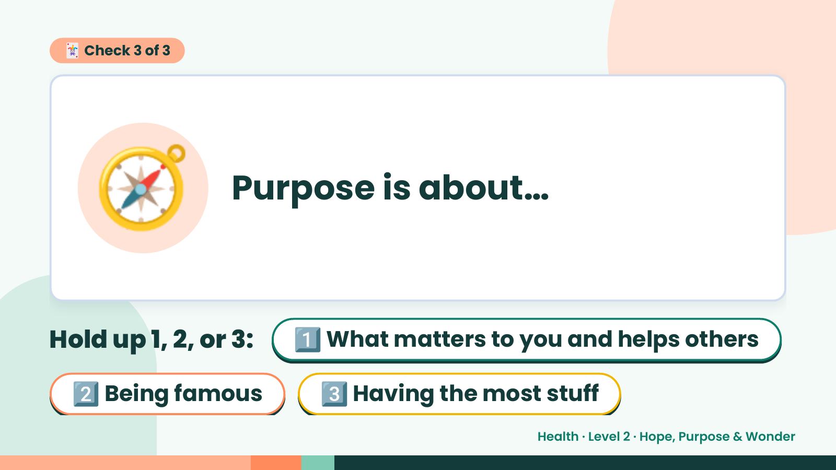
Notes:
🃏 Check 3 of 3
🧭 Purpose is about…
Hold up 1, 2, or 3:1️⃣ What matters to you and helps others
2️⃣ Being famous 3️⃣ Having the most stuff
Health · Level 2 · Hope, Purpose & Wonder

Slide 15
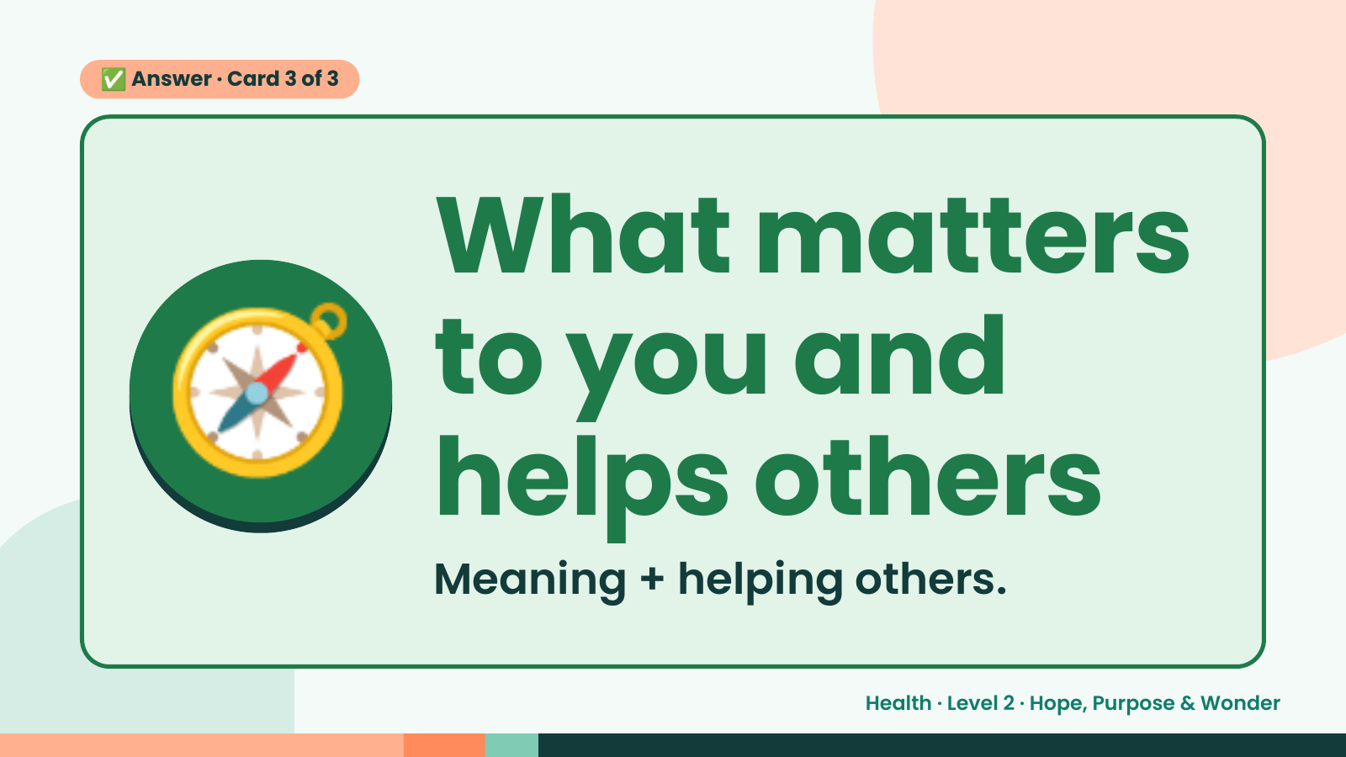
Notes:
✅ Answer · Card 3 of 3
🧭 What matters
to you and
helps others
Meaning + helping others.
Health · Level 2 · Hope, Purpose & Wonder

Slide 16
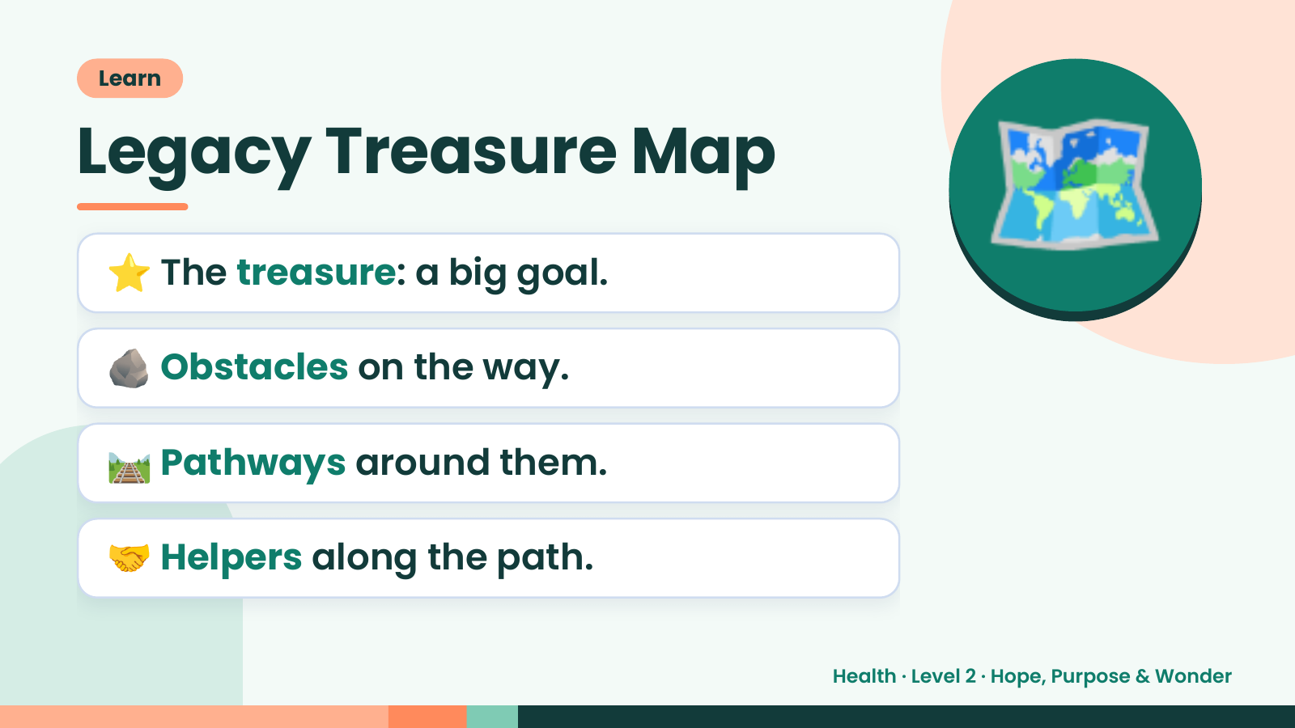
Notes:
Learn
Legacy Treasure Map
⭐ The treasure: a big goal.
🪨 Obstacles on the way.
🗺️
🛤️ Pathways around them.
🤝 Helpers along the path.
Health · Level 2 · Hope, Purpose & Wonder

Slide 17
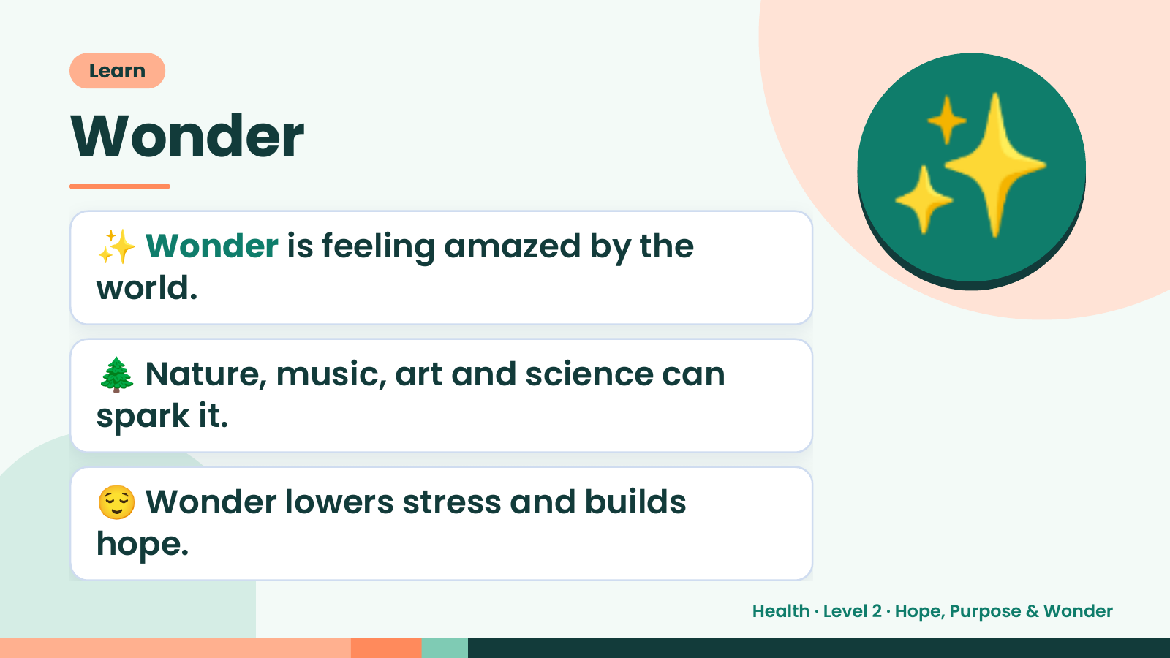
Notes:
Learn
Wonder
✨ Wonder is feeling amazed by the
world.
✨
🌲 Nature, music, art and science can
spark it.
😌 Wonder lowers stress and builds
hope.
Health · Level 2 · Hope, Purpose & Wonder

Slide 18
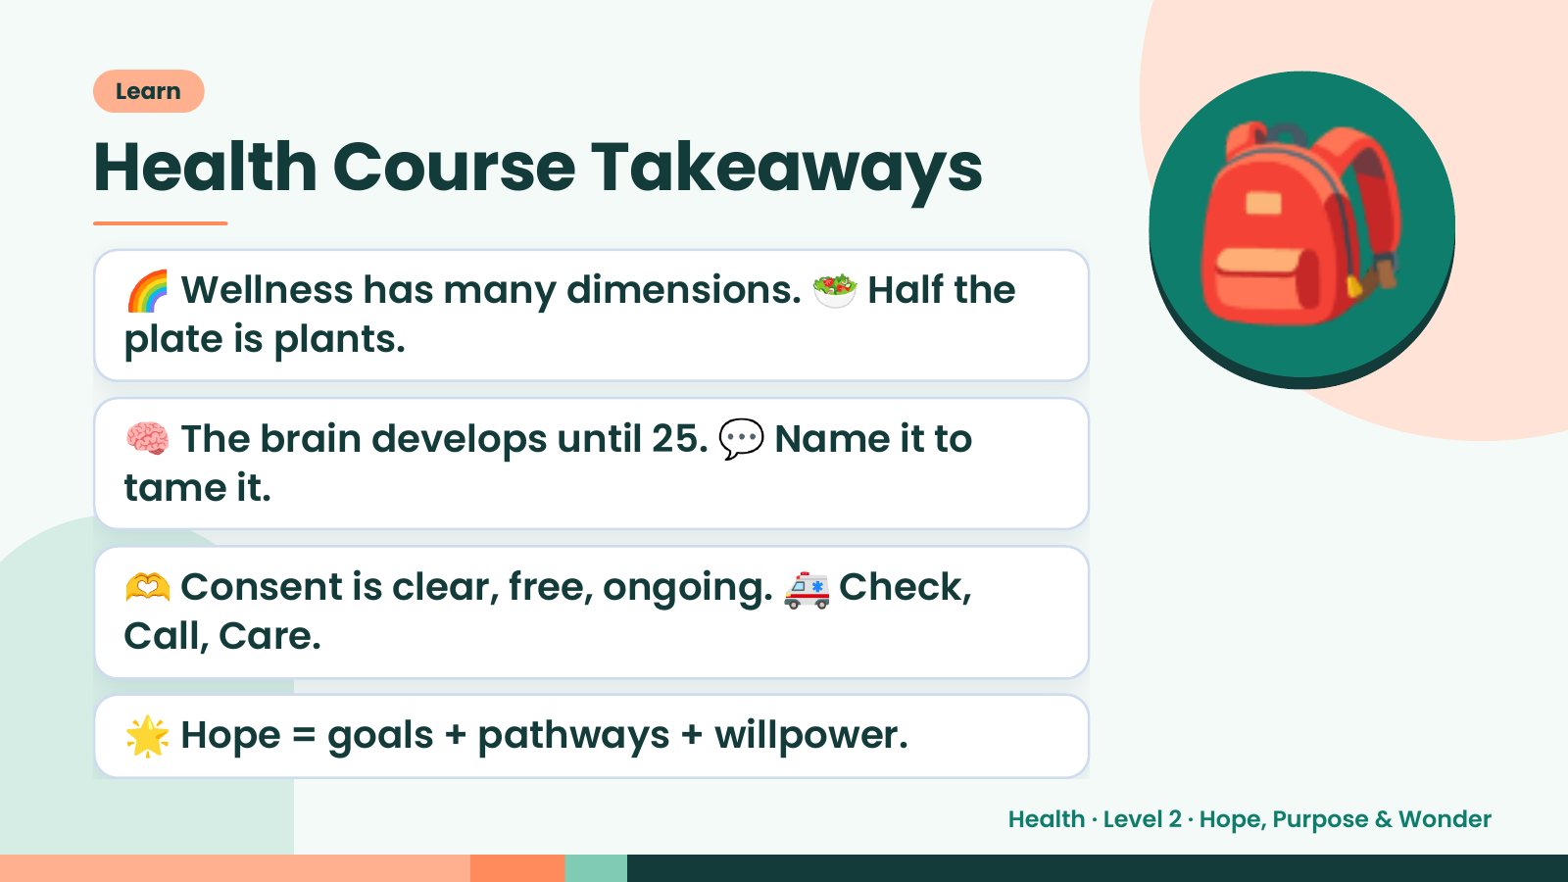
Notes:
Learn
Health Course Takeaways
🌈 Wellness has many dimensions. 🥗 Half the
plate is plants.
🧠 The brain develops until 25. 💬 Name it to
tame it.
🎒
🫶 Consent is clear, free, ongoing. 🚑 Check,
Call, Care.
🌟 Hope = goals + pathways + willpower.
Health · Level 2 · Hope, Purpose & Wonder

Slide 19
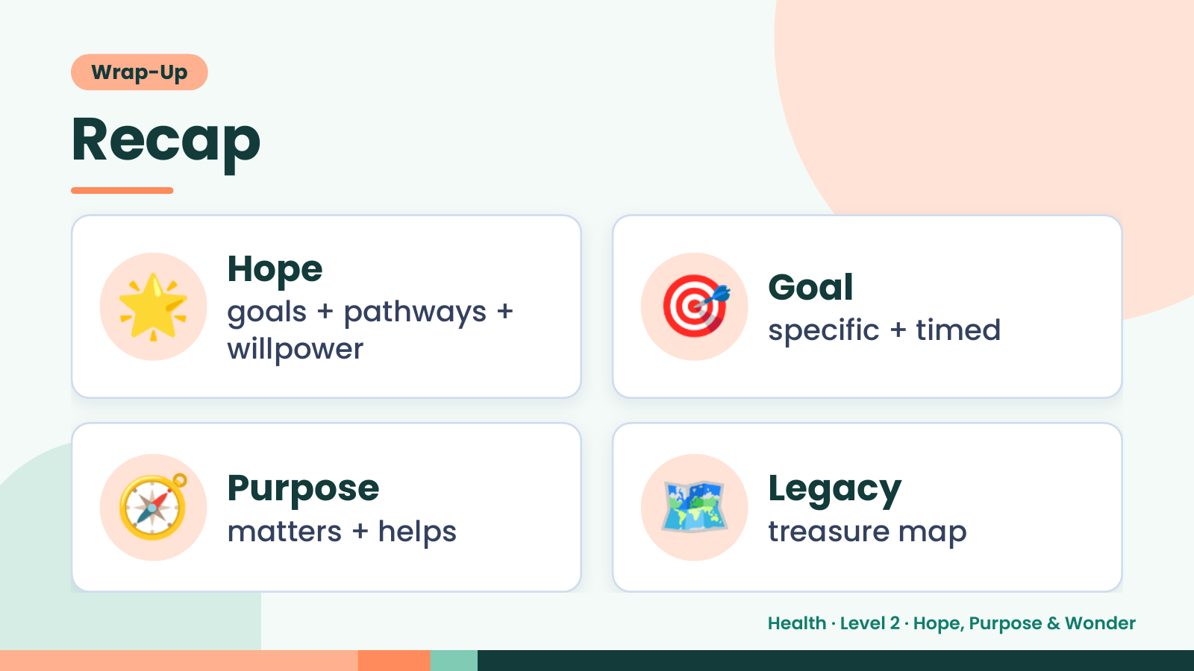
Notes:
Wrap-Up
Recap
🌟 Hope
goals + pathways +
willpower
🎯 Goal
specific + timed
🧭 Purpose
matters + helps 🗺️ Legacy
treasure map
Health · Level 2 · Hope, Purpose & Wonder

Slide 20
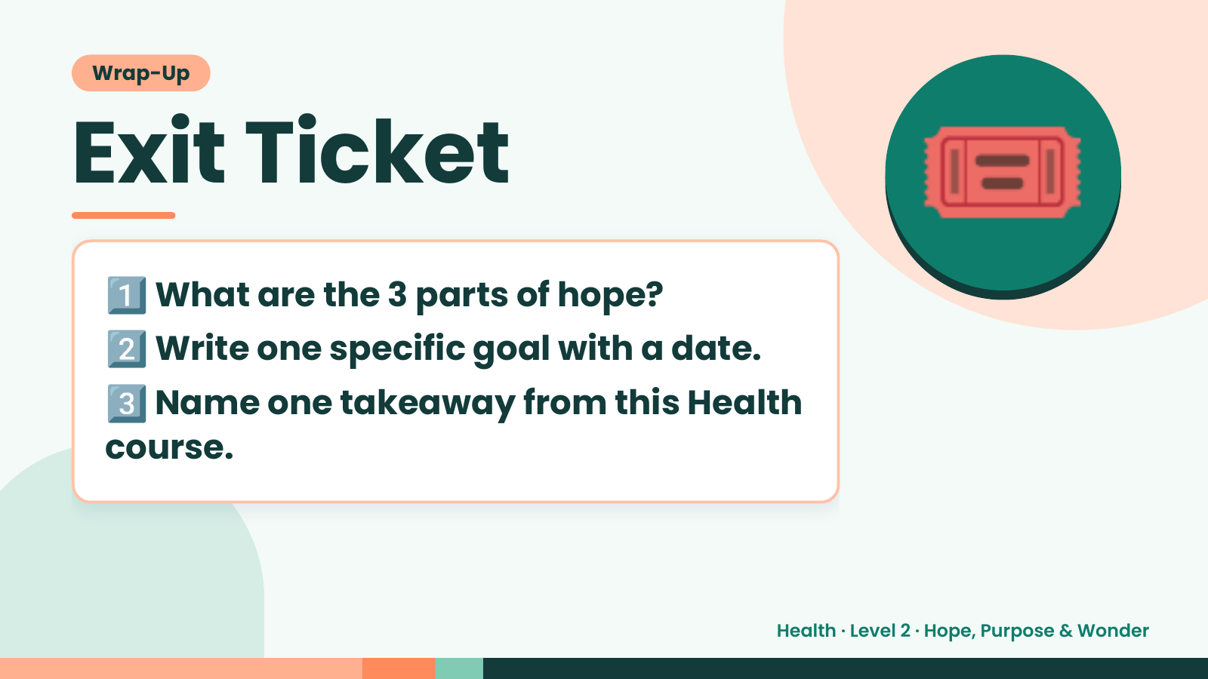
Notes:
Wrap-Up
Exit Ticket
1️⃣
2️⃣
What are the 3 parts of hope?
Write one specific goal with a date.
🎟️
3️⃣
Name one takeaway from this Health
course.
Health · Level 2 · Hope, Purpose & Wonder

