Slide 1
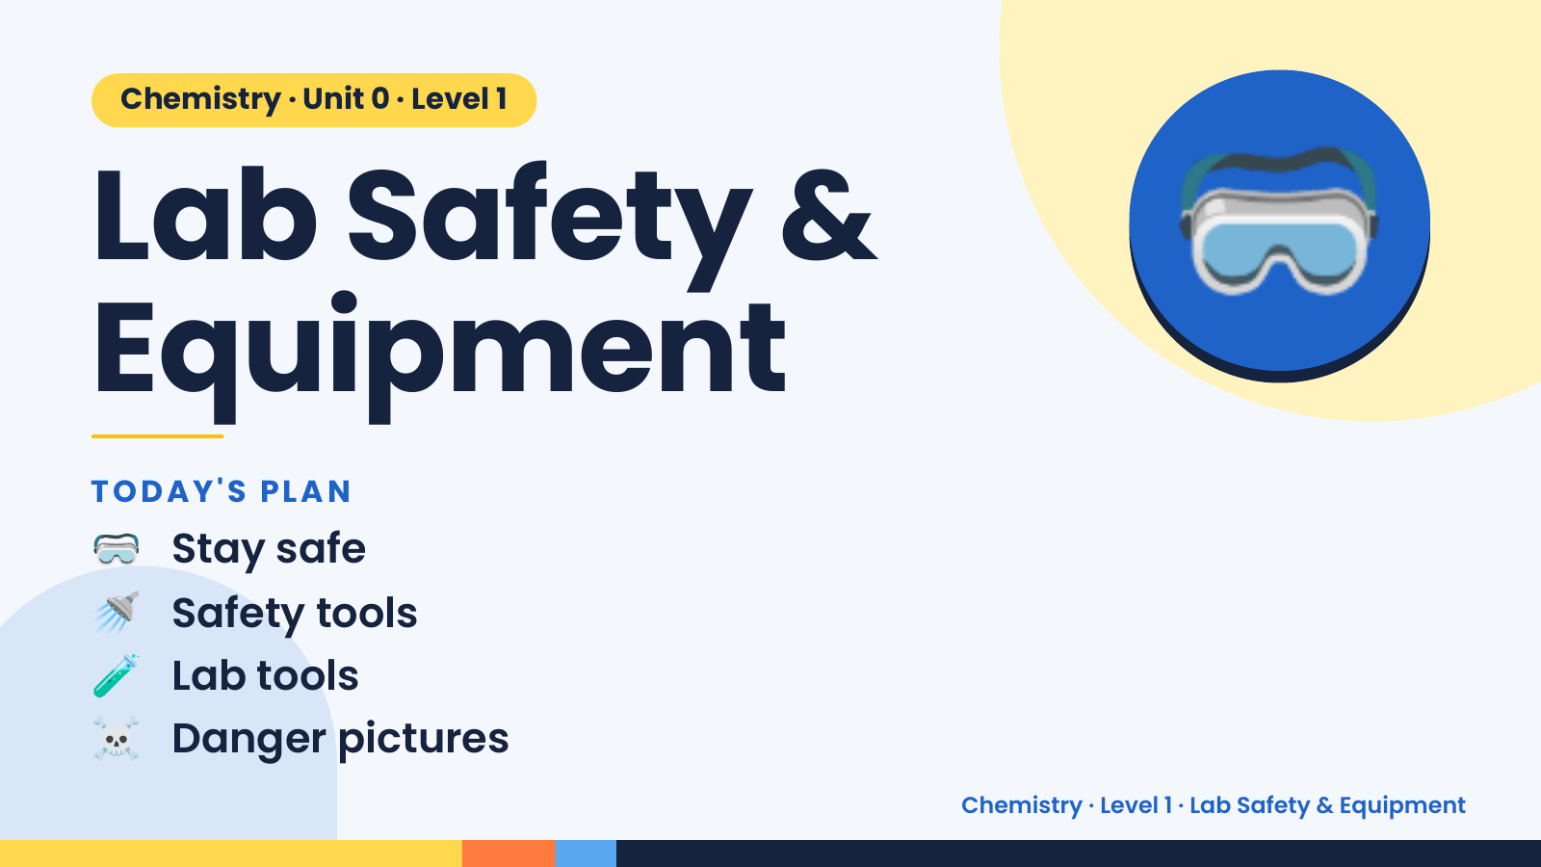
Notes:
Chemistry · Unit 0 · Level 1
Lab Safety &
Equipment
🥽
🥽 Stay safe
TODAY'S PLAN
🚿 Safety tools
🧪 Lab tools
☠️ Danger pictures
Chemistry · Level 1 · Lab Safety & Equipment

Slide 2
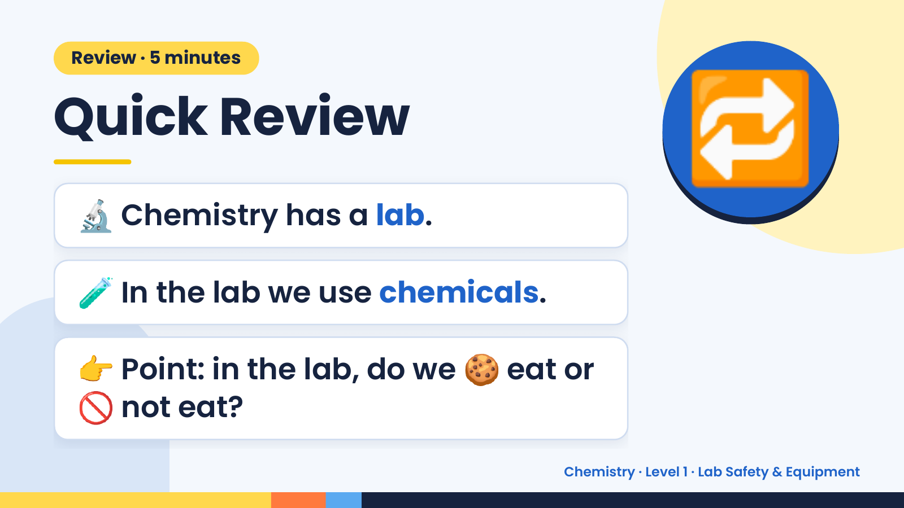
Notes:
Review · 5 minutes
Quick Review
🔬 Chemistry has a lab.
🔁
🧪 In the lab we use chemicals.
👉 Point: in the lab, do we 🍪 eat or
🚫 not eat?
Chemistry · Level 1 · Lab Safety & Equipment

Slide 3
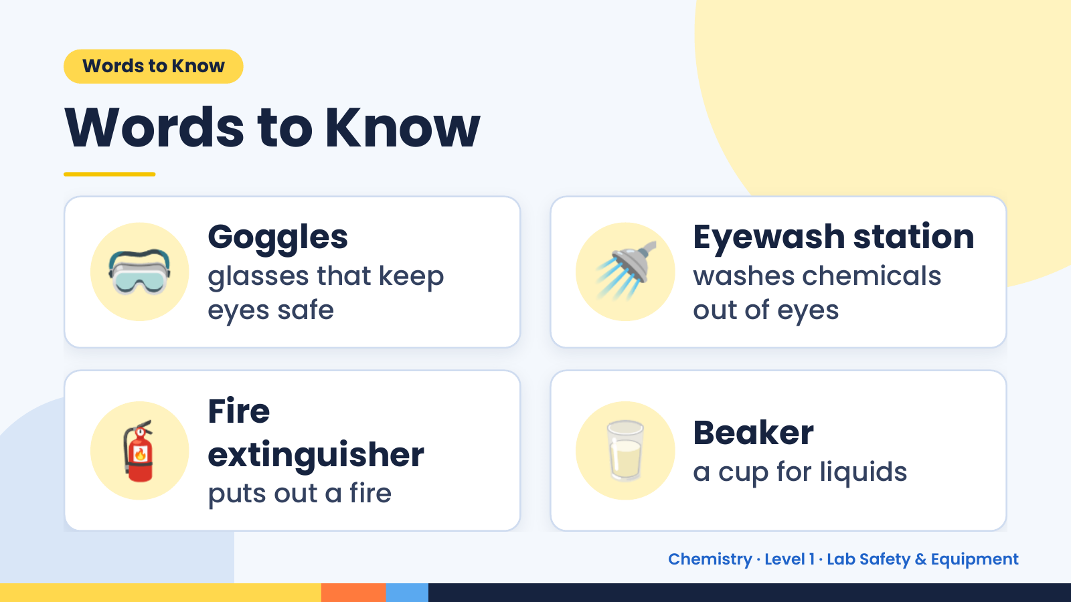
Notes:
Words to Know
Words to Know
🥽 Goggles
glasses that keep
eyes safe
🚿 Eyewash station
washes chemicals
out of eyes
🧯 Fire
extinguisher
puts out a fire
🥛 Beaker
a cup for liquids
Chemistry · Level 1 · Lab Safety & Equipment

Slide 4
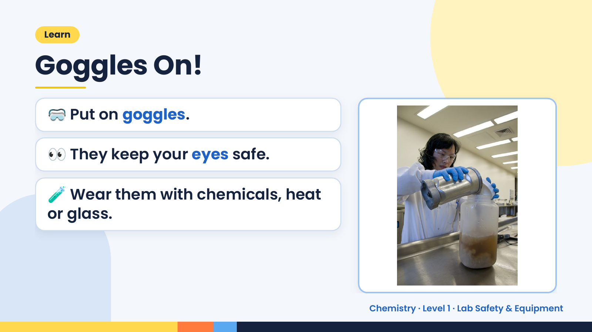
Notes:
Learn
Goggles On!
🥽 Put on goggles.
👀 They keep your eyes safe.
🧪 Wear them with chemicals, heat
or glass.
Chemistry · Level 1 · Lab Safety & Equipment

Slide 5
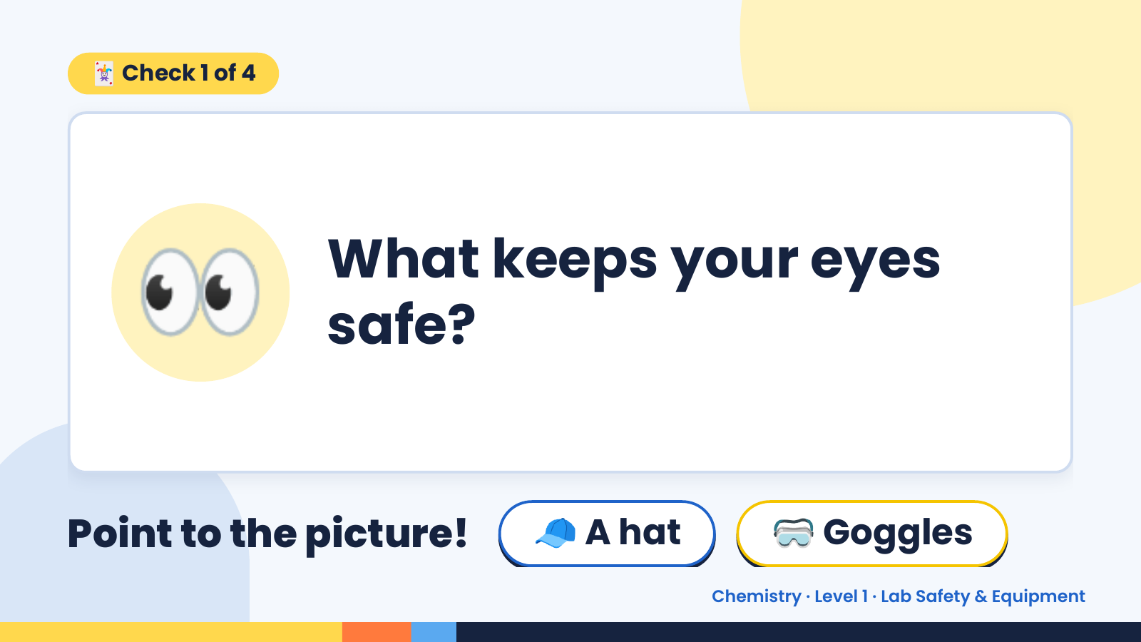
Notes:
🃏 Check 1 of 4
👀 What keeps your eyes
safe?
Point to the picture! 🧢 A hat 🥽 Goggles
Chemistry · Level 1 · Lab Safety & Equipment

Slide 6
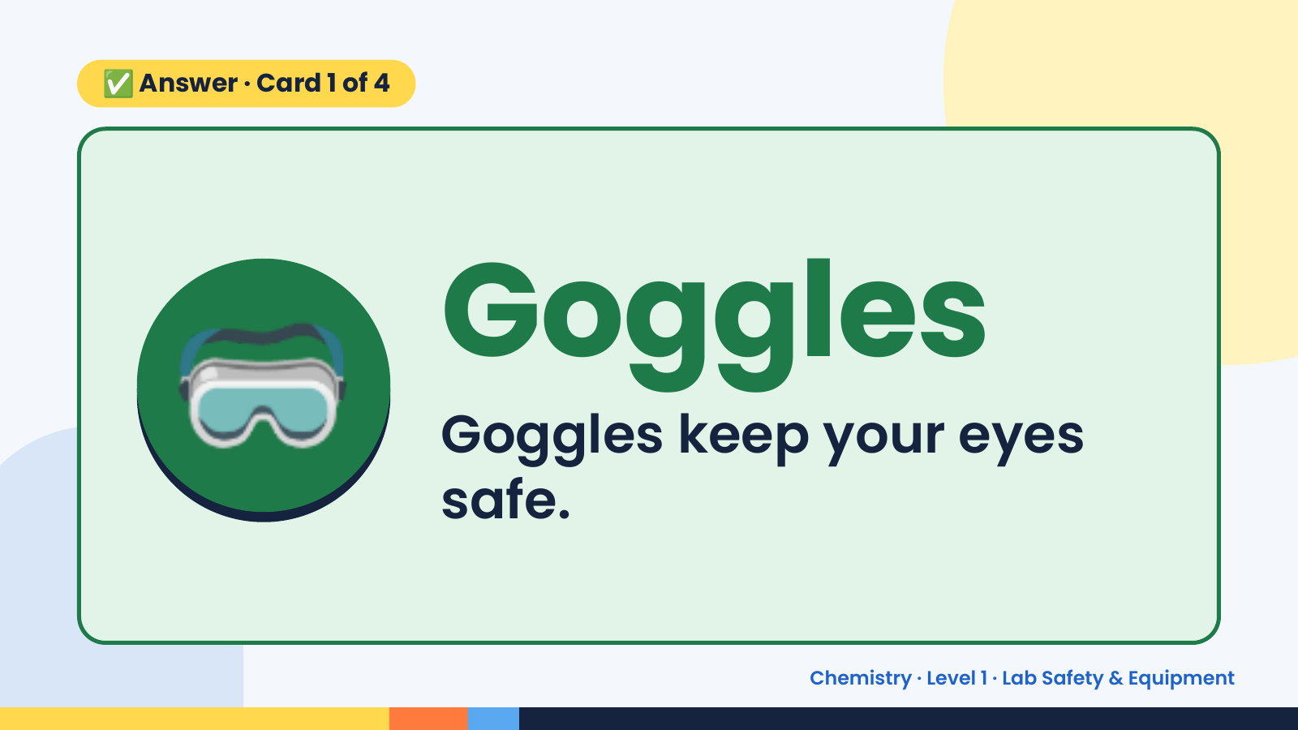
Notes:
✅ Answer · Card 1 of 4
🥽 Goggles
Goggles keep your eyes
safe.
Chemistry · Level 1 · Lab Safety & Equipment

Slide 7
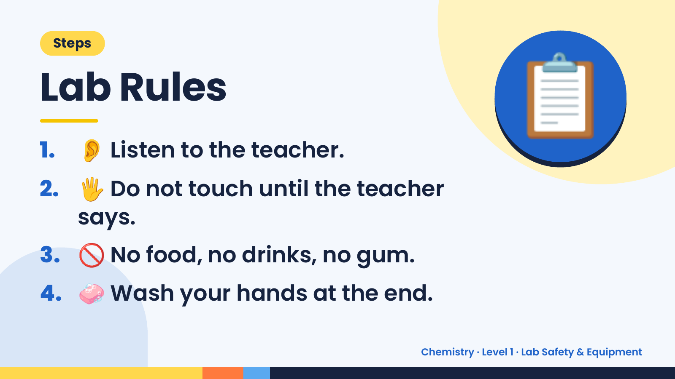
Notes:
Steps
Lab Rules
1. 👂 Listen to the teacher.
2. 🖐️ Do not touch until the teacher
📋
says.
3. 🚫 No food, no drinks, no gum.
4. 🧼 Wash your hands at the end.
Chemistry · Level 1 · Lab Safety & Equipment

Slide 8
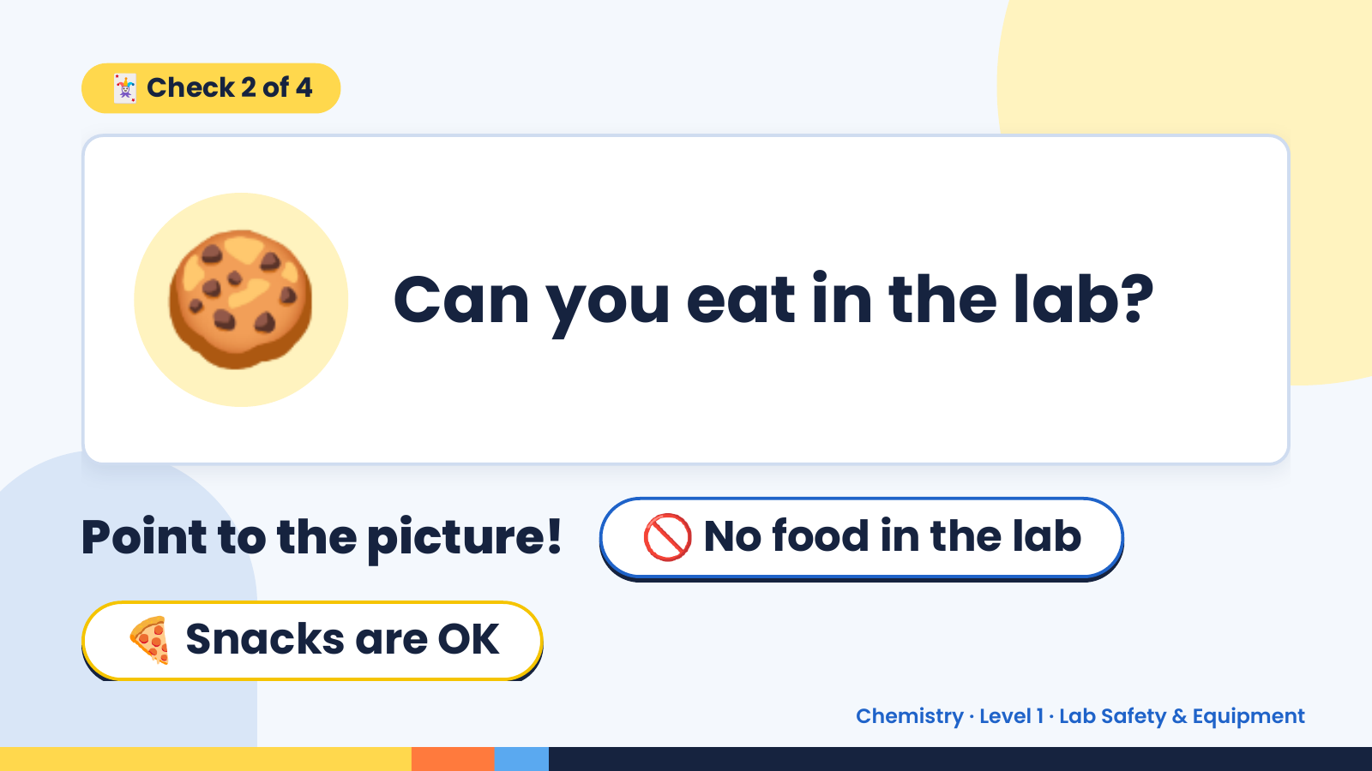
Notes:
🃏 Check 2 of 4
🍪 Can you eat in the lab?
Point to the picture! 🚫 No food in the lab
🍕 Snacks are OK
Chemistry · Level 1 · Lab Safety & Equipment

Slide 9
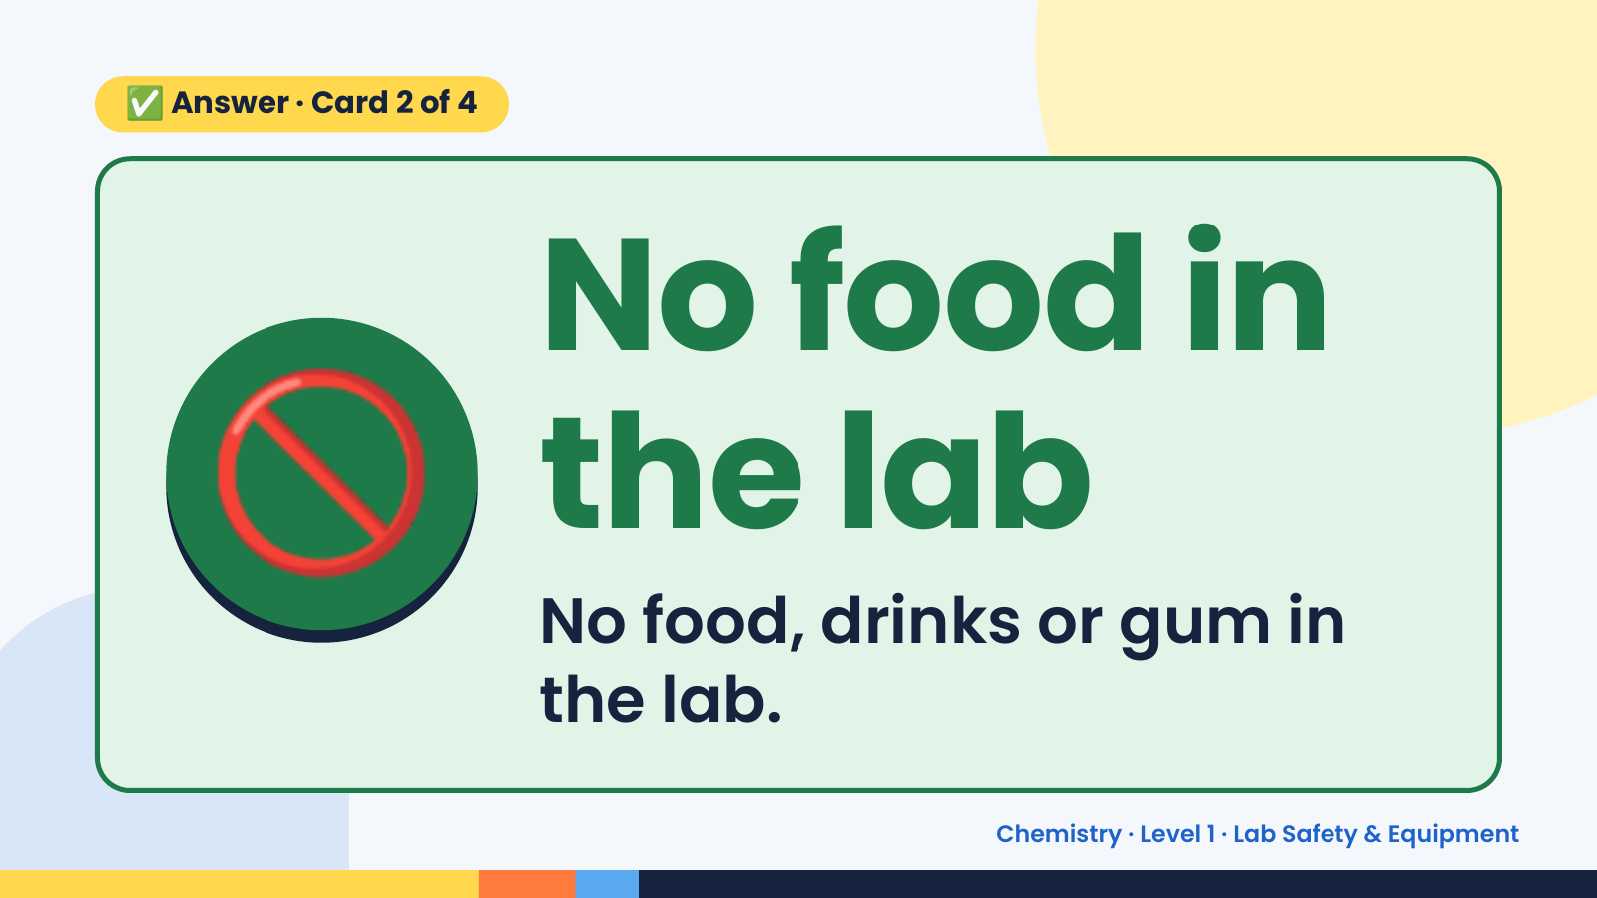
Notes:
✅ Answer · Card 2 of 4
🚫 No food in
the lab
No food, drinks or gum in
the lab.
Chemistry · Level 1 · Lab Safety & Equipment

Slide 10
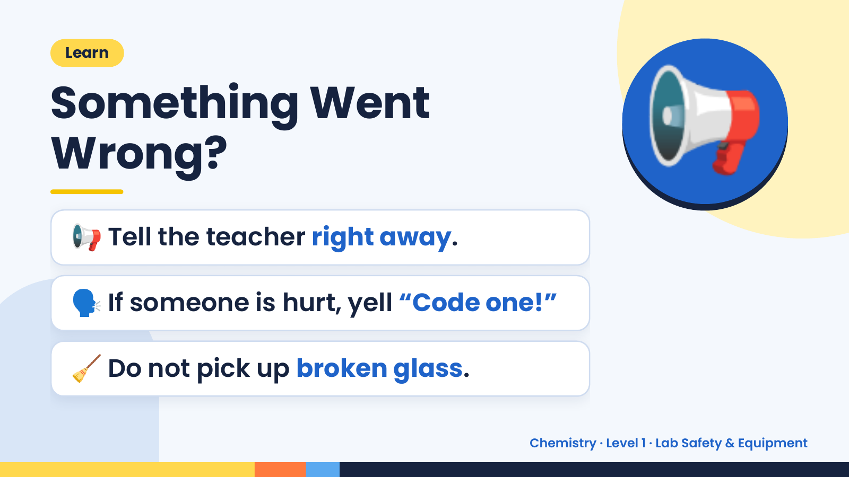
Notes:
Learn
Something Went
Wrong?
📢 Tell the teacher right away.
📢
🗣️ If someone is hurt, yell “Code one!”
🧹 Do not pick up broken glass.
Chemistry · Level 1 · Lab Safety & Equipment

Slide 11
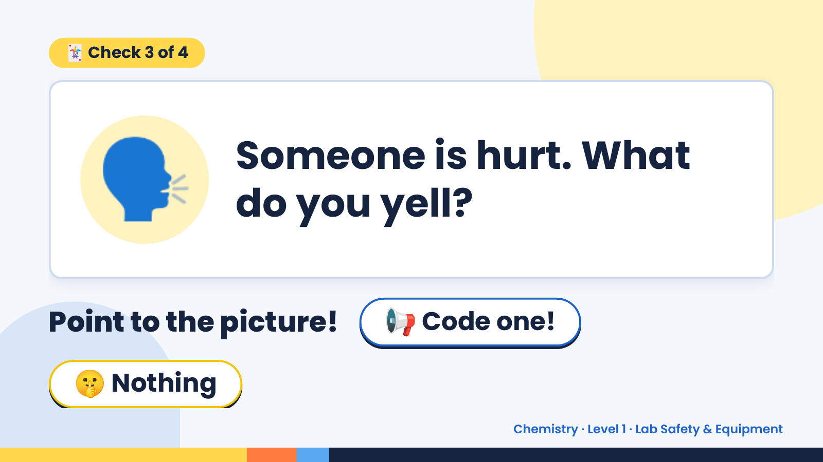
Notes:
🃏 Check 3 of 4
🗣️ Someone is hurt. What
do you yell?
Point to the picture! 📢 Code one!
🤫 Nothing
Chemistry · Level 1 · Lab Safety & Equipment

Slide 12
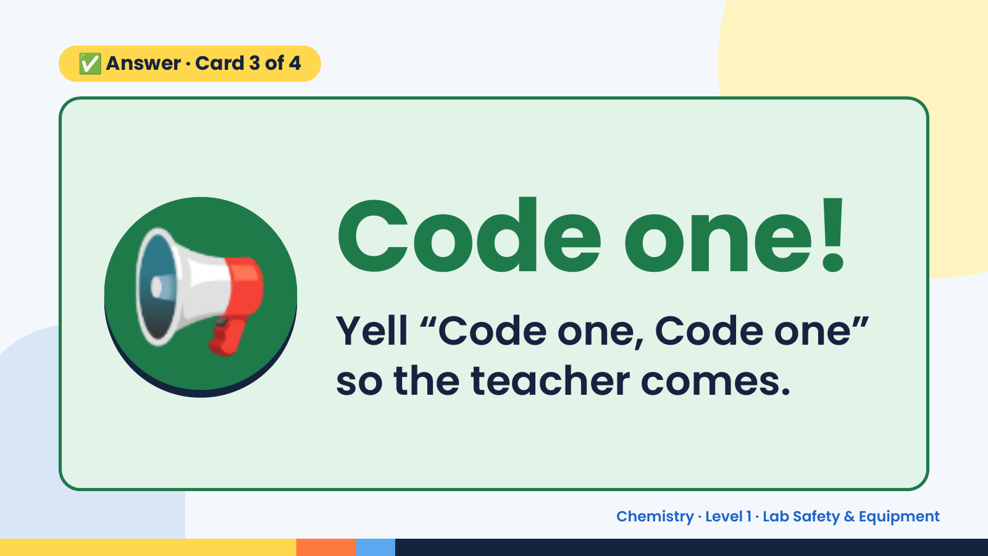
Notes:
✅ Answer · Card 3 of 4
📢 Code one!
Yell “Code one, Code one”
so the teacher comes.
Chemistry · Level 1 · Lab Safety & Equipment

Slide 13
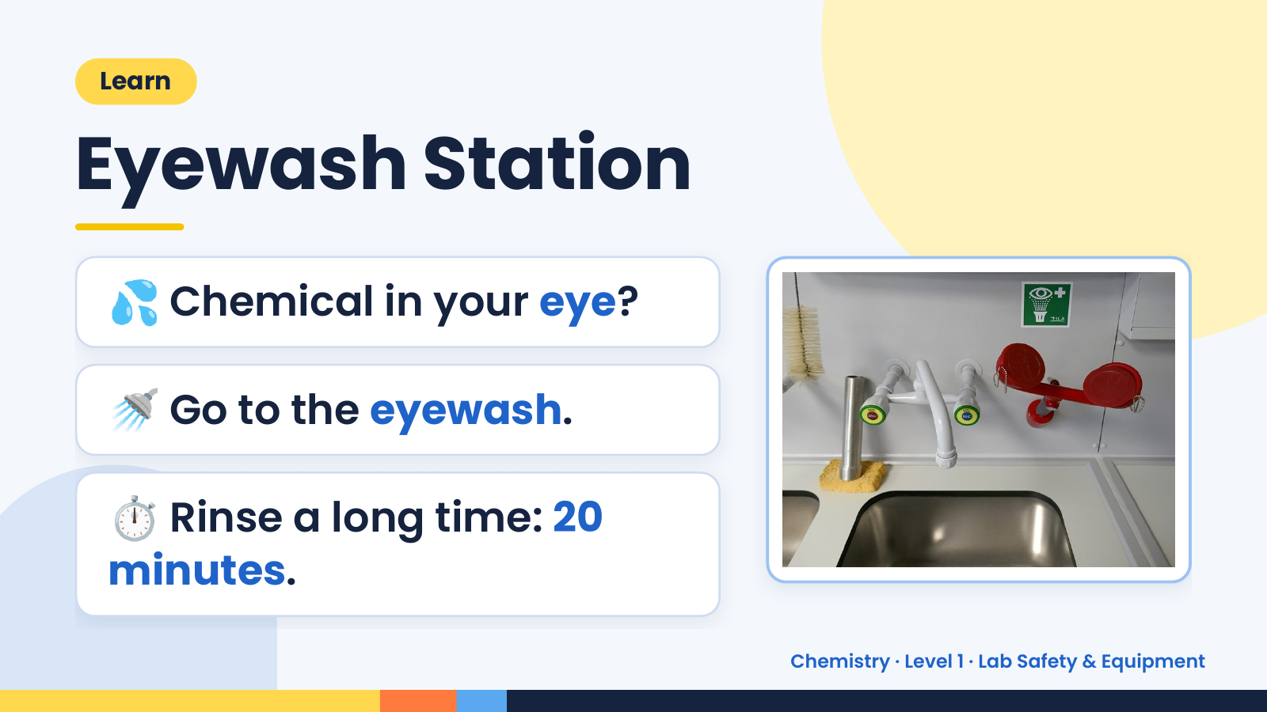
Notes:
Learn
Eyewash Station
💦 Chemical in your eye?
🚿 Go to the eyewash.
⏱️ Rinse a long time: 20
minutes.
Chemistry · Level 1 · Lab Safety & Equipment

Slide 14
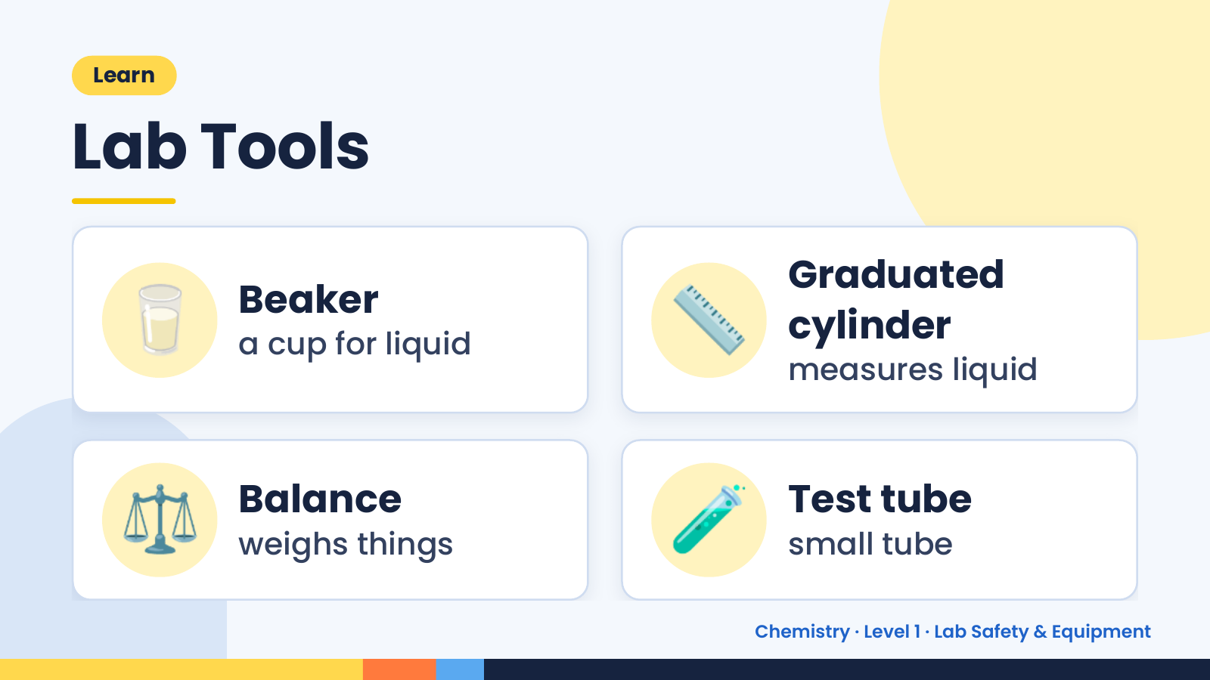
Notes:
Learn
Lab Tools
🥛 Beaker
a cup for liquid 📏 Graduated
cylinder
measures liquid
⚖️ Balance
weighs things 🧪 Test tube
small tube
Chemistry · Level 1 · Lab Safety & Equipment

Slide 15
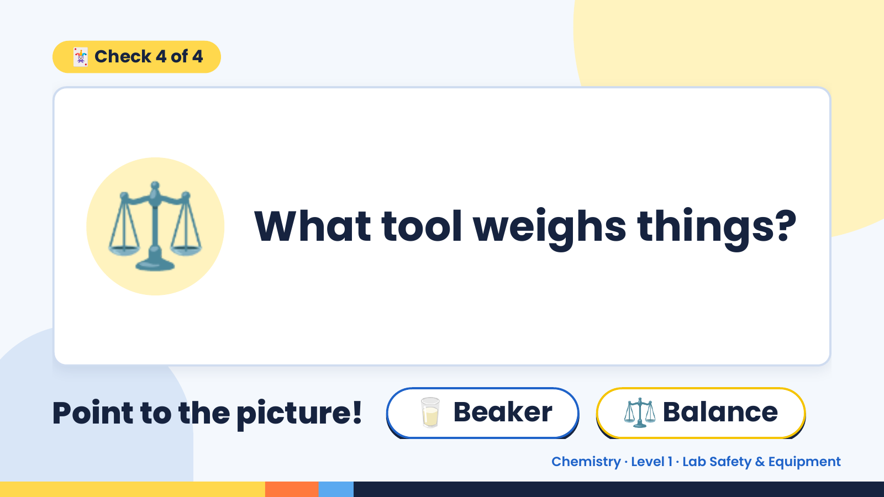
Notes:
🃏 Check 4 of 4
⚖️ What tool weighs things?
Point to the picture! 🥛 Beaker ⚖️ Balance
Chemistry · Level 1 · Lab Safety & Equipment

Slide 16
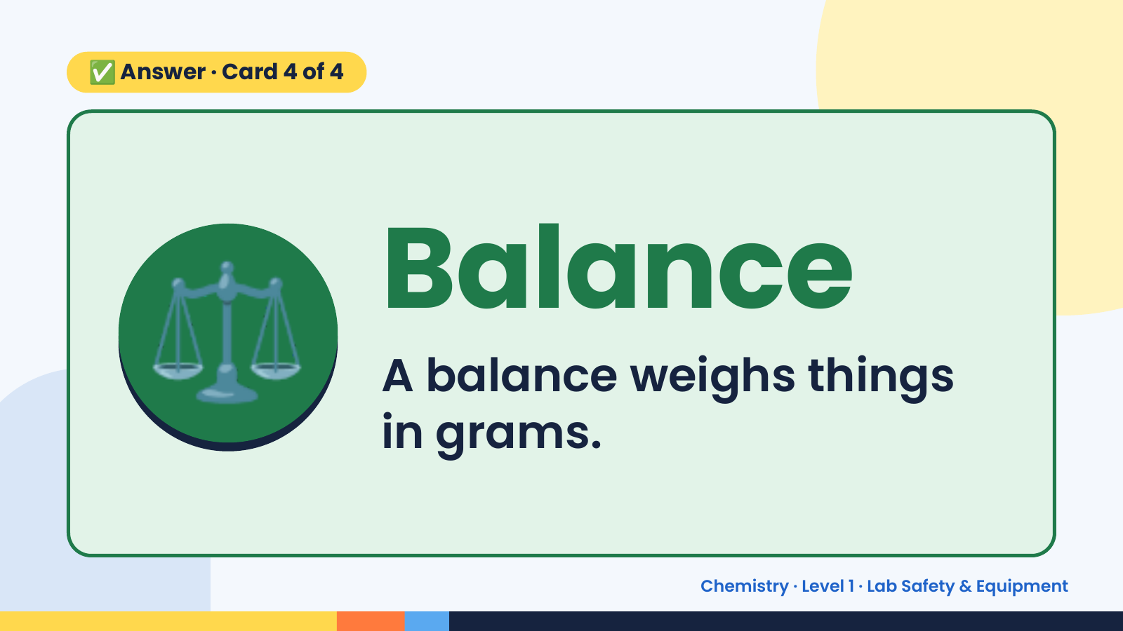
Notes:
✅ Answer · Card 4 of 4
⚖️ Balance
A balance weighs things
in grams.
Chemistry · Level 1 · Lab Safety & Equipment

Slide 17
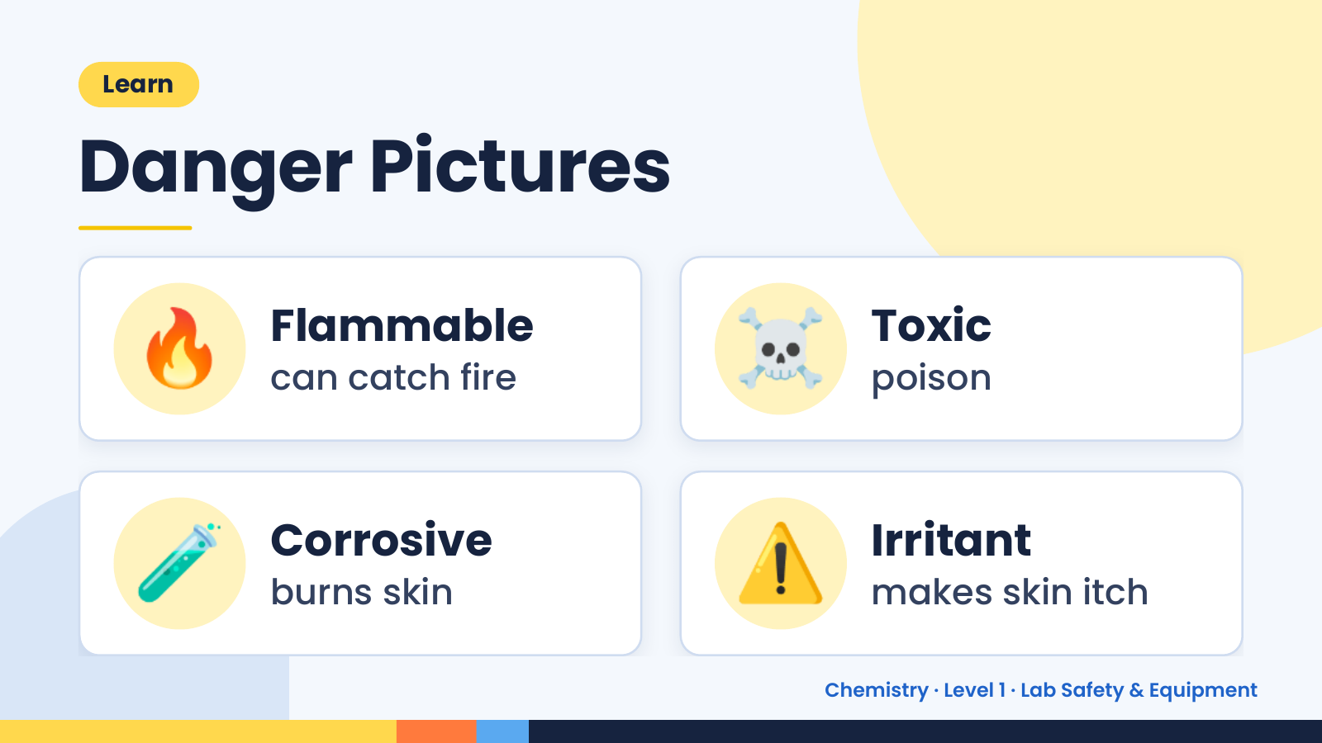
Notes:
Learn
Danger Pictures
🔥 Flammable
can catch fire ☠️ Toxic
poison
🧪 Corrosive
burns skin ⚠️ Irritant
makes skin itch
Chemistry · Level 1 · Lab Safety & Equipment

Slide 18
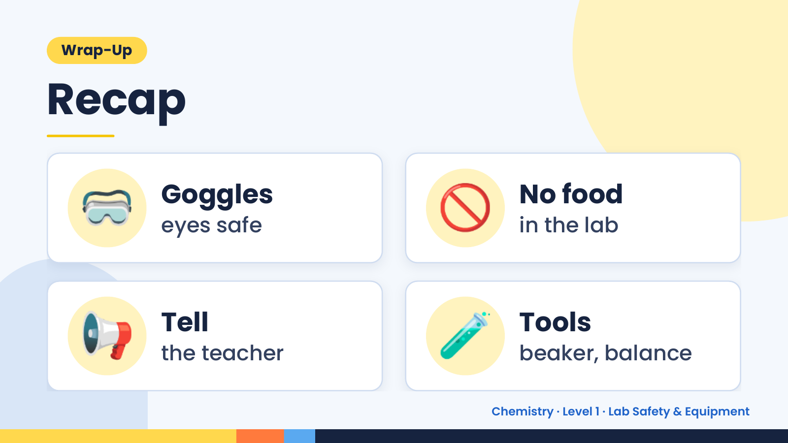
Notes:
Wrap-Up
Recap
🥽 Goggles
eyes safe 🚫 No food
in the lab
📢 Tell
the teacher 🧪 Tools
beaker, balance
Chemistry · Level 1 · Lab Safety & Equipment

Slide 19
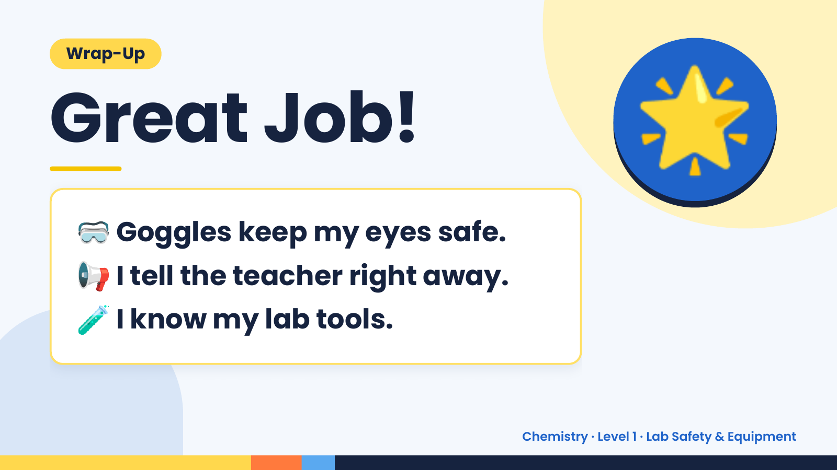
Notes:
Wrap-Up
Great Job!
🥽 Goggles keep my eyes safe.
🌟
📢 I tell the teacher right away.
🧪 I know my lab tools.
Chemistry · Level 1 · Lab Safety & Equipment

