Slide 1
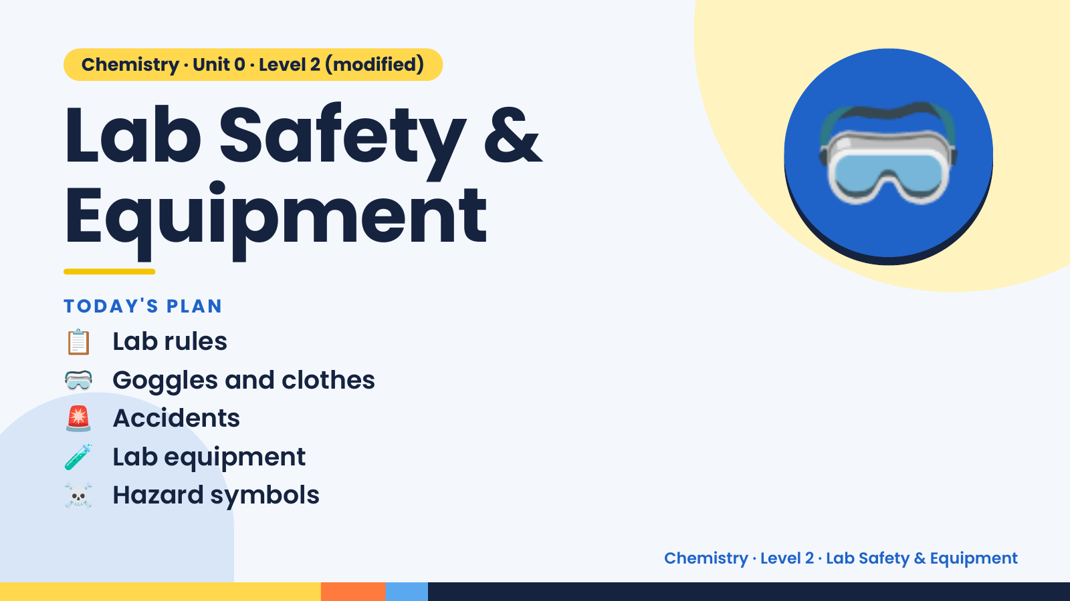
Notes:
Chemistry · Unit 0 · Level 2 (modified)
Lab Safety &
Equipment
📋 Lab rules
TODAY'S PLAN
🥽
🥽 Goggles and clothes
🚨 Accidents
🧪 Lab equipment
☠️ Hazard symbols
Chemistry · Level 2 · Lab Safety & Equipment

Slide 2
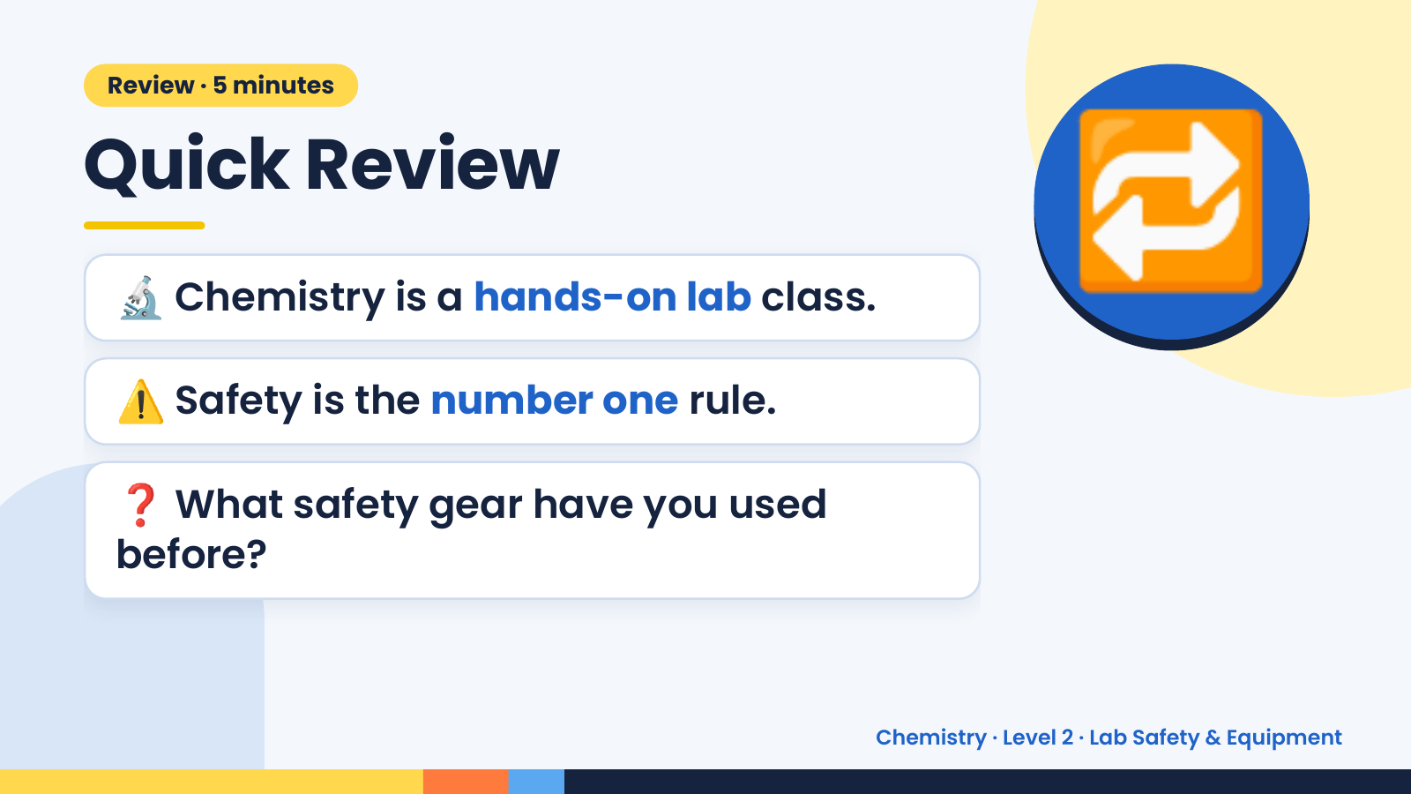
Notes:
Review · 5 minutes
Quick Review
🔬 Chemistry is a hands-on lab class.
⚠️ Safety is the number one rule.
🔁
❓ What safety gear have you used
before?
Chemistry · Level 2 · Lab Safety & Equipment

Slide 3
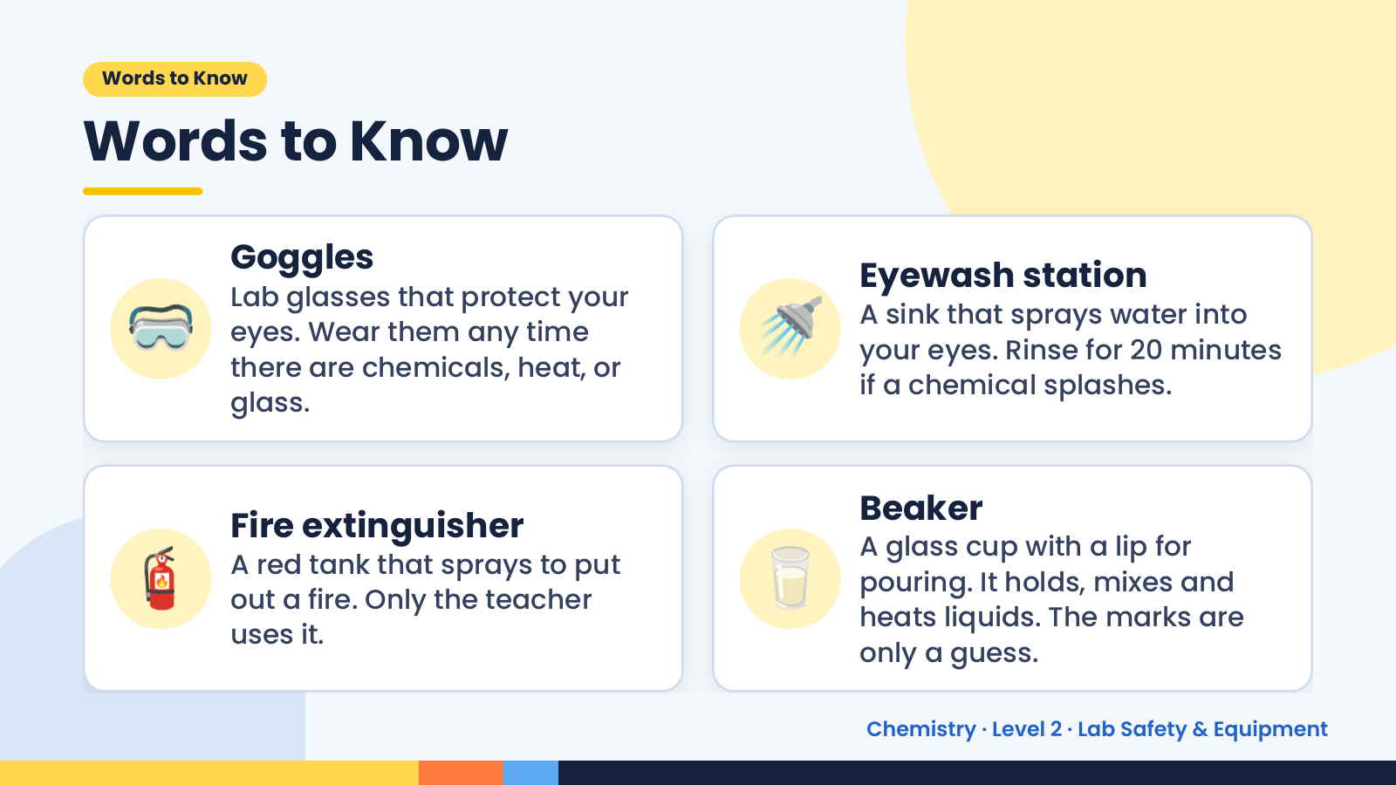
Notes:
Words to Know
Words to Know
🥽 🚿
Goggles
Eyewash station
Lab glasses that protect your
A sink that sprays water into
eyes. Wear them any time
your eyes. Rinse for 20 minutes
there are chemicals, heat, or
if a chemical splashes.
glass.
🧯 🥛
Beaker
Fire extinguisher
A glass cup with a lip for
A red tank that sprays to put
pouring. It holds, mixes and
out a fire. Only the teacher
heats liquids. The marks are
uses it.
only a guess.
Chemistry · Level 2 · Lab Safety & Equipment

Slide 4
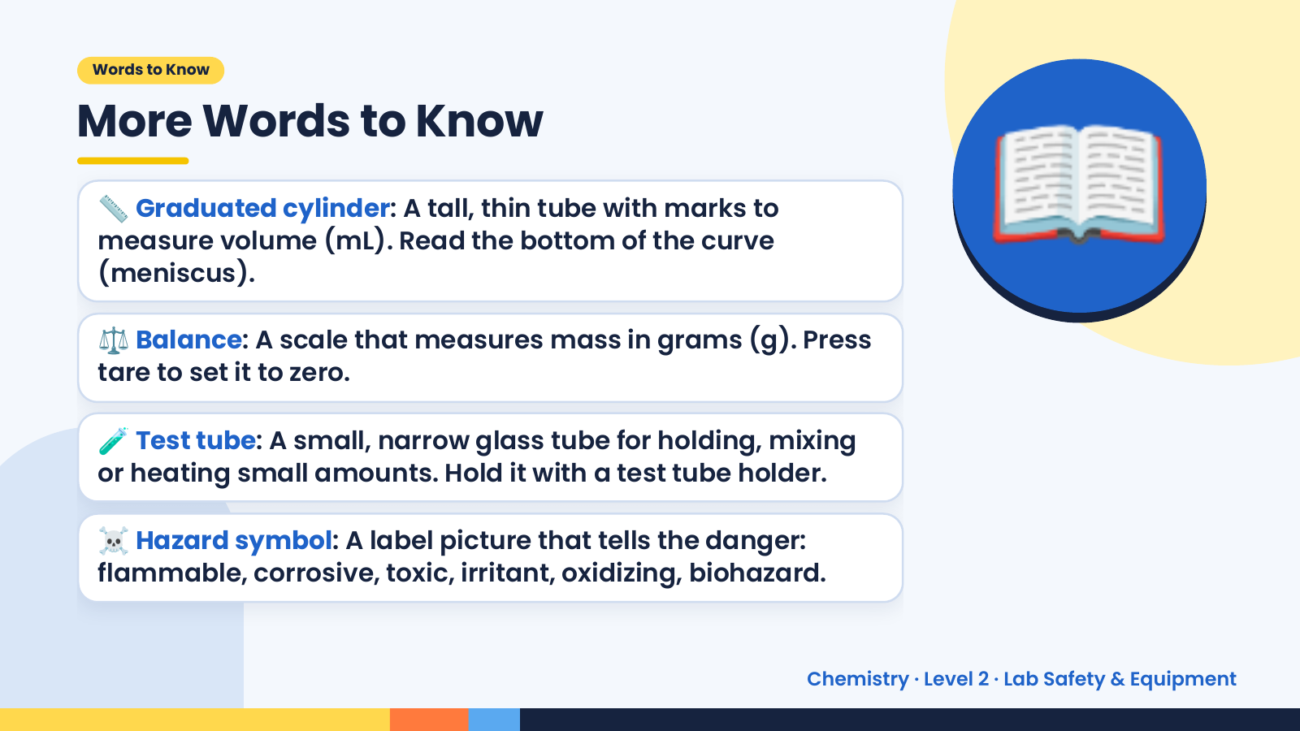
Notes:
Words to Know
More Words to Know
📏 Graduated cylinder: A tall, thin tube with marks to
measure volume (mL). Read the bottom of the curve
(meniscus).
⚖️ Balance: A scale that measures mass in grams (g). Press
tare to set it to zero.
📖
🧪 Test tube: A small, narrow glass tube for holding, mixing
or heating small amounts. Hold it with a test tube holder.
☠️ Hazard symbol: A label picture that tells the danger:
flammable, corrosive, toxic, irritant, oxidizing, biohazard.
Chemistry · Level 2 · Lab Safety & Equipment

Slide 5
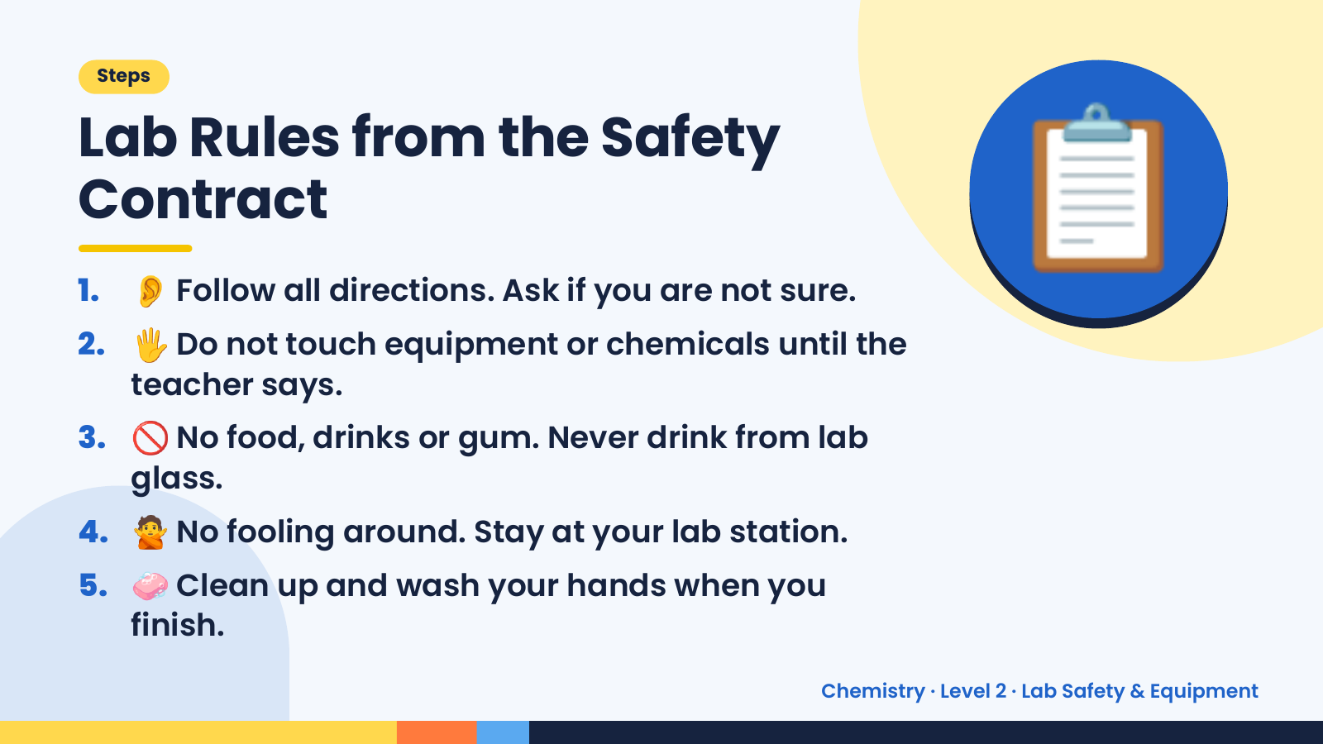
Notes:
Steps
Lab Rules from the Safety
Contract
1. 👂 Follow all directions. Ask if you are not sure.
2. 🖐️ Do not touch equipment or chemicals until the
teacher says.
📋
3. 🚫 No food, drinks or gum. Never drink from lab
glass.
4. 🙅 No fooling around. Stay at your lab station.
5. 🧼 Clean up and wash your hands when you
finish.
Chemistry · Level 2 · Lab Safety & Equipment

Slide 6
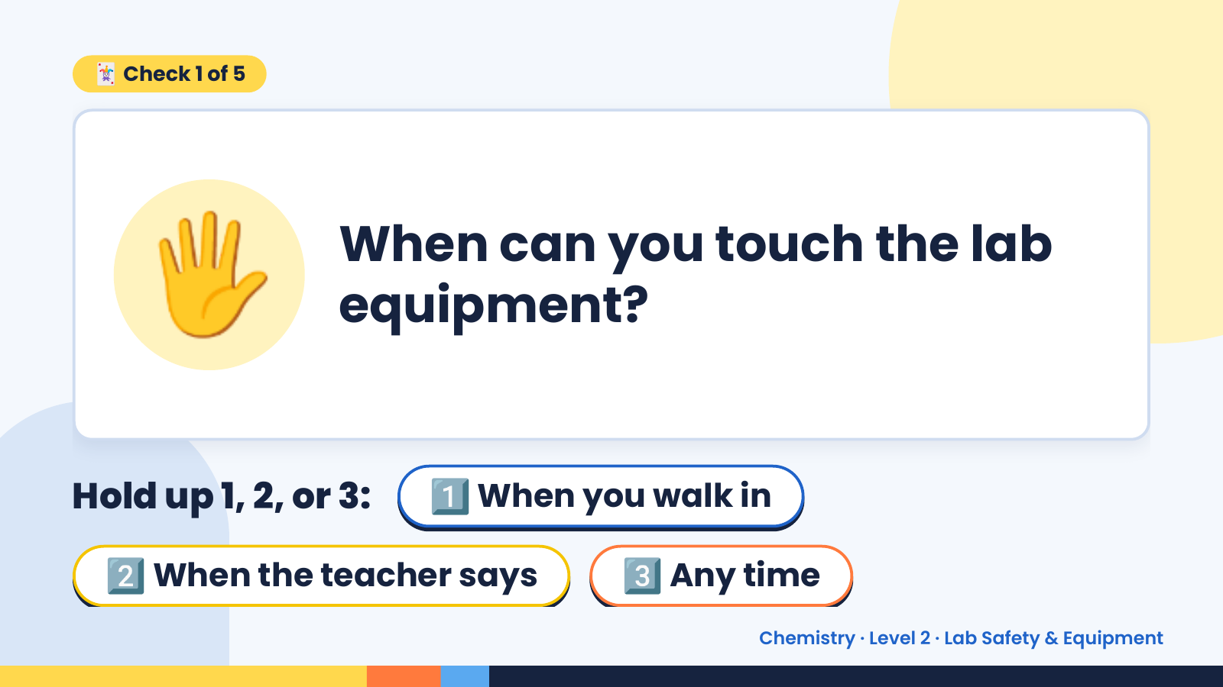
Notes:
🃏 Check 1 of 5
🖐️ When can you touch the lab
equipment?
Hold up 1, 2, or 3: 1️⃣ When you walk in
2️⃣ When the teacher says 3️⃣ Any time
Chemistry · Level 2 · Lab Safety & Equipment

Slide 7
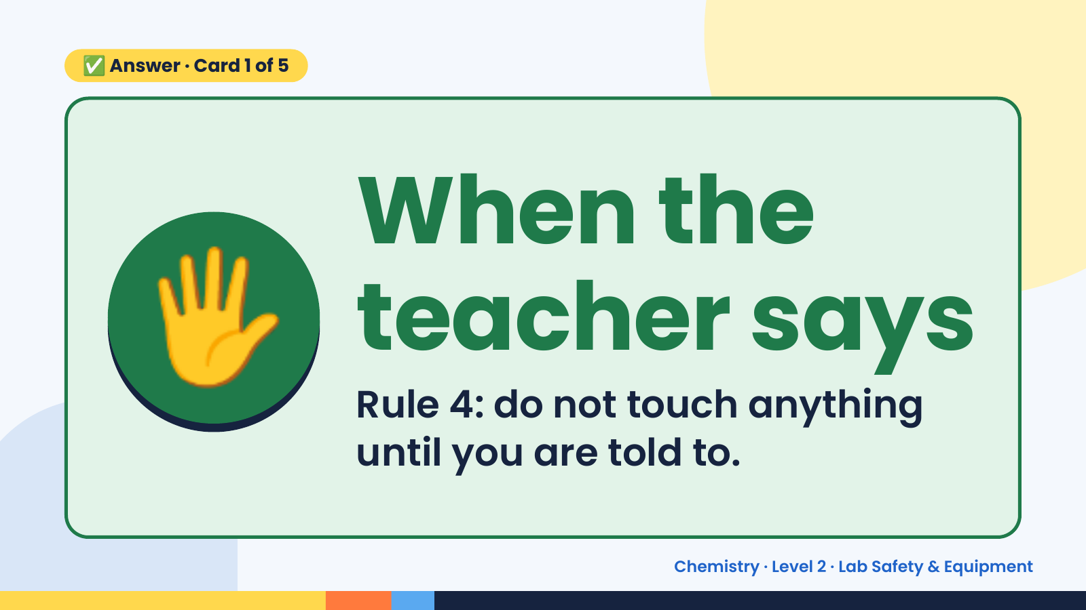
Notes:
✅ Answer · Card 1 of 5
🖐️ When the
teacher says
Rule 4: do not touch anything
until you are told to.
Chemistry · Level 2 · Lab Safety & Equipment

Slide 8
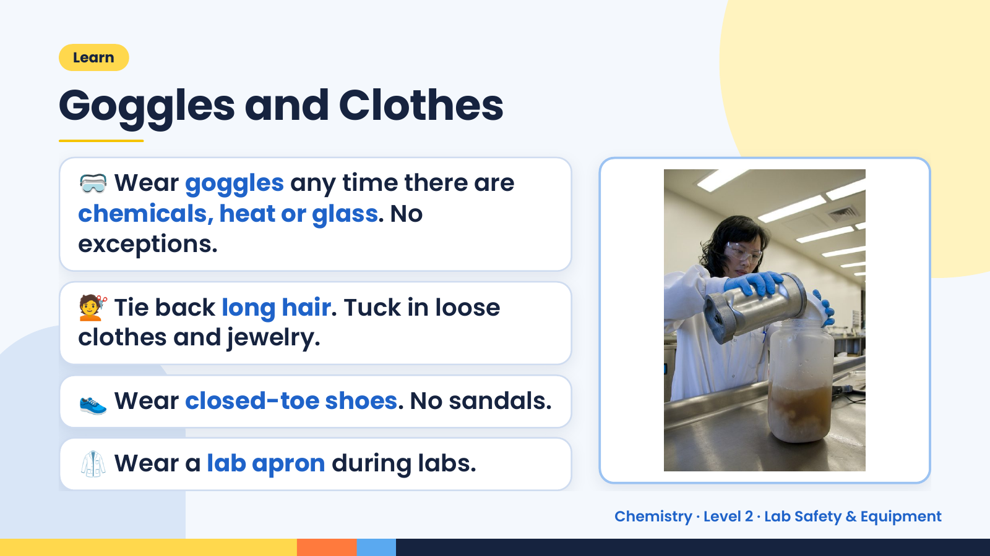
Notes:
Learn
Goggles and Clothes
🥽 Wear goggles any time there are
chemicals, heat or glass. No
exceptions.
💇 Tie back long hair. Tuck in loose
clothes and jewelry.
👟 Wear closed-toe shoes. No sandals.
🥼 Wear a lab apron during labs.
Chemistry · Level 2 · Lab Safety & Equipment

Slide 9
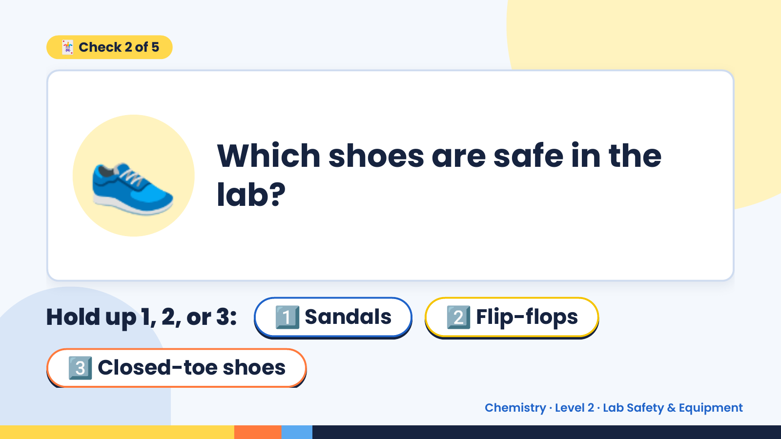
Notes:
🃏 Check 2 of 5
👟 Which shoes are safe in the
lab?
Hold up 1, 2, or 3: 1️⃣ Sandals 2️⃣ Flip-flops
3️⃣ Closed-toe shoes
Chemistry · Level 2 · Lab Safety & Equipment

Slide 10
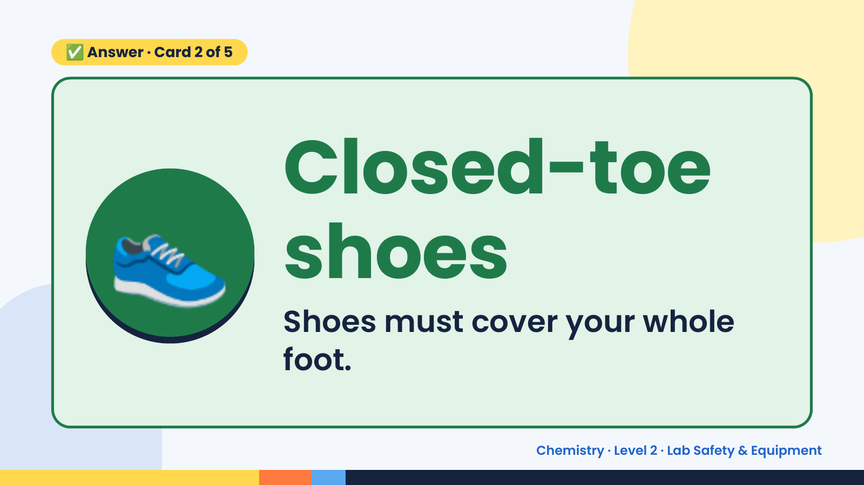
Notes:
✅ Answer · Card 2 of 5
👟 Closed-toe
shoes
Shoes must cover your whole
foot.
Chemistry · Level 2 · Lab Safety & Equipment

Slide 11
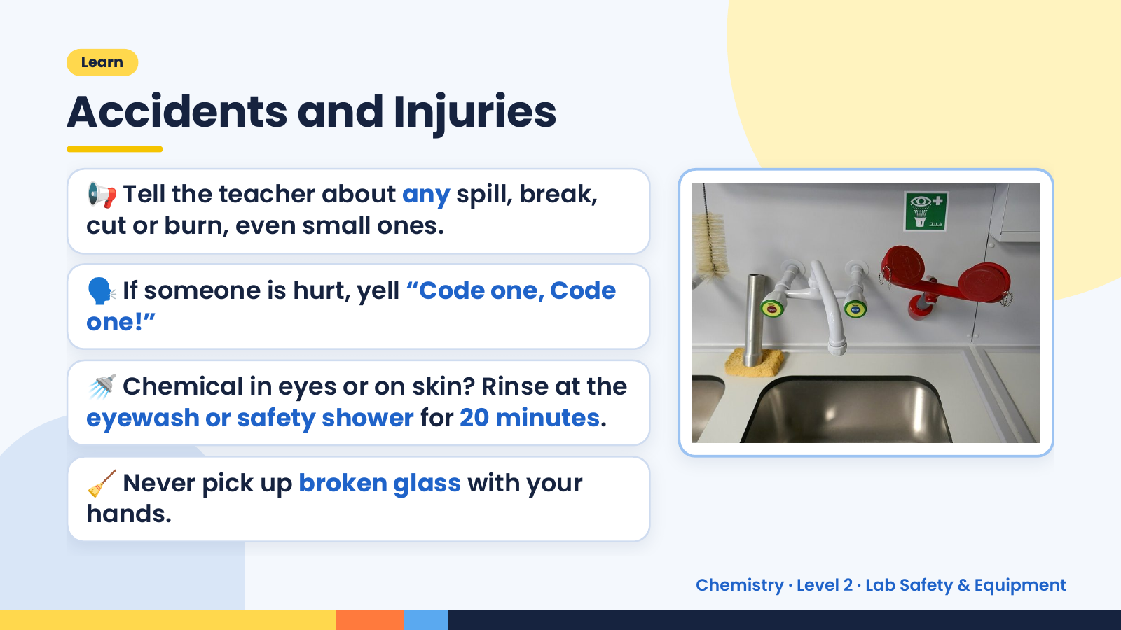
Notes:
Learn
Accidents and Injuries
📢 Tell the teacher about any spill, break,
cut or burn, even small ones.
🗣️ If someone is hurt, yell “Code one, Code
one!”
🚿 Chemical in eyes or on skin? Rinse at the
eyewash or safety shower for 20 minutes.
🧹 Never pick up broken glass with your
hands.
Chemistry · Level 2 · Lab Safety & Equipment

Slide 12
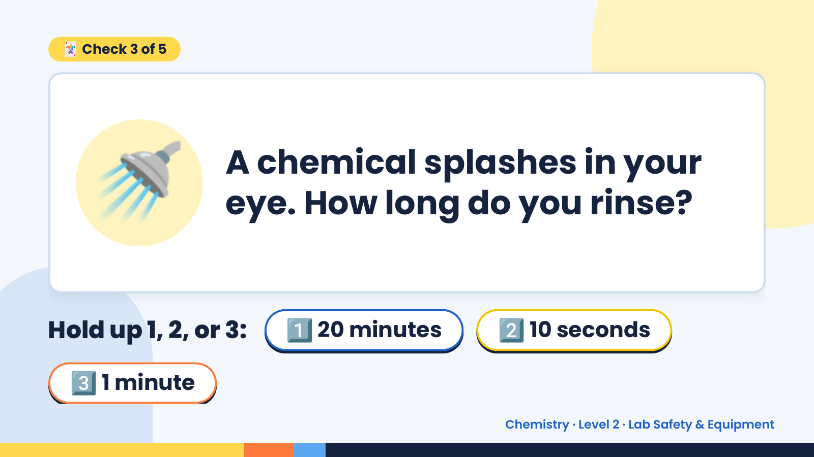
Notes:
🃏 Check 3 of 5
🚿 A chemical splashes in your
eye. How long do you rinse?
Hold up 1, 2, or 3: 1️⃣ 20 minutes 2️⃣ 10 seconds
3️⃣ 1 minute
Chemistry · Level 2 · Lab Safety & Equipment

Slide 13
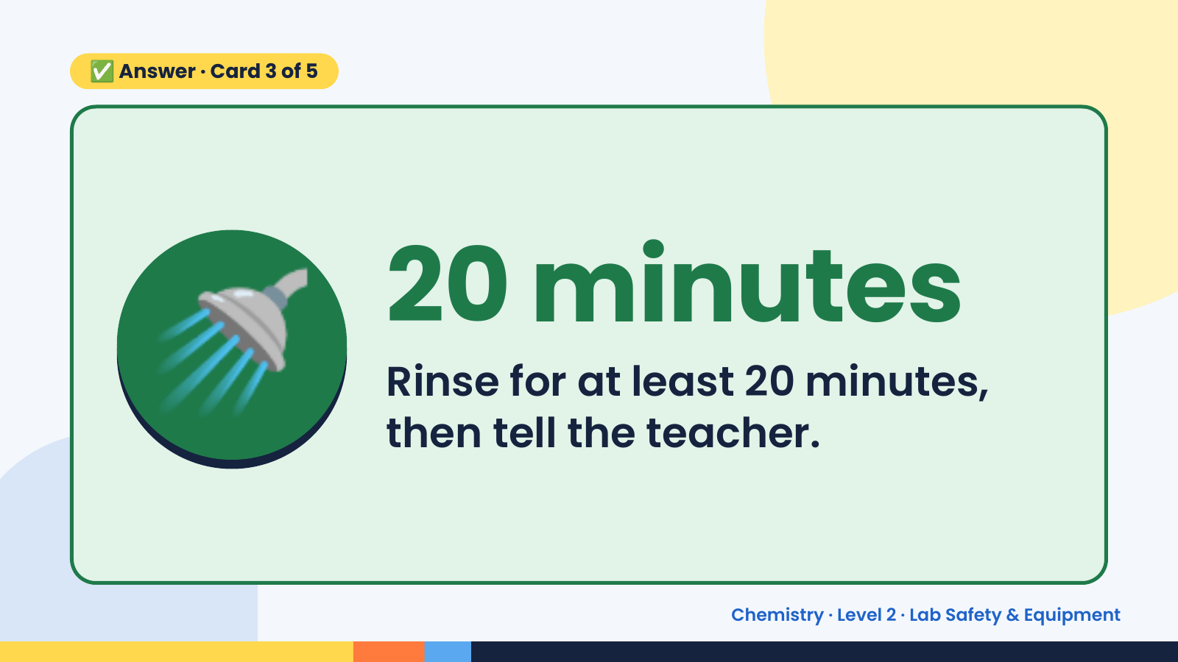
Notes:
✅ Answer · Card 3 of 5
🚿 20 minutes
Rinse for at least 20 minutes,
then tell the teacher.
Chemistry · Level 2 · Lab Safety & Equipment

Slide 14
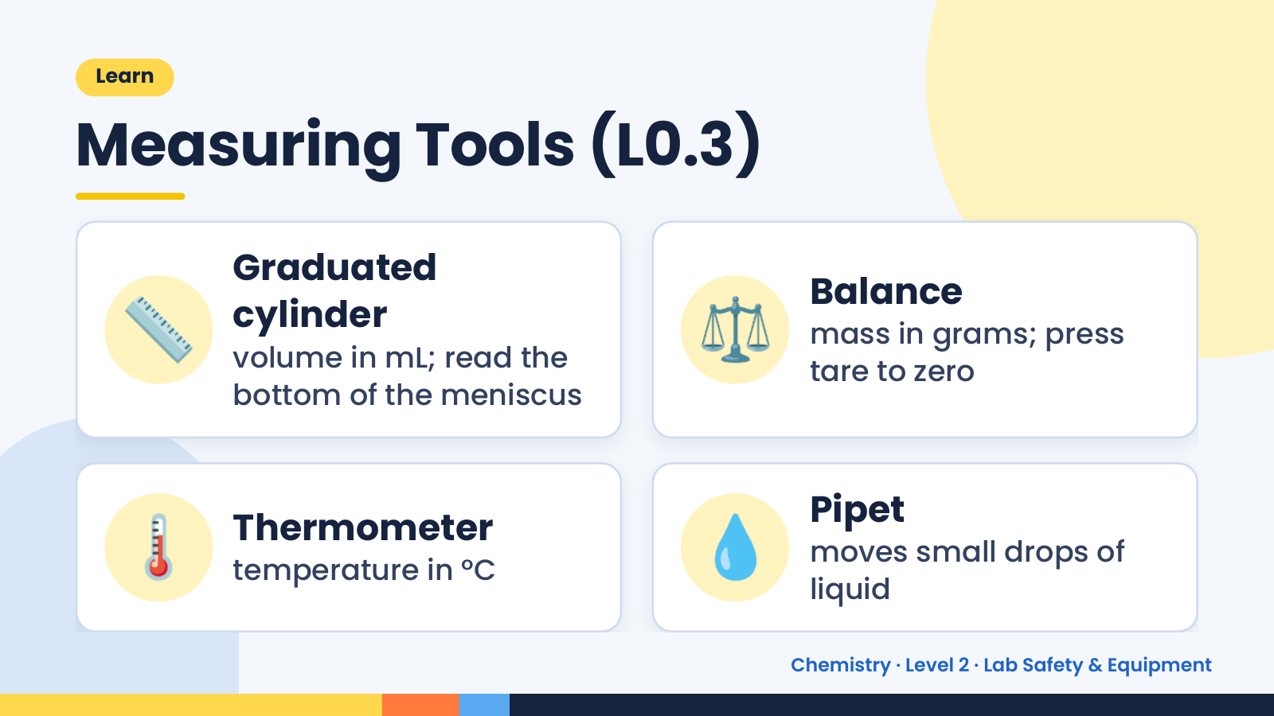
Notes:
Learn
Measuring Tools (L0.3)
📏 Graduated
cylinder
volume in mL; read the
bottom of the meniscus
⚖️ Balance
mass in grams; press
tare to zero
🌡️ Thermometer
temperature in °C 💧 Pipet
moves small drops of
liquid
Chemistry · Level 2 · Lab Safety & Equipment

Slide 15
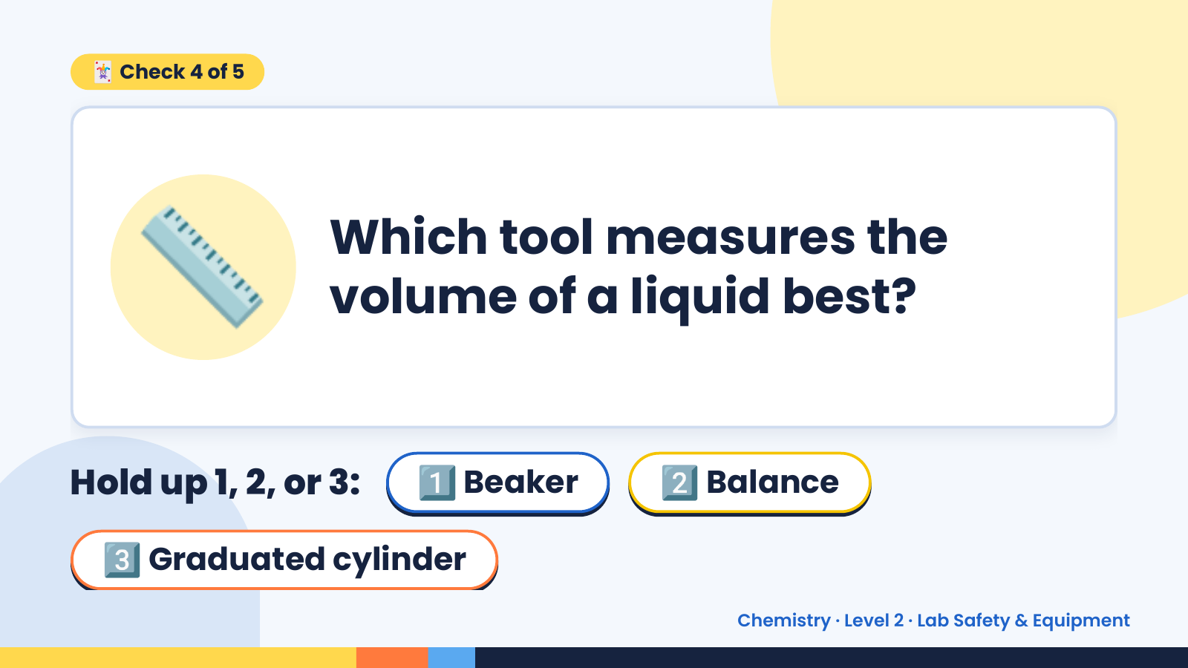
Notes:
🃏 Check 4 of 5
📏 Which tool measures the
volume of a liquid best?
Hold up 1, 2, or 3: 1️⃣ Beaker 2️⃣ Balance
3️⃣ Graduated cylinder
Chemistry · Level 2 · Lab Safety & Equipment

Slide 16
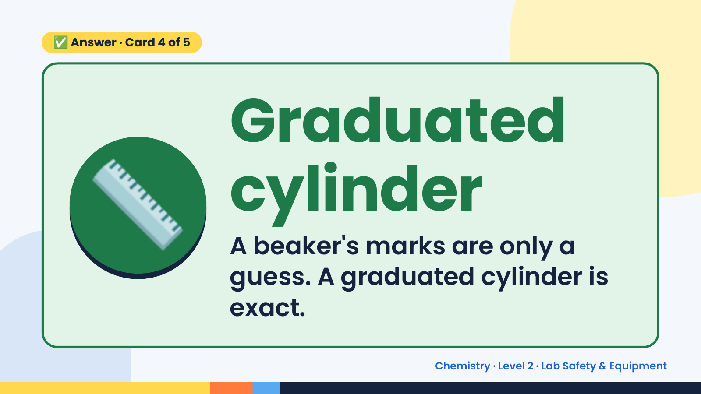
Notes:
✅ Answer · Card 4 of 5
📏 Graduated
cylinder
A beaker's marks are only a
guess. A graduated cylinder is
exact.
Chemistry · Level 2 · Lab Safety & Equipment

Slide 17
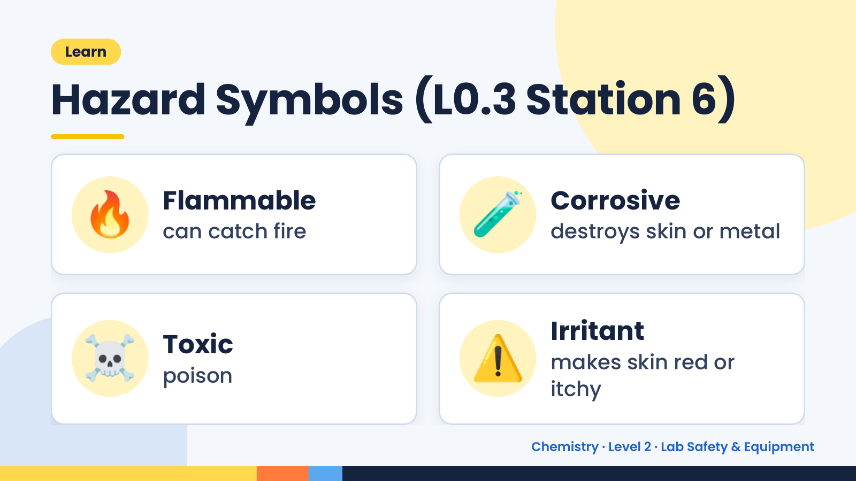
Notes:
Learn
Hazard Symbols (L0.3 Station 6)
🔥 Flammable
can catch fire 🧪 Corrosive
destroys skin or metal
☠️ Toxic
poison ⚠️ Irritant
makes skin red or
itchy
Chemistry · Level 2 · Lab Safety & Equipment

Slide 18
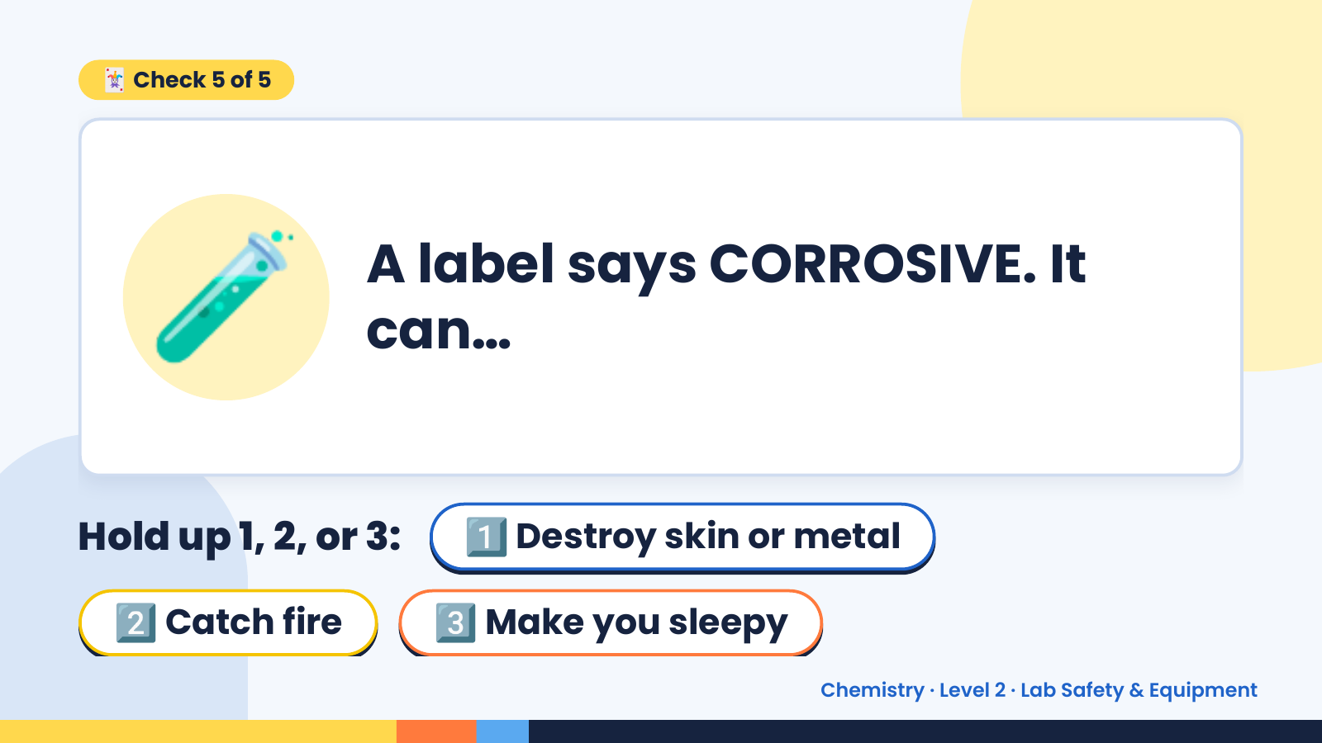
Notes:
🃏 Check 5 of 5
🧪 A label says CORROSIVE. It
can…
Hold up 1, 2, or 3: 1️⃣ Destroy skin or metal
2️⃣ Catch fire 3️⃣ Make you sleepy
Chemistry · Level 2 · Lab Safety & Equipment

Slide 19
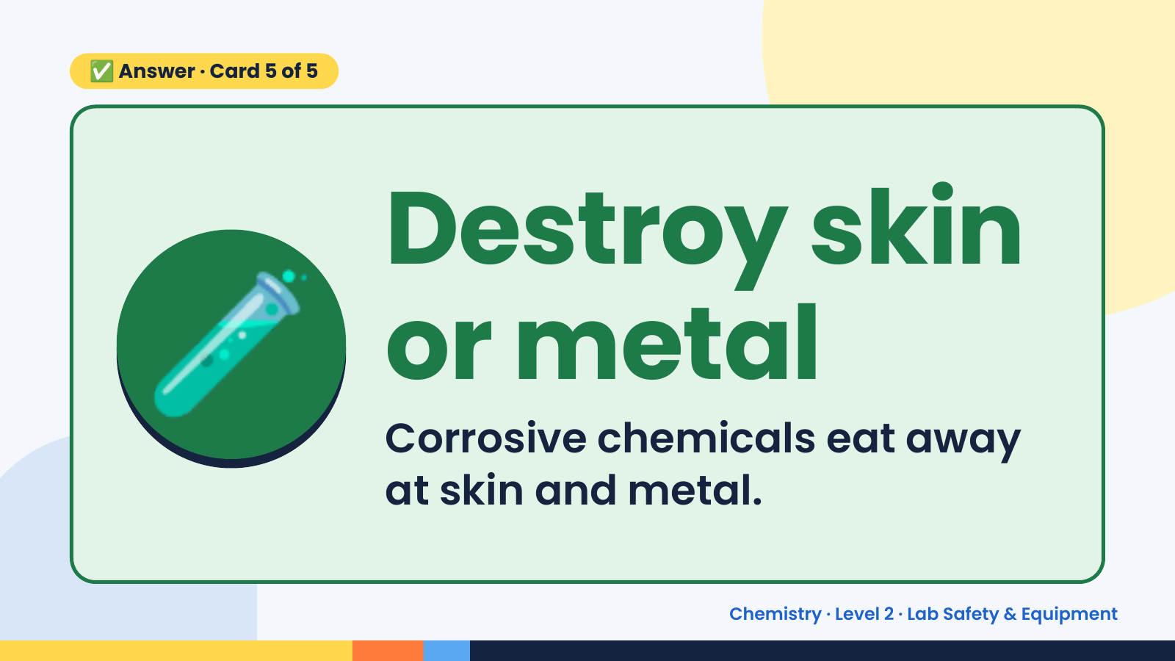
Notes:
✅ Answer · Card 5 of 5
🧪 Destroy skin
or metal
Corrosive chemicals eat away
at skin and metal.
Chemistry · Level 2 · Lab Safety & Equipment

Slide 20
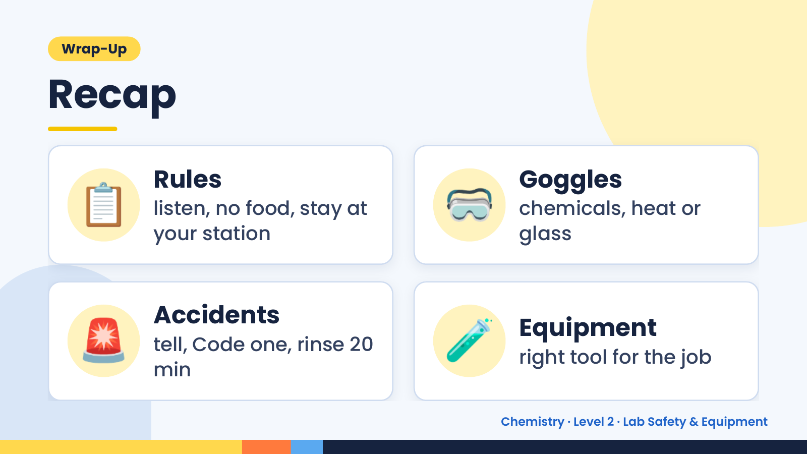
Notes:
Wrap-Up
Recap
📋 Rules
listen, no food, stay at
your station
🥽 Goggles
chemicals, heat or
glass
🚨 Accidents
tell, Code one, rinse 20
min
🧪 Equipment
right tool for the job
Chemistry · Level 2 · Lab Safety & Equipment

Slide 21
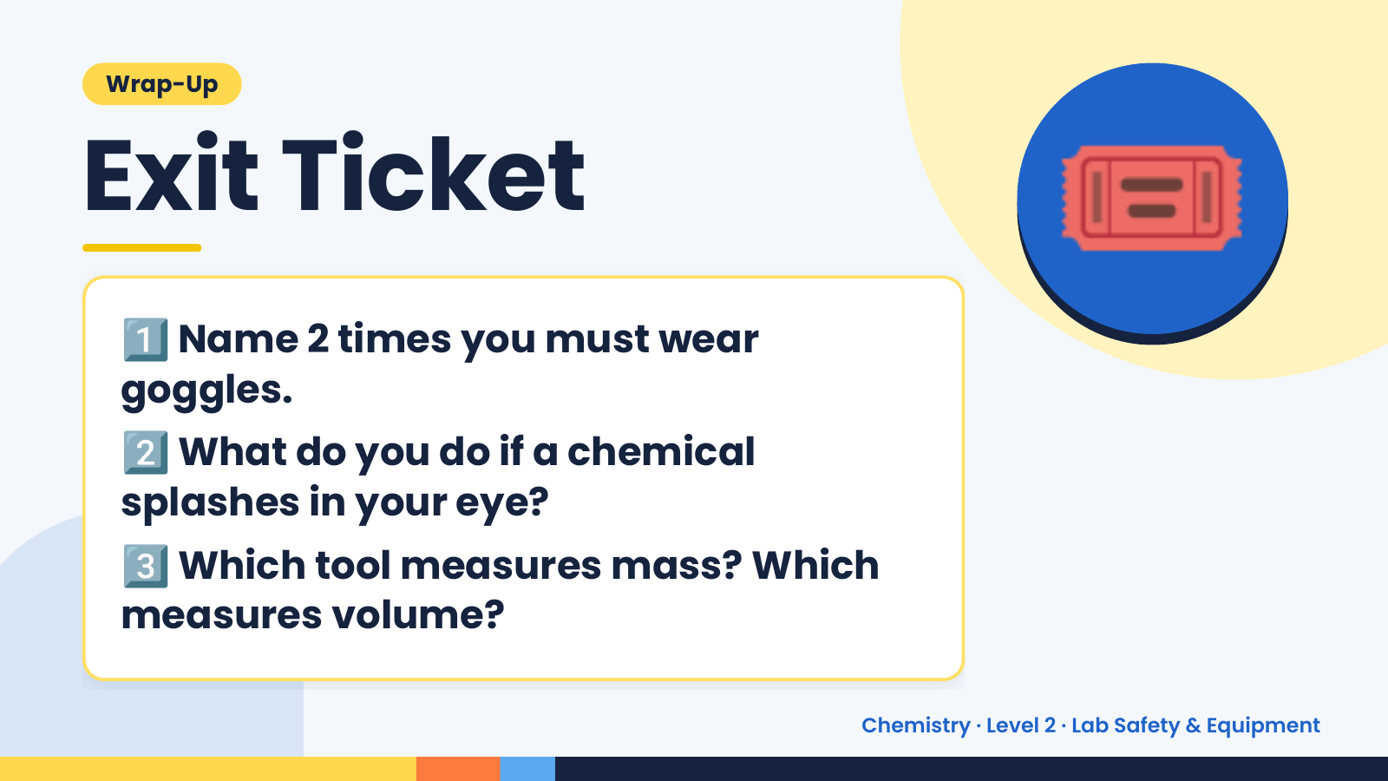
Notes:
Wrap-Up
Exit Ticket
1️⃣
Name 2 times you must wear
goggles.
🎟️
2️⃣
What do you do if a chemical
splashes in your eye?
3️⃣
Which tool measures mass? Which
measures volume?
Chemistry · Level 2 · Lab Safety & Equipment

