Slide 1
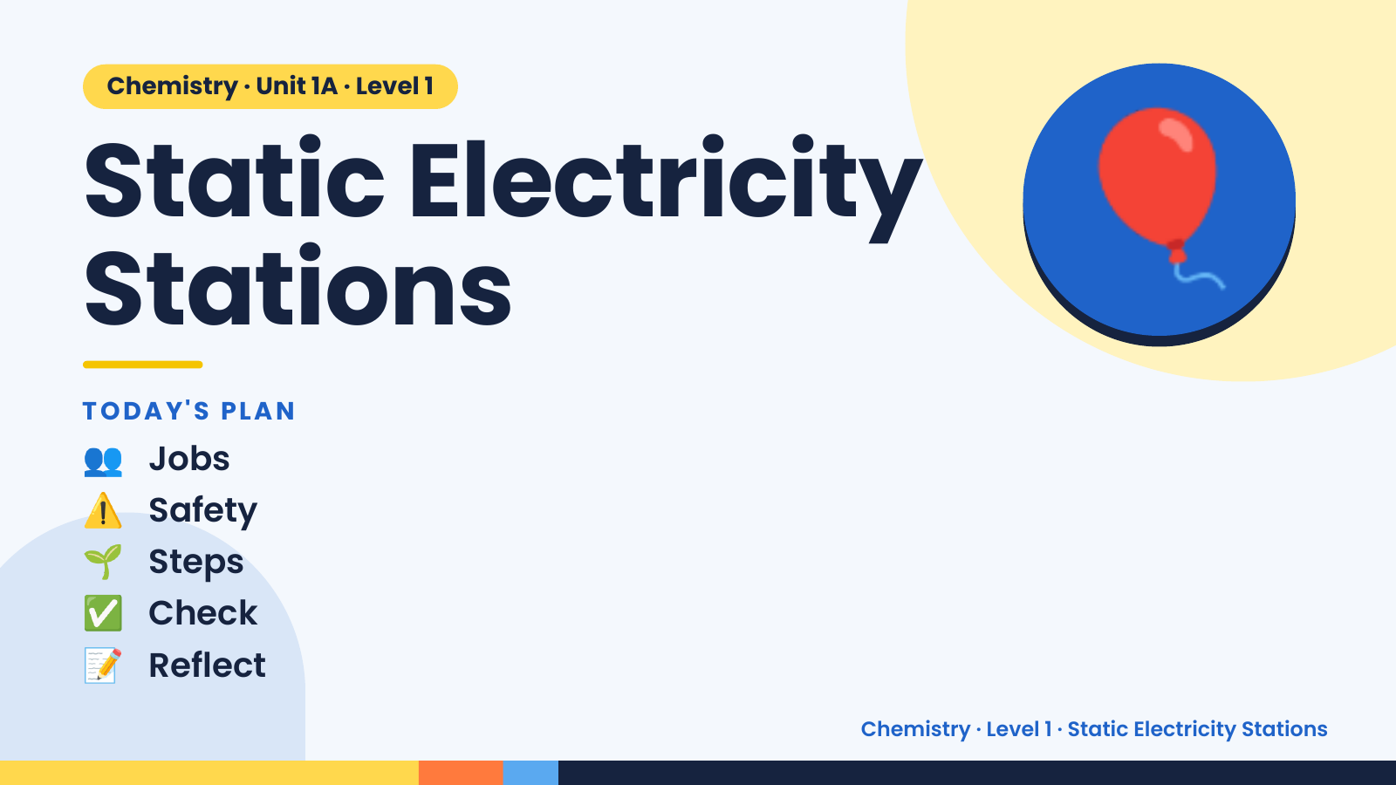
Notes:
Chemistry · Unit 1A · Level 1
Static Electricity
Stations
TODAY'S PLAN
🎈
👥 Jobs
⚠️ Safety
🌱 Steps
✅ Check
📝 Reflect
Chemistry · Level 1 · Static Electricity Stations

Slide 2
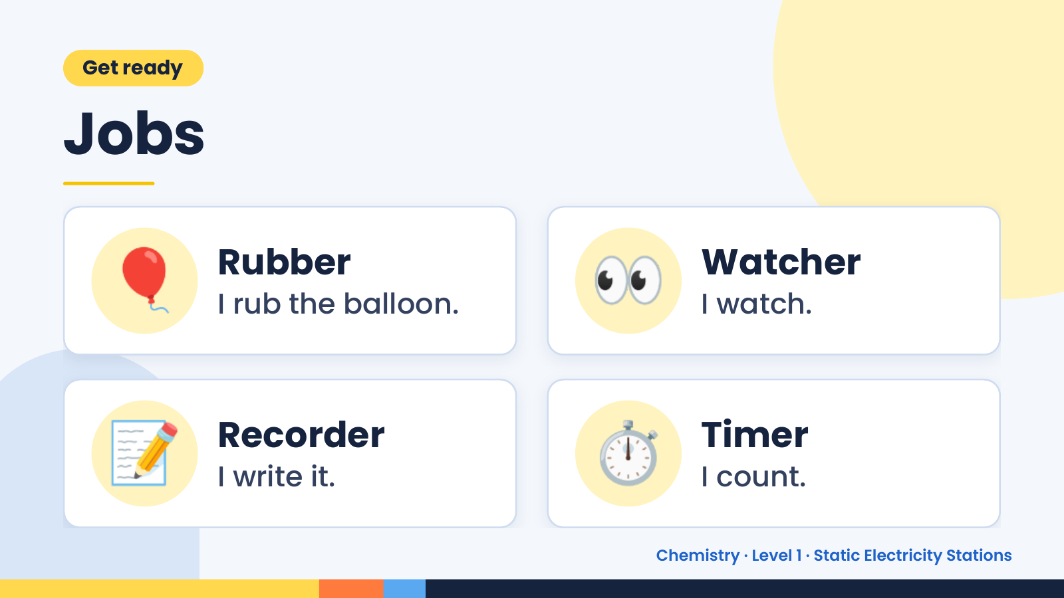
Notes:
Get ready
Jobs
🎈 Rubber
I rub the balloon. 👀 Watcher
I watch.
📝 Recorder
I write it. ⏱️ Timer
I count.
Chemistry · Level 1 · Static Electricity Stations

Slide 3
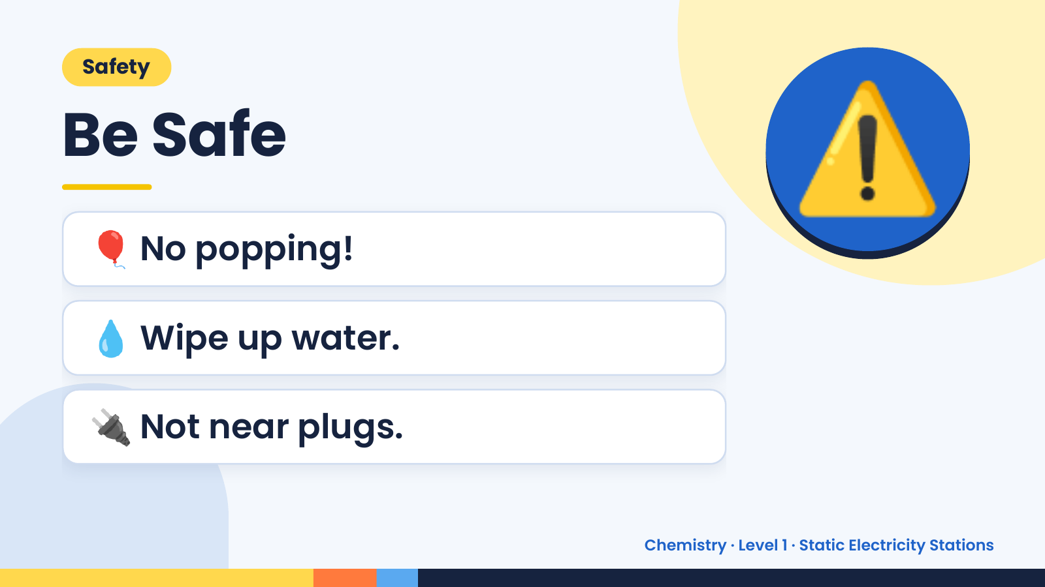
Notes:
Safety
Be Safe
🎈 No popping!
⚠️
💧 Wipe up water.
🔌 Not near plugs.
Chemistry · Level 1 · Static Electricity Stations

Slide 4
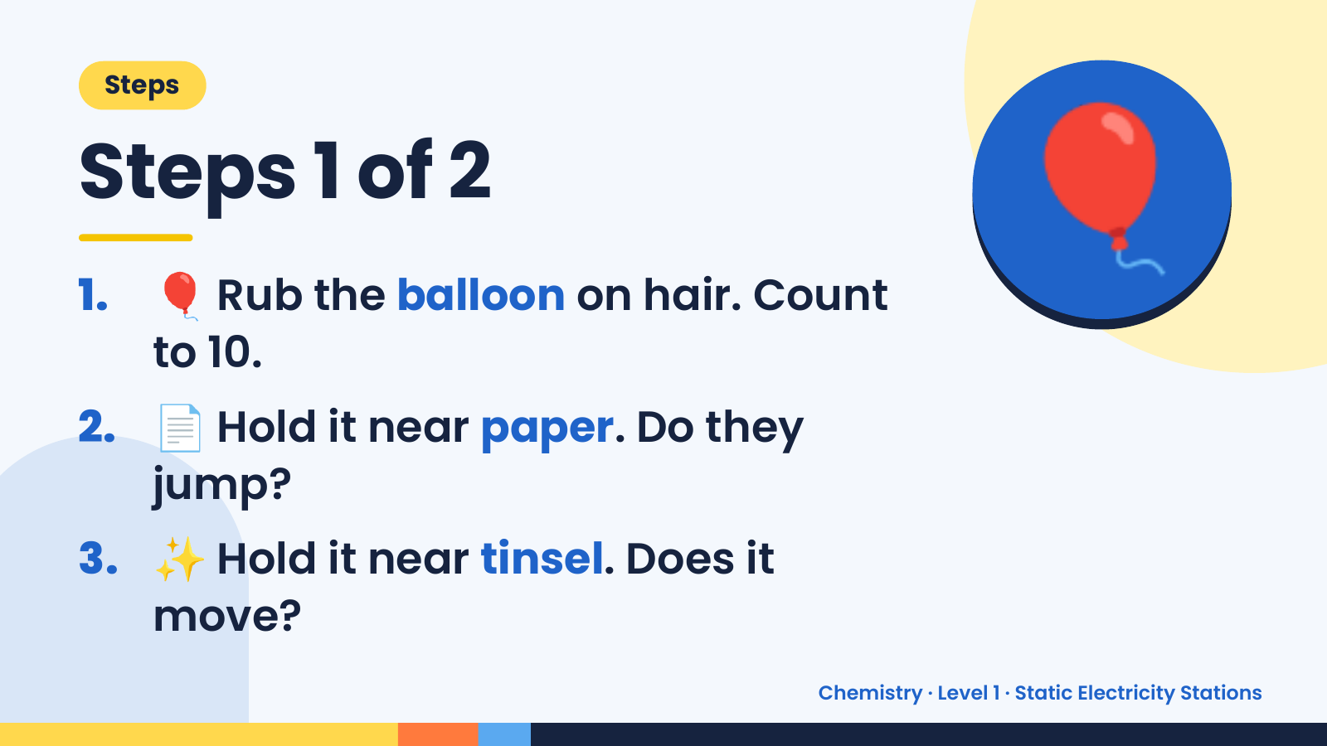
Notes:
Steps
Steps 1 of 2
1. 🎈 Rub the balloon on hair. Count
to 10.
🎈
2. 📄 Hold it near paper. Do they
jump?
3. ✨ Hold it near tinsel. Does it
move?
Chemistry · Level 1 · Static Electricity Stations

Slide 5
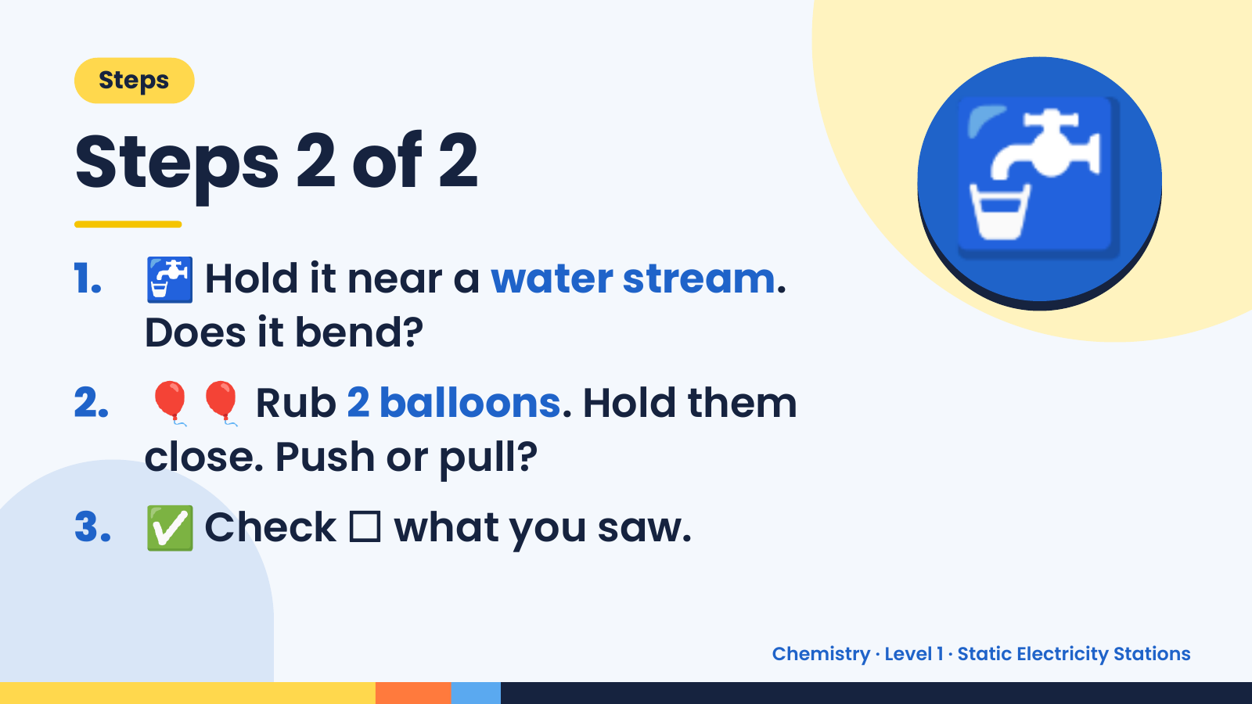
Notes:
Steps
Steps 2 of 2
1. 🚰 Hold it near a water stream.
Does it bend?
🚰
2. 🎈🎈 Rub 2 balloons. Hold them
close. Push or pull?
3. ✅ Check ☐ what you saw.
Chemistry · Level 1 · Static Electricity Stations

Slide 6
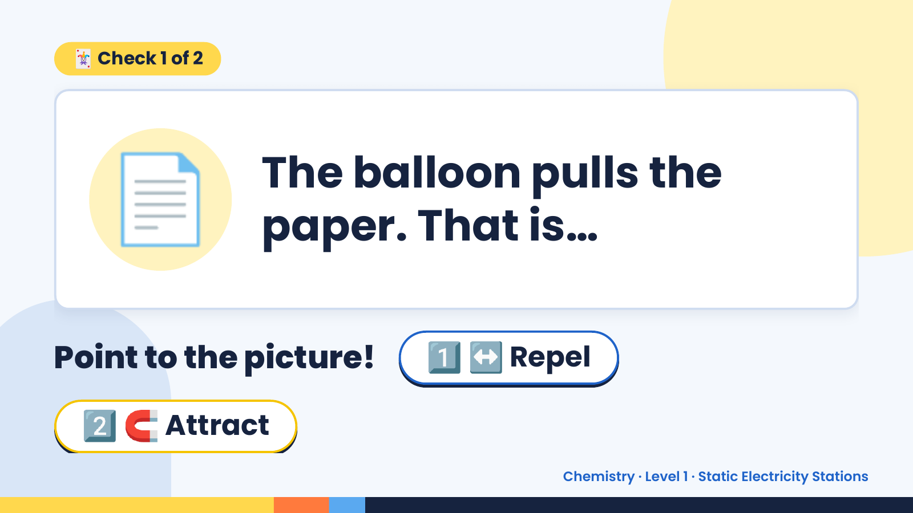
Notes:
🃏 Check 1 of 2
📄 The balloon pulls the
paper. That is…
Point to the picture! 1️⃣ ↔️ Repel
2️⃣ 🧲 Attract
Chemistry · Level 1 · Static Electricity Stations

Slide 7
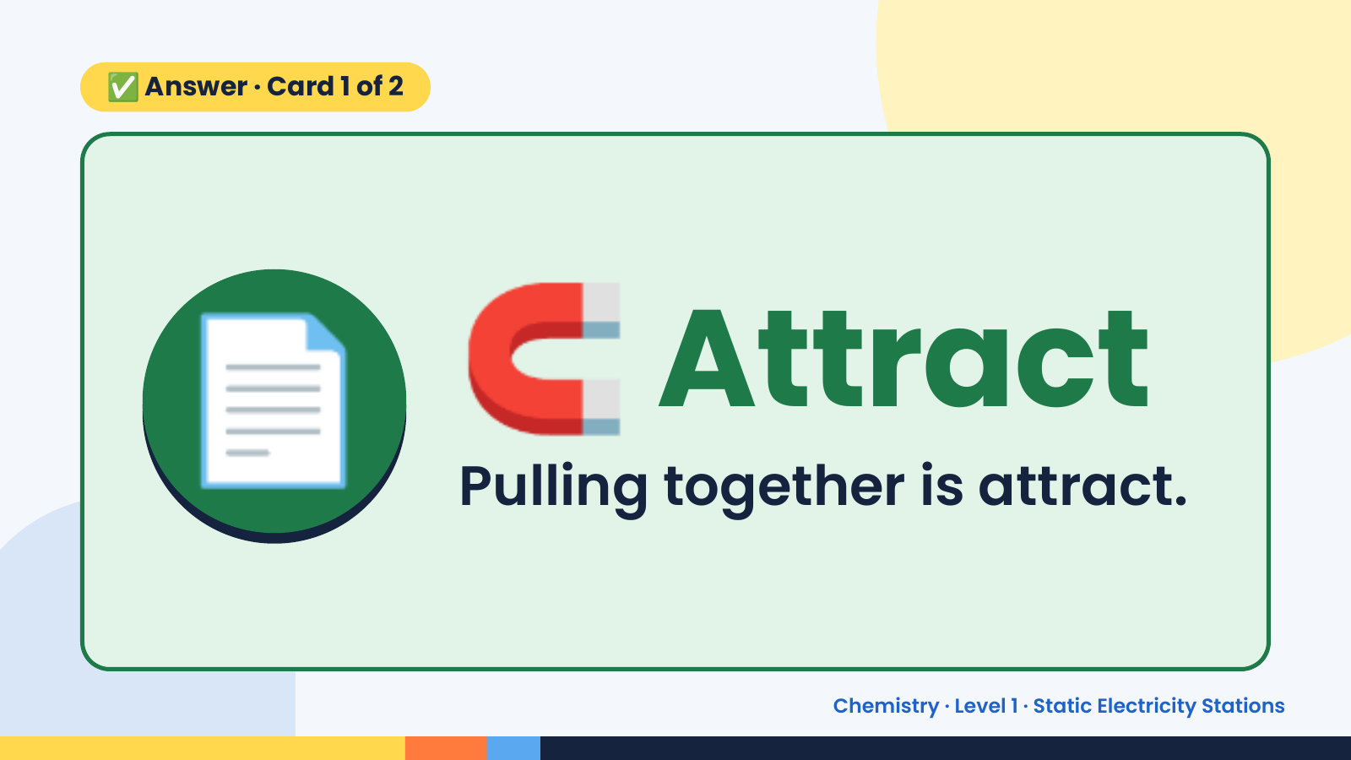
Notes:
✅ Answer · Card 1 of 2
📄 🧲 Attract
Pulling together is attract.
Chemistry · Level 1 · Static Electricity Stations

Slide 8
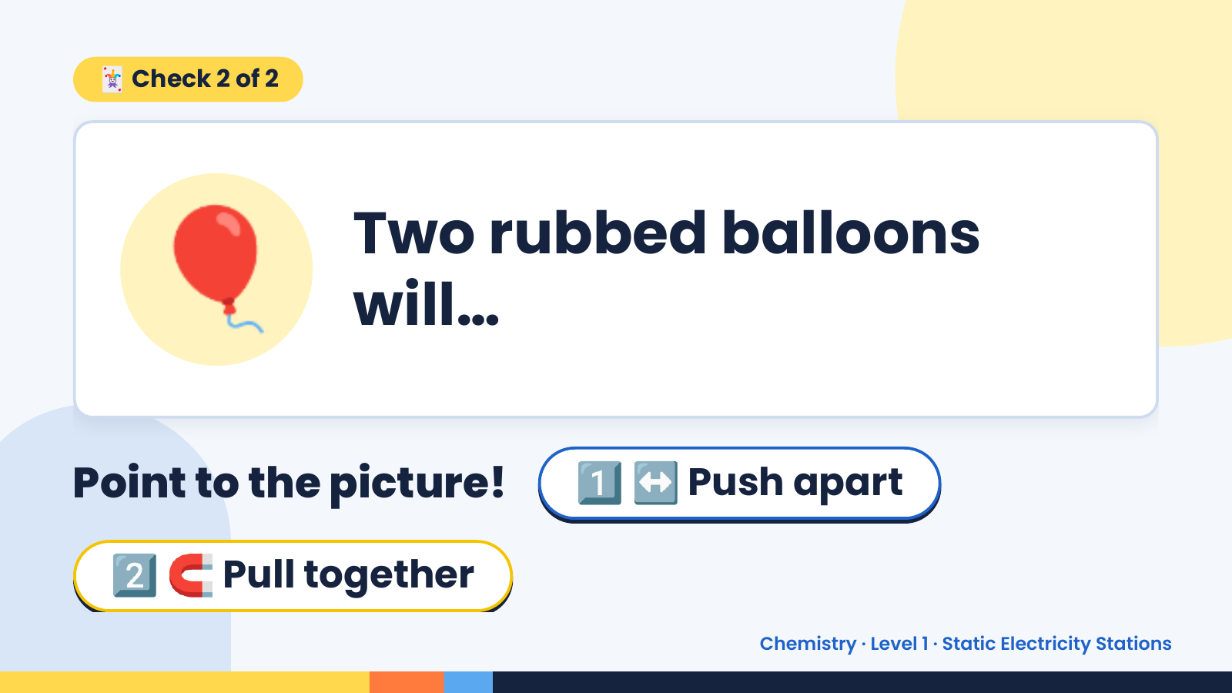
Notes:
🃏 Check 2 of 2
🎈 Two rubbed balloons
will…
Point to the picture! 1️⃣ ↔️ Push apart
2️⃣ 🧲 Pull together
Chemistry · Level 1 · Static Electricity Stations

Slide 9
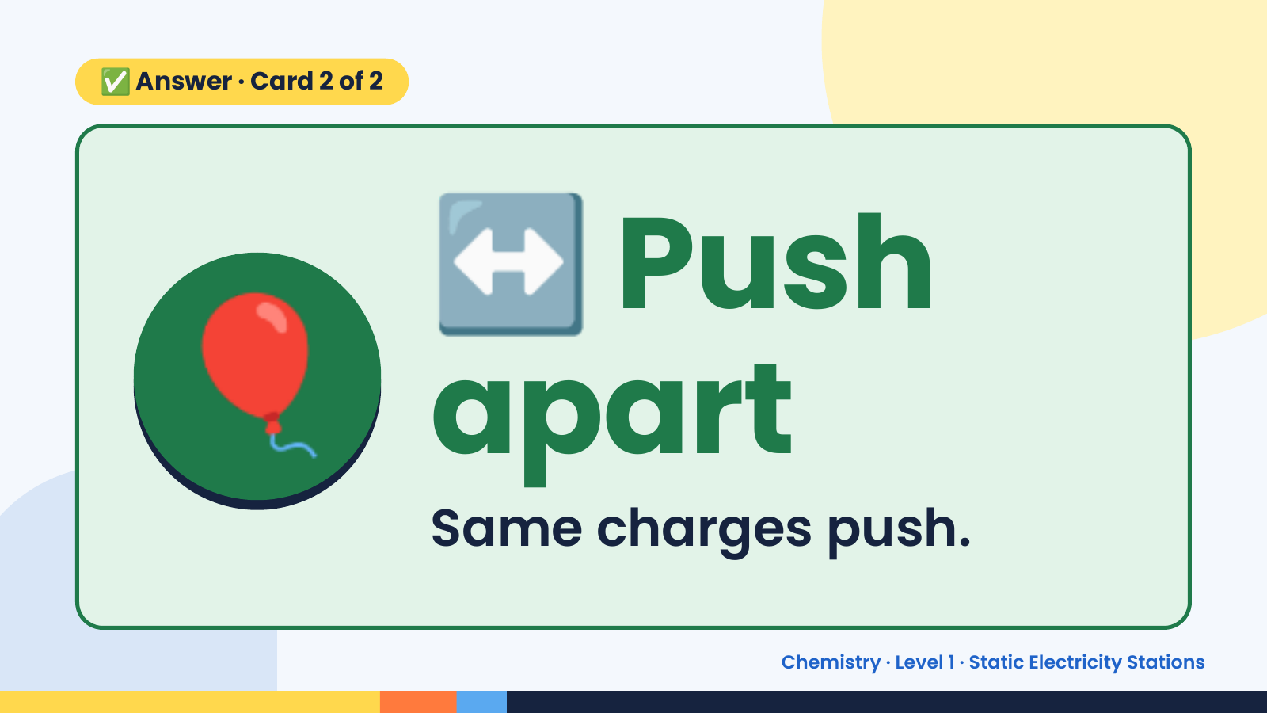
Notes:
↔️
✅ Answer · Card 2 of 2
🎈 apart
Push
Same charges push.
Chemistry · Level 1 · Static Electricity Stations

Slide 10
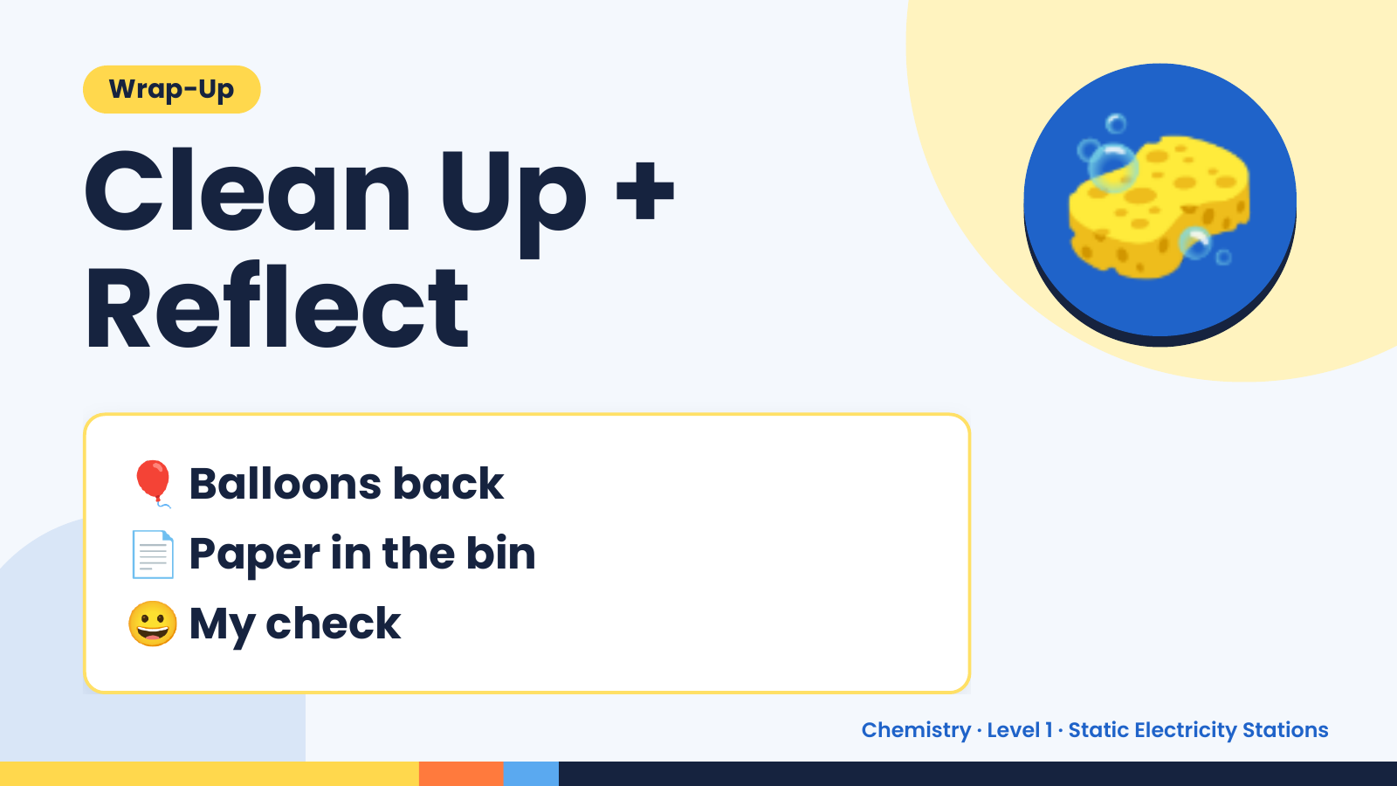
Notes:
Wrap-Up
Clean Up +
Reflect
🧽
🎈 Balloons back
📄 Paper in the bin
😀 My check
Chemistry · Level 1 · Static Electricity Stations

