Slide 1
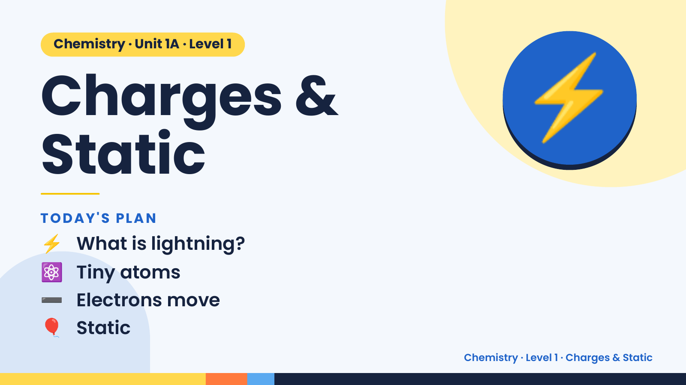
Notes:
Chemistry · Unit 1A · Level 1
Charges &
Static
⚡
⚡ What is lightning?
TODAY'S PLAN
⚛️ Tiny atoms
➖ Electrons move
🎈 Static
Chemistry · Level 1 · Charges & Static

Slide 2
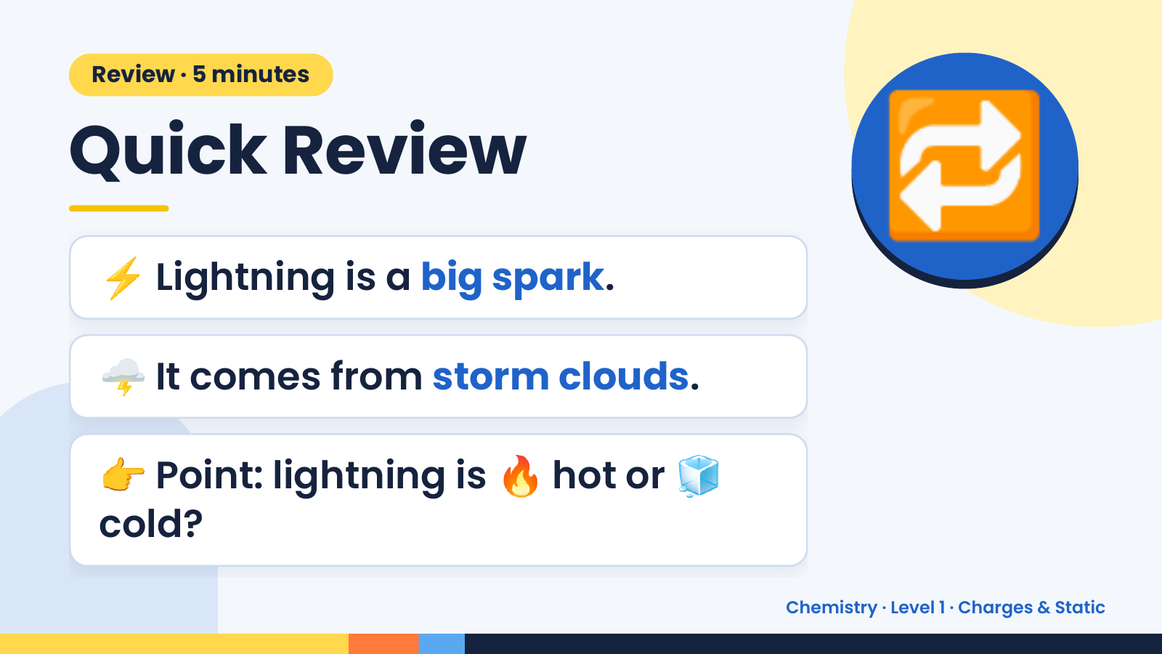
Notes:
Review · 5 minutes
Quick Review
⚡ Lightning is a big spark.
🔁
🌩️ It comes from storm clouds.
👉 Point: lightning is 🔥 hot or 🧊
cold?
Chemistry · Level 1 · Charges & Static

Slide 3
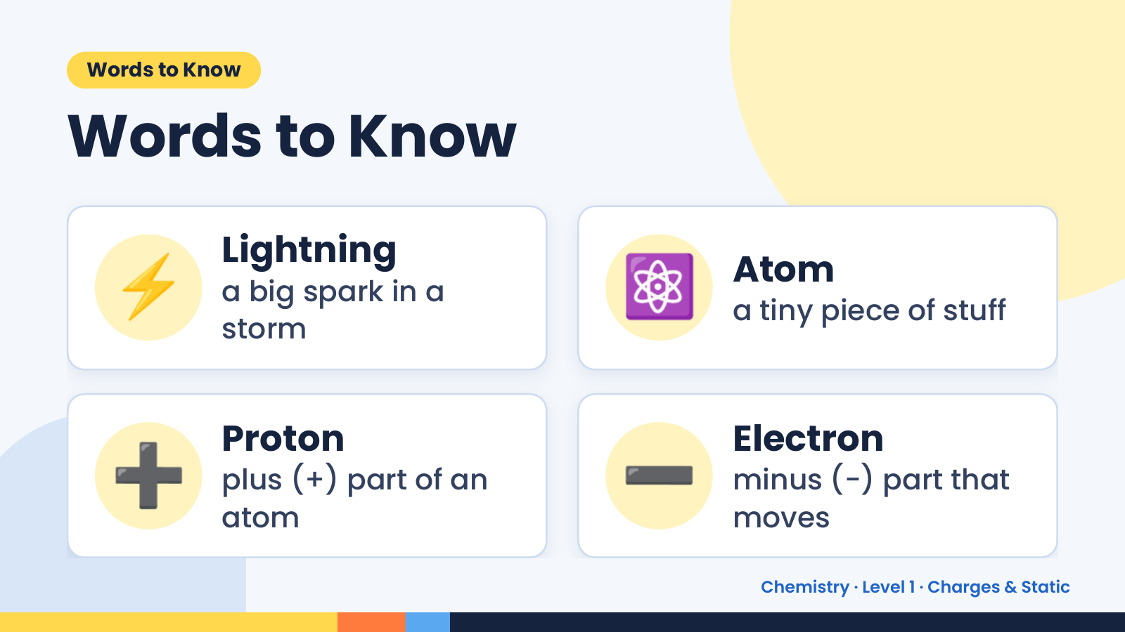
Notes:
Words to Know
Words to Know
⚡ Lightning
a big spark in a
storm
⚛️ Atom
a tiny piece of stuff
➕ Proton
plus (+) part of an
atom
➖ Electron
minus (−) part that
moves
Chemistry · Level 1 · Charges & Static

Slide 4
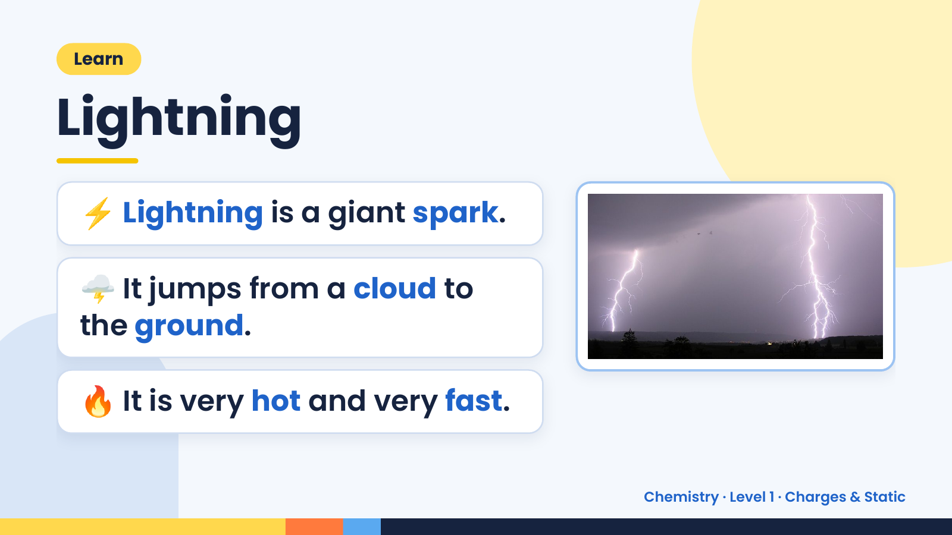
Notes:
Learn
Lightning
⚡ Lightning is a giant spark.
🌩️ It jumps from a cloud to
the ground.
🔥 It is very hot and very fast.
Chemistry · Level 1 · Charges & Static

Slide 5
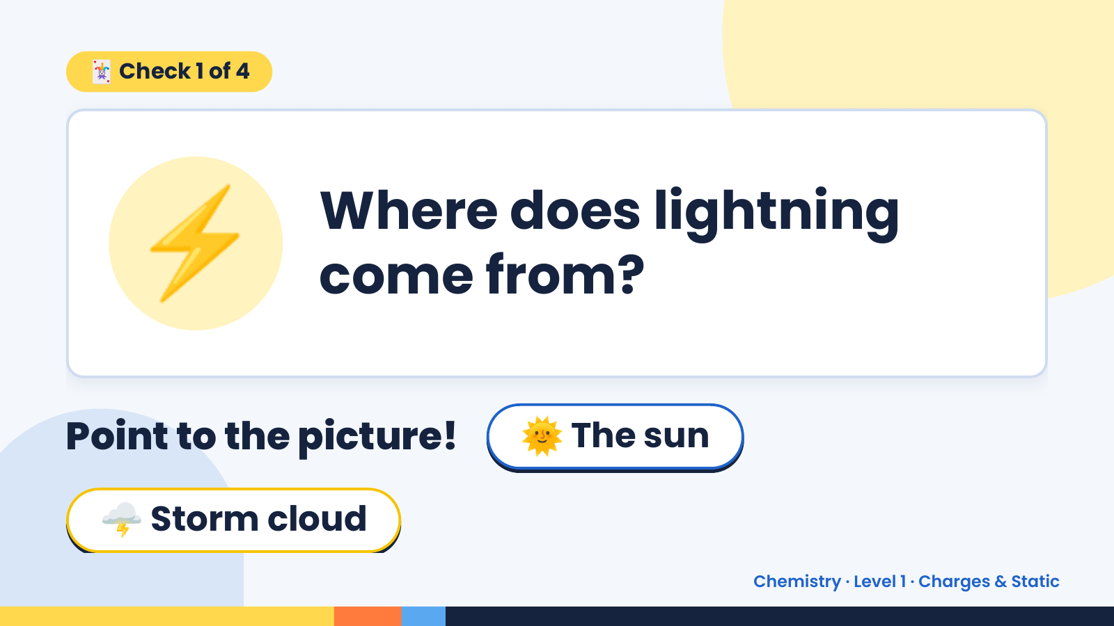
Notes:
🃏 Check 1 of 4
⚡ Where does lightning
come from?
Point to the picture! 🌞 The sun
🌩️ Storm cloud
Chemistry · Level 1 · Charges & Static

Slide 6
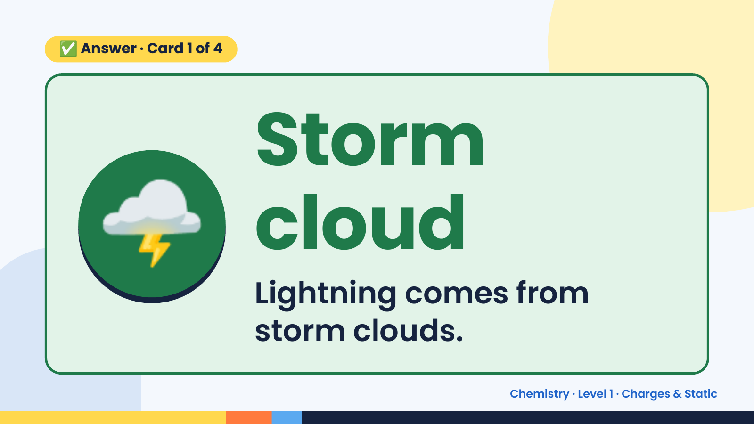
Notes:
✅ Answer · Card 1 of 4
🌩️ Storm
cloud
Lightning comes from
storm clouds.
Chemistry · Level 1 · Charges & Static

Slide 7
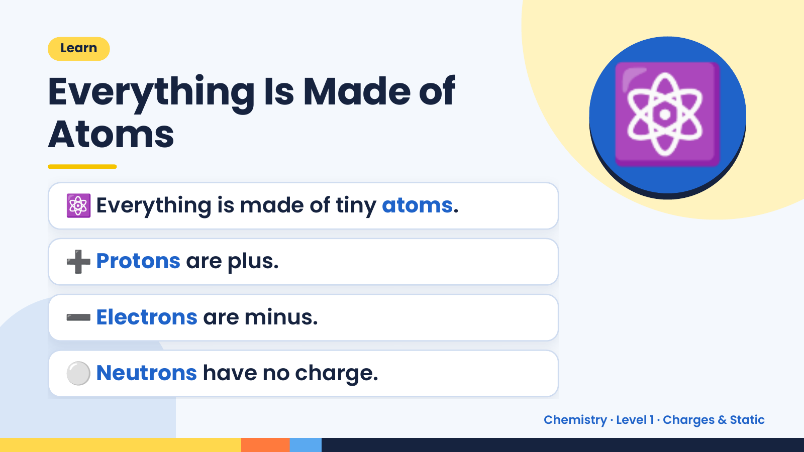
Notes:
Learn
Everything Is Made of
Atoms
⚛️ Everything is made of tiny atoms.
⚛️
➕ Protons are plus.
➖ Electrons are minus.
⚪ Neutrons have no charge.
Chemistry · Level 1 · Charges & Static

Slide 8
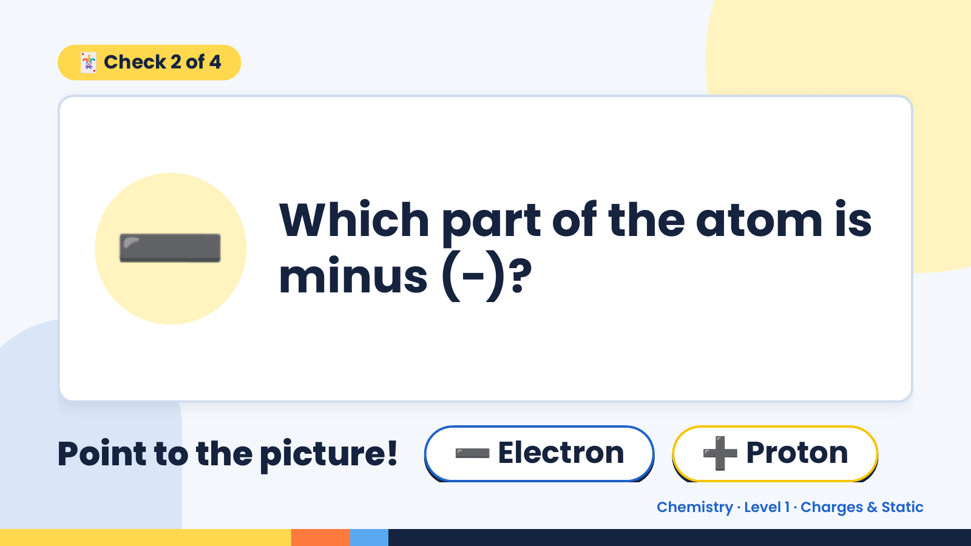
Notes:
🃏 Check 2 of 4
➖ Which part of the atom is
minus (−)?
Point to the picture! ➖ Electron ➕ Proton
Chemistry · Level 1 · Charges & Static

Slide 9
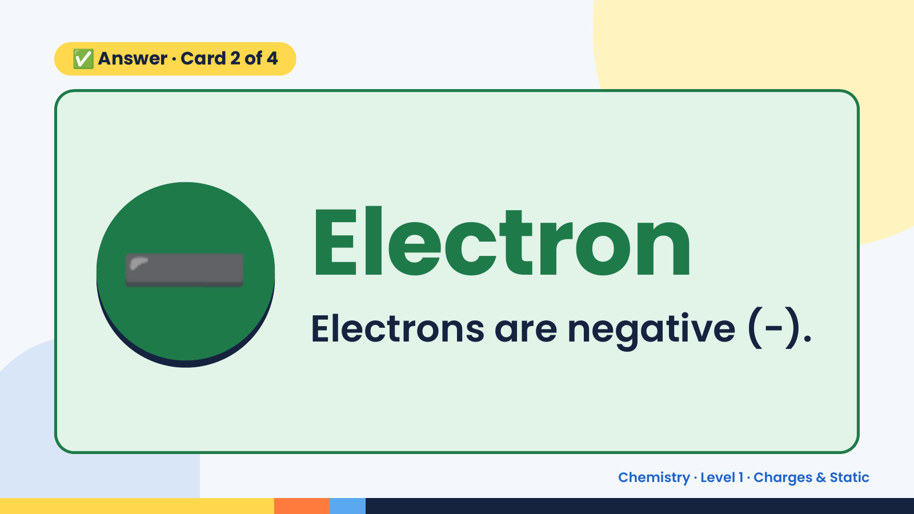
Notes:
✅ Answer · Card 2 of 4
➖ Electron
Electrons are negative (−).
Chemistry · Level 1 · Charges & Static

Slide 10
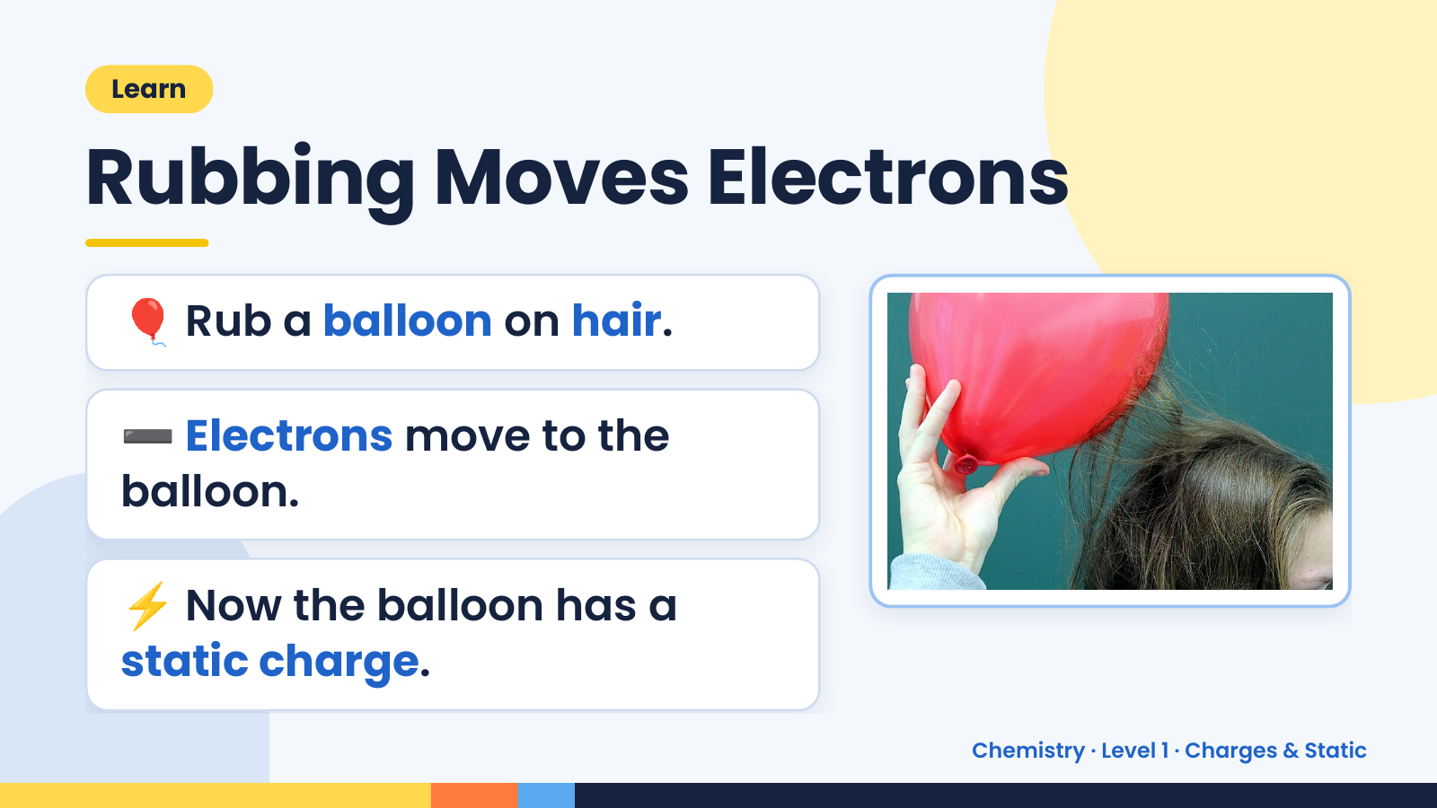
Notes:
Learn
Rubbing Moves Electrons
🎈 Rub a balloon on hair.
➖ Electrons move to the
balloon.
⚡ Now the balloon has a
static charge.
Chemistry · Level 1 · Charges & Static

Slide 11
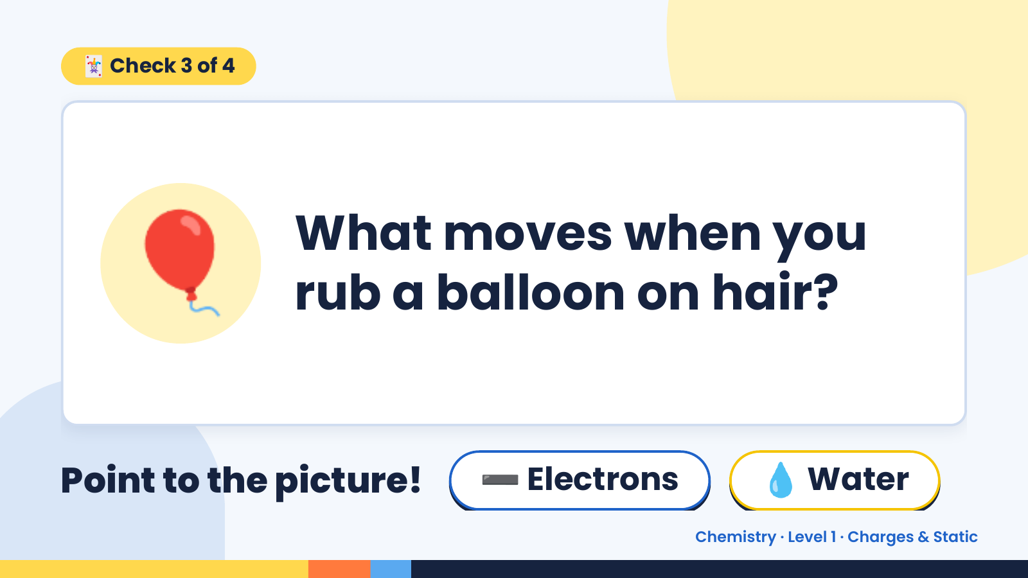
Notes:
🃏 Check 3 of 4
🎈 What moves when you
rub a balloon on hair?
Point to the picture! ➖ Electrons 💧 Water
Chemistry · Level 1 · Charges & Static

Slide 12
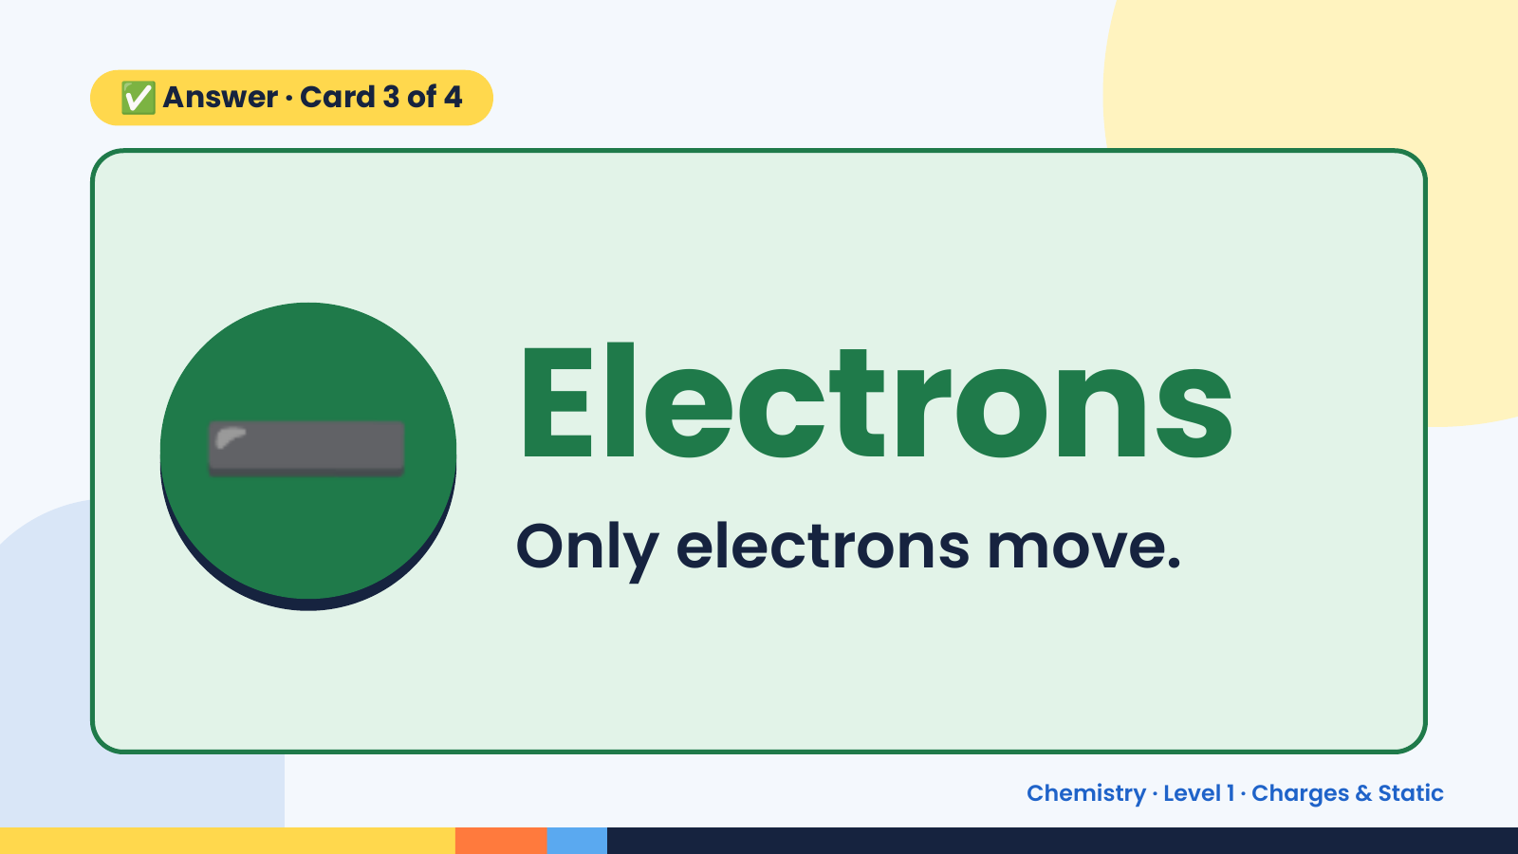
Notes:
✅ Answer · Card 3 of 4
➖ Electrons
Only electrons move.
Chemistry · Level 1 · Charges & Static

Slide 13
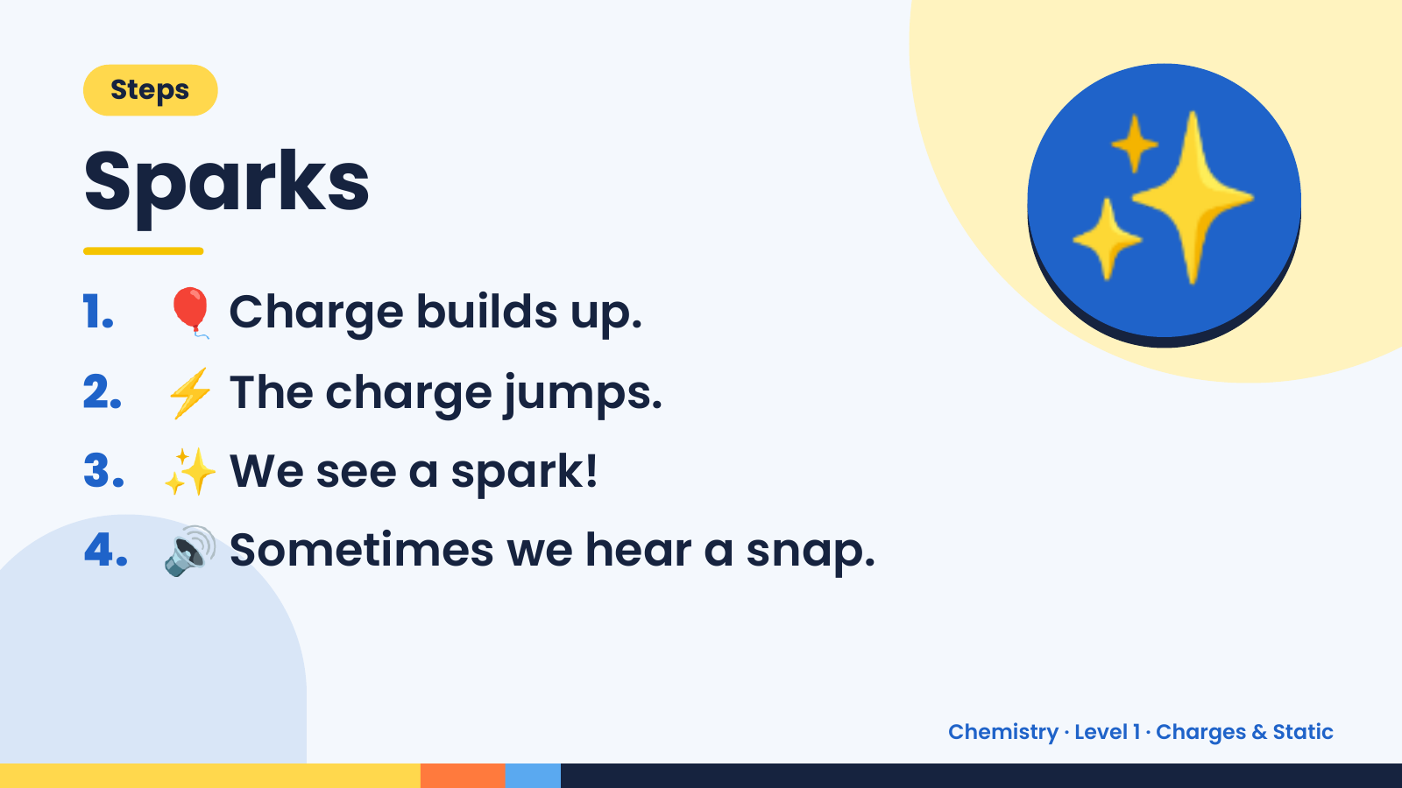
Notes:
Steps
Sparks
1. 🎈 Charge builds up.
2. ⚡ The charge jumps.
✨
3. ✨ We see a spark!
4. 🔊 Sometimes we hear a snap.
Chemistry · Level 1 · Charges & Static

Slide 14
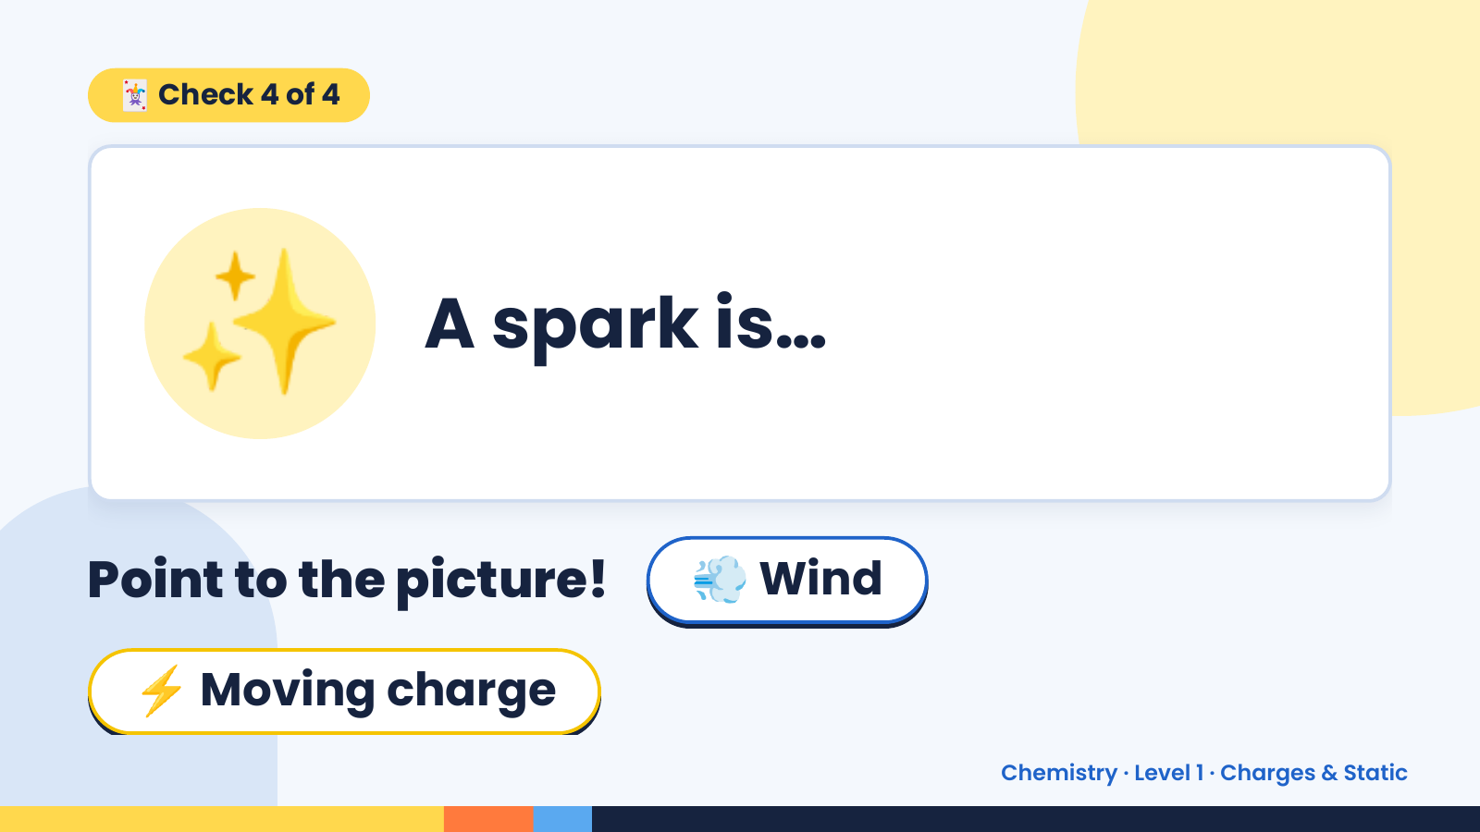
Notes:
🃏 Check 4 of 4
✨ A spark is…
Point to the picture! 💨 Wind
⚡ Moving charge
Chemistry · Level 1 · Charges & Static

Slide 15
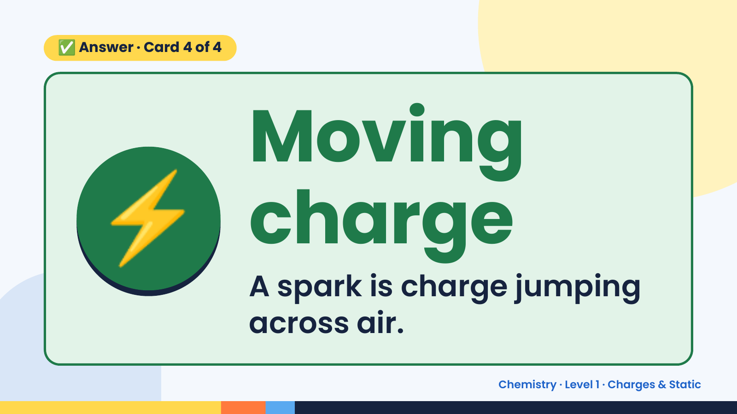
Notes:
✅ Answer · Card 4 of 4
⚡ Moving
charge
A spark is charge jumping
across air.
Chemistry · Level 1 · Charges & Static

Slide 16
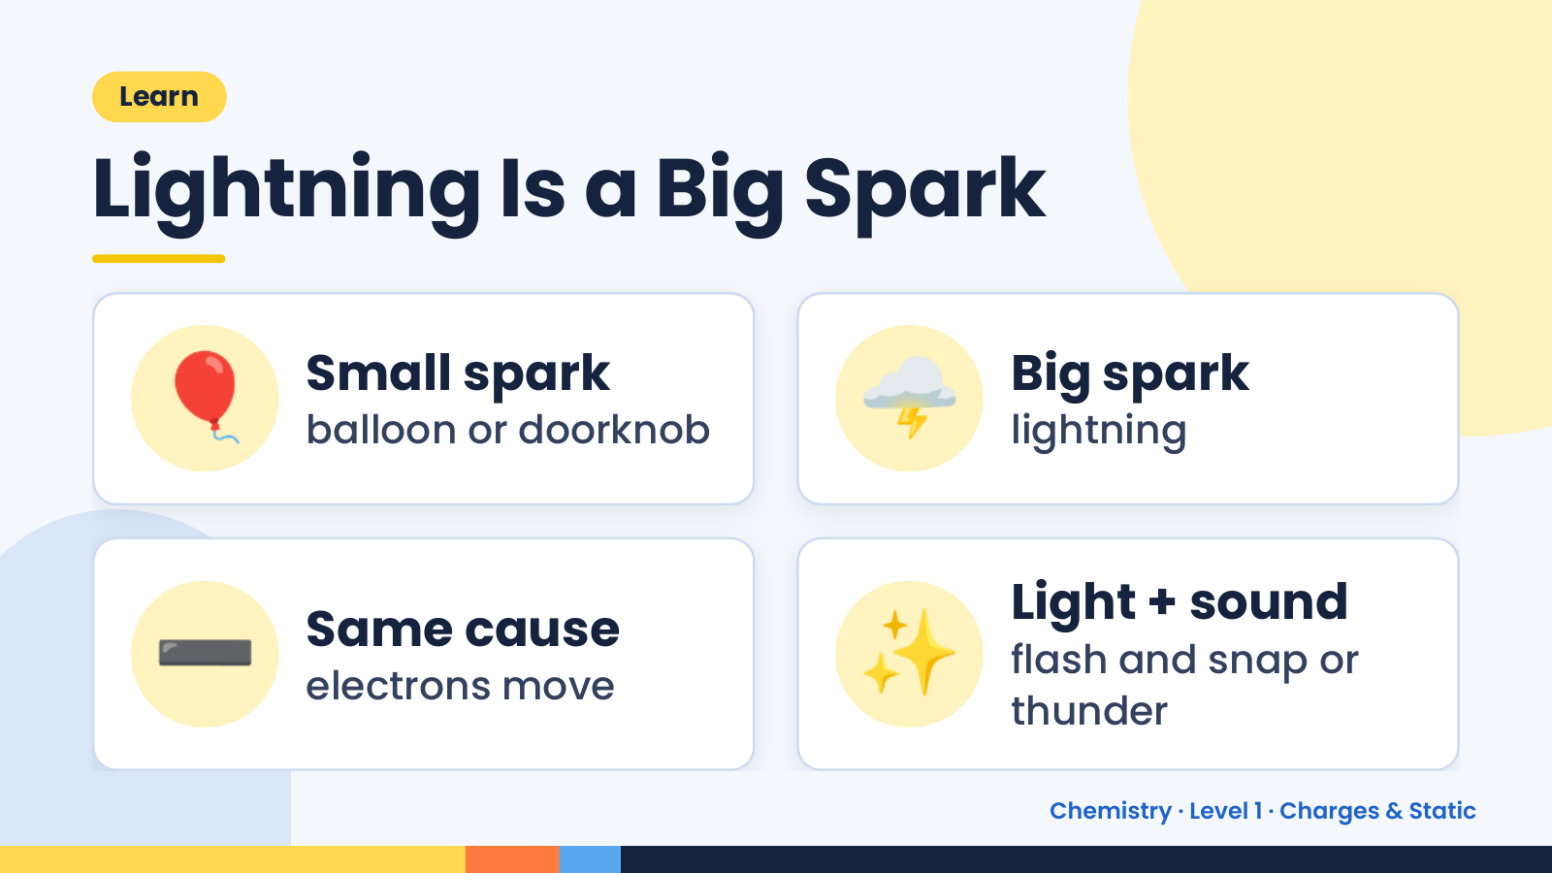
Notes:
Learn
Lightning Is a Big Spark
🎈 Small spark
balloon or doorknob 🌩️ Big spark
lightning
➖ Same cause
electrons move ✨ Light + sound
flash and snap or
thunder
Chemistry · Level 1 · Charges & Static

Slide 17
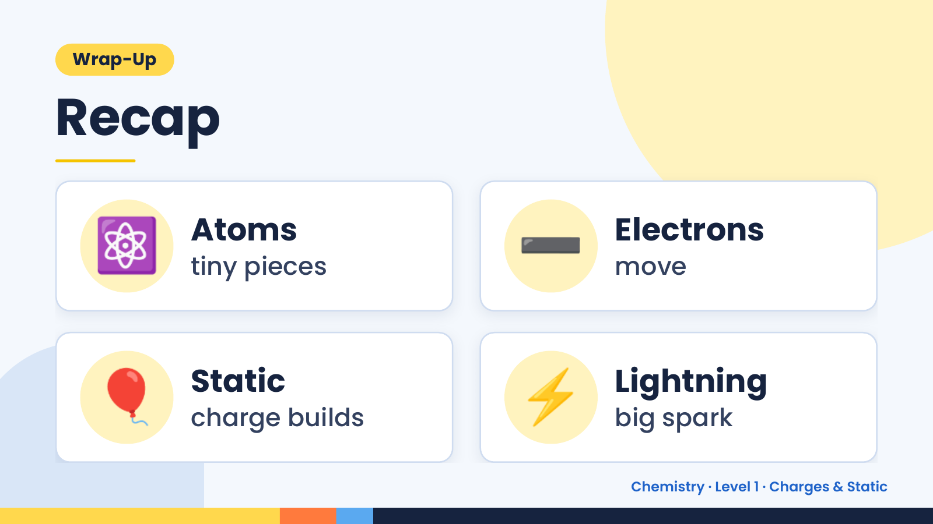
Notes:
Wrap-Up
Recap
⚛️ Atoms
tiny pieces ➖ Electrons
move
🎈 Static
charge builds ⚡ Lightning
big spark
Chemistry · Level 1 · Charges & Static

Slide 18
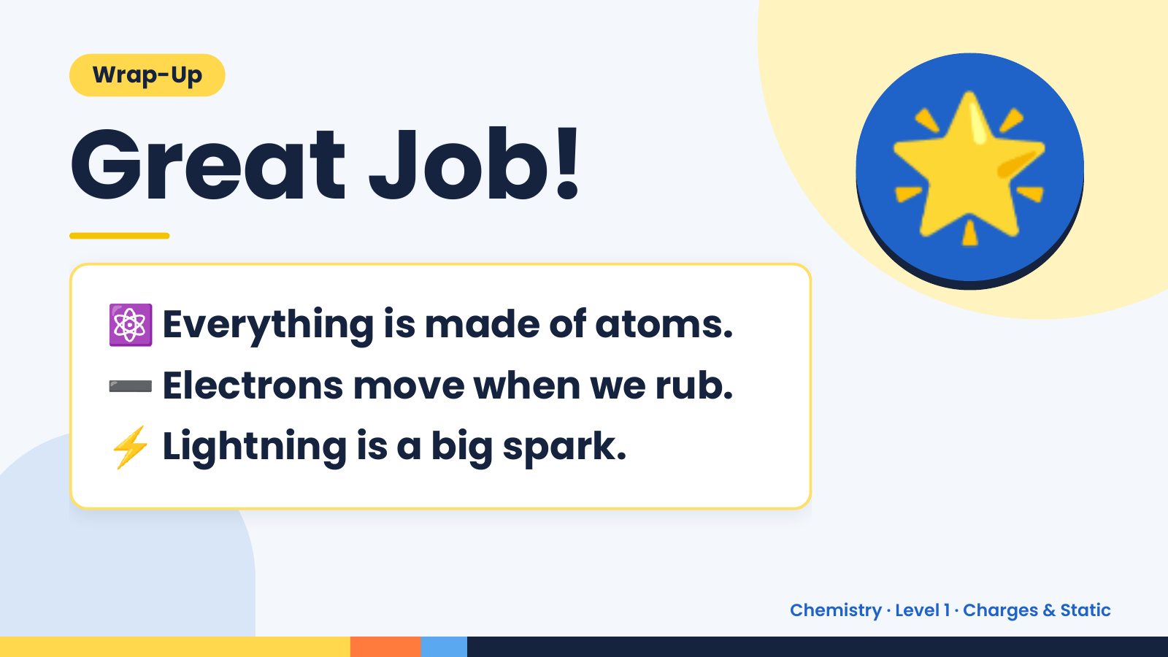
Notes:
Wrap-Up
Great Job!
⚛️ Everything is made of atoms.
🌟
➖ Electrons move when we rub.
⚡ Lightning is a big spark.
Chemistry · Level 1 · Charges & Static

