Slide 1
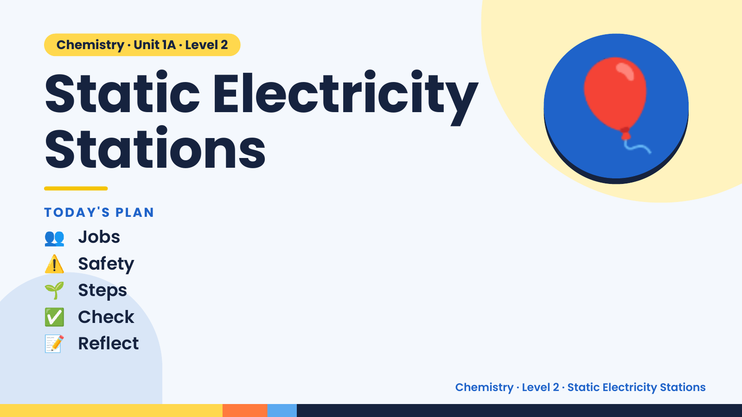
Notes:
Chemistry · Unit 1A · Level 2
Static Electricity
Stations
👥 Jobs
TODAY'S PLAN
🎈
⚠️ Safety
🌱 Steps
✅ Check
📝 Reflect
Chemistry · Level 2 · Static Electricity Stations

Slide 2
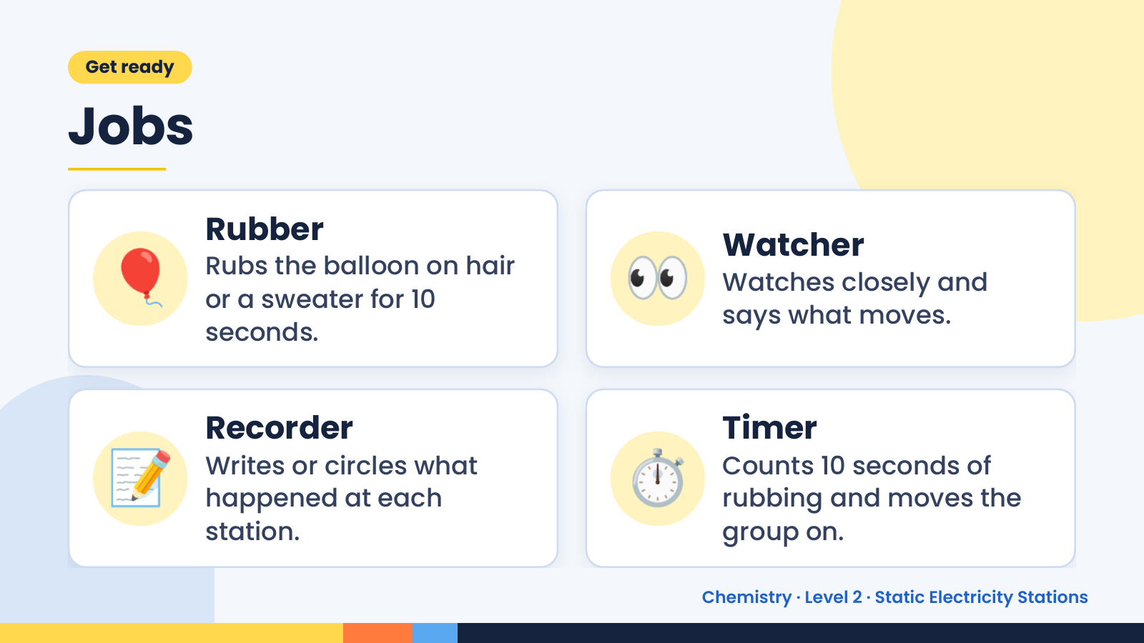
Notes:
Get ready
Jobs
🎈 Rubber
Rubs the balloon on hair
or a sweater for 10
seconds.
👀 Watcher
Watches closely and
says what moves.
📝 Recorder
Writes or circles what
happened at each
station.
⏱️ Timer
Counts 10 seconds of
rubbing and moves the
group on.
Chemistry · Level 2 · Static Electricity Stations

Slide 3
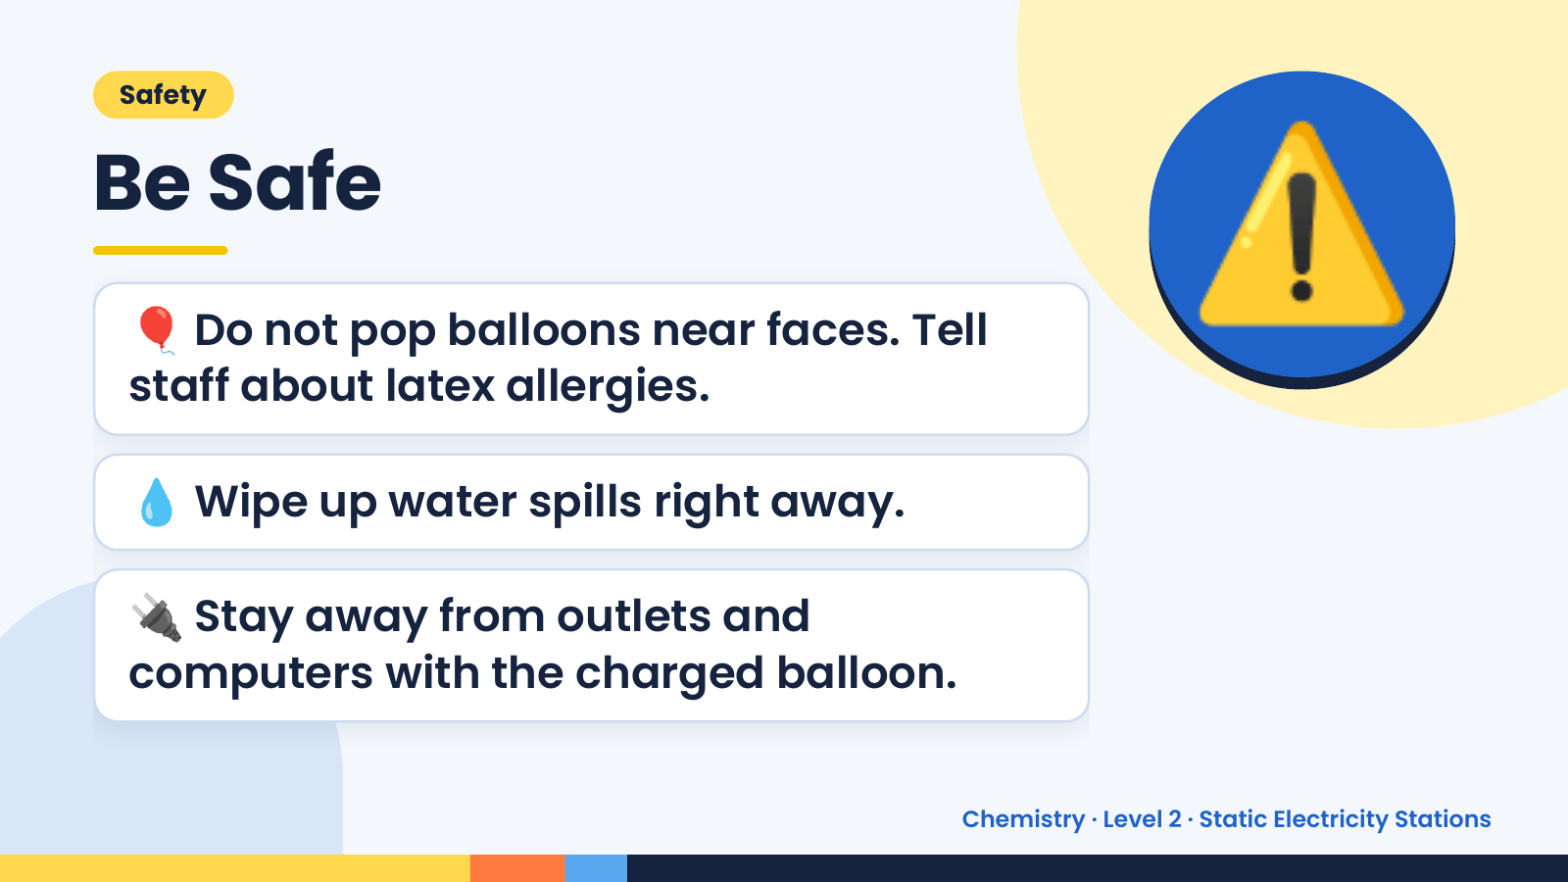
Notes:
Safety
Be Safe
🎈 Do not pop balloons near faces. Tell
staff about latex allergies.
⚠️
💧 Wipe up water spills right away.
🔌 Stay away from outlets and
computers with the charged balloon.
Chemistry · Level 2 · Static Electricity Stations

Slide 4
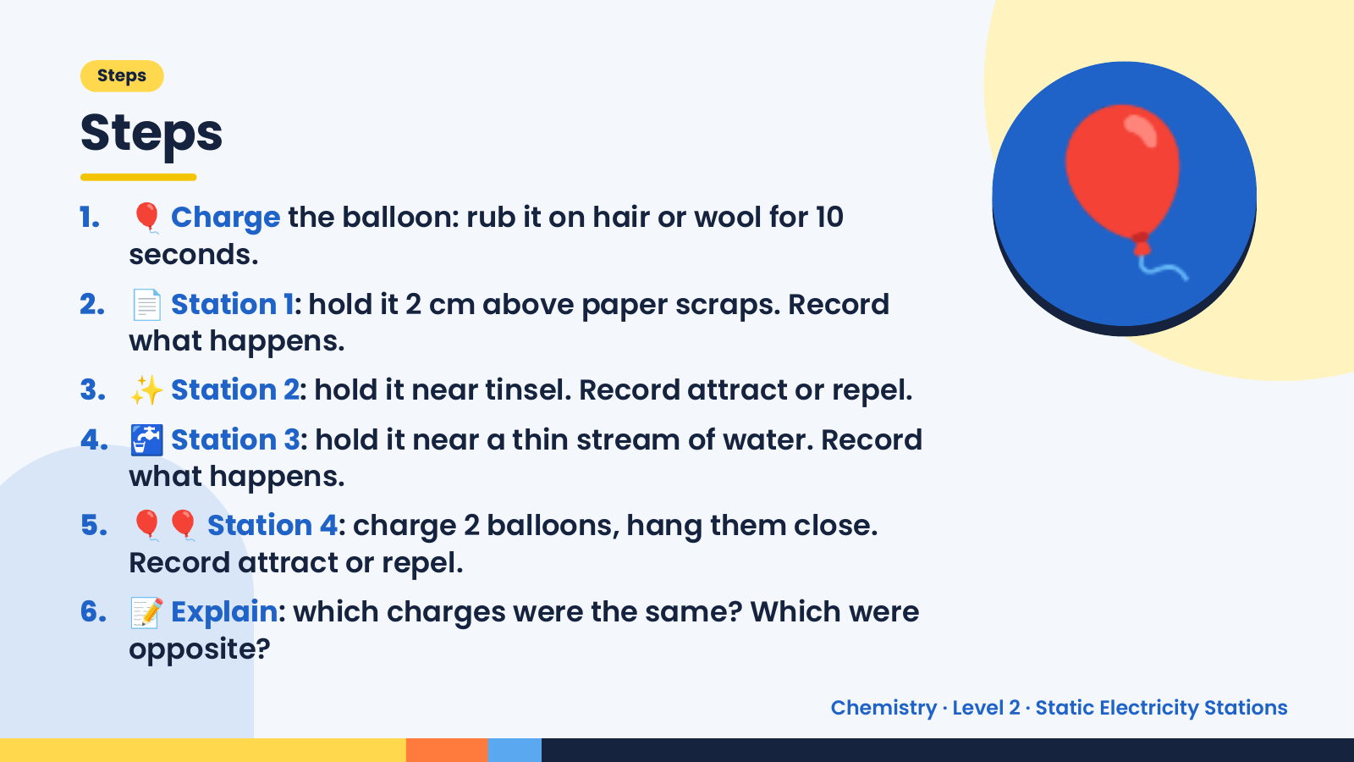
Notes:
Steps
Steps
1. 🎈 Charge the balloon: rub it on hair or wool for 10
seconds.
2. 📄 Station 1: hold it 2 cm above paper scraps. Record
what happens.
3. ✨ Station 2: hold it near tinsel. Record attract or repel.
🎈
4. 🚰 Station 3: hold it near a thin stream of water. Record
what happens.
5. 🎈🎈 Station 4: charge 2 balloons, hang them close.
Record attract or repel.
6. 📝 Explain: which charges were the same? Which were
opposite?
Chemistry · Level 2 · Static Electricity Stations

Slide 5
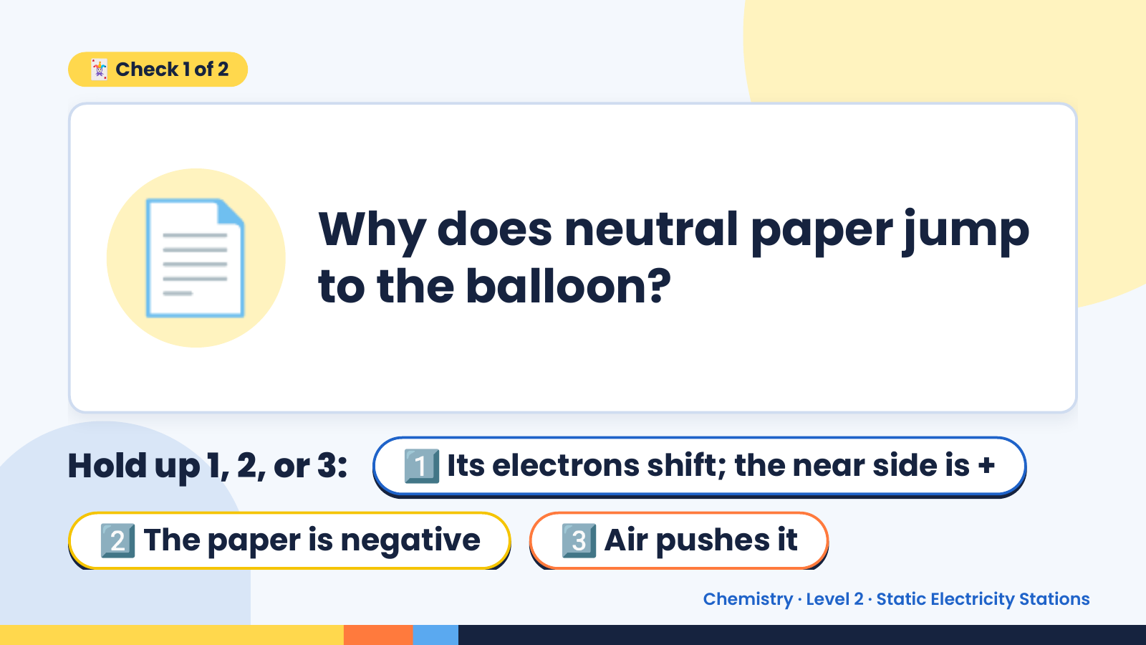
Notes:
🃏 Check 1 of 2
📄 Why does neutral paper jump
to the balloon?
Hold up 1, 2, or 3: 1️⃣ Its electrons shift; the near side is +
2️⃣ The paper is negative 3️⃣ Air pushes it
Chemistry · Level 2 · Static Electricity Stations

Slide 6
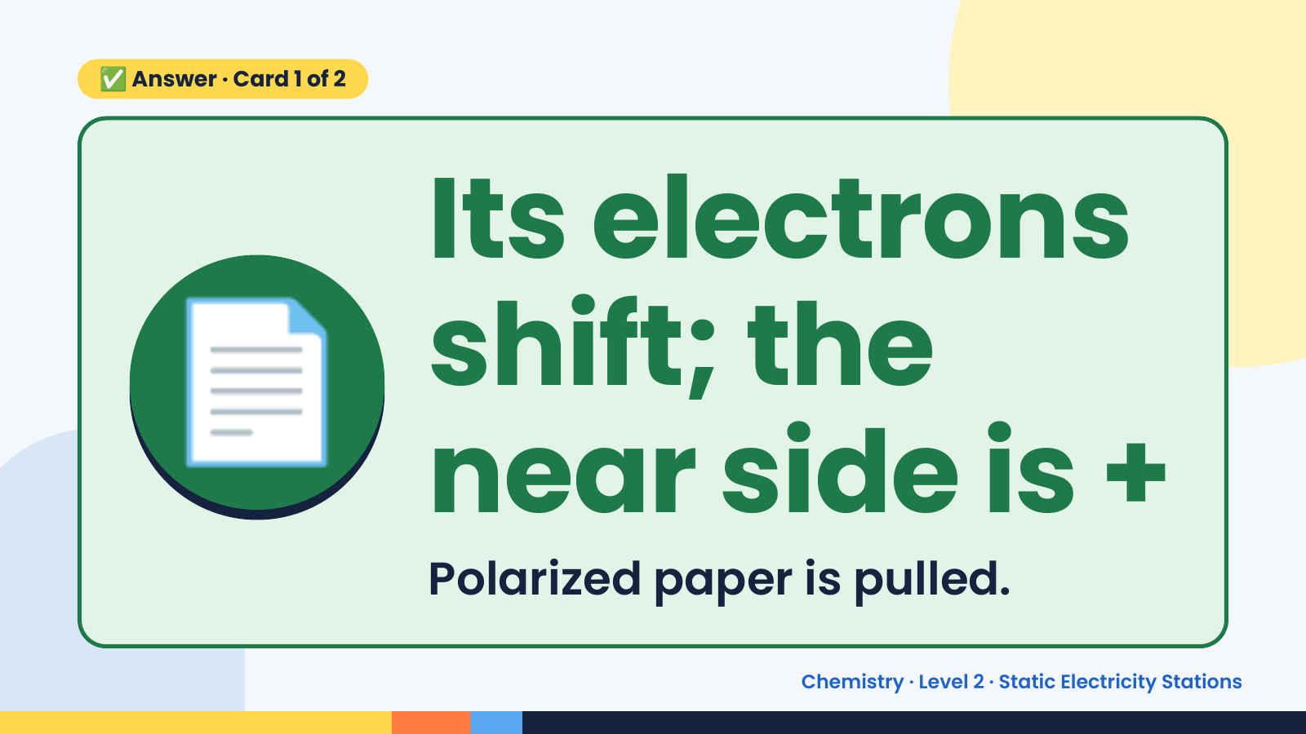
Notes:
✅ Answer · Card 1 of 2
📄 Its electrons
shift; the
near side is +
Polarized paper is pulled.
Chemistry · Level 2 · Static Electricity Stations

Slide 7
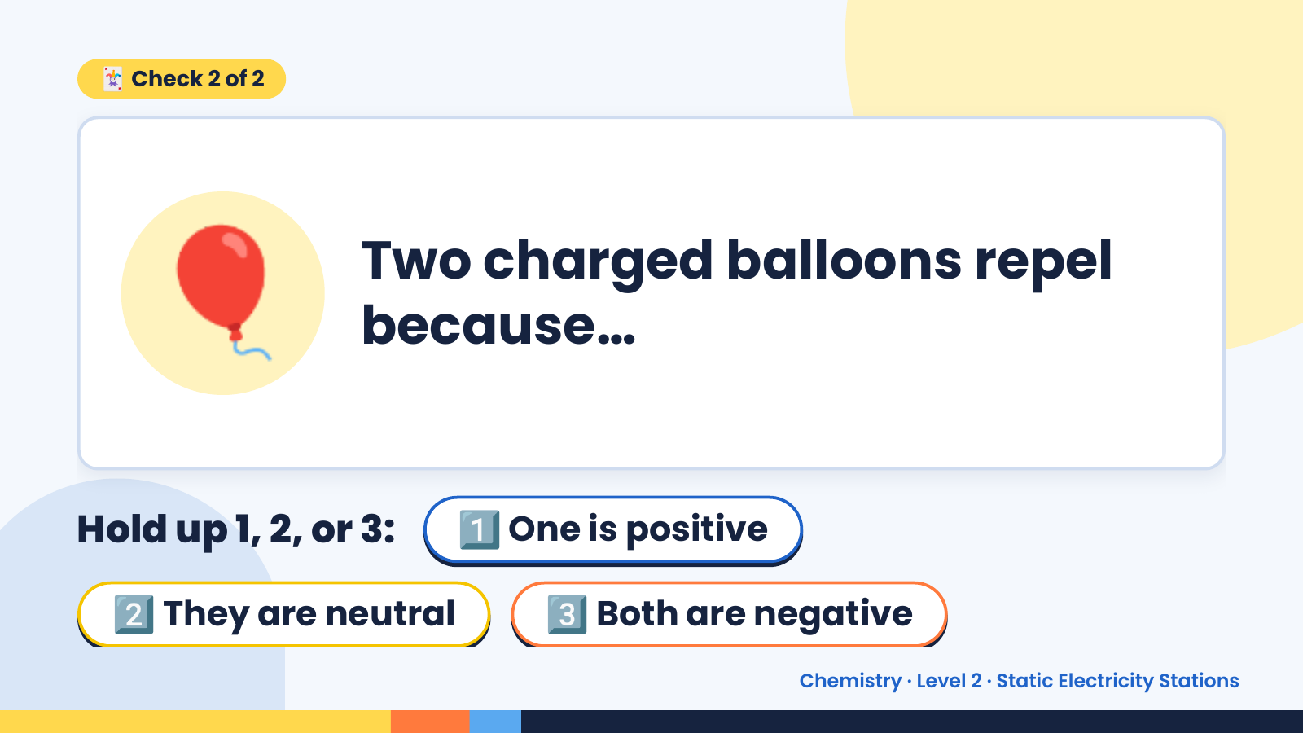
Notes:
🃏 Check 2 of 2
🎈 Two charged balloons repel
because…
Hold up 1, 2, or 3: 1️⃣ One is positive
2️⃣ They are neutral 3️⃣ Both are negative
Chemistry · Level 2 · Static Electricity Stations

Slide 8
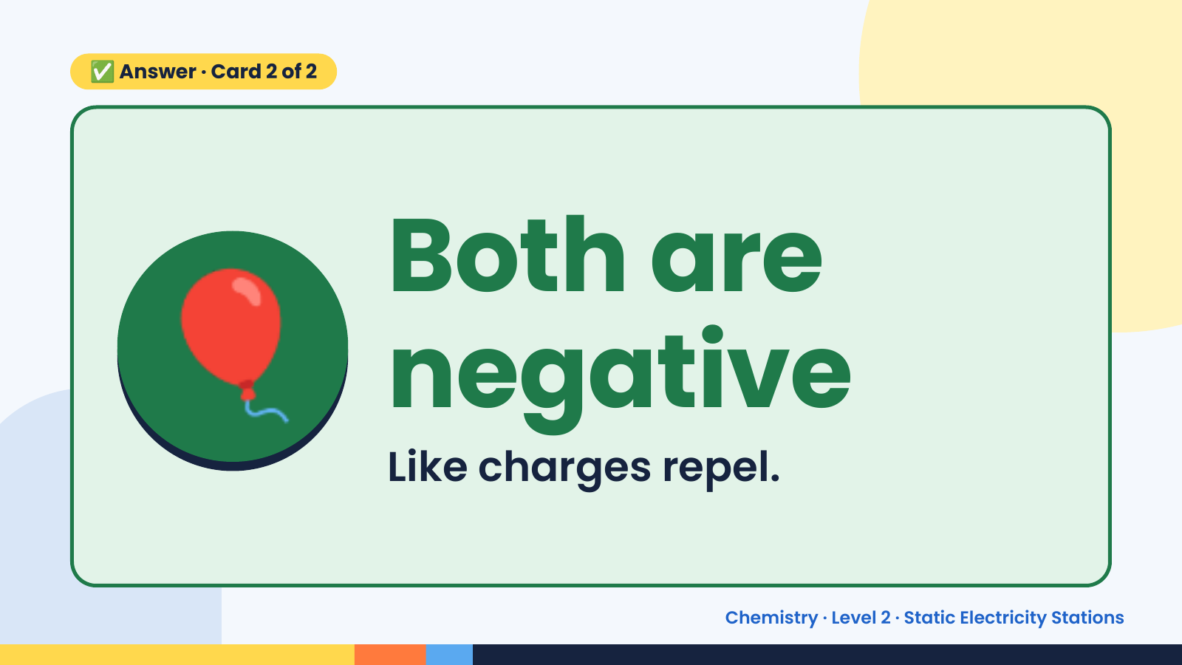
Notes:
✅ Answer · Card 2 of 2
🎈 Both are
negative
Like charges repel.
Chemistry · Level 2 · Static Electricity Stations

Slide 9
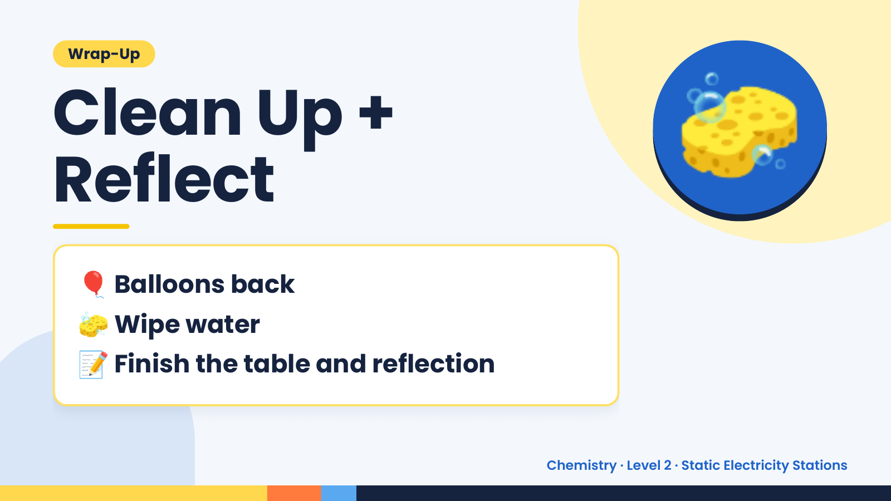
Notes:
Wrap-Up
Clean Up +
Reflect
🧽
🎈 Balloons back
🧽 Wipe water
📝 Finish the table and reflection
Chemistry · Level 2 · Static Electricity Stations

