Slide 1
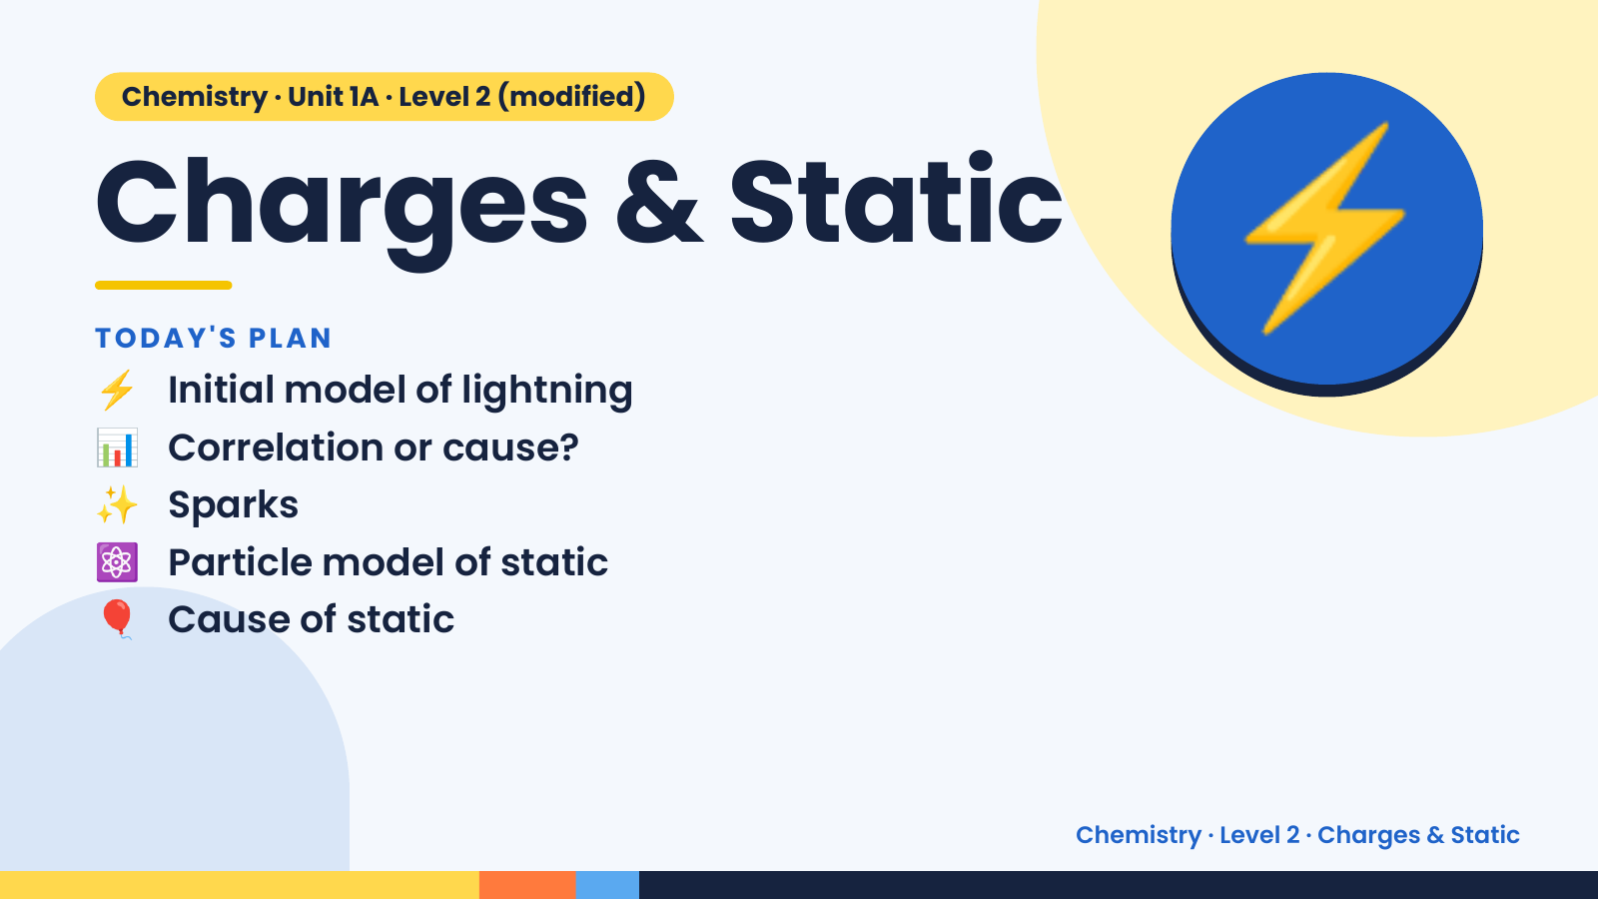
Notes:
Chemistry · Unit 1A · Level 2 (modified)
Charges & Static
⚡ Initial model of lightning
TODAY'S PLAN
📊 Correlation or cause?
✨ Sparks
⚡
⚛️ Particle model of static
🎈 Cause of static
Chemistry · Level 2 · Charges & Static

Slide 2
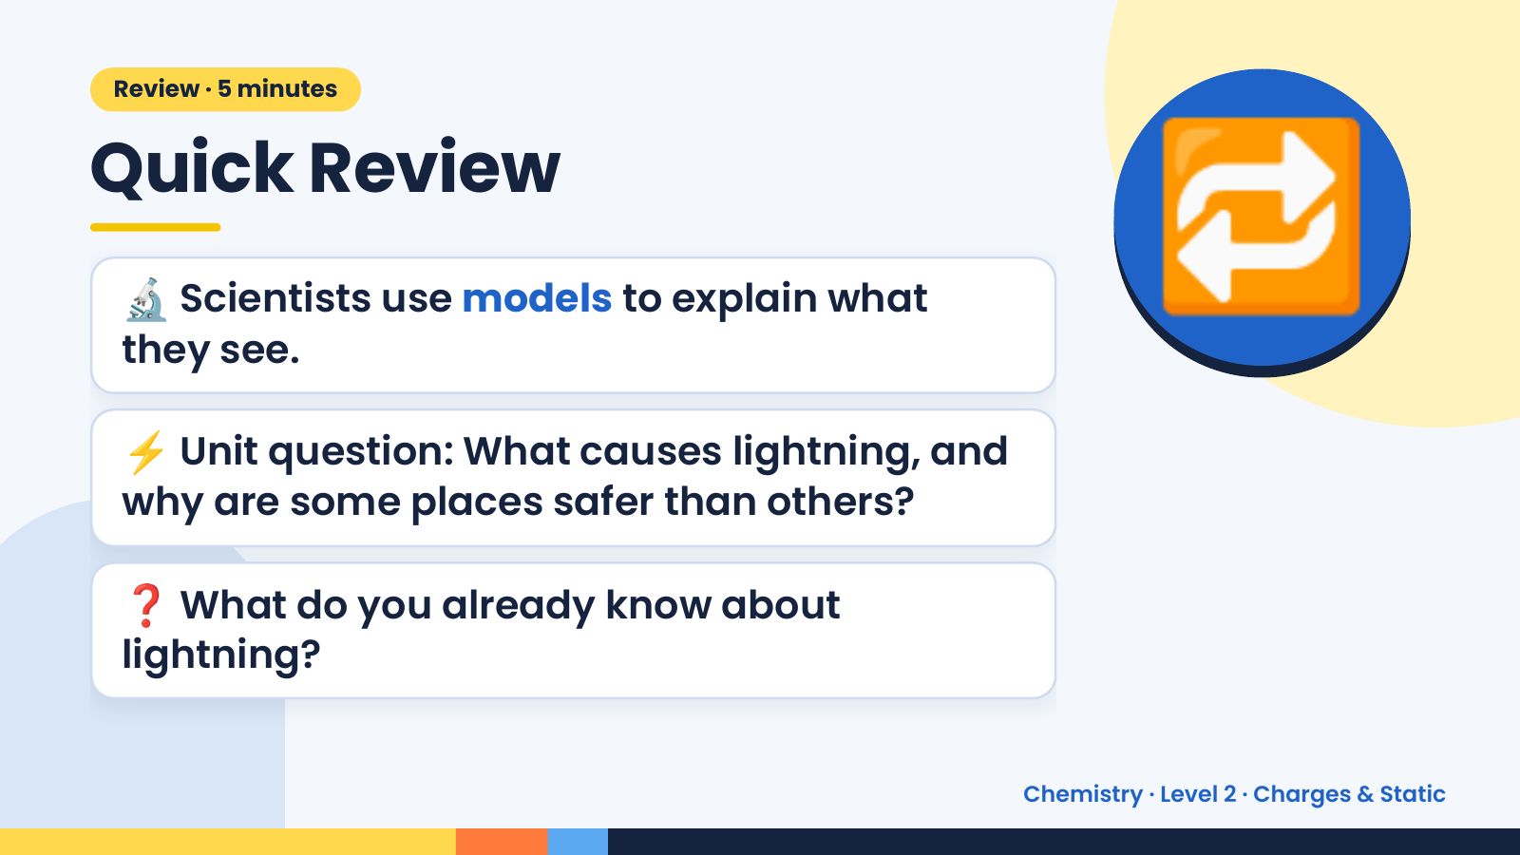
Notes:
Review · 5 minutes
Quick Review
🔬 Scientists use models to explain what
they see.
⚡ Unit question: What causes lightning, and
🔁
why are some places safer than others?
❓ What do you already know about
lightning?
Chemistry · Level 2 · Charges & Static

Slide 3
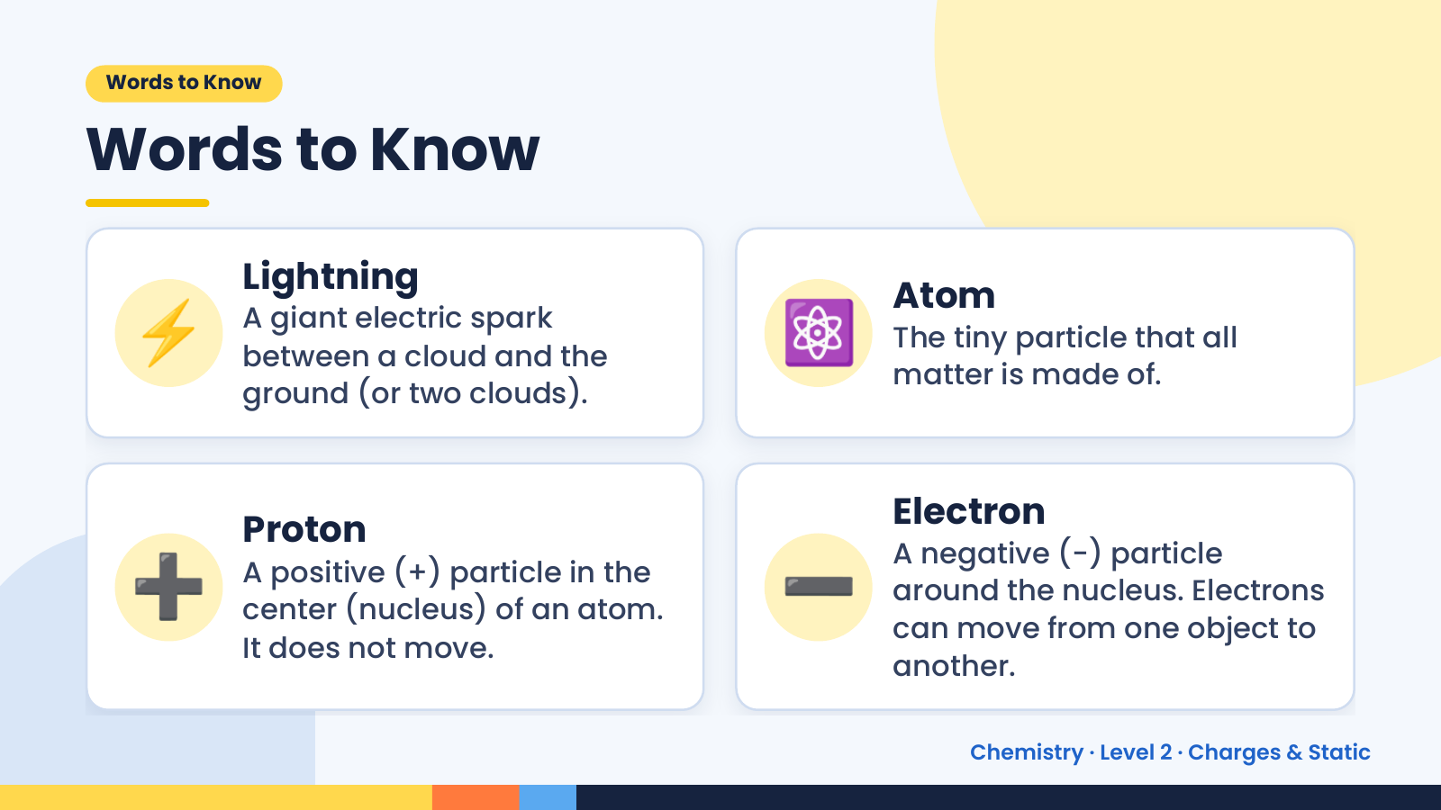
Notes:
Words to Know
Words to Know
⚡ Lightning
A giant electric spark
between a cloud and the
ground (or two clouds).
⚛️ Atom
The tiny particle that all
matter is made of.
➕ ➖
Proton Electron
A negative (−) particle
A positive (+) particle in the
around the nucleus. Electrons
center (nucleus) of an atom.
can move from one object to
It does not move.
another.
Chemistry · Level 2 · Charges & Static

Slide 4
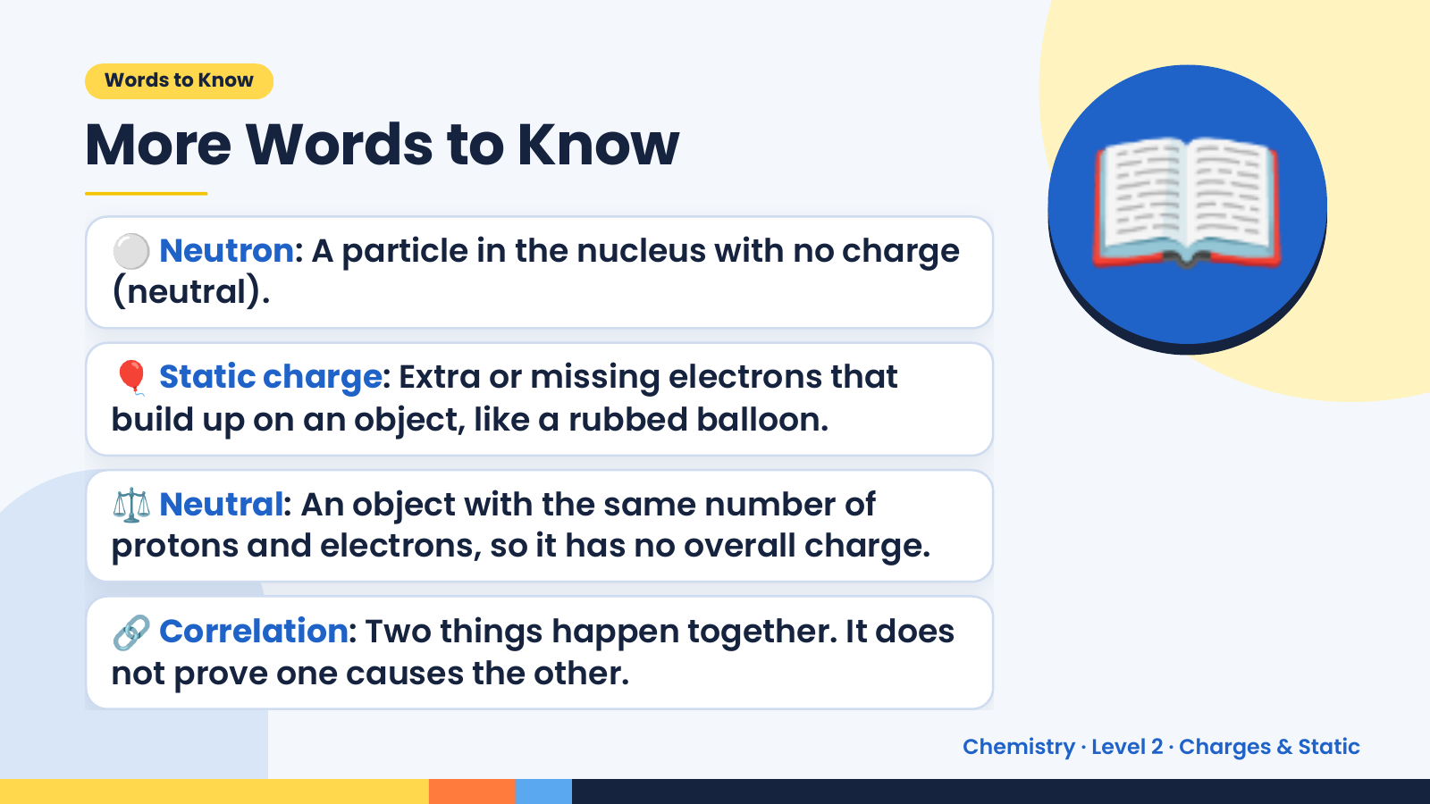
Notes:
Words to Know
More Words to Know
⚪ Neutron: A particle in the nucleus with no charge
(neutral).
🎈 Static charge: Extra or missing electrons that
build up on an object, like a rubbed balloon.
📖
⚖️ Neutral: An object with the same number of
protons and electrons, so it has no overall charge.
🔗 Correlation: Two things happen together. It does
not prove one causes the other.
Chemistry · Level 2 · Charges & Static

Slide 5
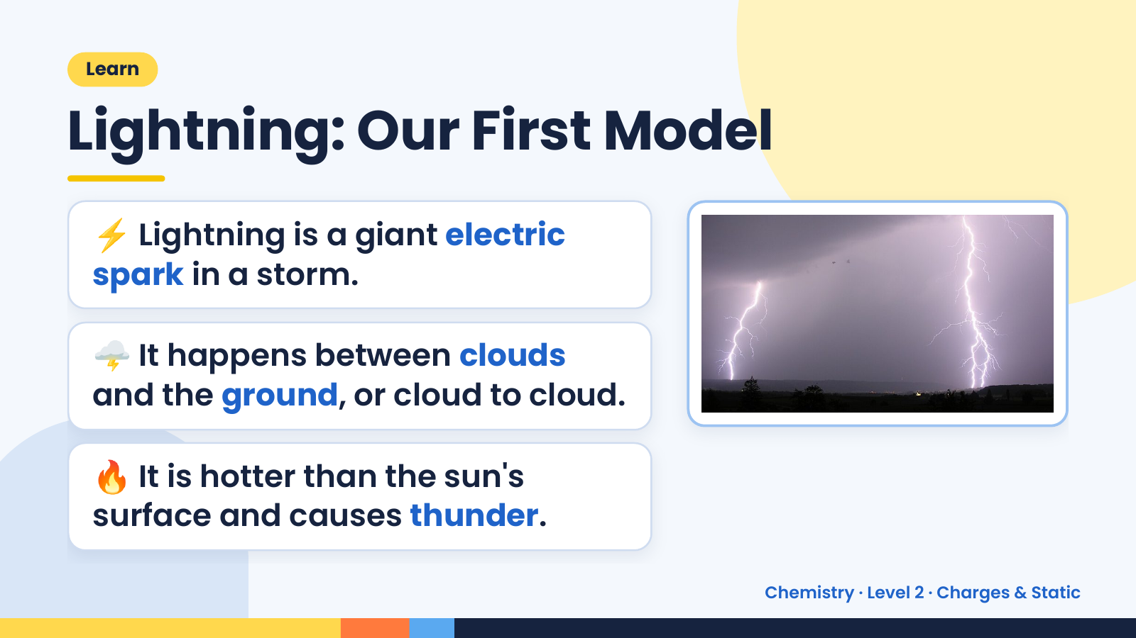
Notes:
Learn
Lightning: Our First Model
⚡ Lightning is a giant electric
spark in a storm.
🌩️ It happens between clouds
and the ground, or cloud to cloud.
🔥 It is hotter than the sun's
surface and causes thunder.
Chemistry · Level 2 · Charges & Static

Slide 6
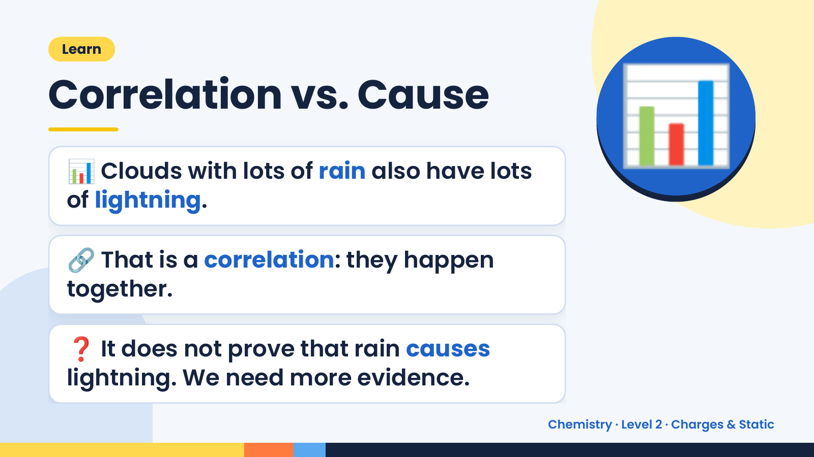
Notes:
Learn
Correlation vs. Cause
📊 Clouds with lots of rain also have lots
of lightning.
📊
🔗 That is a correlation: they happen
together.
❓ It does not prove that rain causes
lightning. We need more evidence.
Chemistry · Level 2 · Charges & Static

Slide 7
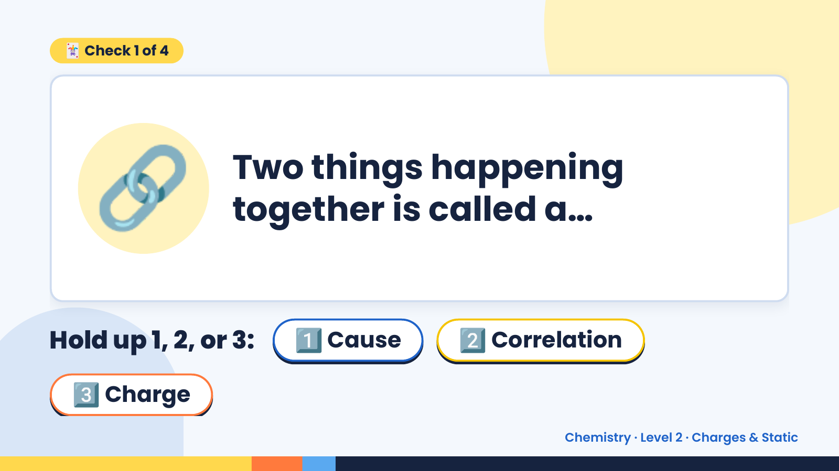
Notes:
🃏 Check 1 of 4
🔗 Two things happening
together is called a…
Hold up 1, 2, or 3: 1️⃣ Cause 2️⃣ Correlation
3️⃣ Charge
Chemistry · Level 2 · Charges & Static

Slide 8
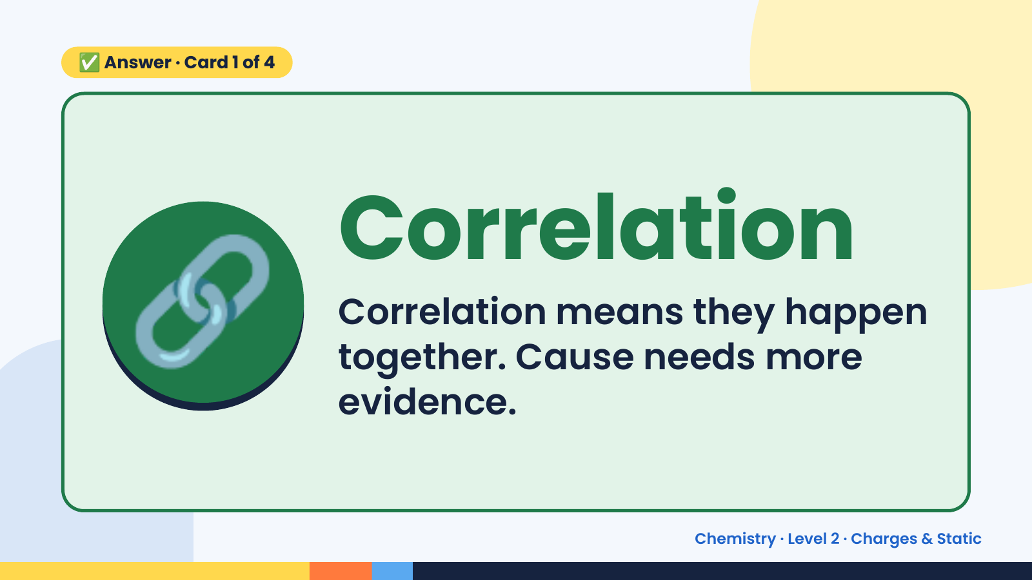
Notes:
✅ Answer · Card 1 of 4
🔗 Correlation
Correlation means they happen
together. Cause needs more
evidence.
Chemistry · Level 2 · Charges & Static

Slide 9
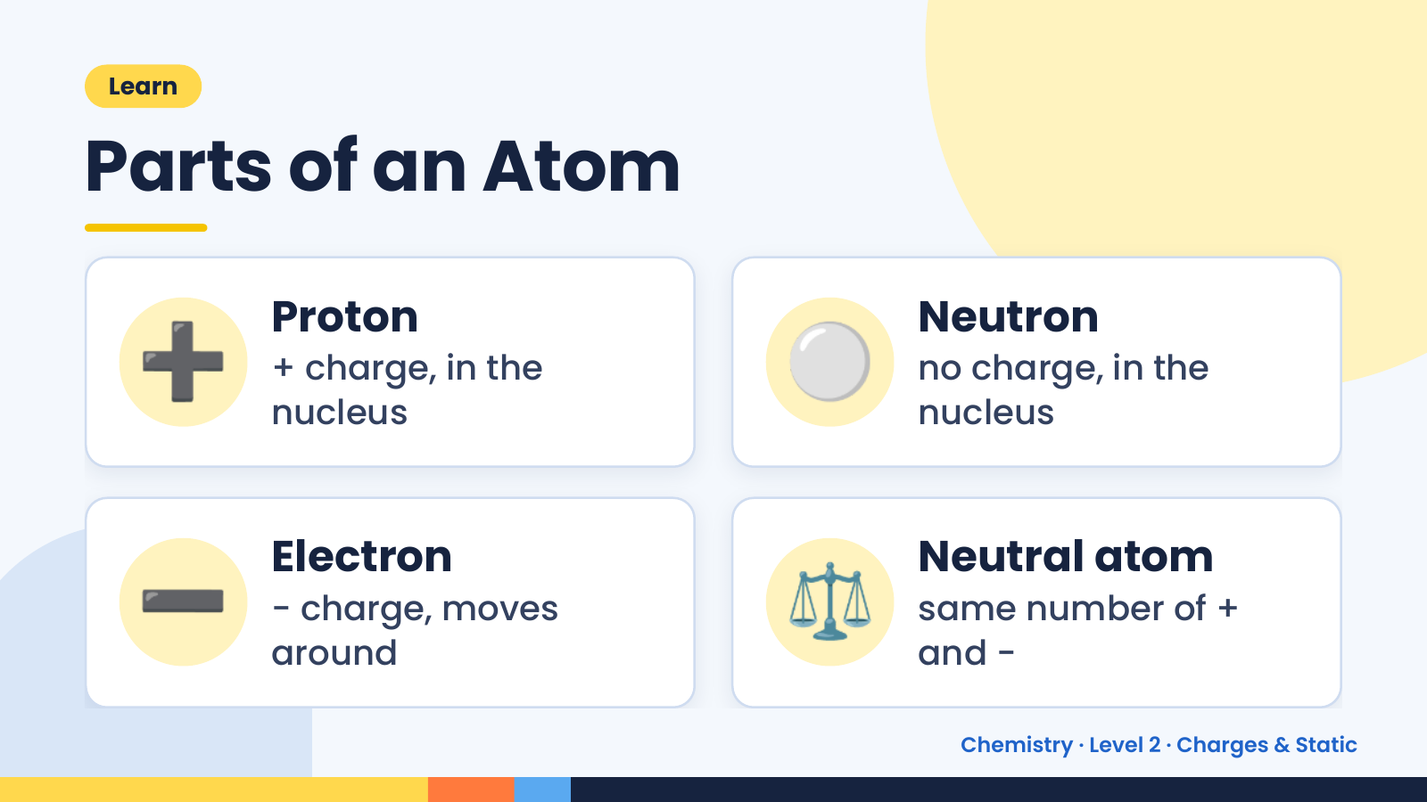
Notes:
Learn
Parts of an Atom
➕ Proton
+ charge, in the
nucleus
⚪ Neutron
no charge, in the
nucleus
➖ Electron
− charge, moves
around
⚖️ Neutral atom
same number of +
and −
Chemistry · Level 2 · Charges & Static

Slide 10
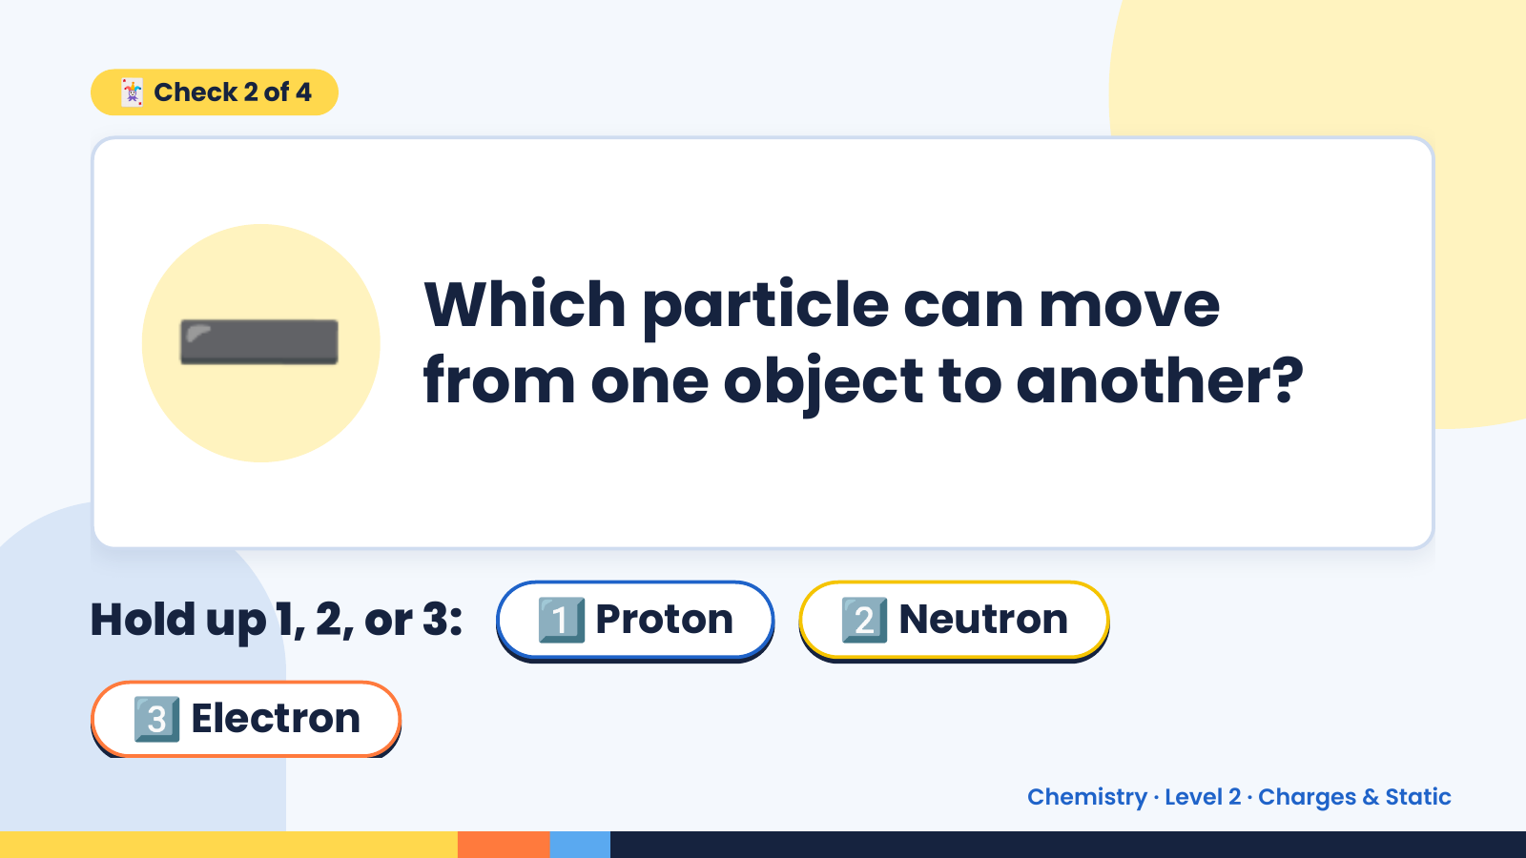
Notes:
🃏 Check 2 of 4
➖ Which particle can move
from one object to another?
Hold up 1, 2, or 3: 1️⃣ Proton 2️⃣ Neutron
3️⃣ Electron
Chemistry · Level 2 · Charges & Static

Slide 11
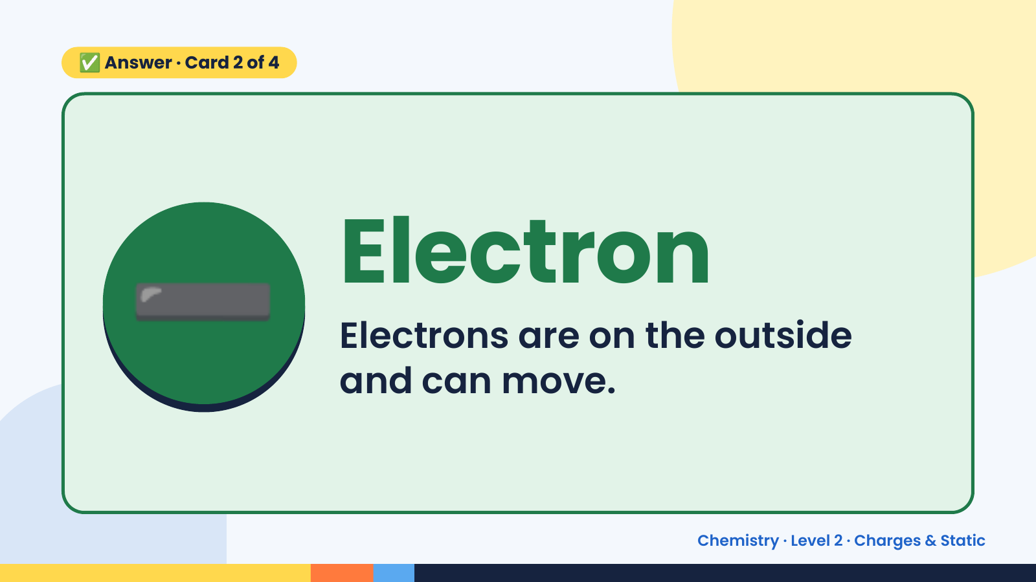
Notes:
✅ Answer · Card 2 of 4
➖ Electron
Electrons are on the outside
and can move.
Chemistry · Level 2 · Charges & Static

Slide 12
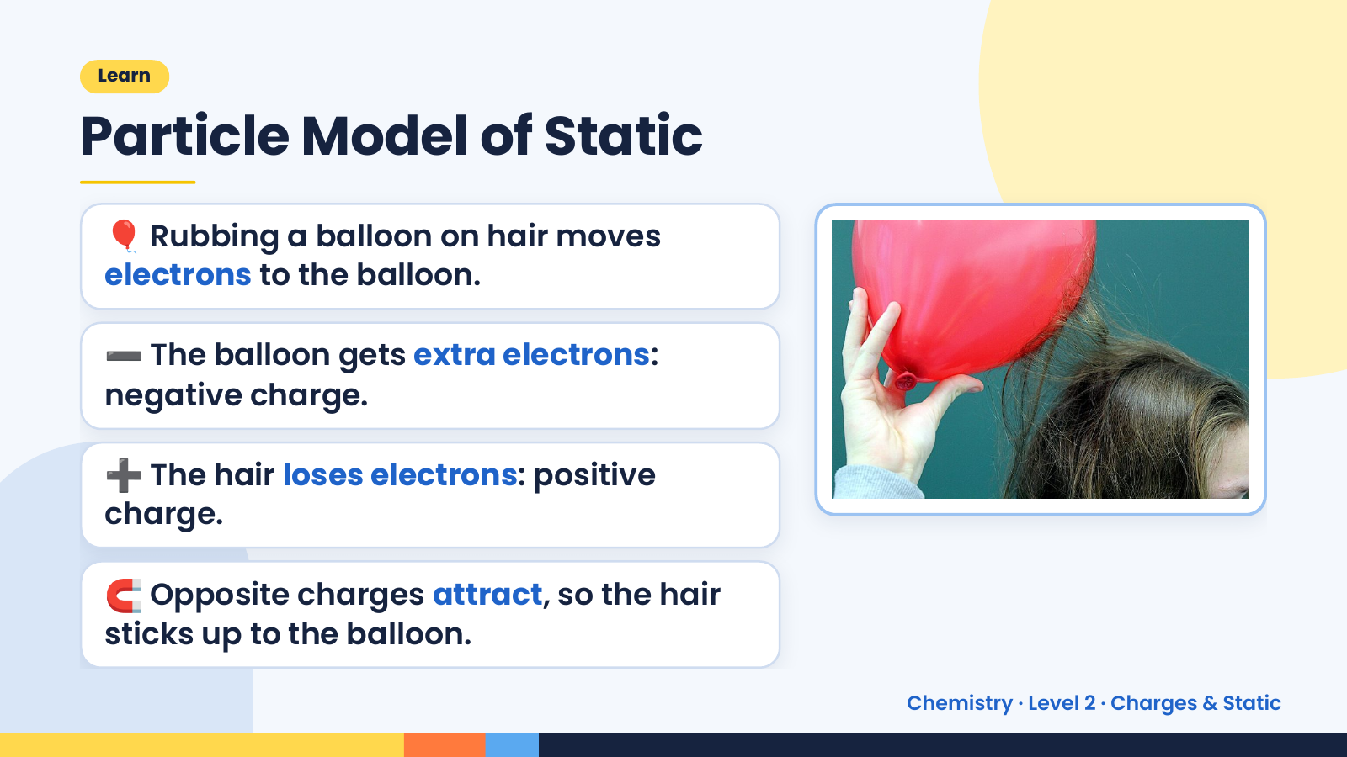
Notes:
Learn
Particle Model of Static
🎈 Rubbing a balloon on hair moves
electrons to the balloon.
➖ The balloon gets extra electrons:
negative charge.
➕ The hair loses electrons: positive
charge.
🧲 Opposite charges attract, so the hair
sticks up to the balloon.
Chemistry · Level 2 · Charges & Static

Slide 13
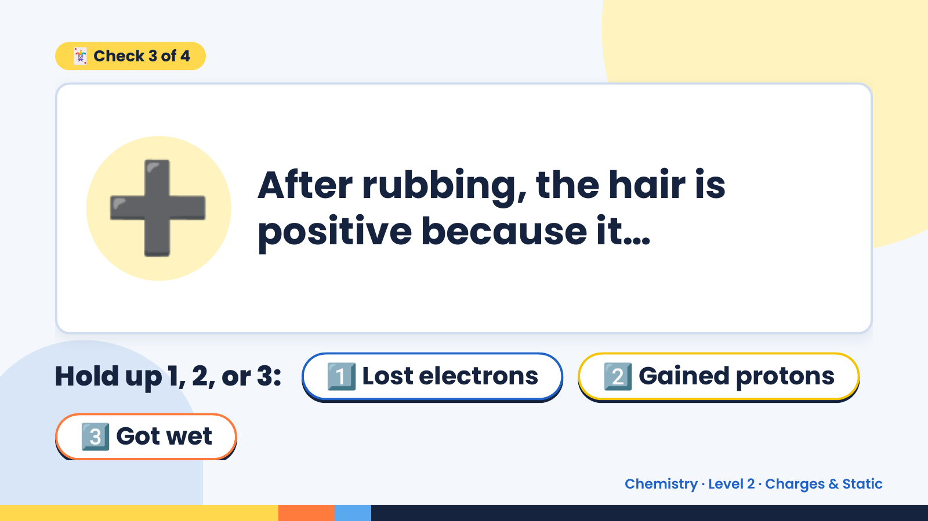
Notes:
🃏 Check 3 of 4
➕ After rubbing, the hair is
positive because it…
Hold up 1, 2, or 3: 1️⃣ Lost electrons 2️⃣ Gained protons
3️⃣ Got wet
Chemistry · Level 2 · Charges & Static

Slide 14
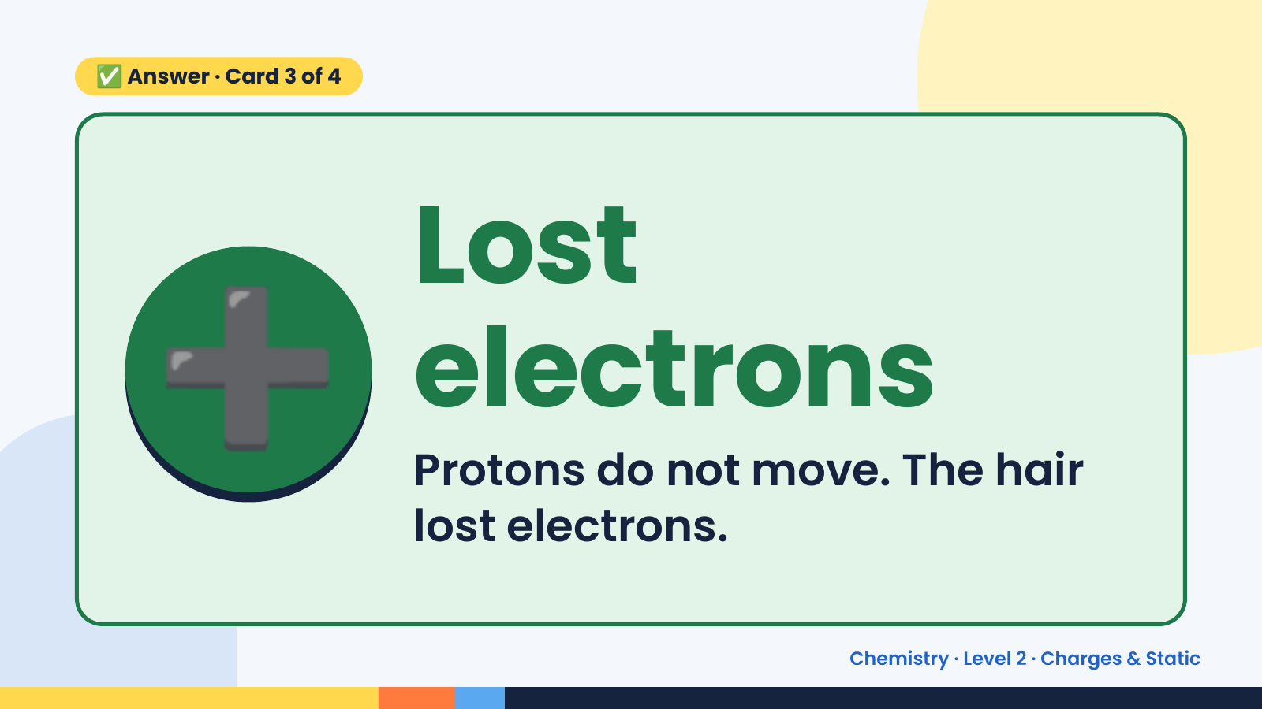
Notes:
✅ Answer · Card 3 of 4
➕ Lost
electrons
Protons do not move. The hair
lost electrons.
Chemistry · Level 2 · Charges & Static

Slide 15
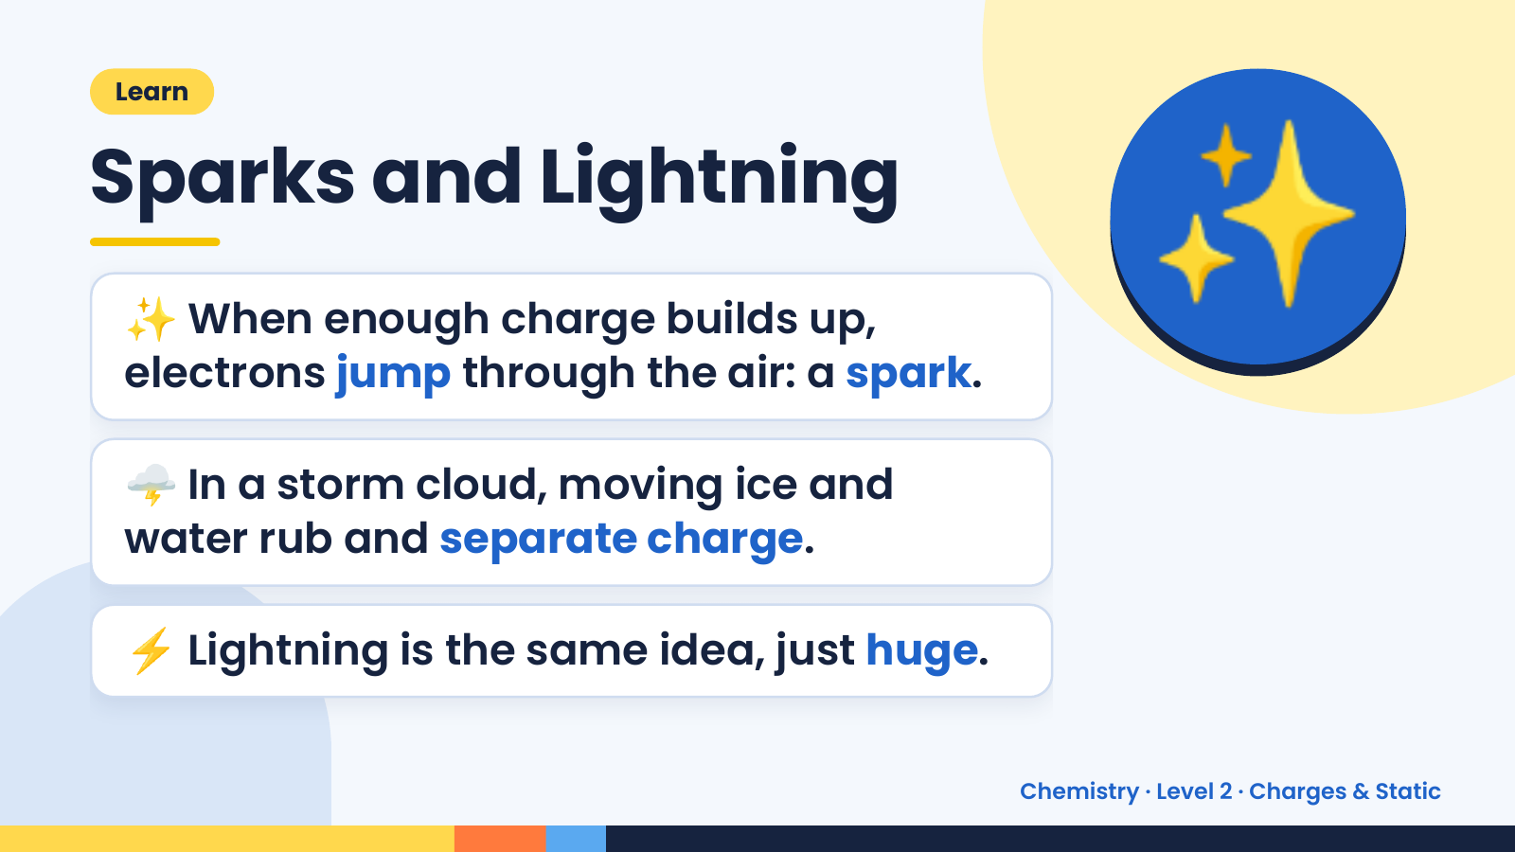
Notes:
Learn
Sparks and Lightning
✨ When enough charge builds up,
electrons jump through the air: a spark.
✨
🌩️ In a storm cloud, moving ice and
water rub and separate charge.
⚡ Lightning is the same idea, just huge.
Chemistry · Level 2 · Charges & Static

Slide 16
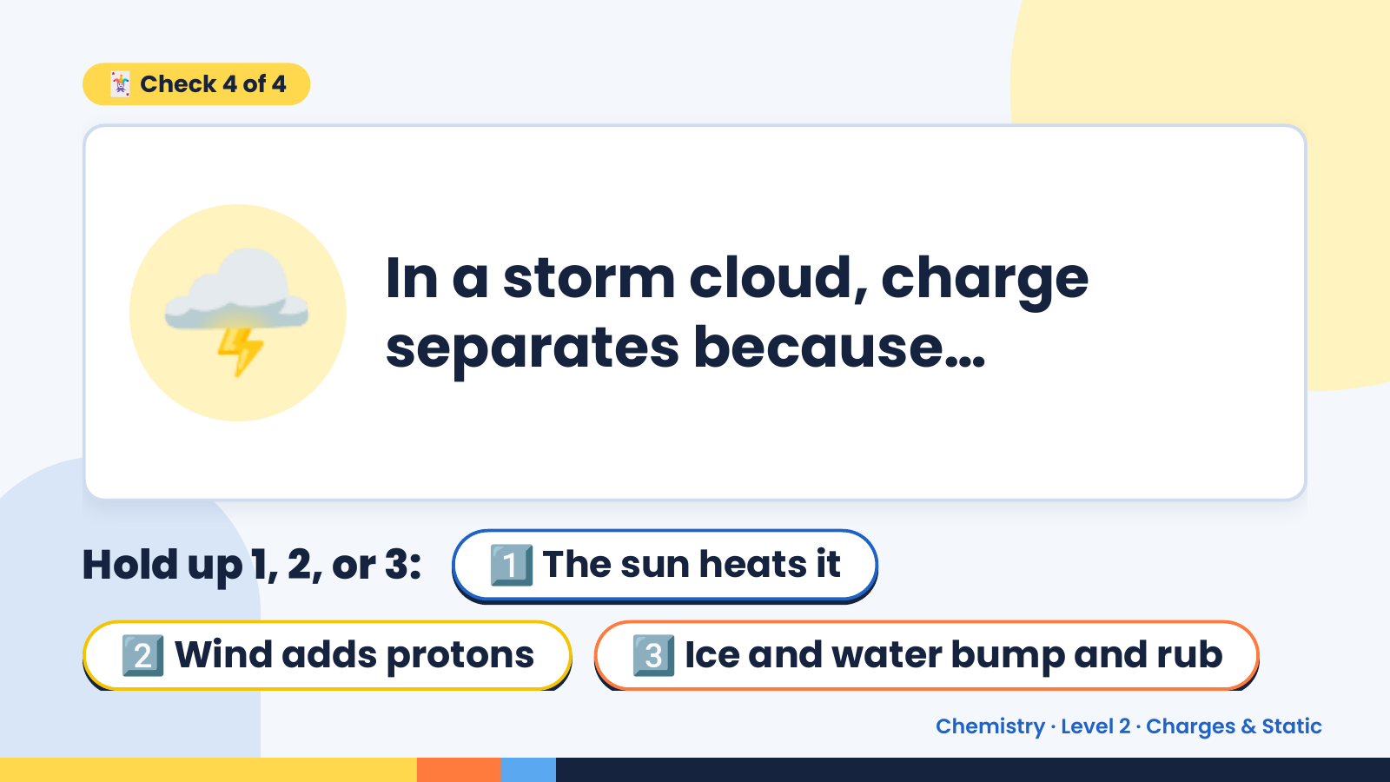
Notes:
🃏 Check 4 of 4
🌩️ In a storm cloud, charge
separates because…
Hold up 1, 2, or 3: 1️⃣ The sun heats it
2️⃣ Wind adds protons 3️⃣ Ice and water bump and rub
Chemistry · Level 2 · Charges & Static

Slide 17
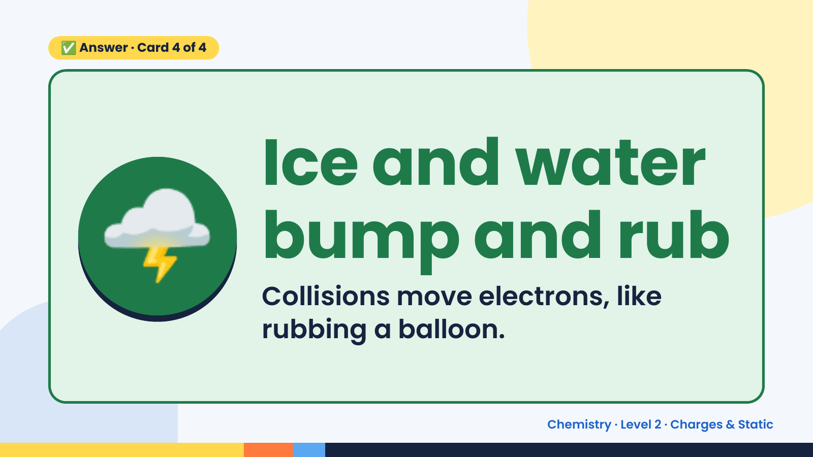
Notes:
✅ Answer · Card 4 of 4
🌩️ Ice and water
bump and rub
Collisions move electrons, like
rubbing a balloon.
Chemistry · Level 2 · Charges & Static

Slide 18
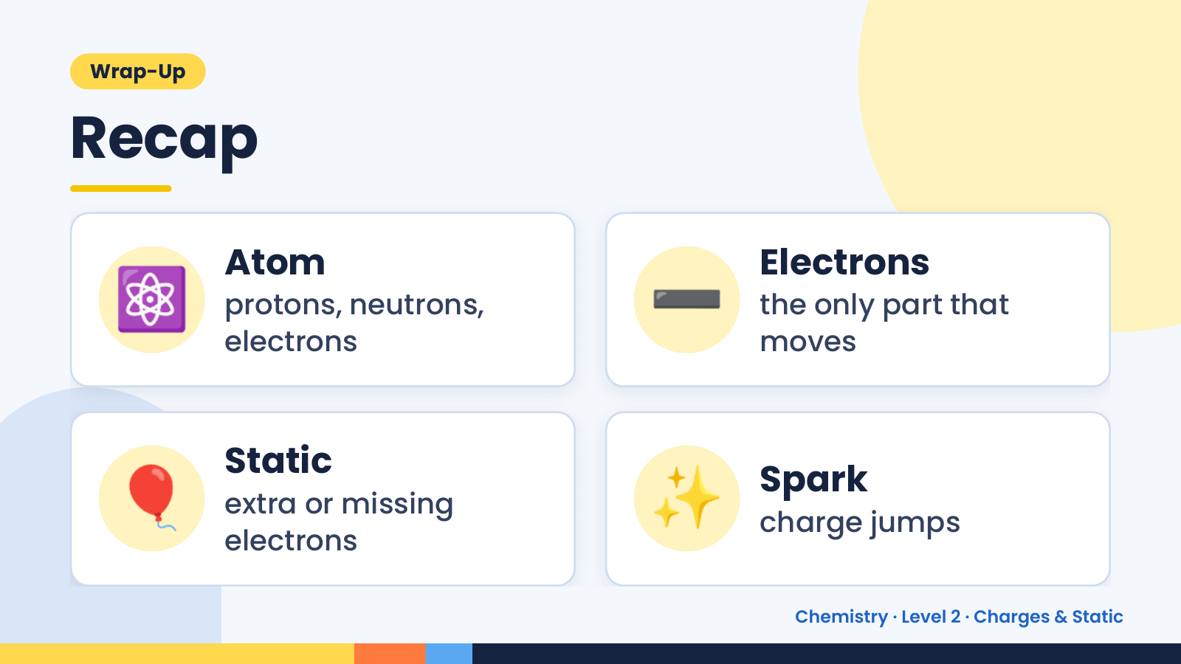
Notes:
Wrap-Up
Recap
⚛️ Atom
protons, neutrons,
electrons
➖ Electrons
the only part that
moves
🎈 Static
extra or missing
electrons
✨ Spark
charge jumps
Chemistry · Level 2 · Charges & Static

Slide 19
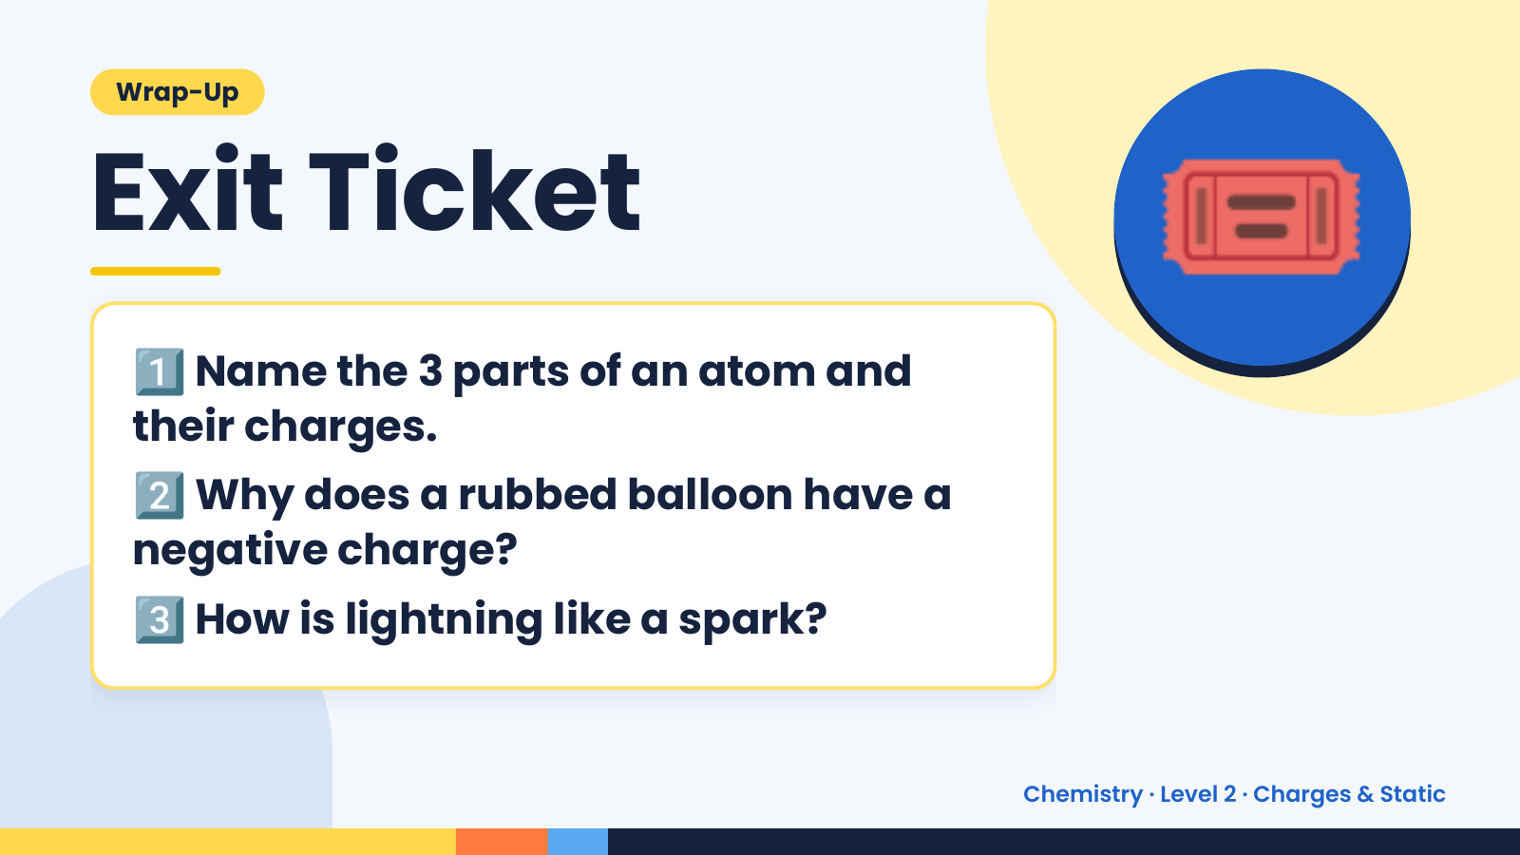
Notes:
Wrap-Up
Exit Ticket
1️⃣
Name the 3 parts of an atom and
their charges.
🎟️
2️⃣
Why does a rubbed balloon have a
negative charge?
3️⃣How is lightning like a spark?
Chemistry · Level 2 · Charges & Static

