Slide 1
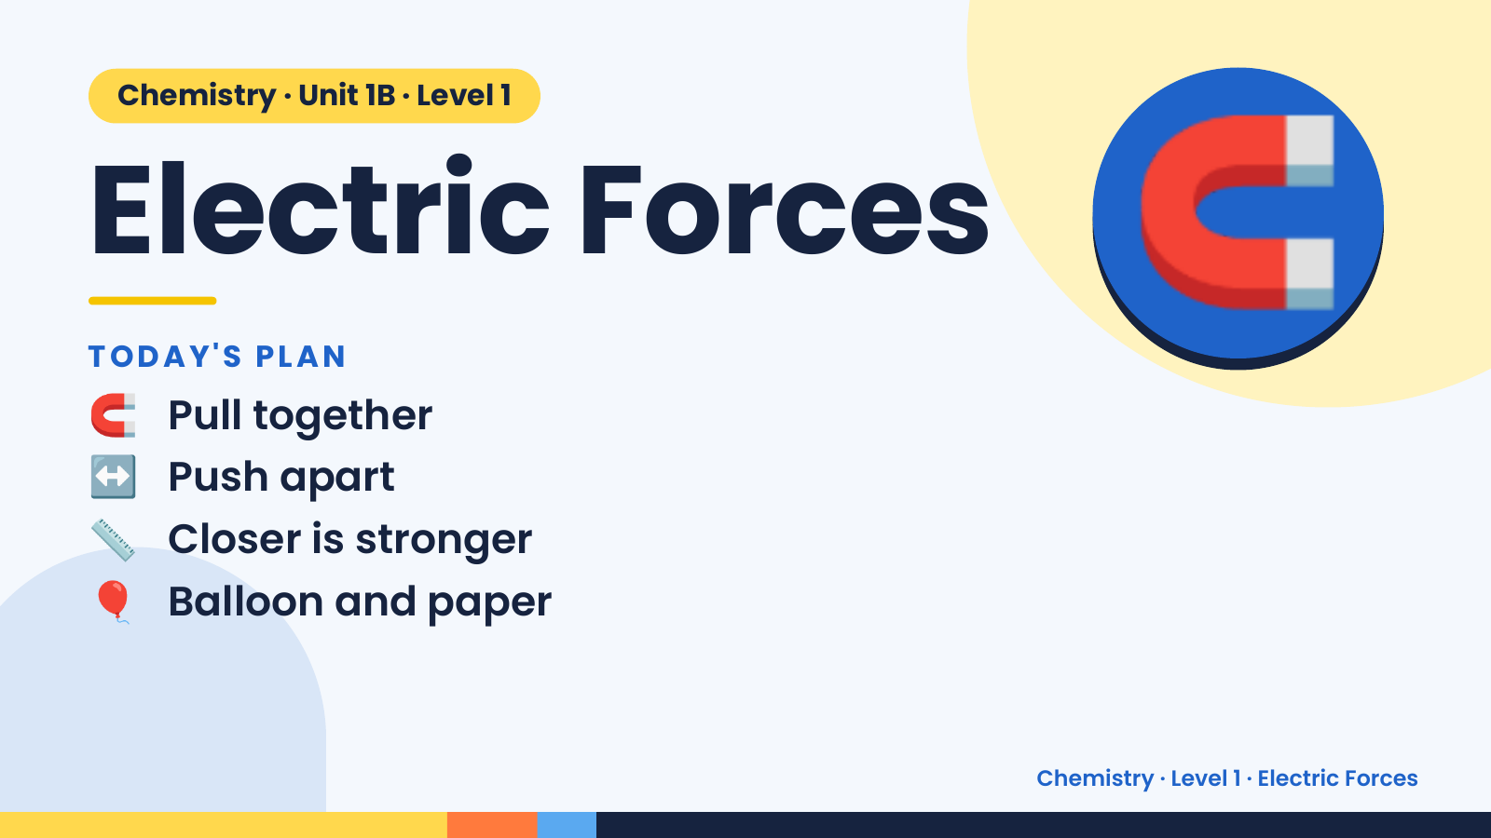
Notes:
Chemistry · Unit 1B · Level 1
Electric Forces
TODAY'S PLAN
🧲 Pull together
🧲
↔️ Push apart
📏 Closer is stronger
🎈 Balloon and paper
Chemistry · Level 1 · Electric Forces

Slide 2
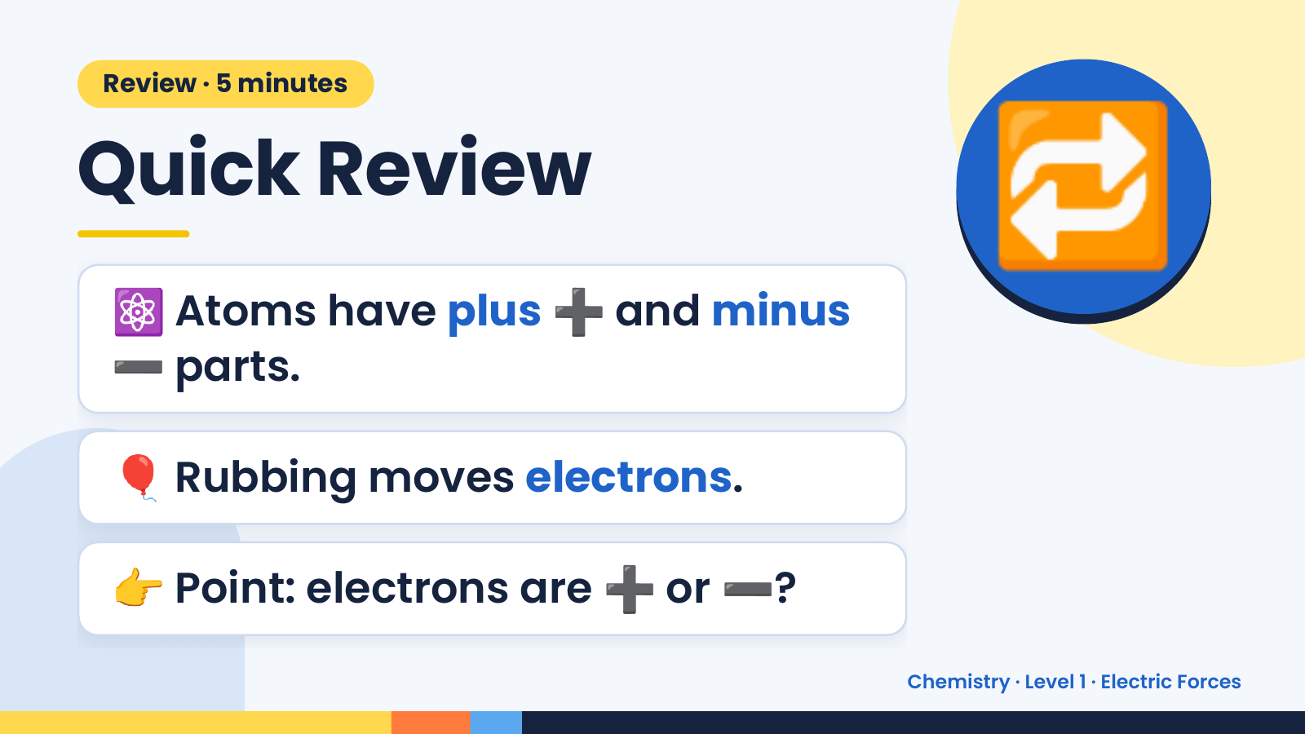
Notes:
Review · 5 minutes
Quick Review
⚛️ Atoms have plus ➕ and minus
➖ parts.
🔁
🎈 Rubbing moves electrons.
👉 Point: electrons are ➕ or ➖?
Chemistry · Level 1 · Electric Forces

Slide 3
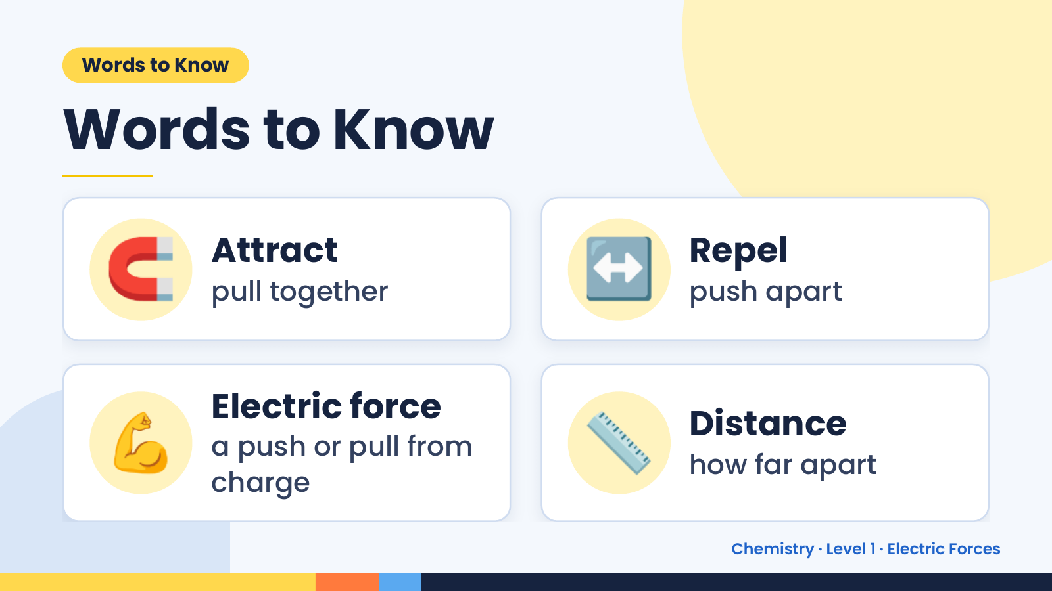
Notes:
Words to Know
Words to Know
🧲 Attract
pull together ↔️ Repel
push apart
💪 Electric force
a push or pull from
charge
📏 Distance
how far apart
Chemistry · Level 1 · Electric Forces

Slide 4
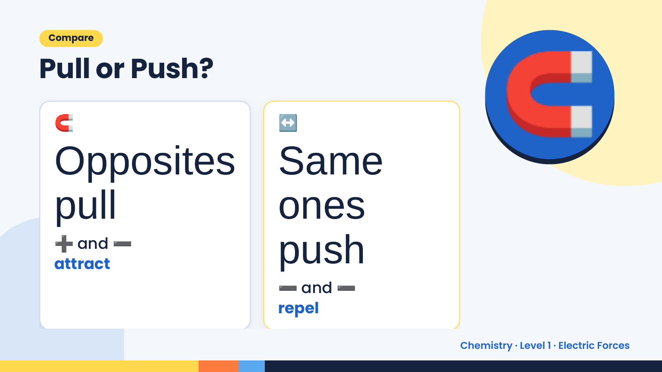
Notes:
Compare
Pull or Push?
🧲
Opposites Same
↔️ 🧲
pull ones
➕ ➖and
attract push
➖ ➖ and
repel
Chemistry · Level 1 · Electric Forces

Slide 5
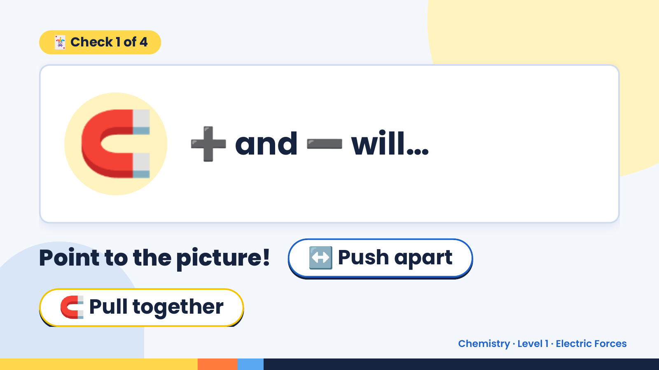
Notes:
🃏 Check 1 of 4
🧲 ➕ and ➖ will…
Point to the picture! ↔️ Push apart
🧲 Pull together
Chemistry · Level 1 · Electric Forces

Slide 6
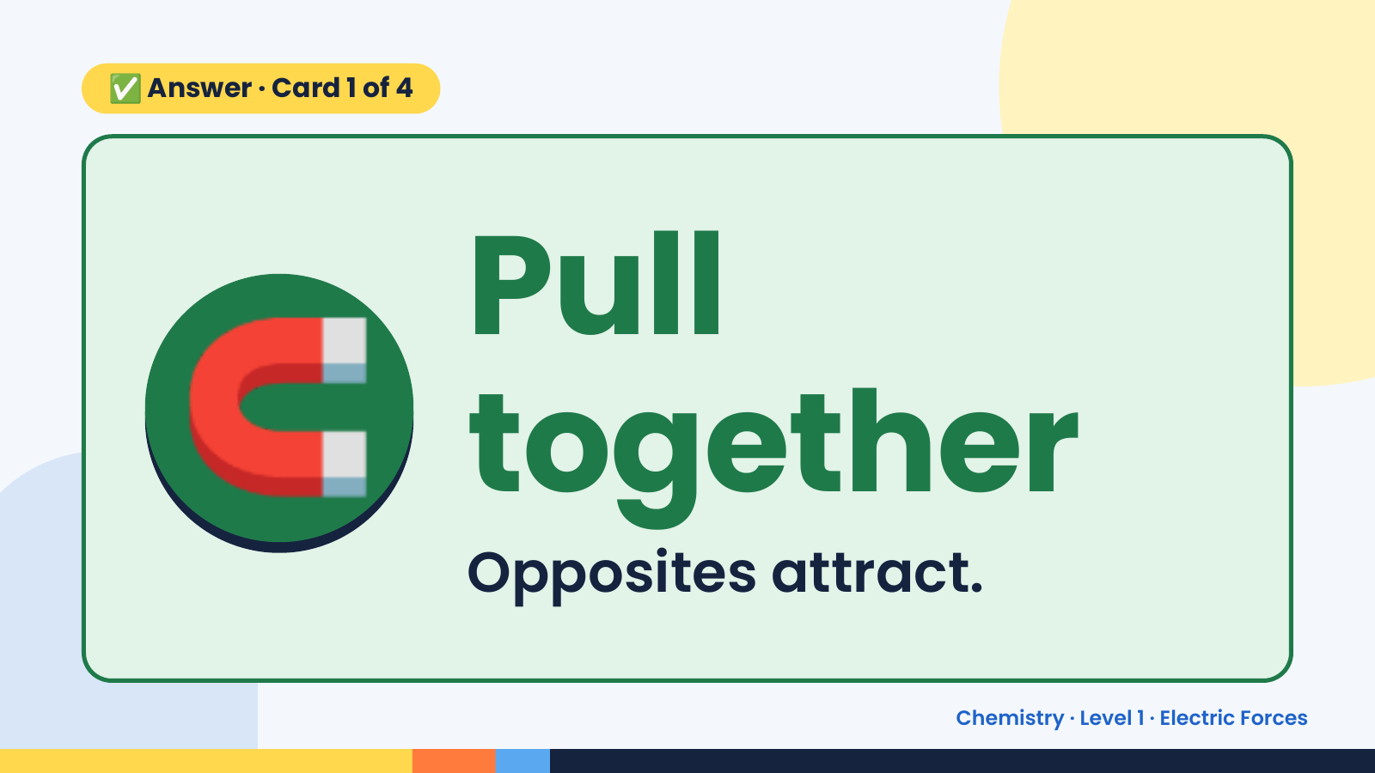
Notes:
✅ Answer · Card 1 of 4
🧲 Pull
together
Opposites attract.
Chemistry · Level 1 · Electric Forces

Slide 7
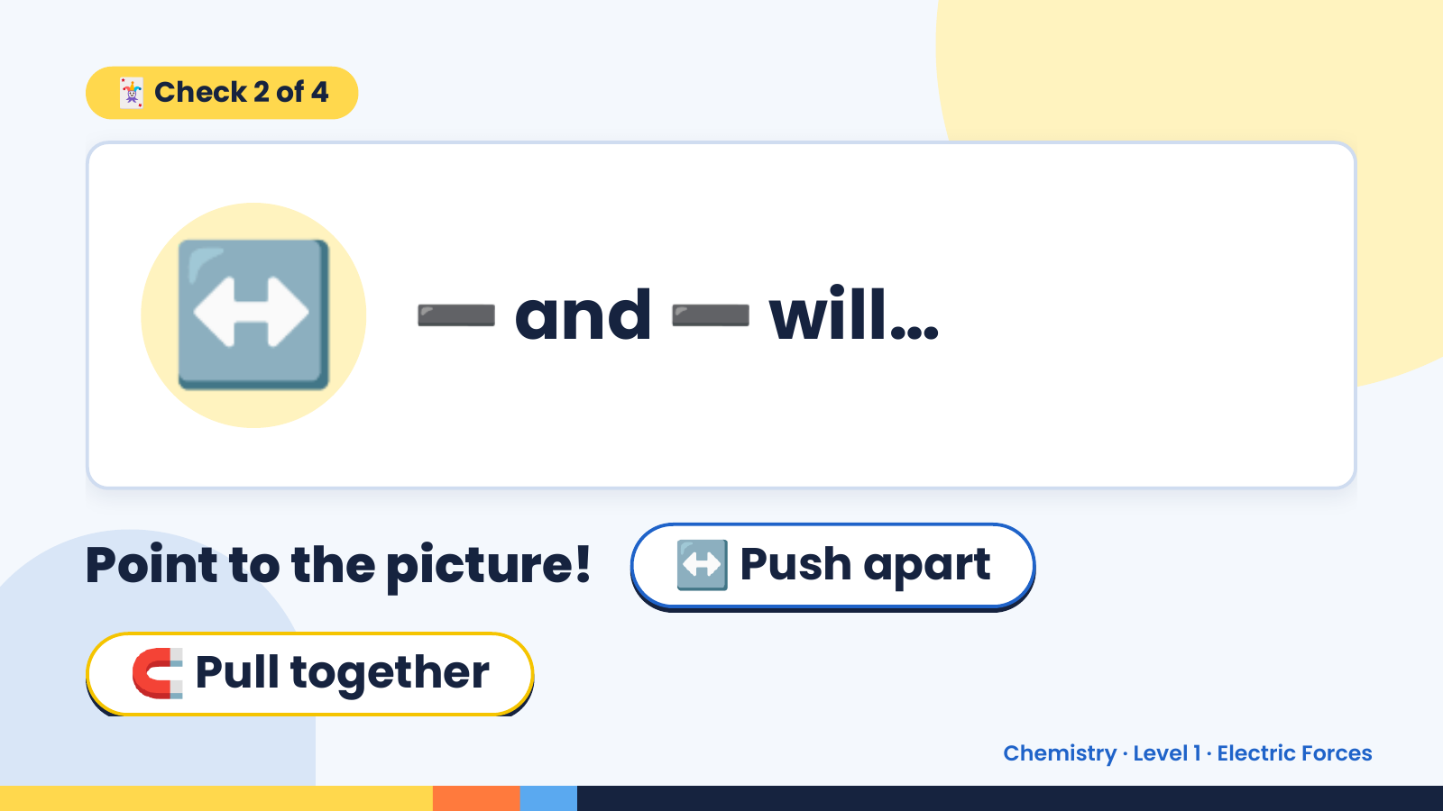
Notes:
🃏 Check 2 of 4
↔️ ➖ and ➖ will…
Point to the picture! ↔️ Push apart
🧲 Pull together
Chemistry · Level 1 · Electric Forces

Slide 8
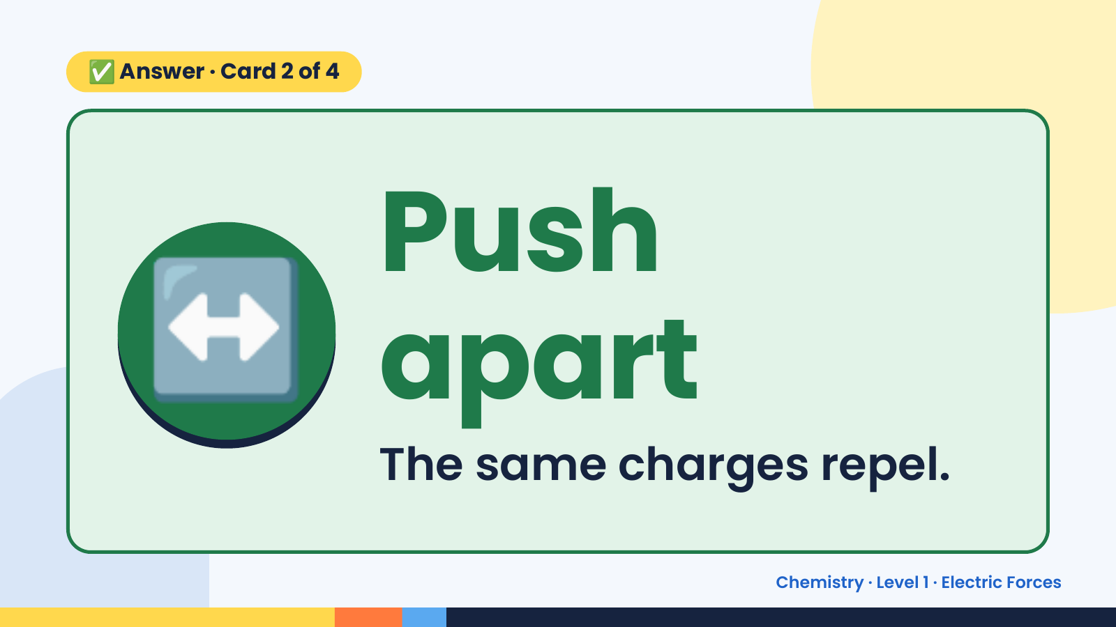
Notes:
✅ Answer · Card 2 of 4
↔️ Push
apart
The same charges repel.
Chemistry · Level 1 · Electric Forces

Slide 9
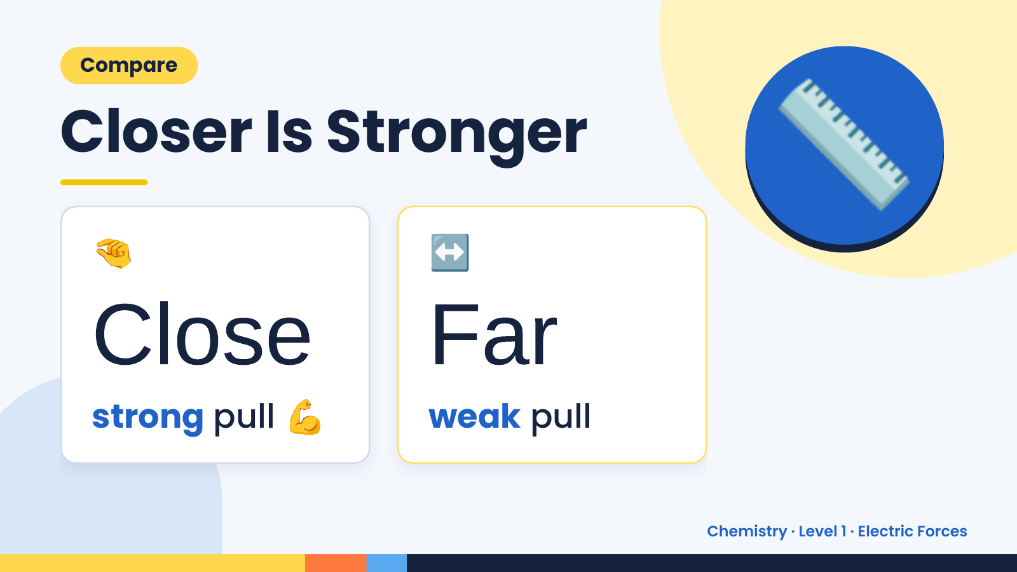
Notes:
Compare
Closer Is Stronger
🤏 ↔️
📏
Close💪 Far
strong pull weak pull
Chemistry · Level 1 · Electric Forces

Slide 10
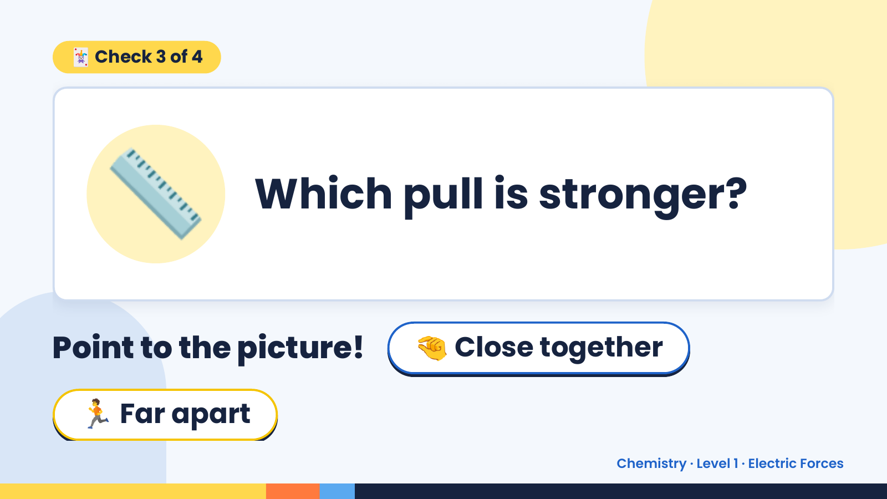
Notes:
🃏 Check 3 of 4
📏 Which pull is stronger?
Point to the picture! 🤏 Close together
🏃 Far apart
Chemistry · Level 1 · Electric Forces

Slide 11
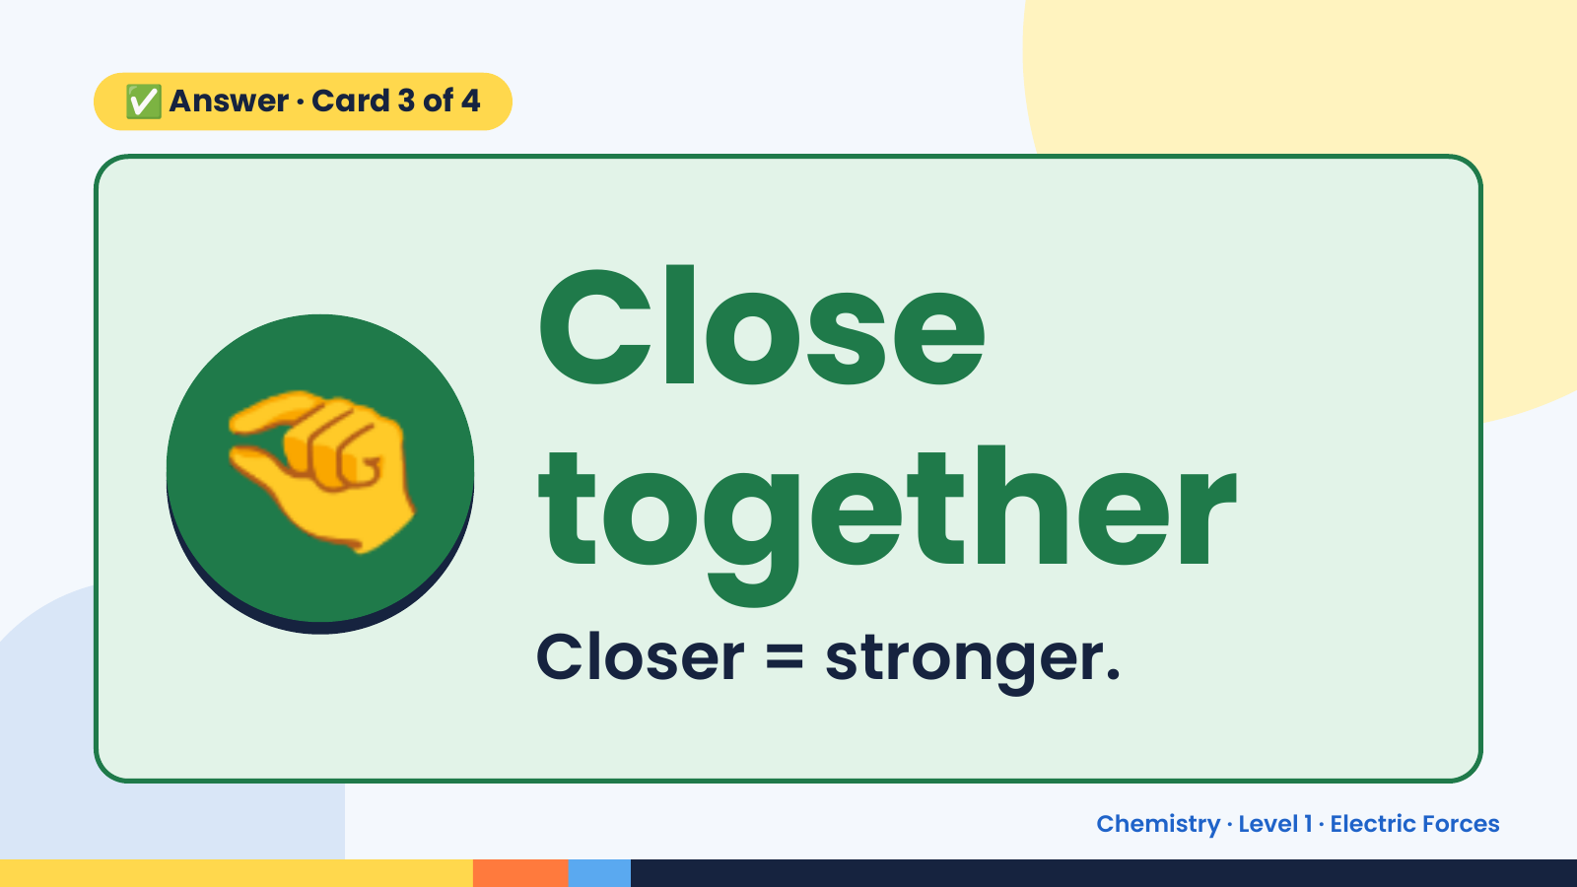
Notes:
✅ Answer · Card 3 of 4
🤏 Close
together
Closer = stronger.
Chemistry · Level 1 · Electric Forces

Slide 12
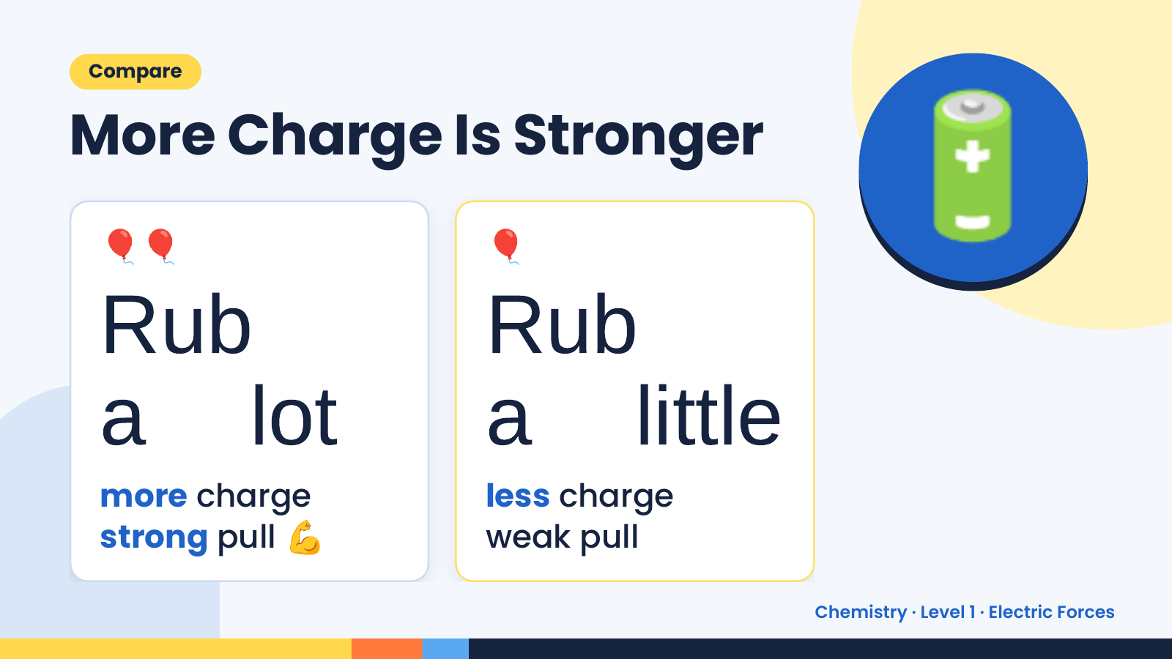
Notes:
Compare
More Charge Is Stronger
🎈🎈
Rub
🎈
Rub
🔋
a lot a little
💪
more charge less charge
strong pull weak pull
Chemistry · Level 1 · Electric Forces

Slide 13
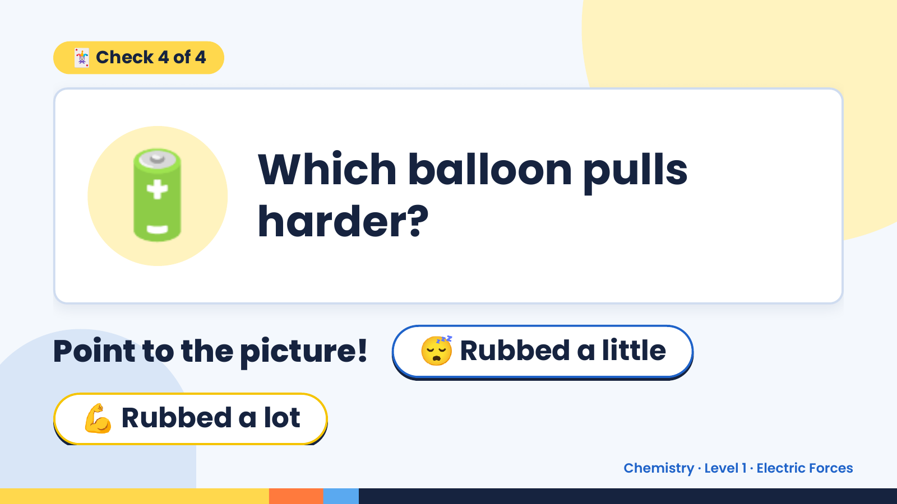
Notes:
🃏 Check 4 of 4
🔋 Which balloon pulls
harder?
Point to the picture! 😴 Rubbed a little
💪 Rubbed a lot
Chemistry · Level 1 · Electric Forces

Slide 14
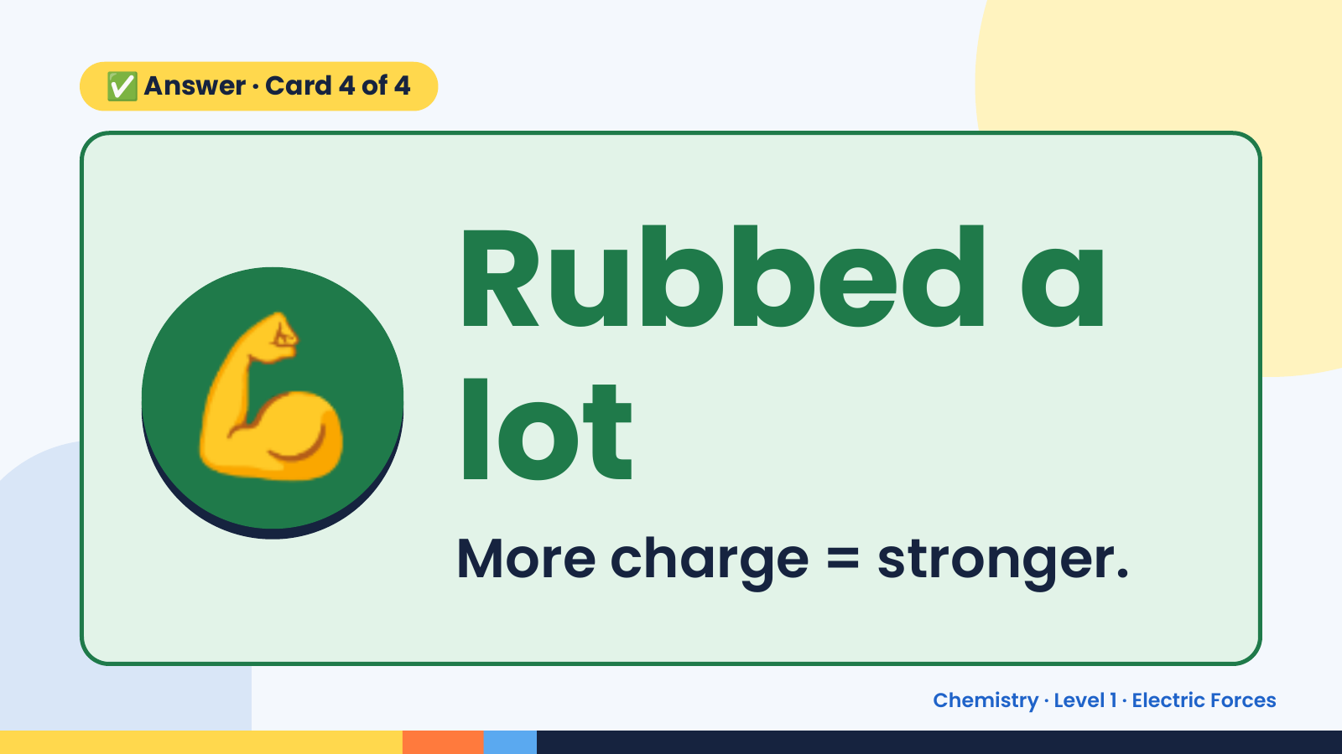
Notes:
✅ Answer · Card 4 of 4
💪 Rubbed a
lot
More charge = stronger.
Chemistry · Level 1 · Electric Forces

Slide 15
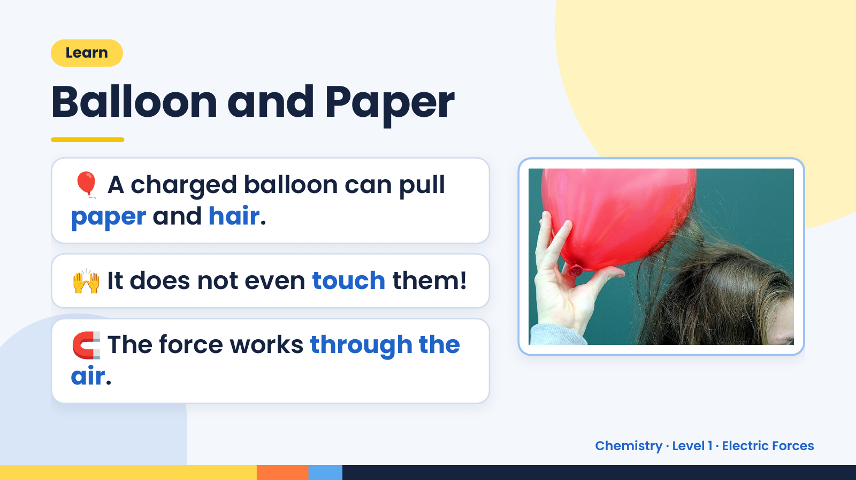
Notes:
Learn
Balloon and Paper
🎈 A charged balloon can pull
paper and hair.
🙌 It does not even touch them!
🧲 The force works through the
air.
Chemistry · Level 1 · Electric Forces

Slide 16
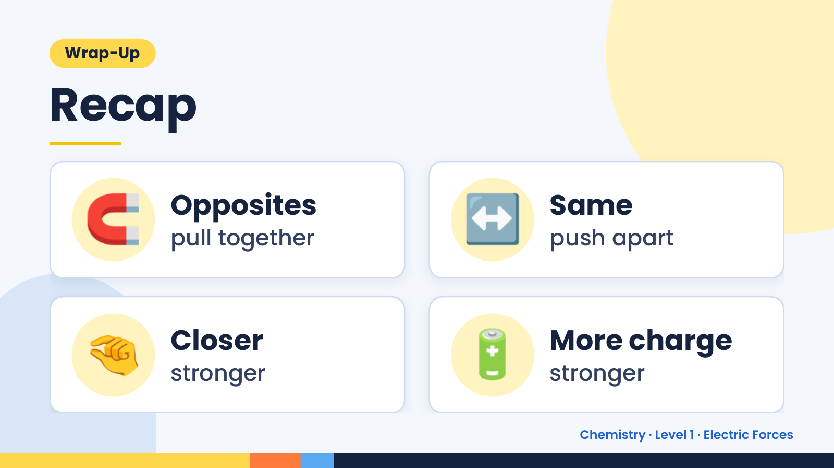
Notes:
Wrap-Up
Recap
🧲 Opposites
pull together ↔️ Same
push apart
🤏 Closer
stronger 🔋 More charge
stronger
Chemistry · Level 1 · Electric Forces

Slide 17
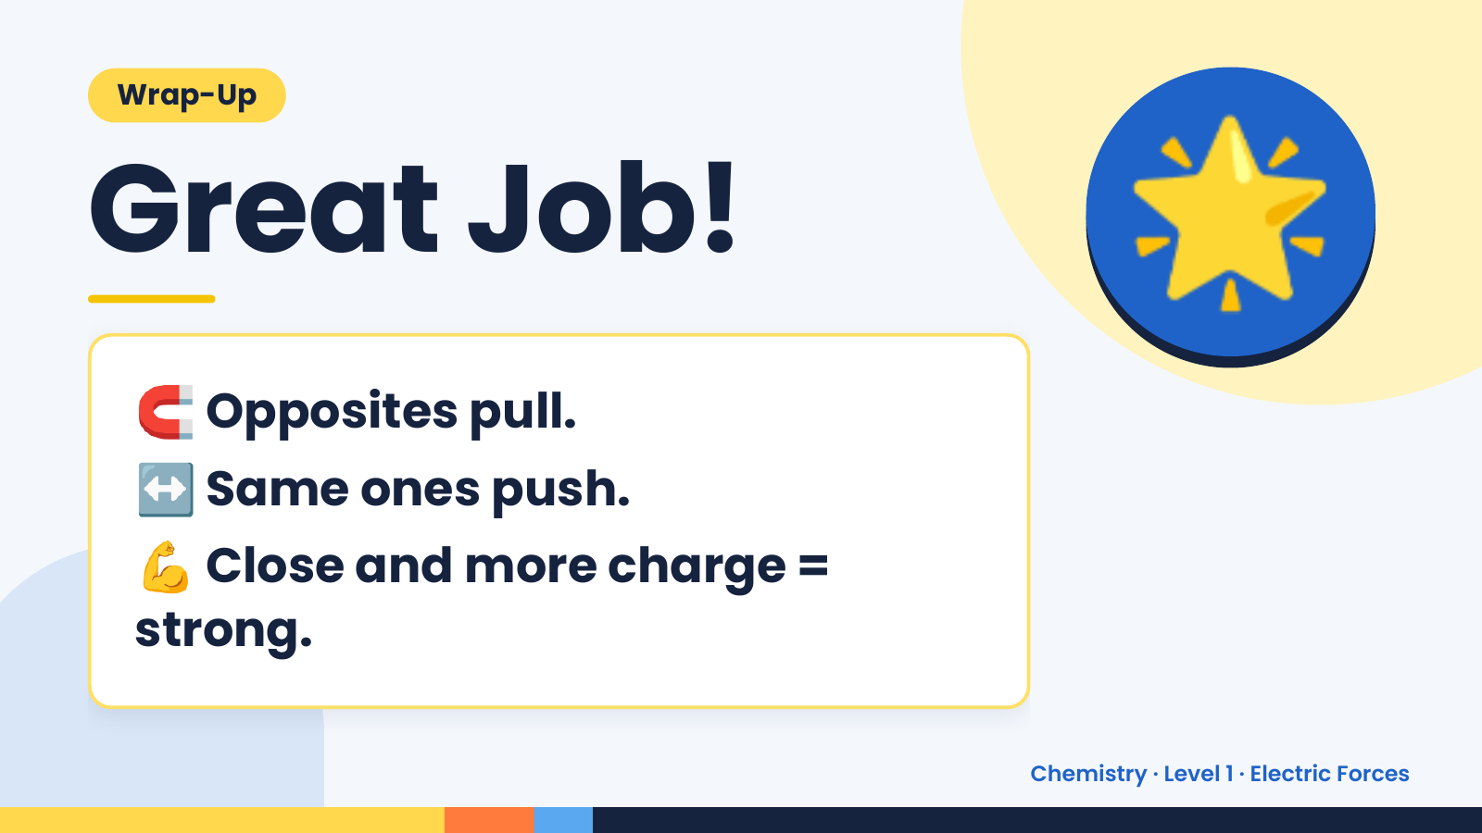
Notes:
Wrap-Up
Great Job!
🧲 Opposites pull.
🌟
↔️ Same ones push.
💪 Close and more charge =
strong.
Chemistry · Level 1 · Electric Forces

