Slide 1
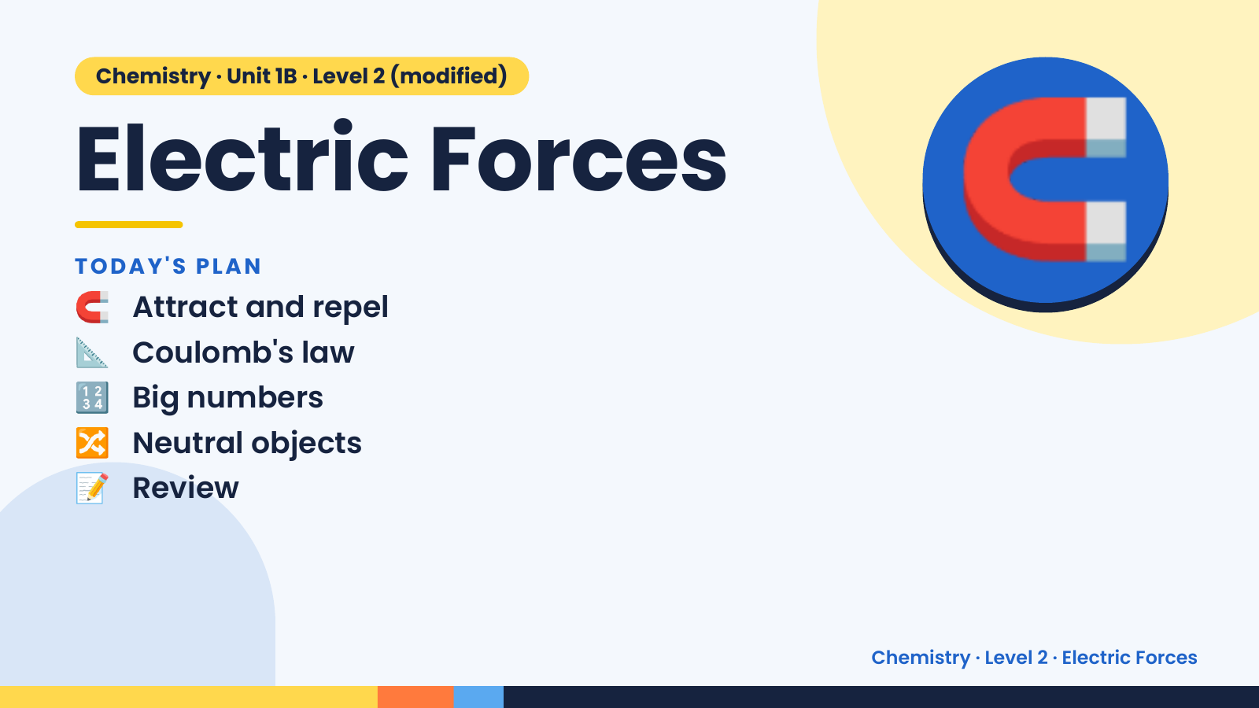
Notes:
Chemistry · Unit 1B · Level 2 (modified)
Electric Forces
🧲 Attract and repel
TODAY'S PLAN
📐 Coulomb's law
🔢 Big numbers
🧲
🔀 Neutral objects
📝 Review
Chemistry · Level 2 · Electric Forces

Slide 2
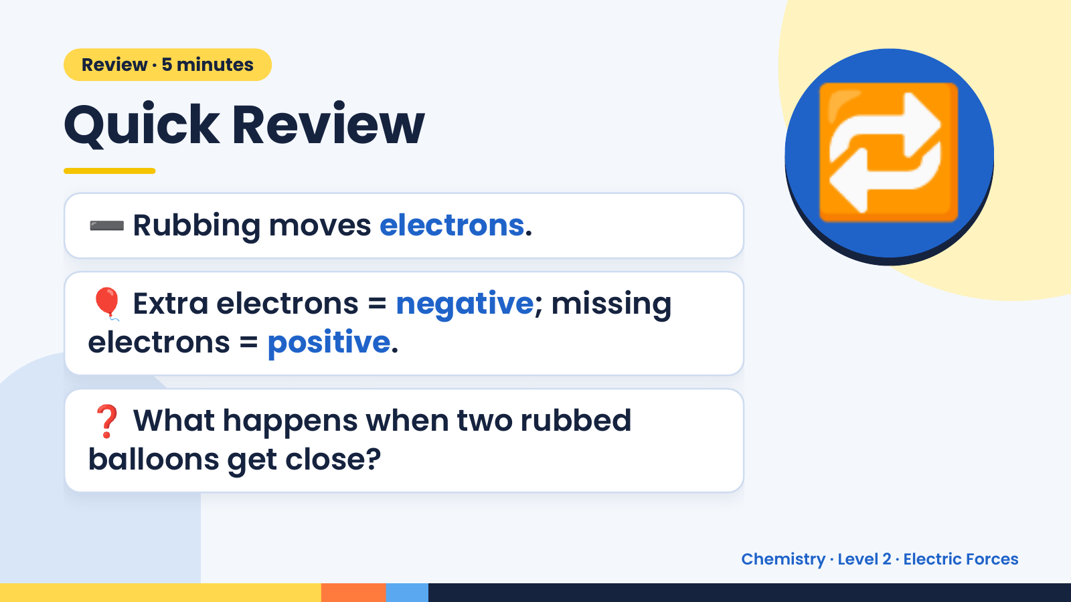
Notes:
Review · 5 minutes
Quick Review
➖ Rubbing moves electrons.
🎈 Extra electrons = negative; missing
🔁
electrons = positive.
❓ What happens when two rubbed
balloons get close?
Chemistry · Level 2 · Electric Forces

Slide 3
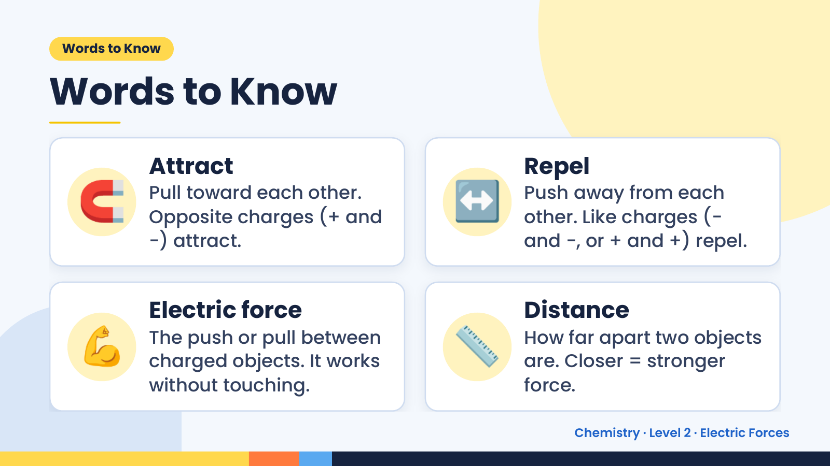
Notes:
Words to Know
Words to Know
🧲 Attract
Pull toward each other.
Opposite charges (+ and
−) attract.
↔️ Repel
Push away from each
other. Like charges (−
and −, or + and +) repel.
💪 Electric force
The push or pull between
charged objects. It works
without touching.
📏 Distance
How far apart two objects
are. Closer = stronger
force.
Chemistry · Level 2 · Electric Forces

Slide 4
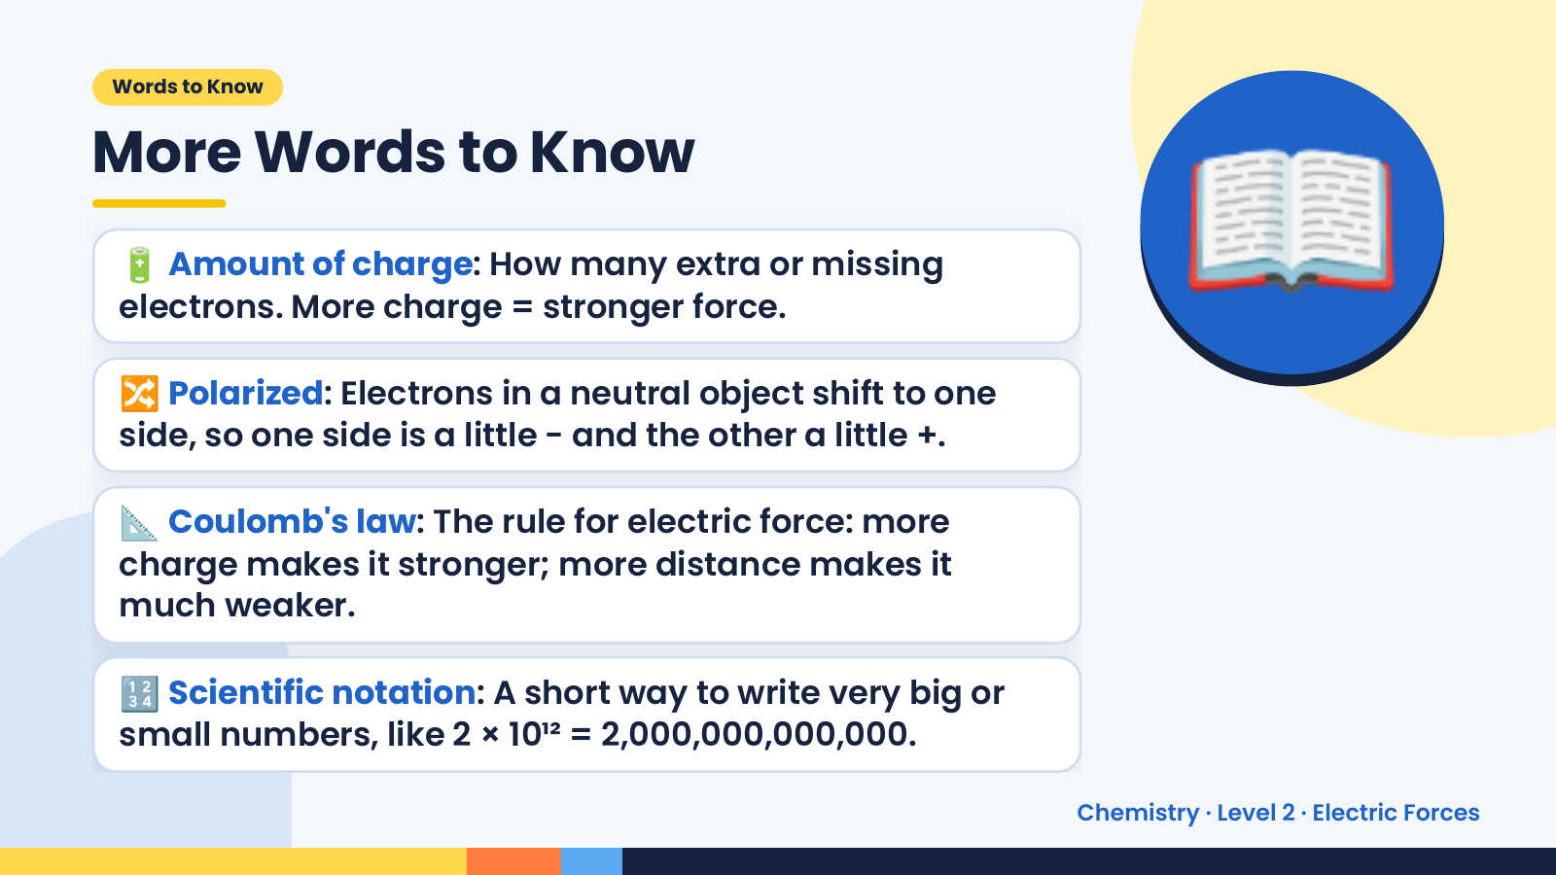
Notes:
Words to Know
More Words to Know
🔋 Amount of charge: How many extra or missing
electrons. More charge = stronger force.
🔀 Polarized: Electrons in a neutral object shift to one
side, so one side is a little − and the other a little +.
📖
📐 Coulomb's law: The rule for electric force: more
charge makes it stronger; more distance makes it
much weaker.
🔢 Scientific notation: A short way to write very big or
small numbers, like 2 × 10¹² = 2,000,000,000,000.
Chemistry · Level 2 · Electric Forces

Slide 5
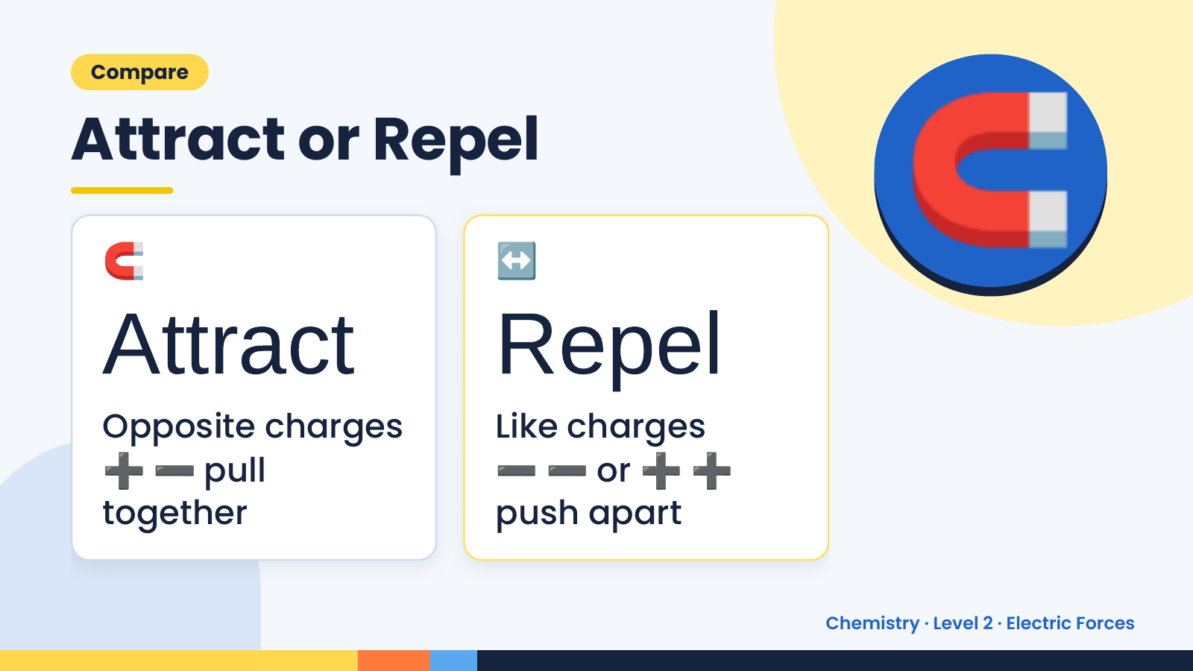
Notes:
Compare
Attract or Repel
🧲
Attract
↔️
Repel
🧲
➕➖ ➖➖ ➕➕
Opposite charges Like charges
pull or
together push apart
Chemistry · Level 2 · Electric Forces

Slide 6
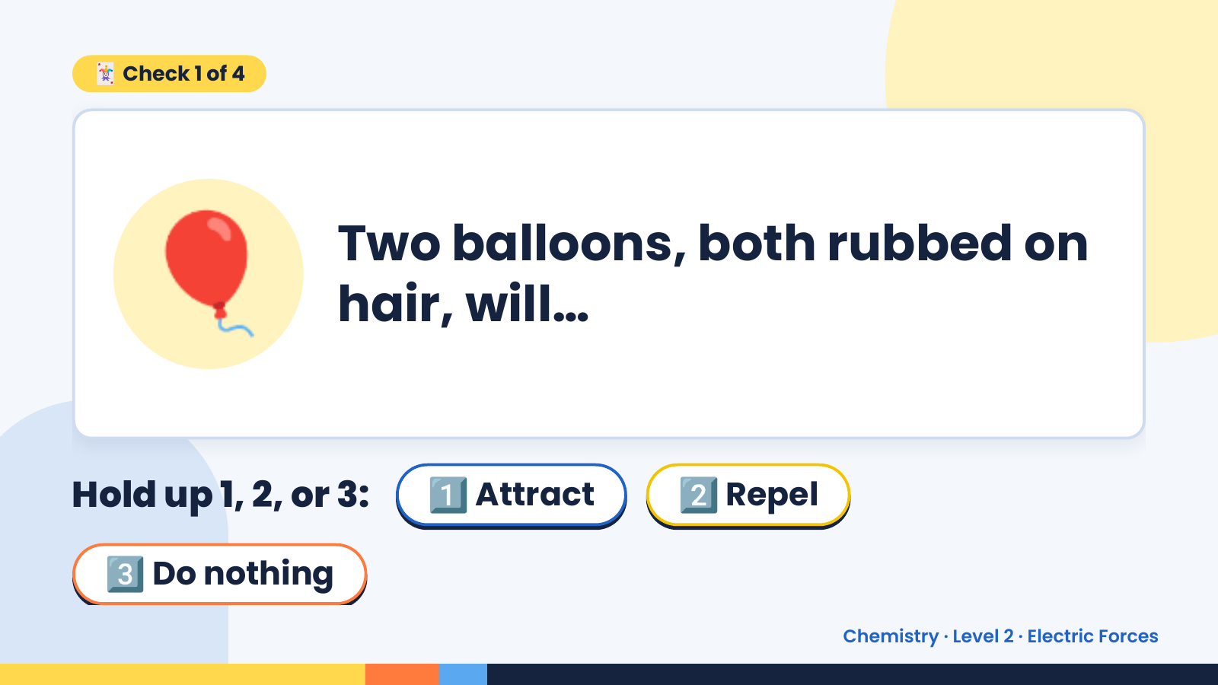
Notes:
🃏 Check 1 of 4
🎈 Two balloons, both rubbed on
hair, will…
Hold up 1, 2, or 3: 1️⃣ Attract 2️⃣ Repel
3️⃣ Do nothing
Chemistry · Level 2 · Electric Forces

Slide 7
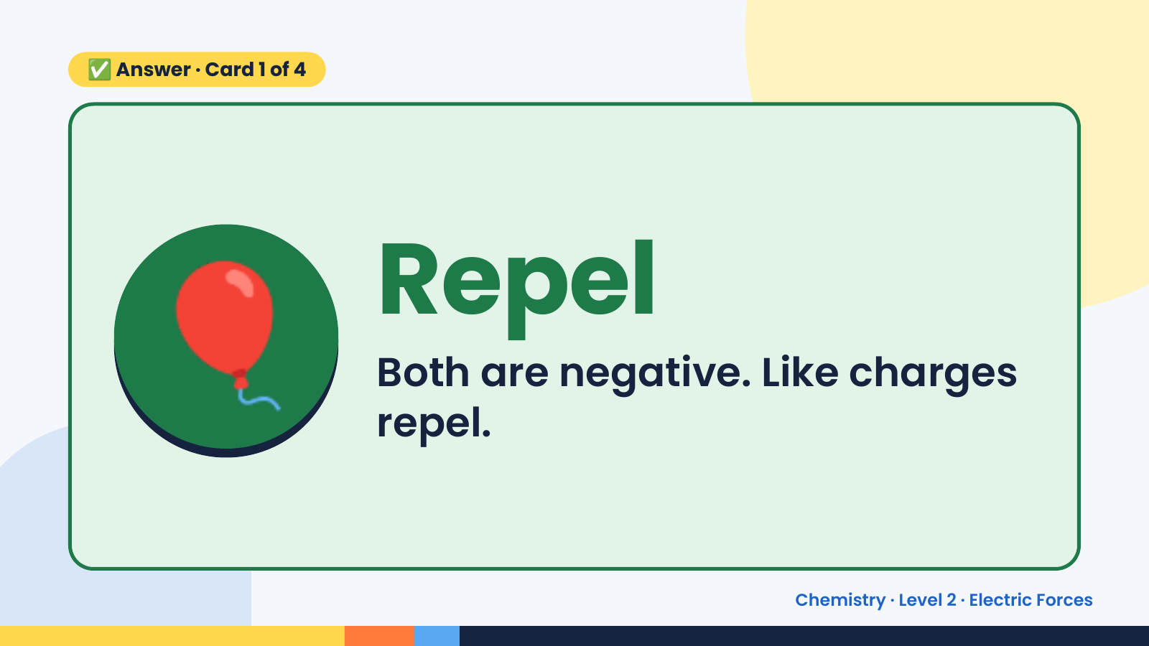
Notes:
✅ Answer · Card 1 of 4
🎈 Repel
Both are negative. Like charges
repel.
Chemistry · Level 2 · Electric Forces

Slide 8
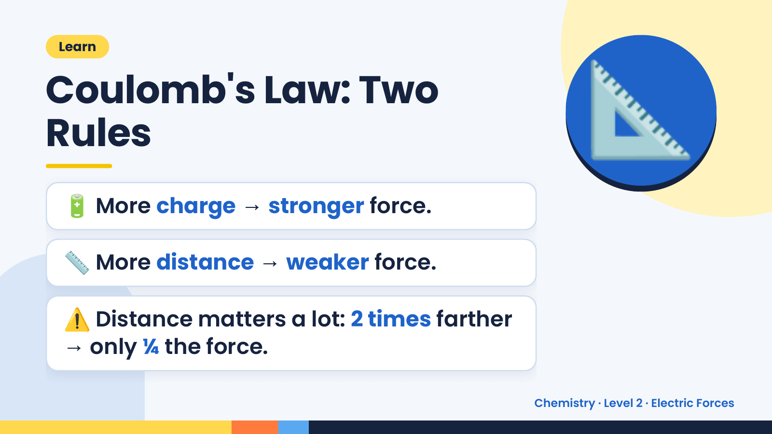
Notes:
Learn
Coulomb's Law: Two
Rules
🔋 More charge → stronger force.
📐
📏 More distance → weaker force.
⚠️ Distance matters a lot: 2 times farther
→ only ¼ the force.
Chemistry · Level 2 · Electric Forces

Slide 9
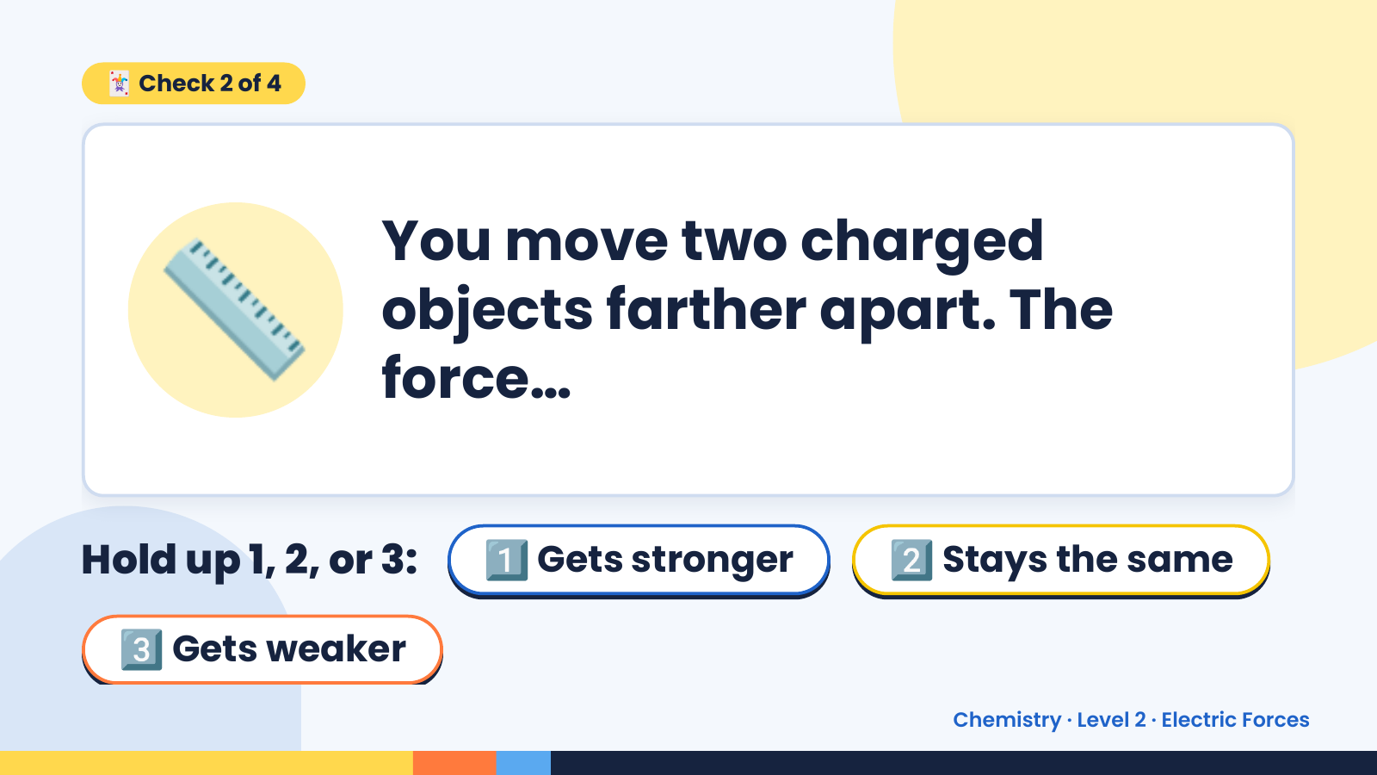
Notes:
🃏 Check 2 of 4
📏 You move two charged
objects farther apart. The
force…
Hold up 1, 2, or 3: 1️⃣ Gets stronger 2️⃣ Stays the same
3️⃣ Gets weaker
Chemistry · Level 2 · Electric Forces

Slide 10
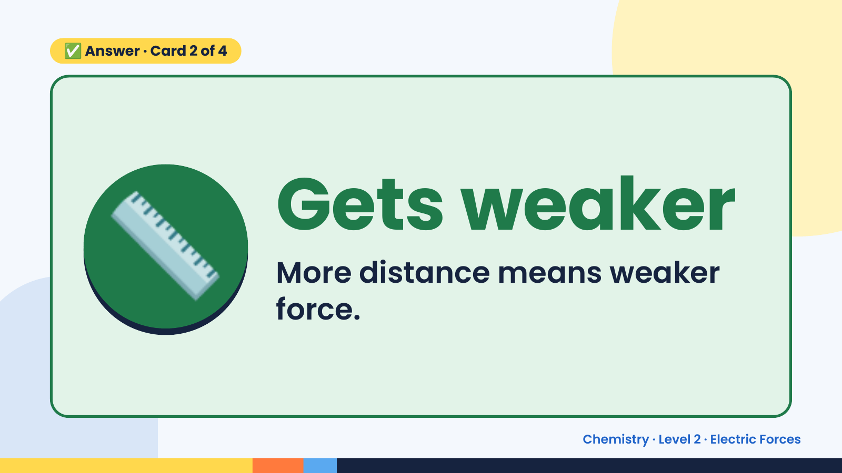
Notes:
✅ Answer · Card 2 of 4
📏 Gets weaker
More distance means weaker
force.
Chemistry · Level 2 · Electric Forces

Slide 11
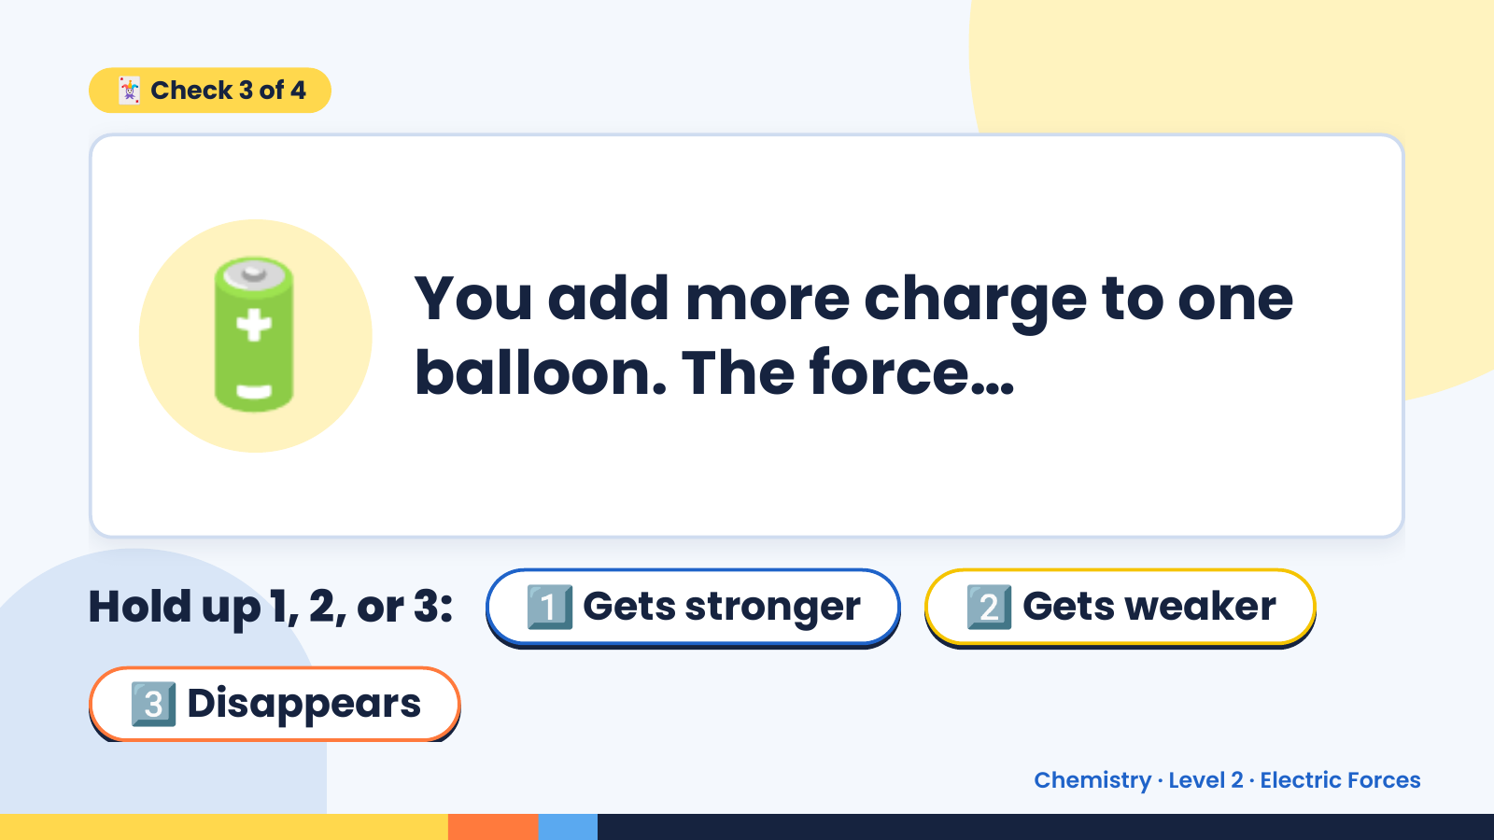
Notes:
🃏 Check 3 of 4
🔋 You add more charge to one
balloon. The force…
Hold up 1, 2, or 3: 1️⃣ Gets stronger 2️⃣ Gets weaker
3️⃣ Disappears
Chemistry · Level 2 · Electric Forces

Slide 12
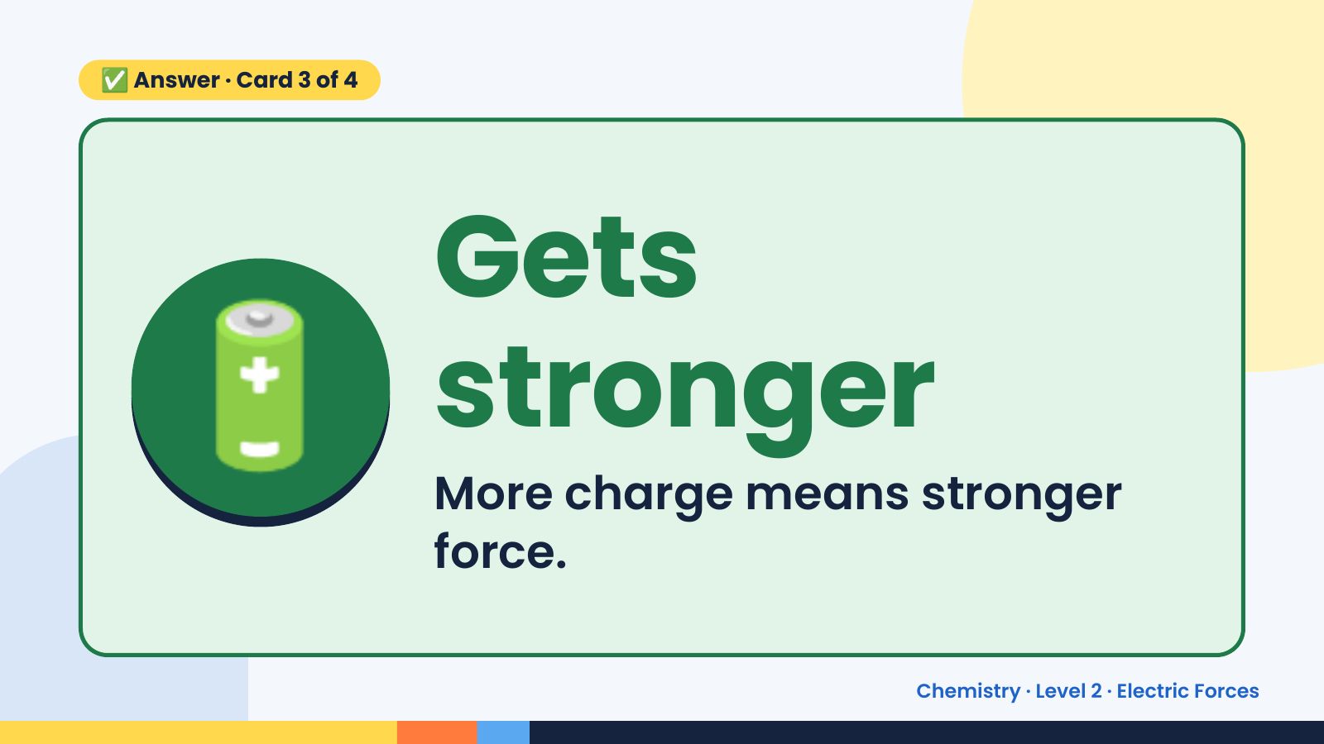
Notes:
✅ Answer · Card 3 of 4
🔋 Gets
stronger
More charge means stronger
force.
Chemistry · Level 2 · Electric Forces

Slide 13
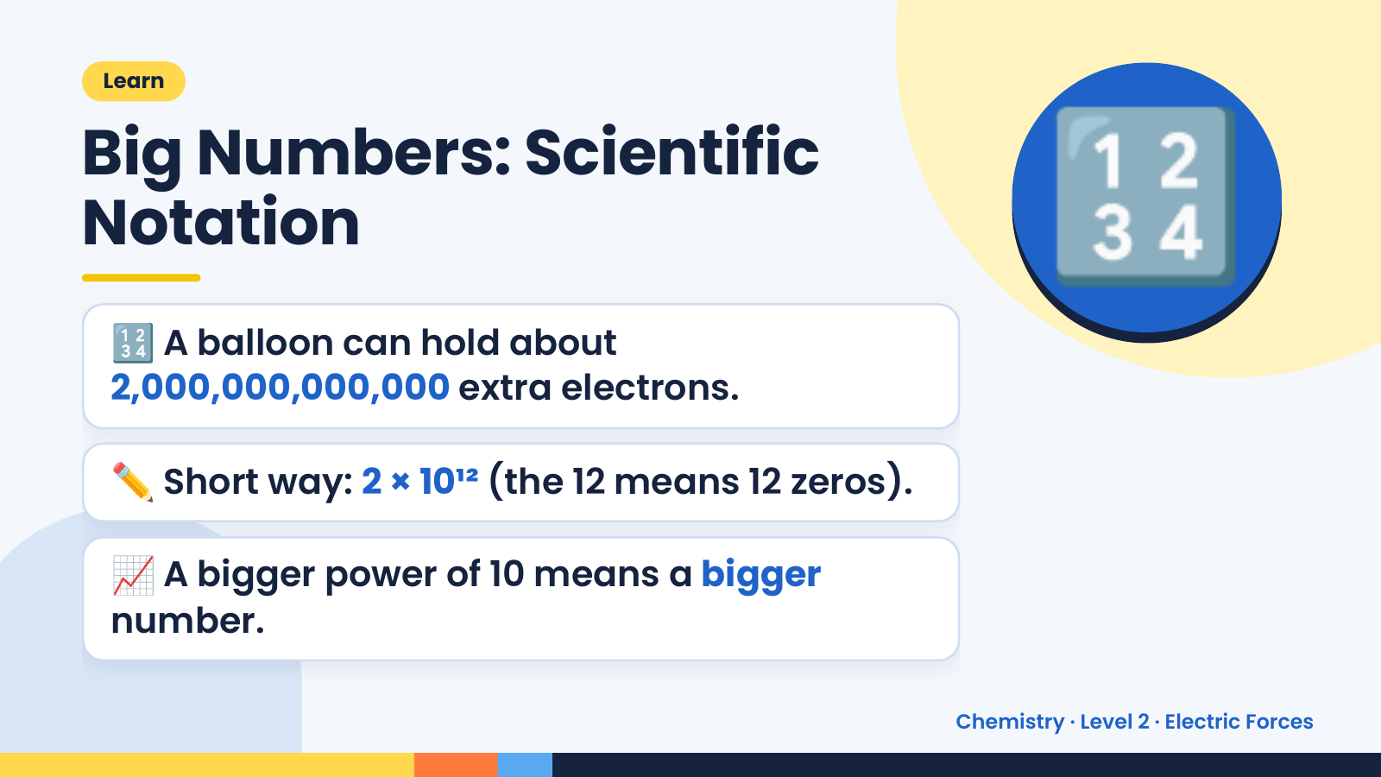
Notes:
Learn
Big Numbers: Scientific
Notation
🔢 A balloon can hold about
2,000,000,000,000 extra electrons.
🔢
✏️ Short way: 2 × 10¹² (the 12 means 12 zeros).
📈 A bigger power of 10 means a bigger
number.
Chemistry · Level 2 · Electric Forces

Slide 14
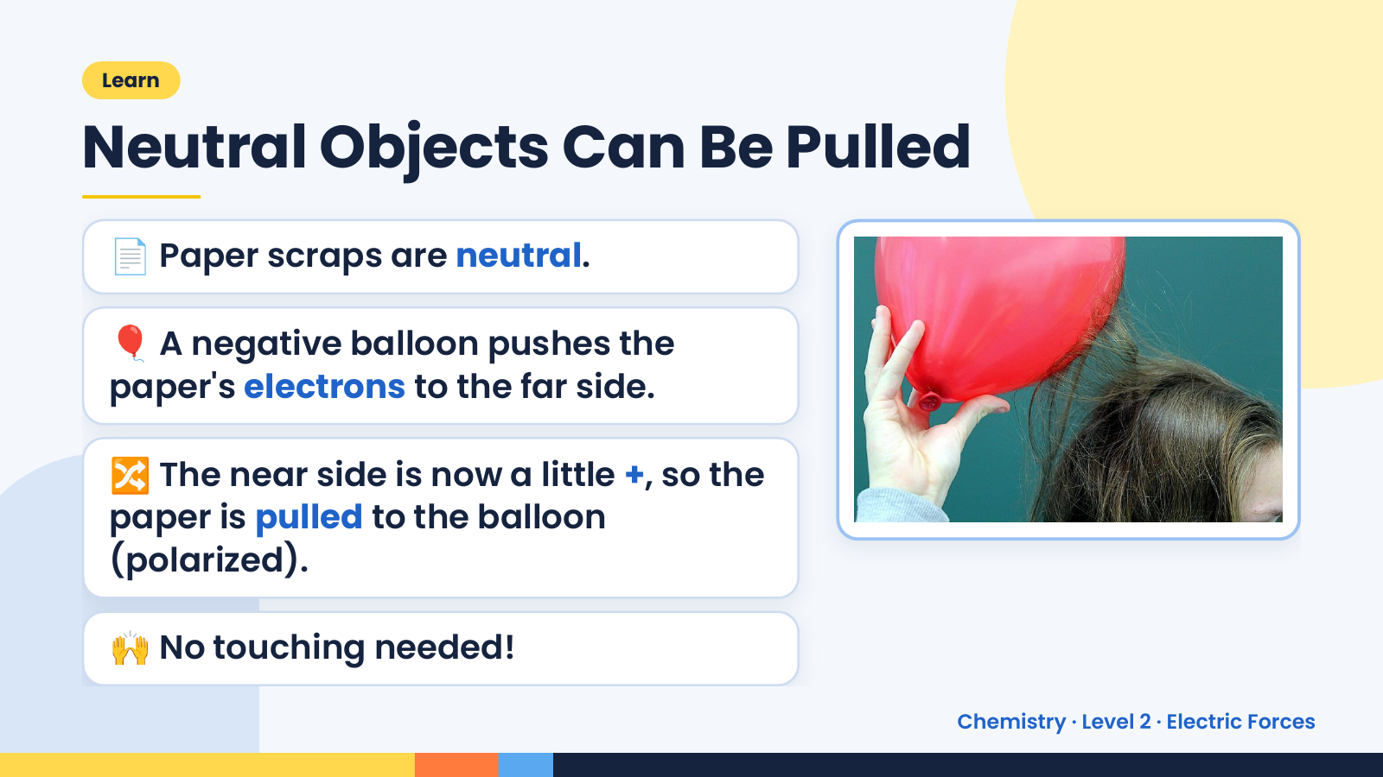
Notes:
Learn
Neutral Objects Can Be Pulled
📄 Paper scraps are neutral.
🎈 A negative balloon pushes the
paper's electrons to the far side.
🔀 The near side is now a little +, so the
paper is pulled to the balloon
(polarized).
🙌 No touching needed!
Chemistry · Level 2 · Electric Forces

Slide 15
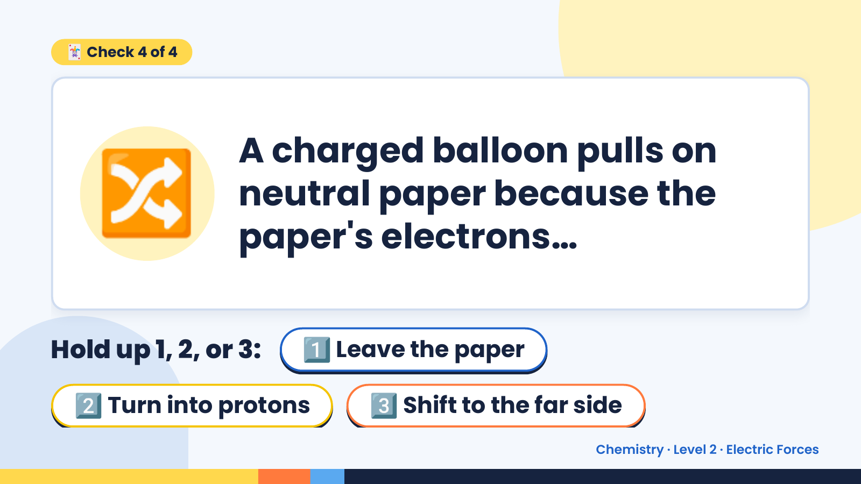
Notes:
🃏 Check 4 of 4
🔀 A charged balloon pulls on
neutral paper because the
paper's electrons…
Hold up 1, 2, or 3: 1️⃣ Leave the paper
2️⃣ Turn into protons 3️⃣ Shift to the far side
Chemistry · Level 2 · Electric Forces

Slide 16
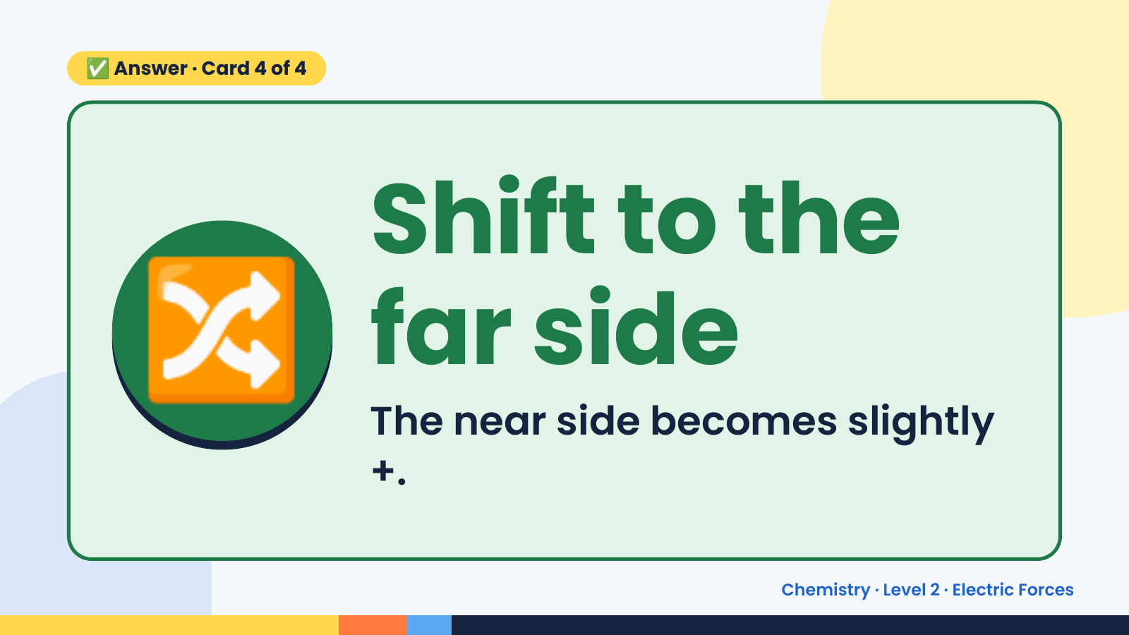
Notes:
✅ Answer · Card 4 of 4
🔀 Shift to the
far side
The near side becomes slightly
+.
Chemistry · Level 2 · Electric Forces

Slide 17
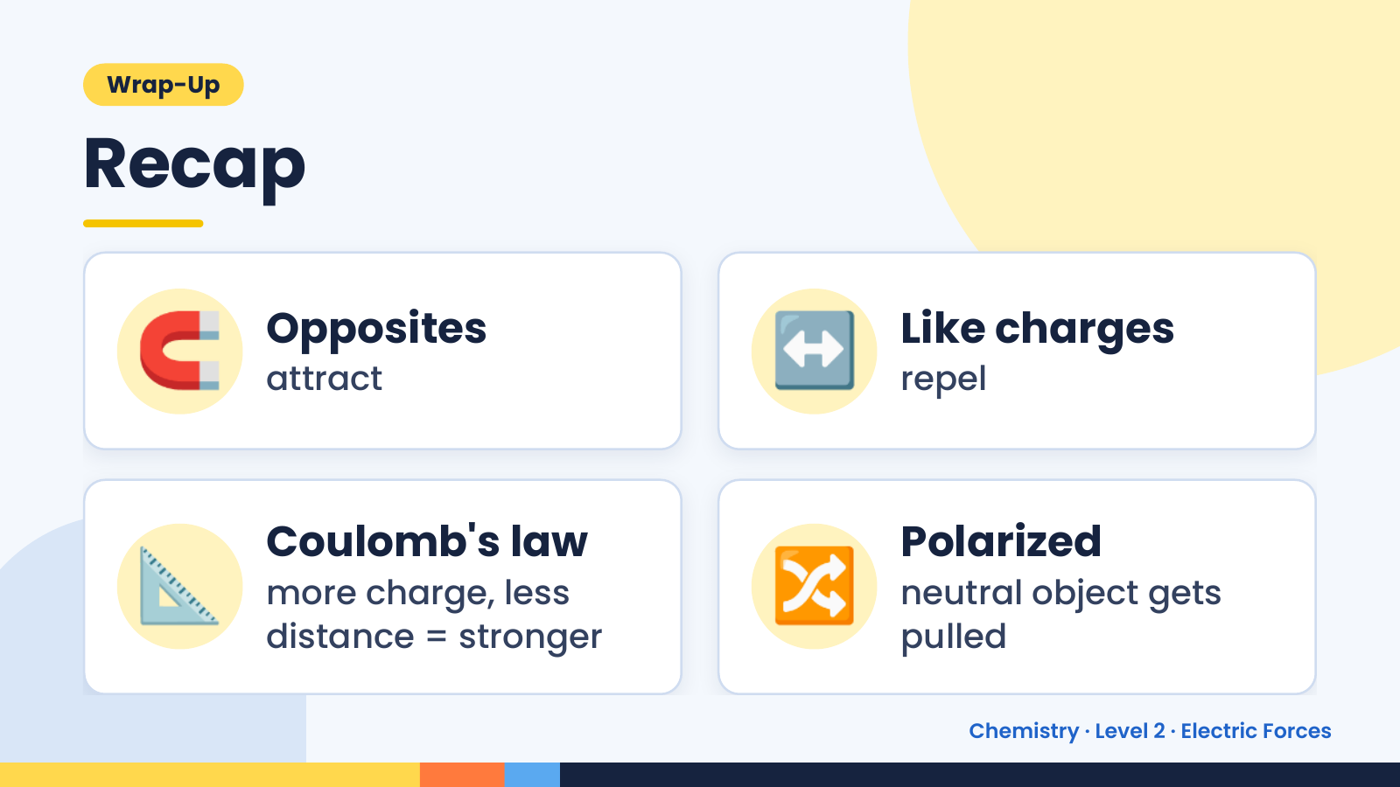
Notes:
Wrap-Up
Recap
🧲 Opposites
attract ↔️ Like charges
repel
📐 Coulomb's law
more charge, less
distance = stronger
🔀 Polarized
neutral object gets
pulled
Chemistry · Level 2 · Electric Forces

Slide 18
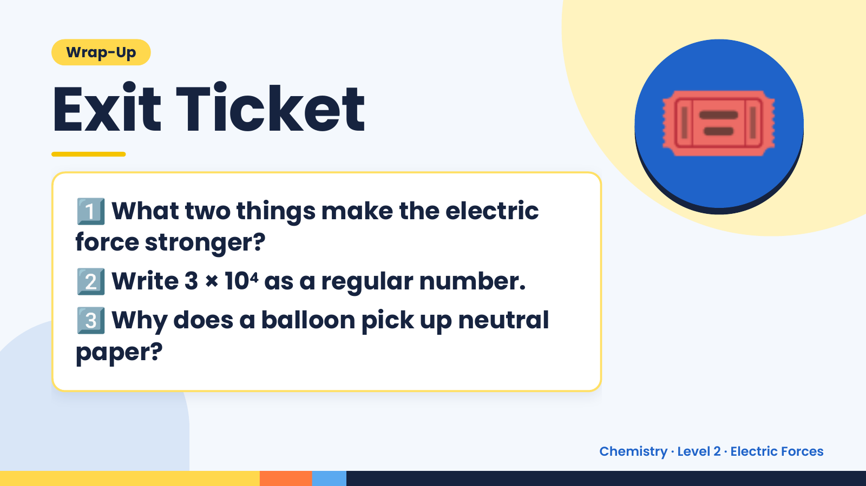
Notes:
Wrap-Up
Exit Ticket
1️⃣
What two things make the electric
force stronger?
🎟️
2️⃣Write 3 × 10⁴ as a regular number.
3️⃣
Why does a balloon pick up neutral
paper?
Chemistry · Level 2 · Electric Forces

