Slide 1
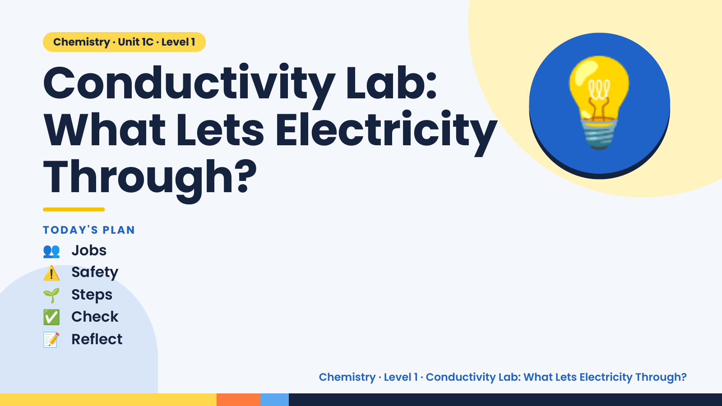
Notes:
Chemistry · Unit 1C · Level 1
Conductivity Lab:
What Lets Electricity
Through?
💡
👥 Jobs
TODAY'S PLAN
⚠️ Safety
🌱 Steps
✅ Check
📝 Reflect
Chemistry · Level 1 · Conductivity Lab: What Lets Electricity Through?

Slide 2
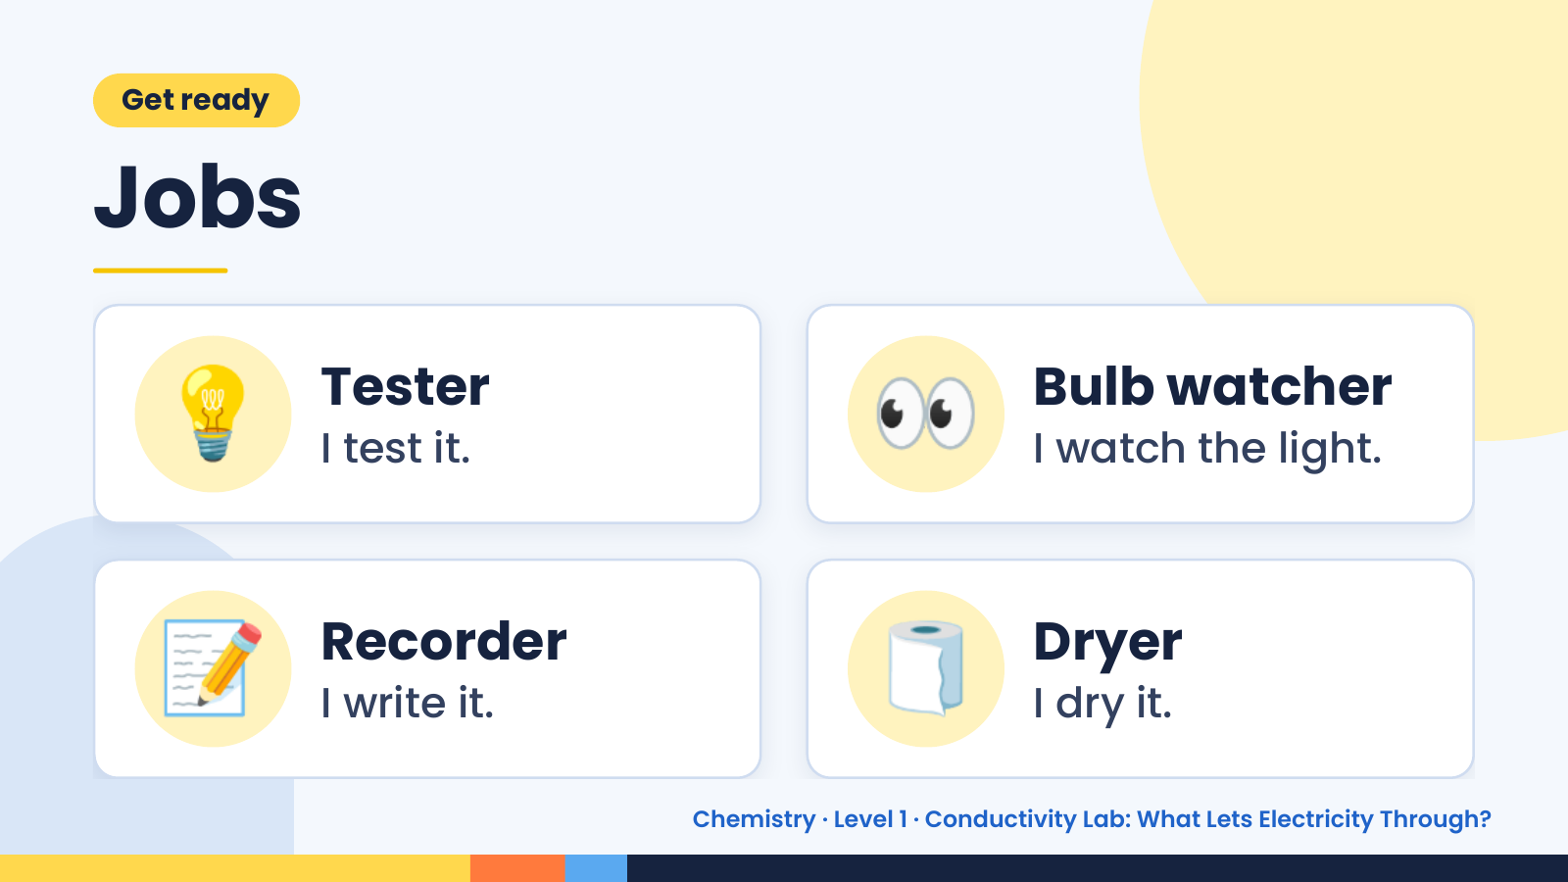
Notes:
Get ready
Jobs
💡 Tester
I test it. 👀 Bulb watcher
I watch the light.
📝 Recorder
I write it. 🧻 Dryer
I dry it.
Chemistry · Level 1 · Conductivity Lab: What Lets Electricity Through?

Slide 3
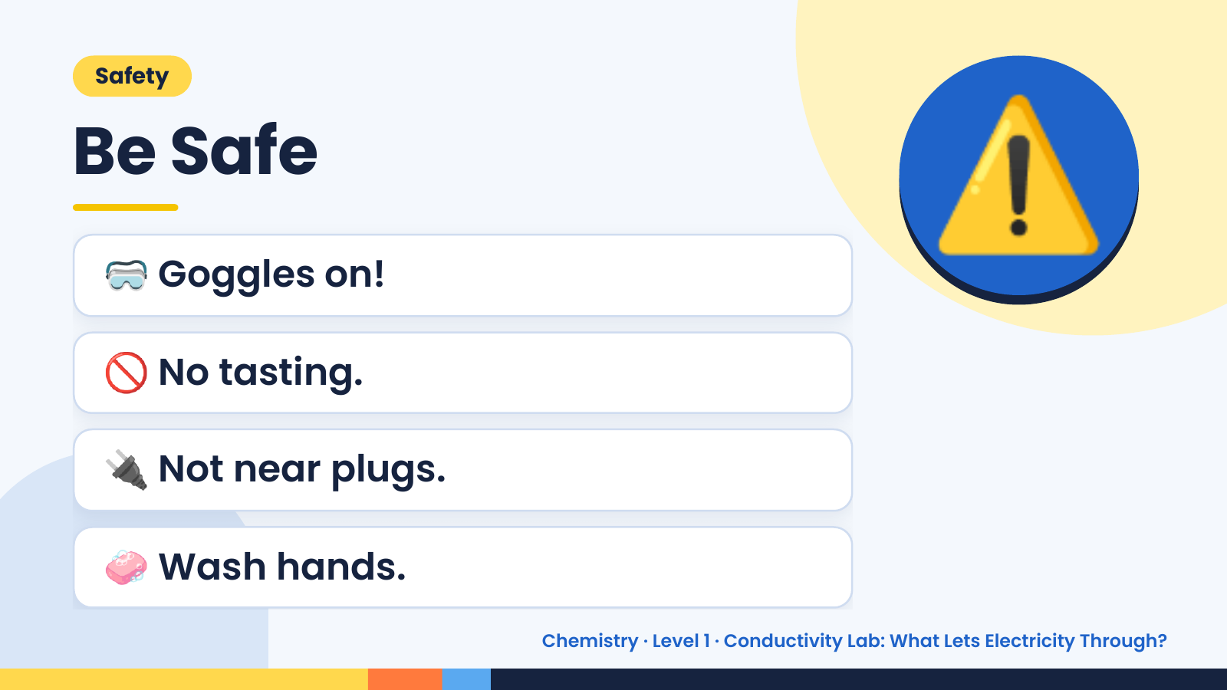
Notes:
Safety
Be Safe
🥽 Goggles on!
🚫 No tasting.
⚠️
🔌 Not near plugs.
🧼 Wash hands.
Chemistry · Level 1 · Conductivity Lab: What Lets Electricity Through?

Slide 4
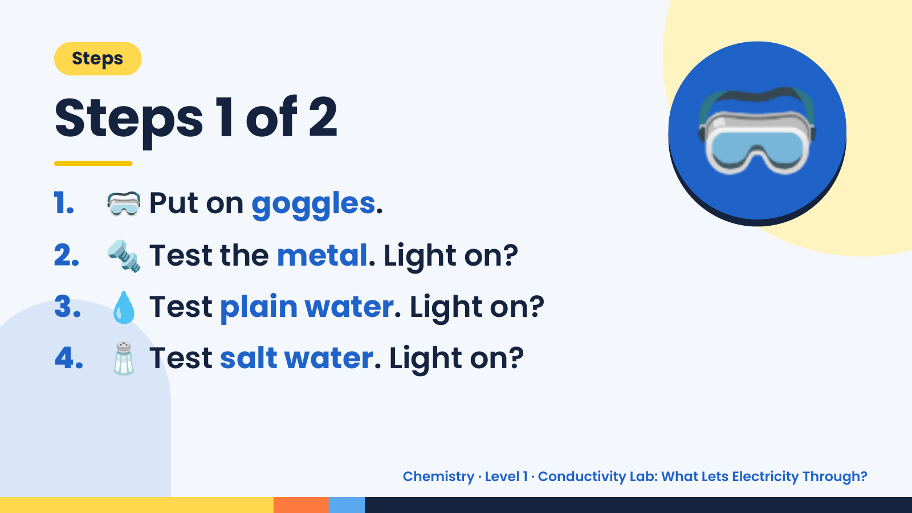
Notes:
Steps
Steps 1 of 2
1. 🥽 Put on goggles.
2. 🔩 Test the metal. Light on?
🥽
3. 💧 Test plain water. Light on?
4. 🧂 Test salt water. Light on?
Chemistry · Level 1 · Conductivity Lab: What Lets Electricity Through?

Slide 5
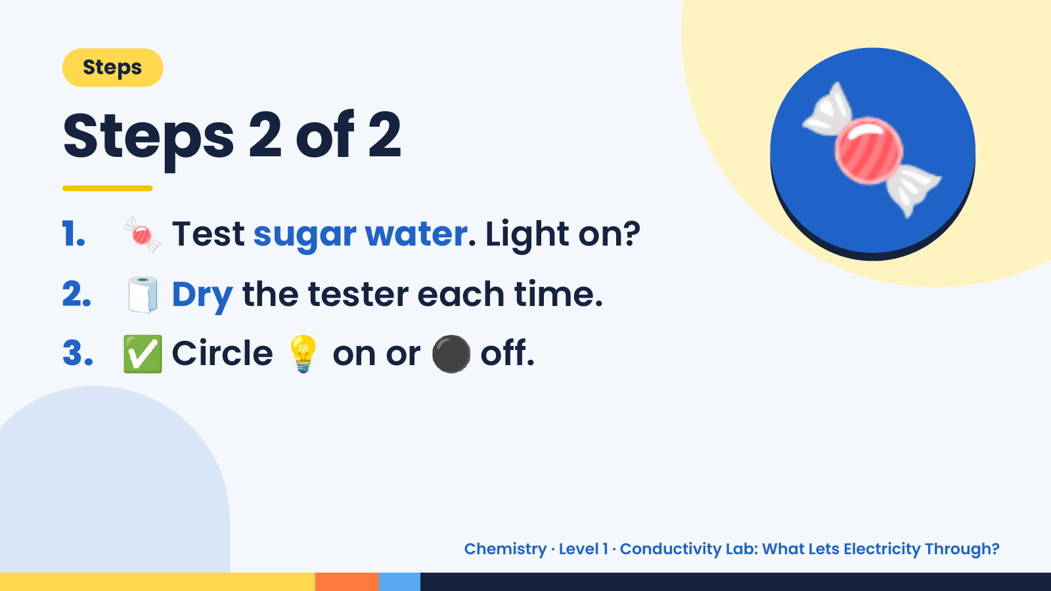
Notes:
Steps
Steps 2 of 2
1. 🍬 Test sugar water. Light on?
2. 🧻 Dry the tester each time.
🍬
3. ✅ Circle 💡 on or ⚫ off.
Chemistry · Level 1 · Conductivity Lab: What Lets Electricity Through?

Slide 6
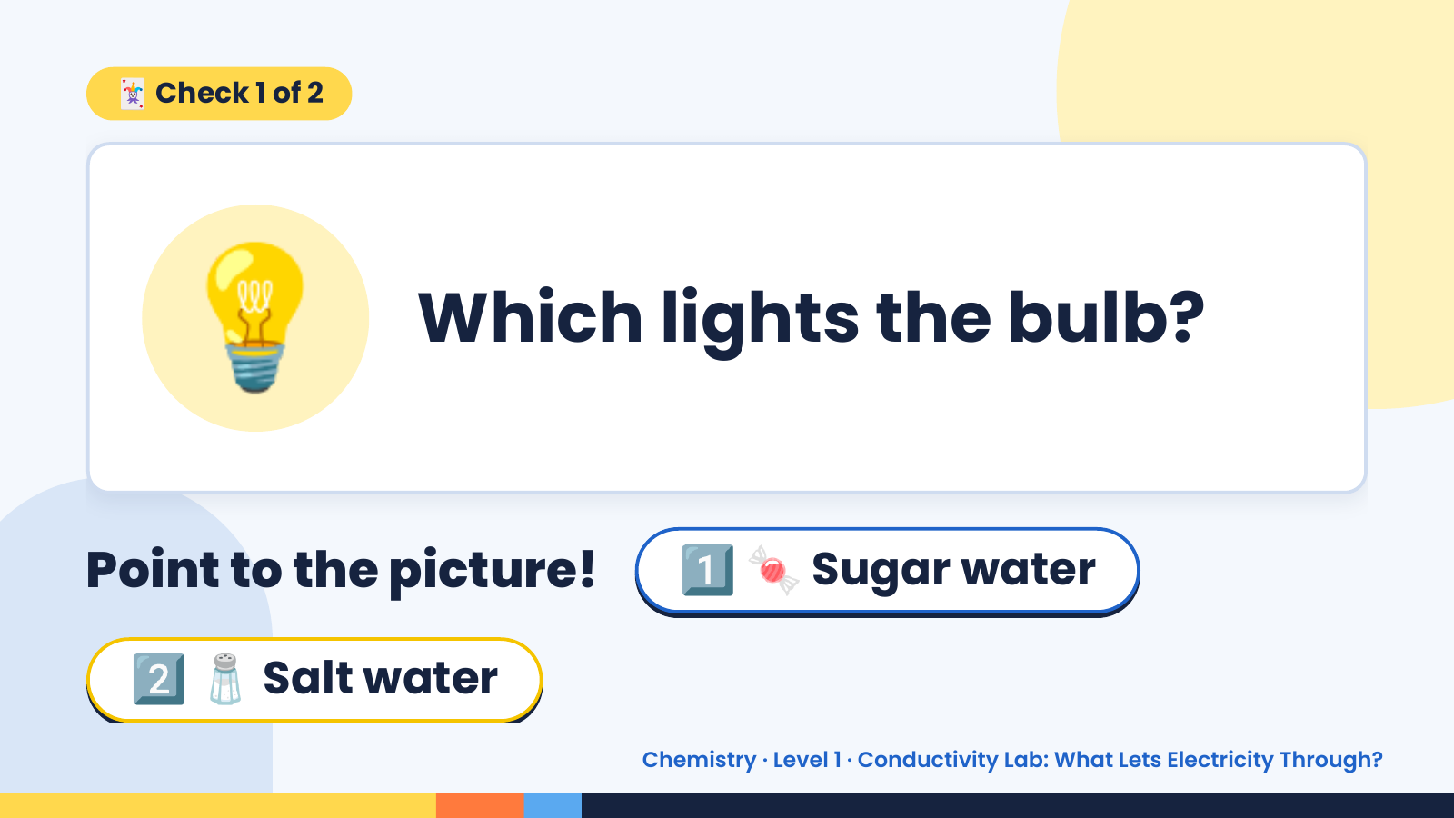
Notes:
🃏 Check 1 of 2
💡 Which lights the bulb?
Point to the picture! 1️⃣ 🍬 Sugar water
2️⃣ 🧂 Salt water
Chemistry · Level 1 · Conductivity Lab: What Lets Electricity Through?

Slide 7
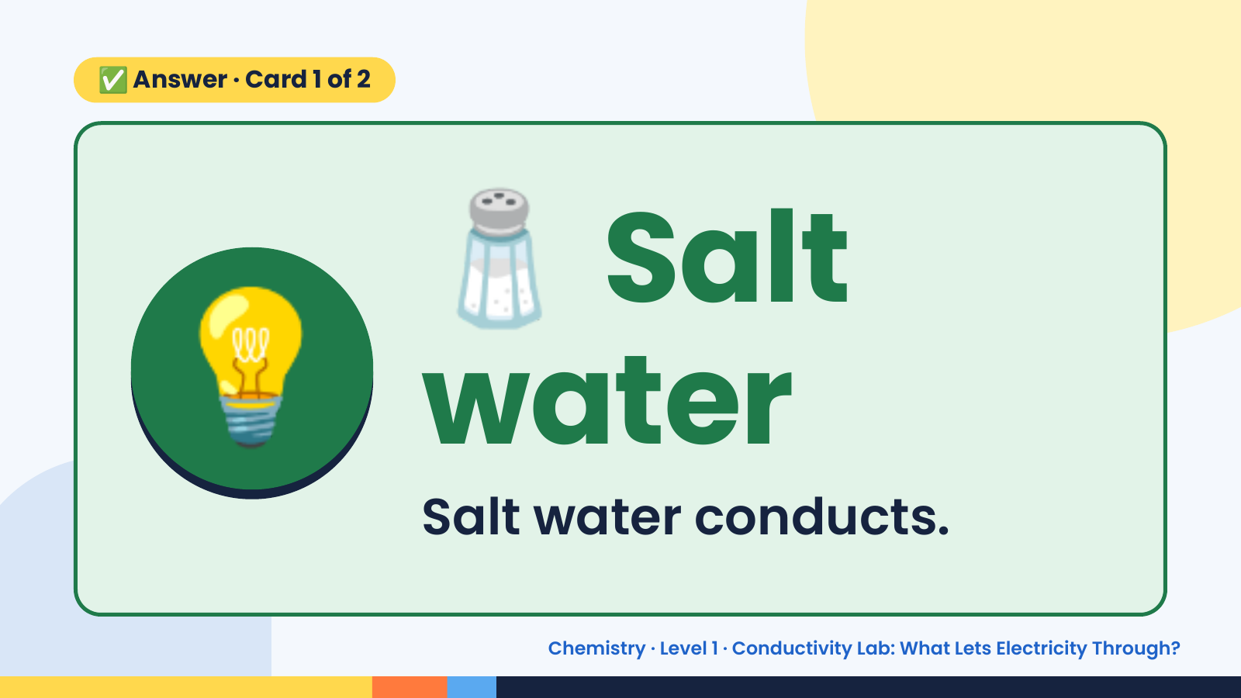
Notes:
🧂
✅ Answer · Card 1 of 2
💡 water
Salt
Salt water conducts.
Chemistry · Level 1 · Conductivity Lab: What Lets Electricity Through?

Slide 8
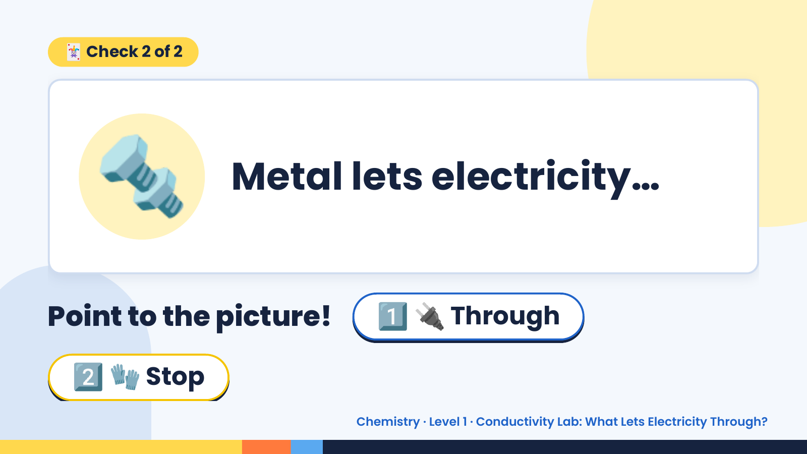
Notes:
🃏 Check 2 of 2
🔩 Metal lets electricity…
Point to the picture! 1️⃣ 🔌 Through
2️⃣ 🧤 Stop
Chemistry · Level 1 · Conductivity Lab: What Lets Electricity Through?

Slide 9
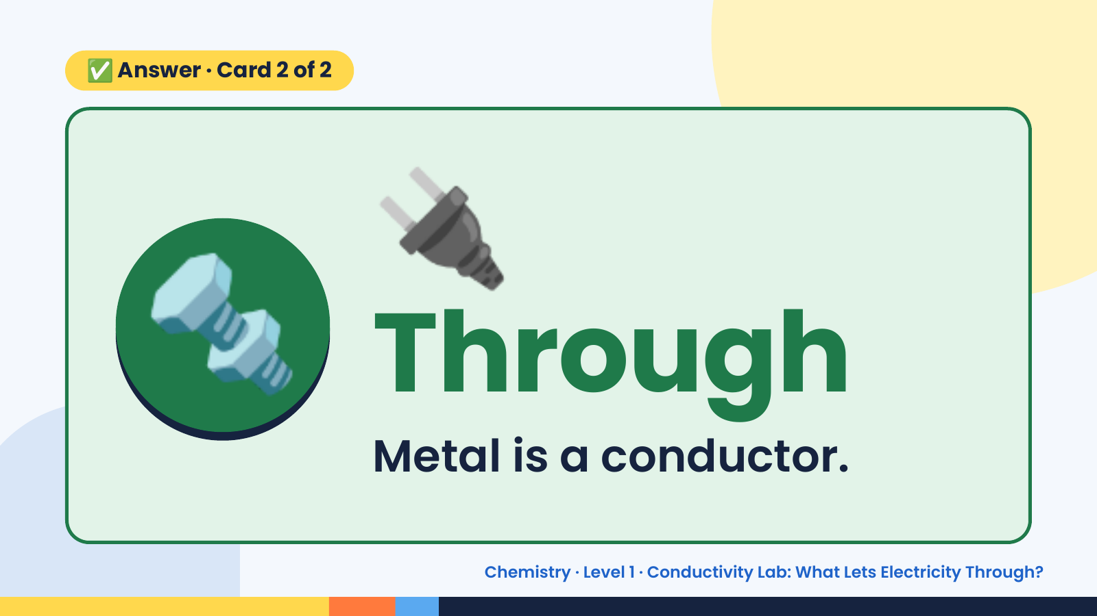
Notes:
🔌
✅ Answer · Card 2 of 2
🔩 Through Metal is a conductor.
Chemistry · Level 1 · Conductivity Lab: What Lets Electricity Through?

Slide 10
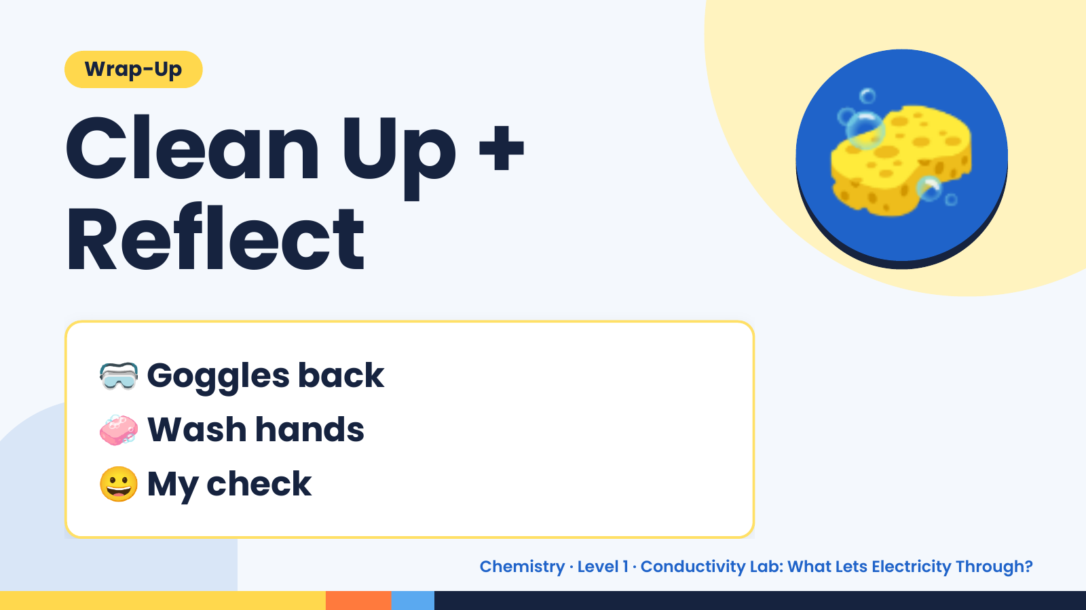
Notes:
Wrap-Up
Clean Up +
Reflect
🧽
🥽 Goggles back
🧼 Wash hands
😀 My check
Chemistry · Level 1 · Conductivity Lab: What Lets Electricity Through?

