Slide 1

Notes:
Chemistry · Unit 1C · Level 1
The Strike &
Staying Safe
🌩️
🌩️ Storm cloud
TODAY'S PLAN
⚡ The strike
🔌 Lets it through
🏠 Stay safe
Chemistry · Level 1 · The Strike & Staying Safe

Slide 2
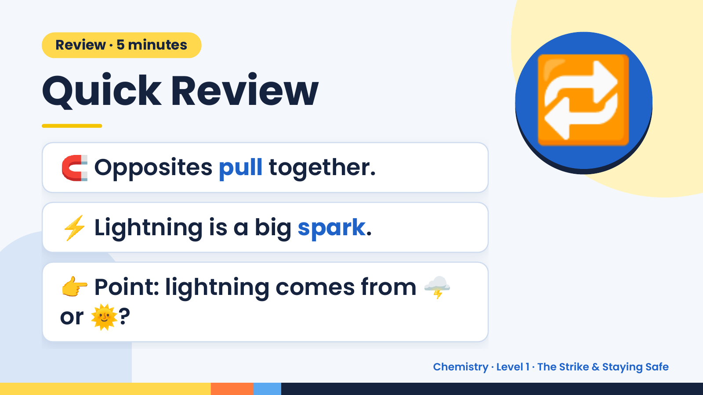
Notes:
Review · 5 minutes
Quick Review
🧲 Opposites pull together.
🔁
⚡ Lightning is a big spark.
👉 Point: lightning comes from 🌩️
or 🌞?
Chemistry · Level 1 · The Strike & Staying Safe

Slide 3
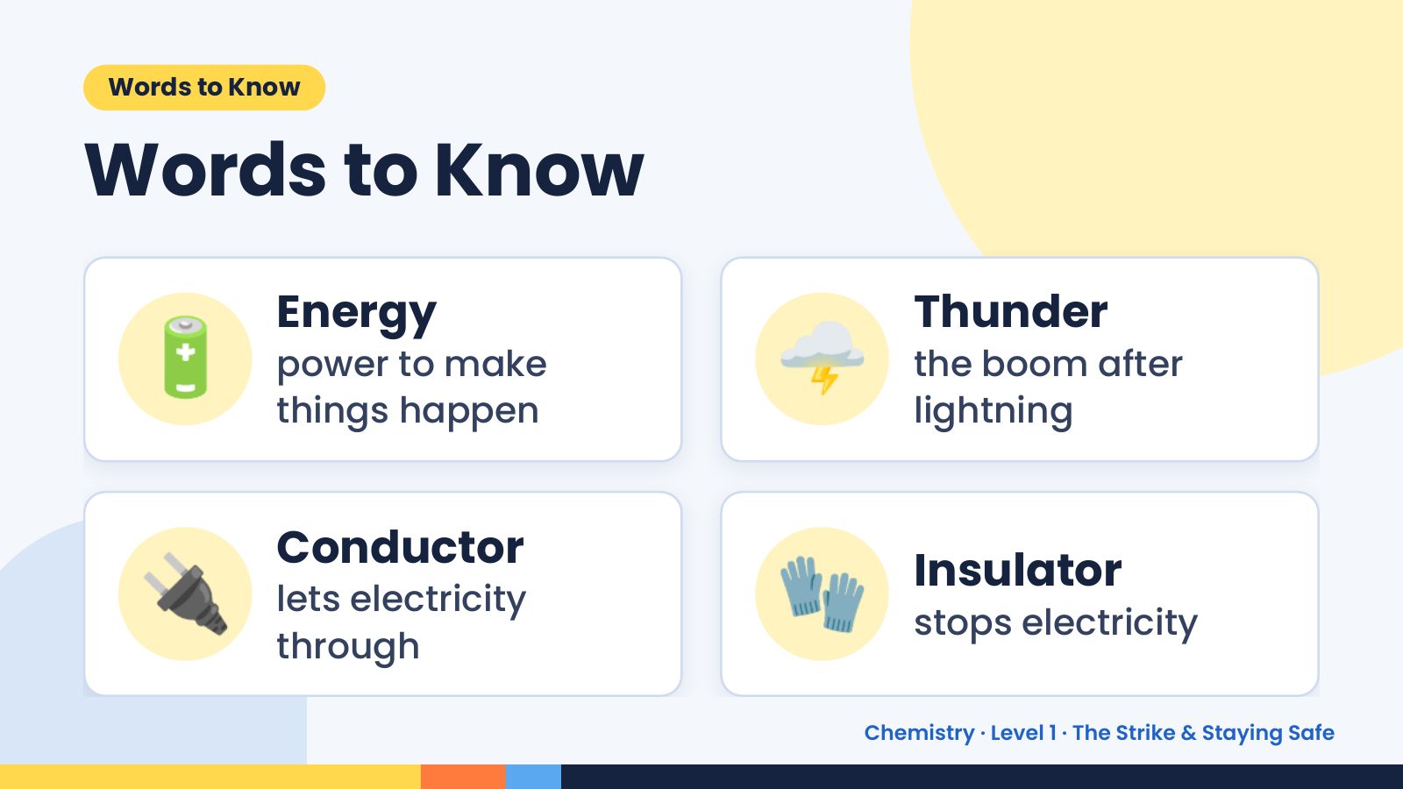
Notes:
Words to Know
Words to Know
🔋 Energy
power to make
things happen
🌩️ Thunder
the boom after
lightning
🔌 Conductor
lets electricity
through
🧤 Insulator
stops electricity
Chemistry · Level 1 · The Strike & Staying Safe

Slide 4
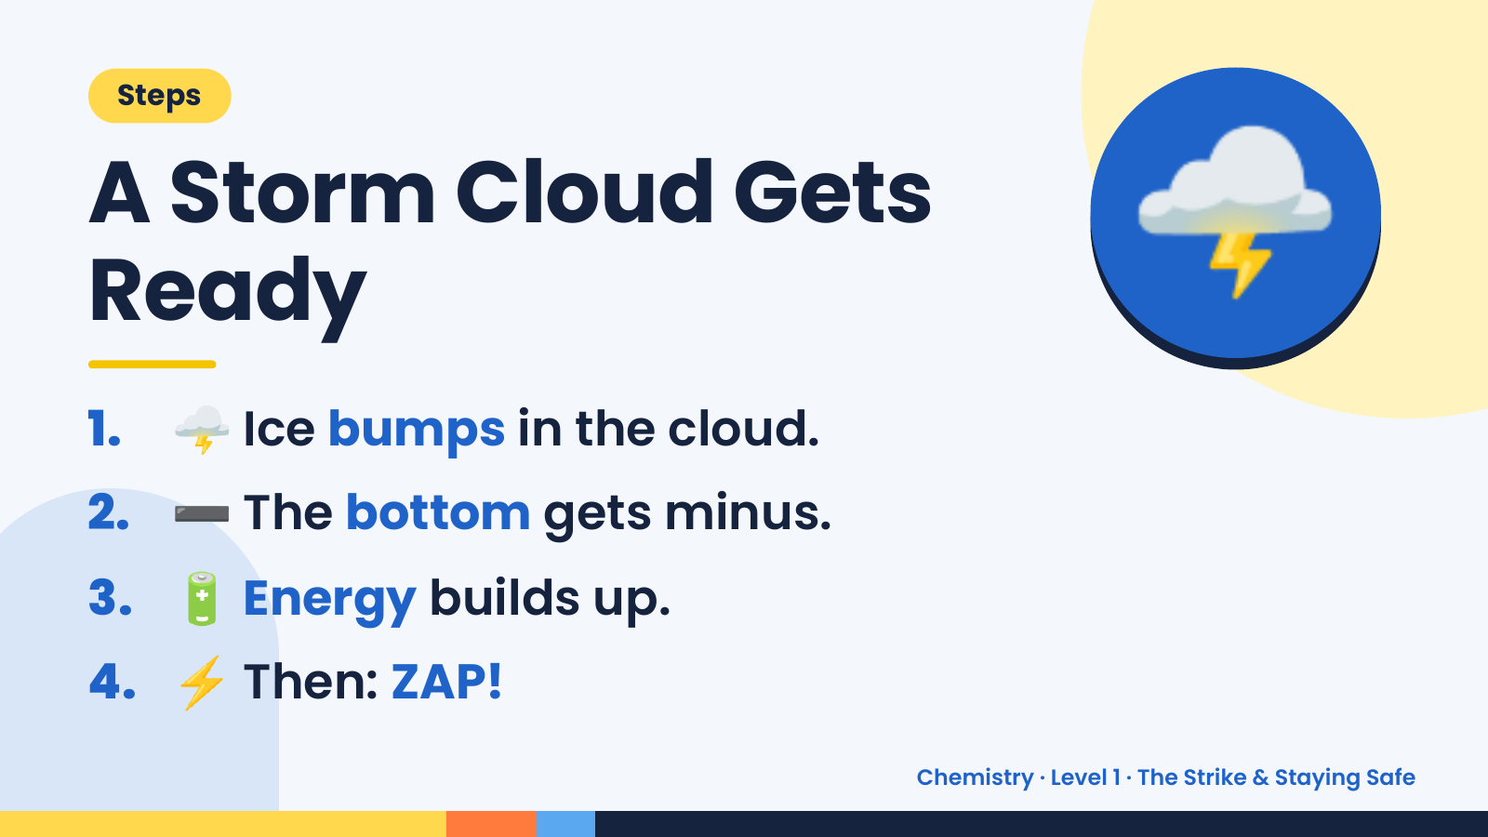
Notes:
Steps
A Storm Cloud Gets
Ready
1. 🌩️ Ice bumps in the cloud.
🌩️
2. ➖ The bottom gets minus.
3. 🔋 Energy builds up.
4. ⚡ Then: ZAP!
Chemistry · Level 1 · The Strike & Staying Safe

Slide 5
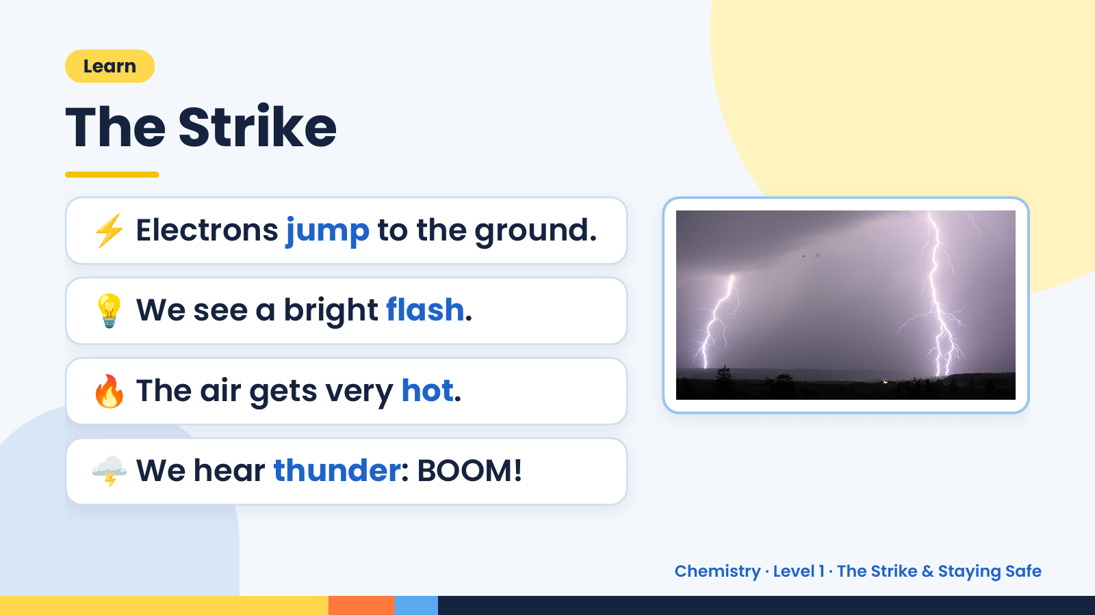
Notes:
Learn
The Strike
⚡ Electrons jump to the ground.
💡 We see a bright flash.
🔥 The air gets very hot.
🌩️ We hear thunder: BOOM!
Chemistry · Level 1 · The Strike & Staying Safe

Slide 6
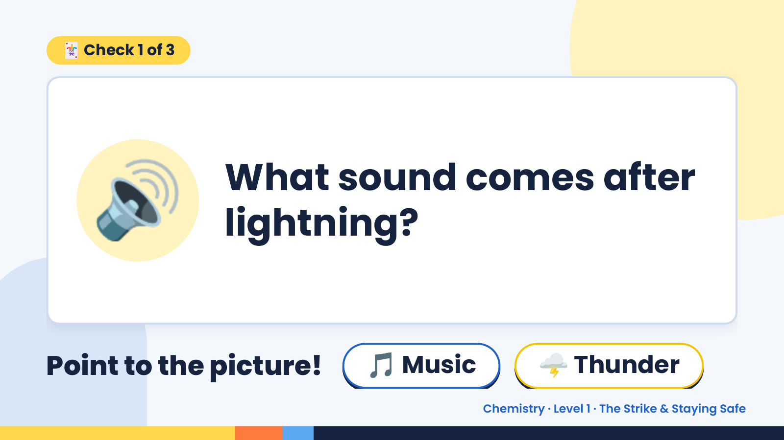
Notes:
🃏 Check 1 of 3
🔊 What sound comes after
lightning?
Point to the picture! 🎵 Music 🌩️ Thunder
Chemistry · Level 1 · The Strike & Staying Safe

Slide 7
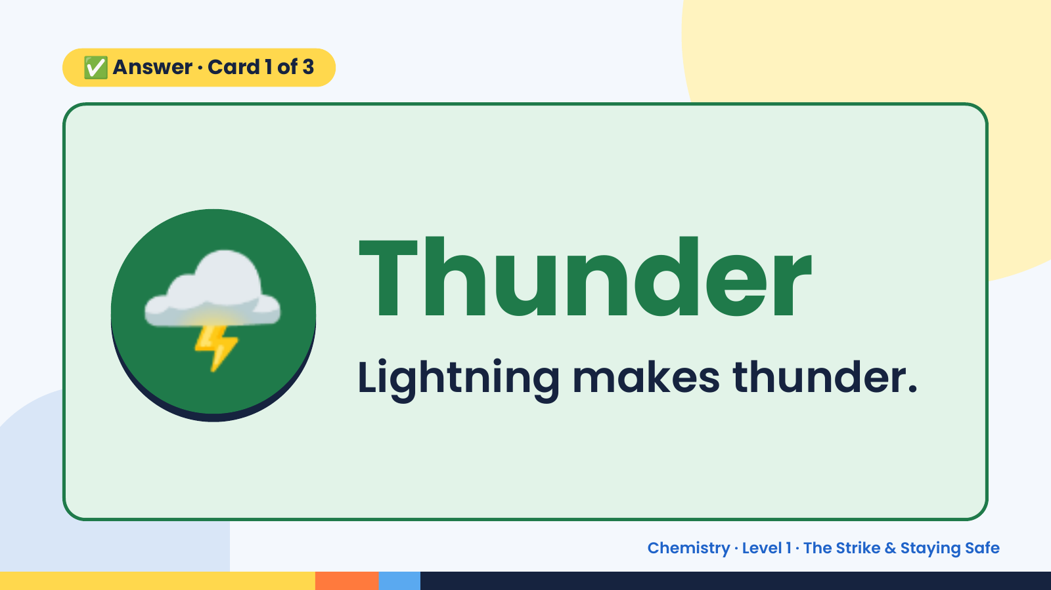
Notes:
✅ Answer · Card 1 of 3
🌩️ Thunder
Lightning makes thunder.
Chemistry · Level 1 · The Strike & Staying Safe

Slide 8
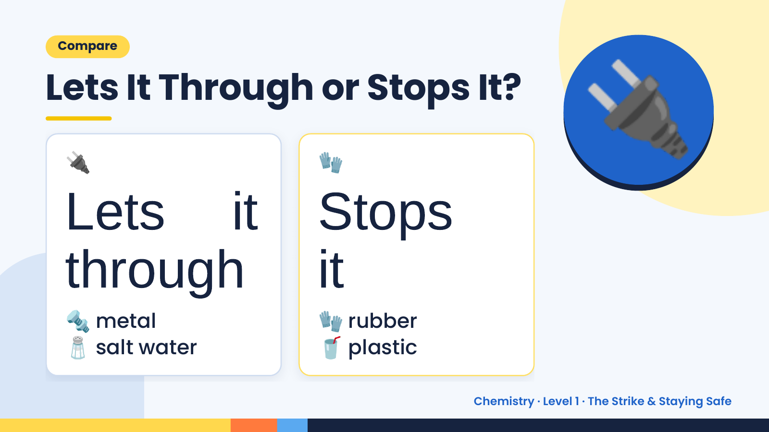
Notes:
Compare
Lets It Through or Stops It?
🔌
Lets it Stops
🧤
🔌
through it
🔩 metal 🧤 rubber
🧂 salt water 🥤 plastic
Chemistry · Level 1 · The Strike & Staying Safe

Slide 9
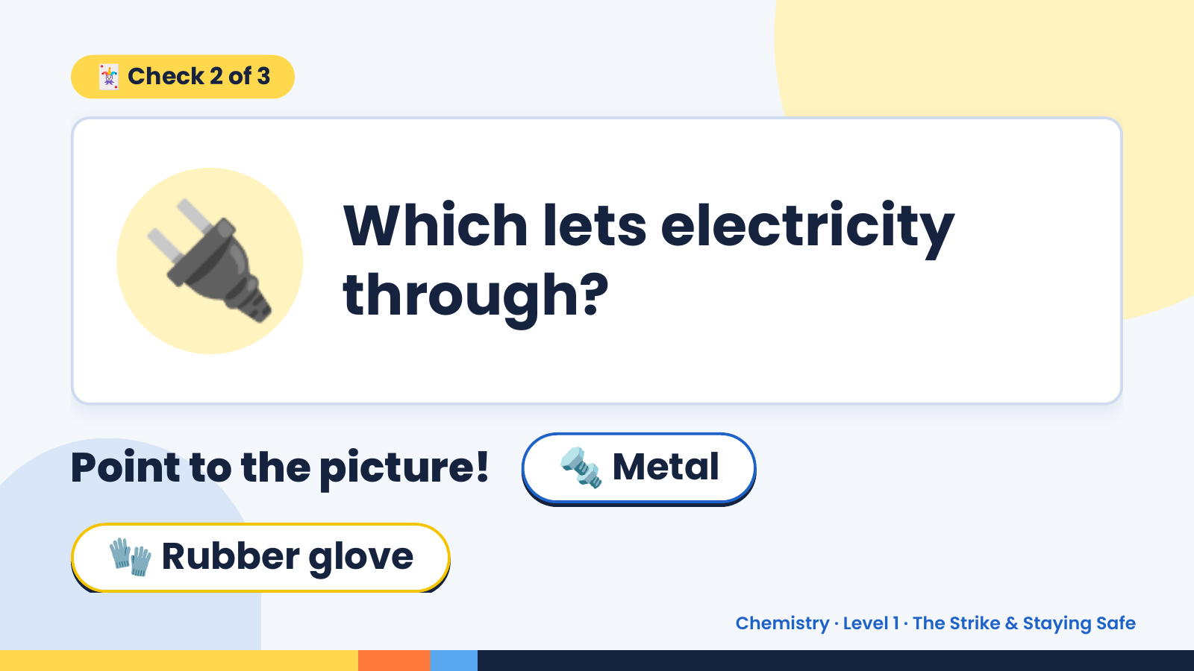
Notes:
🃏 Check 2 of 3
🔌 Which lets electricity
through?
Point to the picture! 🔩 Metal
🧤 Rubber glove
Chemistry · Level 1 · The Strike & Staying Safe

Slide 10
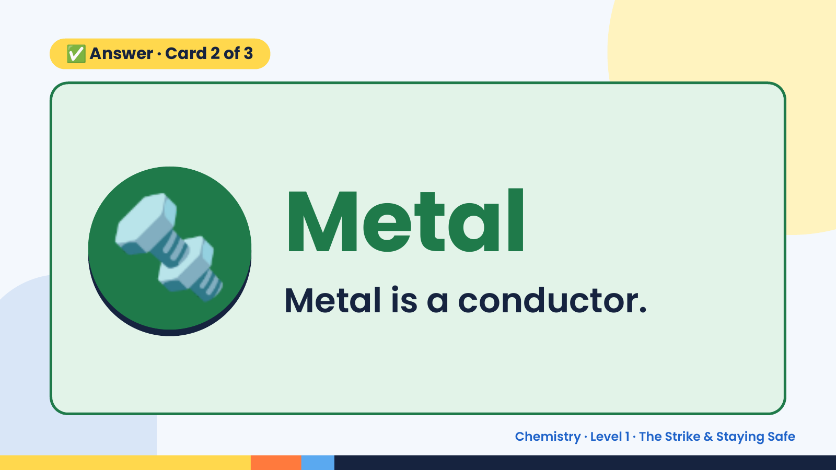
Notes:
✅ Answer · Card 2 of 3
🔩 Metal
Metal is a conductor.
Chemistry · Level 1 · The Strike & Staying Safe

Slide 11
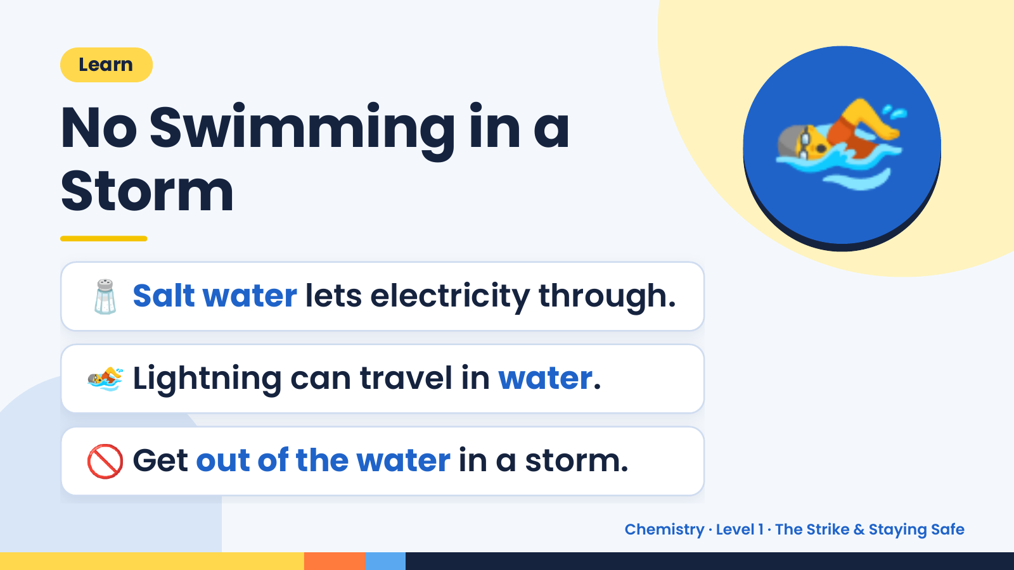
Notes:
Learn
No Swimming in a
Storm
🧂 Salt water lets electricity through.
🏊
🏊 Lightning can travel in water.
🚫 Get out of the water in a storm.
Chemistry · Level 1 · The Strike & Staying Safe

Slide 12
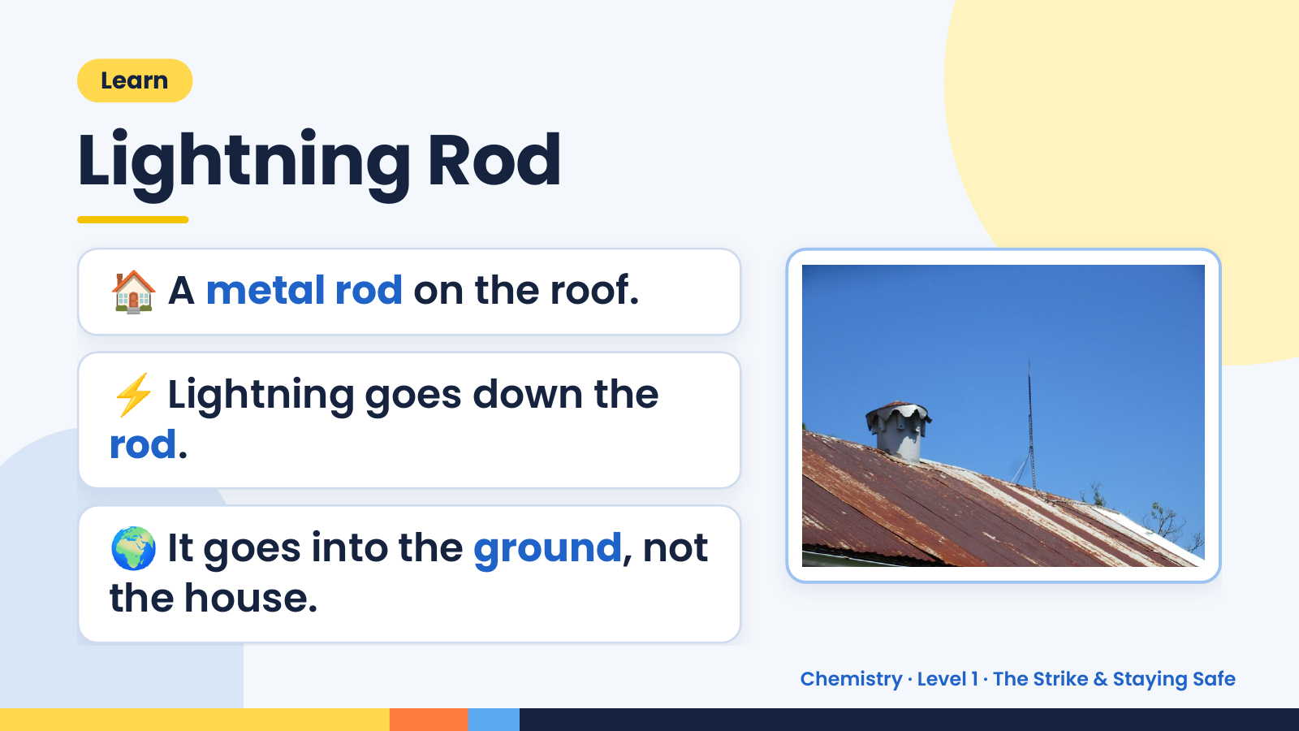
Notes:
Learn
Lightning Rod
🏠 A metal rod on the roof.
⚡ Lightning goes down the
rod.
🌍 It goes into the ground, not
the house.
Chemistry · Level 1 · The Strike & Staying Safe

Slide 13
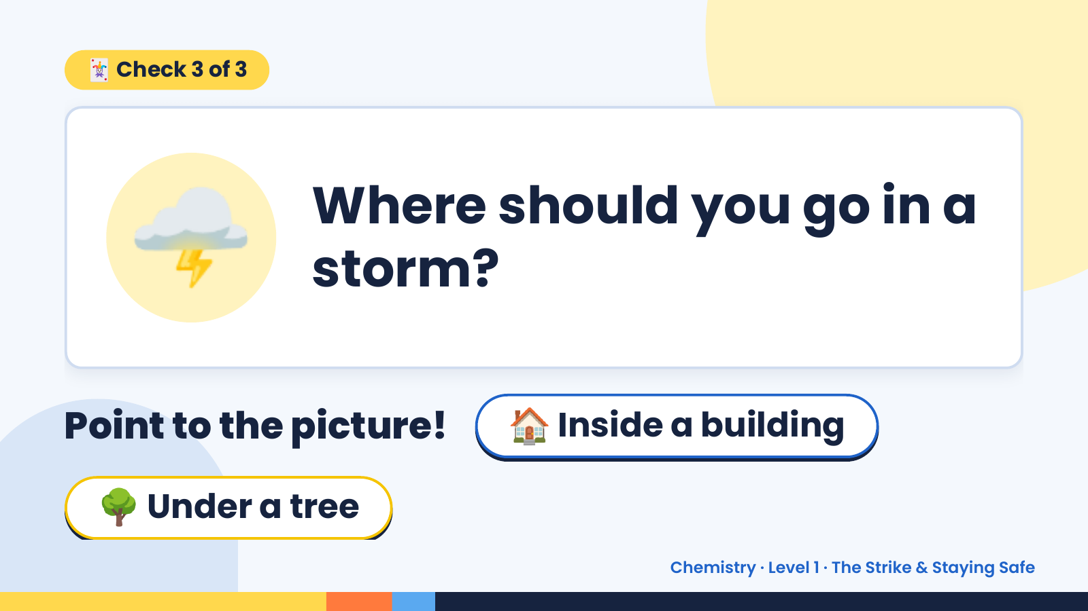
Notes:
🃏 Check 3 of 3
🌩️ Where should you go in a
storm?
Point to the picture! 🏠 Inside a building
🌳 Under a tree
Chemistry · Level 1 · The Strike & Staying Safe

Slide 14
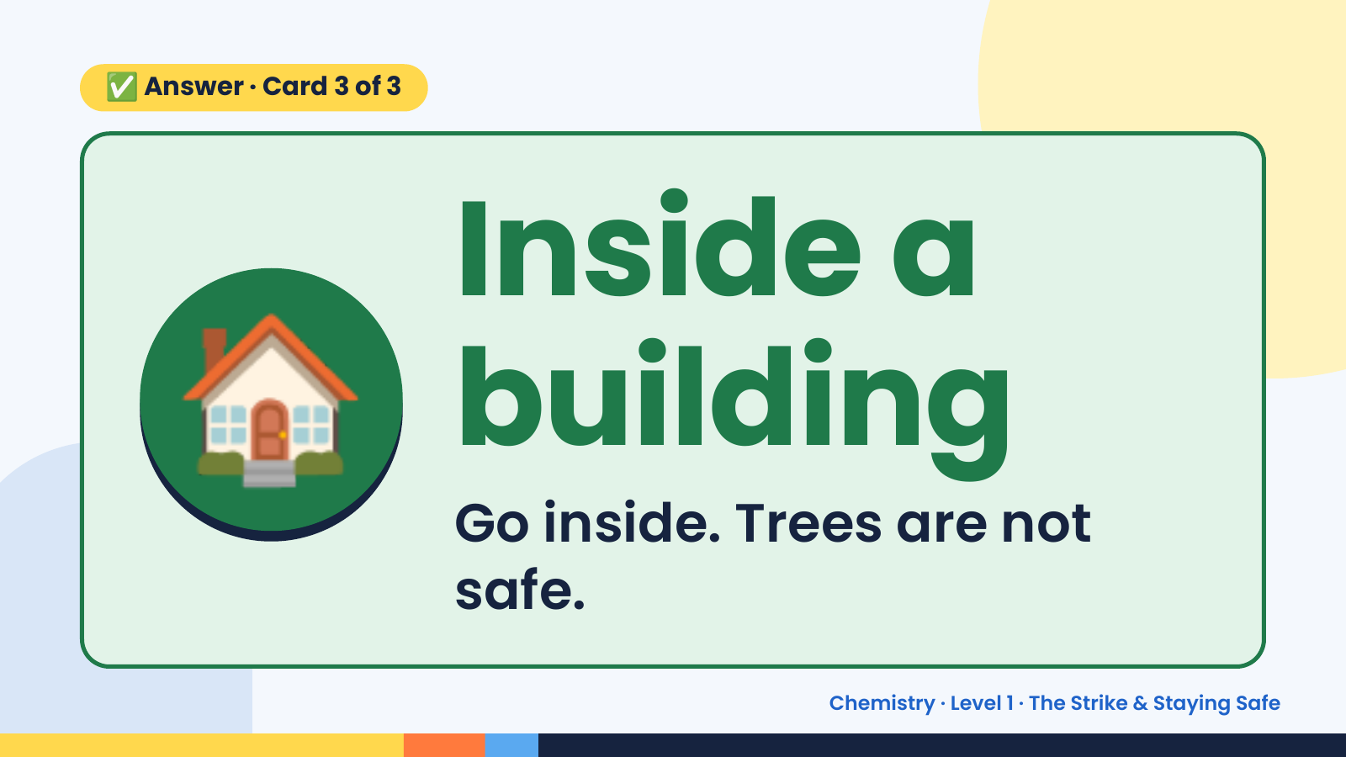
Notes:
✅ Answer · Card 3 of 3
🏠 Inside a
building
Go inside. Trees are not
safe.
Chemistry · Level 1 · The Strike & Staying Safe

Slide 15
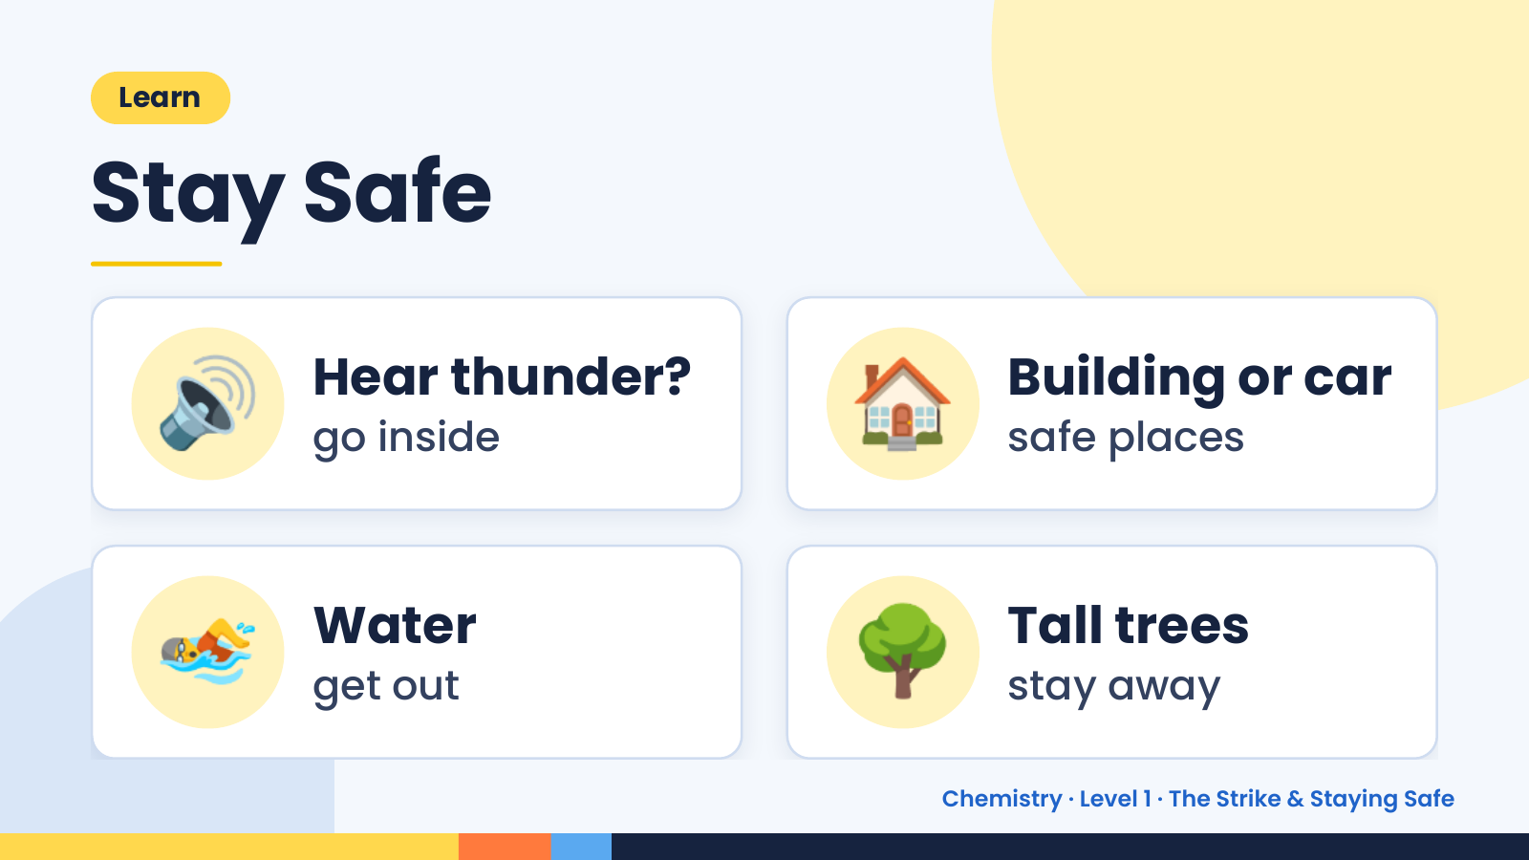
Notes:
Learn
Stay Safe
🔊 Hear thunder?
go inside 🏠 Building or car
safe places
🏊 Water
get out 🌳 Tall trees
stay away
Chemistry · Level 1 · The Strike & Staying Safe

Slide 16
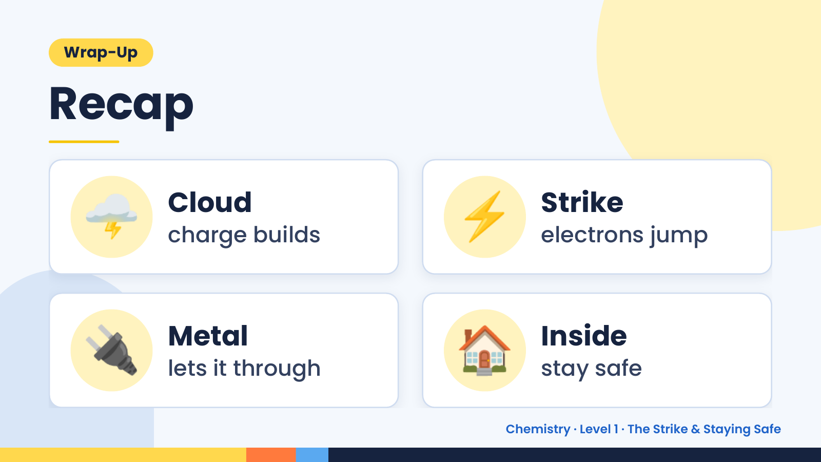
Notes:
Wrap-Up
Recap
🌩️ Cloud
charge builds ⚡ Strike
electrons jump
🔌 Metal
lets it through 🏠 Inside
stay safe
Chemistry · Level 1 · The Strike & Staying Safe

Slide 17
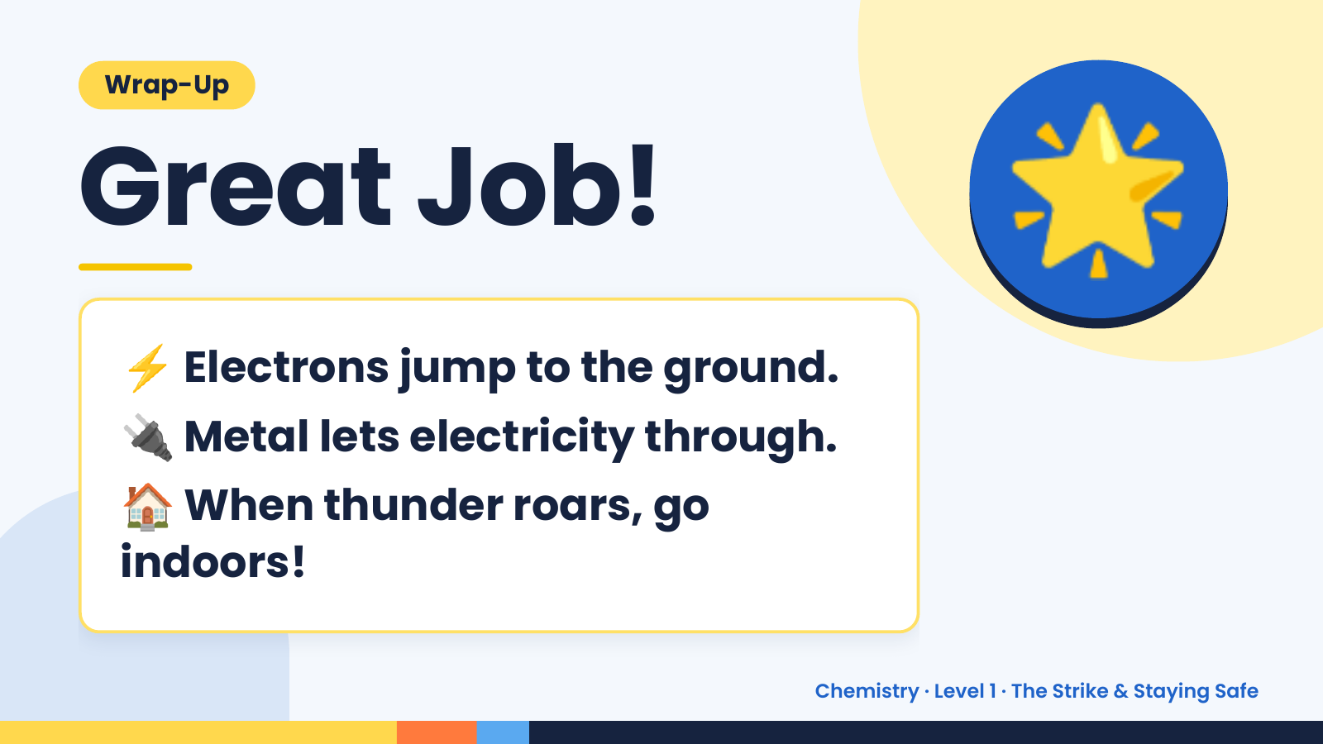
Notes:
Wrap-Up
Great Job!
⚡ Electrons jump to the ground.
🌟
🔌 Metal lets electricity through.
🏠 When thunder roars, go
indoors!
Chemistry · Level 1 · The Strike & Staying Safe

