Slide 1
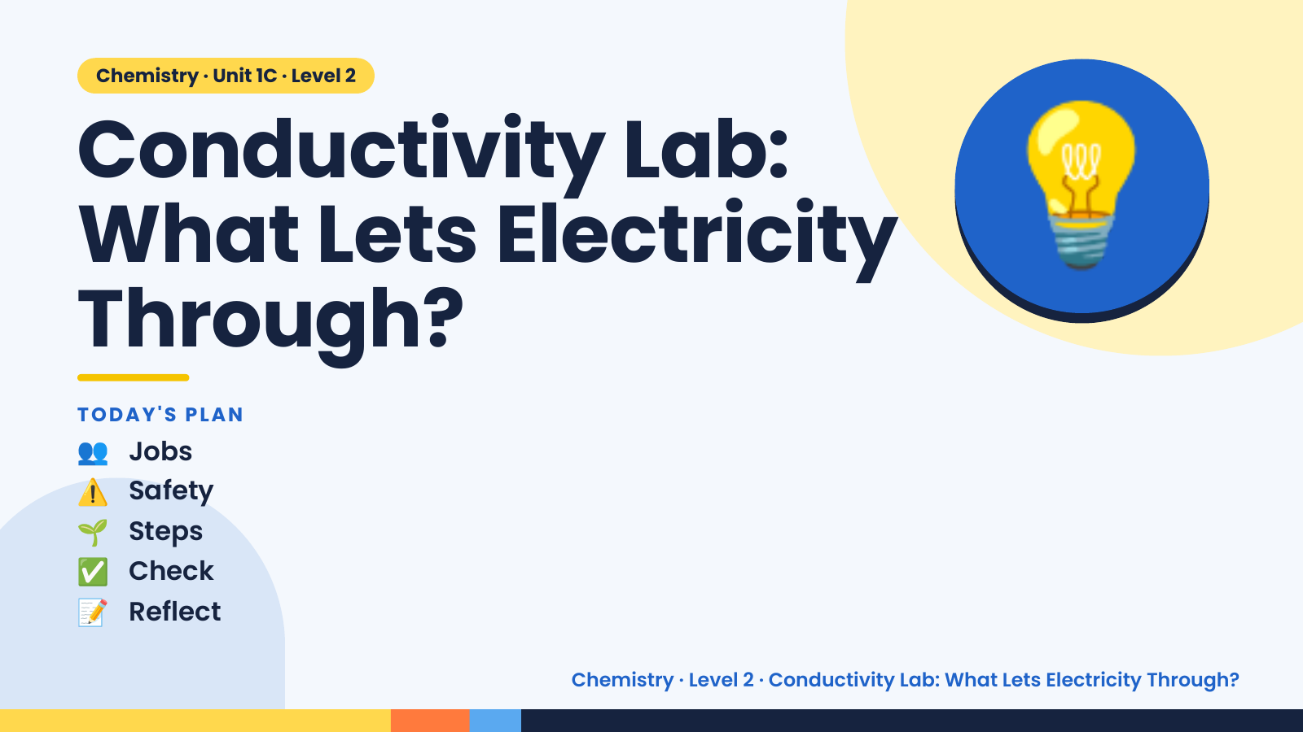
Notes:
Chemistry · Unit 1C · Level 2
Conductivity Lab:
What Lets Electricity
Through?
💡
👥 Jobs
TODAY'S PLAN
⚠️ Safety
🌱 Steps
✅ Check
📝 Reflect
Chemistry · Level 2 · Conductivity Lab: What Lets Electricity Through?

Slide 2
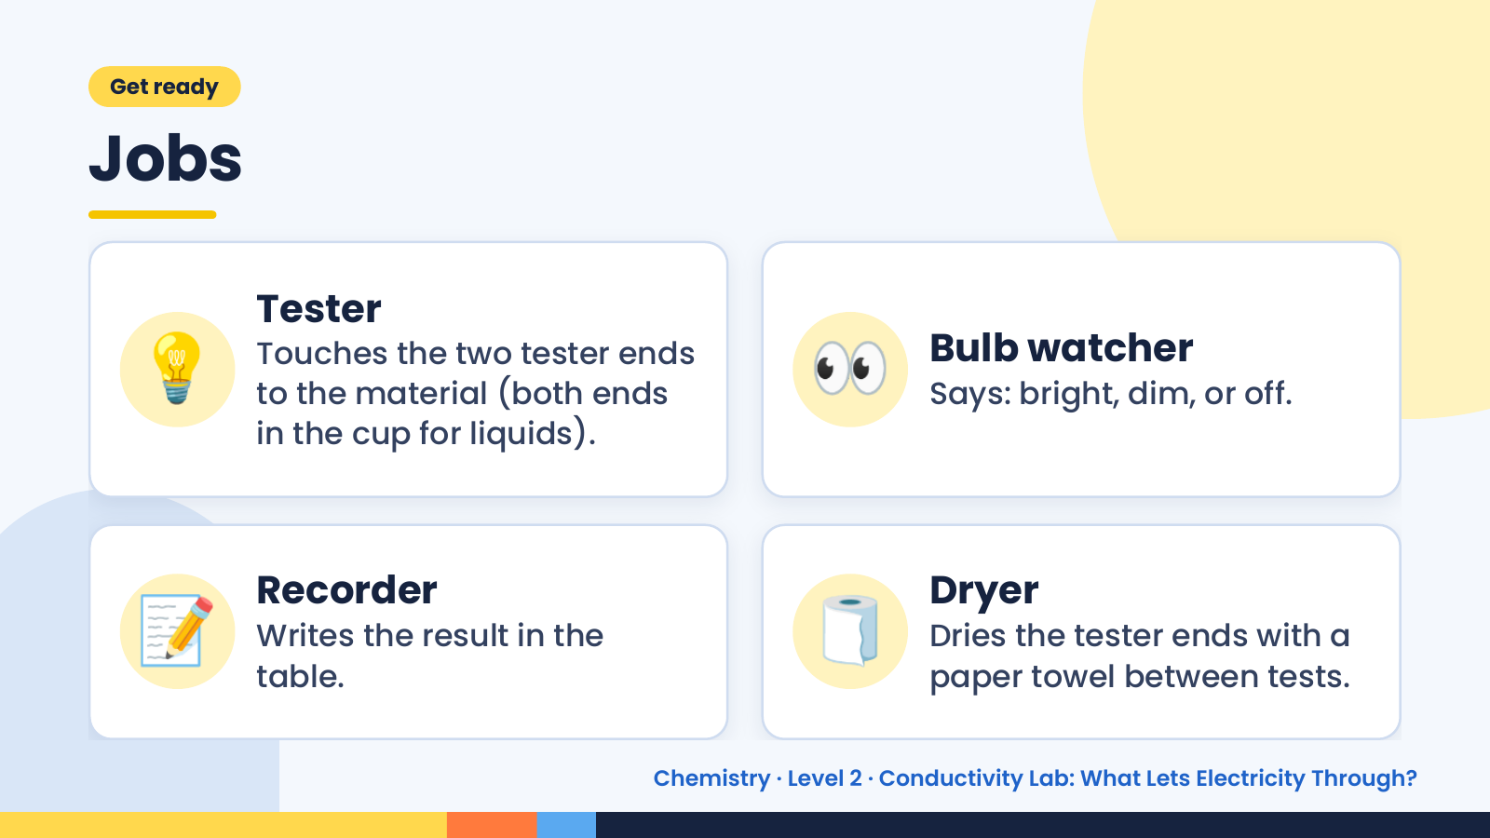
Notes:
Get ready
Jobs
💡 Tester
Touches the two tester ends
to the material (both ends
in the cup for liquids).
👀 Bulb watcher
Says: bright, dim, or off.
📝 Recorder
Writes the result in the
table.
🧻 Dryer
Dries the tester ends with a
paper towel between tests.
Chemistry · Level 2 · Conductivity Lab: What Lets Electricity Through?

Slide 3
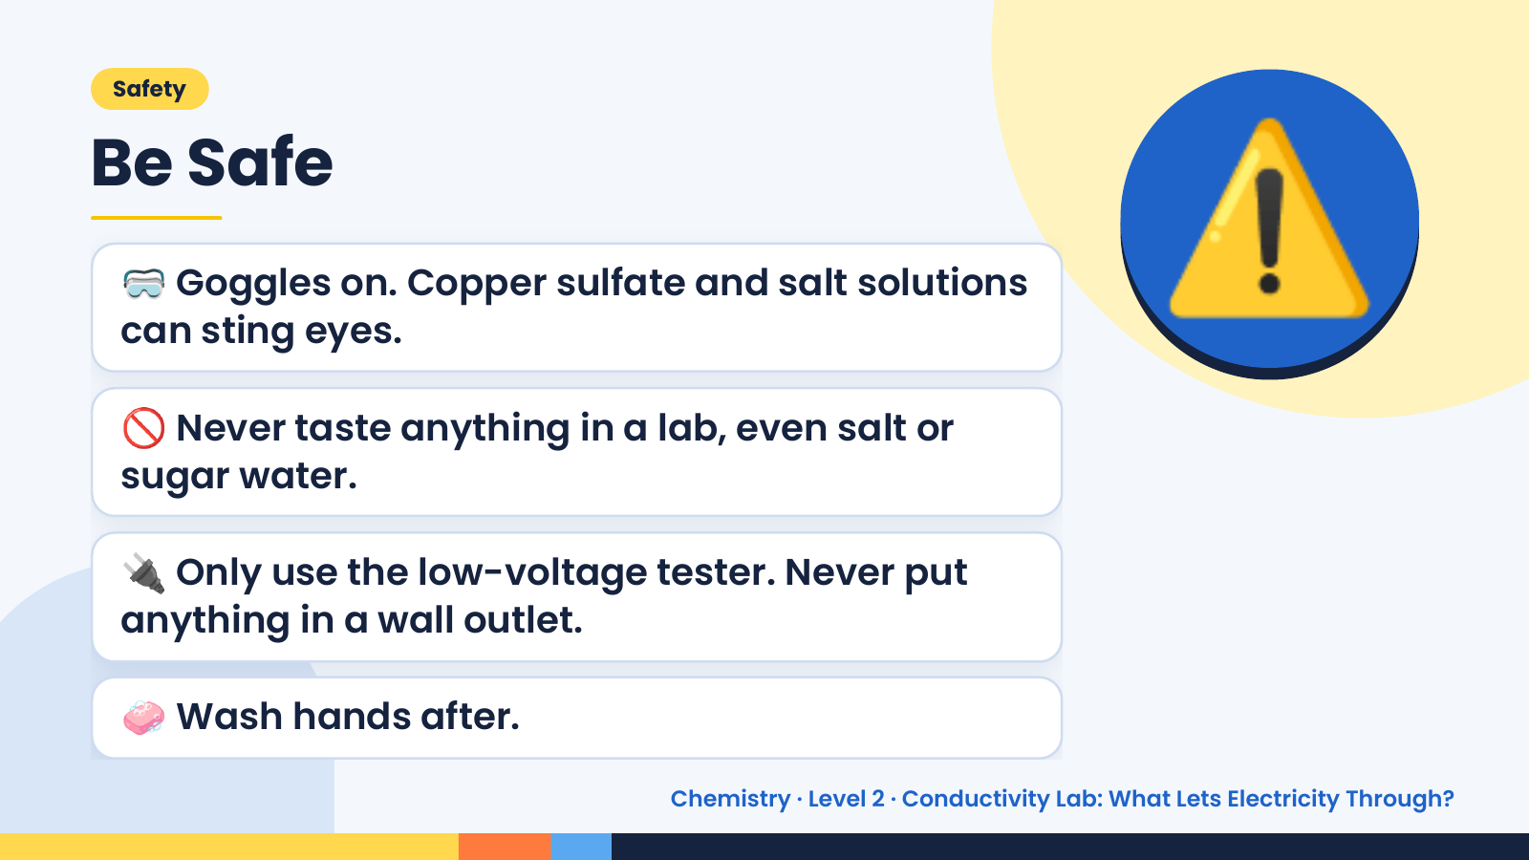
Notes:
Safety
Be Safe
🥽 Goggles on. Copper sulfate and salt solutions
can sting eyes.
🚫 Never taste anything in a lab, even salt or
sugar water.
⚠️
🔌 Only use the low-voltage tester. Never put
anything in a wall outlet.
🧼 Wash hands after.
Chemistry · Level 2 · Conductivity Lab: What Lets Electricity Through?

Slide 4
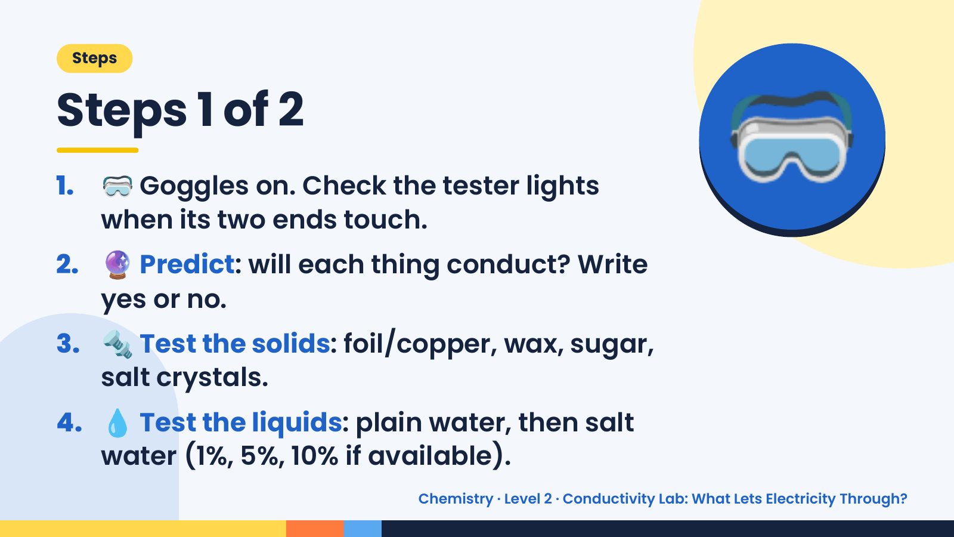
Notes:
Steps
Steps 1 of 2
1. 🥽 Goggles on. Check the tester lights
when its two ends touch.
2. 🔮 Predict: will each thing conduct? Write
yes or no.
🥽
3. 🔩 Test the solids: foil/copper, wax, sugar,
salt crystals.
4. 💧 Test the liquids: plain water, then salt
water (1%, 5%, 10% if available).
Chemistry · Level 2 · Conductivity Lab: What Lets Electricity Through?

Slide 5
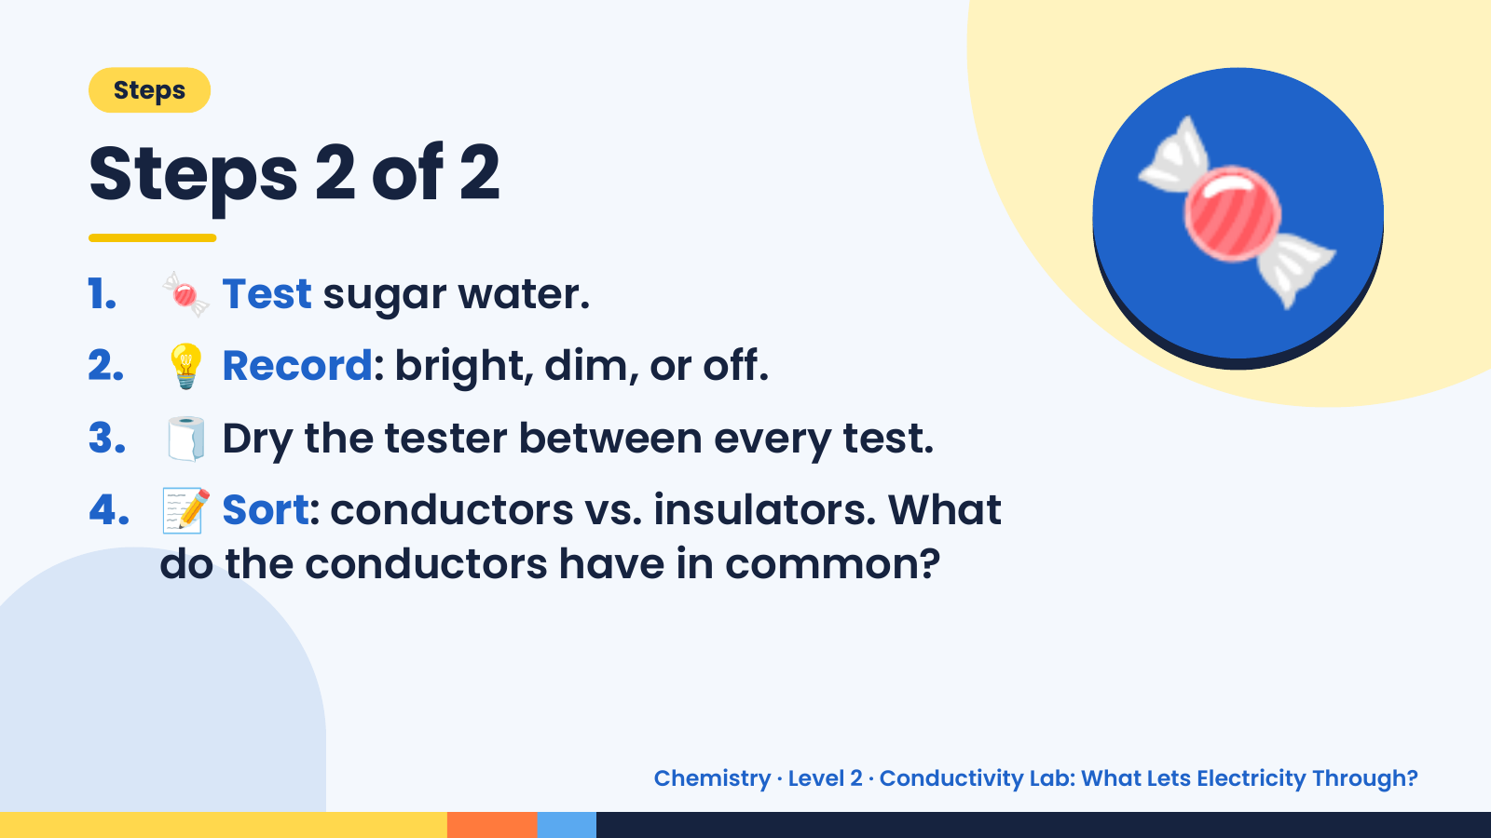
Notes:
Steps
Steps 2 of 2
1. 🍬 Test sugar water.
2. 💡 Record: bright, dim, or off.
3. 🧻 Dry the tester between every test.
🍬
4. 📝 Sort: conductors vs. insulators. What
do the conductors have in common?
Chemistry · Level 2 · Conductivity Lab: What Lets Electricity Through?

Slide 6
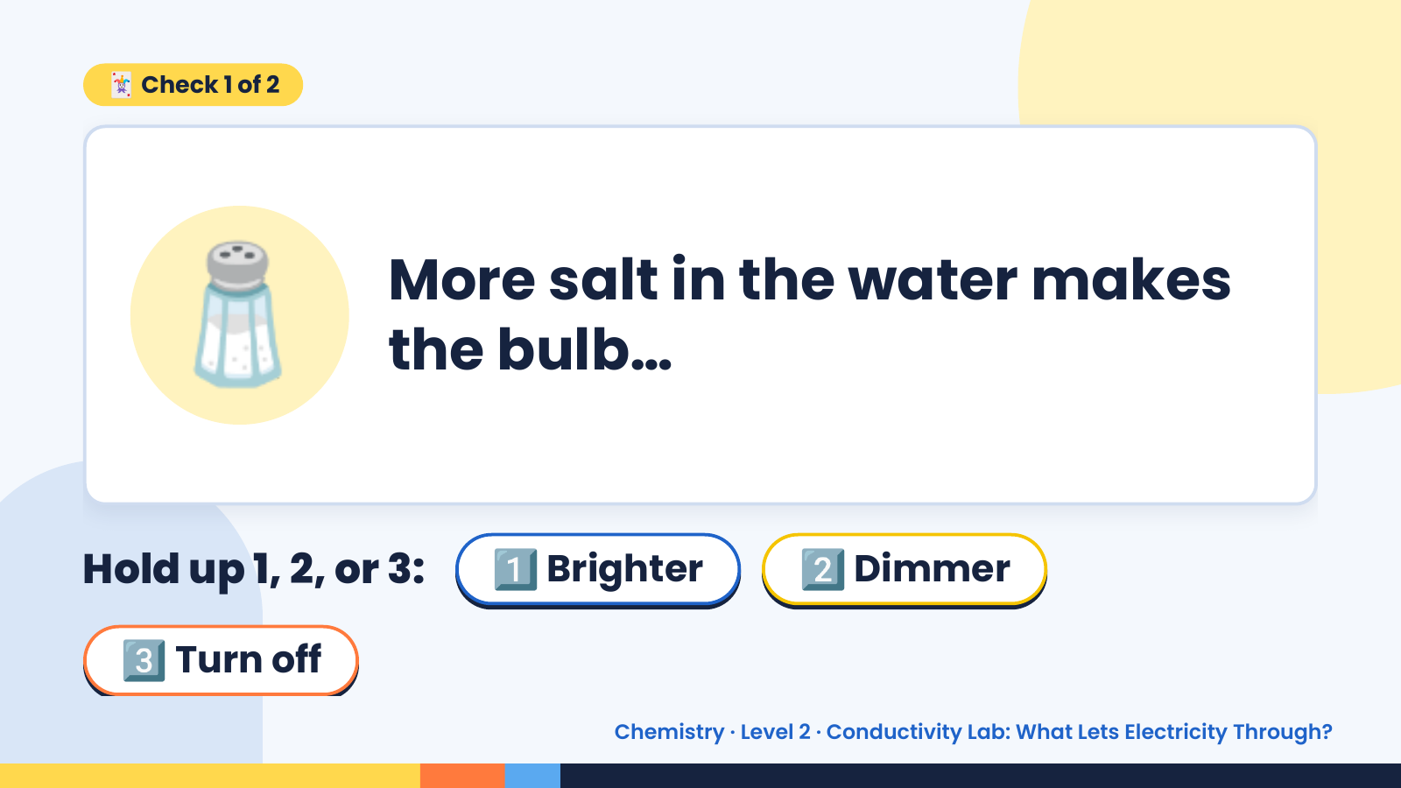
Notes:
🃏 Check 1 of 2
🧂 More salt in the water makes
the bulb…
Hold up 1, 2, or 3: 1️⃣ Brighter 2️⃣ Dimmer
3️⃣ Turn off
Chemistry · Level 2 · Conductivity Lab: What Lets Electricity Through?

Slide 7
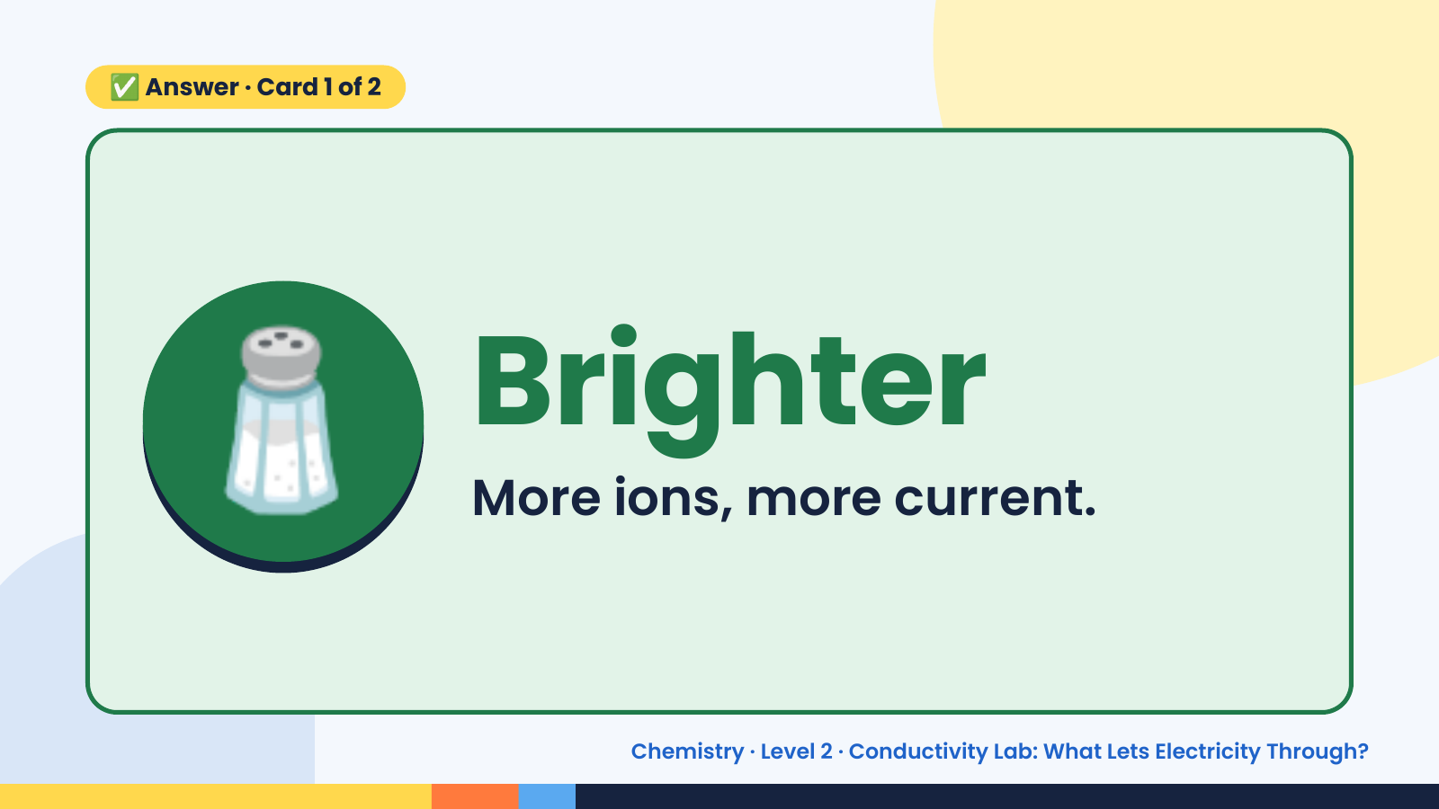
Notes:
✅ Answer · Card 1 of 2
🧂 Brighter
More ions, more current.
Chemistry · Level 2 · Conductivity Lab: What Lets Electricity Through?

Slide 8
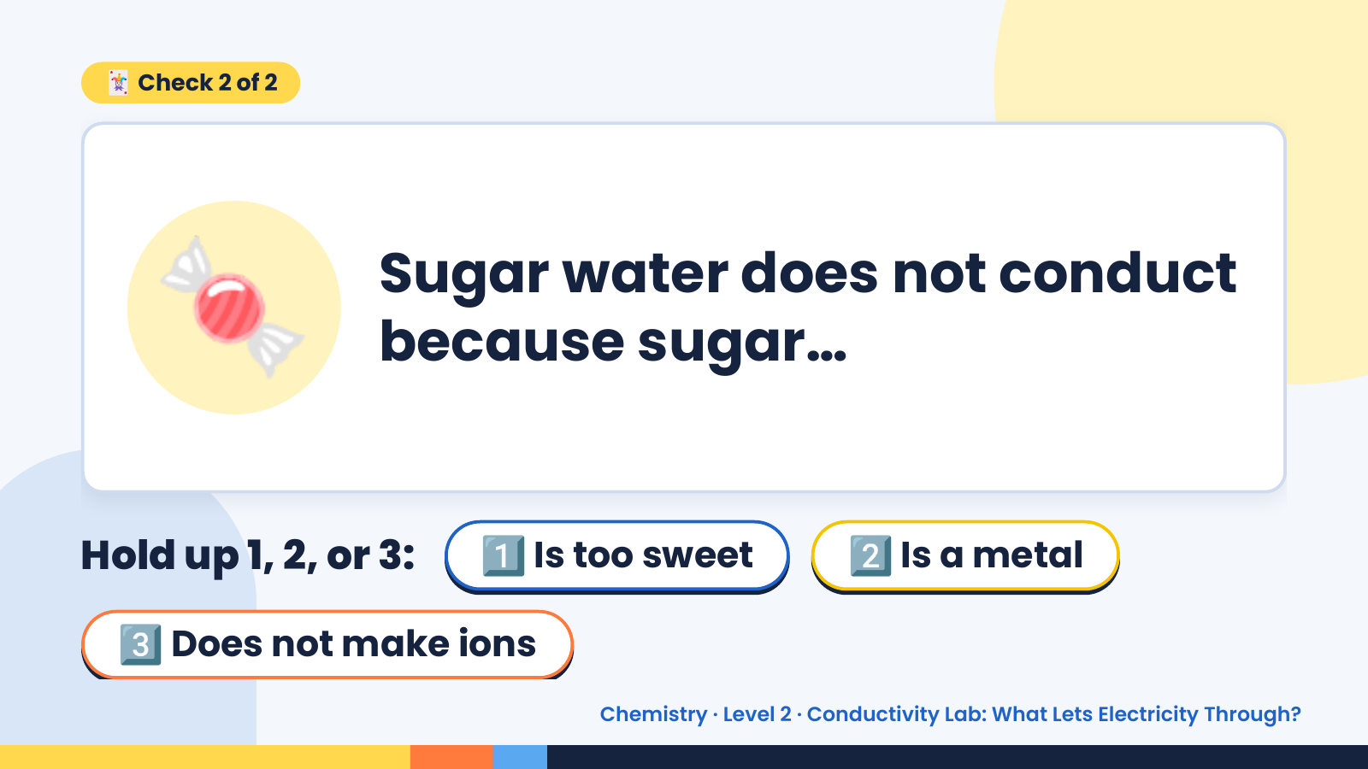
Notes:
🃏 Check 2 of 2
🍬 Sugar water does not conduct
because sugar…
Hold up 1, 2, or 3: 1️⃣ Is too sweet 2️⃣ Is a metal
3️⃣ Does not make ions
Chemistry · Level 2 · Conductivity Lab: What Lets Electricity Through?

Slide 9
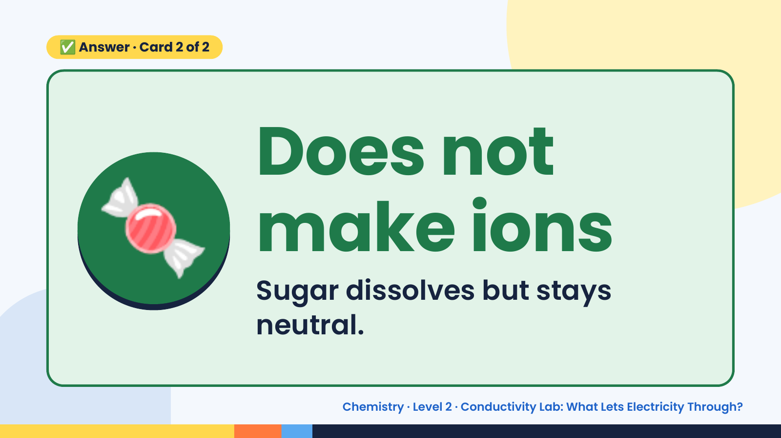
Notes:
✅ Answer · Card 2 of 2
🍬 Does not
make ions
Sugar dissolves but stays
neutral.
Chemistry · Level 2 · Conductivity Lab: What Lets Electricity Through?

Slide 10
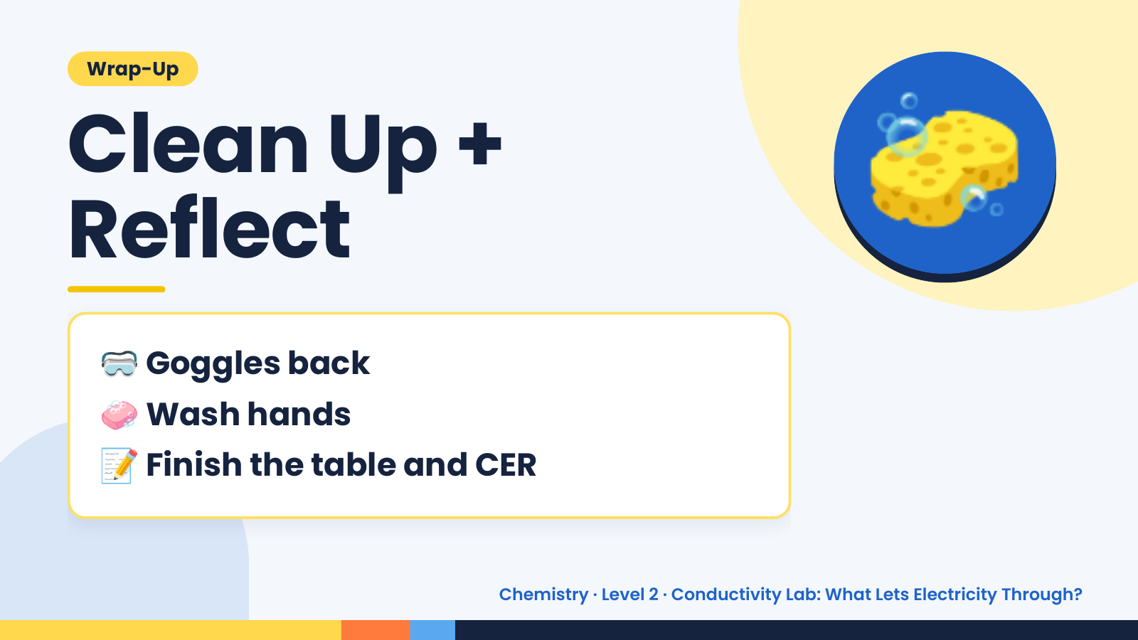
Notes:
Wrap-Up
Clean Up +
Reflect
🧽
🥽 Goggles back
🧼 Wash hands
📝 Finish the table and CER
Chemistry · Level 2 · Conductivity Lab: What Lets Electricity Through?

