Slide 1
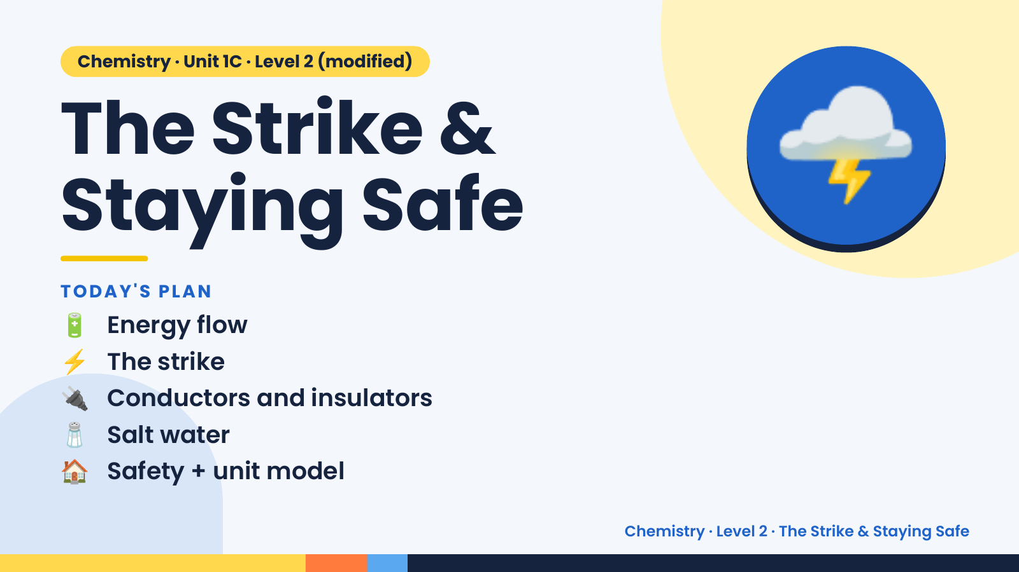
Notes:
Chemistry · Unit 1C · Level 2 (modified)
The Strike &
Staying Safe
🔋 Energy flow
TODAY'S PLAN
🌩️
⚡ The strike
🔌 Conductors and insulators
🧂 Salt water
🏠 Safety + unit model
Chemistry · Level 2 · The Strike & Staying Safe

Slide 2
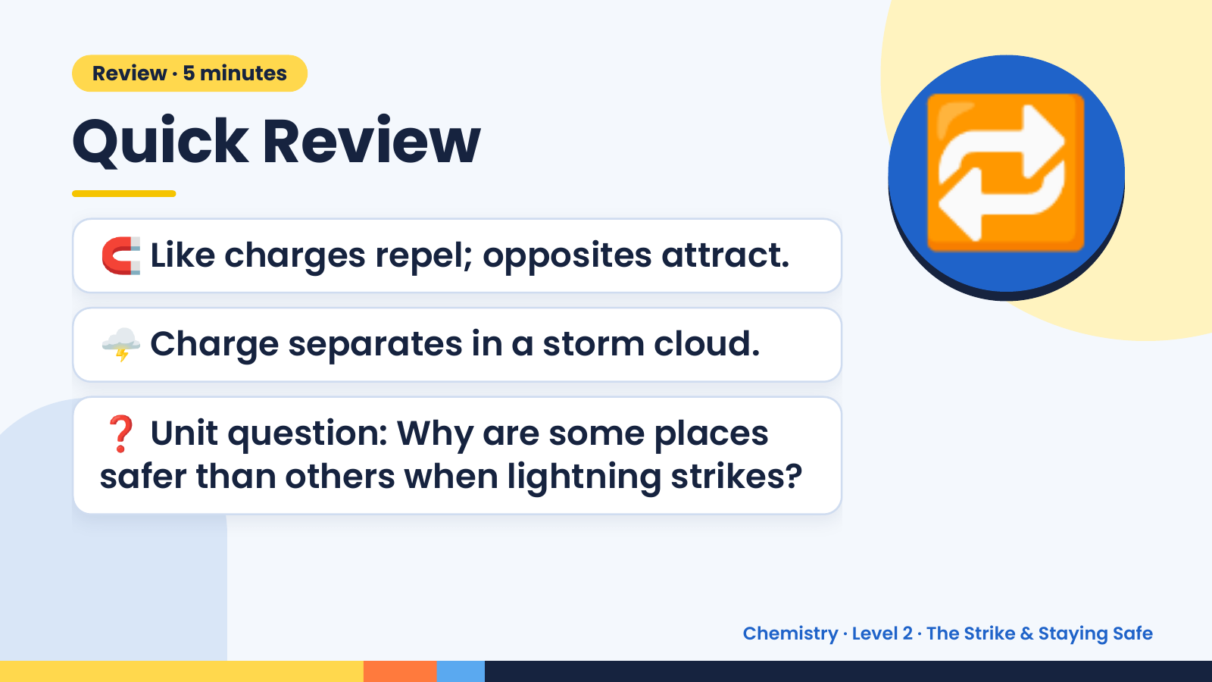
Notes:
Review · 5 minutes
Quick Review
🧲 Like charges repel; opposites attract.
🌩️ Charge separates in a storm cloud.
🔁
❓ Unit question: Why are some places
safer than others when lightning strikes?
Chemistry · Level 2 · The Strike & Staying Safe

Slide 3
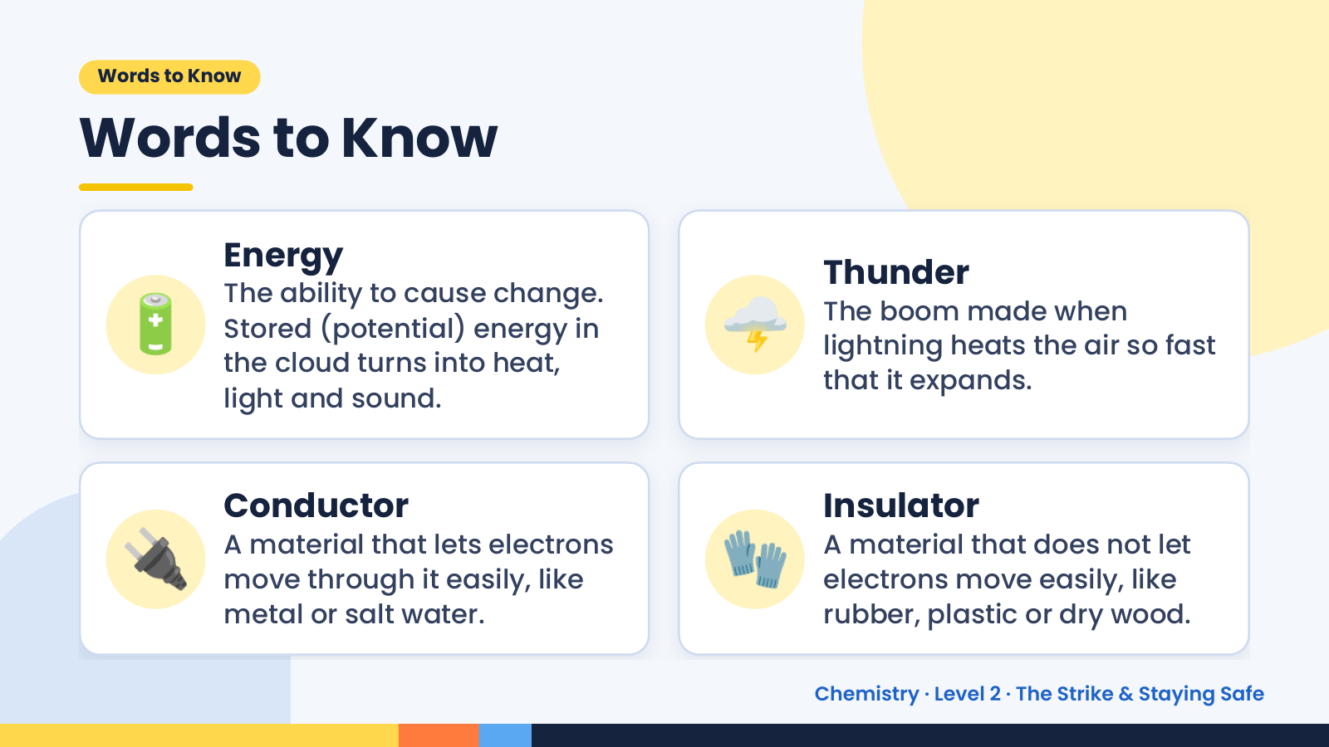
Notes:
Words to Know
Words to Know
🔋 🌩️
Energy
Thunder
The ability to cause change.
The boom made when
Stored (potential) energy in
lightning heats the air so fast
the cloud turns into heat,
that it expands.
light and sound.
🔌 Conductor
A material that lets electrons
move through it easily, like
metal or salt water.
🧤 Insulator
A material that does not let
electrons move easily, like
rubber, plastic or dry wood.
Chemistry · Level 2 · The Strike & Staying Safe

Slide 4
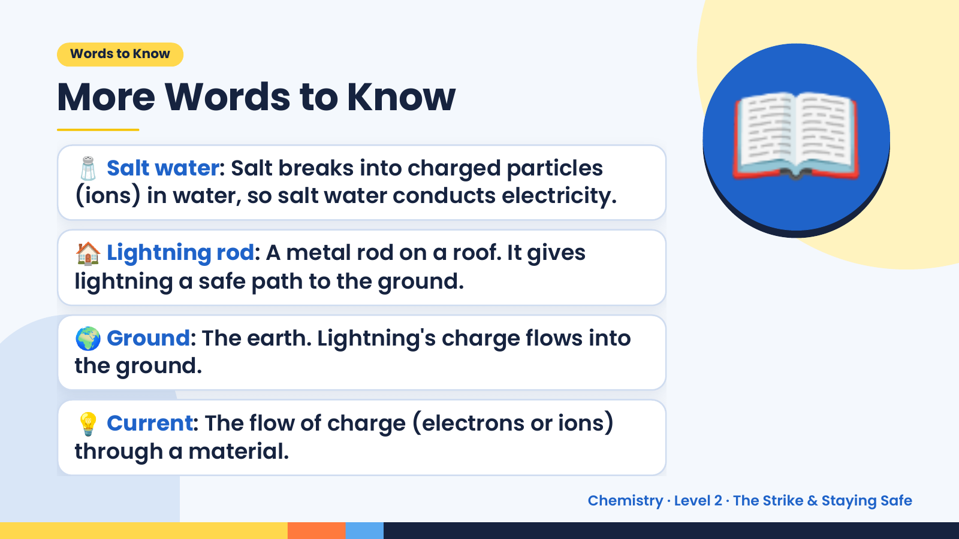
Notes:
Words to Know
More Words to Know
🧂 Salt water: Salt breaks into charged particles
(ions) in water, so salt water conducts electricity.
🏠 Lightning rod: A metal rod on a roof. It gives
lightning a safe path to the ground.
📖
🌍 Ground: The earth. Lightning's charge flows into
the ground.
💡 Current: The flow of charge (electrons or ions)
through a material.
Chemistry · Level 2 · The Strike & Staying Safe

Slide 5
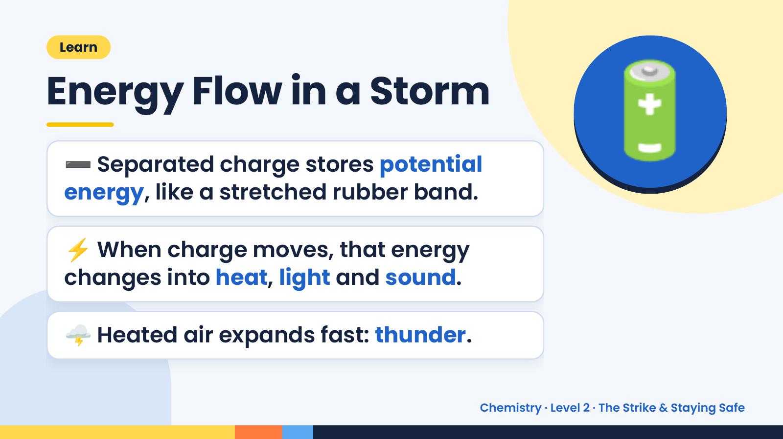
Notes:
Learn
Energy Flow in a Storm
➖ Separated charge stores potential
energy, like a stretched rubber band.
🔋
⚡ When charge moves, that energy
changes into heat, light and sound.
🌩️ Heated air expands fast: thunder.
Chemistry · Level 2 · The Strike & Staying Safe

Slide 6
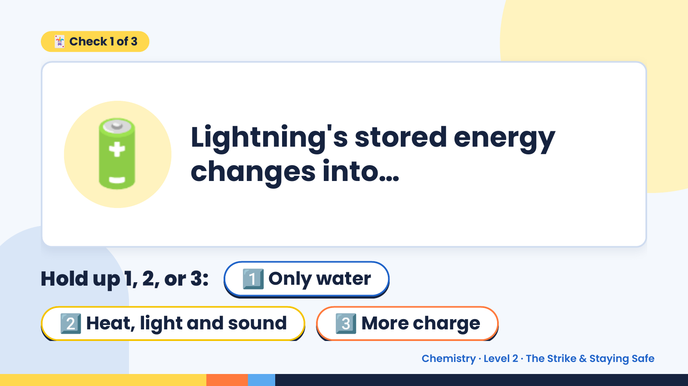
Notes:
🃏 Check 1 of 3
🔋 Lightning's stored energy
changes into…
Hold up 1, 2, or 3: 1️⃣ Only water
2️⃣ Heat, light and sound 3️⃣ More charge
Chemistry · Level 2 · The Strike & Staying Safe

Slide 7
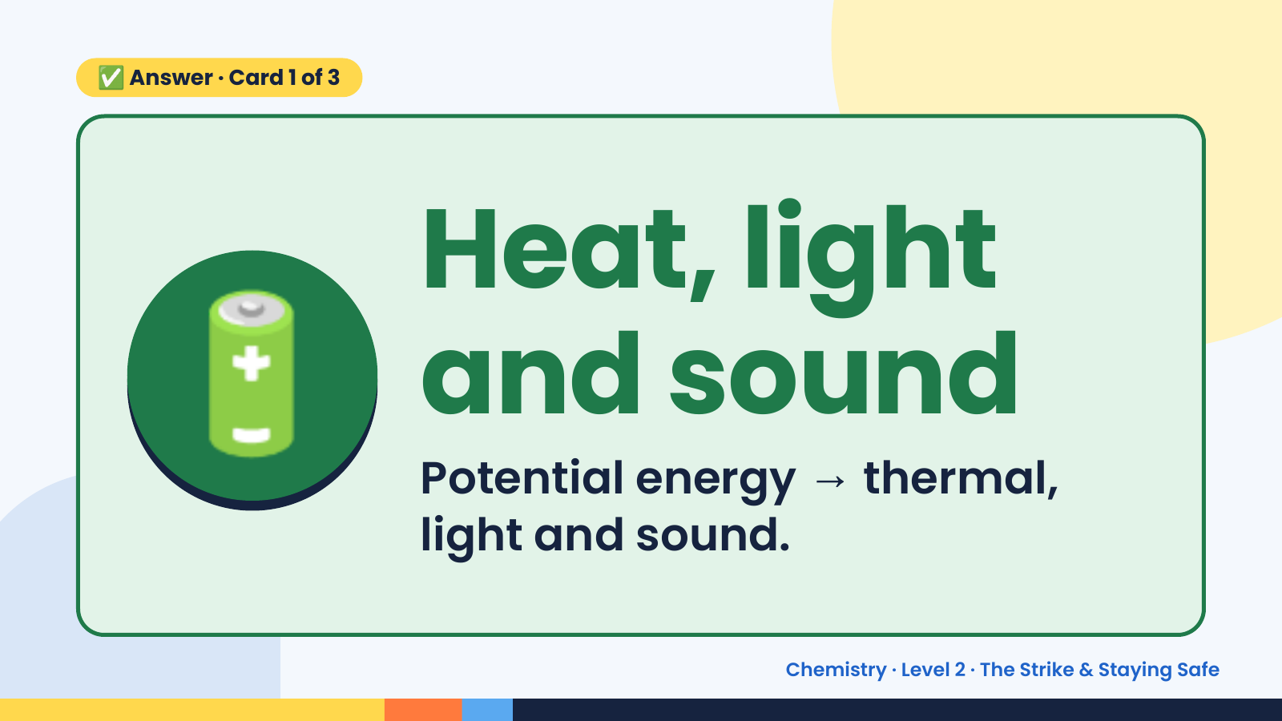
Notes:
✅ Answer · Card 1 of 3
🔋 Heat, light
and sound
Potential energy → thermal,
light and sound.
Chemistry · Level 2 · The Strike & Staying Safe

Slide 8
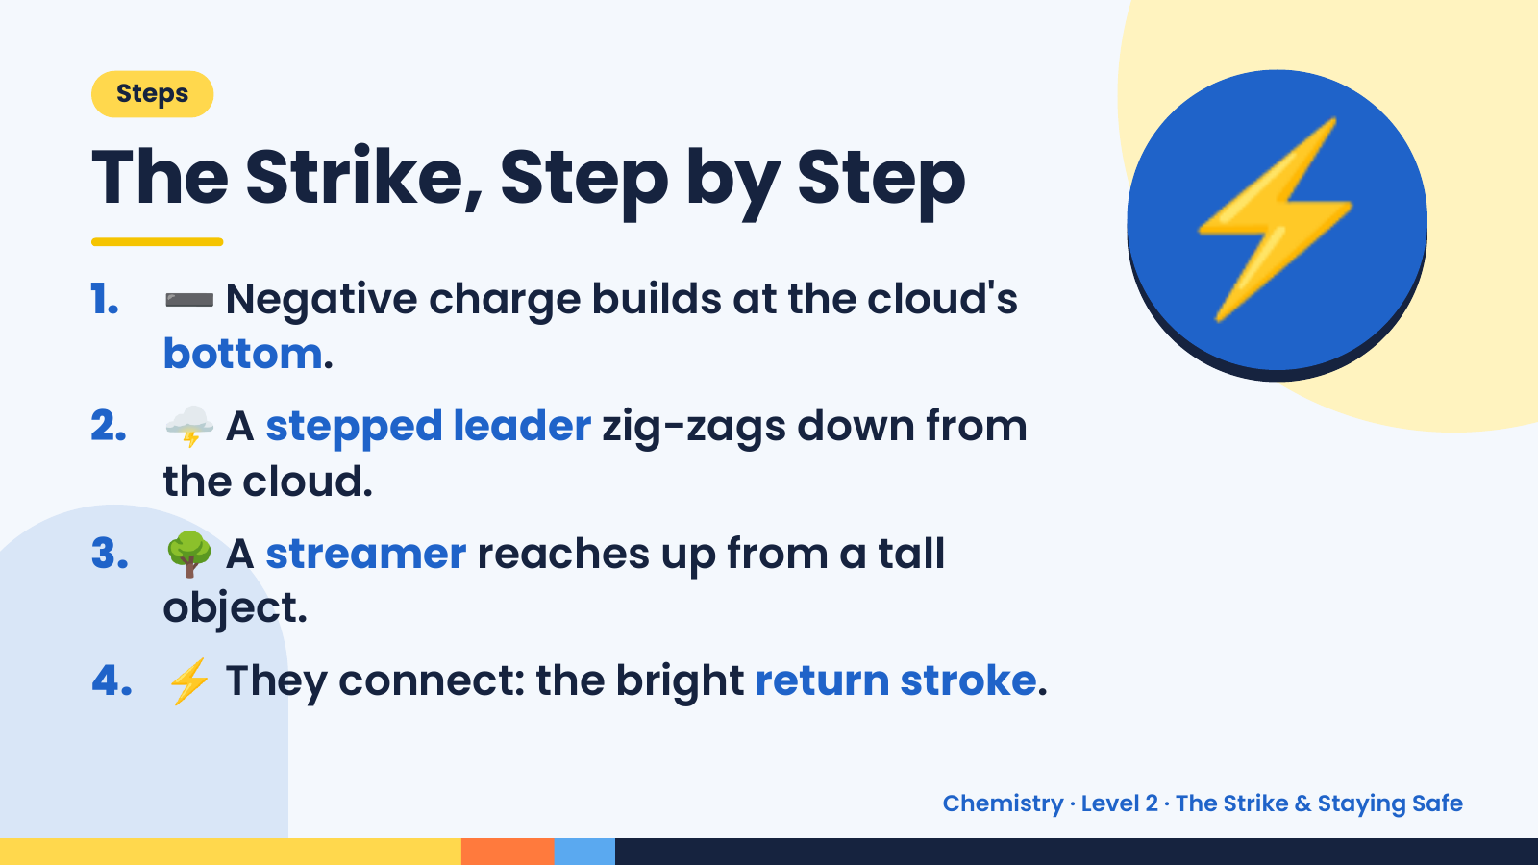
Notes:
Steps
The Strike, Step by Step
1. ➖ Negative charge builds at the cloud's
bottom.
2. 🌩️ A stepped leader zig-zags down from
the cloud.
⚡
3. 🌳 A streamer reaches up from a tall
object.
4. ⚡ They connect: the bright return stroke.
Chemistry · Level 2 · The Strike & Staying Safe

Slide 9
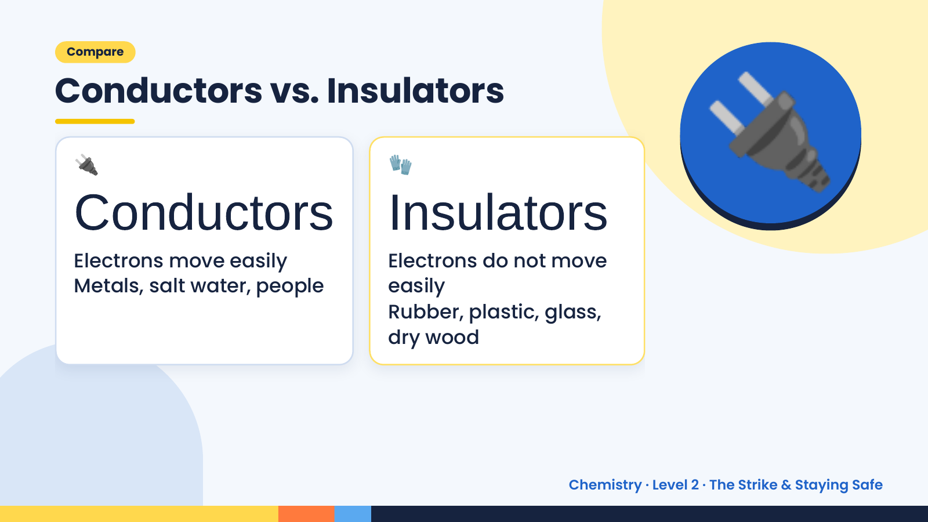
Notes:
Compare
Conductors vs. Insulators
🔌
Conductors Insulators
Electrons move easily
Metals, salt water, people
🧤
Electrons do not move
easily
🔌
Rubber, plastic, glass,
dry wood
Chemistry · Level 2 · The Strike & Staying Safe

Slide 10
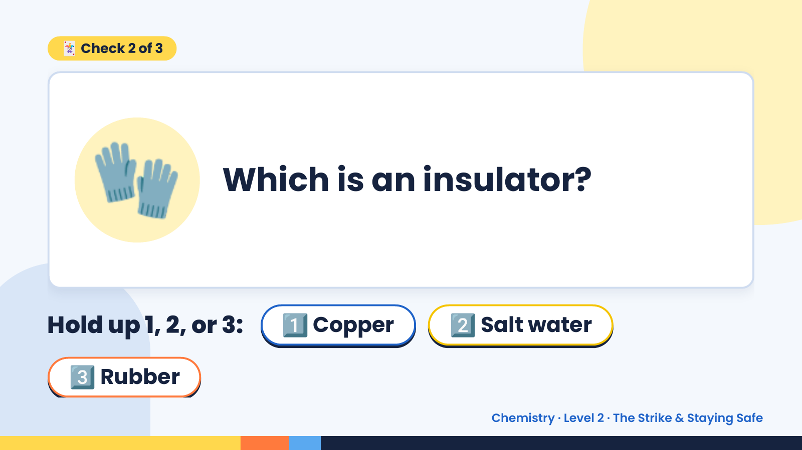
Notes:
🃏 Check 2 of 3
🧤 Which is an insulator?
Hold up 1, 2, or 3: 1️⃣ Copper 2️⃣ Salt water
3️⃣ Rubber
Chemistry · Level 2 · The Strike & Staying Safe

Slide 11
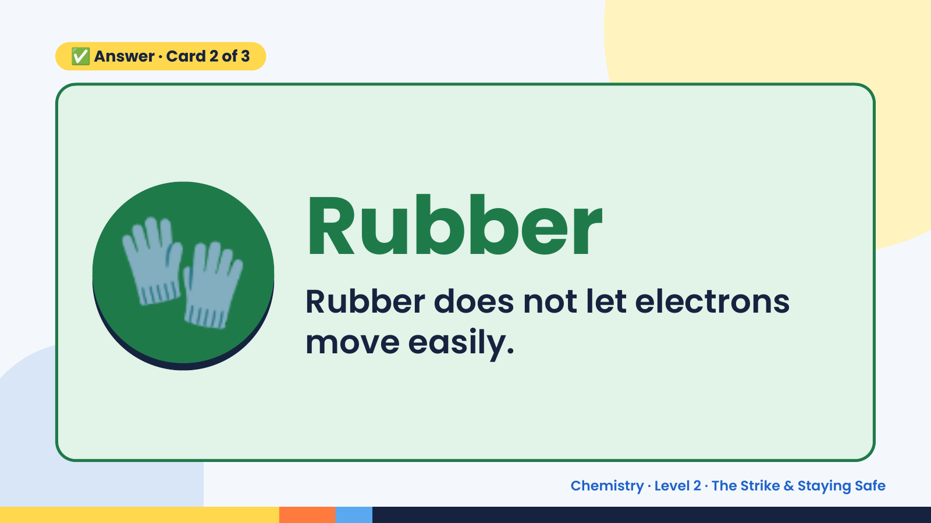
Notes:
✅ Answer · Card 2 of 3
🧤 Rubber
Rubber does not let electrons
move easily.
Chemistry · Level 2 · The Strike & Staying Safe

Slide 12
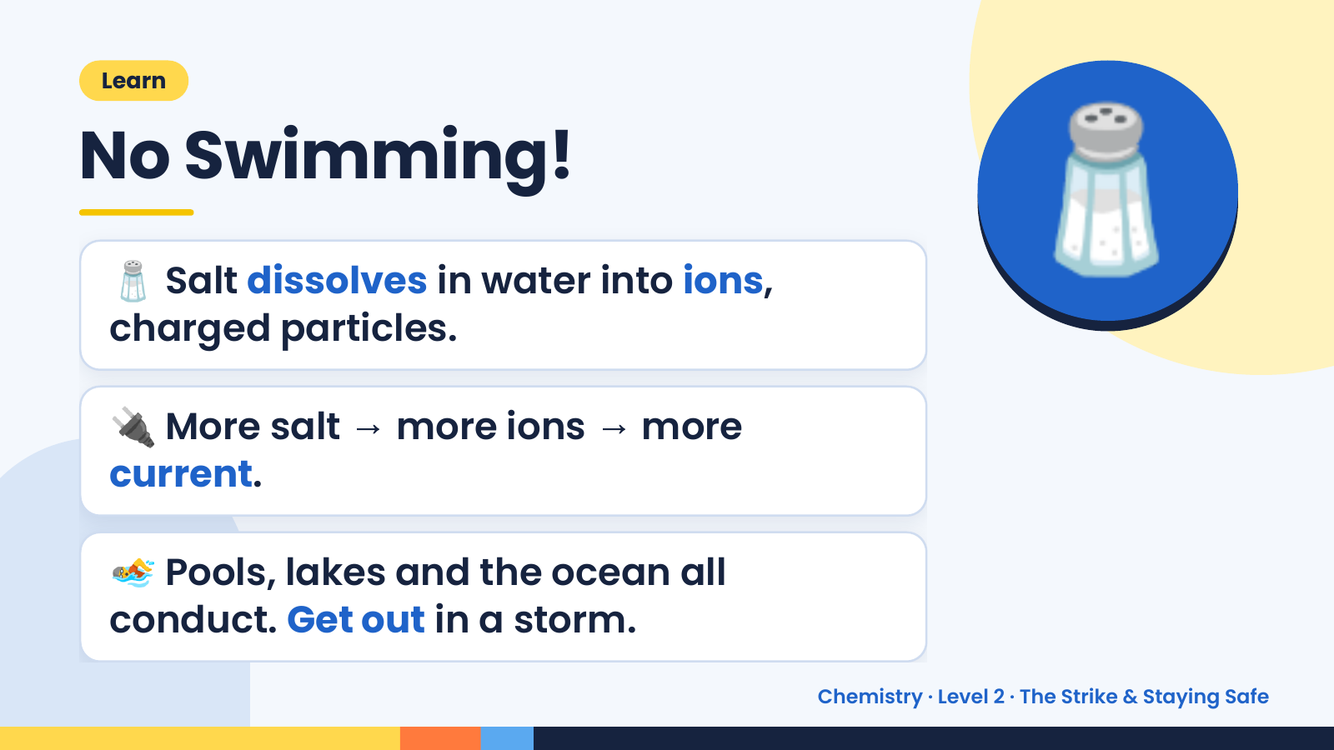
Notes:
Learn
No Swimming!
🧂 Salt dissolves in water into ions,
charged particles.
🧂
🔌 More salt → more ions → more
current.
🏊 Pools, lakes and the ocean all
conduct. Get out in a storm.
Chemistry · Level 2 · The Strike & Staying Safe

Slide 13
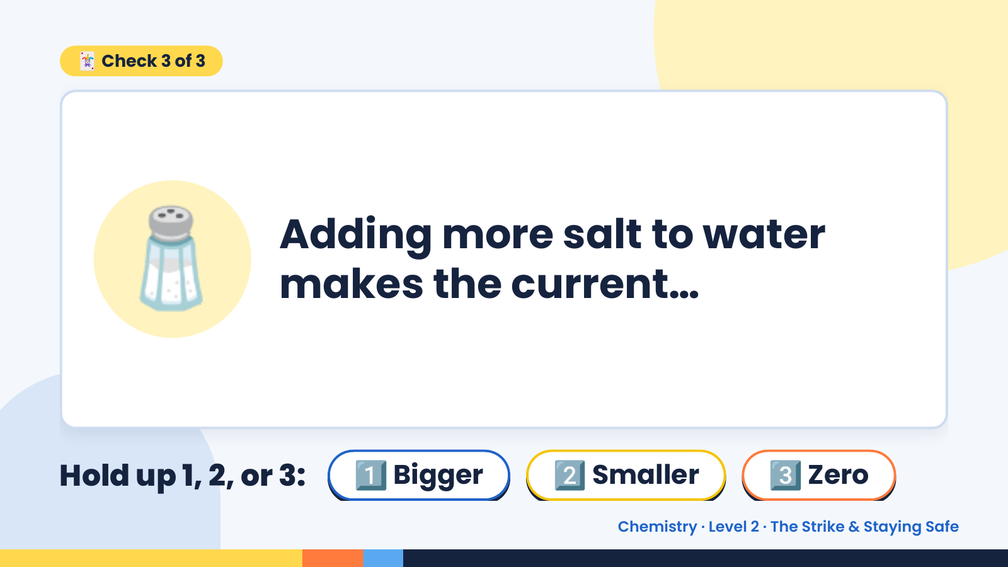
Notes:
🃏 Check 3 of 3
🧂 Adding more salt to water
makes the current…
Hold up 1, 2, or 3: 1️⃣ Bigger 2️⃣ Smaller 3️⃣ Zero
Chemistry · Level 2 · The Strike & Staying Safe

Slide 14
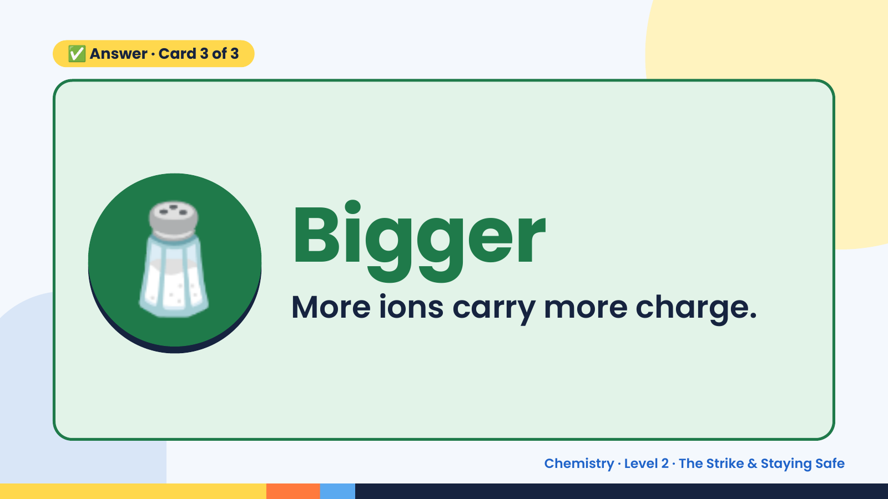
Notes:
✅ Answer · Card 3 of 3
🧂 Bigger
More ions carry more charge.
Chemistry · Level 2 · The Strike & Staying Safe

Slide 15
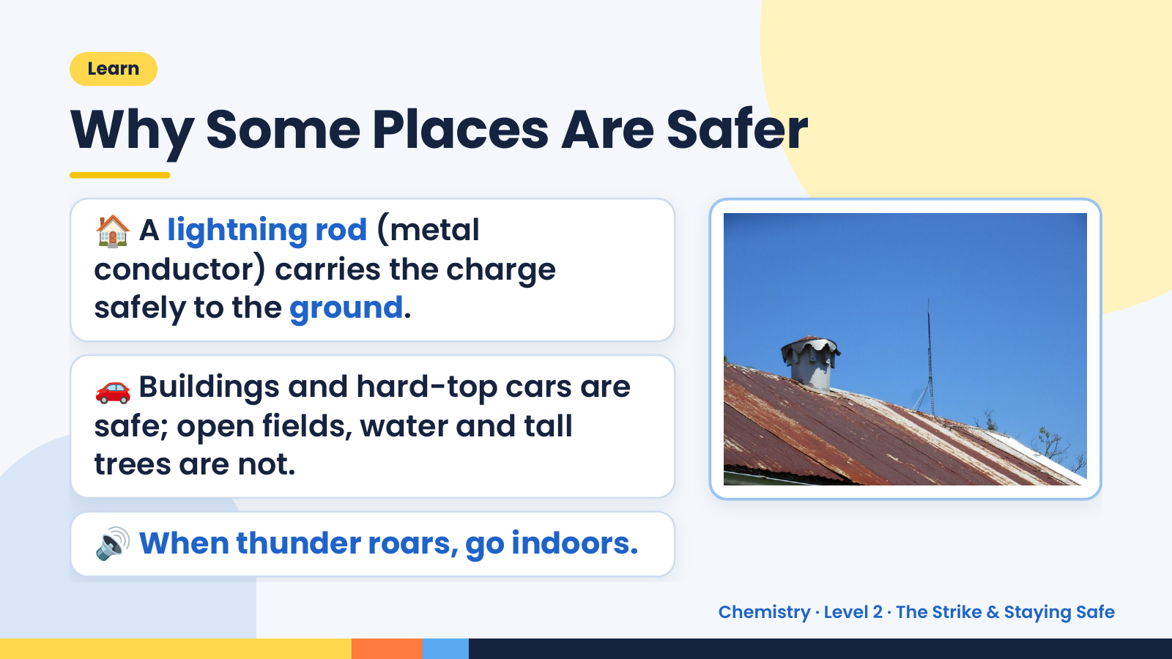
Notes:
Learn
Why Some Places Are Safer
🏠 A lightning rod (metal
conductor) carries the charge
safely to the ground.
🚗 Buildings and hard-top cars are
safe; open fields, water and tall
trees are not.
🔊 When thunder roars, go indoors.
Chemistry · Level 2 · The Strike & Staying Safe

Slide 16
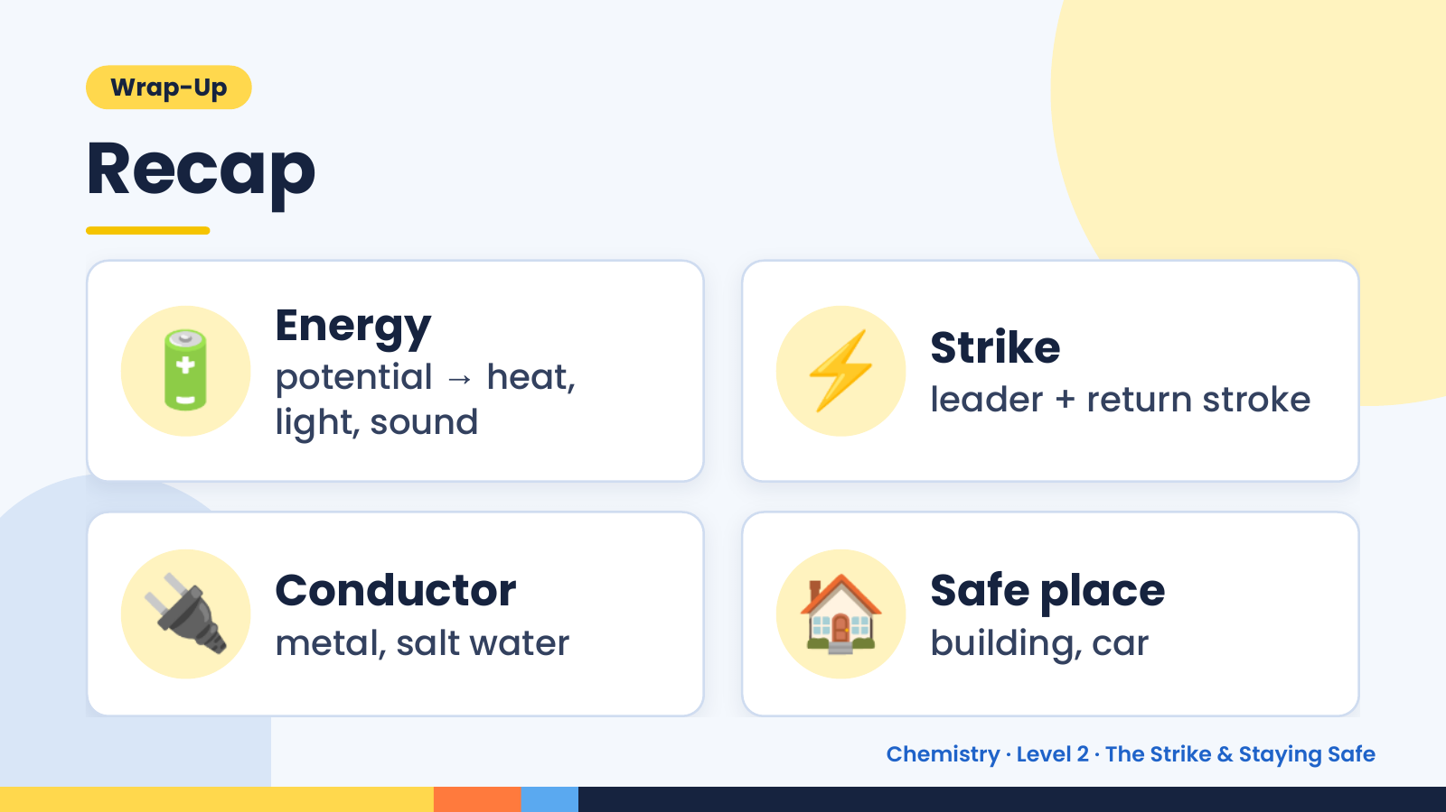
Notes:
Wrap-Up
Recap
🔋 Energy
potential → heat,
light, sound
⚡ Strike
leader + return stroke
🔌 Conductor
metal, salt water 🏠 Safe place
building, car
Chemistry · Level 2 · The Strike & Staying Safe

Slide 17
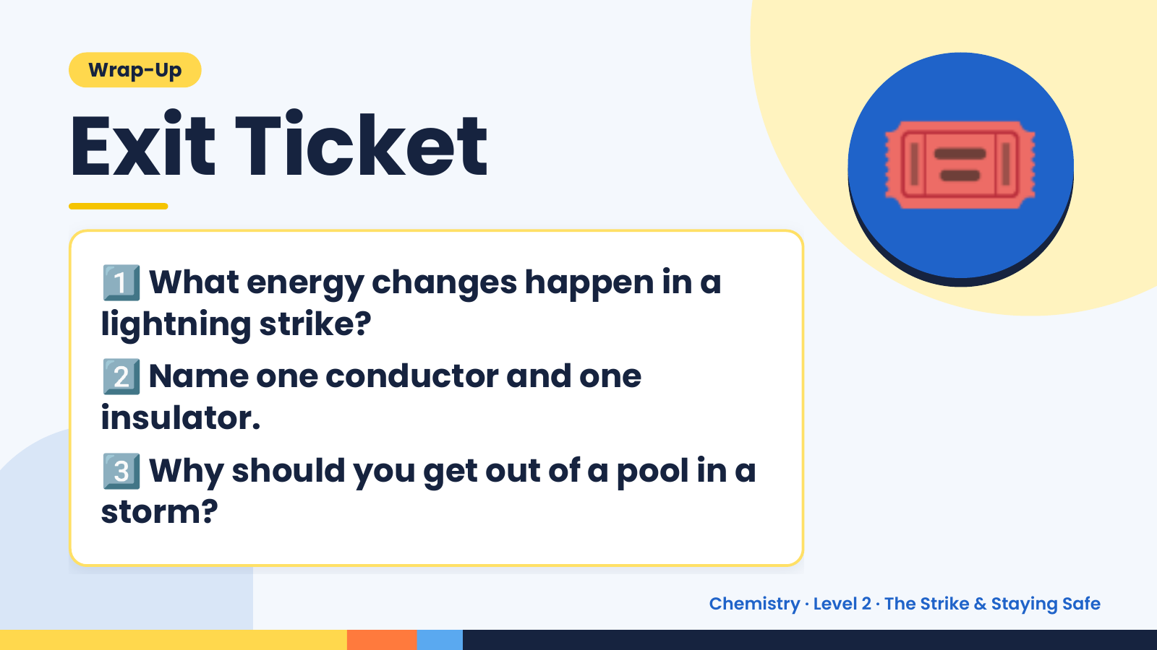
Notes:
Wrap-Up
Exit Ticket
1️⃣
What energy changes happen in a
lightning strike?
🎟️
2️⃣
Name one conductor and one
insulator.
3️⃣
Why should you get out of a pool in a
storm?
Chemistry · Level 2 · The Strike & Staying Safe

