Slide 1
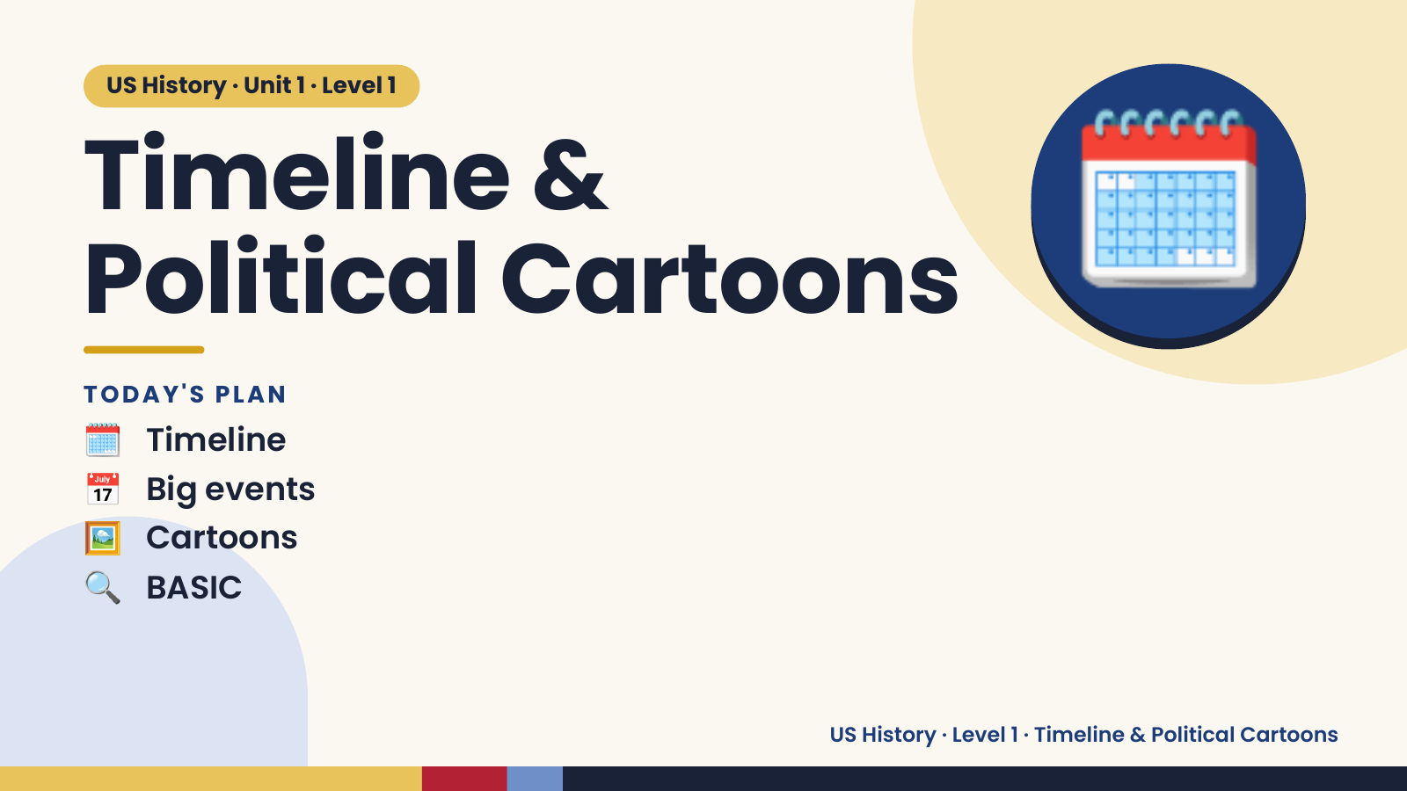
Notes:
US History · Unit 1 · Level 1
Timeline &
Political Cartoons
🗓️ Timeline
TODAY'S PLAN
🗓️
📅 Big events
🖼️ Cartoons
🔍 BASIC
US History · Level 1 · Timeline & Political Cartoons

Slide 2
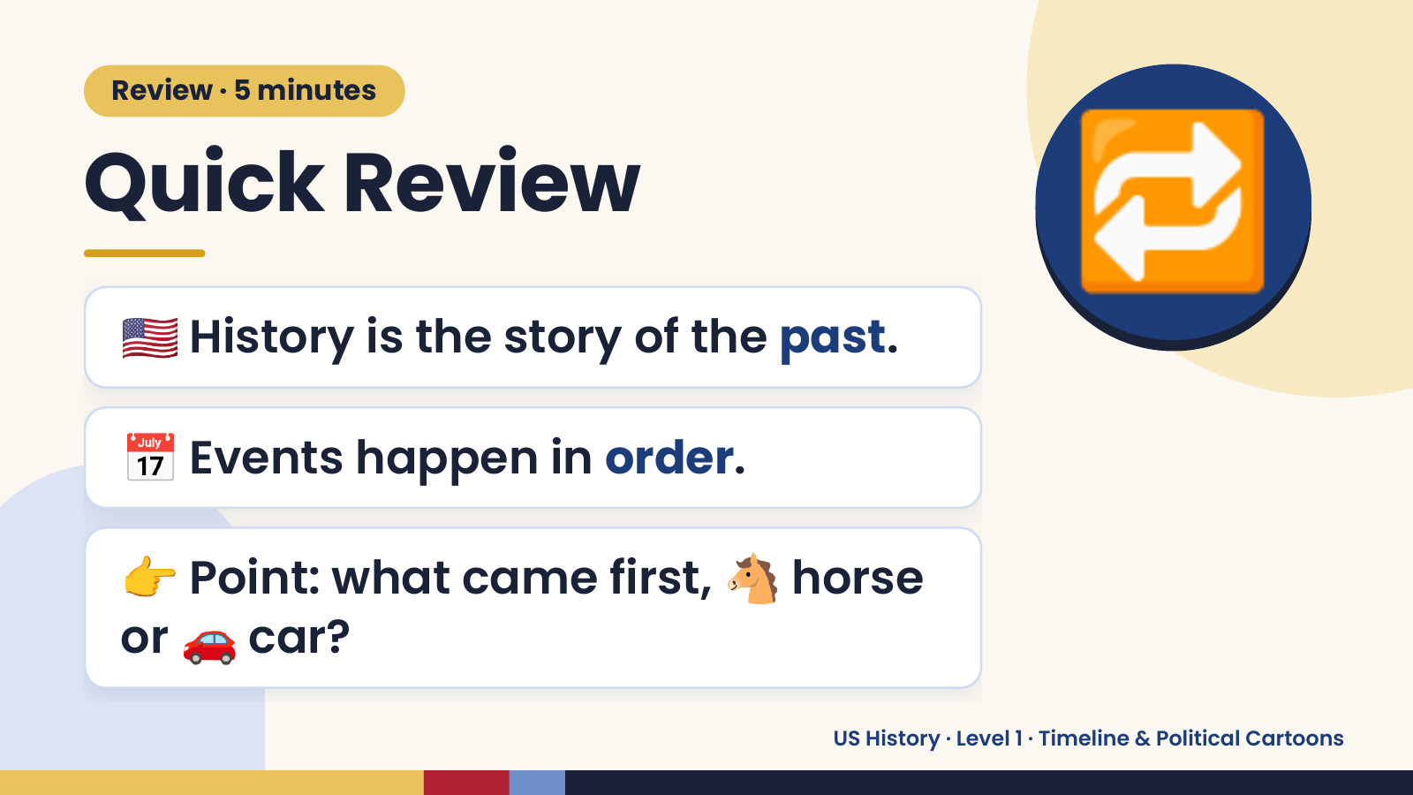
Notes:
Review · 5 minutes
Quick Review
🇺🇸 History is the story of the past.
🔁
📅 Events happen in order.
👉 Point: what came first, 🐴 horse
or 🚗 car?
US History · Level 1 · Timeline & Political Cartoons

Slide 3
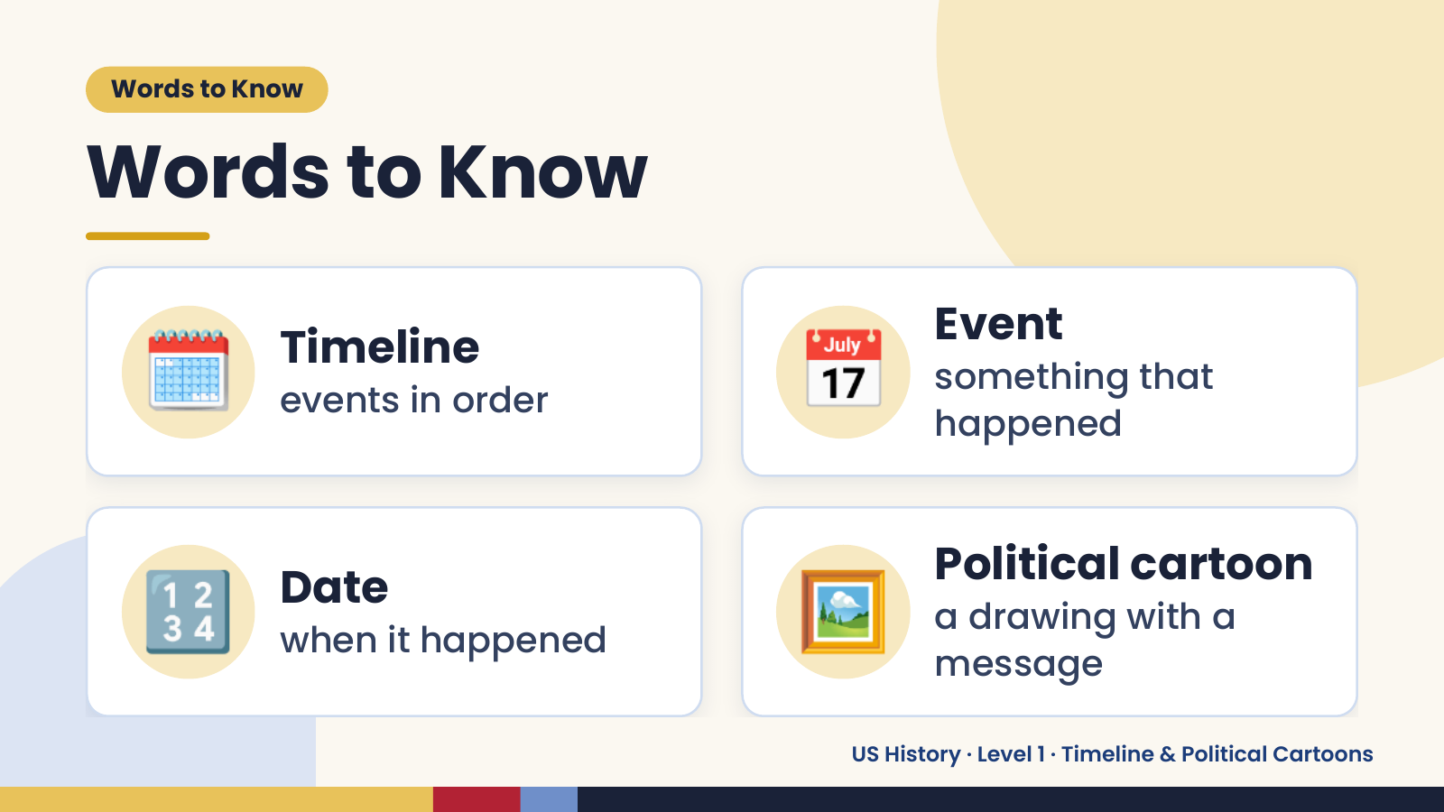
Notes:
Words to Know
Words to Know
🗓️ Timeline
events in order 📅 Event
something that
happened
🔢 Date
when it happened 🖼️ Political cartoon
a drawing with a
message
US History · Level 1 · Timeline & Political Cartoons

Slide 4
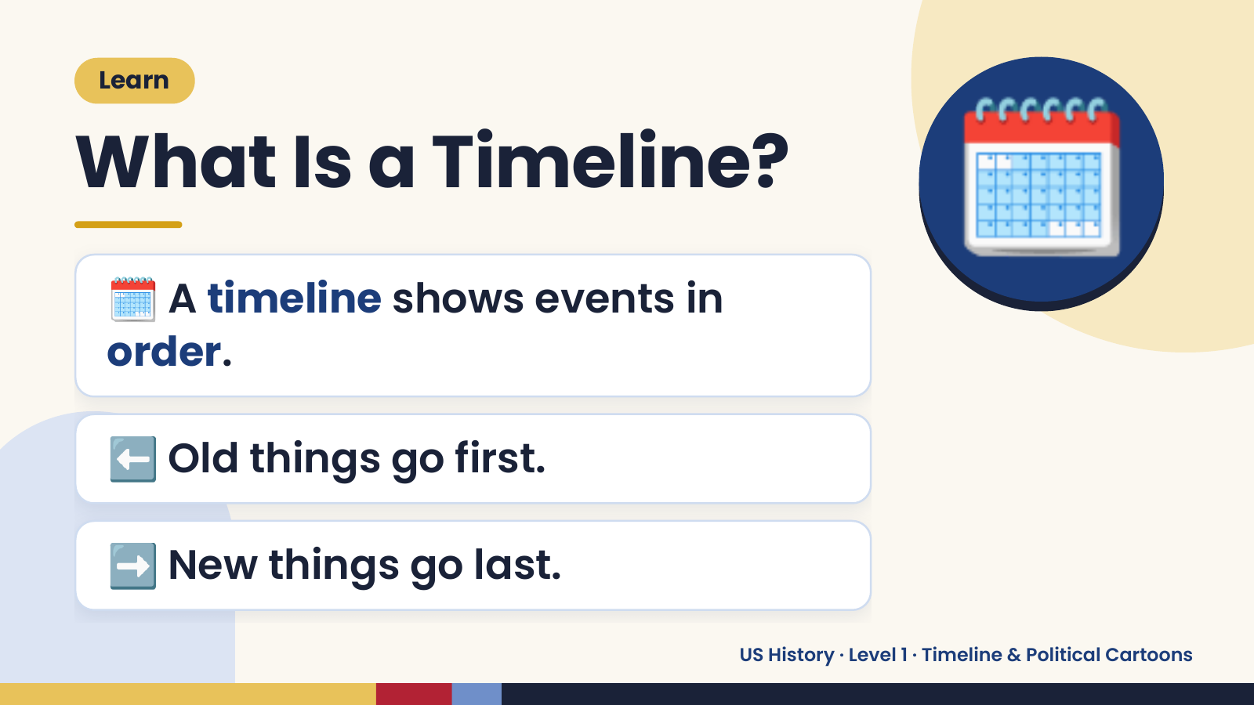
Notes:
Learn
What Is a Timeline?
🗓️ A timeline shows events in
order.
🗓️
⬅️ Old things go first.
➡️ New things go last.
US History · Level 1 · Timeline & Political Cartoons

Slide 5
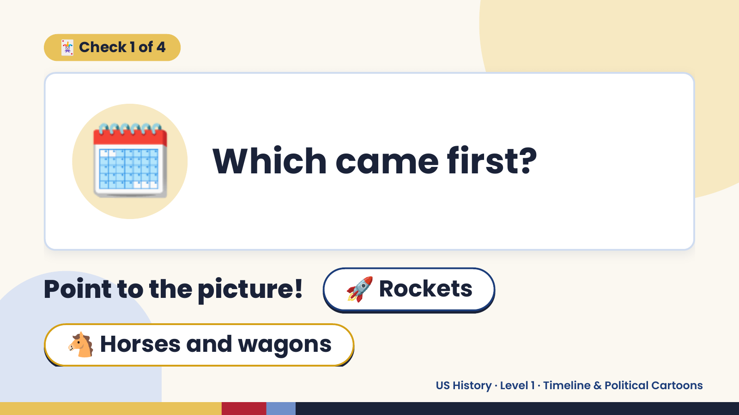
Notes:
🃏 Check 1 of 4
🗓️ Which came first?
Point to the picture! 🚀 Rockets
🐴 Horses and wagons
US History · Level 1 · Timeline & Political Cartoons

Slide 6
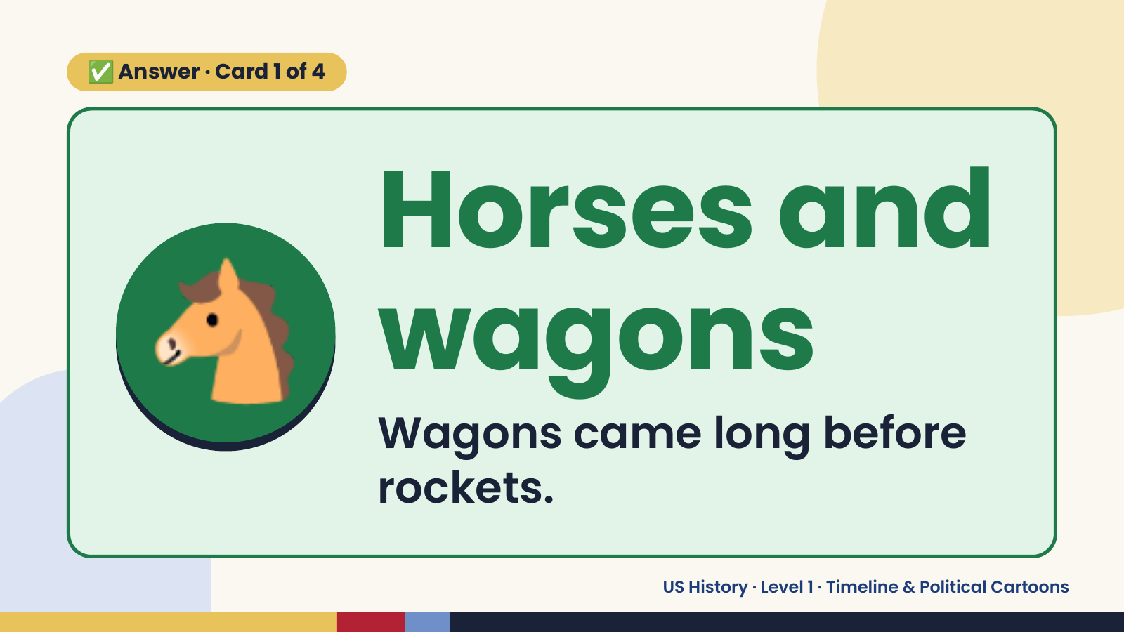
Notes:
✅ Answer · Card 1 of 4
🐴 Horses and
wagons
Wagons came long before
rockets.
US History · Level 1 · Timeline & Political Cartoons

Slide 7
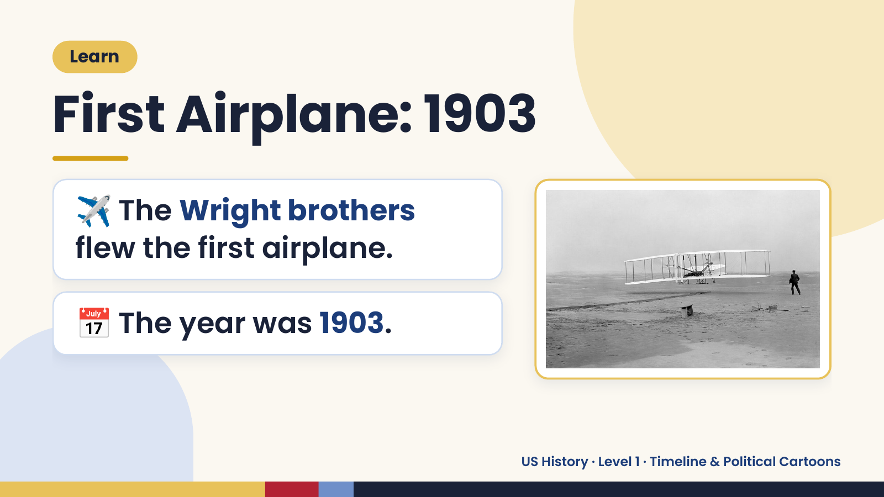
Notes:
Learn
First Airplane: 1903
✈️ The Wright brothers
flew the first airplane.
📅 The year was 1903.
US History · Level 1 · Timeline & Political Cartoons

Slide 8
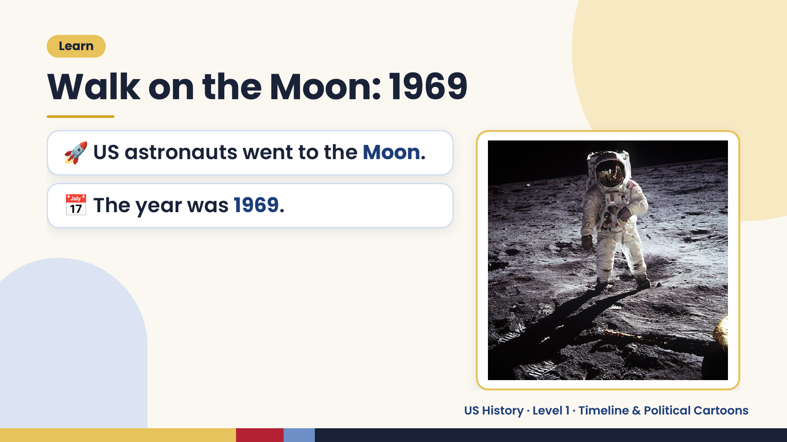
Notes:
Learn
Walk on the Moon: 1969
🚀 US astronauts went to the Moon.
📅 The year was 1969.
US History · Level 1 · Timeline & Political Cartoons

Slide 9
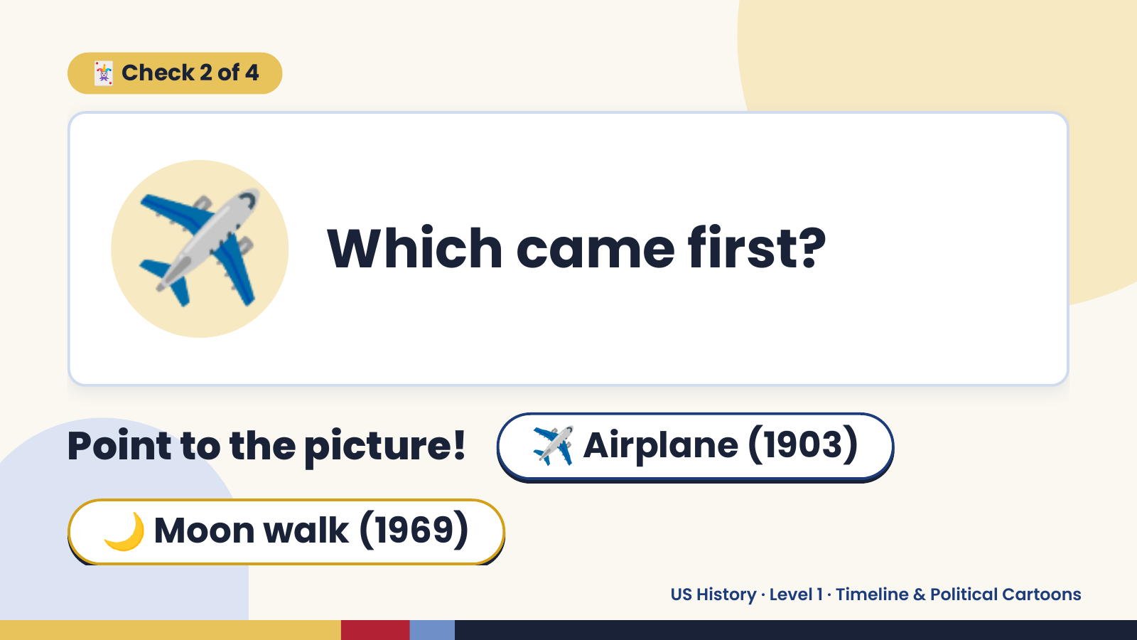
Notes:
🃏 Check 2 of 4
✈️ Which came first?
Point to the picture! ✈️ Airplane (1903)
🌙 Moon walk (1969)
US History · Level 1 · Timeline & Political Cartoons

Slide 10
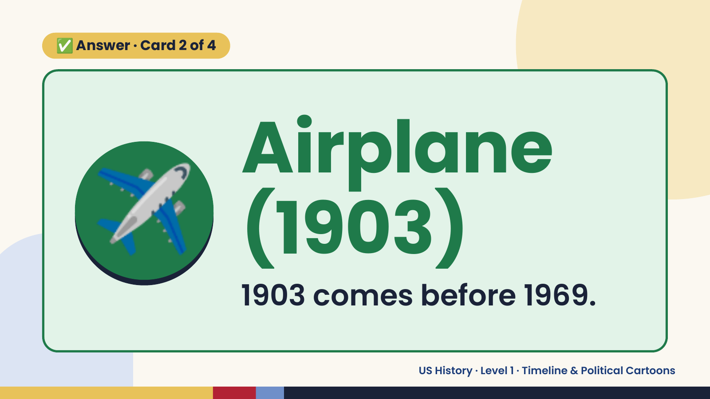
Notes:
✅ Answer · Card 2 of 4
✈️ Airplane
(1903)
1903 comes before 1969.
US History · Level 1 · Timeline & Political Cartoons

Slide 11
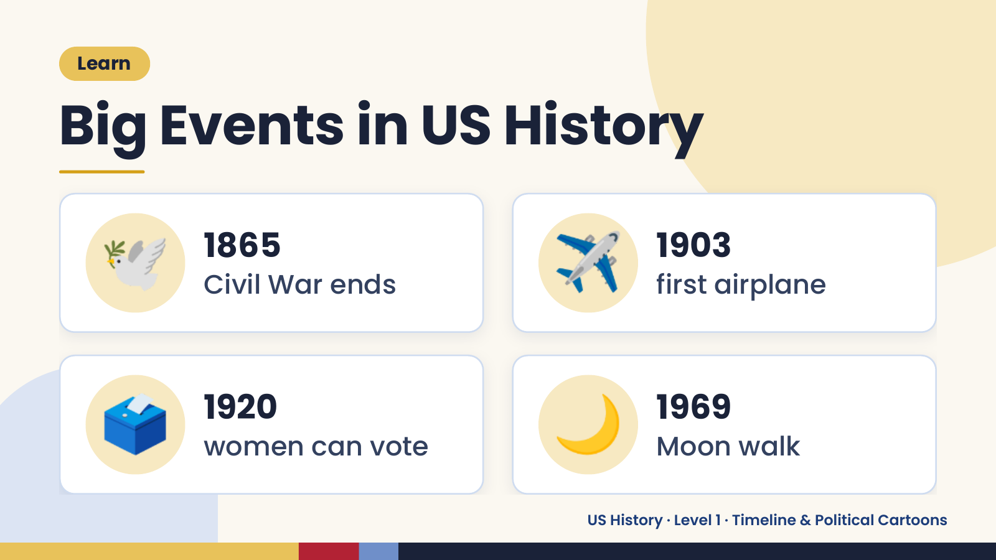
Notes:
Learn
Big Events in US History
🕊️ 1865
Civil War ends ✈️ 1903
first airplane
🗳️ 1920
women can vote 🌙 1969
Moon walk
US History · Level 1 · Timeline & Political Cartoons

Slide 12
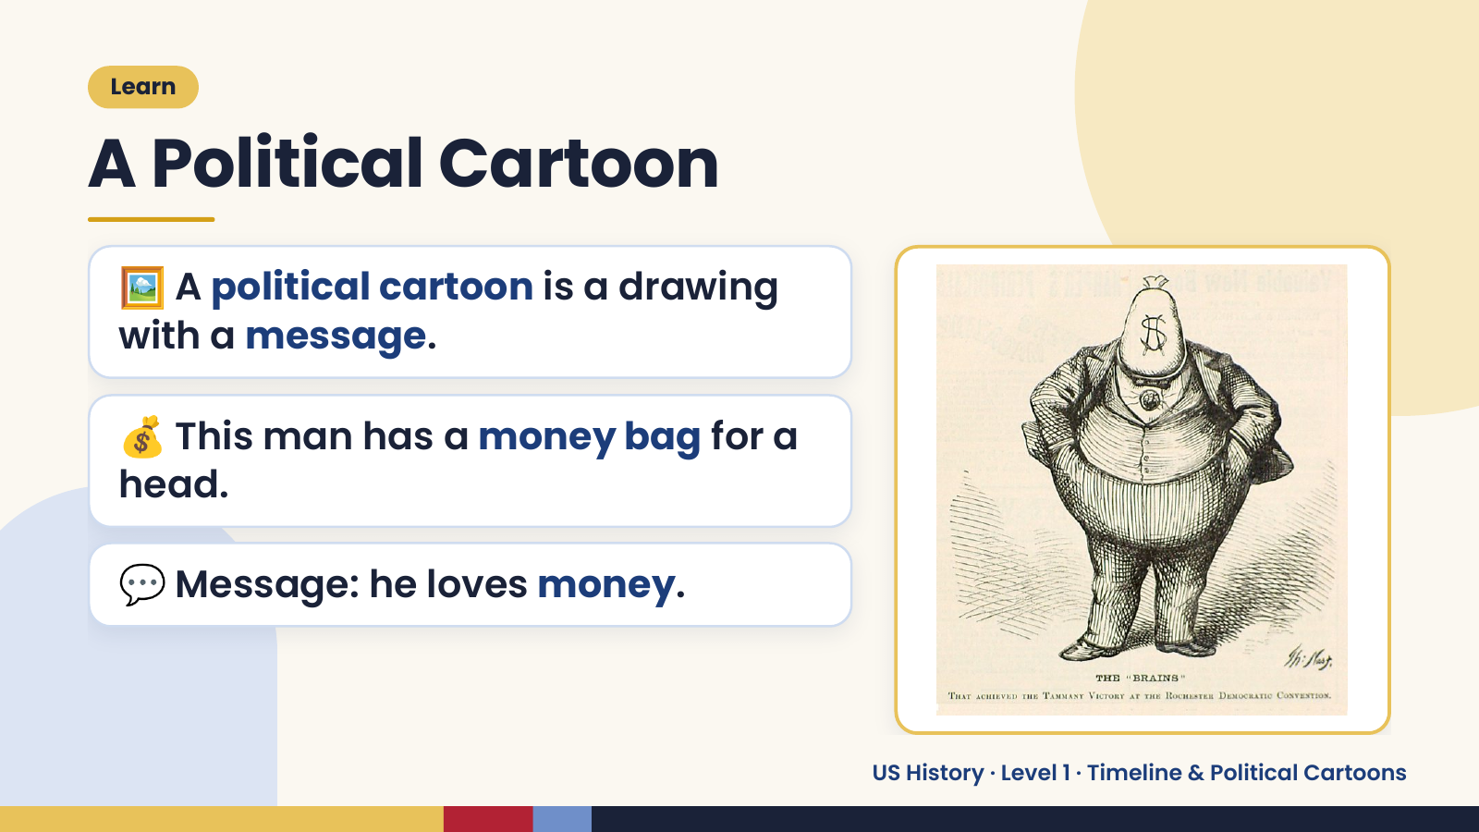
Notes:
Learn
A Political Cartoon
🖼️ A political cartoon is a drawing
with a message.
💰 This man has a money bag for a
head.
💬 Message: he loves money.
US History · Level 1 · Timeline & Political Cartoons

Slide 13
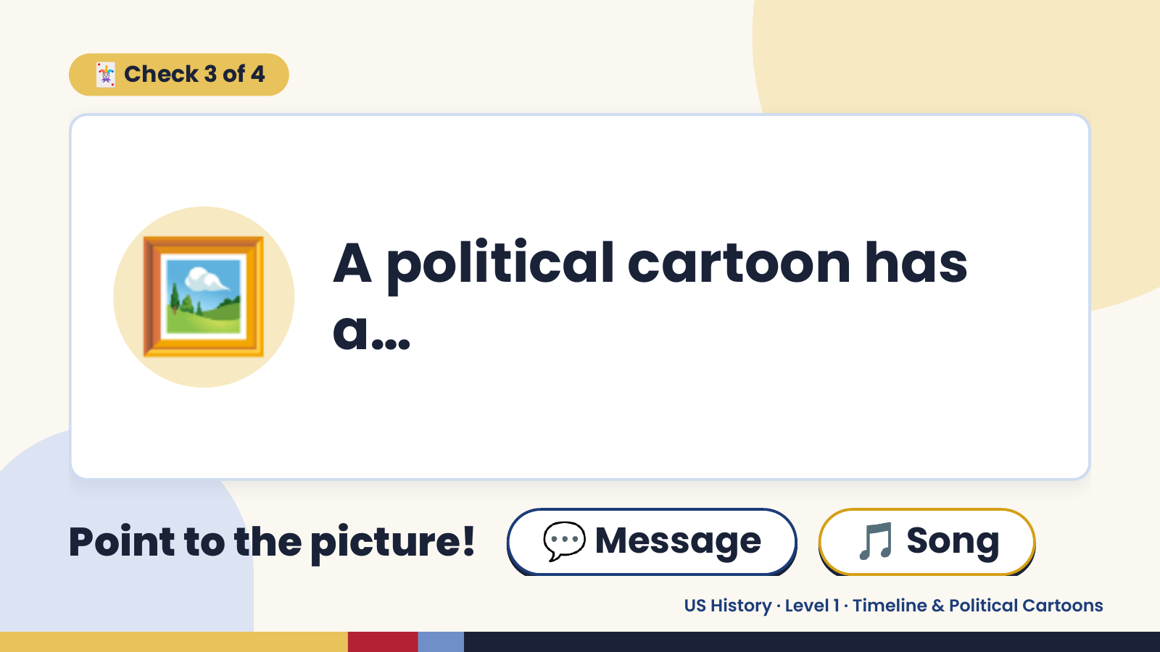
Notes:
🃏 Check 3 of 4
🖼️ A political cartoon has
a…
Point to the picture! 💬 Message 🎵 Song
US History · Level 1 · Timeline & Political Cartoons

Slide 14
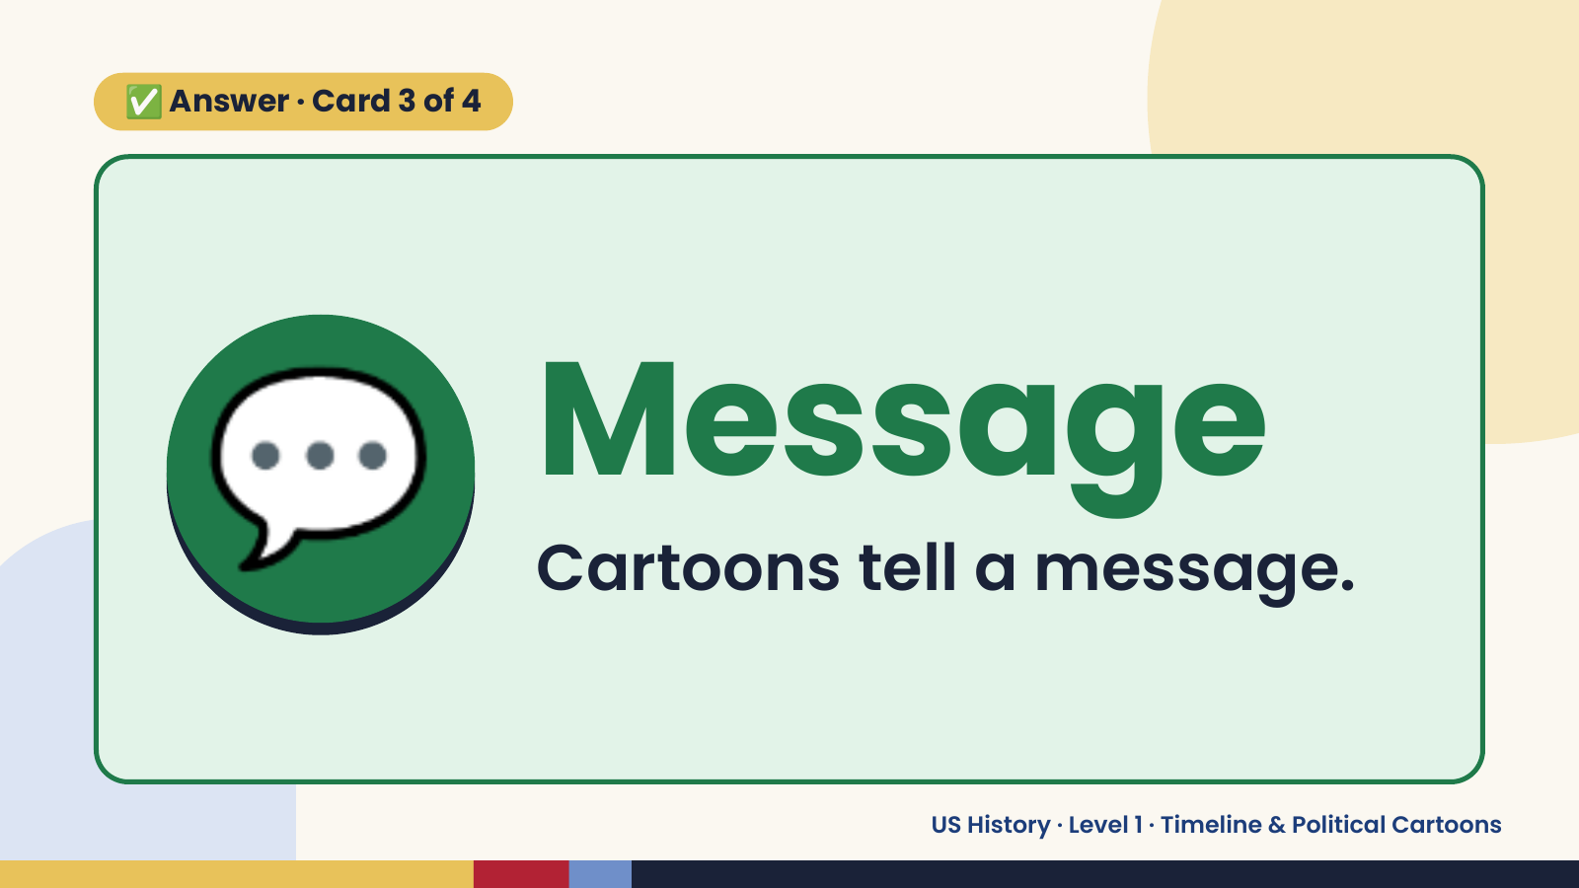
Notes:
✅ Answer · Card 3 of 4
💬 Message
Cartoons tell a message.
US History · Level 1 · Timeline & Political Cartoons

Slide 15
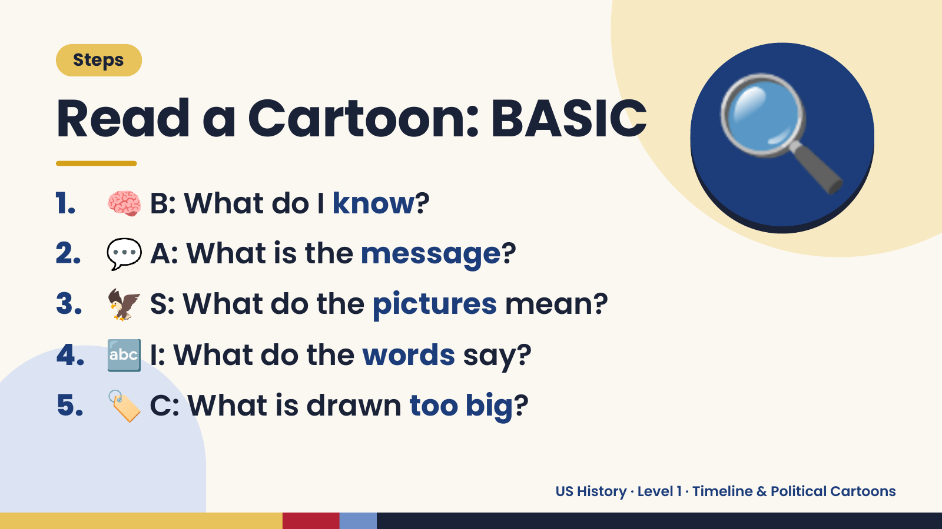
Notes:
Steps
Read a Cartoon: BASIC
1. 🧠 B: What do I know?
2. 💬 A: What is the message?
🔍
3. 🦅 S: What do the pictures mean?
4. 🔤 I: What do the words say?
5. 🏷️ C: What is drawn too big?
US History · Level 1 · Timeline & Political Cartoons

Slide 16
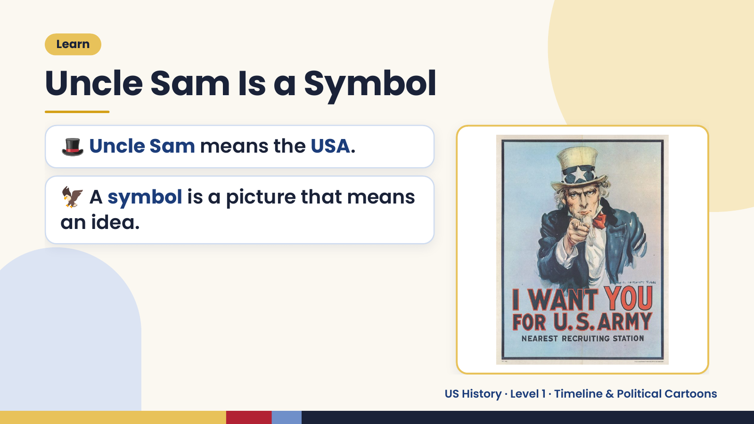
Notes:
Learn
Uncle Sam Is a Symbol
🎩 Uncle Sam means the USA.
🦅 A symbol is a picture that means
an idea.
US History · Level 1 · Timeline & Political Cartoons

Slide 17
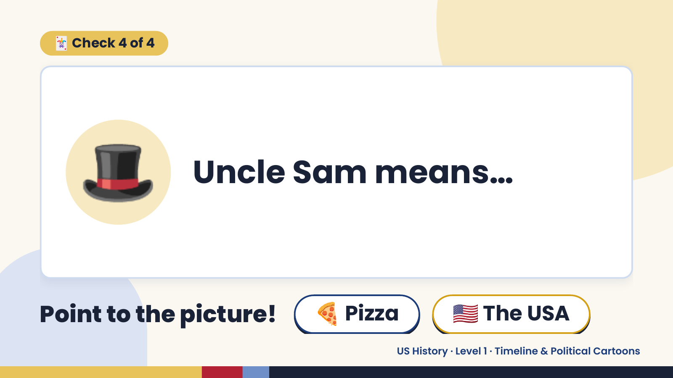
Notes:
🃏 Check 4 of 4
🎩 Uncle Sam means…
Point to the picture! 🍕 Pizza 🇺🇸 The USA
US History · Level 1 · Timeline & Political Cartoons

Slide 18
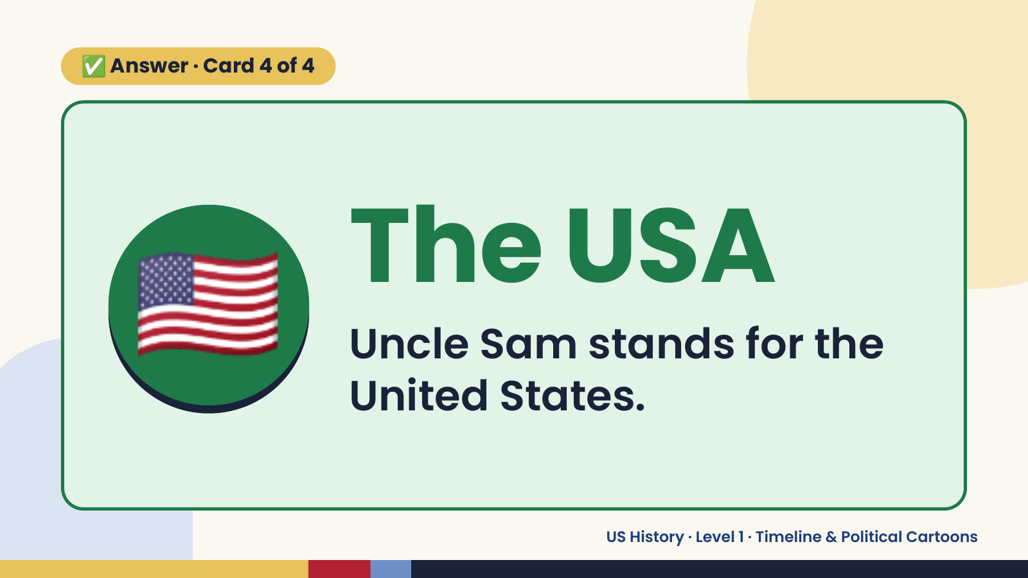
Notes:
✅ Answer · Card 4 of 4
🇺🇸 The USA
Uncle Sam stands for the
United States.
US History · Level 1 · Timeline & Political Cartoons

Slide 19
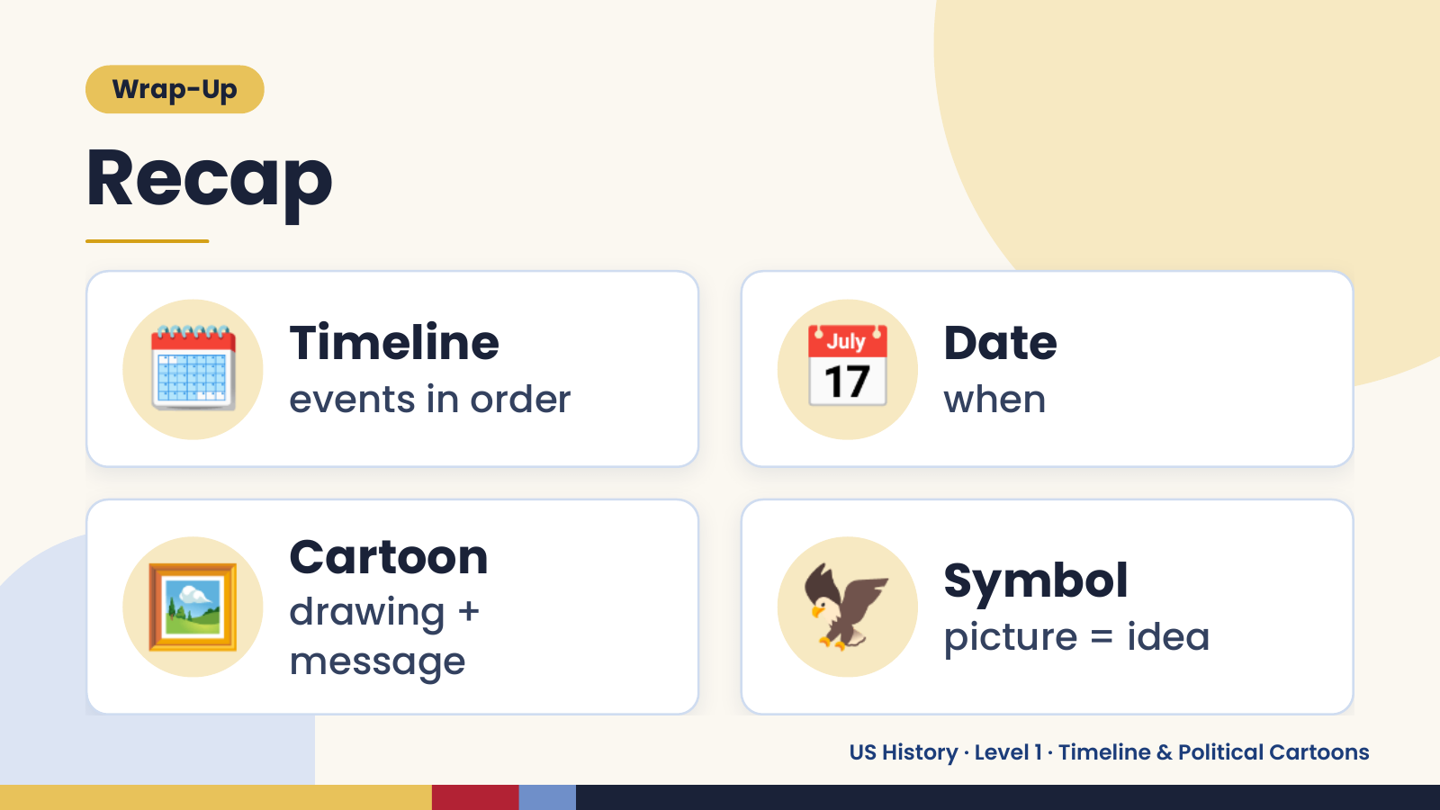
Notes:
Wrap-Up
Recap
🗓️ Timeline
events in order 📅 Date
when
🖼️ Cartoon
drawing +
message
🦅 Symbol
picture = idea
US History · Level 1 · Timeline & Political Cartoons

Slide 20
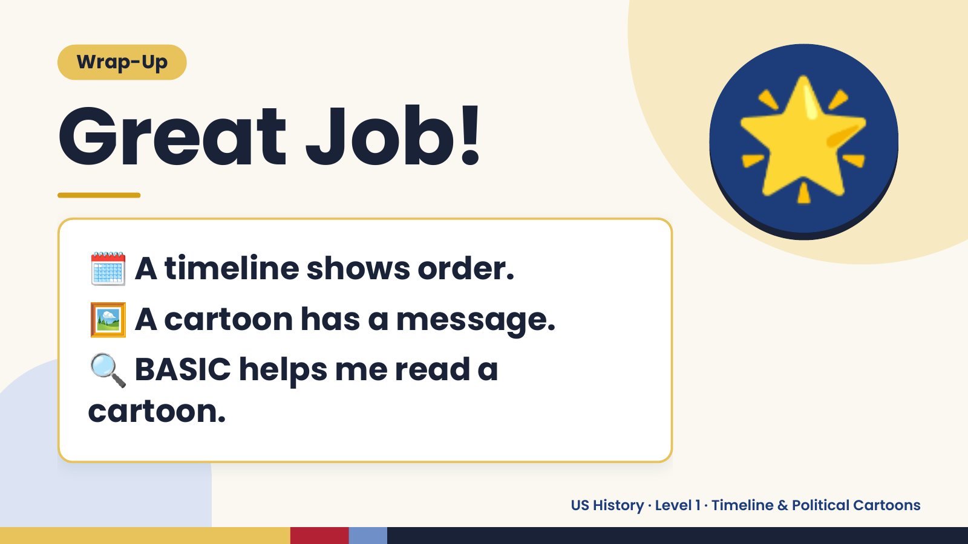
Notes:
Wrap-Up
Great Job!
🗓️ A timeline shows order.
🌟
🖼️ A cartoon has a message.
🔍BASIC helps me read a
cartoon.
US History · Level 1 · Timeline & Political Cartoons

