Slide 1
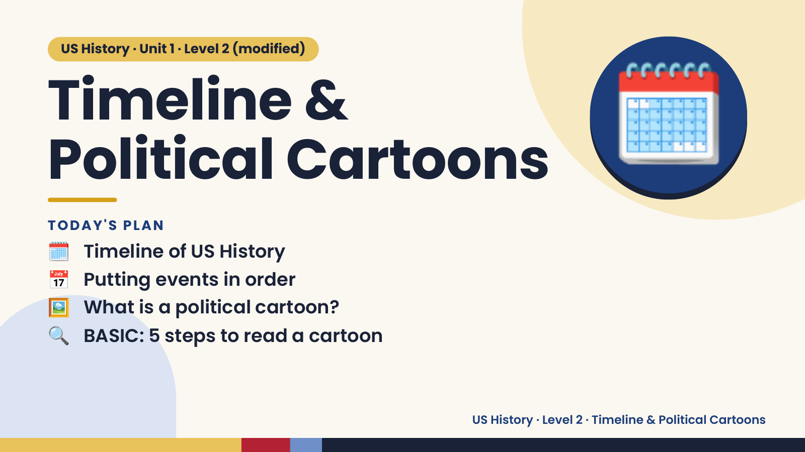
Notes:
US History · Unit 1 · Level 2 (modified)
Timeline &
Political Cartoons
🗓️ Timeline of US History
TODAY'S PLAN
🗓️
📅 Putting events in order
🖼️ What is a political cartoon?
🔍 BASIC: 5 steps to read a cartoon
US History · Level 2 · Timeline & Political Cartoons

Slide 2
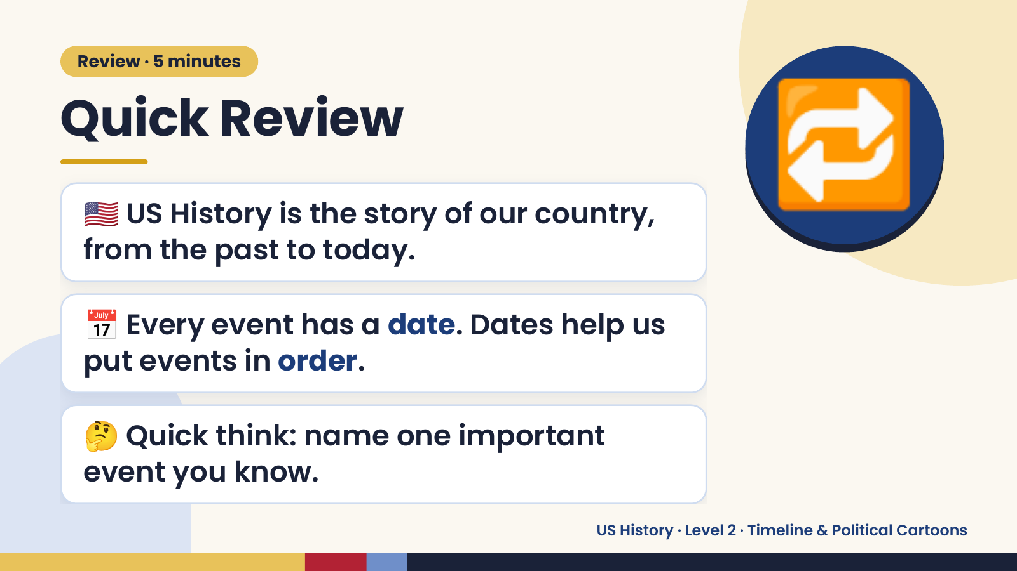
Notes:
Review · 5 minutes
Quick Review
🇺🇸 US History is the story of our country,
from the past to today.
🔁
📅 Every event has a date. Dates help us
put events in order.
🤔 Quick think: name one important
event you know.
US History · Level 2 · Timeline & Political Cartoons

Slide 3
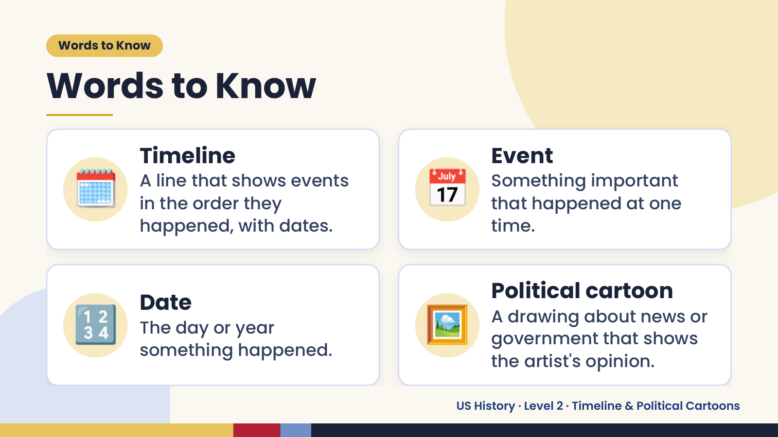
Notes:
Words to Know
Words to Know
🗓️ Timeline
A line that shows events
in the order they
happened, with dates.
📅 Event
Something important
that happened at one
time.
🔢 Date
The day or year
something happened.
🖼️ Political cartoon
A drawing about news or
government that shows
the artist's opinion.
US History · Level 2 · Timeline & Political Cartoons

Slide 4
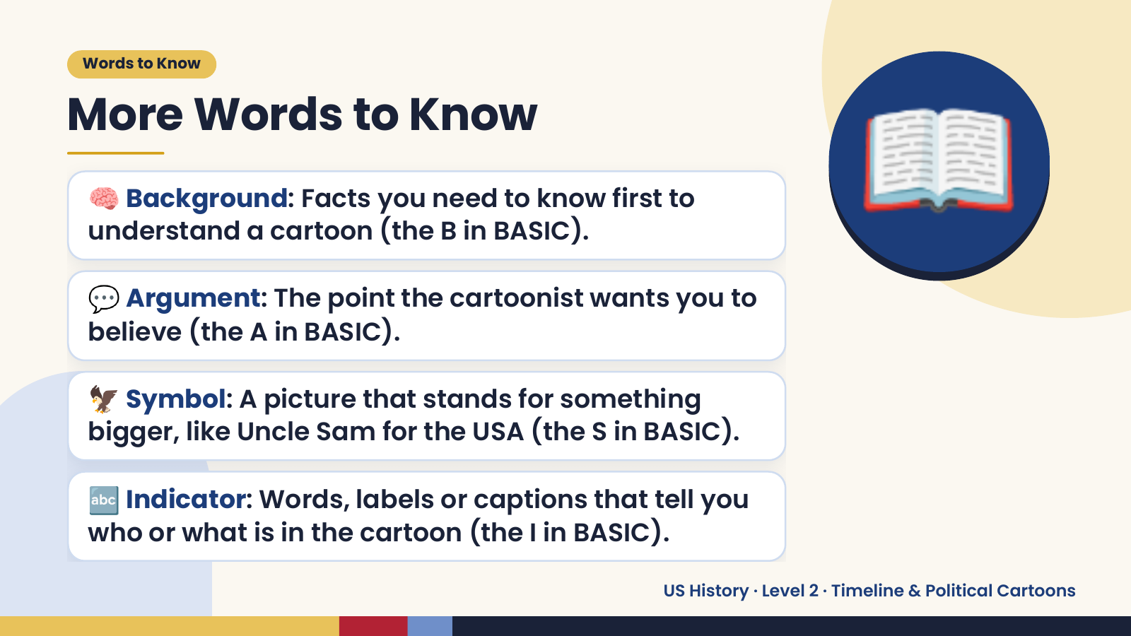
Notes:
Words to Know
More Words to Know
🧠 Background: Facts you need to know first to
understand a cartoon (the B in BASIC).
💬 Argument: The point the cartoonist wants you to
believe (the A in BASIC).
📖
🦅 Symbol: A picture that stands for something
bigger, like Uncle Sam for the USA (the S in BASIC).
🔤 Indicator: Words, labels or captions that tell you
who or what is in the cartoon (the I in BASIC).
US History · Level 2 · Timeline & Political Cartoons

Slide 5
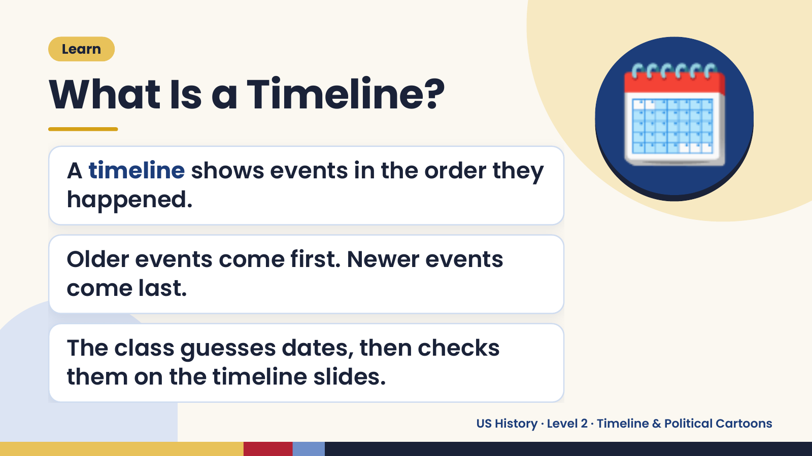
Notes:
Learn
What Is a Timeline?
A timeline shows events in the order they
happened.
🗓️
Older events come first. Newer events
come last.
The class guesses dates, then checks
them on the timeline slides.
US History · Level 2 · Timeline & Political Cartoons

Slide 6
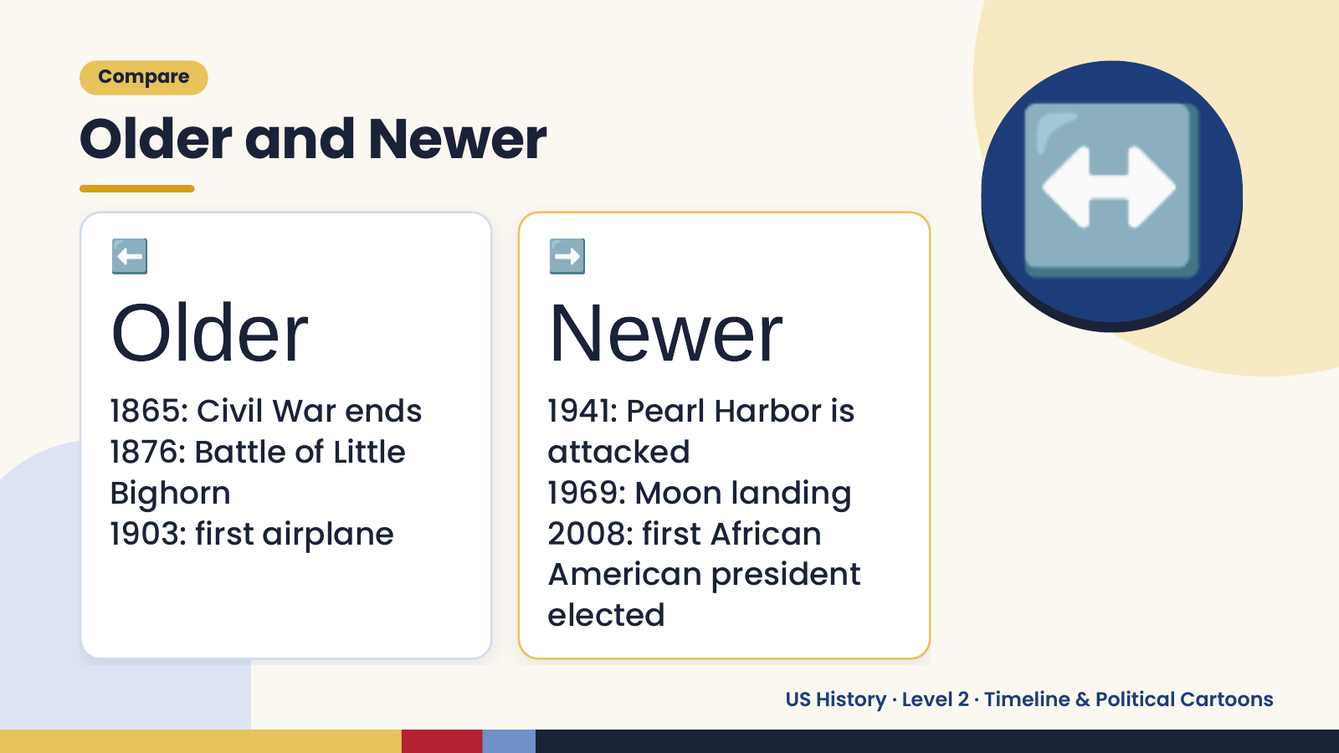
Notes:
Compare
Older and Newer
⬅️
Older
1865: Civil War ends
➡️
Newer
1941: Pearl Harbor is
↔️
1876: Battle of Little attacked
Bighorn 1969: Moon landing
1903: first airplane 2008: first African
American president
elected
US History · Level 2 · Timeline & Political Cartoons

Slide 7
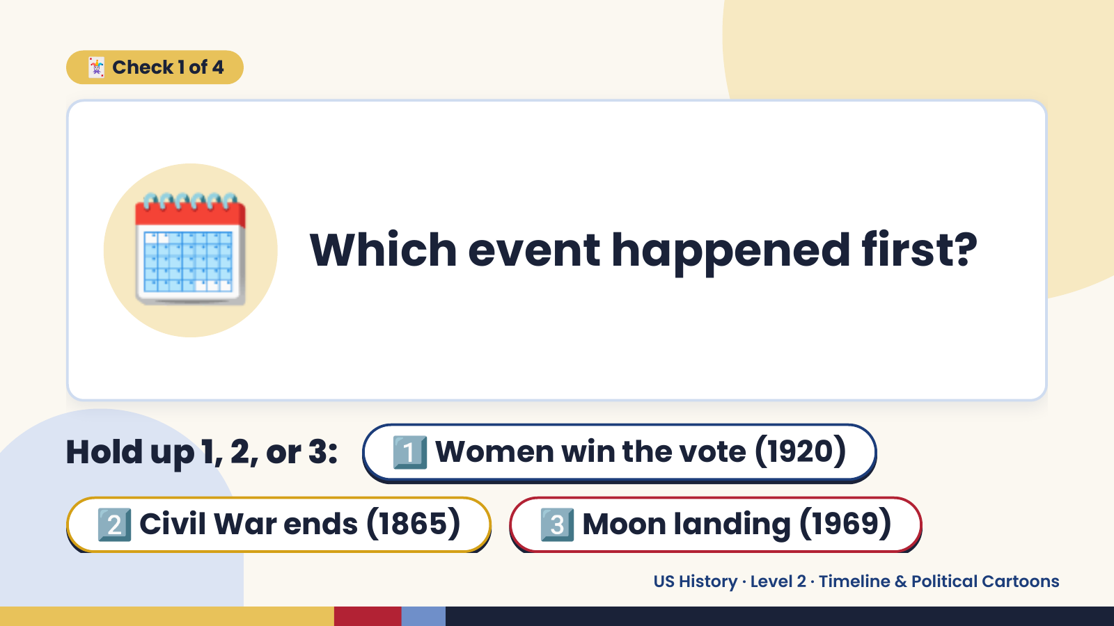
Notes:
🃏 Check 1 of 4
🗓️ Which event happened first?
Hold up 1, 2, or 3: 1️⃣ Women win the vote (1920)
2️⃣ Civil War ends (1865) 3️⃣ Moon landing (1969)
US History · Level 2 · Timeline & Political Cartoons

Slide 8
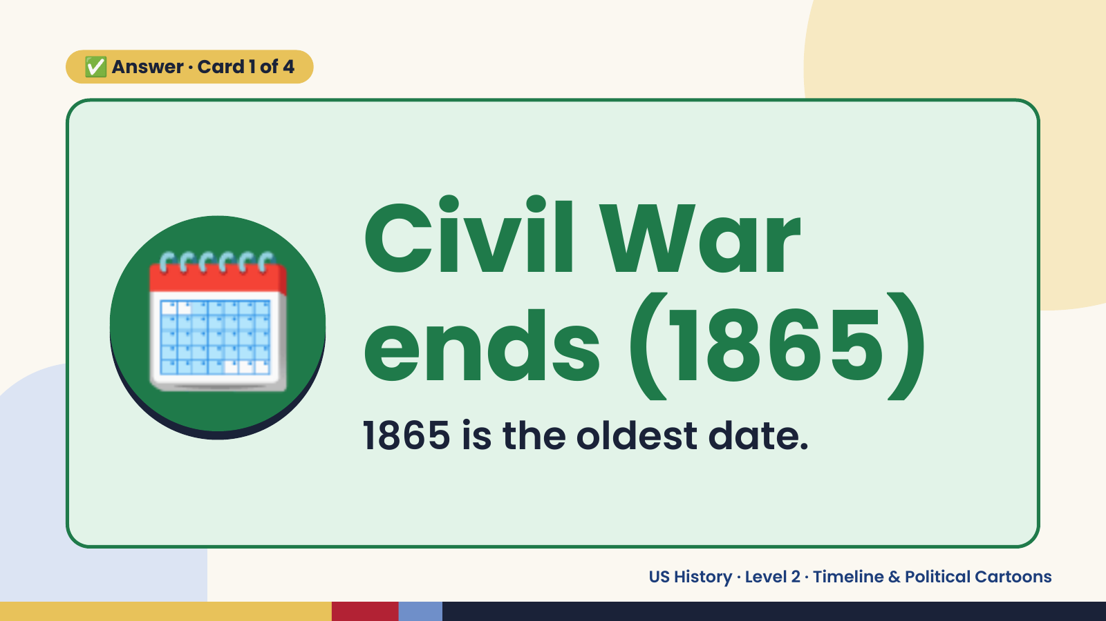
Notes:
✅ Answer · Card 1 of 4
🗓️ Civil War
ends (1865)
1865 is the oldest date.
US History · Level 2 · Timeline & Political Cartoons

Slide 9
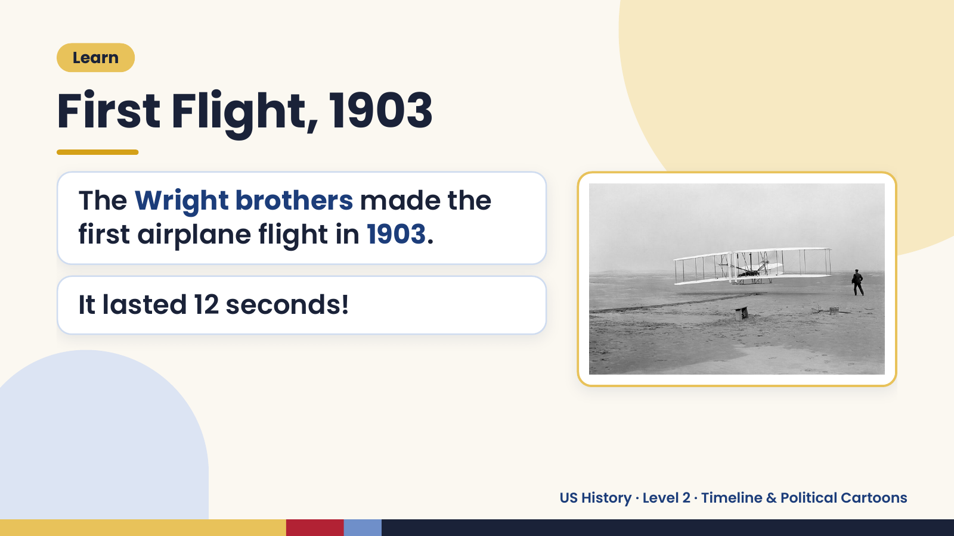
Notes:
Learn
First Flight, 1903
The Wright brothers made the
first airplane flight in 1903.
It lasted 12 seconds!
US History · Level 2 · Timeline & Political Cartoons

Slide 10
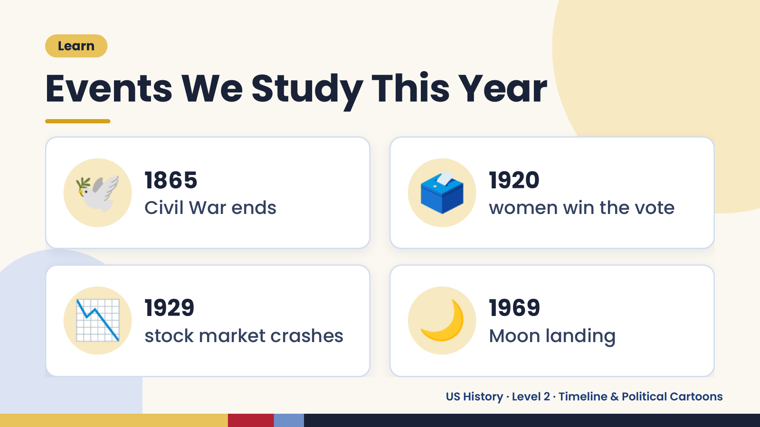
Notes:
Learn
Events We Study This Year
🕊️ 1865
Civil War ends 🗳️ 1920
women win the vote
📉 1929
stock market crashes 🌙 1969
Moon landing
US History · Level 2 · Timeline & Political Cartoons

Slide 11
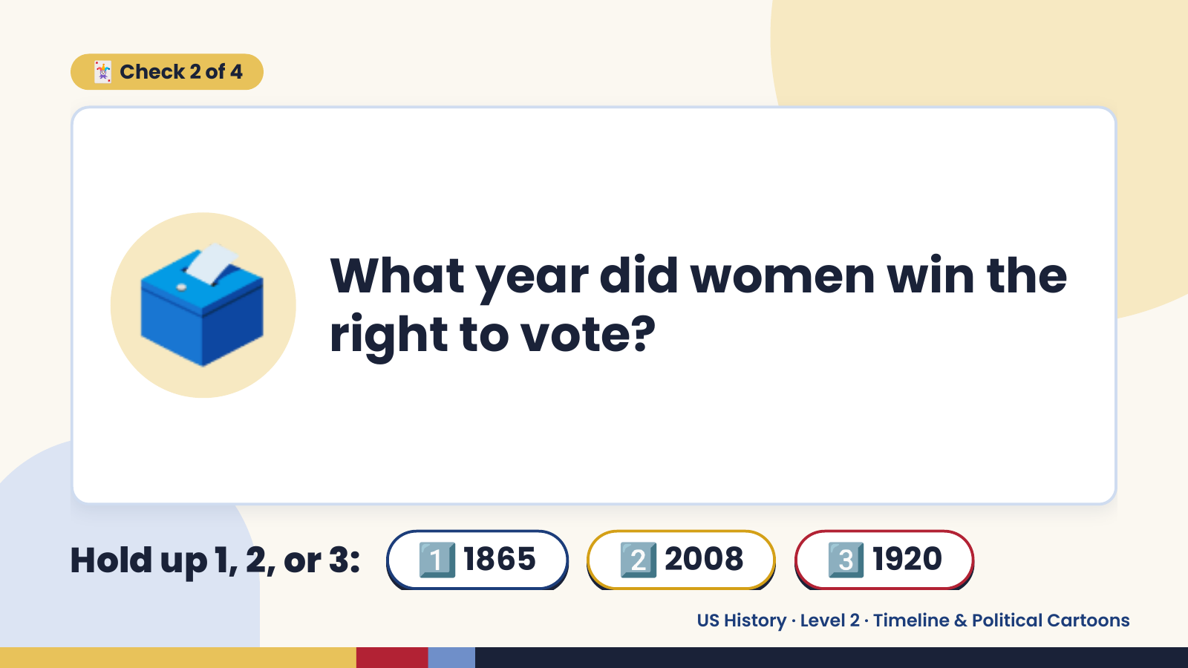
Notes:
🃏 Check 2 of 4
🗳️ What year did women win the
right to vote?
Hold up 1, 2, or 3: 1️⃣ 1865 2️⃣ 2008 3️⃣ 1920
US History · Level 2 · Timeline & Political Cartoons

Slide 12
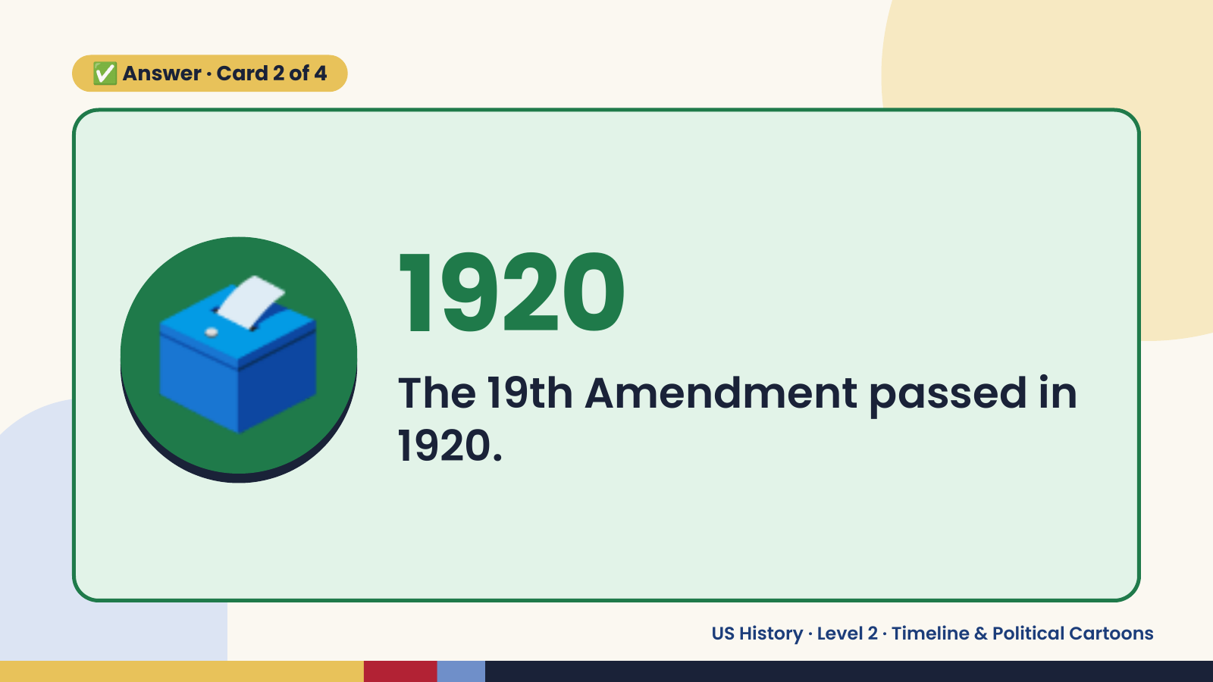
Notes:
✅ Answer · Card 2 of 4
🗳️ 1920
The 19th Amendment passed in
1920.
US History · Level 2 · Timeline & Political Cartoons

Slide 13
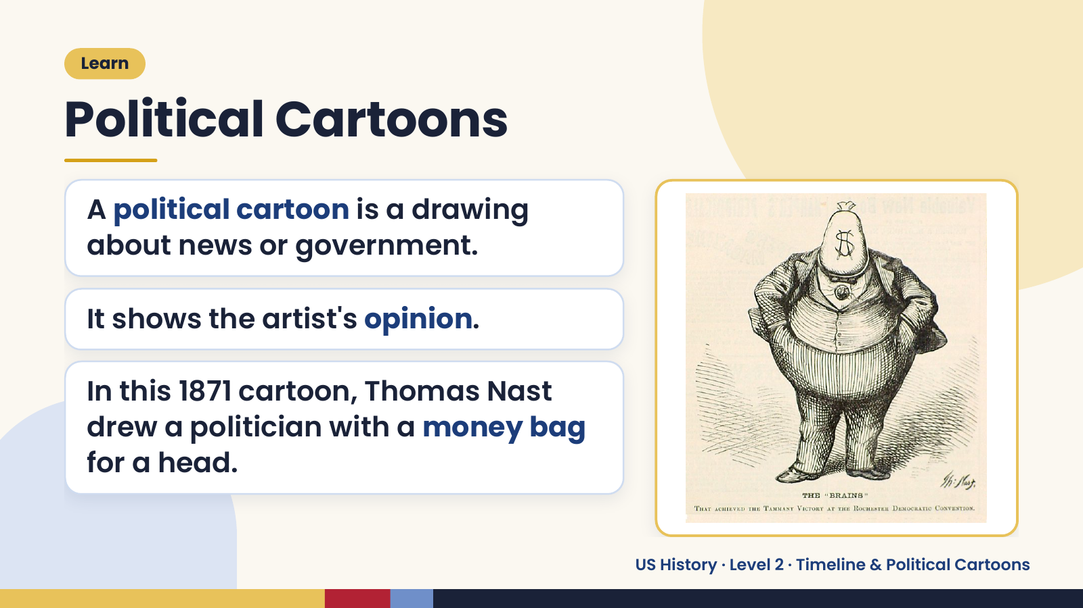
Notes:
Learn
Political Cartoons
A political cartoon is a drawing
about news or government.
It shows the artist's opinion.
In this 1871 cartoon, Thomas Nast
drew a politician with a money bag
for a head.
US History · Level 2 · Timeline & Political Cartoons

Slide 14
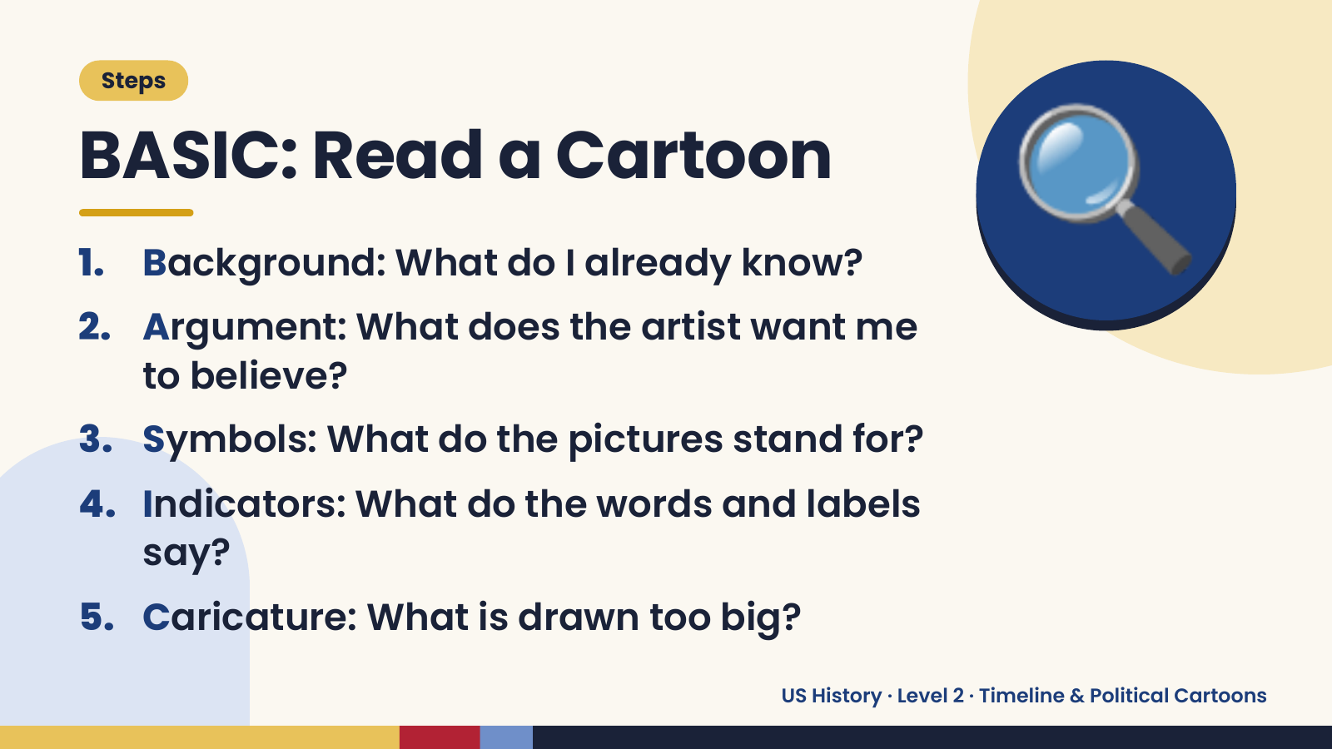
Notes:
Steps
BASIC: Read a Cartoon
1. Background: What do I already know?
2. Argument: What does the artist want me
to believe?
🔍
3. Symbols: What do the pictures stand for?
4. Indicators: What do the words and labels
say?
5. Caricature: What is drawn too big?
US History · Level 2 · Timeline & Political Cartoons

Slide 15
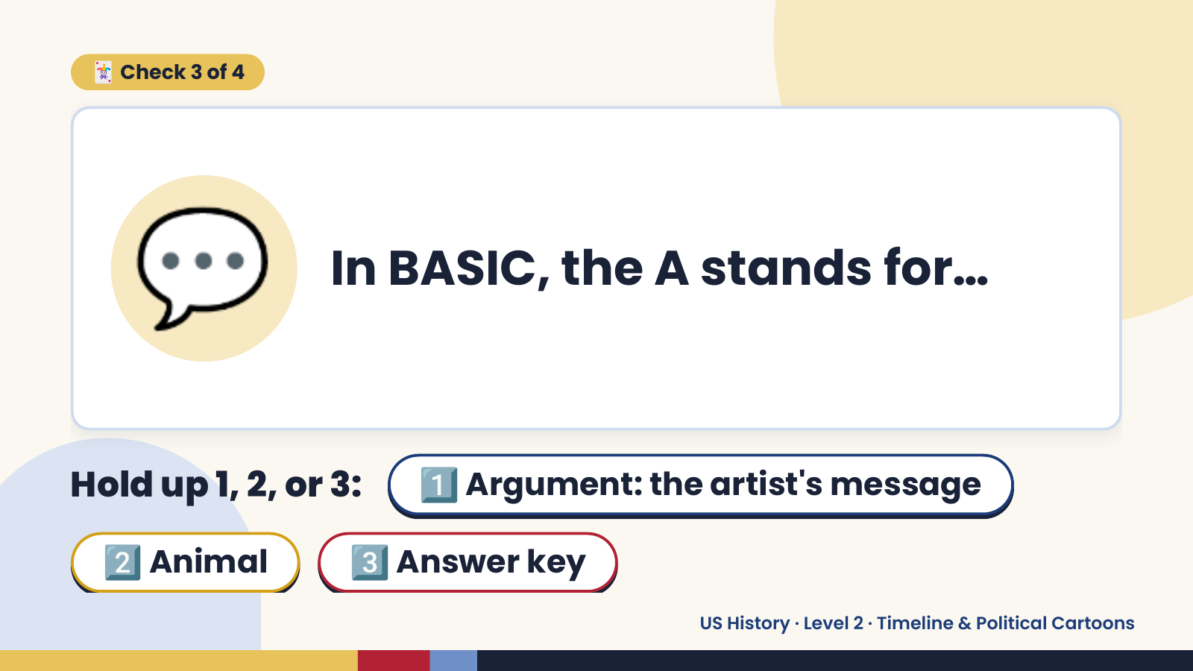
Notes:
🃏 Check 3 of 4
💬 In BASIC, the A stands for…
Hold up 1, 2, or 3: 1️⃣ Argument: the artist's message
2️⃣ Animal 3️⃣ Answer key
US History · Level 2 · Timeline & Political Cartoons

Slide 16
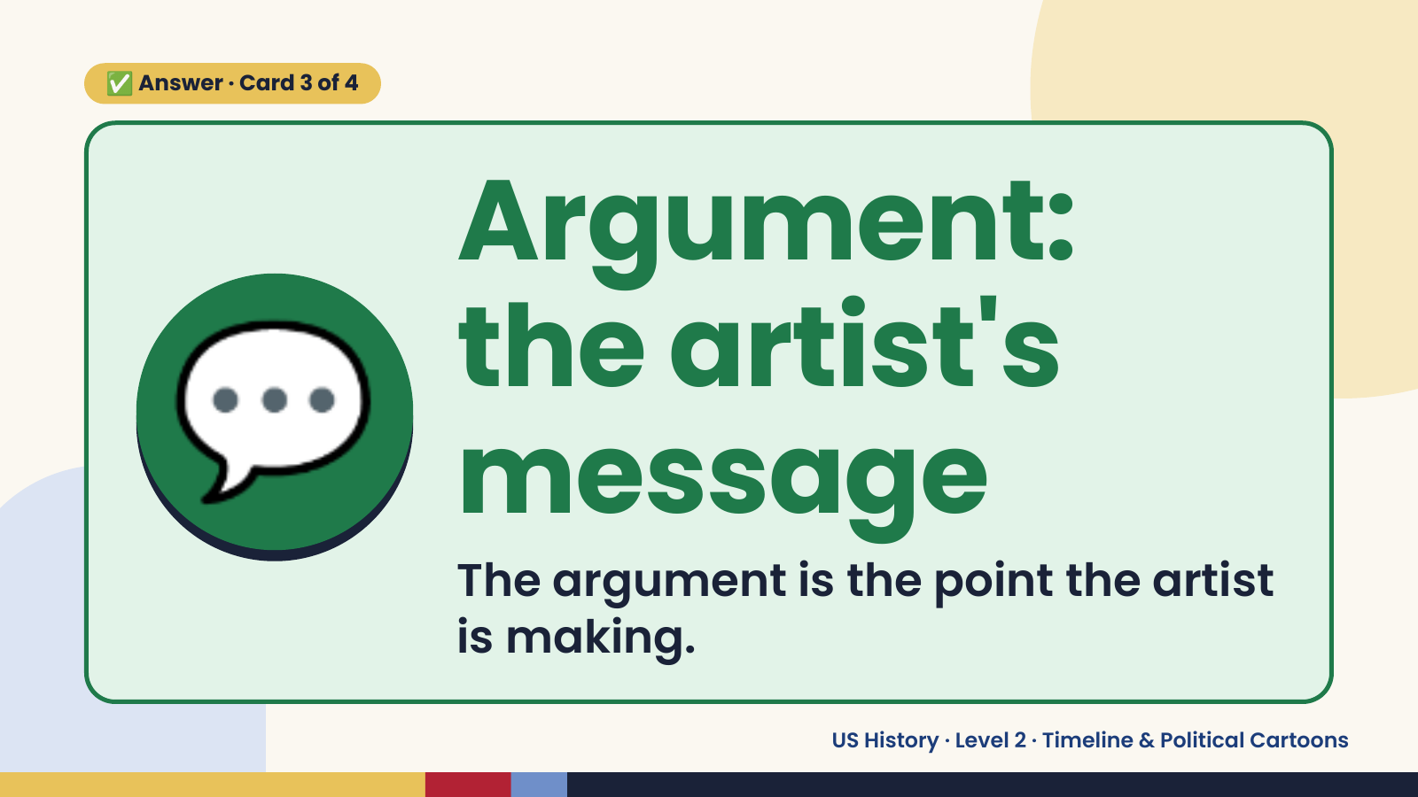
Notes:
✅ Answer · Card 3 of 4
💬
Argument:
the artist's
message
The argument is the point the artist
is making.
US History · Level 2 · Timeline & Political Cartoons

Slide 17
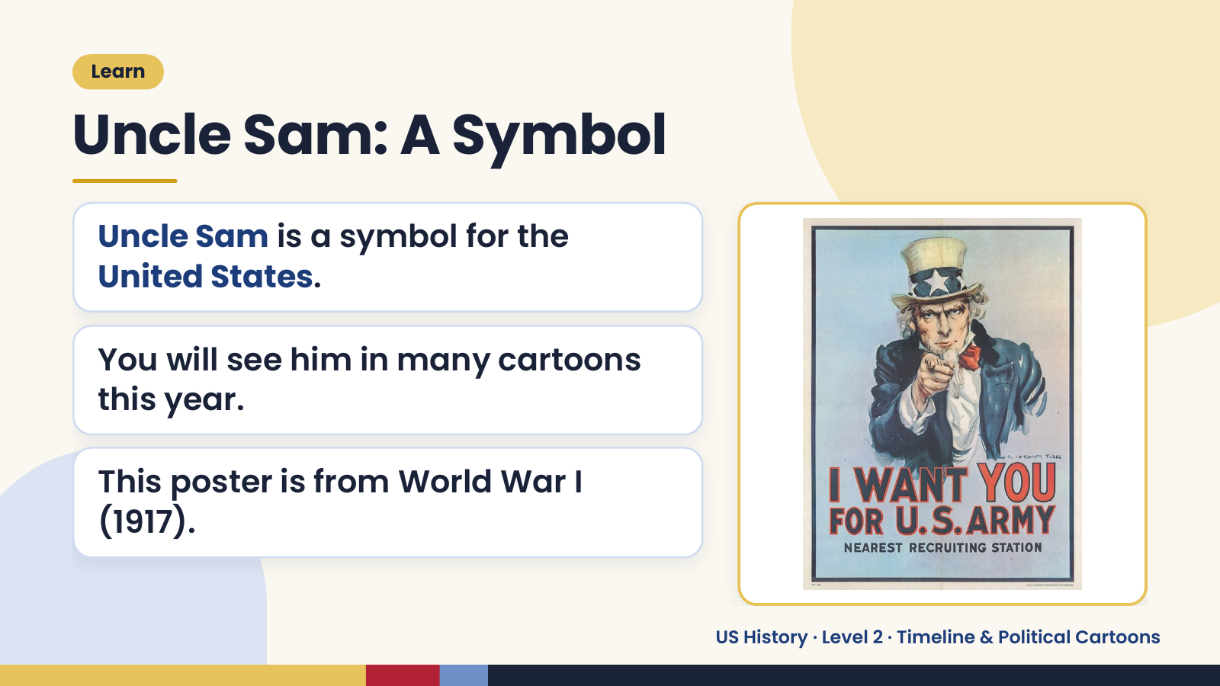
Notes:
Learn
Uncle Sam: A Symbol
Uncle Sam is a symbol for the
United States.
You will see him in many cartoons
this year.
This poster is from World War I
(1917).
US History · Level 2 · Timeline & Political Cartoons

Slide 18
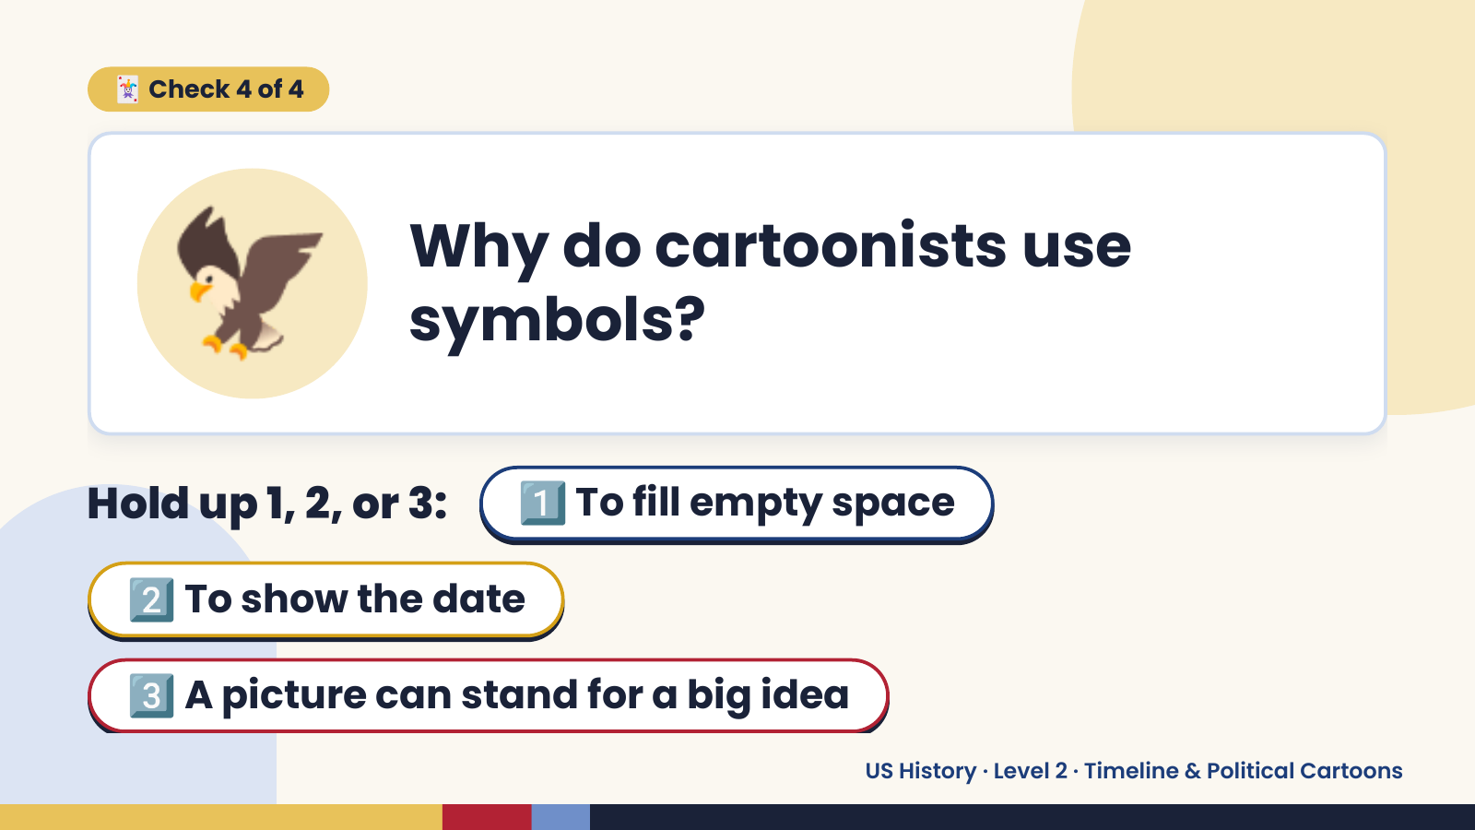
Notes:
🦅
🃏 Check 4 of 4
Why do cartoonists use
symbols?
Hold up 1, 2, or 3: 1️⃣ To fill empty space
2️⃣ To show the date
3️⃣ A picture can stand for a big idea
US History · Level 2 · Timeline & Political Cartoons

Slide 19
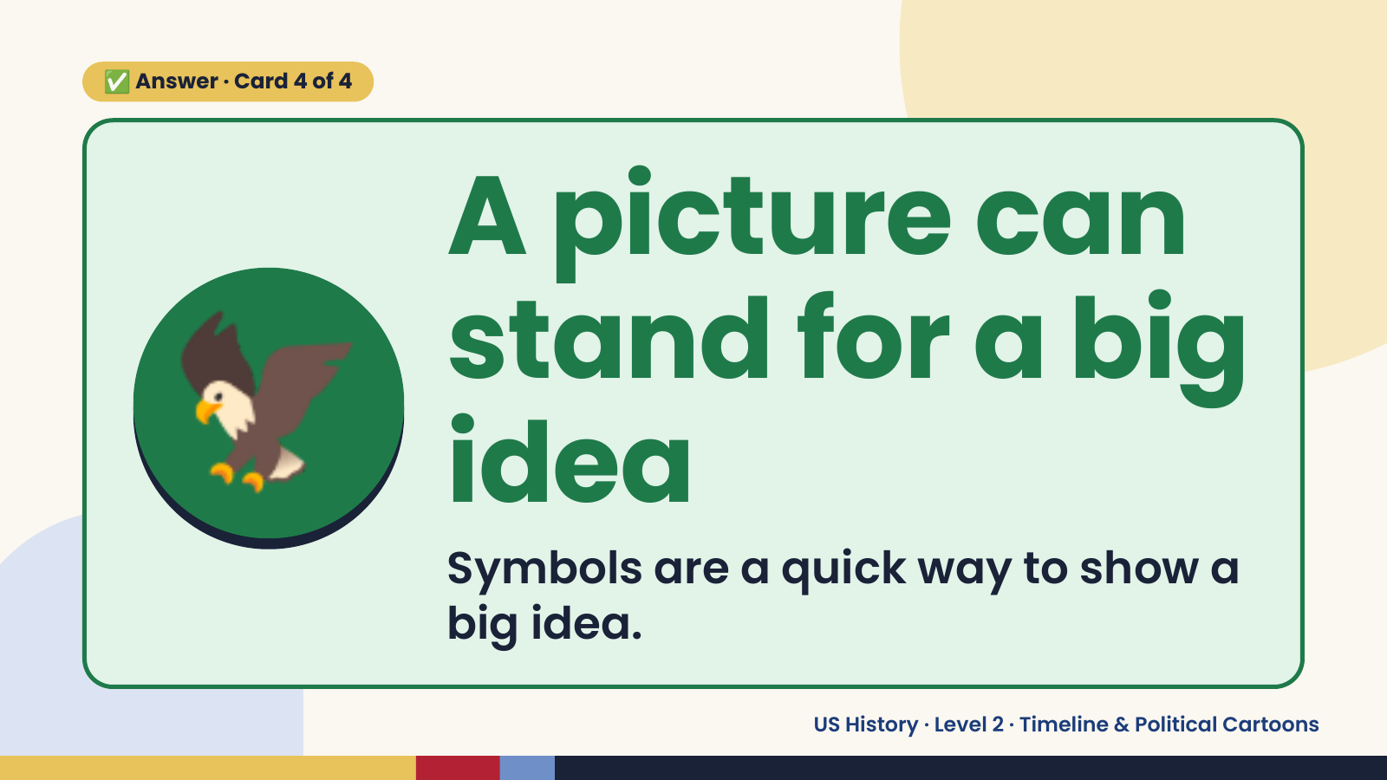
Notes:
✅ Answer · Card 4 of 4
🦅
A picture can
stand for a big
idea
Symbols are a quick way to show a
big idea.
US History · Level 2 · Timeline & Political Cartoons

Slide 20
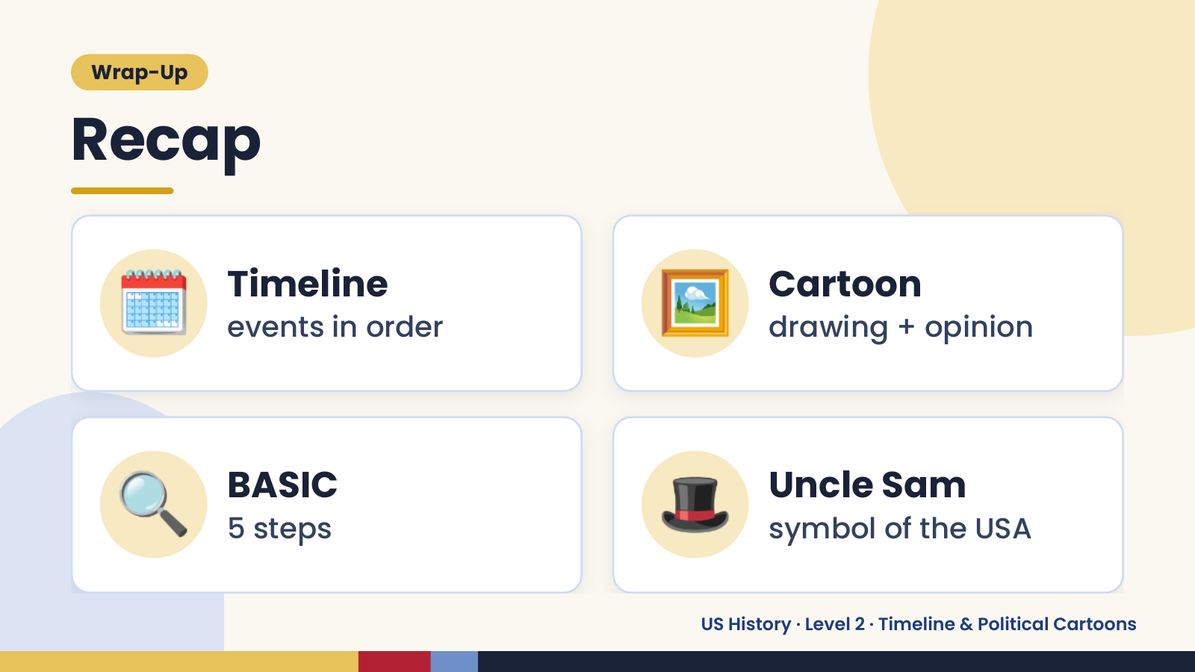
Notes:
Wrap-Up
Recap
🗓️ Timeline
events in order 🖼️ Cartoon
drawing + opinion
🔍 BASIC
5 steps 🎩 Uncle Sam
symbol of the USA
US History · Level 2 · Timeline & Political Cartoons

Slide 21
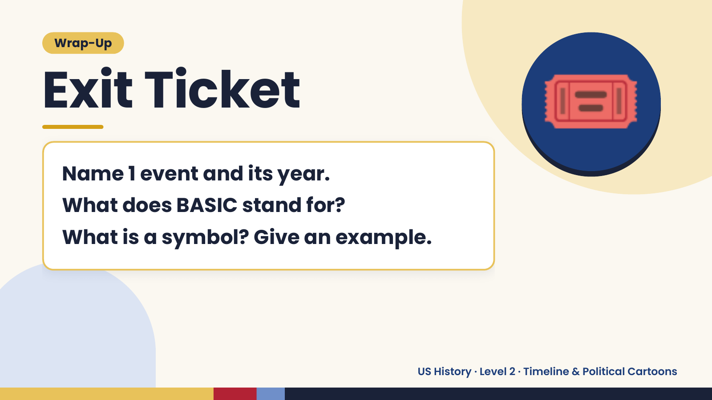
Notes:
Wrap-Up
Exit Ticket
Name 1 event and its year.
What does BASIC stand for?
🎟️
What is a symbol? Give an example.
US History · Level 2 · Timeline & Political Cartoons

