Slide 1
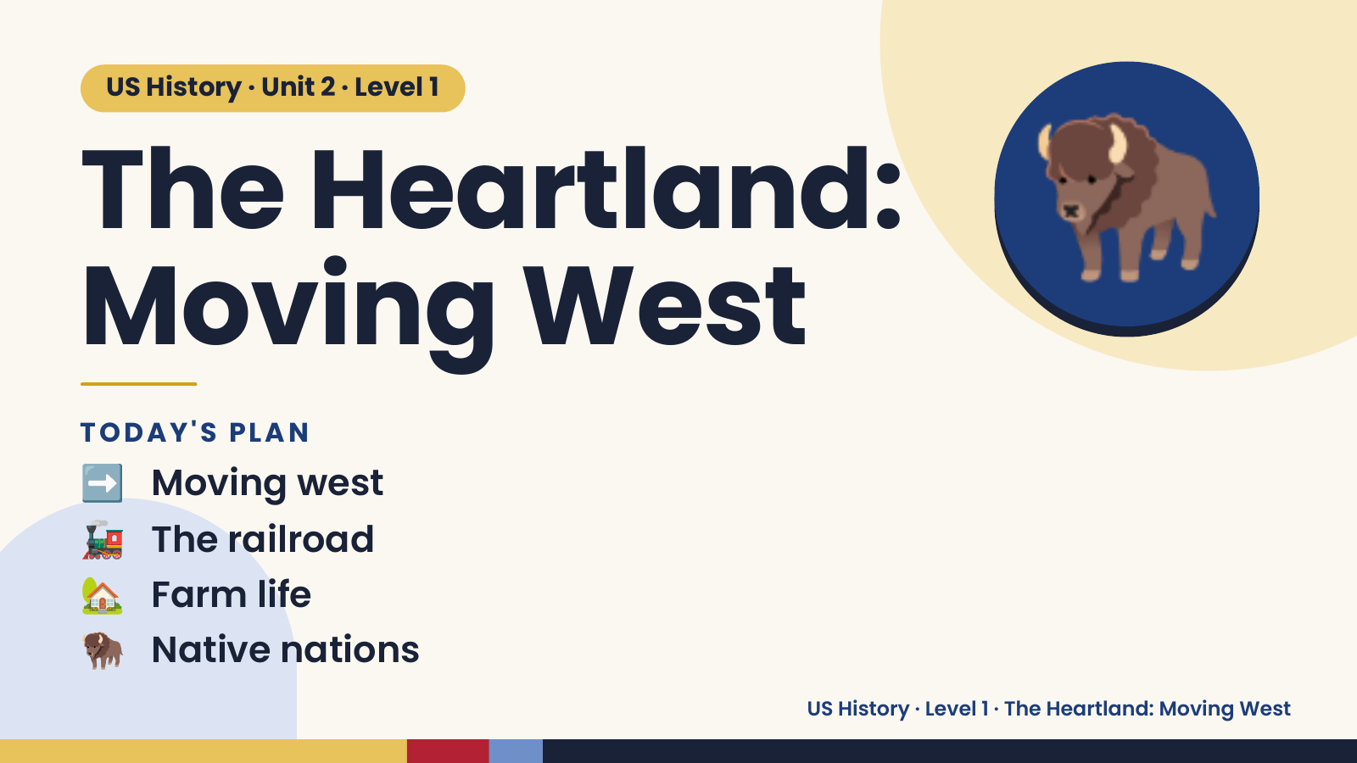
Notes:
US History · Unit 2 · Level 1
The Heartland:
Moving West
🦬
➡️ Moving west
TODAY'S PLAN
🚂 The railroad
🏡 Farm life
🦬 Native nations
US History · Level 1 · The Heartland: Moving West

Slide 2
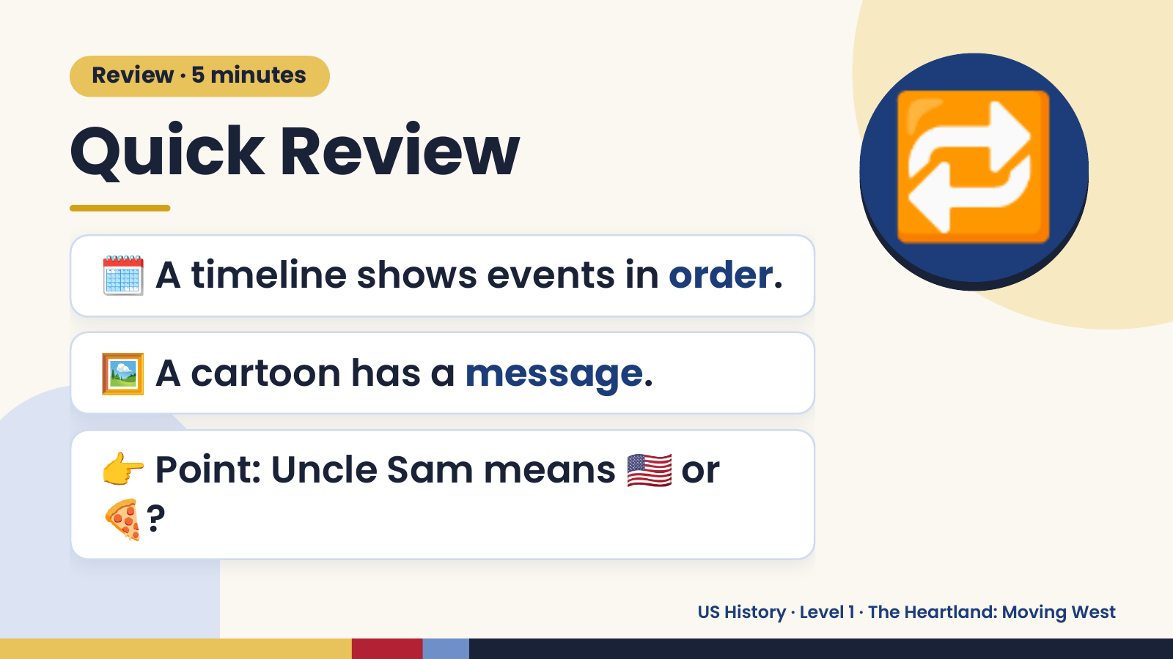
Notes:
Review · 5 minutes
Quick Review
🗓️ A timeline shows events in order.
🔁
🖼️ A cartoon has a message.
👉 Point: Uncle Sam means 🇺🇸 or
🍕?
US History · Level 1 · The Heartland: Moving West

Slide 3
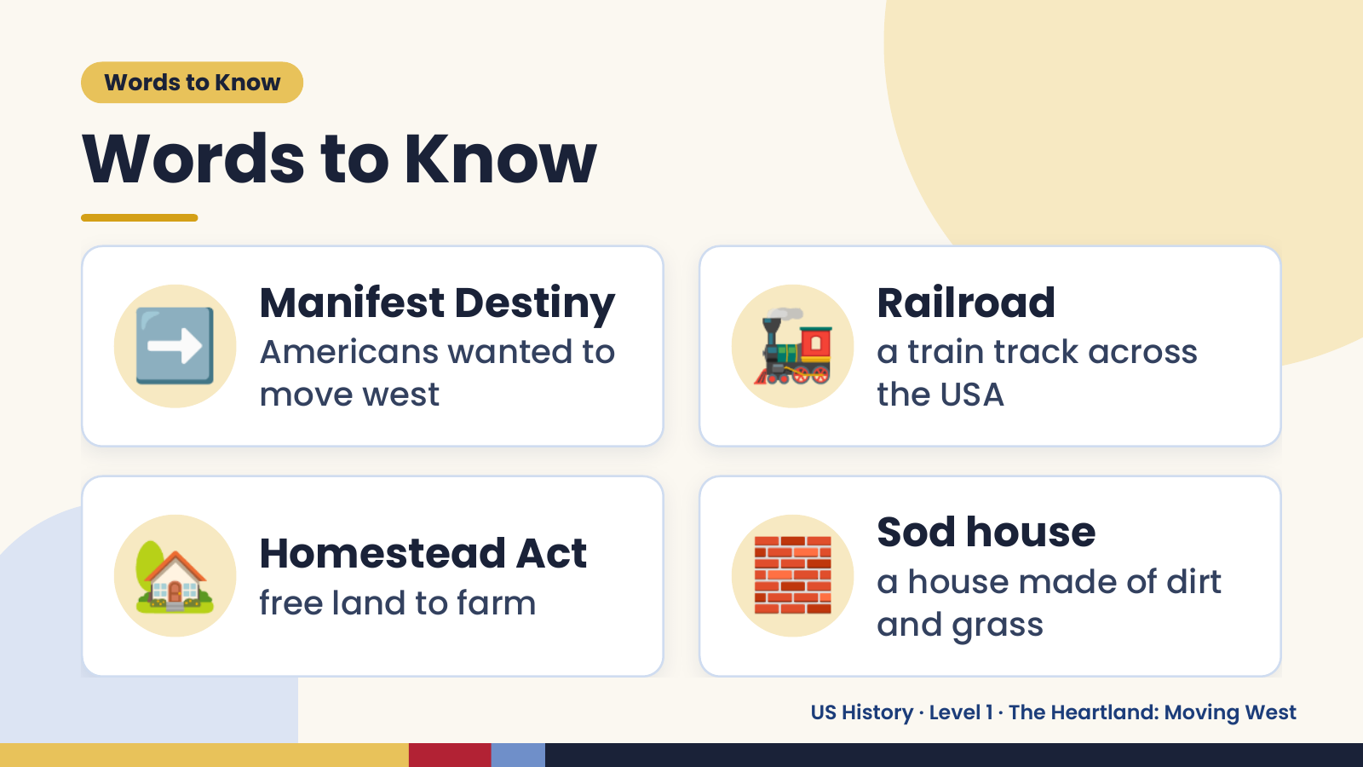
Notes:
Words to Know
Words to Know
➡️ Manifest Destiny
Americans wanted to
move west
🚂 Railroad
a train track across
the USA
🏡 Homestead Act
free land to farm 🧱 Sod house
a house made of dirt
and grass
US History · Level 1 · The Heartland: Moving West

Slide 4
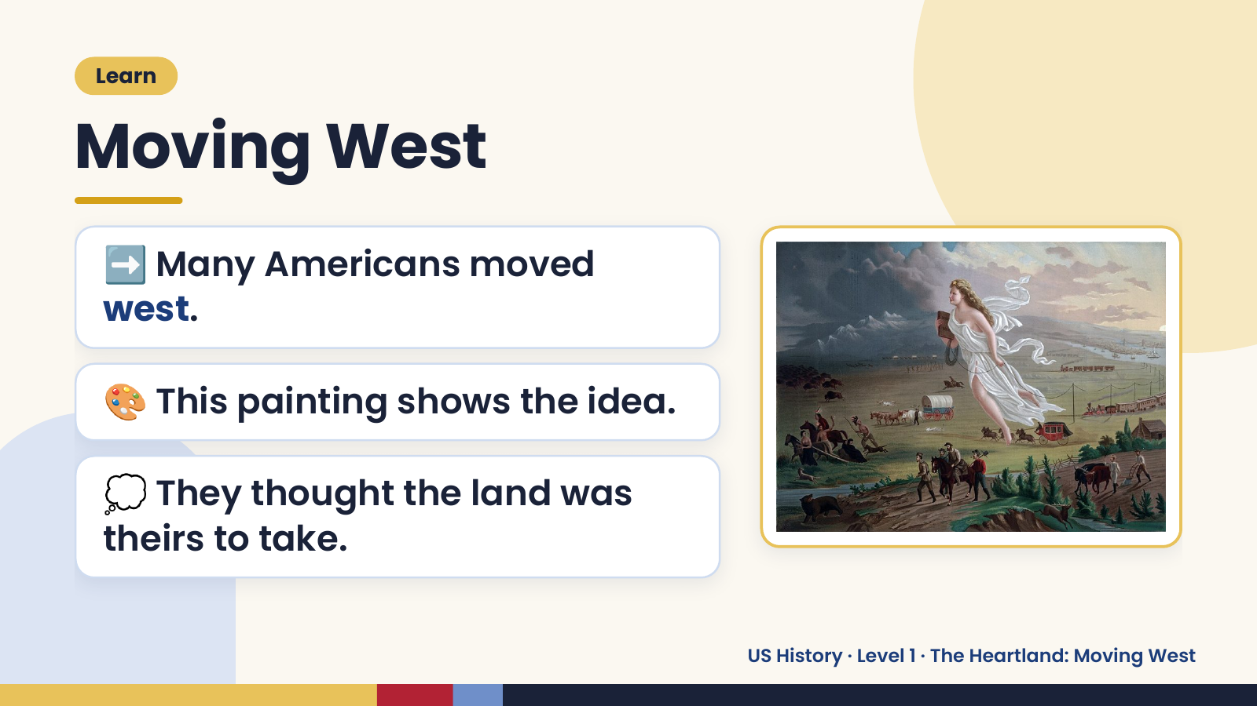
Notes:
Learn
Moving West
➡️ Many Americans moved
west.
🎨 This painting shows the idea.
💭 They thought the land was
theirs to take.
US History · Level 1 · The Heartland: Moving West

Slide 5
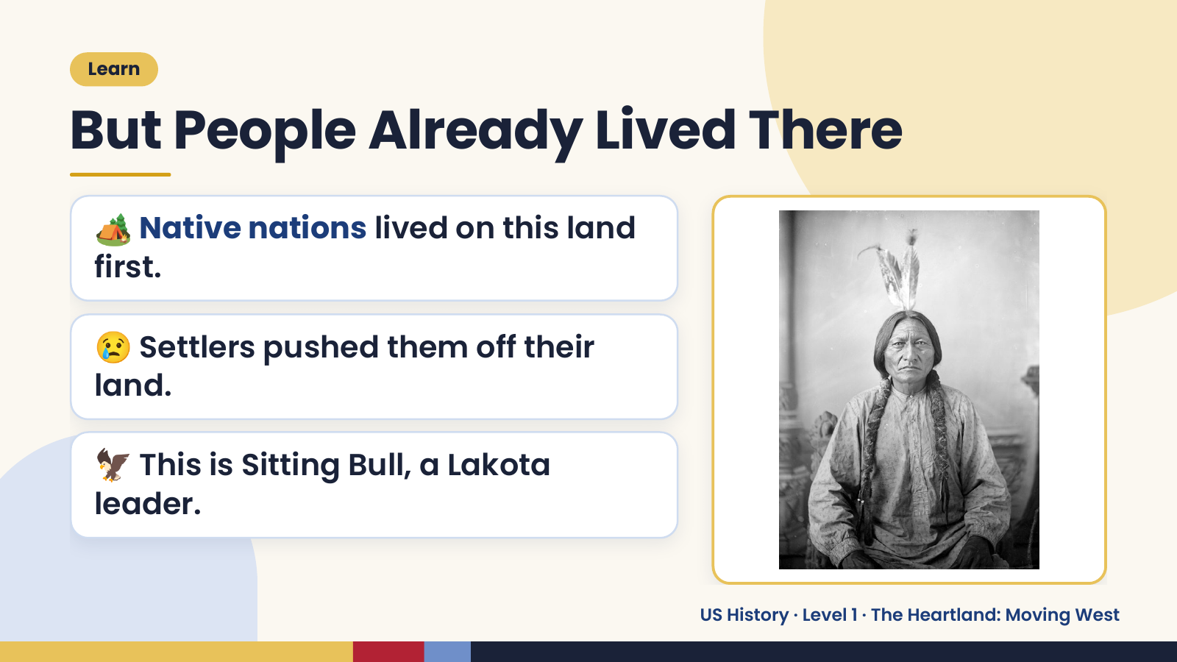
Notes:
Learn
But People Already Lived There
🏕️ Native nations lived on this land
first.
😢 Settlers pushed them off their
land.
🦅 This is Sitting Bull, a Lakota
leader.
US History · Level 1 · The Heartland: Moving West

Slide 6
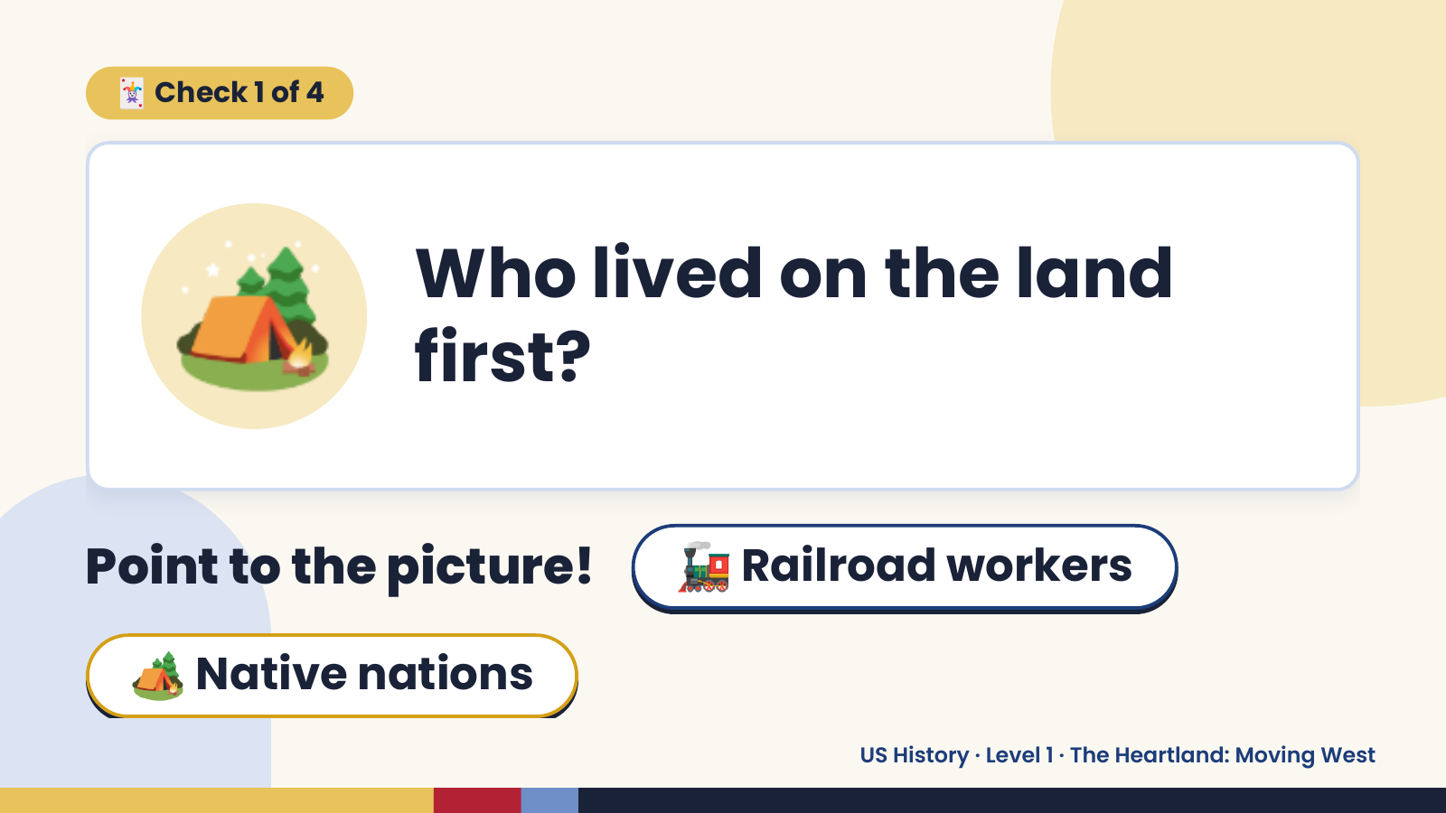
Notes:
🃏 Check 1 of 4
🏕️ Who lived on the land
first?
Point to the picture! 🚂 Railroad workers
🏕️ Native nations
US History · Level 1 · The Heartland: Moving West

Slide 7
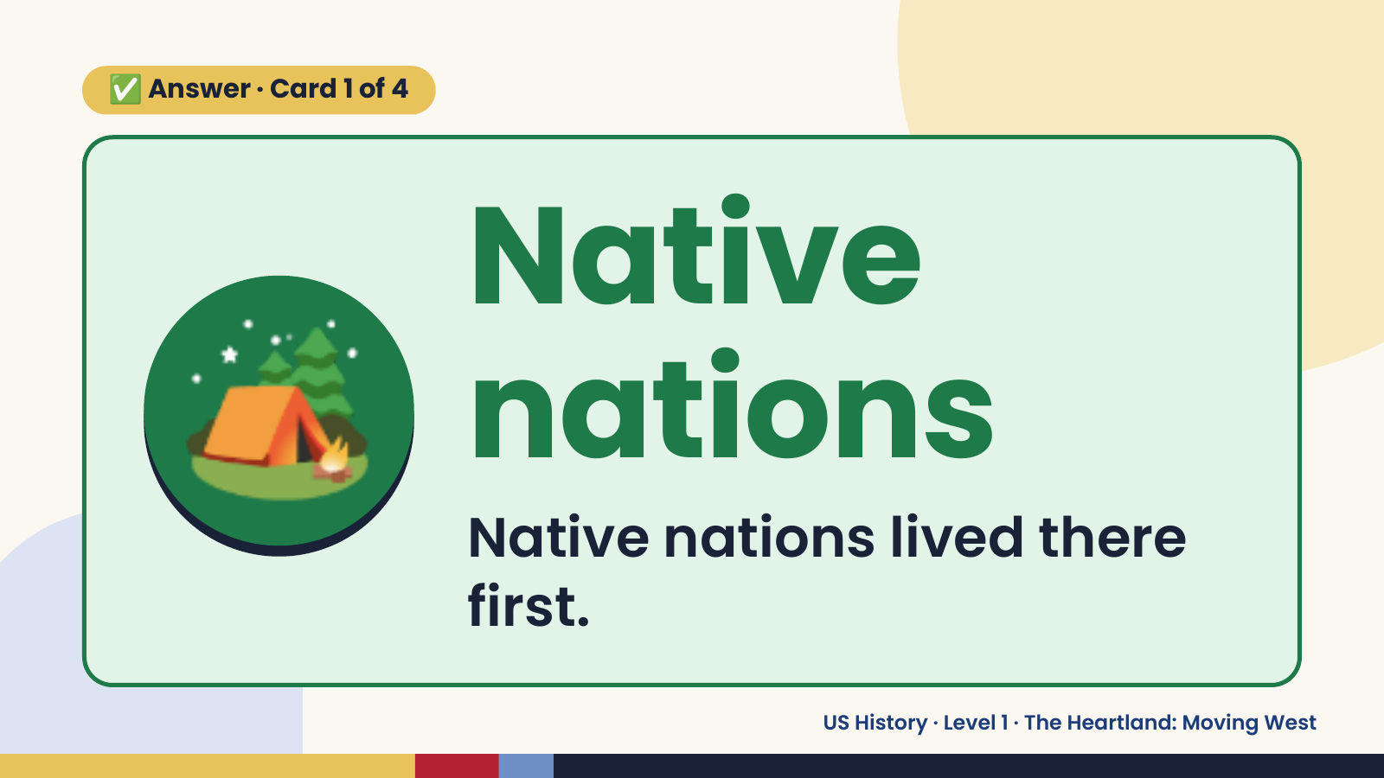
Notes:
✅ Answer · Card 1 of 4
🏕️ Native
nations
Native nations lived there
first.
US History · Level 1 · The Heartland: Moving West

Slide 8
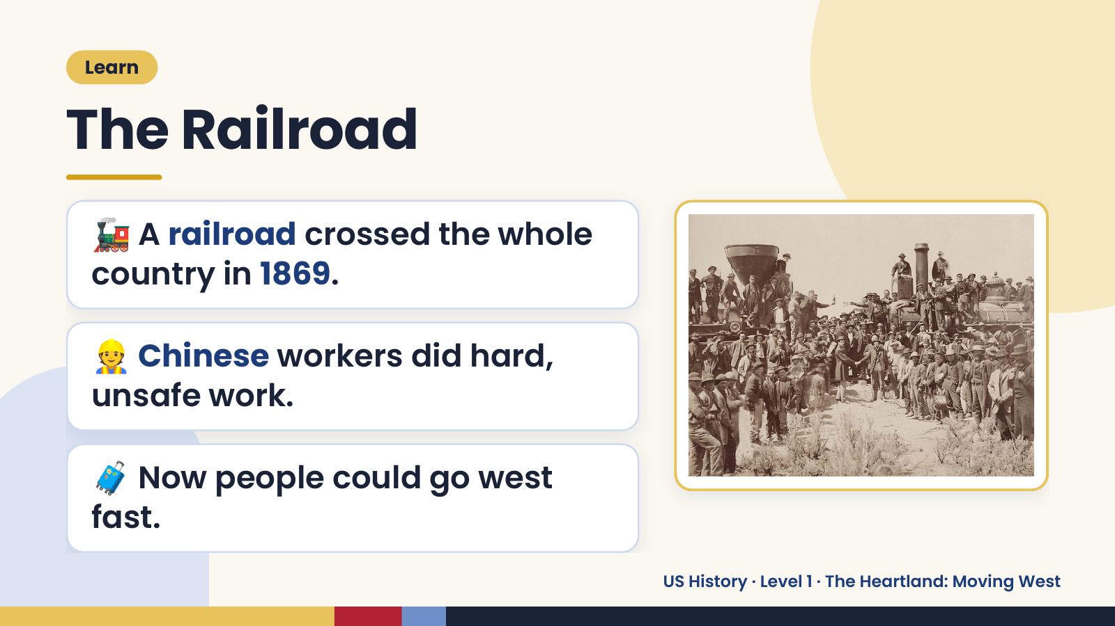
Notes:
Learn
The Railroad
🚂 A railroad crossed the whole
country in 1869.
👷 Chinese workers did hard,
unsafe work.
🧳 Now people could go west
fast.
US History · Level 1 · The Heartland: Moving West

Slide 9
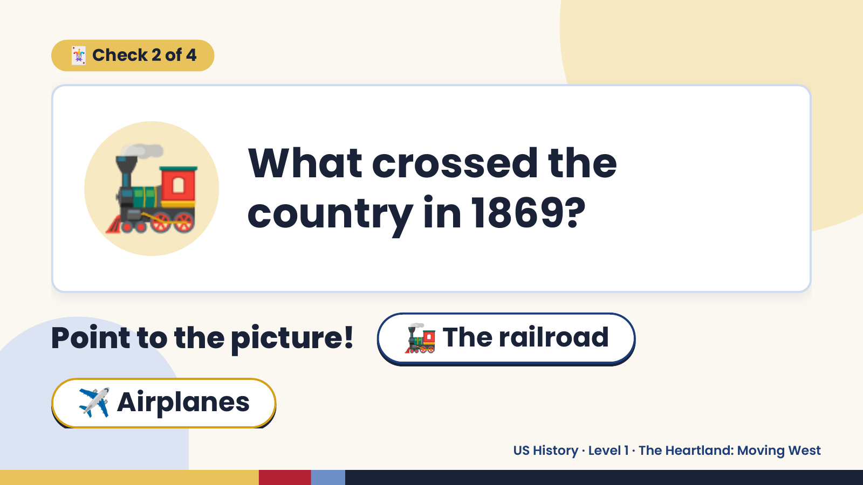
Notes:
🃏 Check 2 of 4
🚂 What crossed the
country in 1869?
Point to the picture! 🚂 The railroad
✈️ Airplanes
US History · Level 1 · The Heartland: Moving West

Slide 10
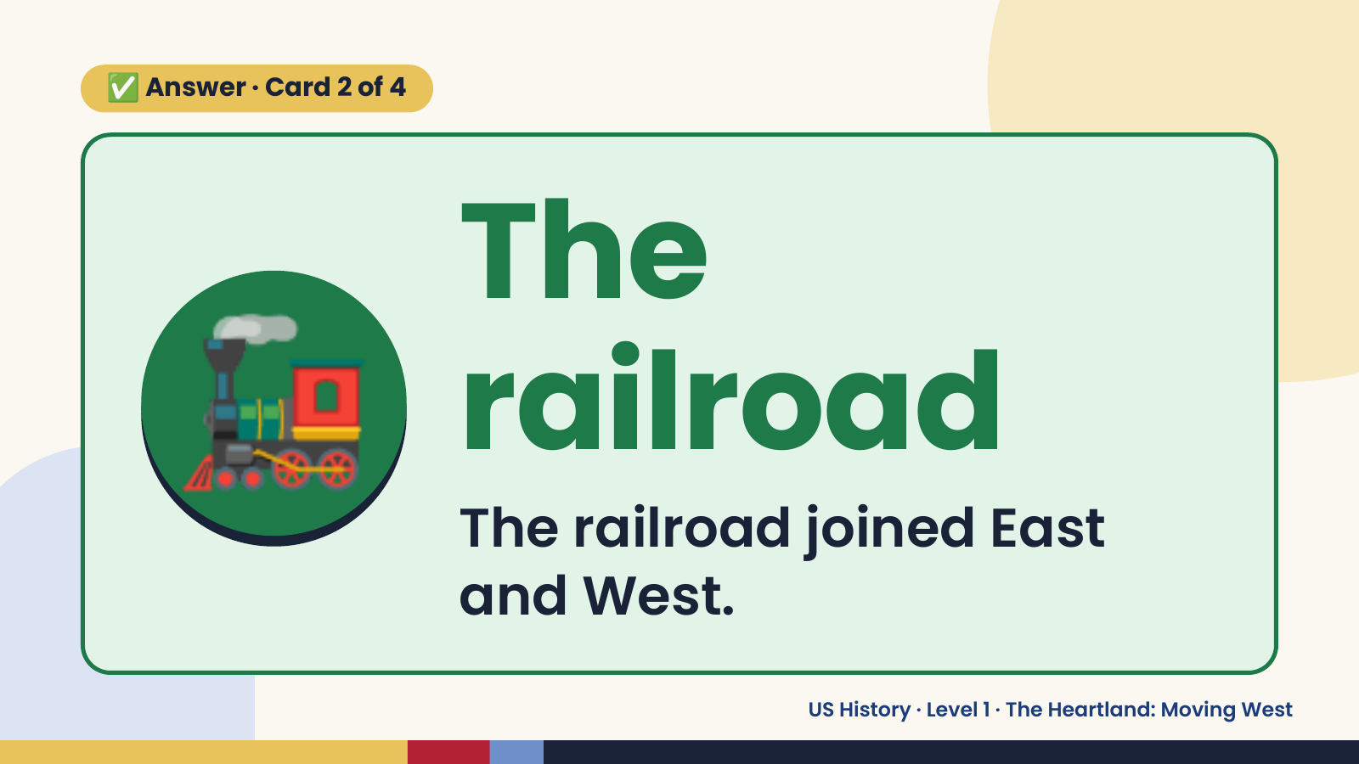
Notes:
✅ Answer · Card 2 of 4
🚂 The
railroad
The railroad joined East
and West.
US History · Level 1 · The Heartland: Moving West

Slide 11
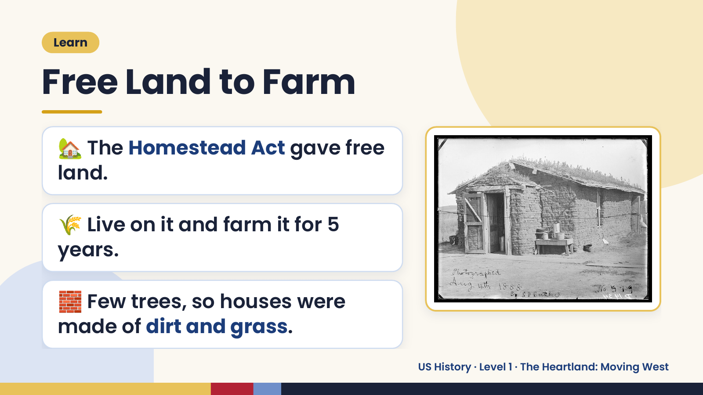
Notes:
Learn
Free Land to Farm
🏡 The Homestead Act gave free
land.
🌾 Live on it and farm it for 5
years.
🧱 Few trees, so houses were
made of dirt and grass.
US History · Level 1 · The Heartland: Moving West

Slide 12
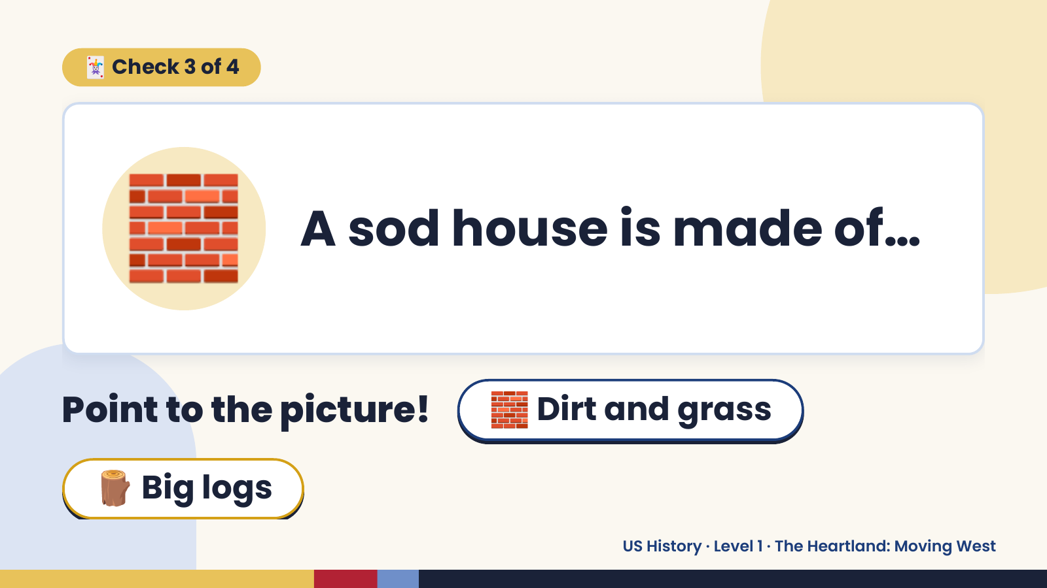
Notes:
🃏 Check 3 of 4
🧱 A sod house is made of…
Point to the picture! 🧱 Dirt and grass
🪵 Big logs
US History · Level 1 · The Heartland: Moving West

Slide 13
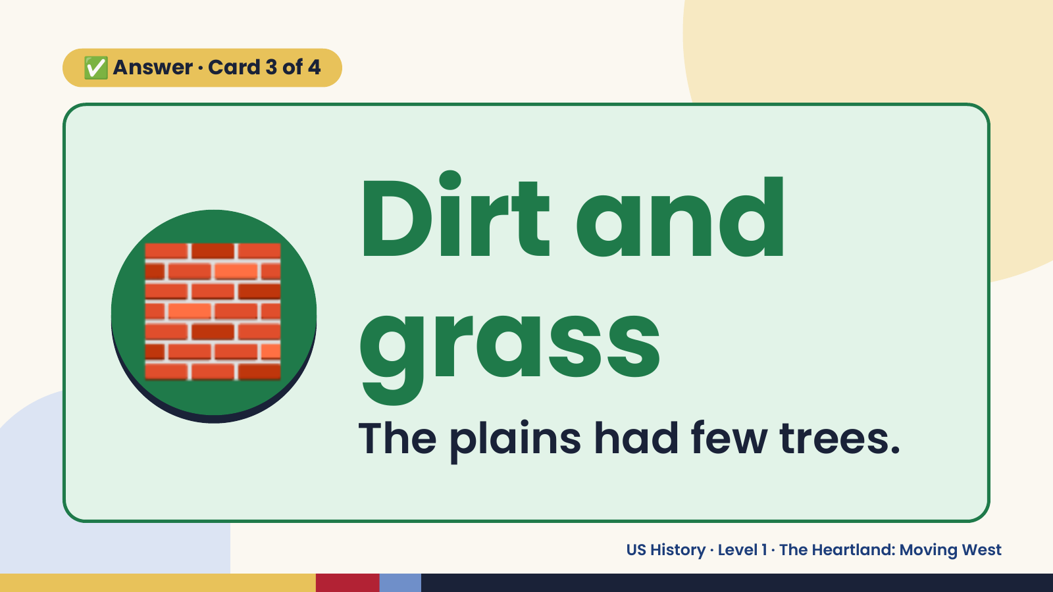
Notes:
✅ Answer · Card 3 of 4
🧱 Dirt and
grass
The plains had few trees.
US History · Level 1 · The Heartland: Moving West

Slide 14
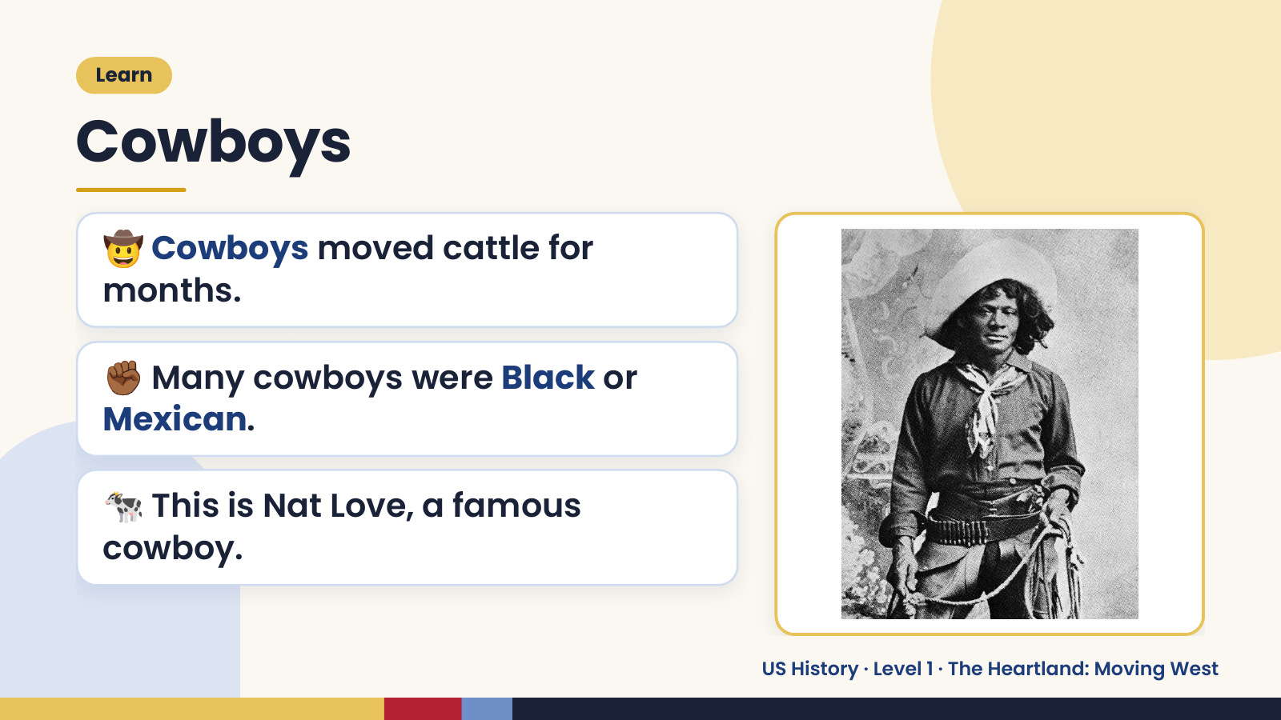
Notes:
Learn
Cowboys
🤠 Cowboys moved cattle for
months.
✊🏾 Many cowboys were Black or
Mexican.
🐄 This is Nat Love, a famous
cowboy.
US History · Level 1 · The Heartland: Moving West

Slide 15
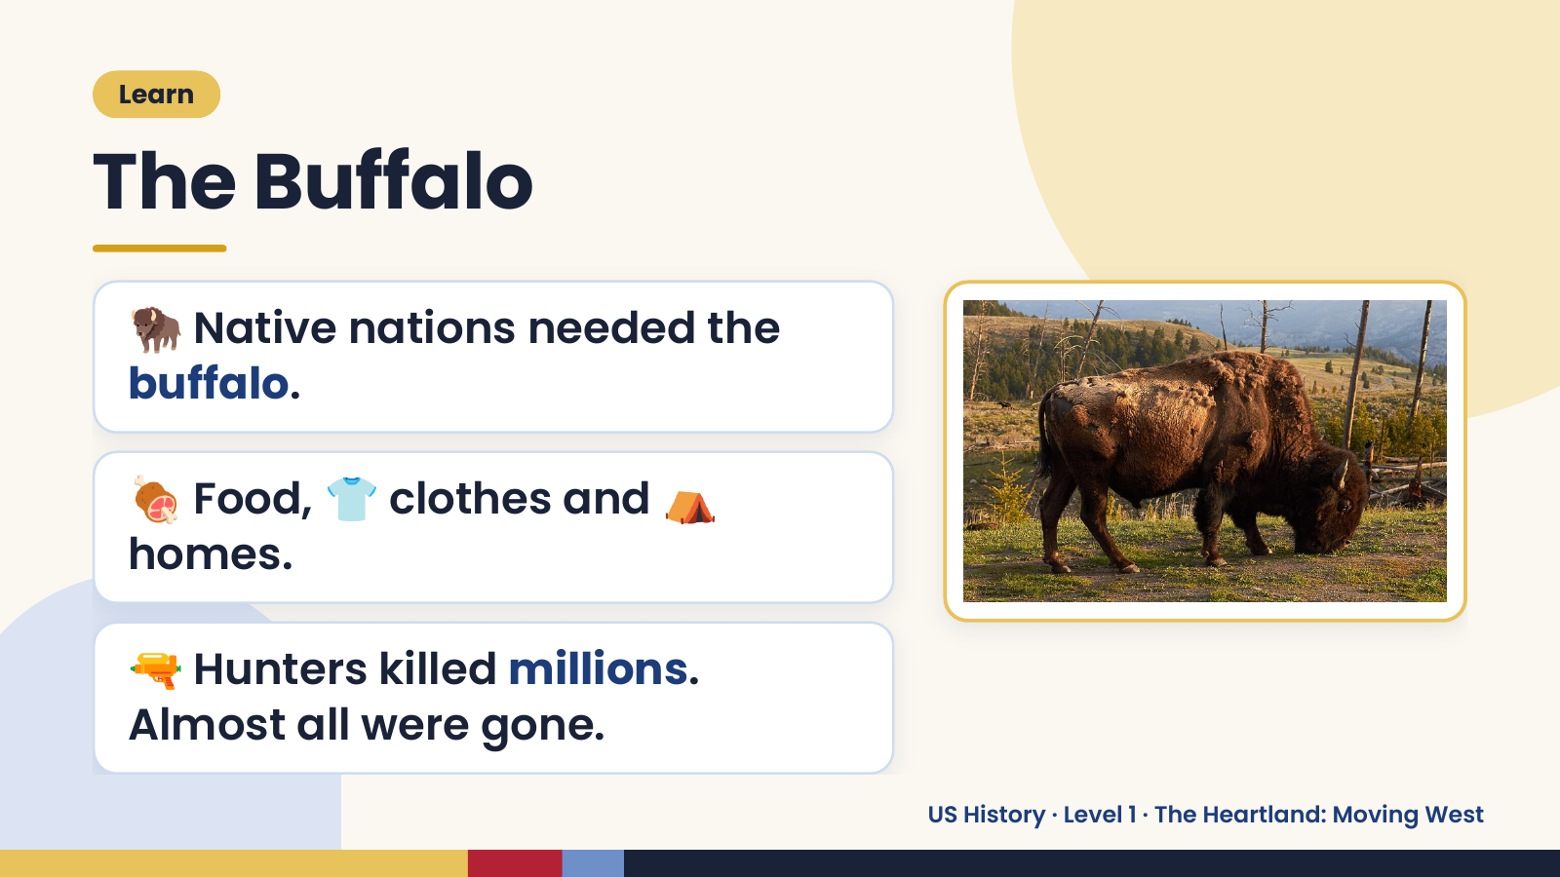
Notes:
Learn
The Buffalo
🦬 Native nations needed the
buffalo.
🍖 Food, 👕 clothes and ⛺
homes.
🔫 Hunters killed millions.
Almost all were gone.
US History · Level 1 · The Heartland: Moving West

Slide 16
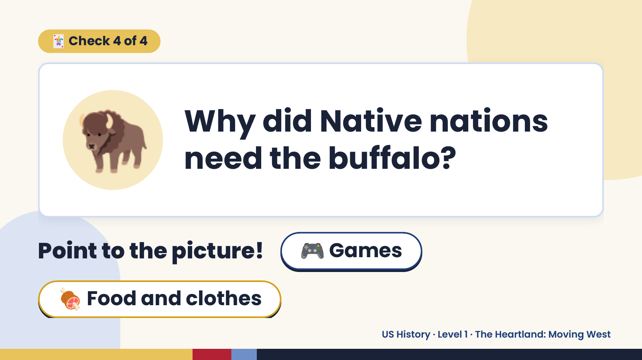
Notes:
🃏 Check 4 of 4
🦬 Why did Native nations
need the buffalo?
Point to the picture! 🎮 Games
🍖 Food and clothes
US History · Level 1 · The Heartland: Moving West

Slide 17
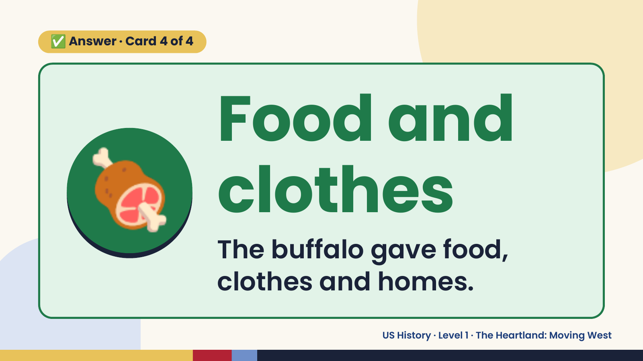
Notes:
✅ Answer · Card 4 of 4
🍖 Food and
clothes
The buffalo gave food,
clothes and homes.
US History · Level 1 · The Heartland: Moving West

Slide 18
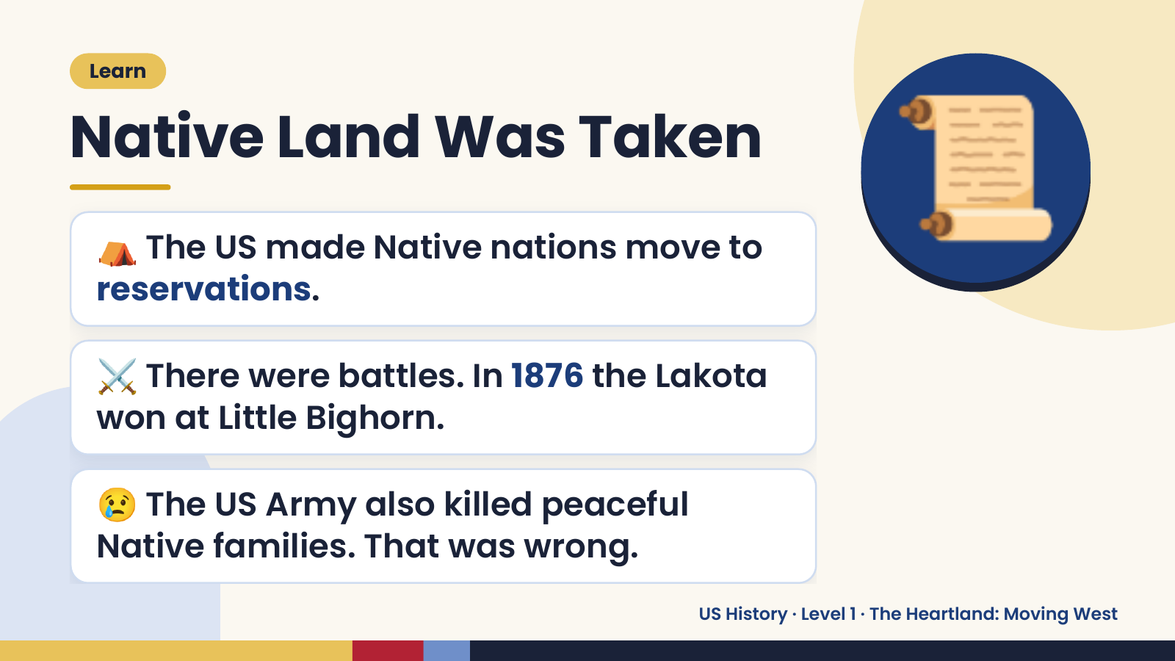
Notes:
Learn
Native Land Was Taken
⛺ The US made Native nations move to
reservations.
📜
⚔️ There were battles. In 1876 the Lakota
won at Little Bighorn.
😢 The US Army also killed peaceful
Native families. That was wrong.
US History · Level 1 · The Heartland: Moving West

Slide 19
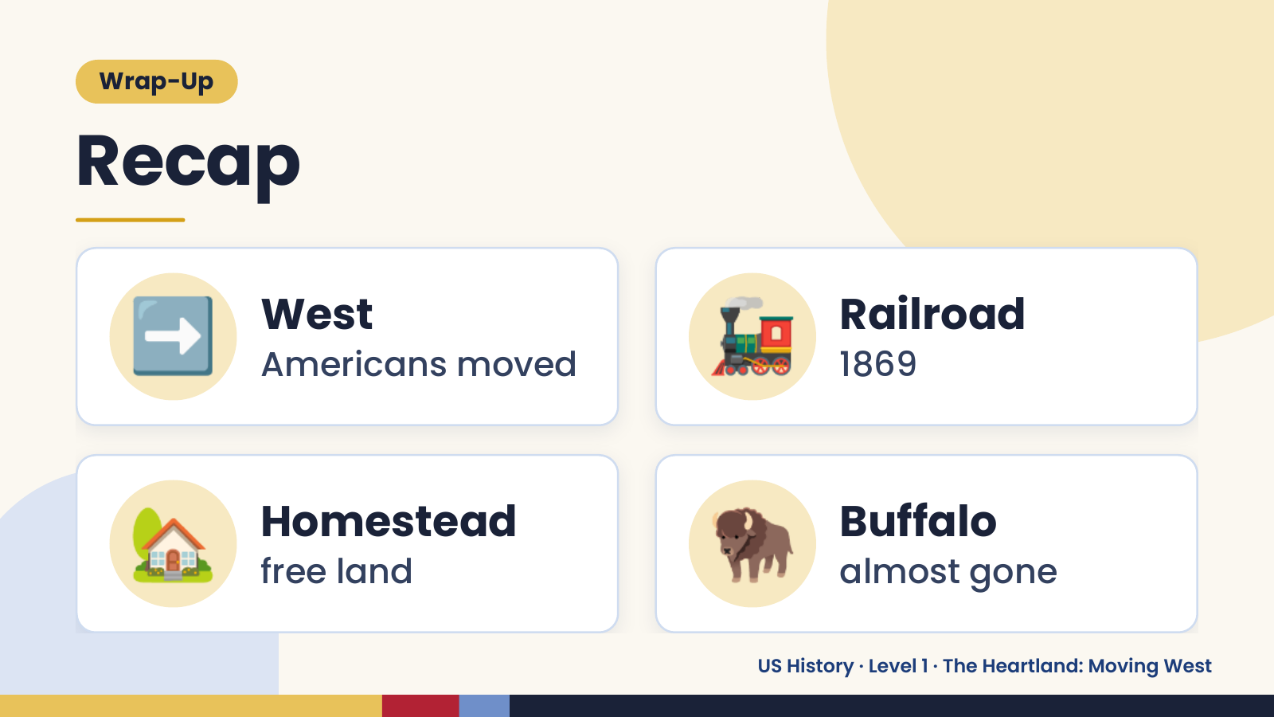
Notes:
Wrap-Up
Recap
➡️ West
Americans moved 🚂 Railroad
1869
🏡 Homestead
free land 🦬 Buffalo
almost gone
US History · Level 1 · The Heartland: Moving West

Slide 20
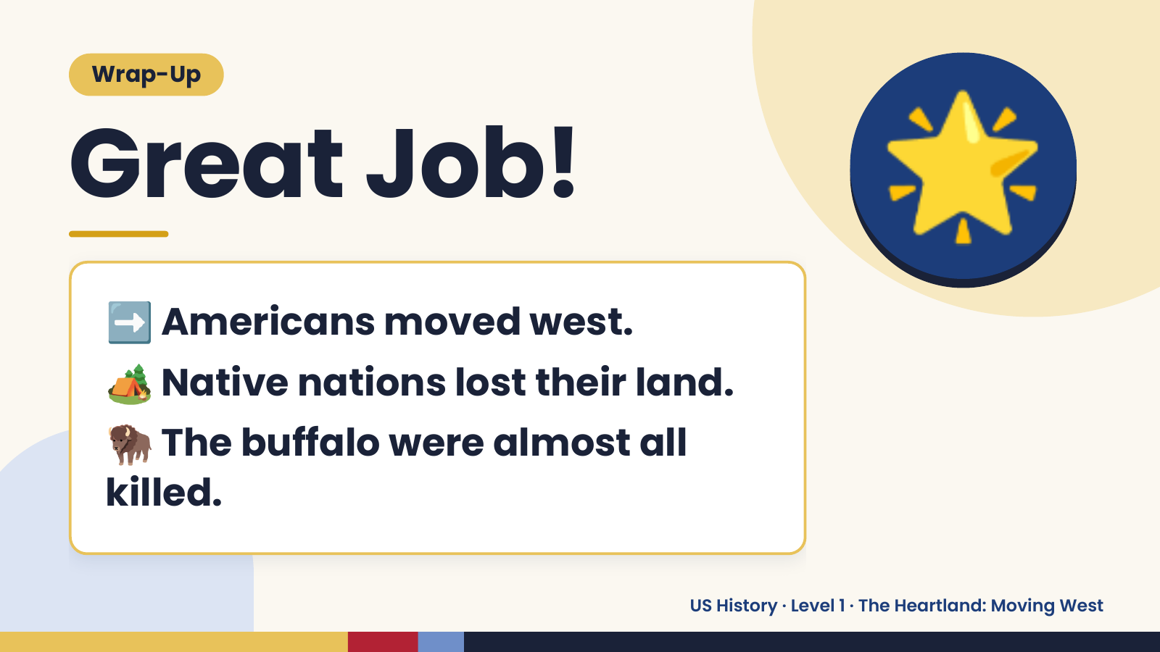
Notes:
Wrap-Up
Great Job!
➡️ Americans moved west.
🌟
🏕️ Native nations lost their land.
🦬 The buffalo were almost all
killed.
US History · Level 1 · The Heartland: Moving West

