Slide 1
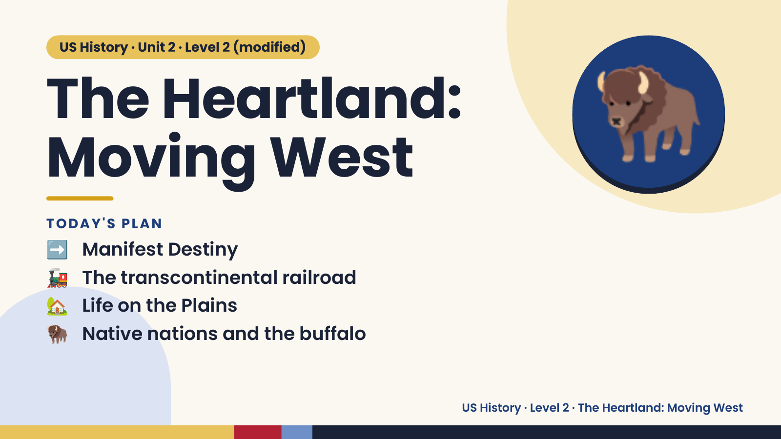
Notes:
US History · Unit 2 · Level 2 (modified)
The Heartland:
Moving West
➡️ Manifest Destiny
TODAY'S PLAN
🦬
🚂 The transcontinental railroad
🏡 Life on the Plains
🦬 Native nations and the buffalo
US History · Level 2 · The Heartland: Moving West

Slide 2
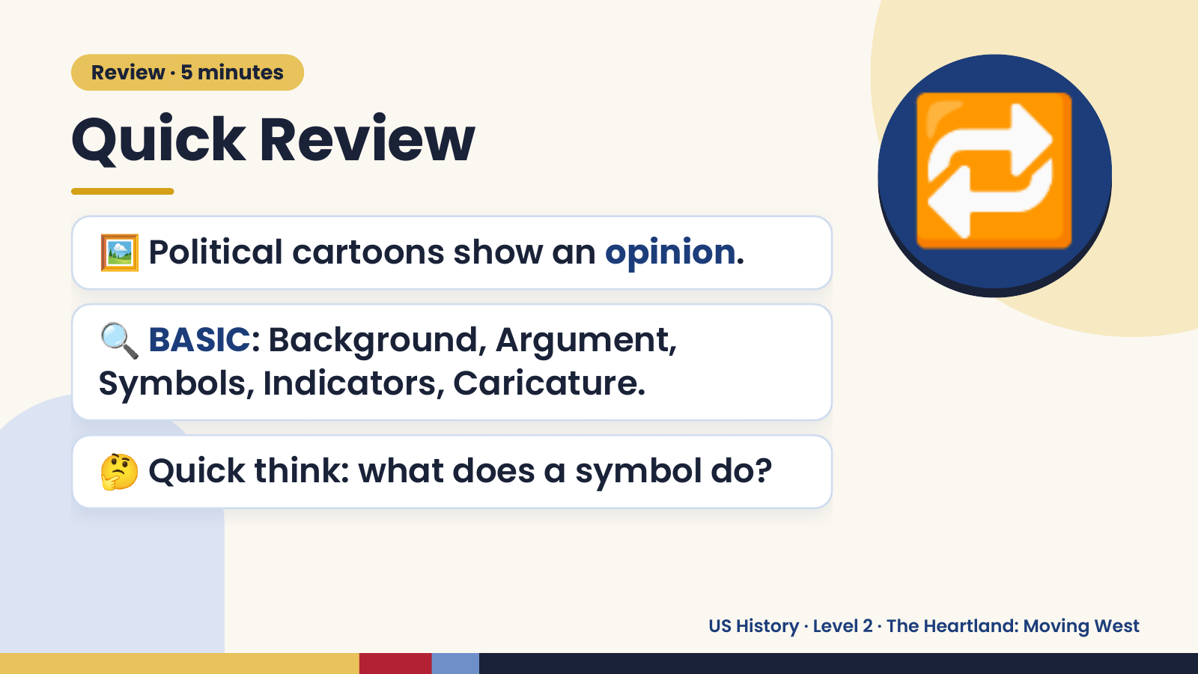
Notes:
Review · 5 minutes
Quick Review
🖼️ Political cartoons show an opinion.
🔍 BASIC: Background, Argument,
🔁
Symbols, Indicators, Caricature.
🤔 Quick think: what does a symbol do?
US History · Level 2 · The Heartland: Moving West

Slide 3
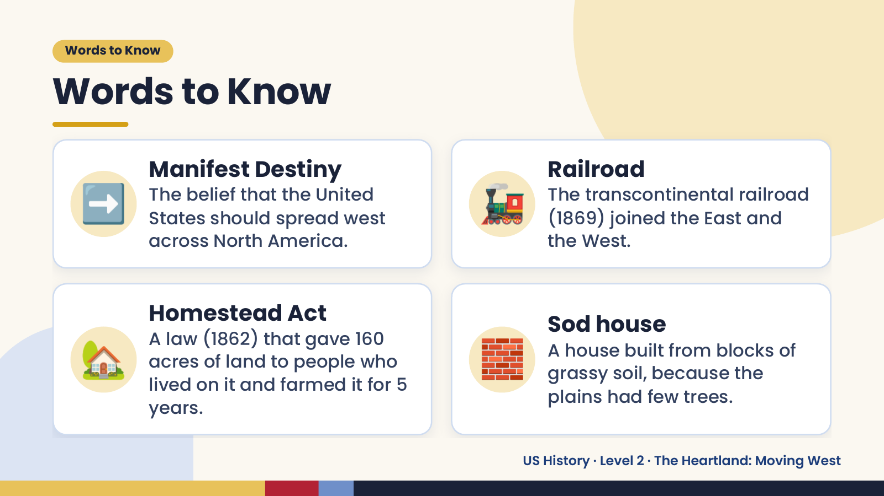
Notes:
Words to Know
Words to Know
➡️ Manifest Destiny
The belief that the United
States should spread west
across North America.
🚂 Railroad
The transcontinental railroad
(1869) joined the East and
the West.
🏡 🧱
Homestead Act Sod house
A law (1862) that gave 160
A house built from blocks of
acres of land to people who
grassy soil, because the
lived on it and farmed it for 5
plains had few trees.
years.
US History · Level 2 · The Heartland: Moving West

Slide 4
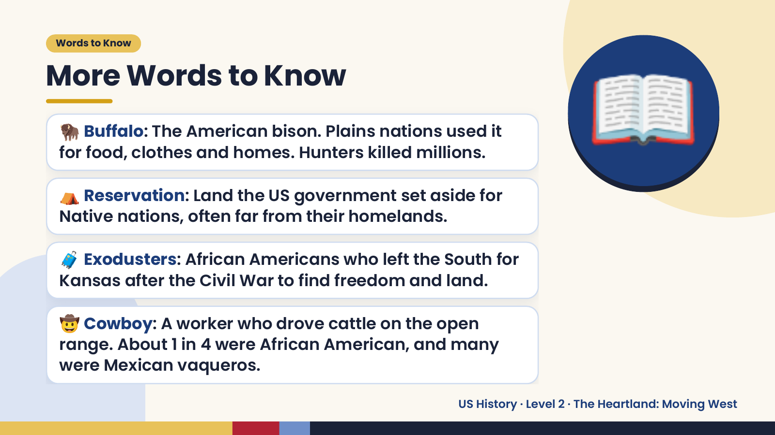
Notes:
Words to Know
More Words to Know
🦬 Buffalo: The American bison. Plains nations used it
for food, clothes and homes. Hunters killed millions.
⛺ Reservation: Land the US government set aside for
Native nations, often far from their homelands.
📖
🧳 Exodusters: African Americans who left the South for
Kansas after the Civil War to find freedom and land.
🤠 Cowboy: A worker who drove cattle on the open
range. About 1 in 4 were African American, and many
were Mexican vaqueros.
US History · Level 2 · The Heartland: Moving West

Slide 5
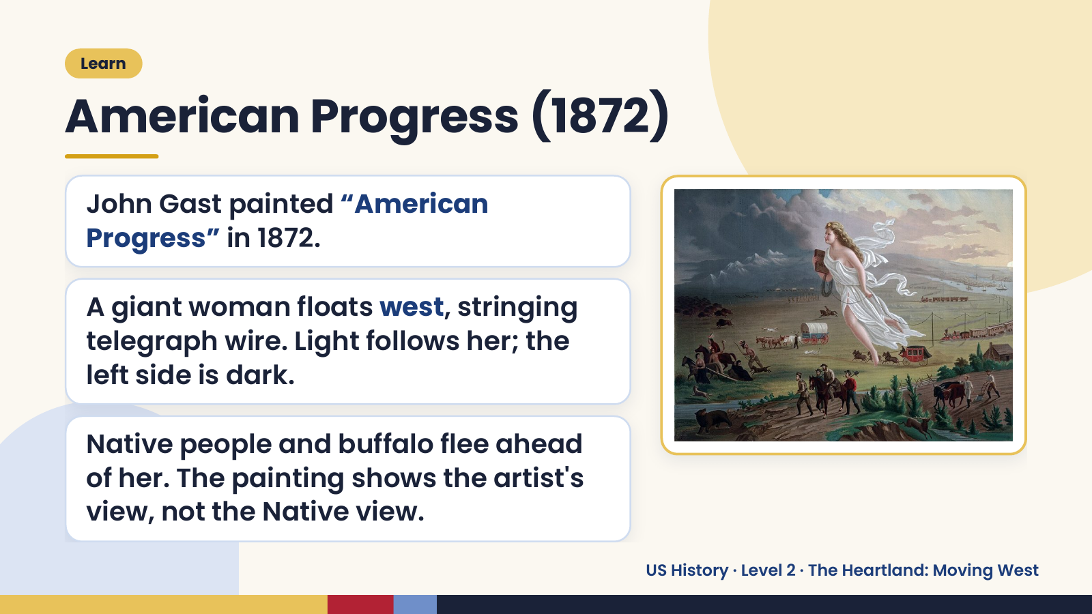
Notes:
Learn
American Progress (1872)
John Gast painted “American
Progress” in 1872.
A giant woman floats west, stringing
telegraph wire. Light follows her; the
left side is dark.
Native people and buffalo flee ahead
of her. The painting shows the artist's
view, not the Native view.
US History · Level 2 · The Heartland: Moving West

Slide 6
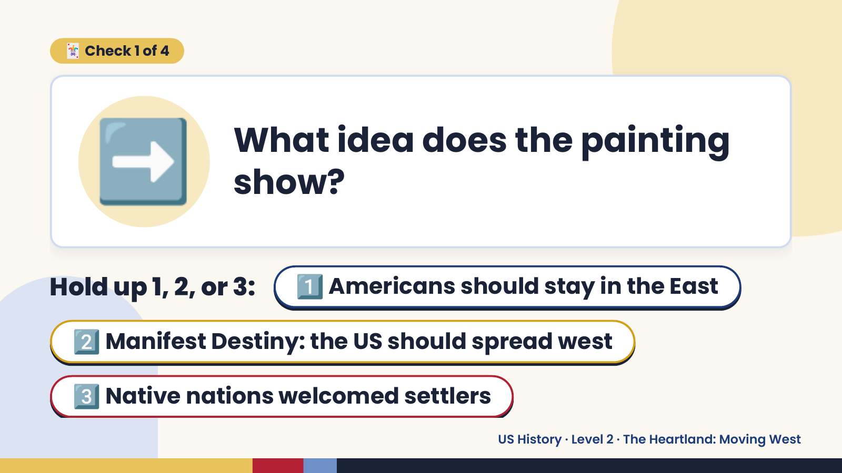
Notes:
➡️
🃏 Check 1 of 4
What idea does the painting
show?
Hold up 1, 2, or 3: 1️⃣ Americans should stay in the East
2️⃣ Manifest Destiny: the US should spread west
3️⃣ Native nations welcomed settlers
US History · Level 2 · The Heartland: Moving West

Slide 7
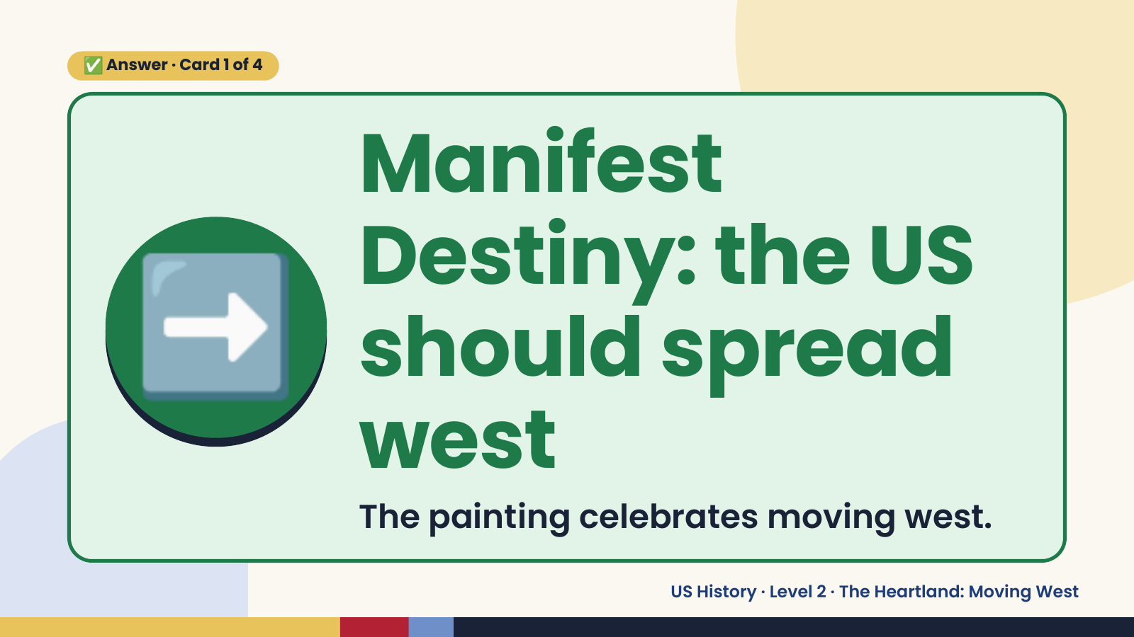
Notes:
✅ Answer · Card 1 of 4
➡️
Manifest
Destiny: the US
should spread
west
The painting celebrates moving west.
US History · Level 2 · The Heartland: Moving West

Slide 8
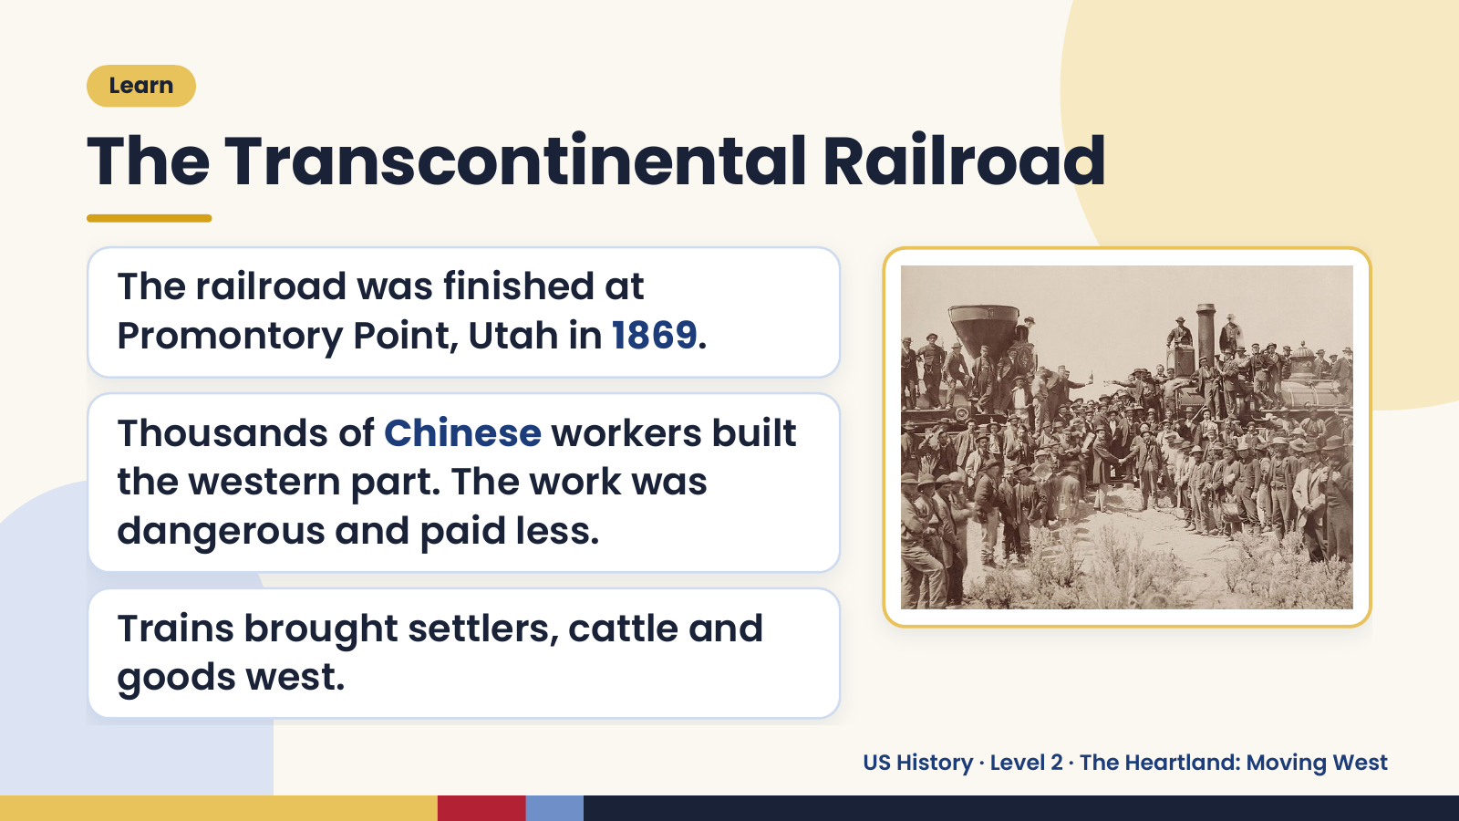
Notes:
Learn
The Transcontinental Railroad
The railroad was finished at
Promontory Point, Utah in 1869.
Thousands of Chinese workers built
the western part. The work was
dangerous and paid less.
Trains brought settlers, cattle and
goods west.
US History · Level 2 · The Heartland: Moving West

Slide 9
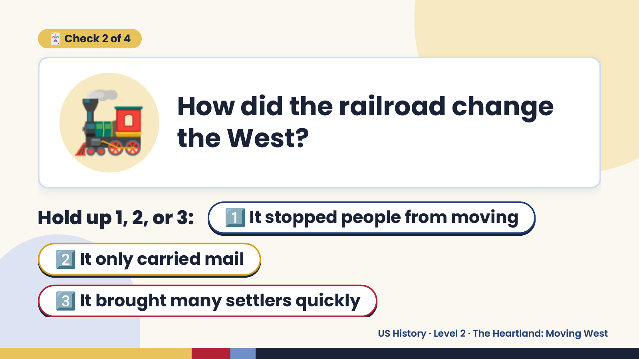
Notes:
🚂
🃏 Check 2 of 4
How did the railroad change
the West?
Hold up 1, 2, or 3: 1️⃣ It stopped people from moving
2️⃣ It only carried mail
3️⃣ It brought many settlers quickly
US History · Level 2 · The Heartland: Moving West

Slide 10
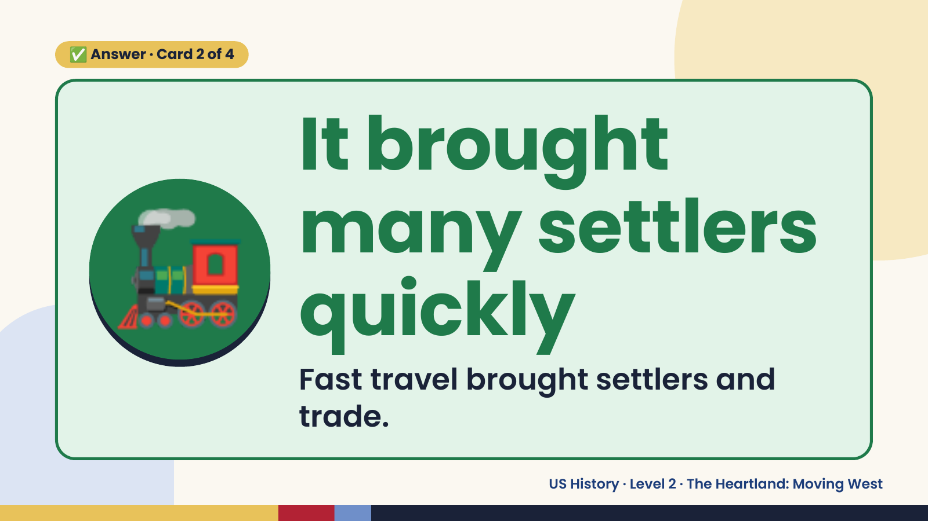
Notes:
✅ Answer · Card 2 of 4
🚂
It brought
many settlers
quickly
Fast travel brought settlers and
trade.
US History · Level 2 · The Heartland: Moving West

Slide 11
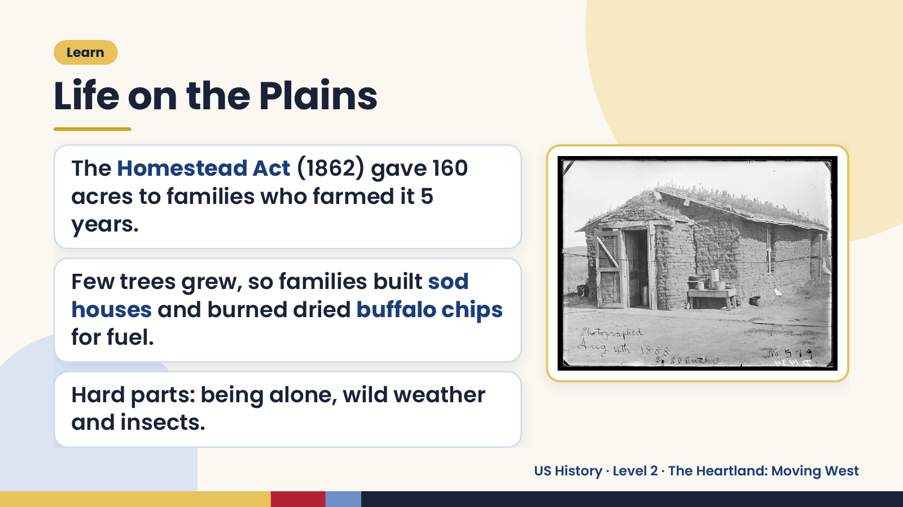
Notes:
Learn
Life on the Plains
The Homestead Act (1862) gave 160
acres to families who farmed it 5
years.
Few trees grew, so families built sod
houses and burned dried buffalo chips
for fuel.
Hard parts: being alone, wild weather
and insects.
US History · Level 2 · The Heartland: Moving West

Slide 12
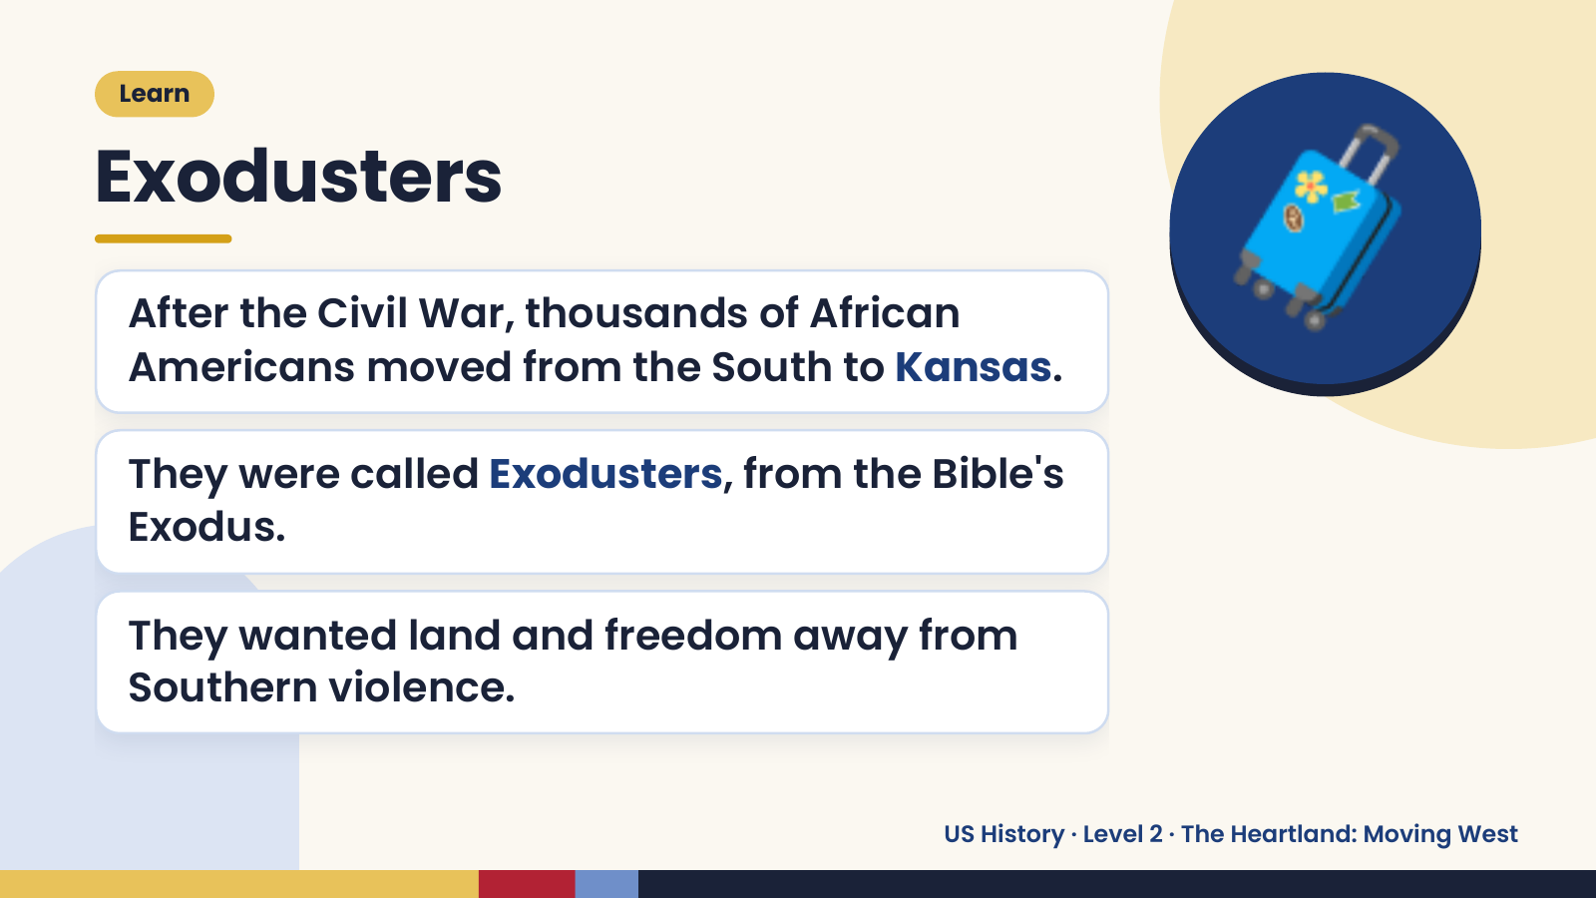
Notes:
Learn
Exodusters
After the Civil War, thousands of African
Americans moved from the South to Kansas.
They were called Exodusters, from the Bible's
🧳
Exodus.
They wanted land and freedom away from
Southern violence.
US History · Level 2 · The Heartland: Moving West

Slide 13
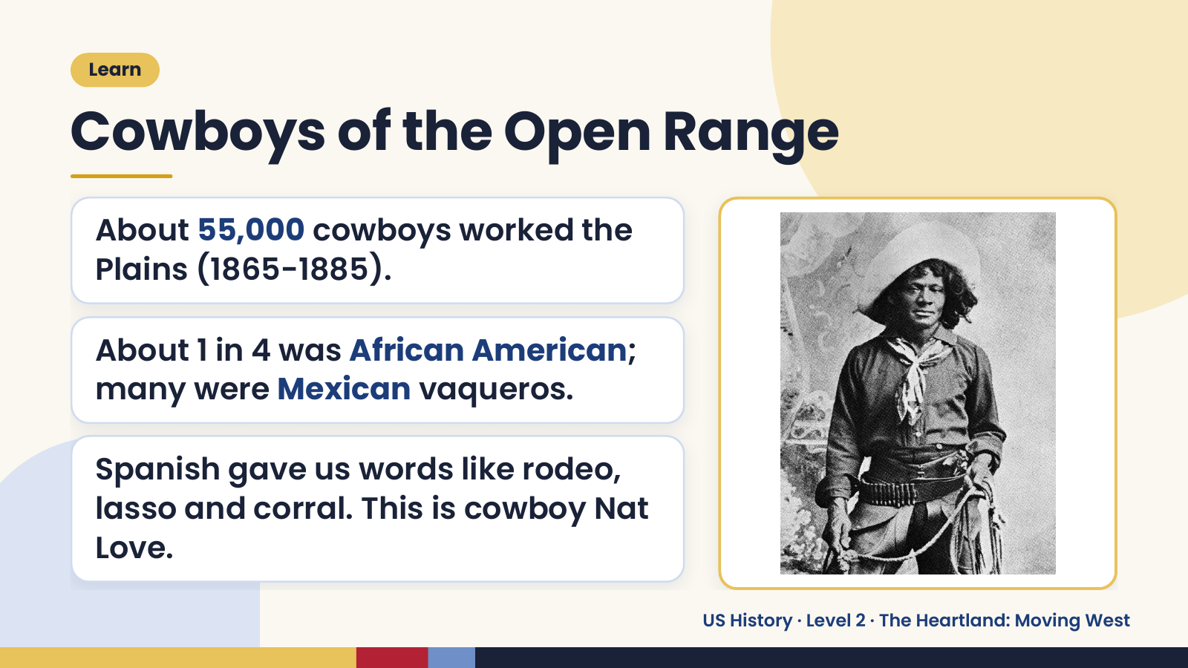
Notes:
Learn
Cowboys of the Open Range
About 55,000 cowboys worked the
Plains (1865-1885).
About 1 in 4 was African American;
many were Mexican vaqueros.
Spanish gave us words like rodeo,
lasso and corral. This is cowboy Nat
Love.
US History · Level 2 · The Heartland: Moving West

Slide 14
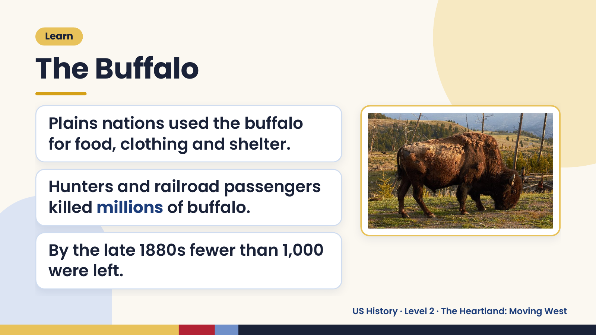
Notes:
Learn
The Buffalo
Plains nations used the buffalo
for food, clothing and shelter.
Hunters and railroad passengers
killed millions of buffalo.
By the late 1880s fewer than 1,000
were left.
US History · Level 2 · The Heartland: Moving West

Slide 15
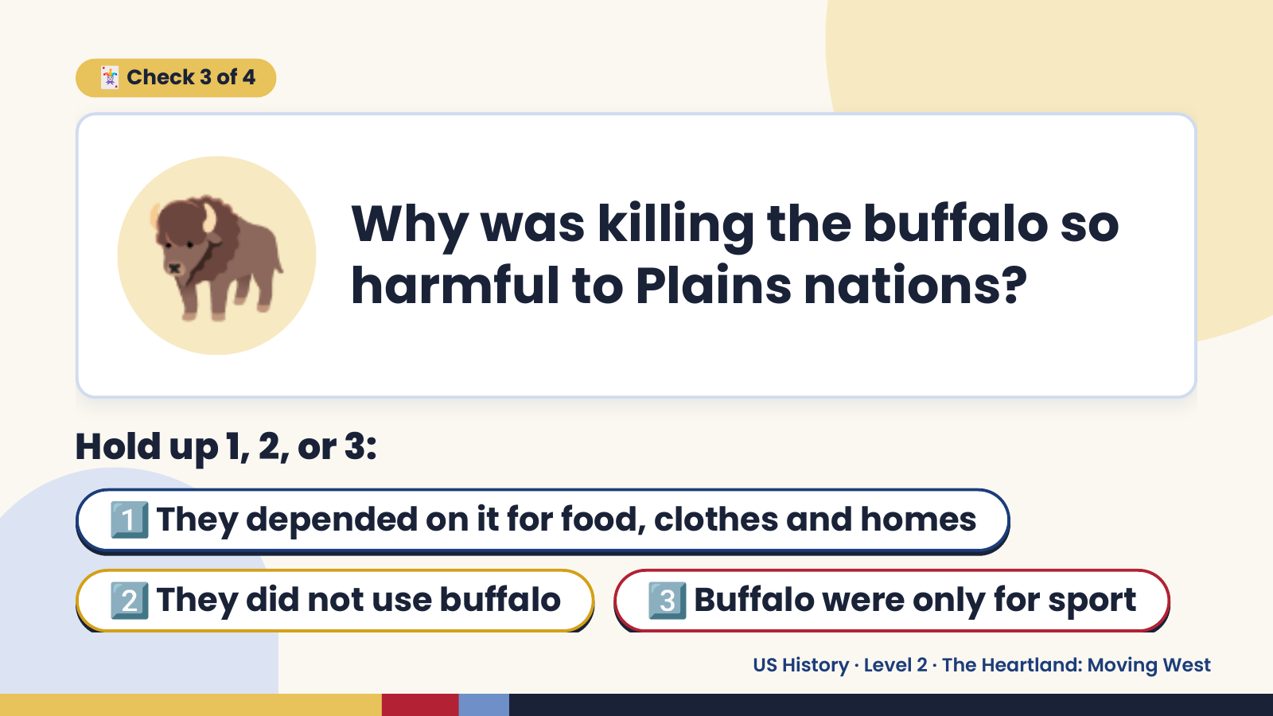
Notes:
🦬
🃏 Check 3 of 4
Why was killing the buffalo so
harmful to Plains nations?
Hold up 1, 2, or 3:
1️⃣ They depended on it for food, clothes and homes
2️⃣ They did not use buffalo 3️⃣ Buffalo were only for sport
US History · Level 2 · The Heartland: Moving West

Slide 16
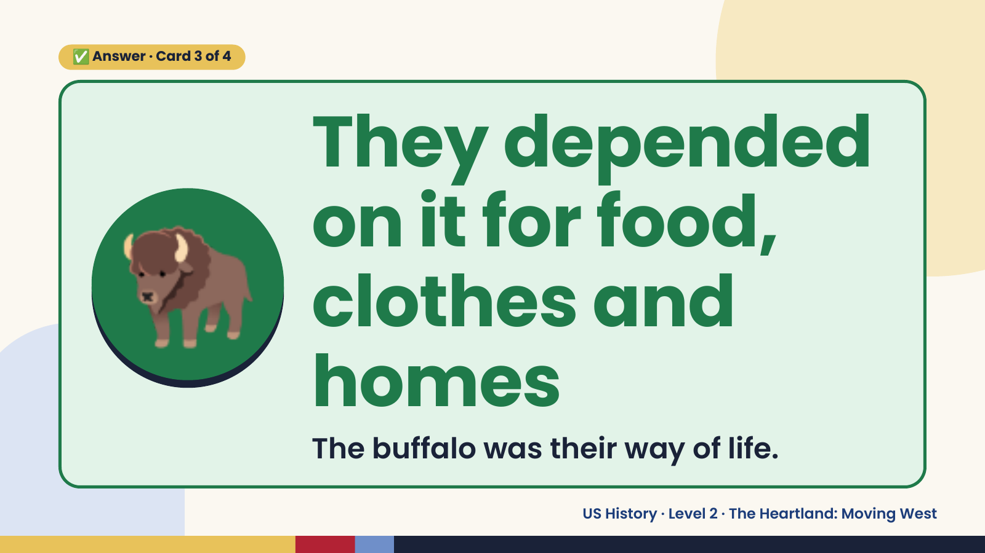
Notes:
✅ Answer · Card 3 of 4
🦬
They depended
on it for food,
clothes and
homes
The buffalo was their way of life.
US History · Level 2 · The Heartland: Moving West

Slide 17
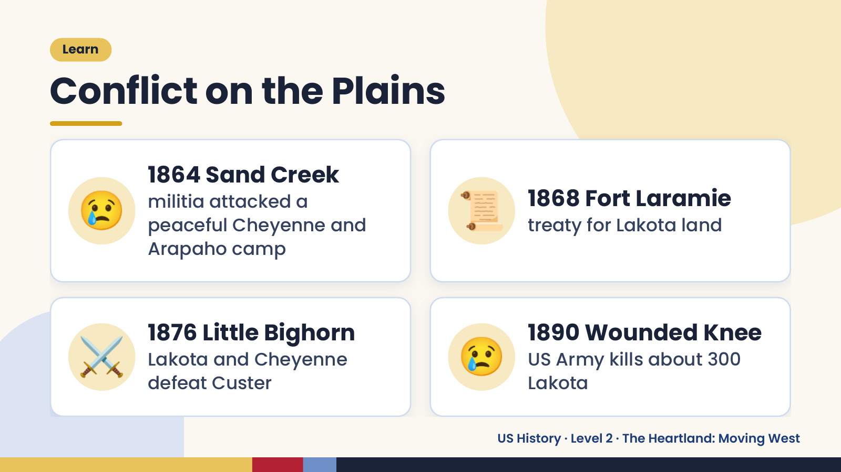
Notes:
Learn
Conflict on the Plains
😢 1864 Sand Creek
militia attacked a
peaceful Cheyenne and
Arapaho camp
📜 1868 Fort Laramie
treaty for Lakota land
⚔️ 1876 Little Bighorn
Lakota and Cheyenne
defeat Custer
😢 1890 Wounded Knee
US Army kills about 300
Lakota
US History · Level 2 · The Heartland: Moving West

Slide 18
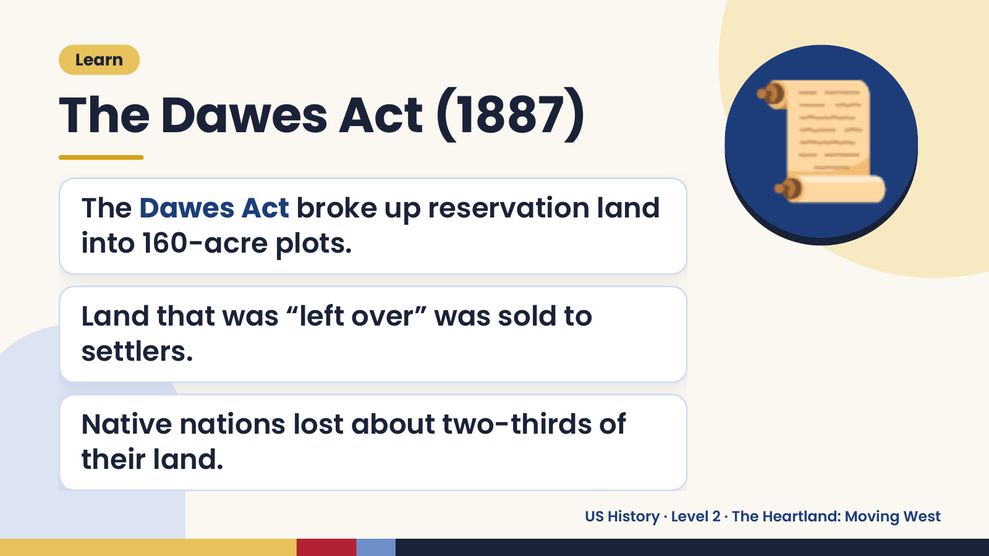
Notes:
Learn
The Dawes Act (1887)
The Dawes Act broke up reservation land
into 160-acre plots.
📜
Land that was “left over” was sold to
settlers.
Native nations lost about two-thirds of
their land.
US History · Level 2 · The Heartland: Moving West

Slide 19
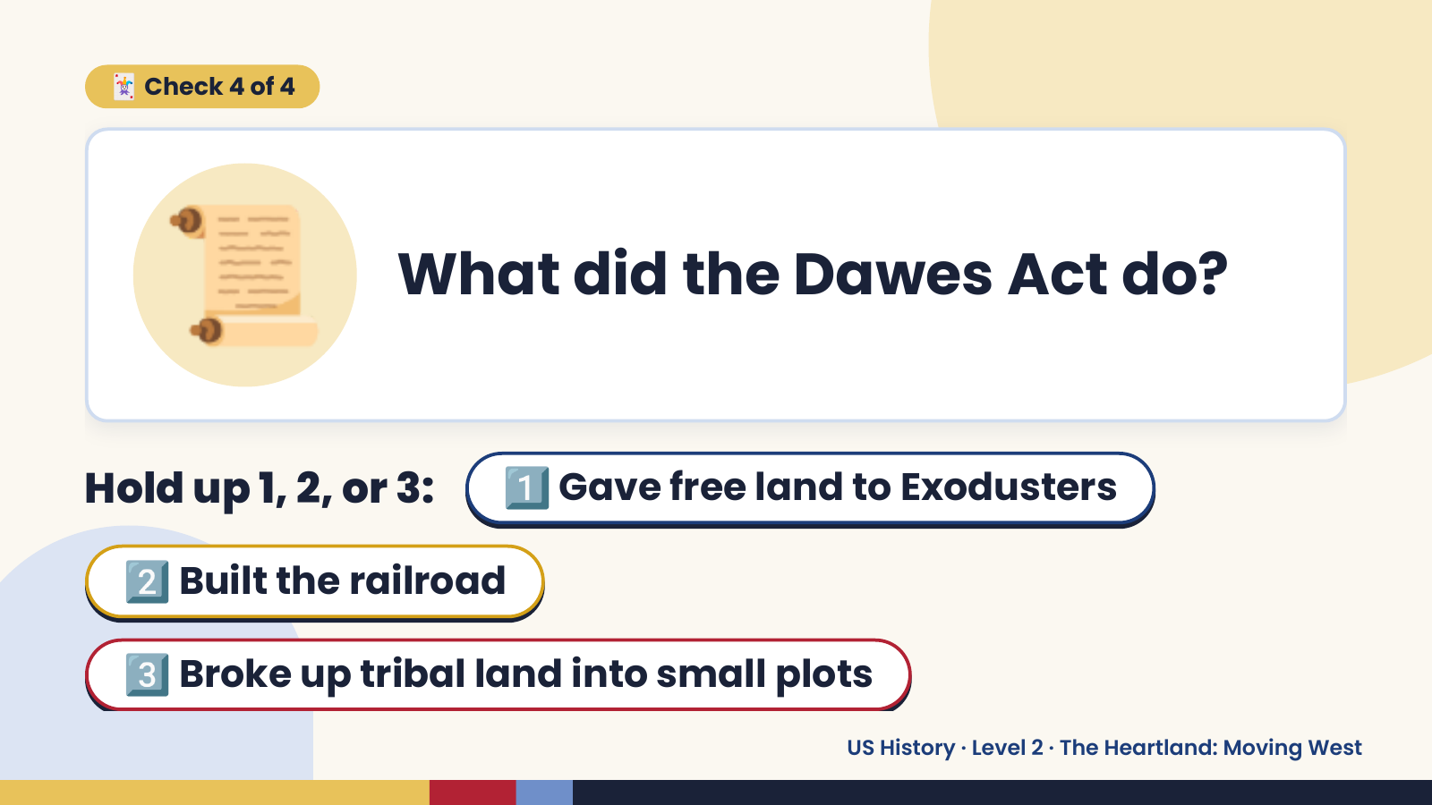
Notes:
📜
🃏 Check 4 of 4
What did the Dawes Act do?
Hold up 1, 2, or 3: 1️⃣ Gave free land to Exodusters
2️⃣ Built the railroad
3️⃣ Broke up tribal land into small plots
US History · Level 2 · The Heartland: Moving West

Slide 20
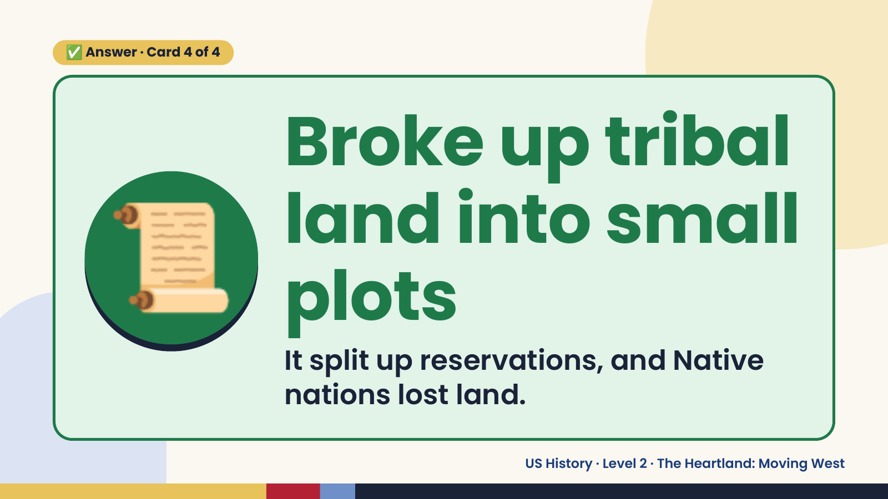
Notes:
✅ Answer · Card 4 of 4
📜 Broke up tribal
land into small
plots
It split up reservations, and Native
nations lost land.
US History · Level 2 · The Heartland: Moving West

Slide 21
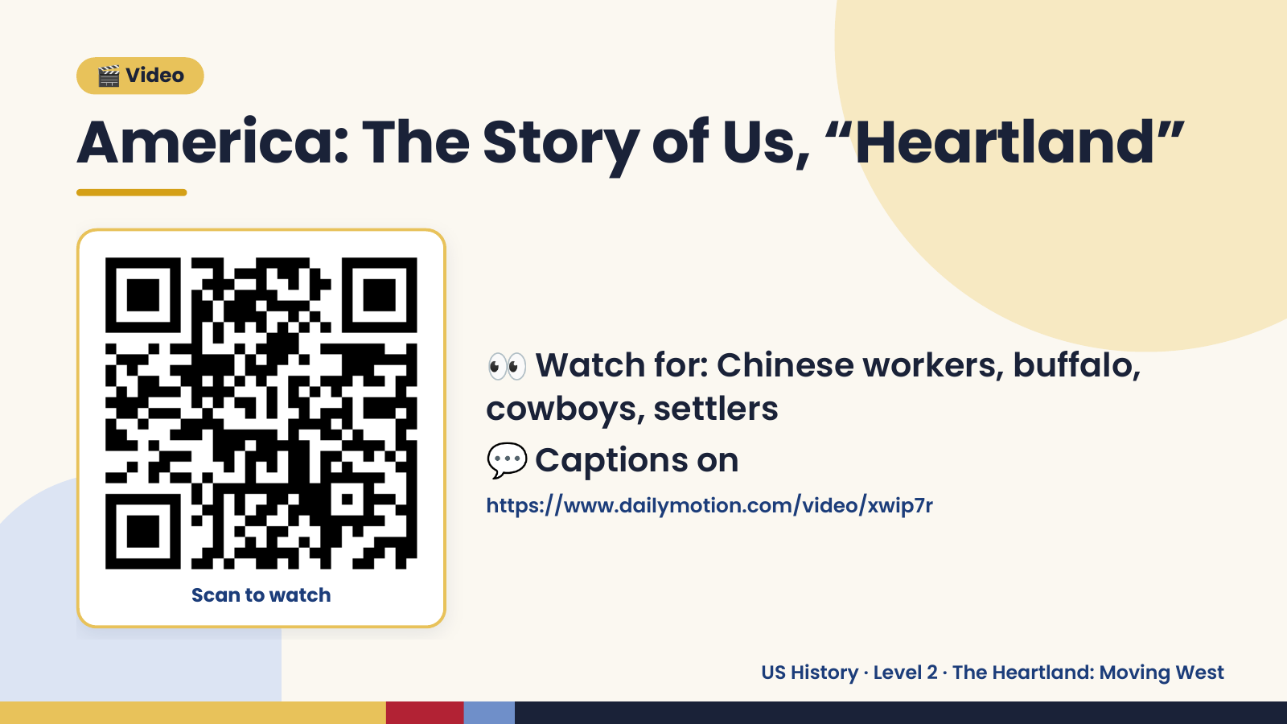
Notes:
🎬 Video
America: The Story of Us, “Heartland”
👀 Watch for: Chinese workers, buffalo,
cowboys, settlers
💬 Captions on
https://www.dailymotion.com/video/xwip7r
Scan to watch
US History · Level 2 · The Heartland: Moving West

Slide 22
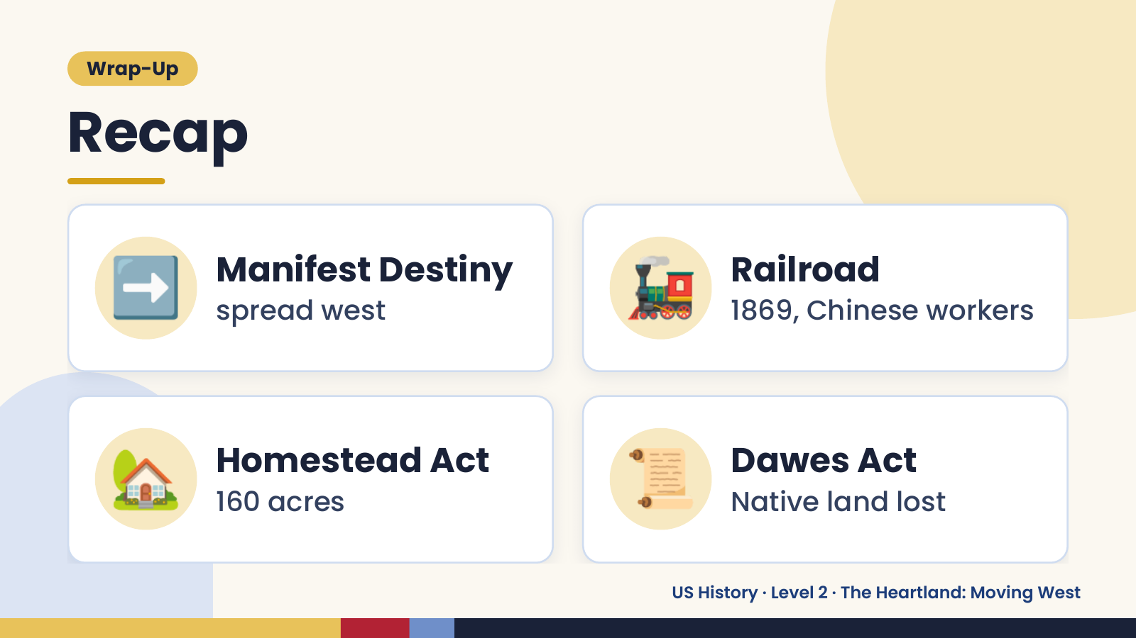
Notes:
Wrap-Up
Recap
➡️ Manifest Destiny
spread west 🚂 Railroad
1869, Chinese workers
🏡 Homestead Act
160 acres 📜 Dawes Act
Native land lost
US History · Level 2 · The Heartland: Moving West

Slide 23
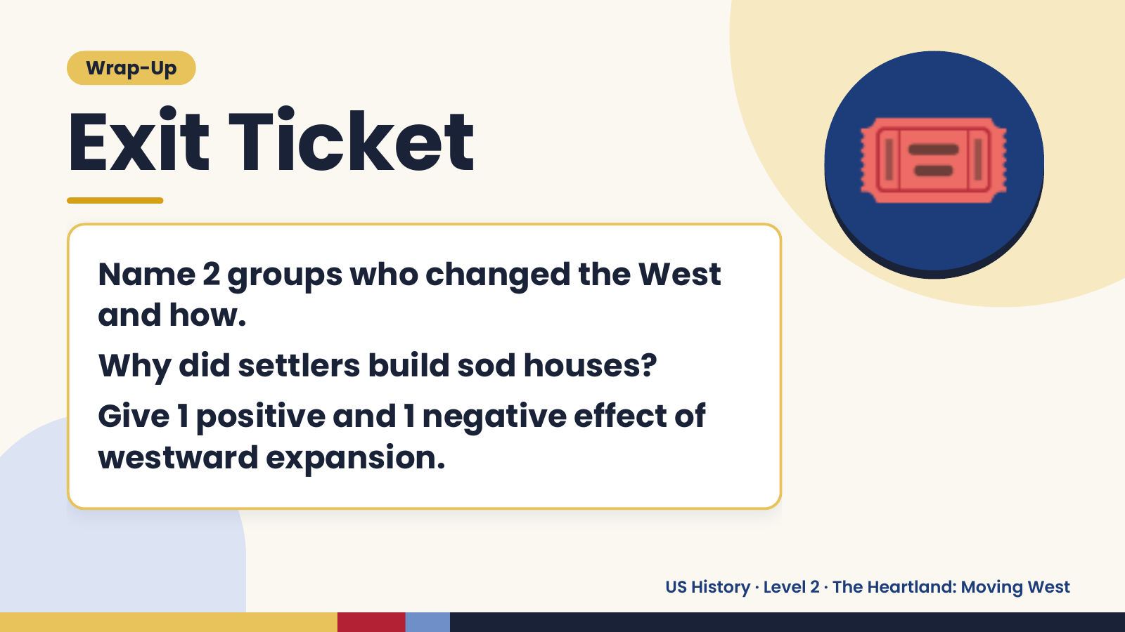
Notes:
Wrap-Up
Exit Ticket
Name 2 groups who changed the West
and how.
🎟️
Why did settlers build sod houses?
Give 1 positive and 1 negative effect of
westward expansion.
US History · Level 2 · The Heartland: Moving West

