Slide 1
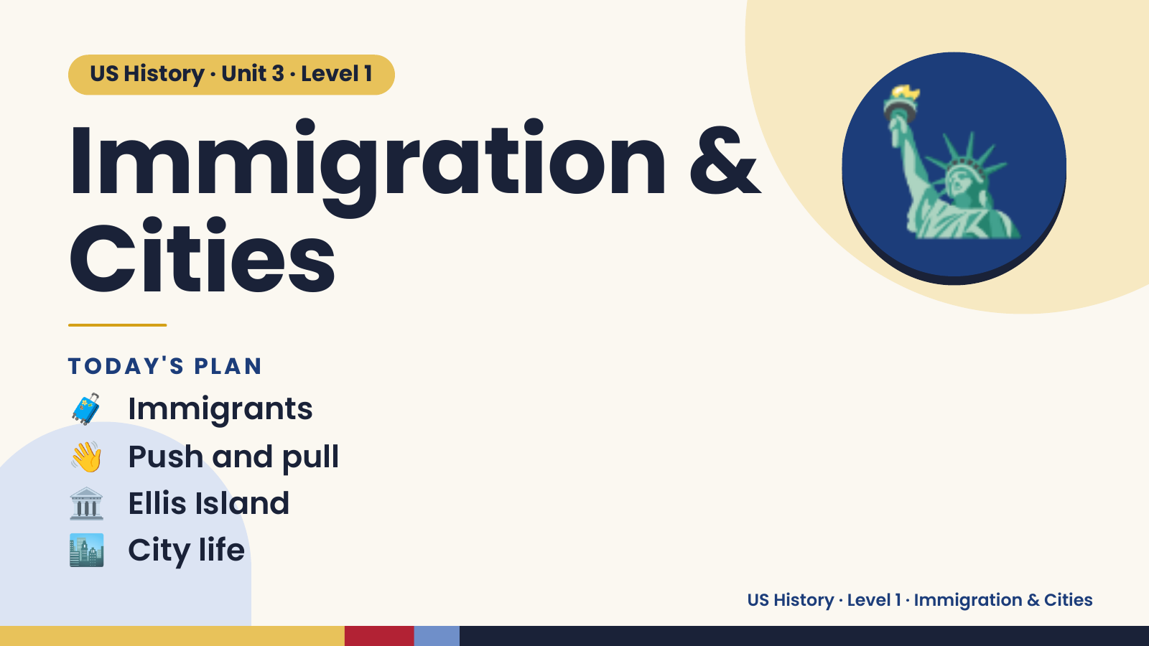
Notes:
US History · Unit 3 · Level 1
Immigration &
Cities
🗽
🧳 Immigrants
TODAY'S PLAN
👋 Push and pull
🏛️ Ellis Island
🏙️ City life
US History · Level 1 · Immigration & Cities

Slide 2
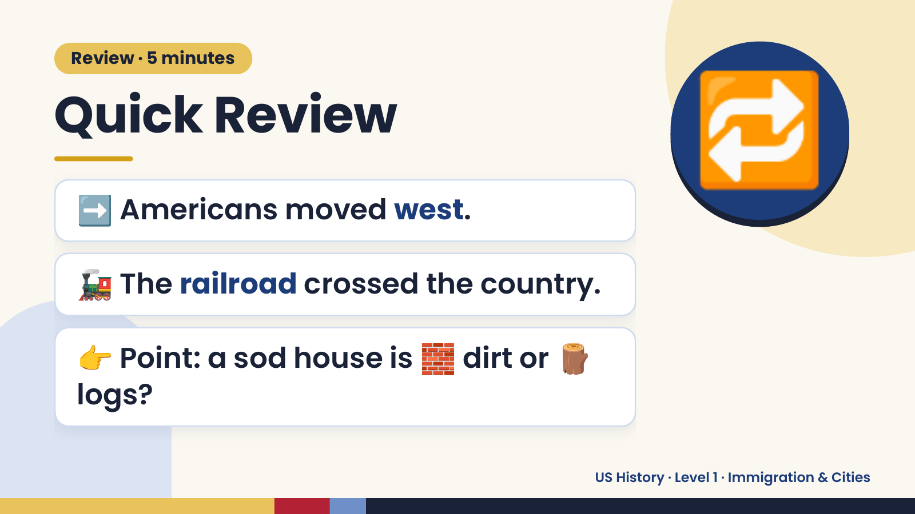
Notes:
Review · 5 minutes
Quick Review
➡️ Americans moved west.
🚂 The railroad crossed the country.
🔁
👉 Point: a sod house is 🧱 dirt or 🪵
logs?
US History · Level 1 · Immigration & Cities

Slide 3
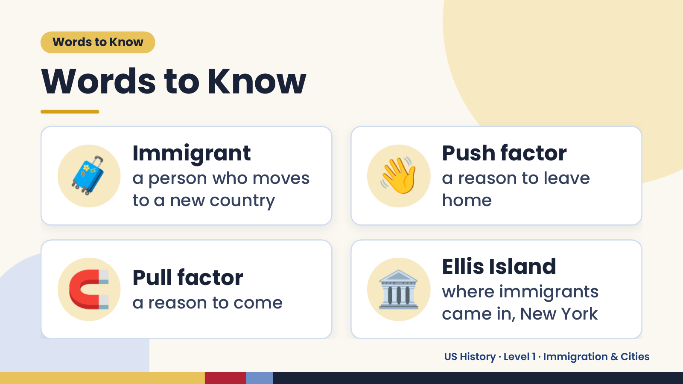
Notes:
Words to Know
Words to Know
🧳 Immigrant
a person who moves
to a new country
👋 Push factor
a reason to leave
home
🧲 Pull factor
a reason to come 🏛️ Ellis Island
where immigrants
came in, New York
US History · Level 1 · Immigration & Cities

Slide 4
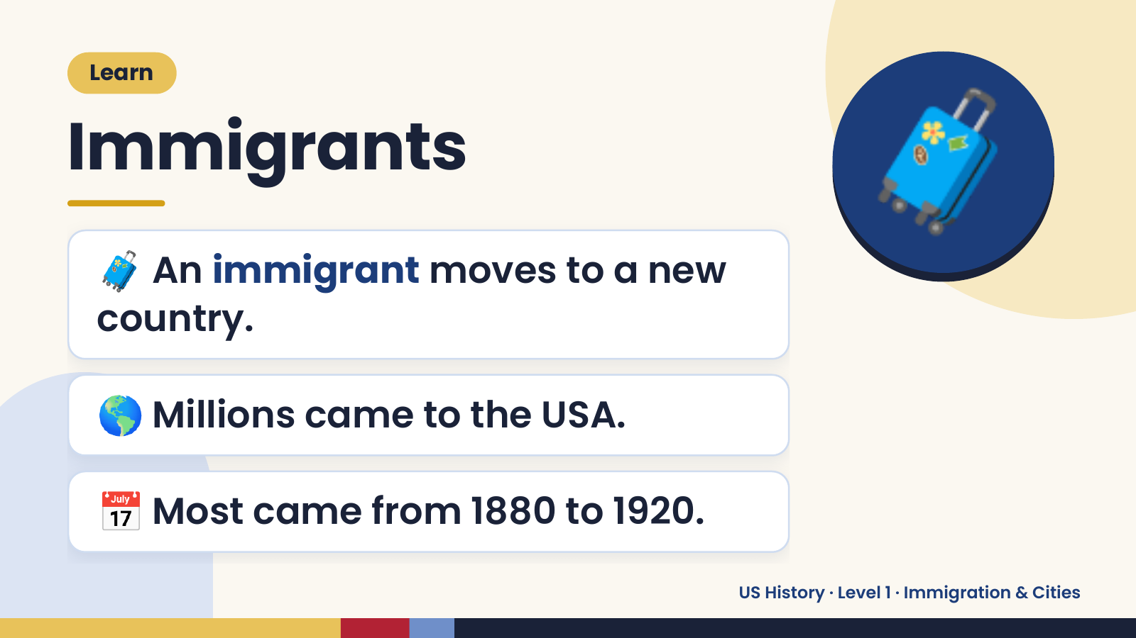
Notes:
Learn
Immigrants
🧳 An immigrant moves to a new
country.
🧳
🌎 Millions came to the USA.
📅 Most came from 1880 to 1920.
US History · Level 1 · Immigration & Cities

Slide 5
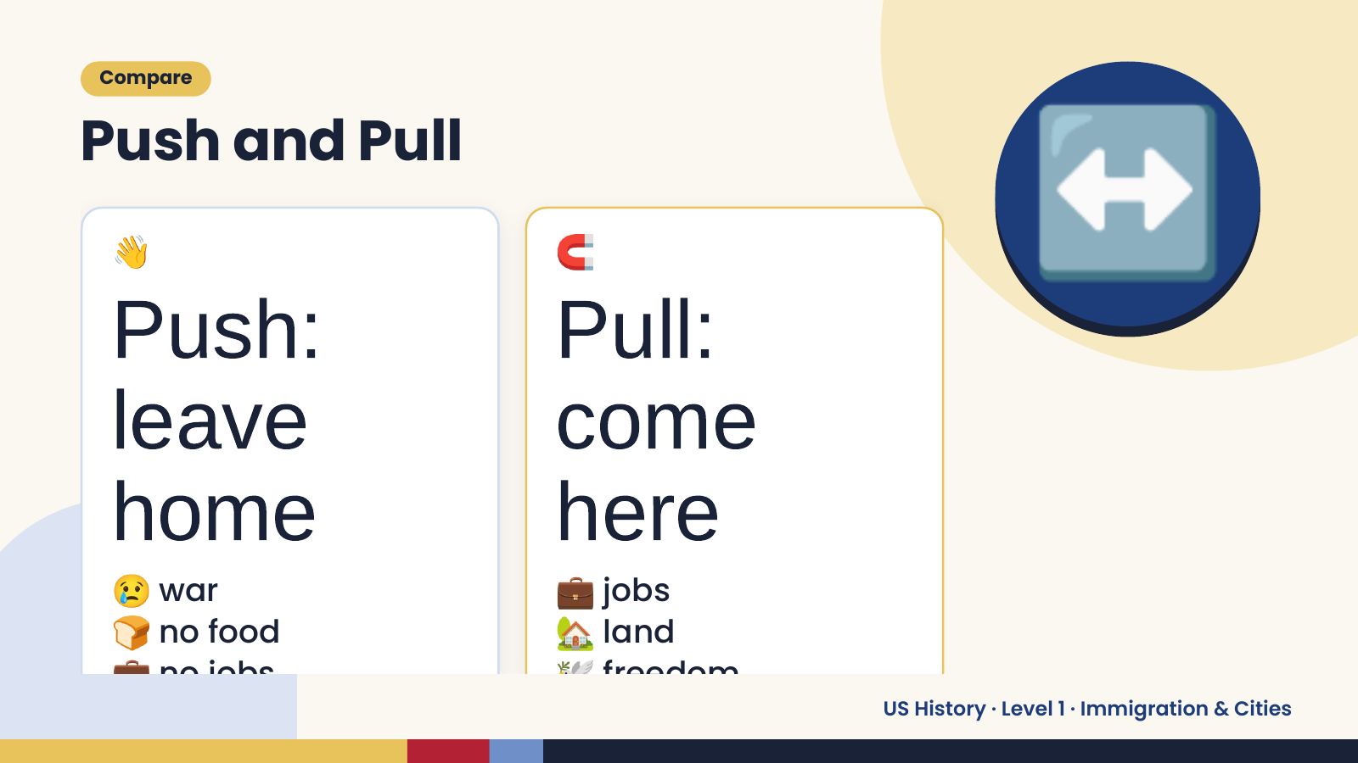
Notes:
Compare
Push and Pull
👋
Push:
🧲
Pull:
↔️
leave come
home
😢
here
💼
🍞 🏡
war jobs
💼 🕊️
no food land
no jobs freedom
US History · Level 1 · Immigration & Cities

Slide 6
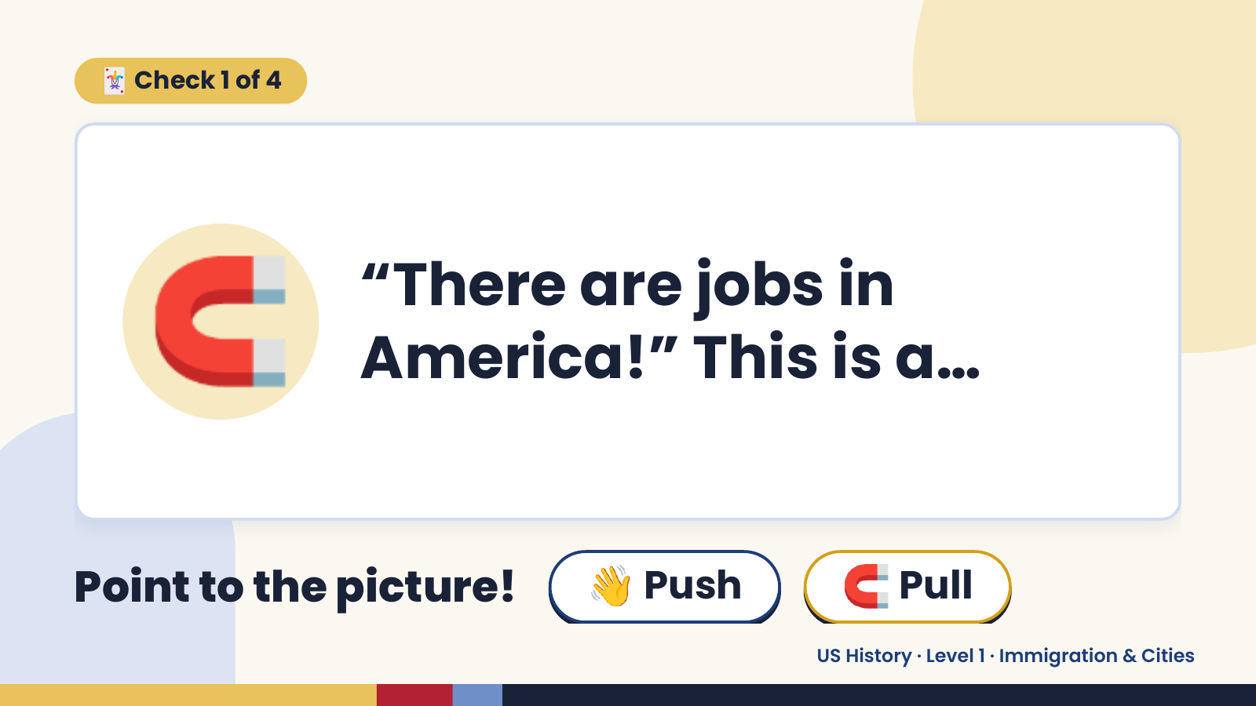
Notes:
🃏 Check 1 of 4
🧲 “There are jobs in
America!” This is a…
Point to the picture! 👋 Push 🧲 Pull
US History · Level 1 · Immigration & Cities

Slide 7

Notes:
✅ Answer · Card 1 of 4
🧲 Pull
Jobs pull people to come.
US History · Level 1 · Immigration & Cities

Slide 8
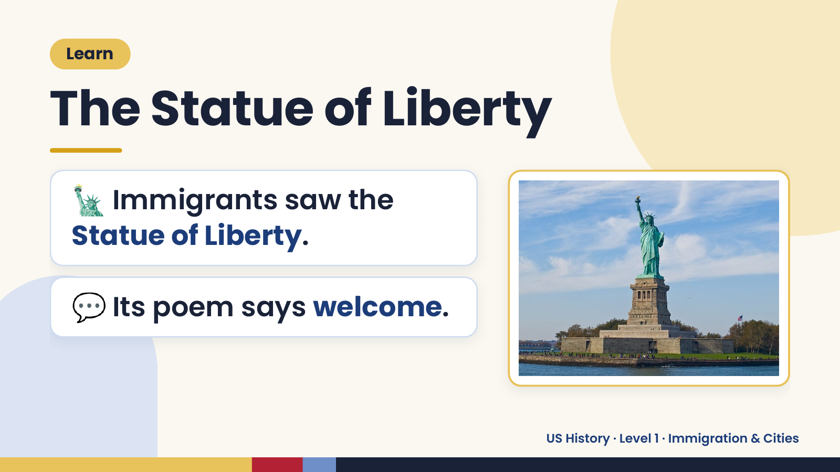
Notes:
Learn
The Statue of Liberty
🗽 Immigrants saw the
Statue of Liberty.
💬 Its poem says welcome.
US History · Level 1 · Immigration & Cities

Slide 9
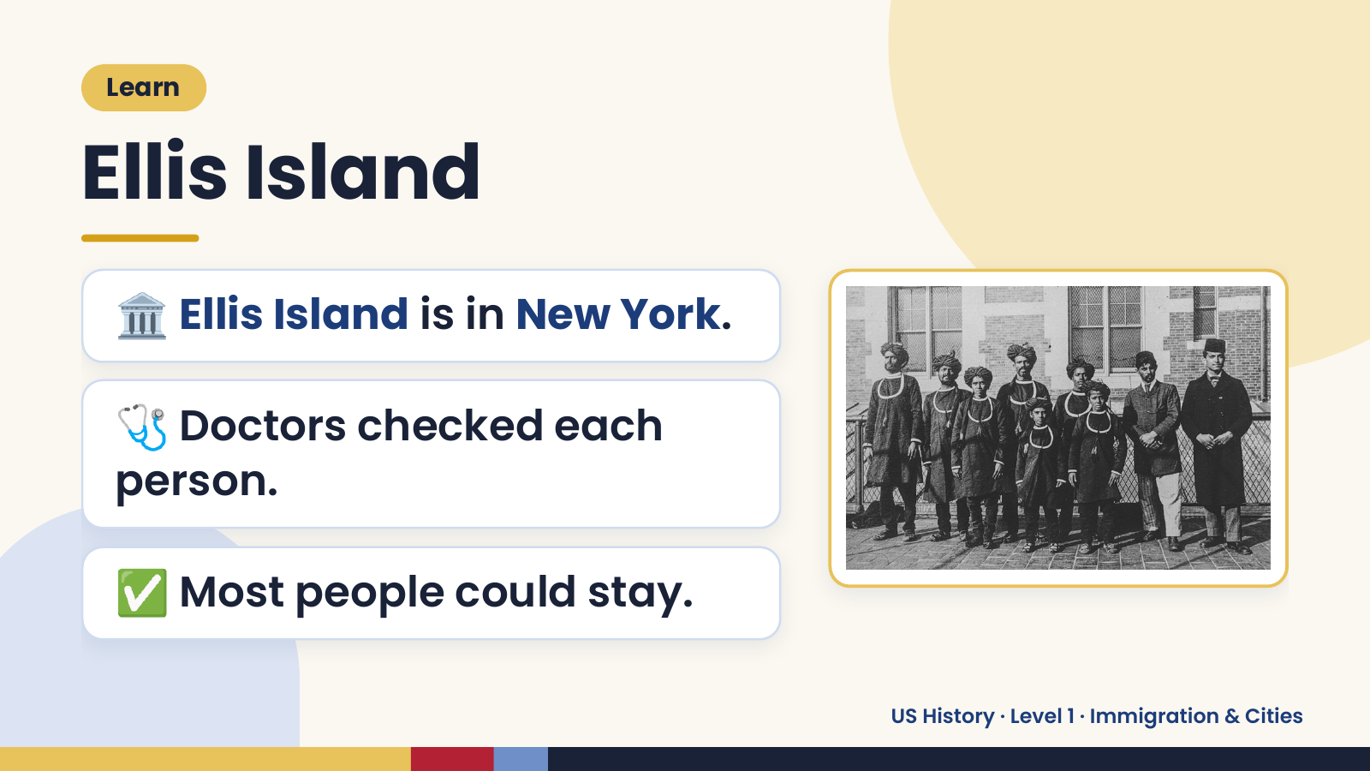
Notes:
Learn
Ellis Island
🏛️ Ellis Island is in New York.
🩺 Doctors checked each
person.
✅ Most people could stay.
US History · Level 1 · Immigration & Cities

Slide 10
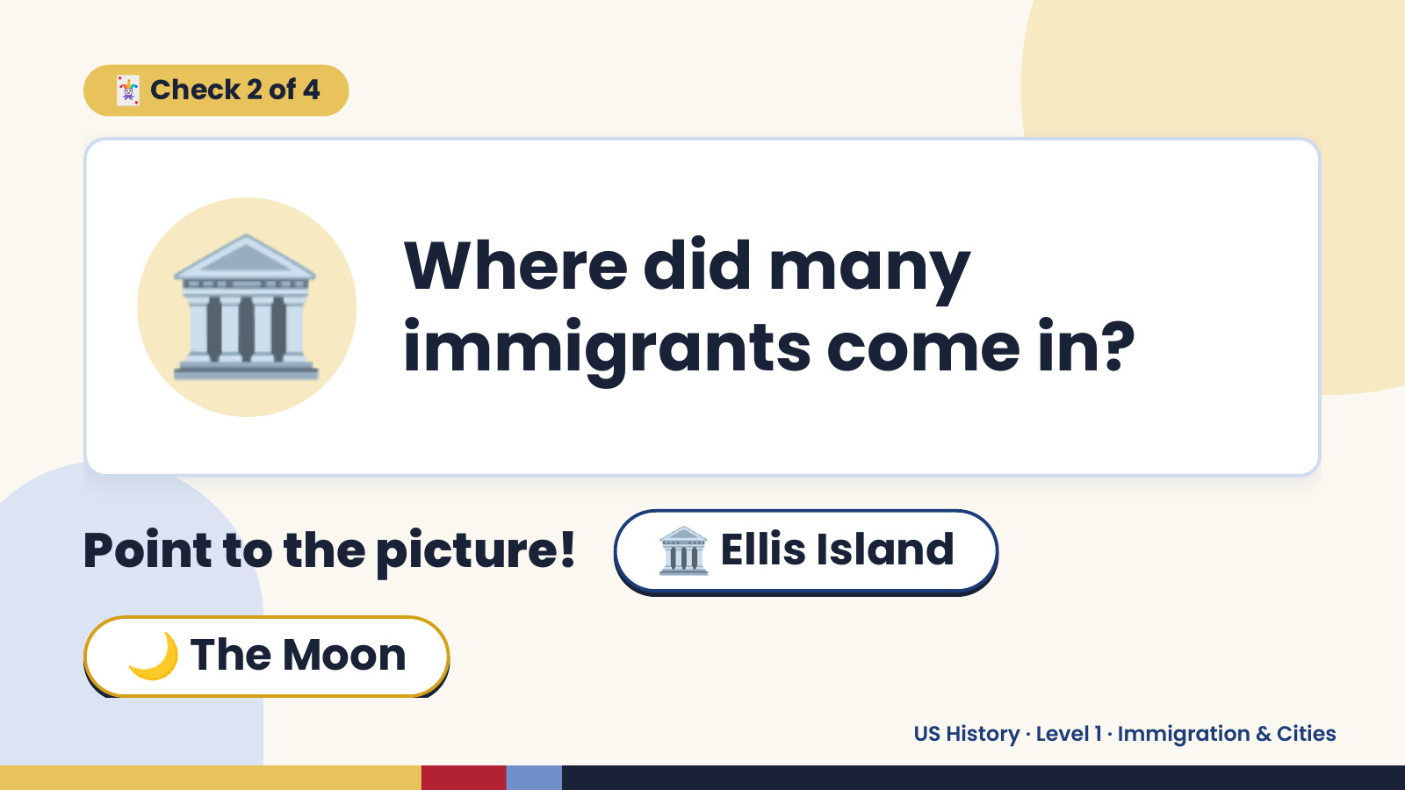
Notes:
🃏 Check 2 of 4
🏛️ Where did many
immigrants come in?
Point to the picture! 🏛️ Ellis Island
🌙 The Moon
US History · Level 1 · Immigration & Cities

Slide 11
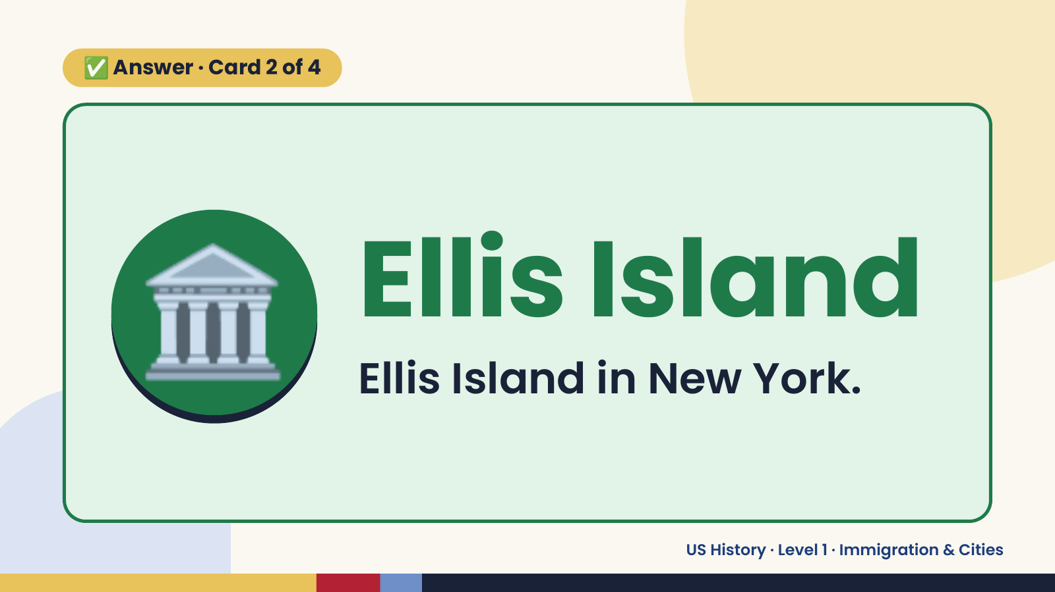
Notes:
✅ Answer · Card 2 of 4
🏛️ Ellis Island
Ellis Island in New York.
US History · Level 1 · Immigration & Cities

Slide 12
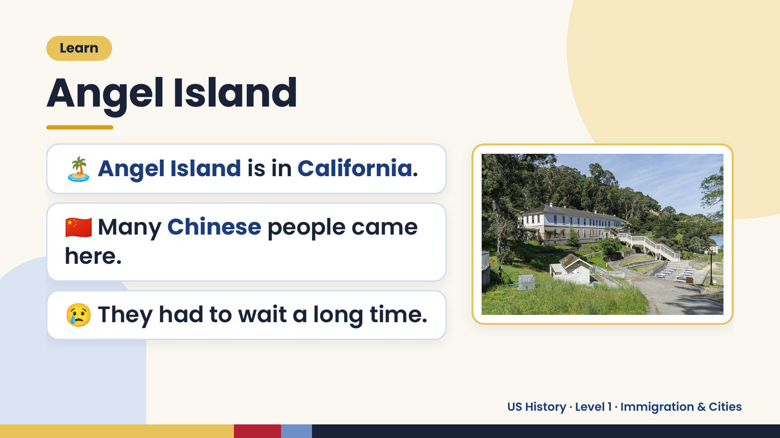
Notes:
Learn
Angel Island
🏝️ Angel Island is in California.
🇨🇳 Many Chinese people came
here.
😢 They had to wait a long time.
US History · Level 1 · Immigration & Cities

Slide 13
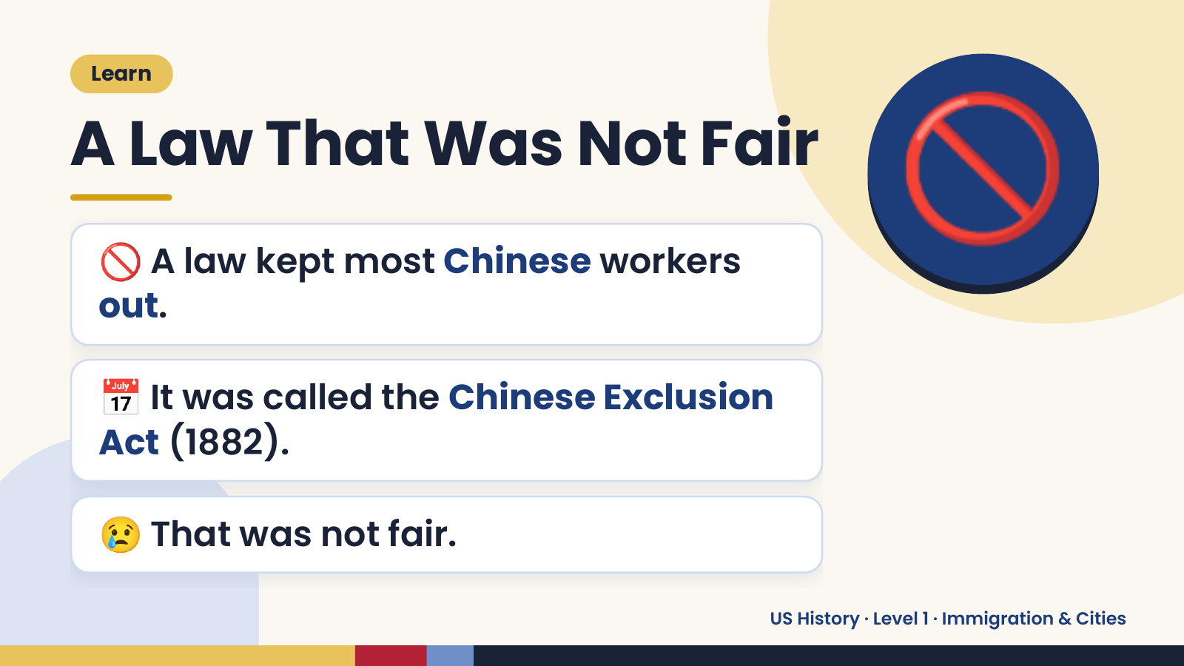
Notes:
Learn
A Law That Was Not Fair
🚫 A law kept most Chinese workers
out.
🚫
📅 It was called the Chinese Exclusion
Act (1882).
😢 That was not fair.
US History · Level 1 · Immigration & Cities

Slide 14
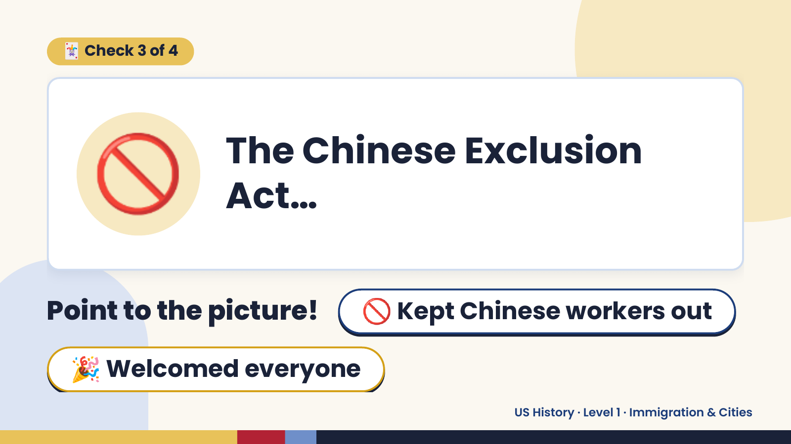
Notes:
🃏 Check 3 of 4
🚫 The Chinese Exclusion
Act…
Point to the picture! 🚫 Kept Chinese workers out
🎉 Welcomed everyone
US History · Level 1 · Immigration & Cities

Slide 15
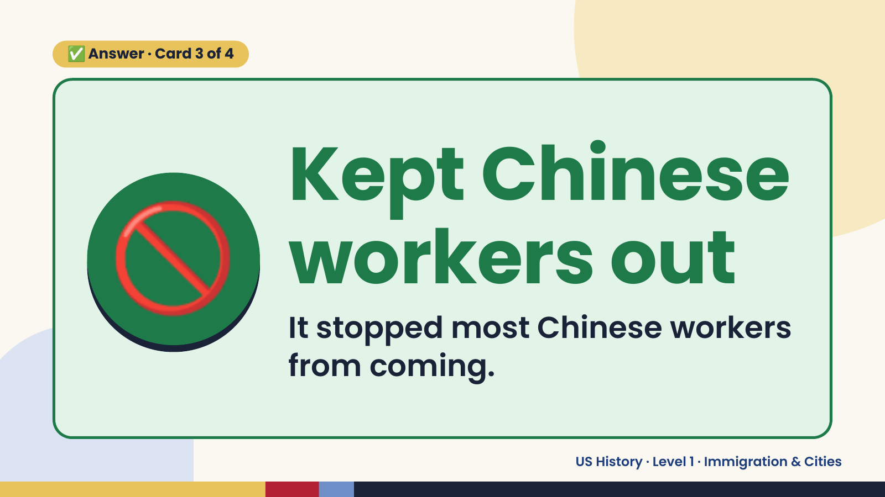
Notes:
✅ Answer · Card 3 of 4
🚫 Kept Chinese
workers out
It stopped most Chinese workers
from coming.
US History · Level 1 · Immigration & Cities

Slide 16
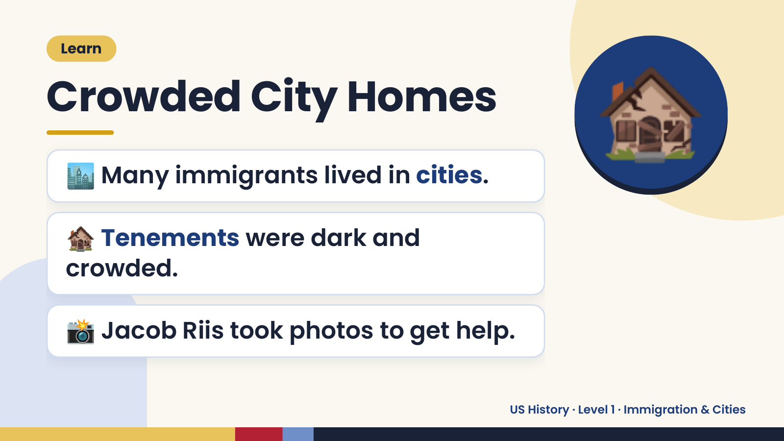
Notes:
Learn
Crowded City Homes
🏙️ Many immigrants lived in cities.
🏚️ Tenements were dark and
🏚️
crowded.
📸 Jacob Riis took photos to get help.
US History · Level 1 · Immigration & Cities

Slide 17
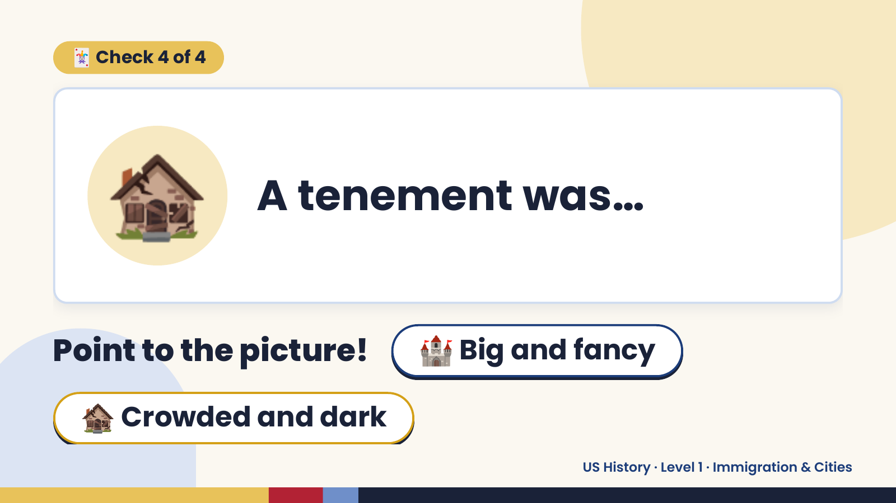
Notes:
🃏 Check 4 of 4
🏚️ A tenement was…
Point to the picture! 🏰 Big and fancy
🏚️ Crowded and dark
US History · Level 1 · Immigration & Cities

Slide 18
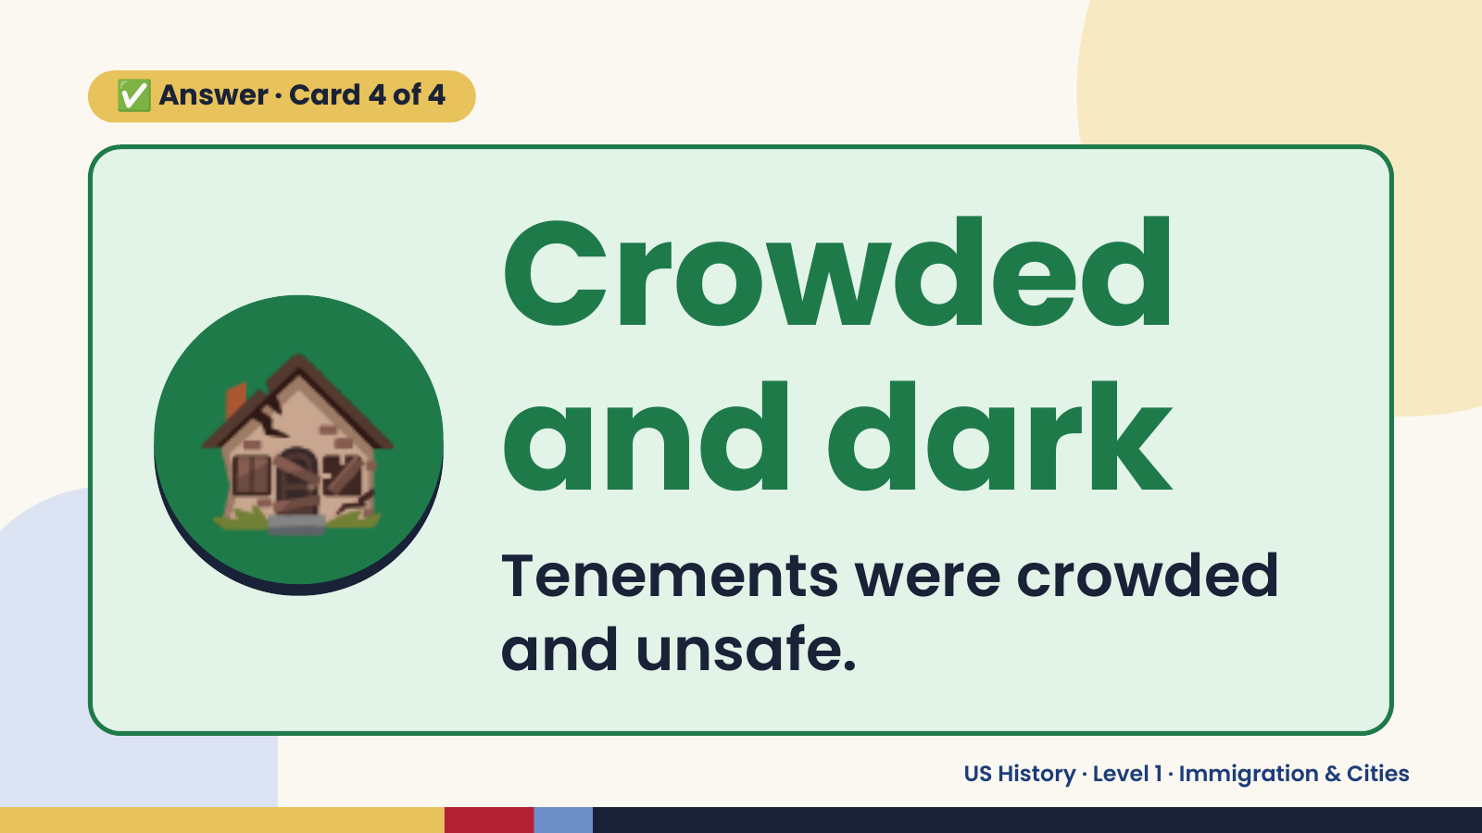
Notes:
✅ Answer · Card 4 of 4
🏚️ Crowded
and dark
Tenements were crowded
and unsafe.
US History · Level 1 · Immigration & Cities

Slide 19
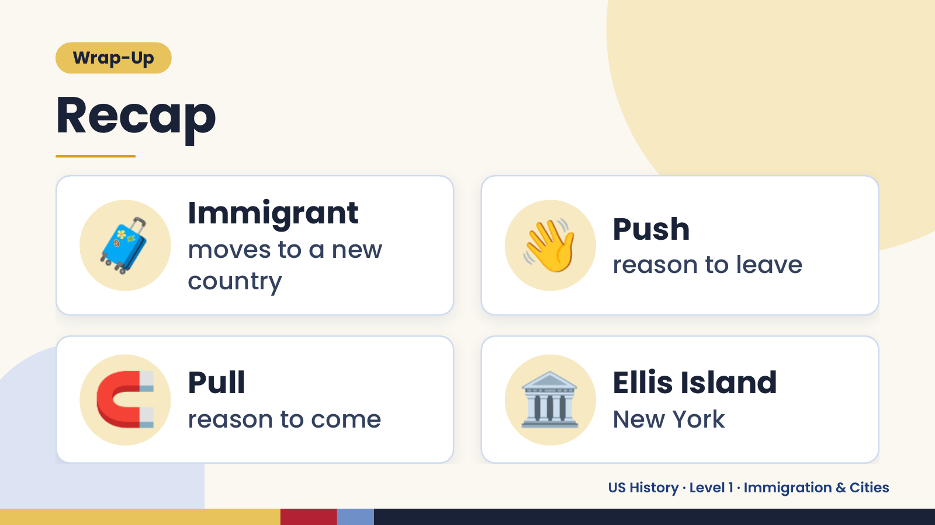
Notes:
Wrap-Up
Recap
🧳 Immigrant
moves to a new
country
👋 Push
reason to leave
🧲 Pull
reason to come 🏛️ Ellis Island
New York
US History · Level 1 · Immigration & Cities

Slide 20

Notes:
Wrap-Up
Great Job!
🧳 Immigrants came for jobs and
🌟
freedom.
🏛️ 🏝️
Ellis Island and Angel Island.
🏚️ City homes were crowded.
US History · Level 1 · Immigration & Cities

