Slide 1
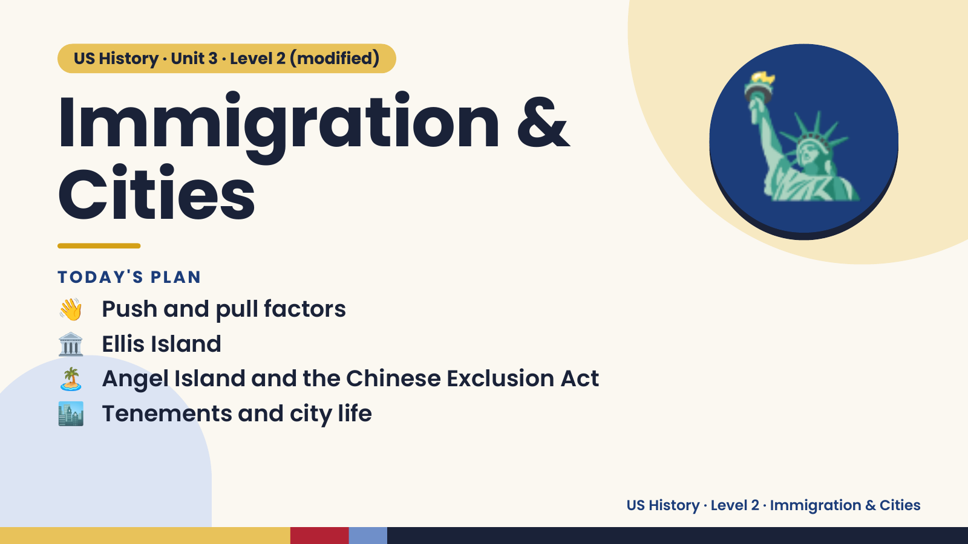
Notes:
US History · Unit 3 · Level 2 (modified)
Immigration &
Cities
👋 Push and pull factors
TODAY'S PLAN
🗽
🏛️ Ellis Island
🏝️ Angel Island and the Chinese Exclusion Act
🏙️ Tenements and city life
US History · Level 2 · Immigration & Cities

Slide 2
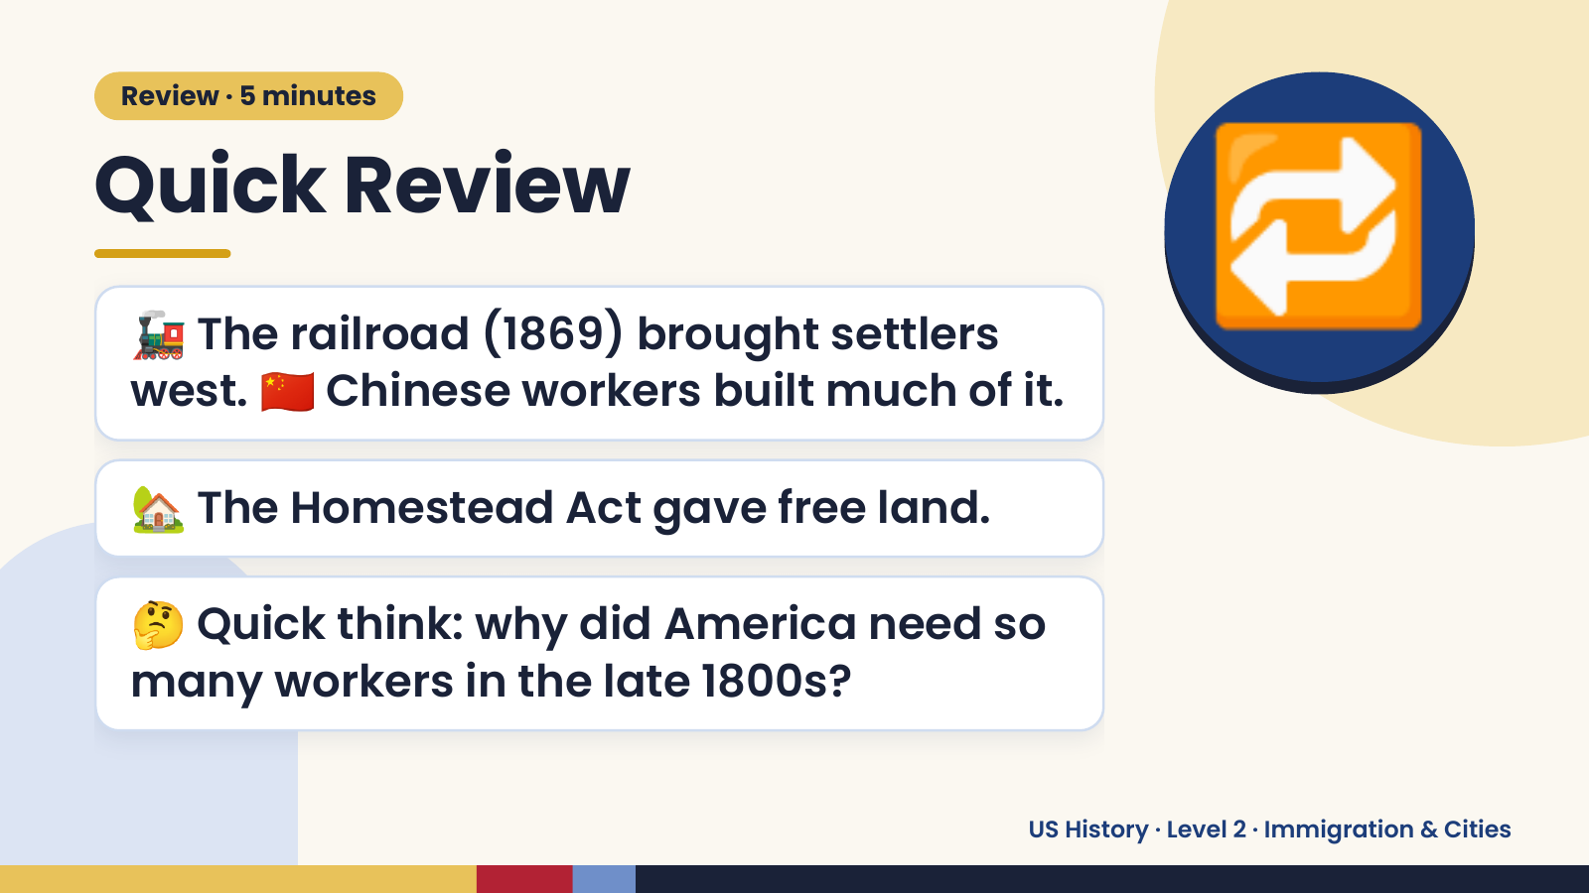
Notes:
Review · 5 minutes
Quick Review
🚂 The railroad (1869) brought settlers
west. 🇨🇳 Chinese workers built much of it.
🔁
🏡 The Homestead Act gave free land.
🤔 Quick think: why did America need so
many workers in the late 1800s?
US History · Level 2 · Immigration & Cities

Slide 3
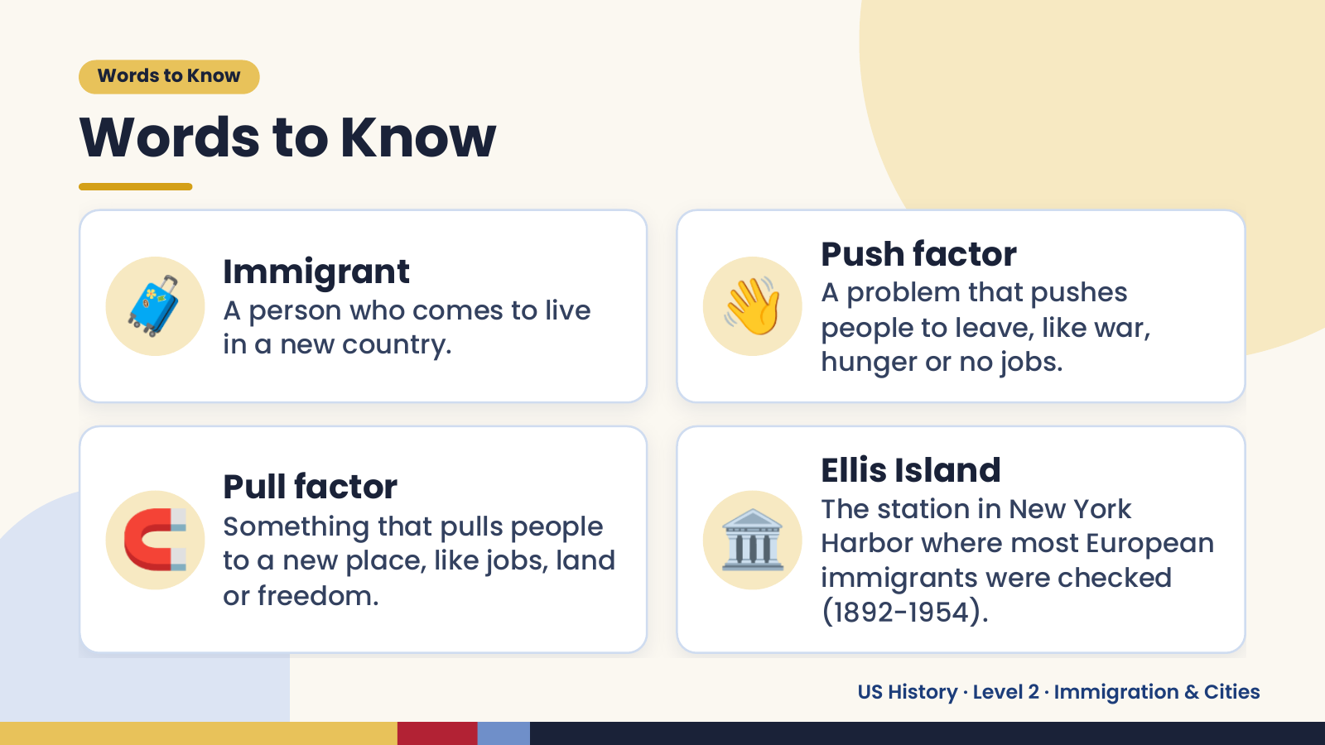
Notes:
Words to Know
Words to Know
🧳 Immigrant
A person who comes to live
in a new country.
👋 Push factor
A problem that pushes
people to leave, like war,
hunger or no jobs.
🧲 🏛️
Pull factor Ellis Island
The station in New York
Something that pulls people
Harbor where most European
to a new place, like jobs, land
immigrants were checked
or freedom.
(1892-1954).
US History · Level 2 · Immigration & Cities

Slide 4
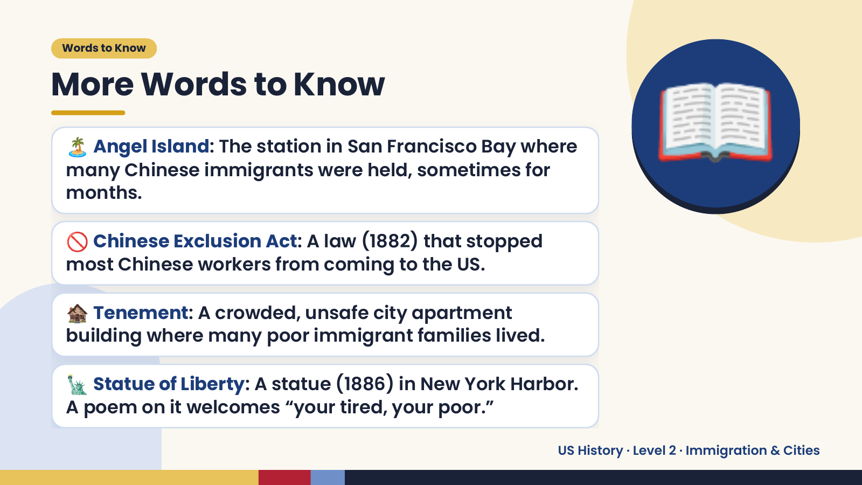
Notes:
Words to Know
More Words to Know
🏝️ Angel Island: The station in San Francisco Bay where
many Chinese immigrants were held, sometimes for
months.
🚫 Chinese Exclusion Act: A law (1882) that stopped
most Chinese workers from coming to the US.
📖
🏚️ Tenement: A crowded, unsafe city apartment
building where many poor immigrant families lived.
🗽 Statue of Liberty: A statue (1886) in New York Harbor.
A poem on it welcomes “your tired, your poor.”
US History · Level 2 · Immigration & Cities

Slide 5
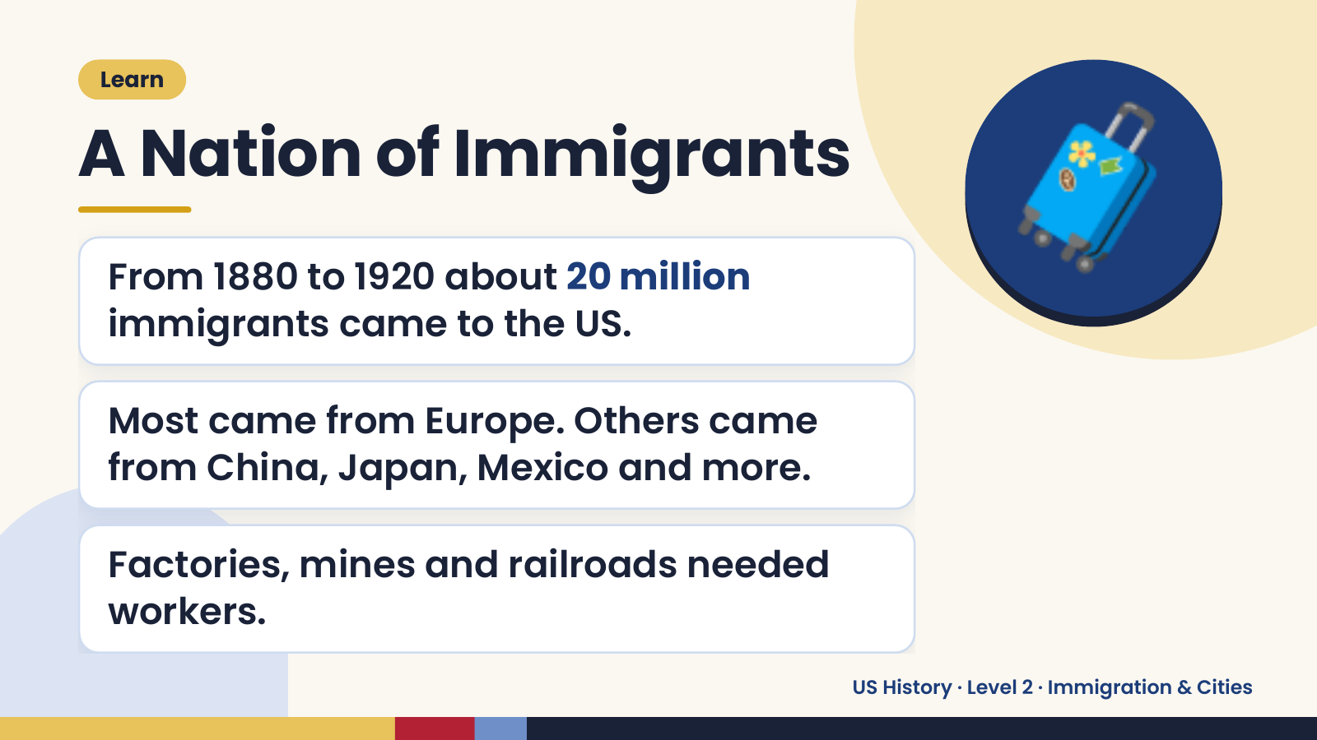
Notes:
Learn
A Nation of Immigrants
From 1880 to 1920 about 20 million
immigrants came to the US.
🧳
Most came from Europe. Others came
from China, Japan, Mexico and more.
Factories, mines and railroads needed
workers.
US History · Level 2 · Immigration & Cities

Slide 6
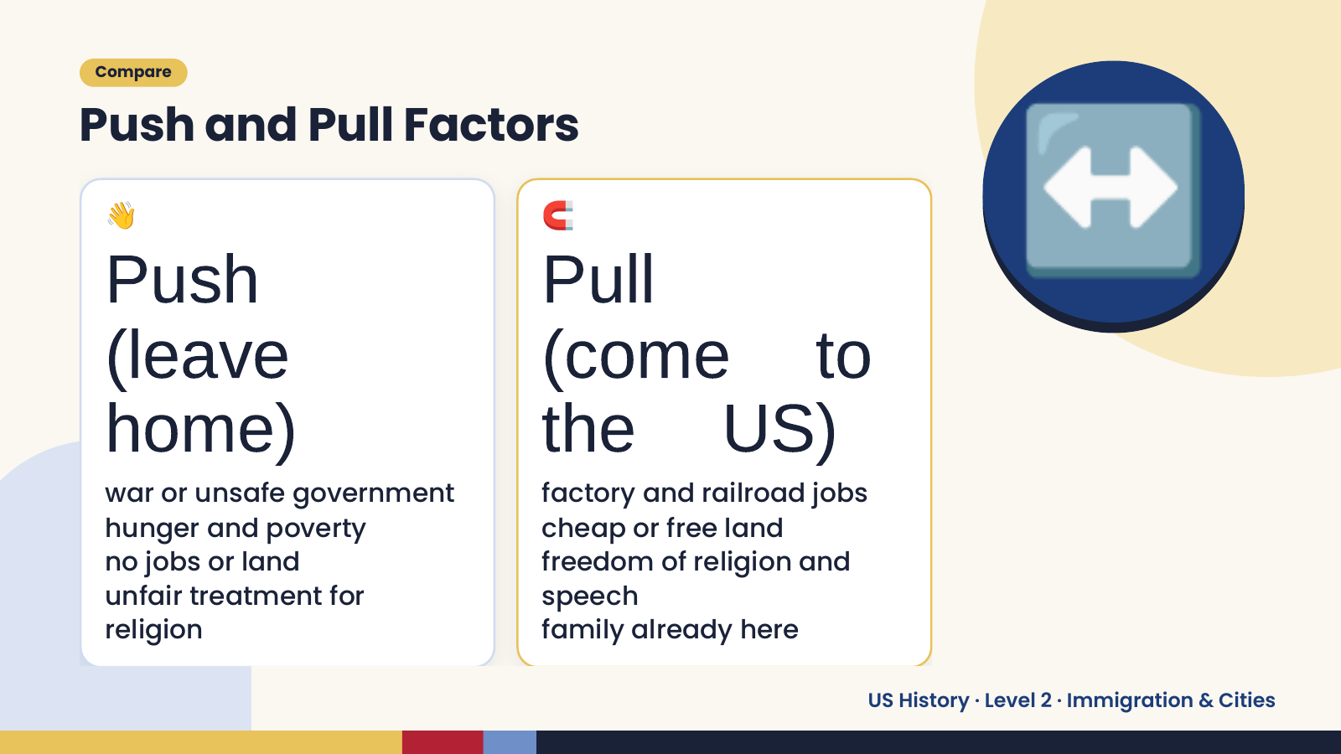
Notes:
Compare
Push and Pull Factors
👋
Push
(leave
🧲
Pull
(come to
↔️
home)
war or unsafe government
the US)
factory and railroad jobs
hunger and poverty cheap or free land
no jobs or land freedom of religion and
unfair treatment for speech
religion family already here
US History · Level 2 · Immigration & Cities

Slide 7
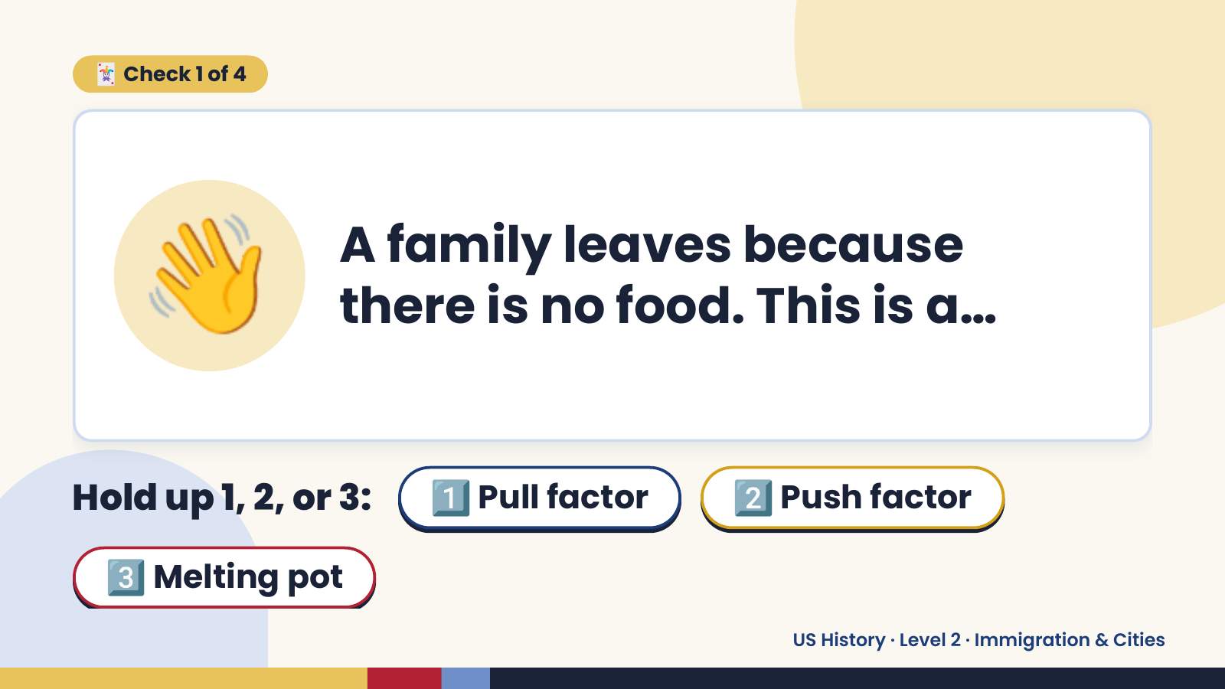
Notes:
🃏 Check 1 of 4
👋 A family leaves because
there is no food. This is a…
Hold up 1, 2, or 3: 1️⃣ Pull factor 2️⃣ Push factor
3️⃣ Melting pot
US History · Level 2 · Immigration & Cities

Slide 8
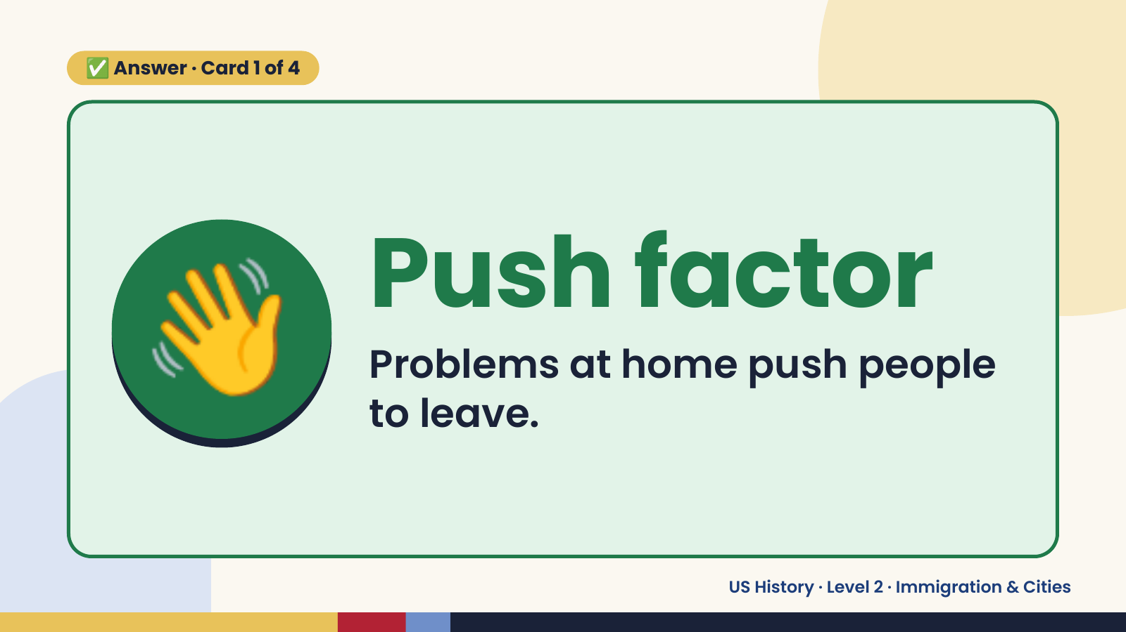
Notes:
✅ Answer · Card 1 of 4
👋 Push factor
Problems at home push people
to leave.
US History · Level 2 · Immigration & Cities

Slide 9
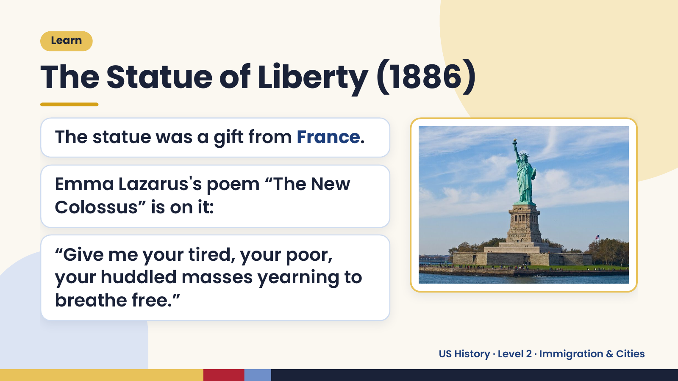
Notes:
Learn
The Statue of Liberty (1886)
The statue was a gift from France.
Emma Lazarus's poem “The New
Colossus” is on it:
“Give me your tired, your poor,
your huddled masses yearning to
breathe free.”
US History · Level 2 · Immigration & Cities

Slide 10
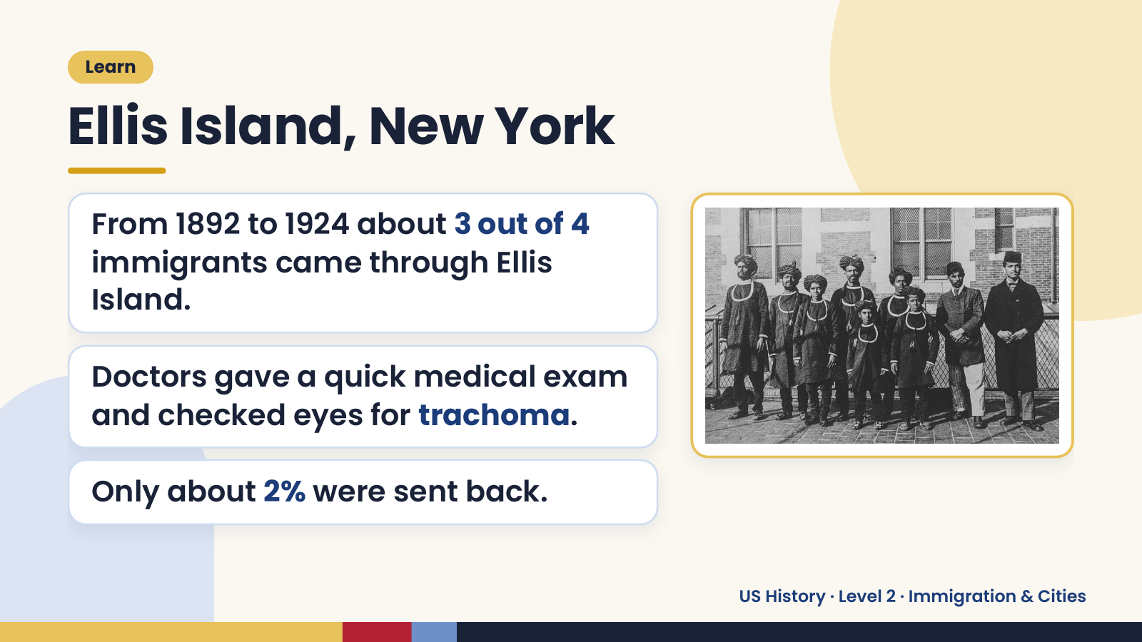
Notes:
Learn
Ellis Island, New York
From 1892 to 1924 about 3 out of 4
immigrants came through Ellis
Island.
Doctors gave a quick medical exam
and checked eyes for trachoma.
Only about 2% were sent back.
US History · Level 2 · Immigration & Cities

Slide 11
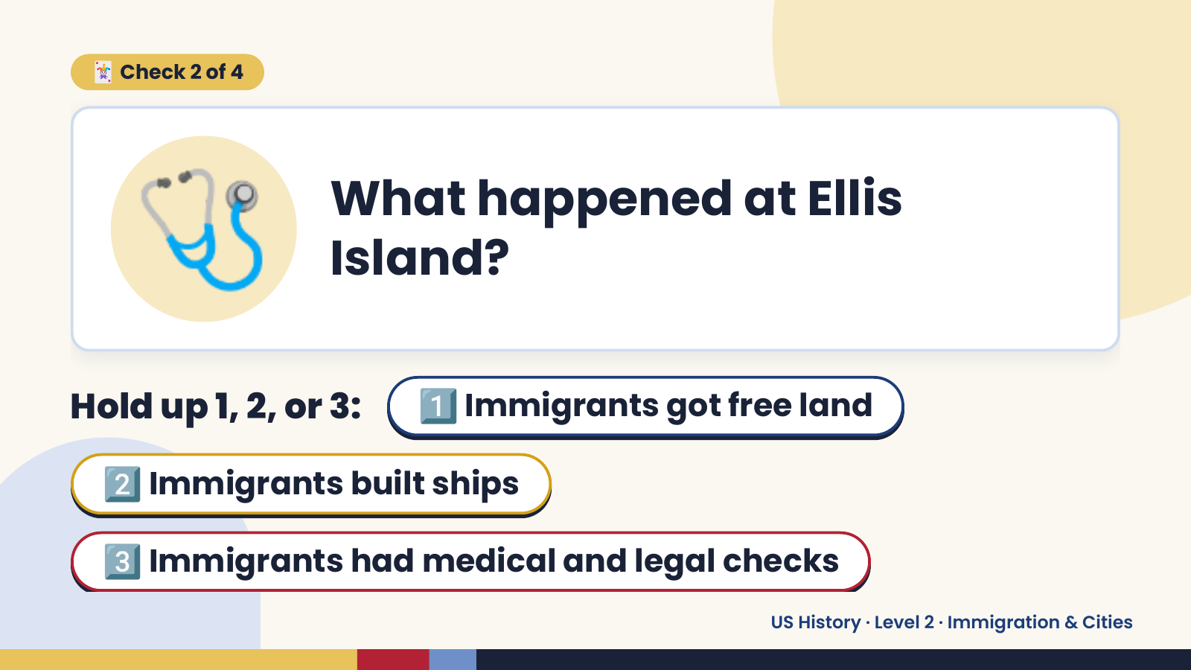
Notes:
🩺
🃏 Check 2 of 4
What happened at Ellis
Island?
Hold up 1, 2, or 3: 1️⃣ Immigrants got free land
2️⃣ Immigrants built ships
3️⃣ Immigrants had medical and legal checks
US History · Level 2 · Immigration & Cities

Slide 12

Notes:
✅ Answer · Card 2 of 4
🩺 Immigrants had
medical and
legal checks
Doctors and inspectors checked each
person.
US History · Level 2 · Immigration & Cities

Slide 13
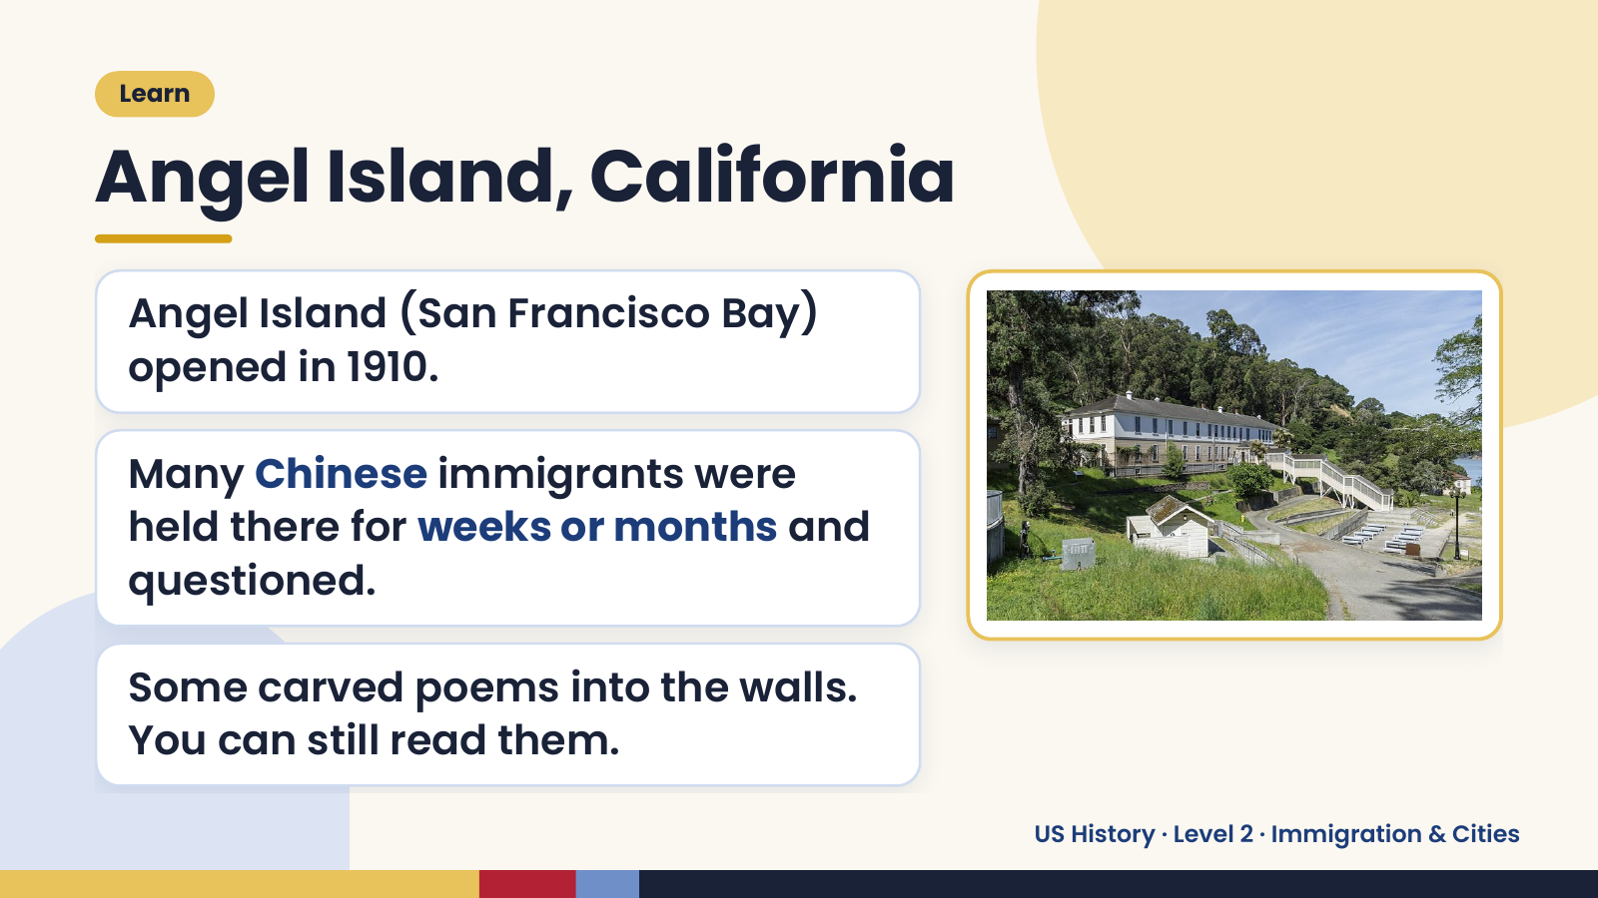
Notes:
Learn
Angel Island, California
Angel Island (San Francisco Bay)
opened in 1910.
Many Chinese immigrants were
held there for weeks or months and
questioned.
Some carved poems into the walls.
You can still read them.
US History · Level 2 · Immigration & Cities

Slide 14
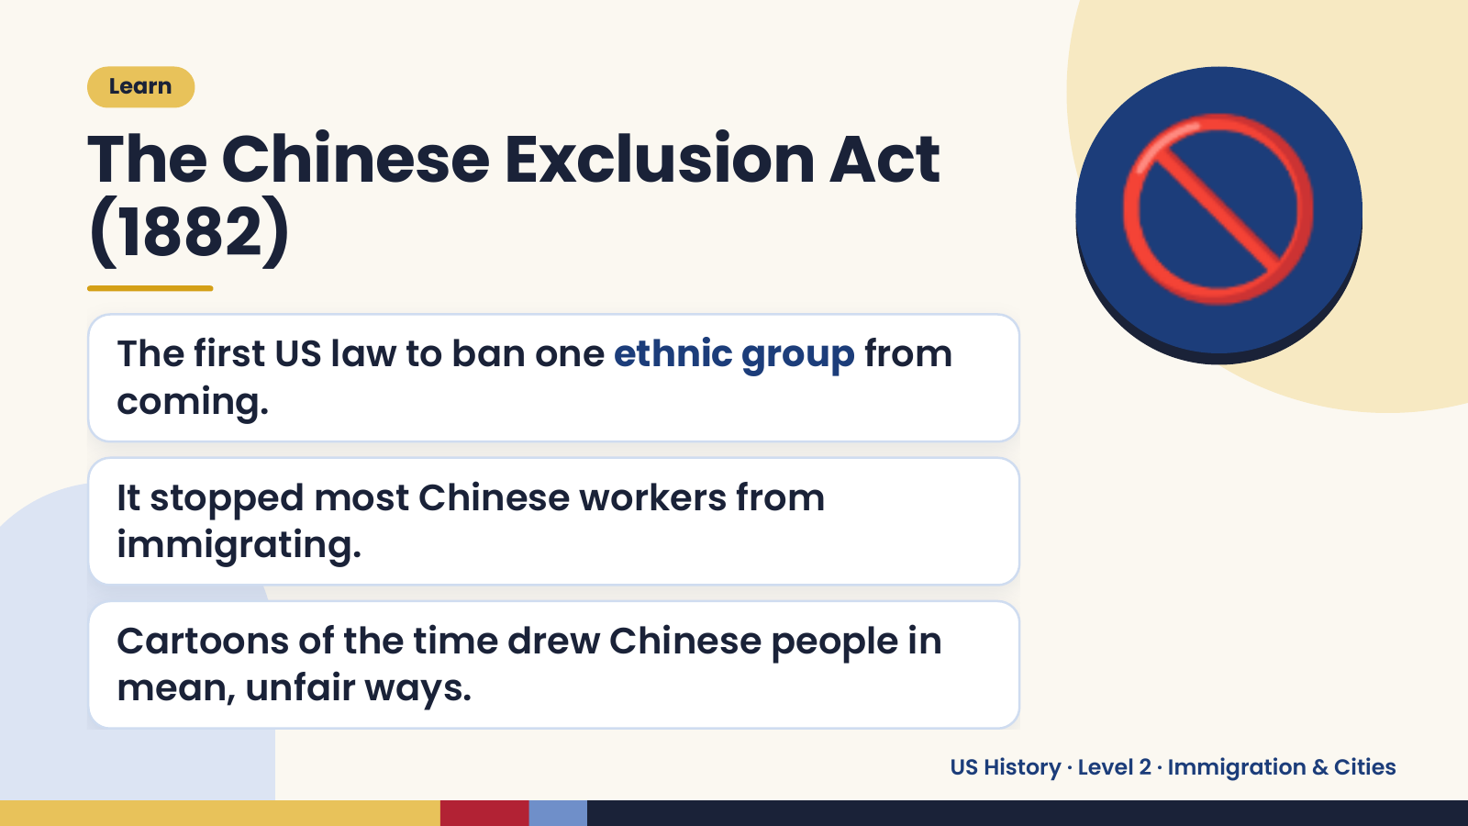
Notes:
Learn
The Chinese Exclusion Act
(1882)
The first US law to ban one ethnic group from
coming.
🚫
It stopped most Chinese workers from
immigrating.
Cartoons of the time drew Chinese people in
mean, unfair ways.
US History · Level 2 · Immigration & Cities

Slide 15
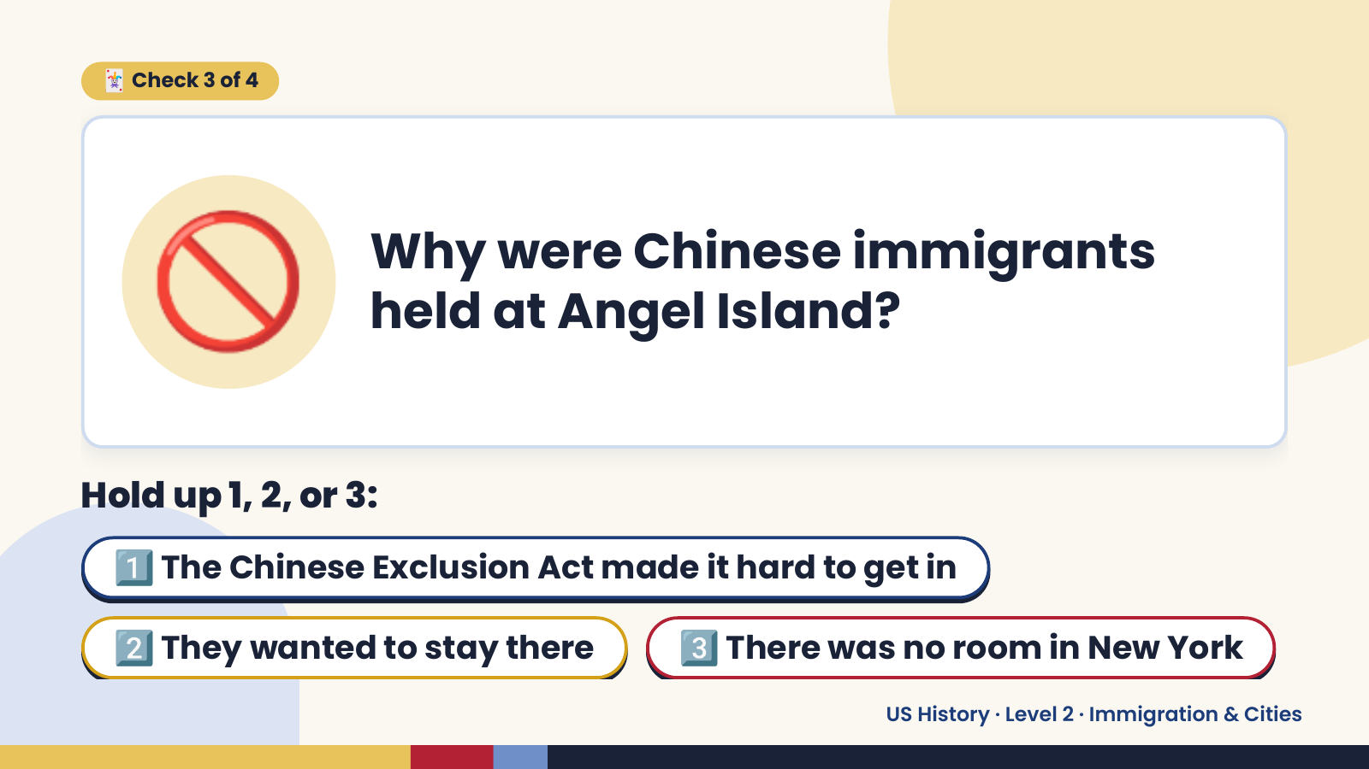
Notes:
🚫
🃏 Check 3 of 4
Why were Chinese immigrants
held at Angel Island?
Hold up 1, 2, or 3:
1️⃣ The Chinese Exclusion Act made it hard to get in
2️⃣ They wanted to stay there 3️⃣ There was no room in New York
US History · Level 2 · Immigration & Cities

Slide 16
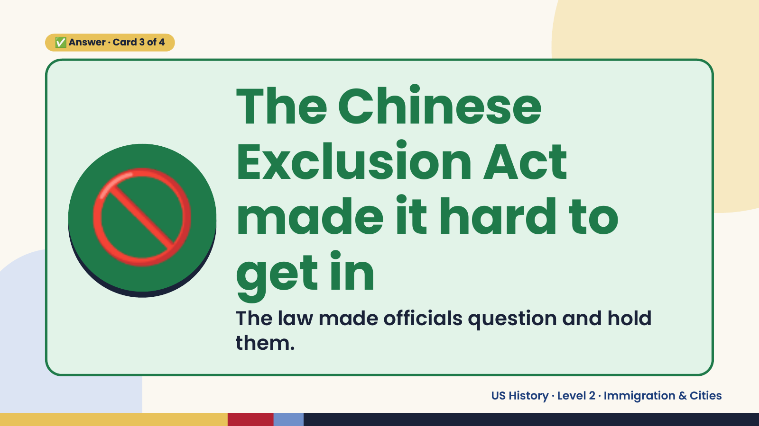
Notes:
✅ Answer · Card 3 of 4
🚫
The Chinese
Exclusion Act
made it hard to
get in
The law made officials question and hold
them.
US History · Level 2 · Immigration & Cities

Slide 17
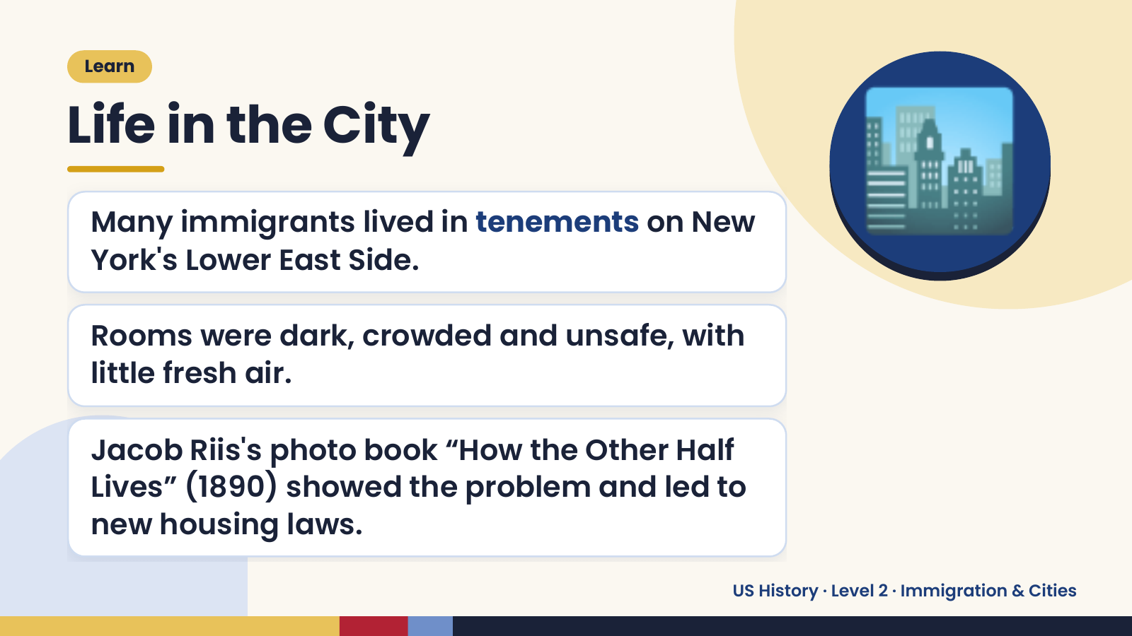
Notes:
Learn
Life in the City
Many immigrants lived in tenements on New
York's Lower East Side.
Rooms were dark, crowded and unsafe, with
🏙️
little fresh air.
Jacob Riis's photo book “How the Other Half
Lives” (1890) showed the problem and led to
new housing laws.
US History · Level 2 · Immigration & Cities

Slide 18
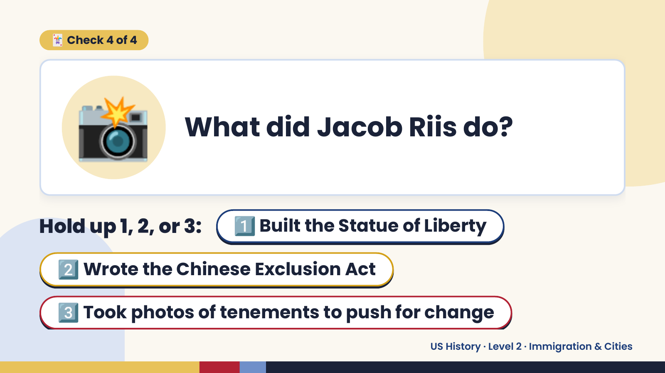
Notes:
📸
🃏 Check 4 of 4
What did Jacob Riis do?
Hold up 1, 2, or 3: 1️⃣ Built the Statue of Liberty
2️⃣ Wrote the Chinese Exclusion Act
3️⃣ Took photos of tenements to push for change
US History · Level 2 · Immigration & Cities

Slide 19
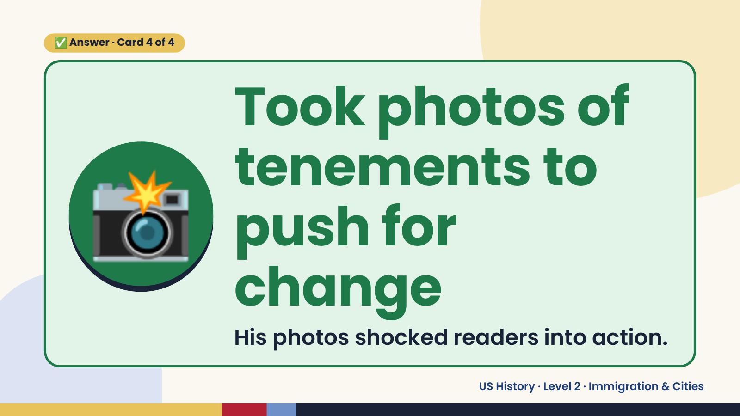
Notes:
✅ Answer · Card 4 of 4
📸
Took photos of
tenements to
push for
change
His photos shocked readers into action.
US History · Level 2 · Immigration & Cities

Slide 20

Notes:
🎬 Video
Voices of Angel Island: Fong See
👀 Watch for: why he came and what
was hard
💬 Captions on
https://www.youtube.com/watch?v=5bxphvFYA7k
Scan to watch
US History · Level 2 · Immigration & Cities

Slide 21

Notes:
Wrap-Up
Recap
👋 Push
reasons to leave 🧲 Pull
reasons to come
🏛️ Ellis Island
New York, mostly
Europeans
🏝️ Angel Island
California, many
Chinese
US History · Level 2 · Immigration & Cities

Slide 22

Notes:
Wrap-Up
Exit Ticket
Give 1 push and 1 pull factor.
Compare Ellis Island and Angel Island.
🎟️
Why did Jacob Riis take photos?
US History · Level 2 · Immigration & Cities

