Slide 1
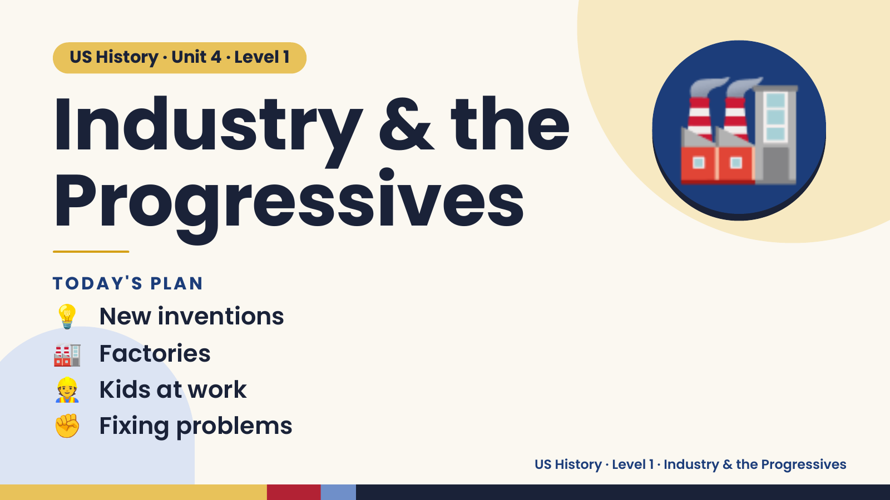
Notes:
US History · Unit 4 · Level 1
Industry & the
Progressives
🏭
💡 New inventions
TODAY'S PLAN
🏭 Factories
👷 Kids at work
✊ Fixing problems
US History · Level 1 · Industry & the Progressives

Slide 2
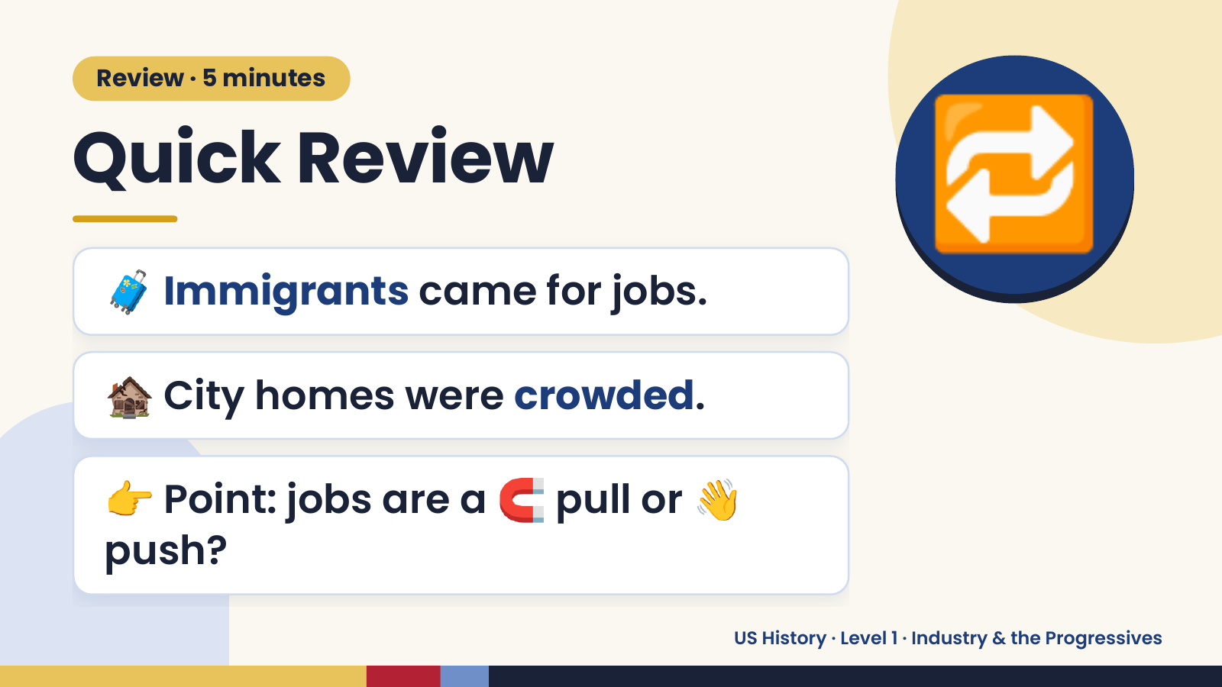
Notes:
Review · 5 minutes
Quick Review
🧳 Immigrants came for jobs.
🔁
🏚️ City homes were crowded.
👉 Point: jobs are a 🧲 pull or 👋
push?
US History · Level 1 · Industry & the Progressives

Slide 3
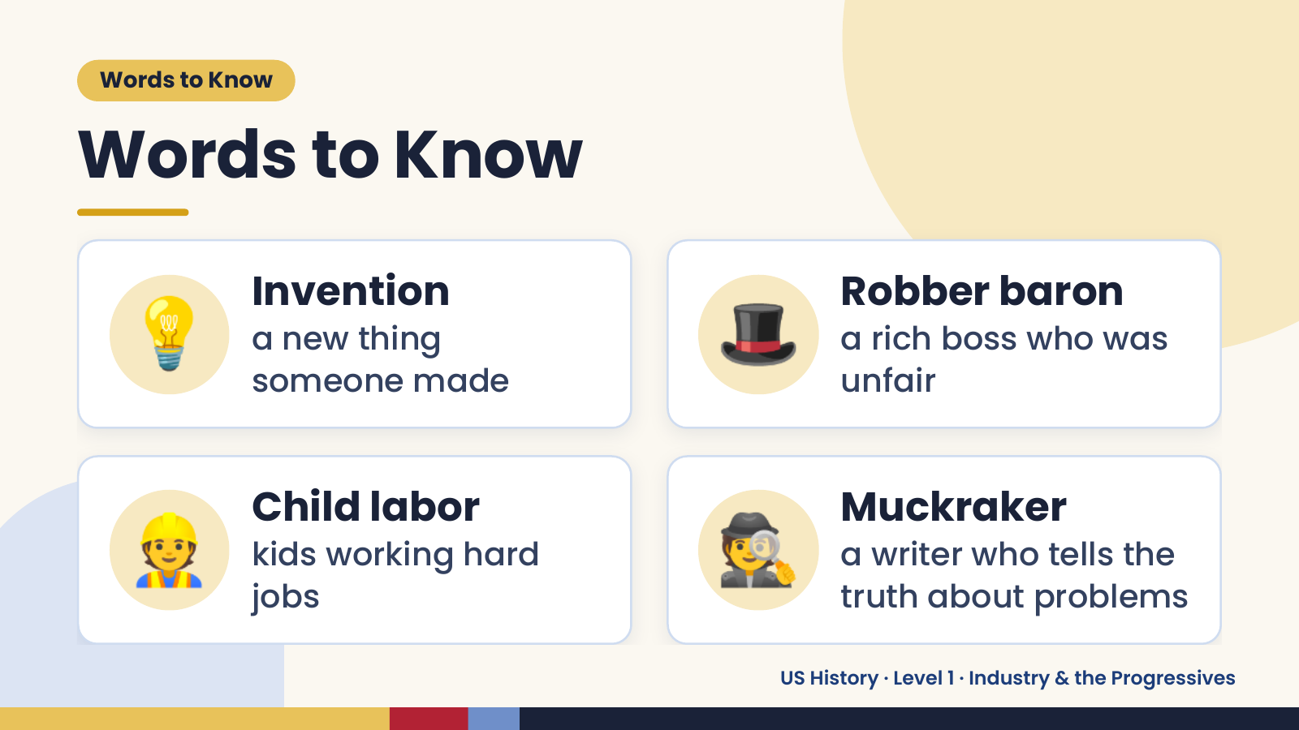
Notes:
Words to Know
Words to Know
💡 Invention
a new thing
someone made
🎩 Robber baron
a rich boss who was
unfair
👷 Child labor
kids working hard
jobs
🕵️ Muckraker
a writer who tells the
truth about problems
US History · Level 1 · Industry & the Progressives

Slide 4
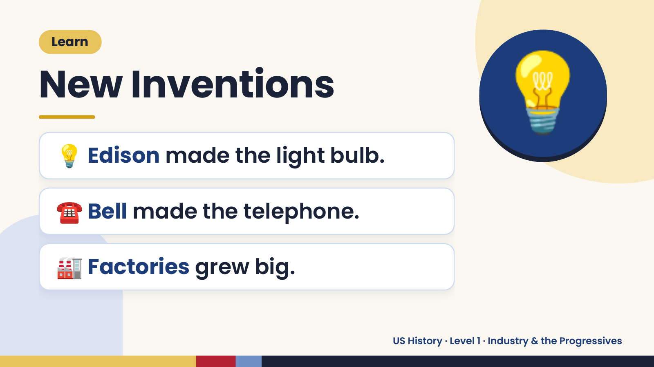
Notes:
Learn
New Inventions
💡 Edison made the light bulb.
💡
☎️ Bell made the telephone.
🏭 Factories grew big.
US History · Level 1 · Industry & the Progressives

Slide 5
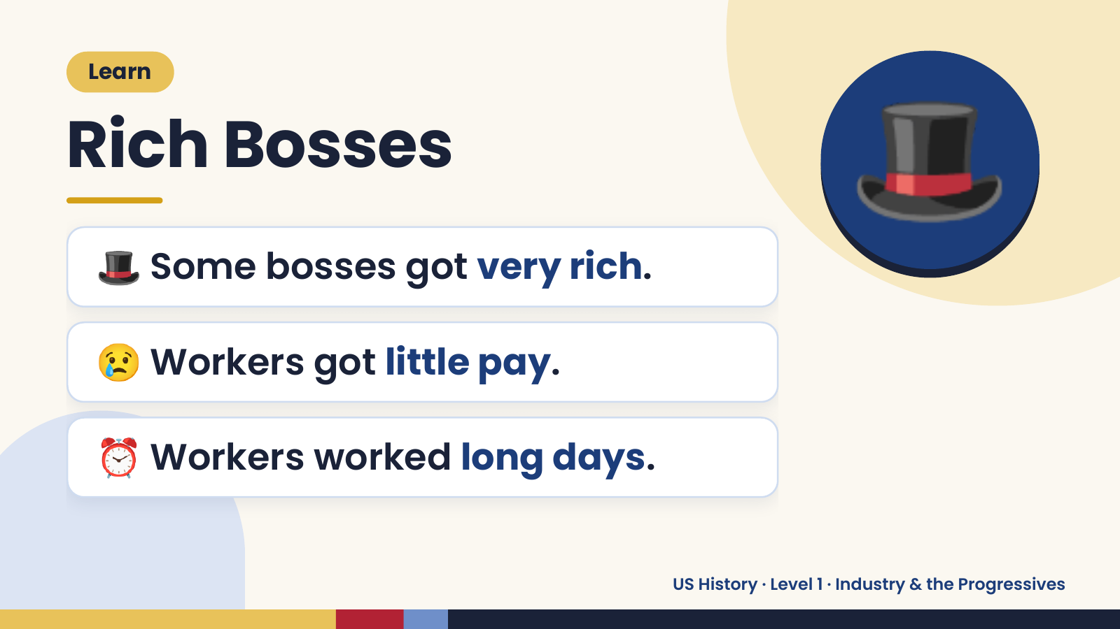
Notes:
Learn
Rich Bosses
🎩 Some bosses got very rich.
🎩
😢 Workers got little pay.
⏰ Workers worked long days.
US History · Level 1 · Industry & the Progressives

Slide 6
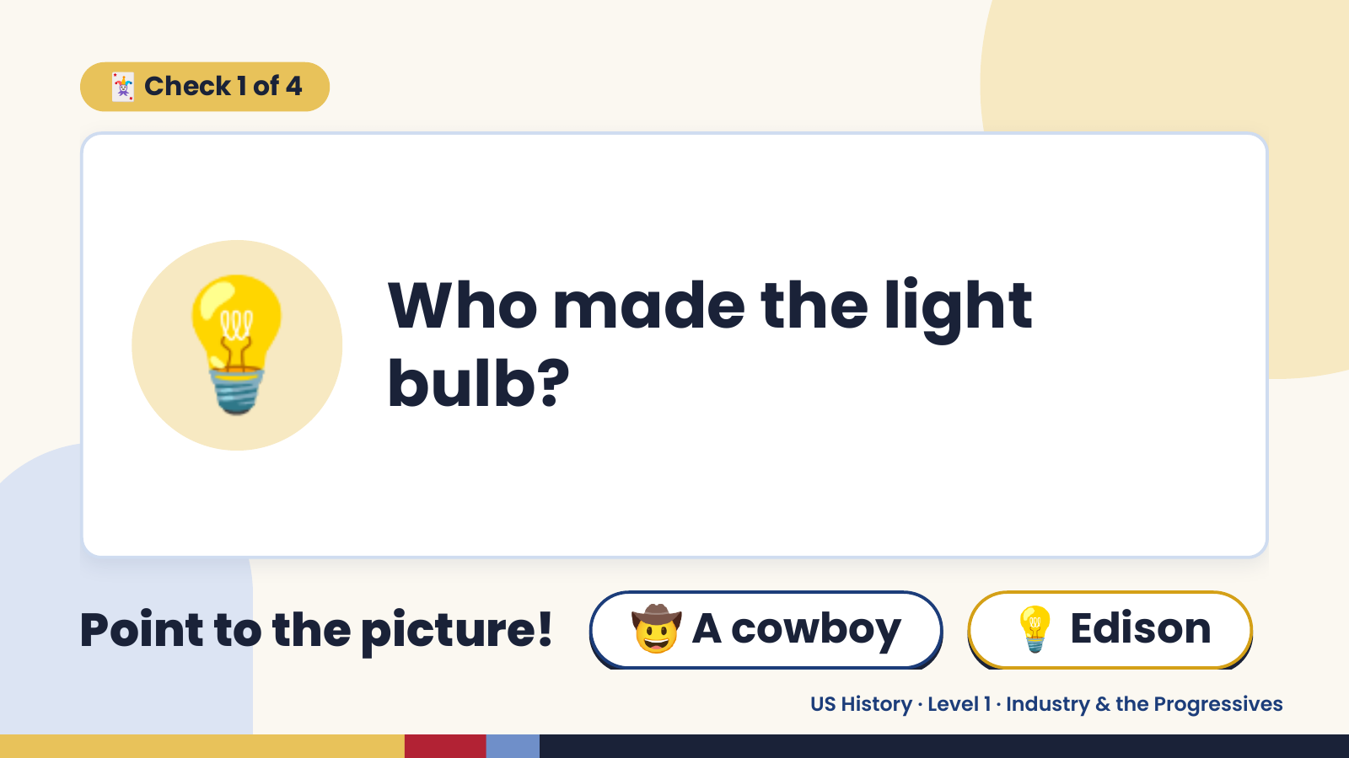
Notes:
🃏 Check 1 of 4
💡 Who made the light
bulb?
Point to the picture! 🤠 A cowboy 💡 Edison
US History · Level 1 · Industry & the Progressives

Slide 7
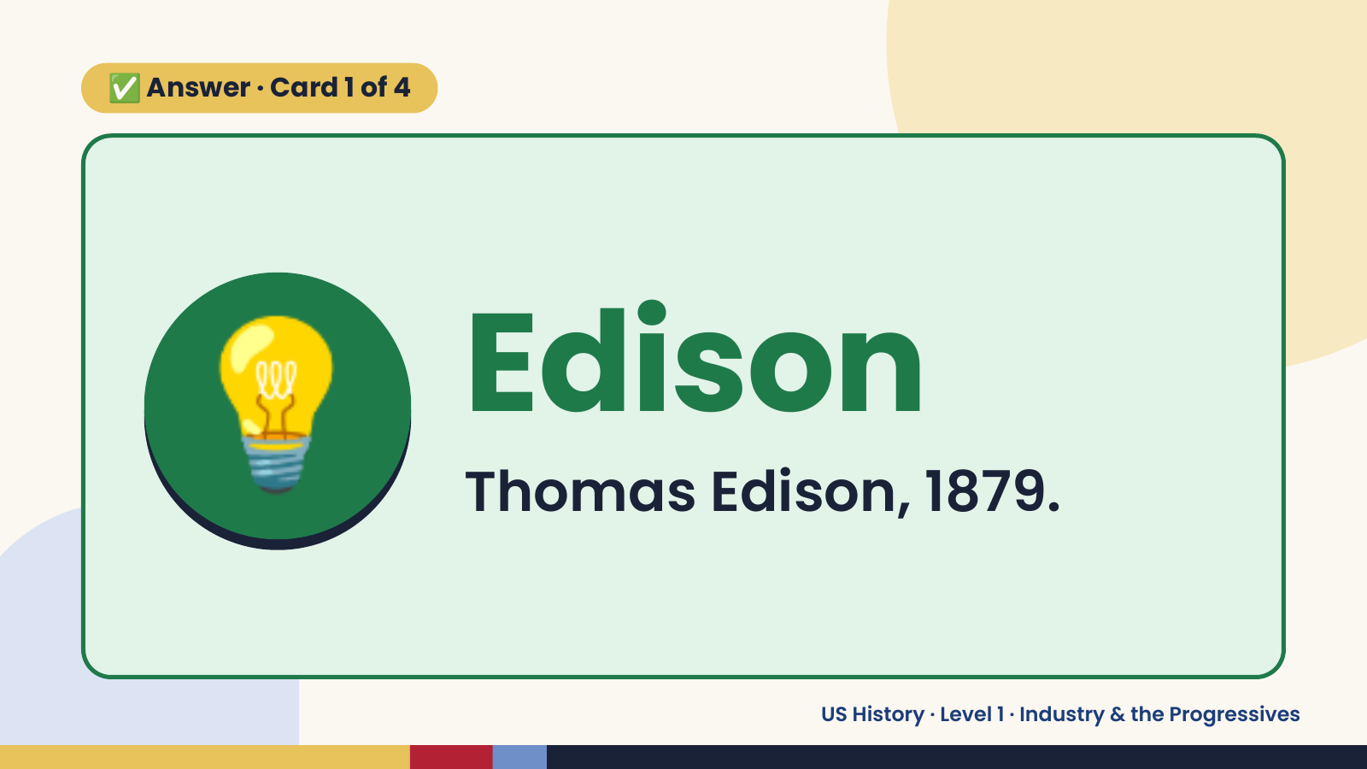
Notes:
✅ Answer · Card 1 of 4
💡 Edison
Thomas Edison, 1879.
US History · Level 1 · Industry & the Progressives

Slide 8
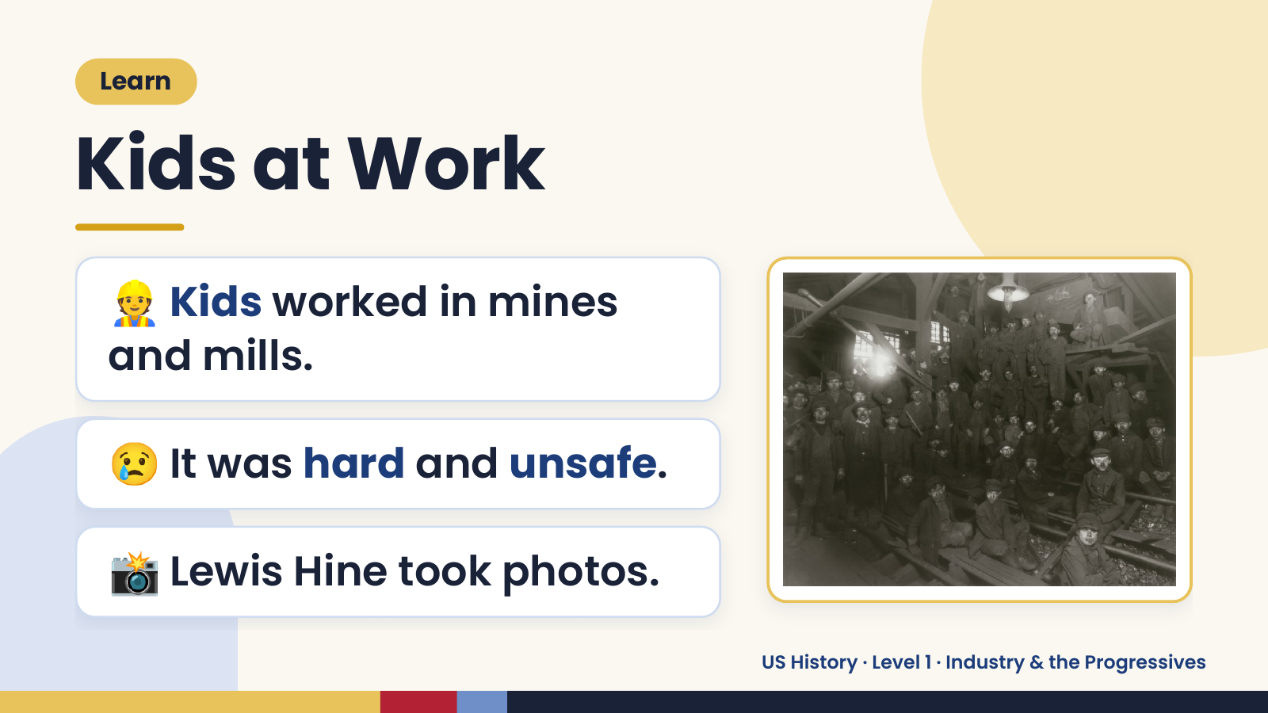
Notes:
Learn
Kids at Work
👷 Kids worked in mines
and mills.
😢 It was hard and unsafe.
📸 Lewis Hine took photos.
US History · Level 1 · Industry & the Progressives

Slide 9
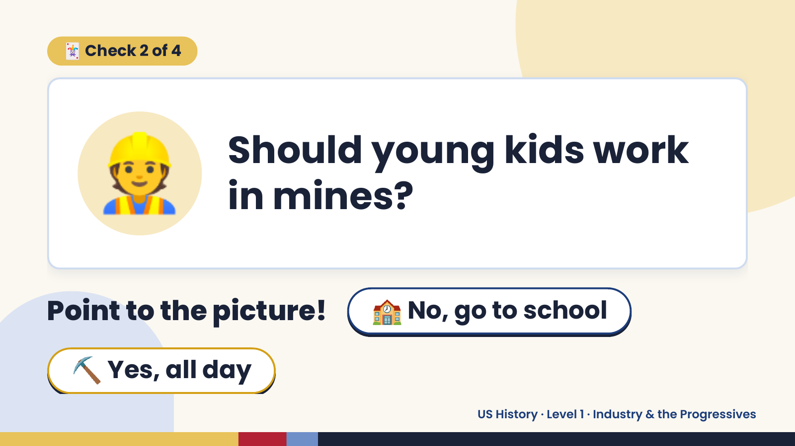
Notes:
🃏 Check 2 of 4
👷 Should young kids work
in mines?
Point to the picture! 🏫 No, go to school
⛏️ Yes, all day
US History · Level 1 · Industry & the Progressives

Slide 10

Notes:
✅ Answer · Card 2 of 4
🏫 No, go to
school
Kids belong in school.
US History · Level 1 · Industry & the Progressives

Slide 11
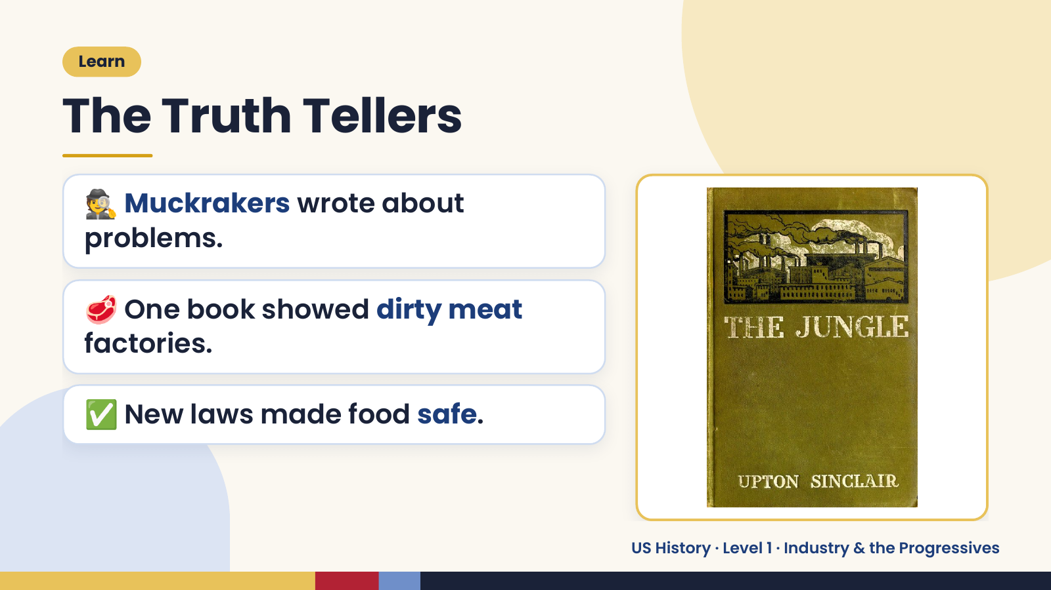
Notes:
Learn
The Truth Tellers
🕵️ Muckrakers wrote about
problems.
🥩 One book showed dirty meat
factories.
✅ New laws made food safe.
US History · Level 1 · Industry & the Progressives

Slide 12
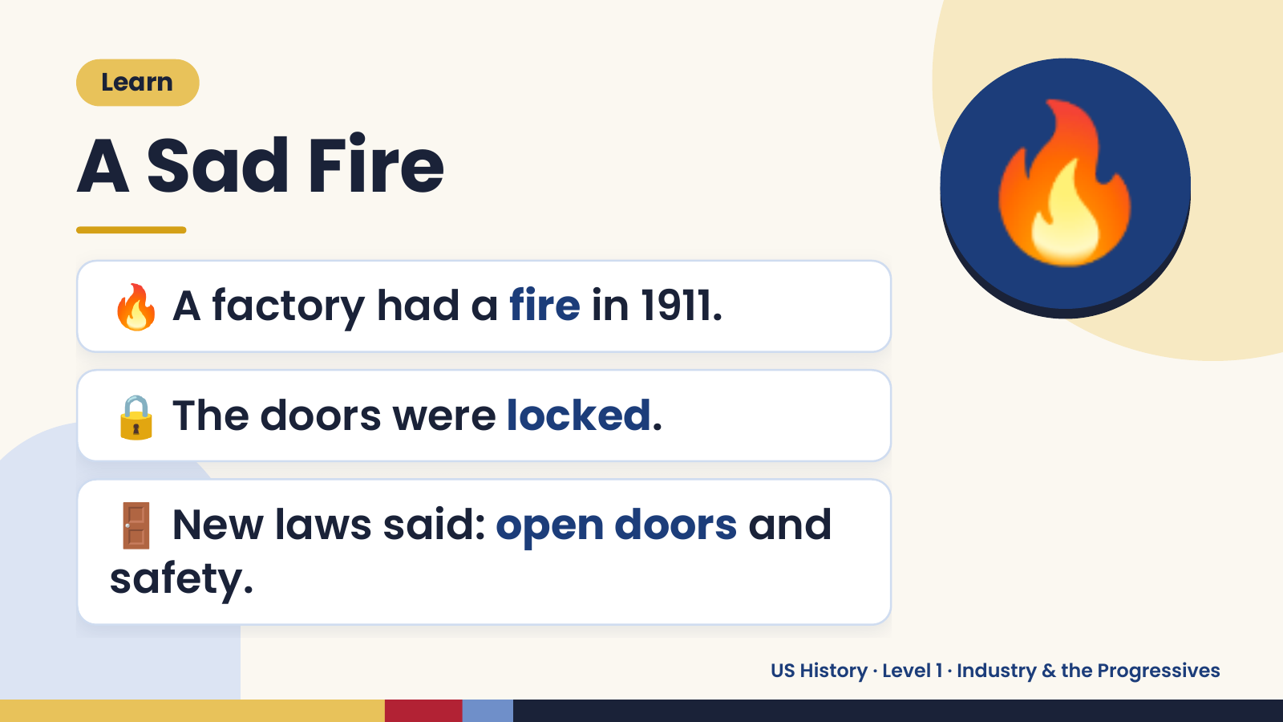
Notes:
Learn
A Sad Fire
🔥 A factory had a fire in 1911.
🔥
🔒 The doors were locked.
🚪 New laws said: open doors and
safety.
US History · Level 1 · Industry & the Progressives

Slide 13
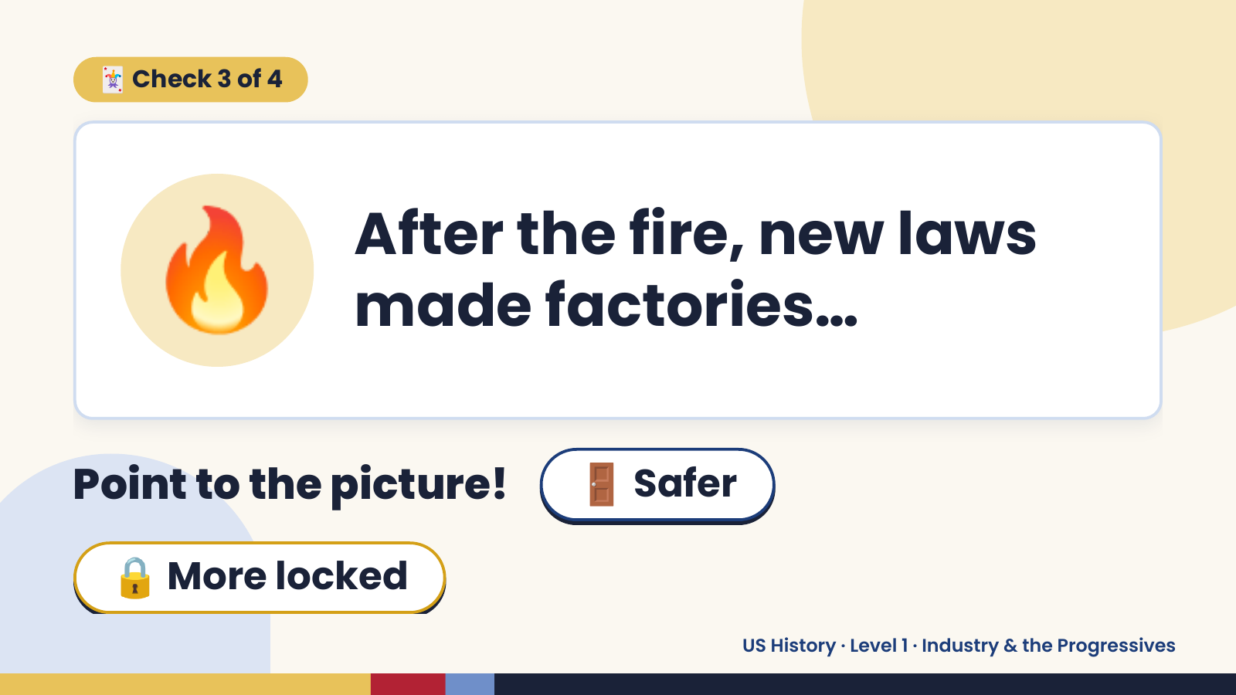
Notes:
🃏 Check 3 of 4
🔥 After the fire, new laws
made factories…
Point to the picture! 🚪 Safer
🔒 More locked
US History · Level 1 · Industry & the Progressives

Slide 14
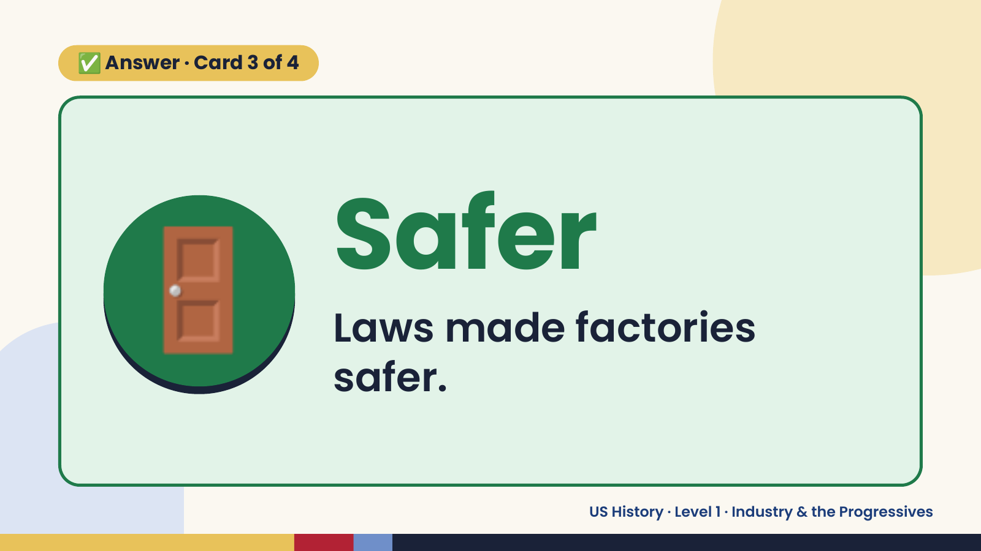
Notes:
✅ Answer · Card 3 of 4
🚪 Safer
Laws made factories
safer.
US History · Level 1 · Industry & the Progressives

Slide 15
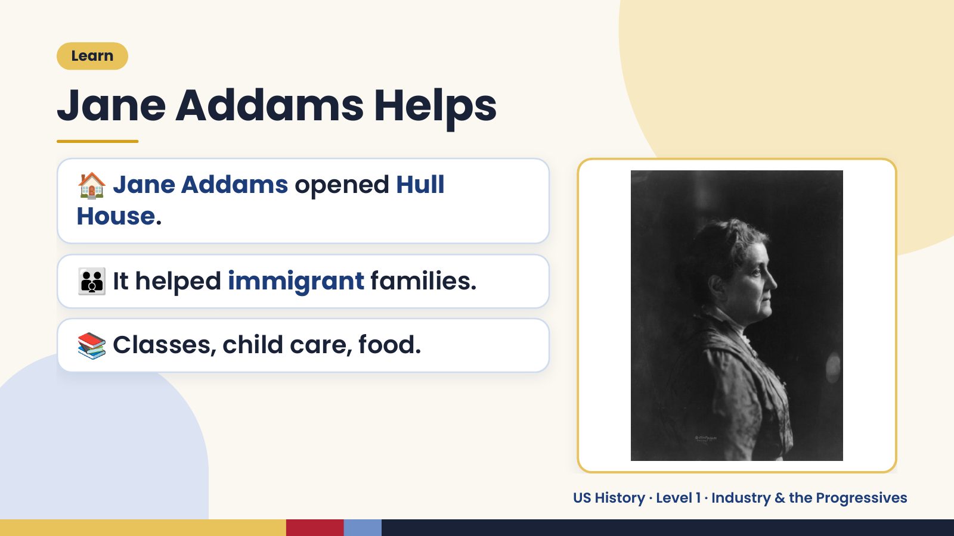
Notes:
Learn
Jane Addams Helps
🏠 Jane Addams opened Hull
House.
👪 It helped immigrant families.
📚 Classes, child care, food.
US History · Level 1 · Industry & the Progressives

Slide 16
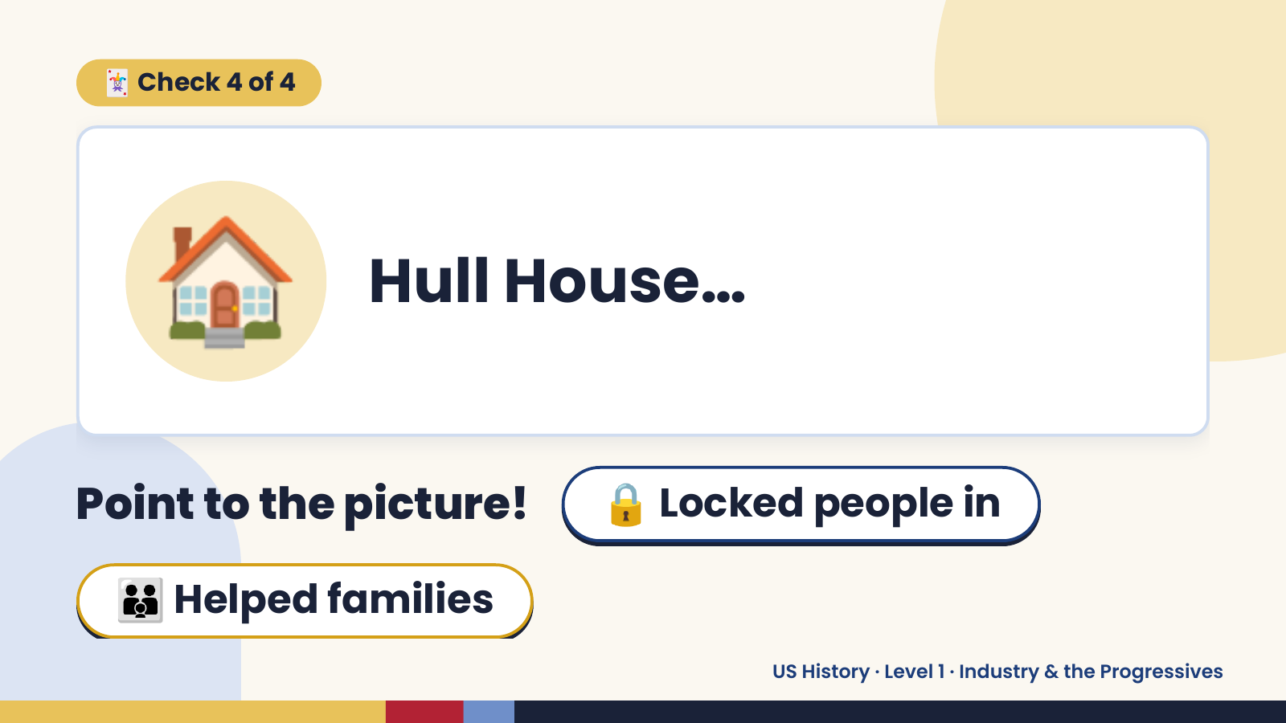
Notes:
🃏 Check 4 of 4
🏠 Hull House…
Point to the picture! 🔒 Locked people in
👪 Helped families
US History · Level 1 · Industry & the Progressives

Slide 17
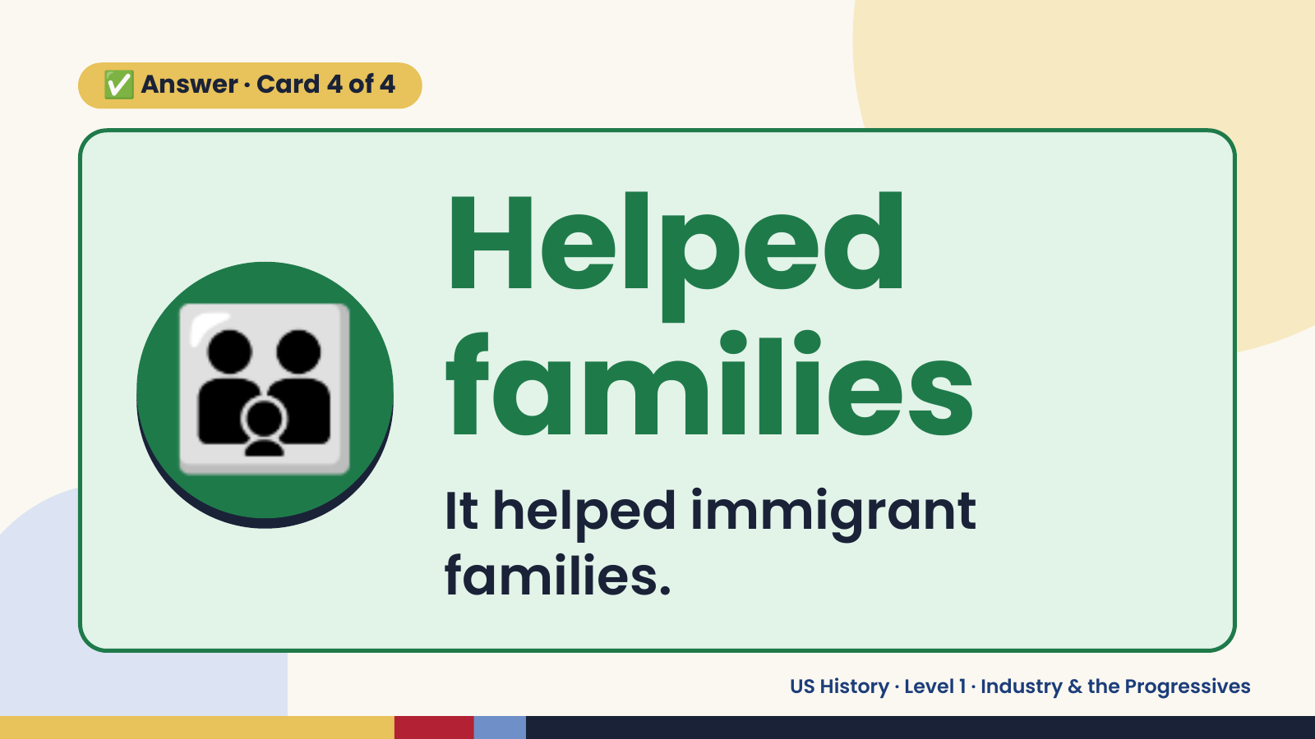
Notes:
✅ Answer · Card 4 of 4
👪 Helped
families
It helped immigrant
families.
US History · Level 1 · Industry & the Progressives

Slide 18
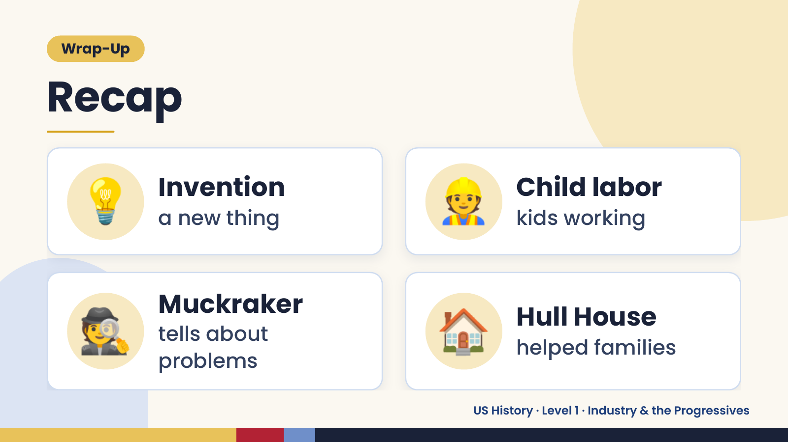
Notes:
Wrap-Up
Recap
💡 Invention
a new thing 👷 Child labor
kids working
🕵️ Muckraker
tells about
problems
🏠 Hull House
helped families
US History · Level 1 · Industry & the Progressives

Slide 19
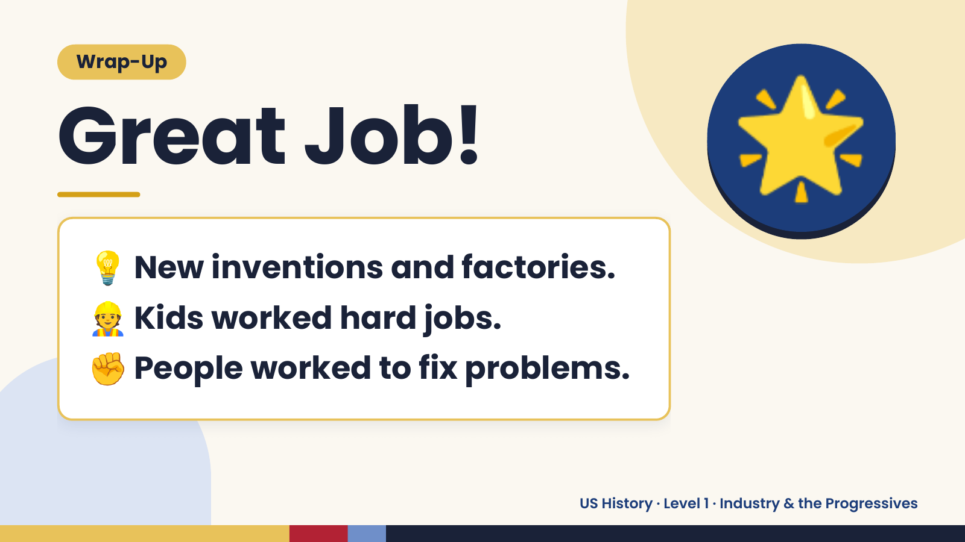
Notes:
Wrap-Up
Great Job!
💡 New inventions and factories.
🌟
👷 Kids worked hard jobs.
✊ People worked to fix problems.
US History · Level 1 · Industry & the Progressives

