Slide 1
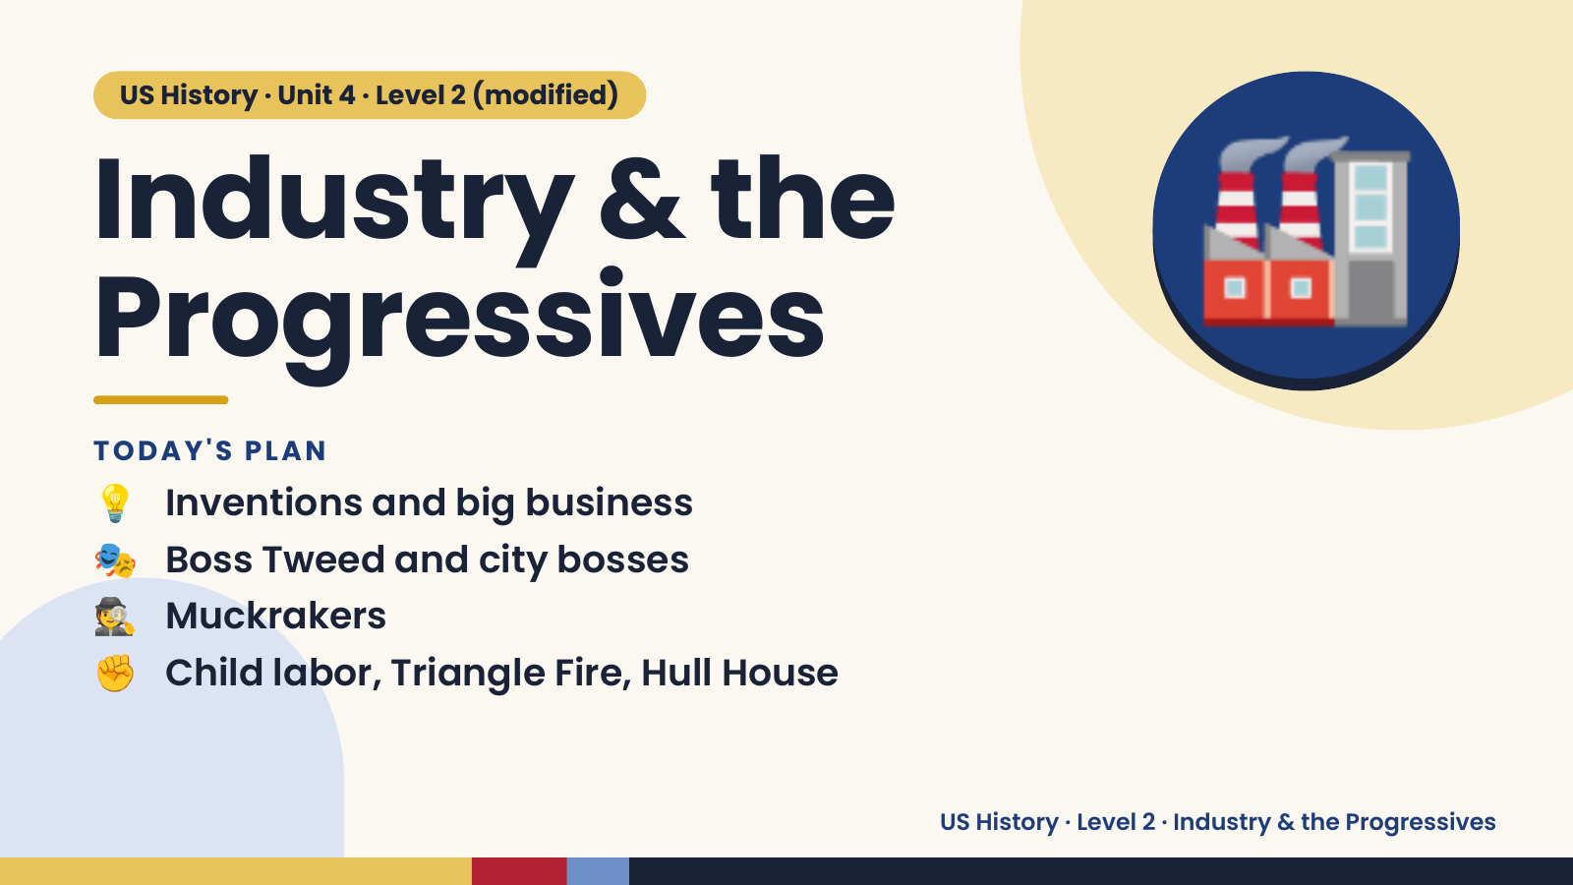
Notes:
US History · Unit 4 · Level 2 (modified)
Industry & the
Progressives
💡 Inventions and big business
TODAY'S PLAN
🏭
🎭 Boss Tweed and city bosses
🕵️ Muckrakers
✊ Child labor, Triangle Fire, Hull House
US History · Level 2 · Industry & the Progressives

Slide 2
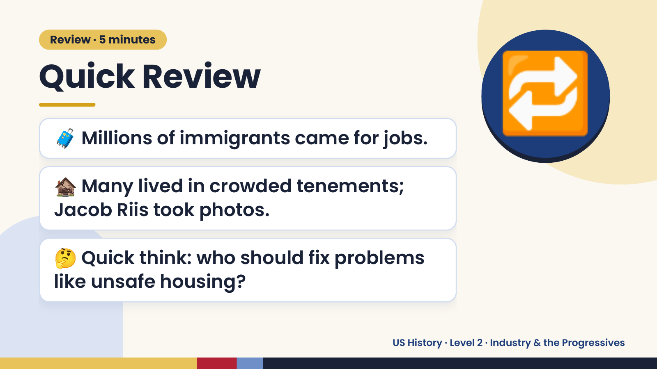
Notes:
Review · 5 minutes
Quick Review
🧳 Millions of immigrants came for jobs.
🏚️ Many lived in crowded tenements;
🔁
Jacob Riis took photos.
🤔 Quick think: who should fix problems
like unsafe housing?
US History · Level 2 · Industry & the Progressives

Slide 3
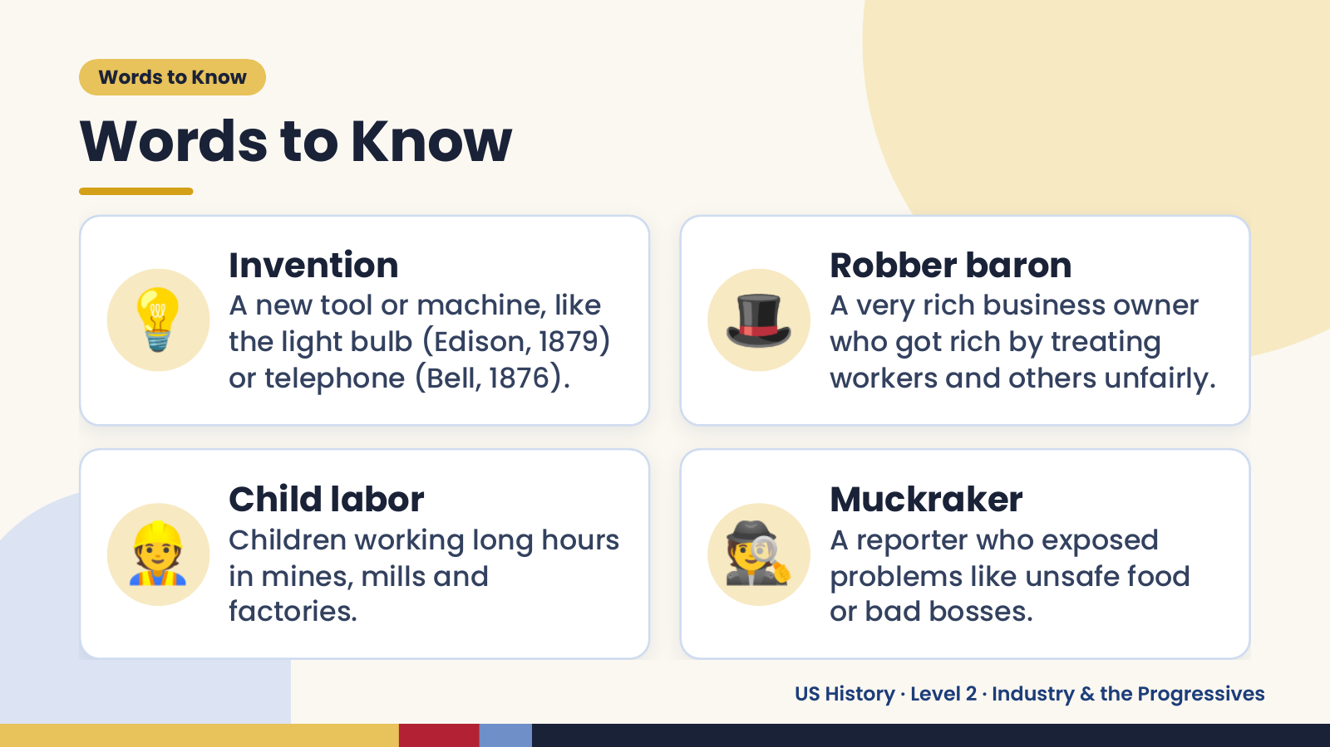
Notes:
Words to Know
Words to Know
💡 Invention
A new tool or machine, like
the light bulb (Edison, 1879)
or telephone (Bell, 1876).
🎩 Robber baron
A very rich business owner
who got rich by treating
workers and others unfairly.
👷 Child labor
Children working long hours
in mines, mills and
factories.
🕵️ Muckraker
A reporter who exposed
problems like unsafe food
or bad bosses.
US History · Level 2 · Industry & the Progressives

Slide 4
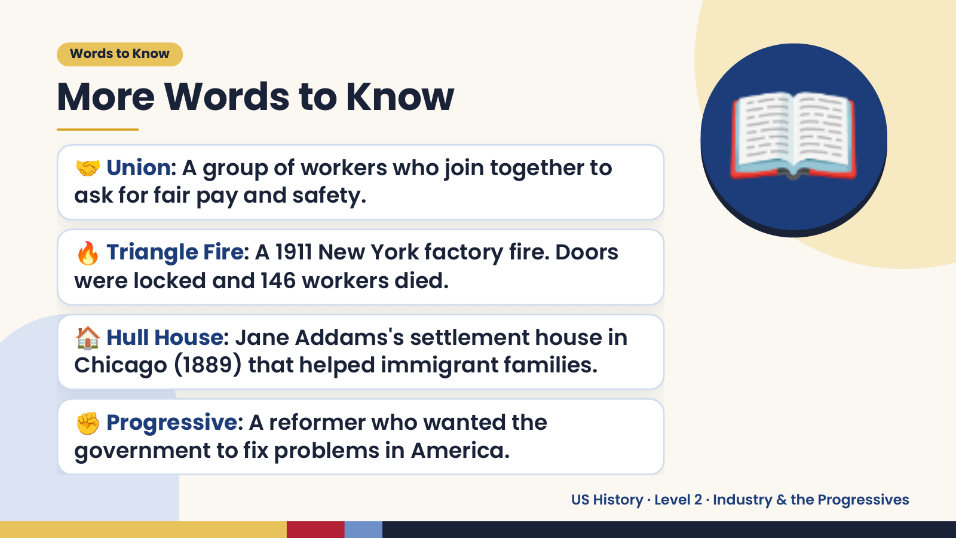
Notes:
Words to Know
More Words to Know
🤝 Union: A group of workers who join together to
ask for fair pay and safety.
🔥 Triangle Fire: A 1911 New York factory fire. Doors
were locked and 146 workers died.
📖
🏠 Hull House: Jane Addams's settlement house in
Chicago (1889) that helped immigrant families.
✊ Progressive: A reformer who wanted the
government to fix problems in America.
US History · Level 2 · Industry & the Progressives

Slide 5
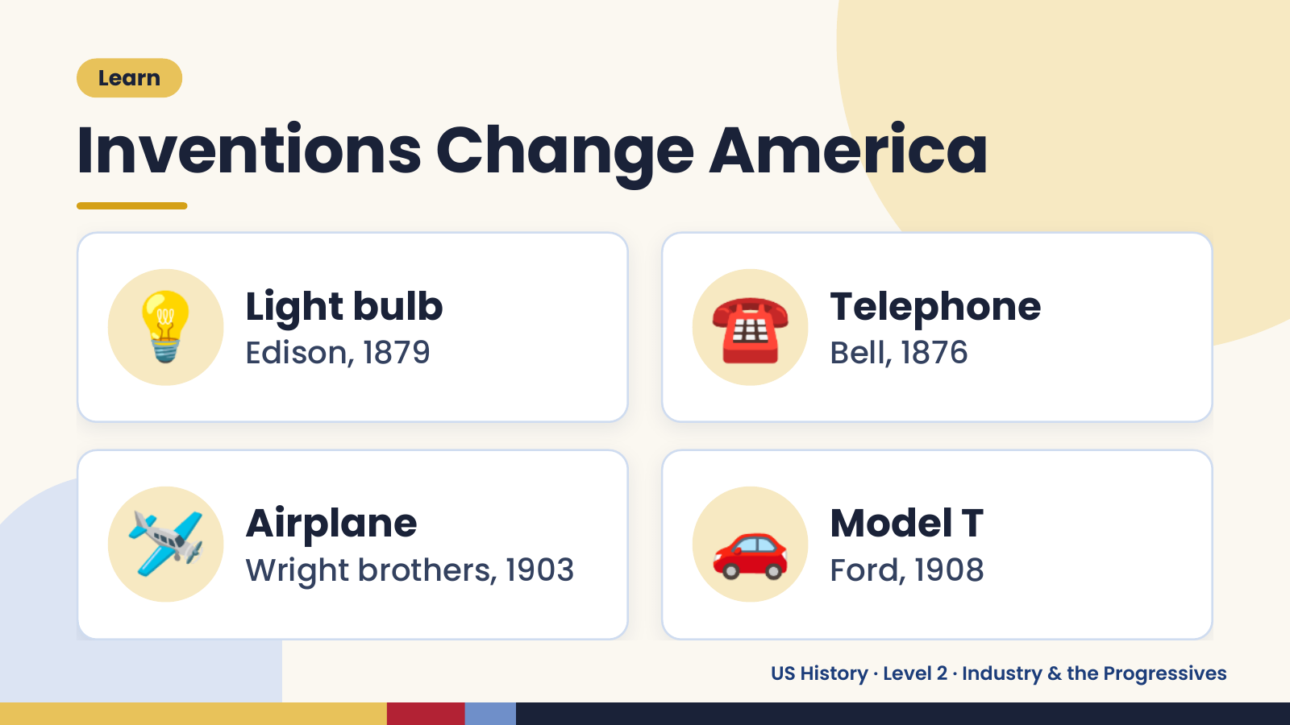
Notes:
Learn
Inventions Change America
💡 Light bulb
Edison, 1879 ☎️ Telephone
Bell, 1876
🛩️ Airplane
Wright brothers, 1903 🚗 Model T
Ford, 1908
US History · Level 2 · Industry & the Progressives

Slide 6
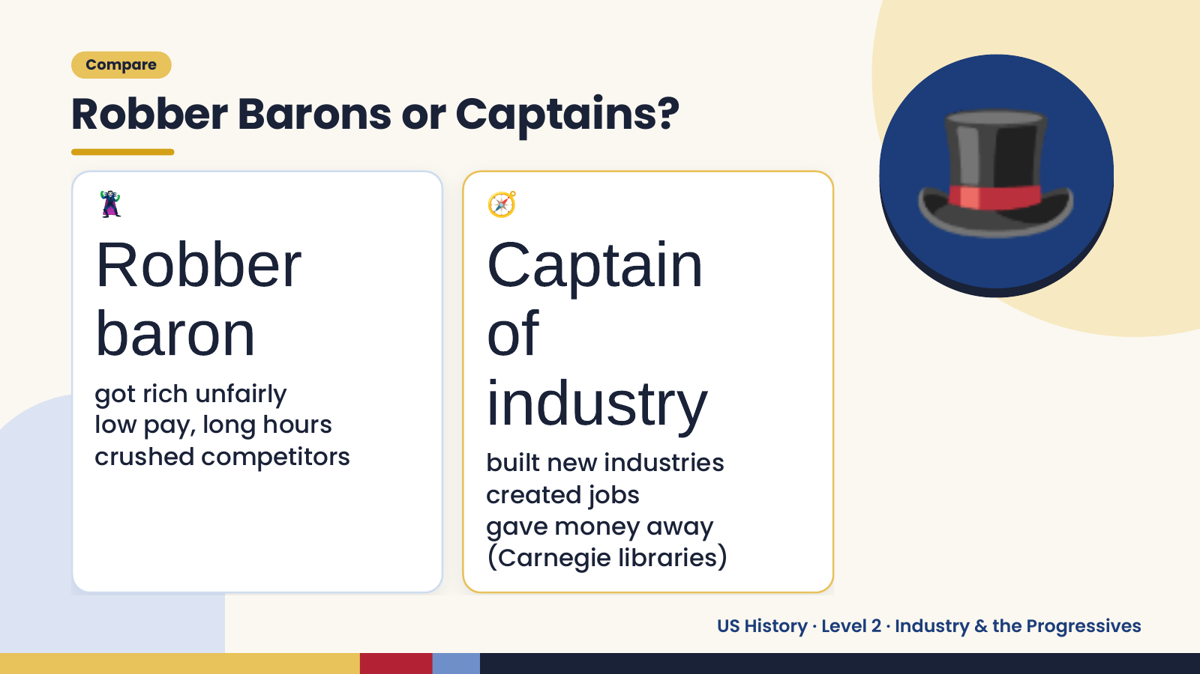
Notes:
Compare
Robber Barons or Captains?
🦹
Robber
baron
🧭
Captain
of
🎩
got rich unfairly
low pay, long hours
crushed competitors
industry
built new industries
created jobs
gave money away
(Carnegie libraries)
US History · Level 2 · Industry & the Progressives

Slide 7
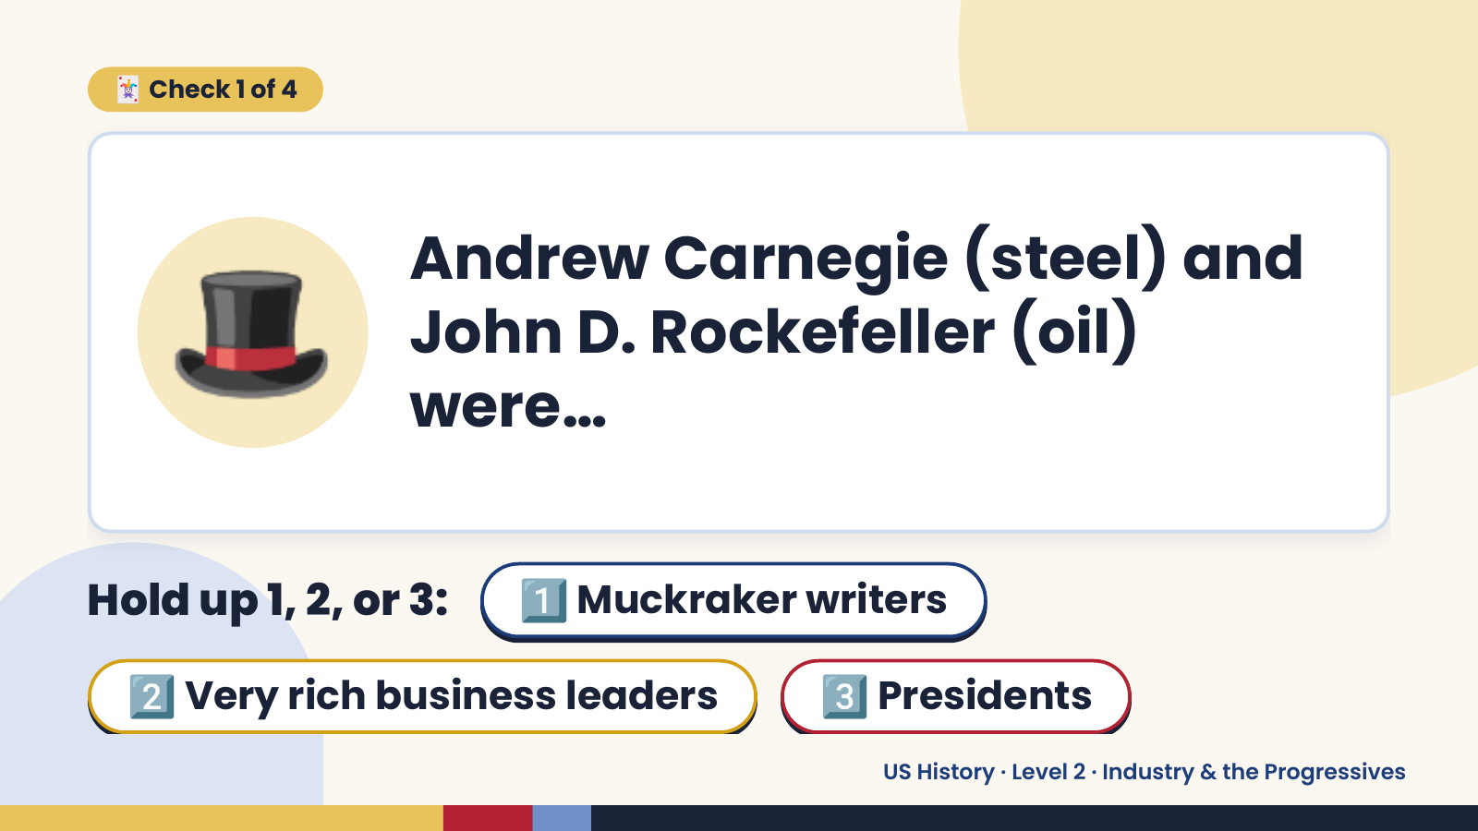
Notes:
🃏 Check 1 of 4
🎩 Andrew Carnegie (steel) and
John D. Rockefeller (oil)
were…
Hold up 1, 2, or 3: 1️⃣ Muckraker writers
2️⃣ Very rich business leaders 3️⃣ Presidents
US History · Level 2 · Industry & the Progressives

Slide 8
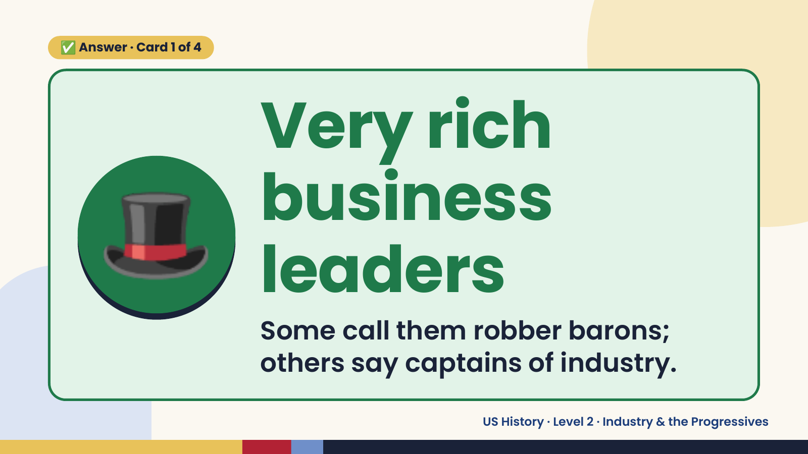
Notes:
✅ Answer · Card 1 of 4
🎩
Very rich
business
leaders
Some call them robber barons;
others say captains of industry.
US History · Level 2 · Industry & the Progressives

Slide 9
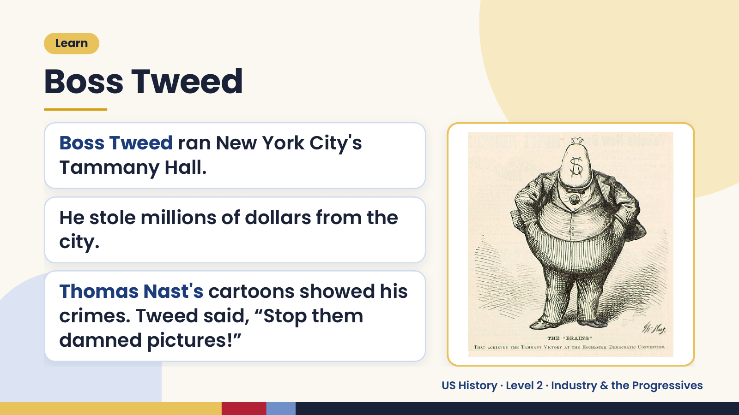
Notes:
Learn
Boss Tweed
Boss Tweed ran New York City's
Tammany Hall.
He stole millions of dollars from the
city.
Thomas Nast's cartoons showed his
crimes. Tweed said, “Stop them
damned pictures!”
US History · Level 2 · Industry & the Progressives

Slide 10
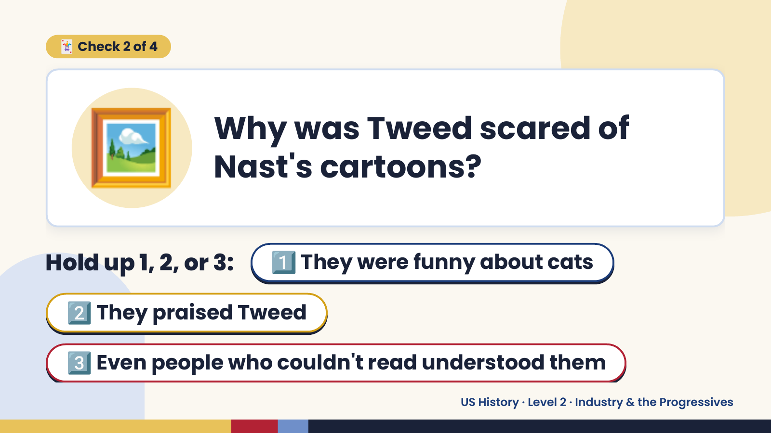
Notes:
🖼️
🃏 Check 2 of 4
Why was Tweed scared of
Nast's cartoons?
Hold up 1, 2, or 3: 1️⃣ They were funny about cats
2️⃣ They praised Tweed
3️⃣ Even people who couldn't read understood them
US History · Level 2 · Industry & the Progressives

Slide 11
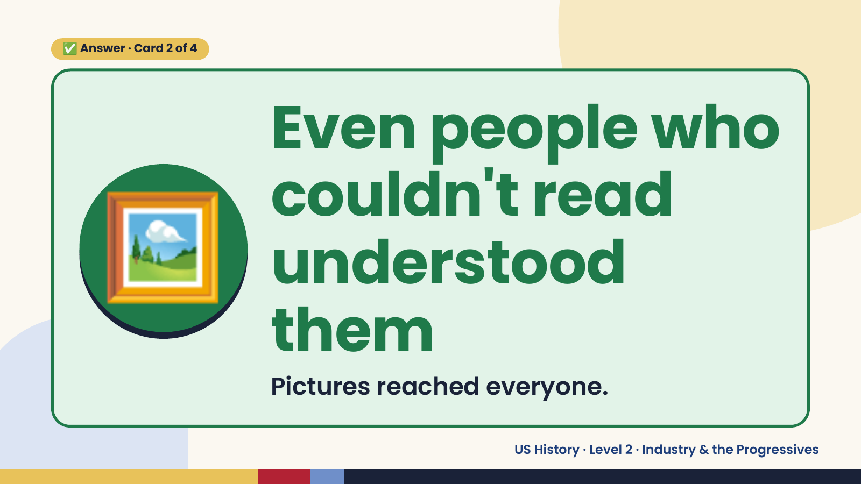
Notes:
✅ Answer · Card 2 of 4
🖼️
Even people who
couldn't read
understood
them
Pictures reached everyone.
US History · Level 2 · Industry & the Progressives

Slide 12
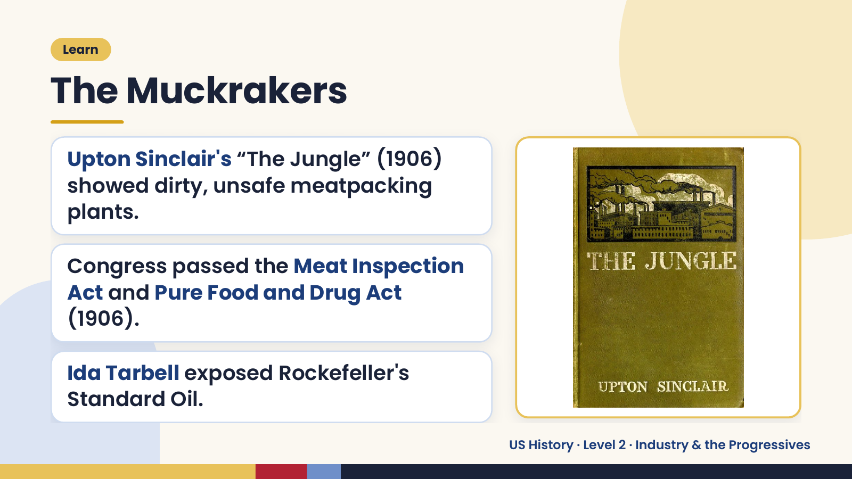
Notes:
Learn
The Muckrakers
Upton Sinclair's “The Jungle” (1906)
showed dirty, unsafe meatpacking
plants.
Congress passed the Meat Inspection
Act and Pure Food and Drug Act
(1906).
Ida Tarbell exposed Rockefeller's
Standard Oil.
US History · Level 2 · Industry & the Progressives

Slide 13
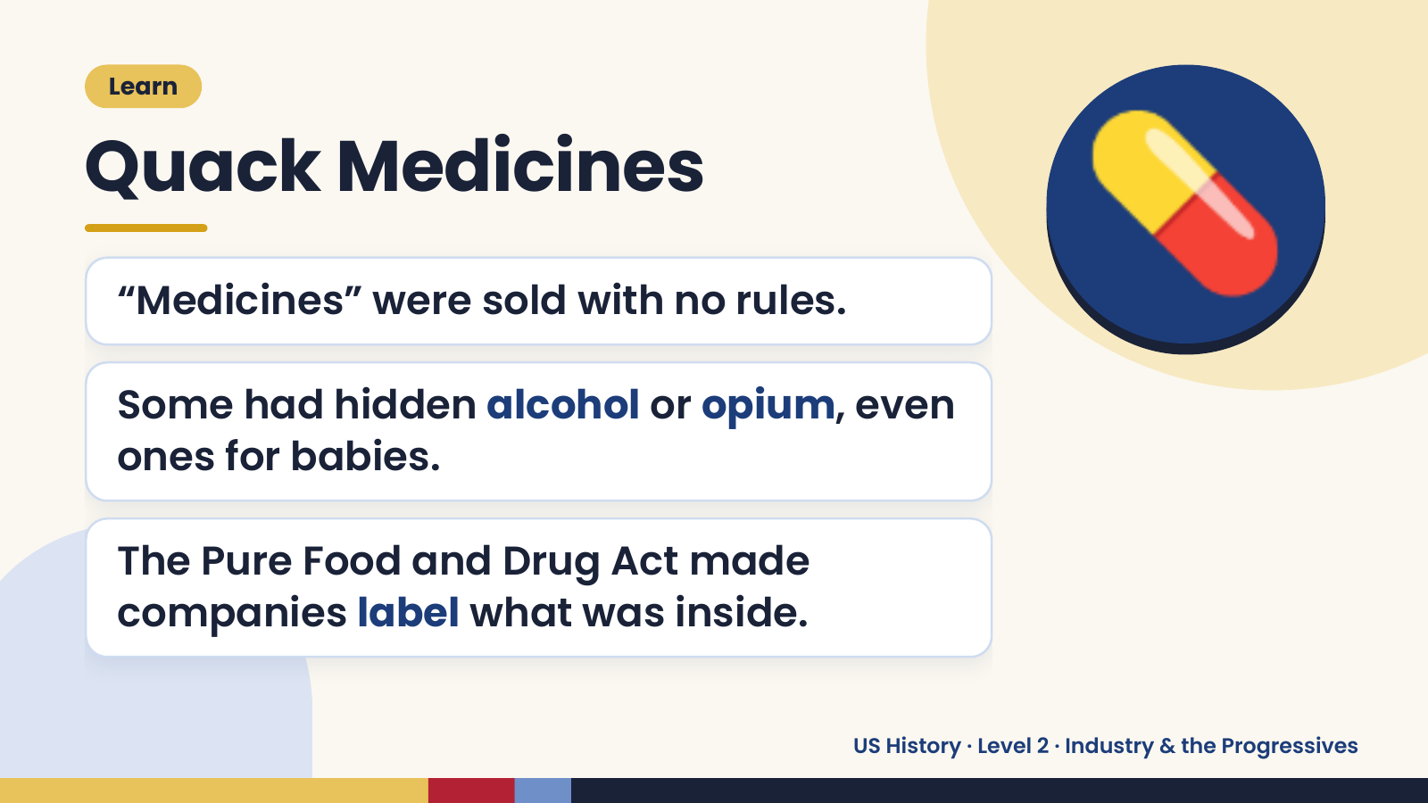
Notes:
Learn
Quack Medicines
“Medicines” were sold with no rules.
Some had hidden alcohol or opium, even
💊
ones for babies.
The Pure Food and Drug Act made
companies label what was inside.
US History · Level 2 · Industry & the Progressives

Slide 14
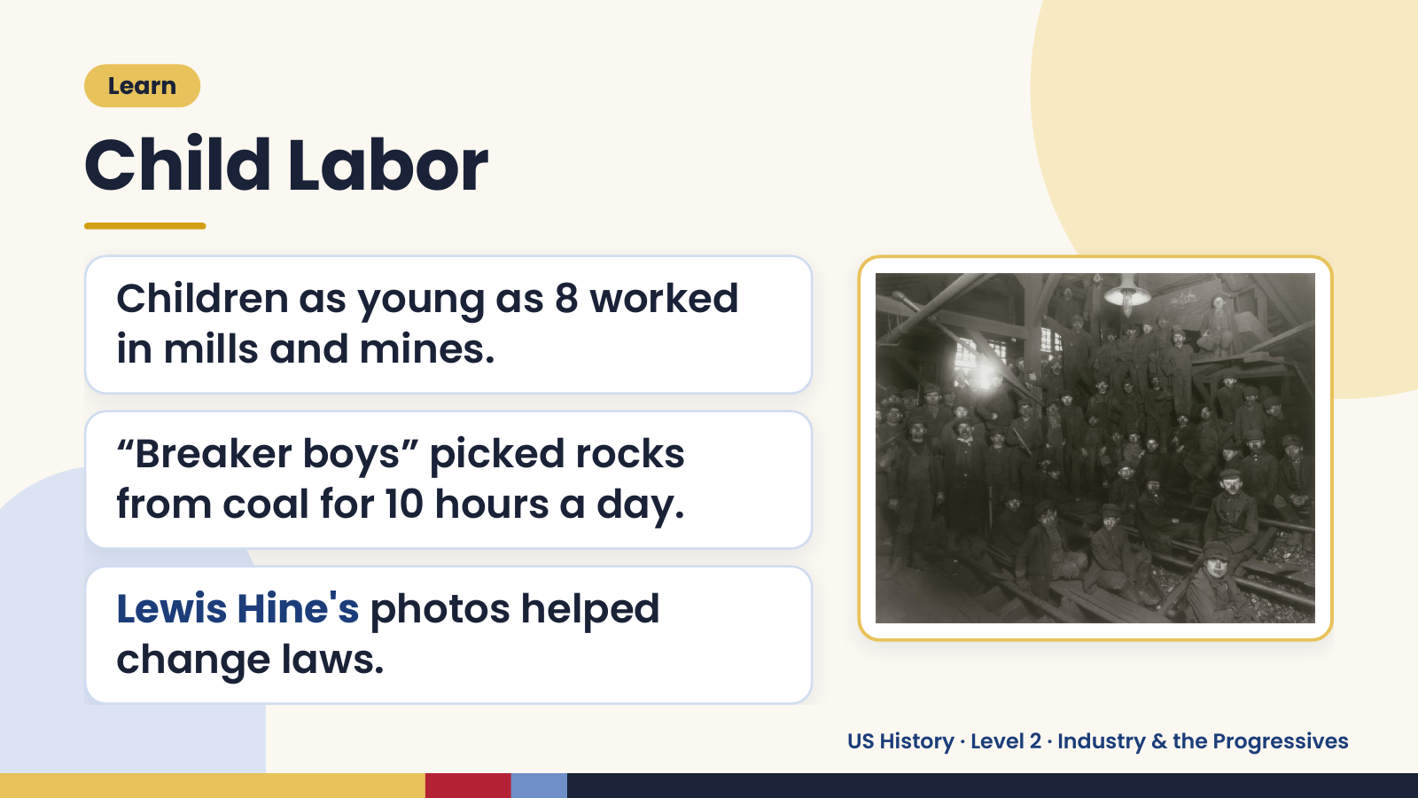
Notes:
Learn
Child Labor
Children as young as 8 worked
in mills and mines.
“Breaker boys” picked rocks
from coal for 10 hours a day.
Lewis Hine's photos helped
change laws.
US History · Level 2 · Industry & the Progressives

Slide 15
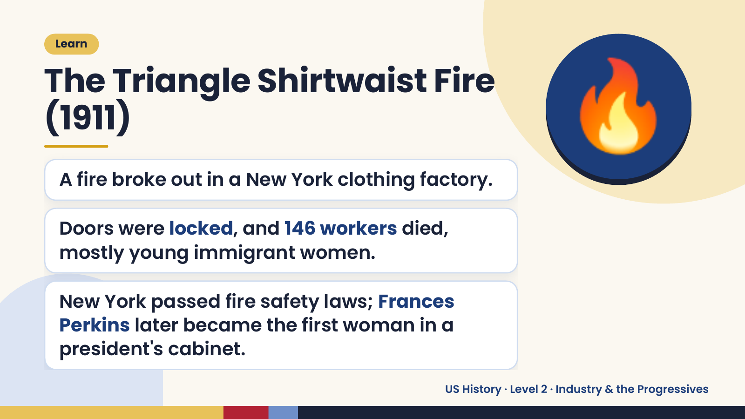
Notes:
Learn
The Triangle Shirtwaist Fire
(1911)
A fire broke out in a New York clothing factory.
Doors were locked, and 146 workers died,
🔥
mostly young immigrant women.
New York passed fire safety laws; Frances
Perkins later became the first woman in a
president's cabinet.
US History · Level 2 · Industry & the Progressives

Slide 16
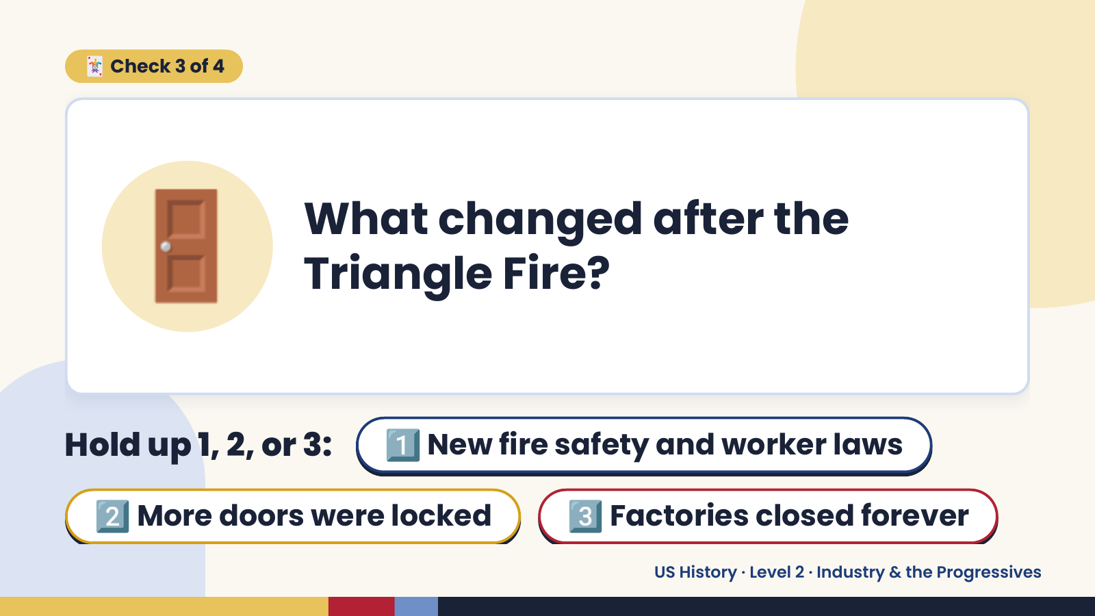
Notes:
🃏 Check 3 of 4
🚪 What changed after the
Triangle Fire?
Hold up 1, 2, or 3: 1️⃣ New fire safety and worker laws
2️⃣ More doors were locked 3️⃣ Factories closed forever
US History · Level 2 · Industry & the Progressives

Slide 17
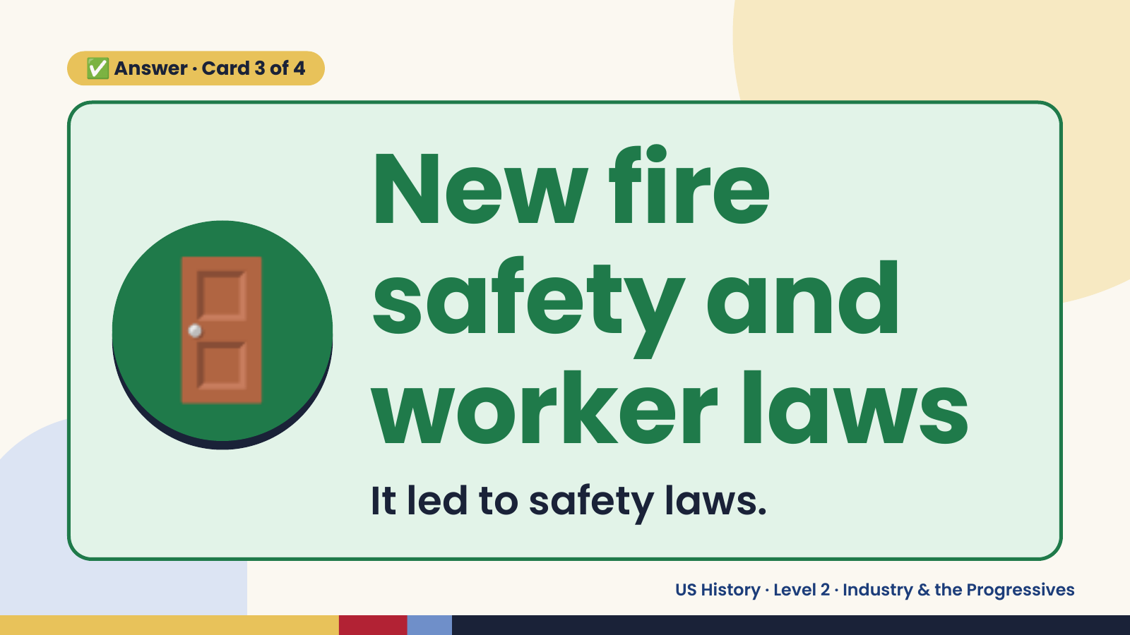
Notes:
✅ Answer · Card 3 of 4
🚪 New fire
safety and
worker laws
It led to safety laws.
US History · Level 2 · Industry & the Progressives

Slide 18
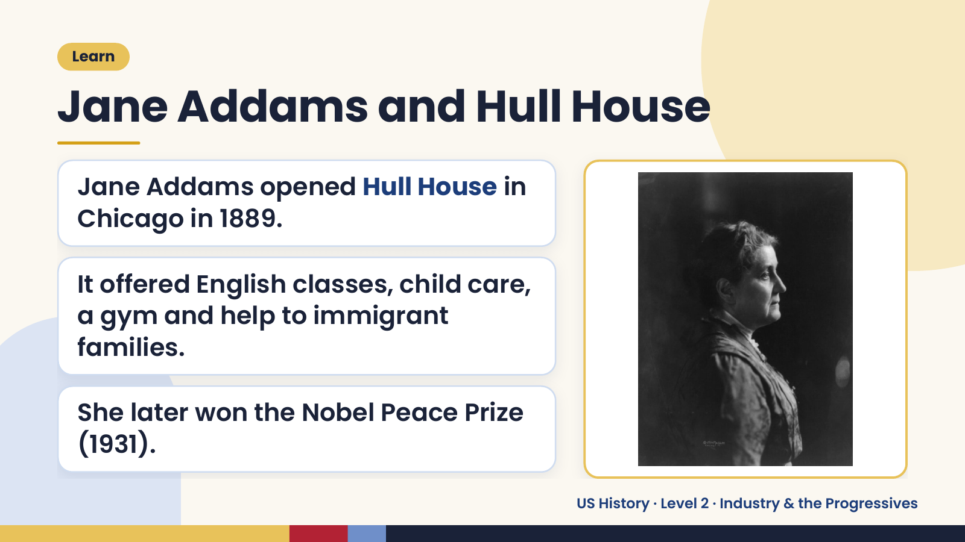
Notes:
Learn
Jane Addams and Hull House
Jane Addams opened Hull House in
Chicago in 1889.
It offered English classes, child care,
a gym and help to immigrant
families.
She later won the Nobel Peace Prize
(1931).
US History · Level 2 · Industry & the Progressives

Slide 19
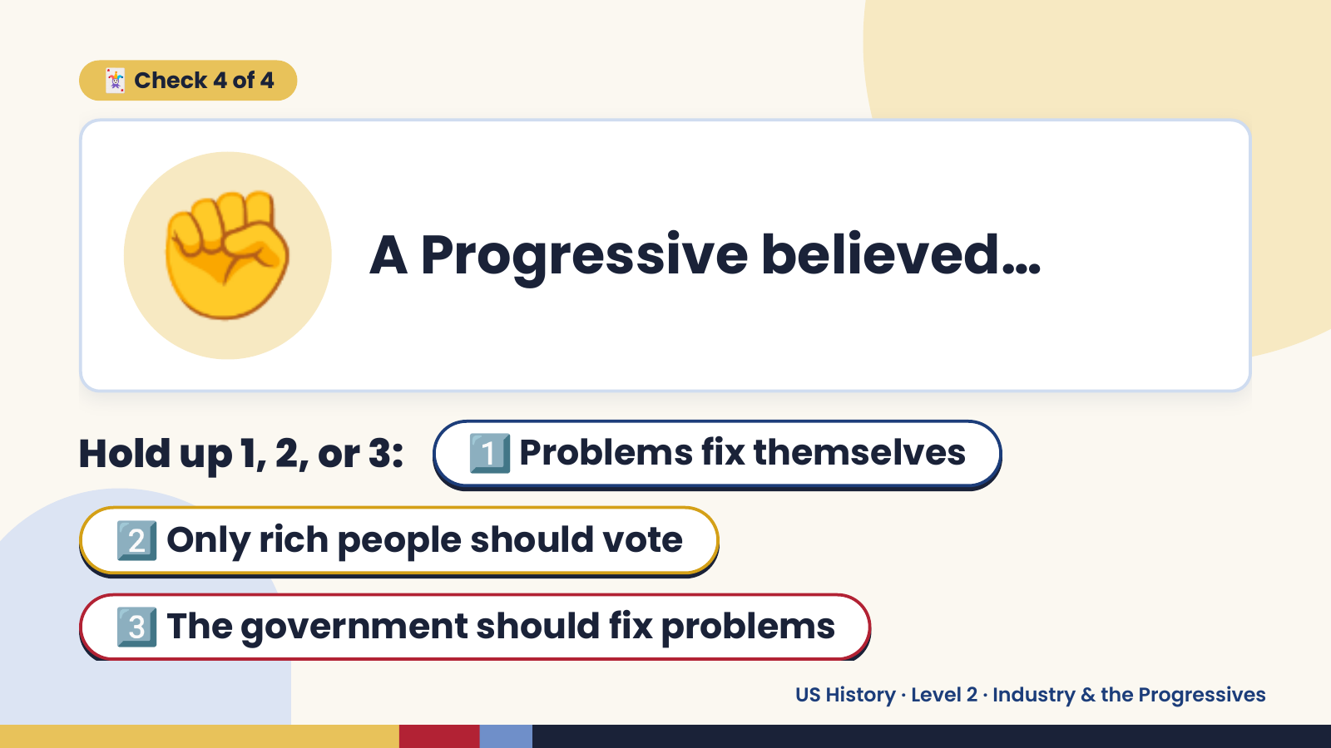
Notes:
✊
🃏 Check 4 of 4
A Progressive believed…
Hold up 1, 2, or 3: 1️⃣ Problems fix themselves
2️⃣ Only rich people should vote
3️⃣ The government should fix problems
US History · Level 2 · Industry & the Progressives

Slide 20

Notes:
✅ Answer · Card 4 of 4
✊
The
government
should fix
problems
Progressives pushed for reform.
US History · Level 2 · Industry & the Progressives

Slide 21
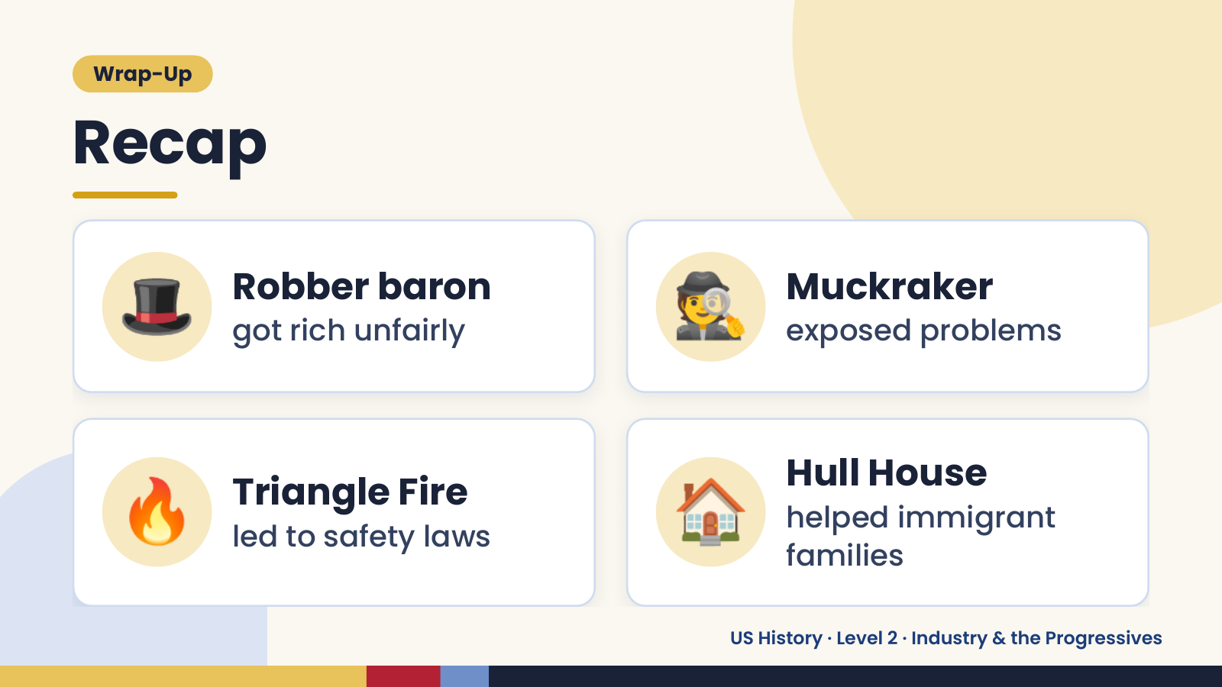
Notes:
Wrap-Up
Recap
🎩 Robber baron
got rich unfairly 🕵️ Muckraker
exposed problems
🔥 Triangle Fire
led to safety laws 🏠 Hull House
helped immigrant
families
US History · Level 2 · Industry & the Progressives

Slide 22
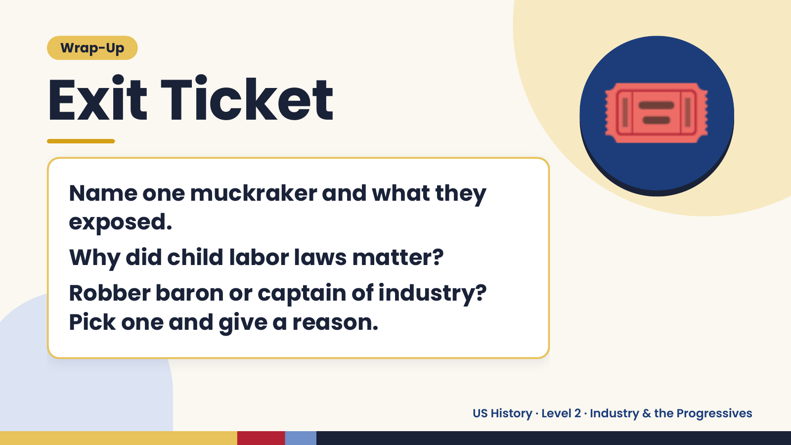
Notes:
Wrap-Up
Exit Ticket
Name one muckraker and what they
exposed.
🎟️
Why did child labor laws matter?
Robber baron or captain of industry?
Pick one and give a reason.
US History · Level 2 · Industry & the Progressives

