Slide 1
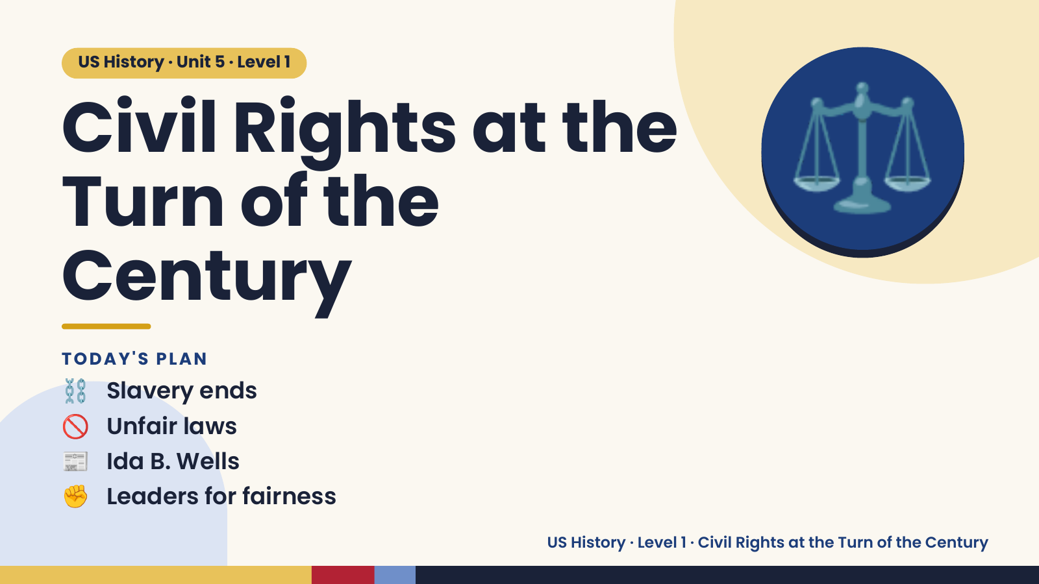
Notes:
US History · Unit 5 · Level 1
Civil Rights at the
Turn of the
Century
⚖️
⛓️ Slavery ends
TODAY'S PLAN
🚫 Unfair laws
📰 Ida B. Wells
✊ Leaders for fairness
US History · Level 1 · Civil Rights at the Turn of the Century

Slide 2
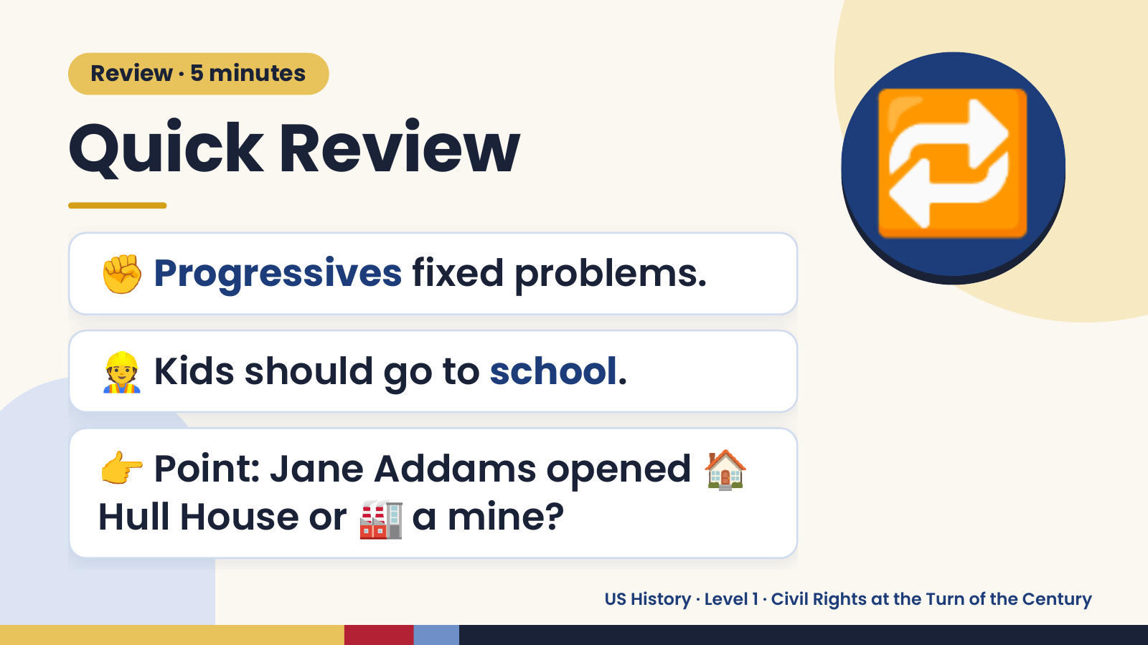
Notes:
Review · 5 minutes
Quick Review
✊ Progressives fixed problems.
🔁
👷 Kids should go to school.
👉 Point: Jane Addams opened 🏠
Hull House or 🏭 a mine?
US History · Level 1 · Civil Rights at the Turn of the Century

Slide 3
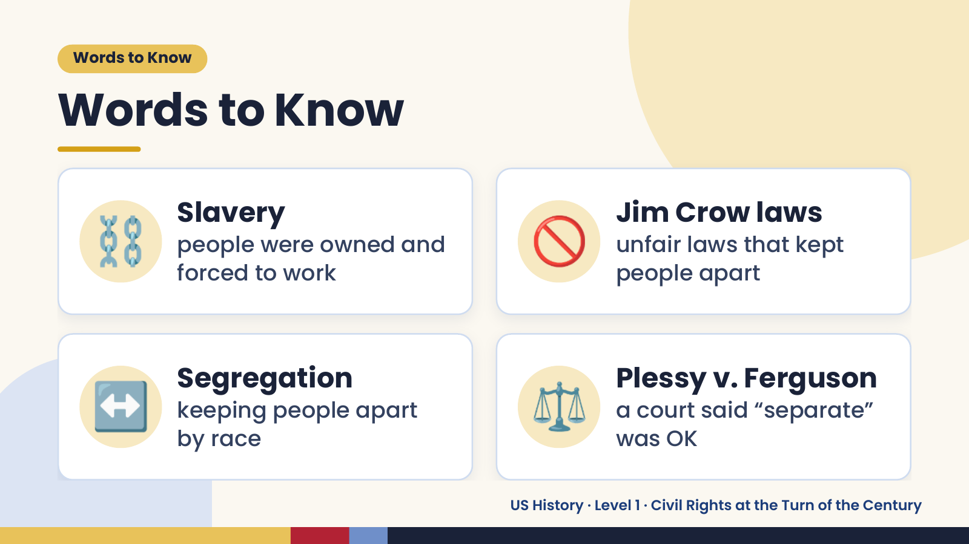
Notes:
Words to Know
Words to Know
⛓️ Slavery
people were owned and
forced to work
🚫 Jim Crow laws
unfair laws that kept
people apart
↔️ Segregation
keeping people apart
by race
⚖️ Plessy v. Ferguson
a court said “separate”
was OK
US History · Level 1 · Civil Rights at the Turn of the Century

Slide 4
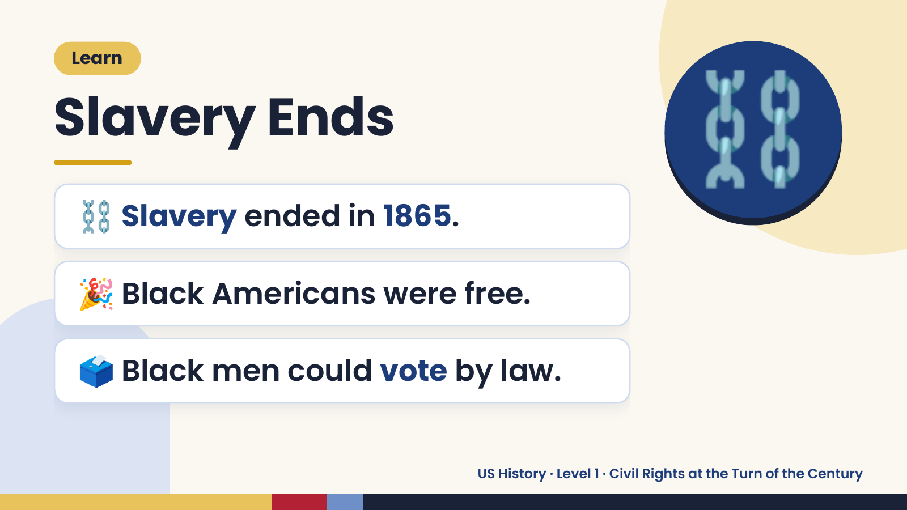
Notes:
Learn
Slavery Ends
⛓️ Slavery ended in 1865.
⛓️
🎉 Black Americans were free.
🗳️ Black men could vote by law.
US History · Level 1 · Civil Rights at the Turn of the Century

Slide 5
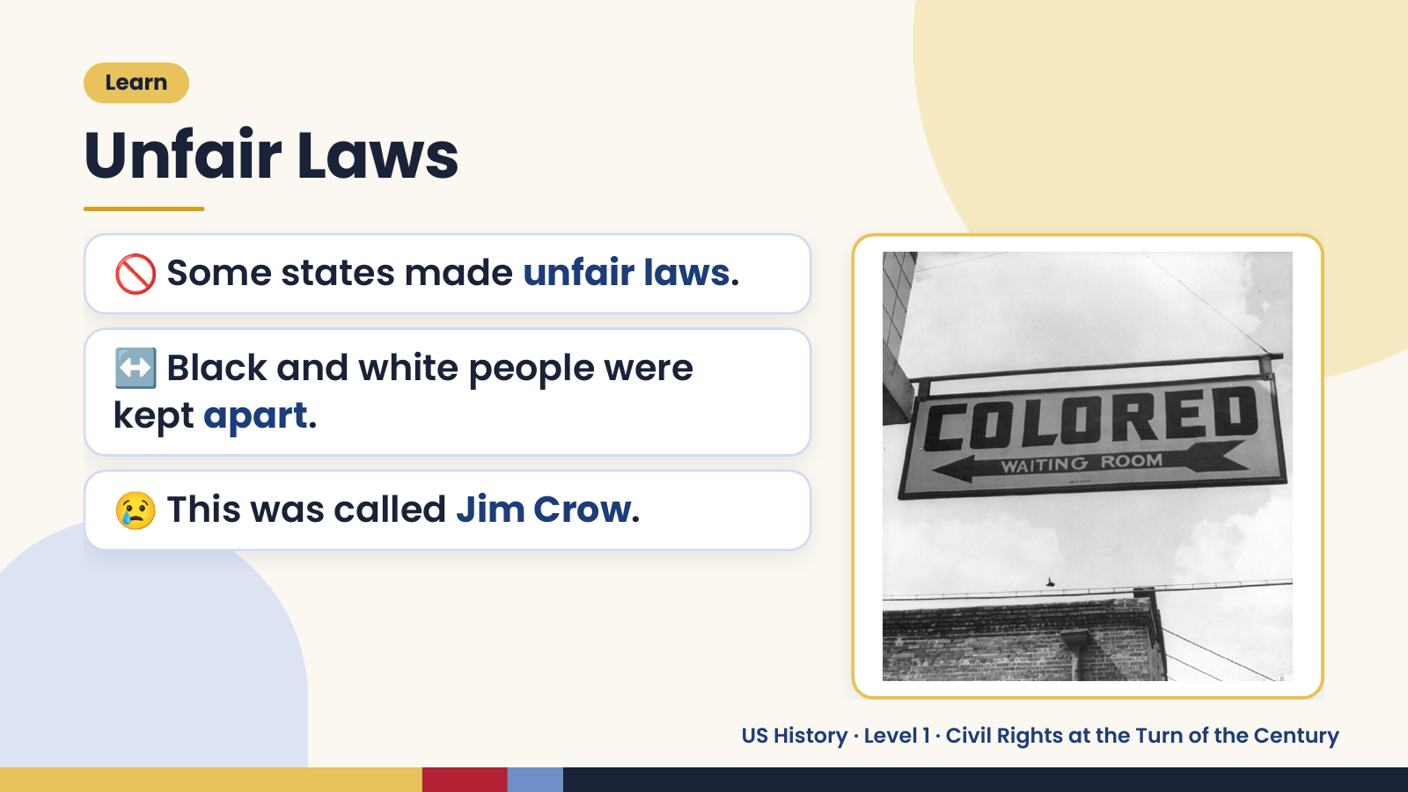
Notes:
Learn
Unfair Laws
🚫 Some states made unfair laws.
↔️ Black and white people were
kept apart.
😢 This was called Jim Crow.
US History · Level 1 · Civil Rights at the Turn of the Century

Slide 6
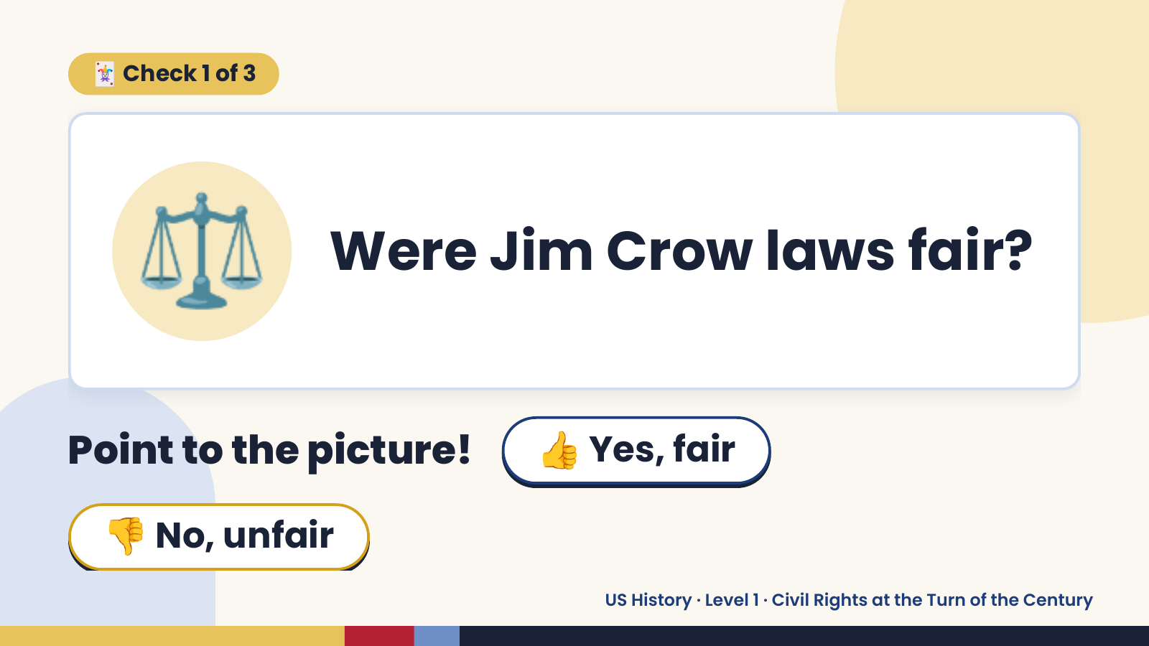
Notes:
🃏 Check 1 of 3
⚖️ Were Jim Crow laws fair?
Point to the picture! 👍 Yes, fair
👎 No, unfair
US History · Level 1 · Civil Rights at the Turn of the Century

Slide 7
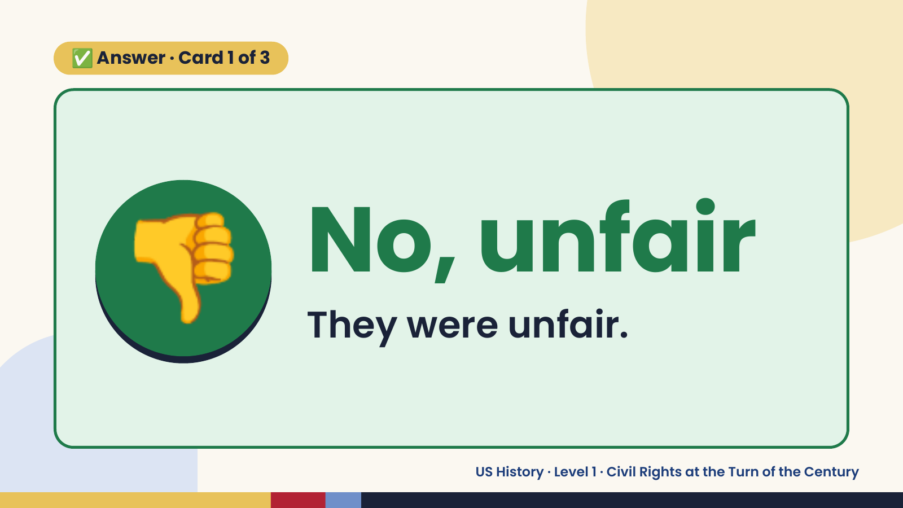
Notes:
✅ Answer · Card 1 of 3
👎 No, unfair
They were unfair.
US History · Level 1 · Civil Rights at the Turn of the Century

Slide 8
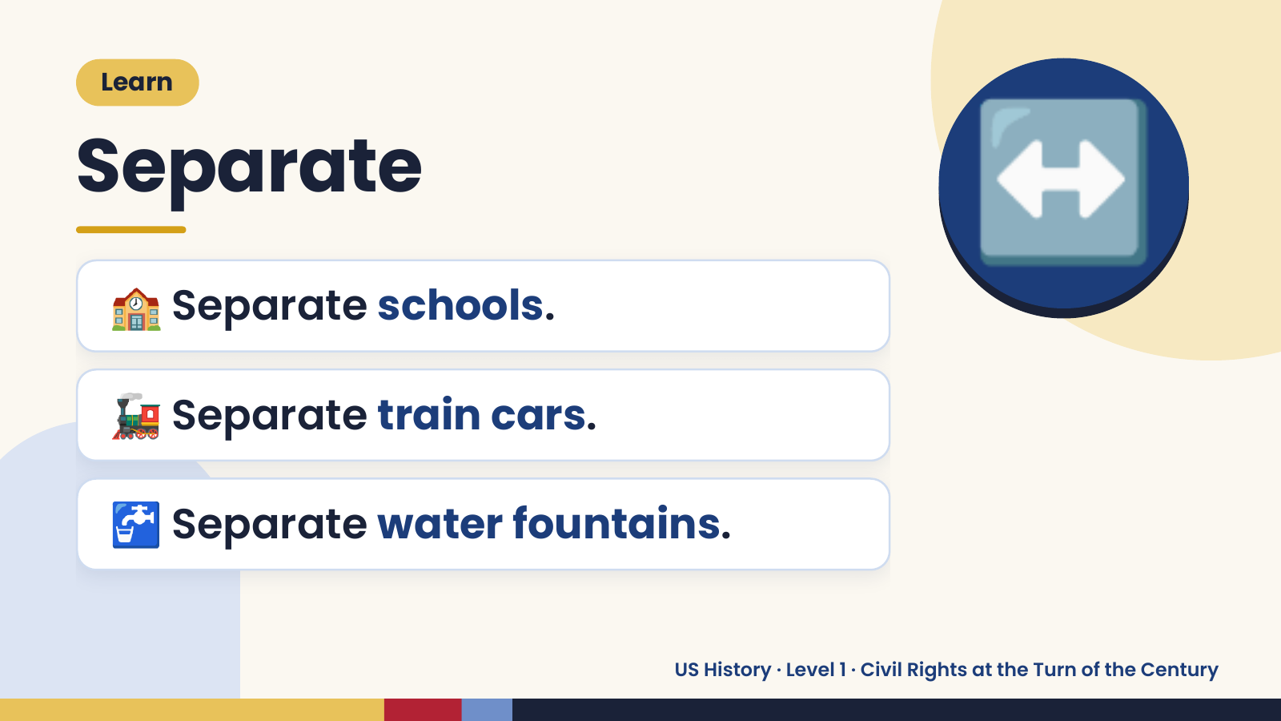
Notes:
Learn
Separate
🏫 Separate schools.
↔️
🚂 Separate train cars.
🚰 Separate water fountains.
US History · Level 1 · Civil Rights at the Turn of the Century

Slide 9
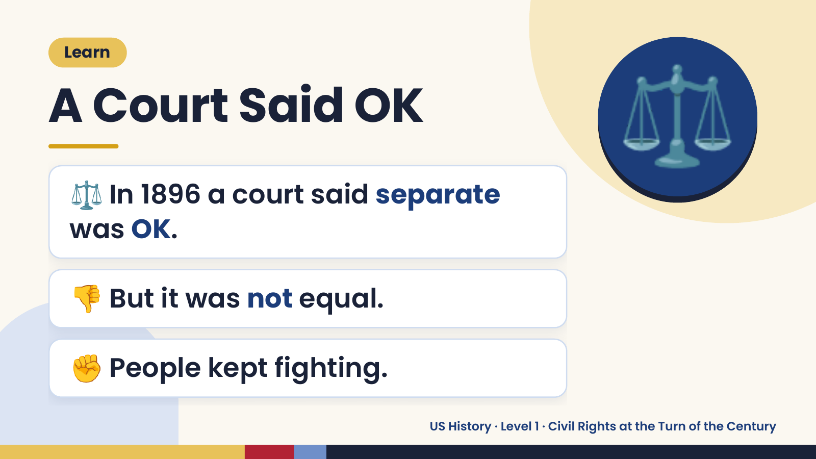
Notes:
Learn
A Court Said OK
⚖️ In 1896 a court said separate
was OK.
⚖️
👎 But it was not equal.
✊ People kept fighting.
US History · Level 1 · Civil Rights at the Turn of the Century

Slide 10
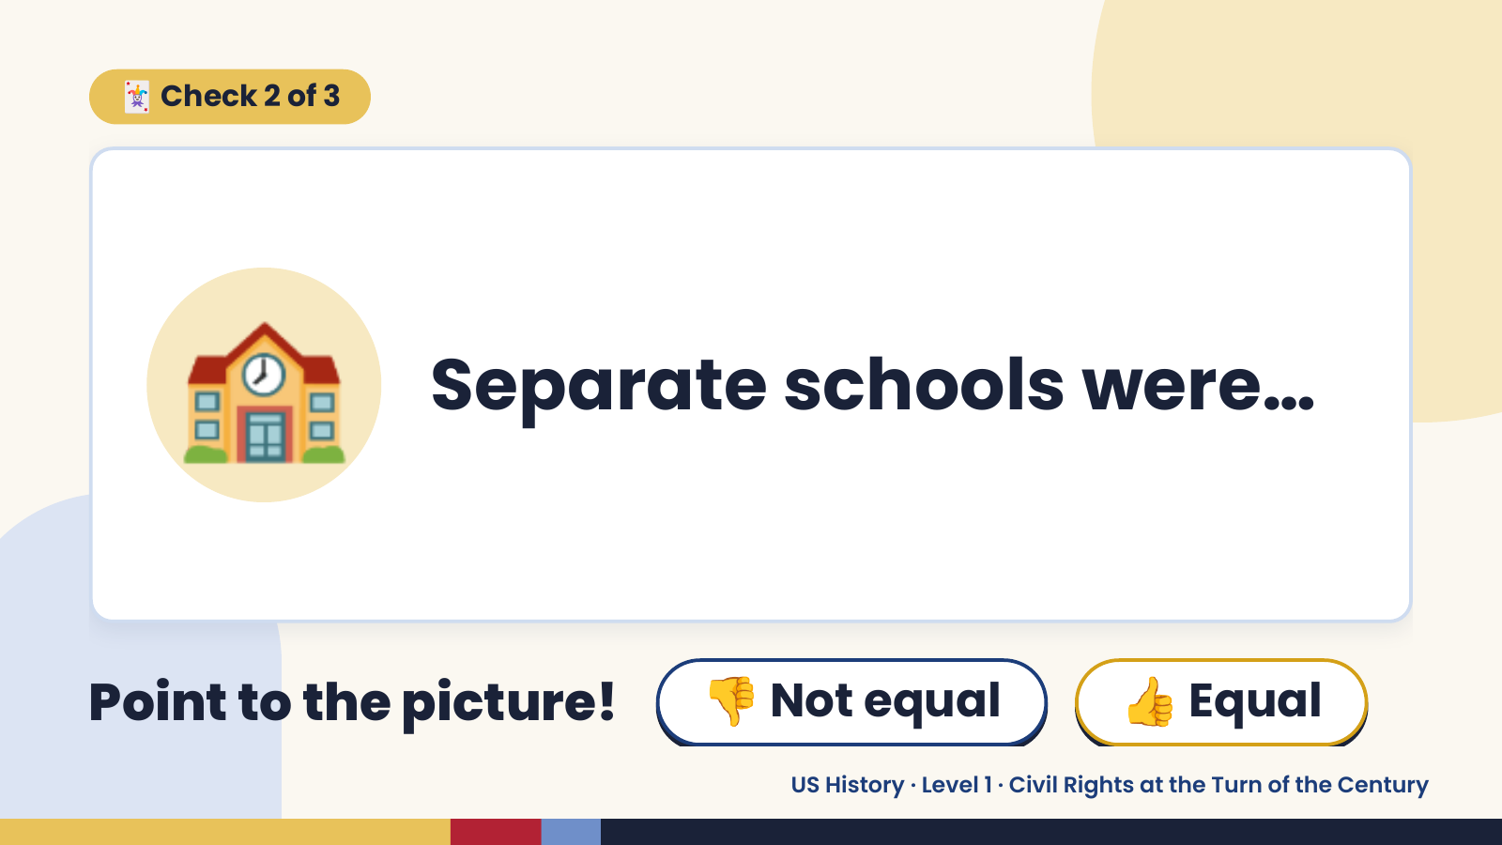
Notes:
🃏 Check 2 of 3
🏫 Separate schools were…
Point to the picture! 👎 Not equal 👍 Equal
US History · Level 1 · Civil Rights at the Turn of the Century

Slide 11
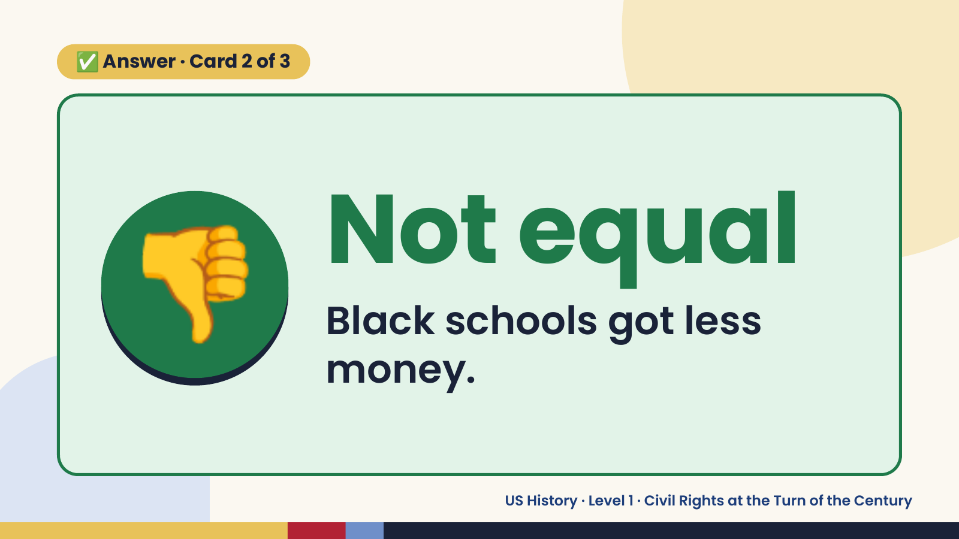
Notes:
✅ Answer · Card 2 of 3
👎 Not equal
Black schools got less
money.
US History · Level 1 · Civil Rights at the Turn of the Century

Slide 12
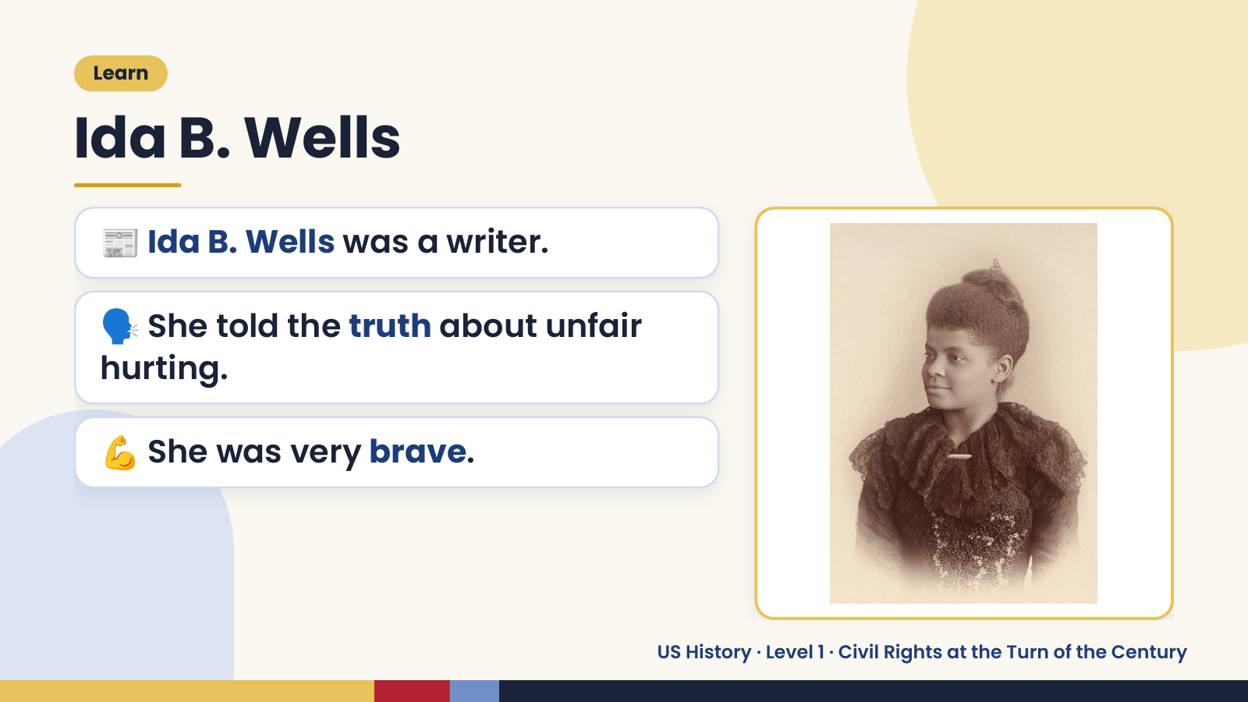
Notes:
Learn
Ida B. Wells
📰 Ida B. Wells was a writer.
🗣️ She told the truth about unfair
hurting.
💪 She was very brave.
US History · Level 1 · Civil Rights at the Turn of the Century

Slide 13
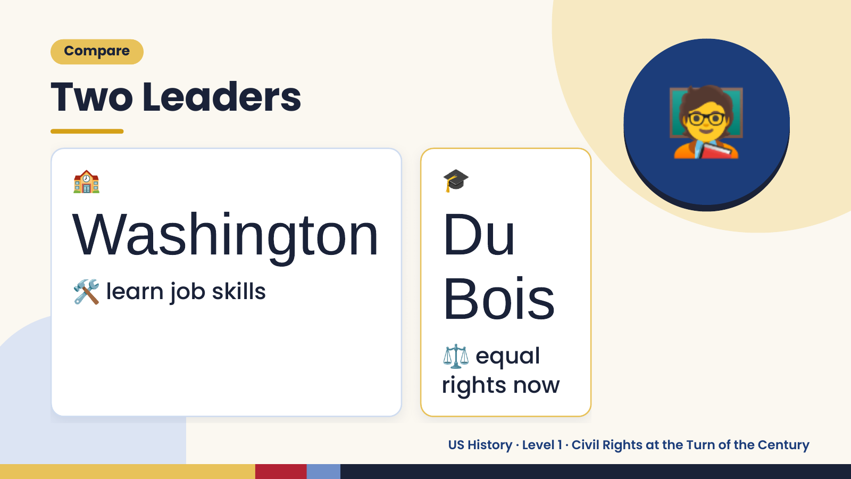
Notes:
🧑‍🏫
Compare
Two Leaders
🏫 🎓
Washington Du
🛠️ Bois
learn job skills
⚖️ equal
rights now
US History · Level 1 · Civil Rights at the Turn of the Century

Slide 14
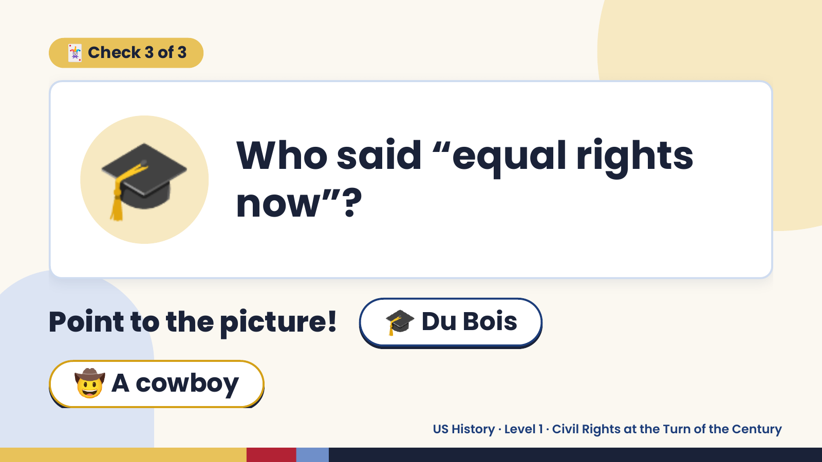
Notes:
🃏 Check 3 of 3
🎓 Who said “equal rights
now”?
Point to the picture! 🎓 Du Bois
🤠 A cowboy
US History · Level 1 · Civil Rights at the Turn of the Century

Slide 15
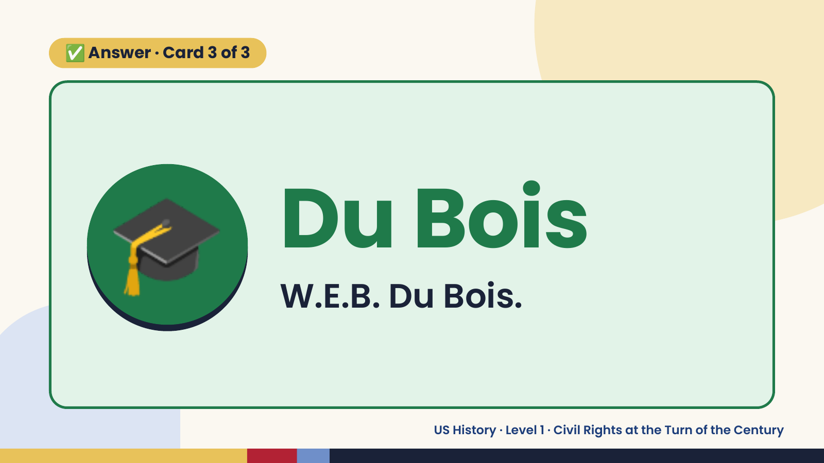
Notes:
✅ Answer · Card 3 of 3
🎓 Du Bois
W.E.B. Du Bois.
US History · Level 1 · Civil Rights at the Turn of the Century

Slide 16
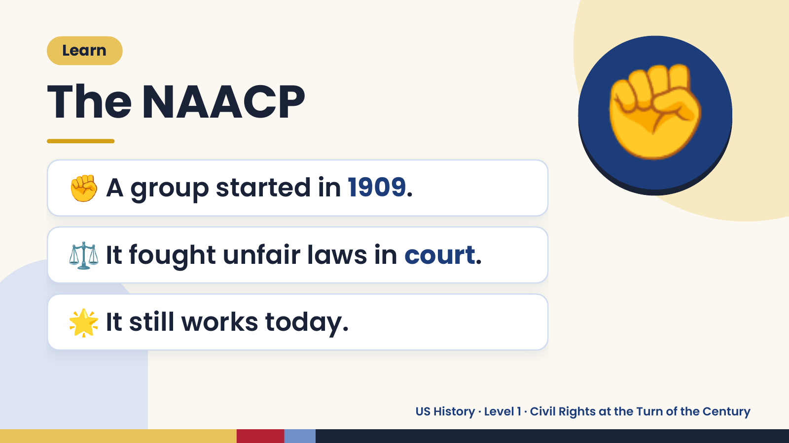
Notes:
Learn
The NAACP
✊ A group started in 1909.
✊
⚖️ It fought unfair laws in court.
🌟 It still works today.
US History · Level 1 · Civil Rights at the Turn of the Century

Slide 17
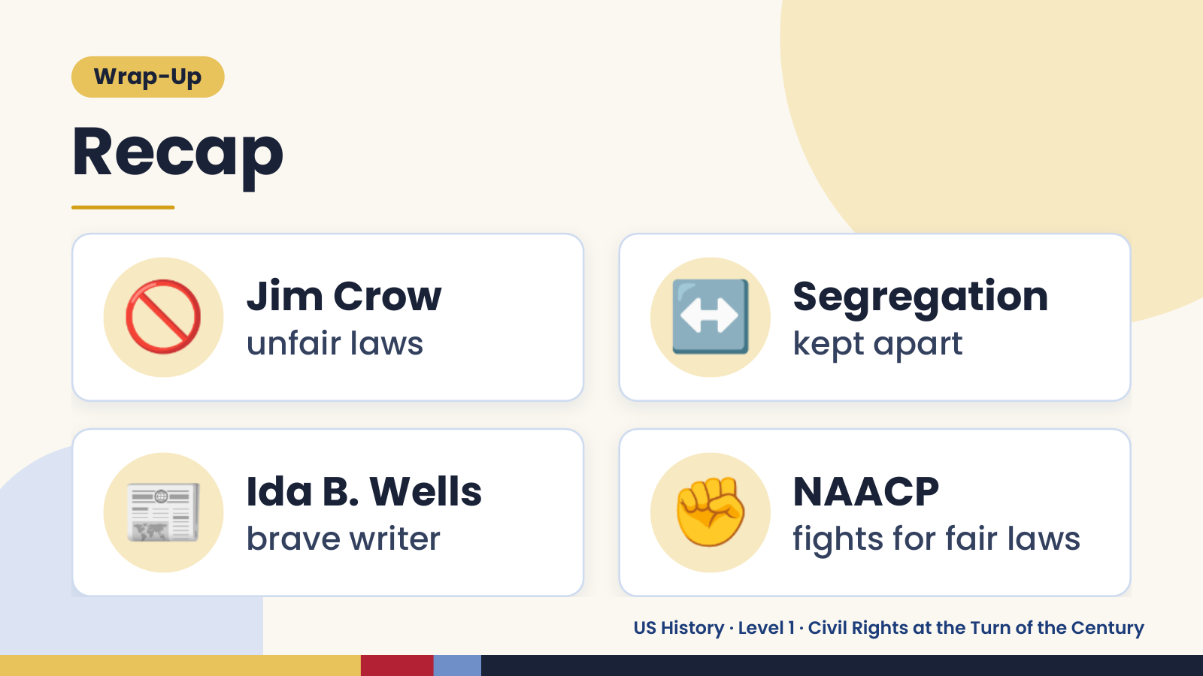
Notes:
Wrap-Up
Recap
🚫 Jim Crow
unfair laws ↔️ Segregation
kept apart
📰 Ida B. Wells
brave writer ✊ NAACP
fights for fair laws
US History · Level 1 · Civil Rights at the Turn of the Century

Slide 18
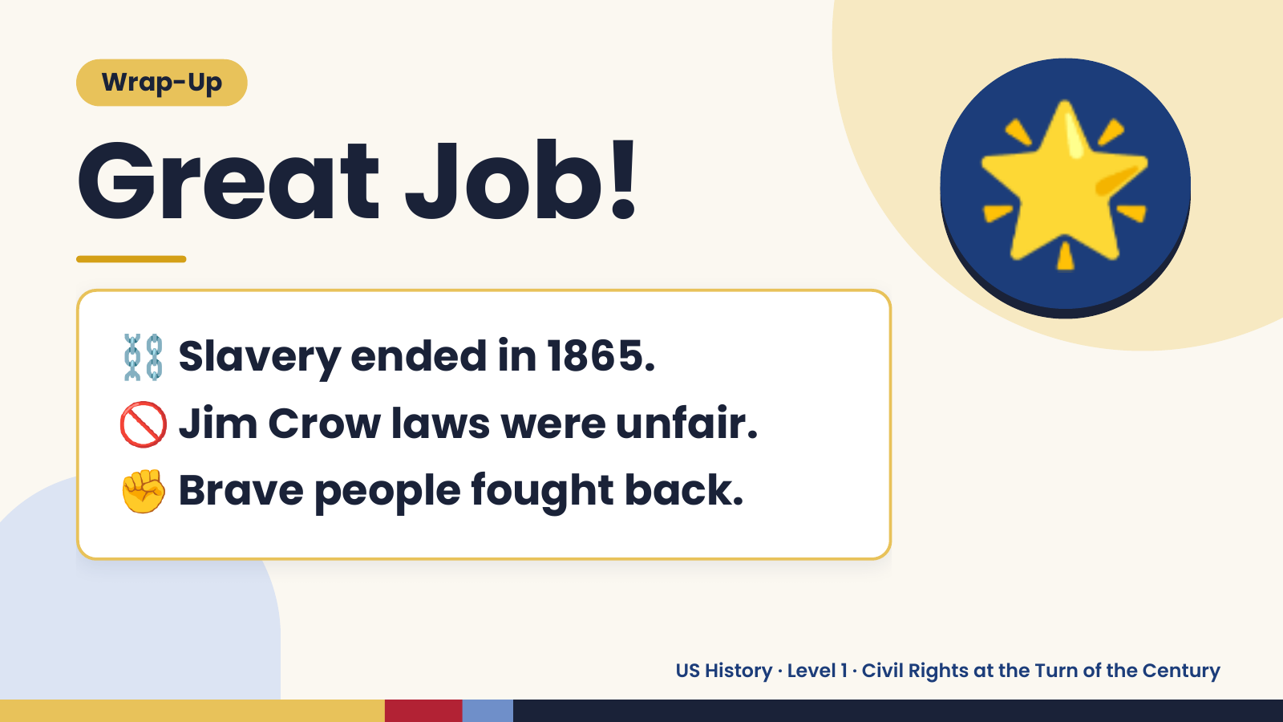
Notes:
Wrap-Up
Great Job!
⛓️ Slavery ended in 1865.
🌟
🚫 Jim Crow laws were unfair.
✊ Brave people fought back.
US History · Level 1 · Civil Rights at the Turn of the Century

